Slide 1
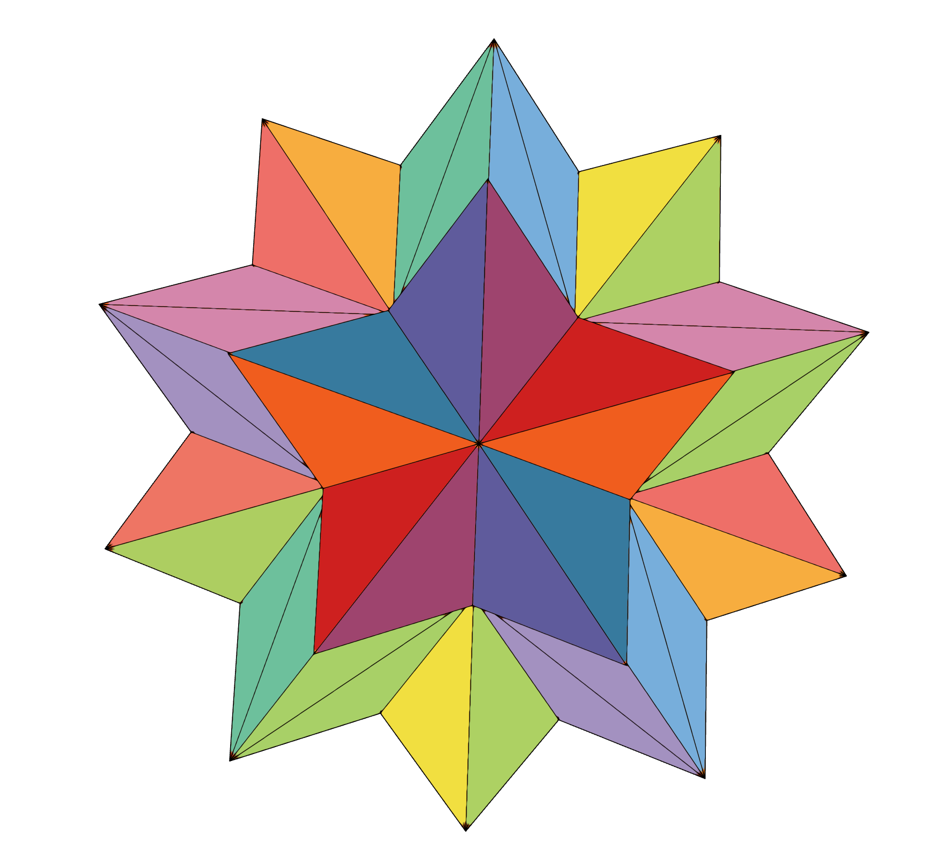
spark: never miss a moment

Slide 2
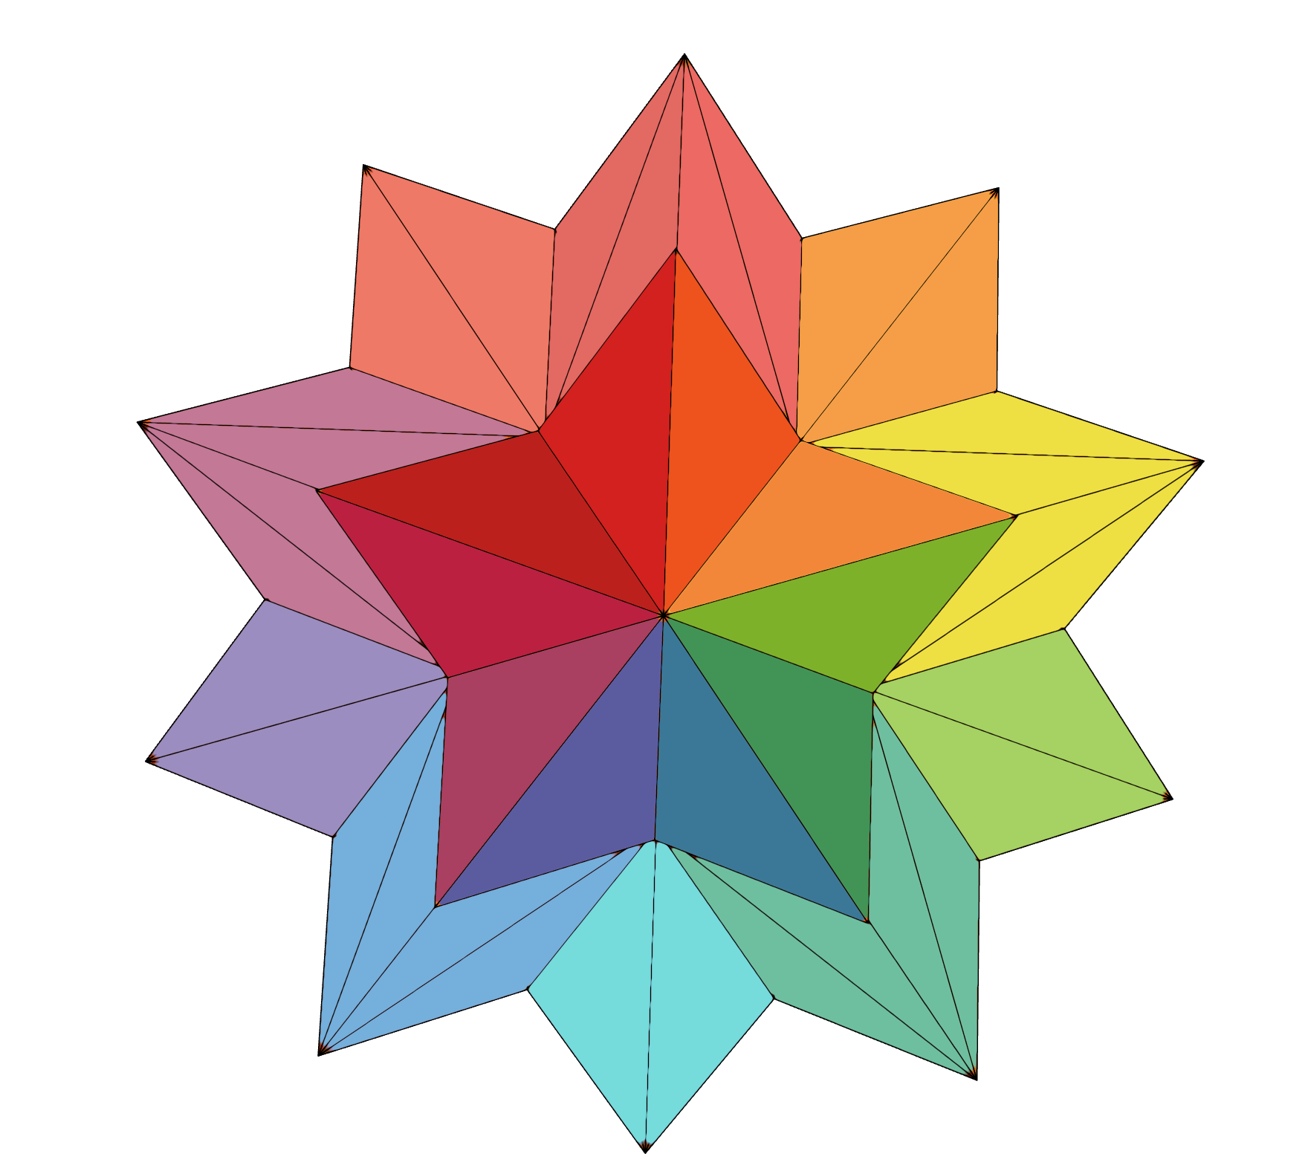

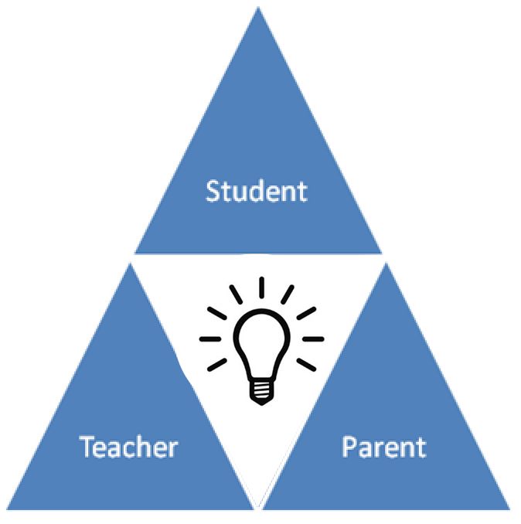



Kevin
David
Melissa
Bronson

Slide 3
Scheduling and resource constraints prevent many parents and teachers from actively working together to support students in their educational development. With communication limited to just quarterly conferences, if even that often, both parents and teachers crave ways to collaboratively and effectively track a child’s development. Spark allows teachers and parents to capture the learning progress of each individual student, and the versatility of Spark allows parents to easily view their child’s progress across a variety of platforms.
Problem - Solution Statement

Slide 4
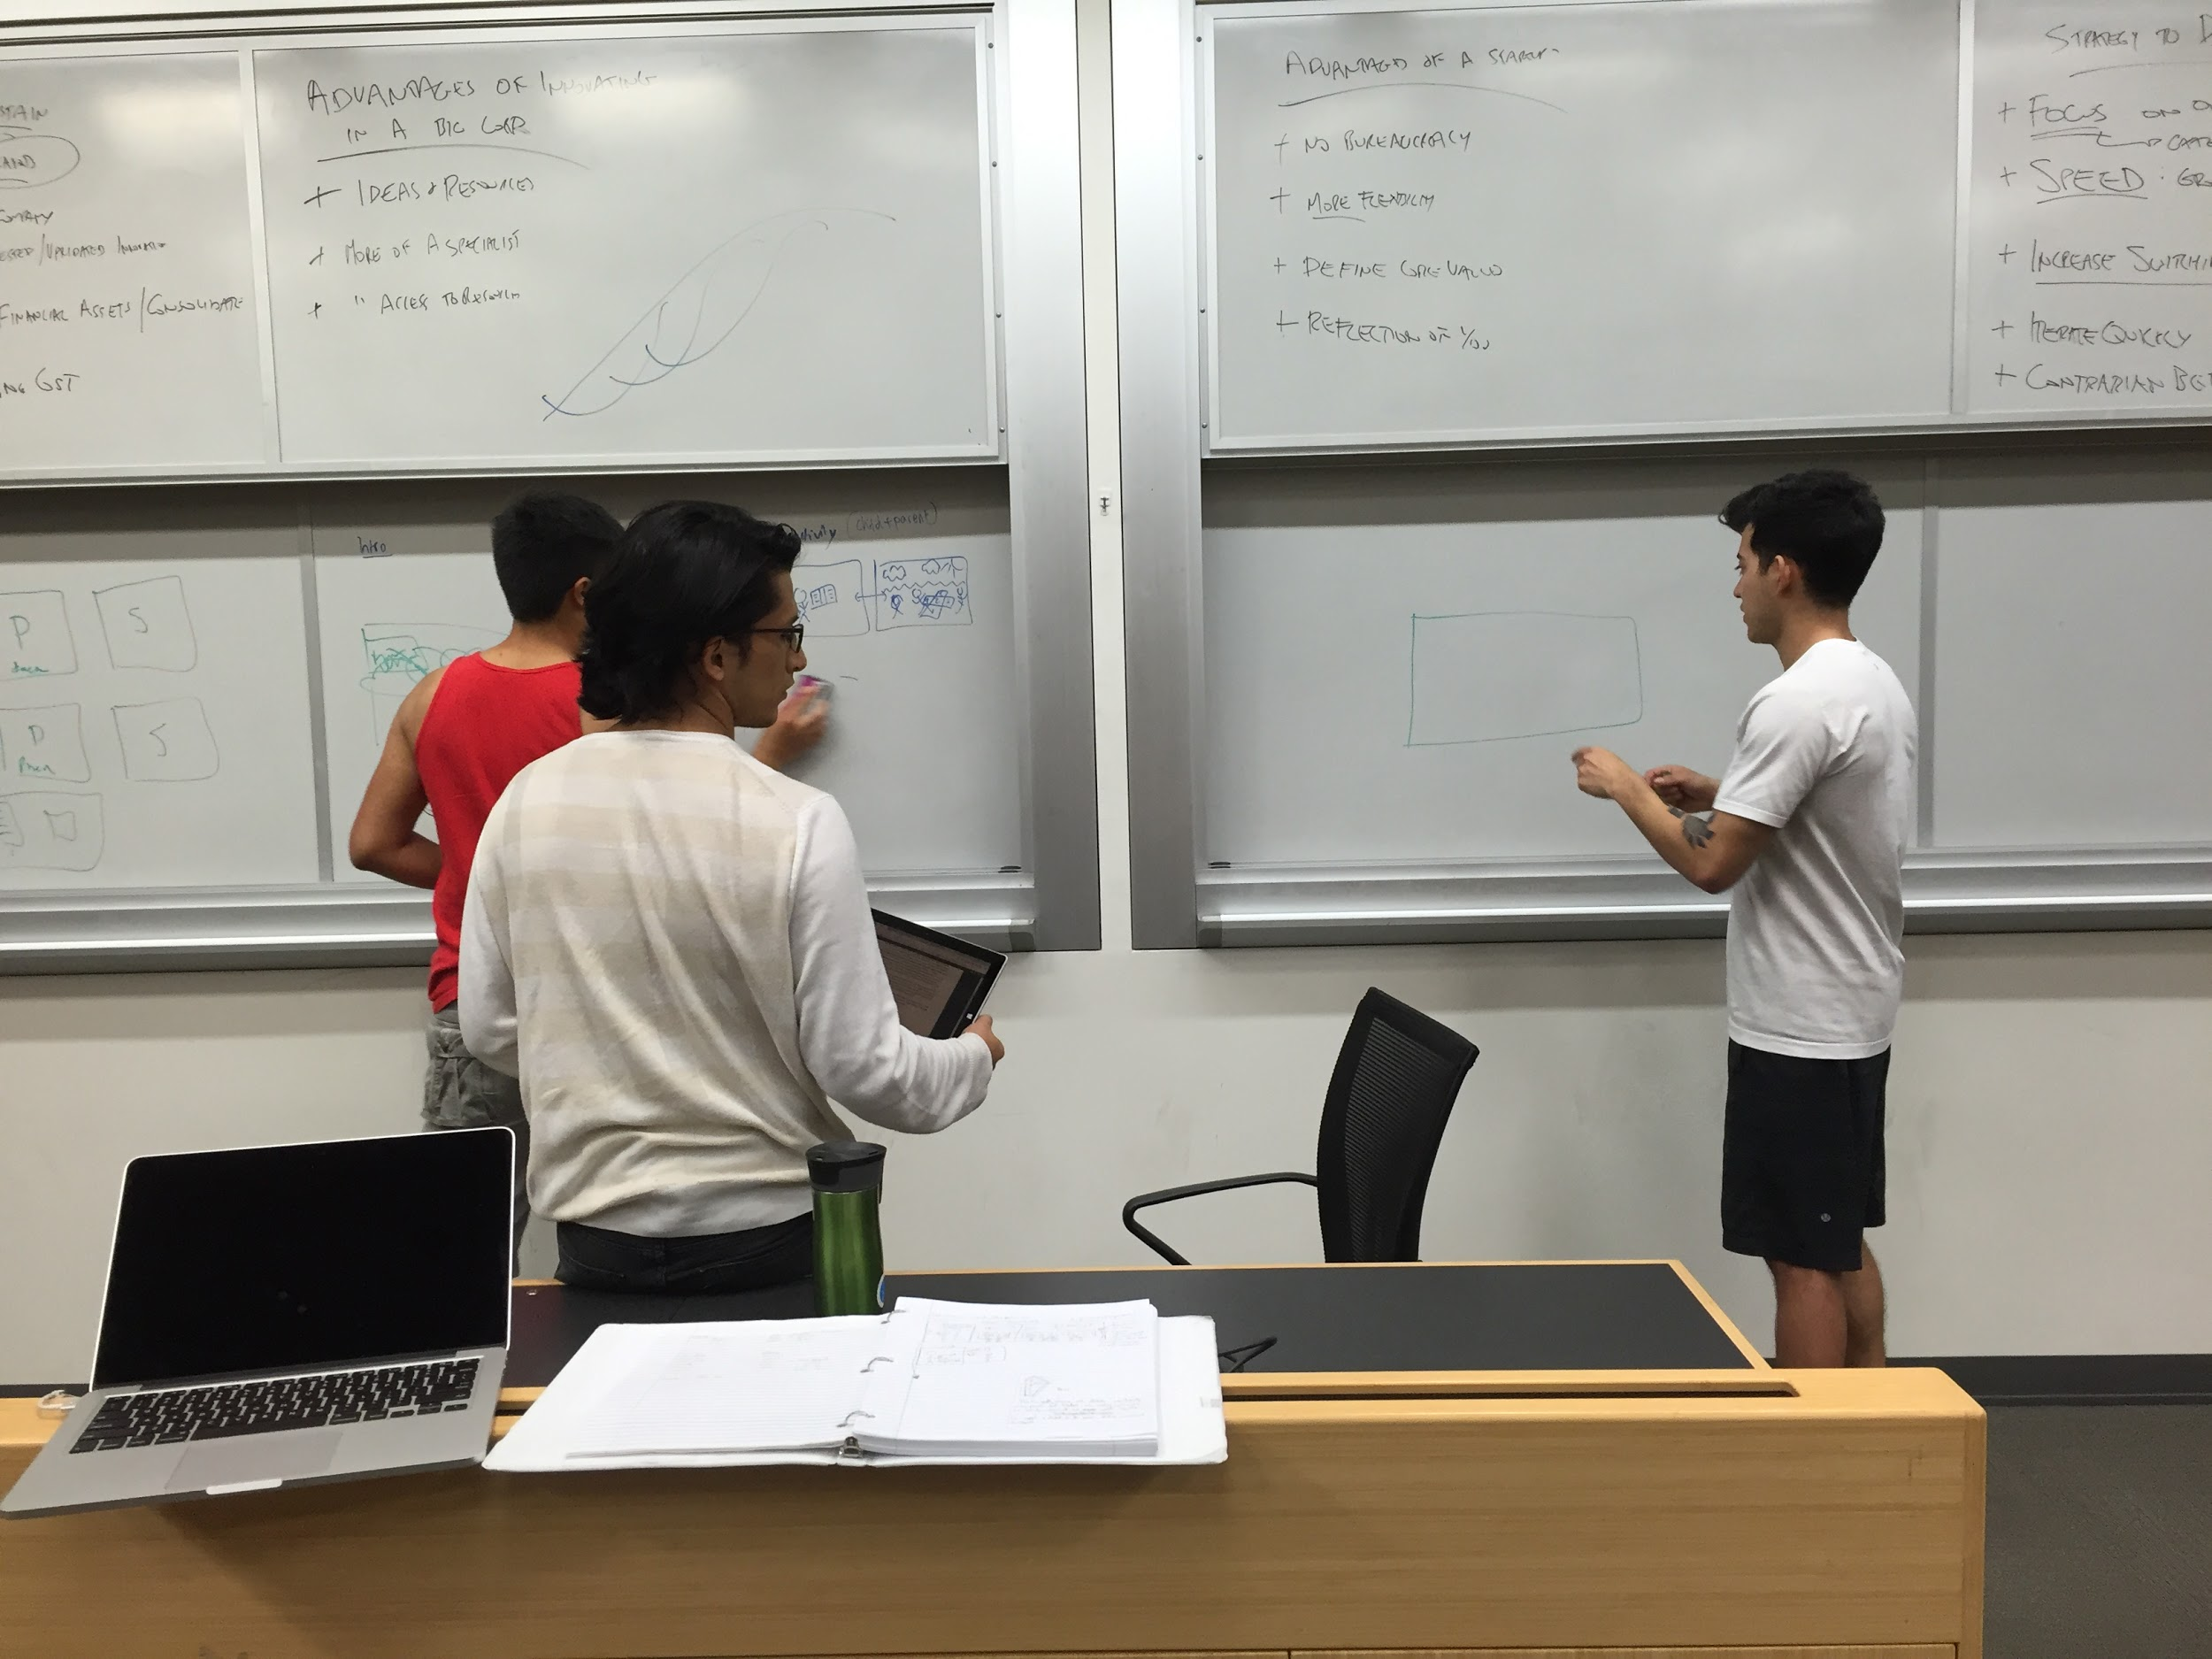
Tasks
Simple: To capture a moment in a child’s education.
Medium: Easily sort & recollect a child’s developmental history for future purposes.
Complex: Share a child’s special moments in their education w/ his/her parents if necessary.

Slide 5
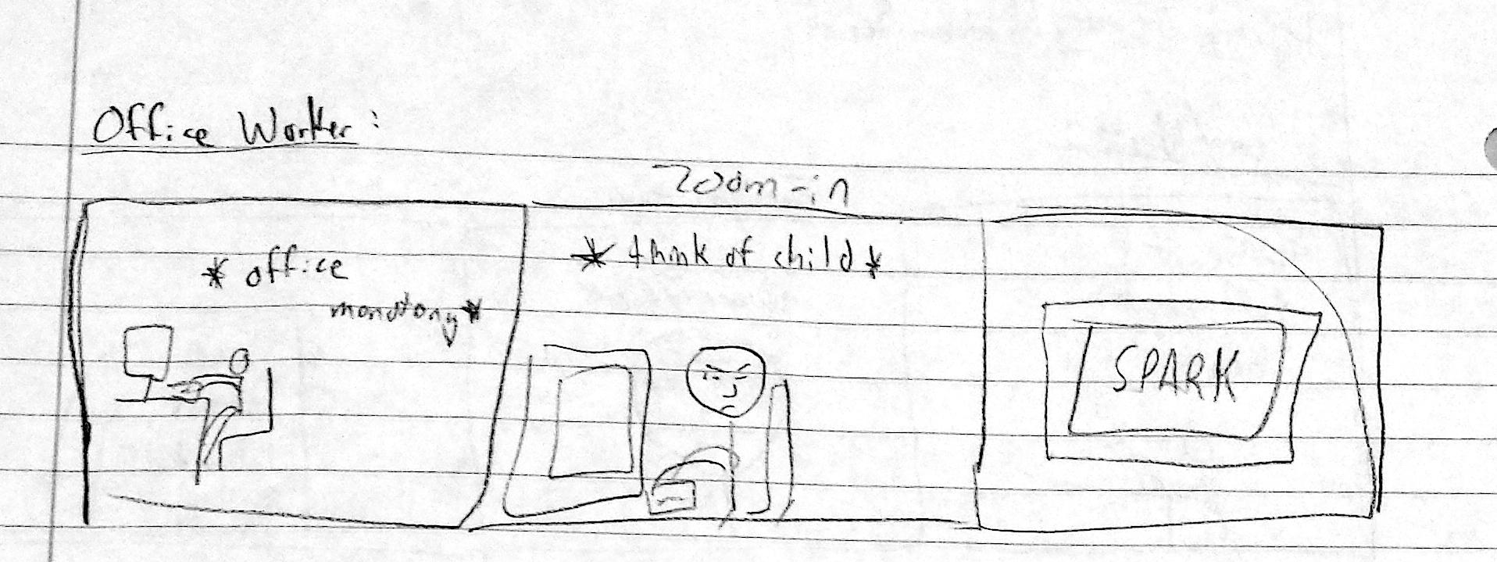
Video Storyboard: Problem Scenes
A working parent is stressed at work whilst also worrying about what his/her child is up to at school.

Slide 6
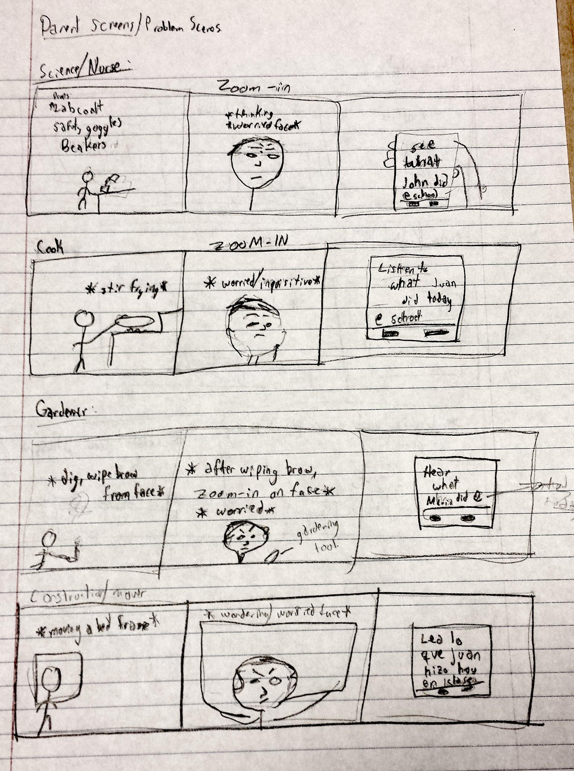
Problem Scenes (cont.)
A montage of different working parents (construction worker, gardener, cook, scientist) becoming stressed at work because they have no time to worry/think about their children.

Slide 7
Problem Scenes (cont.)
A teacher is spending a late night in the office, becoming more and more stressed as he thinks about all the parent teacher conferences (that he has no time to prepare for) the next day.

Slide 8
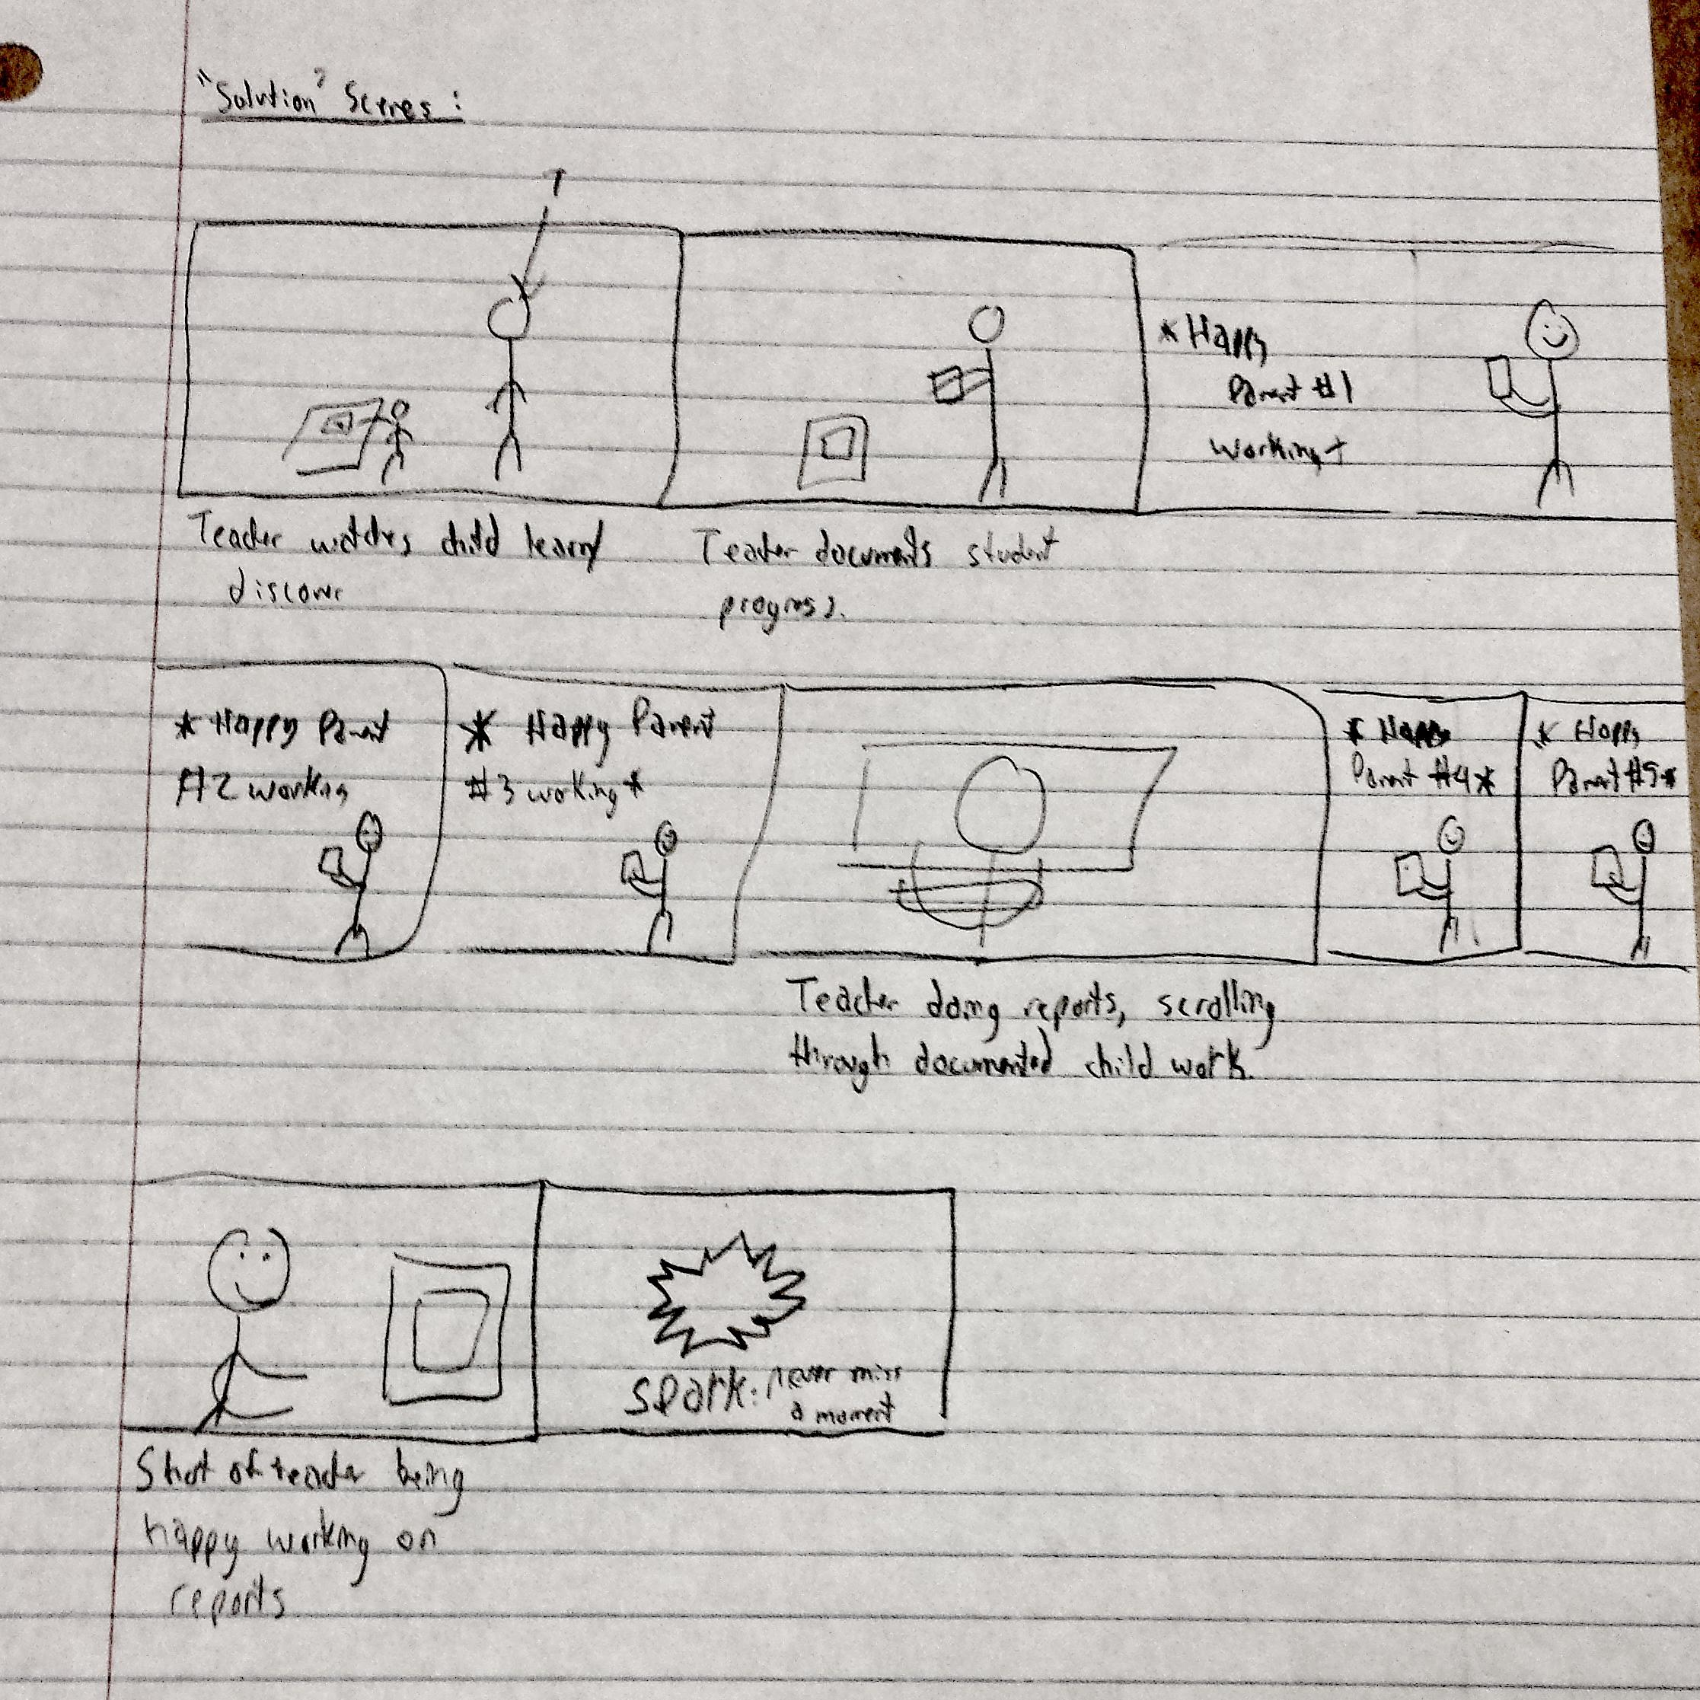
Video Storyboard: Solution Scenes
Both teachers & parents alike easily document and track their student’s work and progress using Spark.

Slide 9
Solution Scenes (cont.)
With the stress of having to worry about keeping track of so many different students taken care of, the teacher can now happily work on his reports.

