Slide 1

NightOwl
Griffin Dietz - Lachlan Green - Zara Saraon - Evan Nixon - Priyanka Rao
Notes:
would be nice to have pics of each of us on this slide (TAs/profs love dem photos)

Slide 2
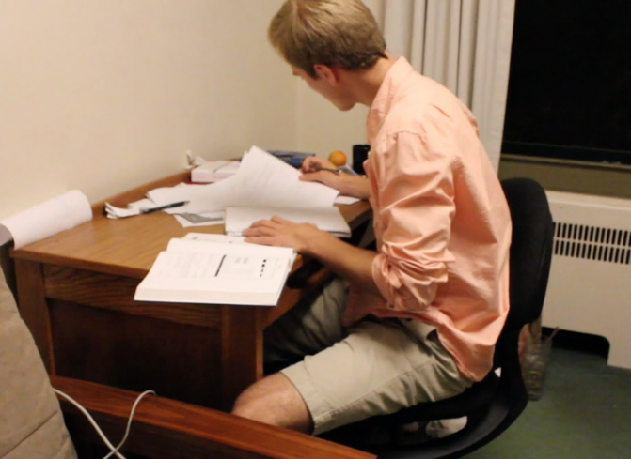
Problem
Imagine...
it’s 2 am
you’re stuck on a pset that’s due in the morning
your two friends in the class are fast asleep

Slide 3
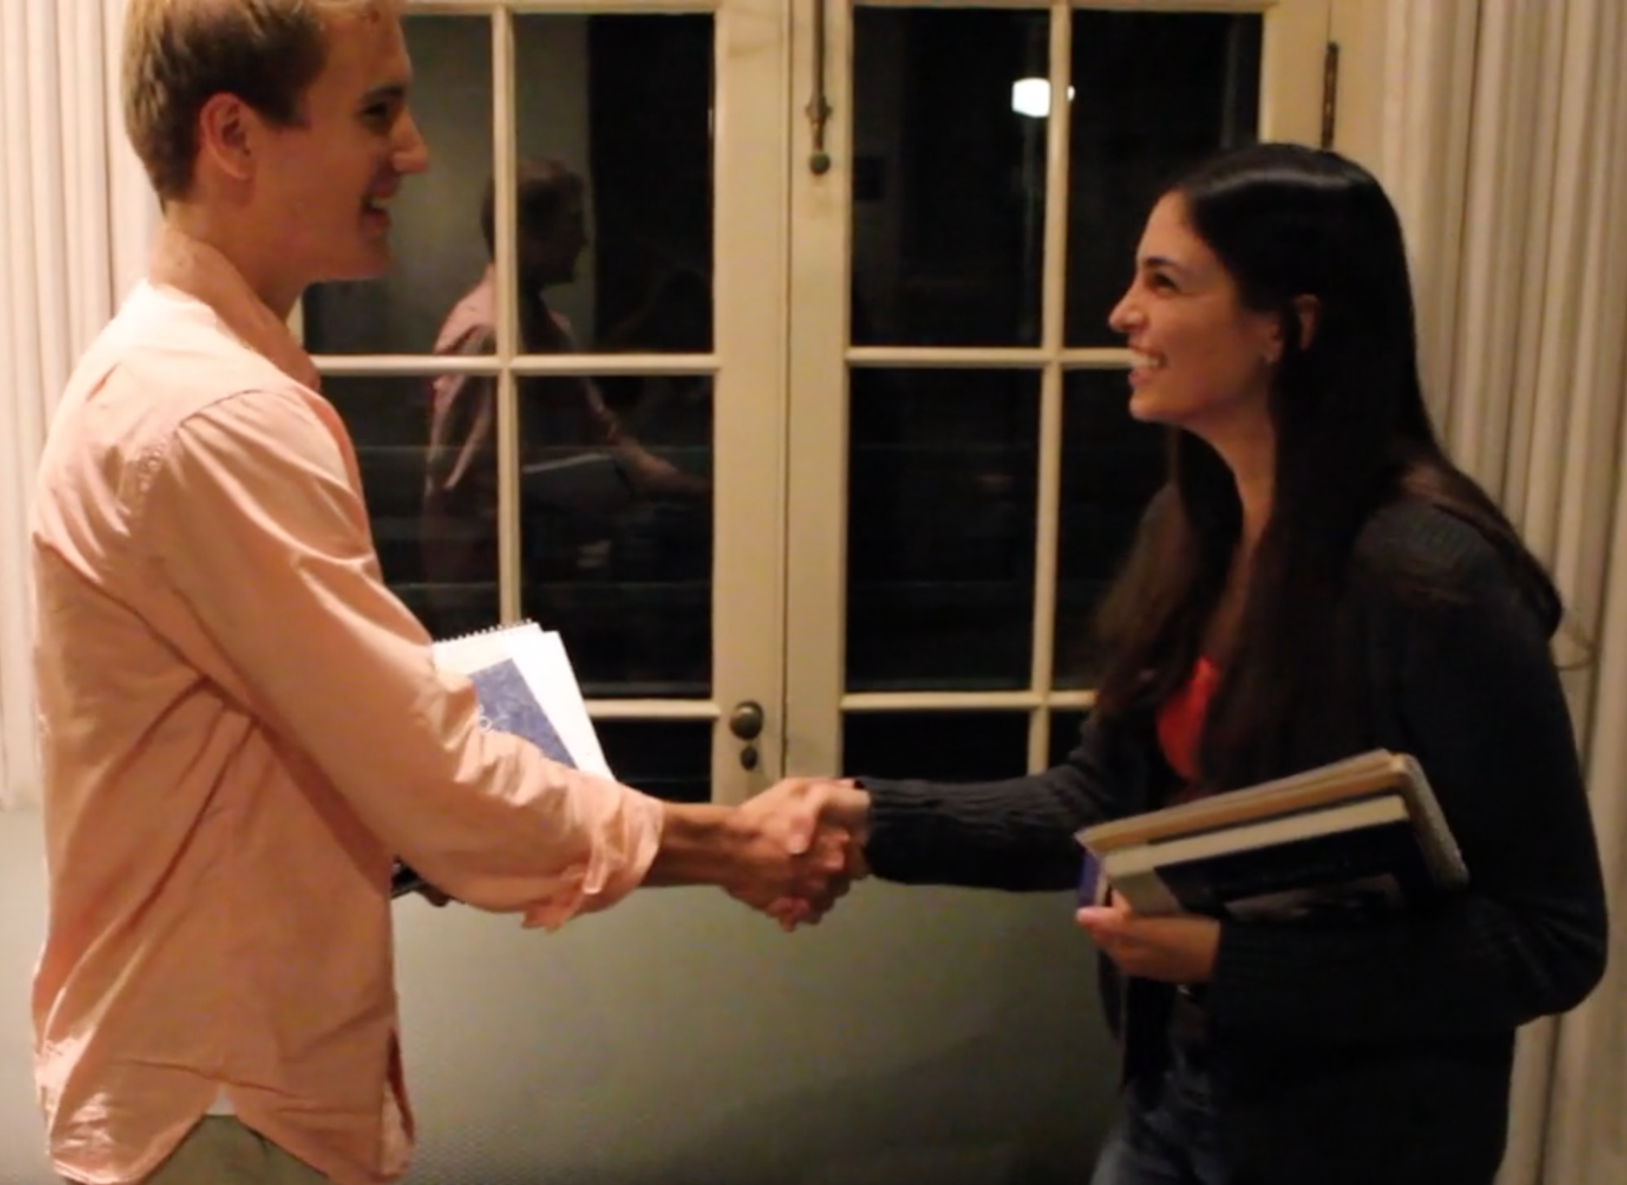
Solution
NightOwl connects students to classmates who are awake, nearby, and working on the same thing.

Slide 4
Today’s Flight Path
Video
Design Evolution
Tasks
Future Changes

Slide 5
Today’s Flight Path
Video
Design Evolution
Tasks
Future Changes

Slide 6
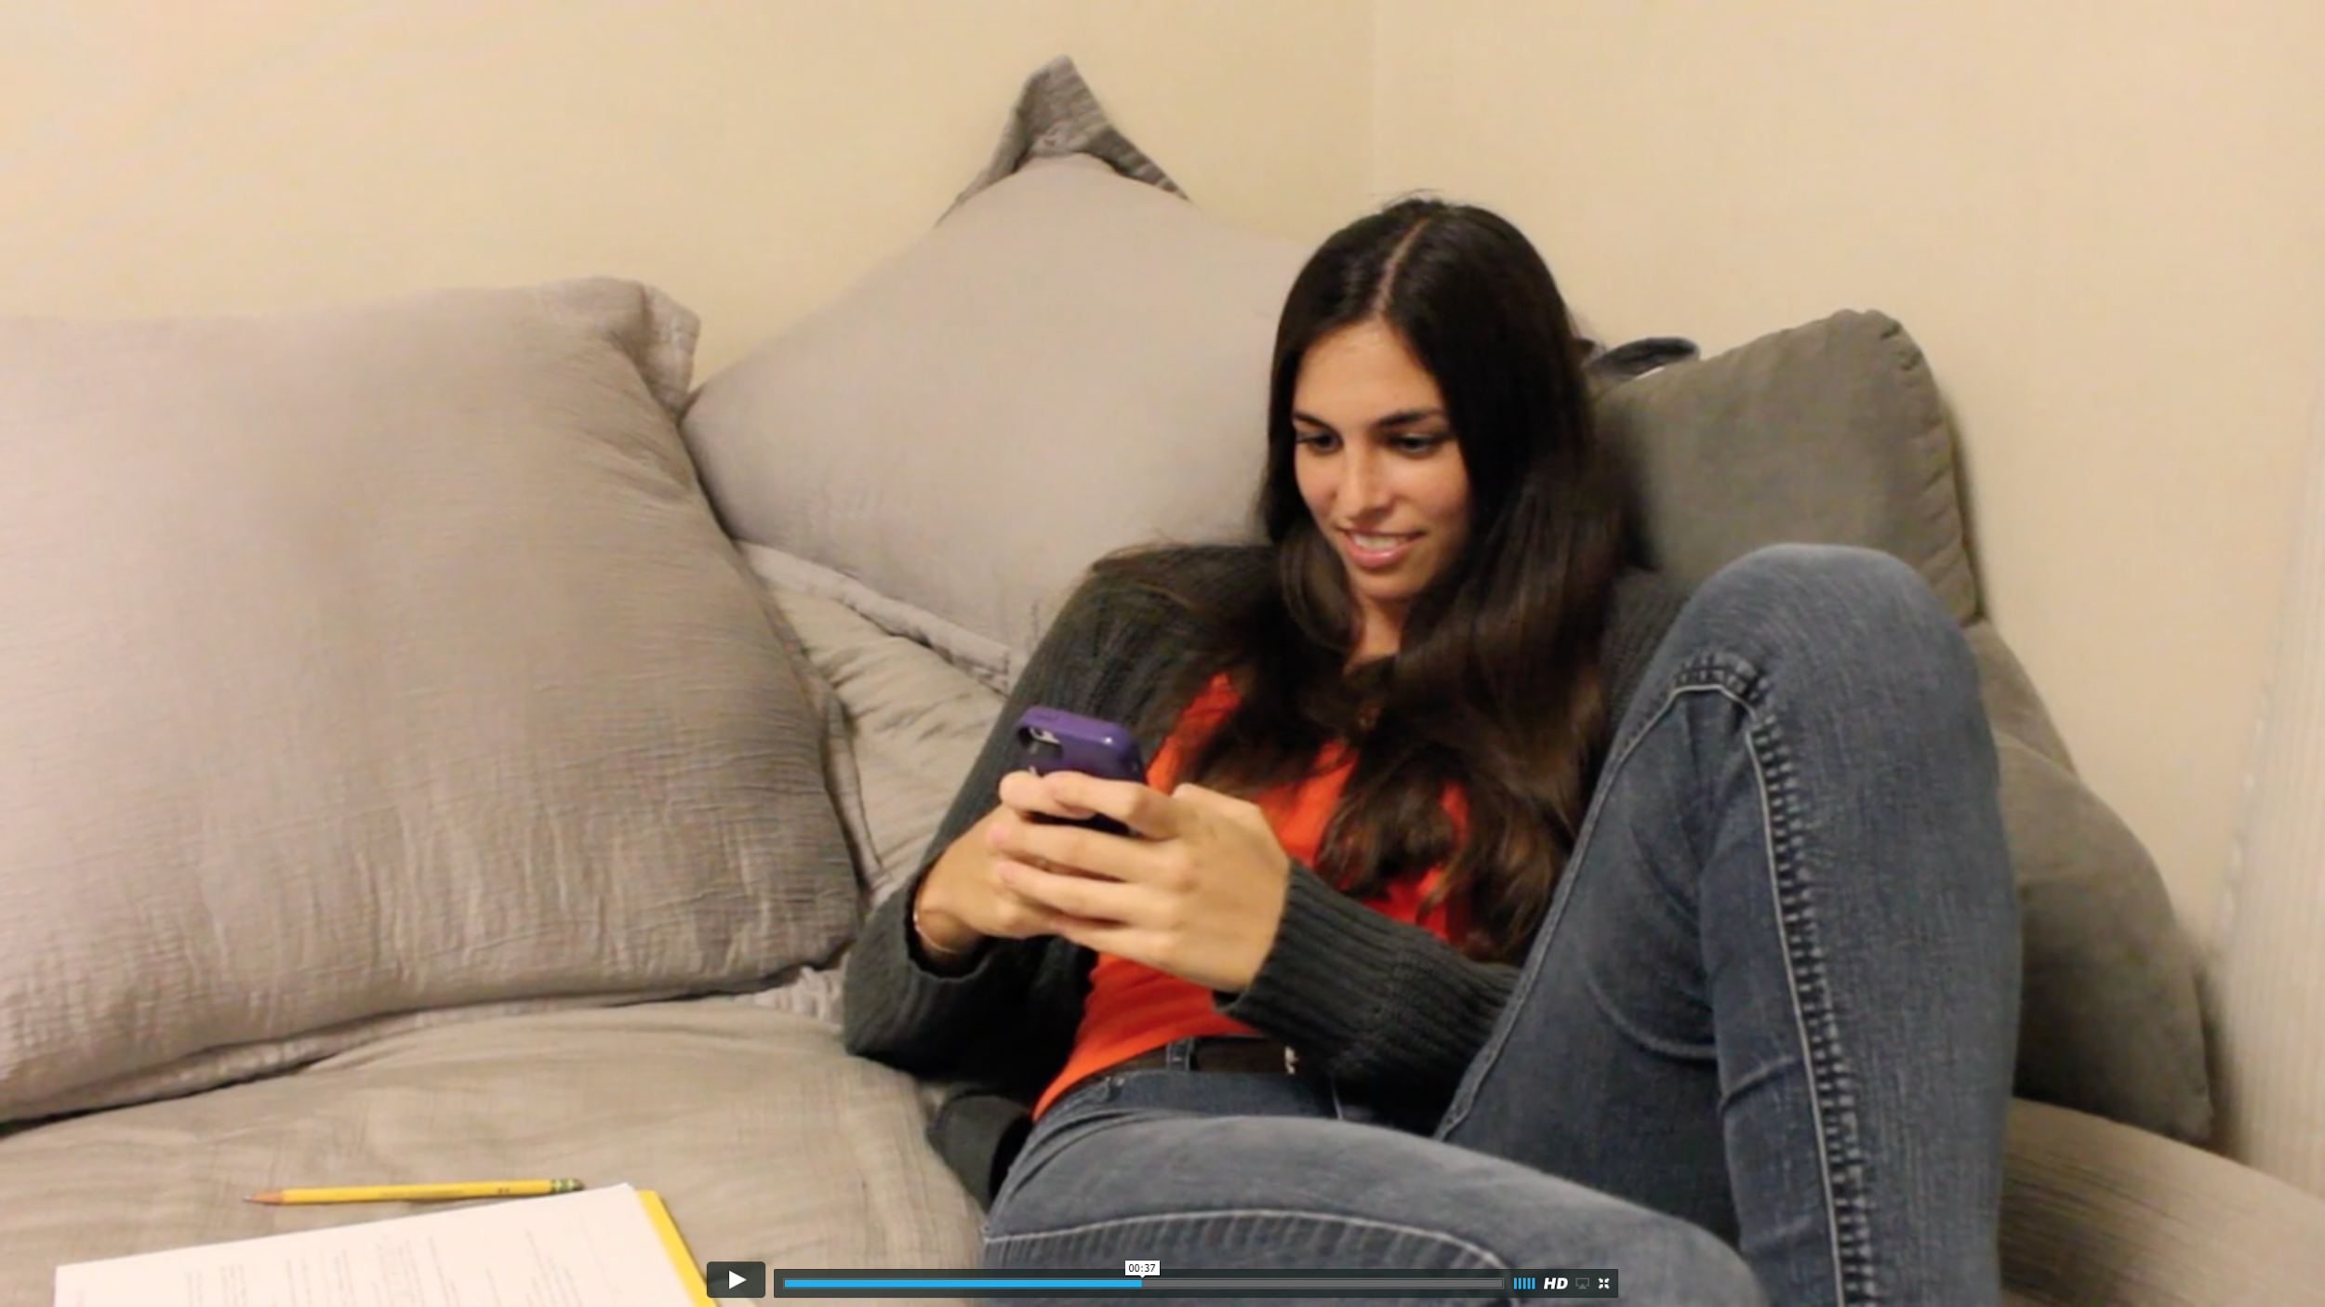
Concept Video
https://vimeo.com/142566913

Slide 7
Today’s Flight Path
Video
Design Evolution
Tasks
Future Changes

Slide 8
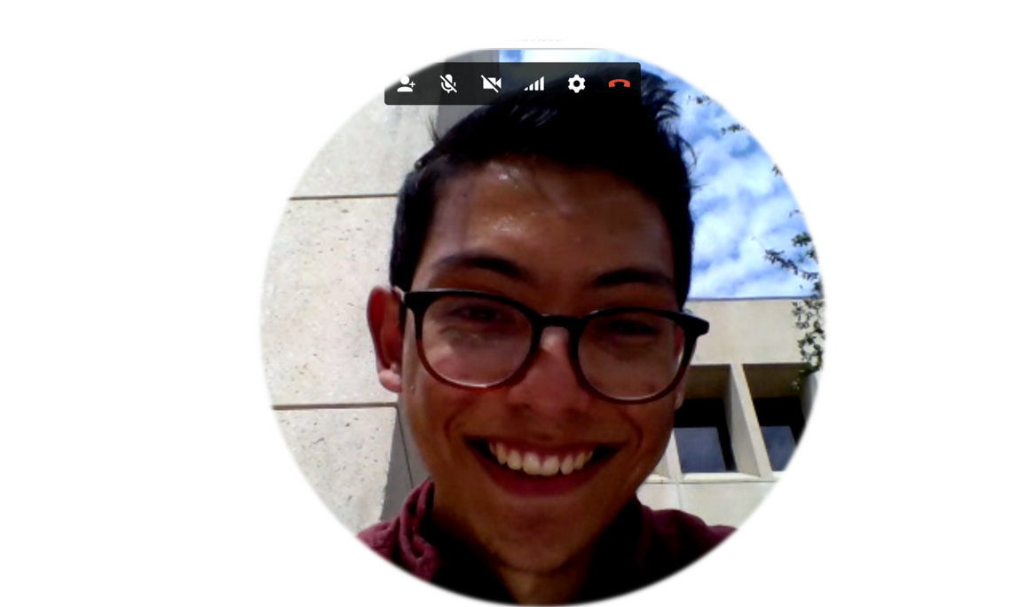
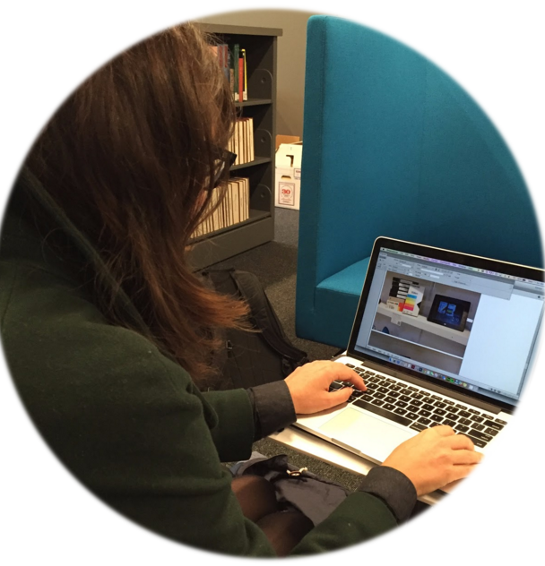
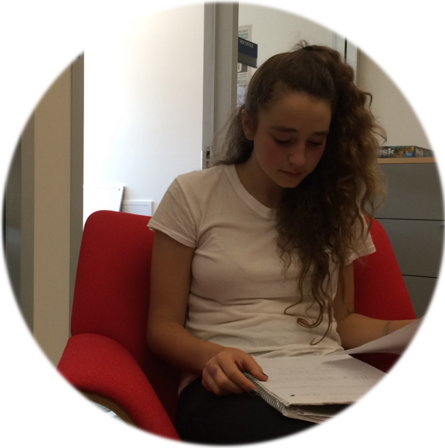
Needfinding
Notes:
Spoke to many people of diverse backgrounds about focus - including digital artist, yoga instructor, olympian high school student. In a second round of needfinding, we narrowed our focus to college students studying STEM fields.
Key Insights
physical comfort and environment important for focus
breaks are important for focus

Slide 9
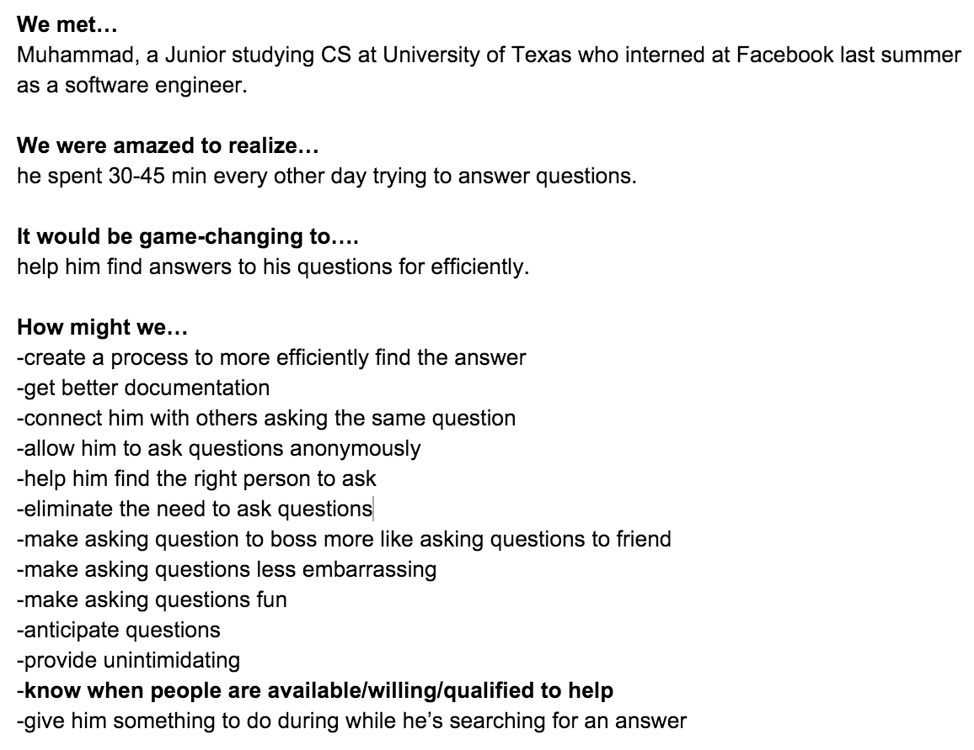
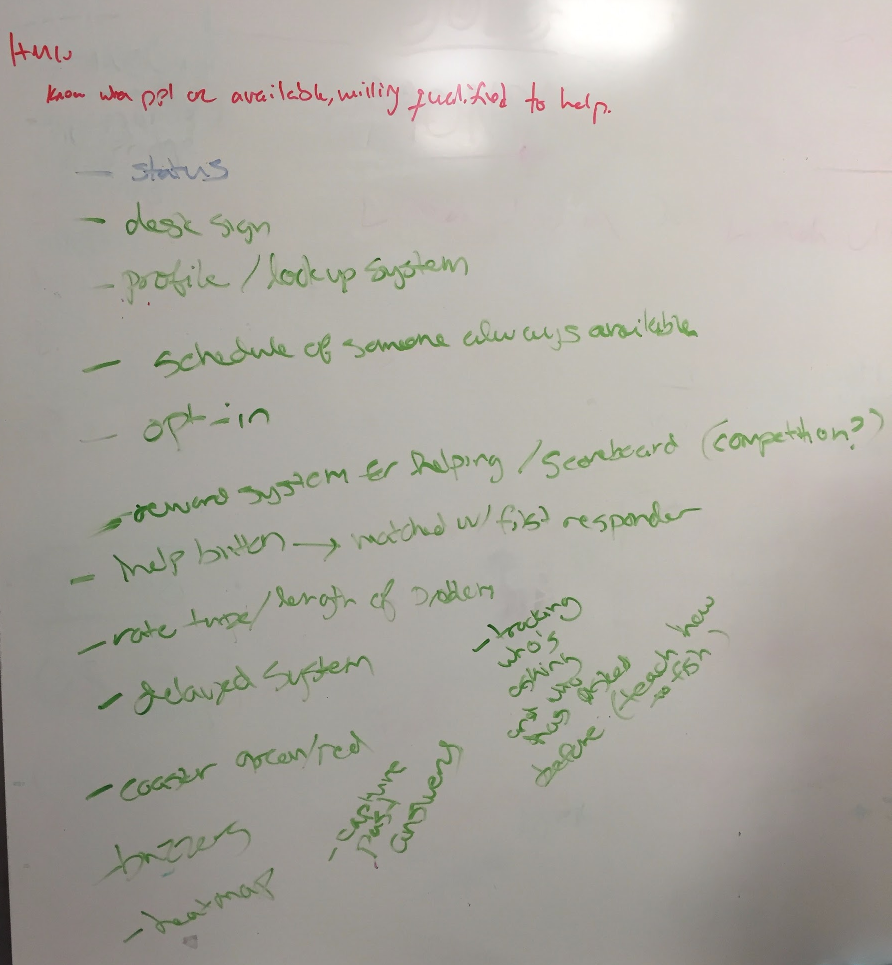
POVs, HMWs
Notes:
Then for each student we spoke to, we generated many “Point of Views,” picked 3 favorites, and then created 15 HMWs per POV

Slide 10
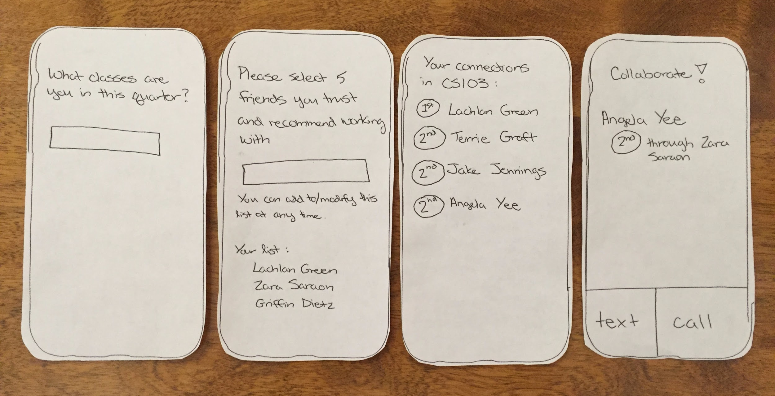
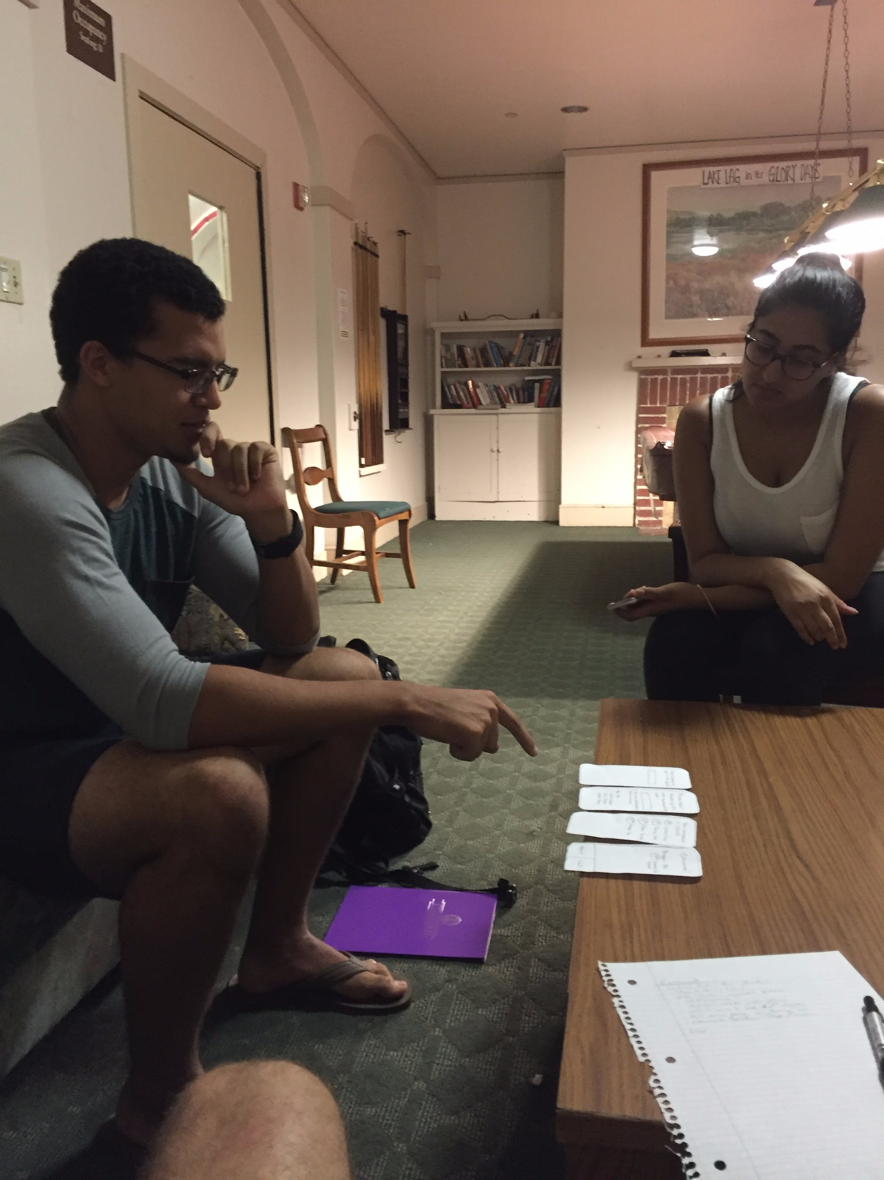
Experience Prototypes
Notes:
We created three experience prototypes that we could show users to test out the core experience for each solution. The third prototype allowed us to test how much people liked being able to find 1st, 2nd and 3rd degree connections in the classes they were taking. During this last experience prototype, we realized that students wanted to be able to find someone to work with, say, the night before a pset was due more than just find friends in general. This insight led us to NightOwl.

Slide 11
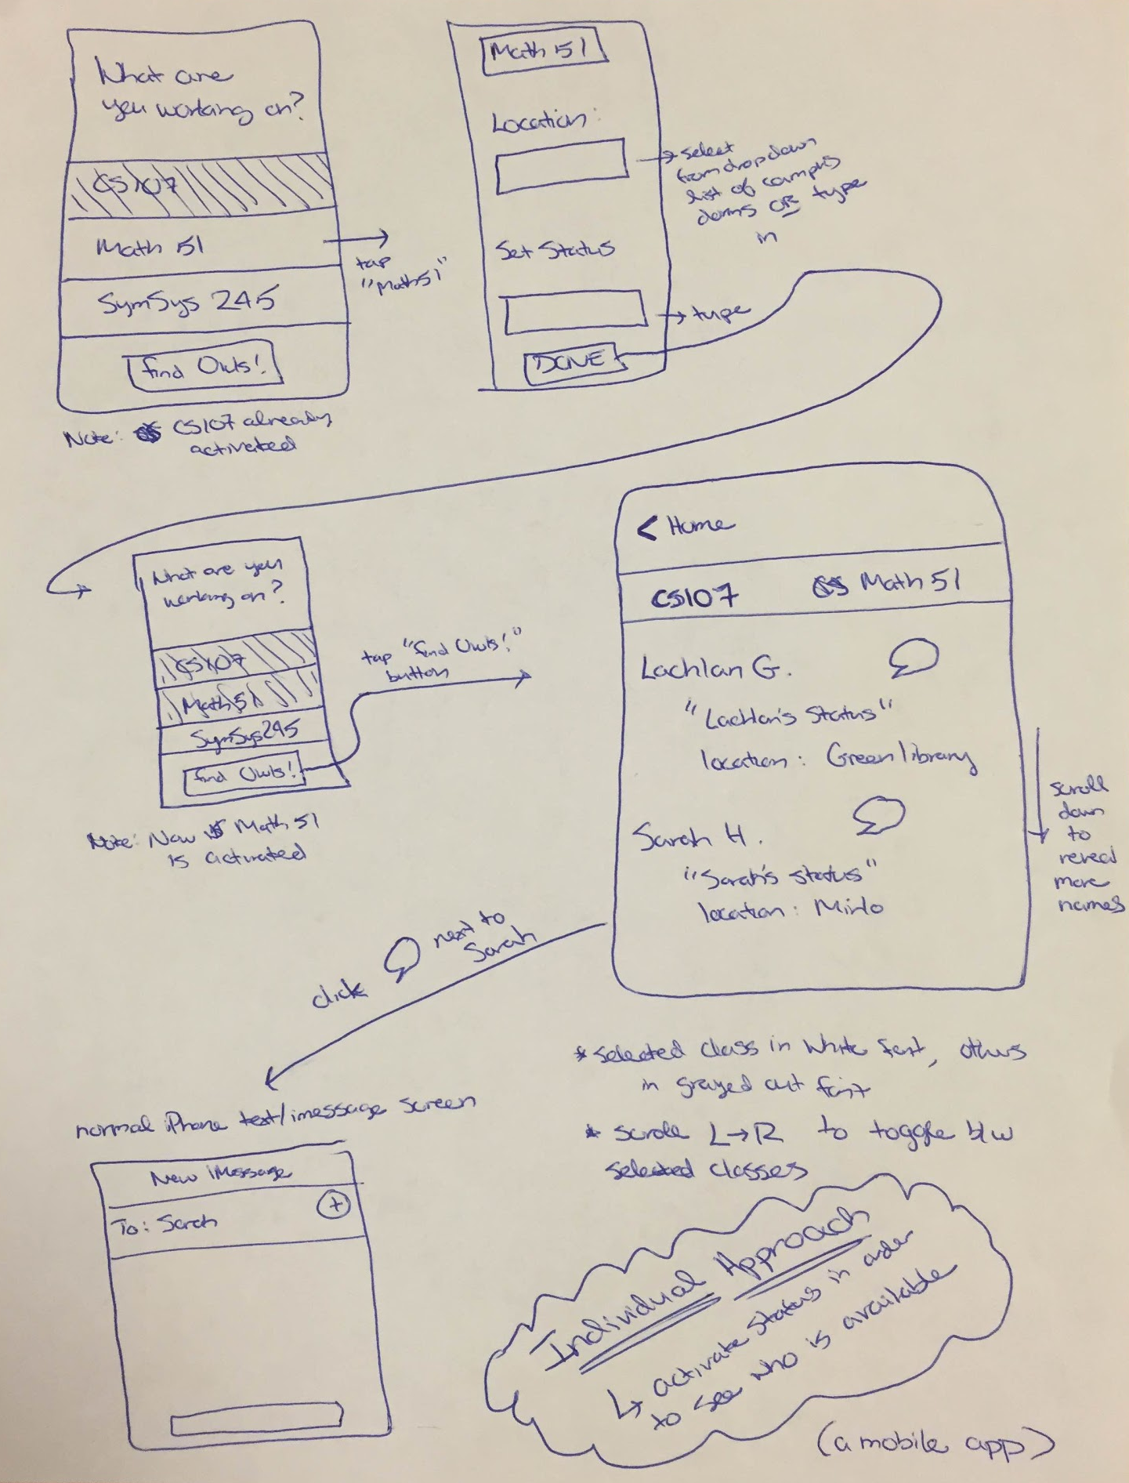
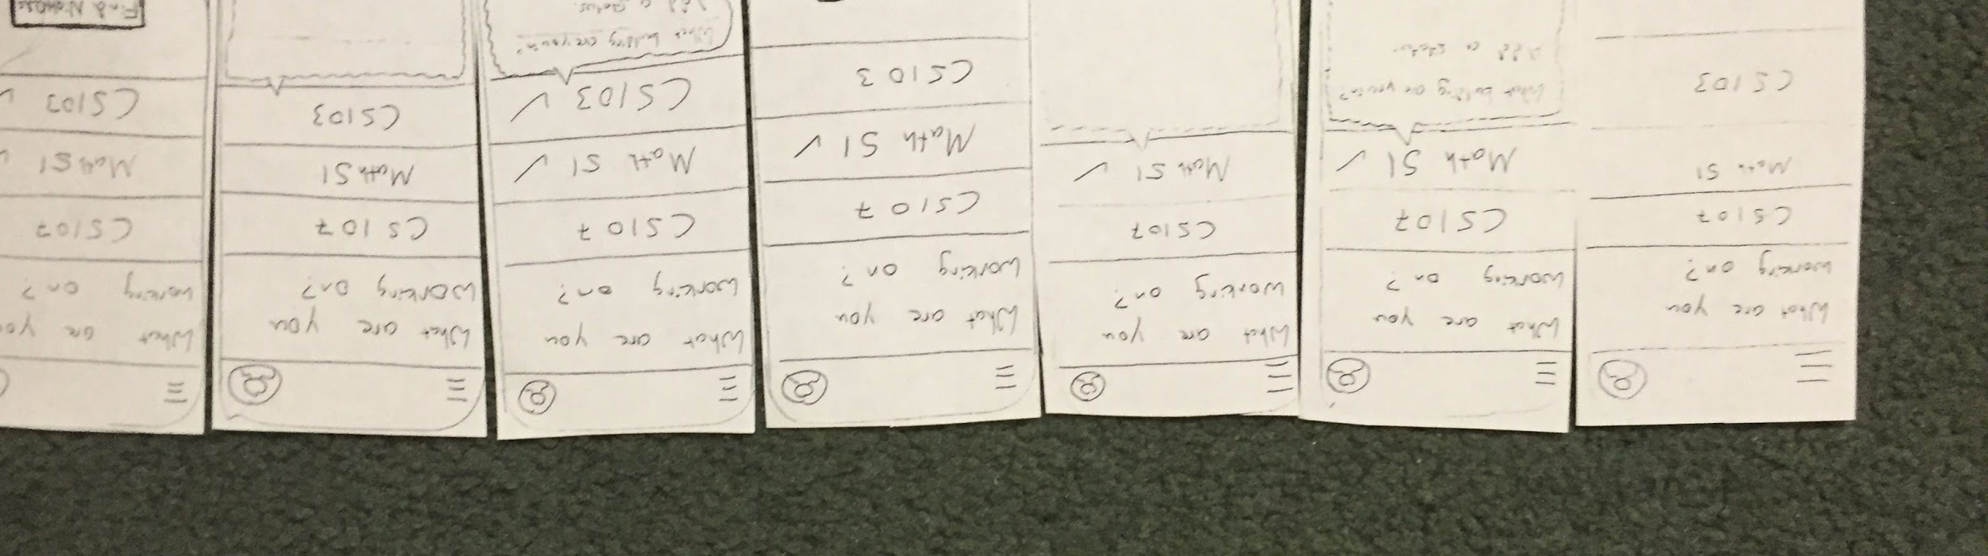
Concept Sketches, Lo-Fi Prototype
Lo-Fi Prototype
Concept Sketches
Notes:
Next, we generated a lot of concept sketches, selected our favorite two to flesh out further, chose our favorite among those two finalists, and then developed and tested that final choice.
We then mocked up the low fi paper prototypes you see below based on the following three tasks:
Simple Task: Respond to someone reaching out to you
Moderate Task: Make yourself available and write a status
Complex Task: Find people in your class who are working now and connect with them
We then tested these paper prototypes with 3 users. We found that:
people struggled with posting a status, particularly since there was no clear “Post” button
people needed to be able to view their conversation threads
people wanted to know more about other people using the service before reaching out to them

Slide 12
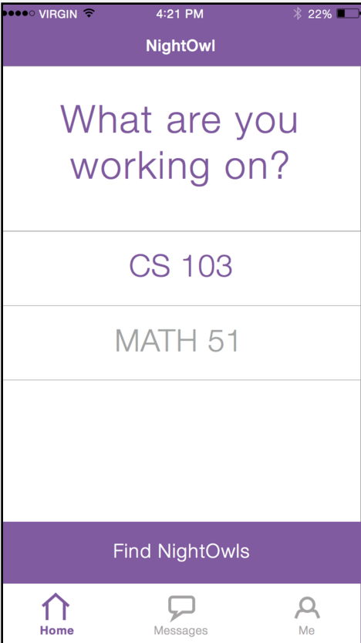
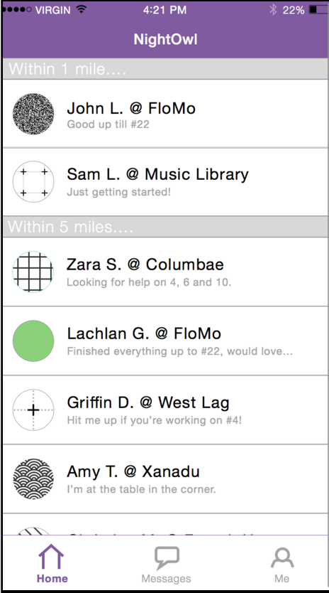
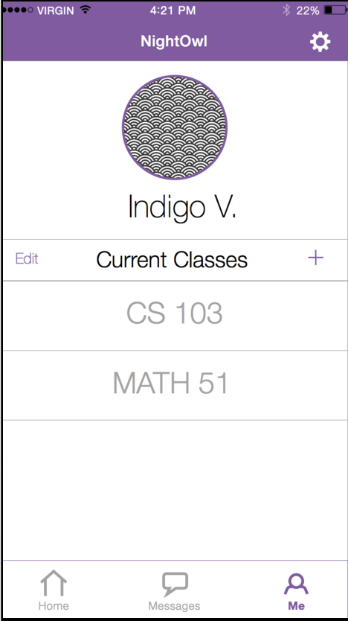
Medium-Fi Prototype
Notes:
For our next iteration, we used Sketch and Marvel to create a Medium-Fi prototype that responded to the feedback we received during from our Low-Fi prototype.
We made posting a status more clear with a large Post button that changed color when the appropriate information had been filled in, we added a Messaging tab where users could view their conversations with other users, and we added informative example text in the status and location fields that disappeared when the user began typing to push the user to add informative statuses.
We also used Sketch to create higher fidelity UIs and Marvel to imitate the UX. These tools allowed us to create prototypes that felt significantly more real.
Some of the major design decisions we made during this process were the colors, the tab bar organization and the icons.

Slide 13

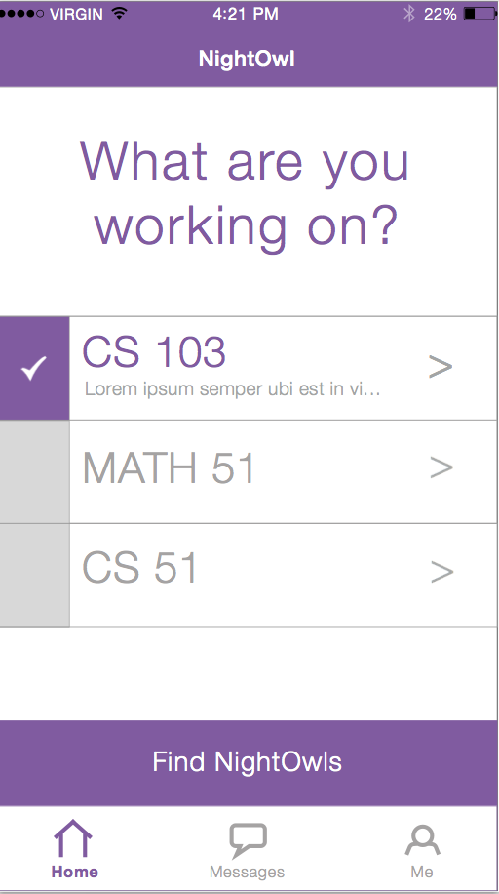
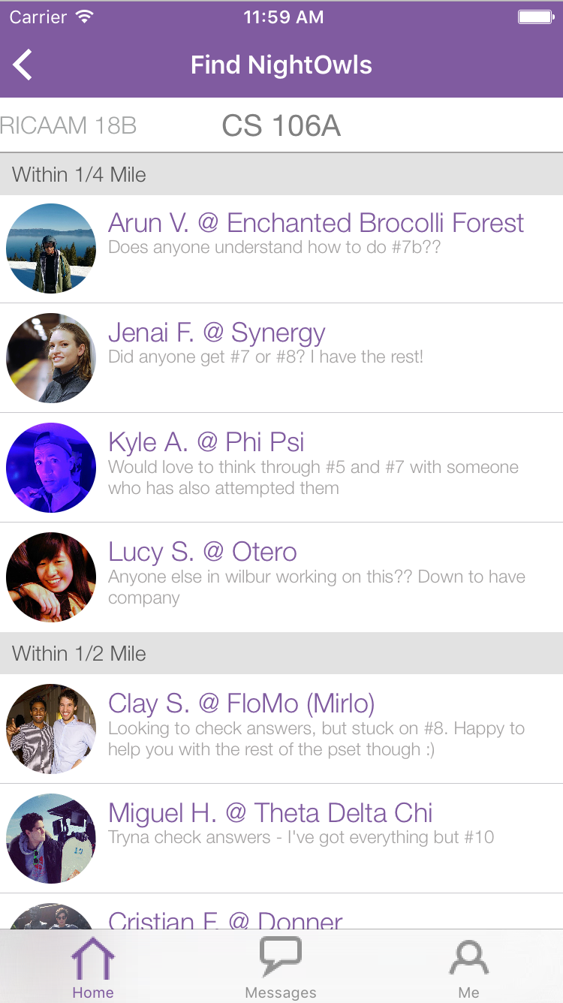
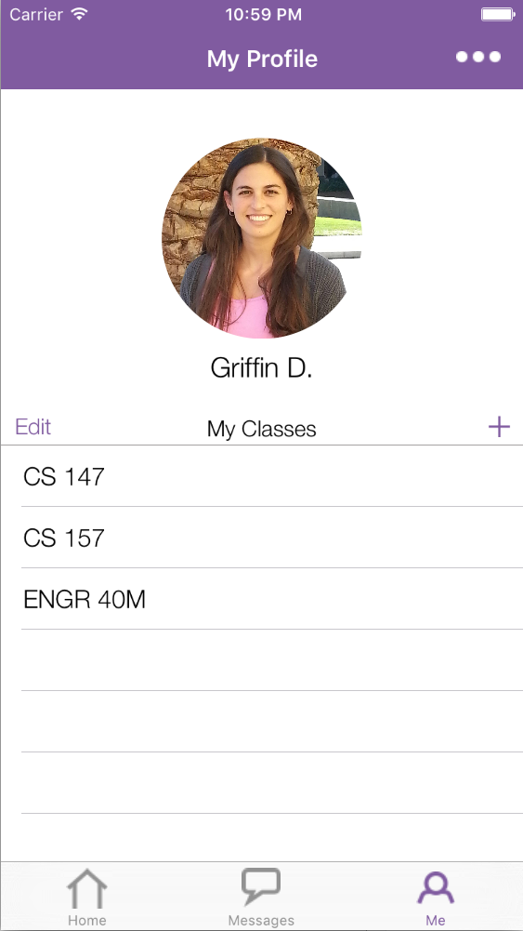
Hi-Fi Prototype
Notes:
Based on the feedback we received from the Heuristic Evaluation conducted on our medium-fi prototype (by CS147 classmates), we developed our hi-fi prototype. We used Sketch to update our UI and to create icons, and used XCode, Objective C and nib files to build the app.

Slide 14
Today’s Flight Path
Video
Design Evolution
Tasks
Future Changes

Slide 15
Tasks
Become available and write a status (Average)
Reach out to classmates (Complex)
Update list of current classes (Simple)
Notes:
We chose this task because in order to use NightOwl over many academic quarters, users need to be able to change the list of classes they are currently enrolled in.
Select the Me tab to view your profile and the list of classes you are enrolled in.
Tap the + button to add more classes to this list.
You are taken to a list of classes. Every ExploreCourses class is available, and you can use the search bar to narrow down the search. Tapping a class adds it to the list of enrolled classes and returns you to the previous page.
Classes can be deleted by swiping left on a cell and hitting delete (standard iOS table functionality). A user can delete multiple classes at once (as they would perhaps want to at the end of a quarter by pressing the edit button).

Slide 16
Today’s Flight Path
Video
Design Evolution
Tasks
Future Changes

Slide 17
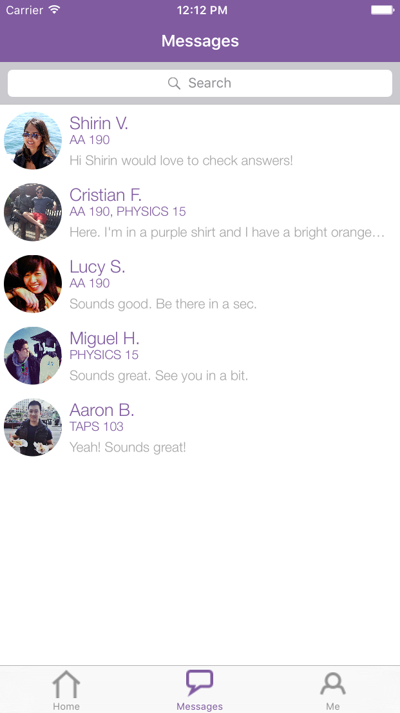
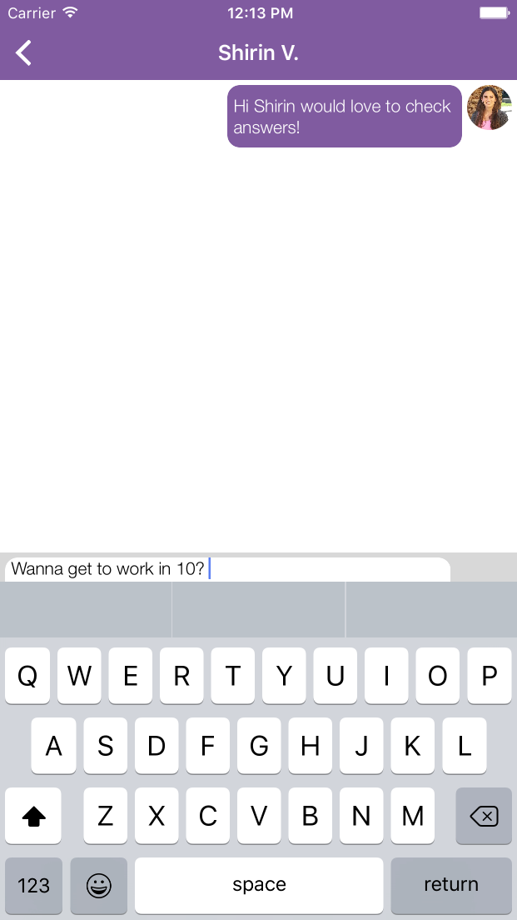
What We Faked
Messaging
User Base
Notes:
Messaging is currently completely Wizard of Oz
We also faked users

Slide 18
What Comes Next
User onboarding
Messaging
Redesign how user inputs status
Implement settings
Add classes not in catalog
Expand outside of Stanford
Notes:
These are just some ideas… add/remove as you see fit

Slide 19

Summary
Notes:
Spent 10 weeks getting it to hi-fi with wizard of oz messaging, no users
Goal for quarter = get app-store ready. We’ve never tested hi-fi on users. lets test and re-iterate.

