Slide 1
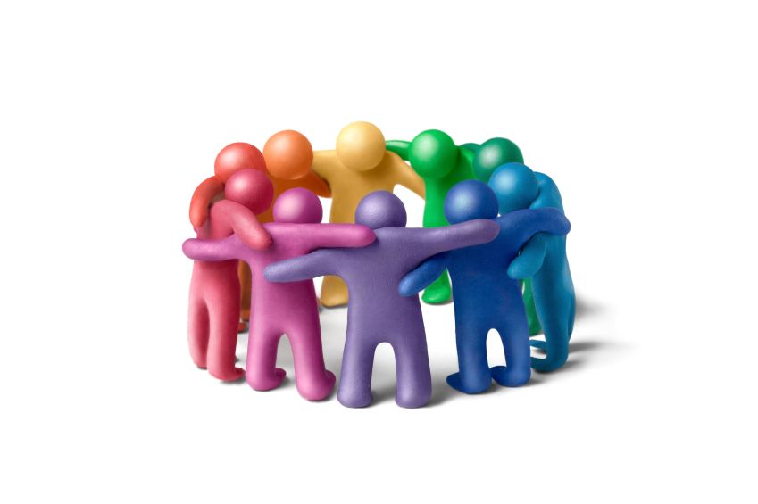
The Power of the Group
Griffin Dietz
Lachlan Green
Zara Saraon

Slide 2
Leverage others to motivate focus

Slide 3
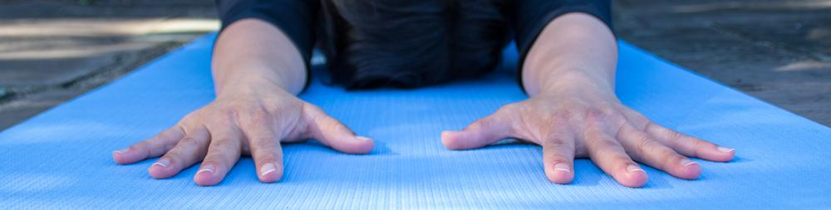
Lorraine
Notes:
Who
Has been teaching Vinyasa and Yin Yoga since 2004 & meditates daily
She hopes people will use the practice of yoga and meditation to become more aware of what goes on in their minds
Why chosen
Because she is in expert in quieting the mind and turning on extreme focus - as she holds physically challenging poses for 10+ minutes at a time
She also teaches others how to use their breath to increase their self-awareness and focus, and thus is acutely aware of the many pitfalls people face as they attempt focus
How recruited
reached out to her via email
Where they were interviewed
I went to her yin yoga class at Yoga Source (weds morning) and then later interviewed her at a Starbucks (weds evening)

Slide 4
Initial POV
We met...
Lorraine, a yoga instructor
We were amazed to realize that...
focus can be enhanced through a shared experience
It would be game changing to...
provide a support system for people trying to focus

Slide 5
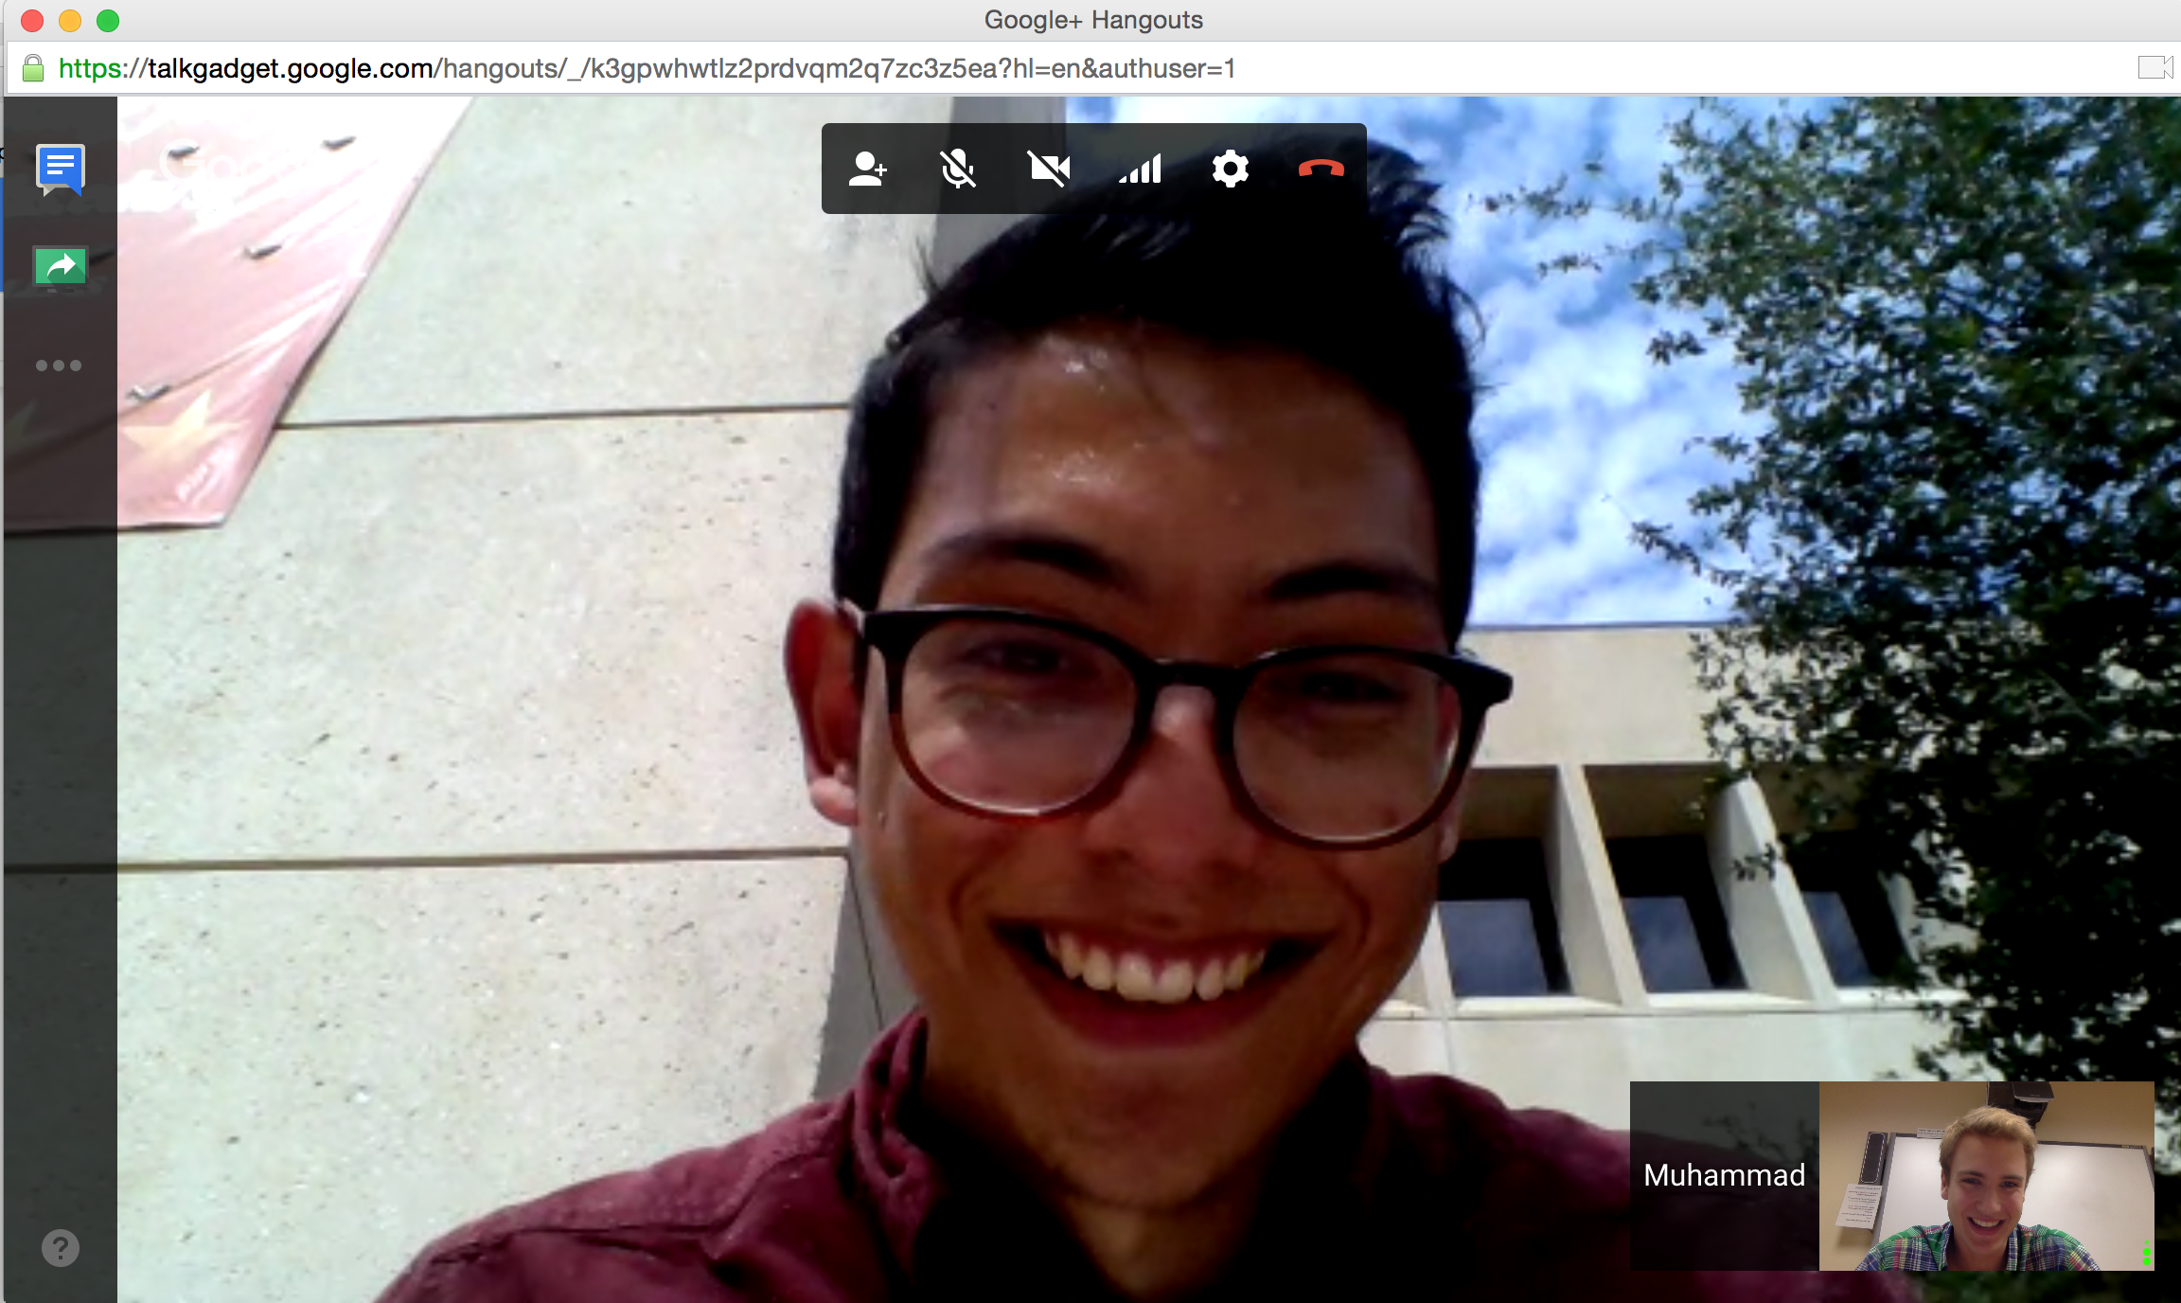
Muhammad

Slide 6
Spends 30-45 minutes trying to find the answer to a question
“I was afraid of feeling dumb”

Slide 7
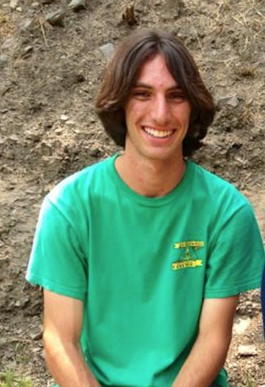
Dustin

Slide 8
“People are intimidating.”
“I won’t necessarily branch out and make a new friends.”
“Having someone to go to or someone to work with would make it easier.”

Slide 9

Alice

Slide 10
“I’m better than most of my group members.”
“I need to be able to trust that the other person knows their shit.”

Slide 11
Revised POVs

Slide 12
We met...
Jenny and Celia

Slide 13
We met...
Jenny and Celia
We were amazed to realize that...
they sometimes lost track of what they were doing as they were doing it

Slide 14
We met...
Jenny and Celia
We were amazed to realize that...
they sometimes lost track of what they were doing as they were doing it
It would be game changing to...
help people keep track of what they’re working on in the present moment

Slide 15
How might we…
encourage people to unitask?

Slide 16
We met...
Muhammad

Slide 17
We met...
Muhammad
We were amazed to realize that...
he spent 30-45 every other day trying to answer questions

Slide 18
We met...
Muhammad
We were amazed to realize that...
he spent 30-45 minutes every other day trying to answer questions
It would be game changing to...
help him find answers to his questions more efficiently

Slide 19
How might we…
know when people are willing/qualified/able to help?

Slide 20
We met...
Alice

Slide 21
We met...
Alice
We were amazed to realize that...
she doesn’t feel like collaborating with her peers is worth it unless there is some level of trust between them and knowledge that the other person “knows their shit”

Slide 22
We met...
Alice
We were amazed to realize that...
she doesn’t feel like collaborating with her peers is worth it unless there is some level of trust between them and knowledge that the other person “knows their shit”
It would be game changing to...
overcome the trust barrier

Slide 23
How might we…
connect students with people in their classes whom they can trust?

Slide 24
Experience Prototypes

Slide 25
How might we…
encourage people to unitask?

Slide 26
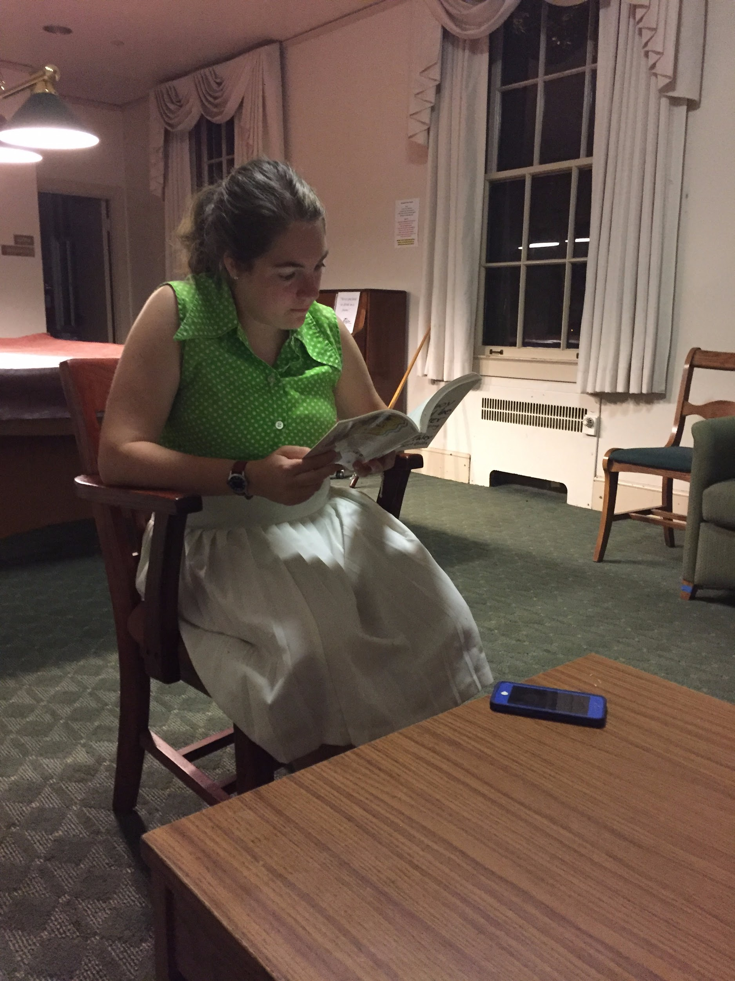
Buzz

Slide 27
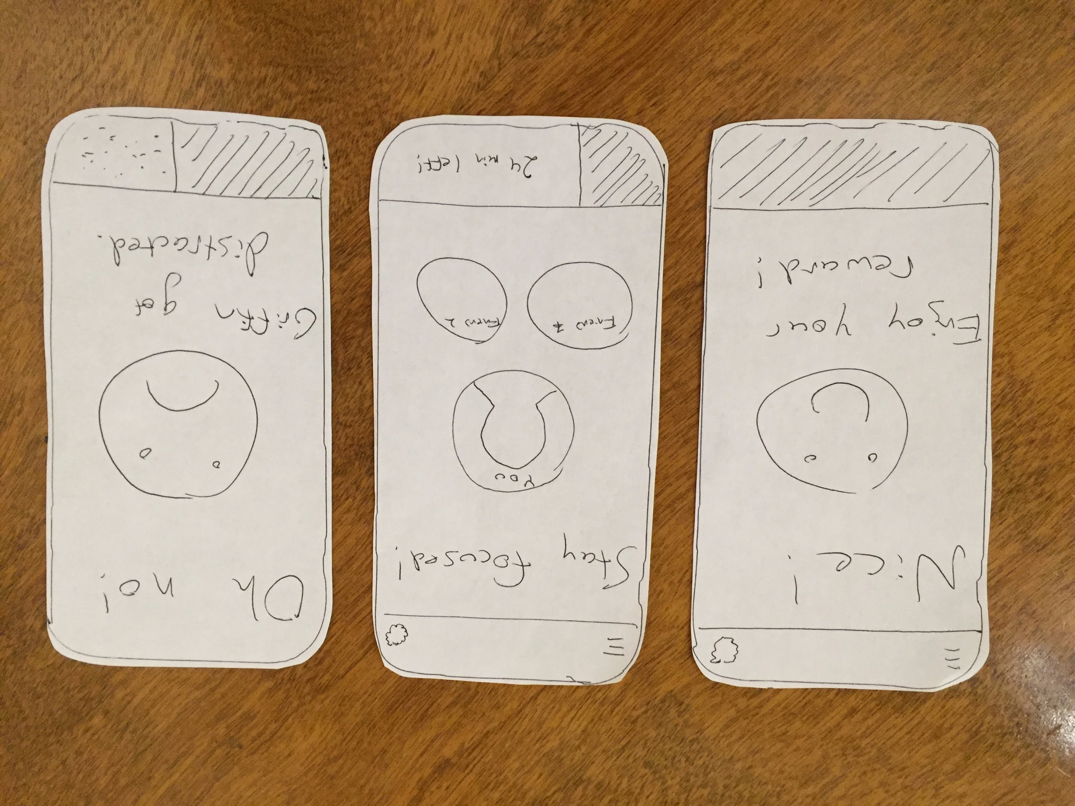
Using social pressure to help people focus

Slide 28
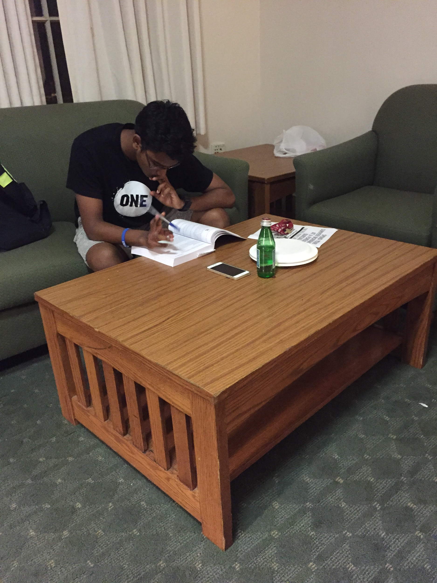
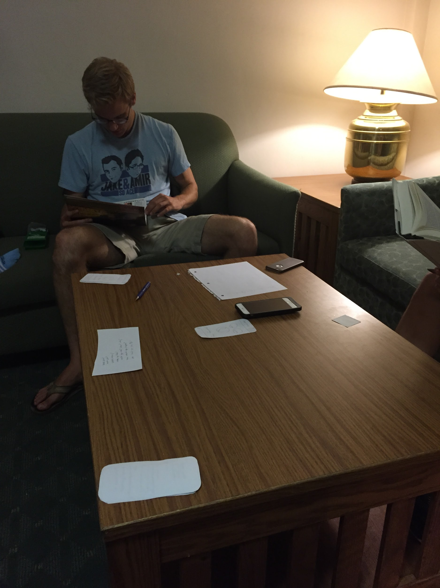
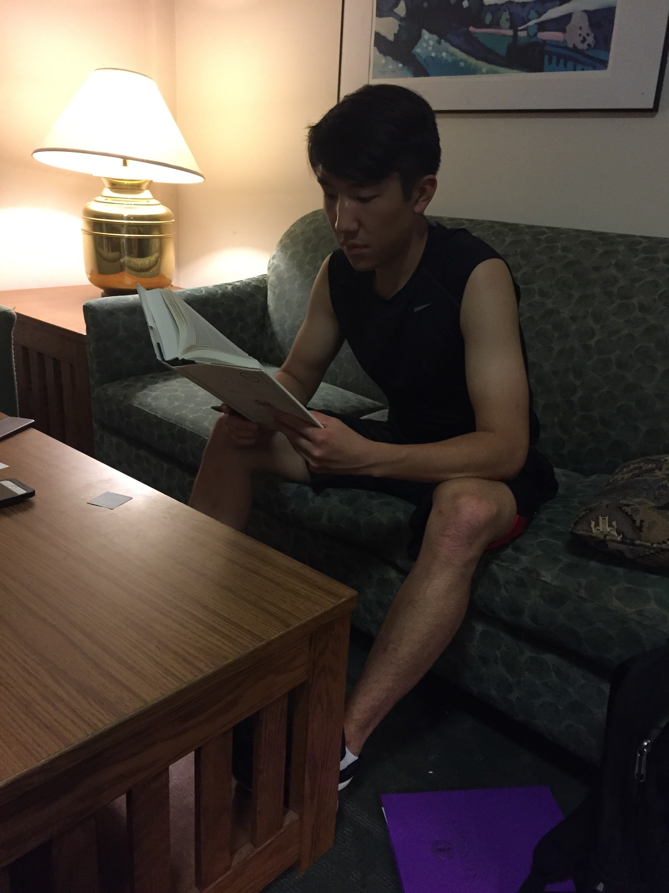

Slide 29
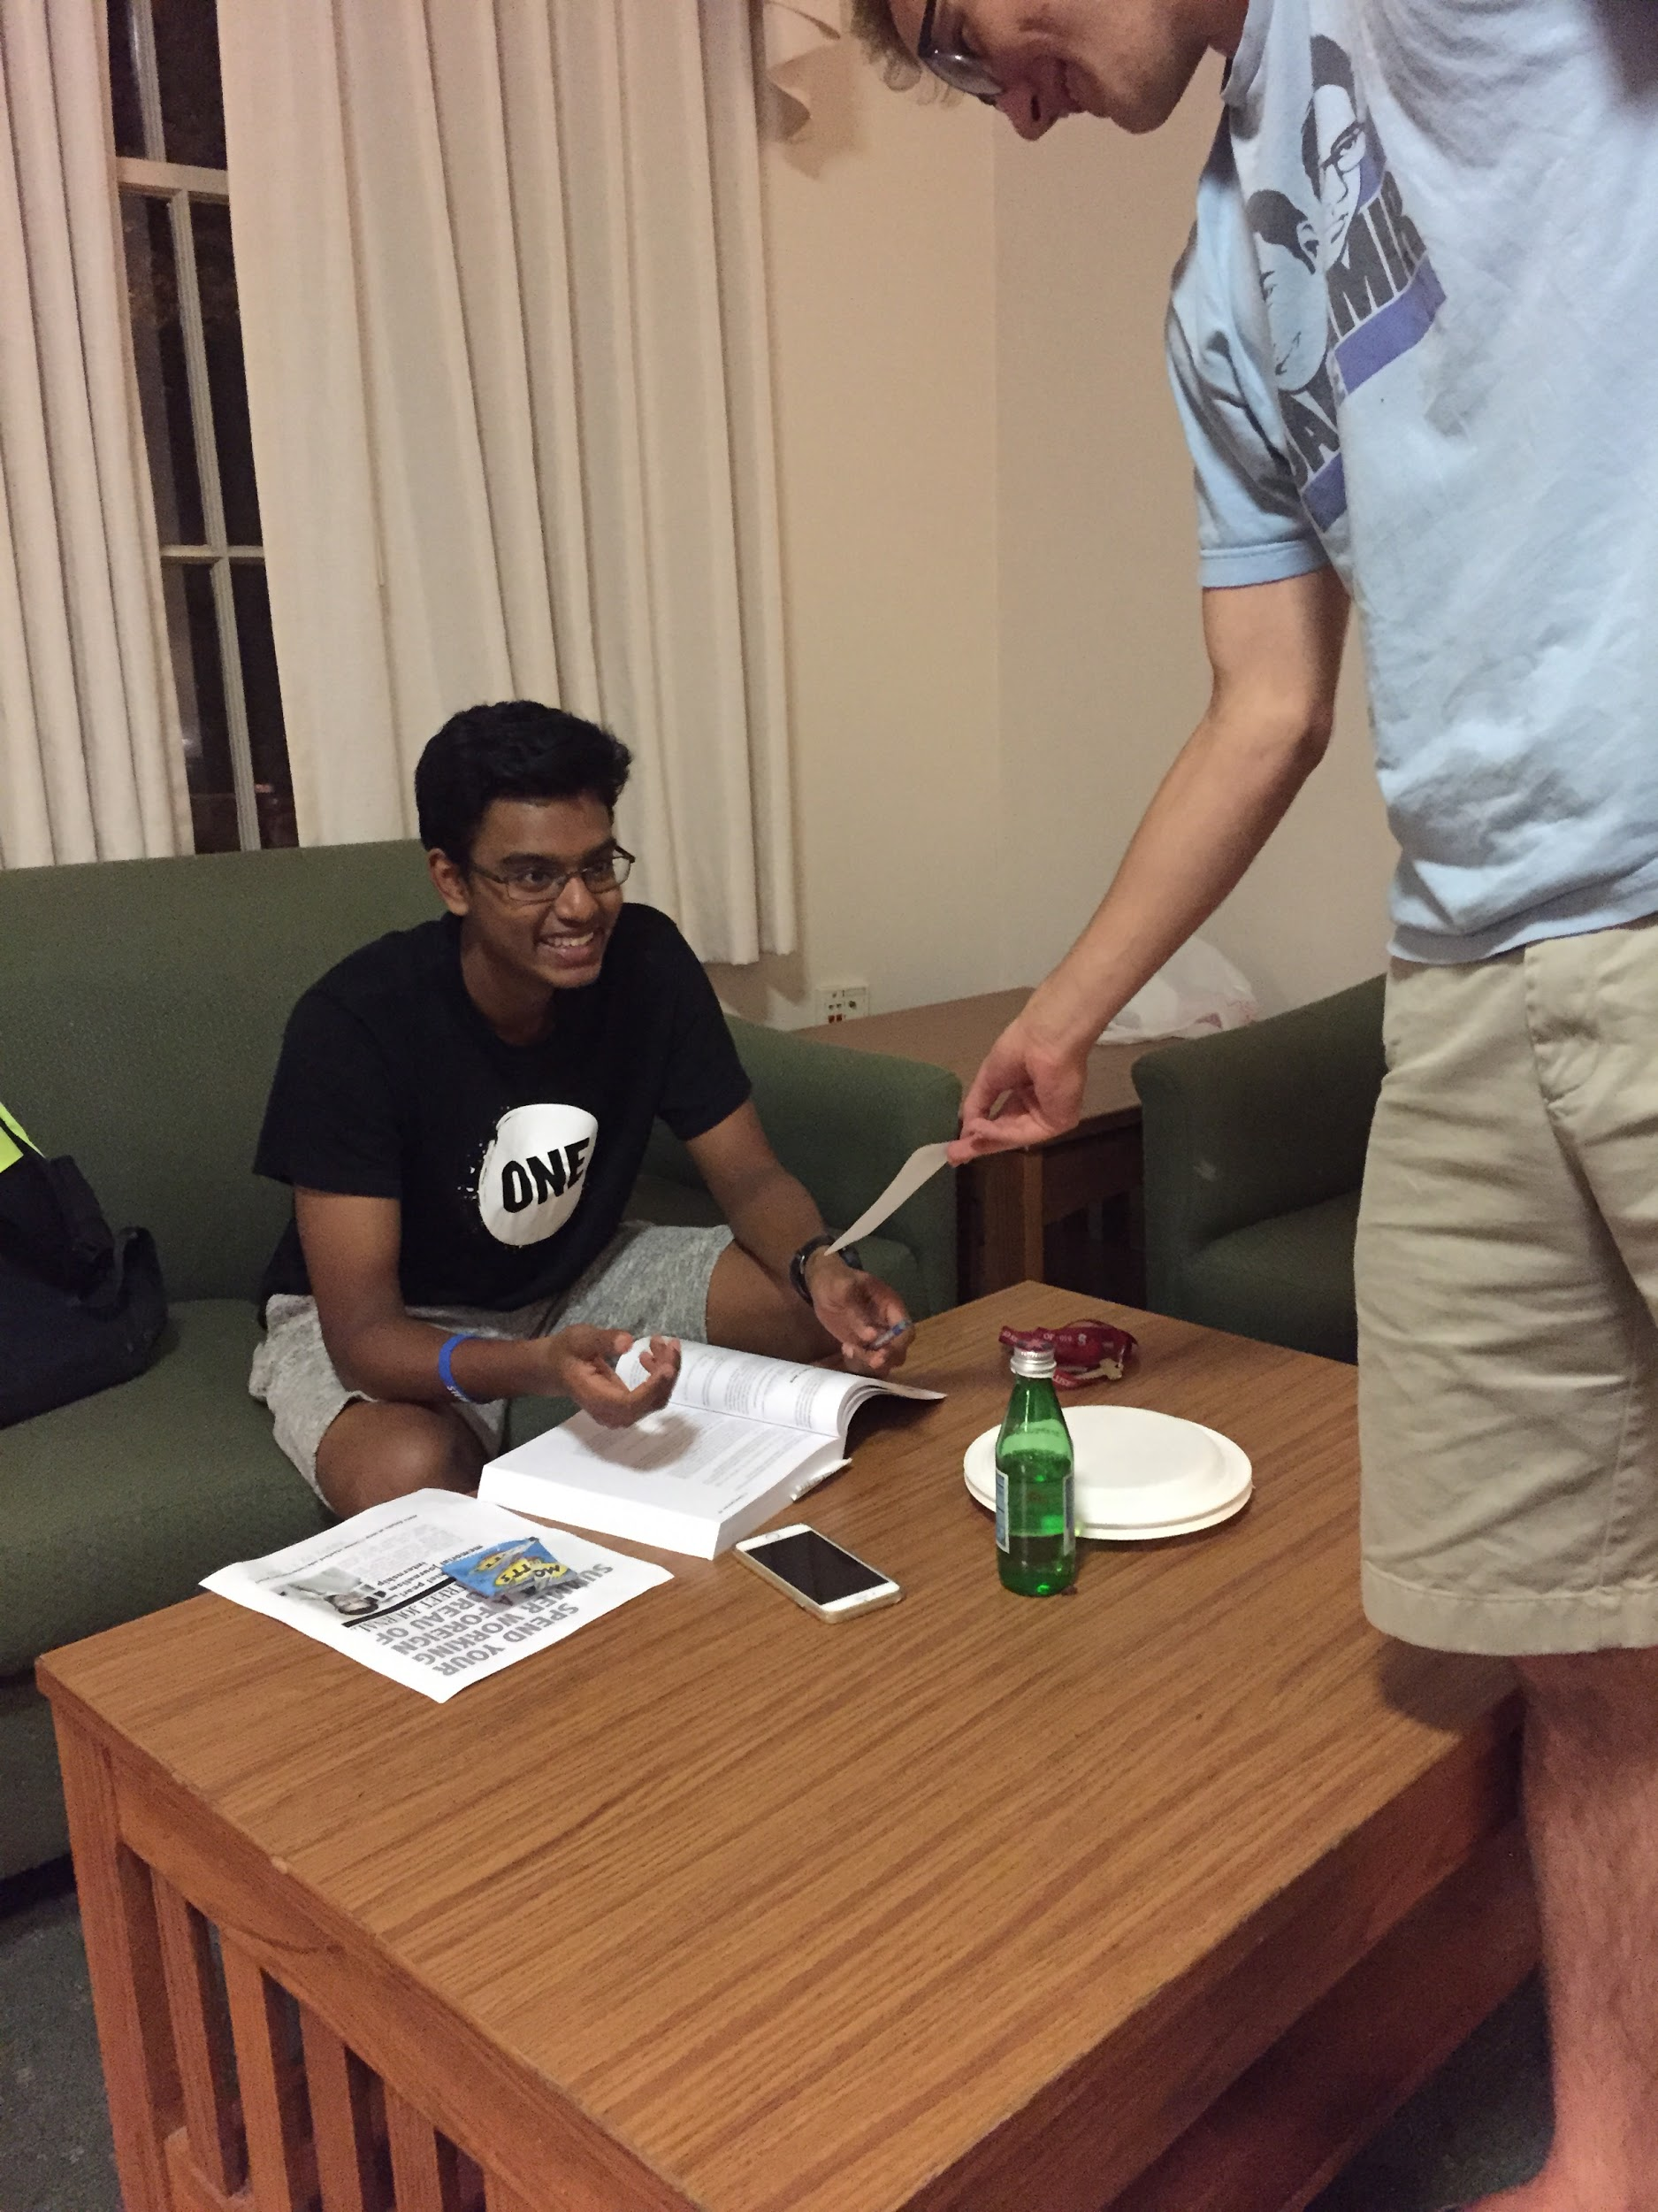


Slide 30
How might we…
connect students with people in their classes whom they can trust?

Slide 31
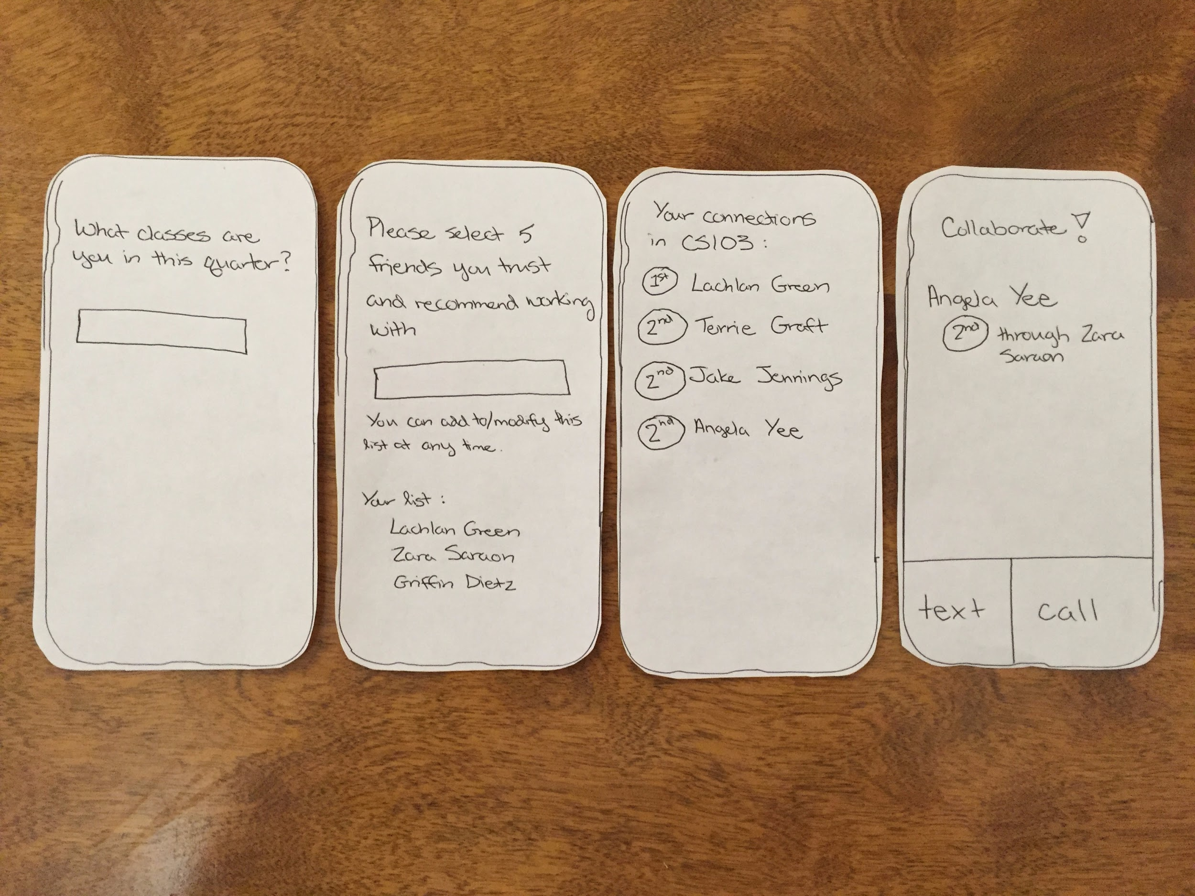

Slide 32
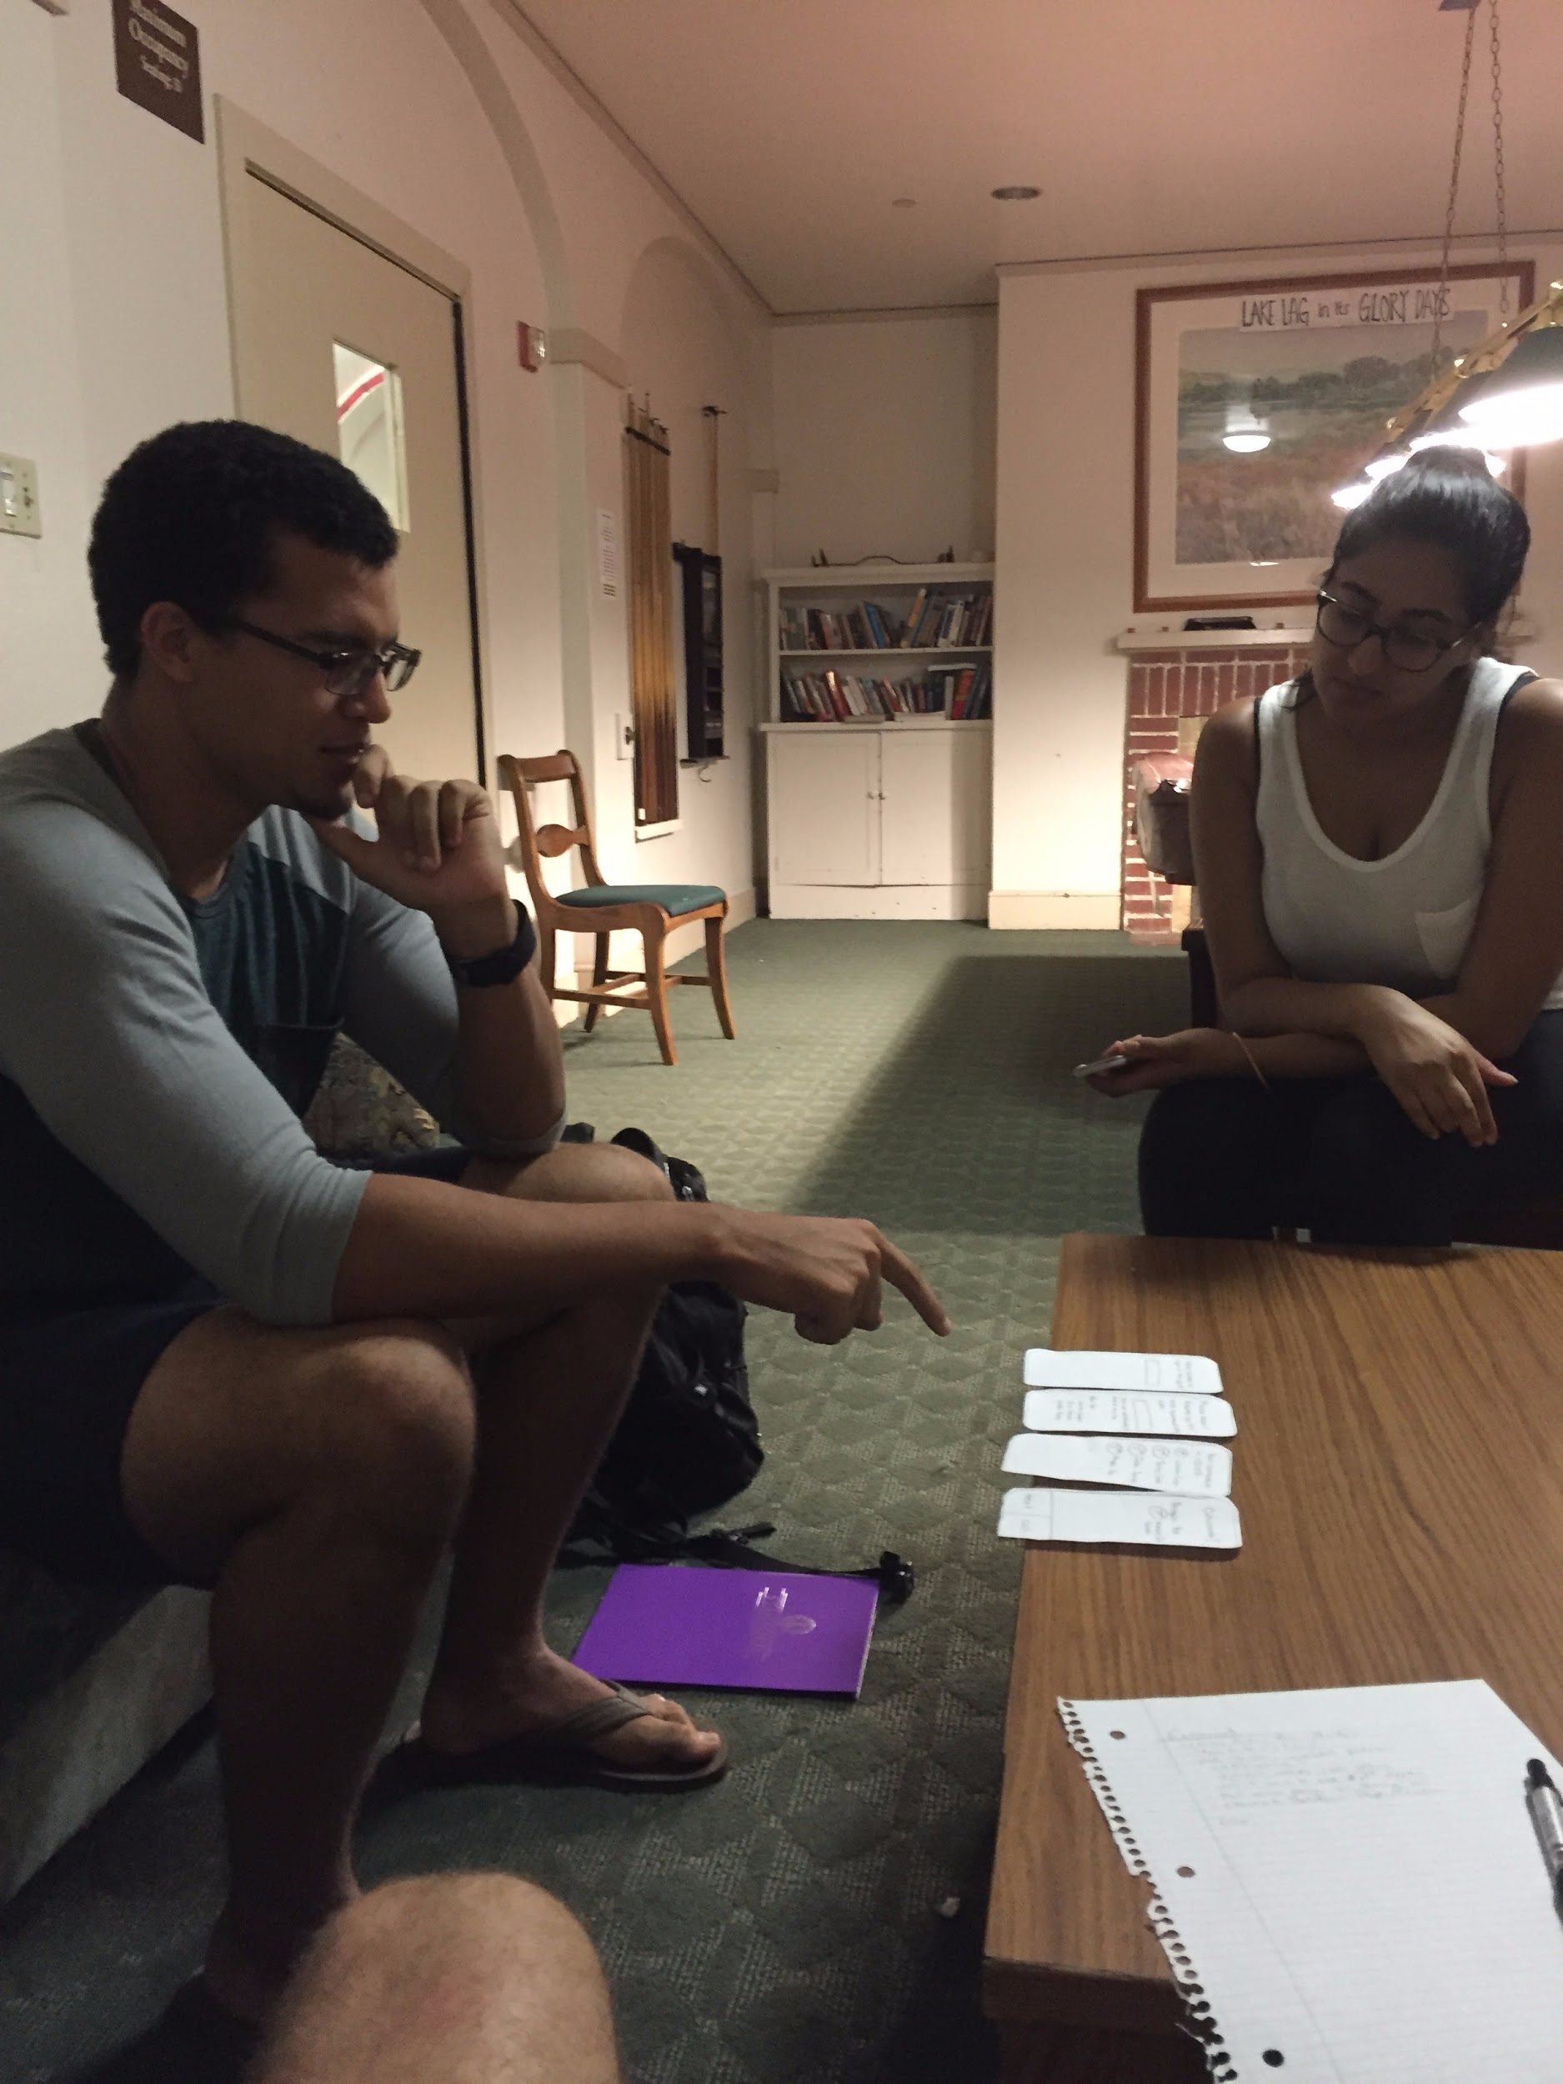
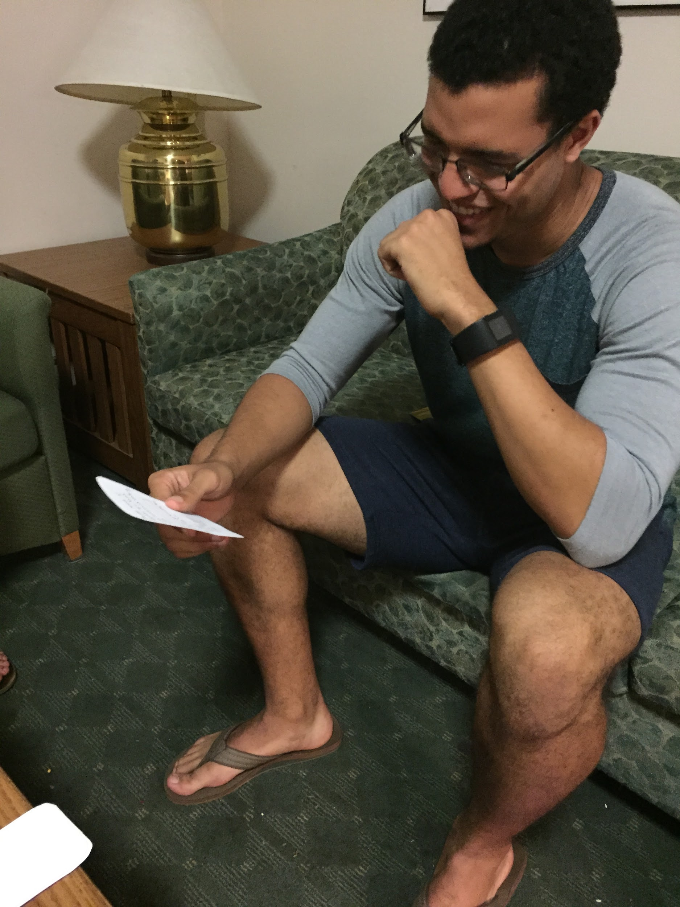

Slide 33
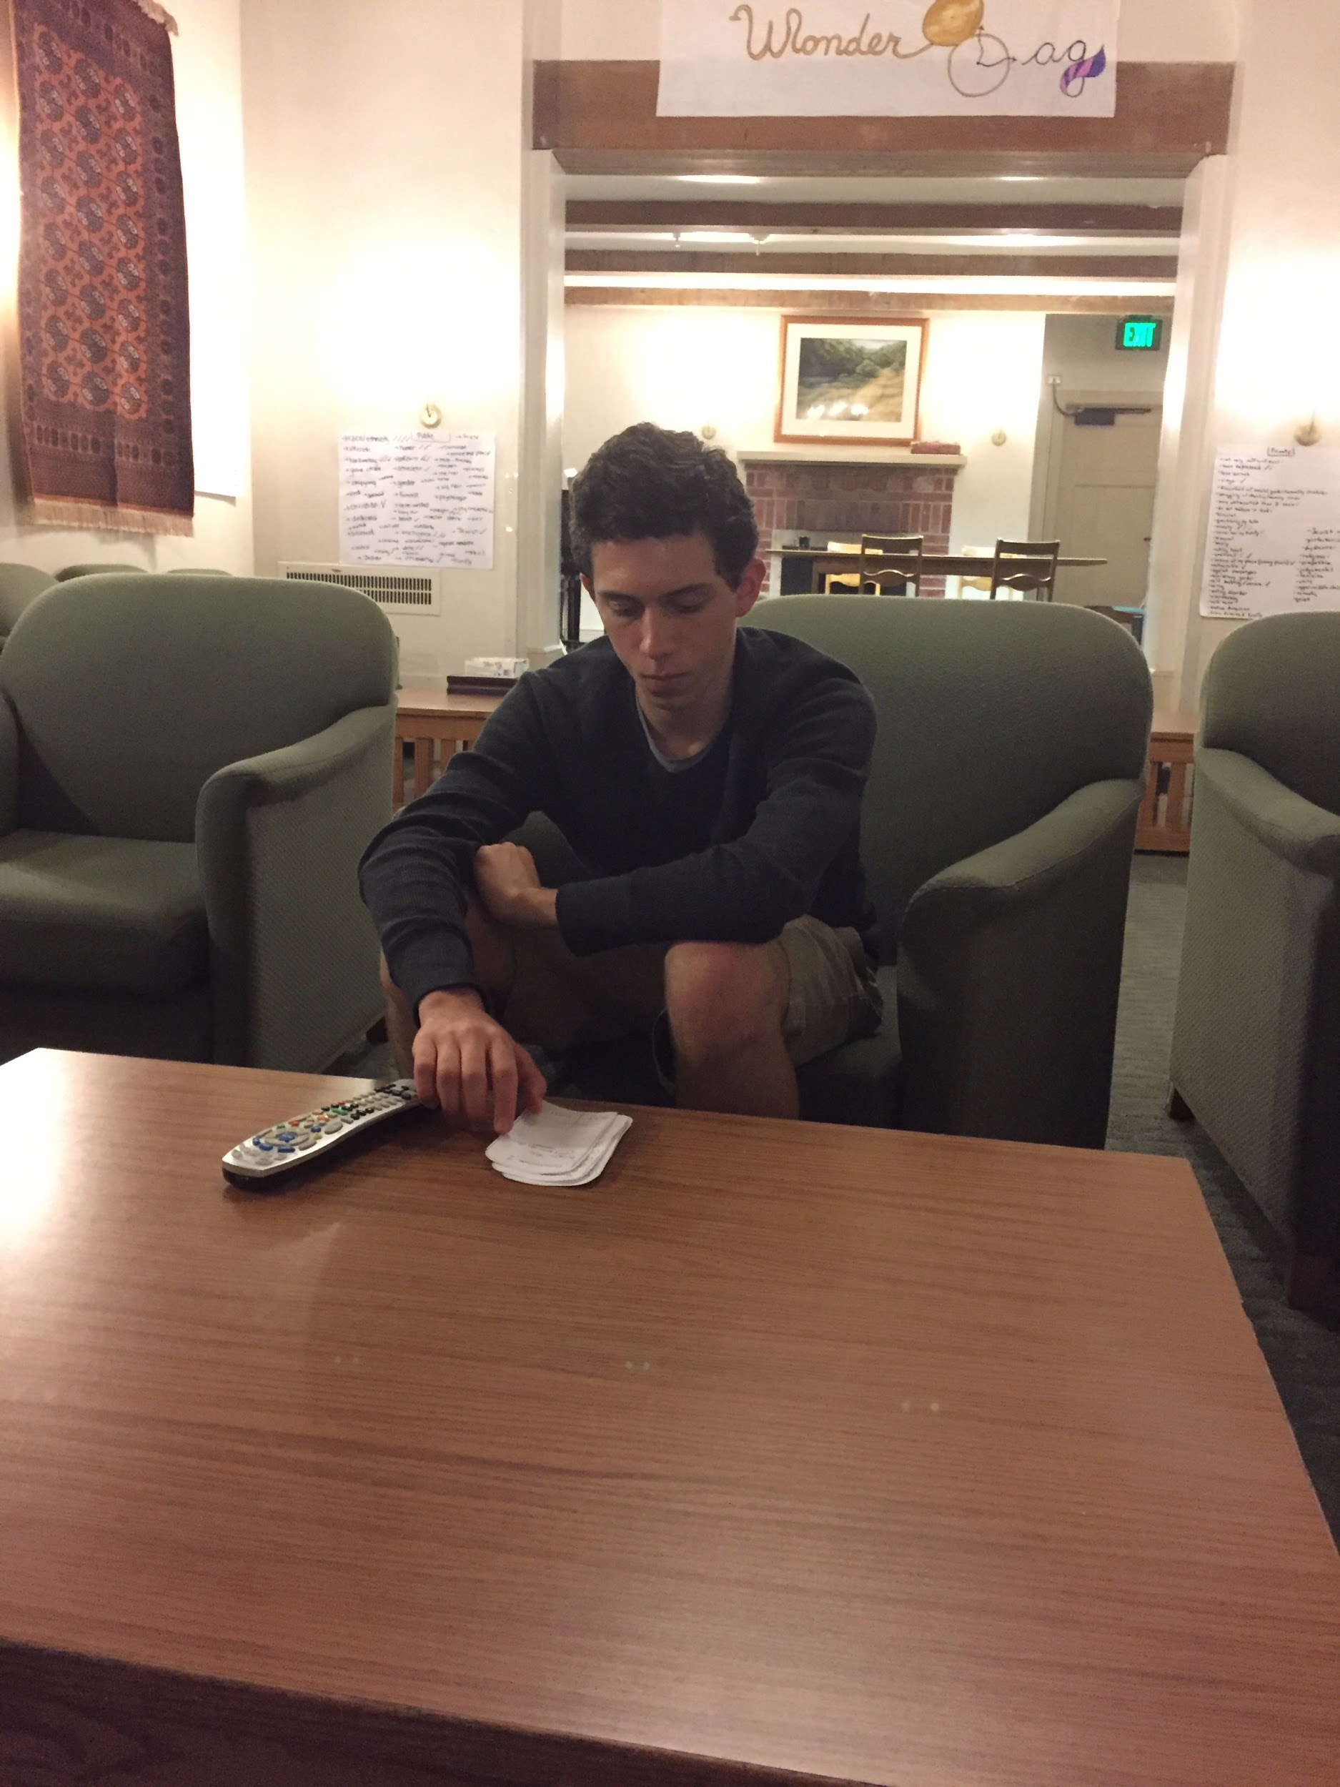

Slide 34
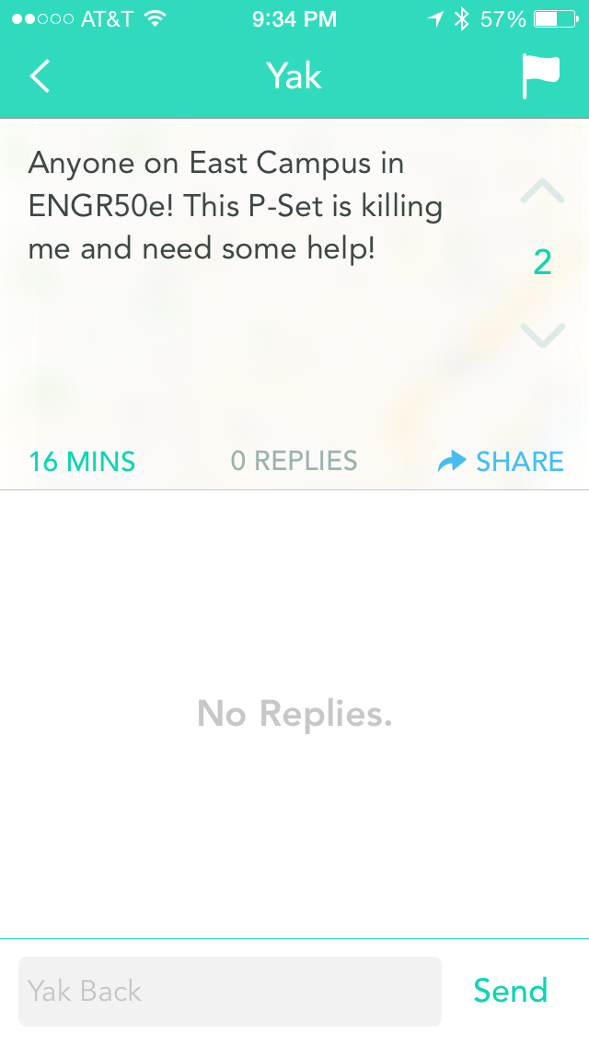

Slide 35
Questions

