Slide 1

Unique Perspectives
on Focus
Griffin Dietz
Lachlan Green
Zara Saraon

Slide 2
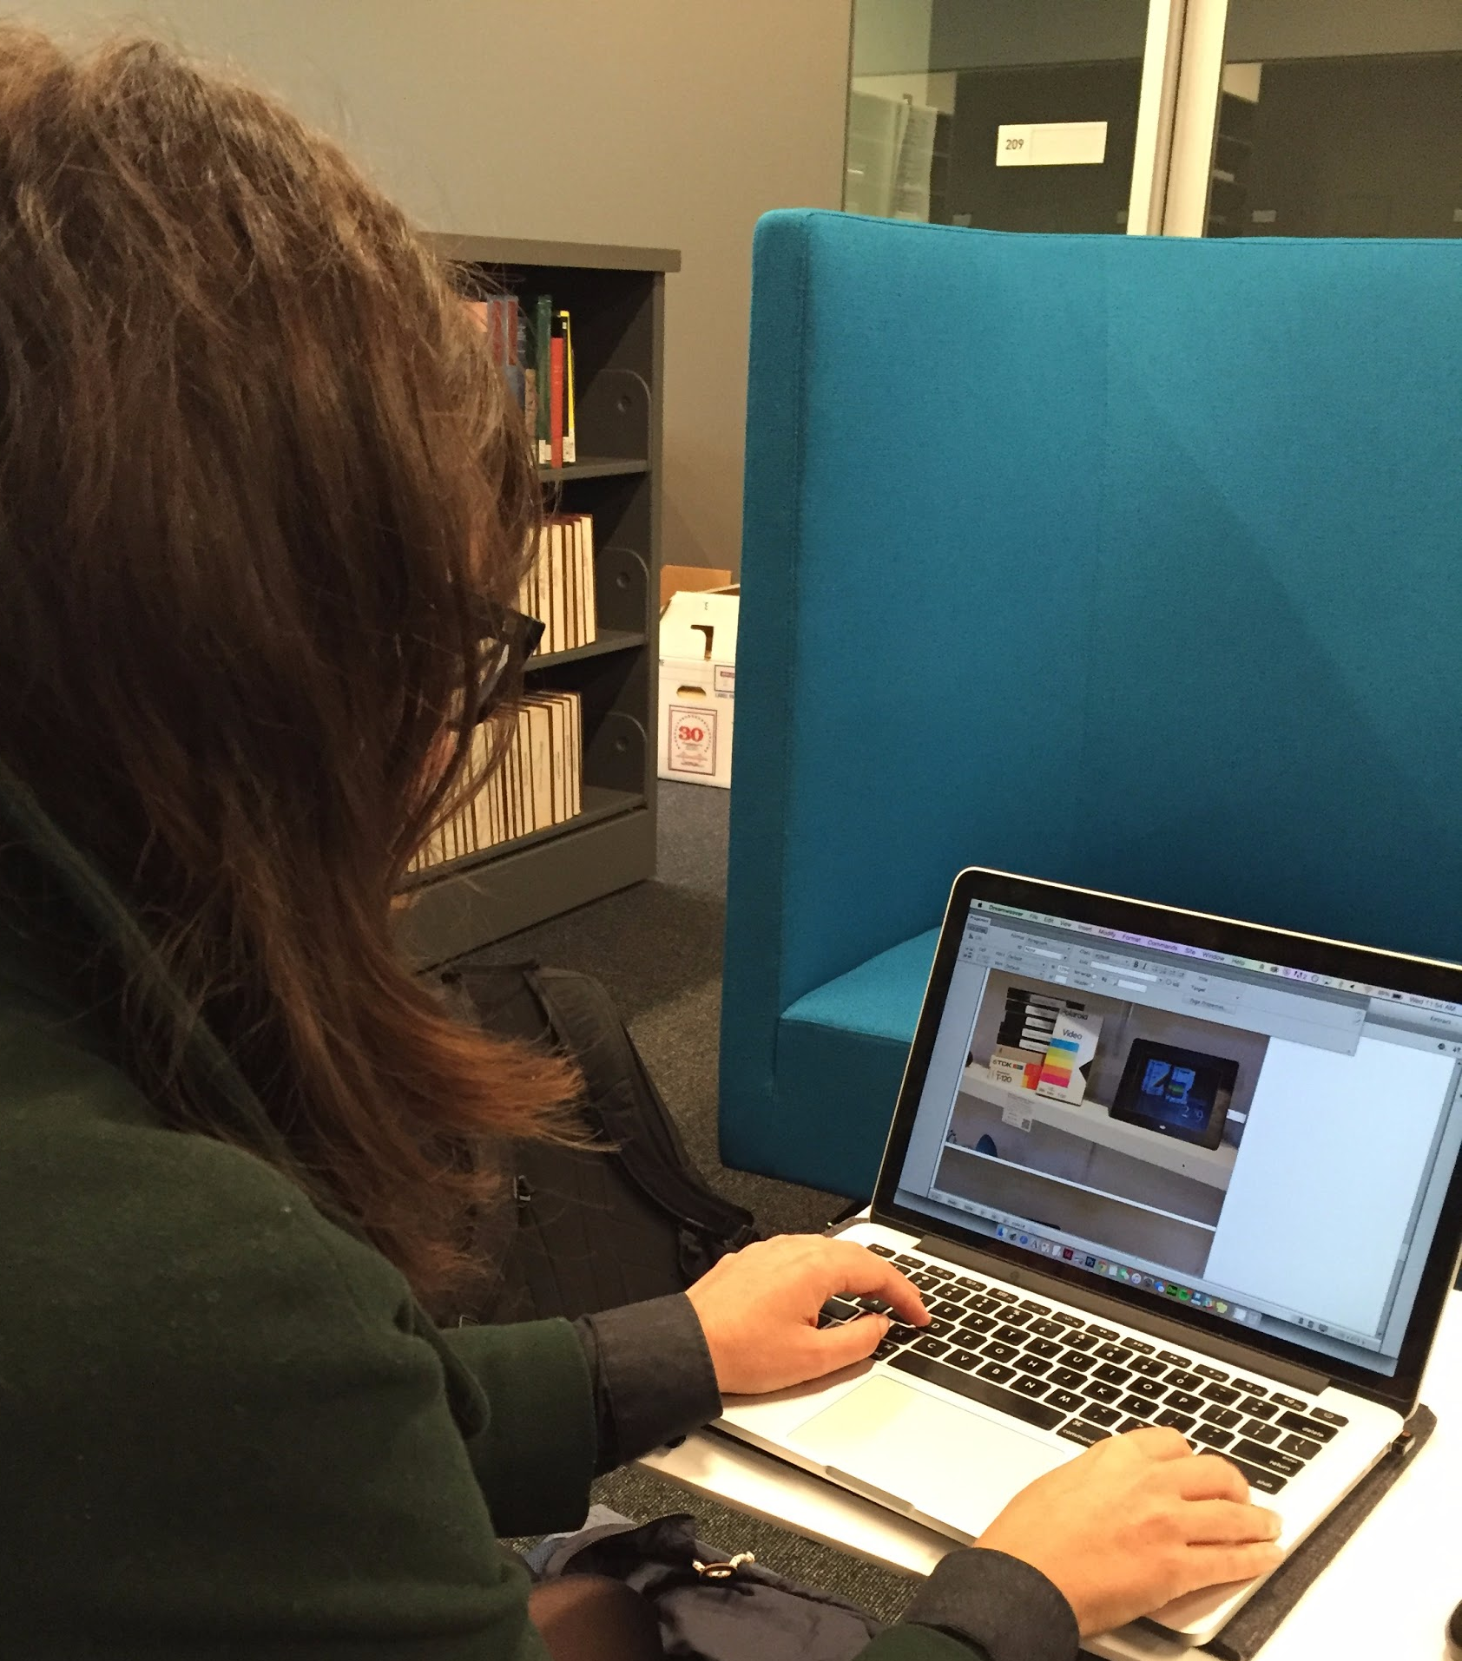
Jenny O’Dell

Slide 3
“my office is in the living room … and that’s can be really dangerous”
“you just can’t treat yourself like a machine”
“Sometimes I forget what I was working on … It’s like walking into a room and forgetting why you’re there”

Slide 4
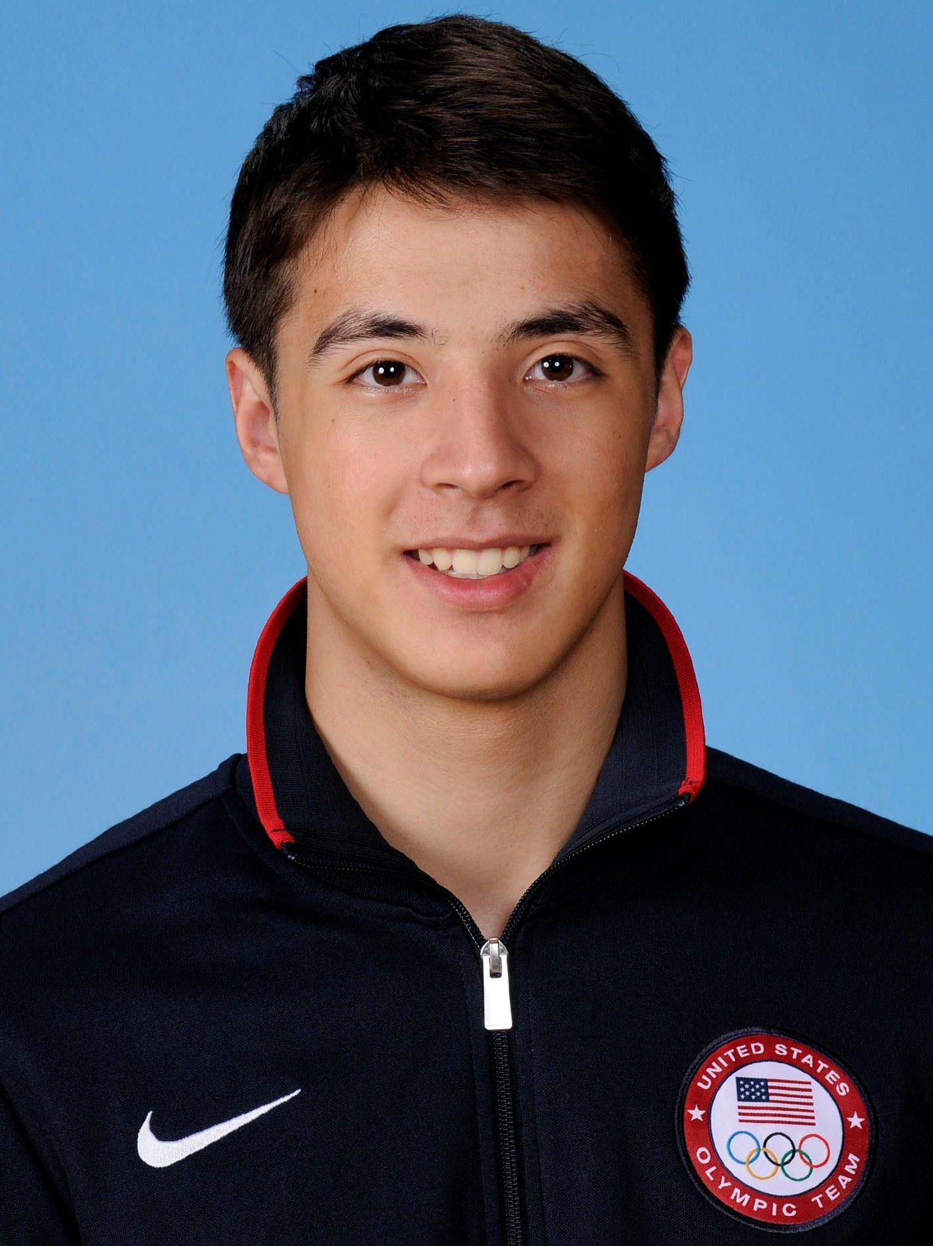
Alex Massialas

Slide 5
“I try to practice the stuff I’m weaker at because I understand it’s better to not win and learn something than win and practice habits you already have”
“then I’ll talk to some friends and then start watching who I have next”
“sometimes I’ll even hum a song to myself to get the rhythm going”

Slide 6
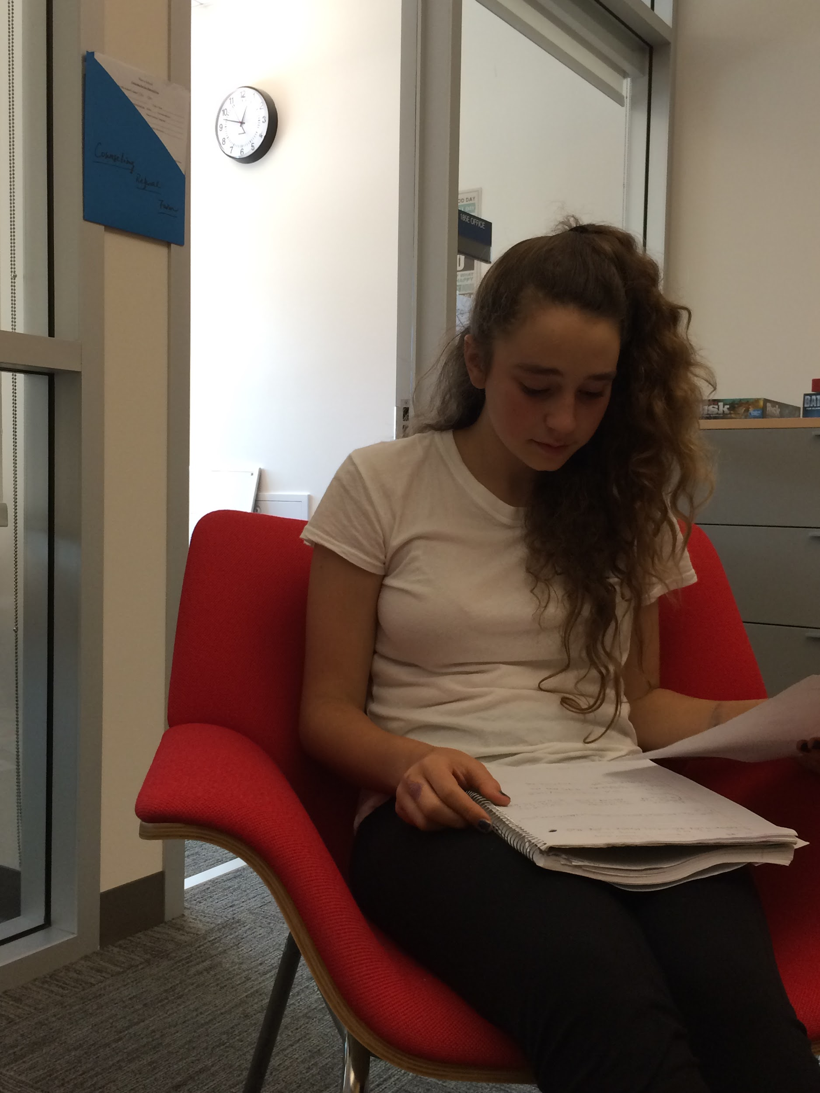
Celia Malone

Slide 7
“My room is really my space where I don’t get distracted as much.”
“Stress damages focus
a lot.”
“I need to focus on the one thing that I’m doing.”

Slide 8
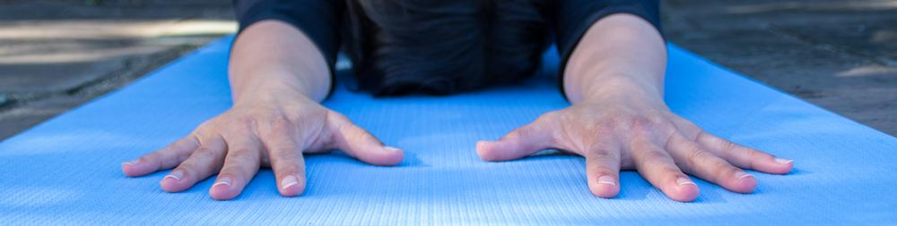
Lorraine Tam
Notes:
Who
Has been teaching Vinyasa and Yin Yoga since 2004 & meditates daily
She hopes people will use the practice of yoga and meditation to become more aware of what goes on in their minds
Why chosen
Because she is in expert in quieting the mind and turning on extreme focus - as she holds physically challenging poses for 10+ minutes at a time
She also teaches others how to use their breath to increase their self-awareness and focus, and thus is acutely aware of the many pitfalls people face as they attempt focus
How recruited
reached out to her via email
Where they were interviewed
I went to her yin yoga class at Yoga Source (weds morning) and then later interviewed her at a Starbucks (weds evening)

Slide 9
“Focus comes from breath”
“can be learned through practice”
“People like being in the same space with others
who are trying to do the same thing”
Notes:
Who
Has been teaching Vinyasa and Yin Yoga since 2004 & meditates daily
She hopes people will use the practice of yoga and meditation to become more aware of what goes on in their minds
Why chosen
Because she is in expert in quieting the mind and turning on extreme focus - as she holds physically challenging poses for 10+ minutes at a time
She also teaches others how to use their breath to increase their self-awareness and focus, and thus is acutely aware of the many pitfalls people face as they attempt focus
How recruited
reached out to her via email
Where they were interviewed
I went to her yin yoga class at Yoga Source (weds morning) and then later interviewed her at a Starbucks (weds evening)

Slide 10

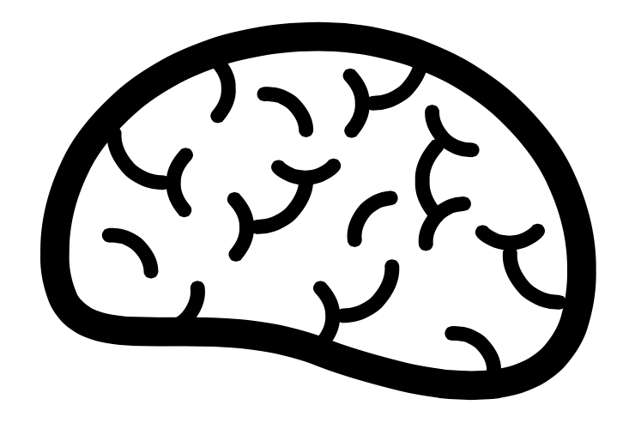


focus feels like being totally relaxed, totally loose
how their body is feeling
you know you’re focused when
you don’t care about anything else
intense focus without breaks is unsustainable
focus is all about rhythm
how quickly they are breathing
phone is distracting practice makes perfect
separate work and non-work spaces
refocused by remembering larger goals
you should be aware of your thoughts like they are clouds drifting in the sky
distracted by iMessage messages
sometimes forgot what she was working on
Instant results aren’t realistic
knew she was focused when she didn’t care about anything except
their environment
what things are distracting them at the moment
what they want to achieve
what is happening around them
think about the need to focus
thinking too far ahead
goals
what thoughts are top of mind
perpetual glances at cell phone
constantly aware of inner thoughts
listen to calm (not pump-up) music
before match
opened another tab rather than navigating in current window
always trying to find his rhythm
attached to work when focused
less reactive
refocus with deepen breath
set goals to focus on and work towards
a set routine to refocus
constantly switching between tasks
create a daily routine
likes reading before working to get focused
has someone hide cell phone before working
play music to drown out distractions
worried about not being efficient enough
guilt for procrastinating
fear of missing out
more calm
anxiety about not producing enough
strong and healthy
the mind and soul are in it
irritated by distractions
stressed out before important events

Slide 11

Insights
environment affects ability to focus
focus is analogous to finding your rhythm
physical comfort is necessary for focus
people focus in different ways
you cannot focus forever, and must take breaks
focus is a means to an end
everyone has a different definition of focus
can be hard to keep track of the task at hand
Notes:
the environment someone is in very much affects their ability to focus
having clear goal in mind helps people focus
physical comfort is necessary for focus
people focus in different ways
you cannot focus forever, and must take breaks
focus is a means to an end
everyone has a different definition of what focus is
you can improve focus with practice
support can help people focus

Slide 12
Needs
find personal rhythm
focus early on to stop procrastinating
develop a way to stay organized
drown out background noise
keep track of task at hand
prioritize more important goals
take breaks

Slide 13
Summary
Conducted Interviews
Developed Empathy Map
Identified Needs
Notes:
We interviewed 4 people that we felt represented unique perspectives with regards to focus
We combined their responses onto an Empathy Map, and found many commonalities
We drew insights from those commonalities
From all this, we find keeping track of current task, finding your rhythm and the necessity of taking breaks to long-term focus.
Looking forward learning more about this next week.

Slide 14
Questions
Notes:
We interviewed 4 people that we felt represented unique perspectives with regards to focus
We combined their responses onto an Empathy Map, and found many commonalities
We drew insights from those commonalities
From all this, we find keeping track of current task, finding your rhythm and the necessity of taking breaks to long-term focus.
Looking forward learning more about this next week.

