Slide 1
NightOwl
Medium-Fi Prototype
Zara S.
Griffin D.
Lachlan G.

Slide 2
Get help now.
Notes:
Problem Solution Overview: Students working late at night often struggle to find help on assignments and psets. NightOwl connects students with peers who are awake, nearby, and working on the same thing.
This is where our value proposition comes from: Get help now.

Slide 3
Medium Task: Become Available/Write A Status
Notes:
given a list of the classes you are enrolled in, mark yourself as available and write a status regarding your progress
same task as before

Slide 4
Complex Task: Reach Out to Classmates
Notes:
This task includes getting to the list of classmates, selecting the proper class, and sending the classmate a message.
Same task as before

Slide 5
Old Simple Task: Respond to Connection Request
Notes:
This task is encapsulated in our messaging tab, which was demoed in the last task. Our usability testing gave us feedback re messaging.

Slide 6
New Simple Task: Update list of current classes
Notes:
This new task involves the user being able to access their profile information and make changes to the master list of classes they are currently enrolled in.

Slide 7
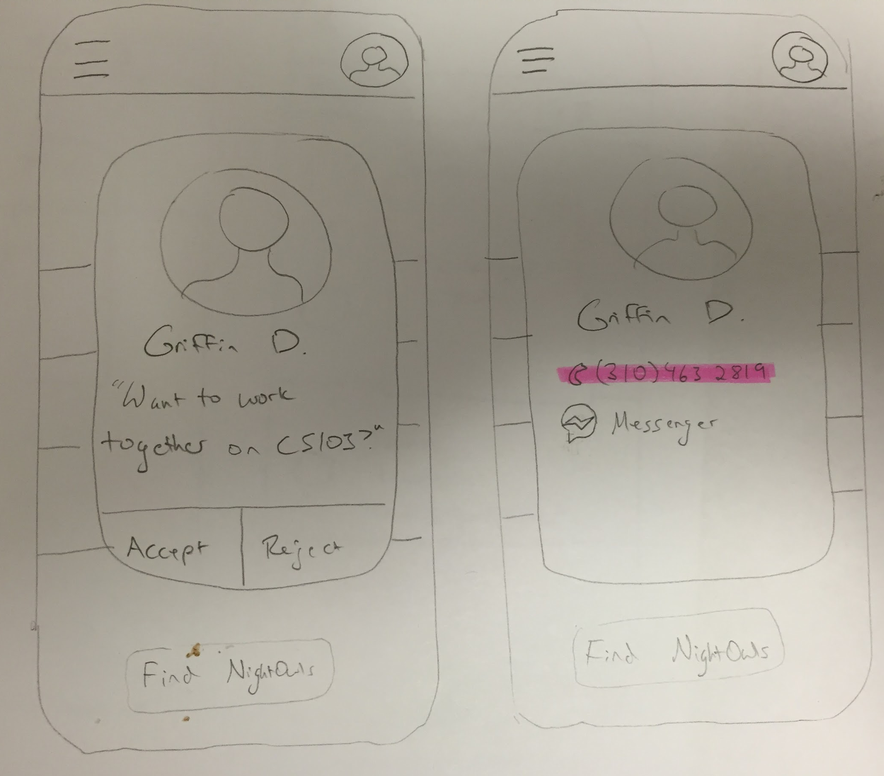
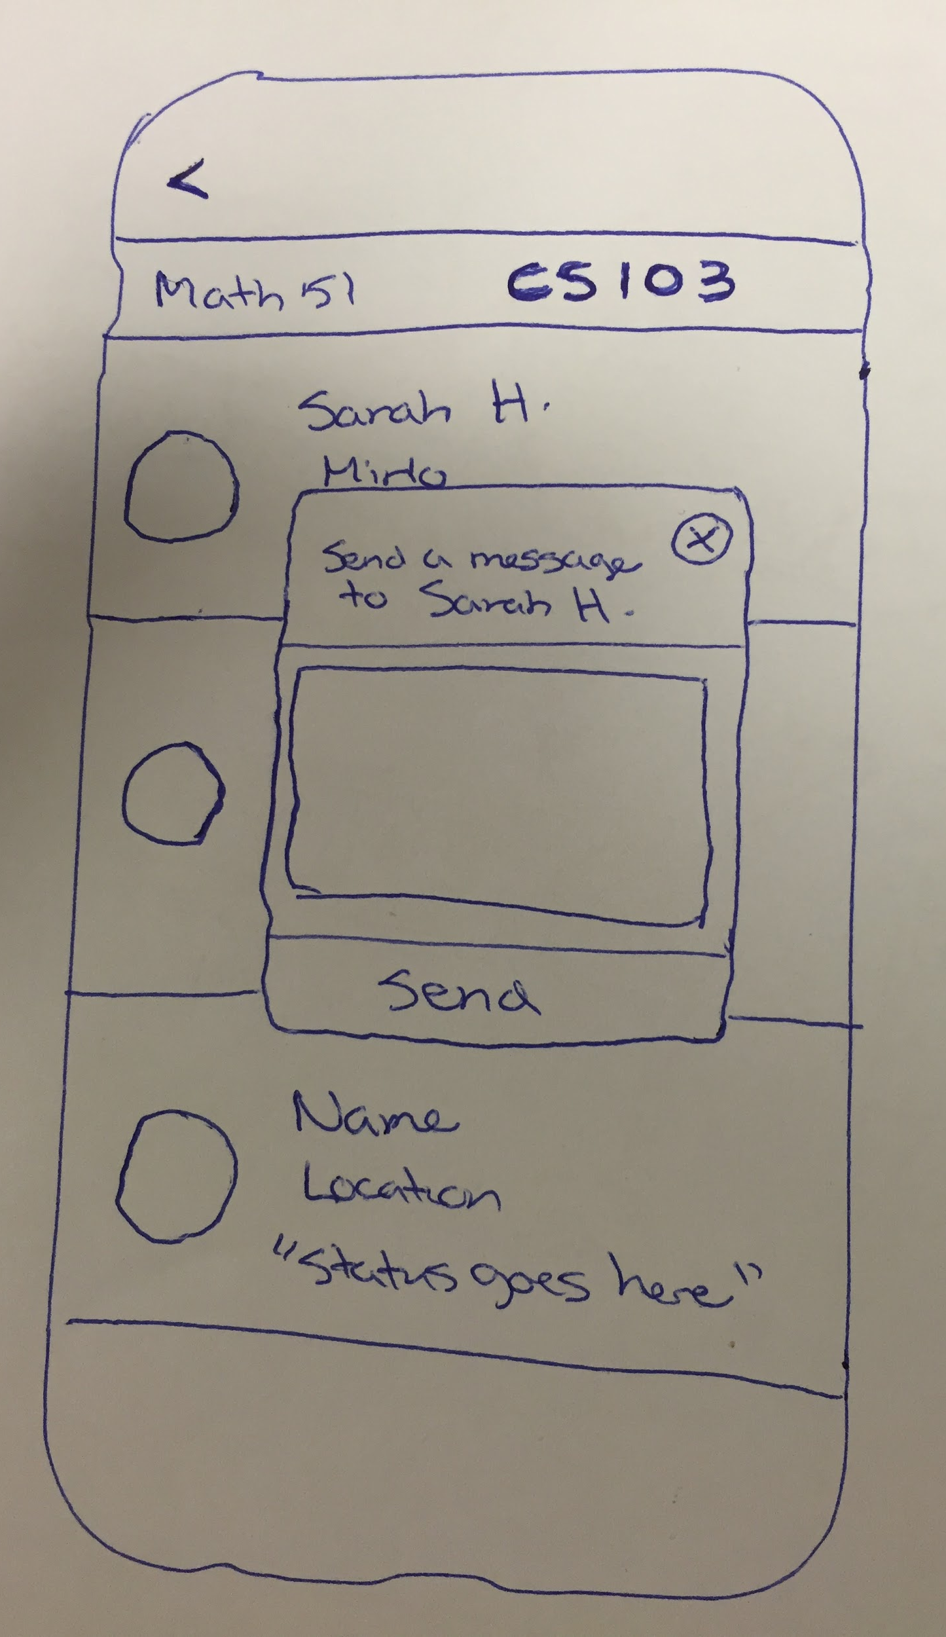
Design change 1: In-app messaging
Notes:
Explain: before, you could send a message to another user, and they would be able to “accept” or “reject” your message. If they “accepted,” they would have access to your contact info (such as a phone number or facebook messenger)

Slide 8
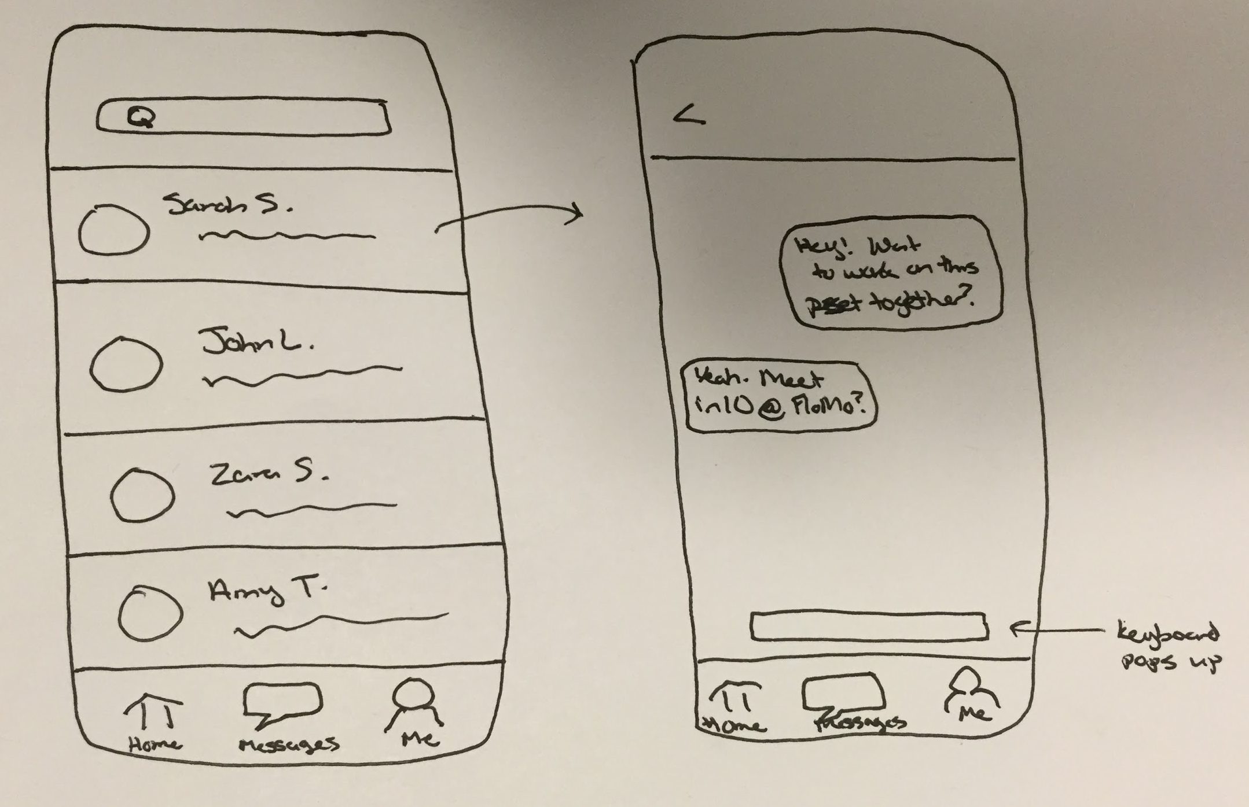
Design change 1: In-app messaging
Notes:
Rationale for change: During our usability testing, all of our participants expressed slight discomfort with sharing their phone number and other personal information. They said they would prefer if all contact occurred withing the app. Additionally, upon sending a message to another participant, they wanted the ability to see their entire conversation thread with that person. Thus, we created an in-app messaging system.
Explain new feature: When you click on the “messages” tab you are able to view all of your conversation threads, with everyone you have connected with on NightOwl. When you click on a name (just like iPhone texting), you are able to see that individual conversation and continue to add to it.

Slide 9
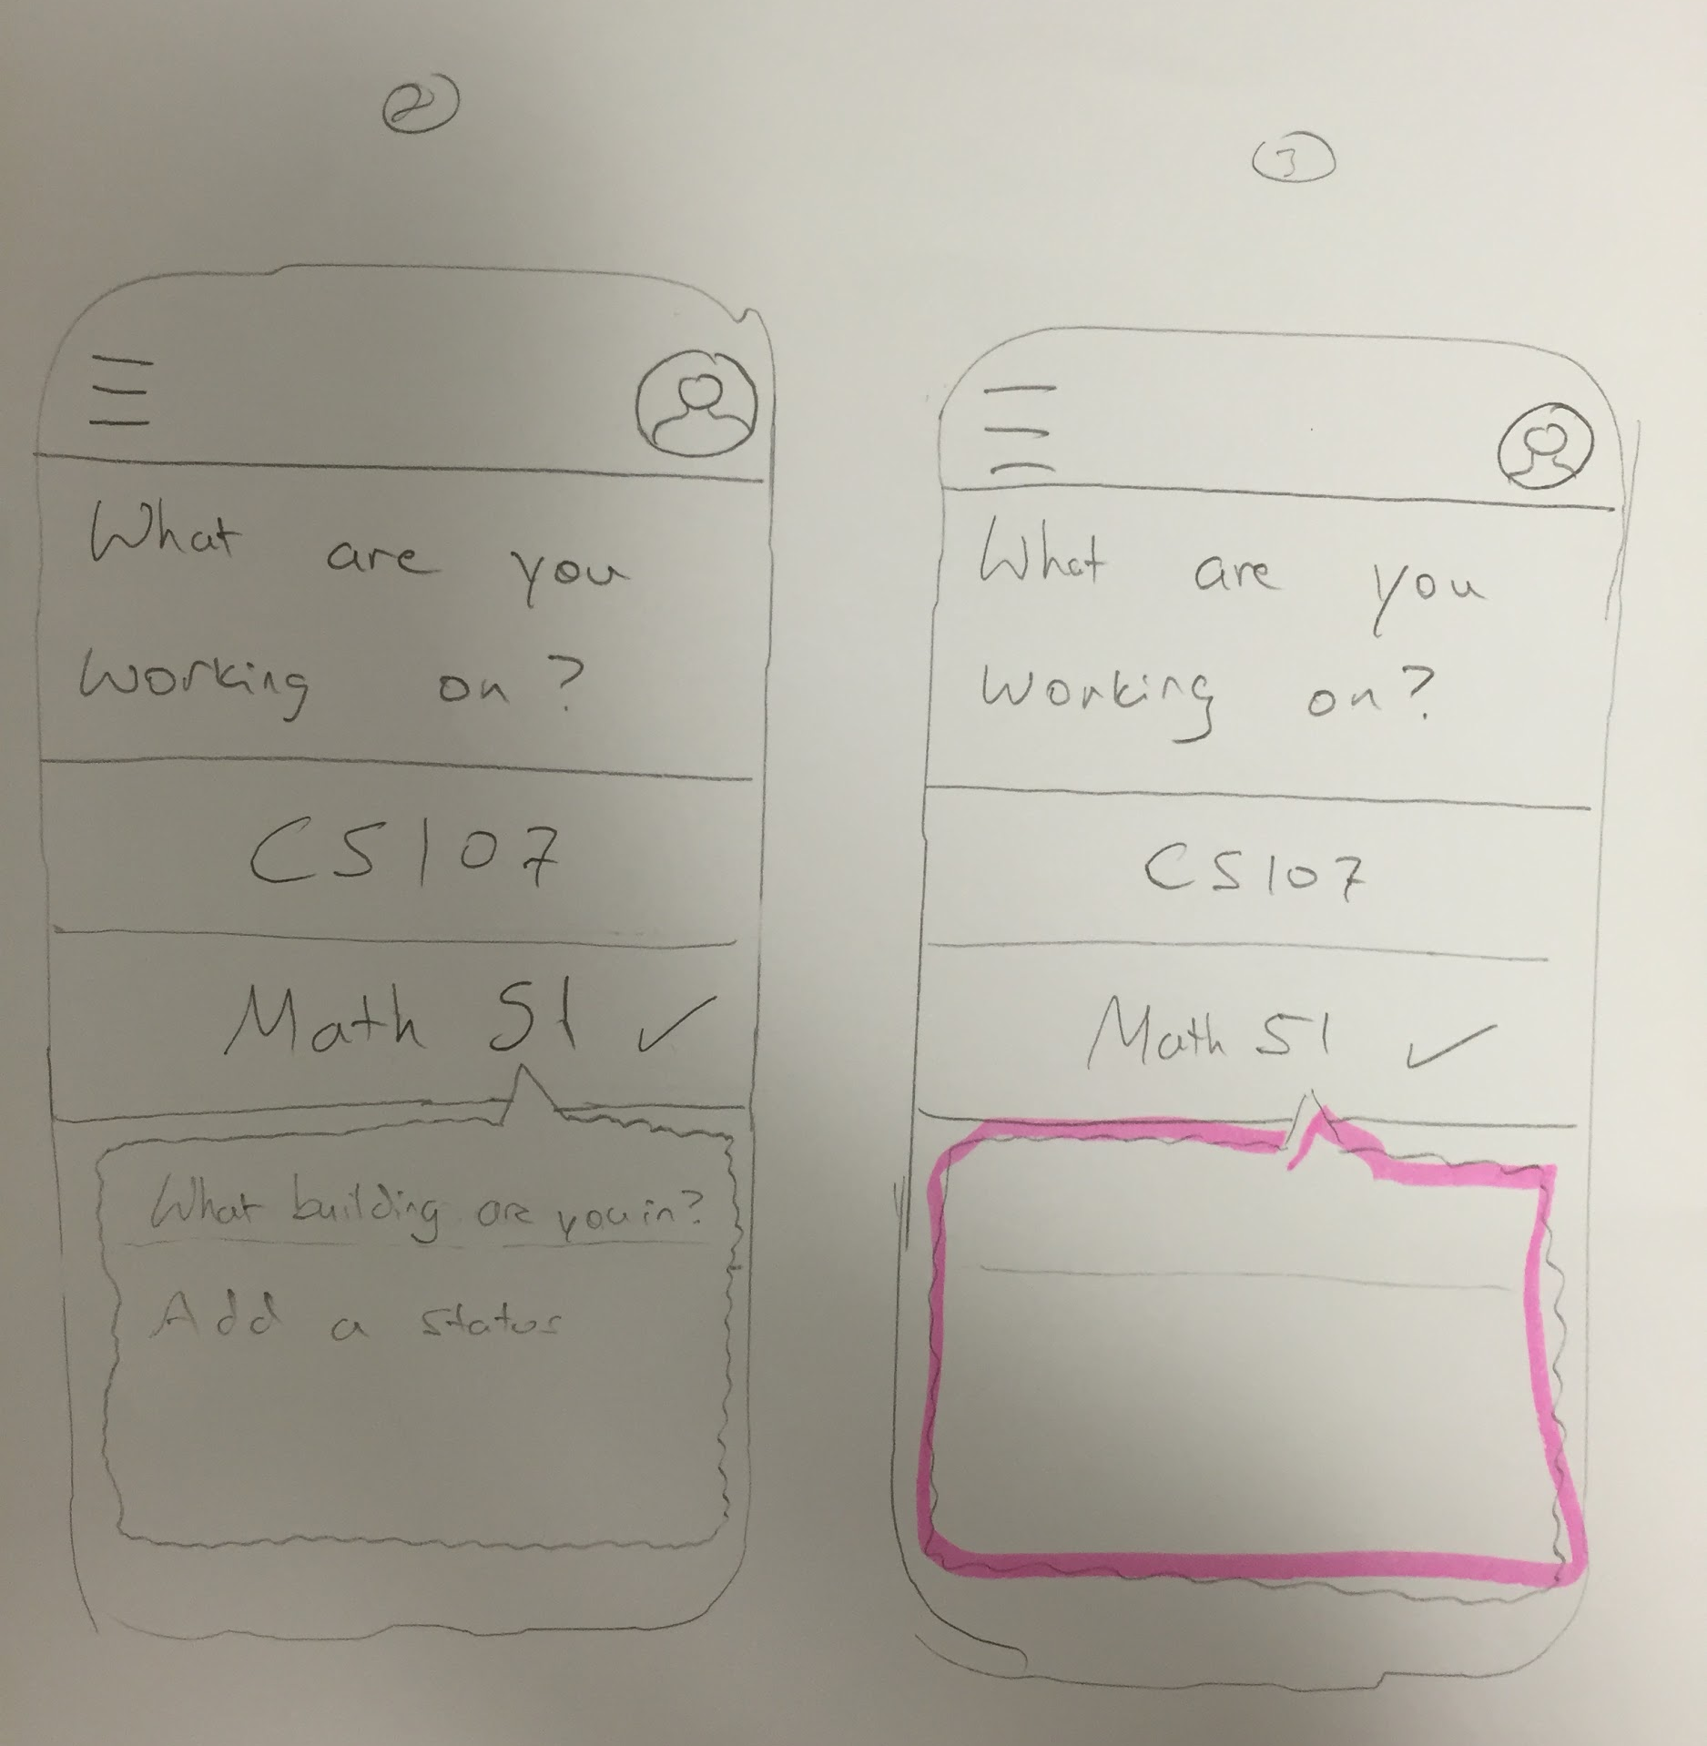
Design Change 2: Clearer Location and Status Posting
Notes:
During usability testing, our participants were all confused by the location/status posting screen.
They wanted location to be a separate box, ideally with a drop down menu or autocomplete.
They wanted a “post” button because it was unclear how to post these items after entering it in.

Slide 10
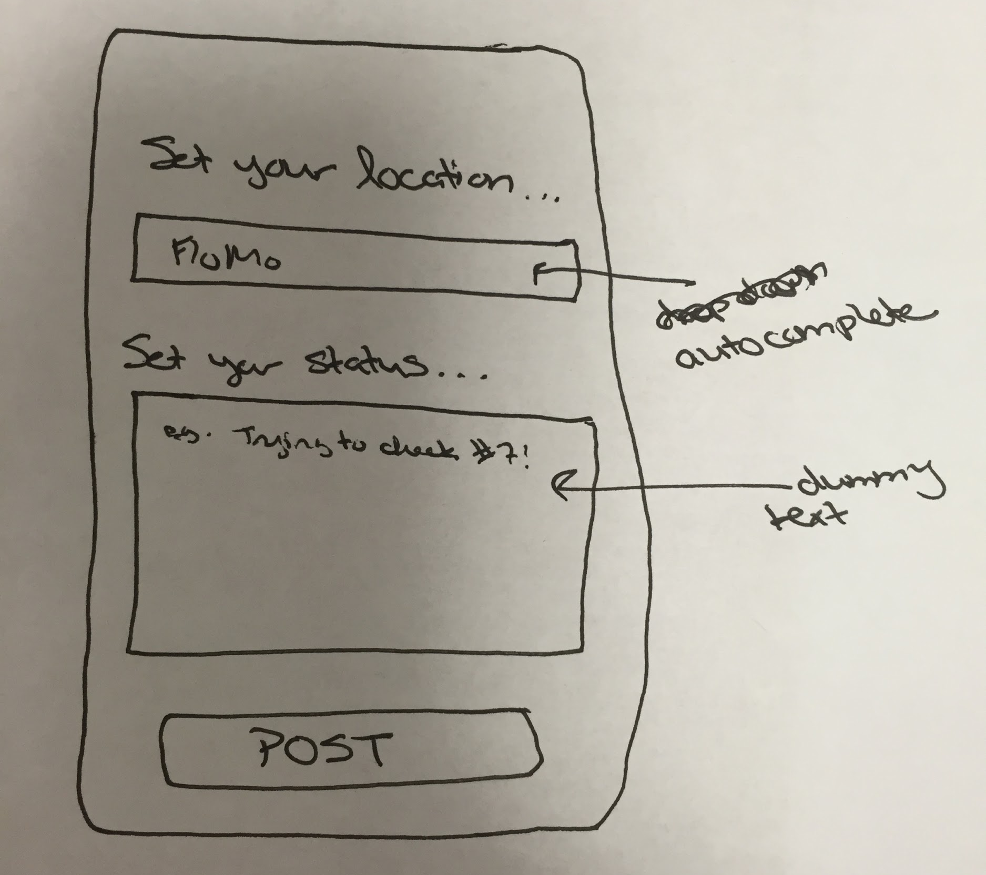
Design Change 2: Clearer Location and Status Posting
Notes:
In our new prototype, we have made this process much clearer. We have a separate box for location and a separate one for status.
For location: start typing and a drop down will appear of possible on-campus locations matching those initial characters
For status, we have dummy text to help user understand what type of info a status should include.
We have added a very clear “POST” button.

Slide 11
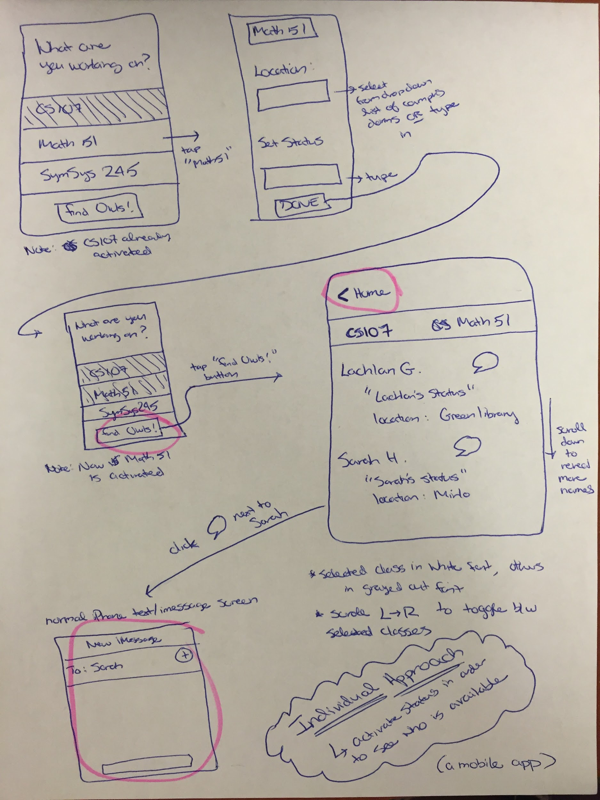
Design Change 3: Tabbed View
Notes:
In the earlier prototype, the user navigates through screens sequentially, and must use the back arrow to return to a previous screen. We realized that this was limiting, and we wanted to allow users to flip between the newsfeed screen, the messaging tab, and their own profile information.

Slide 12
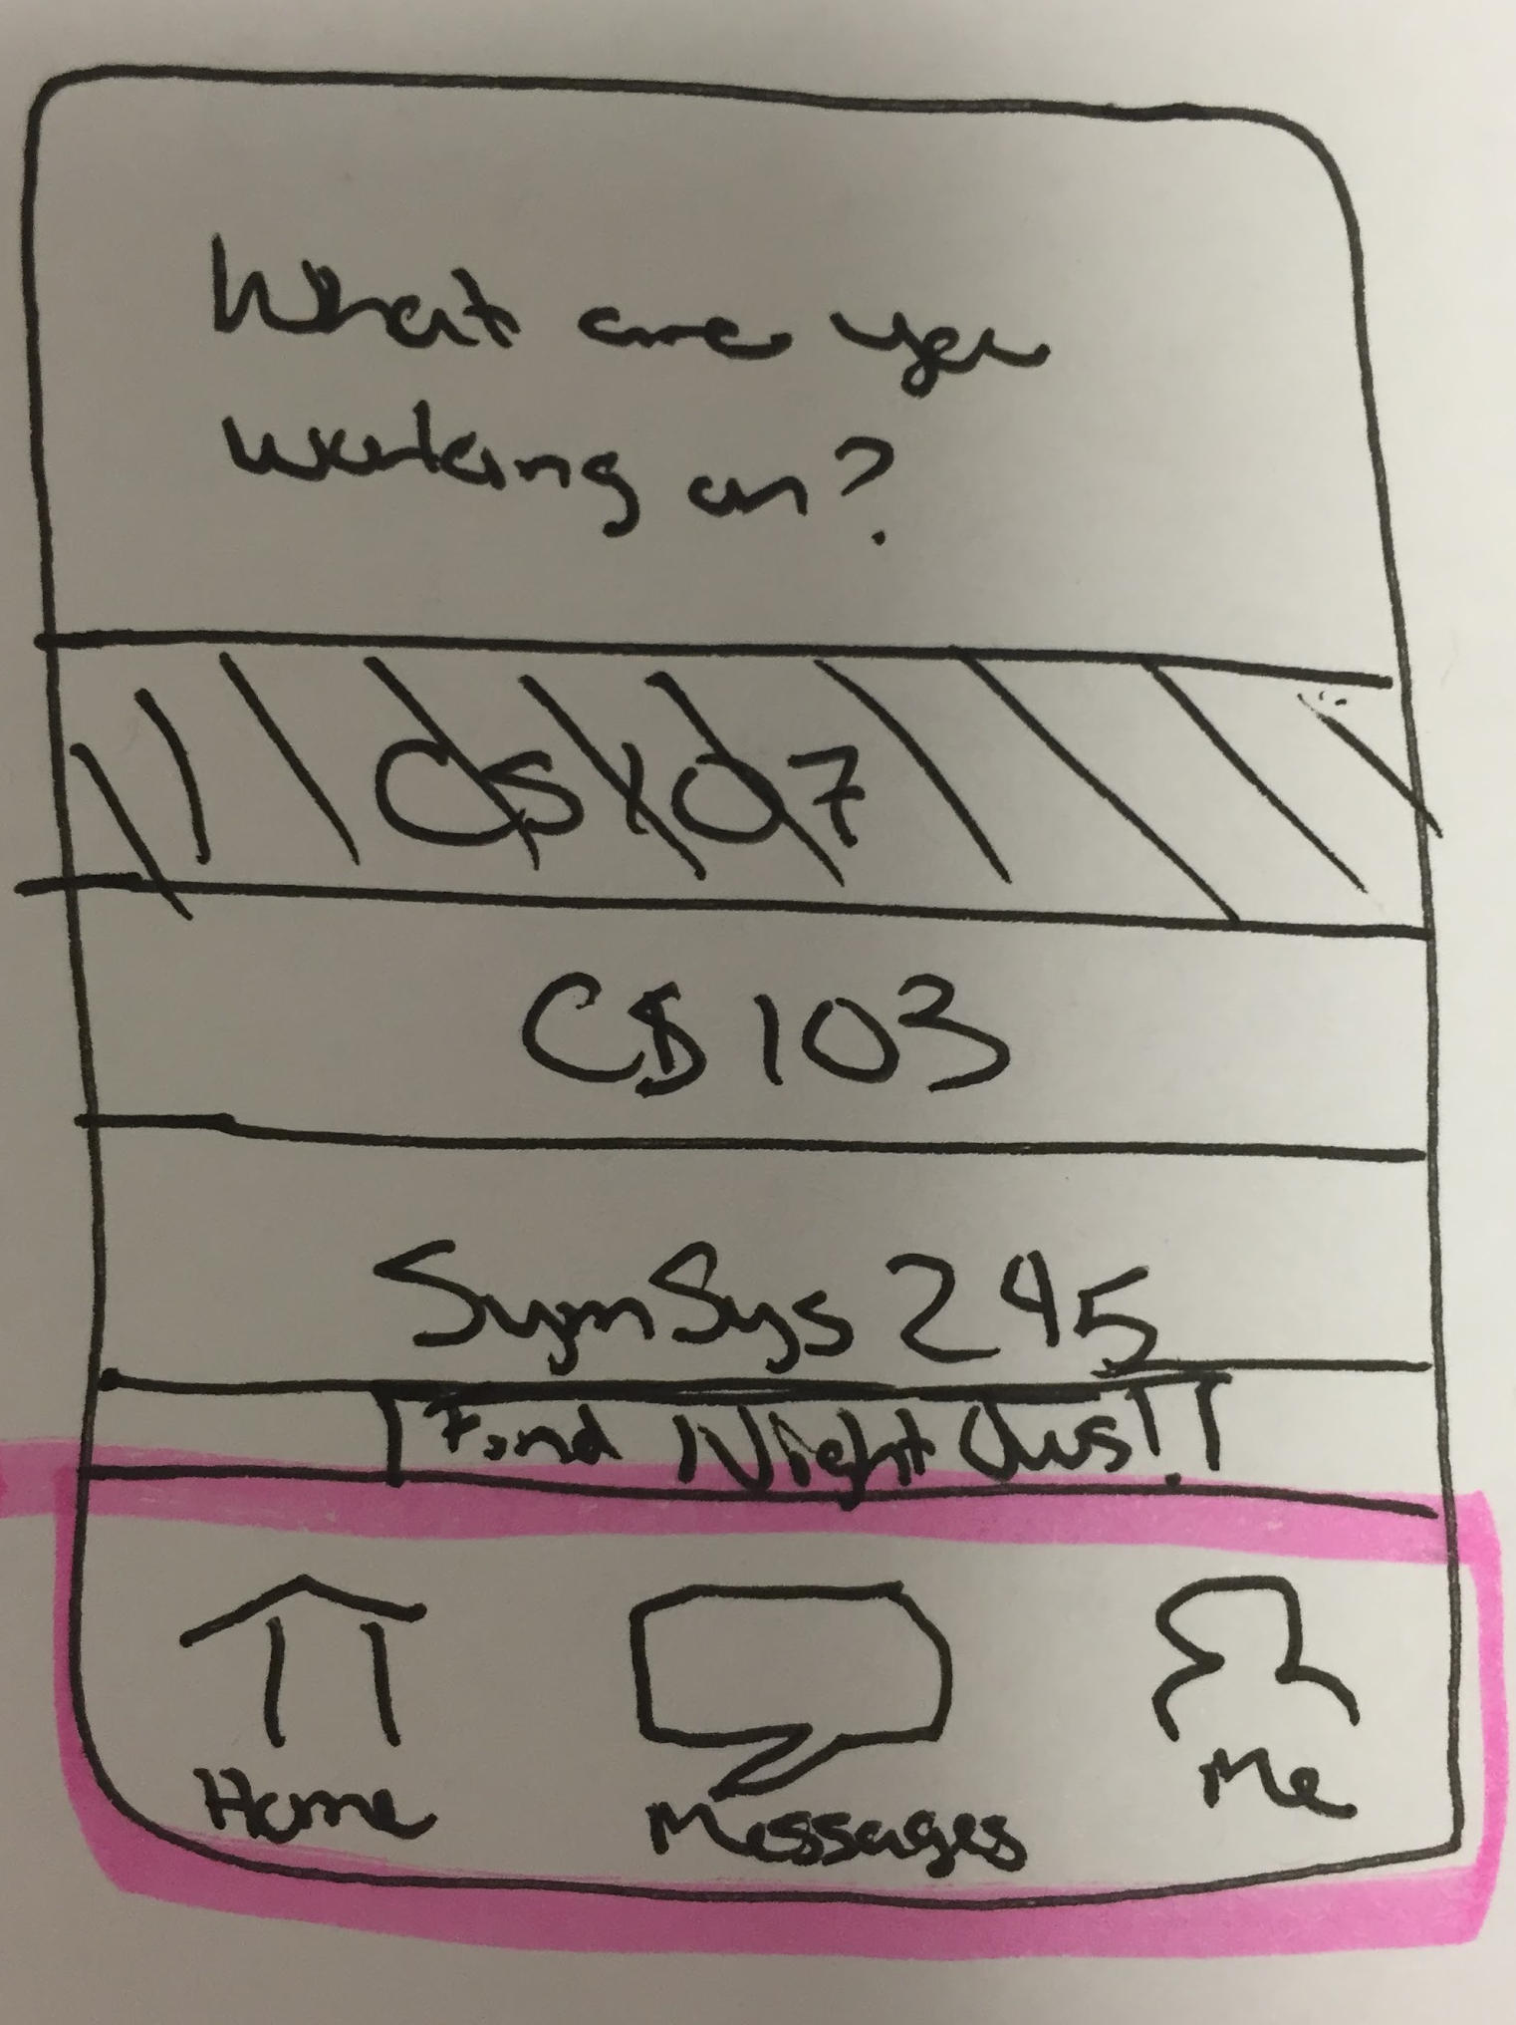
Design Change 3: Tabbed View
Notes:
Created 3 tabs for clarity of navigation and to enable people to easily look at all of their ongoing messaging conversation, and then toggle back to the newsfeed. Also created a “me” tab - which will allow you to update profile information and the list of classes you are currently enrolled in

Slide 13
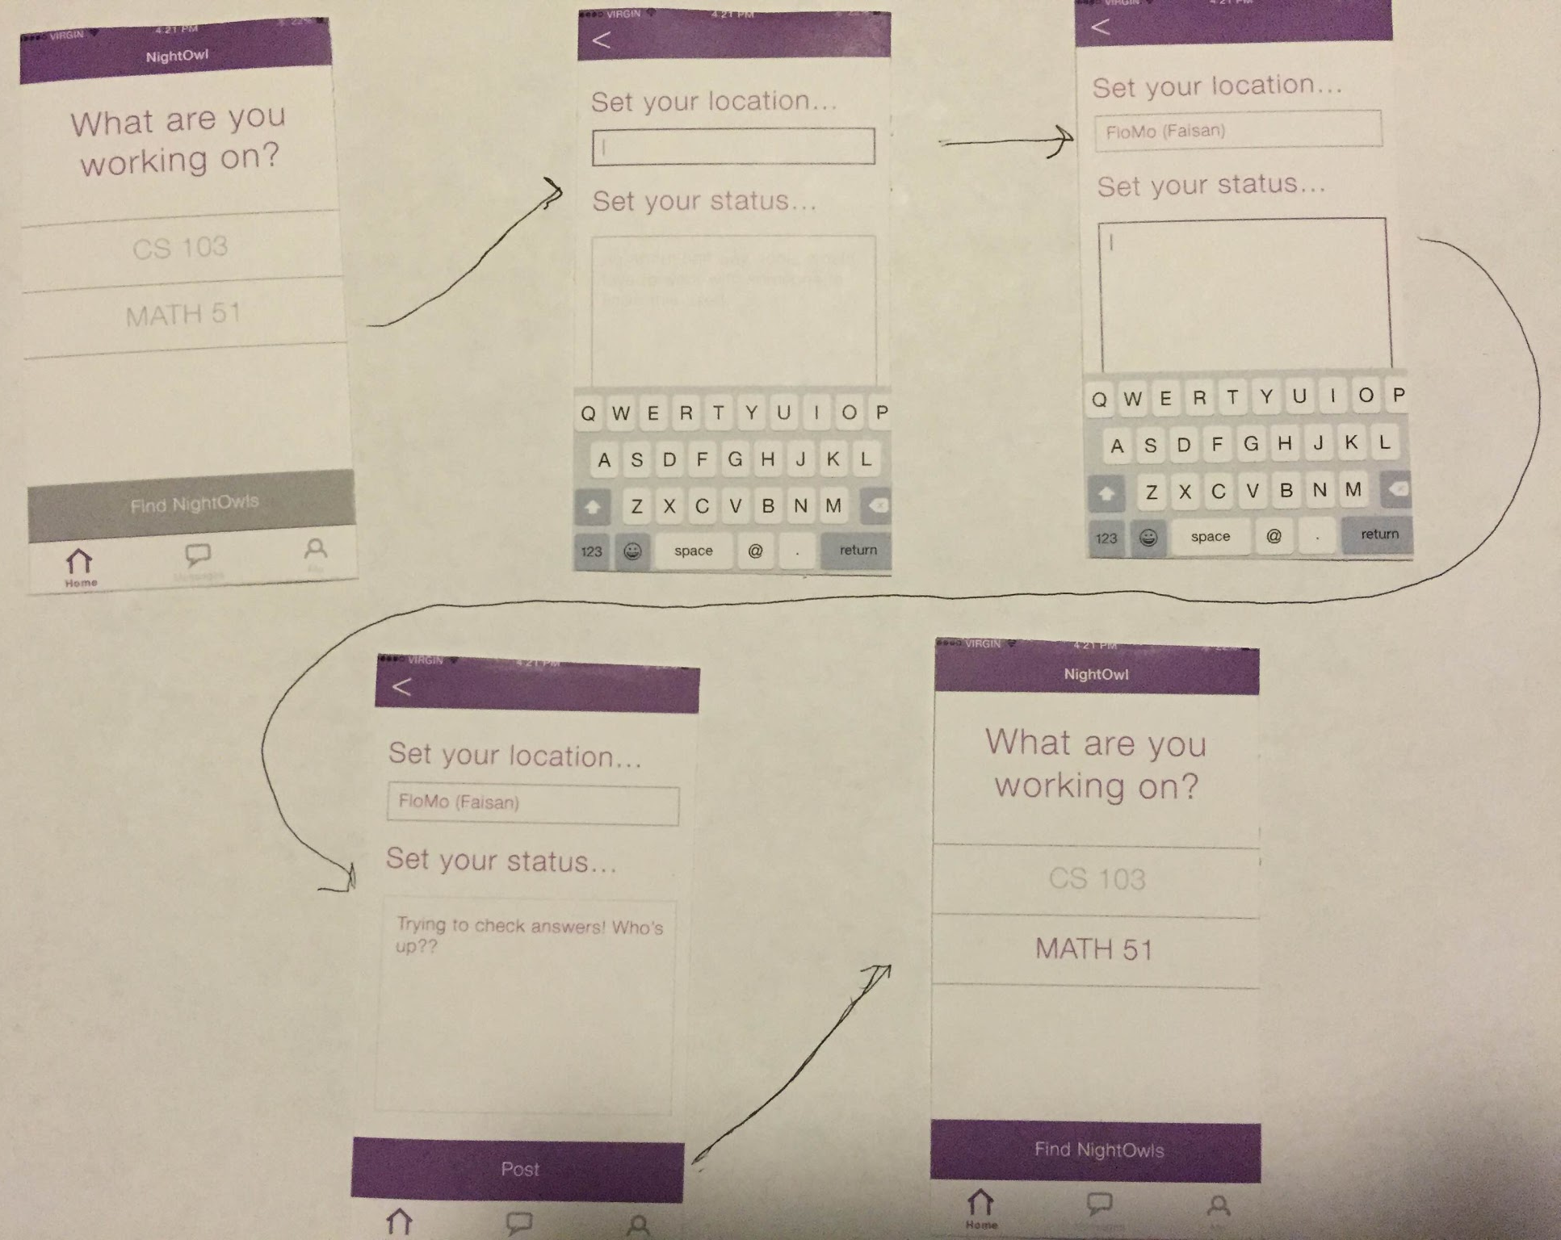
Task Flow 1
Storyboard
Notes:
Become available/write a status

Slide 14
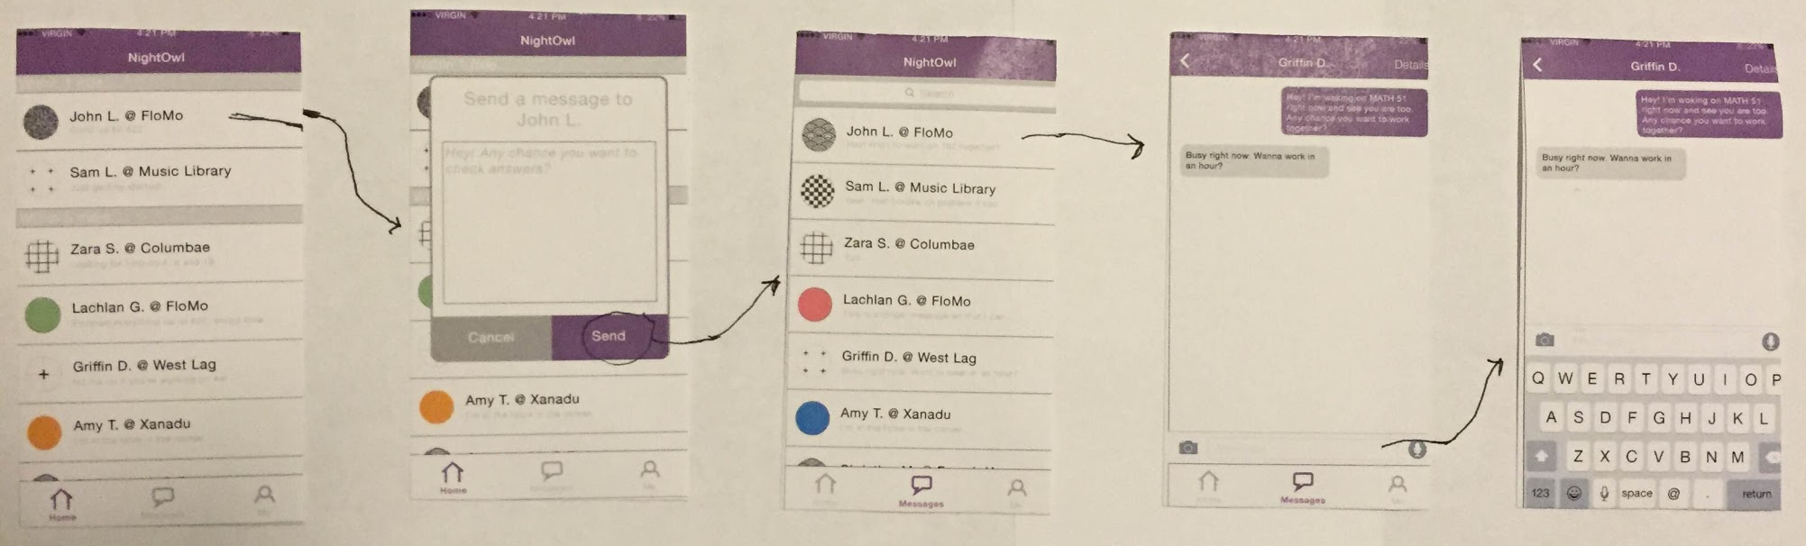
Task Flow 2 Storyboard
Notes:
Reach out to classmates

Slide 15
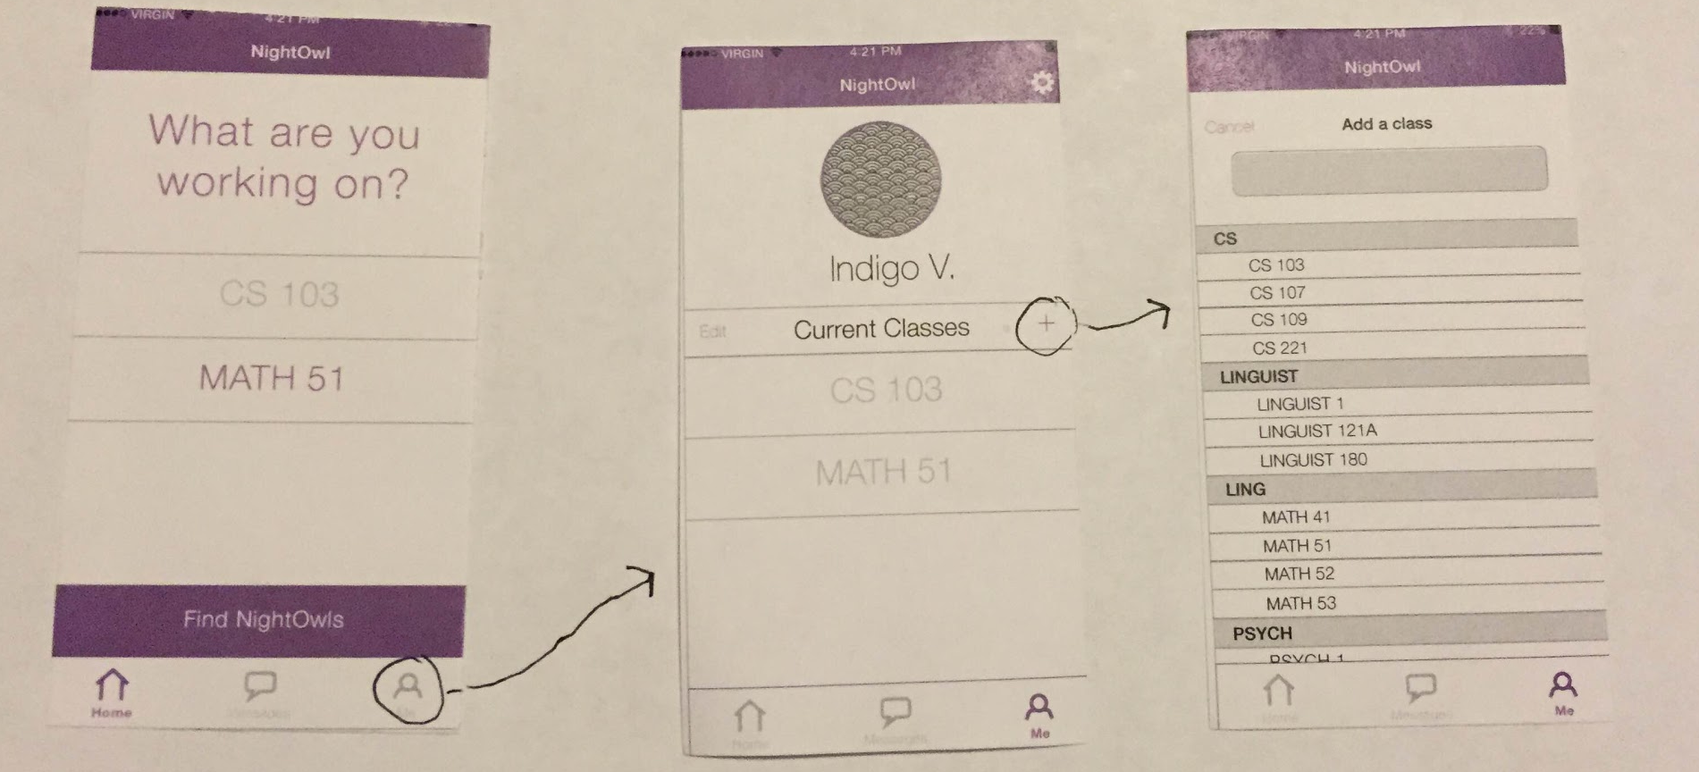
Medium Fi Task Flow 3 Storyboard
Notes:
Access profile information using “Me” tab and update current class list

Slide 16
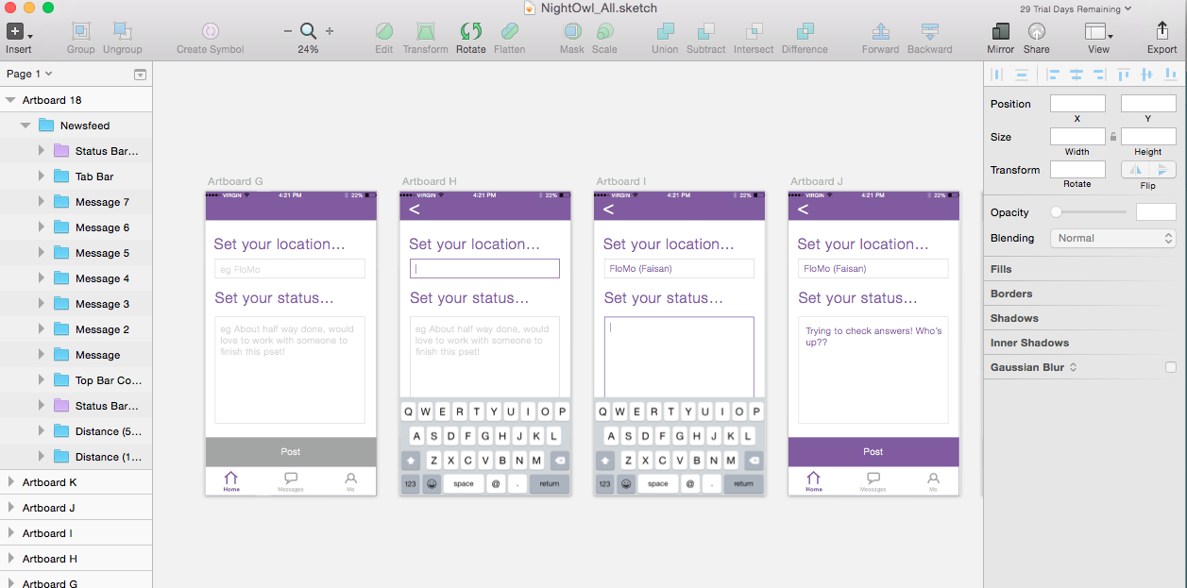
Sketch: to design our UI
Notes:
How it helped: easy to create the UI, design the look and feel, show the color scheme and icon and tabbed bar, maintaining design patterns across screens
How it did not help: all static content, couldn’t imitate typing, can’t show autocomplete

Slide 17
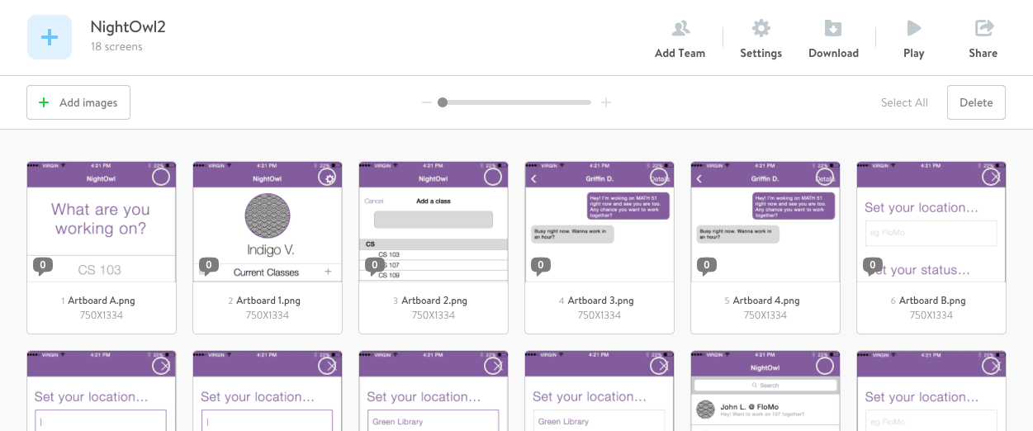
Marvel
Notes:
uploaded .png files of our screens to a new project
added transition buttons to the buttons on our screens
allowed us to simulate the experience of using the app
Good: delivered a much more realistic experience of the three tasks than we were able to provide with paper, even if we had spent more time on the drawings
Bad: buggy at times, picky about how uploads were allowed and still very limiting as it was impossible to build out all possible screens of all combinations

Slide 18
Limitations & Tradeoffs of Current Prototype
Less commonly used screens not shown
Only enrolled in 2 classes - to support full functionality
No onboarding
Messaging is not “real”
Static content
  can’t type
  can’t scroll
Notes:
- less commonly used screens were left out: e.g. deleting classes in Me, changing name, changing image, settings tab
- reduced # of classes than a normal student to limit possible combinations of selections
- Can’t make yourself available in both classes simultaneously
- onboarding process not part of prototype because it is not part of any of our tasks
- content is static: can’t type
-can’t scroll, show scrolling
- messaging isn’t real

Slide 19
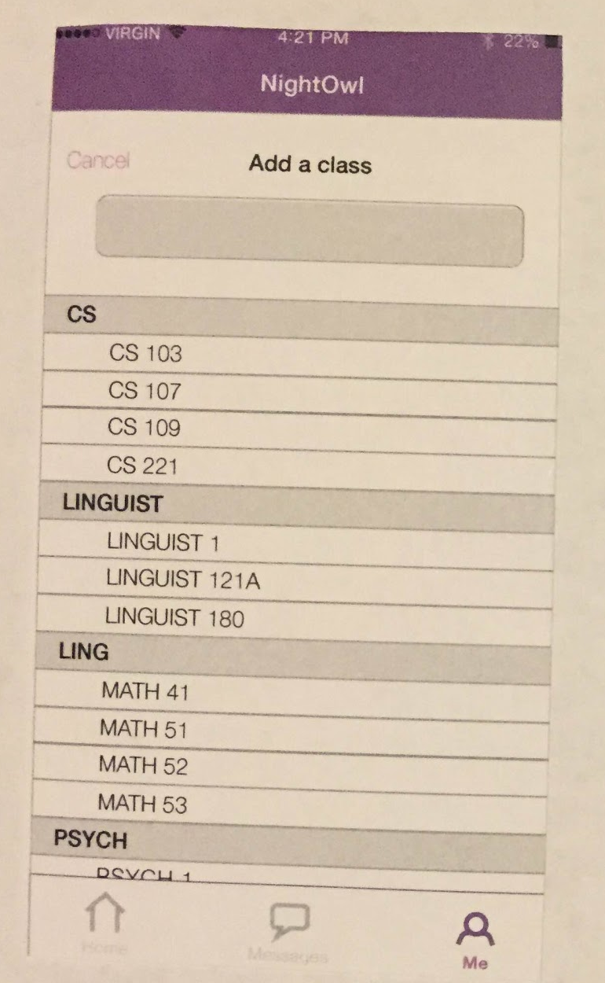
No Wizard of Oz Techniques
Hand Coded Class Options
Notes:
Wizard of Oz - currently no
Hand Coded Features: Put in a list of sample classes in “me” tab - but in reality we would want to grab this data from Explore Courses (stanford course catalog) to have all possible classes in our system

