Slide 1

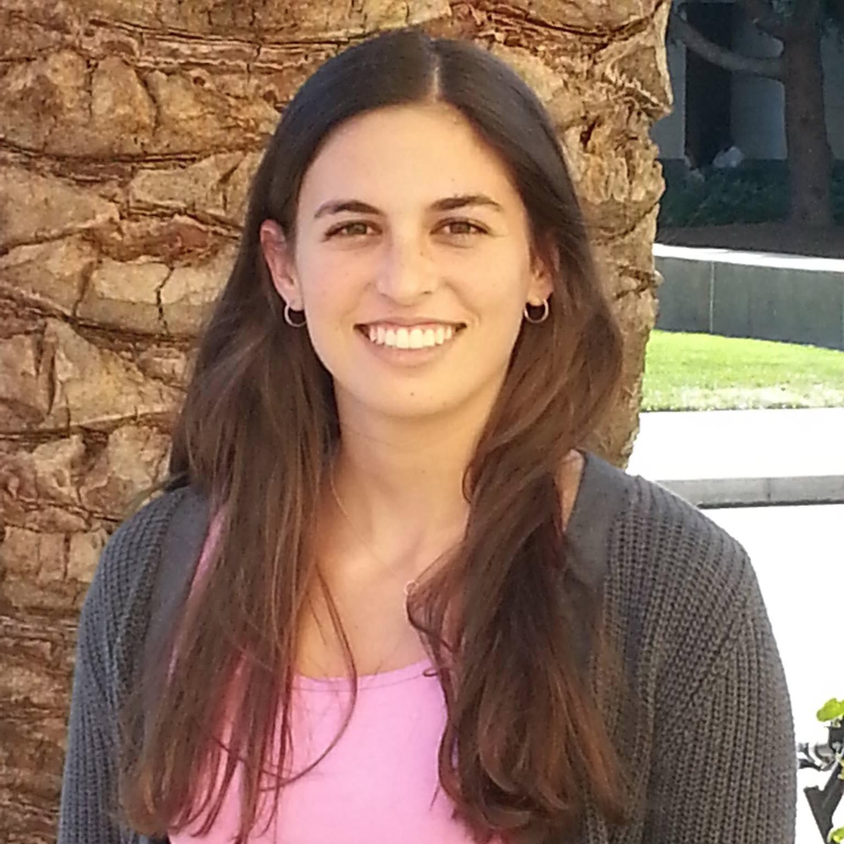
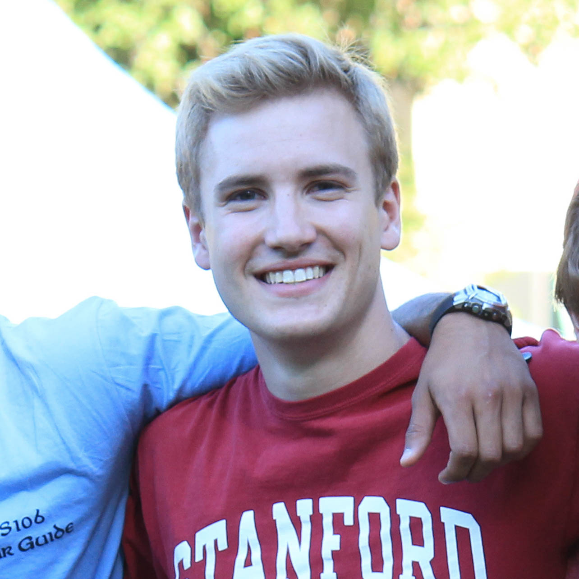
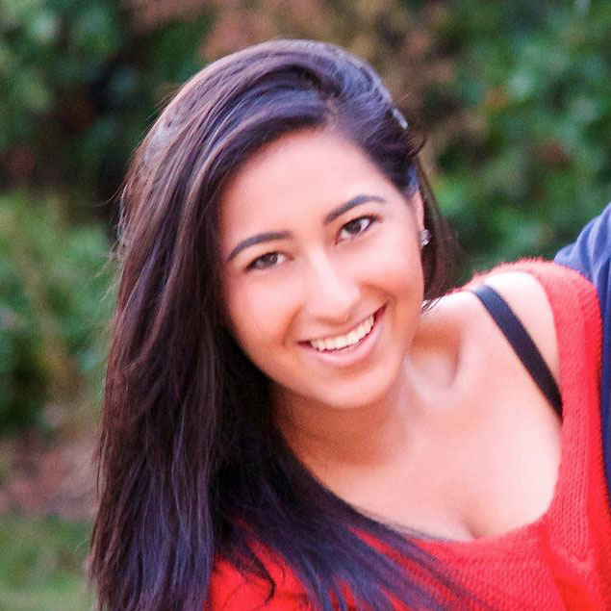
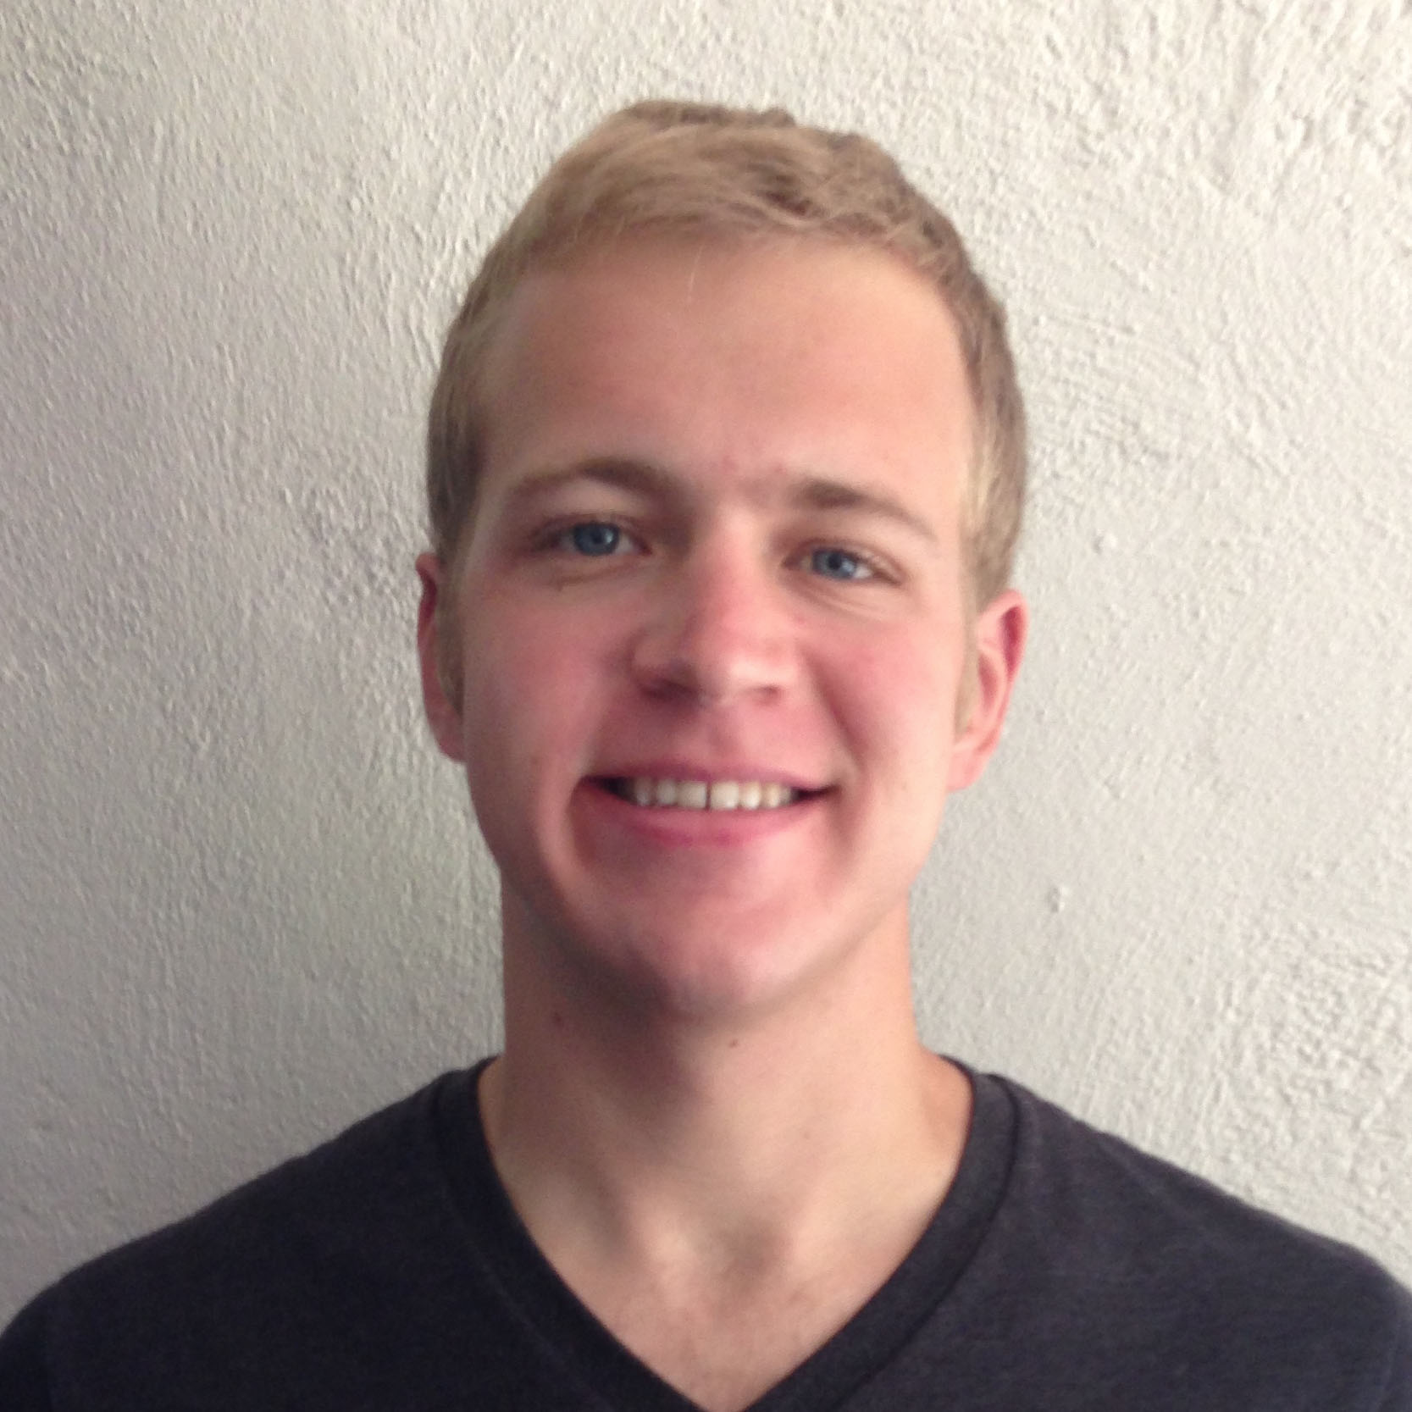

NightOwl
HiFi Prototype #3
Griffin Dietz - Lachlan Green - Zara Saraon - Evan Nixon - Priyanka Rao

Slide 2
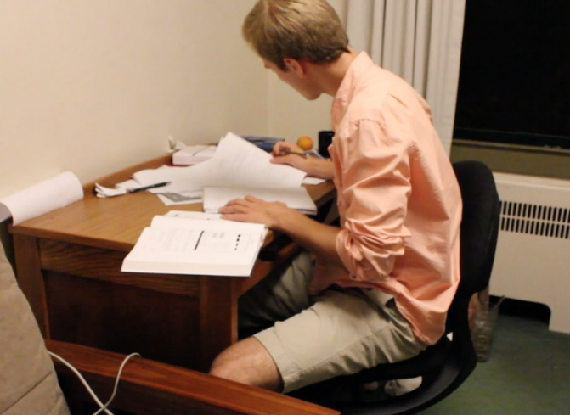
The Problem
Imagine...
it’s 2 am
you’re stuck on a pset that’s due in the morning
your two friends in the class are fast asleep

Slide 3

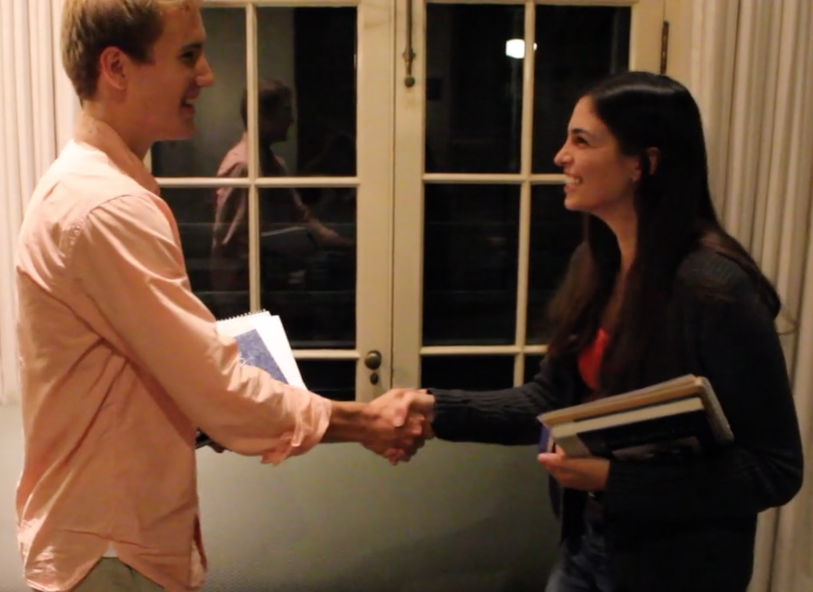
’s Solution
NightOwl connects students to classmates who are awake, nearby, and working on the same thing.

Slide 4
Flight Path
Interface Changes
Demo
Future Work

Slide 5
Flight Path
Interface Changes
Demo
Future Work

Slide 6
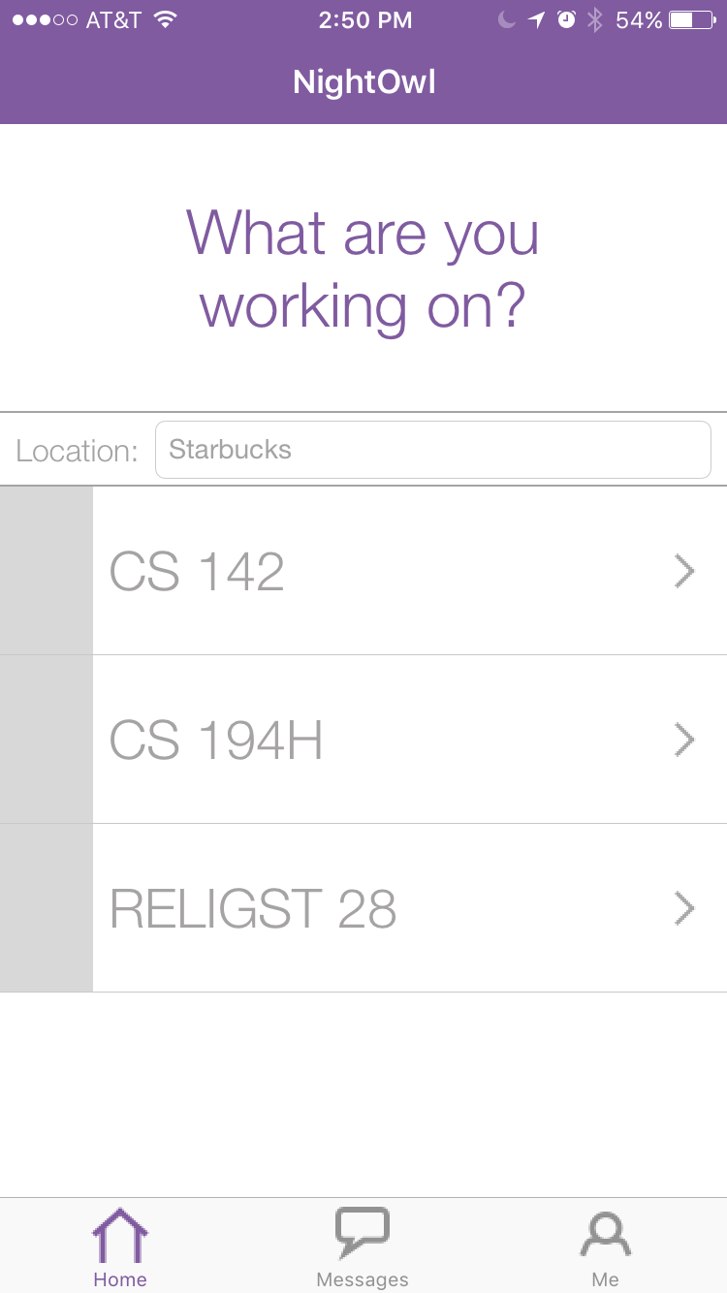
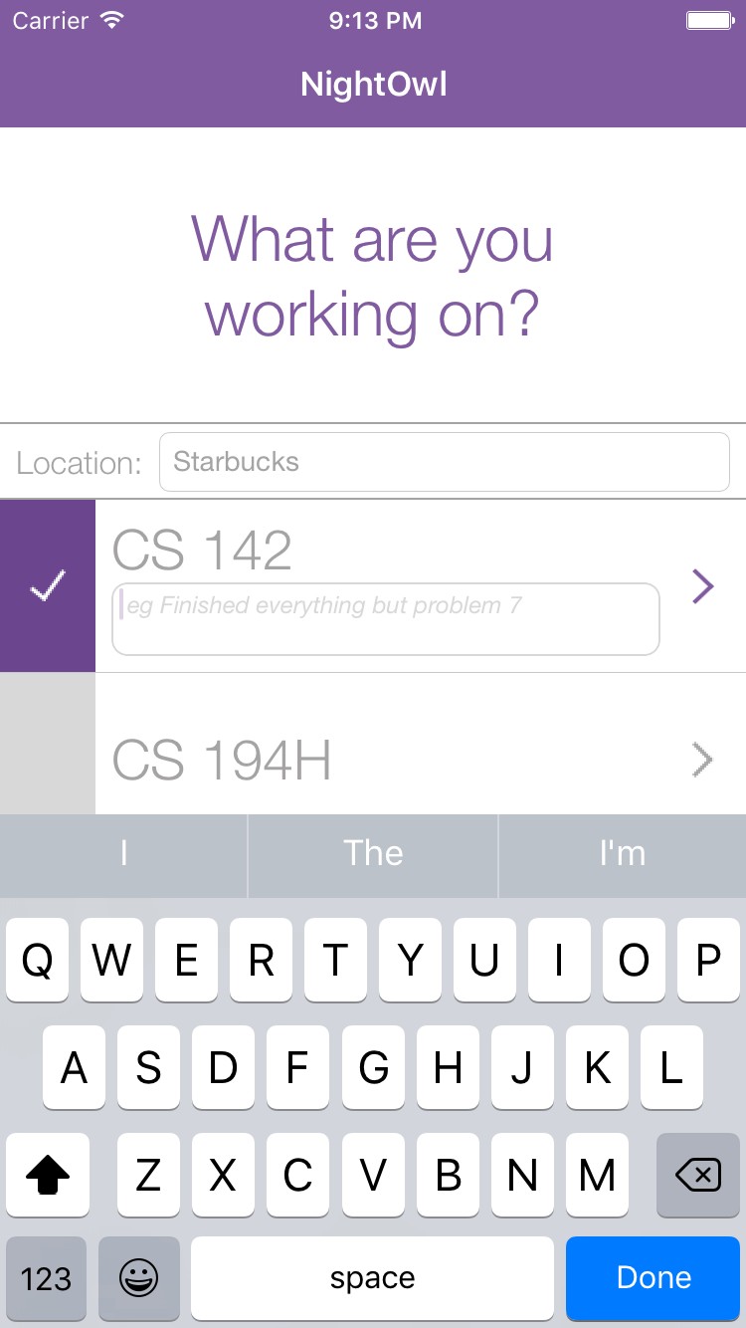
Conveying Availability
Old
Notes:
Reasoning: The biggest issue we found during user testing was that users didn’t realize that highlighting a class meant they were making themselves appear on the feeds of other users. To fix this, we added a one time toast to explain to users this part of the app.
We want users to know when they are visible/not visible, tried a few things, out loud “am I available”
User ex: deactivating class

Slide 7
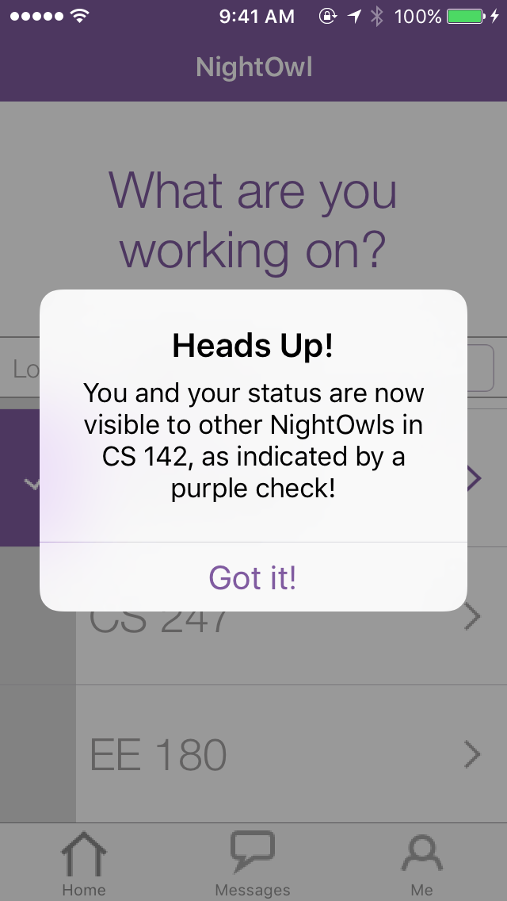
Conveying Availability
Old
New
Notes:
Reasoning: The biggest issue we found during user testing was that users didn’t realize that highlighting a class meant they were making themselves appear on the feeds of other users. To fix this, we added a one time toast to explain to users this part of the app.
We want users to know when they are visible/not visible, tried a few things, out loud “am I available”
User ex: deactivating class

Slide 8
Ensuring status visibility
Old
Notes:
We want users to enter a status (not required previously), adds character, info

Slide 9
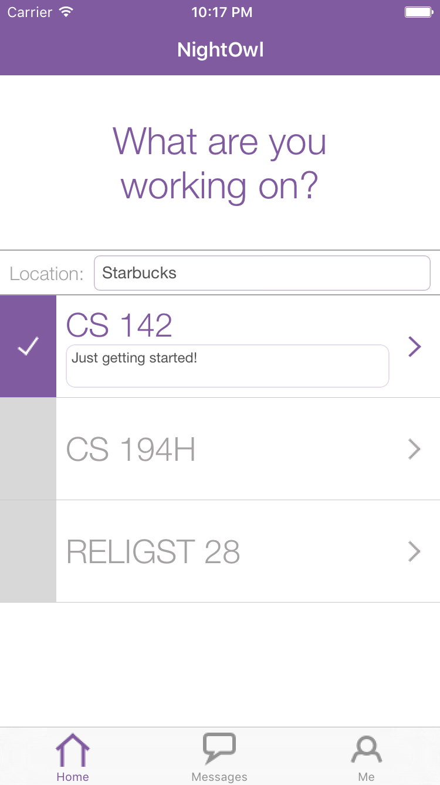
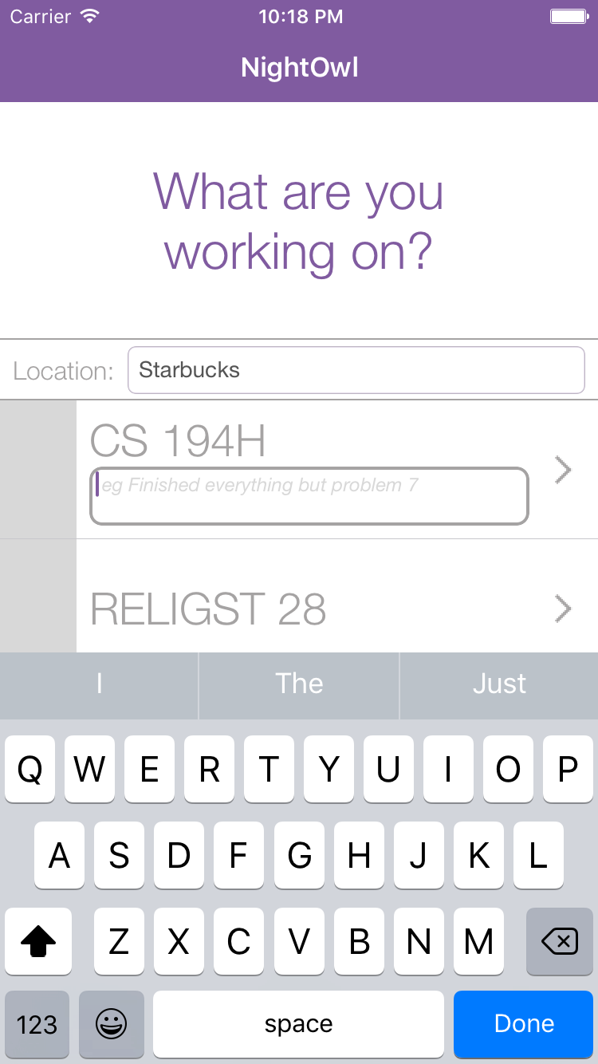
Ensuring status visibility
Old
New
Notes:
We want users to enter a status (not required previously), adds character, info

Slide 10
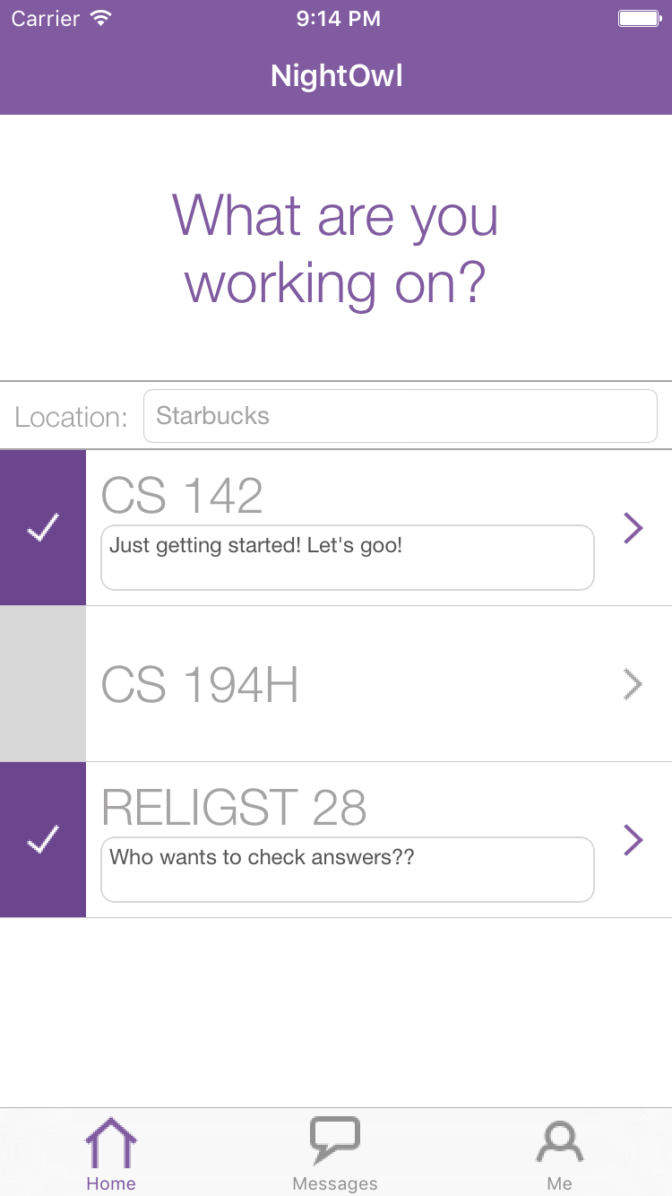
Home Screen UI
Old
Notes:
Forcing status!

Slide 11
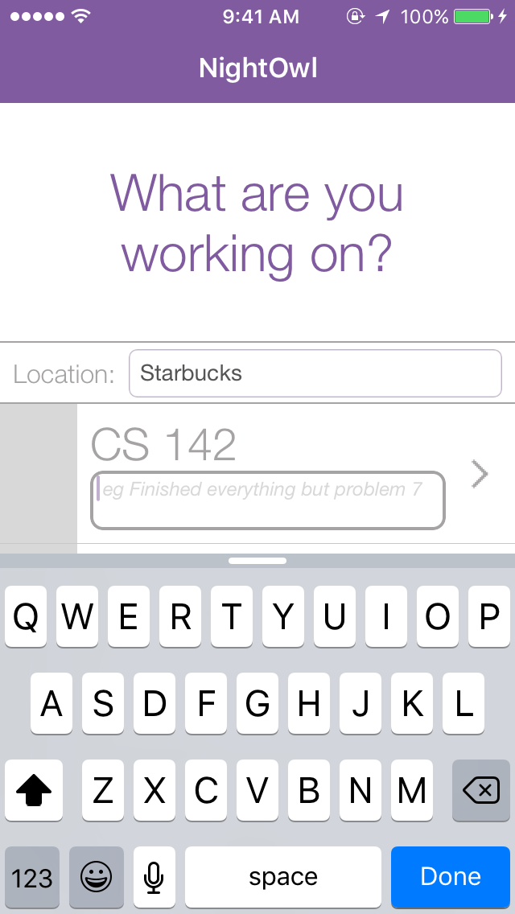
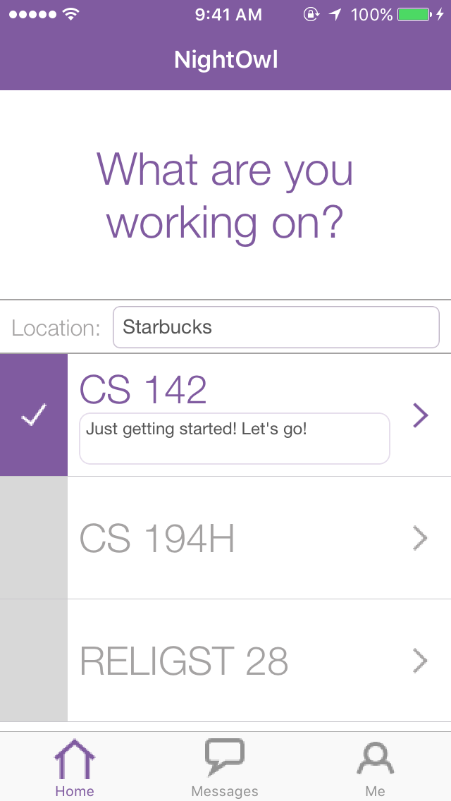
Home Screen UI
Old
New
Notes:
Forcing status!

Slide 12
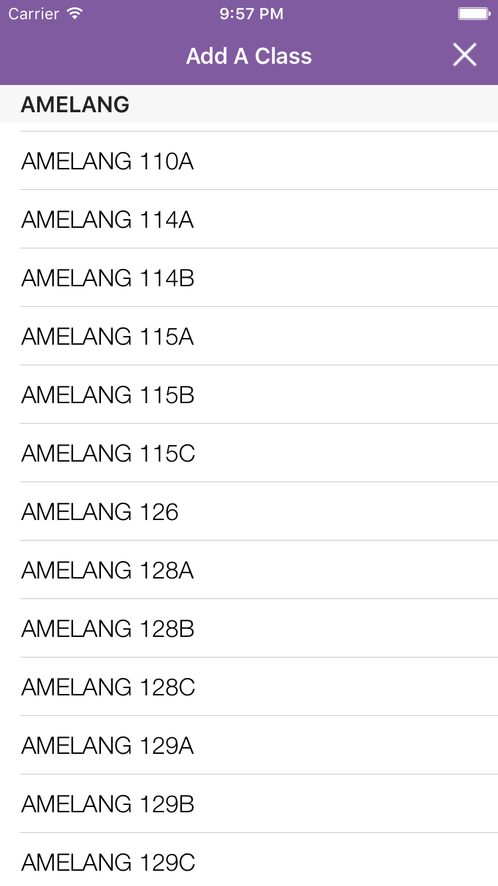
Persistent Search Bar
Old
Notes:
Reasoning: Insight from user testing. A few users missed the search bar initially and then were stuck scrolling for a long time. Now we have put the search bar in a fixed position on the screen so it always remains visible to the user.

Slide 13
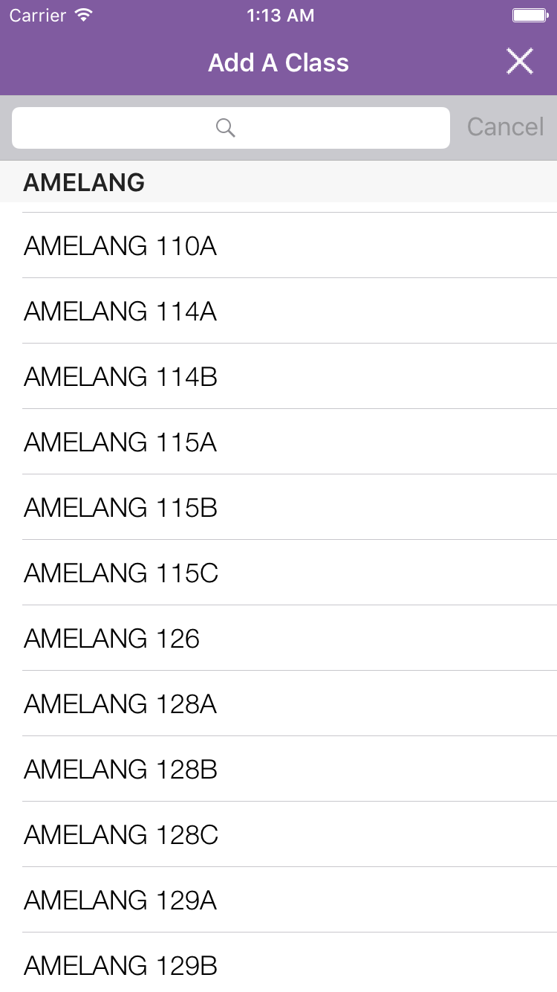
Persistent Search Bar
Old
New
Notes:
Reasoning: Insight from user testing. A few users missed the search bar initially and then were stuck scrolling for a long time. Now we have put the search bar in a fixed position on the screen so it always remains visible to the user.

Slide 14
Required Location
Old
Notes:
Reasoning: Insight from user testing. A few users missed the search bar initially and then were stuck scrolling for a long time. Now we have put the search bar in a fixed position on the screen so it always remains visible to the user.

Slide 15
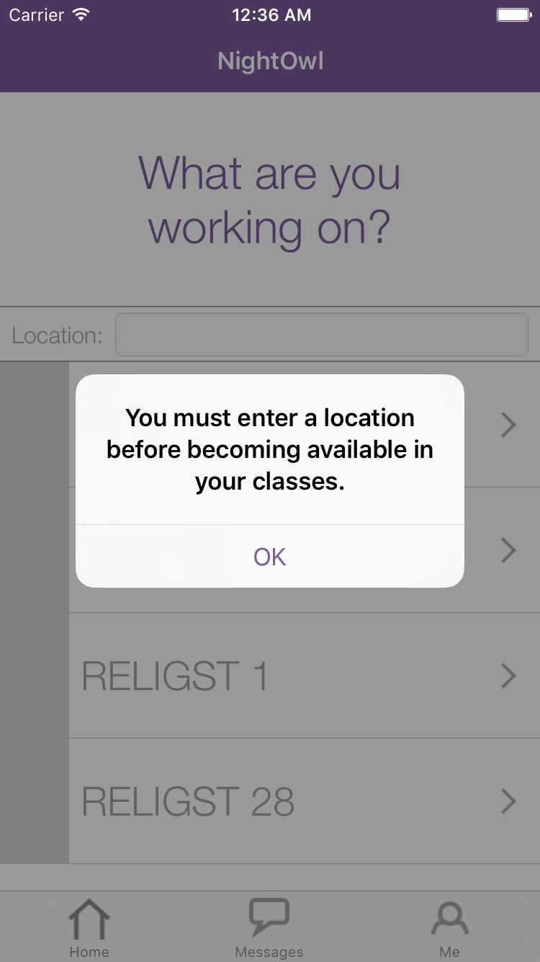
Required Location
Old
New
Notes:
Reasoning: Insight from user testing. A few users missed the search bar initially and then were stuck scrolling for a long time. Now we have put the search bar in a fixed position on the screen so it always remains visible to the user.

Slide 16
Flight Path
Interface Changes
Demo
Future Work

Slide 17
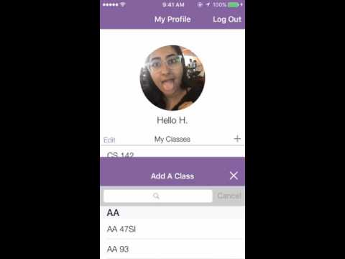
Simple Task: Login and update your classes

Slide 18
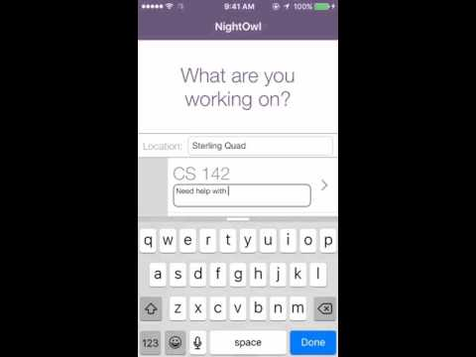
Medium Task: Make yourself available for a class

Slide 19
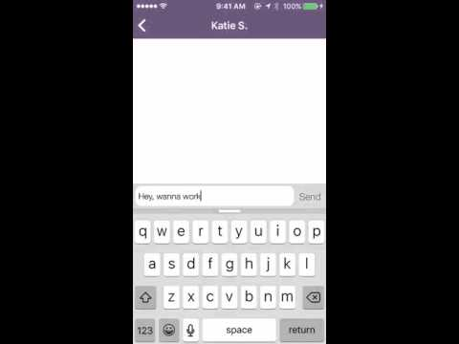
Complex Task: Reach out to a classmate

Slide 20
Flight Path
Interface Changes
Demo
Future Work

Slide 21
Looking forward
Finetune UI
Ability to search by class name
Make scalable
Update backend once Parse shuts down
Get users!
Notes:
If we continue to work on this after this class

Slide 22
Summary
Updated app based on field testing
Major changes
  Home screen
  Messaging
  Search bar

Slide 23
Thank you!

