Slide 1

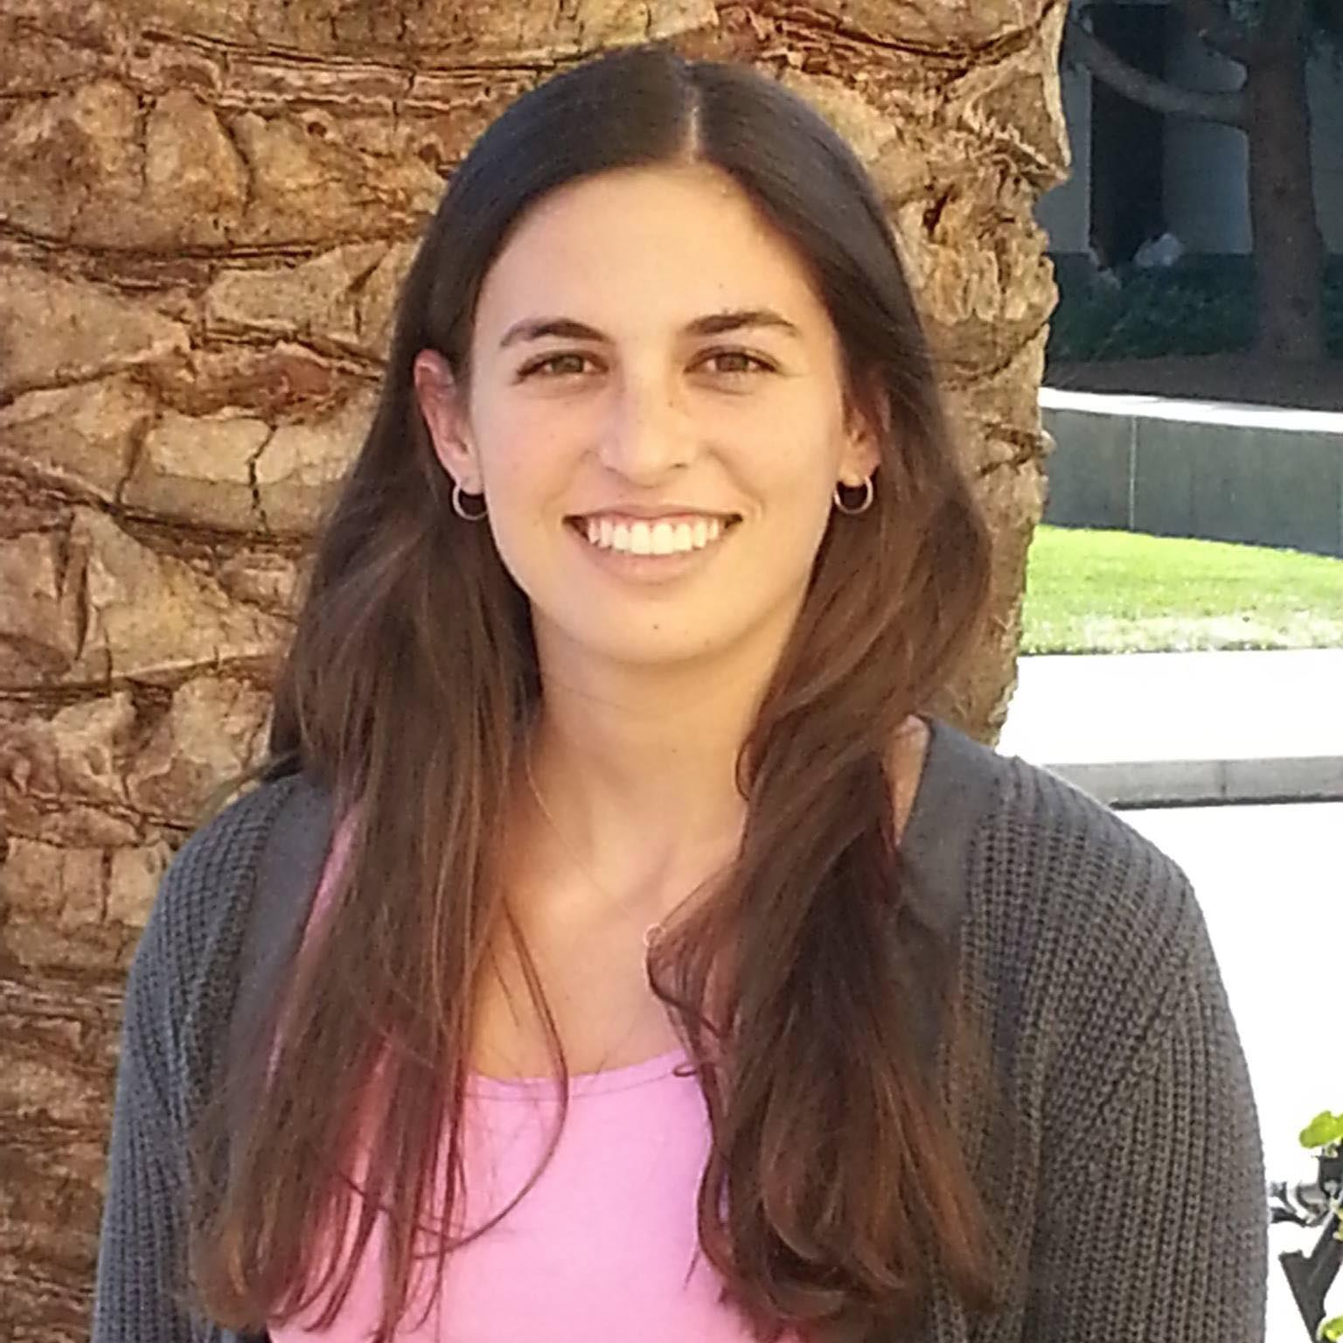
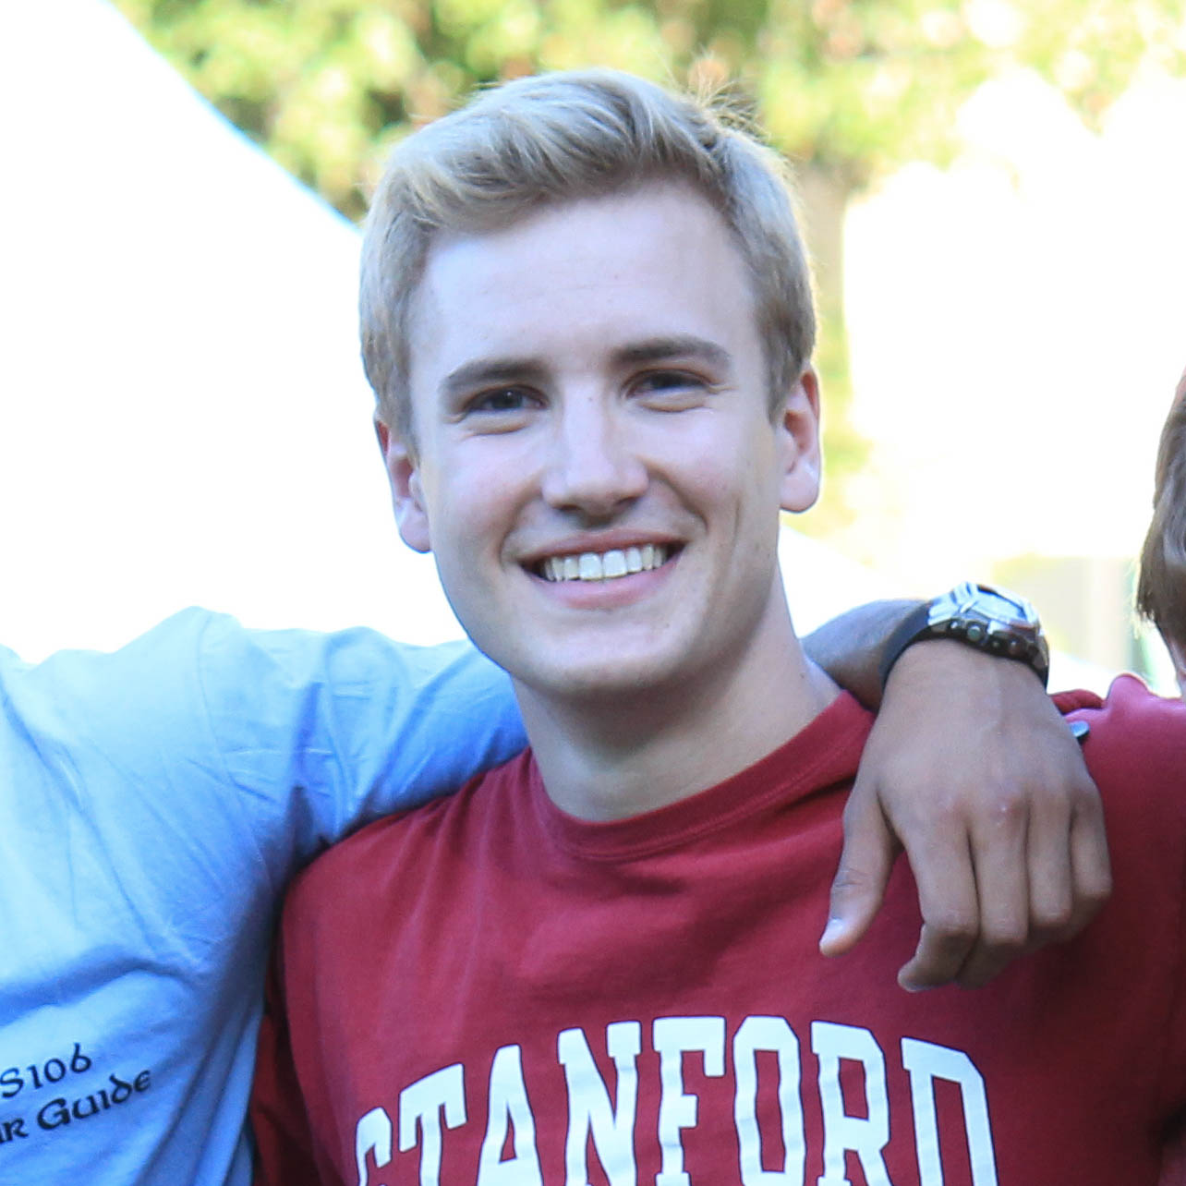

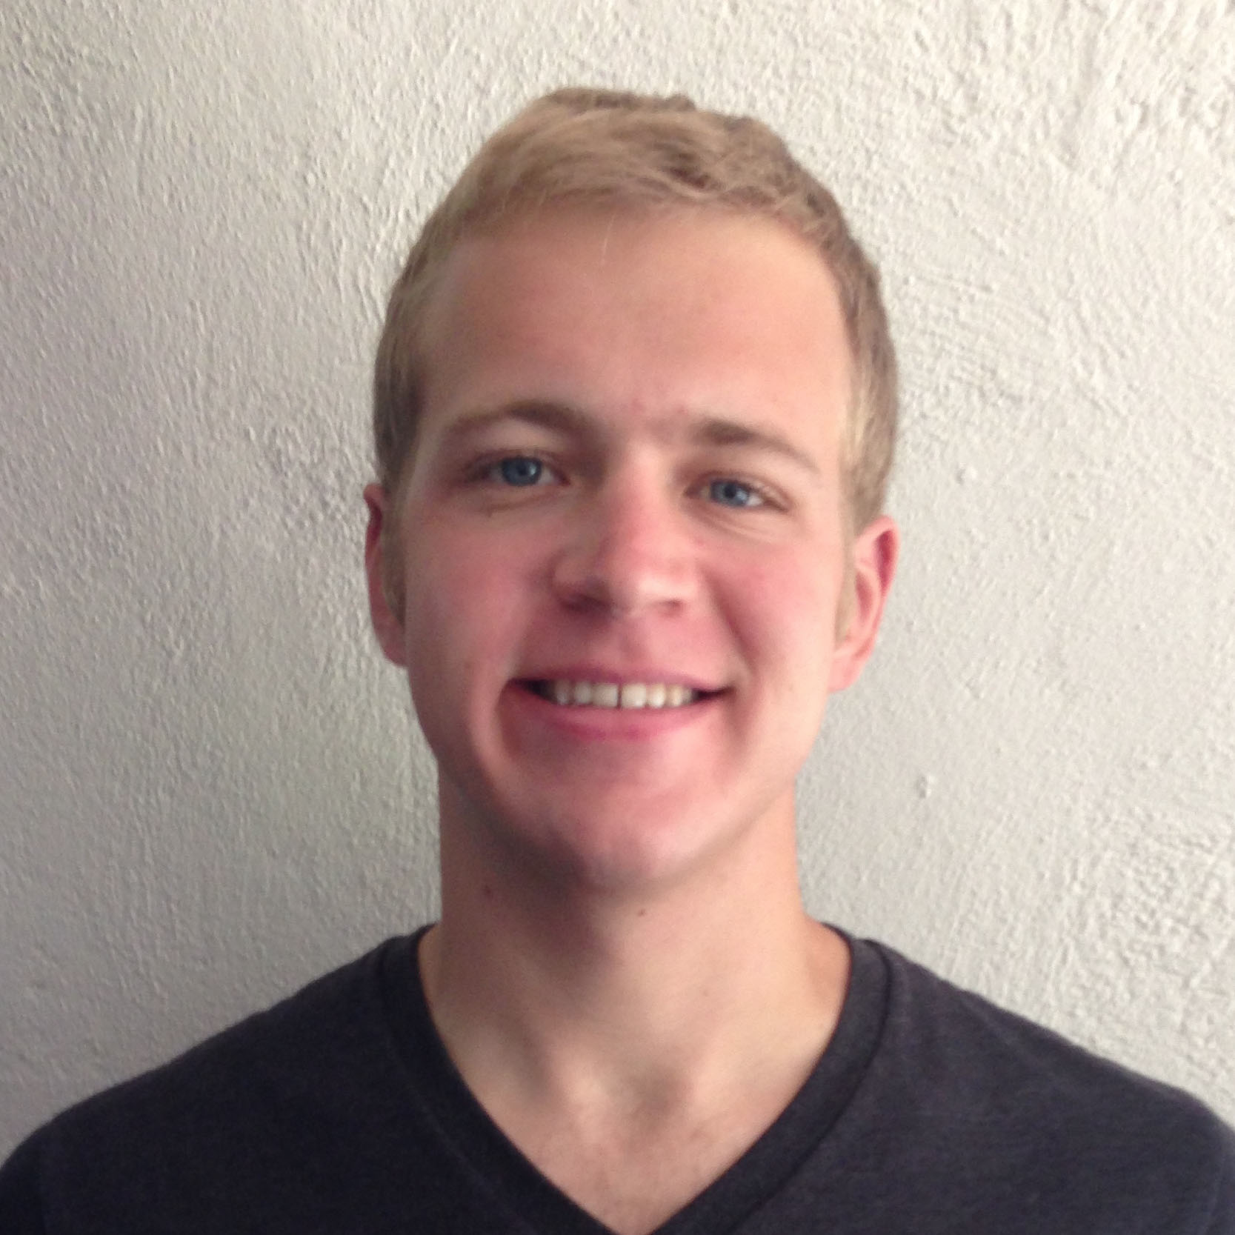

NightOwl
HiFi Prototype #2
Griffin Dietz - Lachlan Green - Zara Saraon - Evan Nixon - Priyanka Rao

Slide 2
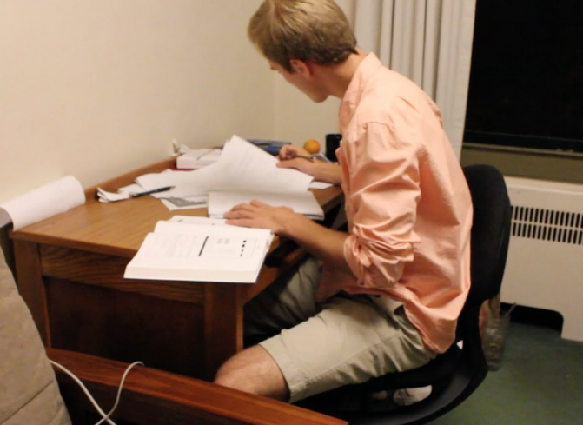
The Problem
Imagine...
it’s 2 am
you’re stuck on a pset that’s due in the morning
your two friends in the class are fast asleep
Notes:
Description of task: We told participants to imagine they are working on psets for CS140 and CS194H and need help. Their task was to make themselves available for both classes, and post informative statuses.
Changes:
Location autofills at top (removes a step)
statuses are inline instead of in modal page (easier and more intuitive)
What we looked for: 1) If they were able to easily make themselves available
2) If there were any issues with entering status or location

Slide 3

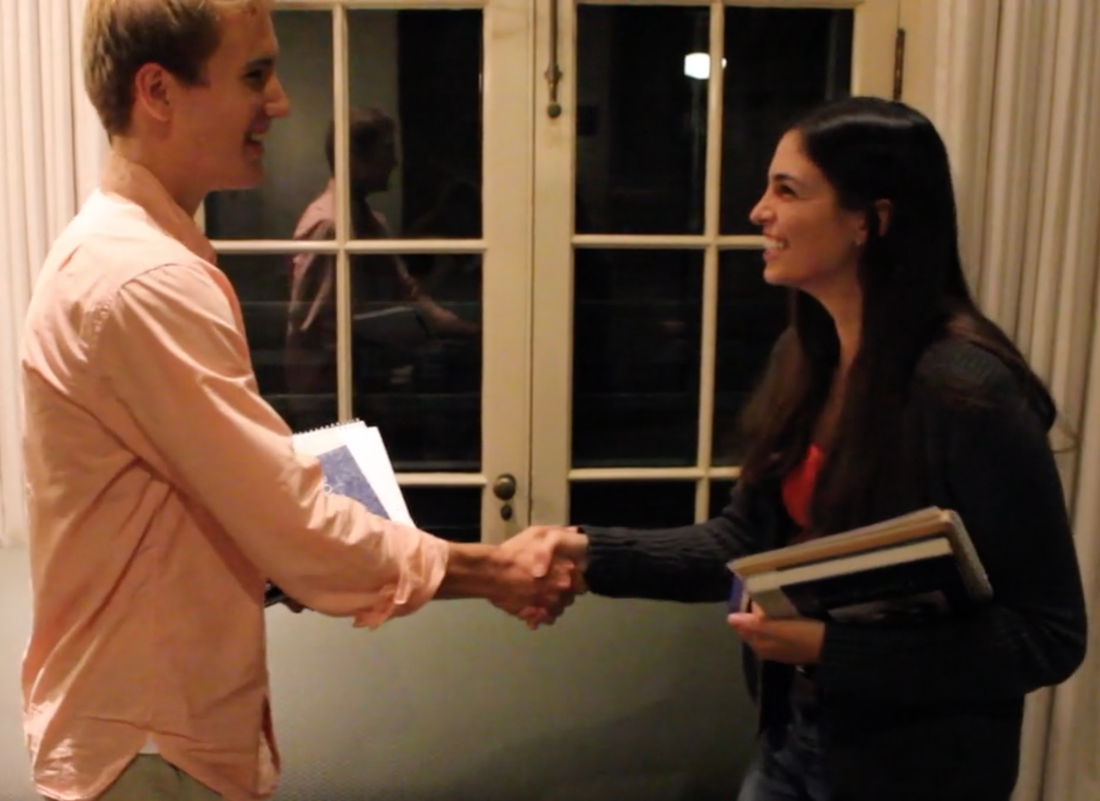
’s Solution
NightOwl connects students to classmates who are awake, nearby, and working on the same thing.
Notes:
Description of task: We told participants to imagine they are working on psets for CS140 and CS194H and need help. Their task was to make themselves available for both classes, and post informative statuses.
Changes:
Location autofills at top (removes a step)
statuses are inline instead of in modal page (easier and more intuitive)
What we looked for: 1) If they were able to easily make themselves available
2) If there were any issues with entering status or location

Slide 4
Flight Path
Interface Changes
Task Flows
Future Work

Slide 5
Flight Path
Interface Changes
Task Flows
Future Work

Slide 6
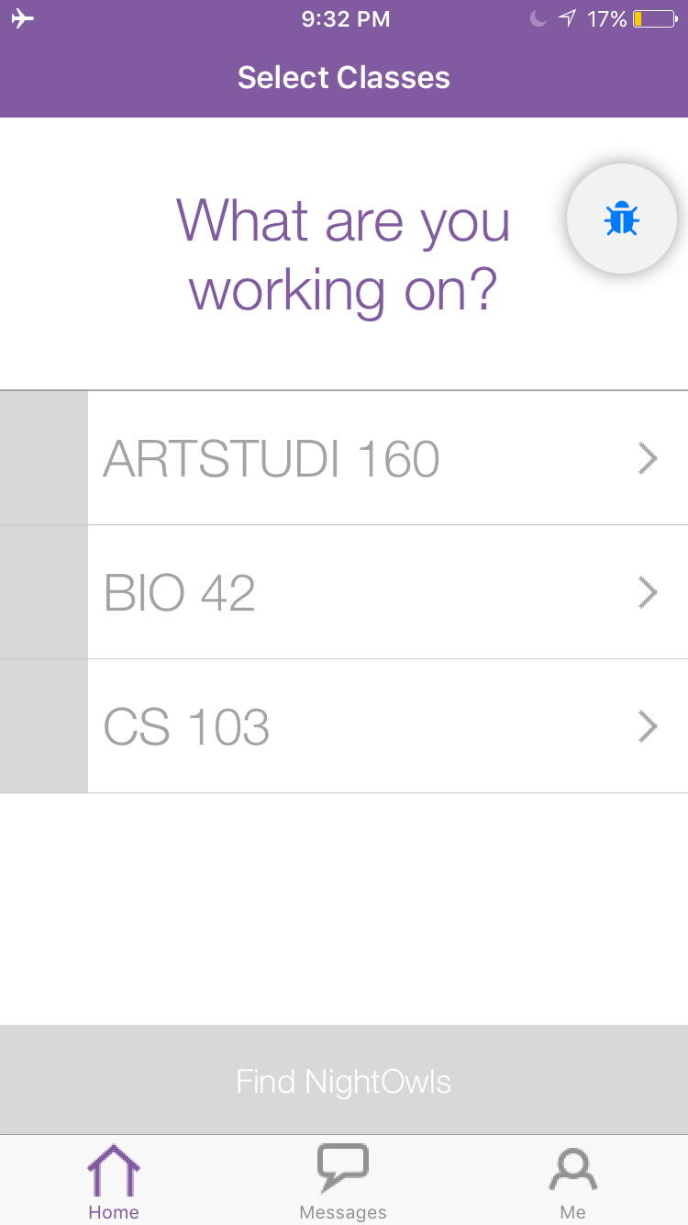
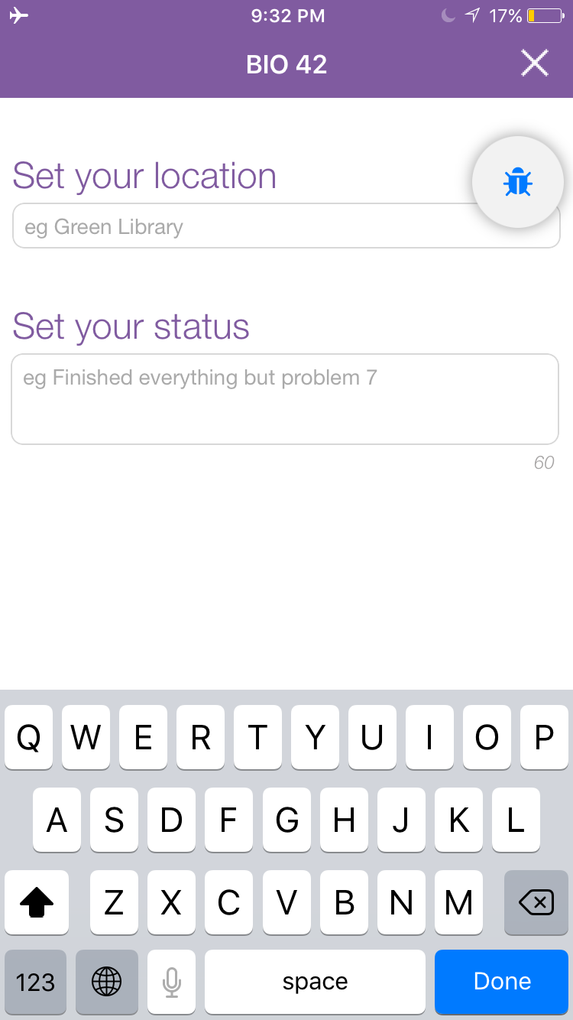
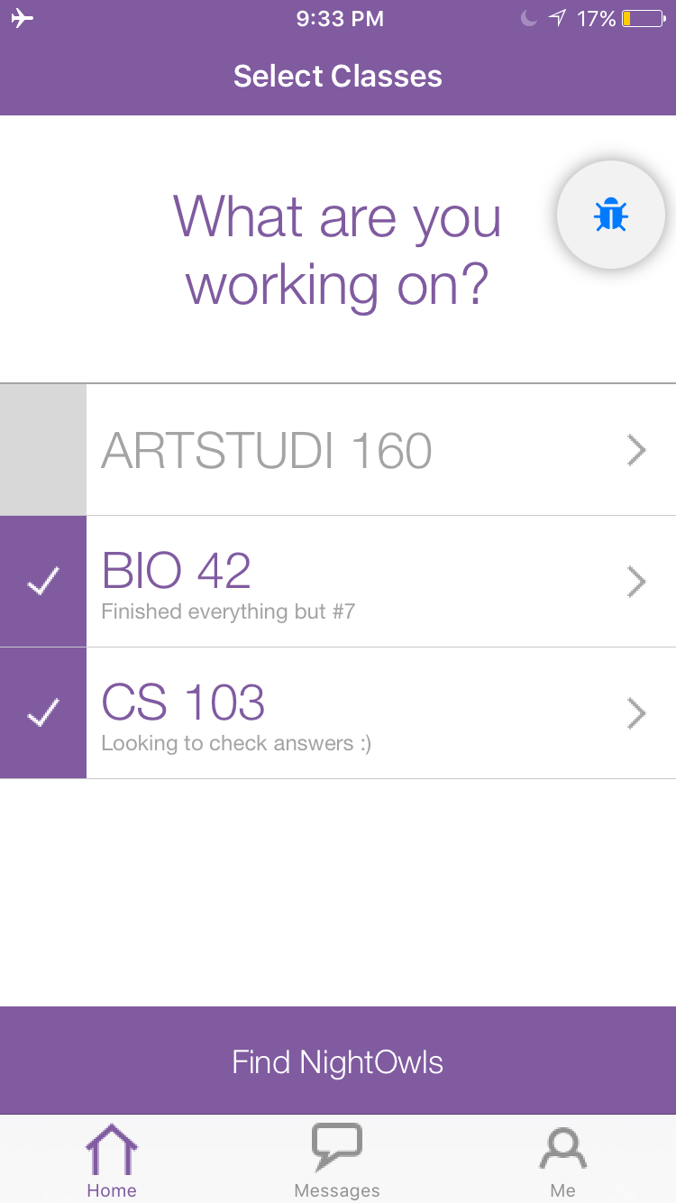
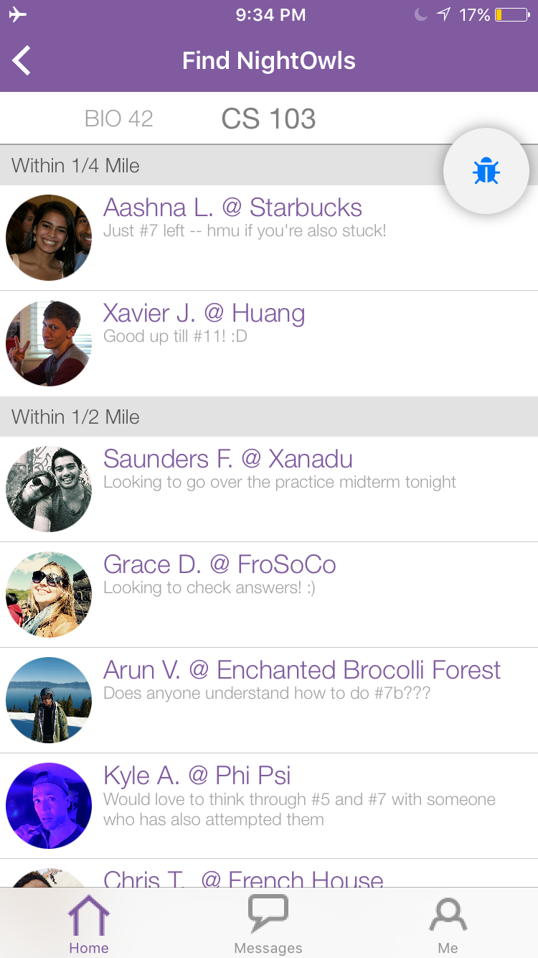
Old Screens
Notes:
Description of task: We told participants to imagine they are working on psets for CS140 and CS194H and need help. Their task was to make themselves available for both classes, and post informative statuses.
Changes:
Location autofills at top (removes a step)
statuses are inline instead of in modal page (easier and more intuitive)
What we looked for: 1) If they were able to easily make themselves available
2) If there were any issues with entering status or location

Slide 7
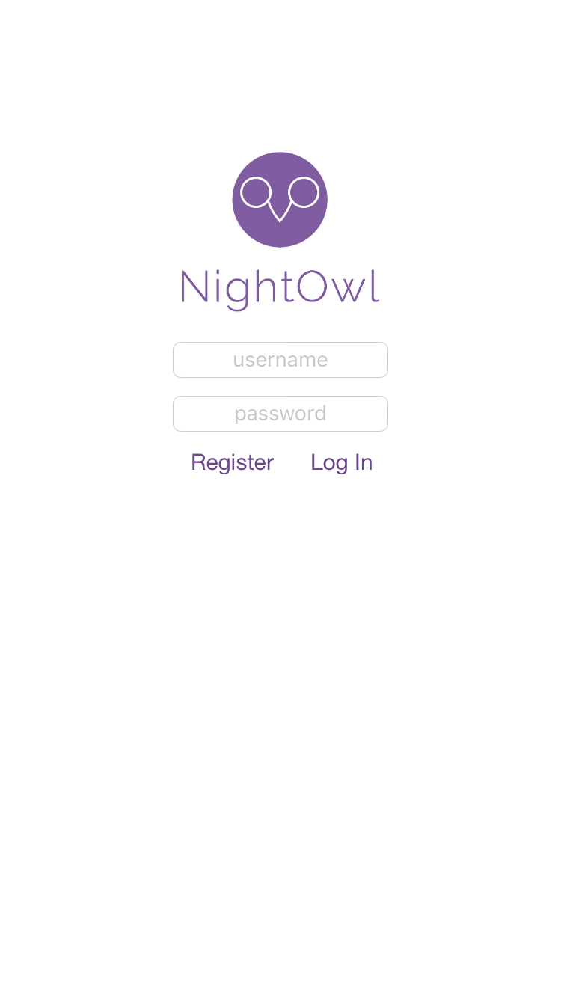
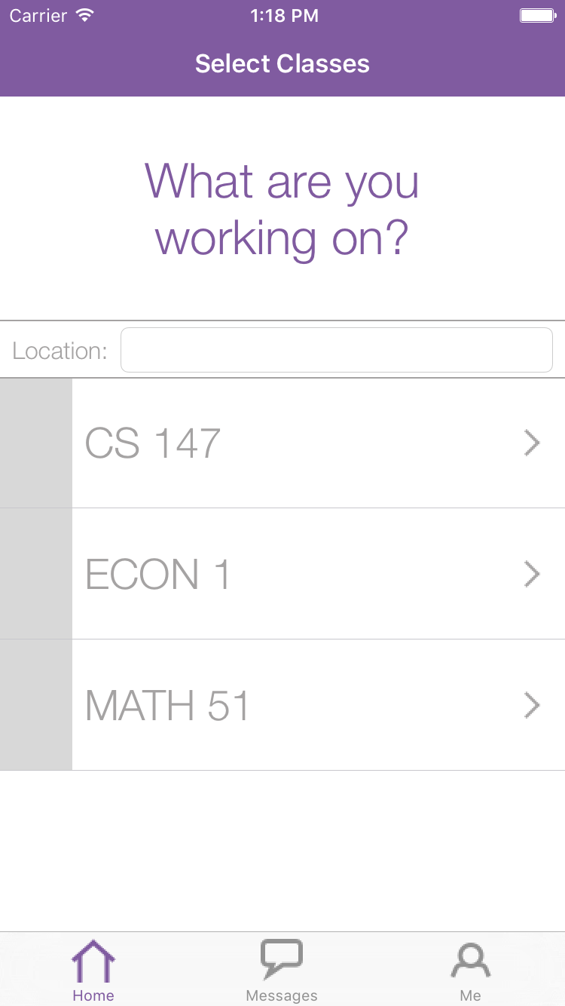
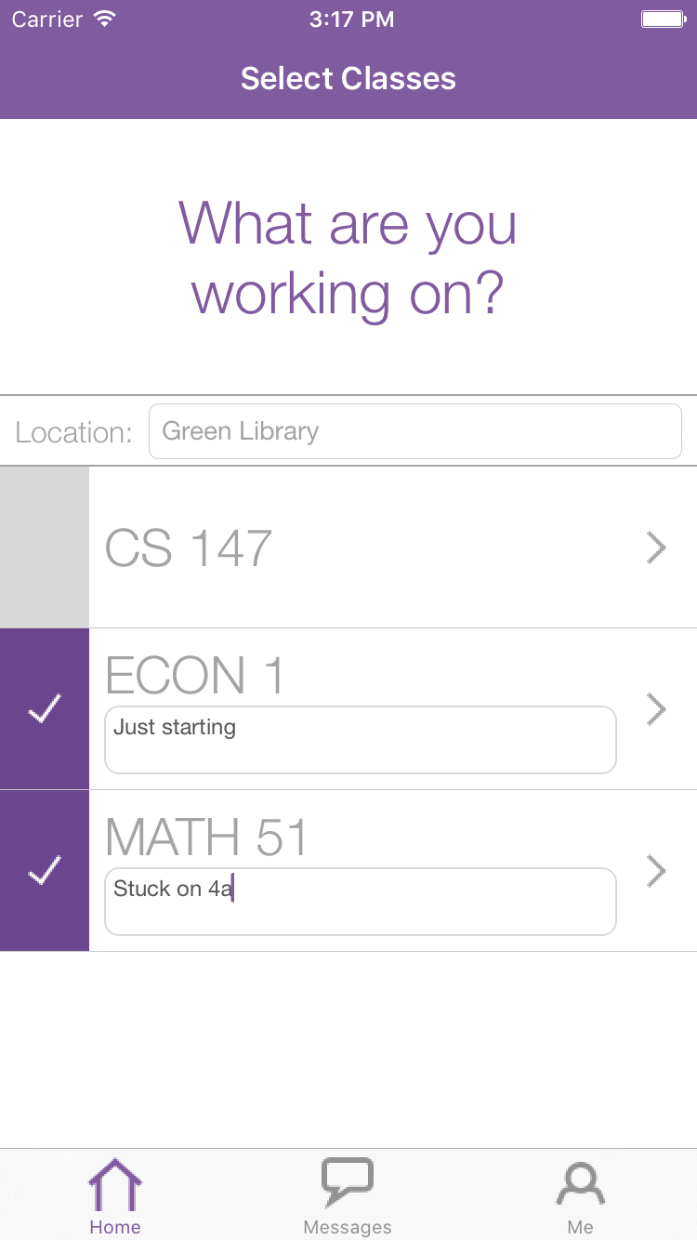
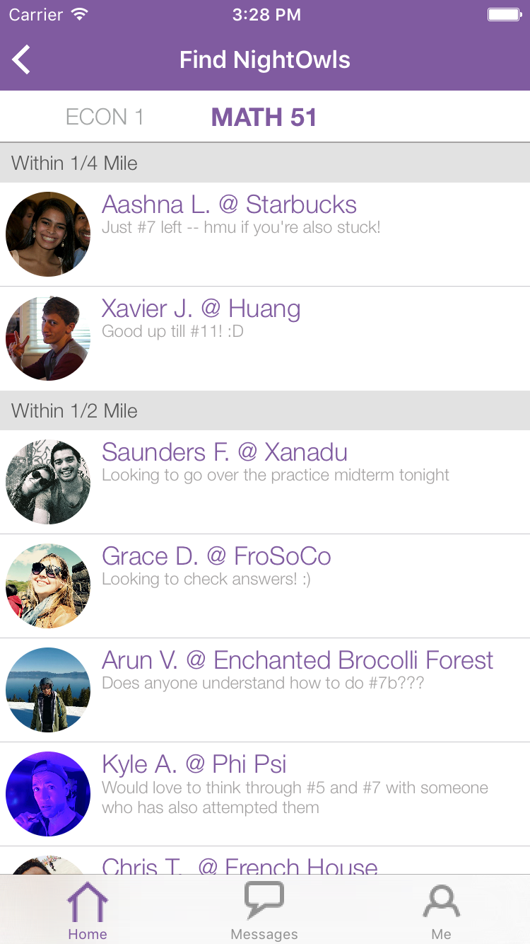
Revised Screens
Notes:
Description of task: We told participants to imagine they are working on psets for CS140 and CS194H and need help. Their task was to make themselves available for both classes, and post informative statuses.
Changes:
Location autofills at top (removes a step)
statuses are inline instead of in modal page (easier and more intuitive)
What we looked for: 1) If they were able to easily make themselves available
2) If there were any issues with entering status or location

Slide 8
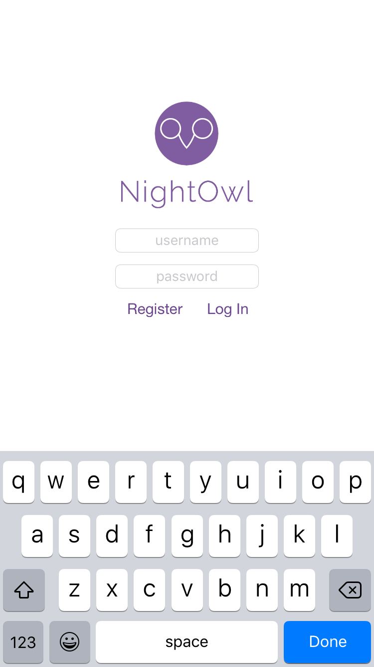
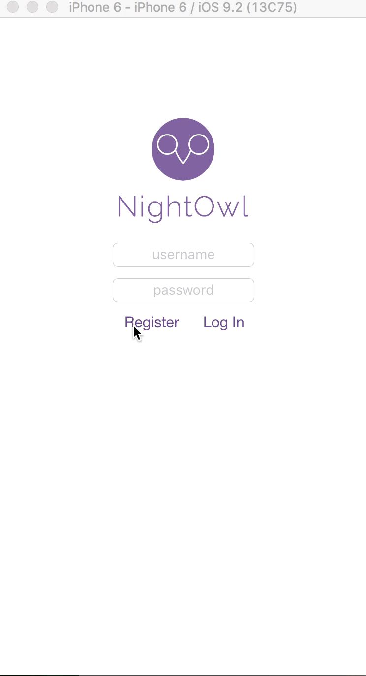
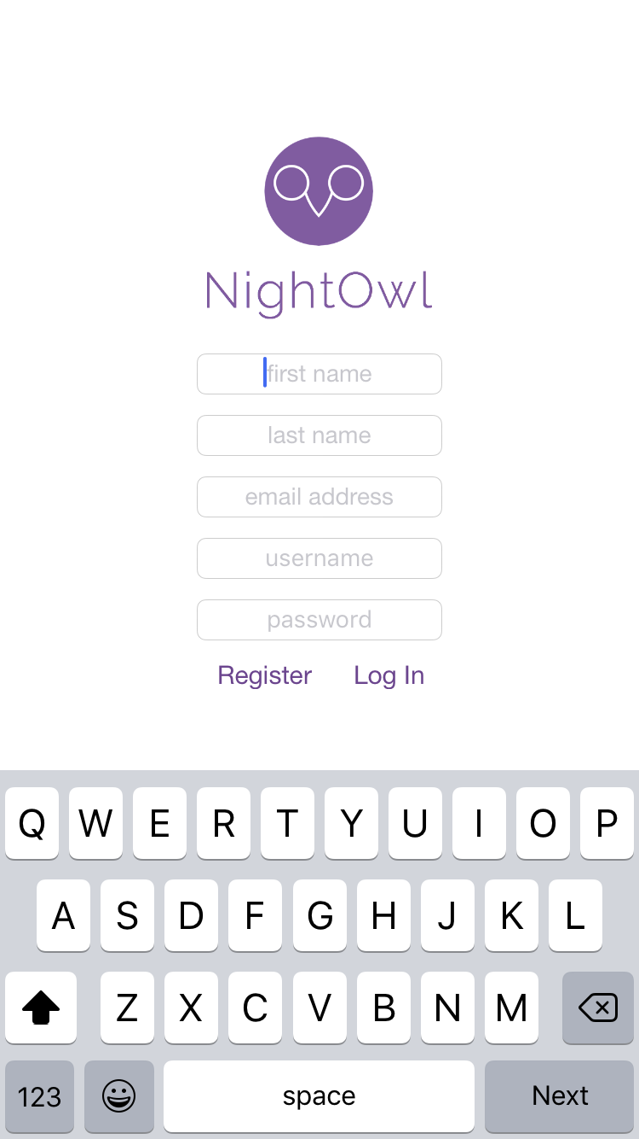
Login and register screen (new)
Notes:
Login and Register screen is new
What you might expect from an app - allows you to login and register
hooked into parse on the backend - no wizard of oz

Slide 9
Home screen
Old
New
Notes:
Removed Find Nightowls button - users did not find it intuitive
Added location to home screen - your location is the same for all classes

Slide 10
Home screen
Old
New
Notes:
Removed Find Nightowls button - users did not find it intuitive
Added location to home screen - your location is the same for all classes

Slide 11
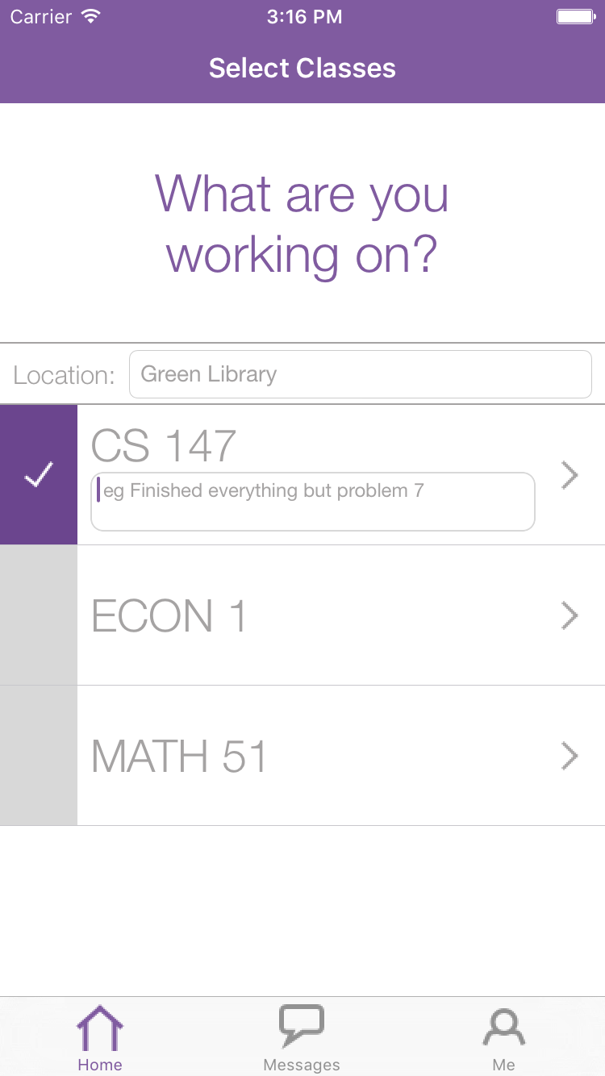
Setting location and status
Old
New
Notes:
Setting status & location on home screen - removing modal
Seemed like the modal screen was cumbersome (user comments)
Location now defaults to Google Places best-guess

Slide 12
Setting location and status
Auto-suggest using Google Places API
Set status on home screen
Old
New
Notes:
Setting status & location on home screen - removing modal
Seemed like the modal screen was cumbersome (user comments)
Location now defaults to Google Places best-guess

Slide 13
After status is entered
Tapping on arrow leads to list of NightOwls
Old
New
Notes:
Many users tried to click on the class to find nightowls first
Intuition: class should be able to drill down into nightowls
Made change: tapping on the class now matches what the user expects

Slide 14
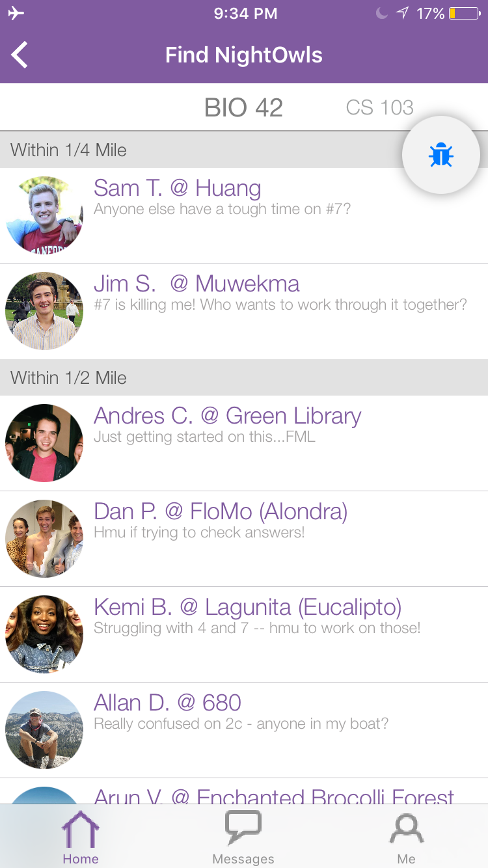
Class filtering
Old
New
Notes:
Description of task: We told participants to imagine they are working on psets for CS140 and CS194H and need help. Their task was to make themselves available for both classes, and post informative statuses.
Changes:
Location autofills at top (removes a step)
statuses are inline instead of in modal page (easier and more intuitive)
What we looked for: 1) If they were able to easily make themselves available
2) If there were any issues with entering status or location

Slide 15
Flight Path
Interface Changes
Task Flows
Future Work

Slide 16
Task Flows
Simple Task: Login and update your classes
Medium Task: Make yourself available for a class
Complex Task: Reach out to classmates
Notes:
Simple, Medium, and Complex task flows have changed
Changes have made complexity of tasks go down! Medium and Complex are easier now.

Slide 17
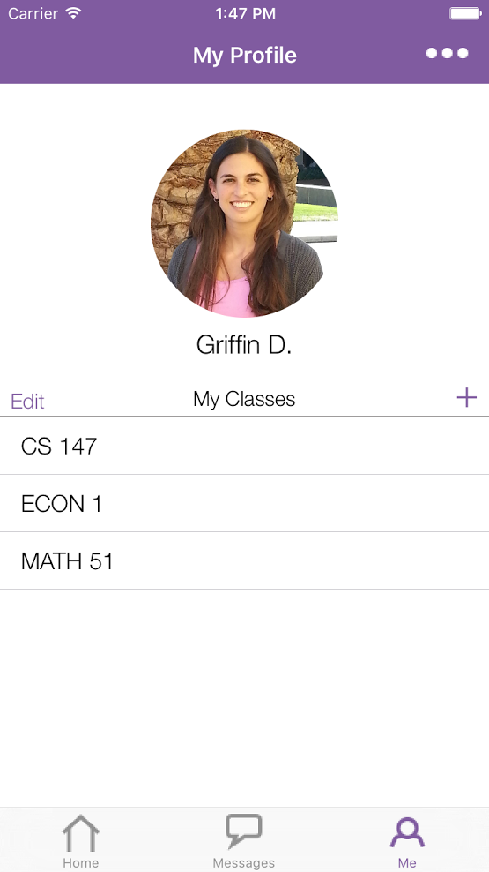
Simple Task: Login and update your classes
Notes:
Description of task: We gave participants the app with 3 classes already loaded in (left screen) and asked them to update their list of current classes to be 3 new classes (right screen).
Changes:
Touchable area on edit and plus buttons is greater (class feedback)

Slide 18
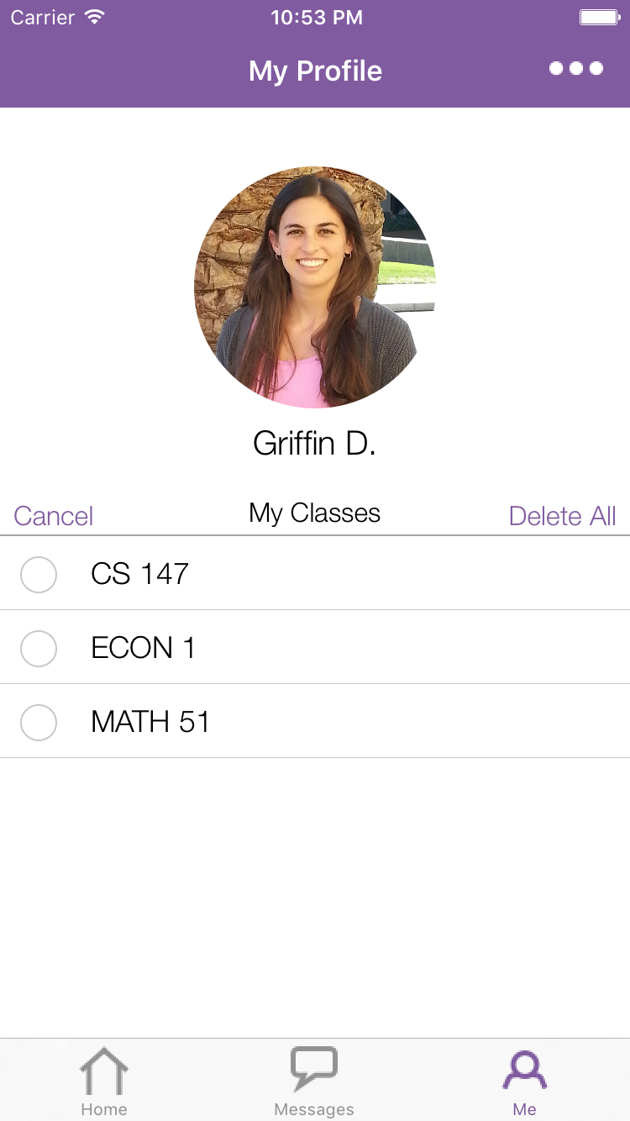
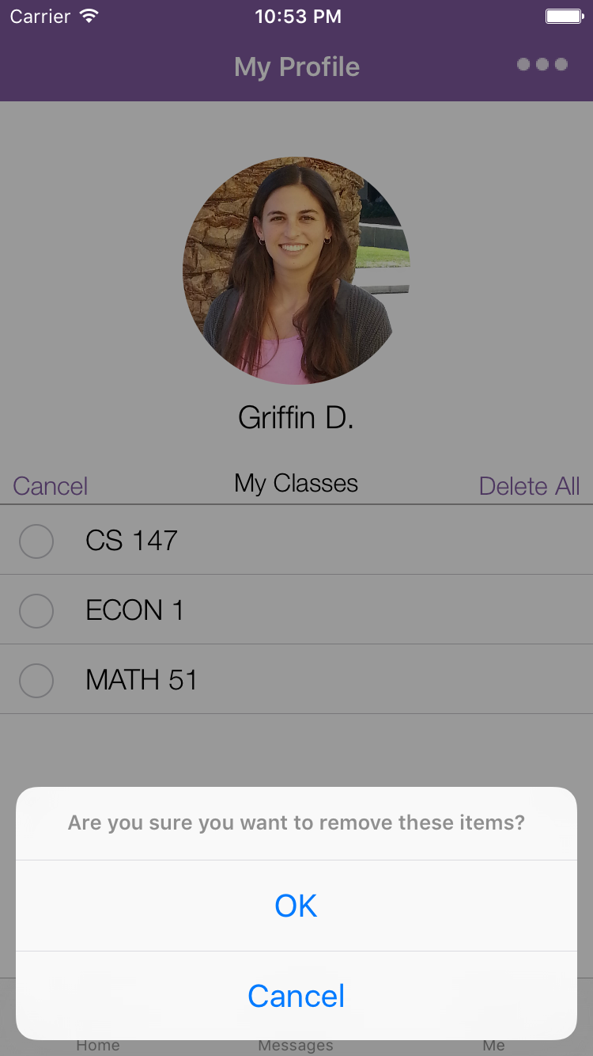
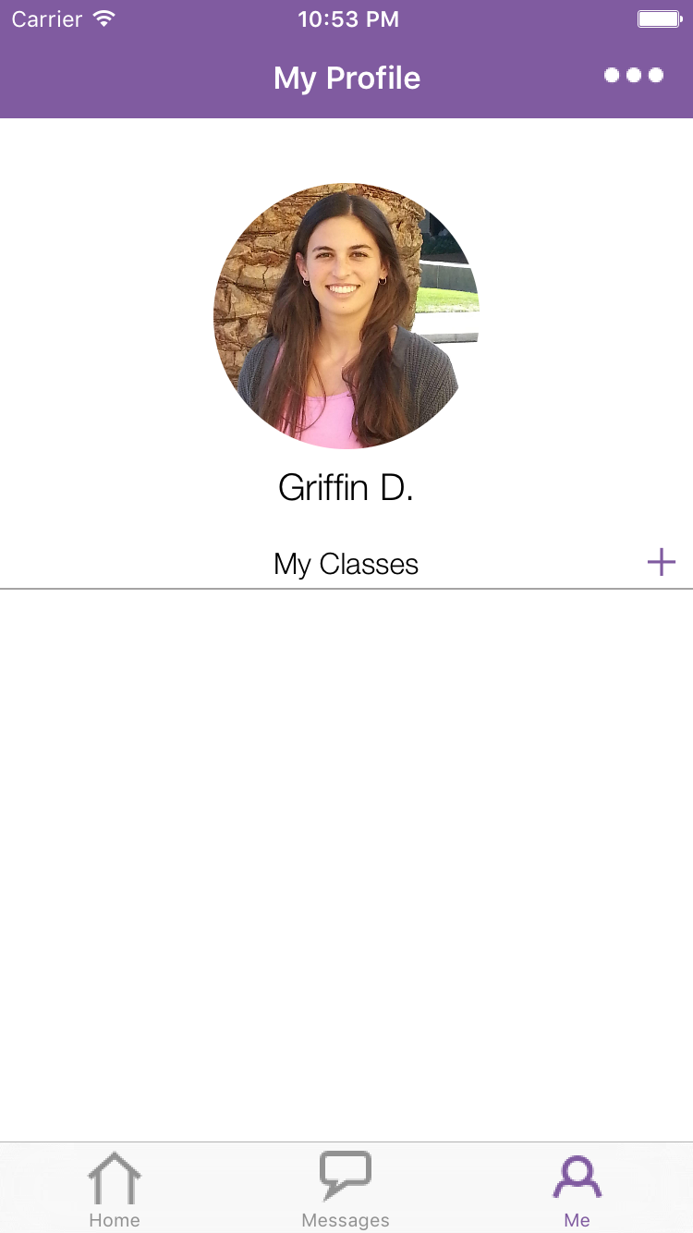
Simple Task: Login and update your classes
Notes:
Description of task: We gave participants the app with 3 classes already loaded in (left screen) and asked them to update their list of current classes to be 3 new classes (right screen).
Changes:
Touchable area on edit and plus buttons is greater
What we looked for: 1) If they were able realize the class list can be edited in the “me” tab
2) any errors or confusion with adding/deleting

Slide 19
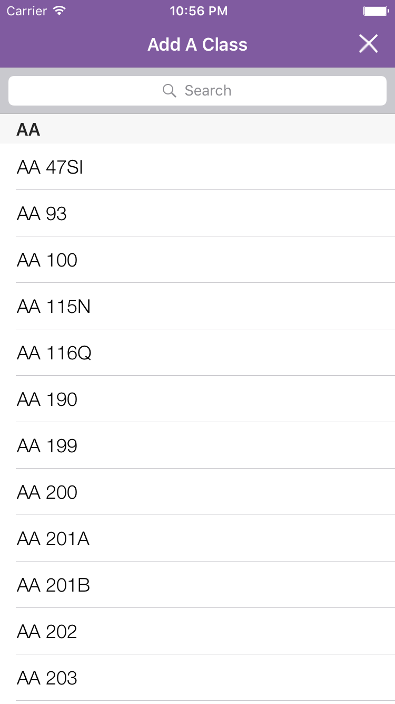
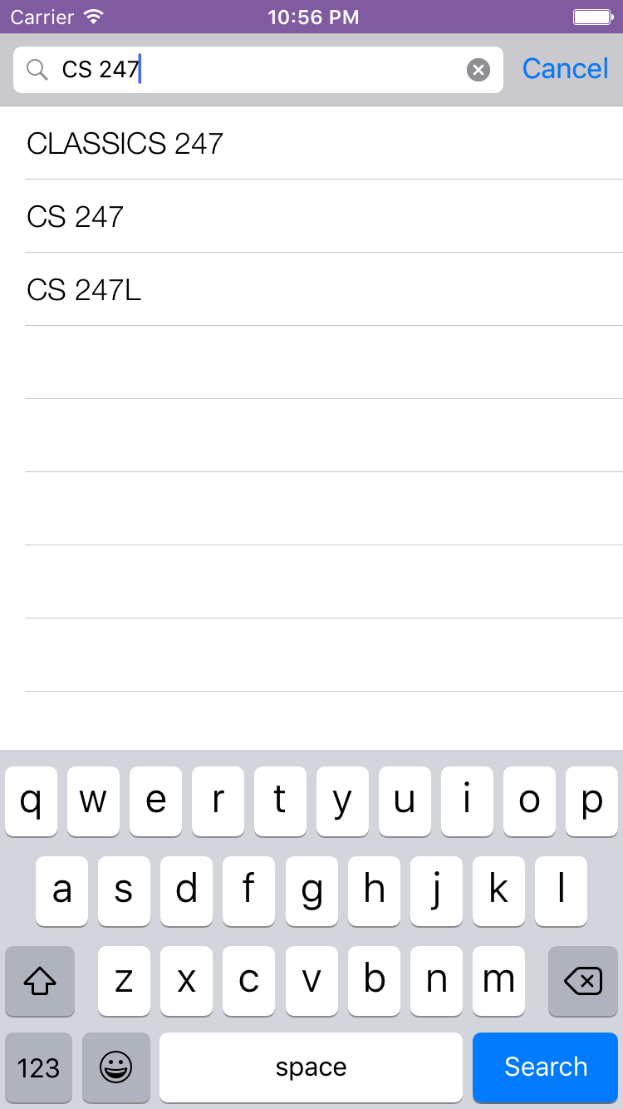

Simple Task: Login and update your classes
Done
Notes:
Description of task: We gave participants the app with 3 classes already loaded in (left screen) and asked them to update their list of current classes to be 3 new classes (right screen).
Changes:
Touchable area on edit and plus buttons is greater (class feedback)

Slide 20
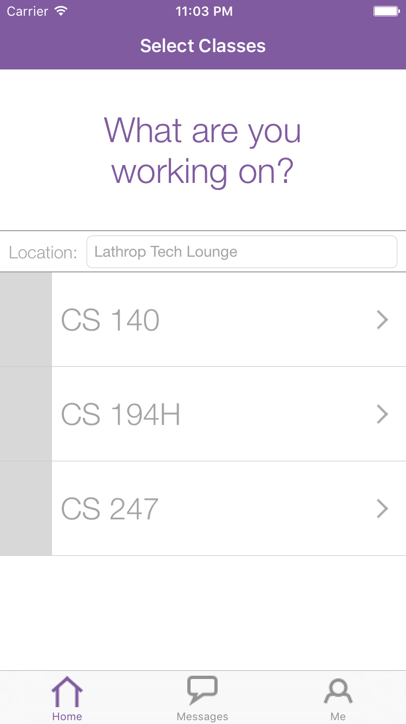
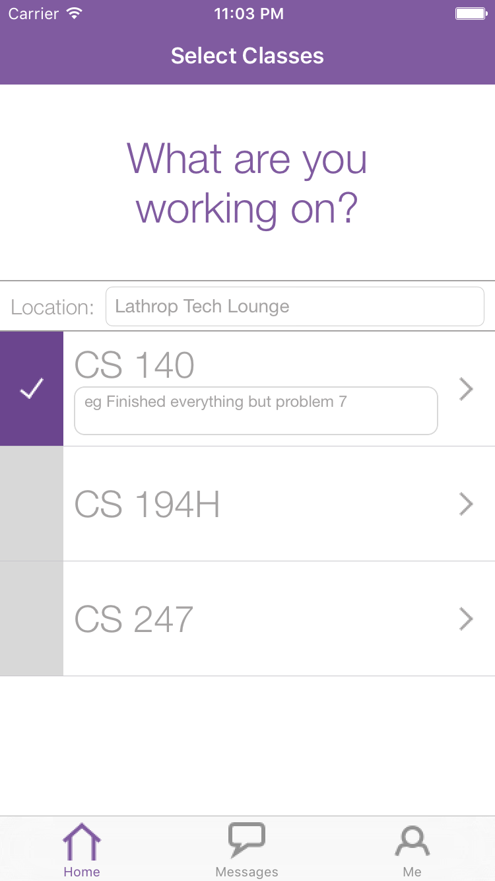
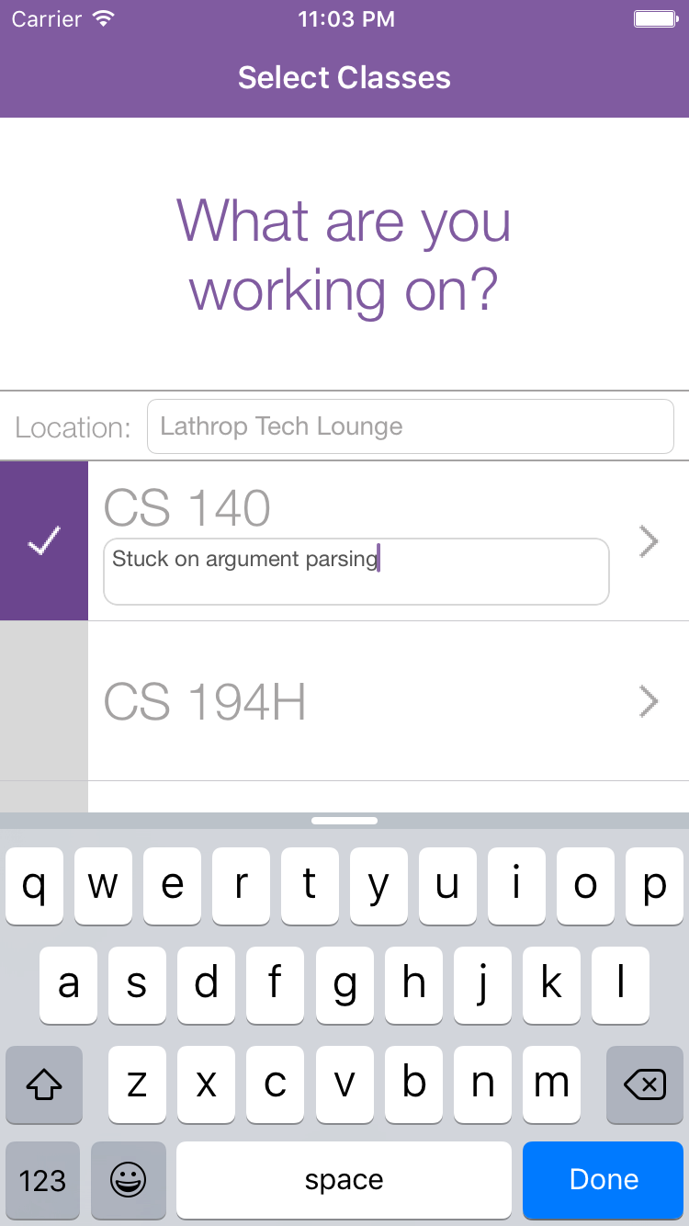
Medium Task: Make yourself available for a class
Notes:
Description of task: We told participants to imagine they are working on psets for CS140 and CS194H and need help. Their task was to make themselves available for both classes, and post informative statuses.
Changes:
Location autofills at top (removes a step)
statuses are inline instead of in modal page (easier and more intuitive)
What we looked for: 1) If they were able to easily make themselves available
2) If there were any issues with entering status or location

Slide 21
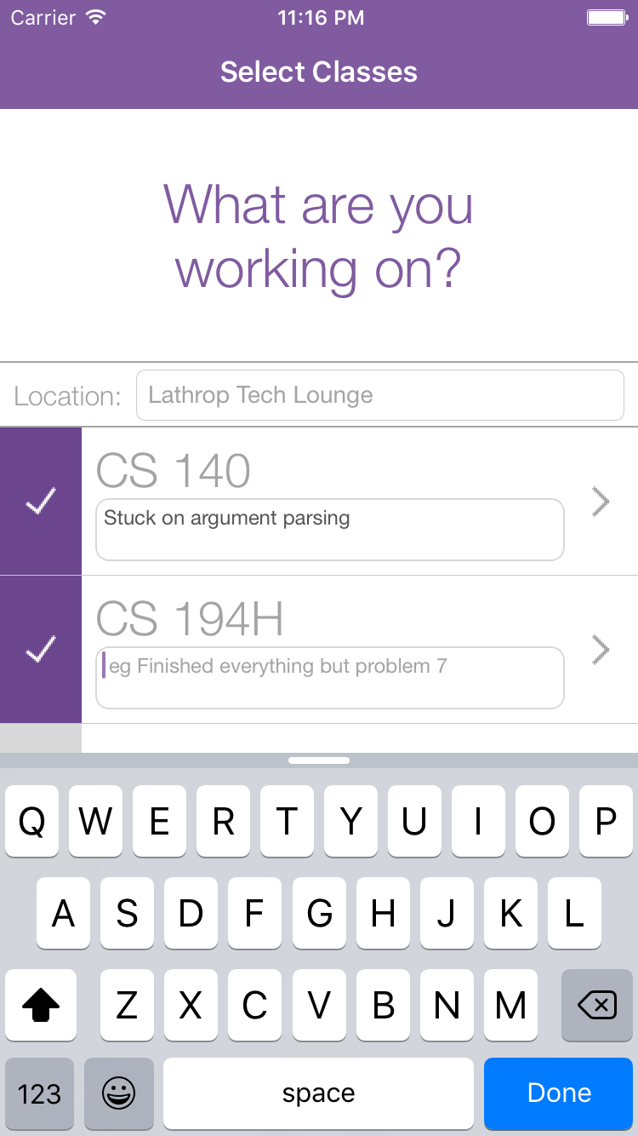
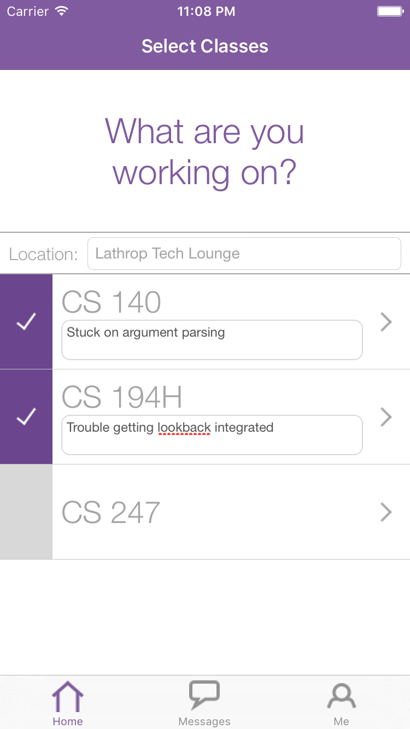
Medium Task: Make yourself available for a class
Done
Notes:
Description of task: We told participants to imagine they are working on psets for CS140 and CS194H and need help. Their task was to make themselves available for both classes, and post informative statuses.
Changes:
Location autofills at top (removes a step)
statuses are inline instead of in modal page (easier and more intuitive)
What we looked for: 1) If they were able to easily make themselves available
2) If there were any issues with entering status or location

Slide 22
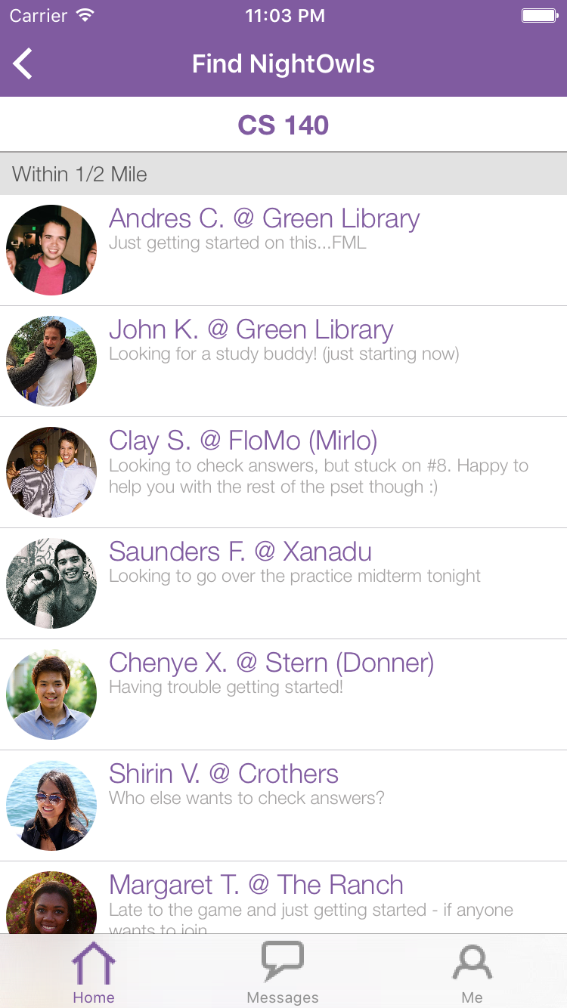
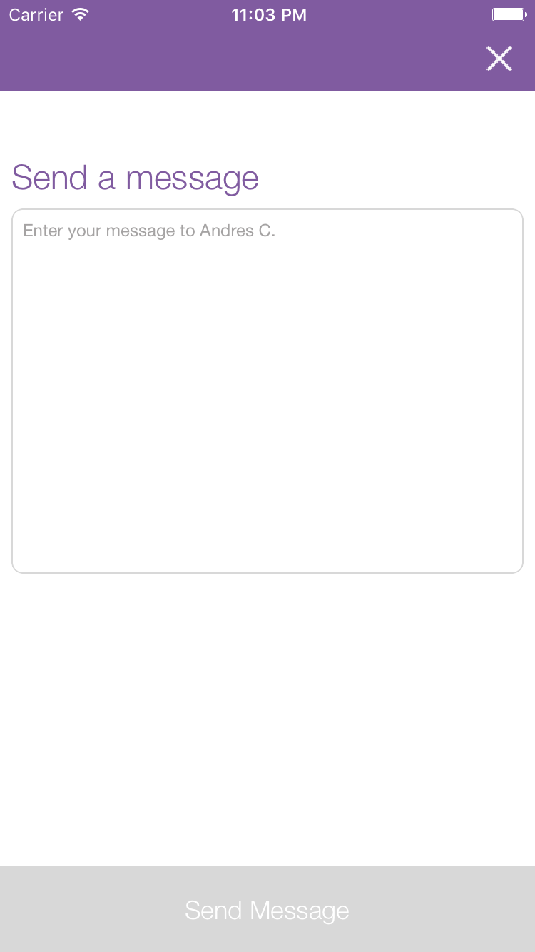
Complex Task: Reach out to a classmate
Notes:
Description of task: Now that they have made themselves available, we asked participants to send a message to one of their peers in CS140
Changes:
Removing nightowl button at bottom makes experience more intuitive
Clicking on a class was the way users wanted to find nightowls
What we looked for: 1) If they knew to click the “Find Nightowls” button to access list of available peers
2) If they recognized that the newsfeed was split into two tabs (one for cs103, one for bio42) and if they were able to toggle
between them
3) If they were able to figure out how to message a specific person once on the newsfeed

Slide 23
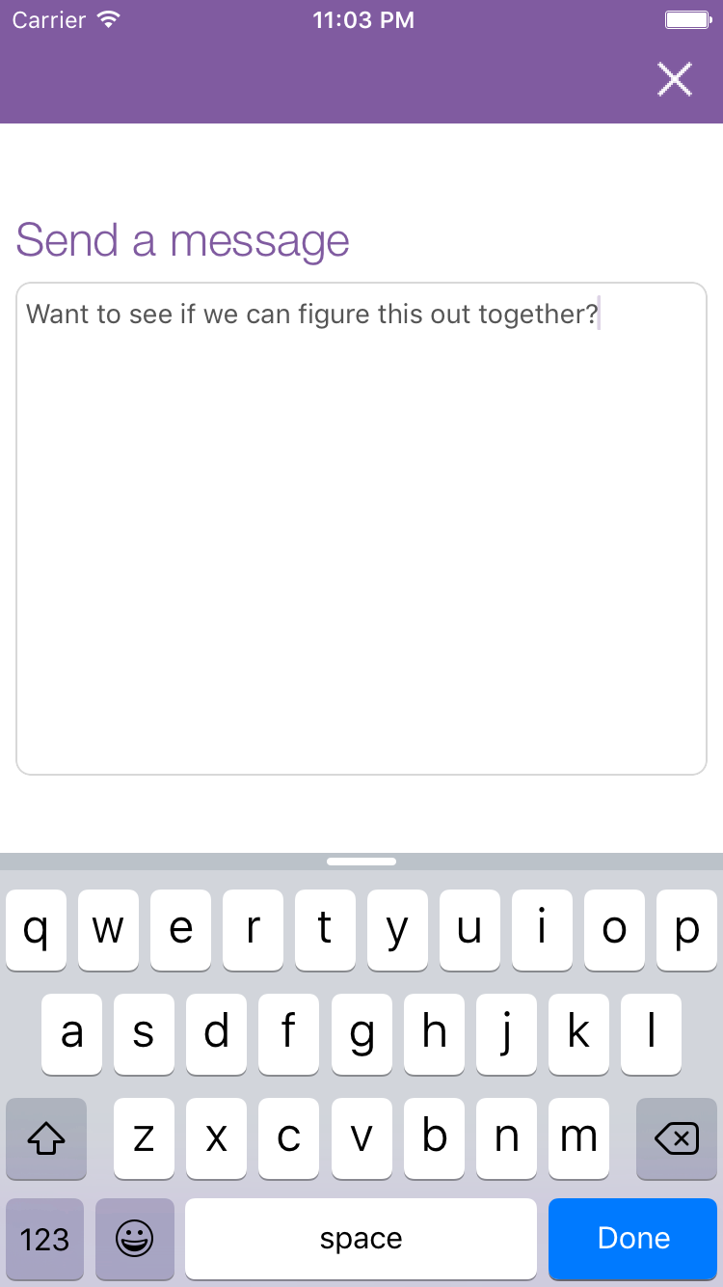
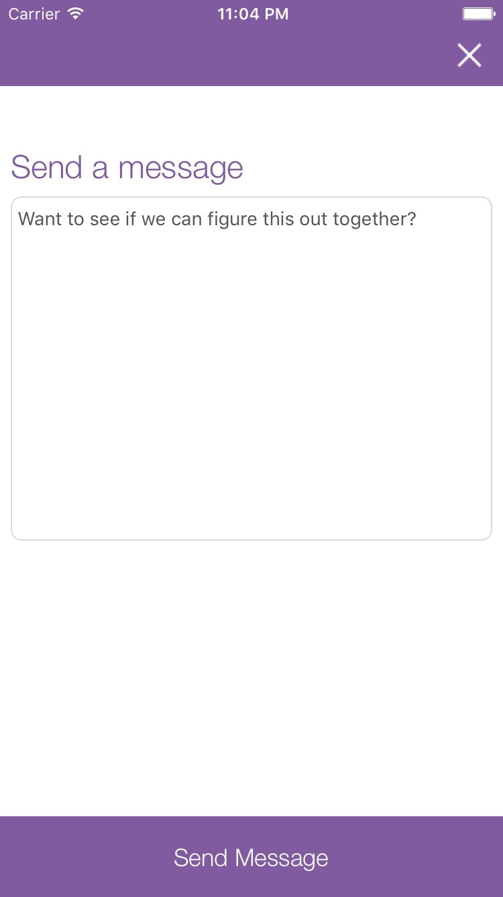
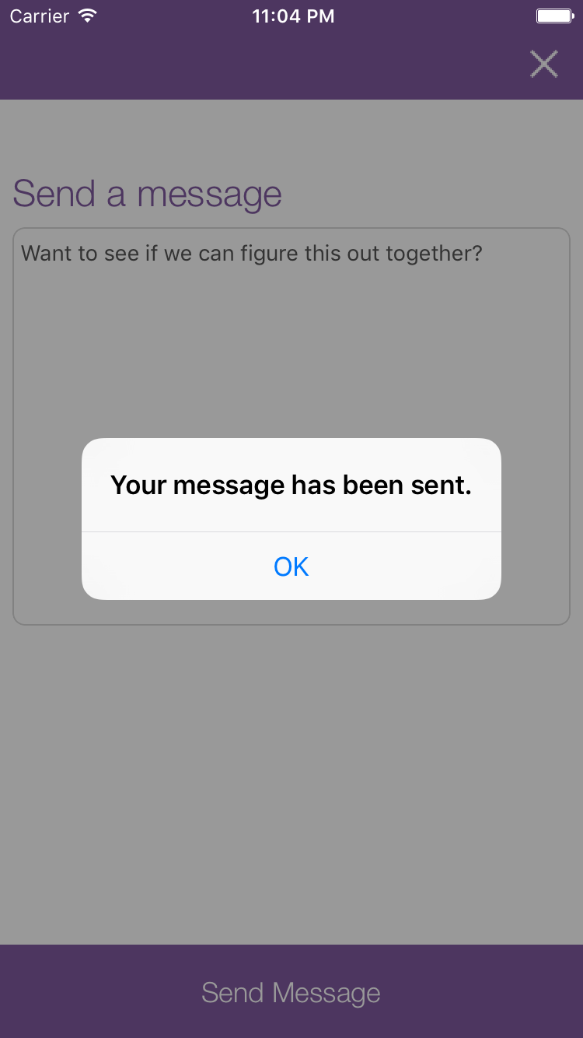
Complex Task: Reach out to a classmate
Done
Notes:
Description of task: Now that they have made themselves available, we asked participants to send a message to one of their peers in CS140
Changes:
Removing nightowl button at bottom makes experience more intuitive
Clicking on a class was the way users wanted to find nightowls
What we looked for: 1) If they knew to click the “Find Nightowls” button to access list of available peers
2) If they recognized that the newsfeed was split into two tabs (one for cs103, one for bio42) and if they were able to toggle
between them
3) If they were able to figure out how to message a specific person once on the newsfeed

Slide 24
Flight Path
Interface Changes
Scenarios
Future Work

Slide 25
Unimplemented features
Messaging with Parse API
#struggles
Wizard of Oz
Dynamic info retrieval from database
Settings screen
Notes:
Had a hard time integrating parse and the google maps places API
lots of debugging
Eventually got them working, but did not implement messaging on this run
Work continues to integrate messaging! Still aiming to finish it before field testing.

Slide 26
Looking forward
Implement messaging
Refine UI of new screens
Build out user database
Explore group study feature
Look into user rating system

Slide 27
Summary
Simplified “Find NightOwls” workflow
Integrated Google Maps API and Parse
To-do
Implement messaging
Run field test
Notes:
In summary, this week we conducted user testing on 5 different students
From this, we learned that the most prominent confusion points were: 1) add/delete buttons need to be bigger, 2) find nightowls button, 3) toggling between classes on peer list page - which we plan to address in the next iteration of the app.

Slide 28
Thank you!

