Slide 1

NightOwl
Get help now.

Slide 2
NightOwl
Get help now.
Griffin D. Lachlan G. Zara S.

Slide 3
Students late at night struggle to get help on assignments and psets.
Notes:
Introduction to Problem & Solution (2 slides)
Students working late at night often struggle to find help on assignments and psets. NightOwl connects students with peers who are awake, nearby, and working on the same thing.

Slide 4
Students late at night struggle to get help on assignments and psets.
NightOwl connects students with peers who are awake, nearby, and working on the same thing.
Notes:
Introduction to Problem & Solution (2 slides)
Students working late at night often struggle to find help on assignments and psets. NightOwl connects students with peers who are awake, nearby, and working on the same thing.

Slide 5
Overview of Today
HE Findings →
Design Changes
Prototype Tools
Next Steps
Notes:
Today, we will first go over our HE findings and explain how those results led to a series of design changes. Then we will explain how we have been creating our hi-fi prototype and what we have built thus far. Finally we will do a live demonstration of our fully implemented simple task flow: update list of current classes.

Slide 6
Overview of Today
HE Findings →
Design Changes
Prototype Tools
Next Steps
Notes:
Today, we will first go over our HE findings and explain how those results led to a series of design changes. Then we will explain how we have been creating our hi-fi prototype and what we have built thus far. Finally we will do a live demonstration of our fully implemented simple task flow: update list of current classes.

Slide 7
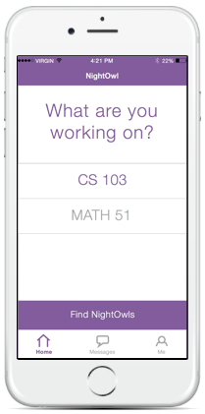
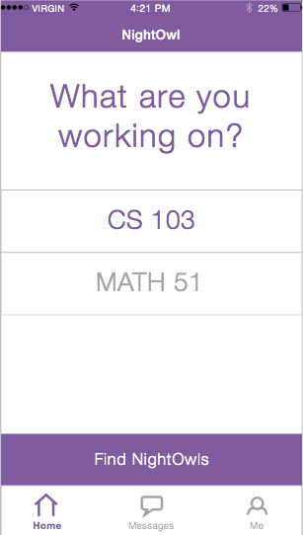
User Control & Freedom
Visibility of System Status
Notes:
NEED TO ADD SCREENSHOT OF NEW DESIGN
#7 [H2-3 User Control & Freedom]
- Unclear how to view current status and update
- Added arrow button for selected classes where you can view and update current status for a class
- Also making stratus visible on current screen
#5 [H2-5 Error Prevention]
- Unclear how to unselect a class when you are done working
- In revised design, we have added a check mark next to selected classes that you can uncheck. You can also unselect a class by hitting the arrow -> where you can update status OR deselect the class. Thus, we have implemented an easy way to deselect for power users while making the option clear to novice users as well. (Include screenshot!)#5 [H2-5 Error Prevention]

Slide 8
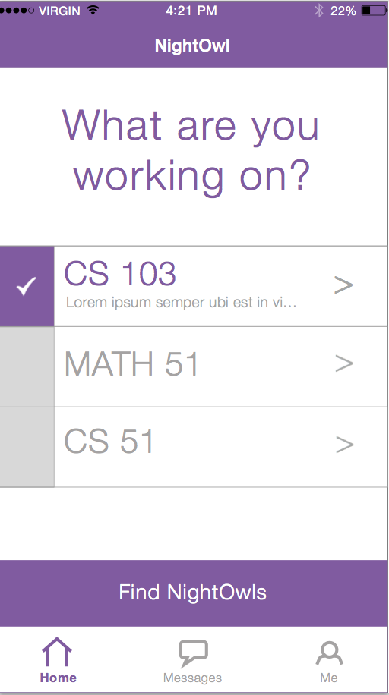
User Control & Freedom
Visibility of System Status
Notes:
NEED TO ADD SCREENSHOT OF NEW DESIGN
#7 [H2-3 User Control & Freedom]
- Unclear how to view current status and update
- Added arrow button for selected classes where you can view and update current status for a class
- Also making stratus visible on current screen
#5 [H2-5 Error Prevention]
- Unclear how to unselect a class when you are done working
- In revised design, we have added a check mark next to selected classes that you can uncheck. You can also unselect a class by hitting the arrow -> where you can update status OR deselect the class. Thus, we have implemented an easy way to deselect for power users while making the option clear to novice users as well. (Include screenshot!)#5 [H2-5 Error Prevention]

Slide 9
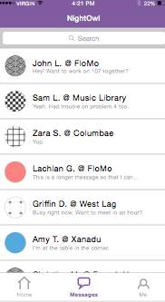
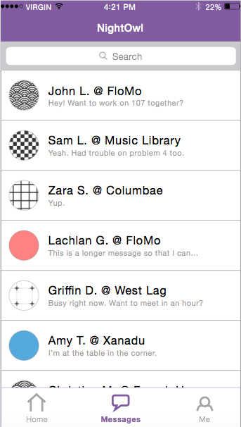
Recognition & Recall
Notes:
#4 [H2-6 Recognition & Recall]
- In messages, no way to tell how you know an individual (aka which class(es) you have in common)
- In revised design, showing list of all shared classes next to a person’s name in our messaging tab

Slide 10
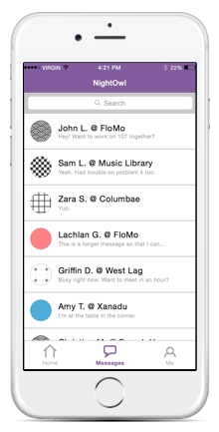
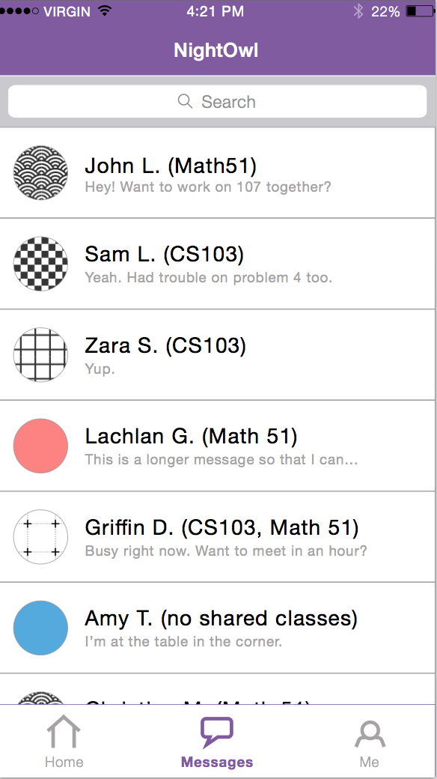
Recognition & Recall
Notes:
#4 [H2-6 Recognition & Recall]
- In messages, no way to tell how you know an individual (aka which class(es) you have in common)
- In revised design, showing list of all shared classes next to a person’s name in our messaging tab

Slide 11
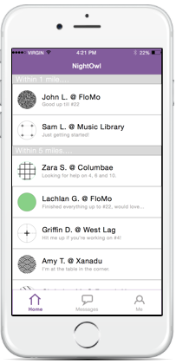
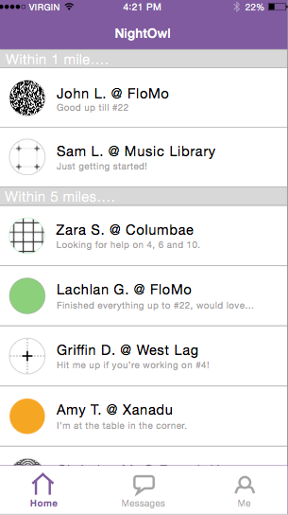
User Control & Freedom
Notes:
#3 [H2-3 User Control & Freedom]
- After clicking “Find NightOwls” there is no way to go back to the “select classes” screen
- In our new design we’ve added a back button

Slide 12
User Control & Freedom
<
Notes:
#3 [H2-3 User Control & Freedom]
- After clicking “Find NightOwls” there is no way to go back to the “select classes” screen
- In our new design we’ve added a back button

Slide 13
Visibility of System Status
Notes:
ADD SCREENSHOT/SKETCH OF REVISED DESIGN
#8 [H2-1 Visibility of System Status]
- If working on 2 psets, no way to know which NightOwls in newsfeed are for which class
- In revised design, we have created a tabbed view so that you can toggle between feeds for each selected class

Slide 14
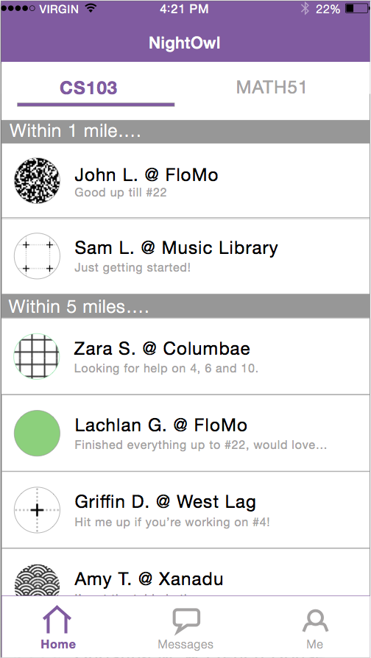
Visibility of System Status
Notes:
#8 [H2-1 Visibility of System Status]
- If working on 2 psets, no way to know which NightOwls in newsfeed are for which class
- In revised design, we have created a tabbed view so that you can toggle between feeds for each selected class

Slide 15
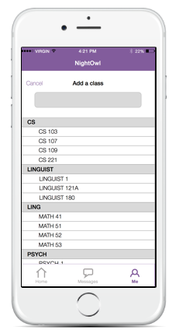
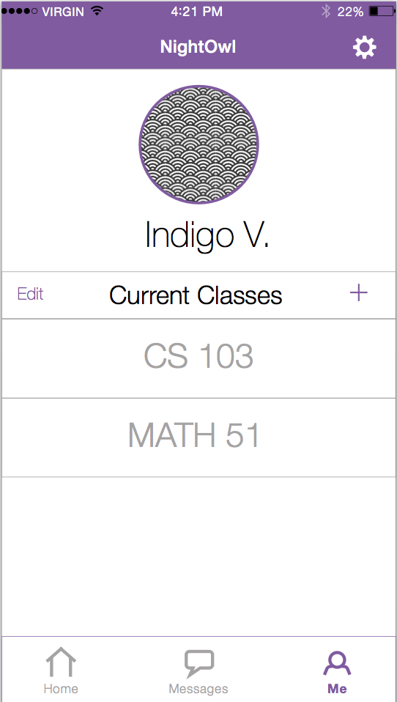
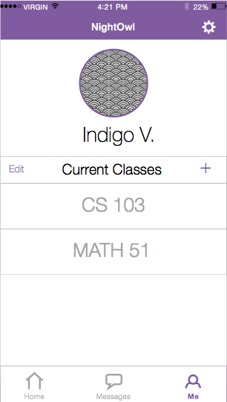
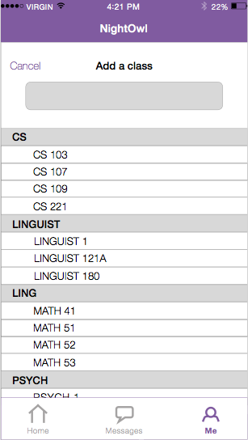
Error Prevention
Notes:
#10 [H2-5 Error Prevention]
- No way to prevent users adding a new class by accident
- We have made the delete class functionality so easy that we have decided to keep the friction of adding a class low (and not changing that flow), realizing that if a user has made a mistake, they are one tap away from deleting that class

Slide 16
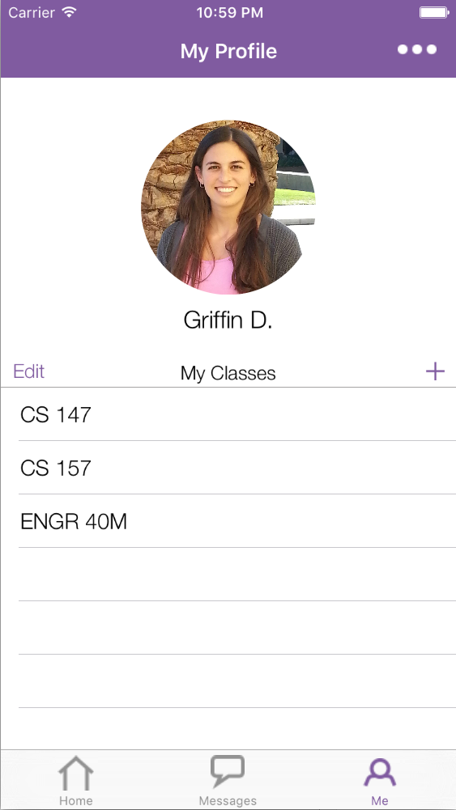
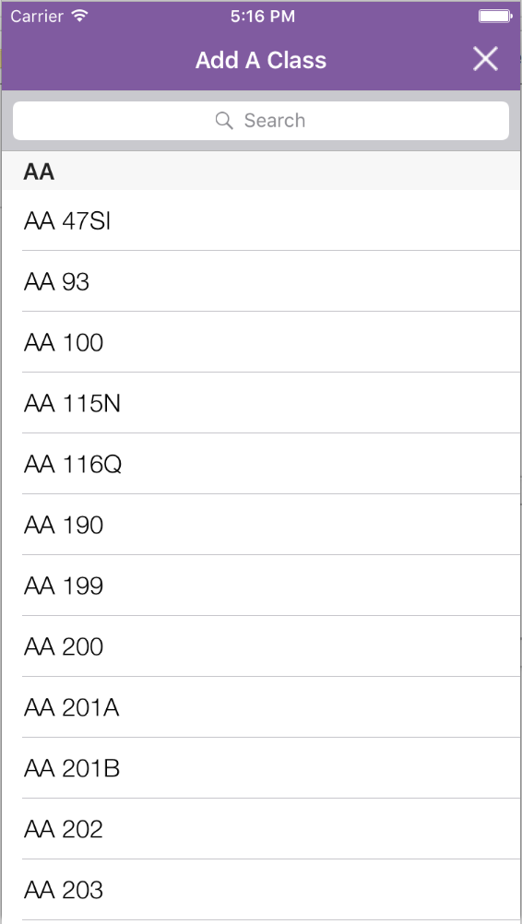
Error Prevention
Notes:
#10 [H2-5 Error Prevention]
- No way to prevent users adding a new class by accident
- We have made the delete class functionality so easy that we have decided to keep the friction of adding a class low (and not changing that flow), realizing that if a user has made a mistake, they are one tap away from deleting that class

Slide 17
Overview of Today
HE Findings →
Design Changes
Prototype Tools
Next Steps
Notes:
Today, we will first go over our HE findings and explain how those results led to a series of design changes. Then we will explain how we have been creating our hi-fi prototype and what we have built thus far. Finally we will do a live demonstration of our fully implemented simple task flow: update list of current classes.

Slide 18
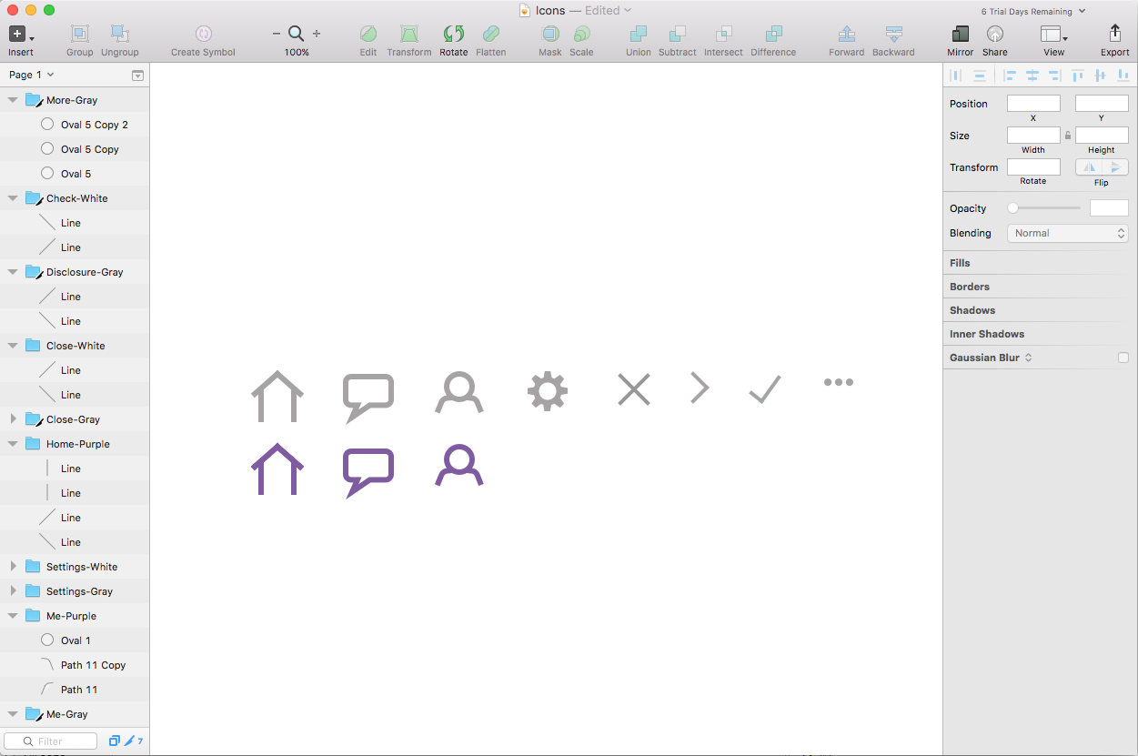
Tools Being Used: Sketch

Slide 19
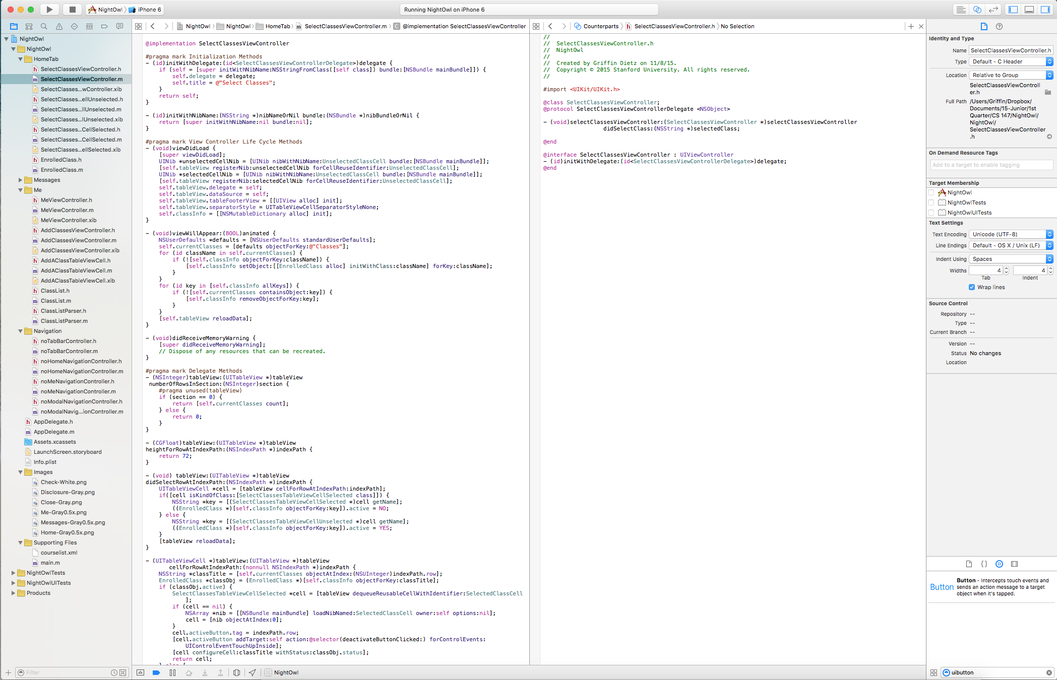
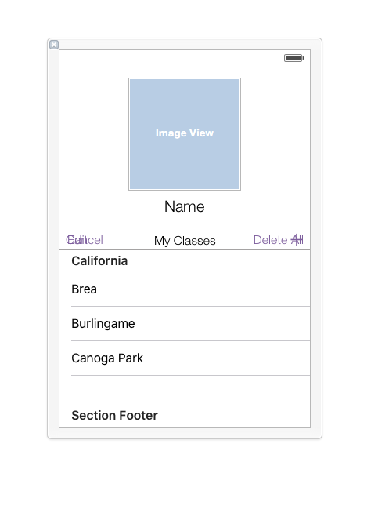
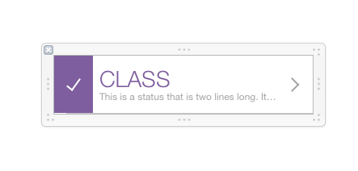
Tools Being Used: XCode, Objective C, Nibs

Slide 20
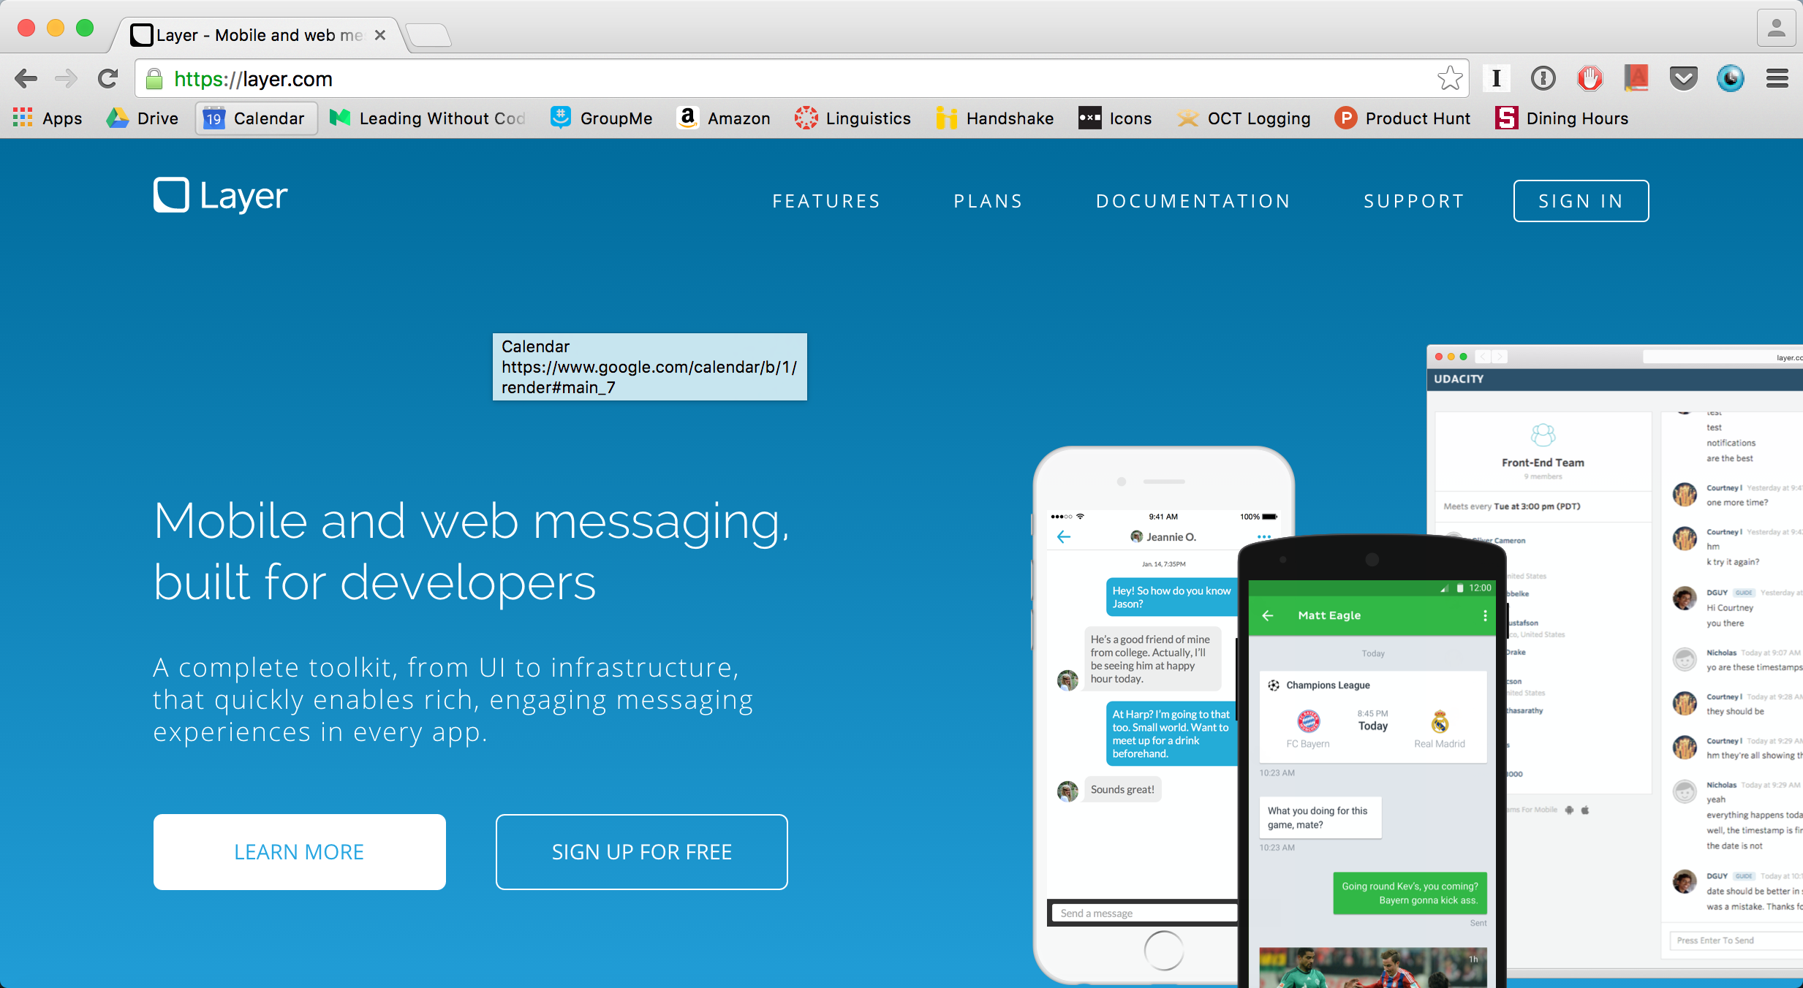
Tools Being Used: Layer (maybe)

Slide 21
Implemented Features
DEMO

Slide 22
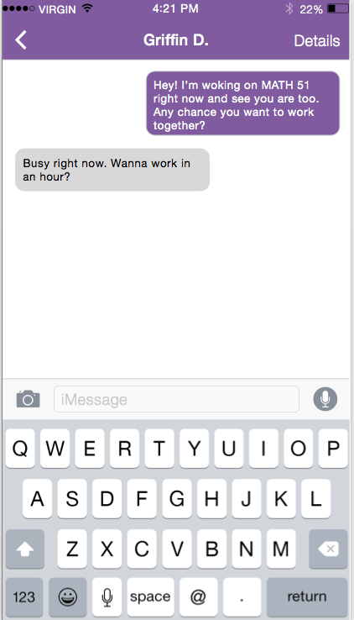
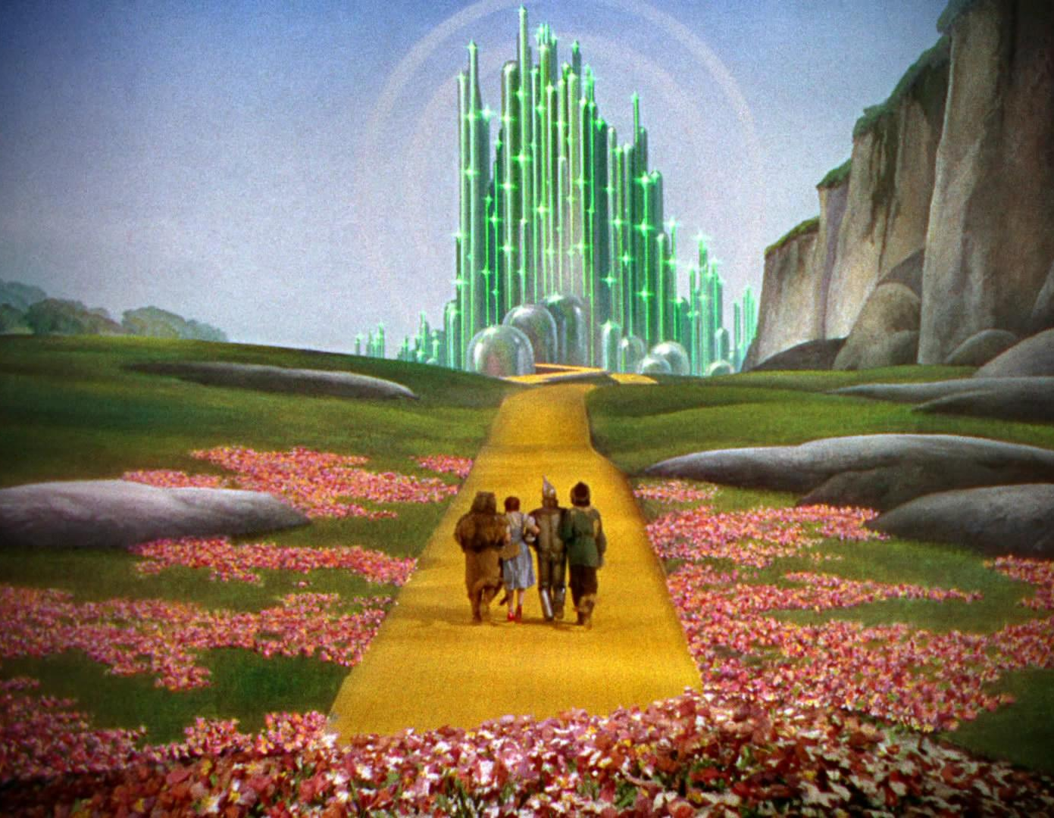
Wizard of Oz Techniques

Slide 23
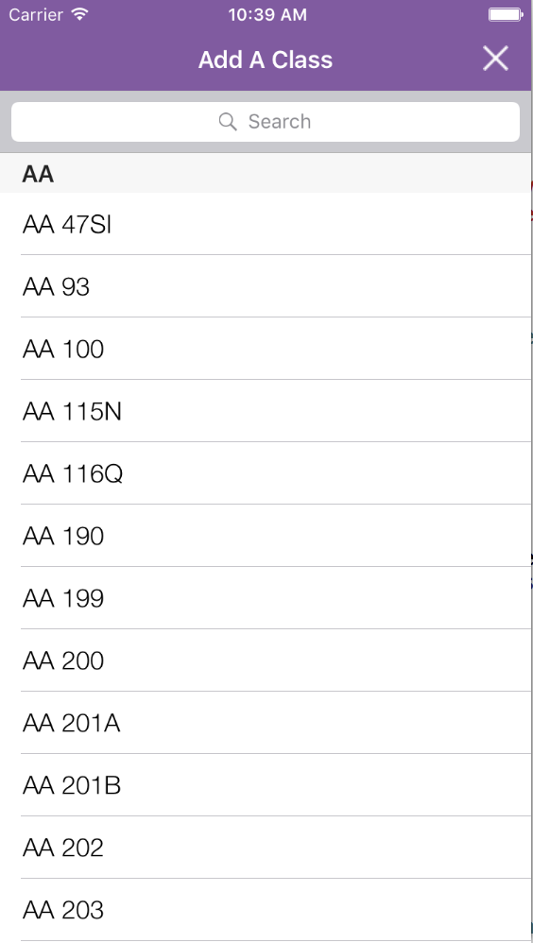
Hard-coded Techniques

Slide 24
Overview of Today
HE Findings →
Design Changes
Prototype Tools
Next Steps
Notes:
Today, we will first go over our HE findings and explain how those results led to a series of design changes. Then we will explain how we have been creating our hi-fi prototype and what we have built thus far. Finally we will do a live demonstration of our fully implemented simple task flow: update list of current classes.

Slide 25
Unimplemented Features (specific to our tasks)
Messages
Notes:
ALSO TALK ABOUT QUESTIONS/CONCERNS WE HAVE

Slide 26
Unimplemented Features (specific to our tasks)
Messages
Newsfeed
Notes:
ALSO TALK ABOUT QUESTIONS/CONCERNS WE HAVE

Slide 27
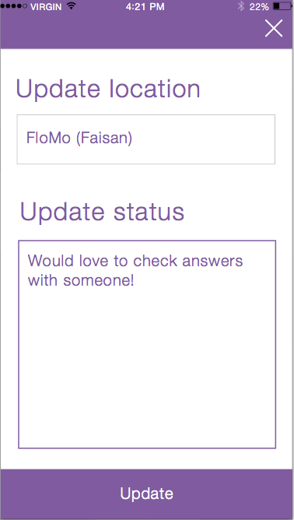
Unimplemented Features (specific to our tasks)
Messages
Newsfeed
Update Location/Status
Notes:
ALSO TALK ABOUT QUESTIONS/CONCERNS WE HAVE

Slide 28
Issues / Questions
Messages
Notes:
ALSO TALK ABOUT QUESTIONS/CONCERNS WE HAVE

Slide 29
Issues / Questions
Messages
Update Screen
Notes:
ALSO TALK ABOUT QUESTIONS/CONCERNS WE HAVE

Slide 30
Summary
HE Findings →
Design Changes
Prototype Tools
Next Steps
Notes:
Today, we will first go over our HE findings and explain how those results led to a series of design changes. Then we will explain how we have been creating our hi-fi prototype and what we have built thus far. Finally we will do a live demonstration of our fully implemented simple task flow: update list of current classes.

