Slide 1

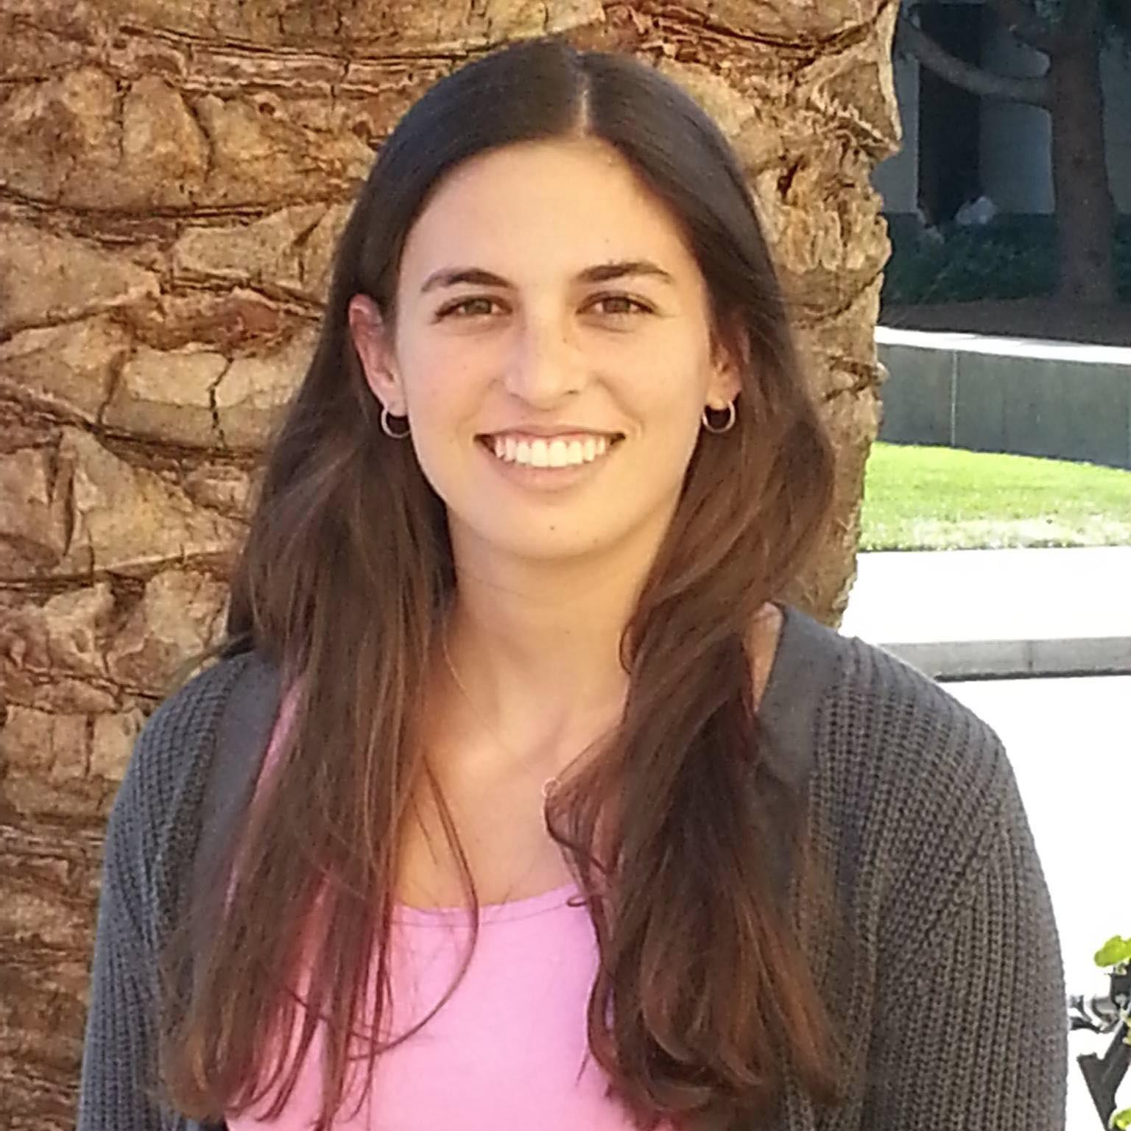
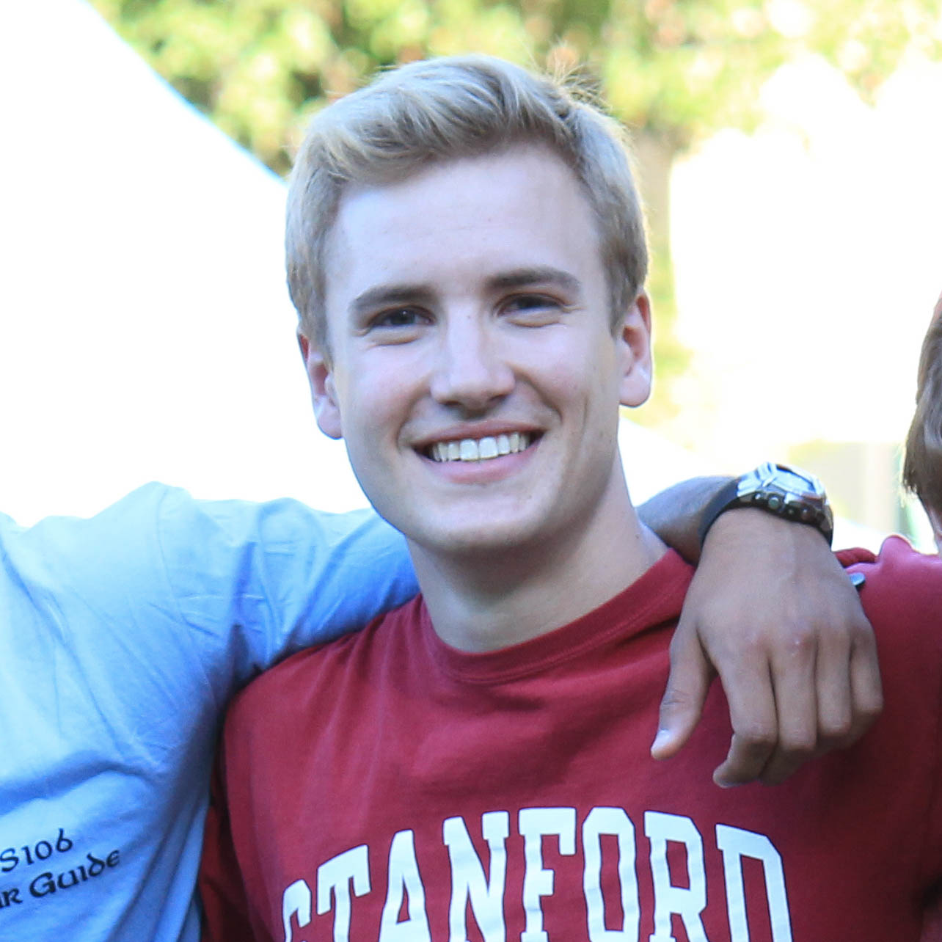
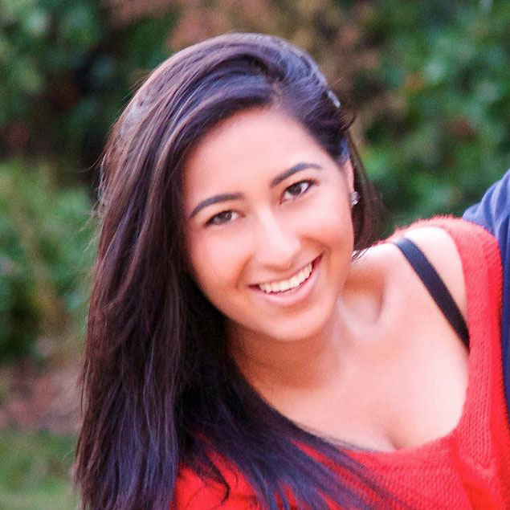
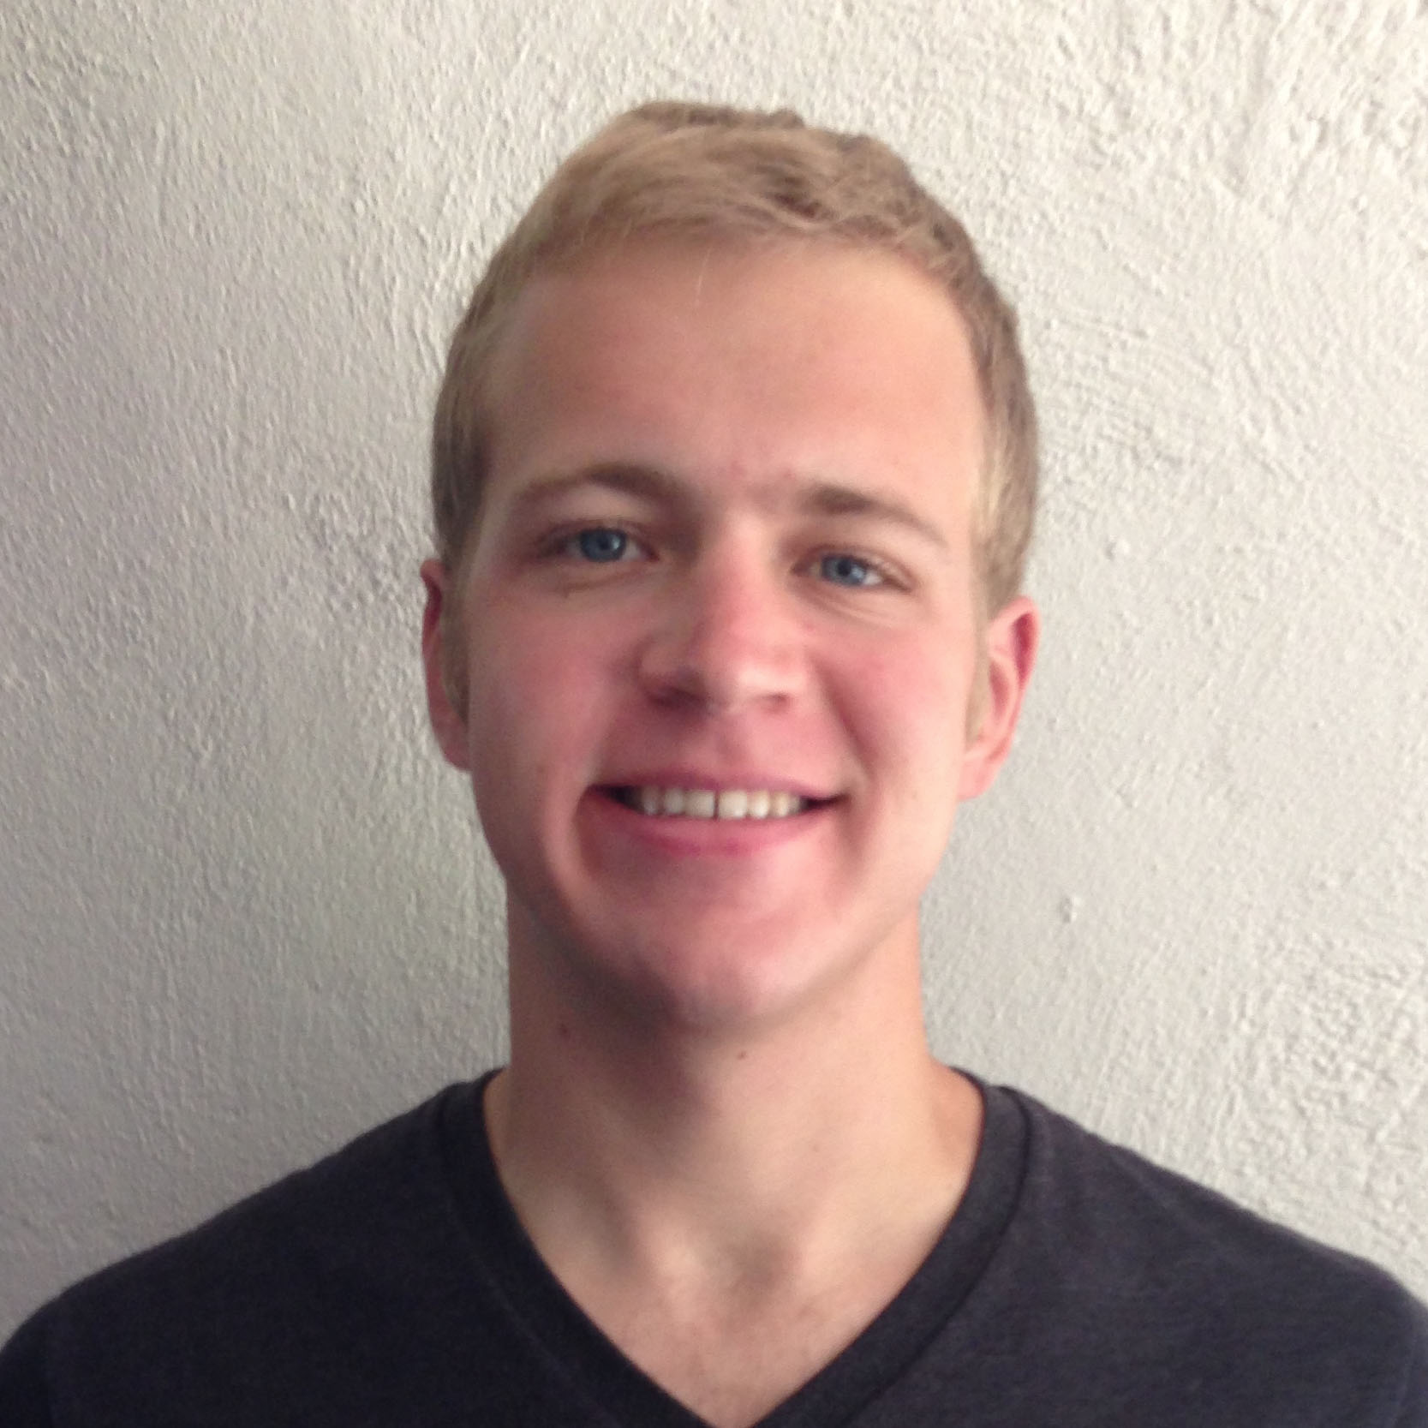
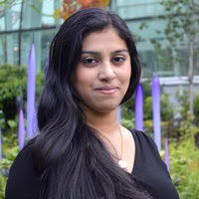
NightOwl
Field Test
Griffin Dietz - Lachlan Green - Zara Saraon - Evan Nixon - Priyanka Rao

Slide 2
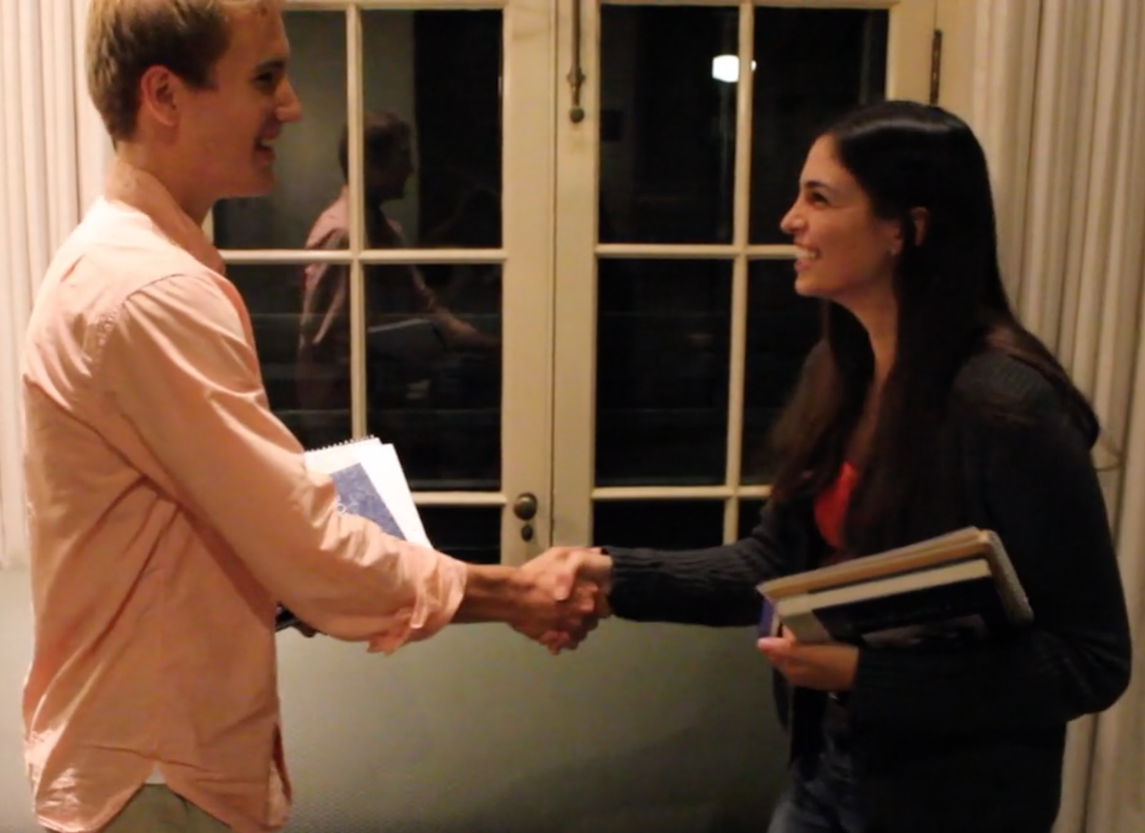
What does NightOwl do?
NightOwl connects students to classmates who are awake, nearby, and working on the same thing.

Slide 3
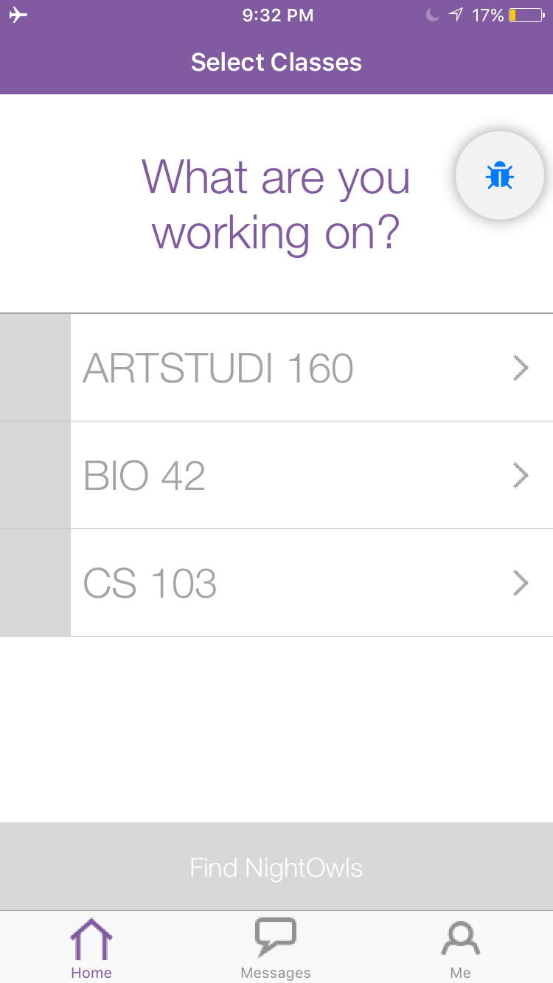
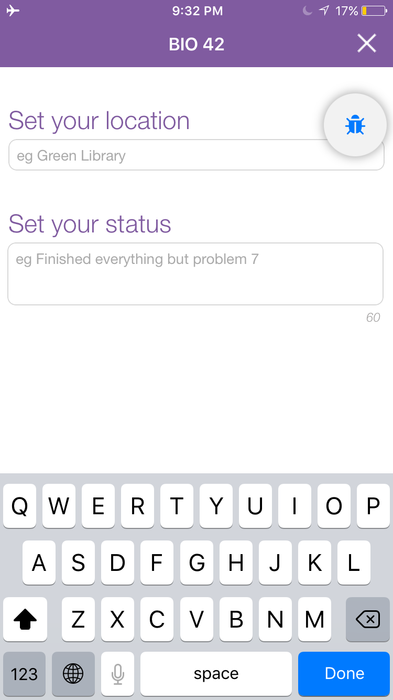
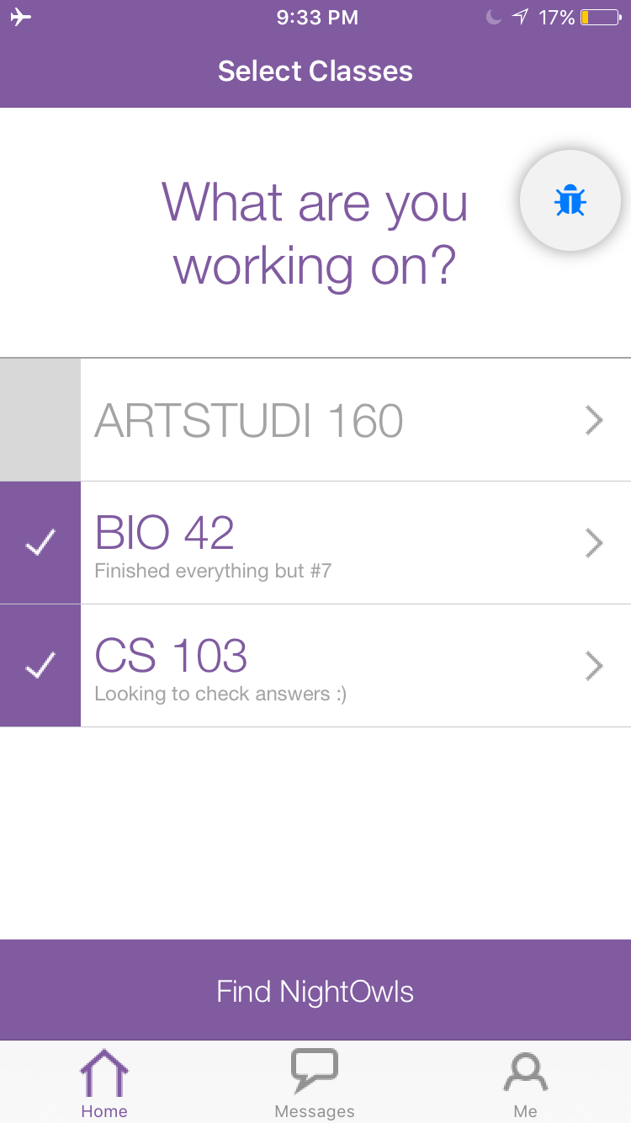
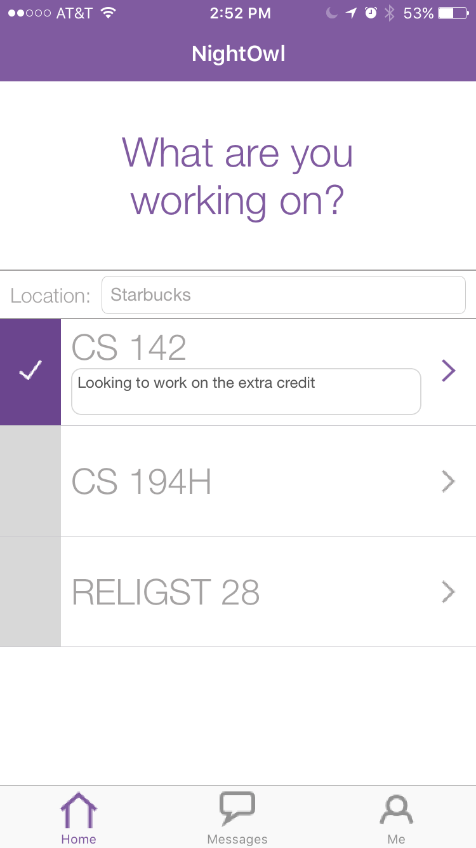
Purpose of field test
Old Screens
New Screen
Notes:
Purpose: We ran our field tests this week with students who were truly in the midst of working on psets to find any remaining usability issues with our hi-fi prototype. In particular, we wanted to test our significantly revised “find NightOwls” flow since it had not yet been tested in any capacity.

Slide 4
Flight Path
Method
Tasks
Results
Discussion

Slide 5
Flight Path
Method
Tasks
Results
Discussion

Slide 6
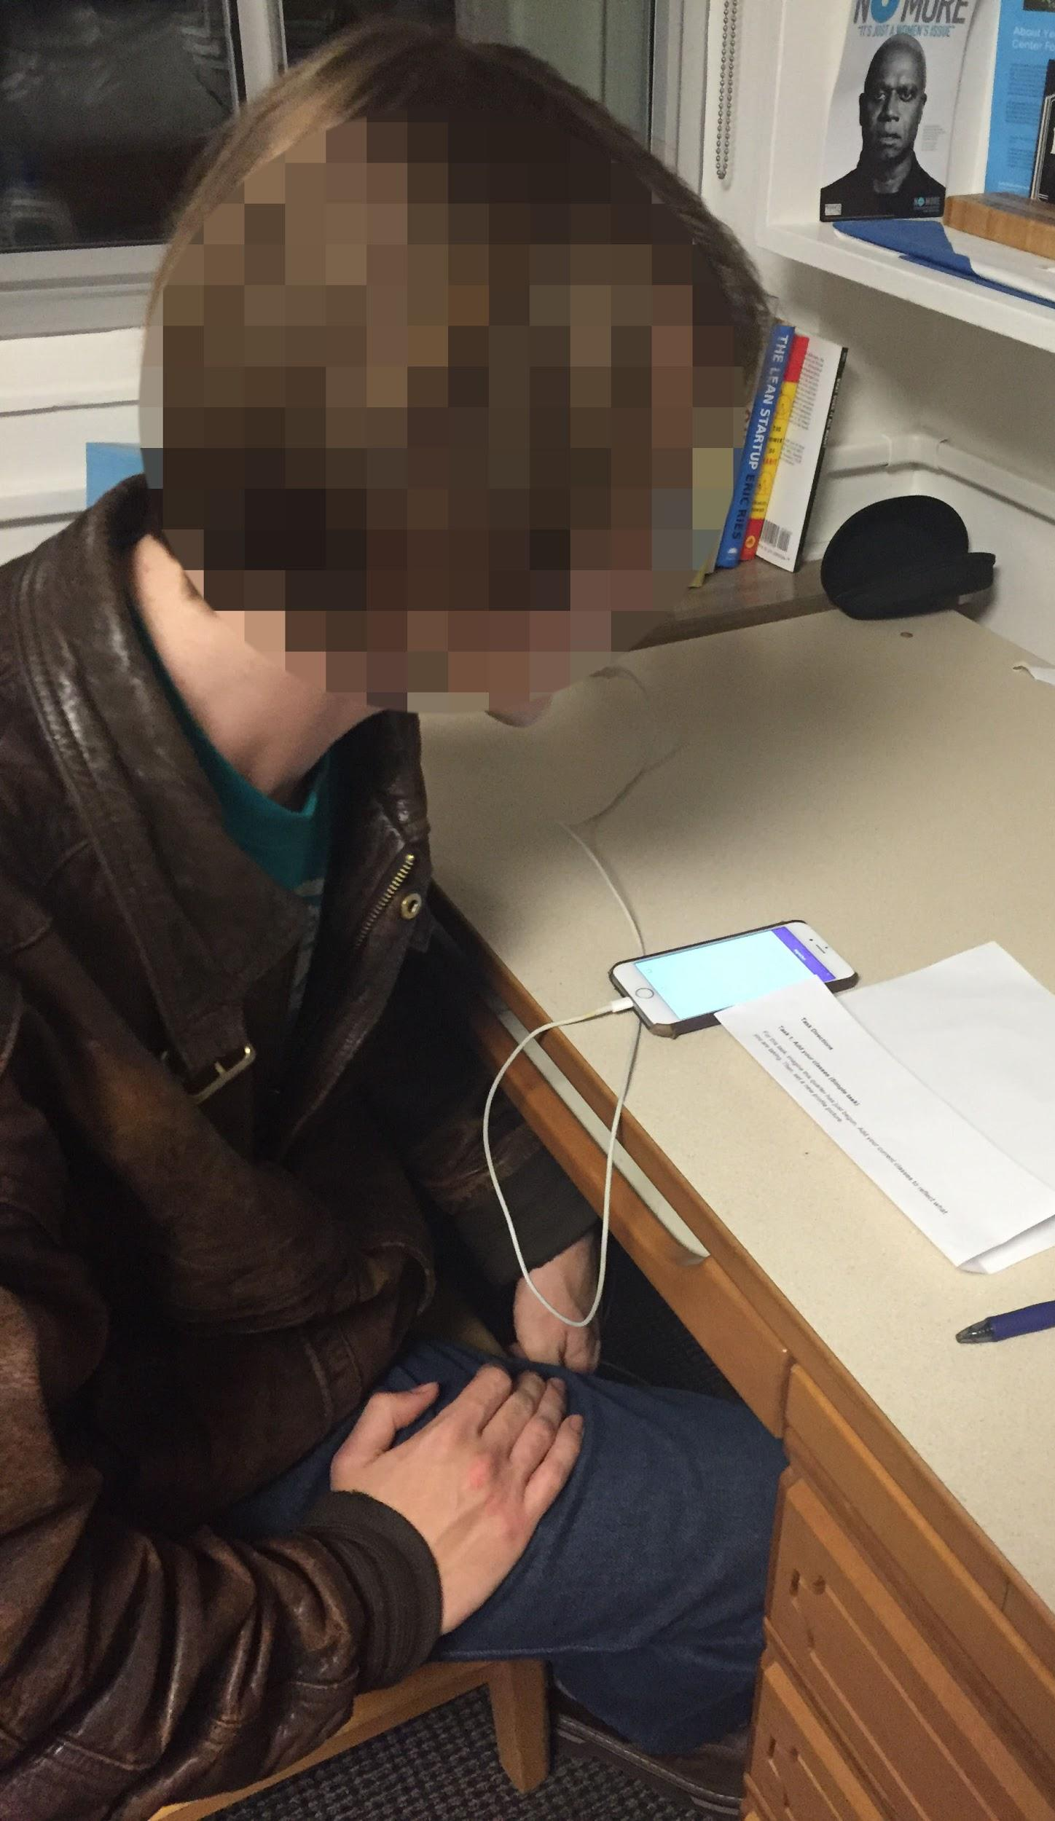
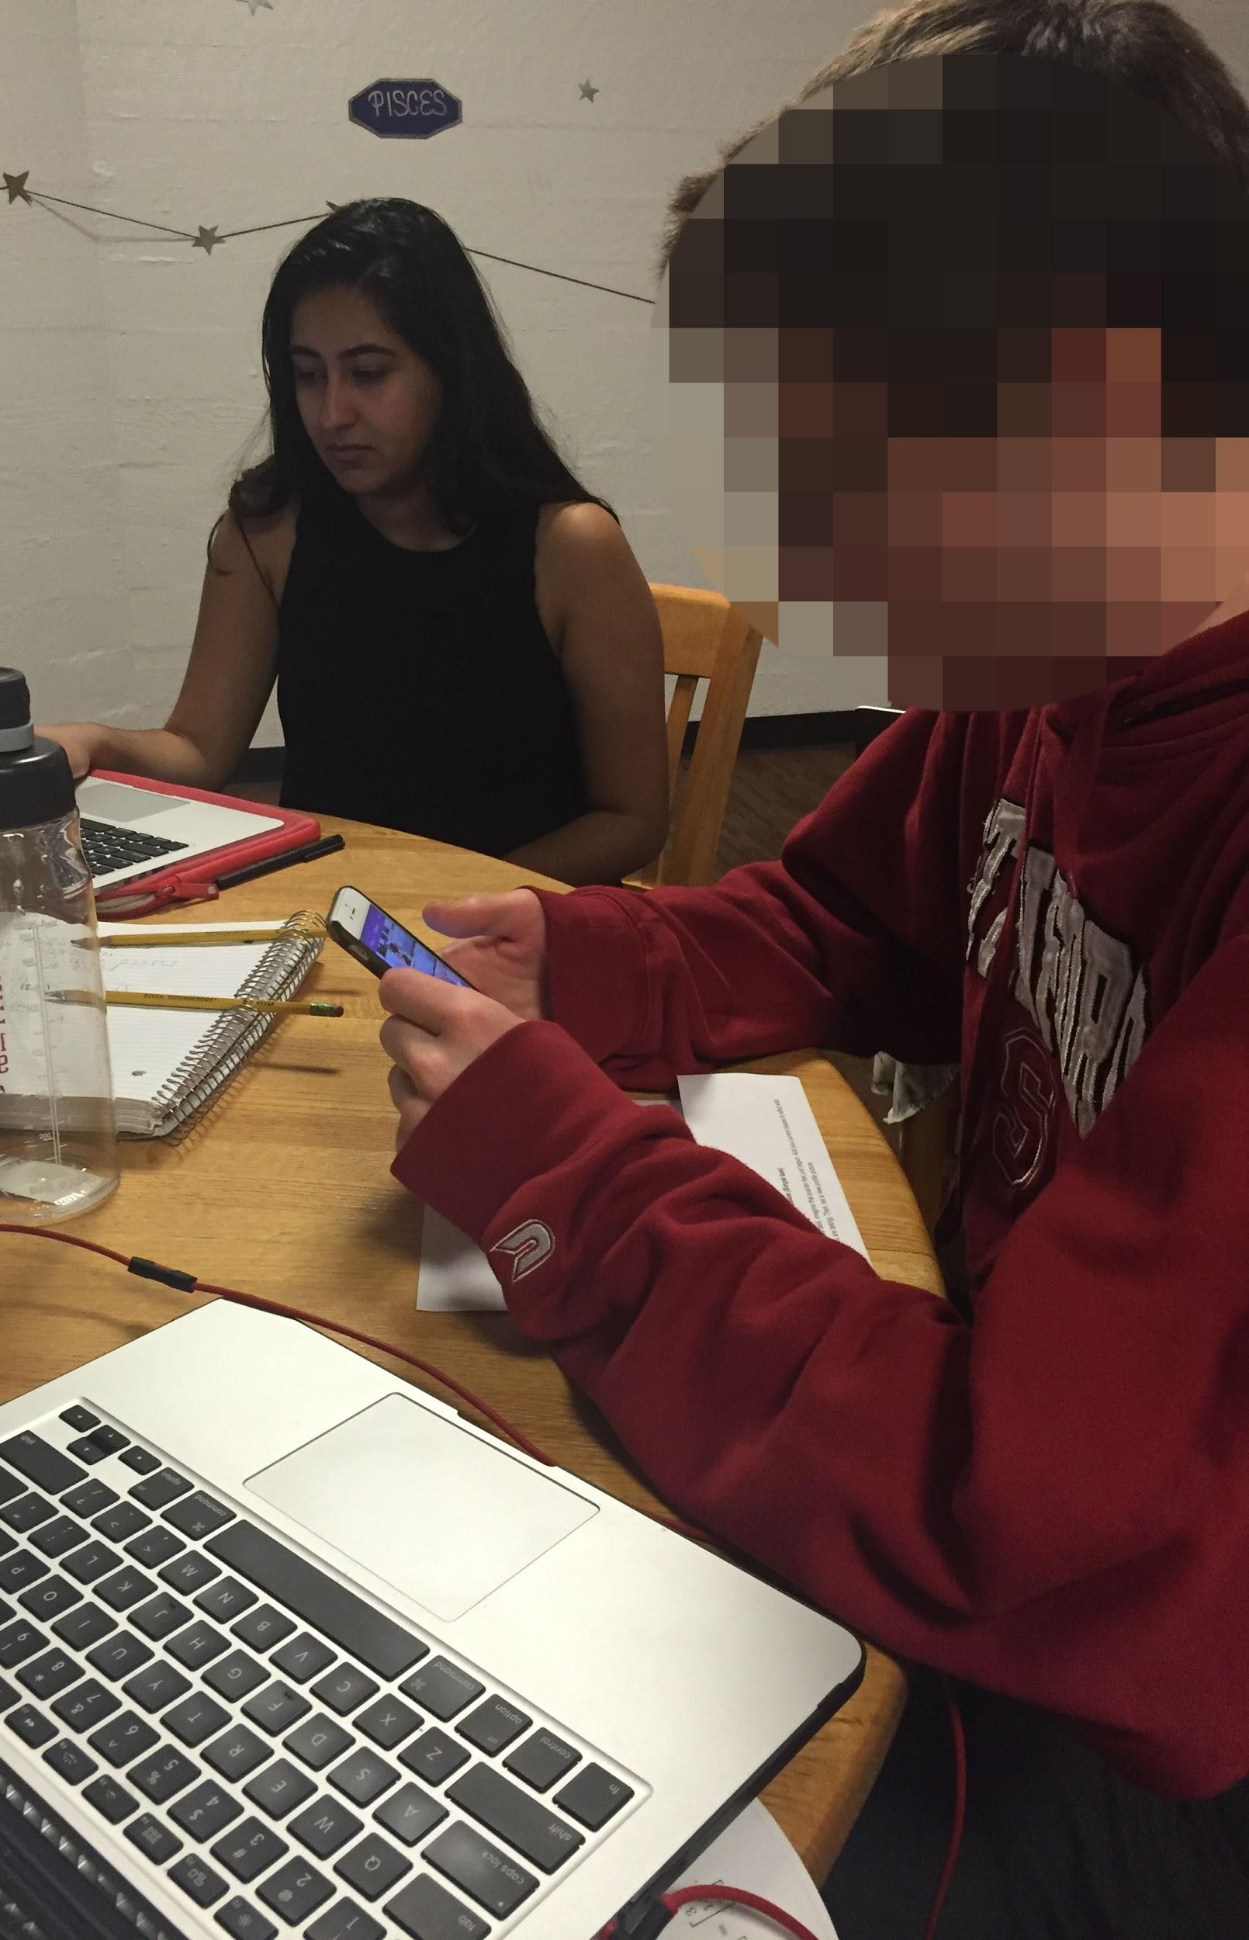
Participants
6 Stanford Students
2 Masters students
1 Junior
3 Freshman
Notes:
Demographics:
1st year masters in ME (M)
2nd year masters in Materials Science Eng (F)
Junior, CS Major (M)
Freshman, Undeclared (M)
Freshman, Undeclared (F)
Freshman, Undeclated (M)
How selected: selected at random from either Lathrop Library, the FloMo lounges, or by knocking on doors in a dorm
Compensation: Participants were not compensated

Slide 7
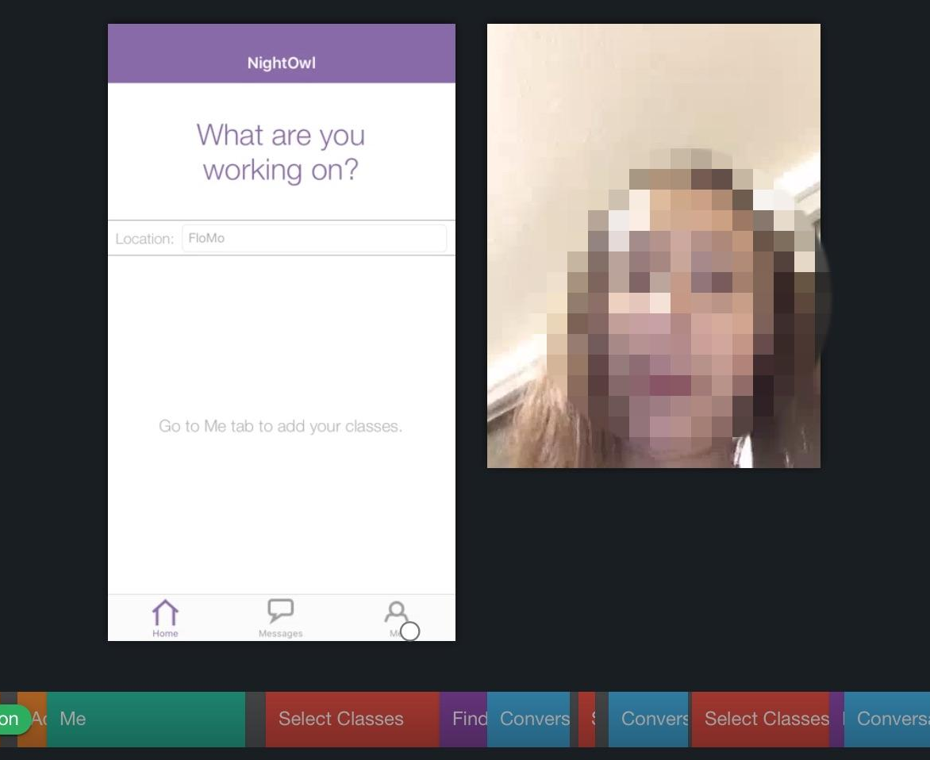
Apparatus
used Lookback
on iPhone 6
tested in an isolated area in Lathrop, a FloMo lounge, and a dorm room
Notes:
Equipment used: Gave participants an iPhone with NightOwl open and Lookback running
Environment where tested: Where participants were already working. Either Lathrop Tech lounge, a FloMo lounge, or at a desk in an individual dorm room.

Slide 8
Flight Path
Method
Tasks
Results
Discussion

Slide 9
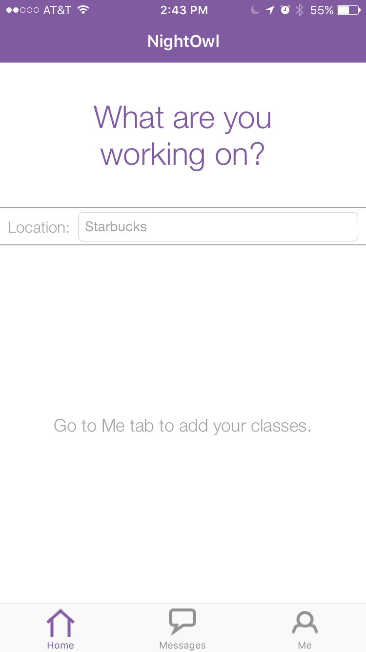
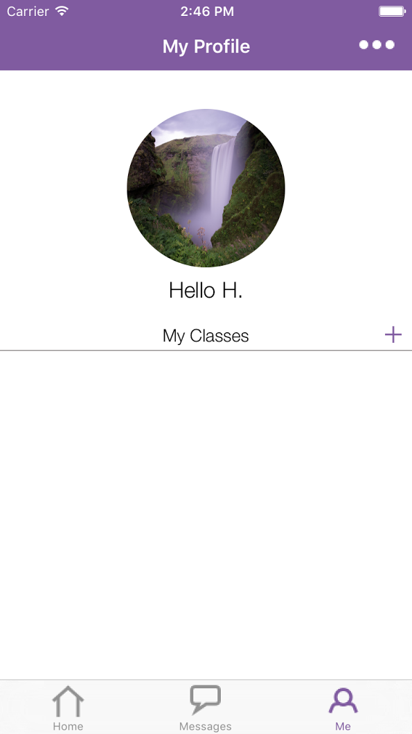
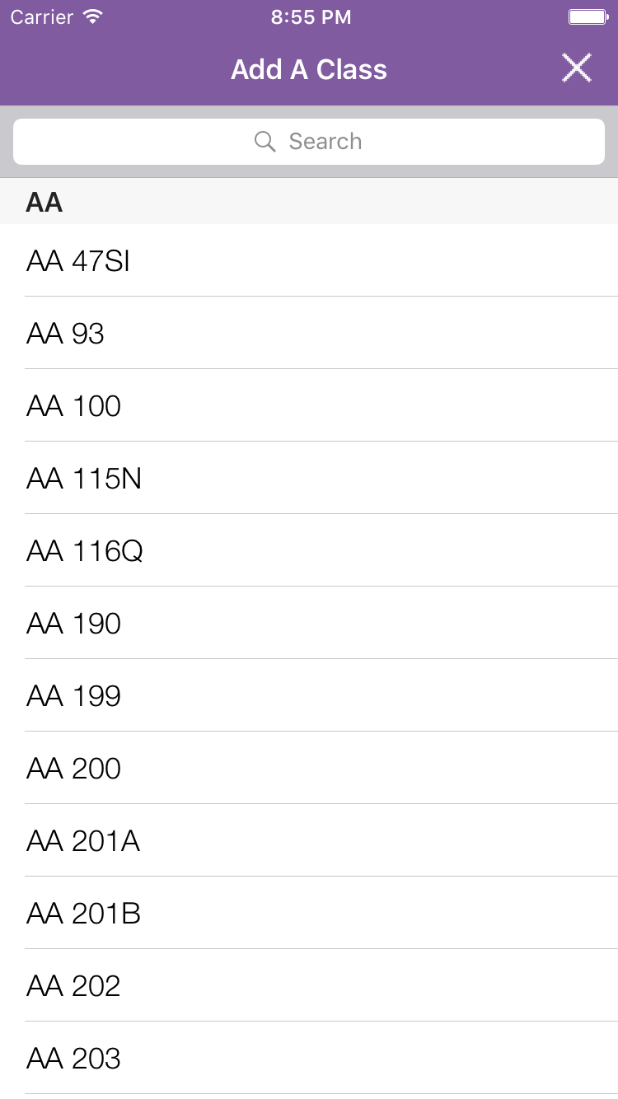
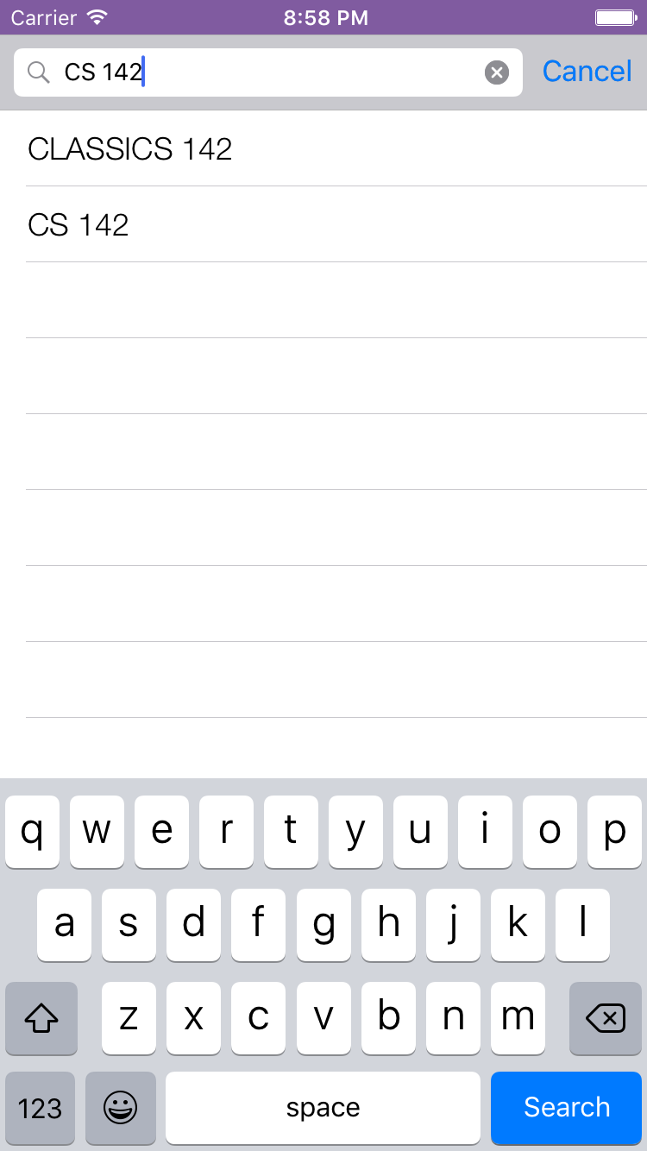
Task 1: Add your classes (Simple)
Notes:
We updated our tasks significantly for this field test so that more of our features were tested and so that the wording was clearer
Task: imagine this quarter has just begun. Add your current classes to reflect what you are taking. Then, set a new profile picture.
What we looked for: if they could navigate to me tab, and easily find and add classes. If they could successfully set a new prof pic.

Slide 10
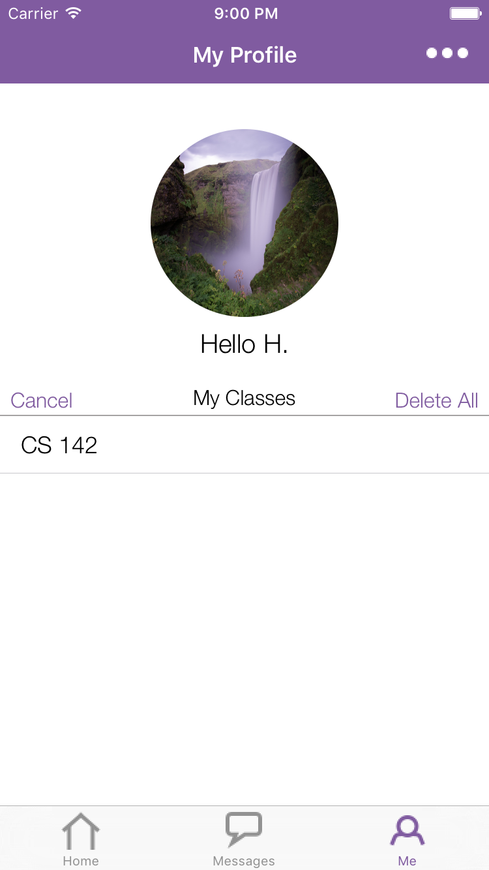
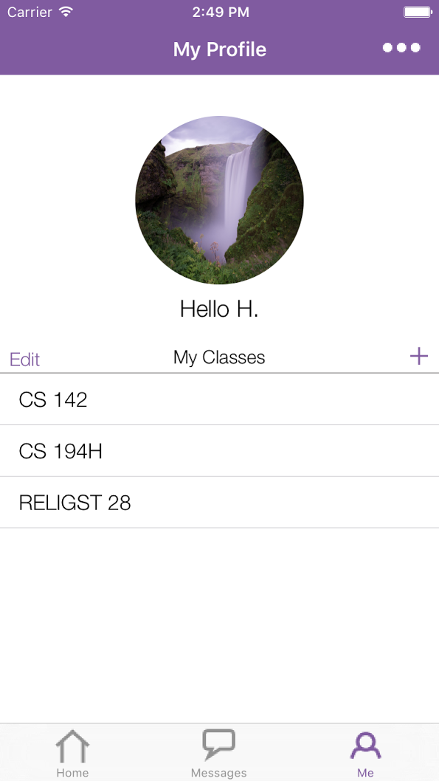
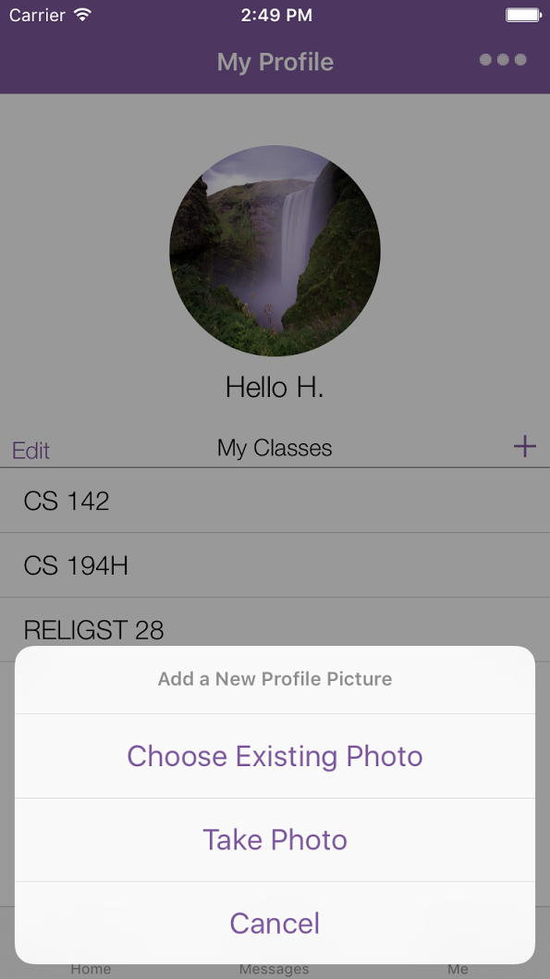
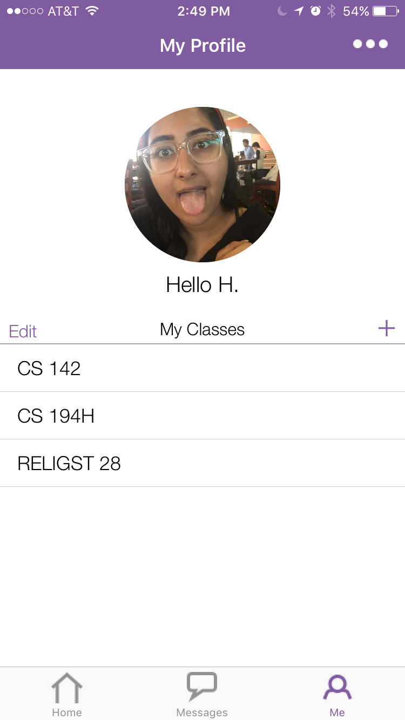
Task 1: Add your classes (Simple)
Done
...
...
Notes:
We updated our tasks significantly for this field test so that more of our features were tested and so that the wording was clearer
Task: imagine this quarter has just begun. Add your current classes to reflect what you are taking. Then, set a new profile picture.
What we looked for: if they could navigate to me tab, and easily find and add classes. If they could successfully set a new prof pic.

Slide 11
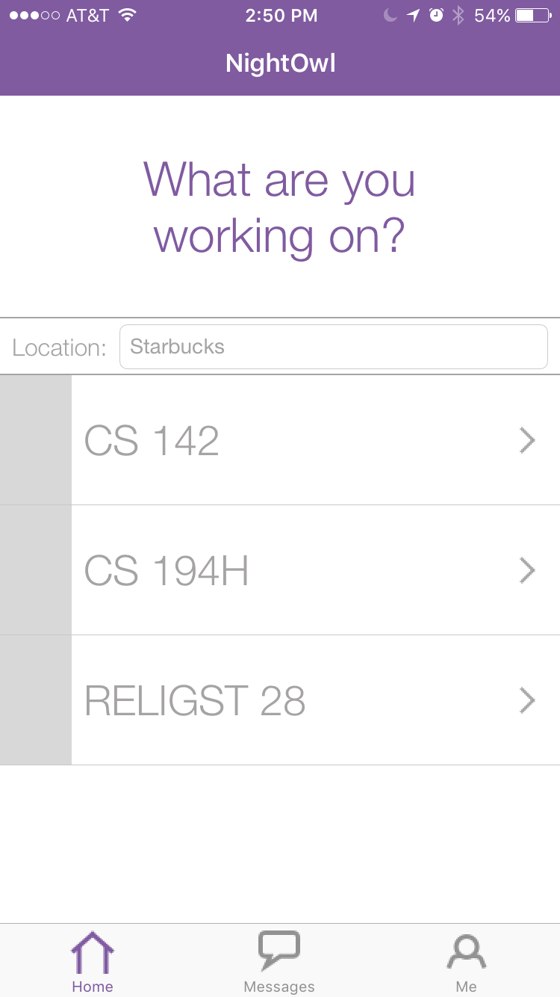
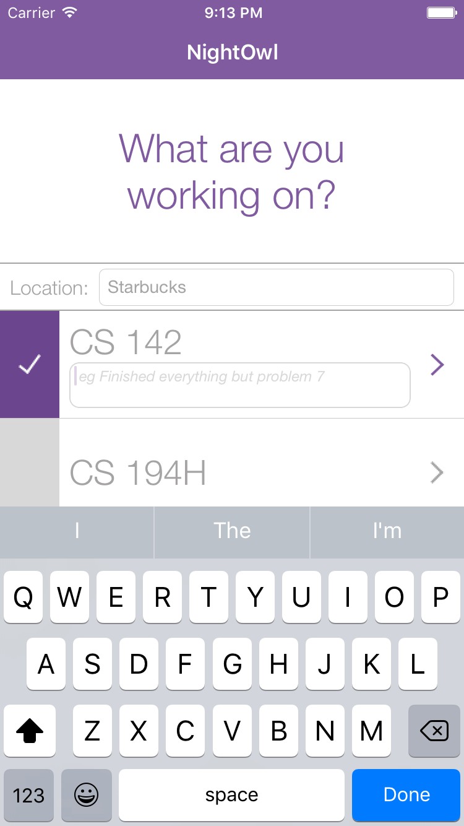
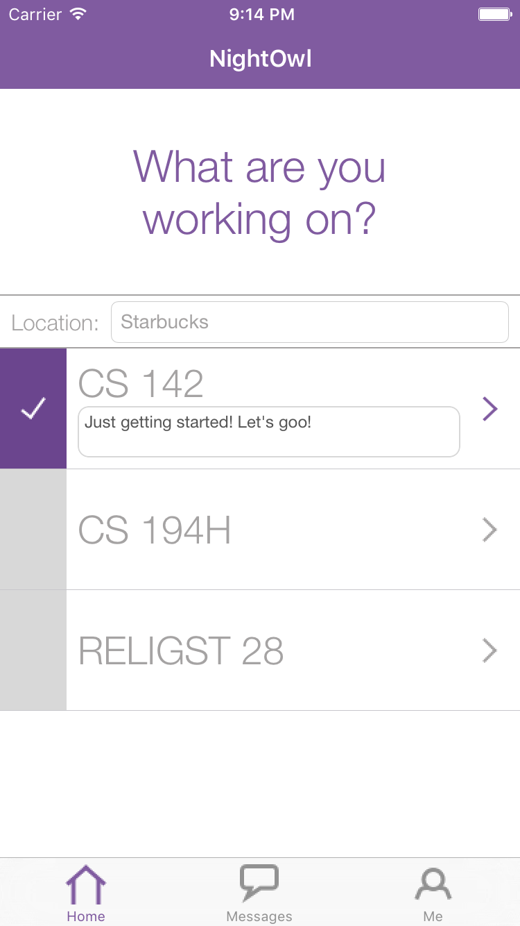
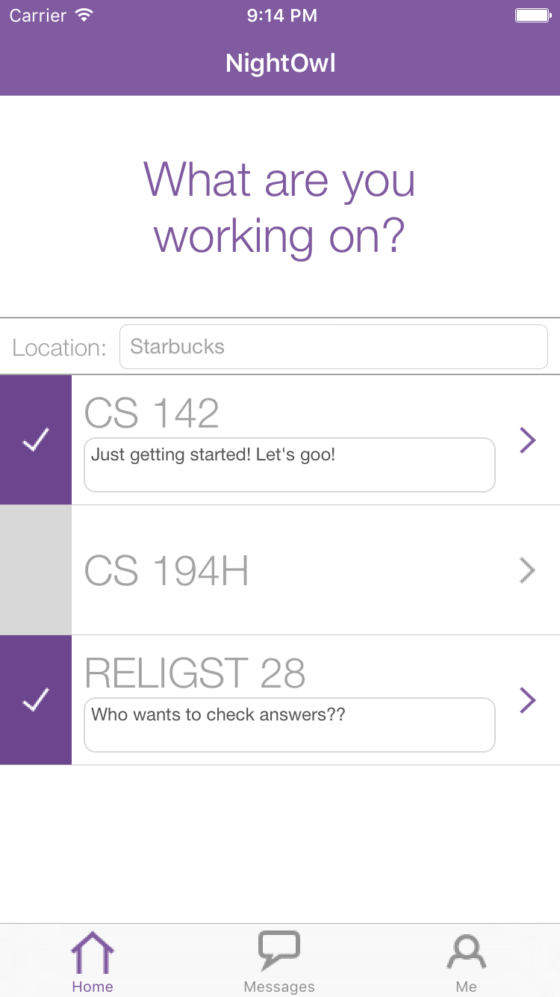
Task 2: Pick 2 classes to get help with (Moderate)
Done
...
Notes:
Task: Imagine you are stuck on psets for 2 of your classes and need help. Choose two classes to get help with.
What we looked for: Understanding of what it means to be “available”

Slide 12
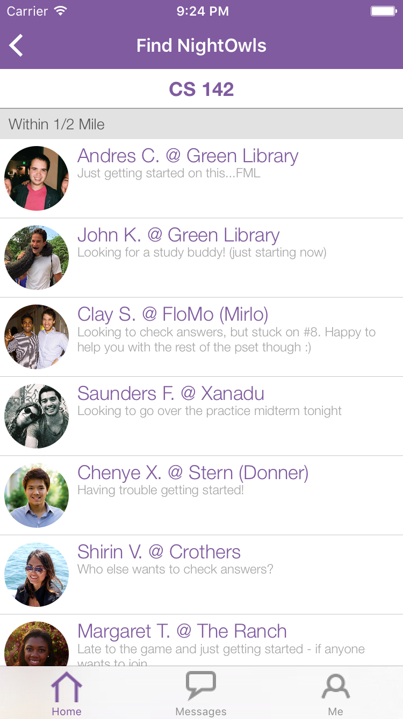
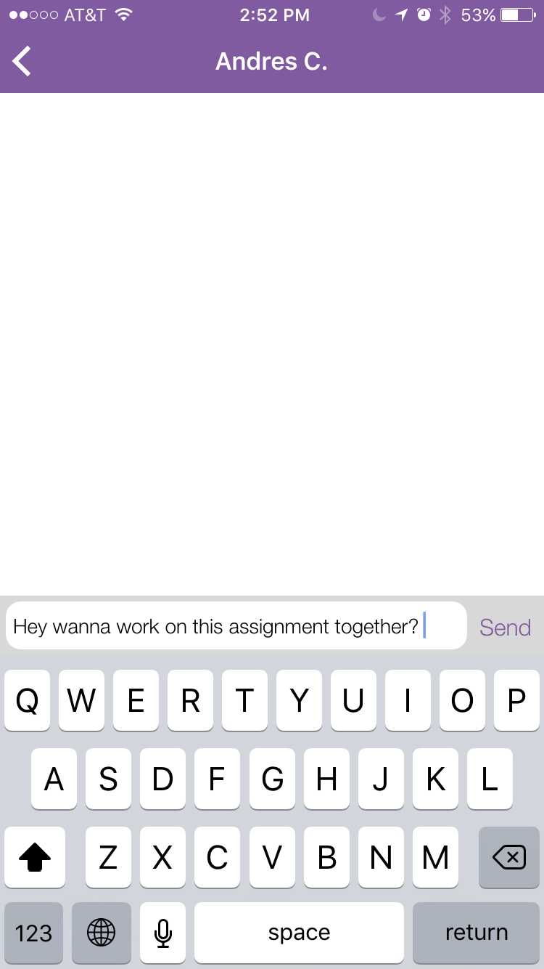
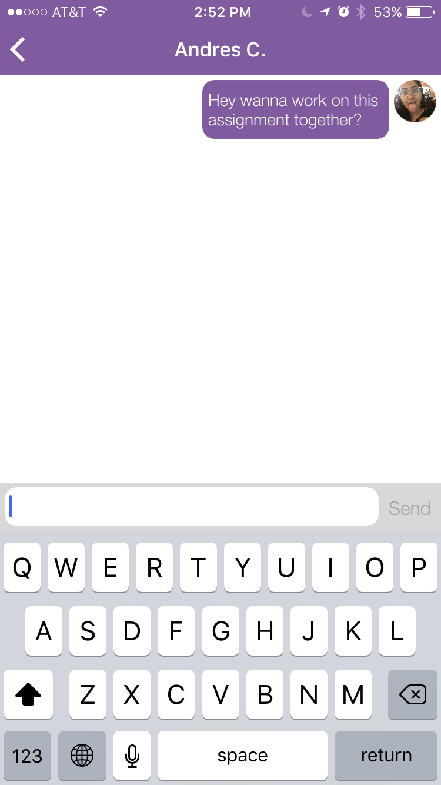
Task 3: Reach out to classmates (Complex)
Notes:
Task: Choose a nearby classmate in one of those classes and send them a message indicating that you want to collaborate with them. After you have sent the message, stop looking for help for the other class (the class you did not message a peer in).
What we looked for: If they could successfully message a peer and if they knew what action to take to stop looking for help in a particular class

Slide 13
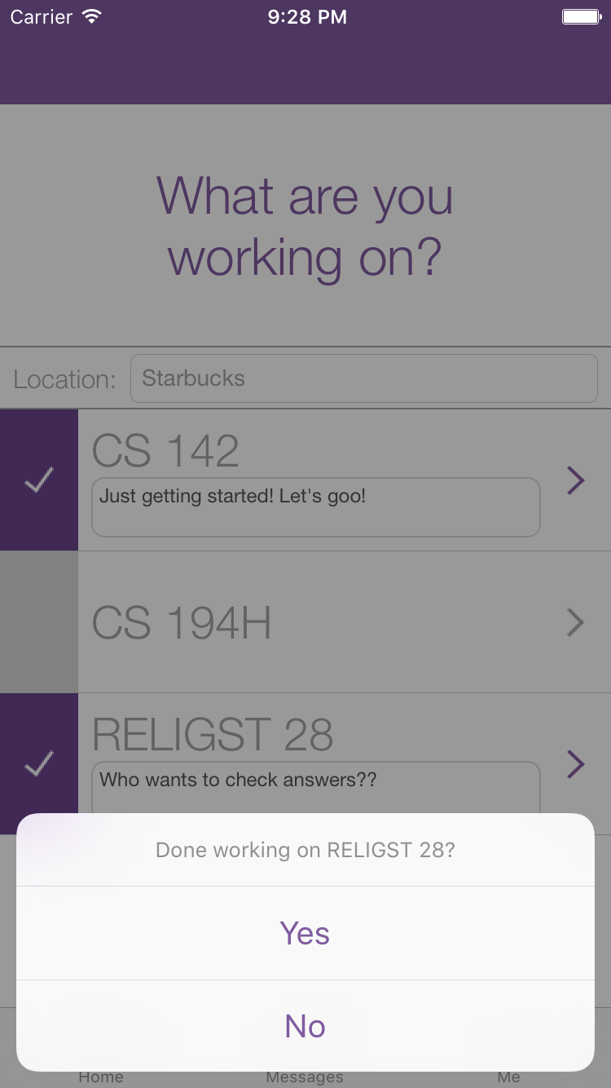
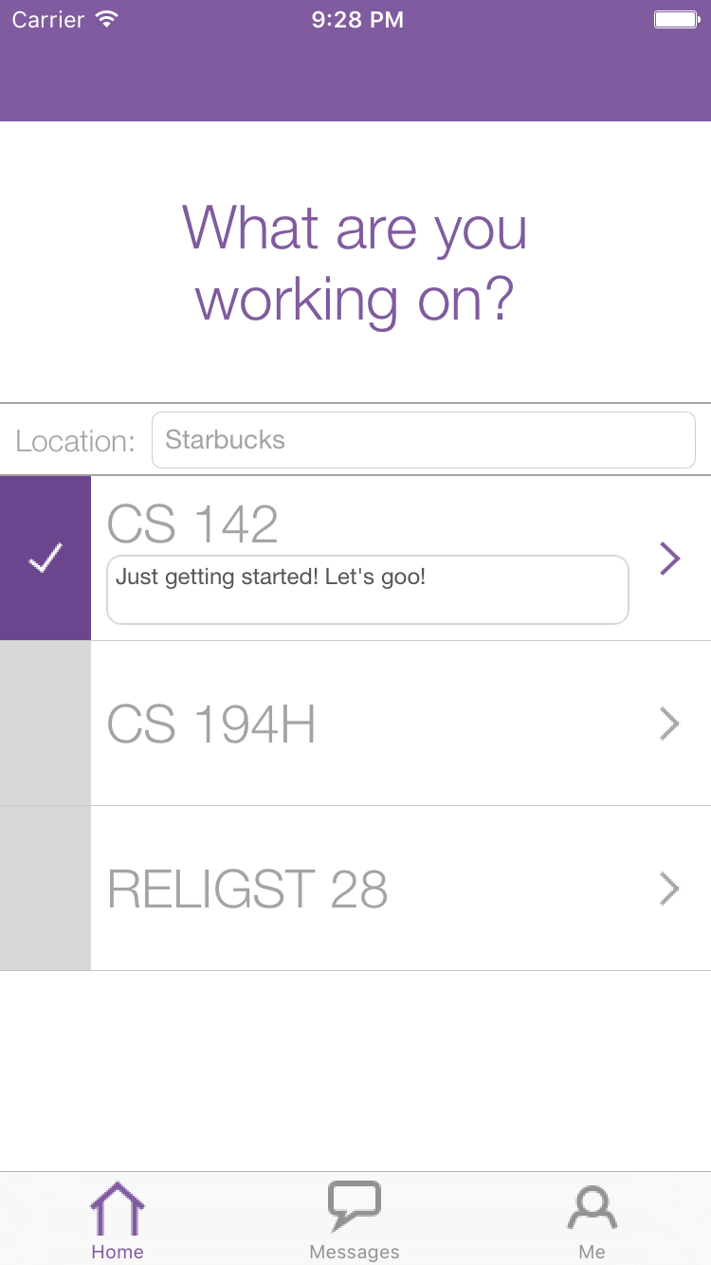
Task 3: Reach out to classmates (Complex)
Done
Notes:
Task: Choose a nearby classmate in one of those classes and send them a message indicating that you want to collaborate with them. After you have sent the message, stop looking for help for the other class (the class you did not message a peer in).
What we looked for: If they could successfully message a peer and if they knew what action to take to stop looking for help in a particular class

Slide 14
Procedure
Collected consent form
Summarized NightOwl (no demo)
Observed participants completing tasks
Solicited general feedback
Reviewed data with Lookback
Notes:
We followed this set of procedures for all participants

Slide 15
A/B Testing
Changes
Classes
Deactivate Message
Task Instructions
Participants #1, #2, #3
Classes already added
“Do you want to deactivate CS140?”
Ambiguous wording
Participants #4, #5, #6
No classes added initially
“Done working on CS140?”
Clearer
Notes:
Talk about A/B TEST and what we changed about our app midway through testing. We witnessed some easy to fix usability errors that we attempted to solve halfway through our tests. Thus, our second round of tests gave us feedback on how successful our fixes were.
no classes initially: more realistic task b/c users will add classes for the first time in a state where there have been no previous classes
pop up message after deselecting a class: “do you want to deactivate this class” to “are you done workin on cs140 for now?”
clearer task instructions: they no longer mention availability but say things like “choose classes you want to get help in”

Slide 16
Test Measures
Qualitative
  exclamations/quotes
  points of confusion
  errors
Quantitative
  time/task
  errors/task
  #taps/task compared to bottomline
Notes:
These are our test measures.
Looked largely at qualitative data: like points of confusion of any exclamations users made.
Also collected bottom line data including: time per task, errors per task and the like.

Slide 17
Flight Path
Method
Tasks
Results
Discussion

Slide 18
Task 1: Add your classes
What worked
navigation
adding classes w/ search feature
deleting classes
changing profile picture
Errors
finding search bar
forgetting class code
Notes:
changing profile picture used a familiar interface and was easy for users to do

Slide 19
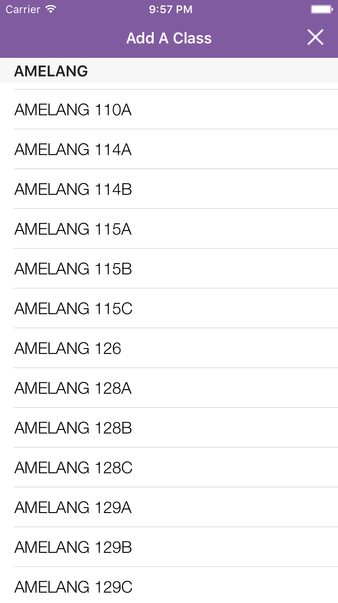
Task 1: Add your classes
What worked
navigation
adding classes w/ search feature
deleting classes
changing profile picture
Errors
finding search bar
forgetting class code
Notes:
changing profile picture used a familiar interface and was easy for users to do

Slide 20
Task 2: Pick 2 classes to get help with
What worked
auto-filled location
setting status on home screen
Errors
not realizing they were available after tapping on a class

Slide 21
Task 2: Pick 2 classes to get help with
What worked
auto-filled location
setting status on home screen
Errors
not realizing they were available after tapping on a class

Slide 22
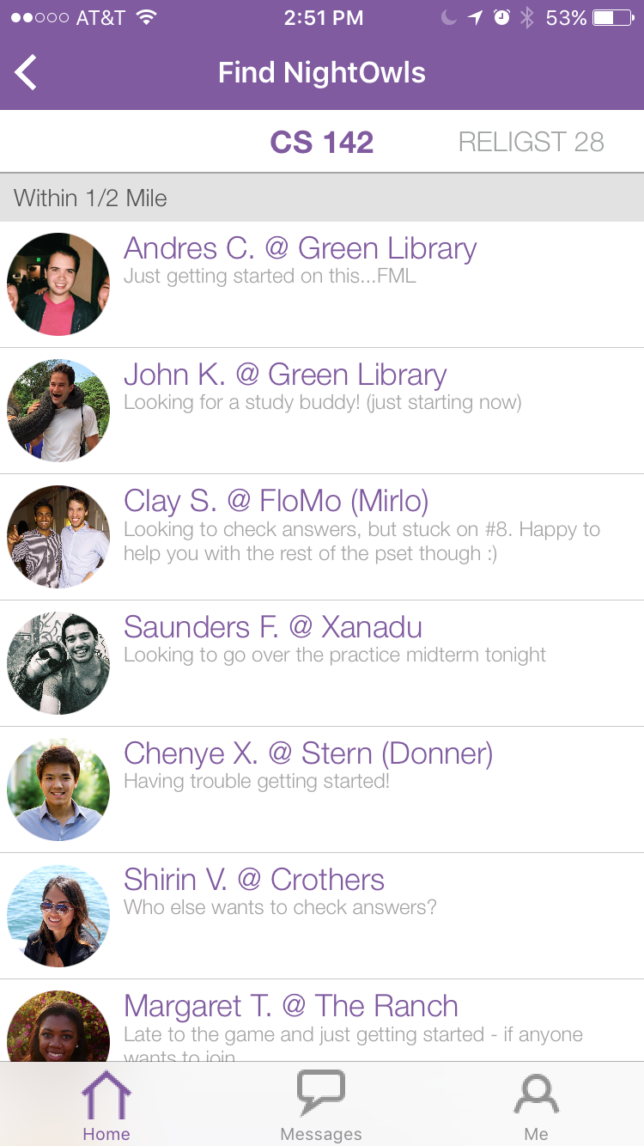
Task 3: Reach out to classmates
What worked
listing by proximity
bolded class title
Errors
thinking deactivating a
class meant dropping it

Slide 23
Task 3: Reach out to classmates
What worked
listing by proximity
bolded class title
Errors
thinking deactivating a
class meant dropping it

Slide 24
Bottom-line Data
Task | Avg. # errors | Avg. time/task (min) | Avg. # taps | Minimum # taps
1 | 1 | 2:25 | 18 | 12
2 | 2 | 1:37 | 8 | 6
3 | 1 | 1:02 | 6 | 5
Notes:
Consistent with our process data

Slide 25
Flight Path
Method
Tasks
Results
Discussion

Slide 26
Pilot run vs “real” experiment: Learnings
Additional A/B testing
Importance of task wording
Really emphasizing thinking out loud
Notes:
What we learned from pilot run that we might change for the “real” experiment…
additional large scale A/B testing to test small changes that our team was divided on

Slide 27
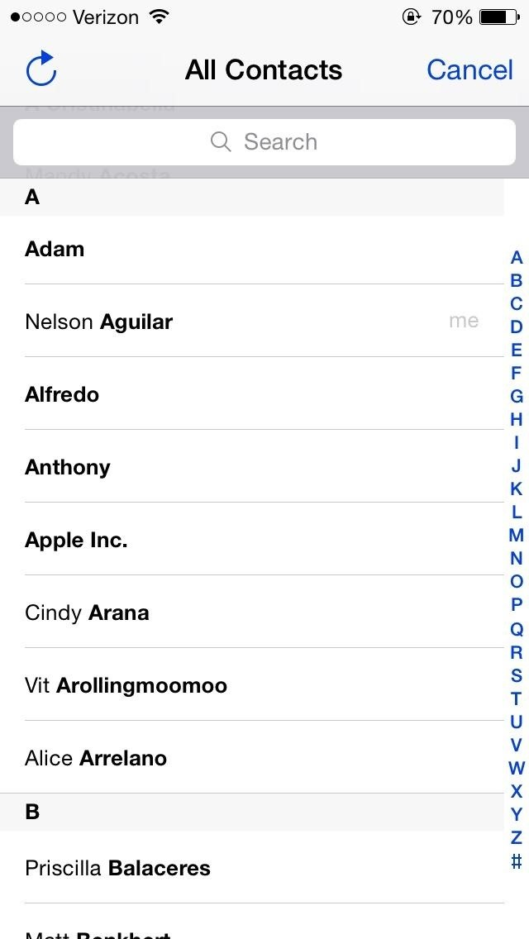
Changes: Task 1 (Add your classes)
Error
finding search bar
Potential Fixes
Add persistent letters on side
Keep search bar during scrolling
Notes:
What we learned from pilot run that we might change for the “real” experiment…

Slide 28
Changes: Task 2 (Pick 2 classes to get help with)
Error
Not realizing they were available
Potential Fixes
Pop up screen (feedback)
Getting rid of text box outline after status entered
Changing check mark
Notes:
What we learned from pilot run that we might change for the “real” experiment…

Slide 29
Changes: Task 3 (Reach out to classmates)
Error
Thinking deactivating a class meant dropping
Fix
Changed pop up text
Notes:
What we learned from pilot run that we might change for the “real” experiment…

Slide 30
Running the experiment in situ
Difficulties
Finding people in the midst of work
Advantages
More realistic, more helpful
Notes:
Description of task: We told participants to imagine they are working on psets for CS140 and CS194H and need help. Their task was to make themselves available for both classes, and post informative statuses.
Changes:
Location autofills at top (removes a step)
statuses are inline instead of in modal page (easier and more intuitive)
What we looked for: 1) If they were able to easily make themselves available
2) If there were any issues with entering status or location

Slide 31
Summary
Interviewed 6 Stanford students in situ
Observed them attempt our tasks
Brainstormed potential changes that respond to errors and points of confusion that came up
Notes:
In summary, this week we conducted user testing on 5 different students
From this, we learned that the most prominent confusion points were: 1) add/delete buttons need to be bigger, 2) find nightowls button, 3) toggling between classes on peer list page - which we plan to address in the next iteration of the app.

Slide 32
Questions

Slide 33
Appendix

Slide 34
Additional Potential UI Changes
making status required to see other NightOwls
exit keyboard by tapping on screen
make classes searchable by class name
make class name purple once student available
purple box outline when tapping
Notes:
What we learned from pilot run that we might change for the “real” experiment…

