Slide 1
clickED
See the Questions Behind Their Masks

Slide 2
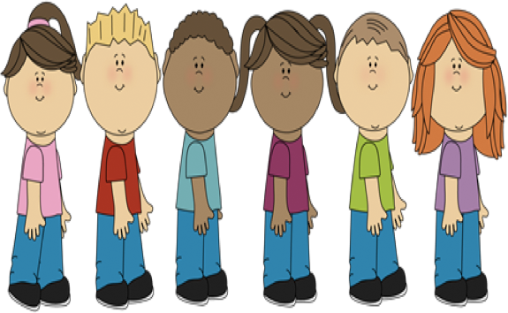
Problem

Slide 3
Solution

Slide 4
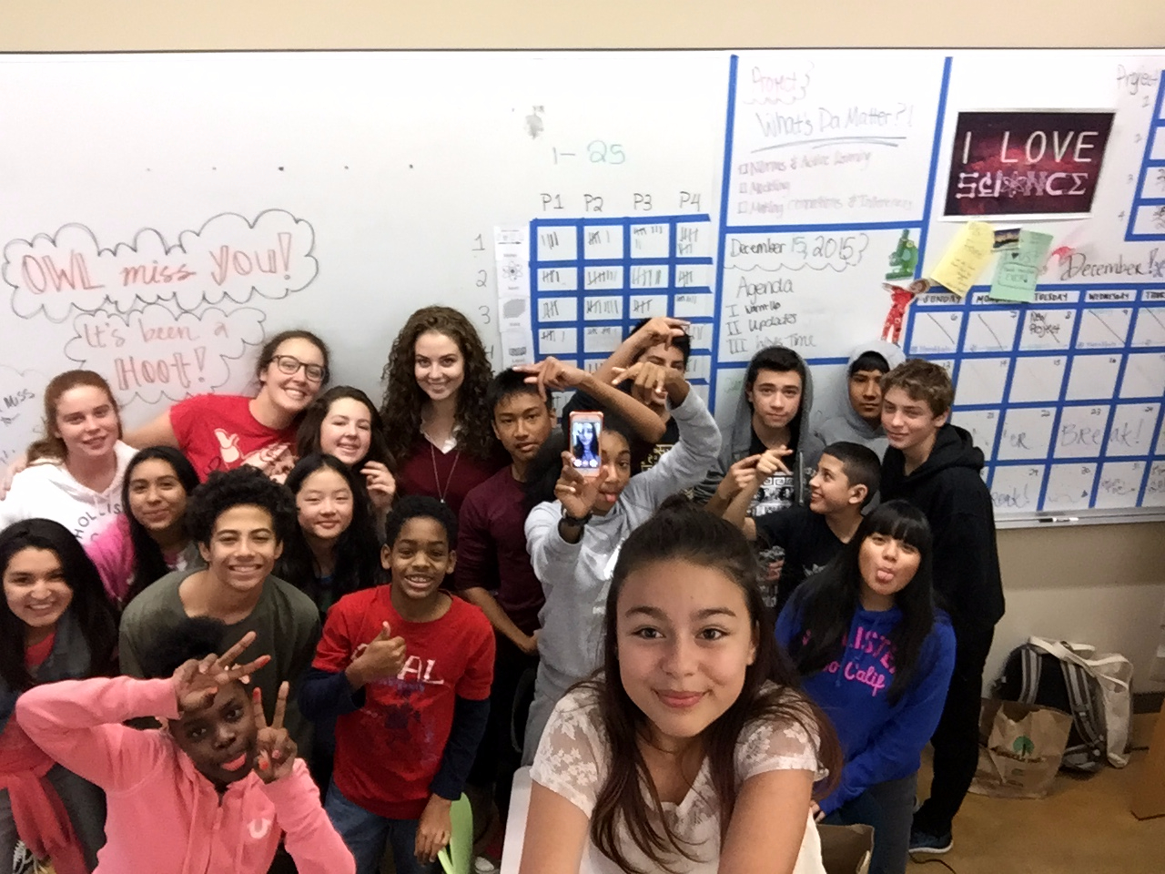

Slide 5
Major Changes

Slide 6
Tasks Overview
https://www.youtube.com/watch?v=cjjZSddfhkw

Slide 7
Wizard of Oz

Slide 8
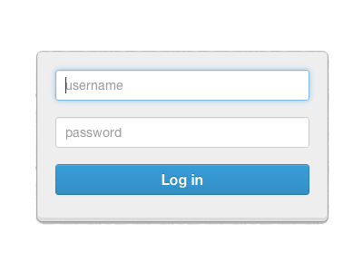
Future Changes

Slide 9
Questions?

