Slide 1
Mobile Computing & Mobile UI Design
January 19, 2016
* Some slides based on slides of Prof. Scott Klemmer, Stanford/UCSD
Notes:
Got to slide #38 and then had class discussion about favorite apps (didn’t have time for last few slides). Cut a few more?

Slide 2
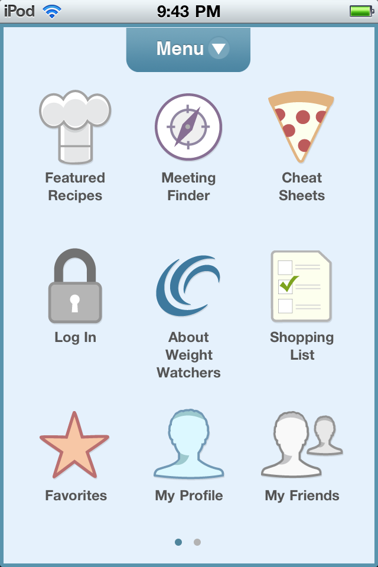
Hall of Fame or Hall of Shame?
Weight Watchers app

Slide 3
Hall of Shame!
Weight Watchers app
What app am I in?
Icon mappings?
Menu non-standard
No overview+detail
How do I do “My Friends” w/o Log In?

Slide 4
Outline
History of Miniaturization & Mobility
Palm Pilot
iPhone
Mobile UI Design

Slide 5
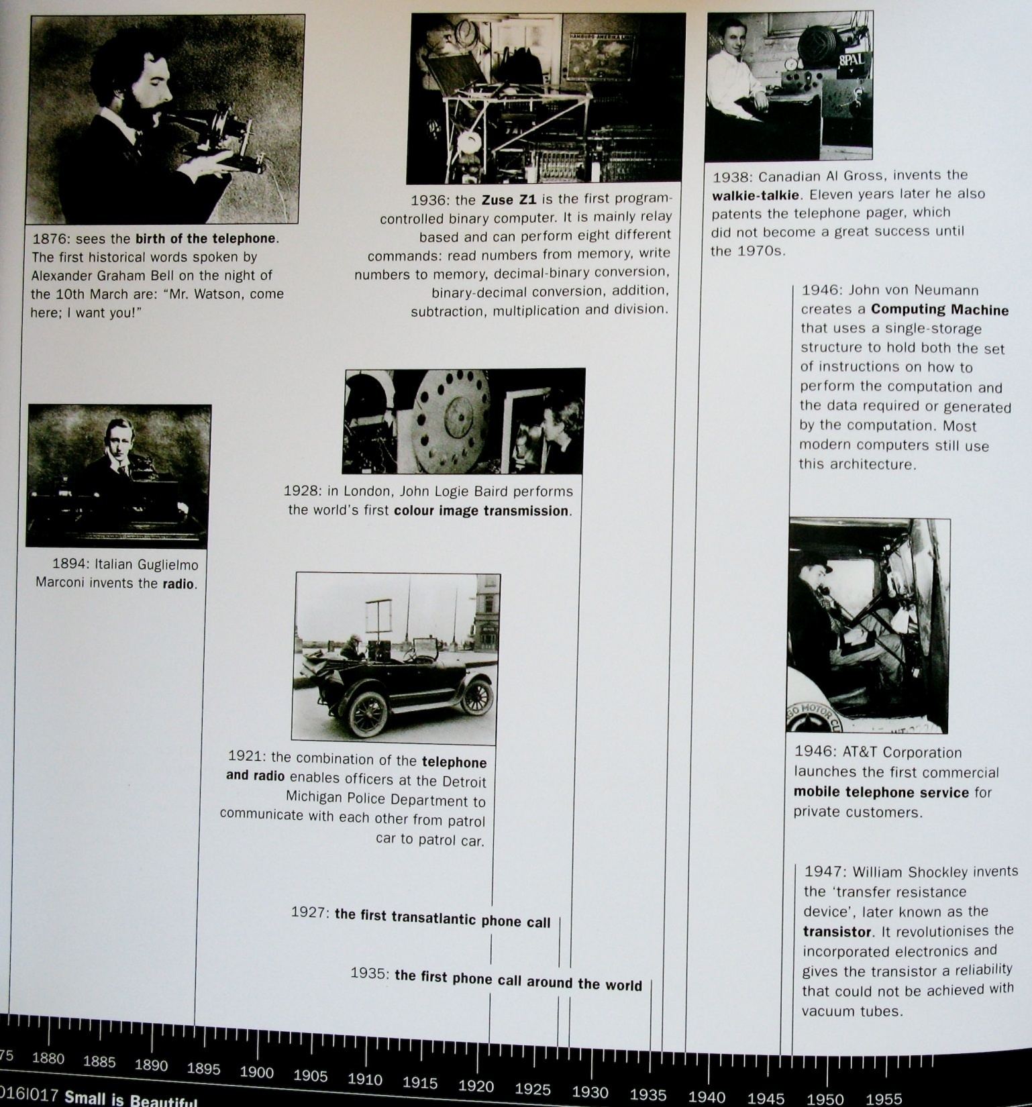
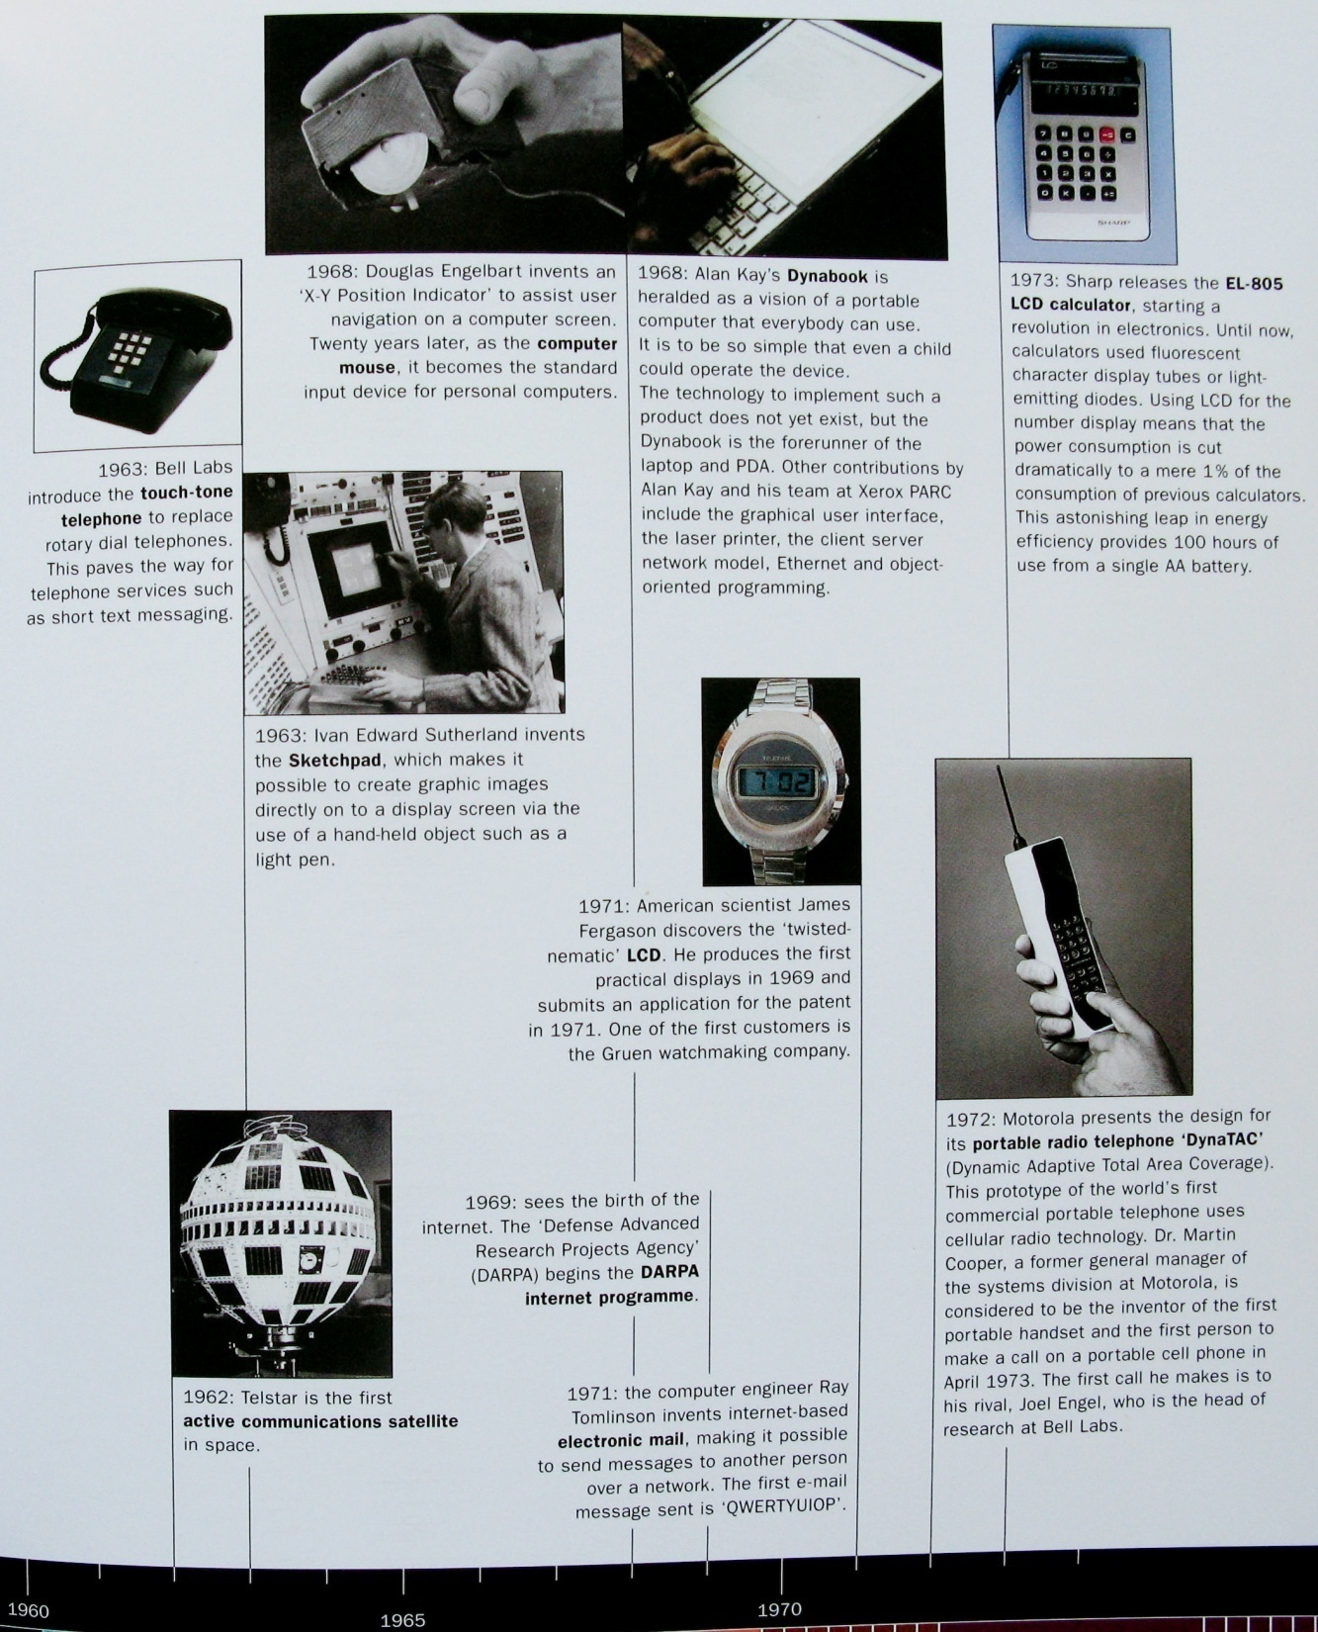
Notes:
This is playing while students stream in; movement from telephone, to radio, to satellite, to mobile.

Slide 6
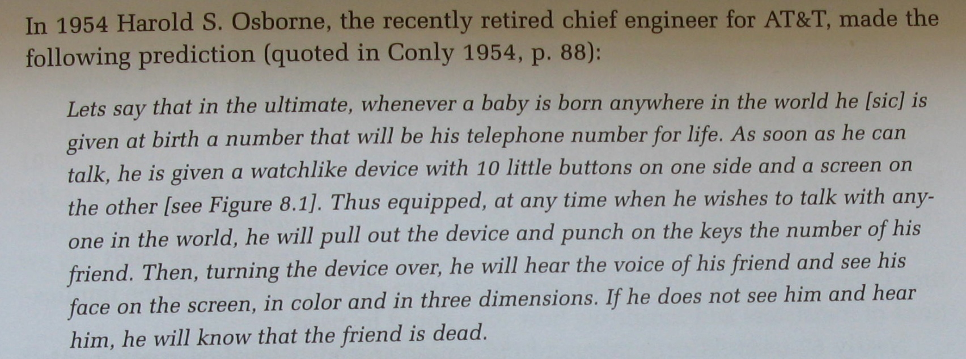
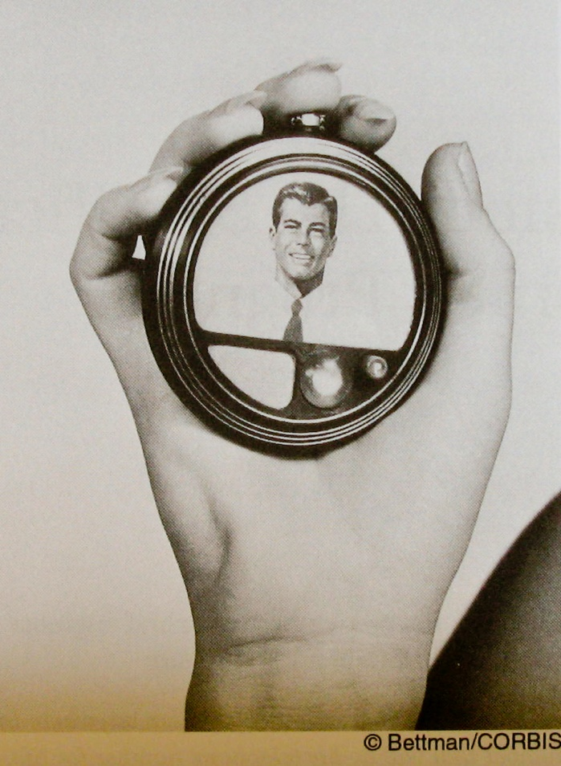

Slide 7
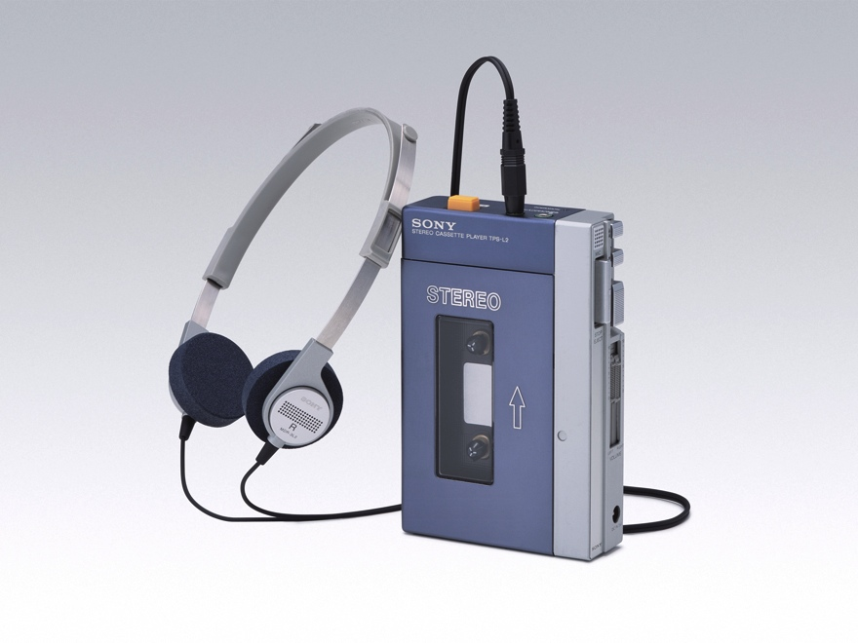
Sony Walkman (1979)
Notes:
The trend towards miniaturization and portability was launched by the Sony Walkman in 1979. It introduced a change in music listening habits, and provided the first of several disruptive mobile innovations by taking a household activity – listening to music – and enabling access anywhere.

Slide 8
Sanyo MG30 (1982-83)
Notes:
The trend towards miniaturization and portability was launched by the Sony Walkman in 1979. It introduced a change in music listening habits, and provided the first of several disruptive mobile innovations by taking a household activity – listening to music – and enabling access anywhere.

Slide 9
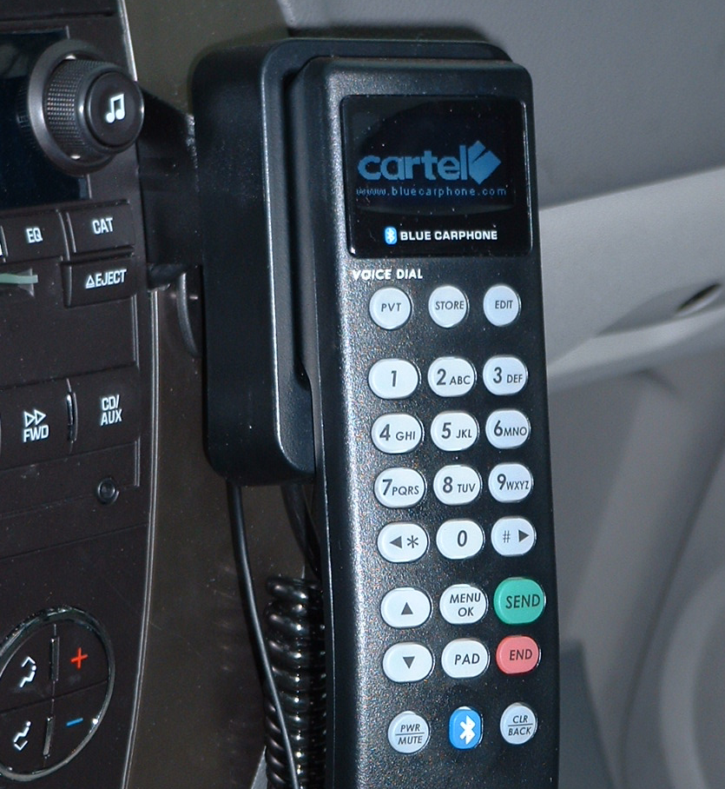
Car Phone (1980s-90s)
Notes:
Around the time that the walkman was launched, the car phone was also gaining popularity. Though they might seem unwieldy and bulky today, in the 1970’s and 80’s they were far more popular (and available) than truly mobile phones.

Slide 10
7 billion Mobile Phones Worldwide (2015)
Mobile Broadband Subscriptions
per 100 inhabitants
Developed 87%
Developing 39%
LDC 12%
World 46%
“of the 940 million people living in the least developed countries, only 89 million use the internet (9.5%)”
Data courtesy ITU (International Telecommunication Union), 2015
http://www.itu.int/en/ITU-D/Statistics/Documents/facts/ICTFactsFigures2015.pdf
Notes:
~97% of global population is connected with mobile phone subscriptions (low is ~70-75% in Africa). How did we get here?

Slide 11
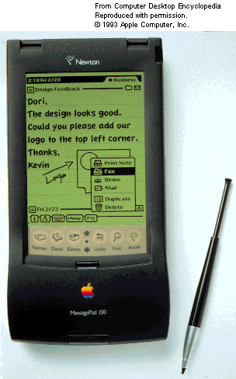
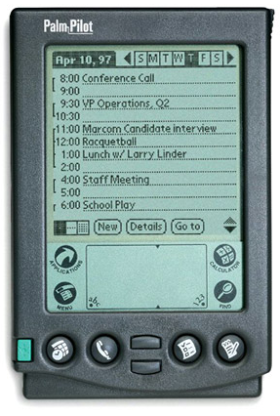
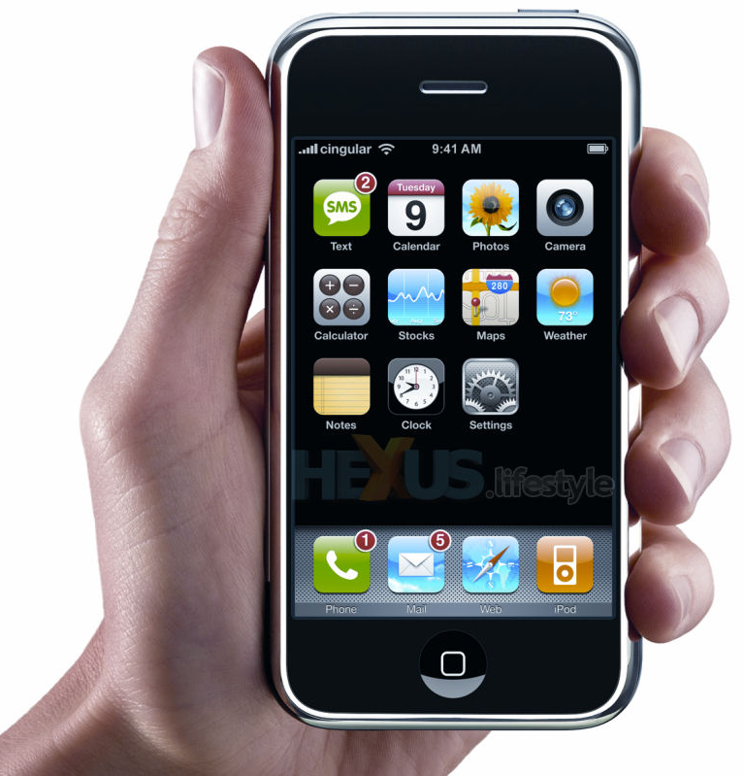
Mobile Design Evolving Rapidly!
Newton (1993)
Palm Pilot (1997)
iPhone (2007)
Notes:
Since the mid 90s, we’ve seen a large acceleration in sophistication and functionality of mobile devices.
Took almost 15 years to get from NEWTON to iPHONE (14 years)

Slide 12
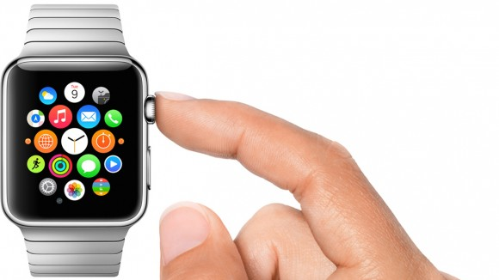
Mobile Design Evolving Rapidly!
Apple Watch (2015)
Notes:
Still evolving rapidly. Will this be the next big thing? WHAT DO YOU THINK?

Slide 13
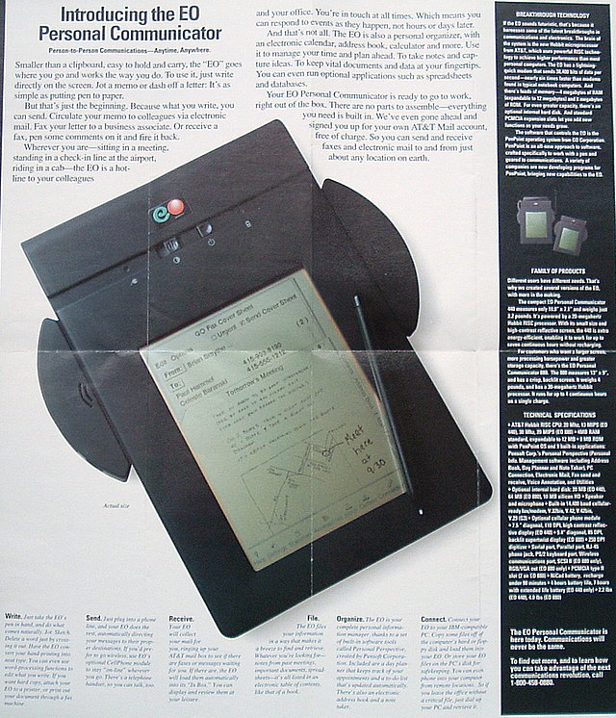
“You Will” – the future comes slower than we’d like
Notes:
Came out in 1993
I worked at Go in 1990 and 1991 (made the underlying OS and originally hardware also)
EO was from AT&T
My brother produced this commercial

Slide 14
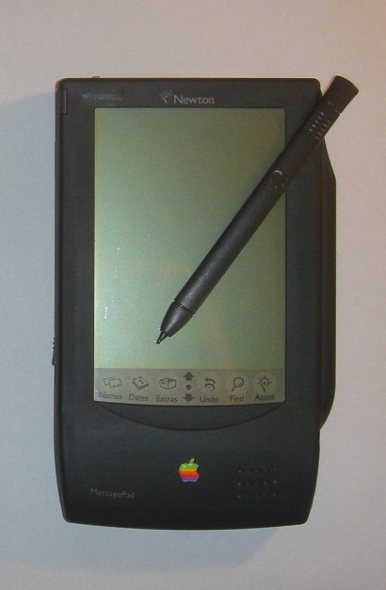
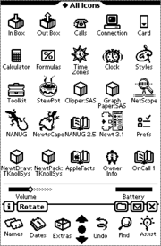
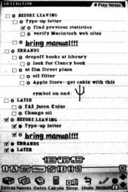
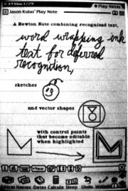
There was the Newton …
Apple Newton
MessagePad
The Newton OS GUI
Photograph of screen displaying Checklist, some bullet points checked and/or “collapsed”
Newton screen displaying a Note with text, “ink text”, a sketch, & vectorized shapes
Notes:
NOTE: It was after Sharp Zaurus, and a few related products from Casio and others! PenPoint Tablet

Slide 15
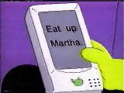
The Newton Had Problems…
Physical size
too big
Connectivity
not much
Recognition
relied on it too much, didn’t work well enough
Design Issues
“Hey, Take a memo on your Newton”
“Beat Up Martin”
“Baahh!”
The Original Apple Newton's handwriting recognition was made light of in The Simpsons episode Lisa on Ice
Source: The Simpsons, Wikipedia

Slide 16
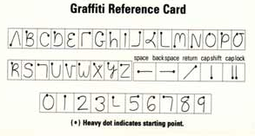
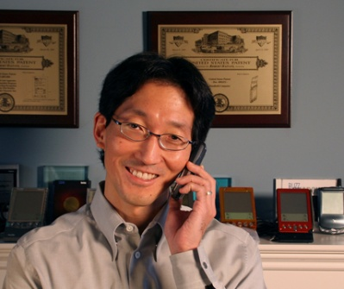
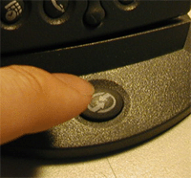
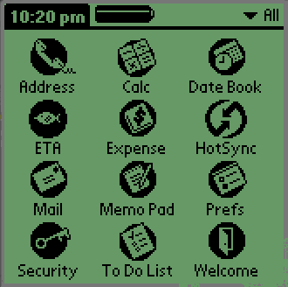
The Palm Pilot Improved…
Design Wins
Physical size: fits in the front pocket
Connectivity: easy sync
Recognition: simple graffiti single stroke
Jeff Hawkins, Palm
Graffiti
Rob Haitani, Palm OS
[Designs] what should be most prominent based on frequency of use, and makes most often used interactions accessible in a single step.
Pocket size
HotSync
Palm OS

Slide 17
Prototyping the Palm hardware, form factor, software
Notes:
Developing a new mobile phone requires prototyping three main aspects: the hardware, the form factor, and the software interface. Here, the Palm Pilot’s original mainboard is shown – clearly too huge to be included in a mobile device, but allowing early testers to try out the screen and interface before more work was undertaken to shrink the board.

Slide 18
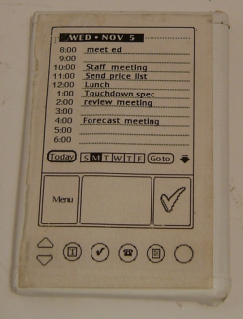
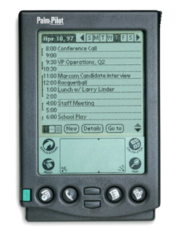
Palm Pilot Prototypes
http://www.computerhistory.org/collections/accession/102716262
Notes:
To prototype the form factor, Jeff Hawkins carried around a block of wood like this in his pocket & pulled it out when meeting people and used a pen to act like he was adding things to his device, to illustrate the potential for a small device.
This led to the prototype in the middle and
The final product: The PalmPilot (right)

Slide 19
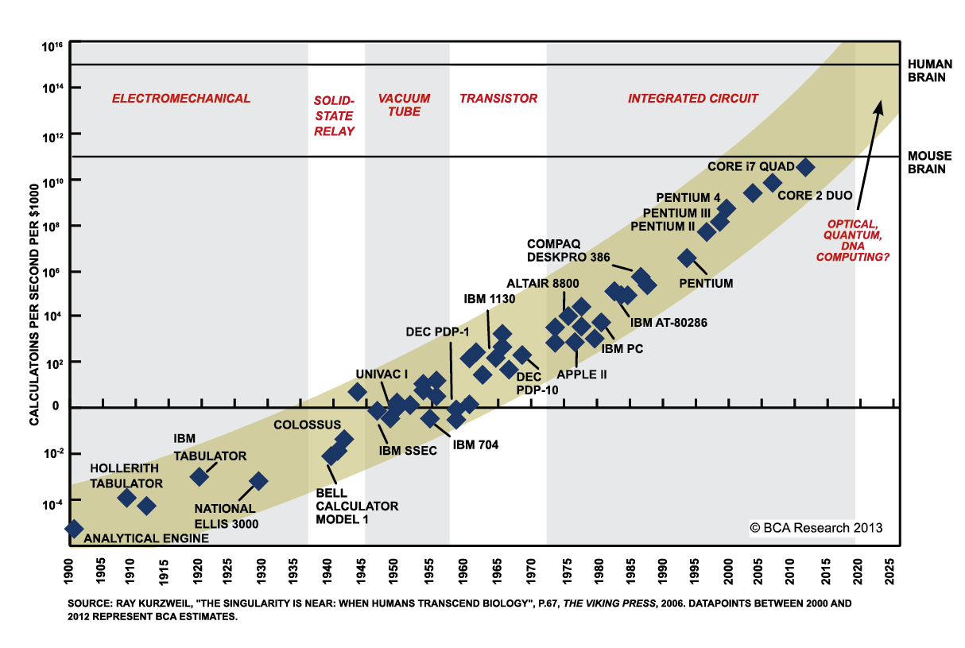
Notes:
Where is all this technology going?

Slide 20
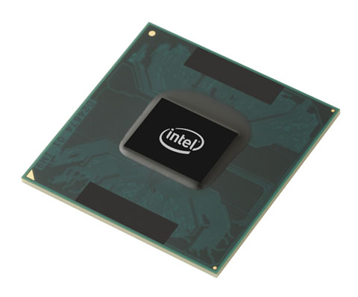
Technology Trends
processing

Slide 21
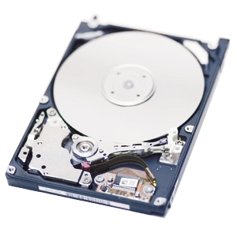
Technology Trends
disk

Slide 22
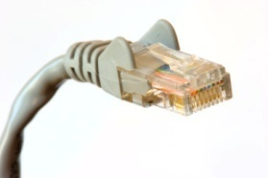
Technology Trends
bandwidth

Slide 23
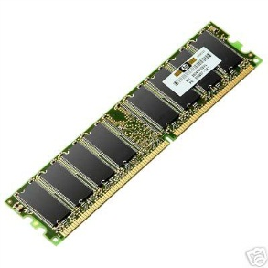
Technology Trends
RAM

Slide 24
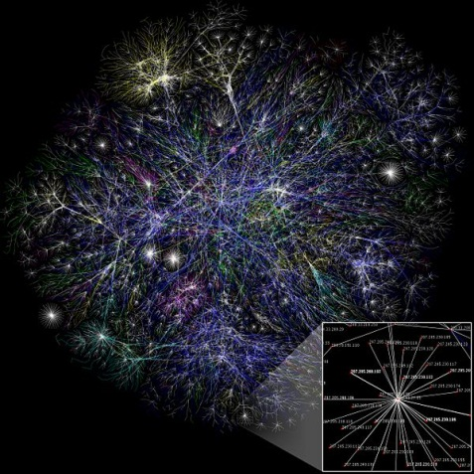
Technology Trends
Devices on Internet

Slide 25
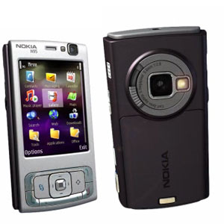
Technology Trends
Imaging Resolution

Slide 26
Technology Trends
Display Resolution

Slide 27
Technology Trends
Size of pockets

Slide 28
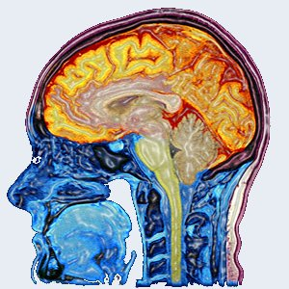
Technology Trends
Unaided human abilities
Notes:
In some ways, one can think of HCI as a discipline born out of these lines crossing.

Slide 29
What will we do with Mobile?
The same applications?
Different ones?
Some of both is most likely… but the context & constraints differ
Think Mobile First

Slide 30
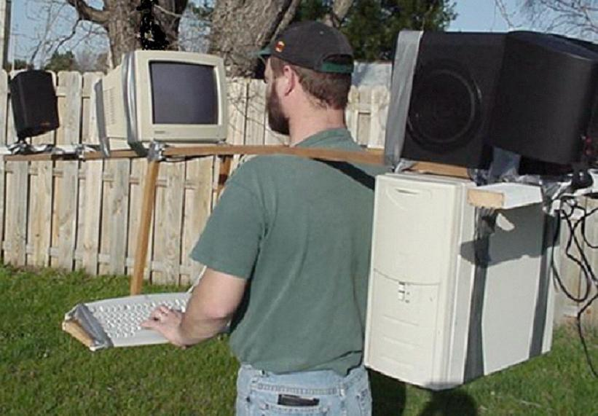
Notes:
Which gets us to the model of mobile computing that we don’t want…
For 40 years, we’ve had the keyboard and mouse, which works great for desktop applications, but not so well for mobile ones.

Slide 31
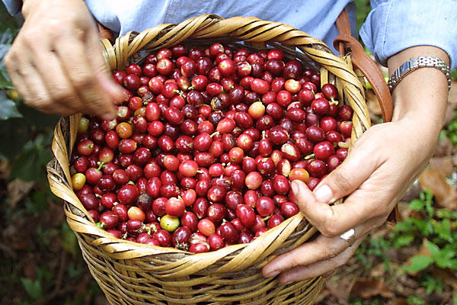
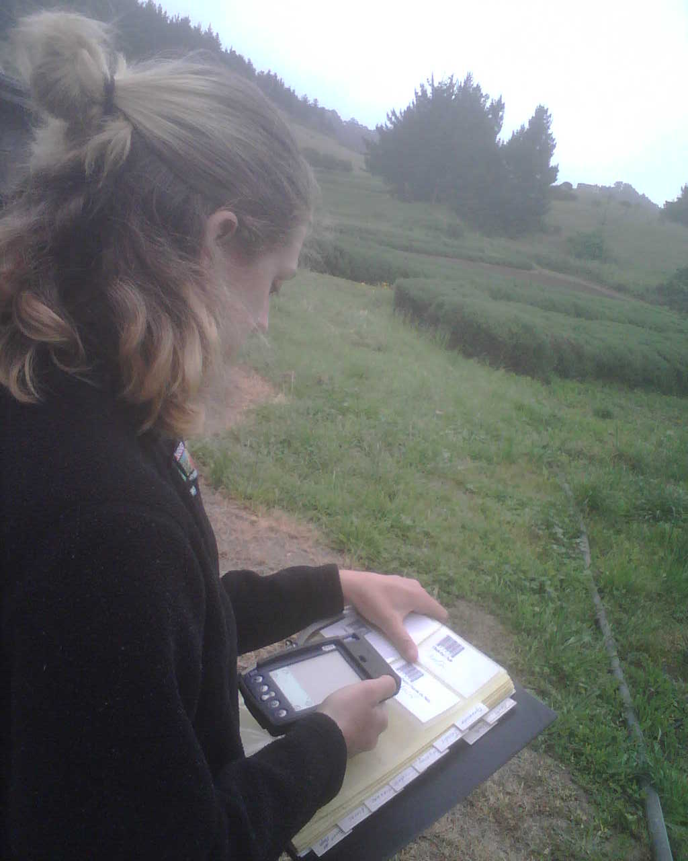
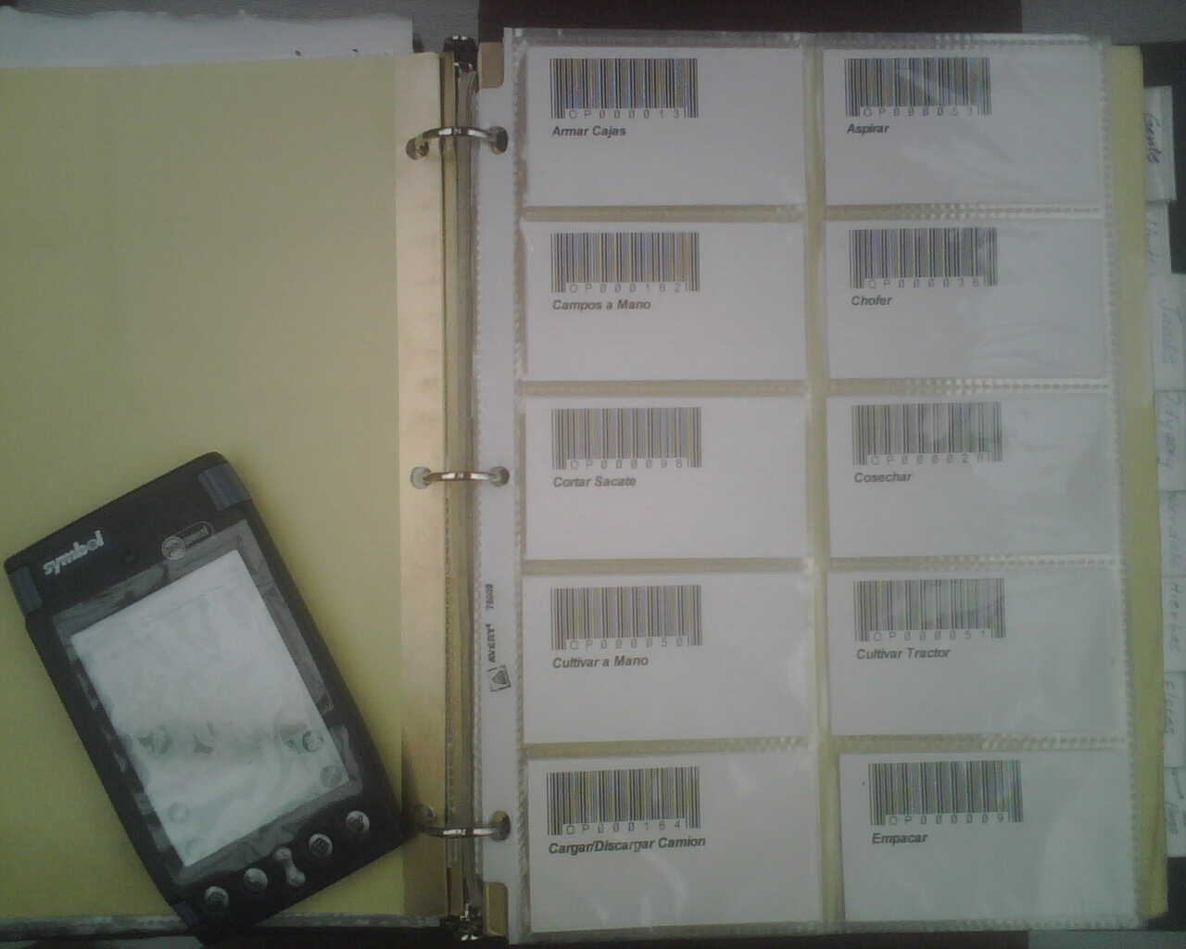
Notes:
Idea: Enlightened trial & error in the domain of agriculture
Organic farmers are progressive and typically inquisitive
They are often looking to try new ways of improving their operations (not just increase yield, but minimize dependence on outside inputs)
This is a farmer in Guatemala taking a picture of a coffee plant to document a problem with his crop.
He would like to know what he can do to fix the problem, and is thus sharing his story with other farmers in the cooperative to get advice. Other farmers with similar issues may chime in to suggest possible ways forward
In a community context (as in cooperative farming), enlightened trial and error becomes increasingly valuable as we are better able to support not only local experimentation, but diffusion of results and new insights.

Slide 32
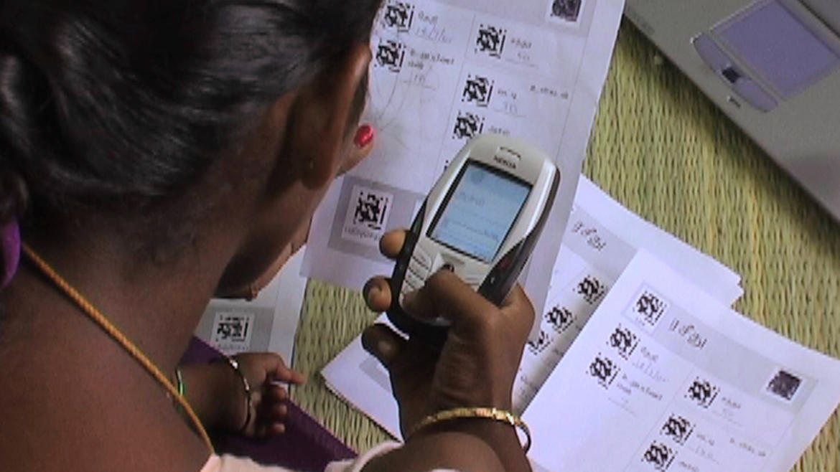
Tapan Parikh, UC Berkeley (2009)

Slide 33
Why Mobile First?
Market size & changing demographics!
Constraints force focus on most important features/tasks of customers
Notes:
Lots of people don’t even have internet access beyond their mobile
Constraints can get best design and some of the ideas can also be implemented on traditional desktop web site

Slide 34
What Makes Mobile Design Exciting?
Many Design Choices
Think different from GUI/Web
Swiss army vs. dedicated
Pen/speech/touch/gesture/vision modalities
Integrate with other real-world tasks
Social apps
Always in your pocket* or w/ you!
*often not true for women

Slide 35
What Makes Mobile Design Difficult?
Design constraints
Limited attention/Interactions bursty
sometimes not true (people increasingly use phones stationary sometimes for long times)
Screen size small (size not resolution)
Form factor / input devices
Limited network connectivity
Speech / pen / multimodal

Slide 36
Mobile Usage Context
Mobile device always with user & on
Use gives clues to context…
Calendar
Job schedule
Repair man example…
Location gives many contextual cues
..
Simple activity inference gives context
Driving? Adapt how?
Notes:
Airline example from littlespringdesign “Mobilize, Don’t Miniaturize”
http://www.littlespringsdesign.com/mobilize/

Slide 37
Limited Attention & Input Interaction
Minimize keystrokes
Provide overview + detail
Understandable interface at a glance
Design with tasks
Minimum set of functions

Slide 38
“Good Artists Borrow, Great Artists Steal” – Pablo Picasso(?)
What apps do you like?
Why?
Borrow good features/styles
Notes:
[got to this point at 1 hour in, took 1 minute break]
Spotify (sliding interface like google mail, quick to create playlists/select them)
IcanHazCheeseburger app (latest memes, immersive – things fade away)
FlipBoard (“makes me feel smarter” than streaming through my facebook)
Task on iOs (todo list – gesture based instead of tapping, color scheme for near and far)
Brightest Flashlight (Android), nice noise

Slide 39
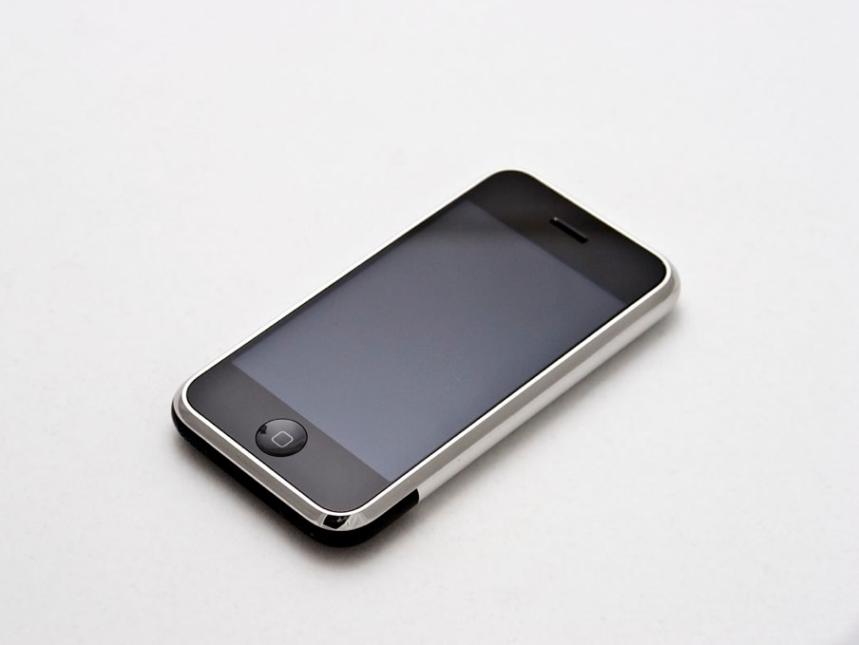
Mobile Design’s Key Moment
iPhone (2007)
App Store (2008)
Notes:
The real big moment happened in July 2008 when the App Store opened & Apple opened up app development on the iPhone, reversing a previous decision?
Apps are reminiscent of the early years of the Web (1995-2002), when many new UI/app ideas were being explored. This is where the action is now.

Slide 40
Mobile Design Constraints & Context
Design constraints
limited attention/interactions bursty (sometimes untrue)
form factor/screen size small (independent of resolution)
natural (ambiguous) input modalities
Notes:
This lady can’t attend to two things at once

Slide 41
Mobile Design Constraints & Context
Design constraints
limited attention/interactions bursty (sometimes untrue)
form factor/screen size small (independent of resolution)
natural (ambiguous) input modalities
Mobile usage context
mobile device with user & on
use gives clues to context…
apps give cues (e.g., calendar or job schedule)
location gives cues
activity inference (e.g., adapt to walking)
Notes:
MTA NYC transit app
Horrible UI but knows where you are!

Slide 42
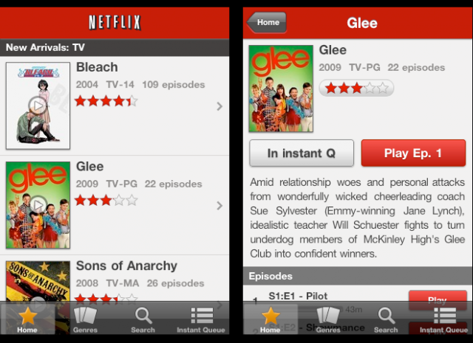
Mobile Design Constraints & Context
Design constraints
limited attention/interactions bursty (sometimes untrue)
form factor/screen size small
natural (ambiguous) input
Mobile usage context
mobile device with user & on
use gives clues to context…
apps give cues
location gives cues
activity inference
Design for limited attention
minimize keystrokes
understandable at a glance (overview + detail)
task-oriented w/ minimum set of functions
Notes:
NetFlix does a great job of overview plus detail. Need to know more you can click on it and see details.

Slide 43
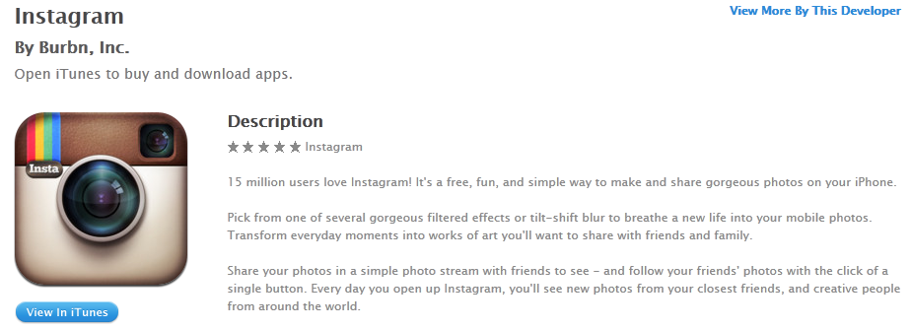
Initial Impressions Matter
If people don’t “get it”, they won’t download or they’ll quit after quick look
need to have clear “value proposition” in both app store title, blurb, & app design

Slide 44
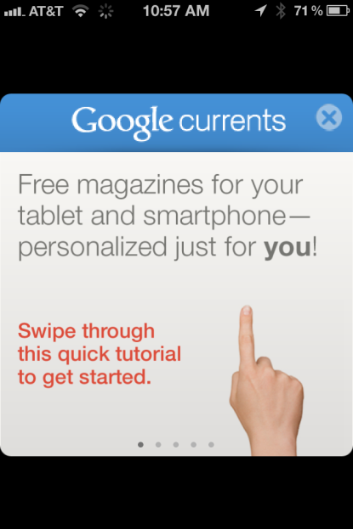
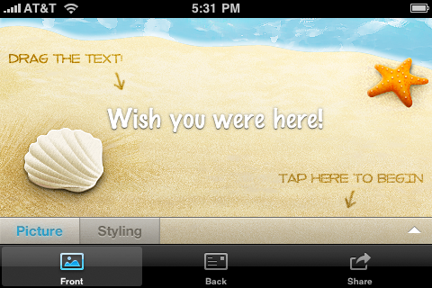
Initial Impressions Matter
If people don’t “get it”, they won’t download or they’ll quit after quick look
need to have clear “value proposition” in both app store title, blurb, & app design
Give “getting started info”, annotate the UI, or provide an optional demo
Google
currents
taptivate
postman
Notes:
Getting started info more important for apps with
Little or no precedence
Need configuration (turn on sound)
Require registration (e.g., twitter client)

Slide 45
Personalize User Experience
Name
use it if known & integral (e.g., social networking)
Settings
common ones in app & rest in settings
don’t make dumping ground for extra features
e.g., font size, sound, units, list view, screen orientation, tab content, history, etc.
Favorites/Bookmarks
save item for viewing later (sync across platforms)
common in content-rich apps (news, photos, recipes)

Slide 46
Personalize User Experience
foursquare
Name
use it if known
Settings
common ones in app
Favorites/Bookmarks
save item for viewing later (sync across platforms)
Behavior
access based on app history (e.g., recent searches)
Notes:
Foursquare Radar feature makes suggestions based on behavior of both you (places you’ve checked in) and YOUR friends behavior

Slide 47
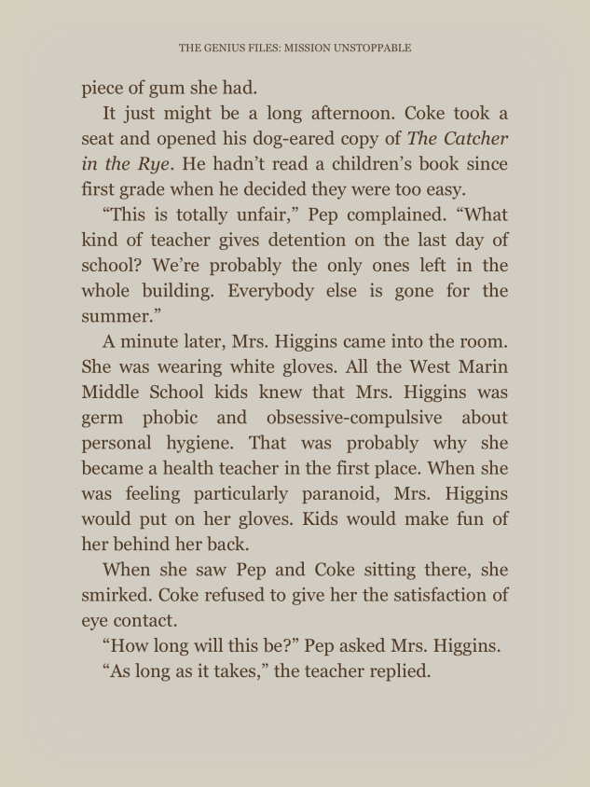
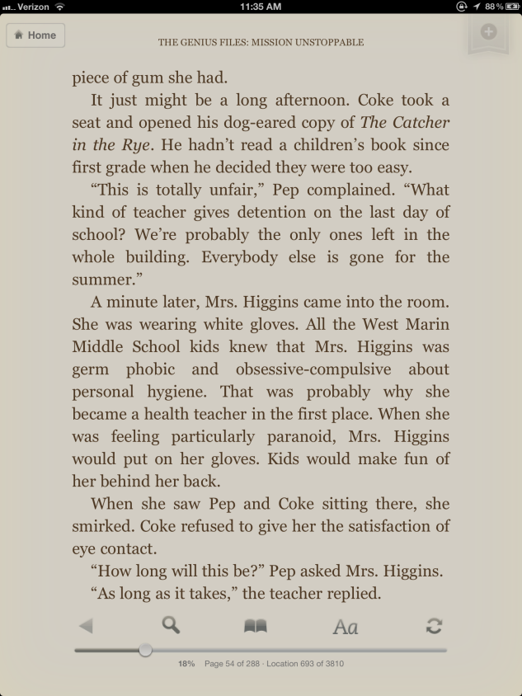
Let the Content Shine
Immersive applications focus on content
“The idea is that the content is the interface, the information is the interface — not computer administrative debris.” – Edward Tufte
Access controls via tap screen, tap button, & scroll up
Kindle reader
Notes:
Edward Tufte, “iPhone Interface Design,” www.edwardtufte.com/bboard/q-and-afetch-msg?msg_id=00036T
Tap screen when all UI controls hidden (photo slideshows, video, news articles)
Caveat – controls that are used a lot (email app) should stay on screen

Slide 48
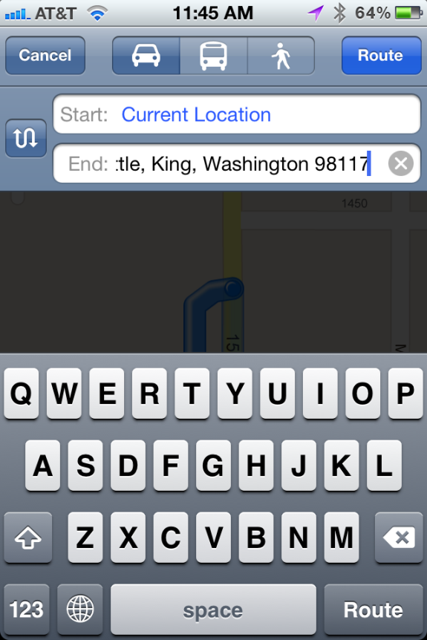
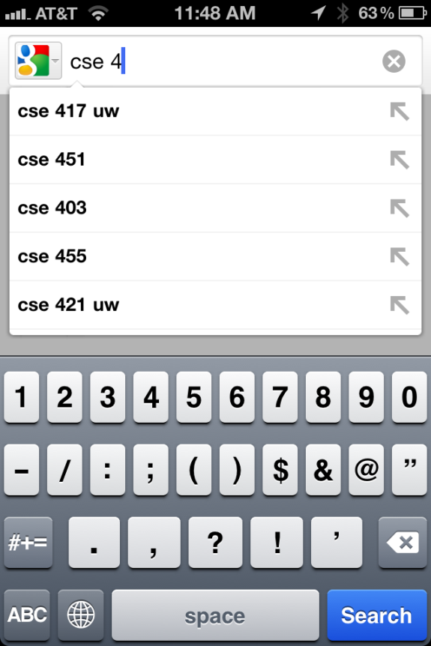
Make Selections Fast & Error Free
Provide smart defaults
Suggest matches during text entry
Store recent activity / selections
iPhone Maps
Google search
Notes:
Map on iPhone pre-populates start field w/ current location & end field w/ most recent search

Slide 49
Provide Appropriate Feedback
Animations
Downloading, moving, end of content…
Transitions
when users move between related screens
e.g., flip (settings/views), slide left/right (lists), slide up/down (secondary panel), fade in/out, curl (e.g., maps)
Text alerts
If visual not enough (inline or overlay-modal)
Sound
use sparingly as can be annoying

