Slide 1
Hi-Fi prototype
Midway Milestone
Ashlee Reynolds
Brad Huang
Charlie Yu
David Young

Slide 2
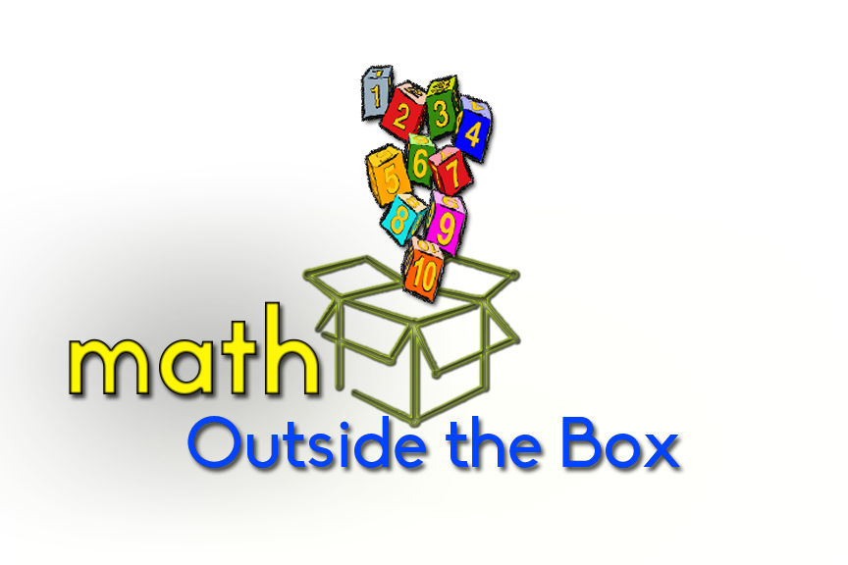
Children's math challenges grounded in real world applications.
See math differently-
See the world differently!

Slide 3

Problem
$$y= \frac{I just don^{′}t care}{x+1}$$

Slide 4
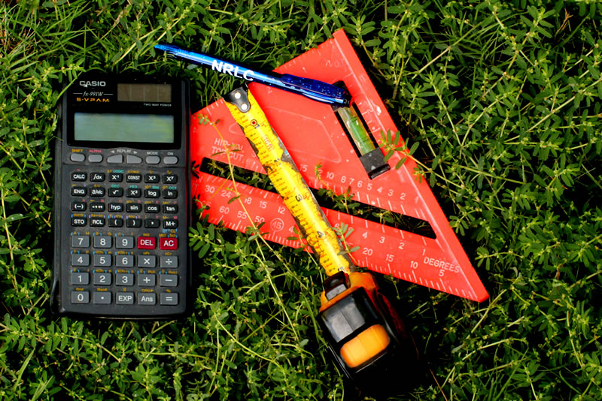
Solution

Slide 5
Overview
Heuristic Evaluation Results
Revised Design
Where We Are Now
Demo

Slide 6
Heuristic Evaluation Results
Severity 5
[H2-10] Parent Mode statistics were ambiguous and hard to navigate
Severity 4
[H2-8] No discernible color scheme. Existing distribution causes confusion, specifically for the buttons.
[H2-2] Too much text for a kid to read.
[H2-3] Not enough backwards navigation

Slide 7
Heuristic Evaluation Results
Severity 3
[H2-1] Parents and children could get their user profiles mixed up if they share a device
[H2-7] The challenge list is cluttered and confusing.
[H2-8] Leaderboard displays irrelevant information
Severity 2
Button design is distracting and inconsistent

Slide 8

Revised Design
Recycled:
Leaderboard
Social Media Aspect
Parent vs Child Mode
Instructional depth

Slide 9

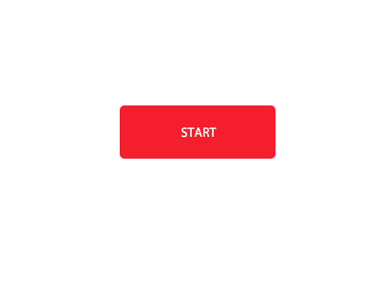

Revised Design

Slide 10
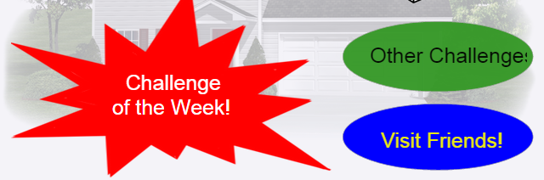
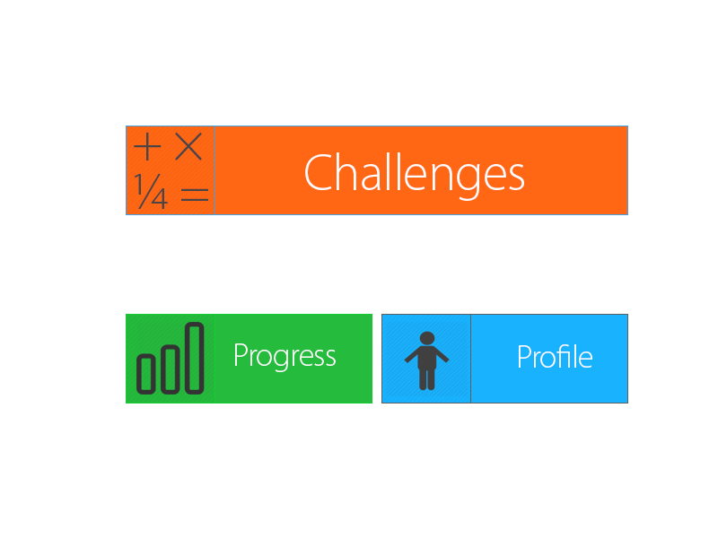
Heuristic Evaluation Results

Slide 11





Where we are now
Tools
IDE: IntelliJ
Platform: Harp
Code: less, coffeescript, html5

Slide 12
Hardcoded Data:
Challenges
Your Profile data
Where we are now
Implemented Features:
Feedback
Features to be Implemented:
Challenges
Friend Lookup
Wizard of Oz:
Search for people
Database of users
Your Profile page

Slide 13
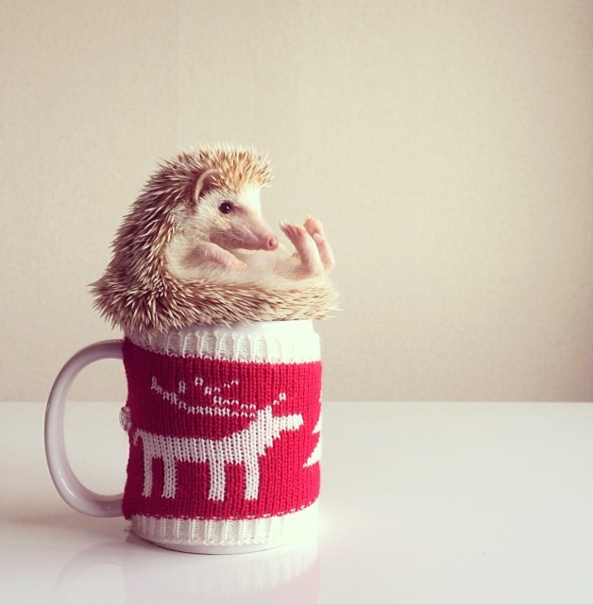
Demo

