Slide 1
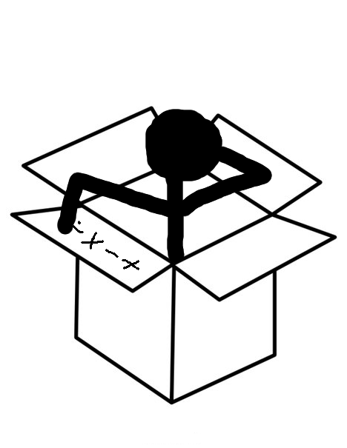
Math Outside the
Interactive Medium-fi Prototype
Ashlee Reynolds, Charlie Yu, David Young, Brad Huang

Slide 2
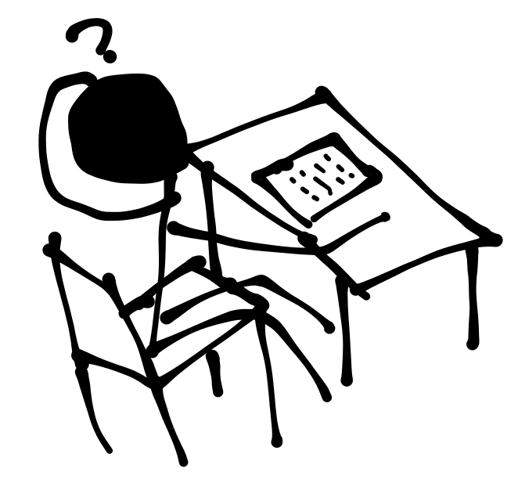
Overview
Changes to the three Tasks
Revised UIs
Three Scenarios
Using JustInMind
Wizard of Oz
Summary

Slide 3

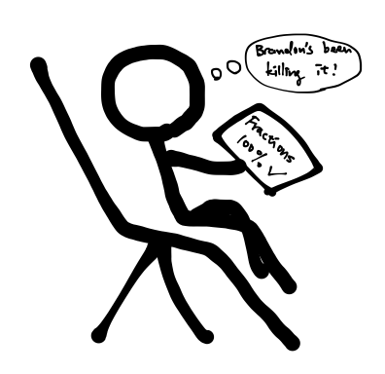

Three Tasks
The Challenge
Parent Mode

Slide 4
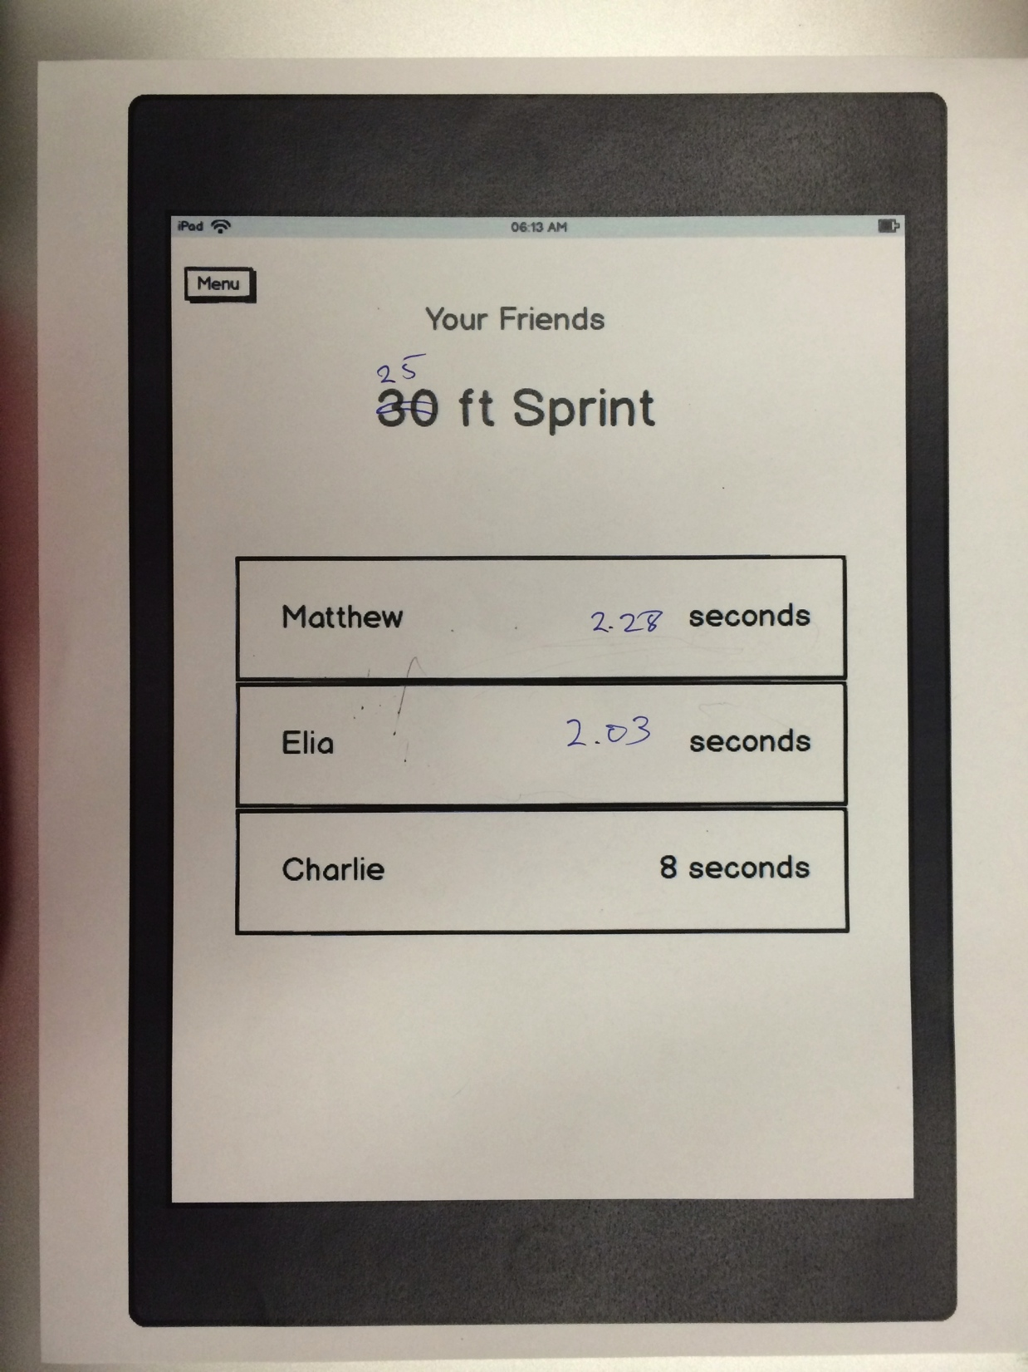
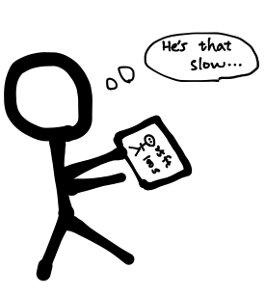
The Social Task

Slide 5
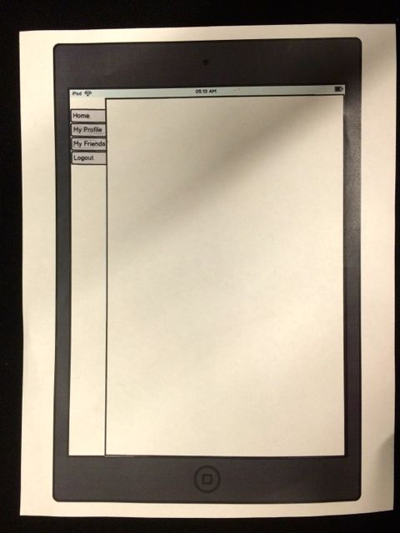
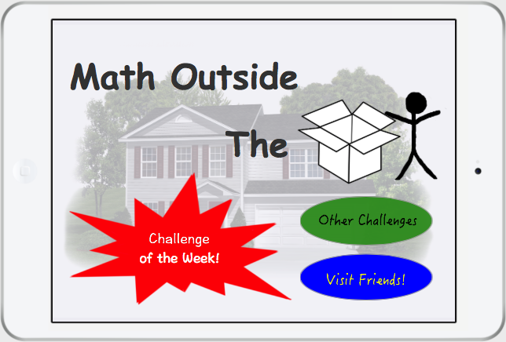
Revised UI Designs
Menu

Slide 6
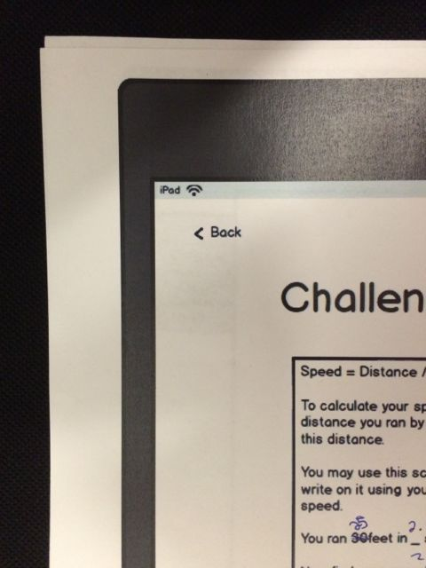
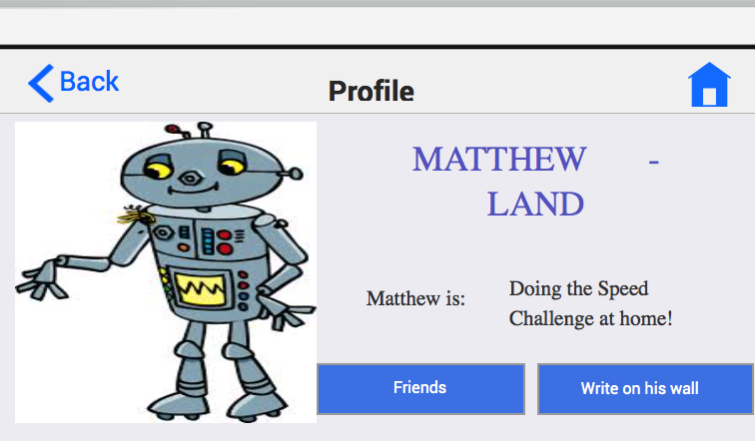
Revised UI Designs
Buttons

Slide 7
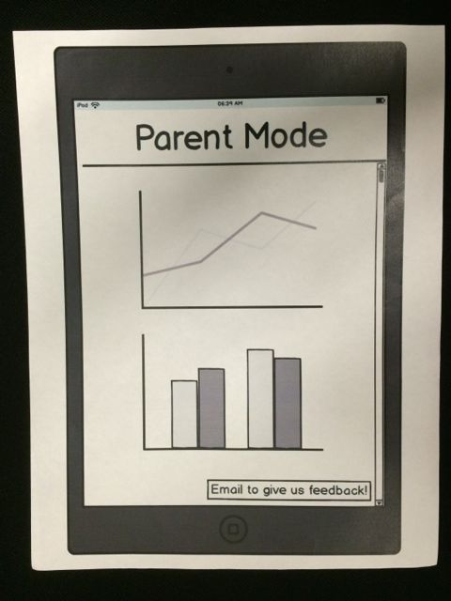
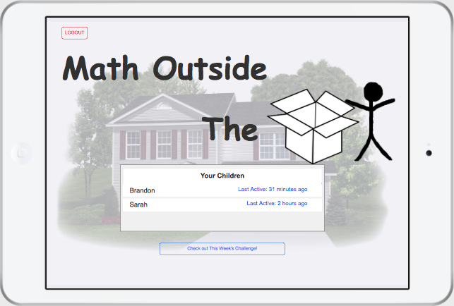
Revised UI Designs
Parent Control

Slide 8
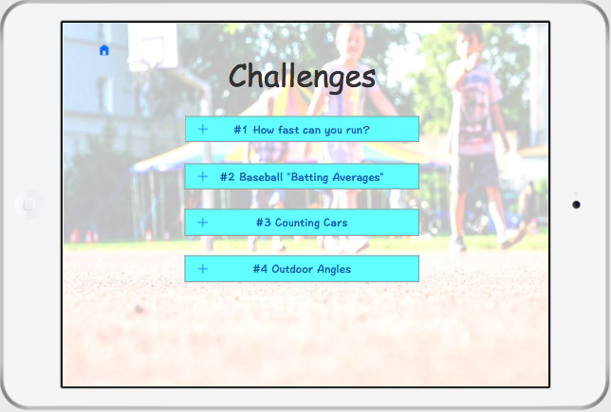
Scenario 1 Running Challenge

Slide 9
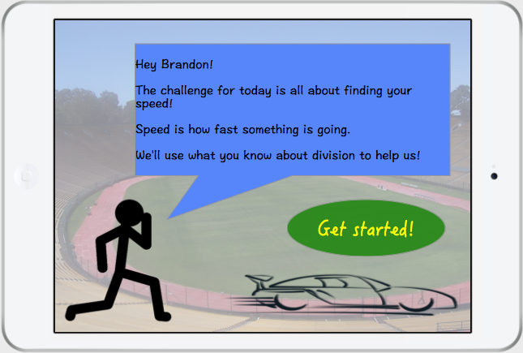
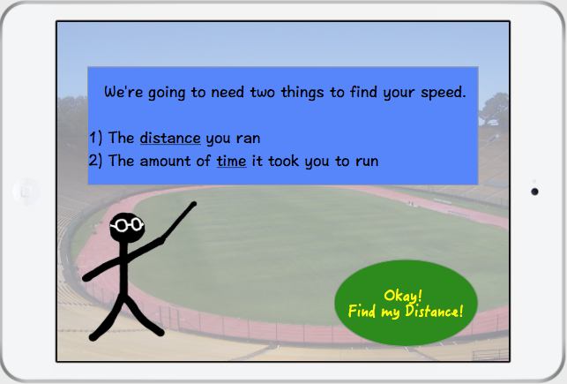
Scenario 1 Running Challenge

Slide 10
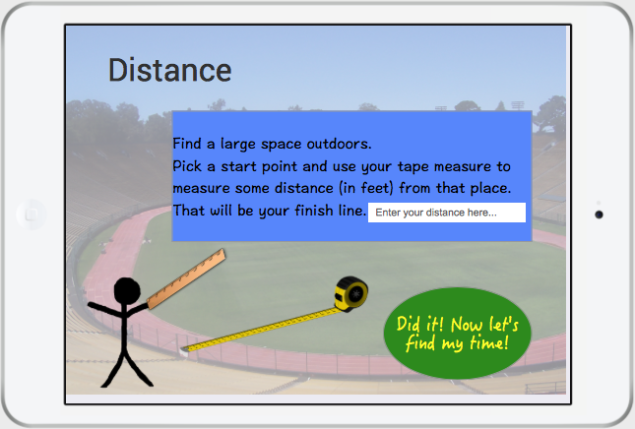
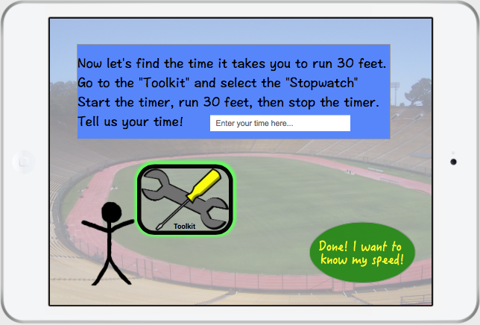
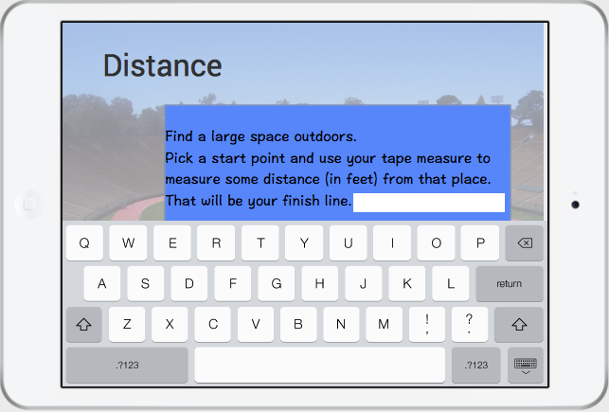
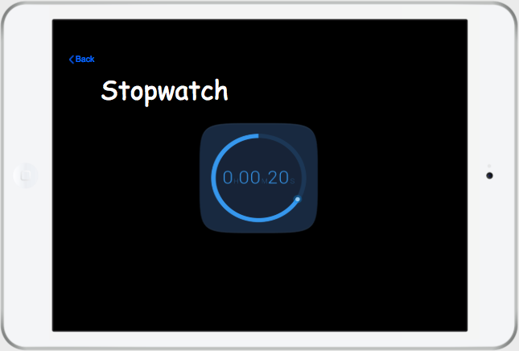
Scenario 1 Running Challenge

Slide 11
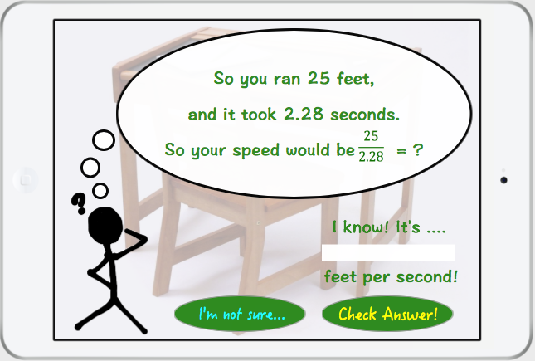
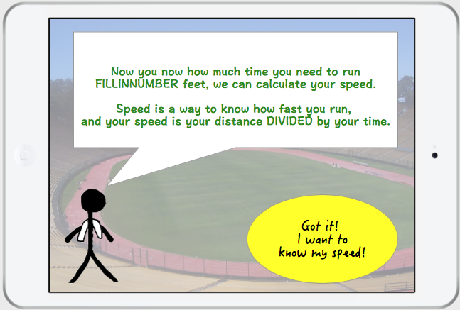
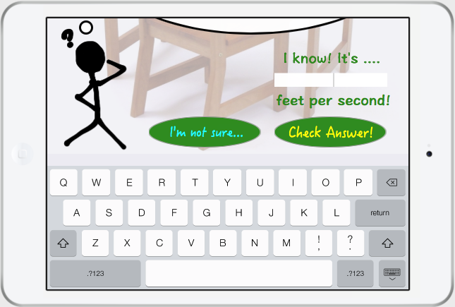
Scenario 1 Running Challenge

Slide 12
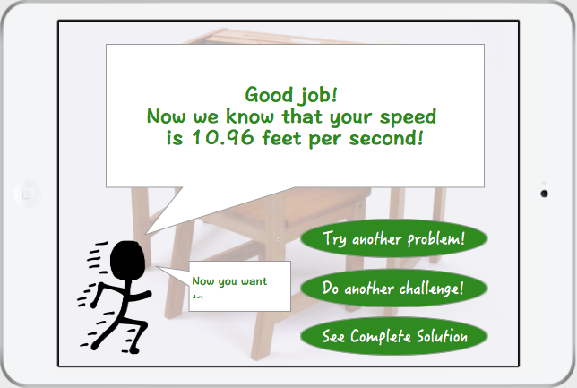
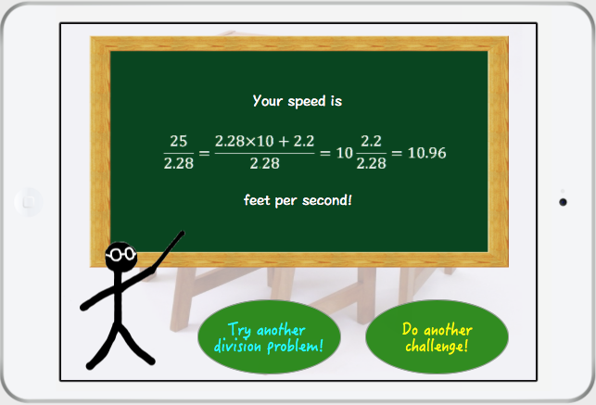
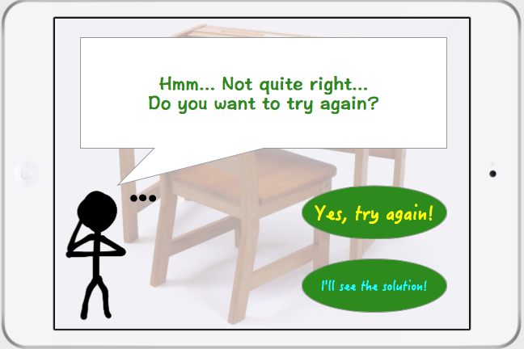
Scenario 1 Running Challenge
Solution

Slide 13
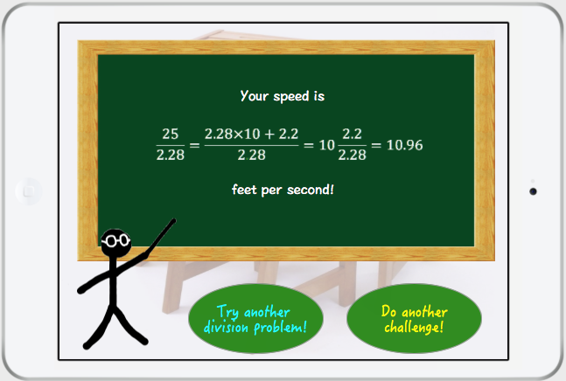
Scenario 1 Running Challenge

Slide 14
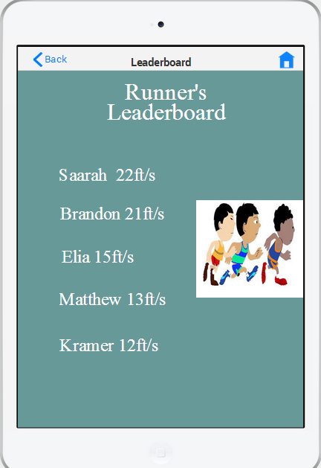
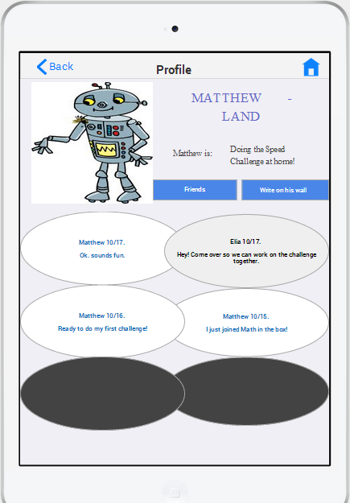
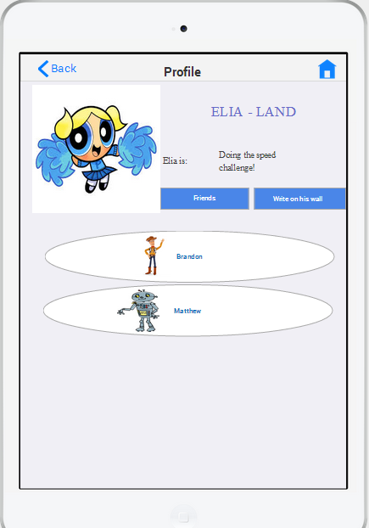
Scenario 2 Elia visits Matthew-Land

Slide 15
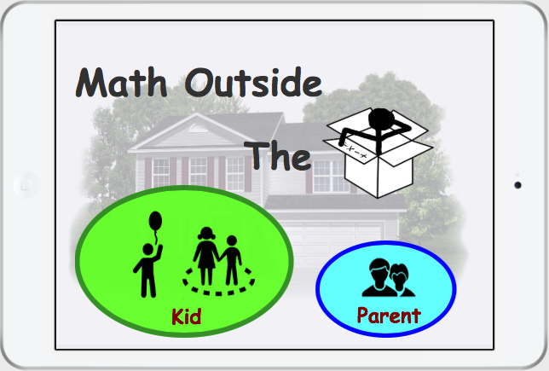
Scenario 3 Parent Control
To challenge

Slide 16
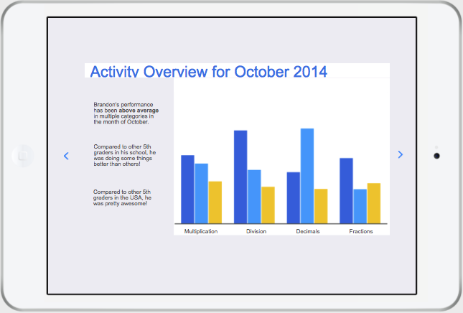
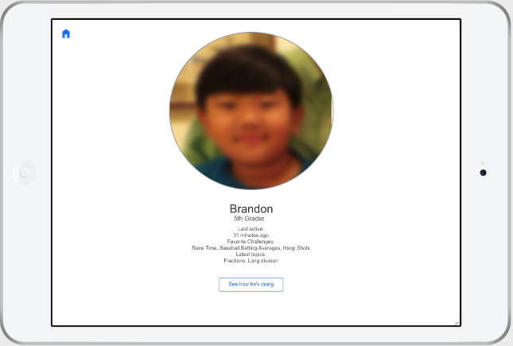
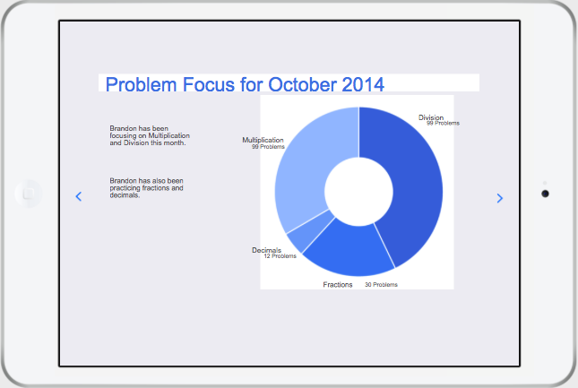
Scenario 3 Parent Control

Slide 17
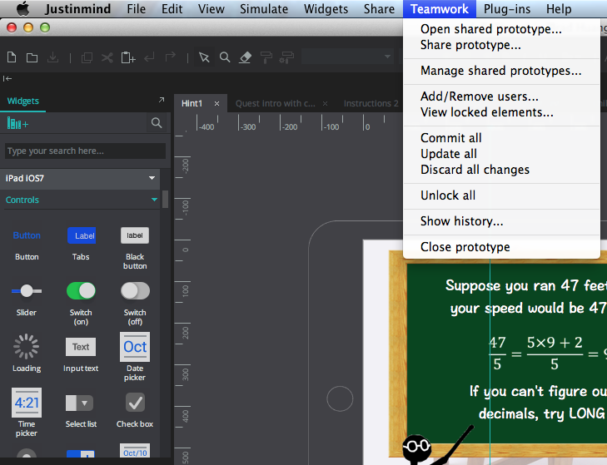
JustInMind - pros
Good icon library
Similar metaphors as other prototyping tools
Freedom
Teamwork

Slide 18
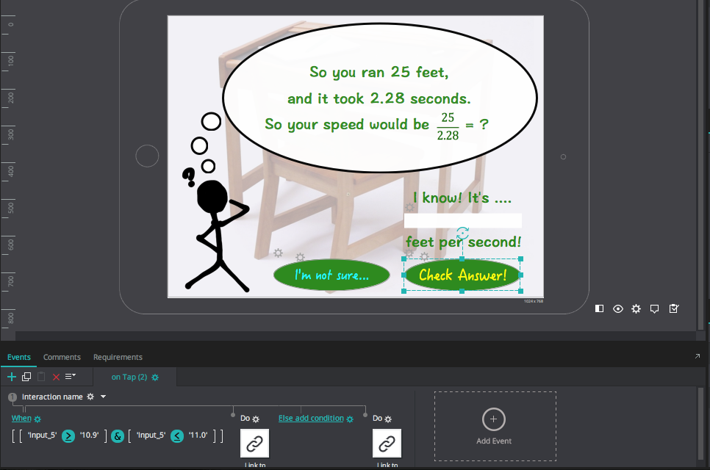
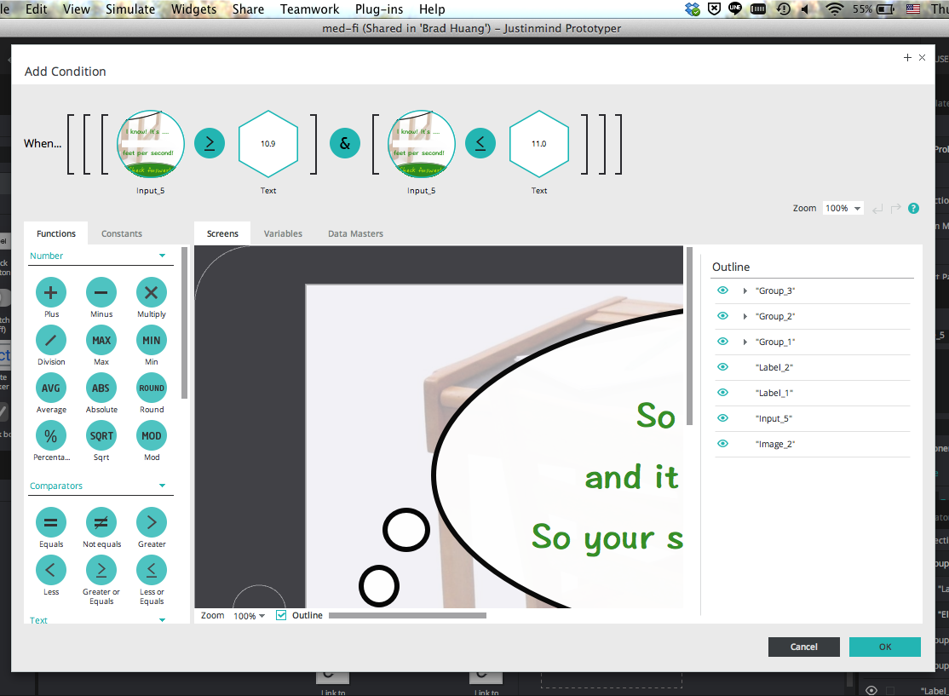
JustInMind - cons
Not intuitive when creating interactive events
Performance issues
Limited overview capability
Teamwork not always working

Slide 19
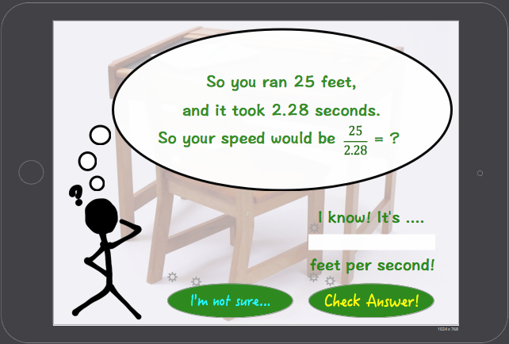
Wizard of Oz

Slide 20
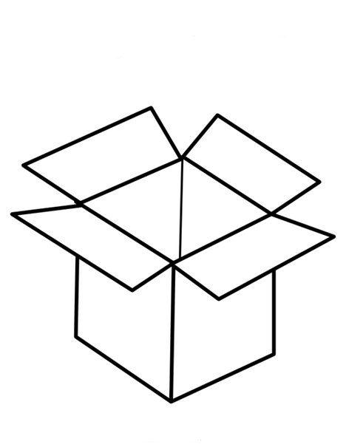

Summary
Improvements in the interfaces
Clear flow between and within different tasks
More improvements needed for dynamic events
However needs database to back up

