Slide 1
Math Outside the Box
Group Members: Ashlee Reynolds, Brad Huang, Charlie Yu, David Young
CS 147 - 10/24/2014

Slide 2
Overview
Mission Statement
Representative Tasks
Lo-Fi prototype structure
3 scenarios shown carrying out each task w/ lo-fi
Experimental method
Experimental results
Suggested UI changes
Summary

Slide 3
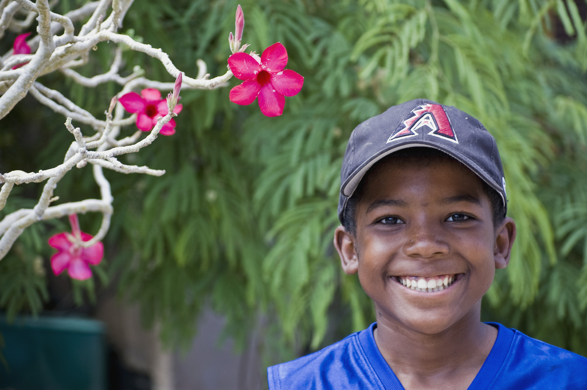
Team Mission Statement
To engage young children with mathematics through fun and instructive challenges

Slide 4
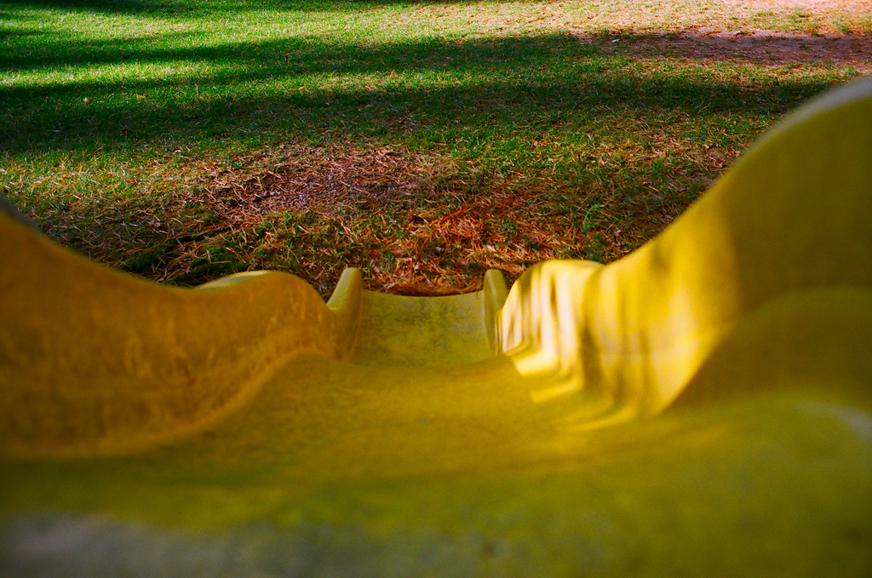
Task 1: Real World Challenge
Their world
Repeatable
“Fun”

Slide 5
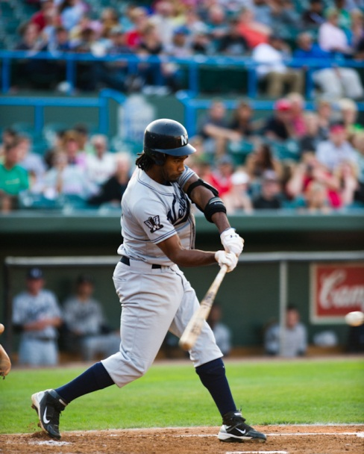
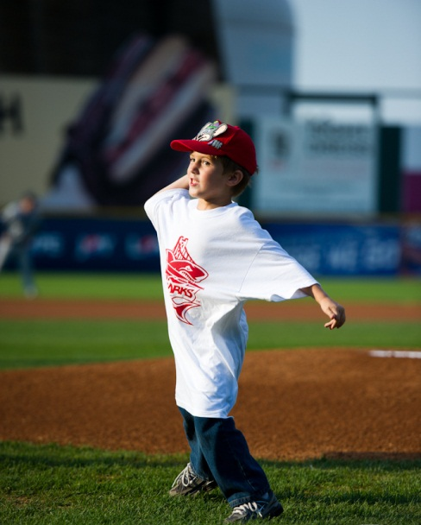
Task 2: Math Challenge
Interesting
Open ended
Memorable
ex: Batting averages

Slide 6
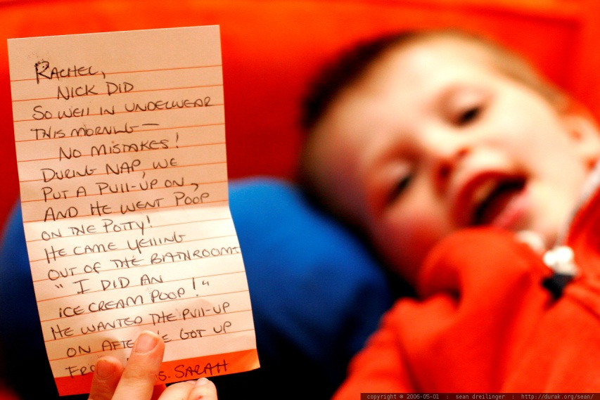
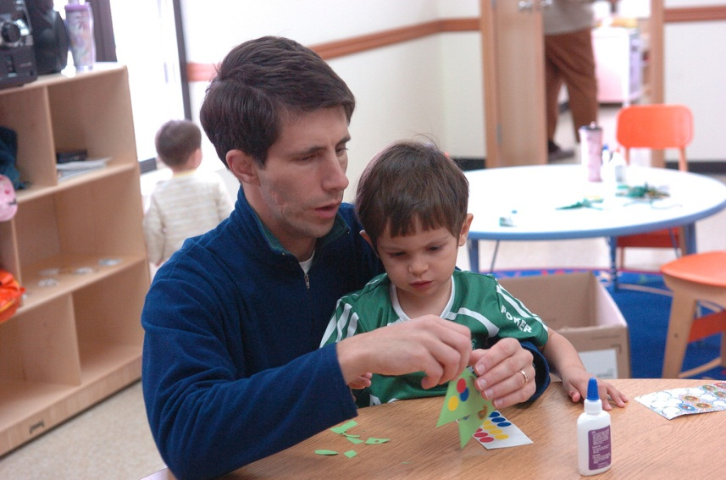
Task 3: Parental Support
Know
Support
Notes:
“his teacher sent him home from pre-school with a congratulatory note for pooping.”
First tests
It was big
It should be one of our major tasks
Simple task because we heard from the parents that they don’t want to be over involved

Slide 7
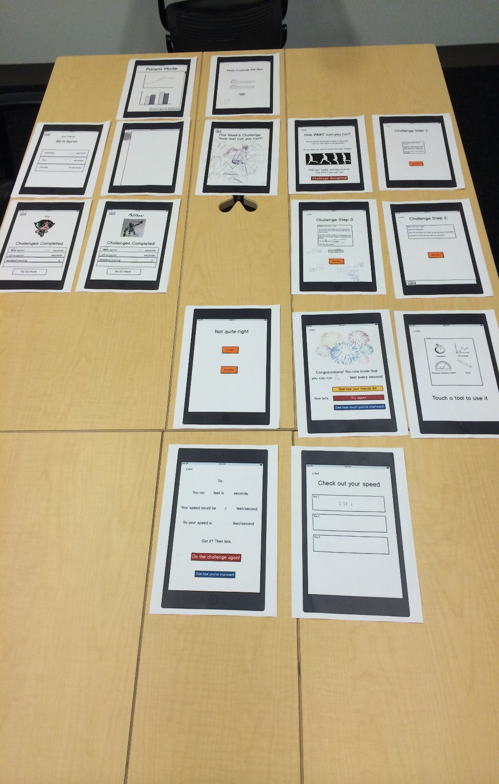
Lo-fi prototype

Slide 8
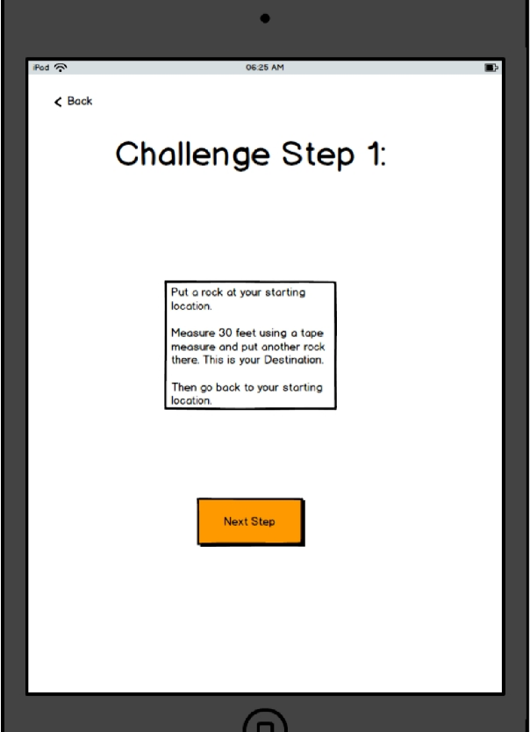
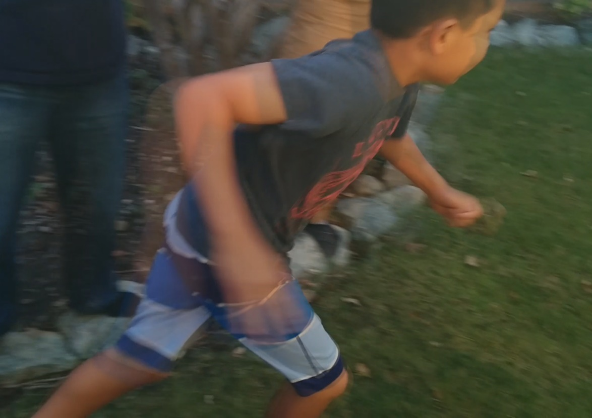
Scenario 1: Real World Challenge Set up a race!
Notes:
--
Screen of challenge step 1
Matthew’s action shot

Slide 9
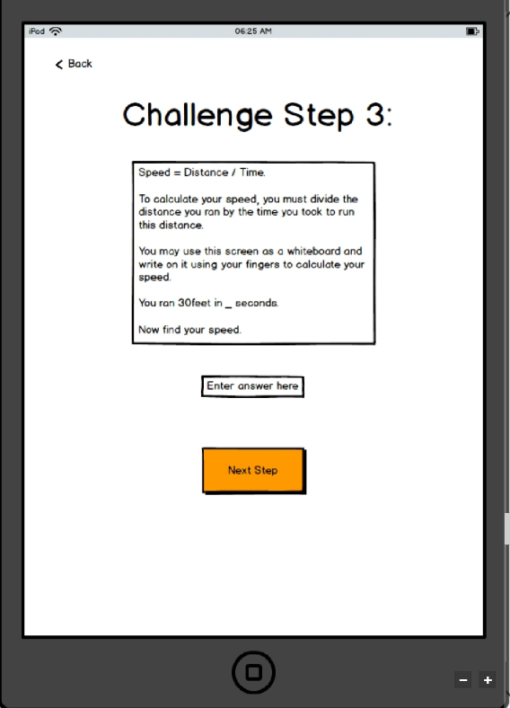
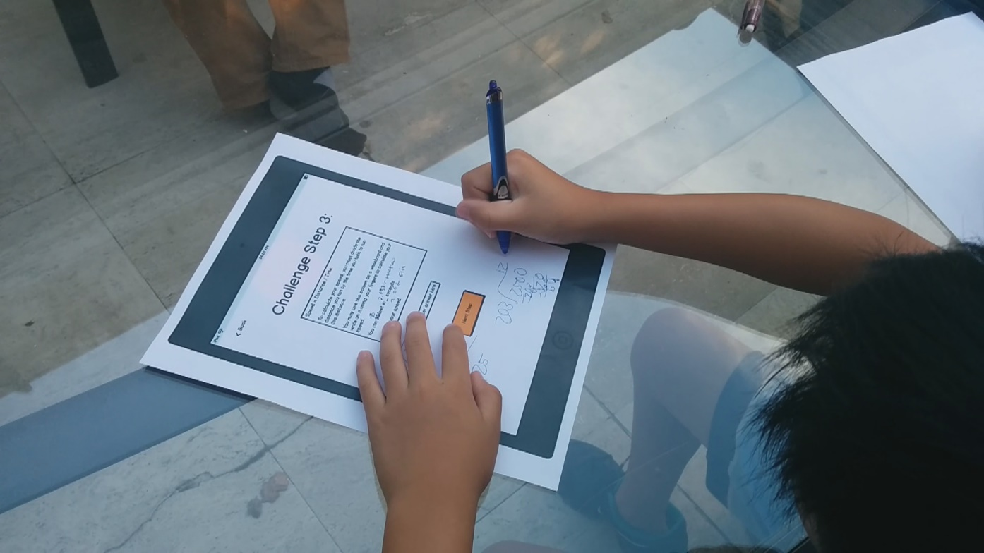
Scenario 2: Math Challenge Calculate your time!
Notes:
--
Screen of matthew
His writing on the paper

Slide 10
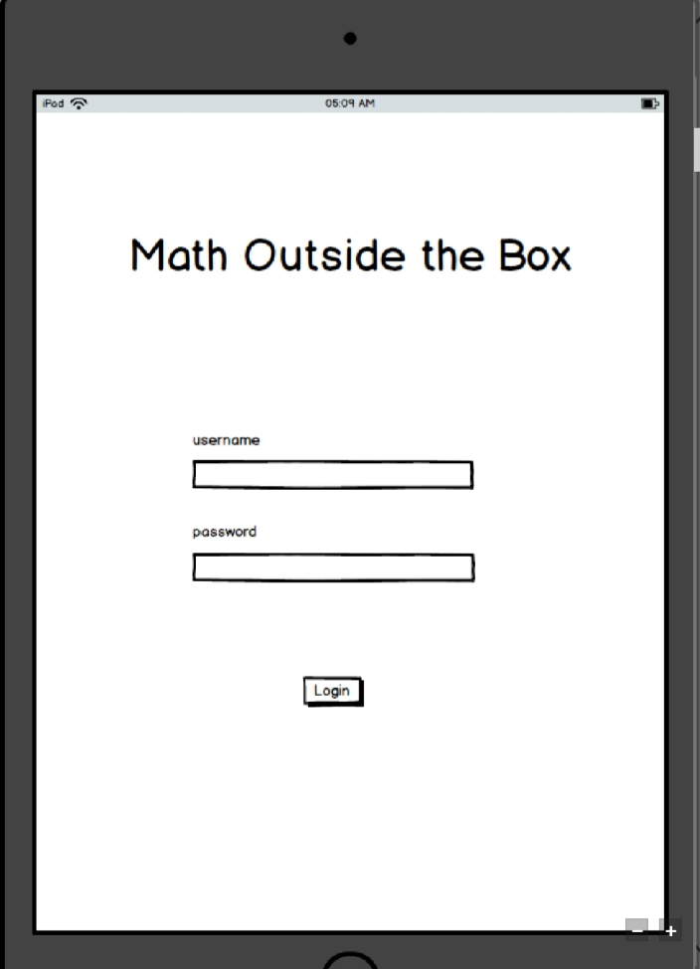
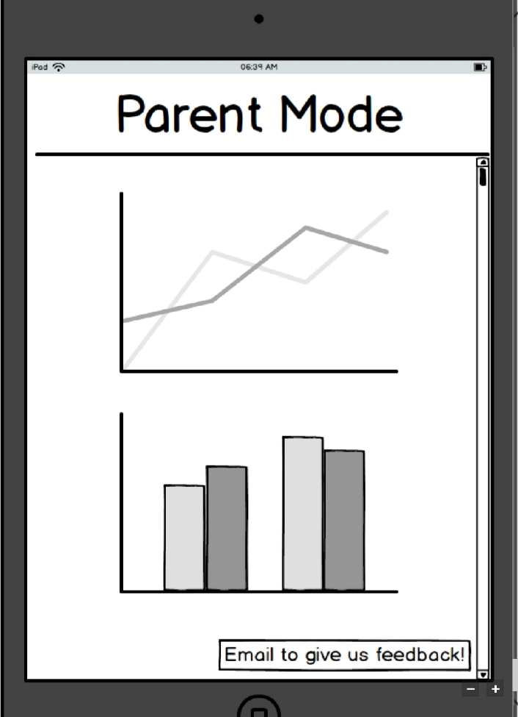
Scenario 3: Parental Support Check up on your child
Notes:
--
Login page
Screen

Slide 11
Experimental Method
Team division
Guided task performance
Think aloud protocol
“What would you do”
Notes:
Ashlee with the paper

Slide 12
Experimental Results - Visual
Button reformatting
Larger and rounder
More and more instructive
Less text, simpler instructions -> more graphics, visuals
Anthropomorphization (personification + cartooning)
Make sure we have common mappings for mathematic operators

Slide 13
Experimental Results - Structural
Condense and simplify
Add semi-transparent note canvas
Add hints along the way
Add rewards that unlock socialization with friends
Add access screens for friends and games
Separate login screens for parents and students
Move to Freemium model
Fix bugs

Slide 14
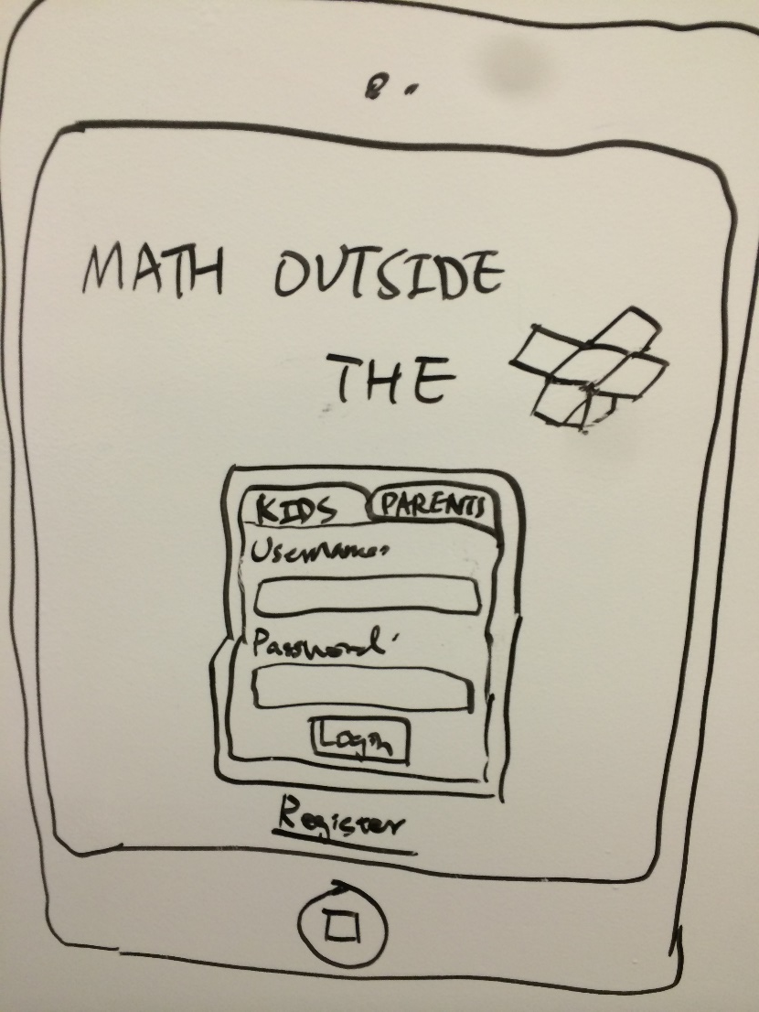
UI Change 1: Login Screen

Slide 15
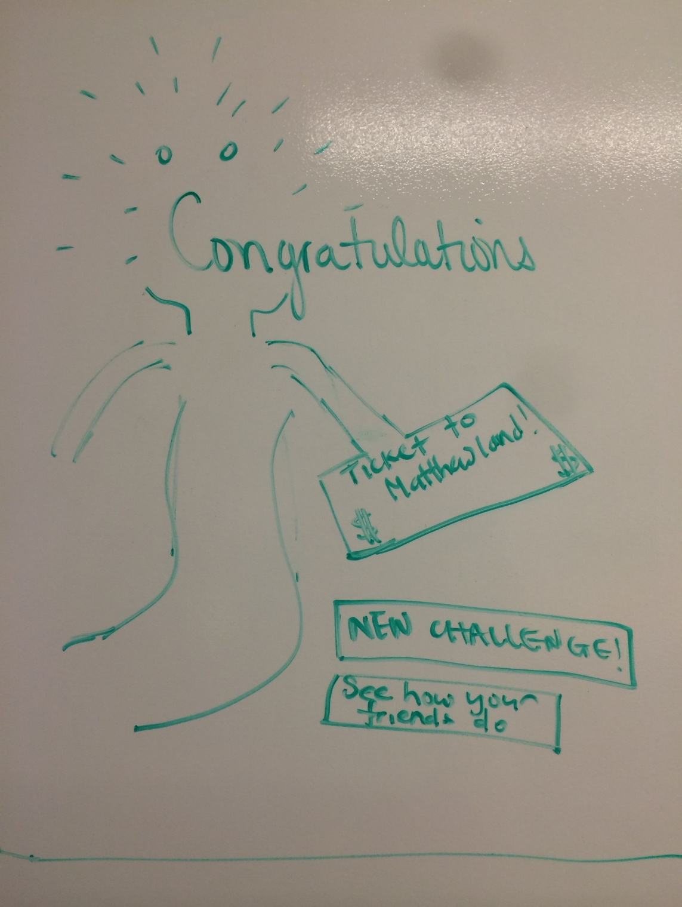
UI Change 2: Personification

Slide 16
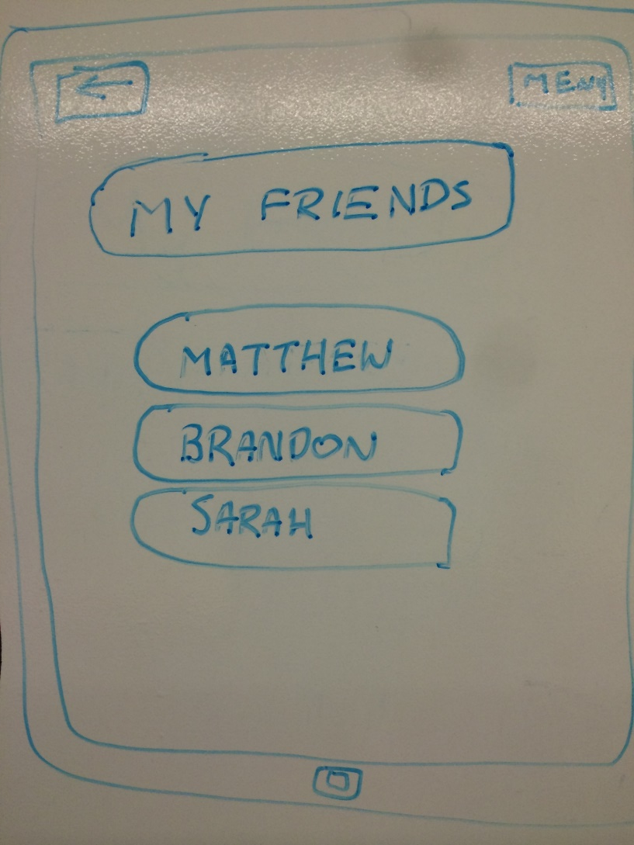
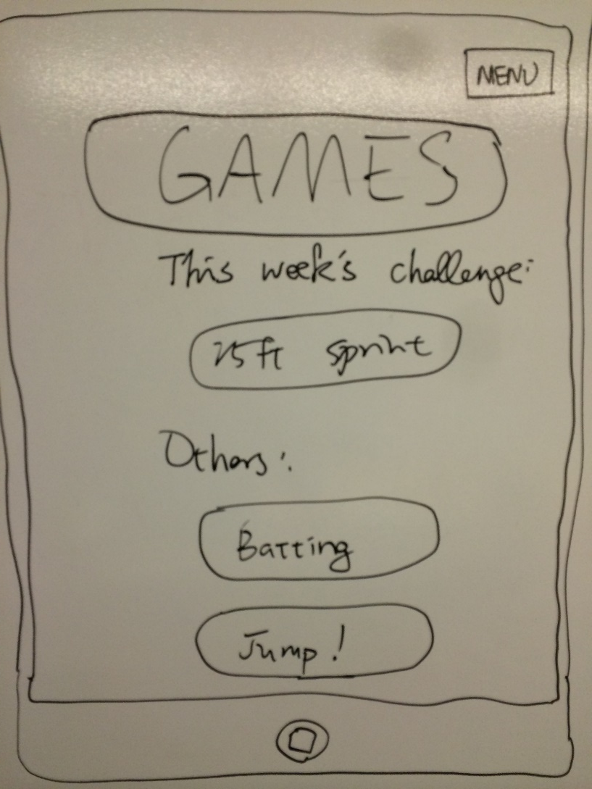
UI Change 3: Access Screens

Slide 17
Summary of Talk
Pivot to Math Outside the Box
Children want to have more interaction
Next steps: Prepare medium fi prototype
Notes:
Cool characters, animations, more guidance moving onto

Slide 18
Sources
Sources:
“Tambako the Jaguar” - https://www.flickr.com/photos/tambako/6257204439/in/photostream/ - Accessed 10/22/2014
Ken Bosma - https://www.flickr.com/photos/kretyen/2506613805 - Accessed 10/22/2014
Nick Aldwin - https://www.flickr.com/photos/ninja999/1733901849 - Accessed 10/22/2014
Jared Polin - https://www.flickr.com/photos/jaredpolin/5148786632 - Accessed 10/22/2014
Jared Polin - https://www.flickr.com/photos/jaredpolin/5148180457 - Accessed 10/22/2014
Sean Dreillinger - https://www.flickr.com/photos/seandreilinger/138514049 - Accessed 10/22/2014
USAG Humphreys- https://www.flickr.com/photos/usaghumphreys/3087535817 - Accessed 10/22/2014

