Slide 1

Math Outside the Box
Ashlee Reynolds, Carey Phelps, David Young, Karen Gomez

Slide 2
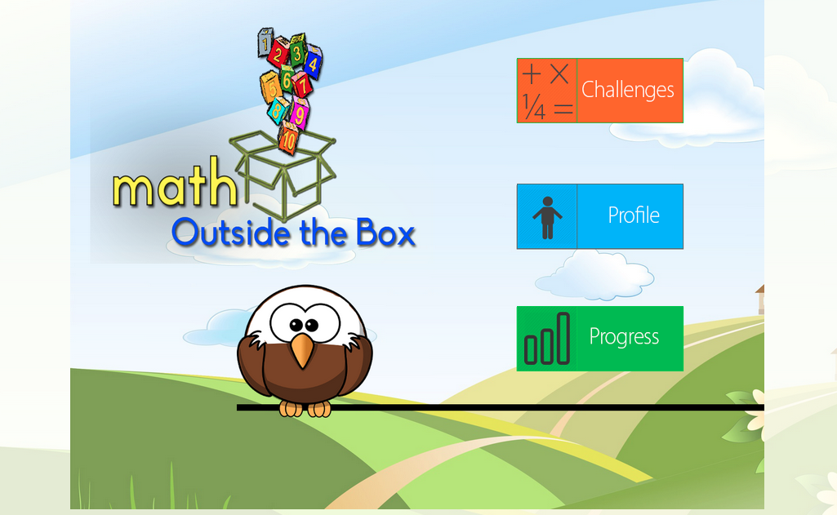
System
Notes:
system being evaluated

Slide 3

Purpose
Notes:
positive design aspects
ease of use and navigation
suggestions for improvementects
ease of use and navigation
suggestions for improvement

Slide 4
Outline
User Testing
participants,
apparatus
tasks
Test Measures
Results
Moving Forward

Slide 5
Participants
Ashlee’s tutees’
two 1st grade students
one 2nd grade student
Student’s parent

Slide 6

Device

Slide 7
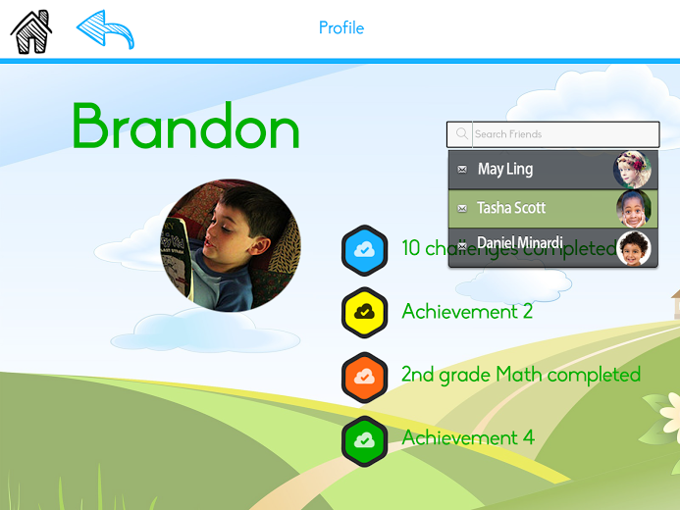
Simple Task
Social: Kid’s Profile Page
Notes:
find information that was on profile page, for example, how many challenges were completed, or how many hours spent on site

Slide 8
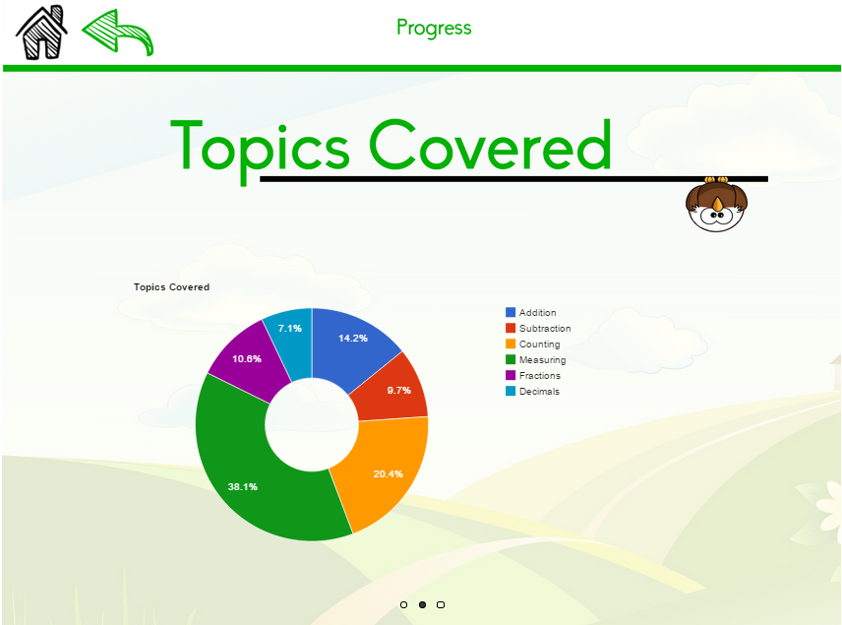
Moderate
Progress: Analysis for Parents
Notes:
-hard coded this data, but the graphics turned out cool and informative as a result of google charts
-Remember Scenario

Slide 9
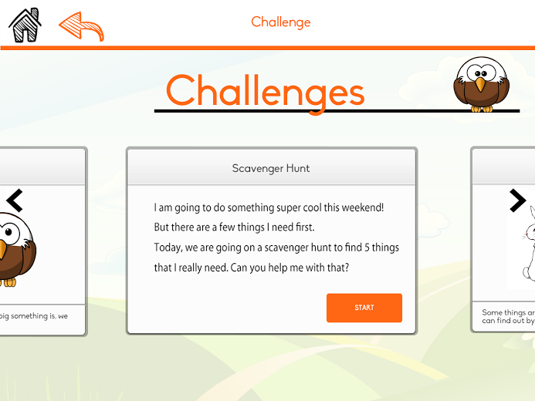
Complex Task
Learning: Challenges
Notes:
this challenge not ones of the ones we implemented but we had the designs done for 3 challenges and only impemented 1
note constraints that led to 1 challenge, and a simple simple one at that
-Remember Scenario

Slide 10

Procedure

Slide 11
Test Measures
time spent completing the challenges
discoverability
ease of use

Slide 12
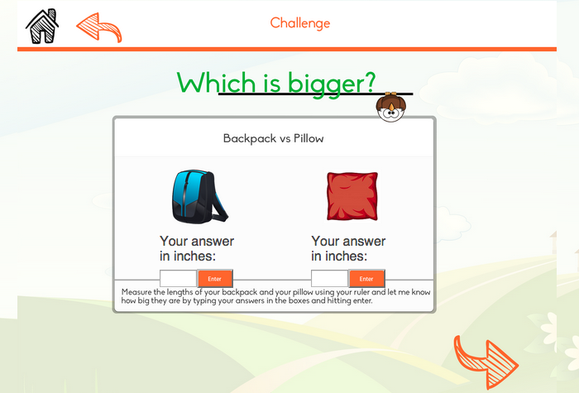
Results
Notes:
make instructions
didn’t know how to measure properly
enter wasn’t clear
numeric keyboard
for first task, 23h4m wasn’t clear

Slide 13

Results
Notes:
-enter button wasn’t obvious

Slide 14
Future Experiments
setup process
have kids create a profile
parent data will dynamically generated
different types of challenges

Slide 15
Design Changes
Kids
more visual instructions
mascot that offers hints/help
“Enter” button
Parents
clearer graphs

Slide 16

Moving Forward
step-by-step instructions
information about state standards
decreasing navigation for child
Notes:
switching between querty and numeric keyboard

Slide 17
Questions?

