Slide 1
Early Stage (lo-fi & med-fi) Prototyping
October 14, 2026
Music: https://soundcloud.com/dansuneroquette
Notes:
Goal to be at 50 min when hit break to have 30 min break (need at least 35 min for second part of lecture)
--- 0 years ago ---
Went 5 min over. Way too long to the break so need to cut more in first half.
--- 1 years ago ---
4 min over. 8 min too long on part one so had to cut break to 21 min. need at least 5 min more for the end.
---- 2 years ago ----
Went 2 minutes over and jammed through last slides with no showing the two tool videos
Did exercise in 5 rather than intended 8 min
Need to cut at least 5 min in first half of lecture (and that would be only allow the 20 min break I did)
--- 3 years ago ----
Goal is 25 min team break at 60 min in
Cut break by 5 min increments for each 5 min past 60 at break
This year we were at 65 min at break so made the team exercise 20 min.
But the low-fi exercise was only set for 5 min and gave them 3 more min when I saw I had time.
Finished exactly on time at 2 hours (may have to cut some for a 1:50 min lecture)

Slide 2

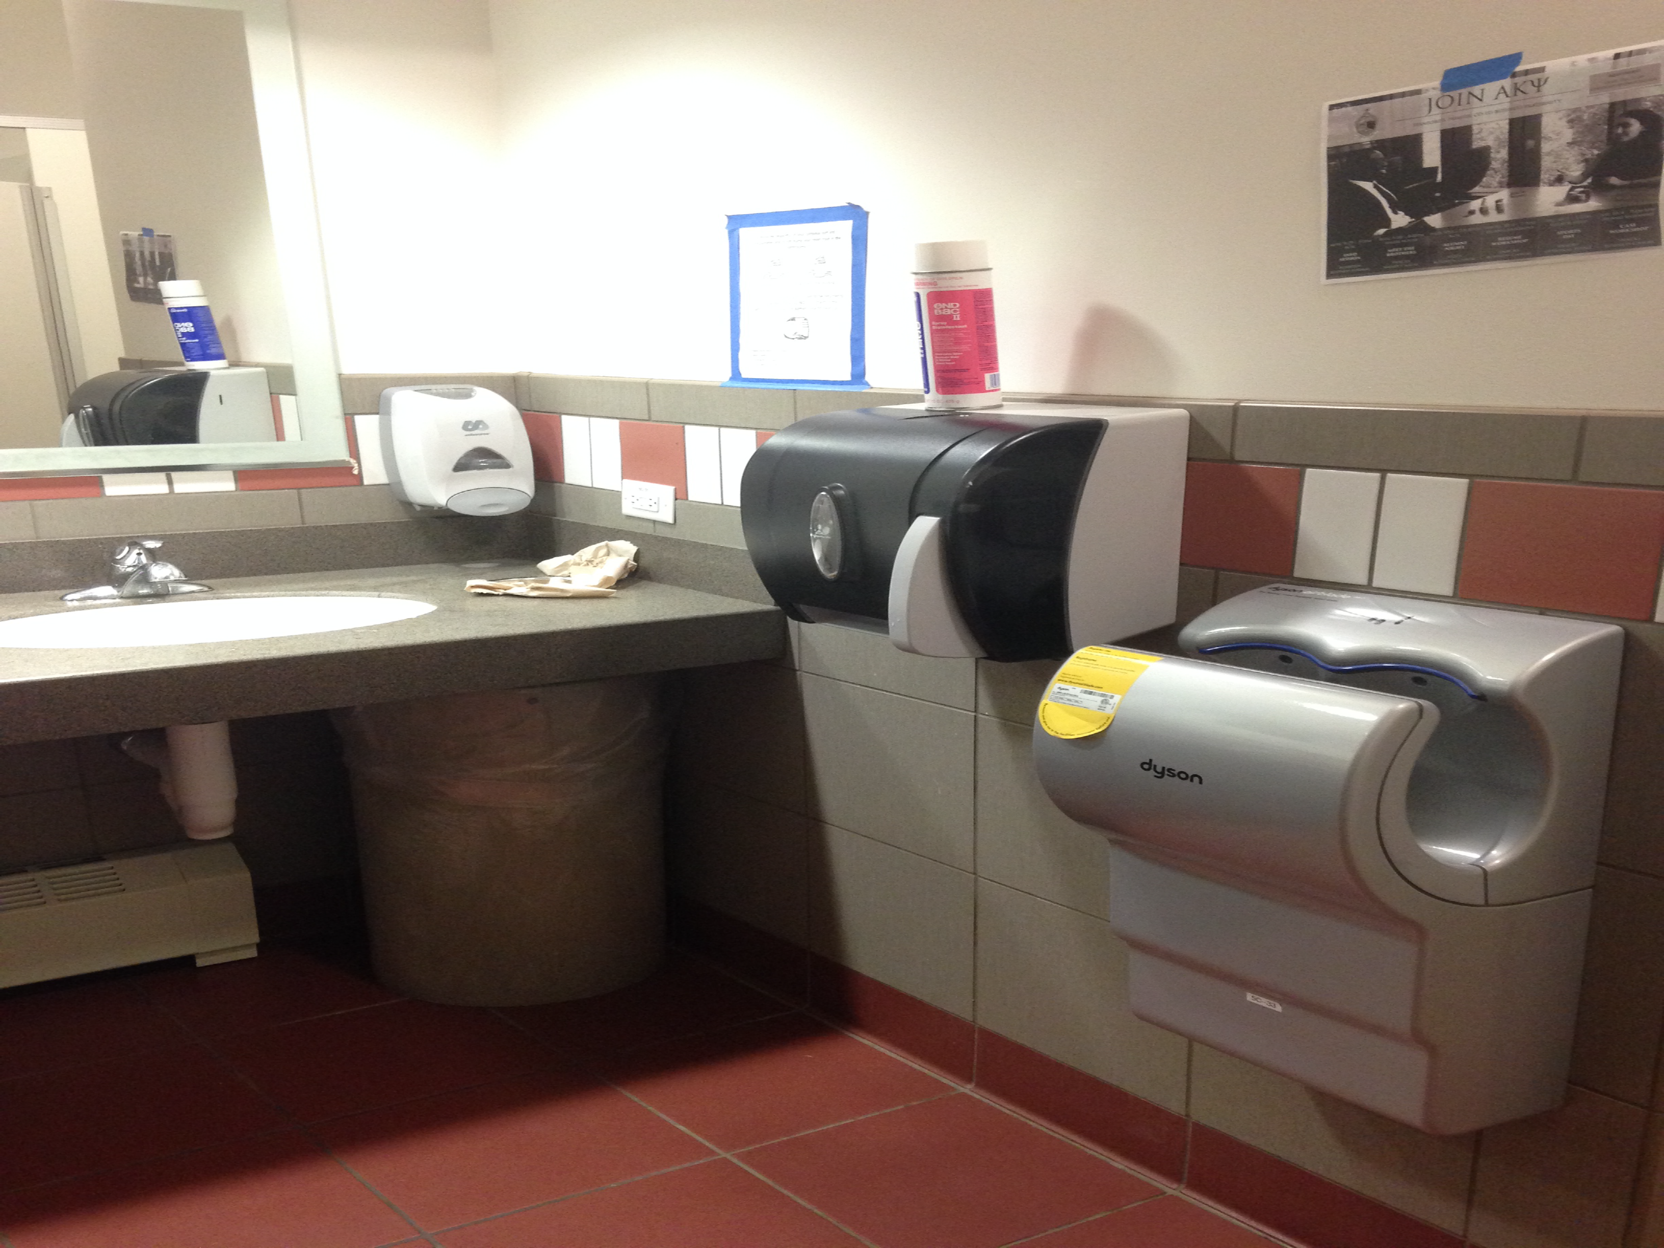
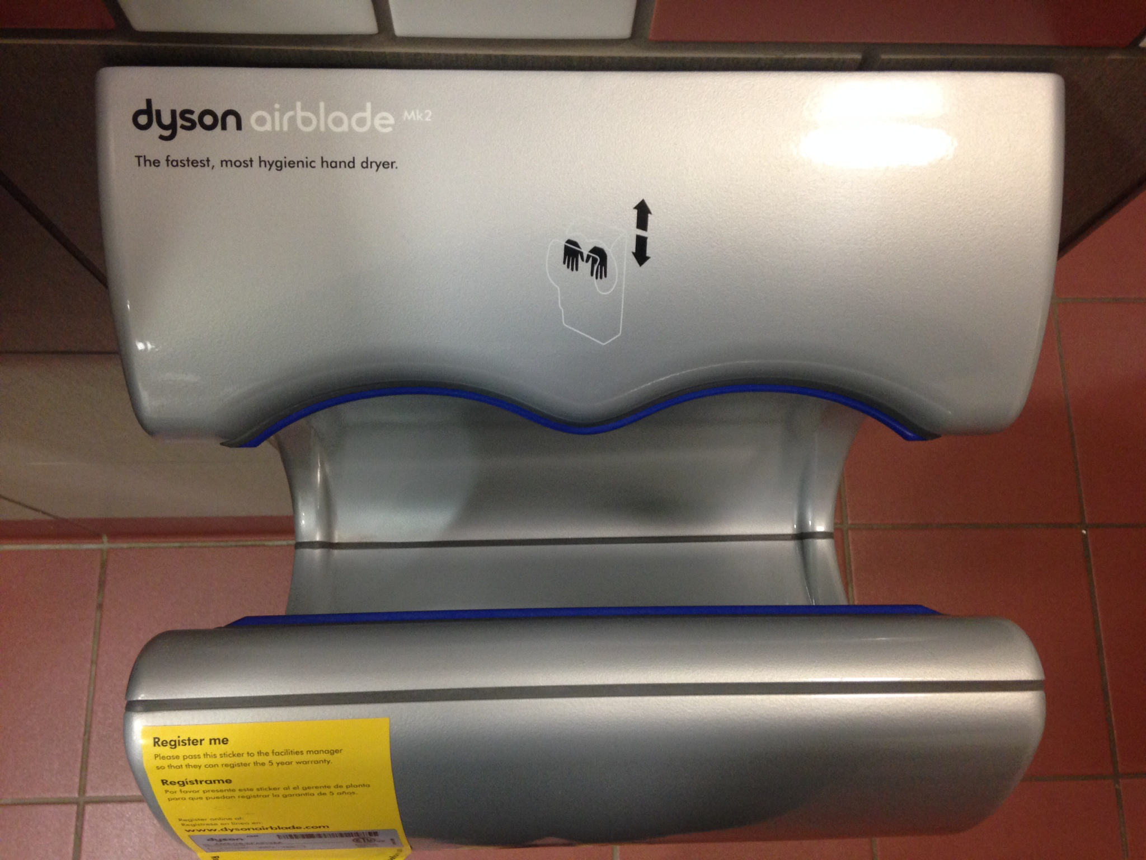
Interface Hall of Fame or Shame?
Dyson AirBlade hand dryer
example courtesy of Maya I.

Slide 3
Interface Hall of Fame or Shame?
Good
  shape indicates function
  so simple that instructions fit in 1 image
  fun!
Bad
  dripping water?
  too much noise
  still takes too long
Dyson AirBlade hand dryer
example courtesy of Maya I.

Slide 4

Interface Hall of Fame!
Good
  shape indicates function
  so simple that instructions fit in 1 image
  fun!
Bad
  dripping water?
  too much noise
  still takes too long
Dyson AirBlade hand dryer
example courtesy of Maya I.
Notes:
Can we do better?

Slide 5
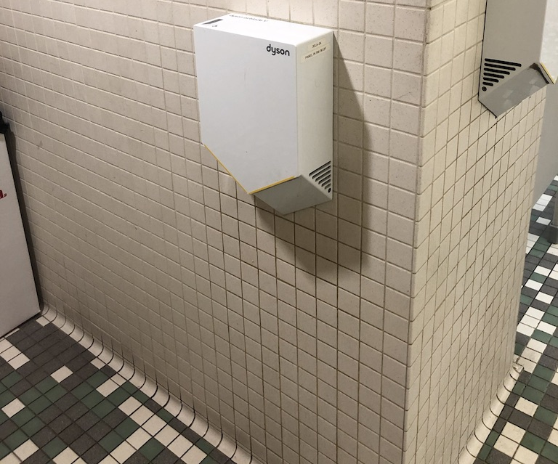
Can We Do Better?
Good?
  Drip on the floor…
Notes:
There are other solutions.
Let the water drip on the ground…
Or…

Slide 6
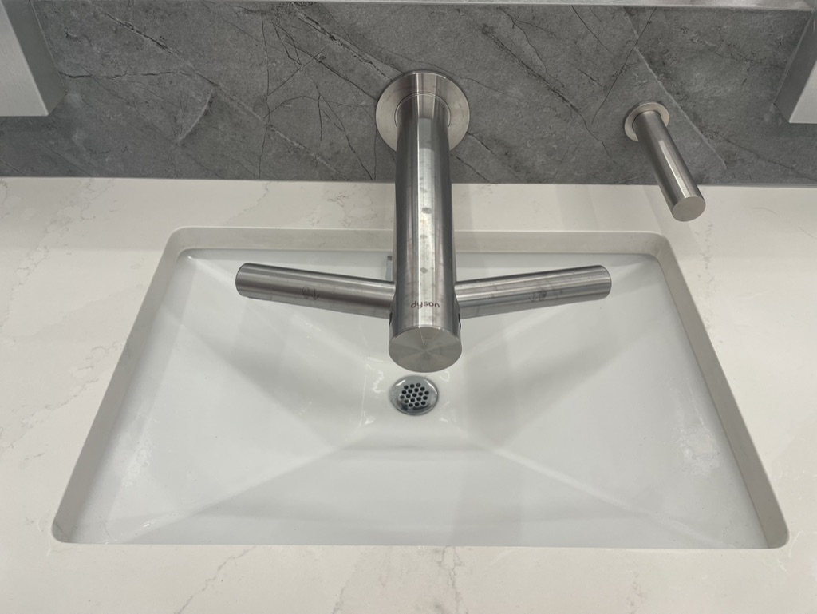
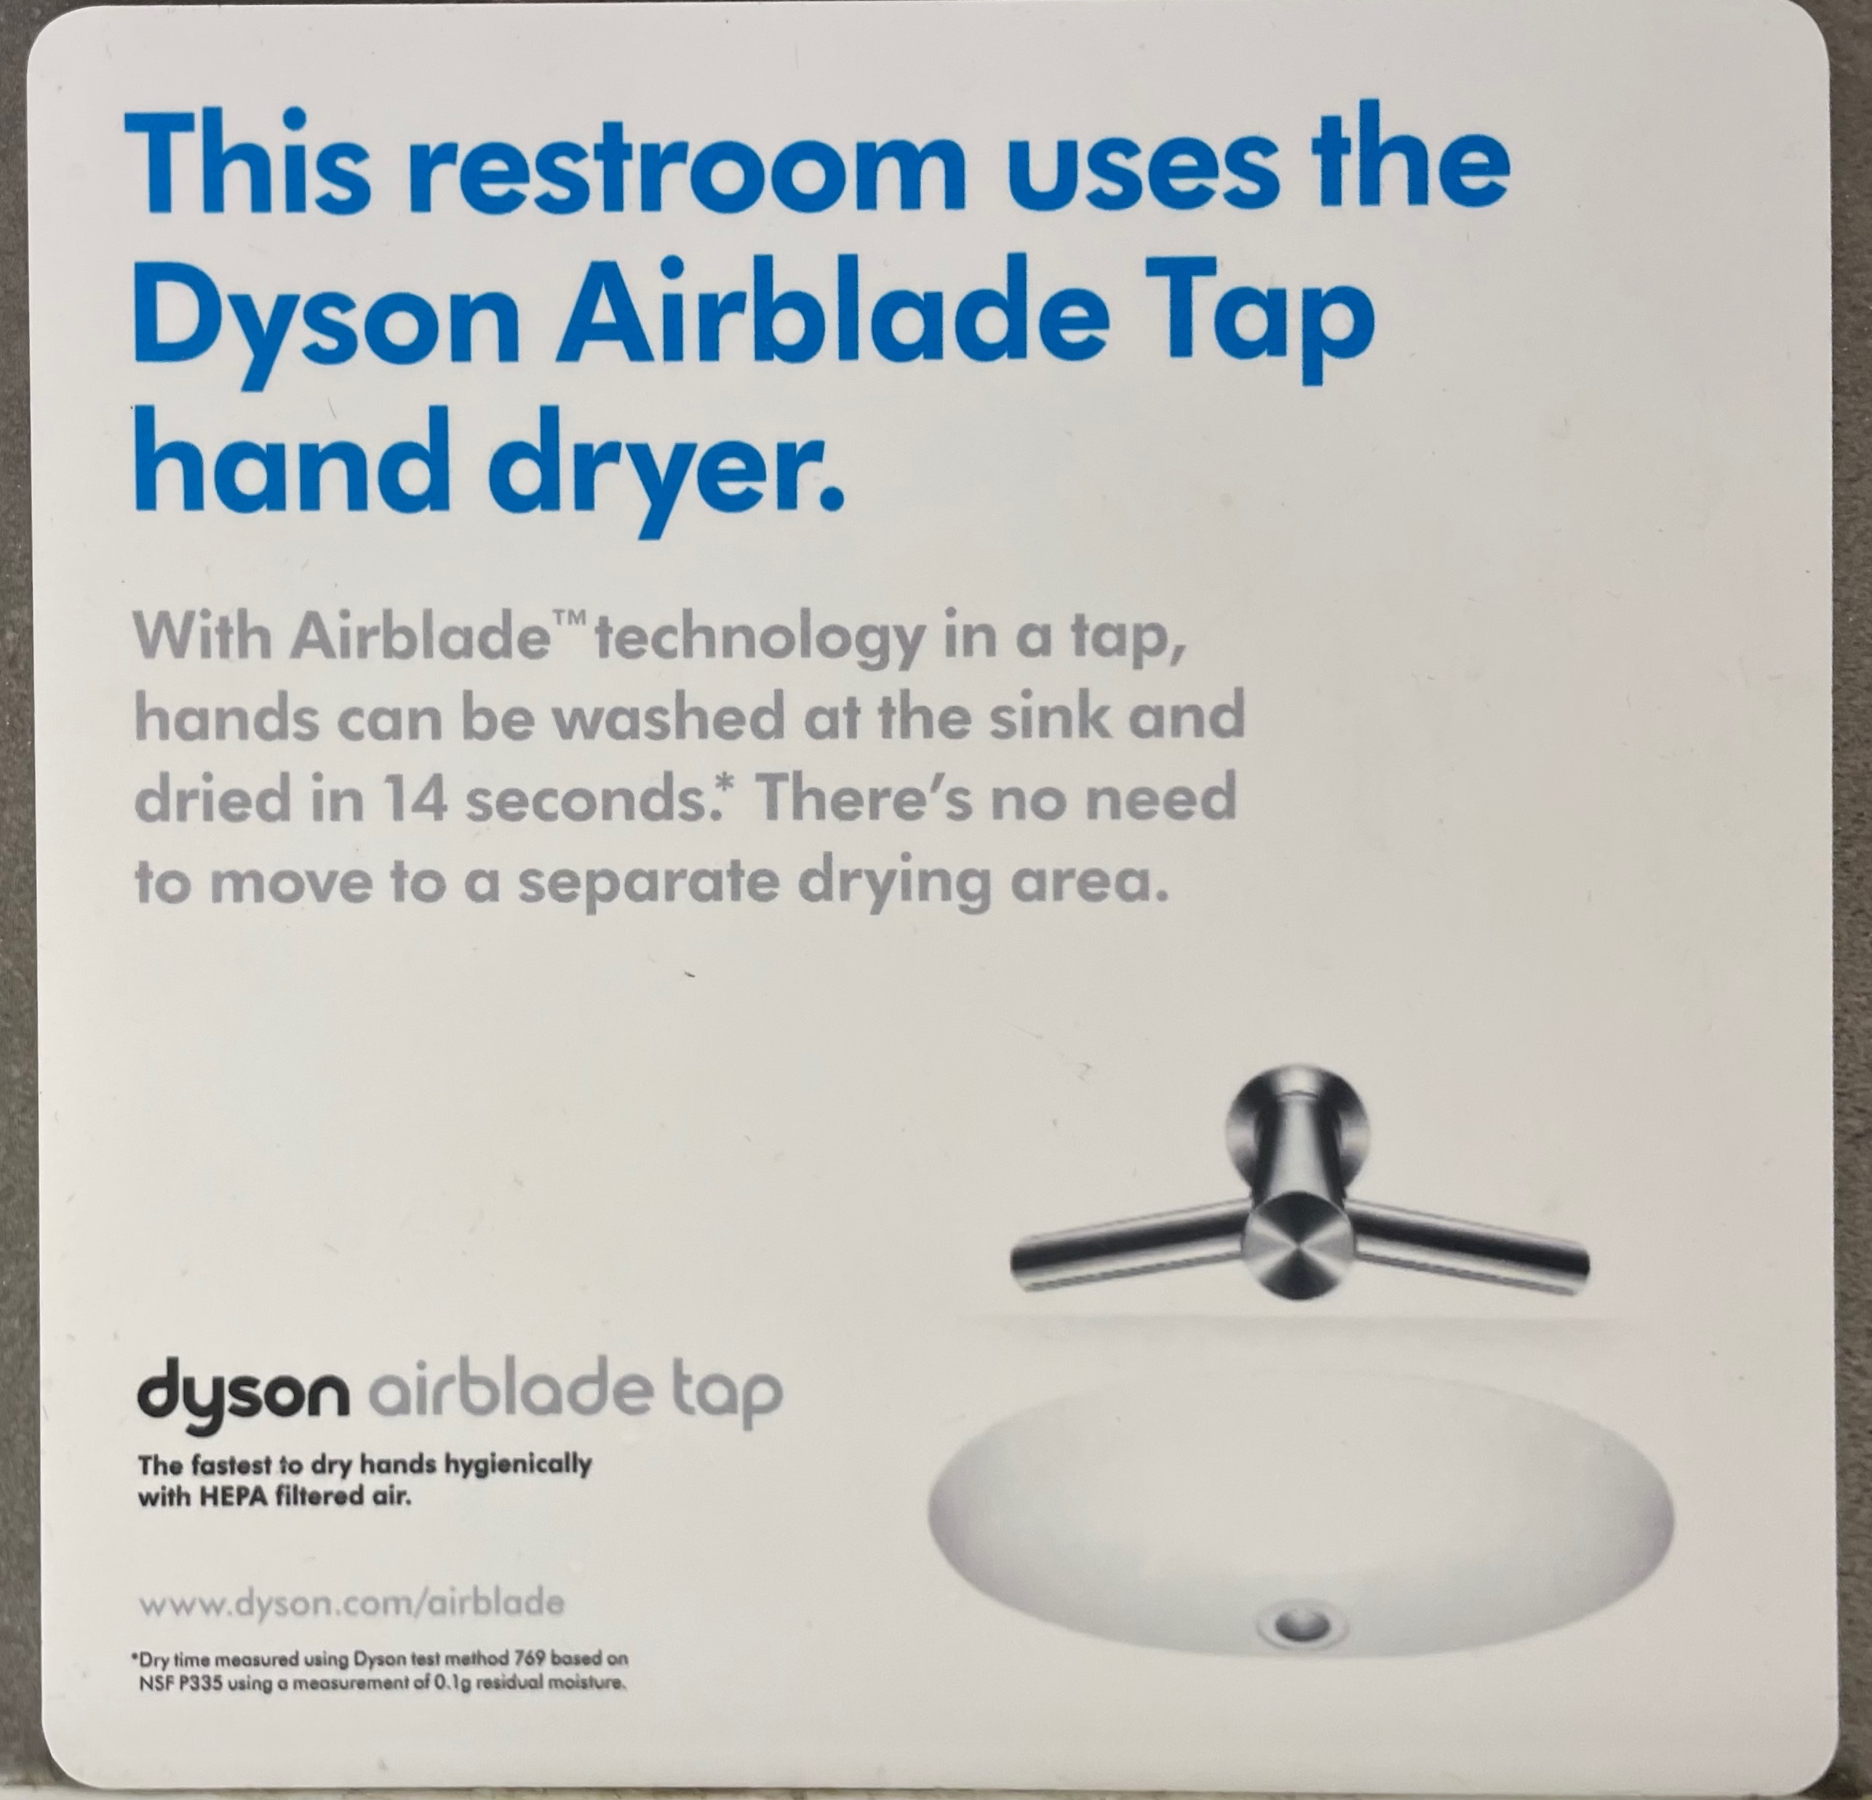
Can We Do Better?
Good
  Integrate hand dryer into sinks…
Notes:
[ADVANCE]

Slide 7
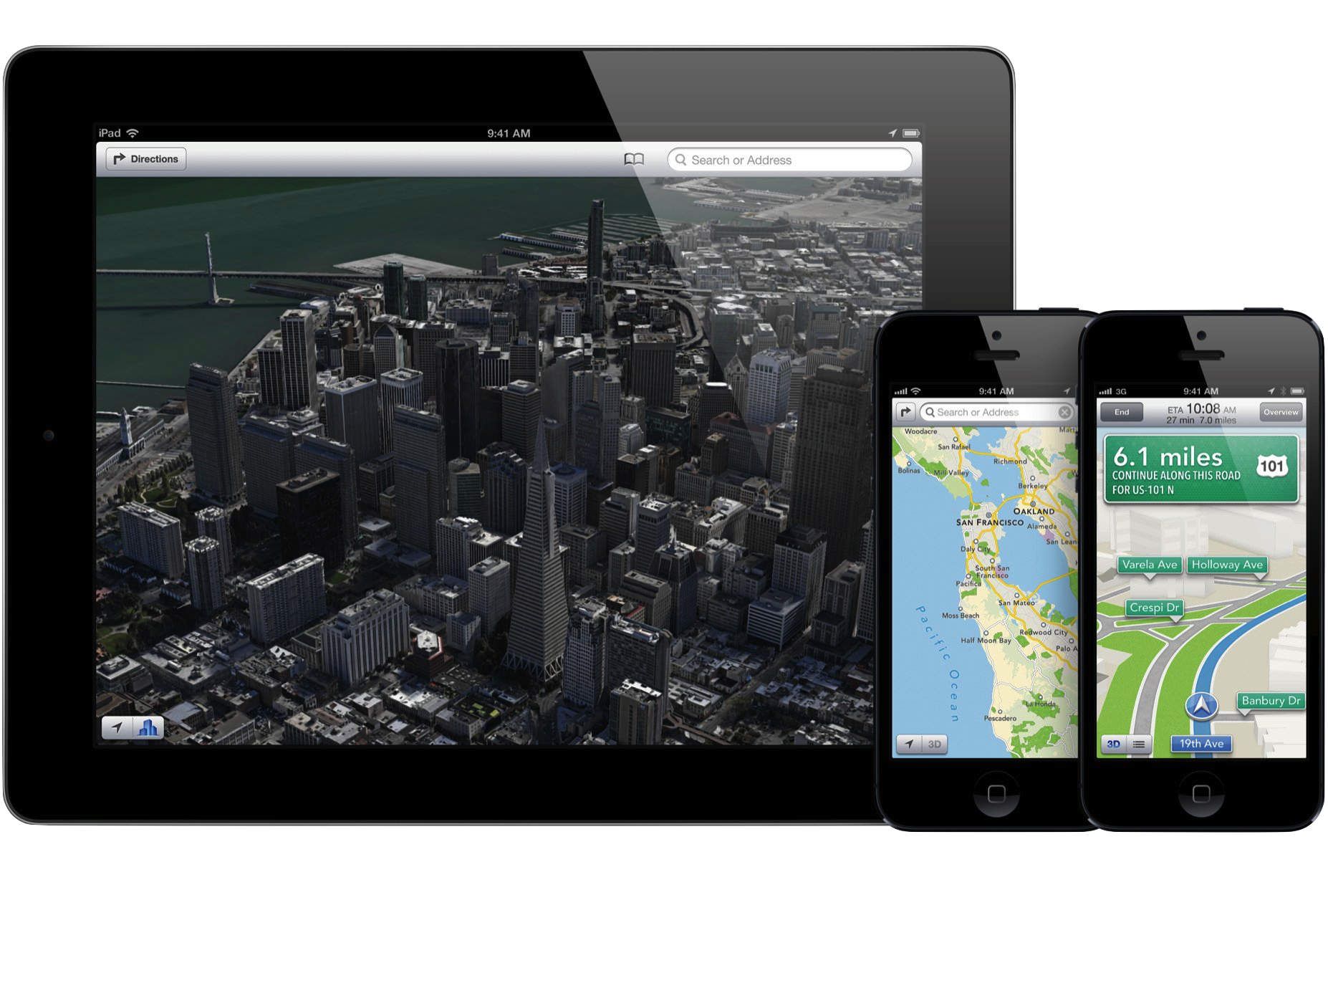
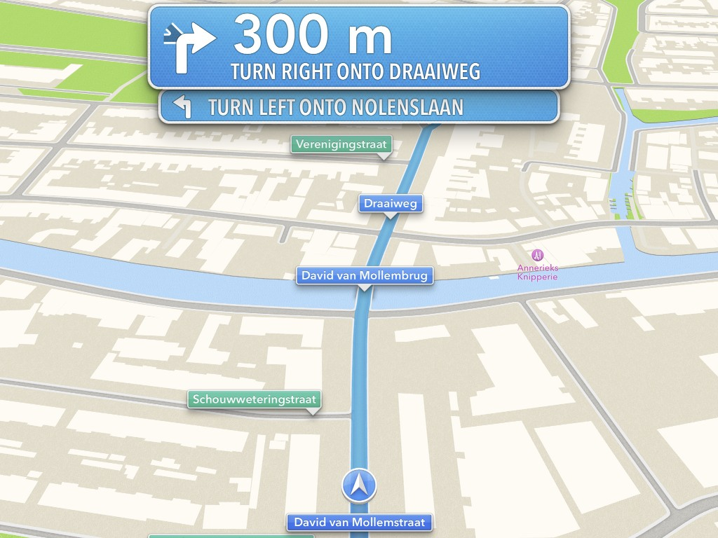
Hall of Fame or Shame?
iOS 6 Maps
By Apple Inc.
Notes:
Beautiful presentation of maps and driving directions
Launched in September of 2012 (now 11 years ago we are on iOS 17 now)
[ADVANCE] to see driving directions
Thumbs up to Apple maps in the slack channel if you primarily use it and
Thumbs up to Google maps if you primarily use that.
What is Good?
What can be improved?
Anyone know what was wrong with it? [changed the future leadership of the company]

Slide 8
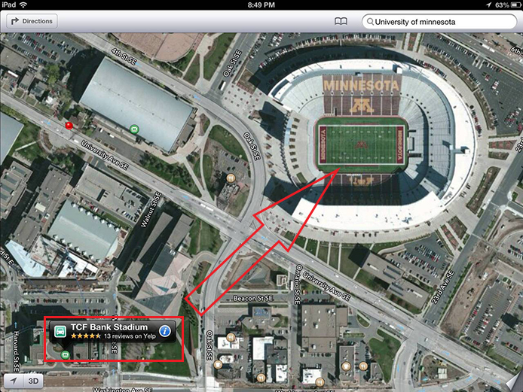

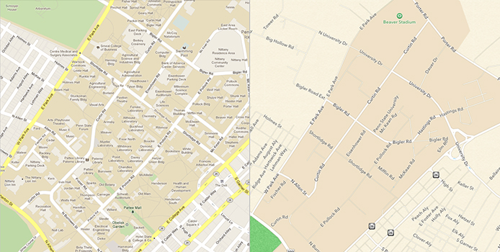
Hall of Shame!
Good
  beautiful alternative to the competition & generally easier to read
  turn by turn directions are efficient, clear & functions well – in general
Bad
  despite any aesthetics, the data is wrong & sparse, meaning, it does not perform the one task it should do well – getting from A to B
iOS 6 Maps
By Apple Inc.
Notes:
Unfortunately, when it came out it was a major hall of shame.
There was some good.
[ADVANCE]
But there was a lot of bad.
[ADVANCE]

Slide 9
Hall of Shame!
Google Maps Data vs iOS6 Maps Data
Notes:
Penn State campus area…

Slide 10
Hall of Shame!
A clear example of where no matter how good a design may be, without supporting its most important task, in this case finding a place with correct data, the interface is useless
iOS 6 Maps
By Apple Inc.

Slide 11
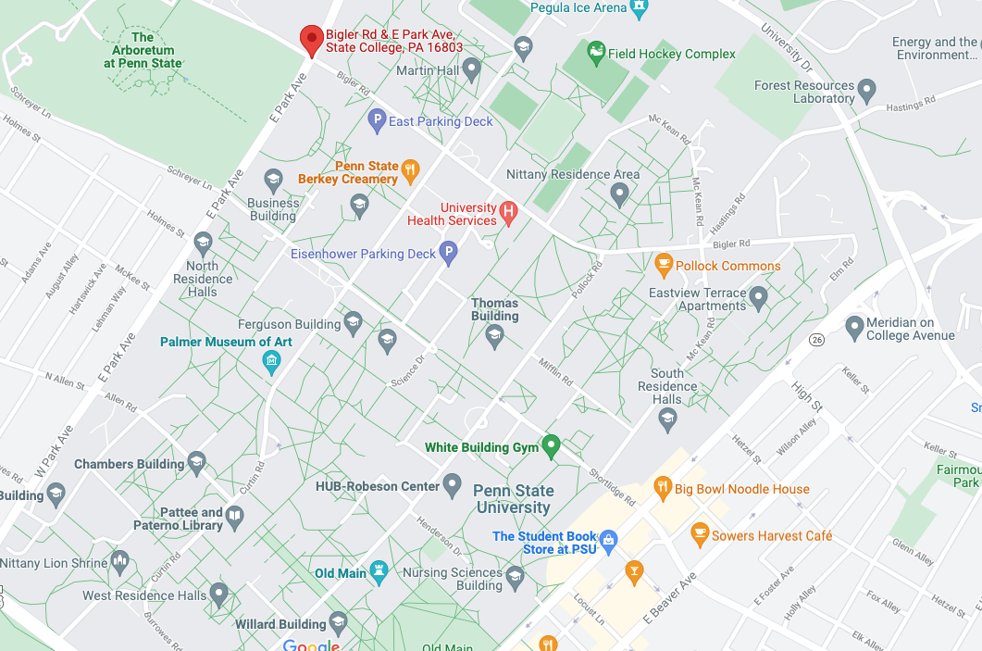
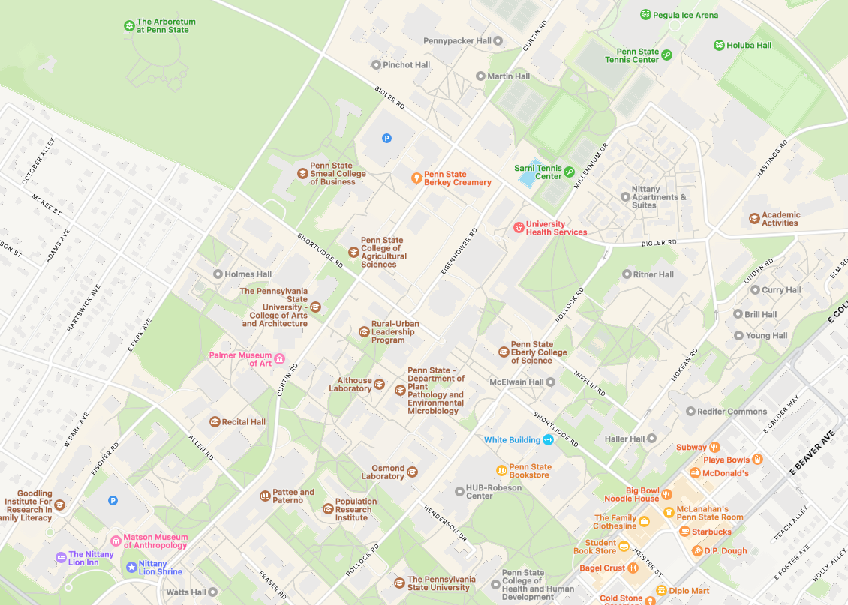
Hall of Shame!
Google Maps Data vs iOS14 Maps Data – much closer in quality
Notes:
Penn State campus area…

Slide 12
Early Stage (lo-fi & med-fi) Prototyping
October 14, 2026
Music: https://soundcloud.com/dansuneroquette
Notes:
LAPTOP POLICY – reminder
Today we are going to talk about how you start prototyping an interface in the early stages of design. You will do this for your assignment next week.
Goal to be at 50 min when hit break to have 30 min break (need at least 35 min for second part of lecture)
--- two years ago ---
Ended exactly on time (with 30 min break at 55 min in – started 5 min late), so PERFECT number of slides for a 2:00 lecture (may need to cut for 1:50)

Slide 13
Outline
Sketching vs. Storyboarding
Prototyping
Low-fi prototyping
Conducting a low-fi test
Medium-fi prototyping
Notes:
Today we will discuss
- sketching vs. storyboarding
....
Why are we learning this.
The costs to fix problems in a design go up by a factor of 10 at each stage in the process. Finding problems early and fixing them is far cheaper. These low-fi prototyping and testing methods let you find problems quickly and cheapy and iterate fast.

Slide 14
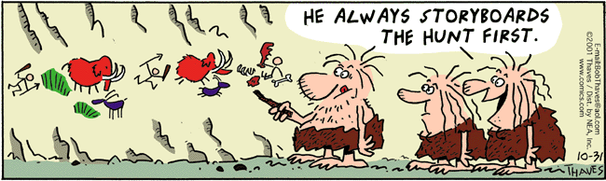
Sketches & Storyboards
Where do storyboards come from?
  film & animation
Give you a “script” of important events
  leave out the details
  concentrate on the important interactions
Notes:
Let’s first talk about sketches & storyboards. Where do storyboards come from?
[ADVANCE]
That’s why we asked you to storyboard your concept videos
[ADVANCE]
Give you a script of key events

Slide 15
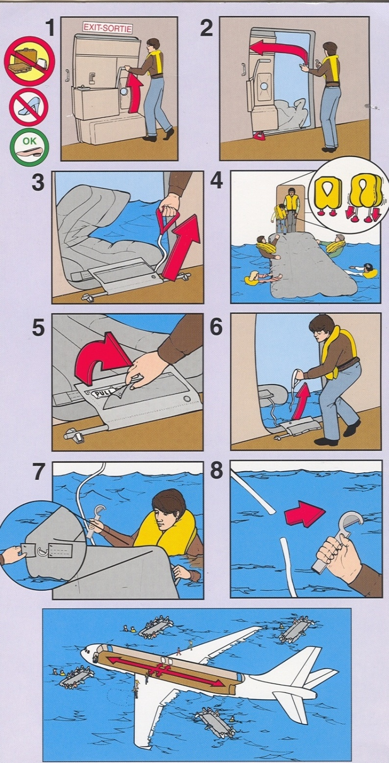
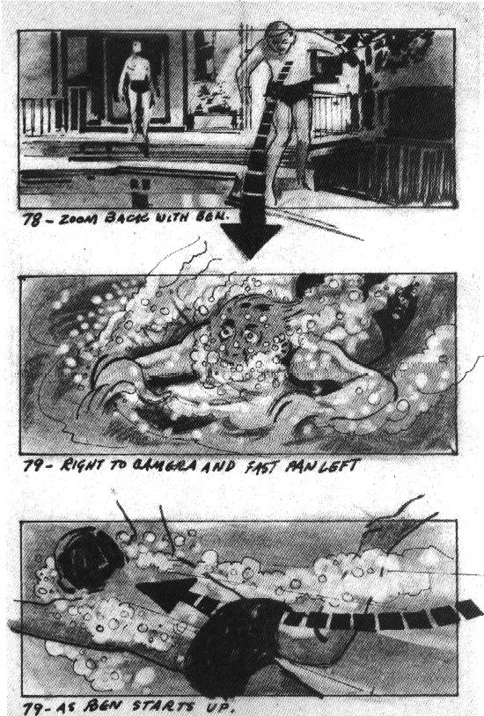
Notes:
Here are some storyboards from a TV show
"zoom back with ben"
"right to camera and fast pan left"
"as ben starts up" -- see the arrow also
[ADVANCE]
or you see this on the plane whenever you travel. Only the key steps are depicted.

Slide 16
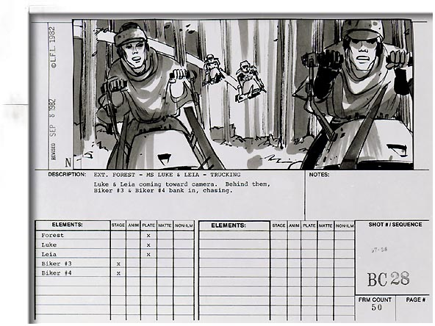
Notes:
Here is one from the Star Wars Film episode VI: Return of the Jedi as troopers on speeder bikes chase Luke and Leia.
The team, especially the director, can see what they expect to do and what to shoot. By planning in advance, they get the right things there at the right time,
[ADVANCE]

Slide 17

Notes:
[ADVANCE]
…., but they could also change it. Maybe we don’t want to be in the trees. And they can make that decision earlier rather than when filming already.
[watch for only 30 sec or so when they start bumping the other speeder]

Slide 18
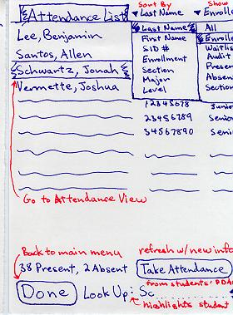
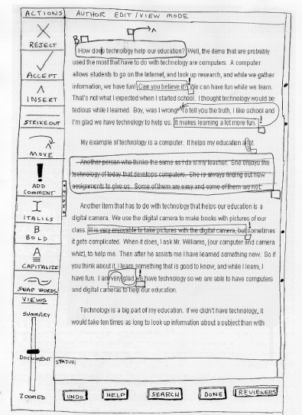
Sketches & Storyboards in UX Design
Greeking
Notes:
This is the level of detail and fidelity you should be sketching in studio this week. Purposely rough. Remember a sketch. Not straight lines. Alignment not perfect. No more detail or resolution than you need. Leave things out.
[ADVANCE]
Notice the "greeking"
[ADVANCE]
See how in this e-reader the interface controls are clearly sketched but they made the text look real to give a sense of that isn't what you are interacting with. you are interacting on top of it.

Slide 19
Sketches & Storyboards in UX Design
Notes:
You are just quickly exploring the space of possible modalities for your interactions…
web site version for a medical application. ChemoSync
[ADVANCE]
Here a watch or voice control version.
Again, really rough and basic.

Slide 20
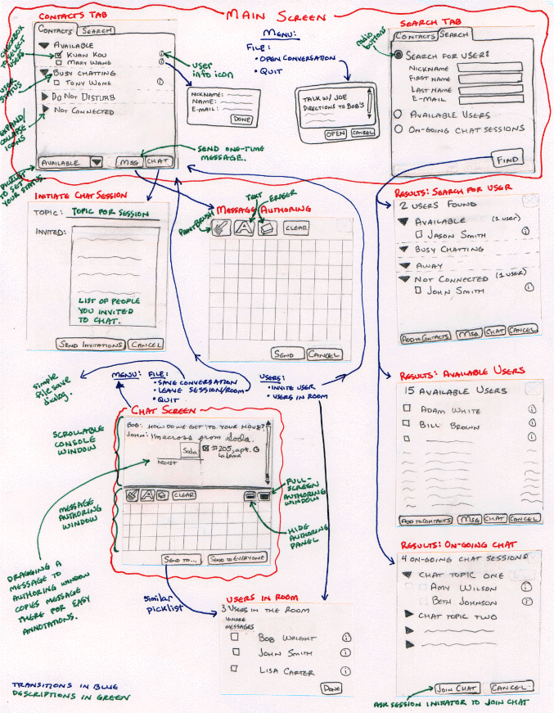
Ink Chat
Starts to tell a story, but still describes the design
Notes:
combination of the two (a sketch AND a storyboard)
[ADVANCE to zoom in]
[ADVANCE]
It starts to tell a story, but still describes the design. See some annotations are about what the functionality is (in red & green), and some are about showing the transitions from screen to screen (in blue)

Slide 21
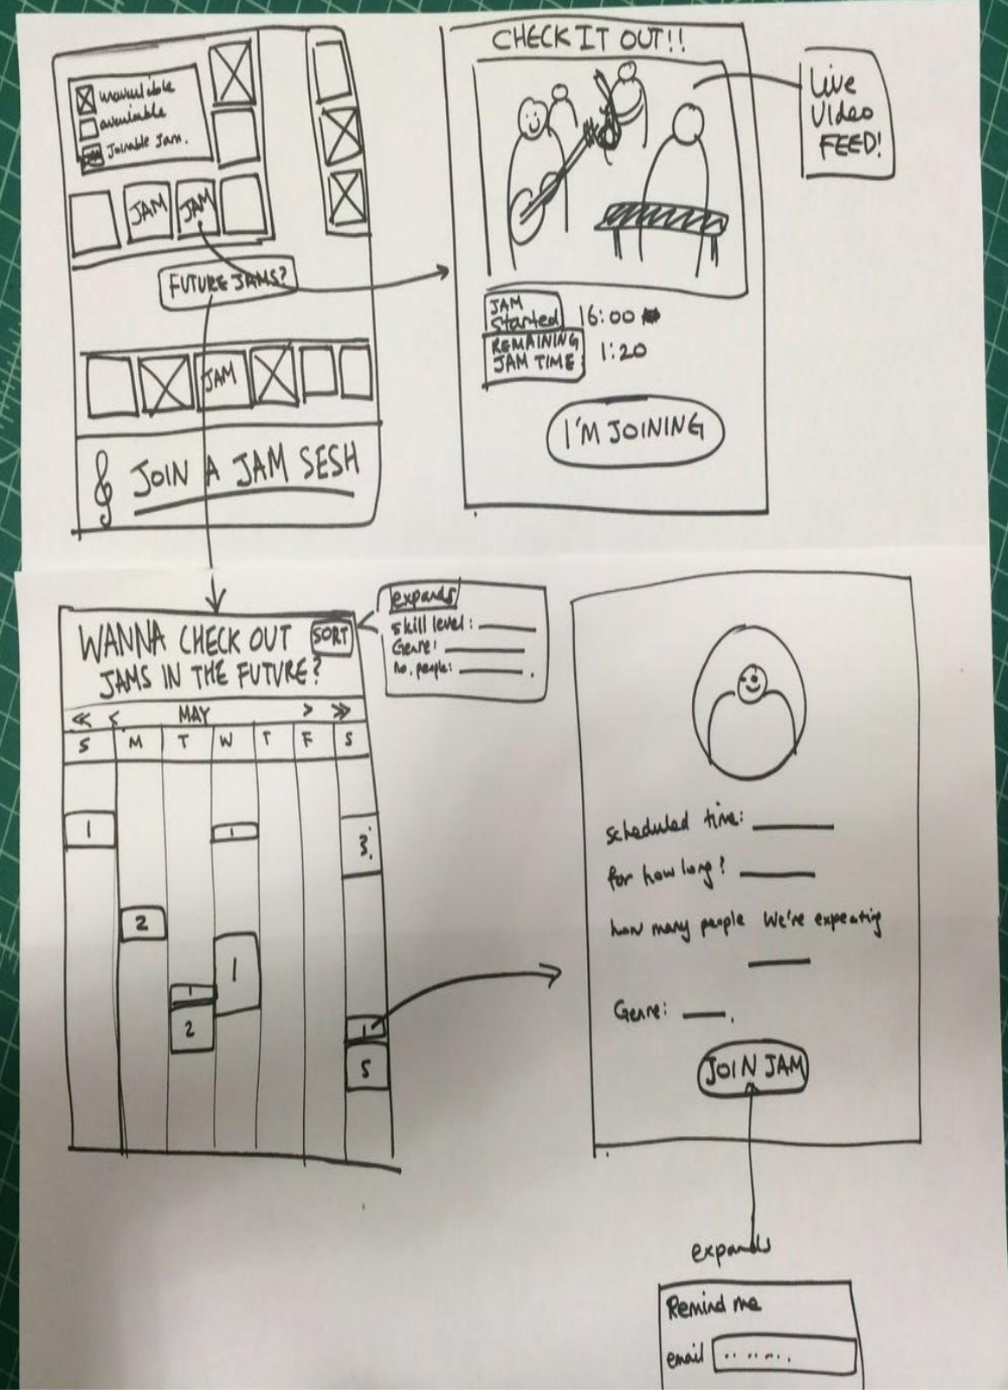
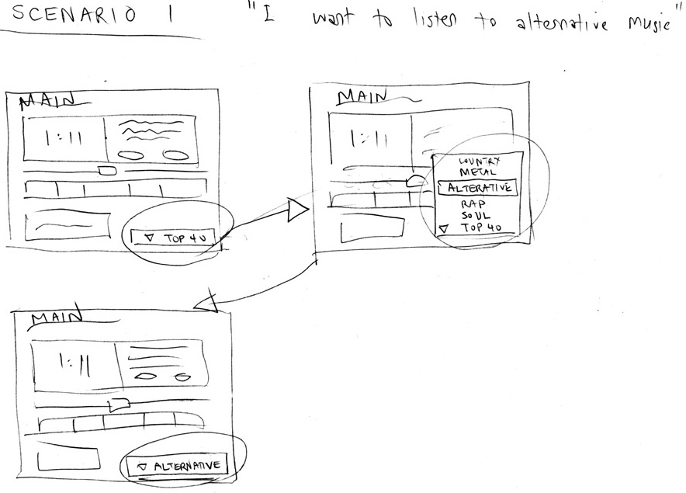
Sketches & Storyboards in UX Design
Task:
Task Flow #1
Task Flow
(Wireframe)
Notes:
Now these are storyboards or task flows.
They allow us to show interaction and time.
[ADVANCE]
This is a task flow (also called a wireframe)
is this a form of prototype? Let’s define a prototype more carefully

Slide 22
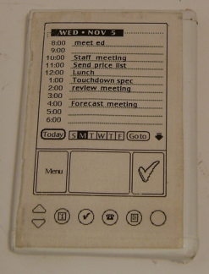
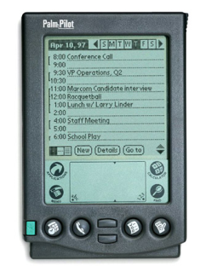
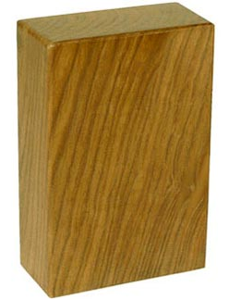
What is a Prototype?
“A prototype is an early sample or model built to test a concept or process or to act as a thing to be replicated or learned from.”
– Wikipedia
CS147 definition: a working representation of a final artifact
http://www.computerhistory.org/collections/accession/102716262
Notes:
What is a prototype? [ask class]
[ADVANCE]
Definition
[ADVANCE]
CS147 definition: “a working representation of a final artifact”
[ADVANCE]
Jeff Hawkins carried around a block of wood like this in his pocket & pulled it out when meeting people and used a pen to act like he was adding things to his device.
This led to the prototype in the middle & the final product: PalmPilot (right).
This is one of the most important prototypes ever made as it is considered the pre-cursor of today’s smartphone.

Slide 23
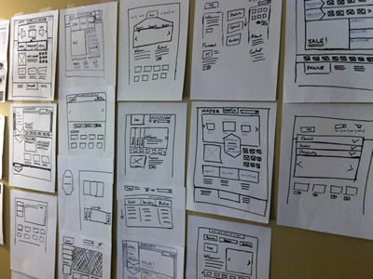
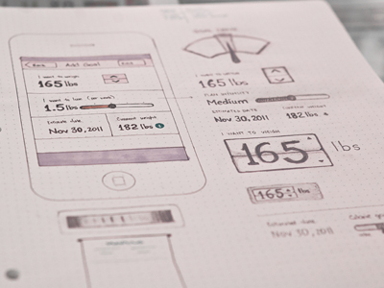
Types of Prototypes
Prototypes are concrete representations of a design
Prototype dimensions
  representation: form of the prototype
    off-line (paper) or on-line (software)
  precision: level of detail (e.g., informal or polished)
  interactivity: watch-only vs. fully interactive
    fixed prototype (video clips)
    fixed-path prototype (each step triggered by specified actions)
      at extreme could be 1 path or possibly more open (e.g., Denim)
    open prototype (real, but limited error handling or performance)
  evolution: expected life cycle of prototype
    e.g., throw away or iterative
PJ McCormick
Karem Suer
Notes:
Prototypes are concrete representations of a design.
[ADVANCE]
Dimensions...
Representation
[ADVANCE]
Precision
[ADVANCE]
Both of these are represented in the form of paper
But the left is informal and the right is polished

Slide 24
Types of Prototypes
Prototypes are concrete representations of a design
Prototype dimensions
  representation: form of the prototype
    off-line (paper) or on-line (software)
  precision: level of detail (e.g., informal or polished)
  interactivity: watch-only to fully interactive
    fixed prototype (video clips)
    fixed-path prototype (each step triggered by specified actions)
      at extreme could be 1 path
    open prototype (real, but limited error handling or performance)
  evolution: expected life cycle of prototype
    e.g., throw away or iterative
Notes:
Interactivity
[ADVANCE]
Evolution

Slide 25

Fidelity in Prototyping
Fidelity refers to the level of detail
High fidelity?
  prototypes look like the
  final product
Low fidelity?
  (often) sketched renditions with
  many details missing
Notes:
[ADVANCE]
What is high fidelity?
Do you know where it comes from [Hi-fi stereos in the 60s and 70s]
[ADVANCE]
Looks like the final product (pixel for pixel)
Like this web site
[ADVANCE]
Or this CS147 prototype
[ADVANCE]
Low fidelity?
[ADVANCE]
sketched rendition with many details missing

Slide 26
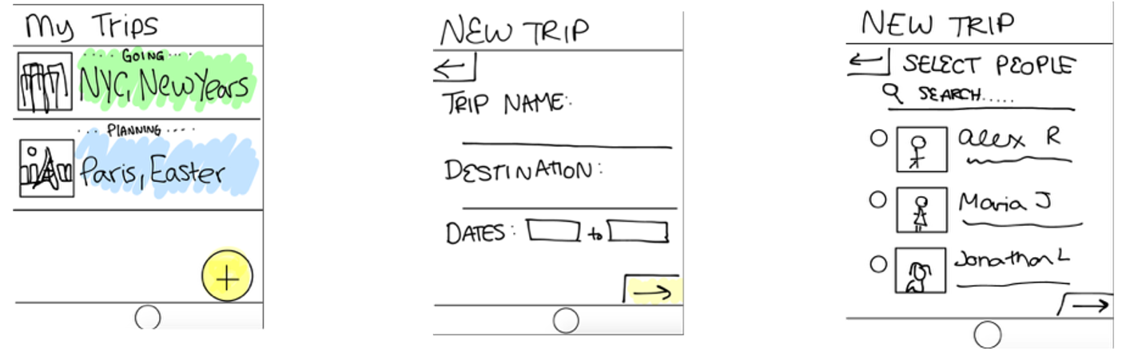
What do we like about this low-fi prototype?
What do we wish could be improved?
Notes:
Here is Instigator, a CS147 app to let friends plan shared vacations
What do we like about it?
Only shows what it needs to show.
Greeks some of the text below each of the friends. Friends images are rough
[ADVANCE]
What could be improved?
Maybe shouldn’t highlight the things user needs to tap

Slide 27
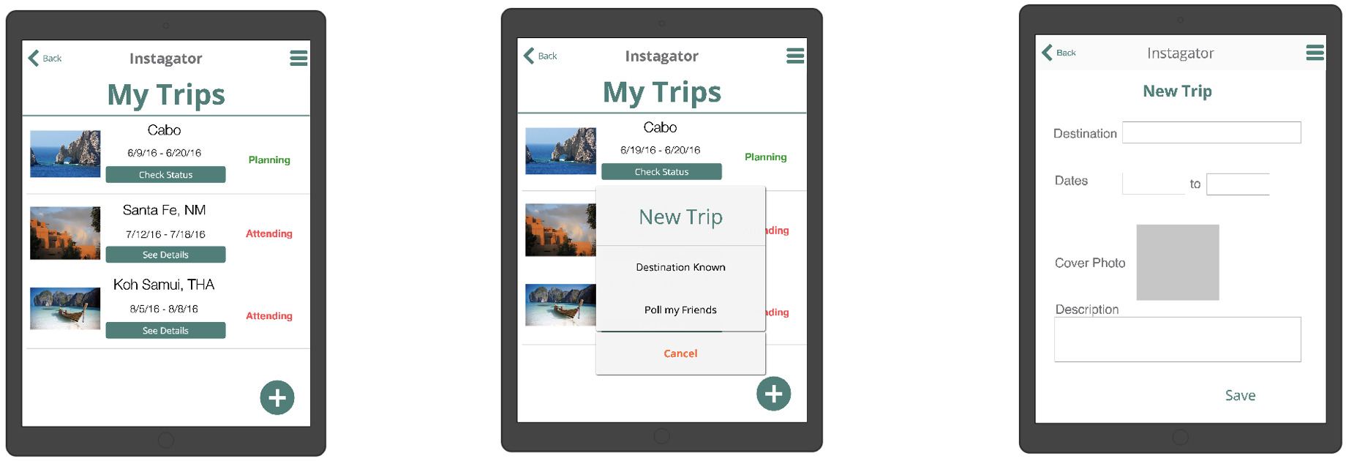
What do we like about this medium-fi prototype?
What do we wish could be improved?
Notes:
What do we like about this version of the Instagator prototype?
looks More like the real app, with pictures, and colors, and fonts
[ADVANCE]
What do we think could be improved?
Better fonts, colors, etc.
Notice it draws my attention to those things?

Slide 28
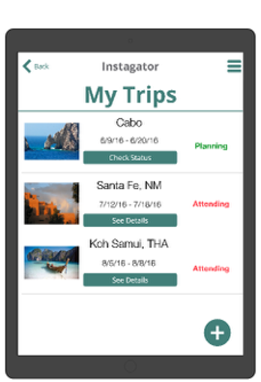
The feedback you get is different
Low-fi Medium-fi
Notes:
The prototype at left is low-fidelity and the one at right is medium-fi.
The type of feedback you will get from each is different.

Slide 29
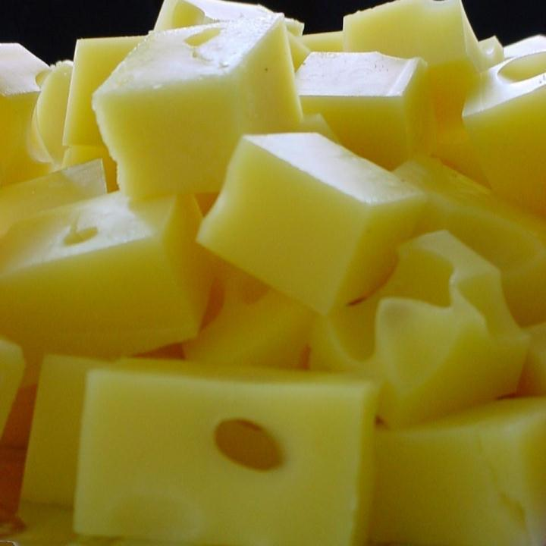
Hi-fi Prototypes Warp
Perceptions of the tester/reviewer
  representation communicates “finished”
    comments focus on color, fonts & alignment
Time of the designer
  encourage precision
    specifying details takes more time
Creativity of the designer
  lose track of the big picture
Notes:
You might wonder. Why not just start with Figma. You might think: "I’m fast with it."
The problem is that tools like this encourage hi-fidelity.
Hi-fi prototypes warp the perceptions of the tester or reviewer (even another team member)
[ADVANCE]
warp the time of the designer
[ADVANCE]
warp the Creativity of the designer
You lose track of the big picture. You need the holes in the cheese to come up with new ideas.

Slide 30
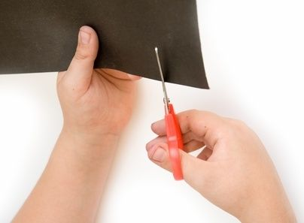
Why Use Low-fi Prototypes?
Traditional methods take too long
  sketches → prototype → evaluate → iterate
Can instead simulate the prototype
  sketches → evaluate → iterate
  sketches act as prototypes
    designer “plays computer”; others observe & record
Kindergarten building skills
  allows non-programmers to participate
Notes:
This is where low-fi prototyping comes in and why it is one of the most important techniques you will learn in this class.
Why do we use low-fi?
[ADVANCE]….

Slide 31
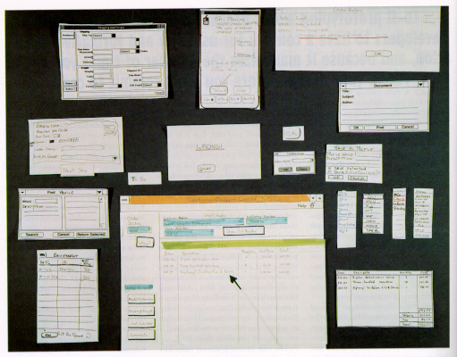
“Prototyping for Tiny Fingers” by Rettig
Notes:
Here is the image from Rettig's groundbreaking paper describing the technique
It is showing a windows desktop application broken down into all the pieces needed on paper cards...
main windows, dialog boxes, pull down menus, etc.

Slide 32
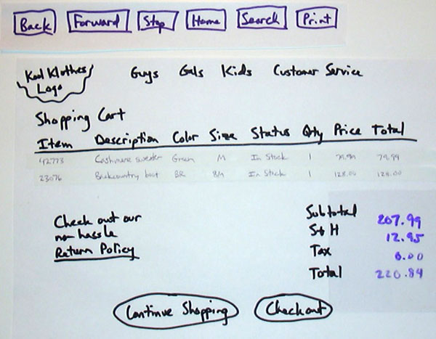
Notes:
This is from when I taught the class at Berkeley and is a shopping cart for an e-commerce web site. See how they use overhead transparency pieces (cellophane) to add things on top (e.g., the items in the cart or the prices, tax and total)

Slide 33
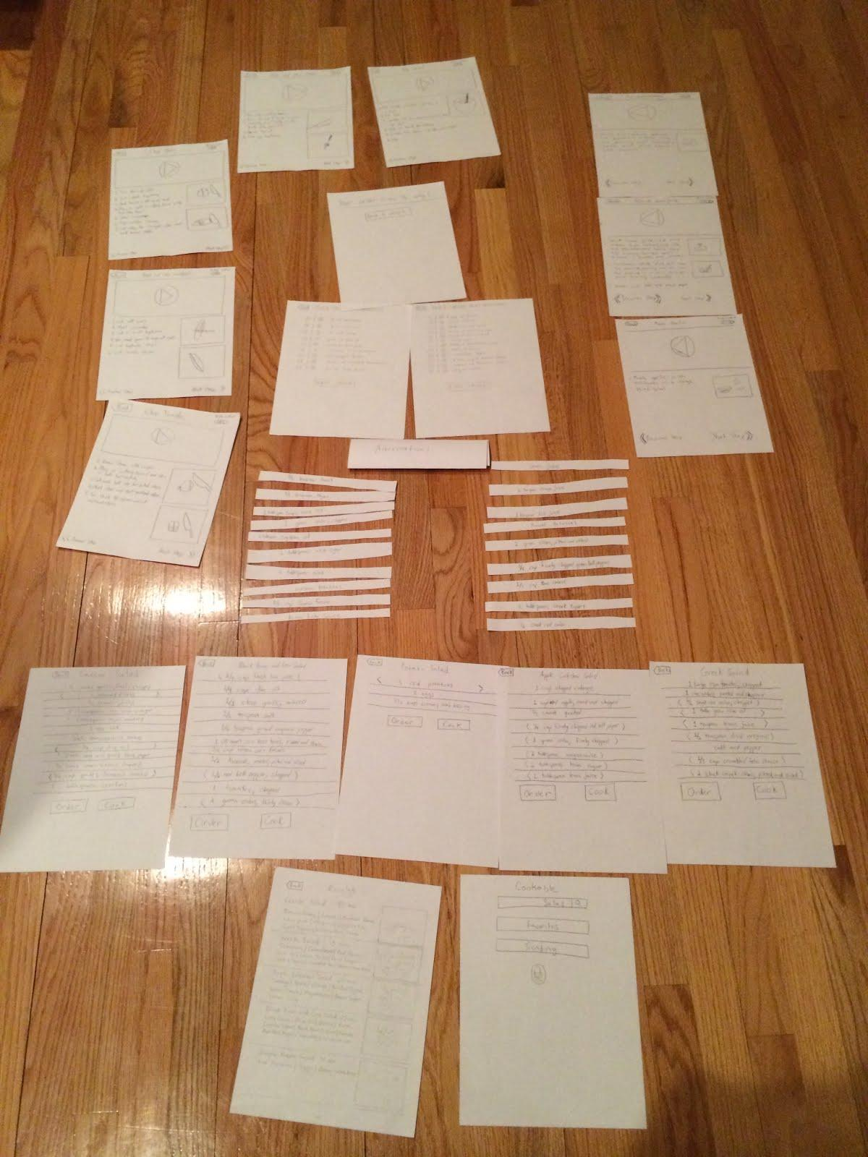
Cookable
Notes:
Here are all the screens for the Cookable prototype (which in in the video lecture, though we skipped it in class -- the video is in the slides and on the web site).
You should take an image of your paper prototype like this showing all the pieces and include it in your slides.

Slide 34
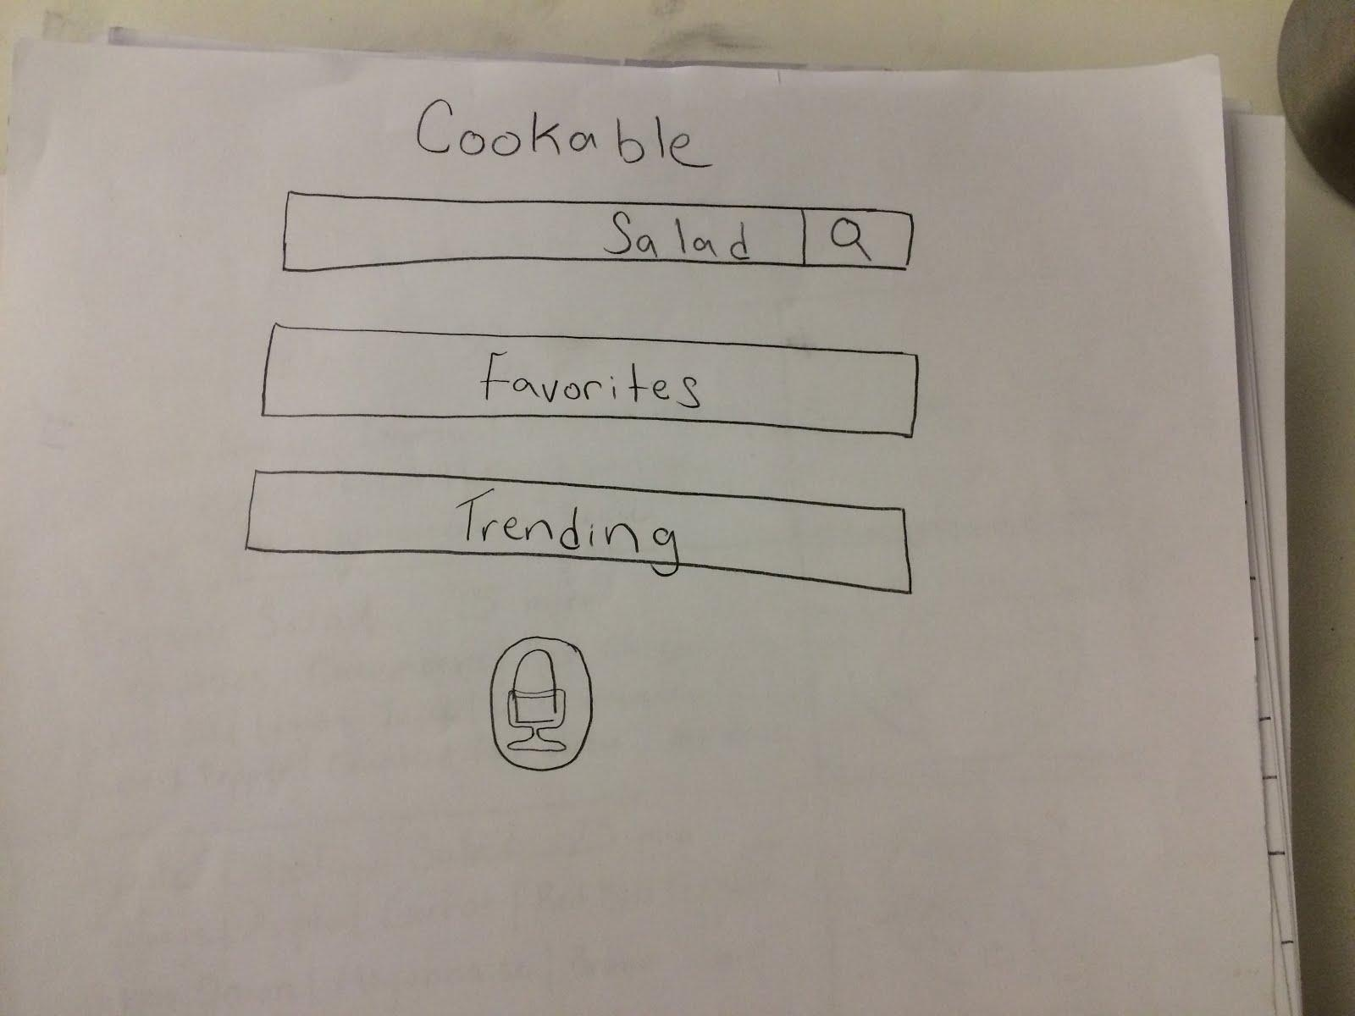
Cookable
Notes:
You can see a main menu and after a search
[ADVANCE]

Slide 35
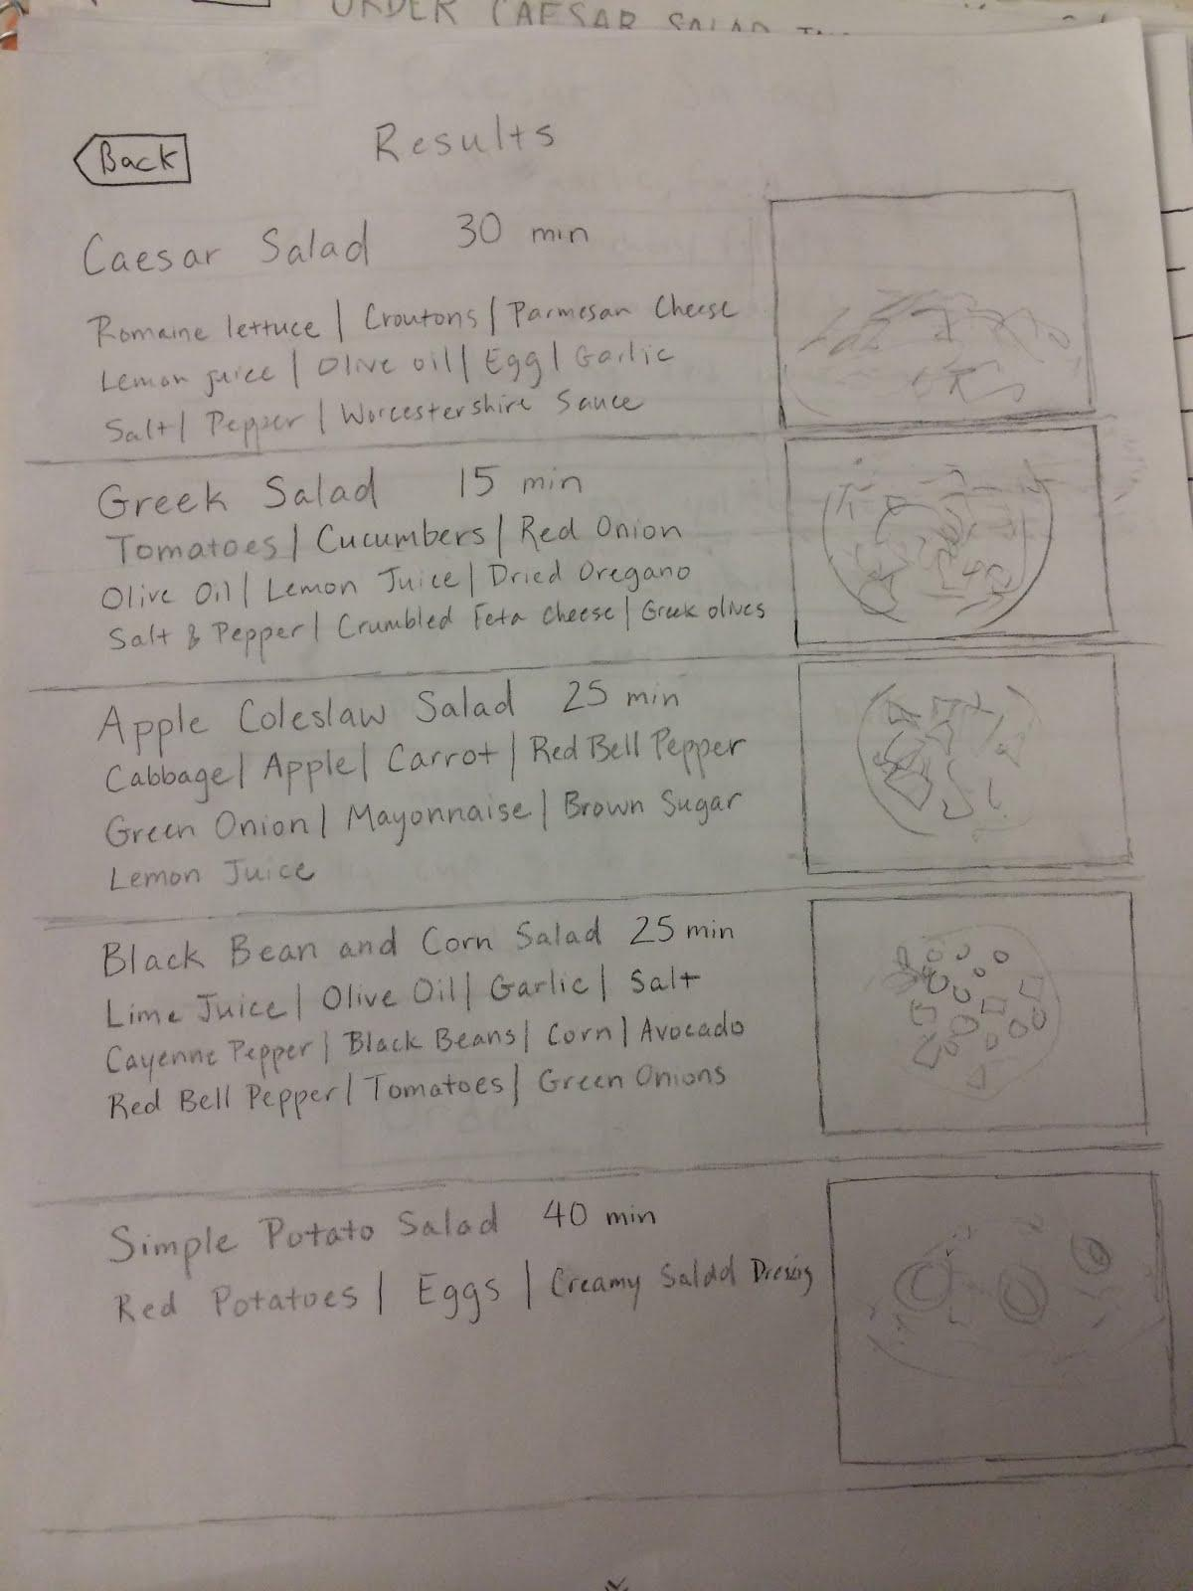
Cookable
Notes:
The salads that come up

Slide 36
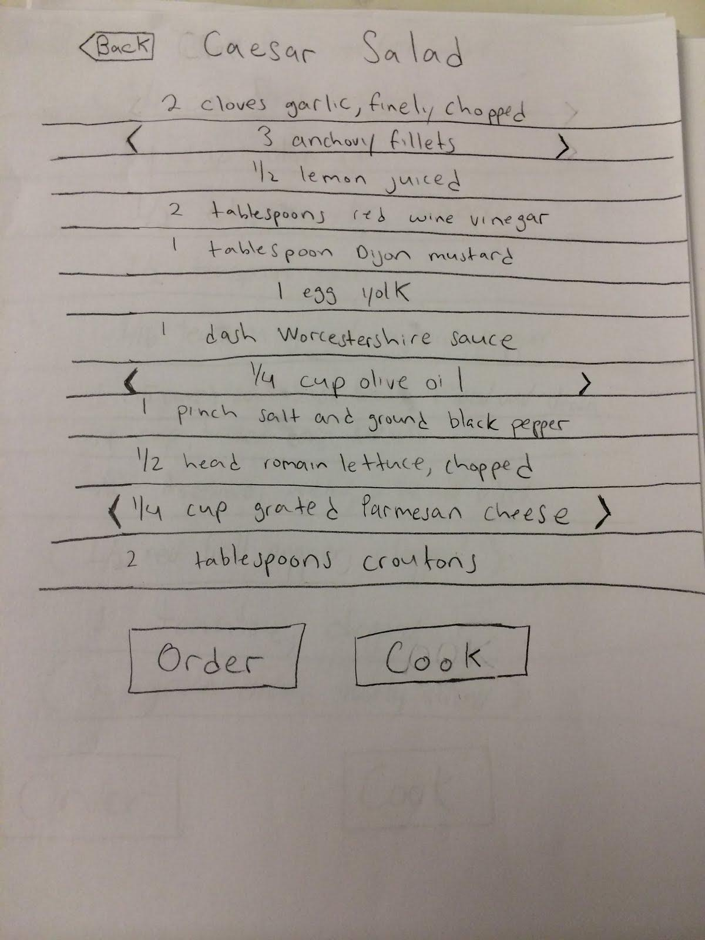
Cookable
Notes:
And the ingredients for a Caesar Salad

Slide 37
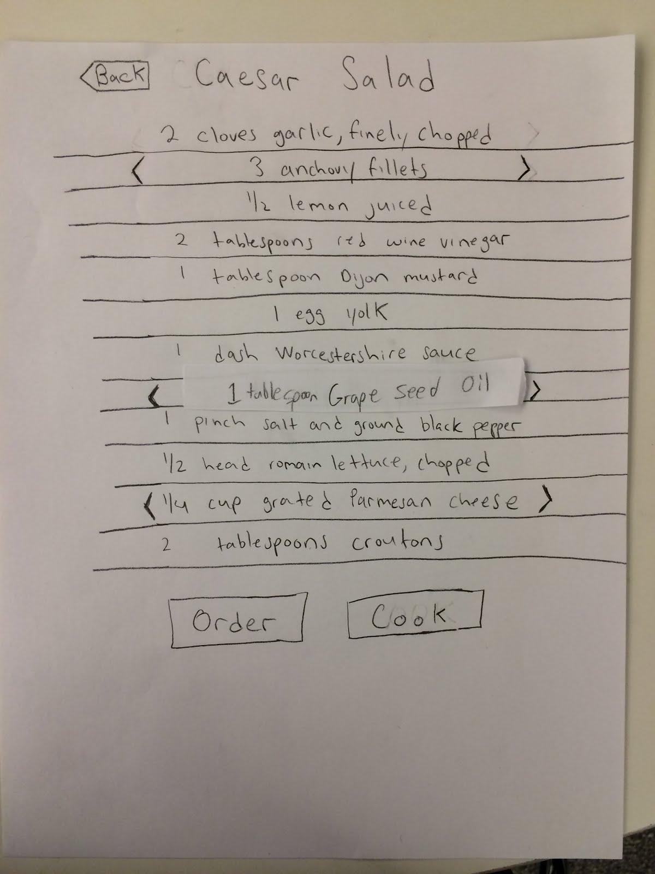
Cookable
Notes:
And they add little strips when you flick across an ingredient to replace it with a substitution

Slide 38
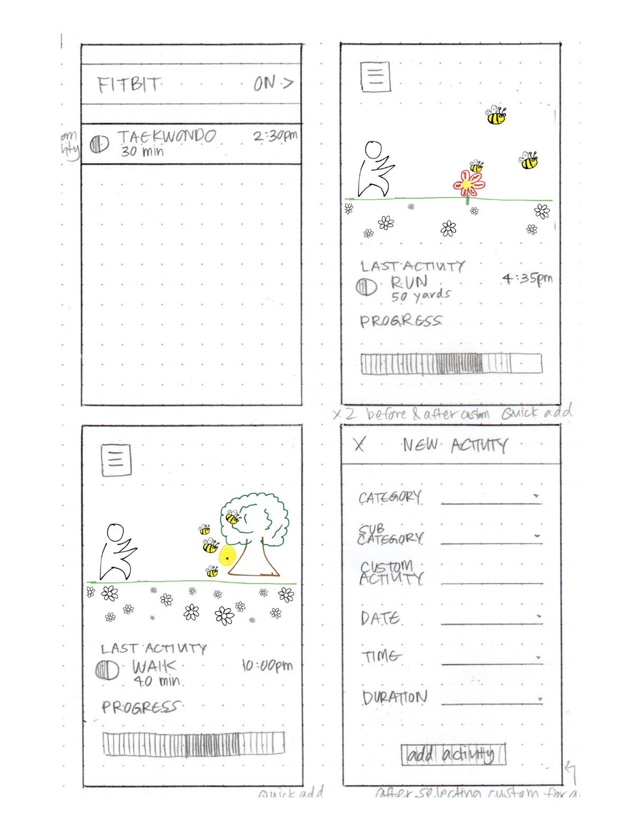
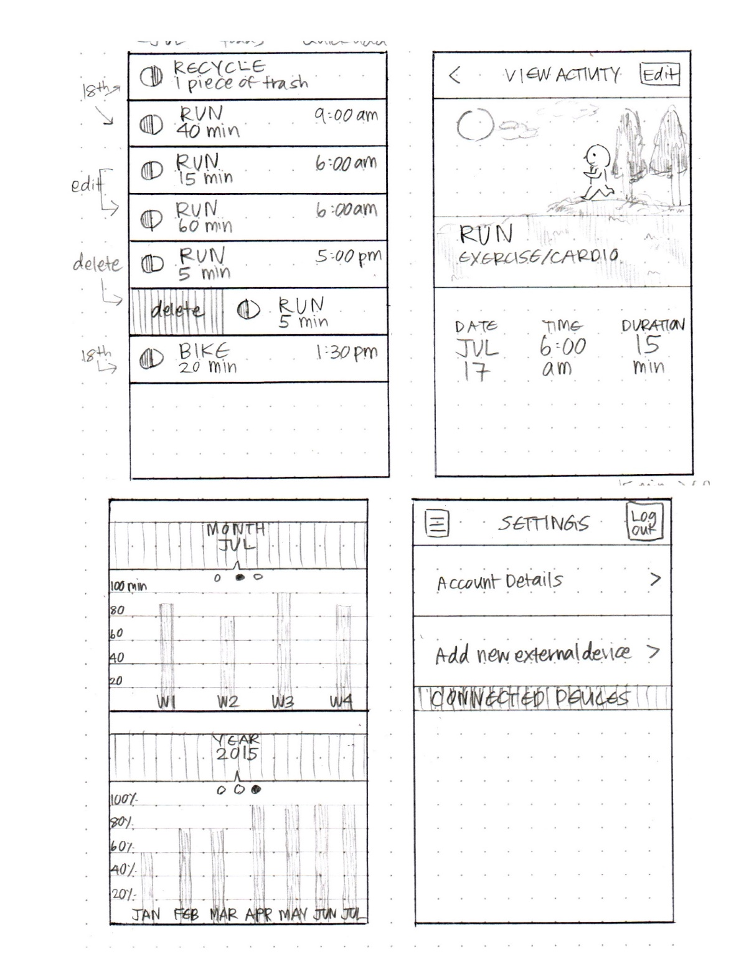
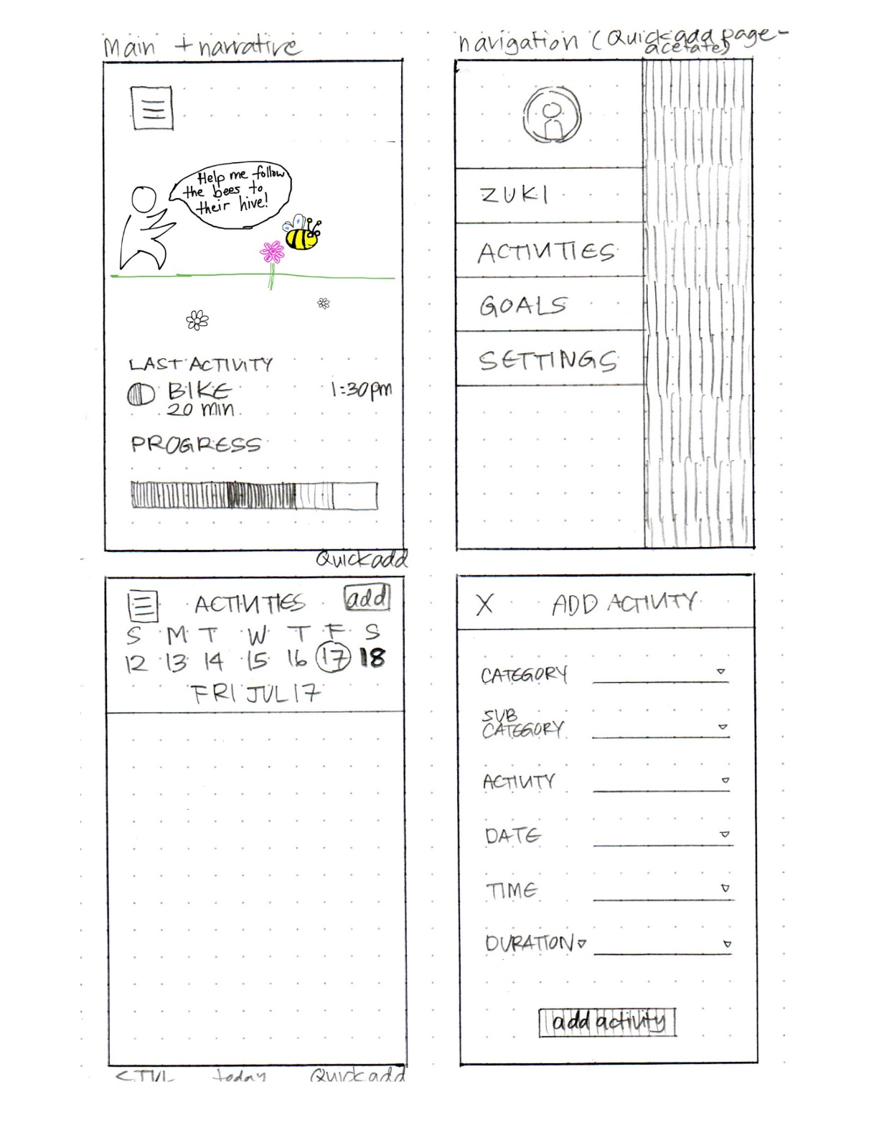
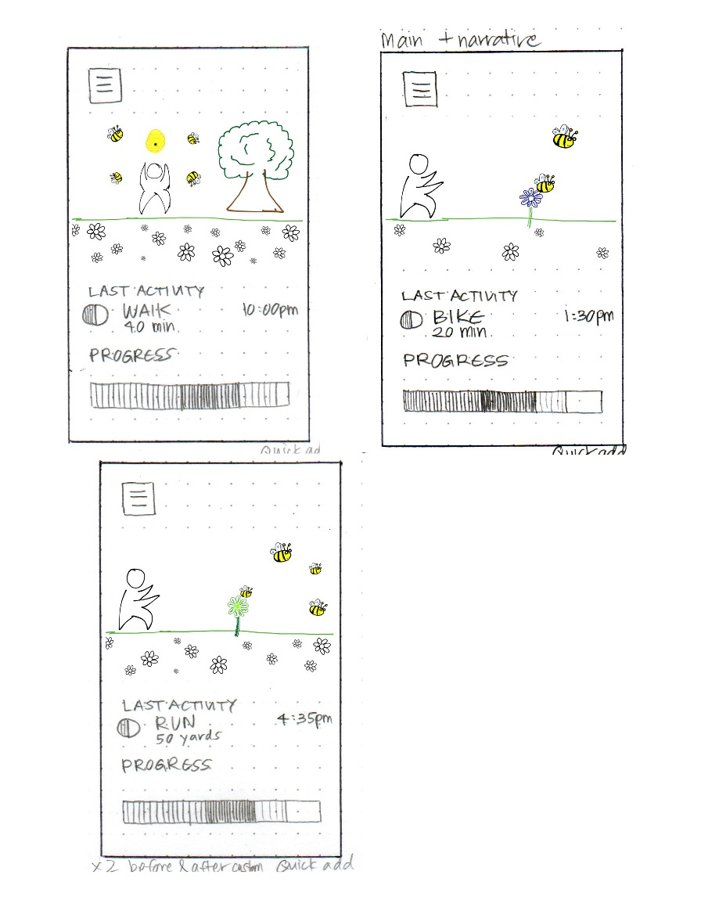
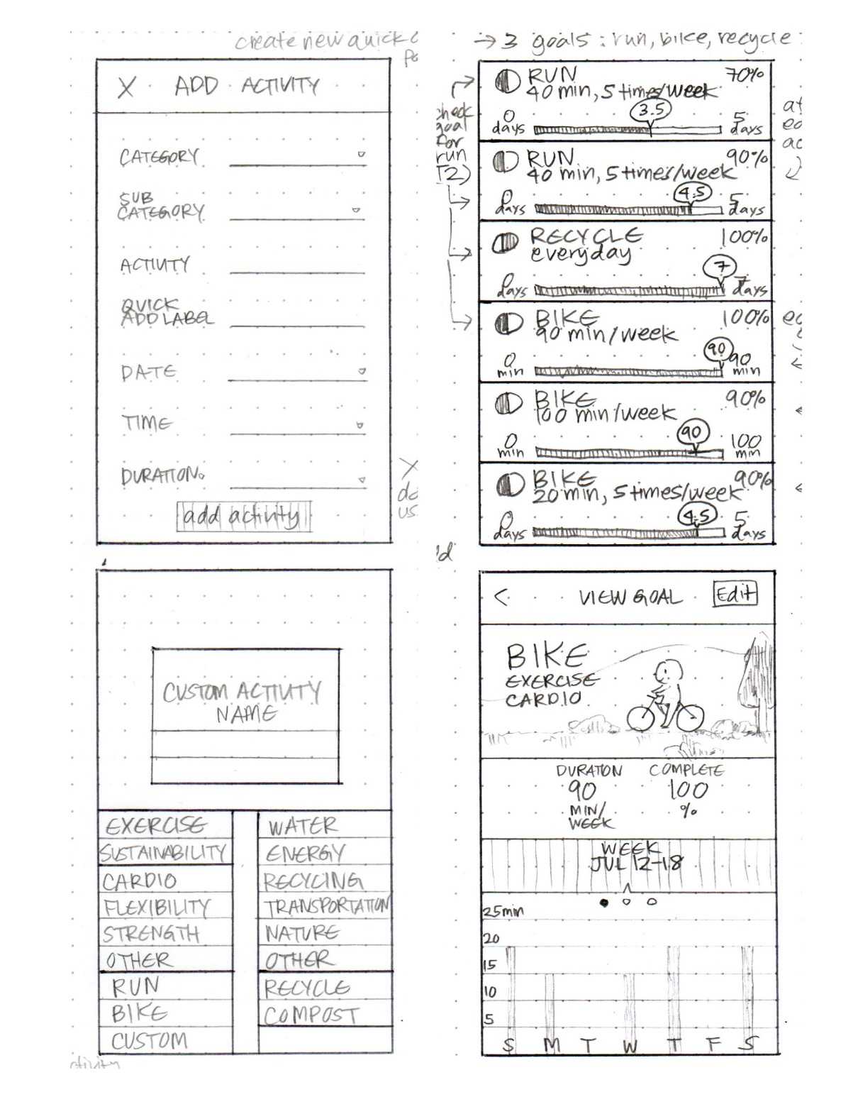
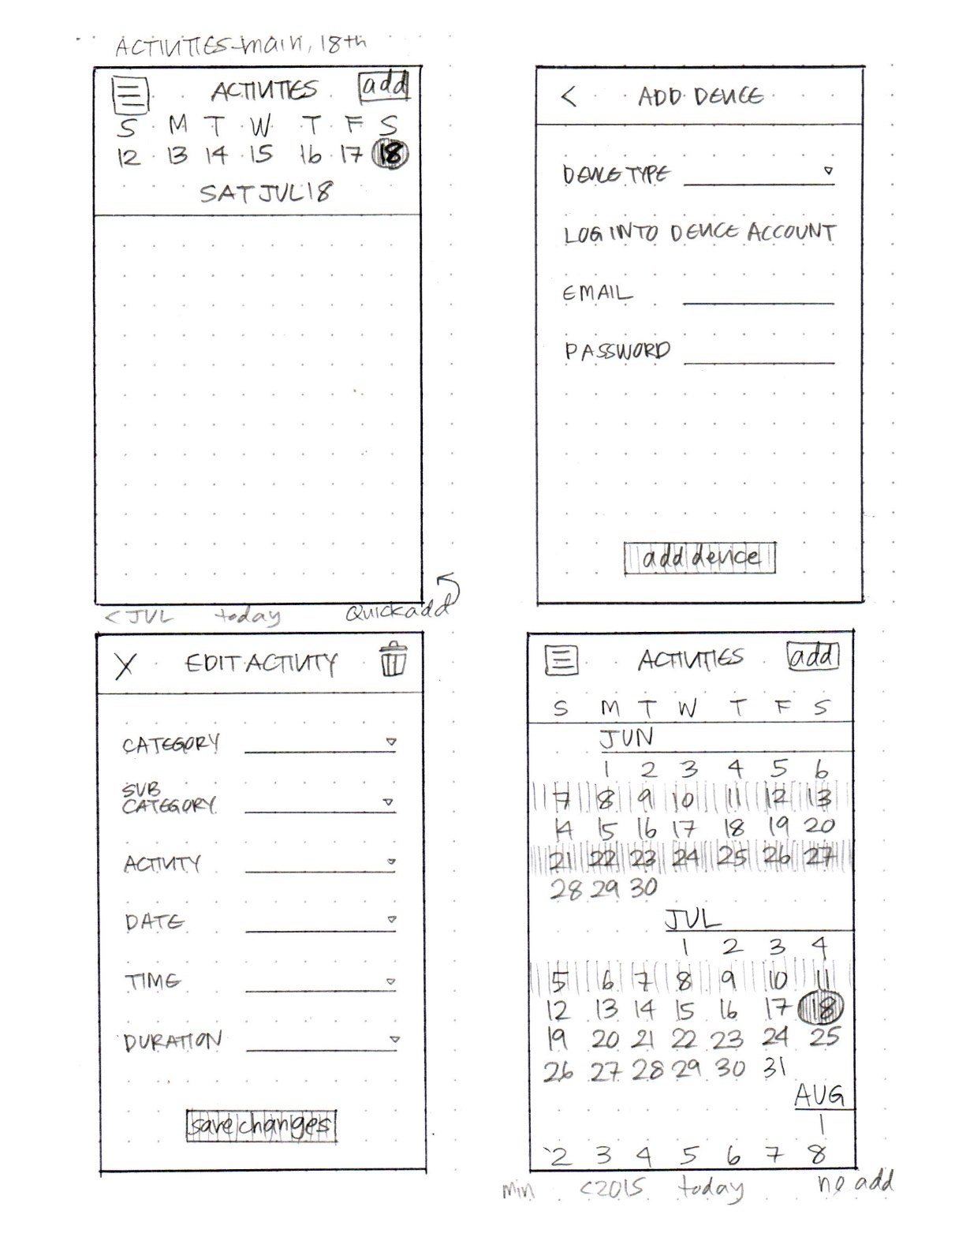
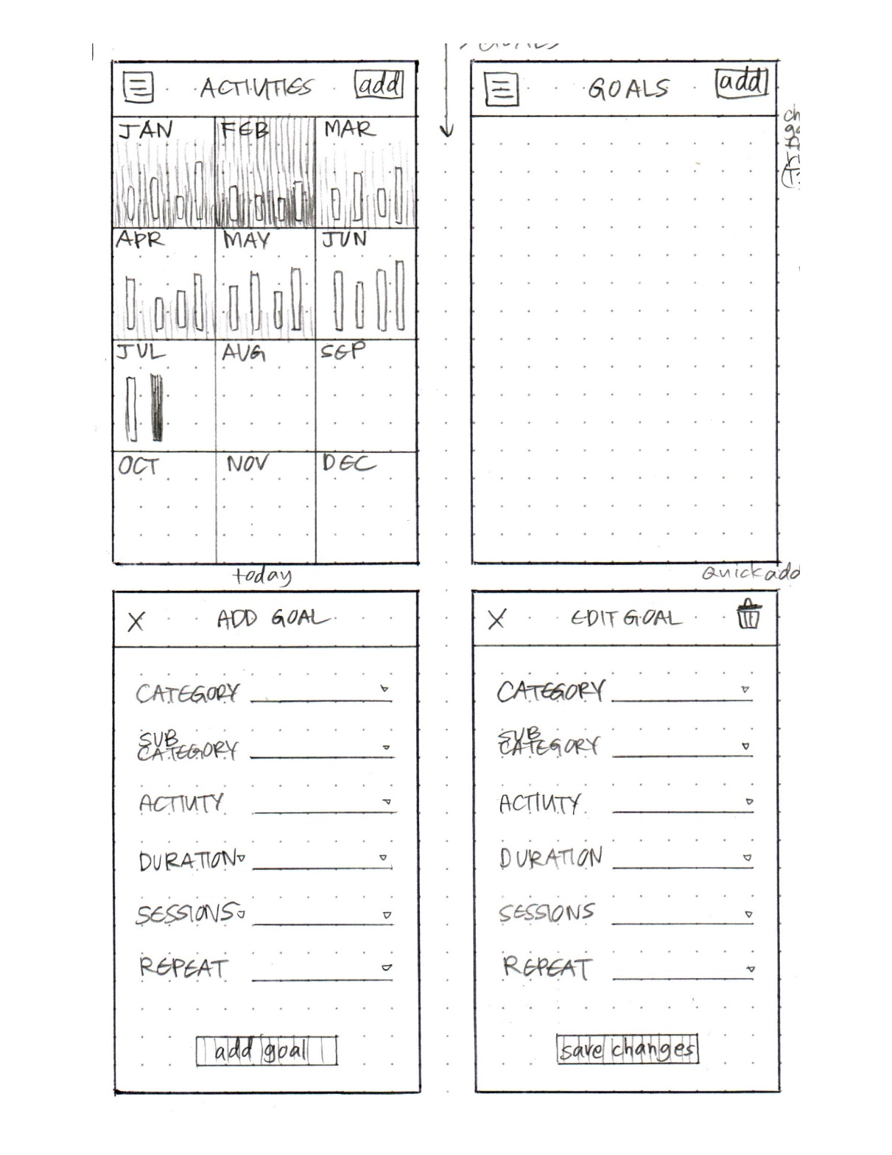
Who is Zuki?
Notes:
Here are the sketches for the who is zuki video (also in the concept video lecture). My project, but again didn’t have time to show it in class. In the slides and linked on the web site.
Note the level of detail. It is rough but comprehensive. The designer used color to make a few things pop. The bees and flowers, for example.
[ADVANCE]1
[ADVANCE]2
[ADVANCE]3
[ADVANCE]4
[ADVANCE]5
[ADVANCE]6

Slide 39
Administrivia: Assignment 2 Grades/Feedback
A2 Group Presentations: -: 0% ✓- -: 0% ✓-: 6% ✓:72% ✓+: 22% ✓ ++: 0%
A2 Individual Presentation: -: 0% ✓- -: 0% ✓-: 6% ✓: 44% ✓+: 44% ✓ ++: 6%
We liked
  “prototype findings were grounded in observations and quotes”
  “thorough documentation of experience prototype methods”
  “creativity and diversity of HMWs”
  “intentionality behind the diversity of prototype testers”
  “use of empathy maps to unpack interview insights”
  “creative design of prototypes to test assumptions, where the prototype looks outside of the box compared to the solution”
We wished
  “we wonder statements for POVs were more user-specific & took bigger leaps”
  “HMWs were more generative to capture user pain”
  “stronger rationale for chosen assumptions”
  “stronger connection between prototype learnings & final solution choice”
  “exploration of design opportunities in relation to excluded communities”
  “more novel, robust solutions that don’t feel like ‘Tinder for X’ or single features”
Notes:
Bullet point #4 for ‘we wished’: many teams merely mentioned which communities are excluded by their solution without acknowledging the potential design choices that they can make moving forward to make their solution more inclusive & accessible

Slide 40
Administrivia
Video slide deck to turn in but not present
Check slack channels #lecture, #q-and-a, #announce
  If you help your peers in a significant way, we can raise your class participation grade
Check web site for Figma workshop recording end of week
Web site directories will be created for each team by end of week
  each team should have filled out this form by Monday, Oct 12th
    https://forms.gle/eNNGyoXWdamLdStQ9
    start to get sites (even basic) up there this weekend
    should have all your work – not graded until mid-point check-in & near end of quarter
  CAs will send you your directory path/name on web.stanford.edu
Notes:
Concept video – deck – not a presentation
Team form was due Monday night. As of last night only 11 of 18 teams filled it out. GET IT DONE NOW!

Slide 41
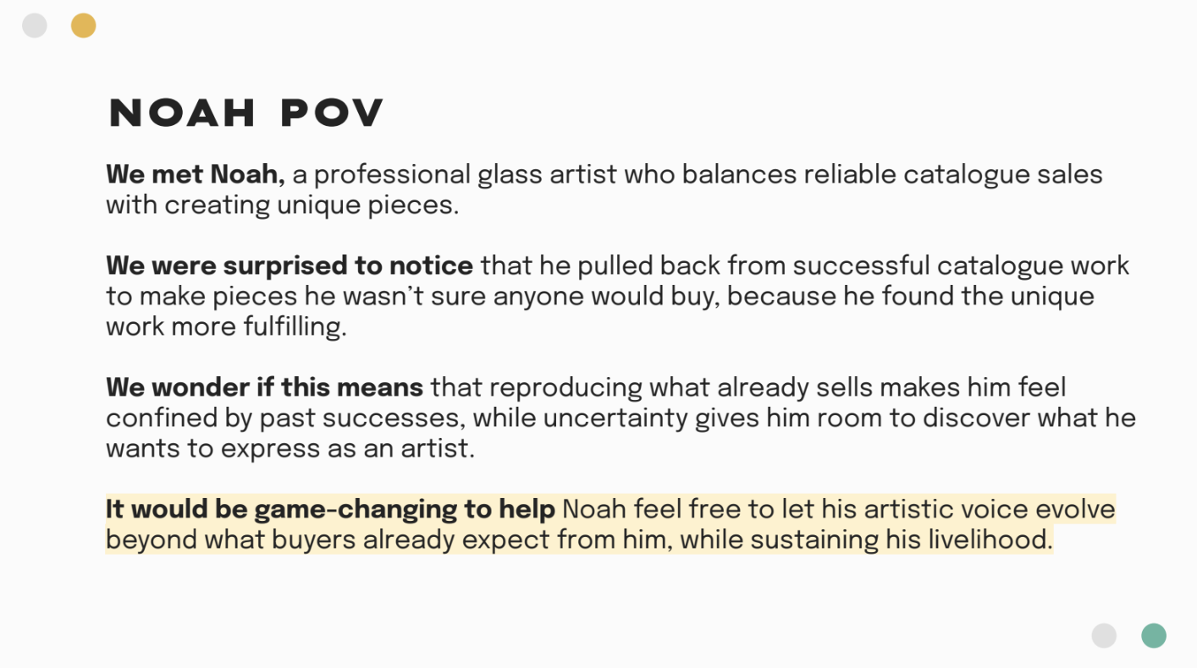
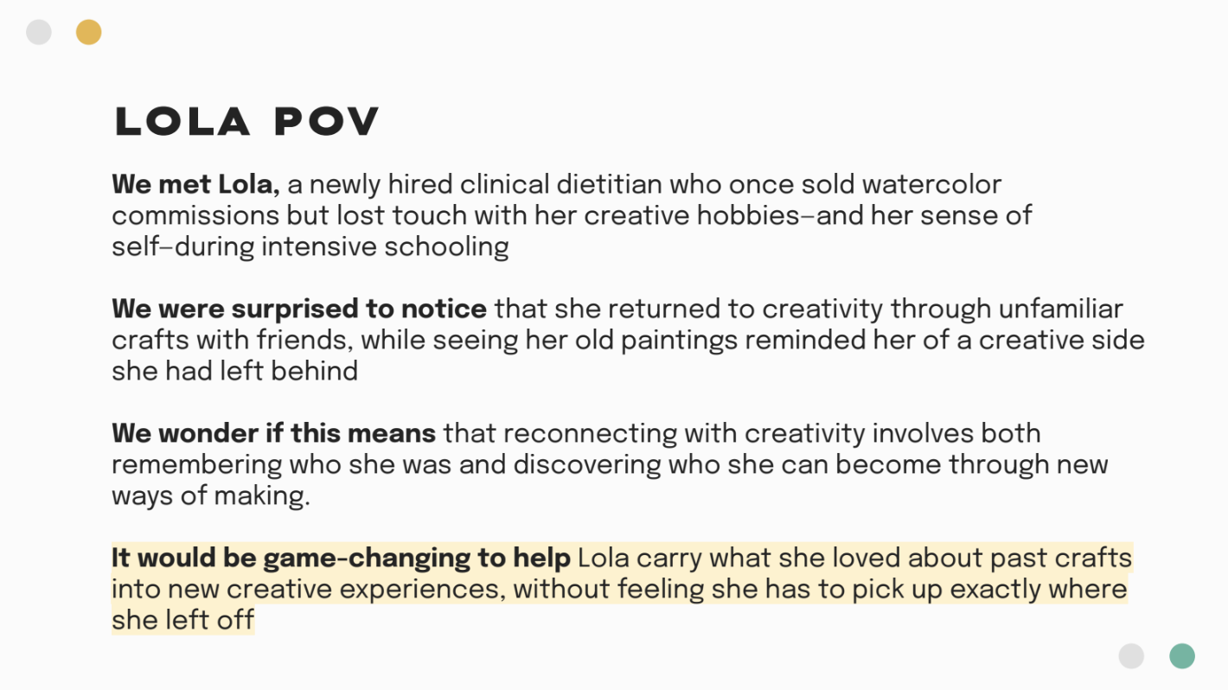
Good Examples from A2
Team 1 – Renn’s studio
Notes:
Team 1 from Renn’s studio on Design for Meaningful Work had strong POVs. They did each step properly, yielding surprising realizations, and had gamechangers that were quite generative.

Slide 42
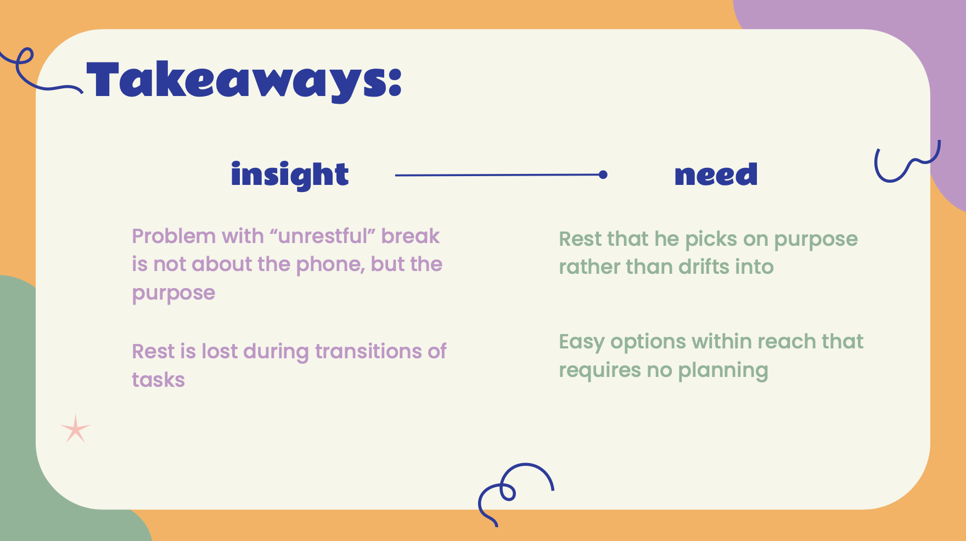
Good Examples from A2
Team 5 –
Lindsay’s studio
Notes:
Team 5 from Lindsay’s studio on Self Improvement had insights that really home in on the specific pain point and required the interviews to find (not easily guessable).

Slide 43
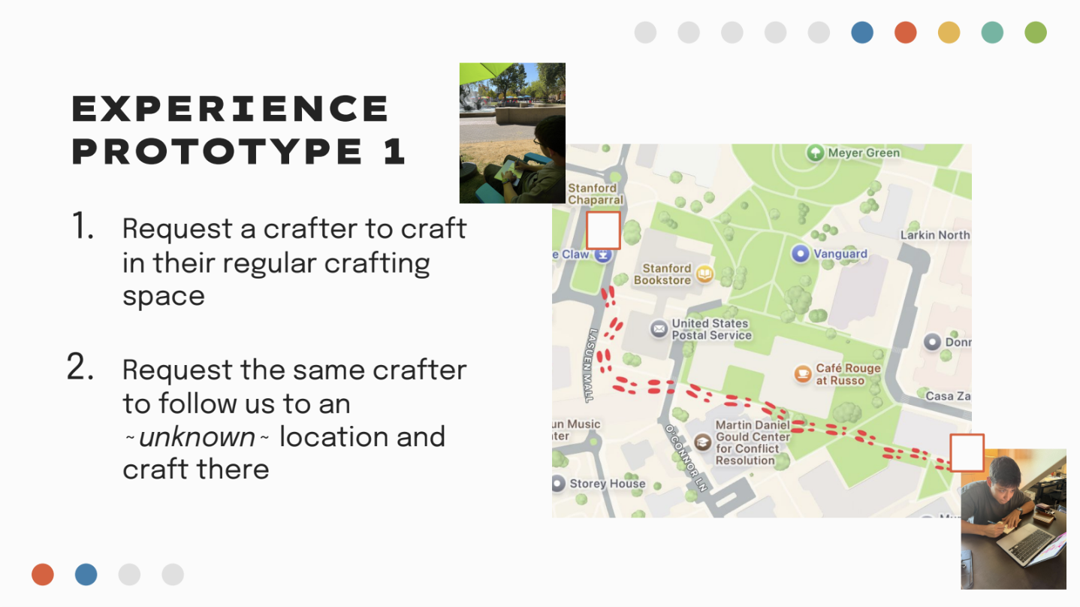
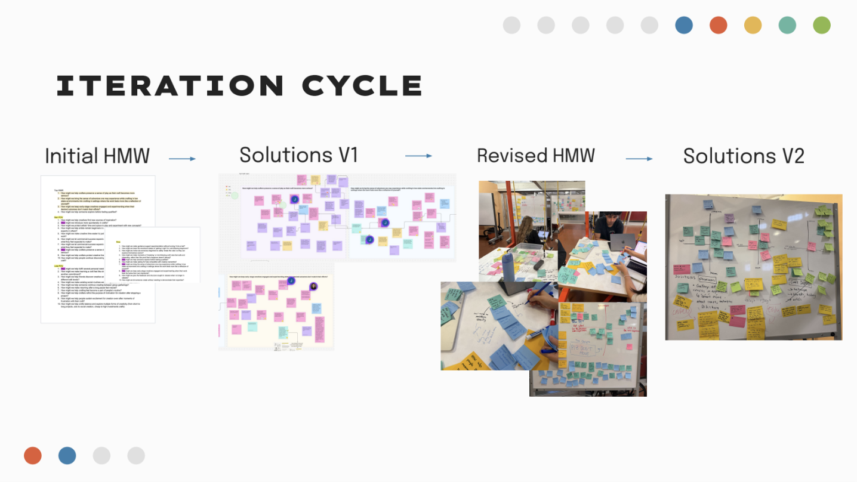
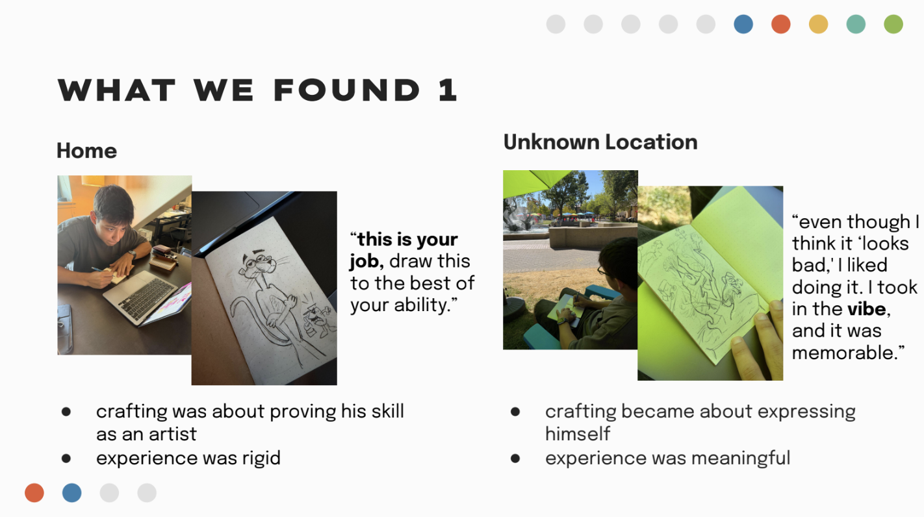
Good Examples from A2
Team 1 – Renn’s studio
Notes:
Team 1 from Renn’s studio on Design for Meaningful Work did a great job at documentation. Very clear combination of photos and brief written information that showed their process clearly.

Slide 44

Good Examples from A2
Team 12 –
Lindsay’s studio
Notes:
Team 12 from Lindsay’s studio on Offline Experiences had a really creative experience prototype to test if people had things to share with their friends grounded in different locations.

Slide 45


Good Examples from A2
Team 4 – Renn’s studio
Notes:
Team 4 from Renn’s studio on Design for Meaningful Work was especially clear in reflecting and outlining the underlying assumptions of their experience prototypes -- in particular on what worked/what didn't and that an assumption was partially held.

Slide 46
Administrivia: Video Hints
Under 2 minutes (90 seconds or less even better)
Add credits at end
  Team/project name
  Your names (first name & last initial)
  “CS 147 – Autumn 2026”
  Credits will not count in your time limit

Slide 47

Administrivia
Use must use handbrake to compress your video
  It will take your video from 250MB-1GB down to ~50MB

Slide 48
Team Break
Reflect on last week’s assignment (~5-8 min)
  what did you like about your teamwork?
  what do you wish could be improved?
  share out with each other
This week’s assignment (~15 min)
  Get greenlight from CA on solution + tasks
  work on your video storyboards/editing
Notes:
65 min again
Need to be here by 50 min to take a 30 min break (need 35 min for lecture after break – for every 5 min over, take 5 min off break)
--- 0 years ago ---
65 min in (2:37) so took 15 min break to restart at 2:50 PM and have only 30 min for last part.
--- 1 years ago ---
got here at 59 min so took a 21 min break to leave 30 min for second half (restart at 2:50)
--- 2 years ago --
got here at 57 min, so took a 23 min break and that should leave 30 min for second half (restart at 2:50 pm)
--- 3 years ago ---
got here at 1:02 min in. Took 23 min break so had 25 min for second half (restart 2:55 PM)
--- 4 years ago ---
Finished the announcements at 67 min in and took ~20 min break to come back at 3 PM (need to go fast to finish in 20 min so I hid 3 slides)
--- 5 years ago ---
Planned 20-minute break at 1:08 minutes
If (so I did a 20 min breakout)

Slide 49
Constructing the Model
Set a deadline
  don’t think too long - build it!
Draw a window/phone frame on large paper
Put different screen regions on cards
  anything that moves, changes, appears/disappears
Ready response for any user action
  e.g., have those pop-up dialogs, etc. already made
Use printer/scanner to make many versions
Notes:
How do you make a low-fi prototype?

Slide 50

Constructing the Model
Notes:
Note that sometimes people find it easier to make a phone at 2x scale – easier to read handwritten text and to tap on buttons.

Slide 51

Constructing the Model
Notes:
Here is one at scale. Puling on the tabs will pull a sheet out to reveal the appropriate screen.

Slide 52
Preparing for a Test
Select your “customers”
  understand background of intended users
  use a screening questionnaire to get the people you need
  don’t use friends or family (at most 1 Stanford student)
  start recruiting today
Prepare scenarios that are
  typical of the product during actual use
  make prototype support these (small, yet broad)
Practice to avoid “bugs”
Notes:
At most 1 Stanford student

Slide 53
Conducting a Test
Four Roles
Greeter – puts users at ease & gets data
Facilitator – only team member who speaks
  gives instructions & encourages thoughts, opinions
Computer – knows application logic & controls it
  always simulates the response, w/o explanation
Observers – take notes & recommendations
Can combine
Notes:
Gretter….
Facilitator….
[ADVANCE]
You can combine these two roles
Computer…
Observers…
[ADVANCE]
Don’t do this. Definitely don’t try to give hints. You are there to test the interface and improve it. Not for people to validate you are right in your design ideas.

Slide 54


Conducting a Test
Notes:
Note USE REAL IMAGES in your reports (blur faces if you need to)
Leila Takayama, formerly PhD from Stanford Comm and then a professor at UC Santa Cruz doing a low-fi test with fire-fighters in Berkeley as an undergrad over 20 years ago
[ADVANCE]
Note a key to recruiting sometimes

Slide 55

Wonderlust
Notes:
Wonderlust, CS147, 2014au

Slide 56

Who is Zuki?
Notes:
1:46 video
Watch this session on testing WhoIsZuki.
It is not perfect, but note the test was a high school kid who simply watched this lecture to learn how to do it (he graduated a few years ago from Cal Tech)

Slide 57

Practice: Low-fi Prototype Testing
In a group of 3-4 people around you, you will test the low-fi prototype of Dishcovery app!
One will play user, one will play facilitator, and 1- 2 will play observers taking notes.
Share the critical incidents (both positive and negative events) from your test in Slack.
Note: If you are the user, remember to talk-aloud about what you are thinking as you navigate the prototype
Notes:
Groups of 3-4
Roles: user, facilitator, observers
Share critical incidents on slack (we’ll create promps)
If you are the user, remember to talk-aloud everything you are thinking as you navigate the prototype!

Slide 58

Practice: Low-fi Prototype Testing
Dishcovery allows users to cook with foreign ingredients by learning more about their history & how they are consumed.
Simple task: Scan an ingredient
Moderate task: Learn about the ingredient
Complex task: Cook with the ingredient
https://tinyurl.com/dishcovery-lofi
Notes:
Need to be here by 3 PM to finish lecture.
--- 0 years ago ---
got here at 3:13 so only gave 5 min
--- 1 year ago ---
Got here at 3:11 after all instructions so only gave 7 minutes to do it
[change this to 8 min]-got here at 3:07 so gave 8 min to leave 5 min to finish lecture [could use 10 so hope to be here at 3pm]
FIGMA: https://tinyurl.com/dishcovery-lofi
Create a thread on slack and post the task flows for the facilitators to reference.
Post Question:
What are positive events during your test?
What are negative events during your test?
If you are the user, remember to talk-aloud everything you are thinking as you navigate the prototype!

Slide 59

Simple task: Scan an ingredient

Slide 60

Moderate task: Learn about the ingredient

Slide 61

Complex task: Cook with ingredient

Slide 62

Complex task (cont.): Cook with ingredient

Slide 63
Evaluating Results From a Low-fi Test
High level questions about your design
  does it address the problem you want to solve?
  is this the right realization of your solution?
Sort & prioritize observations
  what was important?
  lots of problems in the same area?
Make changes & iterate
  even iterate between tests

Slide 64
Advantages of Low-fi Prototyping
Takes only a few hours
  no expensive equipment needed
Can test multiple alternatives
  fast iterations
    number of iterations is tied to final quality
Participants do not focus on visual details
Almost all interaction can be faked (Wizard of Oz)

Slide 65

Problems with Low-fi Prototypes
“Computer” inherently buggy
Slow compared to real app
  timings not accurate
Hard to implement some functionality
  pulldowns, feedback, drag, viz …
Won’t look like final product
  some widgets/controls hard to recognize
End-users can’t use by themselves
  not in context of user’s work environment

Slide 66


Interactive Lo-fi Tools
Balsamiq Mockups
http://balsamiq.com
POP
https://marvelapp.com/pop
Notes:
There are some tools that can be used as alternatives to working purely on paper.
These tools will make things look more consistent and maybe clearer to the user, but still take a lot more time to create and change prototypes as compared to paper
Balsamiq is a drag and drop design tool, but has a sketchy look and feel.
POP, let’s you make paper prototypes but then interact with them on a phone. Nice idea (we did something earlier like this in my research group).
[ADVANCE] Balsamiq video
Marvel ships with POP — a mobile app that helps convert drawn wireframes into interactive, digital wireframes. It seamlessly integrates with user testing tool Lookback, and is known to be one of the easiest design tools to master, although the downside is that high-fidelity prototyping with Marvel relies heavily on their Sketch integration
[ADVANCE] Marvel video
https://uxdesign.cc/moderating-ux-research-with-zoom-1d4e89614277

Slide 67

Remote Testing of Low-fi Prototypes only used by permission & as last resort
Participant runs & records prototype (e.g., Balsamiq/POP) on
their phone [hardest]
  user records interaction by recording screen on iOS/Android
  you record zoom meeting while participant speaks aloud
  https://uxdesign.cc/moderating-ux-research-with-zoom-1d4e89614277
Participant runs zoom on their phone while you screen share prototype [moderate]
  user taps on items & verbalizes aloud
  you control prototype & record meeting
  https://uxdesign.cc/moderating-ux-research-with-zoom-1d4e89614277
Participant hugs their laptop [easiest]
  user runs your prototype (e.g., Balsamiq/POP) on their phone
  you record zoom of their screen as captured by their laptop camera
  https://medium.com/@beparticular/were-still-hugging-our-laptops-8c7f22ed800e
Notes:
3 good ways to do low-fi testing remotely
Though for this class we prefer you do it in person. This should only be a very last resort for some of the same reasons we talked about with interviews. You lose out at noticing a lot of body language when testing remotely.

Slide 68
Fidelity in Prototyping:
Instagator
Notes:
Let’s talk a bit more about fidelity in prototyping.
Here is the Instigator app again
This is clearly a low-fi sketch

Slide 69

Fidelity in Prototyping
Task 1: Take a Destination Poll
Low-fi
Medium-fi
Notes:
And here are the low-fi storyboards
[ADVANCE]
It is clearly low-fi
[ADVANCE]
Medium-fi start to give us more realism. Most often tested on the target device and fonts, colors, and interactive elements (widgets) look real to people.
[ADVANCE]
Often harder to change as rapidly and can cause tunnel vision. So do NOT start with medium-fi or high-fi prototypes.

Slide 70
Summary
Prototypes are a concrete representation of a design or final product
Low-fi testing allows us to quickly iterate
  get feedback from users & change right away

Slide 71
Further Reading
Prototyping
Books
  Paper Prototyping: The Fast and Easy Way to Design and Refine User Interfaces, by Carolyn Snyder, Morgan Kaufmann, 2003
Articles
  “Prototyping for Tiny Fingers” by Marc Rettig, in Communications of the ACM, 1994
  “Using Paper Prototypes to Manage Risk” by Carolyn Snyder, http://world.std.com/~uieweb/paper.htm
  “The Perils of Prototyping” by Alan Cooper,
  http://www.chi-sa.org.za/Documents/articles/perils.htm

Slide 72
Next Time
Lecture on Monday: Visual Information Design
Watch Scott Klemmer’s HCIOnline lectures
  6.1 Visual Design (7:37)
  6.2 Typography (10:47)
  6.3 Grids & Alignment (17:33)
Project next week
  15-20 sketches of 3-5 design realizations (start in studio…)
  pick the top two & storyboard/task flow those
  pick the top 1 & build/test low-fi prototypes using 3 key tasks for next week’s studio presentation
    recruit representative participants now!

Slide 73

Exit Ticket http://hci.st/cs147-26au-exit-4-239
Notes:
Due tomorrow, Thursday 10/15 at 3:20 PM.

