Slide 1
CS 147 Project Expo Awards Design Thinking for User Experience Design, Prototyping & Evaluation
December 5, 2025
Notes:
15-20 min target

Slide 2
Students’ Choice / Best Pitch
Traverse
DareDrop
Chatatouille

Slide 3
Best Poster
MotiMates & Pill Pal
Nomi
Stitch

Slide 4
Greatest Societal Impact
BlooMe
roots
Medi-Pal

Slide 5
Greatest Personal Impact
Pill Pal
tether
roots
Notes:
Wayn backup

Slide 6
Most Novel Product
Traverse
Wayn
Kyro
Notes:
DareDrop as a backup

Slide 7
Best Website
roots
Wayn
Clarus

Slide 8
Best Concept (3)
Flippin
Kyro
Medi-Pal

Slide 9
Best Demo (3)
AI-Cappella
Mathy
Let Em Cook

Slide 10
Best Visual Design (3)
Theo
ShopCrawl
Chatatouille

Slide 11
Bingo Raffle Winners
Marcus Lintott
Gil Silva
Derek Bao

Slide 12
Best Overall Project
Medi-Pal
Mathy
Chatatouille

Slide 13
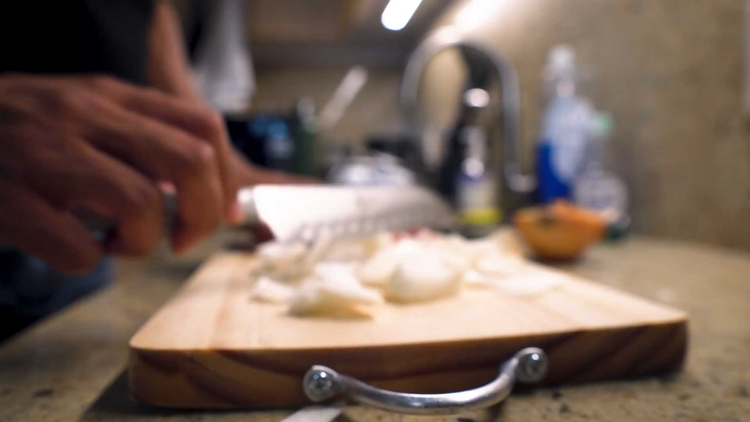
Concept Videos
Chatatouille
Notes:
Here is this year’s best video from Chatatouille

Slide 14



f
THANK YOU!
Entrepreneur Law Group PLLC
Notes:
Gold Sponsors, Unify Dynamics, Florence Venture Partners, Computerlaw Group, and Entrepreneur Law Group
Thanks!

Slide 15

THANK YOU!
f
Notes:
Silver Sponsor, Inflection AI
Thanks!

Slide 16

THANK YOU!
Notes:
Platinum Sponsor, Foundation for Creativity in Dispute Resolution
Thanks!

