Slide 1

Heuristic Evaluation
November 3, 2025
Notes:
Goal: Get to break by 70 min max for a 20 min break
--- 0 years ago ---
Because knew nothing for teams today went all of 85 min to get here and only took a 5 min break leaving 20 min!
-- 1 year ago ---
got to break at 73 min in so took a 17 min break to restart at 3pm
--- 2 years ago ---
Ended on time but had to go really fast because I took way too long on HE (78 min to the break, which I cut to 15 min)
--- 3 years ago ---
Didn’t get to break until 68 min in so gave 20 min break but probably should get there 5 min quicker to give more time to exercise, but it went ok.
---- 4 years ago ----
break at 60 min in (20 minutes for teams) +15 min exercise + 10 min discussion + 5 min wrap up [finished on time!] – started 5 min late

Slide 2

Hall of Fame or Shame?
Big basket
From Bharti Bhagtani
https://uxdesign.cc/heuristic-evaluation-of-bigbasket-application-4a69f43be47d
“India’s largest online supermarket”
Notes:
BigBasket
Online supermarket in India
What do we like?
What do we wish?

Slide 3

Hall of Shame!
Big basket
From Bharti Bhagtani
https://uxdesign.cc/heuristic-evaluation-of-bigbasket-application-4a69f43be47d
“India’s largest online supermarket”
Good
  ?
  Bad
  not aesthetic & minimalist design
  popups with too much info
  cluttered
Notes:
BigBasket
Online supermarket in India

Slide 4
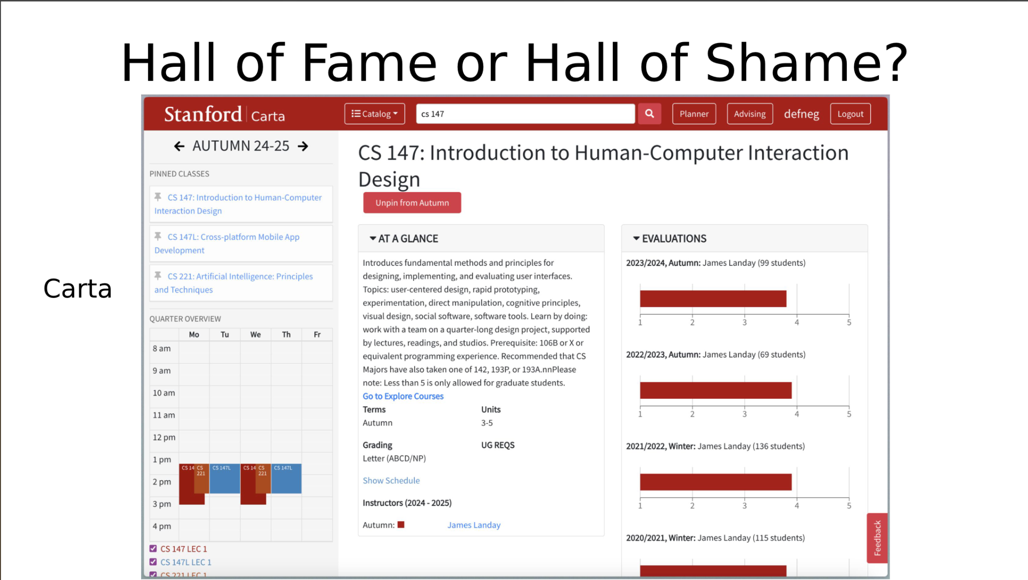
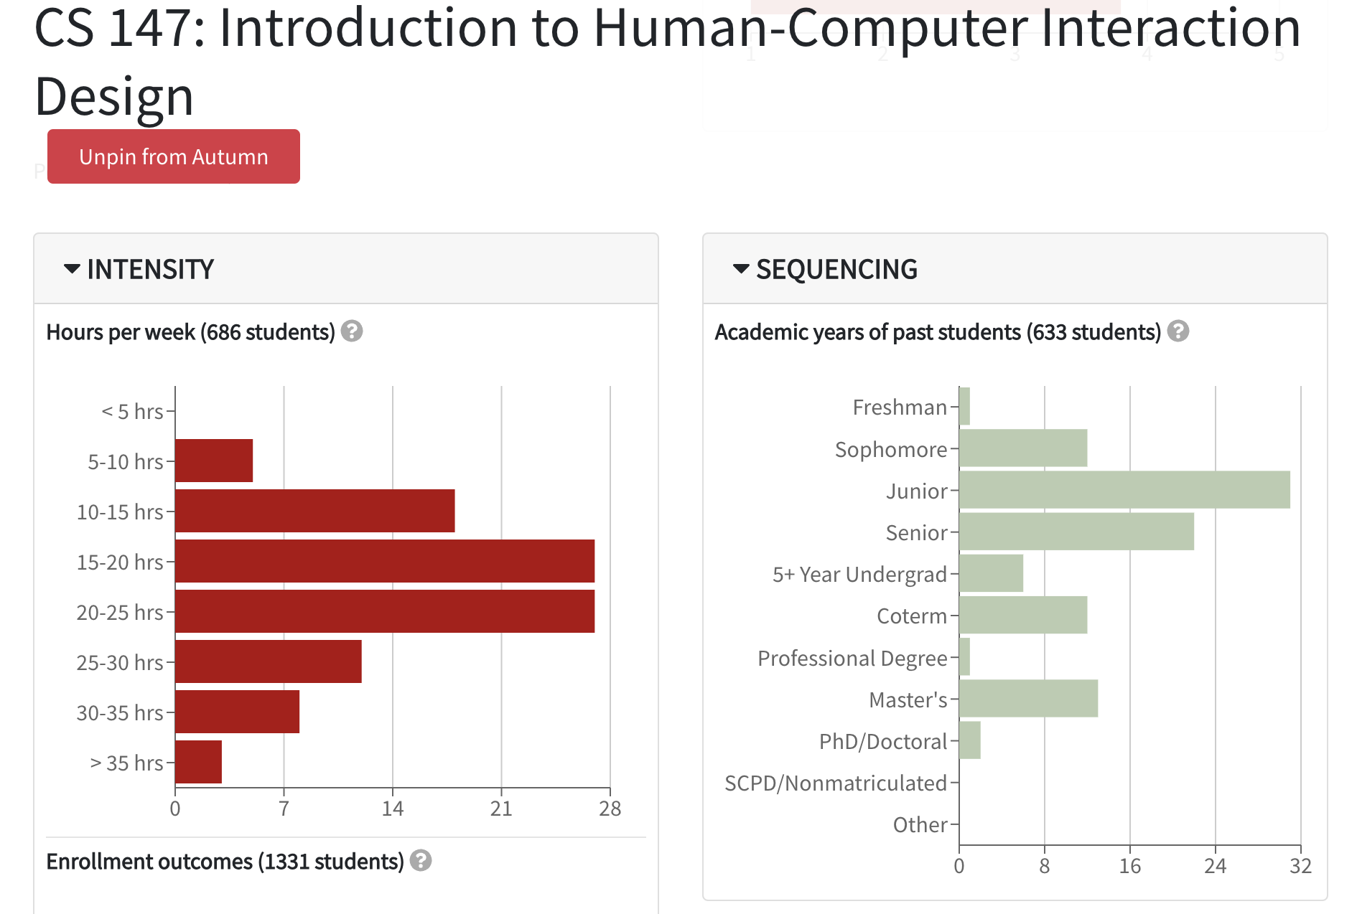
Hall of Fame or Shame?
Carta

Slide 5
Hall of Shame!
Color deficiency: Red and green used without redundant cues
Inconsistent whitespace: No space between course title and “Unpin”

Slide 6
Heuristic Evaluation
November 3, 2025
Notes:
Today I’m going to teach you a useful technique in the evaluation of the DESIGN of software products. This is a technique that you will use for years if you go into user interface/user experience work. By the end of lecture, you should be able to do this yourself.

Slide 7
Outline
Heuristic Evaluation Overview
The Heuristics
Team Break
Exercise (graded)

Slide 8
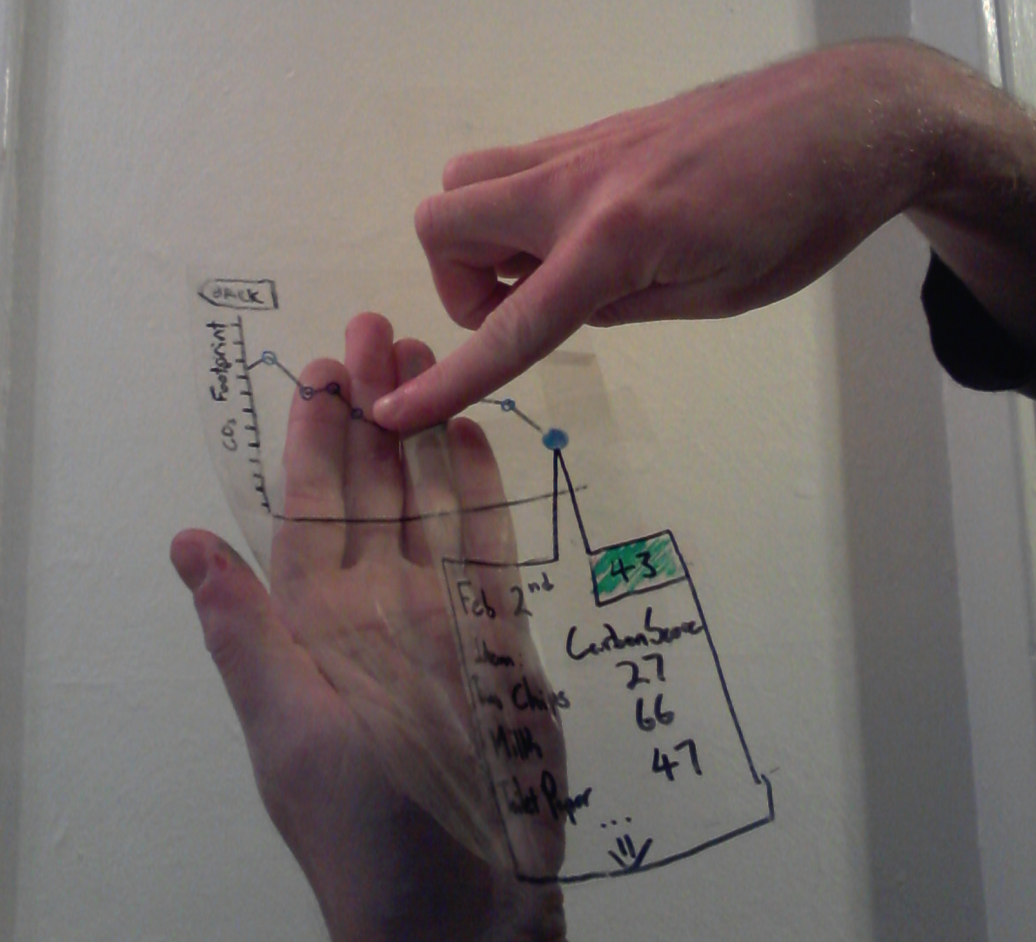
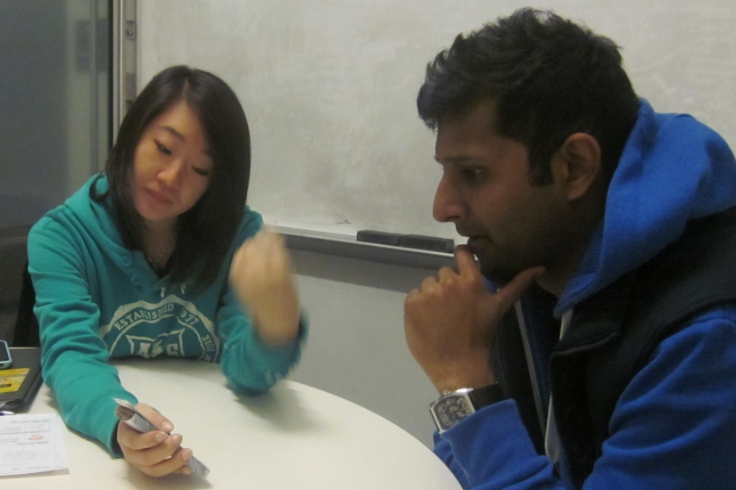
Evaluation
About figuring out how to improve design
Issues with lo-fi tests?
Not realistic
  visuals & performance
Not on actual interface
  can’t test alone
Need participants
  can be hard to find repeatedly
Notes:
What are the issues with lo-fi tests?
[ADVANCE]

Slide 9
Evaluation
About figuring out how to improve design
Issues with lo-fi tests?
Not realistic
  visuals & performance
Not on actual interface
  participant can’t test alone
Need participants
  can be hard to find repeatedly
Notes:
Issues with lo-fi:
Not realistic
Not on actual interface, so participant can’t test alone
Need participants

Slide 10
Heuristic Evaluation
Developed by Jakob Nielsen (now famous consulting co.)
Helps find usability problems in a UI design
Key idea: small set (3-5) of evaluators examine UI
  independently check for compliance with usability principles (“heuristics”)
  evaluators only communicate afterwards
    findings are then aggregated
  use violations to redesign/fix problems
Can perform on working UI or on sketches

Slide 11
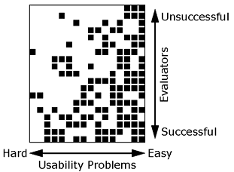
Why Multiple Evaluators?
Every evaluator doesn’t find every problem
Good evaluators find both easy & hard to find problems
Notes:
This graph from Nielsen created by first doing usability testing on an application and then applying HE (with 19 evaluators!) to the same interface.
What is the implication of this graph?
Need multiple evaluators because:
[ADVANCE]
1) Every evaluator doesn’t find every problem
[ADVANCE]
2) Note that Good evaluators find both easy & hard to find ones

Slide 12
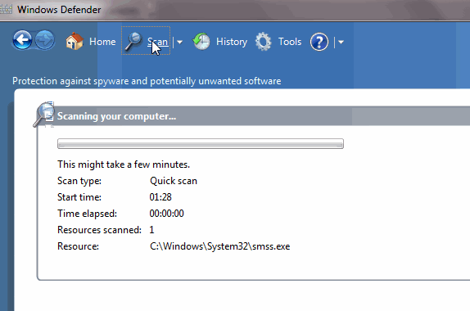
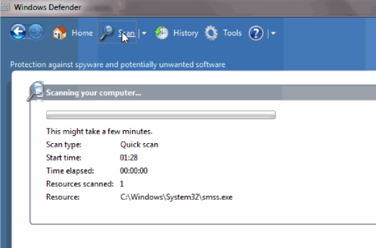

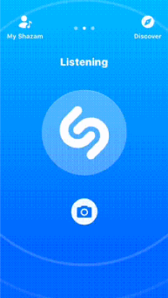
Heuristics
H1: Visibility of system status
H2: Match between
system & real world
H3: User control &
freedom
Notes:
What does this dialog box at left from Windows Defender or Shazam at right tell me?
[ADVANCE]
H1: Visibility of system status... what is it doing? Is it working or has it crashed.
[ADVANCE]
This is a real dialog box.
What is wrong with it?
[ADVANCE]
The language "registered protocol" has no meaning to a user. It doesn't match anything in the real world that they deal with.
[ADVANCE]
DuoLingo – no way when practicing to ask to “test out” like in other parts of the UI. Need to quit & go select the function. (courtesy Armando Mota)
[ADVANCE]
This shows a lack of user control & freedom.

Slide 13
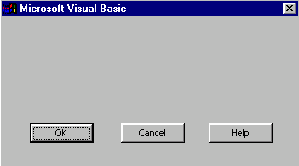
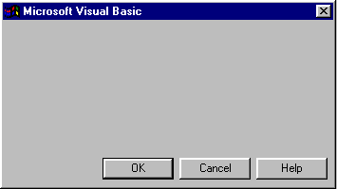
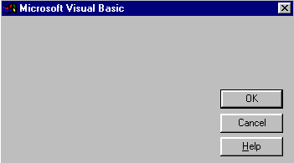
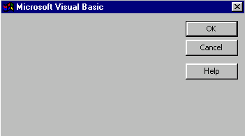
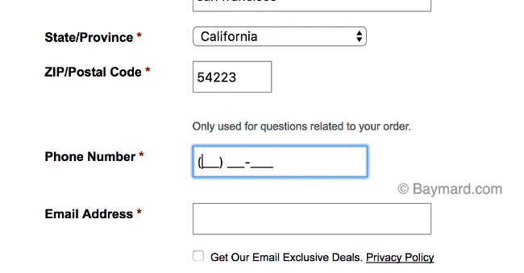
Heuristics (cont.)
H4: Consistency & standards
H5: Error prevention
H6: Recognition rather than recall
Notes:
These are all from the same UI (w/ text removed)… what’s the problem? Why?
[ADVANCE]
(-> consistency)
[ADVANCE]
What does a text field like this lead to?
[ADVANCE]
Errors. That is why you want to prevent it. One key way to prevent it is
Recognition rather than recall. Show me the format. Don’t make me remember it.
[ADVANCE]
Even better, parse it as I type it in!

Slide 14
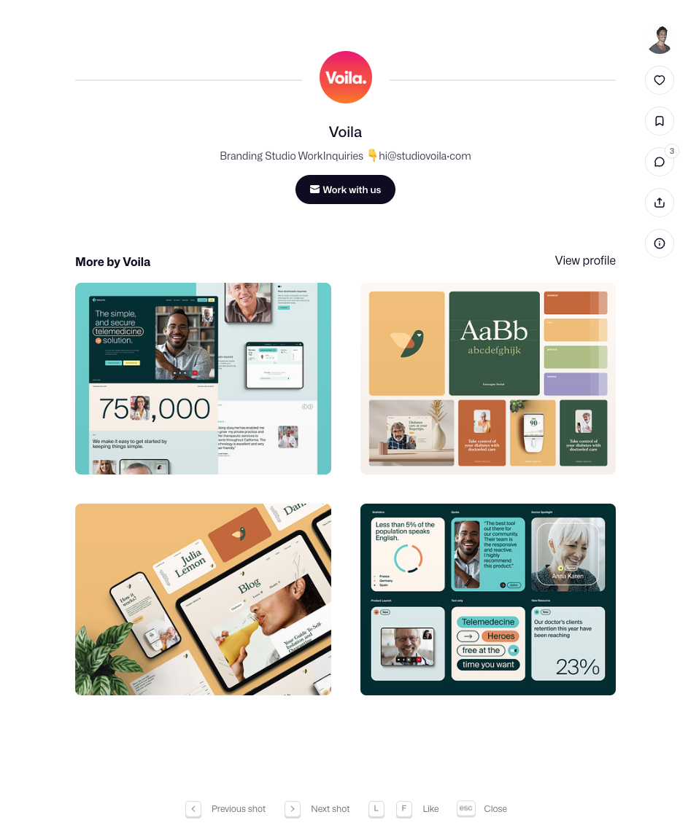

Heuristics (cont.)
H7: Flexibility and efficiency of use
Notes:
This is from Dribble.
[ADVANCE]
To Like an image you can click the “Like” icon. But you can also just hit the keyboard shortcut of “L”.
[ADVANCE]
This is an example of flexibility and efficiency and use.
For example, give power users a way to do things more quickly.

Slide 15
Heuristics (cont.)
bad
good
H8: Aesthetic & minimalist design
https://icons8.com/articles/redesigning-boarding-pass-again/
Notes:
How many of you have ever had to get a paper boarding pass for some reason? I'm still surprised they often give them out.
Notice the difference between these two boarding passes.
The first one, all the information is presented in pretty much the same way. Barely any font size differences. Its ugly and there is a lot of information that may mean nothing to the passenger.
[ADVANCE]
The second is an example of aesthetic & minimalist design. It uses both whitespace and size to point out the important elements. And it simply includes less information and leaves other information for the bar/QR code.

Slide 16
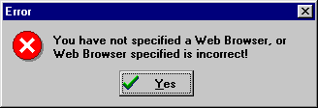
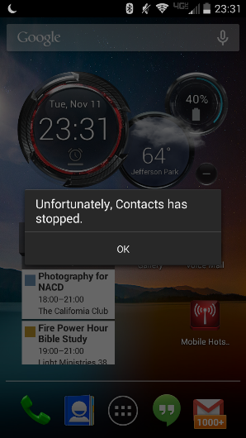
Heuristics (cont.)
bad
H9: Help users recognize, diagnose, & recover from errors
Notes:
A message from windows
Yes!!!!
[ADVANCE]
Galaxy S4 message
"Unfortunately, Contacts has stopped.... OK"
No, it is not OK. If you know about this, you restart it!
[ADVANCE]
You need good error messages so users can recognize what is wrong, and diagnose how to fix it, and then recover.
Even better...
[ADVANCE]

Slide 17
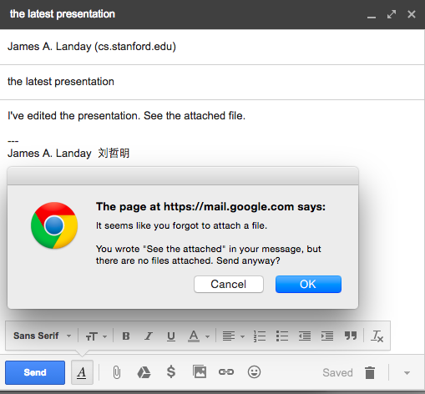
Heuristics (cont.)
good
Notes:
Help them prevent it!

Slide 18
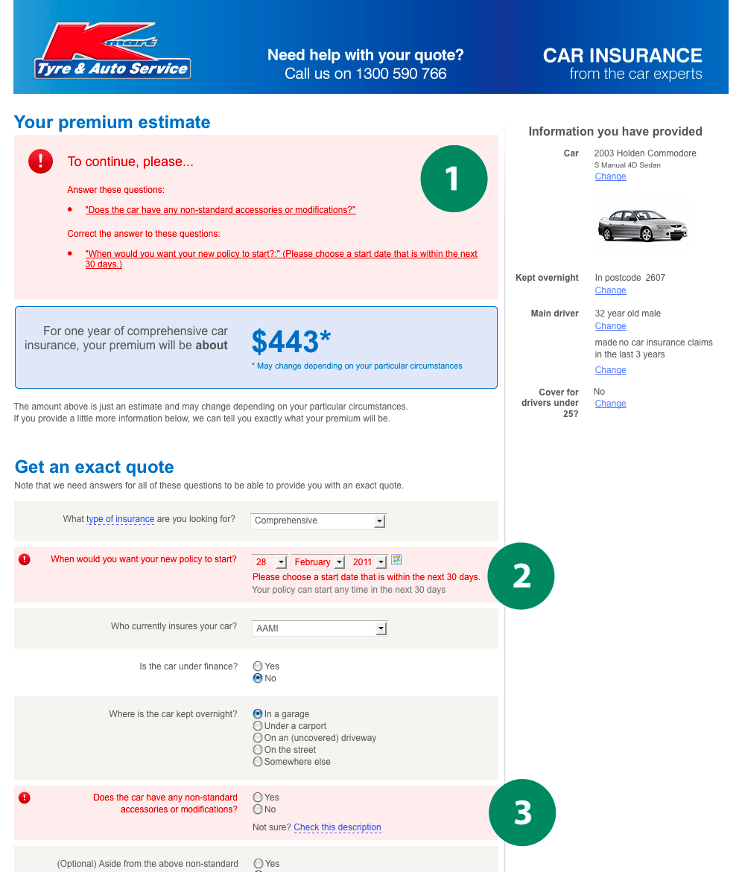
Good Error Messages
Clearly indicate what
has gone wrong
Human readable
Polite
Describe the problem
Explain how to fix it
Highly noticeable
Notes:
There are a few key points to good error messages.
Clearly indicate what has gone wrong
[ADVANCE]
Make sure it is human readable
[ADVANCE]
Be polite
[ADVANCE]
Describe what the problem is
[ADVANCE]
Explain how to fix the problem
[ADVANCE]
And make sure it is highly noticeable (we saw examples of that in the hall of fame/shames).

Slide 19
H10 – Help & Documentation
Better if the system can be used without documentation, but it may be necessary
Make documentation
  easy to search
  focused on task
  list concrete steps
http://blog.screensteps.com/10-examples-of-great-end-user-documentation

Slide 20
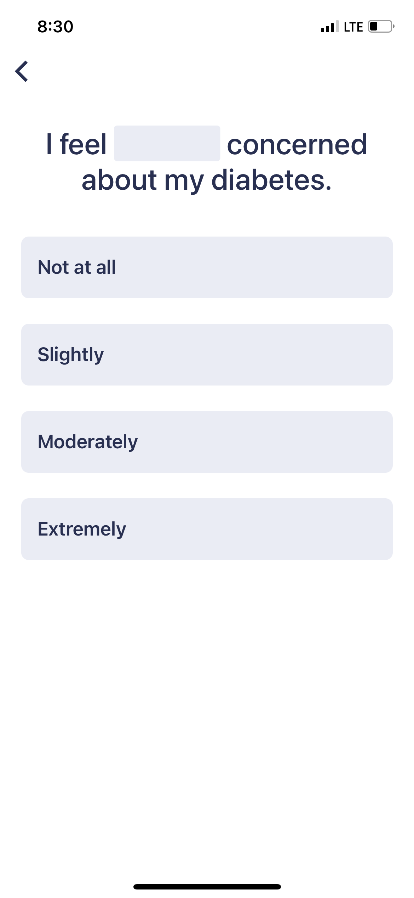
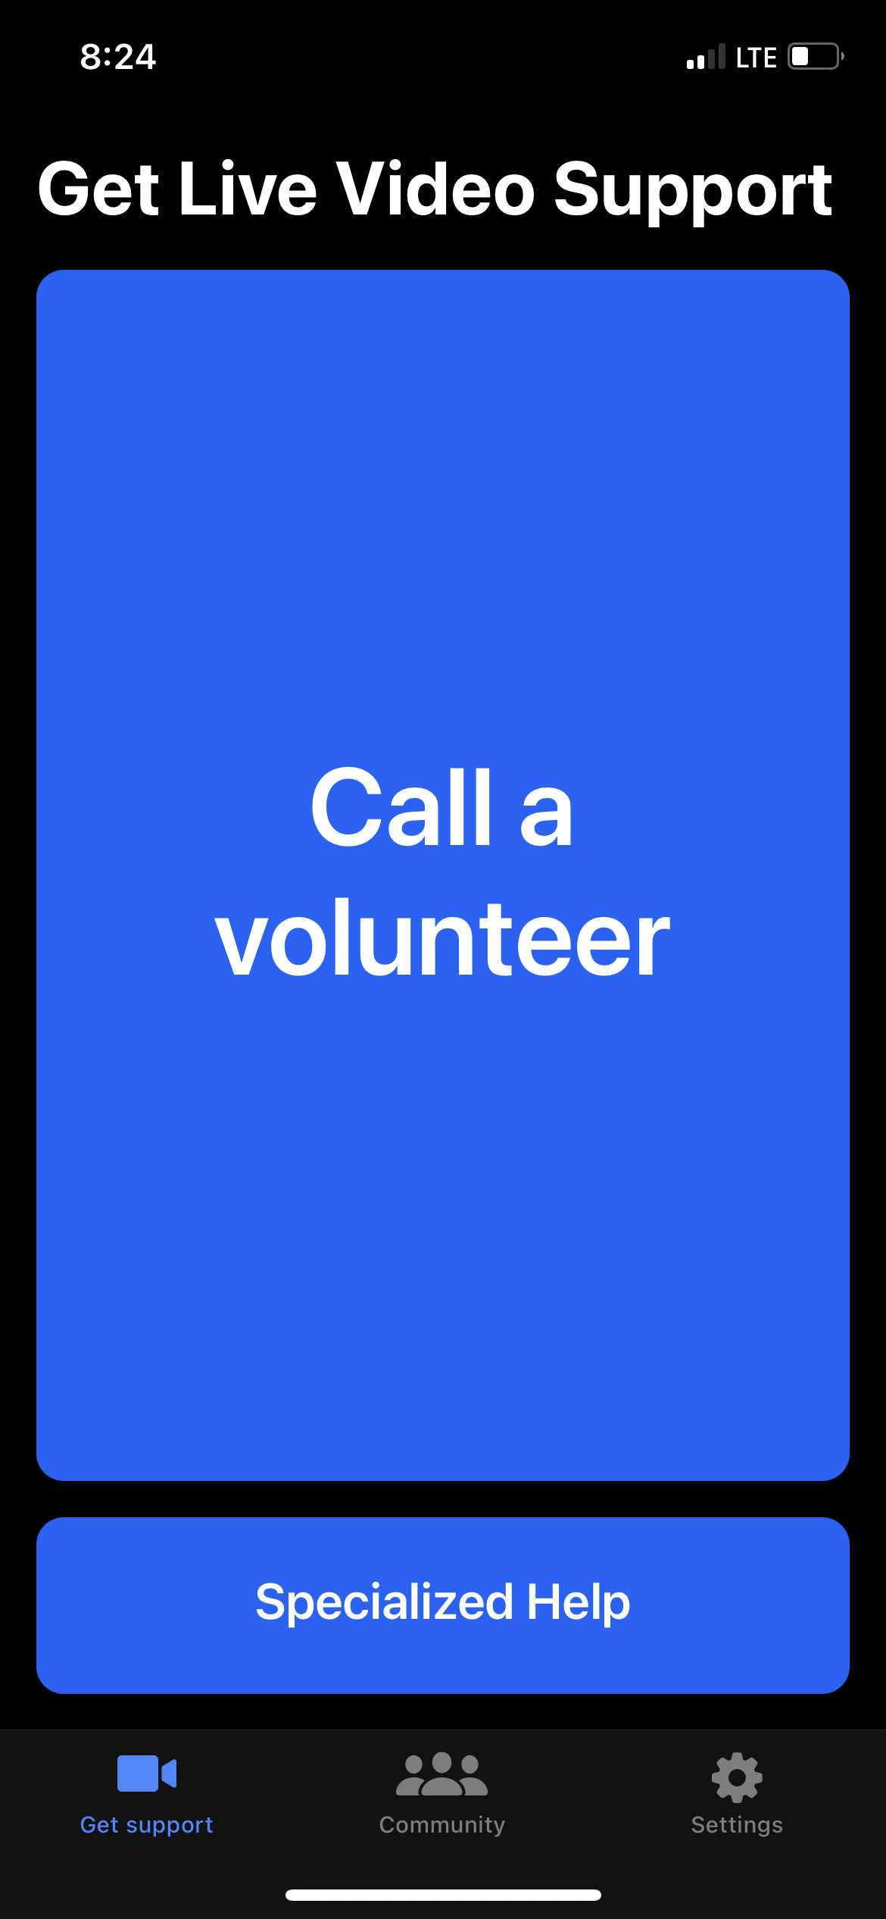
H11* – Accessible Design
Users can interact with the system using alternative input methods.
Content is legible with distinguishable contrast & text size.
Key information is upfront & not nested for screen readers.
Purely visual or auditory content has text-based alternatives for users with low vision & low hearing.
* New heuristic that CS147 staff has added to Nielson’s 10.
Glucose Buddy
Be My Eyes
Spotify (lyrics mode)
Notes:
We’ve added these next 2 heuristics to Nielsen’s 10.
The first is about making your applications accessible.
H11 … allow alternate input methods. For example, Glucose Buddy has an emphasis on non-keyboard input to make onboarding easier. There is no reason to make users type in these things.
[ADVANCE]
Low-vision users are a large percentage of the disabilities that users have. So, it is important to make ... "content legible with distinguishable contrast & text size." See how “Be My Eyes” has clear contrast (blue background), & large buttons to make it usable for people with visual impairments.
[ADVANCE]

Slide 21
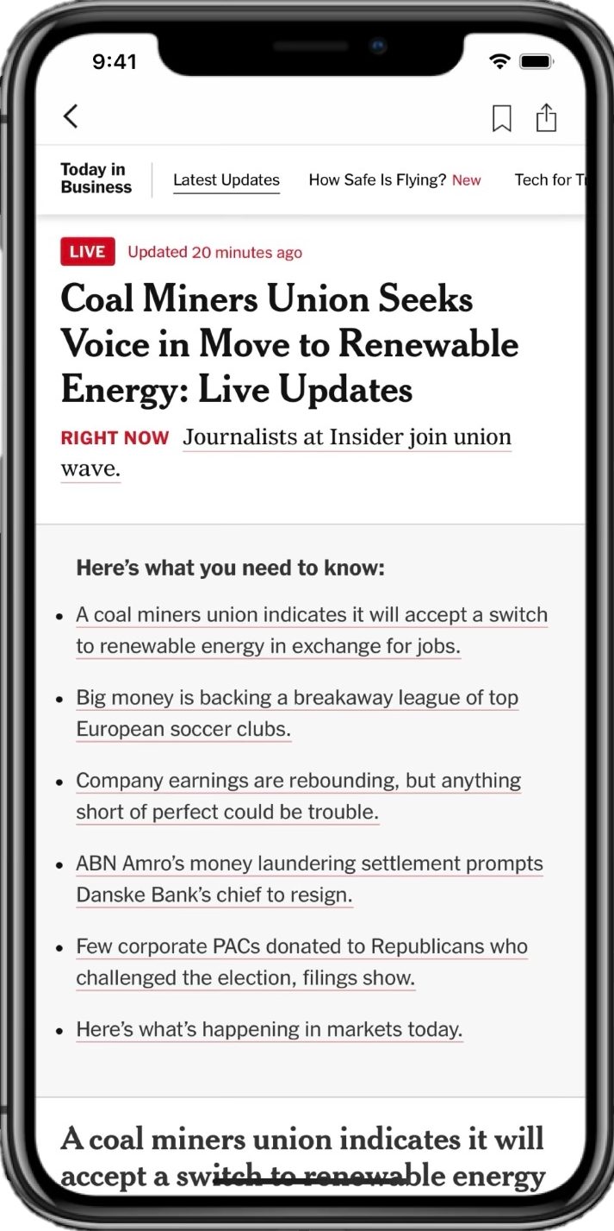
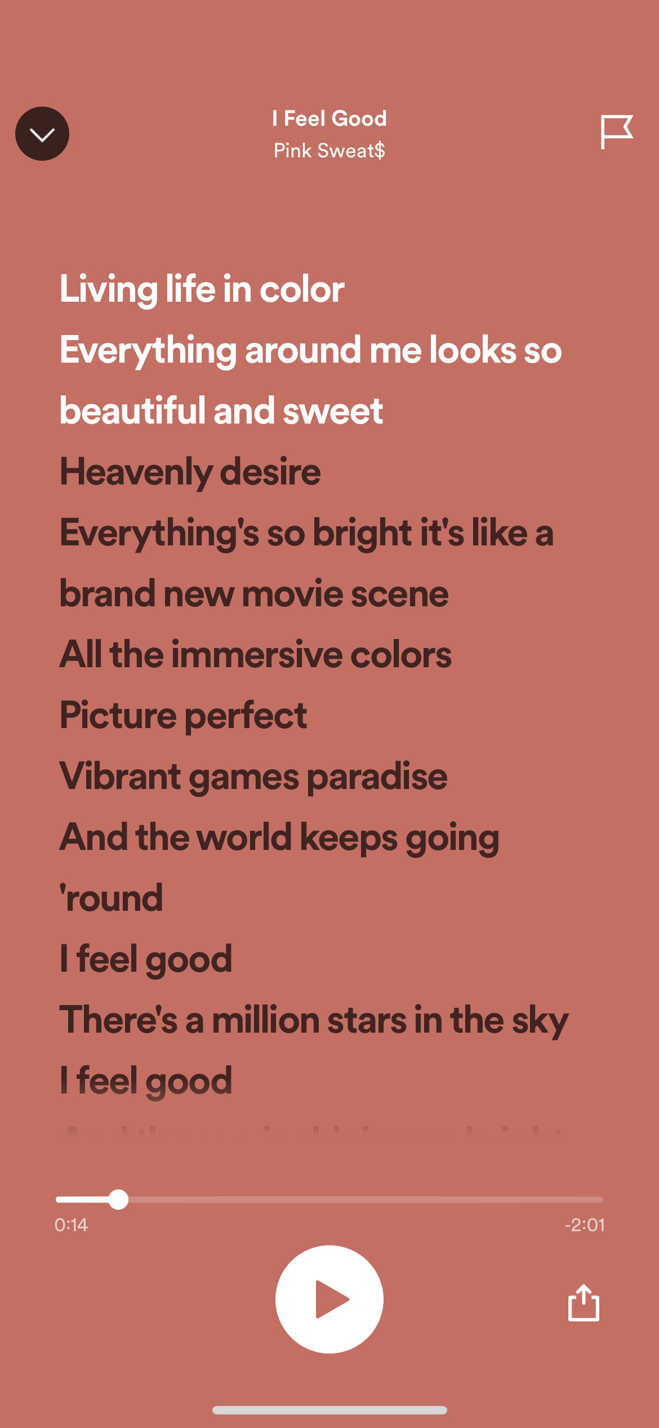
H11* – Accessible Design
Users can interact with the system using alternative input methods.
Content is legible with distinguishable contrast & text size.
Key information is upfront & not nested for screen readers.
Purely visual or auditory content has text-based alternatives for users with low vision & low hearing.
* New heuristic that CS147 staff has added to Nielson’s 10.
NY Times
Spotify (lyrics mode)
Notes:
The NY Times does a good job of having a text hierarchy with clear headings so that a blind individual using a screen reader can skip through without having to listen to all of the text. “Key information is upfront & not nested for screen readers.”
[ADVANCE]
Finally, offer text-based alternatives for visual or auditory content. Here we see Spotify offering a lyrics mode where you can read the lyrics for every song. Again, this feature benefits users beyond those who have hearing differences.

Slide 22
H12* – Value Alignment & Inclusion
Do the values encoded in design match the designers’ target values?
How do the values encoded in respond to users’ circumstances?
Do users encounter conflicting collateral values when interacting with it?
Is there a use context in which users’ & designers’ values diverge?
Does the design deepen or enhance the user’s appreciation/understanding of the encoded values encoded?
Does the design encourage behavior consistent with the target values?
The design should encode values that users can understand and relate to.
It should make a diverse group of users feel included and respected.
The design should prevent the reproduction of preexisting inequities and not create additional burdens for disadvantaged populations.
* New heuristic that CS147 staff has added to Nielson’s 10.
Notes:
H12 is about Value Alignment & Inclusion.
“The design should encode values that users can understand and relate to.”
Questions to ask:
Do the values encoded in design features match the designers’ target values?
How do the values encoded in design respond to users’ circumstances?
Does the user encounter conflicting collateral values when interacting with the product in its intended use context?
Is there a use context in which users’ and designers’ values diverge?
Does the design deepen or enhance the user’s appreciation or understanding of the values encoded?
Does the design encourage user behaviors that are consistent with the target values?
[ADVANCE]

Slide 23
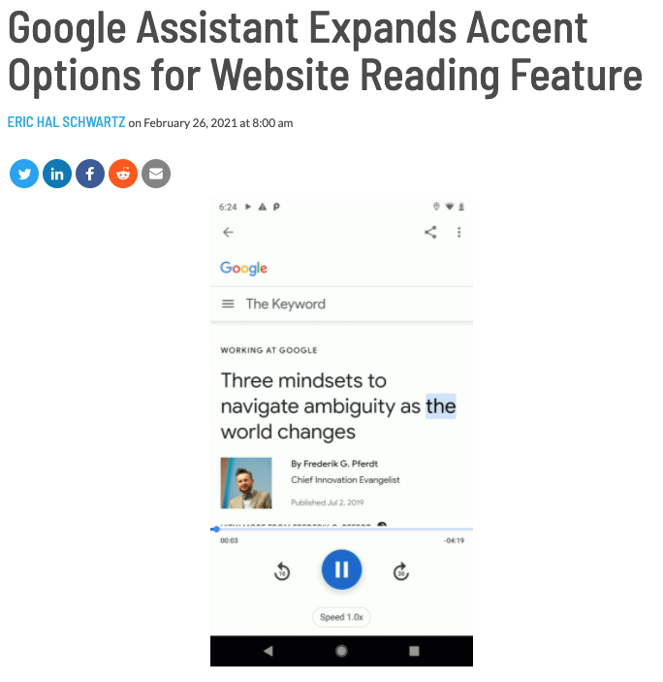
H12* – Value Alignment & Inclusion
The design should encode values that users can understand and relate to.
It should make a diverse group of users feel included and respected.
The design should prevent the reproduction of preexisting inequities and not create additional burdens for disadvantaged populations.
Google adds accented reading but leaves out marginalized groups.
* New heuristic that CS147 staff has added to Nielson’s 10.
Notes:
H12 also states that “A design should make a diverse group of users feel included and respected.”
In this example of the Google Assistant adding accents for mainstream groups, but leaving out marginalized groups, the designers may have failed in that respect.
[ADVANCE]

Slide 24
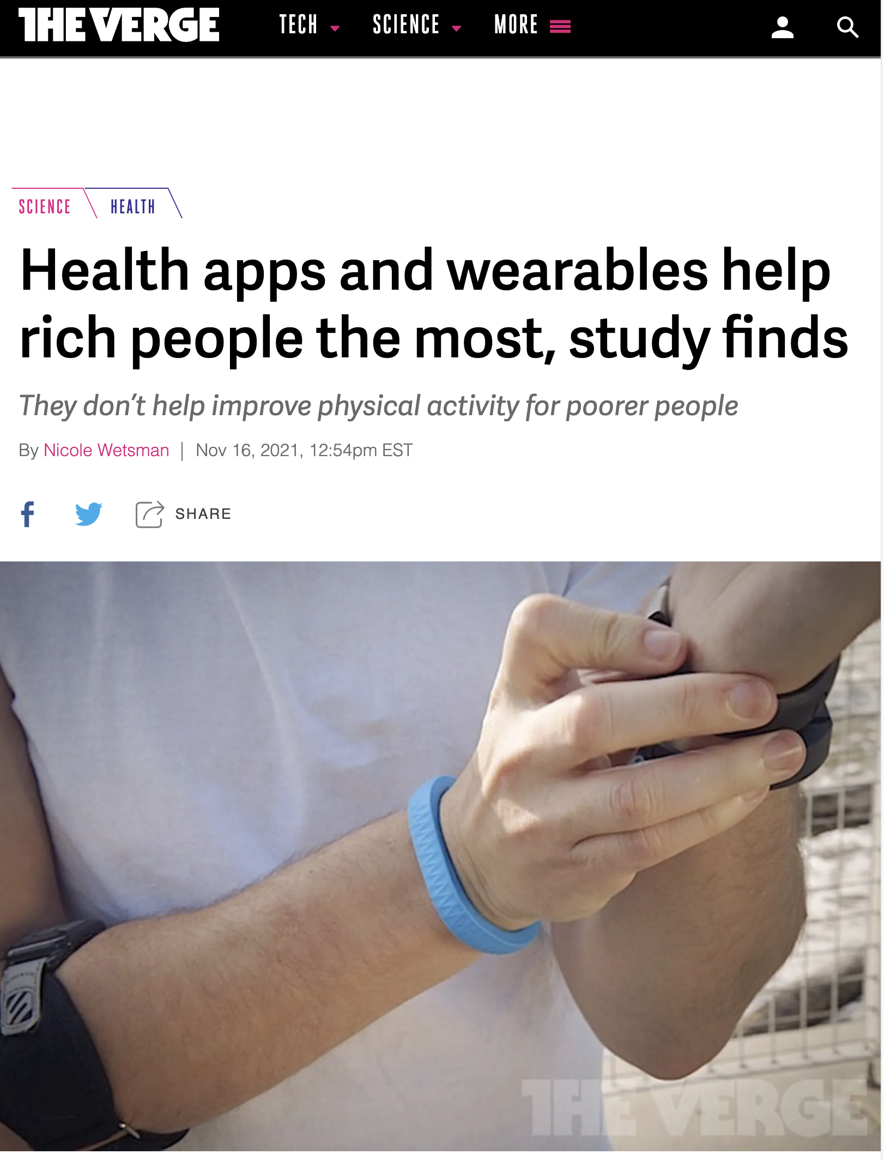
H12* – Value Alignment & Inclusion
The design should encode values that users can understand and relate to.
It should make a diverse group of users feel included and respected.
The design should prevent the reproduction of preexisting inequities and not create additional burdens for disadvantaged populations.
https://www.theverge.com/2021/11/16/22785163/digital-health-physical-activity-inequity
Western, M.J., Armstrong, M.E.G., Islam, I. et al. The effectiveness of digital interventions for increasing physical activity in individuals of low socioeconomic status: a systematic review and meta-analysis. Int J Behav Nutr Phys Act 18, 148 (2021). https://doi.org/10.1186/s12966-021-01218-4
* New heuristic that CS147 staff has added to Nielson’s 10.
Notes:
How do we include more of the population in our designs?
“H12 states the design should prevent the reproduction of preexisting inequities and not create additional burdens for disadvantaged populations.”
For example, the Verge reported on a meta-analysis study that showed that Health apps & wearable technologies benefit rich people far more than poor people. Some is about health literacy, some is about having time to exercise in the ways prescribed, and some is just ignoring these groups in design. In fact, I am working on a project led by my English colleague Paula Moya, where we are creating a health app based on my team’s WhoIsZuki project and targeting the narrative at a low-income, Hispanic senior citizen population to see if we design for this population can we see better health outcomes than with our generic design.
[ADVANCE]

Slide 25
H12* – Value Alignment & Inclusion
The design should encode values that users can understand and relate to.
It should make a diverse group of users feel included and respected.
The design should prevent the reproduction of preexisting inequities and not create additional burdens for disadvantaged populations.
Questions to ask:
Does the design make strong default assumptions about its standard user?
Is it substantially more burdensome for some population(s) to use?
Which users face greater difficulties when using it?
Do these assumptions reproduce existing biases in society?
* New heuristic that CS147 staff has added to Nielson’s 10.
Notes:
Questions to ask: Does the design make strong default assumptions about its standard user? Is it substantially more burdensome for some population(s) to use? Which users face greater difficulties when using it? Do these assumptions reproduce existing biases in society?

Slide 26
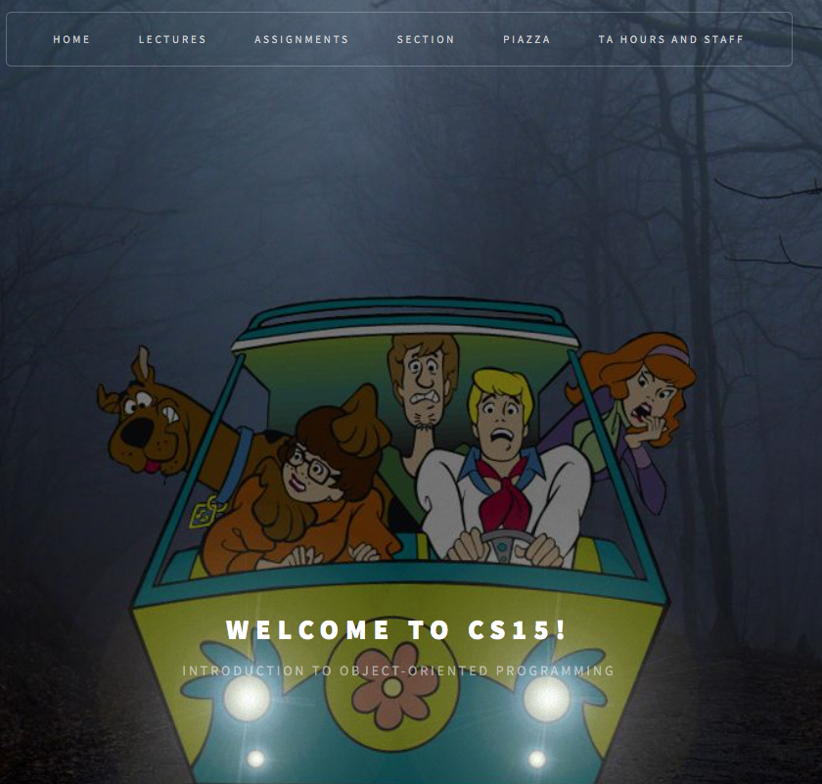
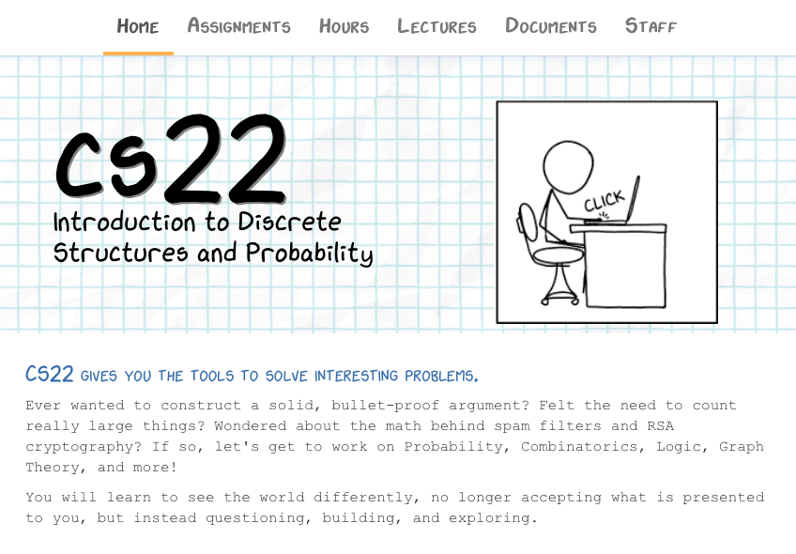
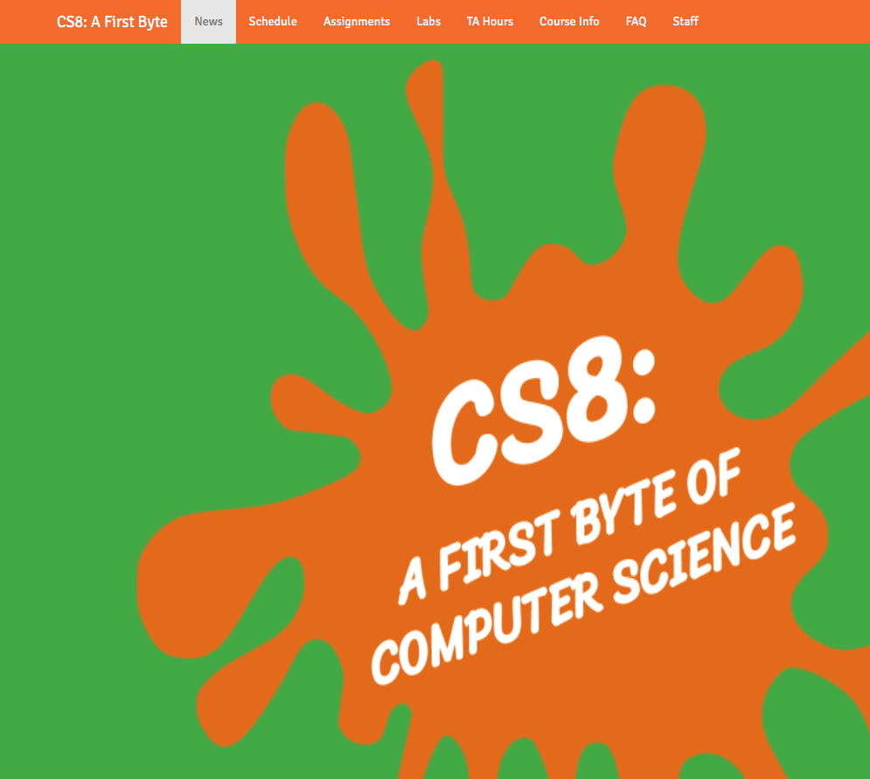
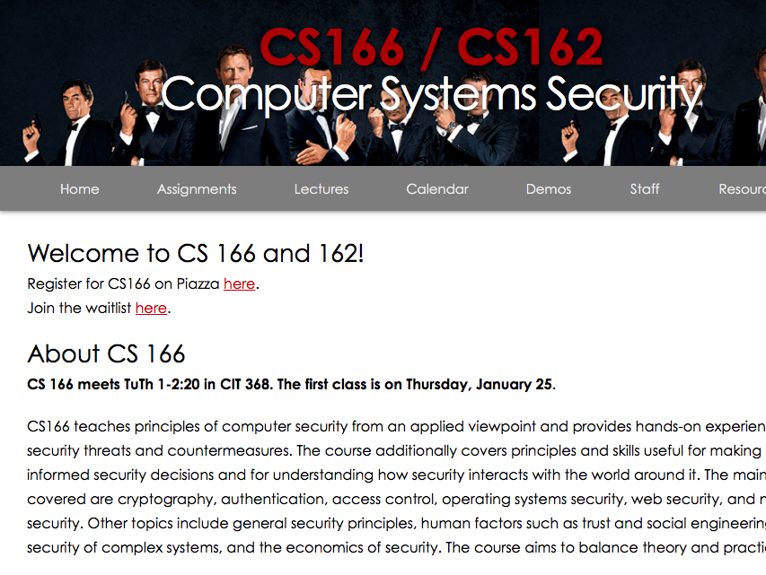
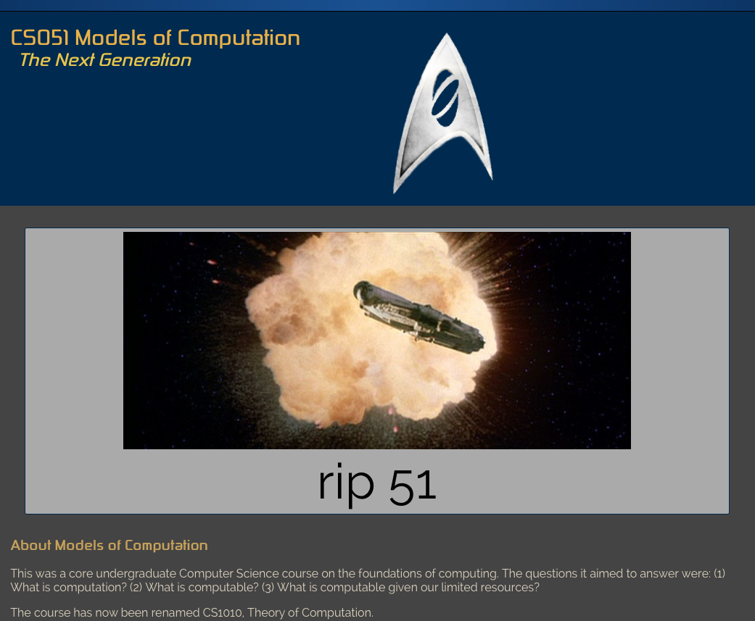
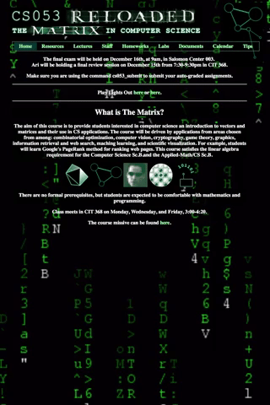
Notes:
Here is another example of value alignment and inclusion. This is based on a research project with my former PhD student Danaë Metaxa. They are now a star professor at the University of Pennsylvania.
When Danaë was an undergrad at Brown, they noticed that the course web sites had a certain style to them. Like those the web sites pictured here.
It’s not that they had any particular issue with the Matrix or with Star Trek.
It was that, despite the fun environment, Danaë noticed that many of their friends in those courses ended up dropping out; this seemed especially true for the women. And there were so few women professors or teaching assistants, too.
Given that context, some of these websites gave Danaë a sort of intuitive unease.
In their PhD, Danaë came across the appropriate theories in psychology that might explain it and set out to test if they would explain if one of the reasons women were dropping out of CS had to do with these web sites. Were the web sites almost sending a message to women that they didn't fit in CS???

Slide 27
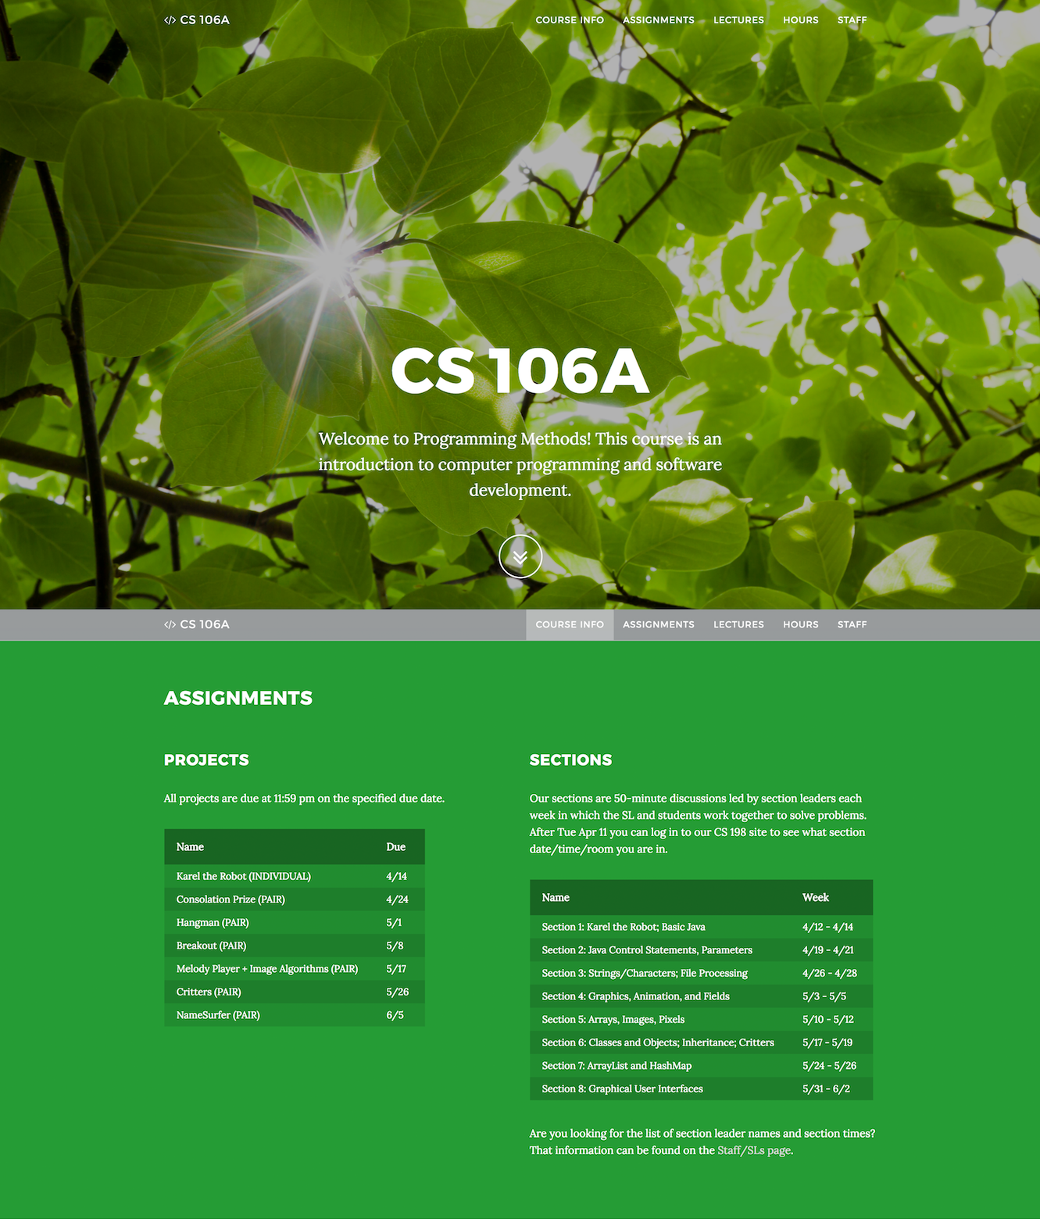
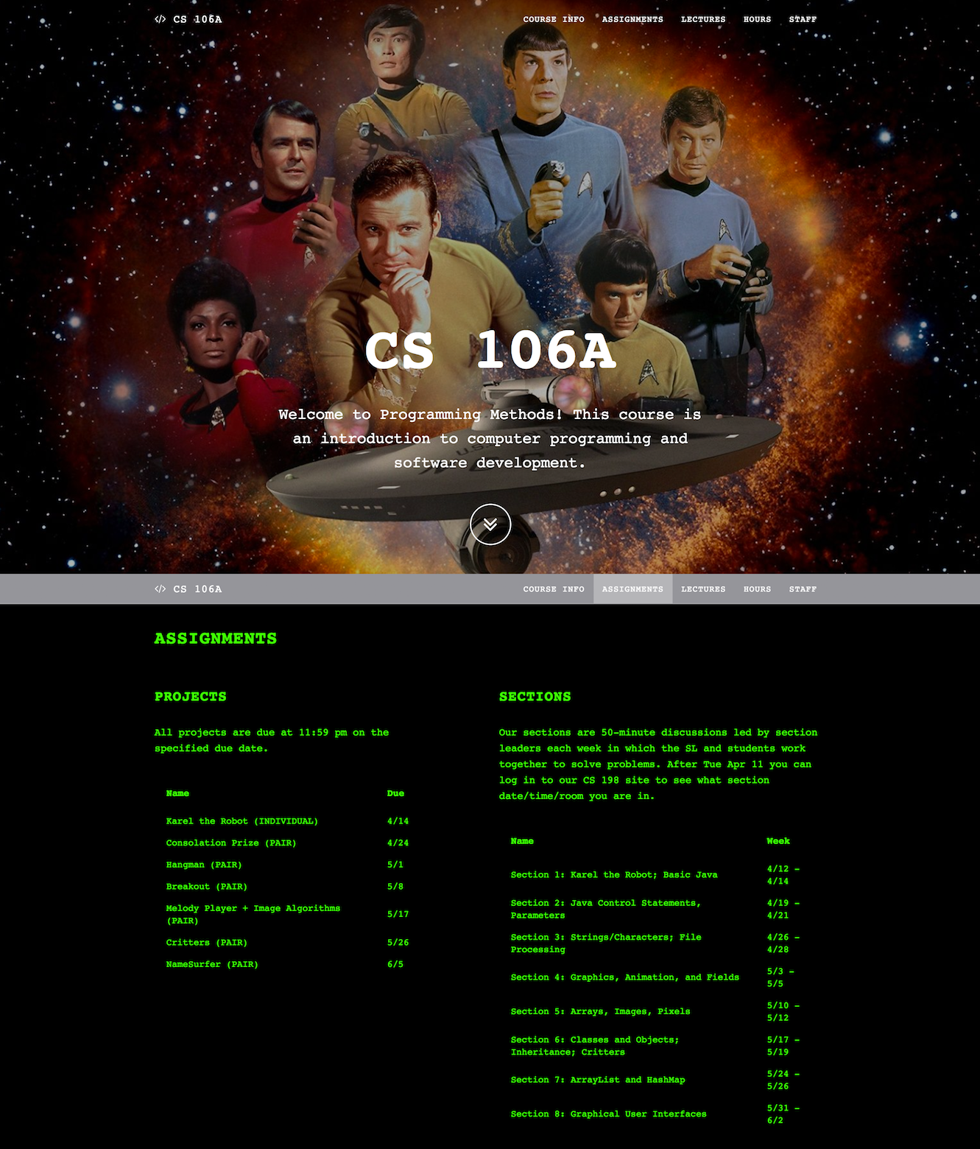
Neutral
Stereotypical
Notes:
For our experiment, we designed two versions of the same course webpage, for an introductory CS course at Stanford.
[ADVANCE]
The first used neutral imagery,
[ADVANCE]
and the other stereotypical imagery.
Both were designed and pretested to look appealing and engaging to students, and the content on the pages was identical—we only changed the aesthetic design.

Slide 28
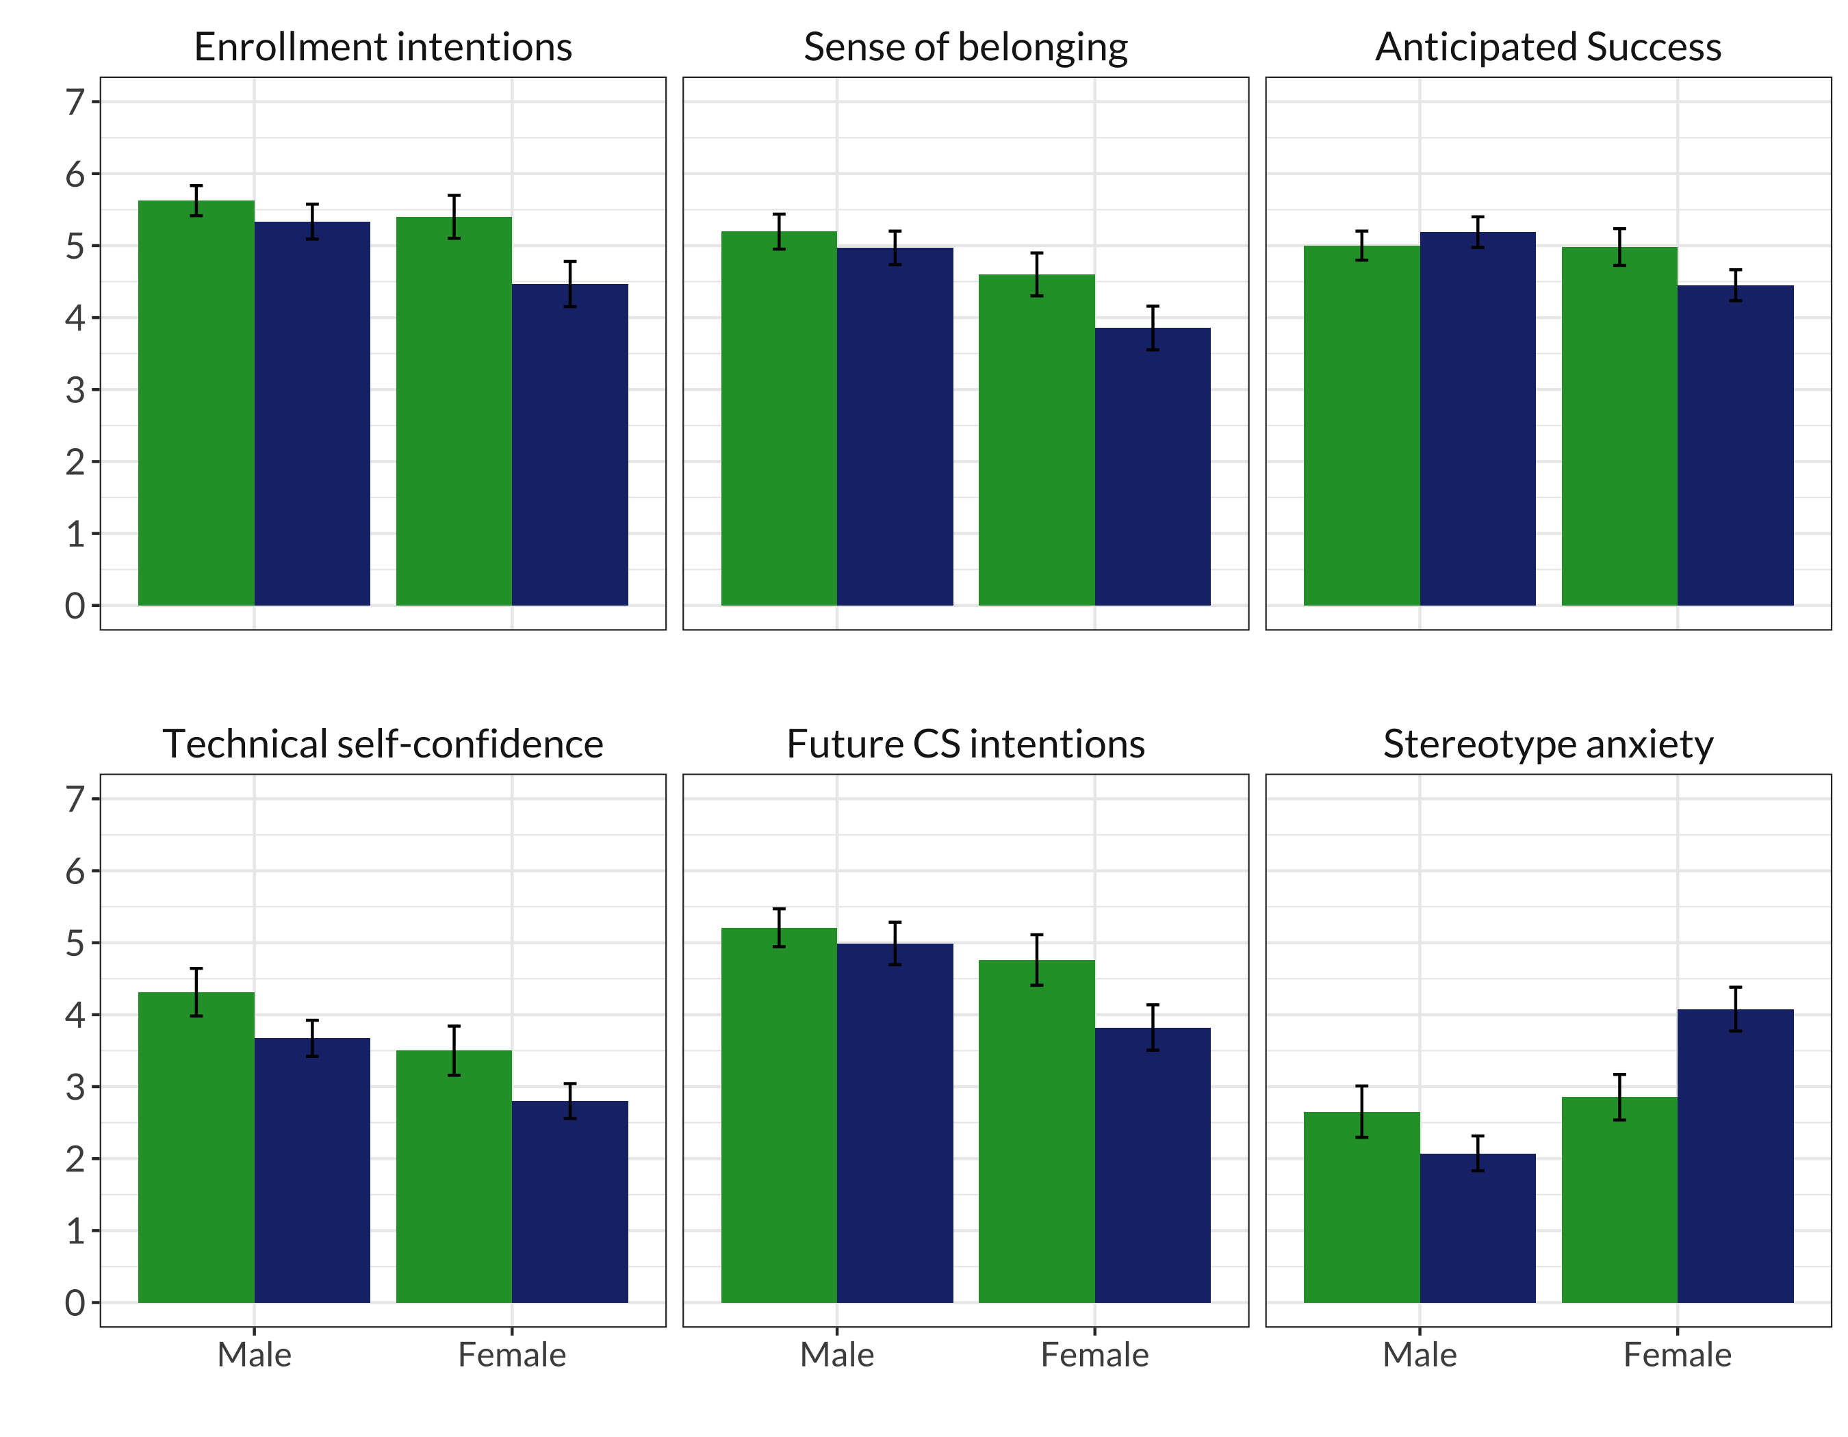
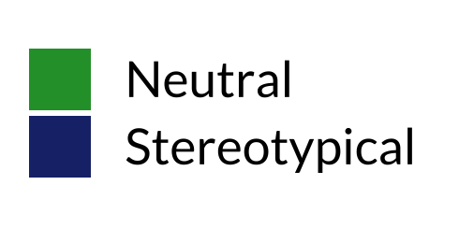
  Experimental
  Measures
Extremely
***
**
Enrollment intentions
***
Sense of belonging
Anticipated success
Not at all
(7-point scales)
Extremely
***
***
***
Technical
self-confidence
Future CS intentions
Stereotype anxiety
** p < 0.01
*** p < 0.001
Danaë Metaxa-Kakavouli, Kelly Wang, James A. Landay, and Jeff Hancock. 2018. Gender-Inclusive Design: Sense of Belonging and Bias in Web Interfaces. In Proceedings of CHI '18, 1–6. https://doi.org/10.1145/3173574.3174188
Not at all
Notes:
After interacting with one of the two websites, assigned at random, we had participants answer questions on a 7-point Likert scale about a range of measures:
whether they would want to take the course, whether they expected they would feel comfortable in it, how well they expected they would do…
…But also measures beyond the scope of one course: whether they felt confident in their technical abilities, whether they ever wanted to study computer science, and finally whether they felt they would be judged according to gender stereotypes in the discipline.
(I’d also note here that rather than potentially negatively impact a whole cohort of actual Stanford students enrolling in this course, we ran the experiment using crowdworkers of undergraduate age in the United States.)
And What we found was striking.
[ADVANCE]
Starting with the course-related measures, women exposed to the stereotypical website suffered. As you can see, for each measure, the right-most darker bar corresponding to women who saw the stereotypical website is statistically significantly lower than all the others in each figure.
So, that means they reported much lower intention to enroll, less sense of belonging, and less anticipated success, relative to all other participants.
[ADVANCE]
Moreover, women who saw that stereotypical website also were negatively impacted on longer-term measures, the ones that ostensibly had little to do with the course:
they said they were less confident in their technical abilities, less interested in CS as a field, and expected to be much more stereotyped in the discipline.
And these were moderate to large effect sizes, as large as any in the prior work on ambient belonging in physical spaces.

Slide 29
Heuristic Violation Examples
Heuristic
Number
[H6 Recognition Rather Than Recall]
Can’t copy info from one window to another
  user needs to memorize the data & retype
  fix: allow copying
[H4 Consistency and Standards]
Typography uses different fonts in 3 dialog boxes
  slows users down
  probably wouldn’t be found by user testing
  fix: pick a single format for entire interface
Reasoning
Fix
Notes:
OK now let's get more practice with how you write up heuristic violations.
You will be writing up violations at the end of class and for your individual homework this week.
Here is an example of how you might write up violations…
[ADVANCE] Numbered
[ADVANCE] the heuristic violated
[ADVANCE] reasoning for the problem
[ADVANCE] potential fix
[ADVANCE]
And another...

Slide 30
Severity Ratings
0 - don’t agree that this is a usability problem
1 - cosmetic problem
2 - minor usability problem
3 - major usability problem; important to fix
4 - usability catastrophe; imperative to fix
Notes:
We also like to add a severity rating to indicate how bad the violation is.

Slide 31
Severity Ratings Example
Severity rating
1. [H4 Consistency & Standards] [Severity 3]
The interface used the string “Save” on the first screen for saving the user’s settings, but used the string “Store” on the second screen. Users may be confused by this different terminology for the same function.
Fix: Use “Save” everywhere in the application.
Notes:
So we might write it like this.
[ADVANCE] adding this severity rating of 3 (major usability problem -- can debate whether a 2 or 3)

Slide 32
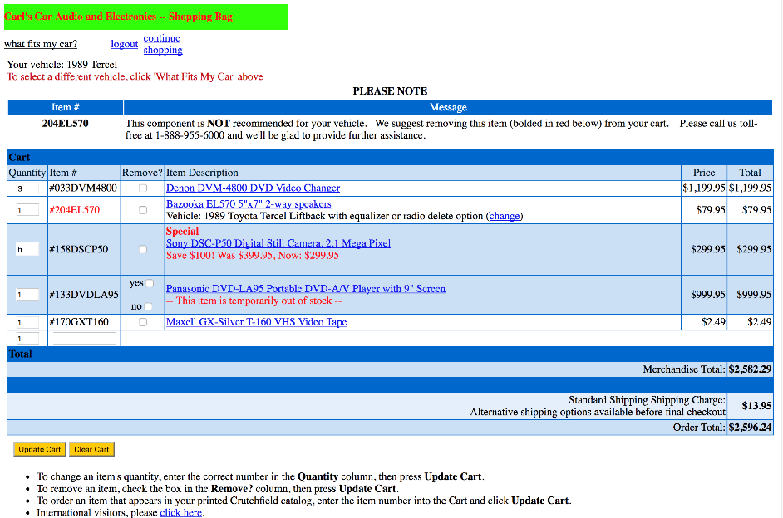
e x e r c i s e
Notes:
Let’s do an example
What violations do you see here?
Take 2 minutes and write down as many violations as you can find
Put them in slack channel after you have found them
--------------------------
-- 0 years ago ---
H4 (consistency): Color of font -- some red and some black. What does it mean?
HE4 (consistency)/HX (error prevention) - yes/no in remove? vs. update button
H7 (flexibility/efficiency)-putting item number and having to press update
--- 1 year ago ---
H4 (consistency): The use of red to indicate errors, out of stock items, and sales/savings
H4 (consistency): two of the check boxes have yes/no next to them but none of the others do. Error prevention?
H9 (Aesthetic): "#" is not needed

Slide 33
Problems Found This Year
1.

Slide 34
Problems Found Last Year
1. H4 Consistency and standards, severity 3
2. H4 - Which red refers to removing objects?
3. H5: Error prevention; the letter "h" is in Quantity, and no error is identified
4. H1: system status; "International Visitors, please click here" doesn't explain why they have to click there, or where it will take them
5. H4: consistency; in the remove column, it's either a toggle or a yes and a no check box
6. H4: consistency; "Total" means different things in different places
7. H5: you're allowed to order something that is out of stock? Severity: 2
8. H4, severity 2. Background color differs between blue and white
9. H4; message about one problem is at the top as opposed to under like out of stock one
10. [H5 Error Prevention][Level 2] Unclear that the message under Please Note is describing an error. Maybe make the error explanation text color red to match.
11. H11 - the title is not accessible to red-green color blindness
12. H9: gives the user the ability to not remove an out-of-stock item
13. H2: uses item numbers and codes that users don’t understand [level 4]
14. H8: minimalist design not followed, lots of different colors without purpose
15. H4: Inconsistent coloring of boxes in the cart
16. h8: cluttered design with lots of extraneous information
17. H4, severity 3 Remove option is one option except for item 4 which is yes or no for some reason
18. H11 - severity 3 - coloring and contrast is not accessible for color blindness, the font is also really small
19. H8 - the design is extremely cluttered with all the information being all displayed in the same size and type (only diff is color), user needs to be able to identify the most important things, remove all irrelevant information, and highlight important information
20. H8: Aesthetic and minimalist design - too many different and vibrant colors for background and text
21. H11: accessible design [3-4] Illegible text, high saturation title and blue text, change colors
22. H8: Unnecessary information added that clusters the page, design is not minimalistic, conflicting colors
23. H5 Error Prevention the quantity is h instead of a number at row 3
24. H8: incredibly cluttered and confusing with different colors
25. H4: Inconsistent coloring of boxes in the cart
26. H4, severity 3 Remove option is one option except for item 4 which is yes or no for some reason
27. H7 severity 3, instructions are at the bottom rather than the top
28. H4 Consistency and Standards Severity 3: Uses links at the top to navigate (logout, continue shopping) but buttons for navigation elsewhere (update cart, clear cart), making navigation unnecessarily difficult
29. H4: Remove checkboxes are inconsistent, one has yes no
30. H4: Waht does red indicate? Used for discounts, stock, and item nums
31. H2: The user does not need to know the item number
32. H8 Aesthetic and Minimalist Design - Screen is cluttered and the colors aren’t great - users don’t care about item numbers, Price, and total seem to be the exact same thing, H6 [3] Recognition rather than recall, what does update cart mean
33. H4: checkbox for one product but not others
34. H8 - users don't need to know the item number, H4 - the color red is inconsistently used, H5 - this component is not recommended, H9 - DVD out of stock but still being charged, H2 - removing an item is confusing
35. H11: the colors aren't good for contrast (red text on a green background)
36. H5- add and clear cart buttons look the same
37. H4: remove boxes either have one checkbox or a yes/no checkboxes
38. H8 Aesthetic and Minimalist Design
39. H4, 2. Background color differs. H8, 4 designs not minimal and have a lot of distracting info
40. H1 - The error message is very hard to read
41. H5, H10 (?): issue with the second item #204… is explained in a message at the top of the screen but has to cross-check the item number with the list of items below… not immediately clear what the message is referring to and why #204… is red
42. H9: Error message, which indicates a product is not compatible with a car, is not easy to spot and requires a multiple step solution
43. H5 [Severity 4]: No error message given for the quantity of the digital still camera being "h". This is a fatal error because we have no idea how many the user actually meant to buy. Inform the user of this incorrect input or only allow them to input numerals.
44. H9: error message doesn't contain ways to resolve the error
45. H5: the component that is not recommended is written in black font and doesn’t alert the user, should stand out more to alert the user before purchasing
46. H4: Use of the color red is inconsistent, means different things in different contexts
47. H1: Green decorative background of title text can confuse users into thinking that they have already completed a process, since green is associated with completion
48. H3 [Severity 4]: I can't see a checkout button. Even if it should not be accessible until I resolve all the errors, it should be greyed out or similar so I don't feel unable to proceed.
49. H4: color red is used for a lot of different things (errors, ads, etc.)
50. H2: don’t need to know the item # (could also be error prevention)
51. H9: out of stock but still being charged
52. H9: there is an h in quantity but no indication
53. H7/10: too many steps to update cart
54. H8: blue text on blue background
Notes:
54 problems!!!!

Slide 35
Problems Found Two Years Ago
H1: Visibility of system status
  Username for current shopping cart missing [1]
H2: Match between system & real world
  "price" and "total" should refer to different things [1]
  Items referred to by their Item Number [3]
H3: User control & freedom
  Not clear where/how user can place order [1]
  Missing a search bar [1]
H4: Consistency & standards
  Red used inconsistently - error, special, title, out of stock [4]
  Yes/No Checkbox in “Remove?’ [5]
  Menu Bar links on different lines - logout, continue, shopping [1]

Slide 36
Problems Found Two Years Ago
H5: Error prevention
  Out of Stock items allowed to be added to cart [4]
  ”h” in Quantity Field [7]
H6: Recognition rather than recall
  Item number not auto-filled, difficult for user to remember [2]
H7: Flexibility and efficiency of use
  Update Cart Button required to update cart and ambiguous use [2]
  Quantity Field could be a selection menu [1]
H8: Aesthetic & minimalist design
  Color Combinations - red/green, black text on blue background [6]
  Crowded Design - columns and text squished [2]
  # Sign not necessary [1]

Slide 37
Problems Found Two Years Ago
H9: Help users recognize, diagnose, & recover from errors
  “Please Note” error message refers to item bolded in red but multiple items bolded in red [2]
  Last row has quantity 1 but no other info, user unsure how to fix [1]
H10: Help & Documentation
  Instructions for use not immediately visible [1]
  International users not immediately redirected to other page [2]
H11*: Accessible
  Aesthetic choices difficult for visually impaired- blue links, small text, blue on blue color scheme [3]
  Error message relies on ability to view red color - hard for color-blind [1]
H12*: Fairness & inclusion
  Requires knowledge of your car beyond just model and year [1]

Slide 38
Problems Found Three Years Ago
H4 (consistency): The use of red to indicate errors, out of stock items, and sales/savings [26]
H4 (consistency): two of the check boxes have yes/no next to them but none of the others do. Error prevention? [22]
H9 (Aesthetic): "#" is not needed [2]
H5 [Error Prevention]: “h” in the quantity box. [11]
Notes:
Three years ago:
H3 – no purchase button [100]
H4 – remove column has check boxes and then one entry w/ yes/no [100]
H5 – illegal input (text) allowed in quantity field [90]
H1 – not clear who is logged in [10]
H2 – “what fits my car” is not a good term that people would know [20]
H5 – user can add “out of stock” items [80]

Slide 39
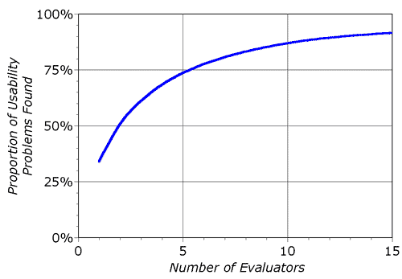
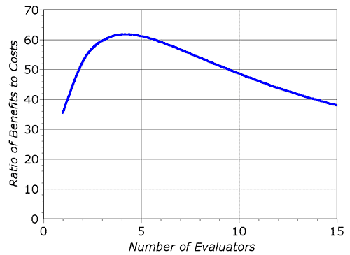
Decreasing Returns
problems found
benefits / cost
* Caveat: graphs for a specific example
Notes:
Why not just add more evaluators?
[ADVANCE]
decreasing returns after about 5 evaluators
note: this was based on only one study

Slide 40
Heuristic Evaluation Summary
Have evaluators go through the UI twice
Ask them to see if it complies with heuristics
  note where it doesn’t & say why
Have evaluators independently rate severity
Combine the findings from 3 to 5 evaluators
  come to agreement on problems, fixes & severity
Alternate with user testing – you’ll find different types of problems

Slide 41
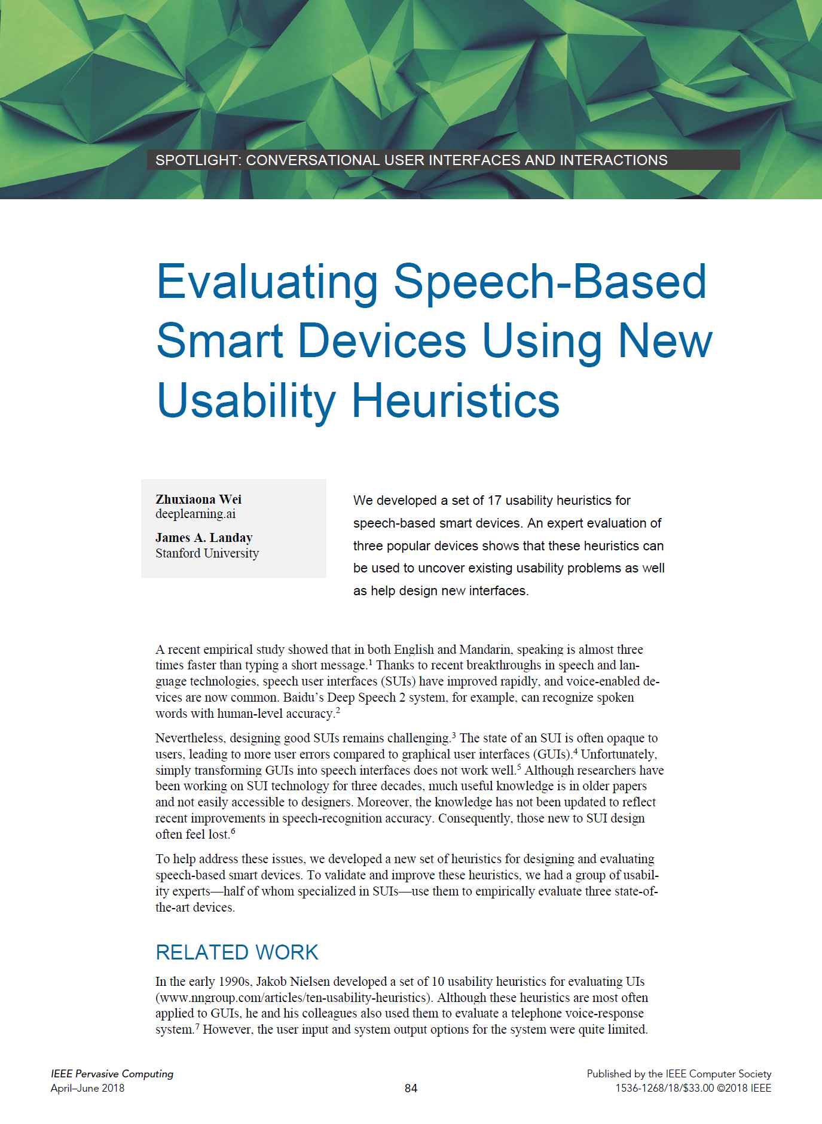
Speech UI Heuristics
S1: Give the agent a persona through language, sounds, and other styles.
S2: Make the system status clear.
S3: Speak the user’s language.
S4: Start and stop conversations.
S5: Pay attention to what the user said and respect the user’s context.
S6: Use spoken language characteristics.
S7: Make conversation a back-and-forth exchange.
S8: Adapt agent style to who users are, how they speak, and how they are feeling.
S9: Guide users through a conversation so they are not easily lost.
S10: Use responses to help users discover what is possible.
Notes:
People have come up with new heuristics for specific modalities. E.g., I worked on this one for speech interfaces with e.g., smart speakers. So if you are evaluating a voice interface you should use these as well!

Slide 42
Speech UI Heuristics
S11: Keep feedback and prompts short.
S12: Confirm input intelligently.
S13: Use speech-recognition system confidence to drive feedback style.
S14: Use multimodal feedback when available.
S15: Avoid cascading correction errors.
S16: Use normal language in communicating errors.
S17: Allow users to exit from errors or a mistaken conversation.
The list of heuristics along with detailed descriptions and examples can be found at http://hci.stanford.edu/publications/2018/speech-he/sui-heuristics.html
Notes:
We had 17 different heuristics.

Slide 43
Administrivia
Individual heuristic evaluation assignment this week
Midterm 1 week from this Wed (in class plus at home design problem)
  Have an OAE letter? If you haven’t gotten it to us, you must by the end of today or we will not able to accommodate
Notes:
Need to turn in your medium-fi prototype assignment promptly at 5PM today so others in your studio or studio at same time can do their HE on your design

Slide 44
Administrivia: Assignment 5 Grades/Feedback
Assignment #5 Low-fi Prototype & Test
A5 Group Grade: ✓--: 0% ✓-: 22% ✓: 35% ✓+: 35% ✓++: 9%
A5 Individual Presentation: ✓--: 0% ✓-: 0% ✓: 39% ✓+: 52% ✓++: 9%
A5 Group Average: 92%
A5 Individual Presentation Average: 93%
We liked
  “Creative widgets and overlays in low-fi prototype”
  “Use of annotations and color to communicate different aspects of sketches”
  “Thorough description of testing environment and procedures”
  “Use of charts and graphs to discuss bottom-line data ”
We wished
  “Rationale for final realization grounded in evidence”
  “Critical incident logs include severities and actionable implications”
  “Clear discussion on usability progress with reference to key measurements”
Notes:
[ADVANCE]
Here you can see the averages for the low-fi prototype & test assignment
Both the group and the individual buckets are up about a point from last year (for example no check++s last year and we had some check -- s last year”
[ADVANCE]
Average for the group and presentations are solid (a little up over last year).
[ADVANCE]
What the TAs liked
[ADVANCE]
We wished
[ADVANCE]

Slide 45
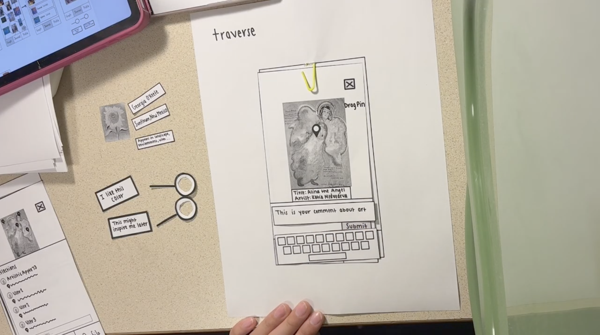
Notes:
Nice examples
Traverse from Abbie’s 1:30 studio had a nice prototype with widgets and overlays for keyboard, pins, and comments
[ADVANCE]

Slide 46
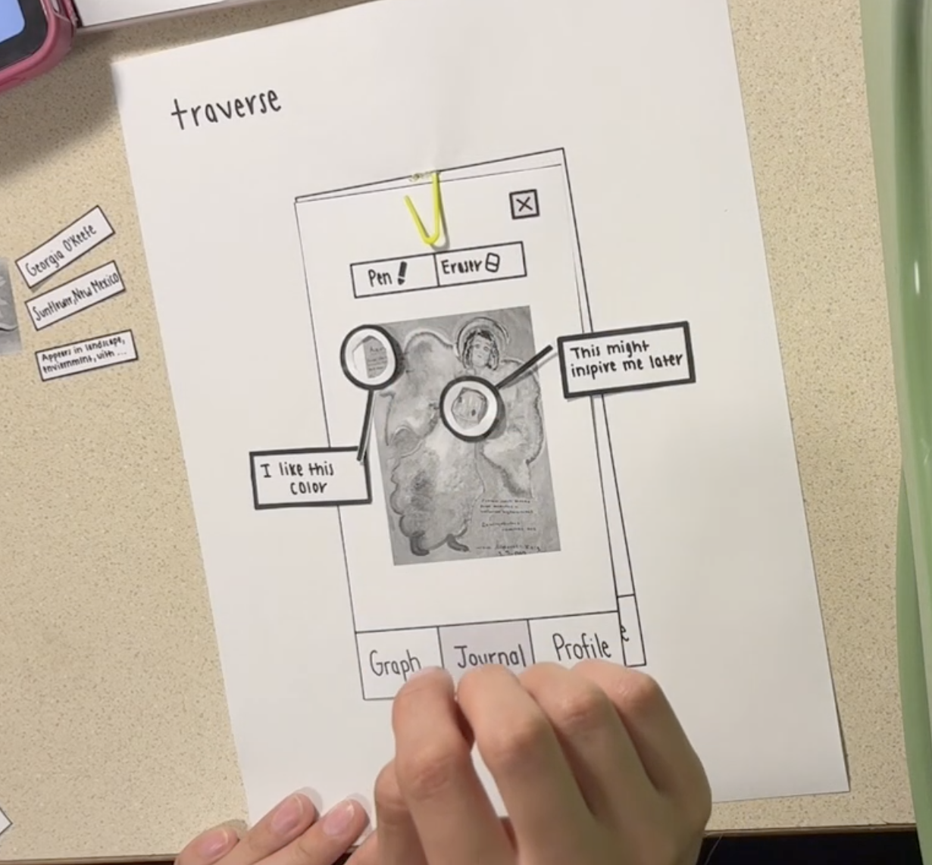
Notes:
Traverse

Slide 47
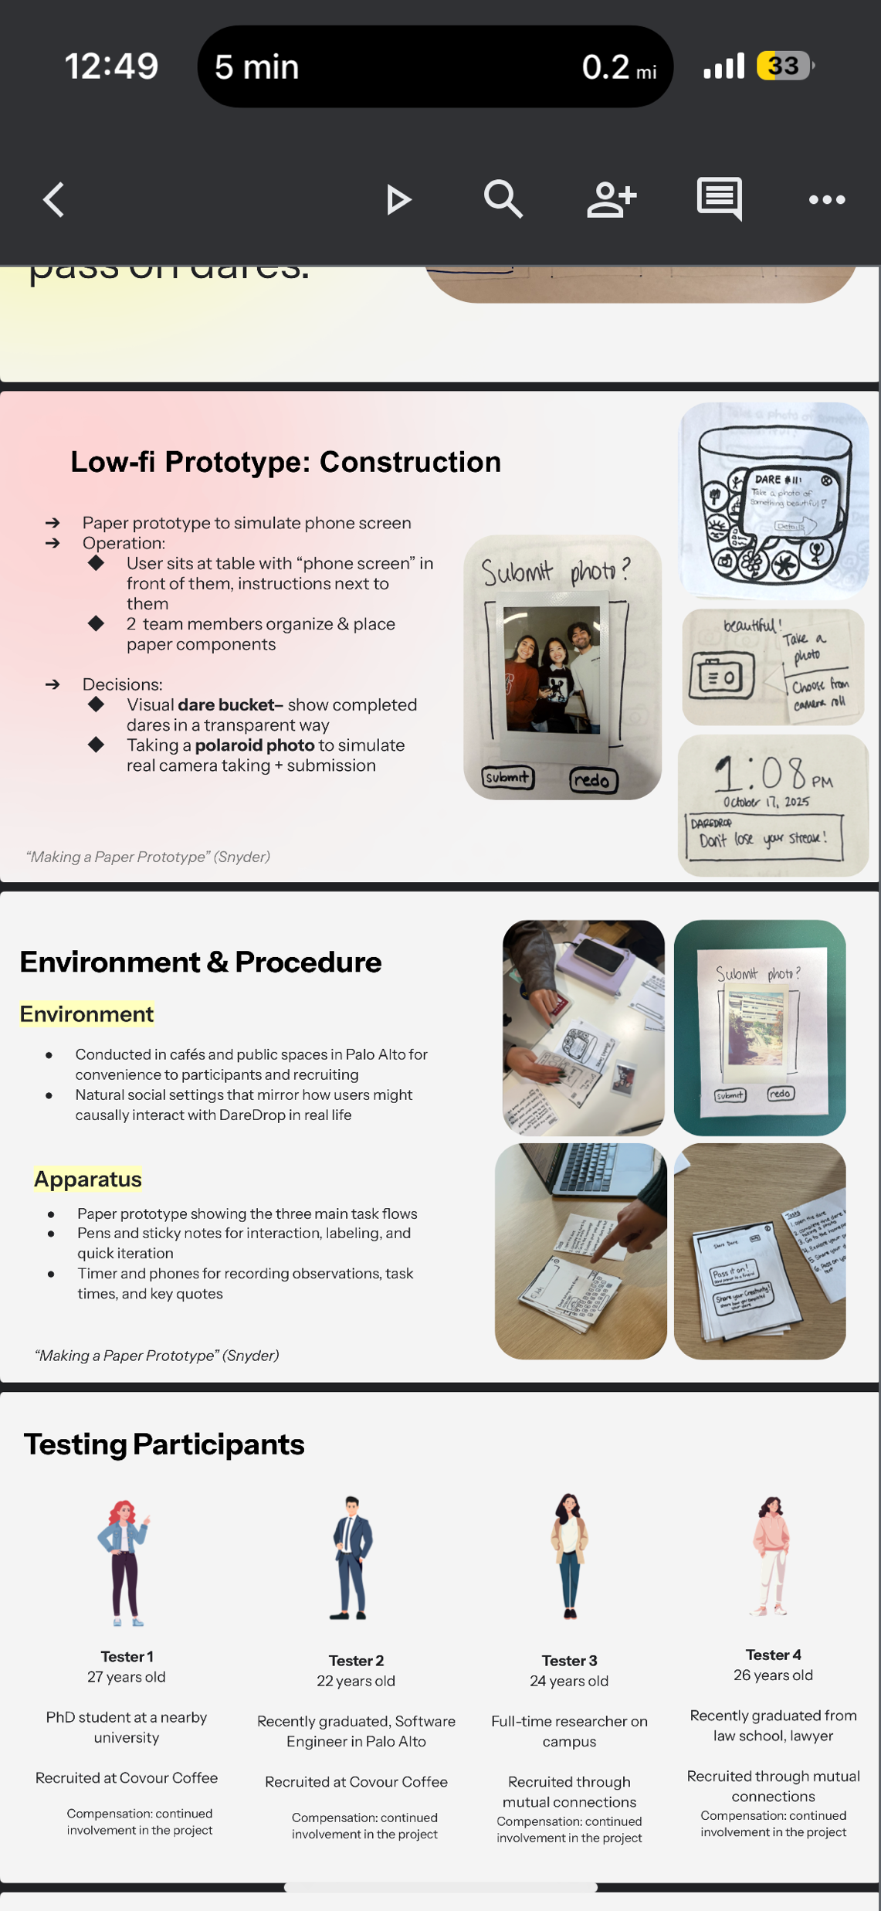
Notes:
DareDrop in Diya’s 11:30 studio had a creative way of simulating the experience of taking a picture in their low-fi prototype. They have a do-a-dare-a-day app to bring creativity and spontaneity into users’ lives. The dare they tested in their low-fi required testers to take a photo. They simulated this experience through using a Polaroid camera, and making the tester take a Polaroid photo and then attaching that Polaroid to the UI to showcase how the photo, once taken, would display in the app. They also tested ths in public

Slide 48
team break
Notes:
Because knew nothing for teams today went all of 85 min to get here and only took a 5 min break leaving 20 min!
Goal:
Need 20 minutes for the HE exercise and about 2 more to finish.
So if get here at 70 min, take 20 min break, and then 18 min for HE + 2 to finish
Any slower than 70 min, remove from break time
--1 year ago --
got here at 73 min in so took a 17 min break to restart at 3pm
---- 2 years ago ---- `
got here at 80 min so only took 15 min (restart 3:05 pm)
need to go much faster through HE!
Get here by 60 min so can take a 20 min break (need time for exercise)
--- 3 years ago ---
took 20 min break at 67 min in -> restart at 2:57 (may be short, should have taken 15 min break)
------------------
If over 60 min, cut break by 5 min (to 15)
-- 4 years ago ---
break at 60 min in (20 minutes for teams).
-- 5 years ago --
Took 20 min break at 85 min in (though started 10 min late due to arriving late)
Had to hurry through HE exercise

Slide 49
E X E R C I S E
Heuristic evaluation practice
(graded – turn it in at the end of class)

Slide 50
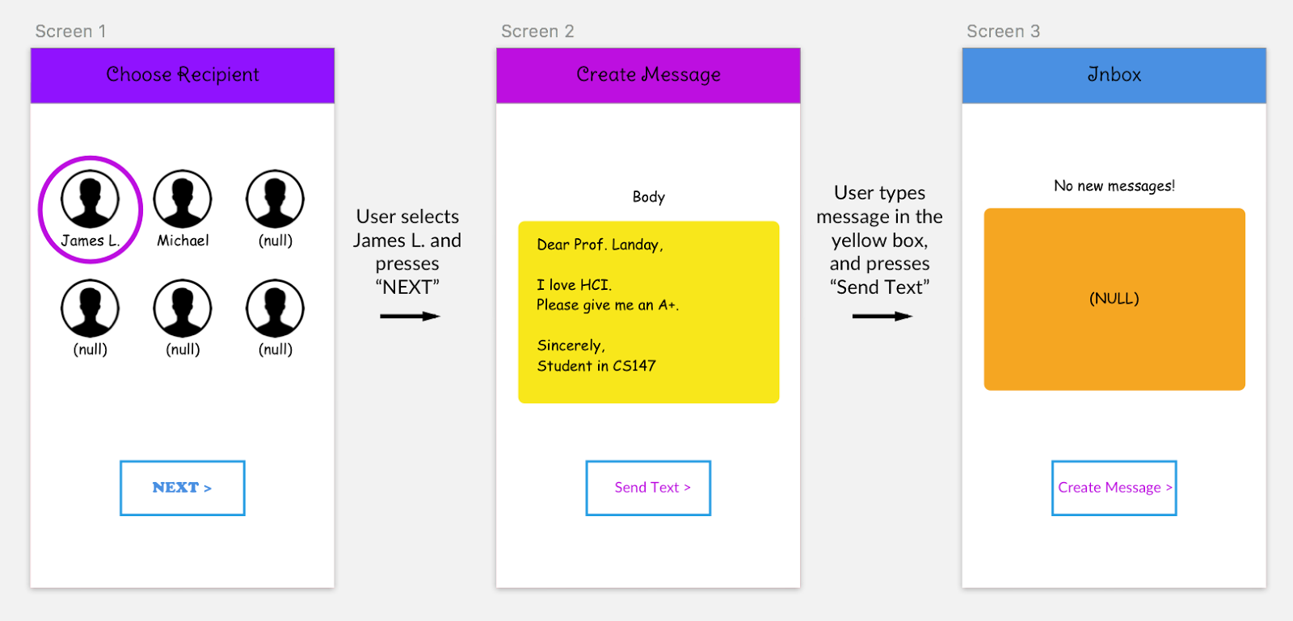
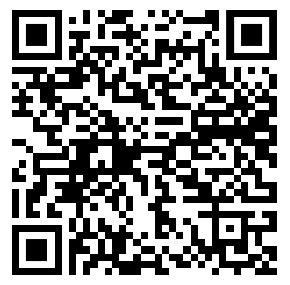
[8 min]: On your own, find 8+ usability violations (type in a google doc/write on this paper & circle things on this image – write your name & SUNetID)
For each one: Which guideline was violated and why? How could it be fixed?
hci.st/cs147-25au-he
Notes:
In the slack, send out the link hci.st/cs147-25au-he
Type up the violations you find individually in a google doc
Annotate this image on paper

Slide 51
[5 min]: Share with your group (3-4)
What violations did you all find? Which ones did only one of you notice?
hci.st/cs147-25au-he

Slide 52
[5 min]: Share with the class
Raise your hand or post a screenshot with your description on Slack.
hci.st/cs147-25au-he
Notes:
In slack, ask: what heuristic violations did you observe? Make sure to include which guideline is violated and why, suggest a solution, and attach a screenshot.

Slide 53

Find, label, & describe 8-10 Heuristic Violations
Notes:
Let’s take 18 minutes

Slide 54
[5 min]: Share with the class
Raise your hand or post a screenshot with your description on Slack. Turn in with your name & SUNetID on piece of paper at end of class (by studio).
H8 – low contrast
H2, H8
H6
Where is the recipient?
H3
Can only go one direction
Why are these buttons all different?
H1
Where is the message confirmation?
H3
How can I go back?
Notes:
In slack, ask: what heuristic violations did you observe? Make sure to include which guideline is violated and why, suggest a solution, and attach a screenshot.

Slide 55
Problems Found This Year
H2: Match between system & real world
?
H3: User control & freedom
?
H6: Recognition rather than recall
?
Notes:
Collect and discuss problems for 10 minutes

Slide 56
Problems Found Last Year
H2: Match between system & real world
Showing “(null)” for empty content
H3: User control & freedom
No “back” button [5]
H6: Recognition rather than recall
No way to see who you’re sending to in the second screen
Notes:
Collect and discuss problems for 10 minutes

Slide 57
Problems Found Two Years Ago
  H1: no feedback on whether the message is sent or not, just navigates to inbox screen
  [H3: user control and freedom] No way to cancel message solution: add an ‘x’ or cancel button that allows them to delete the message on screen 2
  H8. There was unnecessary users listed that were null
  H4: so many different colors, not consistent
  H1: No visibility of system status (can’t really tell which page I’m on - perhaps some sort of diagram at the bottom could fix this)
  H6: James L is not displayed on create message screen
  [H6 Recognition rather than recall] Can’t see who you’re sending the message to when you’re creating the message. Fix: include sub-header that specifies name you just clicked on
  H4: inconsistent button design
  H4: consistency with names on the first screen (names have or don’t have last initials) --> should just choose one format (potentially just first name if we want to avoid clutter)
  H8 (aesthetics) - The headers have low contrast (especially the purple/pink) and should use less saturated colors for better contrast.
  H3/H6: User can’t go back from screen 2 to 1 if they miscliked on the wrong person’s profile, no recall of who you selected --> recall the recipient name on screen 2
  H3: User control and freedom - can only send to recipients in the list, no way to add a new recipient
  H9: “error”/null messages offer no explanation
  H3: can only send text (no images/files which might be helpful in certain cases)
  [H5 Error prevention] Could potentially select (null) users to write messages to. Fix: just don’t display the icons of null users at all.
  H7: unnecessary “next” button on the first page. Might instead click on the person to transition to the next screen, and display the person’s name on screen 2 (H6) and add back button there (H3)
  H3: How do you view old messages?
  H10: no help or documentation included - just buttons indicating the very next step
  H4 consistency: not sure the differences between ‘text’ ‘messages’ ‘body’
  H3 - no ability to edit message text
  H2: "Body" and "Null" might not make sense to user without technical background, but also why would they even see these words to begin with
  H4: terminology of "message" vs "text"
Notes:
Collect and discuss problems for 10 minutes
Two years ago:
1. H2 – icons labelled null. CS term. Probably shouldn’t even be there. Remove. [90]
H4 – sometimes uses “text” and sometimes uses “message”. Pick one and be consistent. [70]
H3 – once in the flow can’t get out until you finish. Have exits. [90]
H1 – no confirmation after sending message. Add a confirmation text or dialog. [70]
H6 – after selecting a recipient, the create message screen doesn’t keep their name around. Show who I’m texting. [75]
Known issues:
H1: Visibility of System Status
No idea if the message was sent
No idea if the message was received
No idea what the content of message was (past sent)
Cannot see who I am sending the message too once I am on the next screen
H2: Match b/w System & World
(NULL) is not something we want to see anywhere in an app, this is an unfamiliar concept/word to the user
H3: User Control & Freedom
Allow users to freely go back & reselect a participant
I cannot add any message recipients besides the ones already there
H4: Consistency & Standards
Switch between “message” and “text”
Inconsistent font
Inconsistent color
Same shape and color for text box as for viewing messages
H5: Error Prevention
If users choose wrong recipient, they cannot go back
If users typed the wrong message thinking they were sending it to a certain recipient… help prevent errors with message composition (before sending message, show a confirmation box)
H6: Recognition not Recall
Need to recall who you’re writing the message to, should show on Screen 2
H7: Flexibility & Efficiency of Use
Perhaps, allow users to tailor frequent actions (a frequent person they send messages to, a frequent message they send)
H8: Aesthetic & Minimalist Design
Too many different fonts
Too many different colors
One screen to simplify three screens

Slide 58
Further Reading
Heuristic Evaluation
Books
  Usability Engineering, by Nielsen, 1994
Web site
  http://www.nngroup.com/articles/
Accessibility
  Accessibility - Foundations - Human Interface Guidelines - Design - Apple Developer

Slide 59
Next Time
Wed.
  Designing the Future: Early and Future Visions of HCI
  Read
    As We May Think by Vannevar Bush
    Tools For Thought (Ch 9), Engelbart Demo
  Listen and Read: Of Mice and Men, 99% Invisible, Episode 149 (21 minutes)
  Film Festival Awards!
Studio
  Heuristic Evaluation Merge (must be present for A8 credit!)

