Slide 1
Visual Information Design
October 22, 2025
* Based on slides by Luke Vink, Scott Klemmer, and James Landay
Notes:
Have to go way faster in first half. Had to have a short break because was at 57 min by then. Then only had 7 min exercise and had to jam through interestingness to finish on time.
Last year:
broke at 54 min in so took a 20 min break (return at 2:45)
This was enough time to do 8 min exercise and jam through last slides, but very fast.
Should have taken only 15 min break.
I think need to be able to do this 1st half in 45 min. Take 25 min break. And can finish in 40 min with 10 min exercise.
-------
Goal break 40 min in and give a 25 min team break
-- last year –
Broke at 48. min and did 20 min break. Speed up a little. Finished on time, but went fast in last section after 10 min exercise
*** two years ago ***
Finished 3 min early
Broke 30 min in and took a 25 min team break
*** three years ago ***
Broke 45 min in for 20 min team break
3 minutes over (cut some slides in interestingness still to fit & reduce bullets on dynamic movement & metaphor)

Slide 2

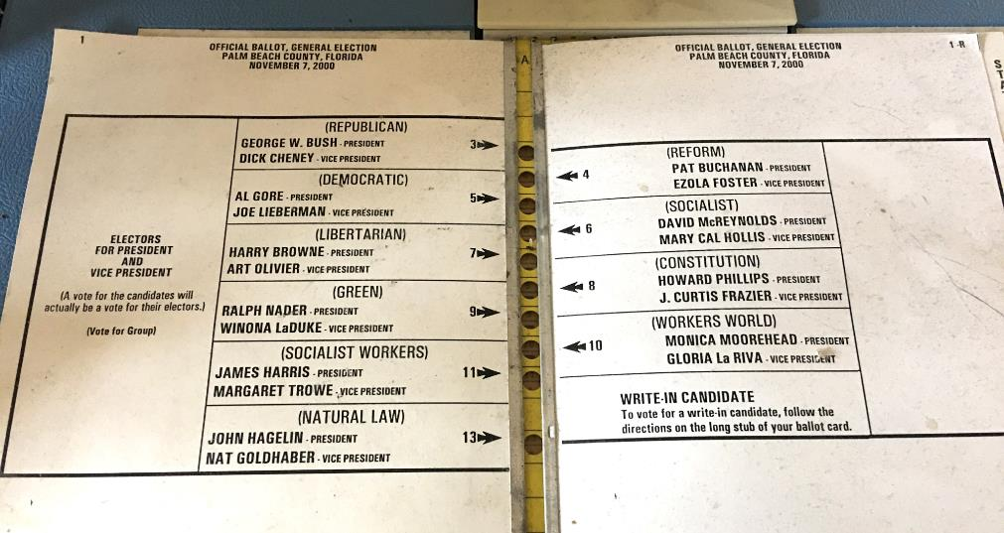
Hall of Fame or Shame?
Palm Beach, Florida
Ballot 2000
Notes:
Maybe one of the most impactful graphic designs of all time
It had an issue. Any idea what it is?
https://tamaractalk.com/wp-content/uploads/2016/11/Butterfly-ballot.jpg

Slide 3

Hall of Shame!
Palm Beach, Florida
Ballot 2000
Eye drawn to the wrong holes
If only 1% error rate, can still change a close election
Notes:
Follow the line with your eye above Democratic?
How might we redesign this ballot to still have the same holes down the middle of the page?

Slide 4
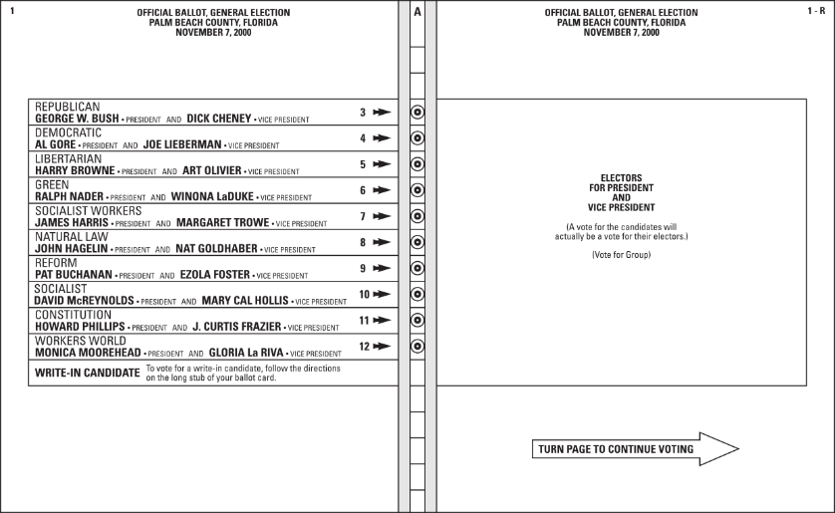
One Possible Redesign
William Lid­well, Kritina Holden, and Jill But­ler Uni­ver­sal Prin­ci­ples of De­sign

Slide 5
Visual Information Design
October 22, 2025
* Based on slides by Luke Vink, Scott Klemmer, and James Landay
Notes:
Why are we learning this?
Since many of the interfaces you design will be visual in nature, knowing some basic rules from visual and graphic design will enhance your ability to make more effective user interfaces. Note, we have one core lecture on this and other pieces on this spread throughout the class. BUT, you could take multiple courses in graphic/visual design (e.g., a single course just on type). If you want that type of depth, you will likely need to do it online or go for an MFA at a design school.

Slide 6
Outline
Good Form
visual hierarchy, layout, proximity, small multiples & space
typography, grids & icons
Team Break
Color
Group mood board exercise
“Interesting Design”
Notes:
First we will go over some key ideas on good form.
We will finish good form with typography, grids, & icons.
Then we will take a team break.
Then we will give you more concrete advice on how to use color wisely.
Do an exercise.
Then we will end with the concept of “Interesting Design”. I’ll use this idea to organize the rest of the content
[ADVANCE]

Slide 7
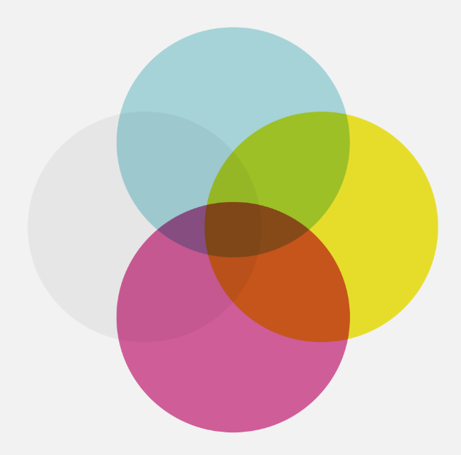
relevant meaningful new
interestingness
proof of concept
experiment
ugly
truth consistency honesty accuracy
How well does it communicate?
easiness usefulness usability fit
How well does it work?
integrity
successful visual design
function
useless
rubbish
boring
eye candy
sketch
form
Based on David McCandless
beauty structure appearance
http://www.informationisbeautiful.net
Notes:
This graphic illustrates what should be balanced to achieve a design that can convey useful information to its observers by creating desire in the information itself.
[ADVANCE]
This middle part (integrity and function) refers to the information itself, whether the data is accurate or useful. Remember the original Apple Maps on the iPhone. It didn’t work because it wasn’t accurate.
Arguably you are all rather talented at this part.
[ADVANCE]
So today I’m going to talk about the other two – some guidelines as to how to achieve designs that successfully communicate and thus allow the user to perform such functions without having to force themselves to do so

Slide 8
The Art of Balance
Promotion & demotion of important objects
First Question for any design
What are the most important things?
Information should be prioritized based on its importance to the user
Notes:
I’ve mentioned several times before that good design is about balance – visual design is no exception.
Information should be prioritized based on its importance or relationship to other information: color, size, position and the other things we have discussed are methods to suggest this.
If we look at objects on a scale of importance, we can decide best how to use those techniques.
Scott Klemmer’s video gave you good examples of how Typography, Layout, and Color give you a good idea of visual hierarchy
The Key Q for any design: What are the most important things? Prioritize those.

Slide 9
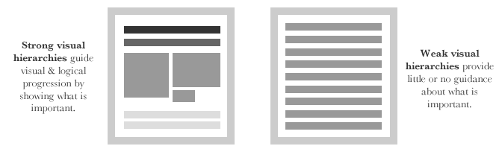
Visual Hierarchy and Reading Order First Read
source: http://52weeksofux.com/post/443828775/visual-hierarchy
Notes:
Strong visual hierarchies can guide people to look where you want, in the order you want them to.
If you don't have this hierarchy, they don't know where to go with their eyes
Remember the idea of the “first read”?
[ADVANCE]
http://52weeksofux.com/post/443828775/visual-hierarchy

Slide 10
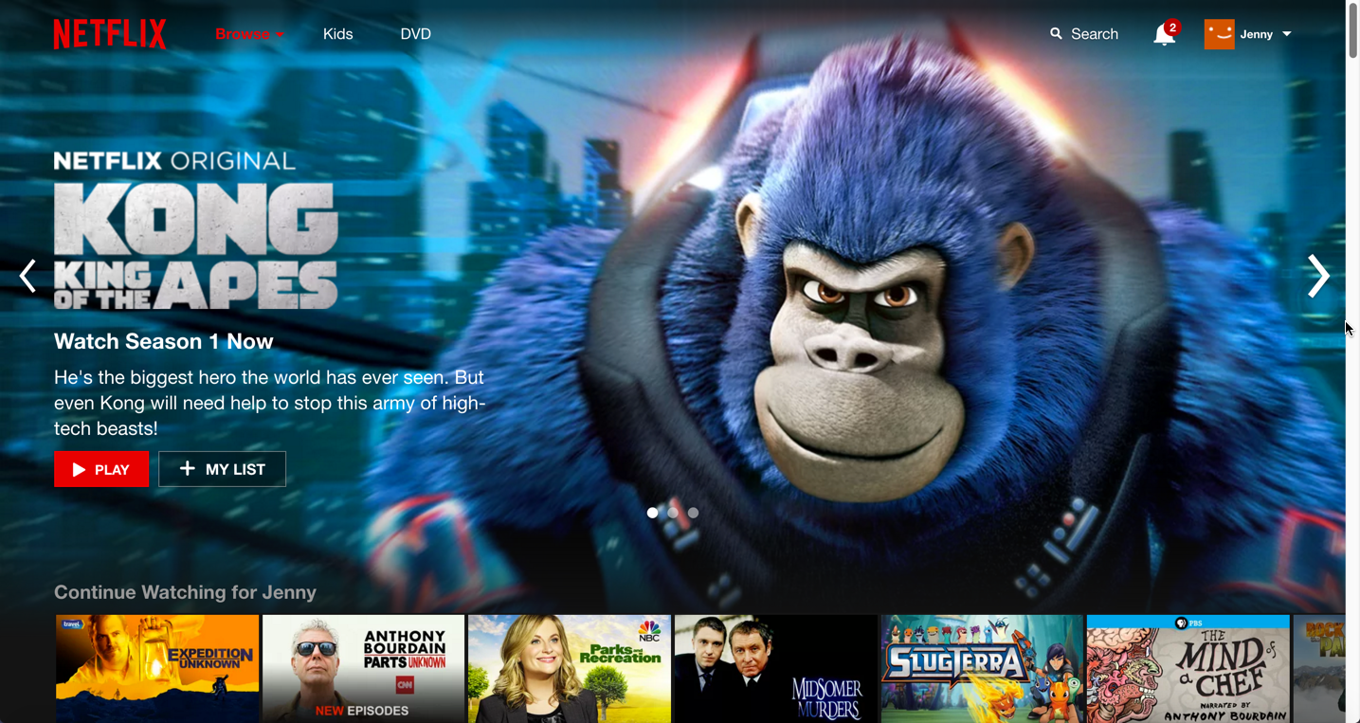
Notes:
what’s the reading order? how is it achieved?
What object is your eye drawn to first?
Second?
Third? Why?
[after the answer go to the next slide]

Slide 11
The First Read: Reading order pillars
size
color
layout
spacing
style
source: http://thenextweb.com/dd/2015/04/30/the-5-pillars-of-visual-hierarchy-in-web-design/#gref
Notes:
This is how you do it and in this order!

Slide 12
Gestalt Psychology in Information Design
Using Proximity to Indicate Relationships
Information blocks should be grouped together if related, but unrelated elements should be located at some distance from each other.
Notes:
The principles of Gestalt psychology are based on the humans’ ability to perceive and generate visual forms.
We talked a bit last time about the perceptual system that underlies these principles.
One of the six Gestalt Principles, “The Proximity principle” is often used in information design.
We can use proximity to describe how elements are related to each other.
Simple: related near. unrelated far.

Slide 13
Using Proximity to Indicate Relationships
Notes:
As we divide a blank space into a layout, we can prioritize a group’s importance by just its size. As with any hierarchy, our eyes are drawn towards the largest sized objects and eventually down to the smaller. In many cases it’s a good idea to prioritize the placement of these in that order as well.

Slide 14
Using Proximity to Indicate Relationships
Notes:
Two groups of two. See how the space in the middle creates these groups?

Slide 15
Using Proximity to Indicate Relationships
Notes:
Two main groups and many subgroups on the left.
Positioning here is more powerful than color, fonts or any other arguably "obvious” methods of suggesting importance and relatedness. A good layout removes the need for other confusing and intruding elements such as labels or popups.

Slide 16
Using Proximity to Indicate Relationships
Notes:
If I want to make sure these are subgroups, I might add more space

Slide 17
Using Proximity to Indicate Relationships
Notes:
Or more relationships among the small ones? I might remove space between each pair of small ones.
Even without color, we can tell these elements are grouped simply by where they are positioned and how similar they are to each other.

Slide 18
Using Proximity to Indicate Relationships
Only make things different when you are trying to call attention to the difference
Notes:
Add color last and only if necessary (start with position, size, space, and then grayscale or luminance)
[ADVANCE]
Only make things different when you are trying to call attention to the difference… THIS IS VERY IMPORTANT for example…

Slide 19
Small Multiples
Economy of line
Similarities enable us to notice differences
IMAGE REMOVED DUE TO EDWARD TUFTE’S UNCLEAR UNDERSTANDING OF FAIR USE
Image 1: Japanese book for children on t-shirt colors that match
The shirts are all the same. The only difference is the colors! The difference that matters here.
Image 2:]
Person holding semaphores to guide in a plane to the gate.
The person is gray… just enough to tell us there is a person. The important thing is that they are holding lights and what they are doing with the lights (the important information is bright – red & yellow)
Images from Edward Tufte’s Envisioning Information
Notes:
Japanese book for children on t-shirt colors that match
The shirts are all the same. The only difference is the colors! The difference that matters here.
[ADVANCE]
Person holding semaphores to guide in a plane to the gate.
The person is gray… just enough to tell us there is a person. The important thing is that they are holding lights and what they are doing with the lights (the important information is bright – red & yellow)

Slide 20


International Women’s Day
S M A L L M U L T I P L E S
Echeverria, Heriberto 1971 March 8 - International Women’s Day
Diaz, Estela 1974 March 8 - International Women’s Day
Revolucion!: Cuban Poster Art by Lincoln Cushing http://www.amazon.com/Revolucion-Cuban-Poster-Lincoln-Cushing/dp/0811835820
Notes:
Small multiples convey the important information:
What do you think these two posters are trying to convey about Women in Cuban society?
multi-racial society & everyone is included (same exact form – the only data is the different colors!)
The woman is the same – but different professions. A woman can be anything she wants! Everyone is included.

Slide 21
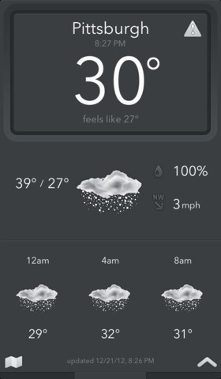
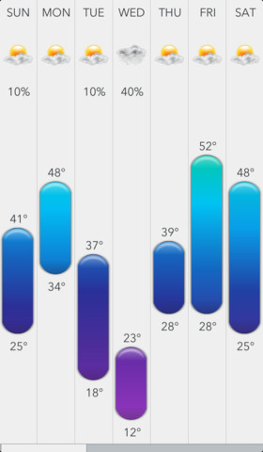
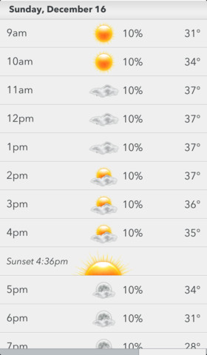
Proximity & Small Multiples in Use
Today Weather iOS App
Notes:
These elements are grouped together really well using spacing/proximity
[ADVANCE]

Slide 22
Proximity & Small Multiples in Use
Today Weather iOS App
Notes:
See the groups. Conveyed by size and space between them....
AND
The interface also uses Small Multiples (repetition) of colors and imagery to make groups even more identifiable.
[ADVANCE] to explain

Slide 23
Proximity & Small Multiples in Use
Today Weather iOS App
Notes:
The viewers can SEE that these are the most important – no one has to tell us. This means the design of this information is successful. If we look deeper we can see a good balance of layout where size is the biggest indicator of importance, followed by color.

Slide 24
Using Blank / White Space as an Object
White space can be used to suggest importance or prestige
The more space around a group, the more valuable it should be for the user
Think of whitespace as an “element” – consider its position
Notes:
Treat blank space as an object. This is a good way to avoid clutter. Designs with a lot of white space suggest the information within is more important: read: Apple. As mentioned before, the more objects you have, the less relevant they may be.

Slide 25
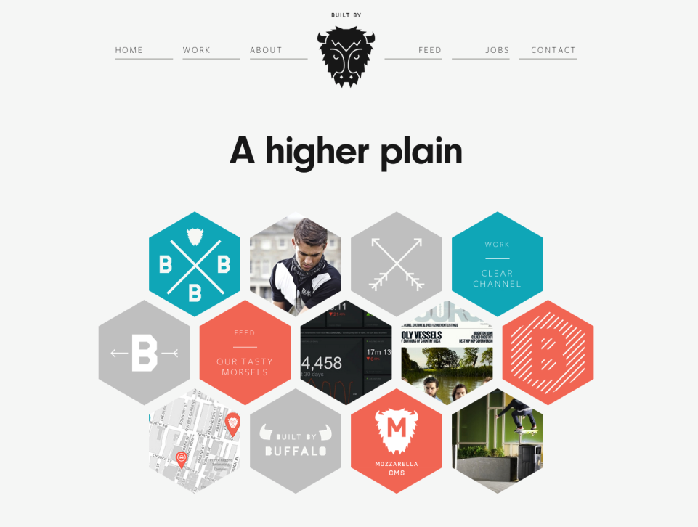
http://builtbybuffalo.com/
White Space = Value
Notes:
Web design provides good examples of the proximity rule where good layouts will organize related items into groups such as seen here with the menu and project elements grouped together.

Slide 26
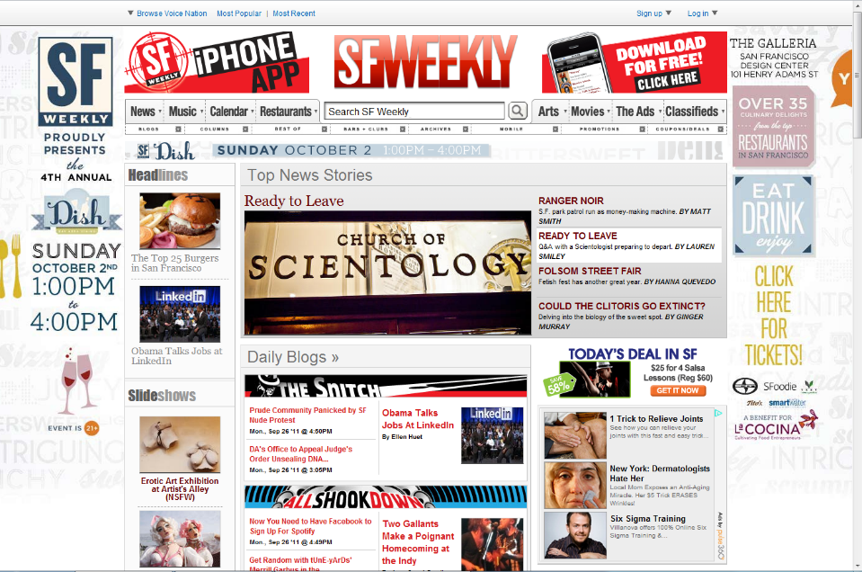
What Are The Important Things Here?
Notes:
We often sacrifice proximity to fit more things in a page. Mistaken idea that the more we offer, the more people will find the need for our solution.

Slide 27
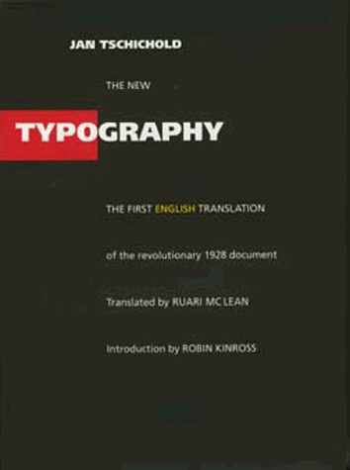
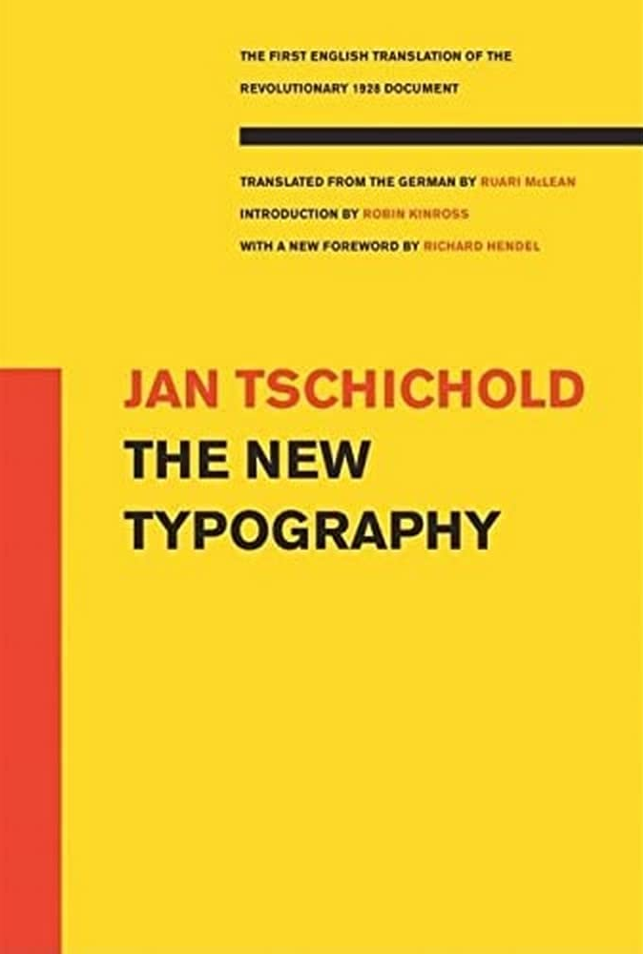
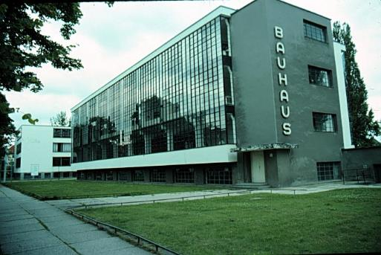
Jan Tschichold’s Revolution
Champion of Modernist Typography
Die Neue Typographie Berlin, 1928
Bauhaus school Dessau, 1925-26
Notes:
Let’s shift gears a bit and talk about history again.
Graphic design as we know it today started with the Bauhaus – literally a school in Germany. Look how modern that building looks for 1925 (if you didn’t know you might say it was out of the 60 or 70s).
Yan CHEE-HOLD was the lead graphic designer in the Bahuaus and pioneered the modernist design principles that are still used today.
The school was short lived as it was shut down by the Nazis in the 30s and the designers spread across the world, spreading this new style of design.

Slide 28
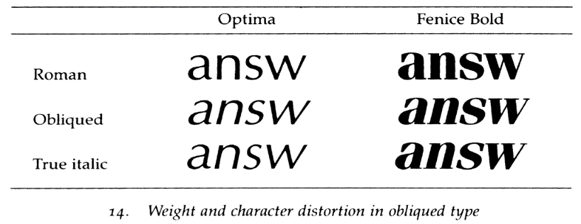
Type Classifications
Typeface (Arial) vs Font (Arial Bold 12pt)
Design of letterform vs Instantiation of that design with weight, style, & size
Serifs: Structural details in letters that (may) help the reader connect them
Sans Serif
Serif
Notes:
One of the keys to modern design was Type.
First, understand Typeface vs a Font
Design of the letterform vs. instantiation of that design w/ weight, style & size
Simple place to start is the difference between Sans Serif and Serif typefaces
Serifs are those little structural details at the ends
Until 1900, all type faces were Serif type faces. Most modernist are Sans Serif
Both are useful, depends on what you are trying to use them for.
German type faces were original straight up and the Italians had a slant to it. At some point in the 18th & 19th century, people figured out they could make 2 versions of the same typeface and use the difference to convey information.
Oblique is bad. That is the automatically transformed typeface you get if you don’t own the Italic version.

Slide 29
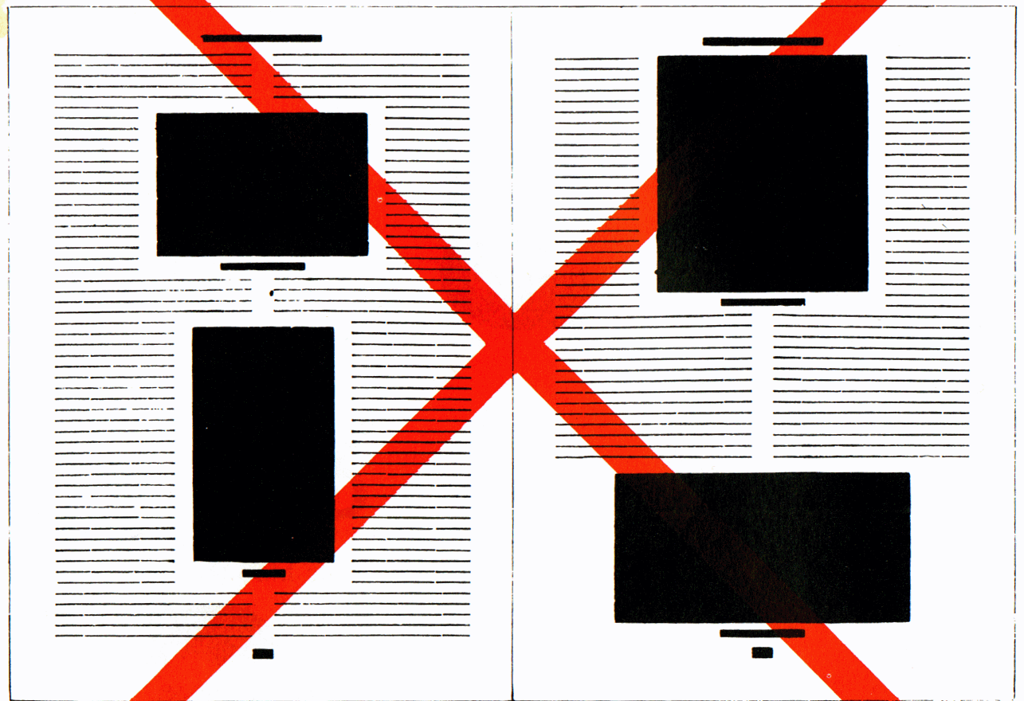
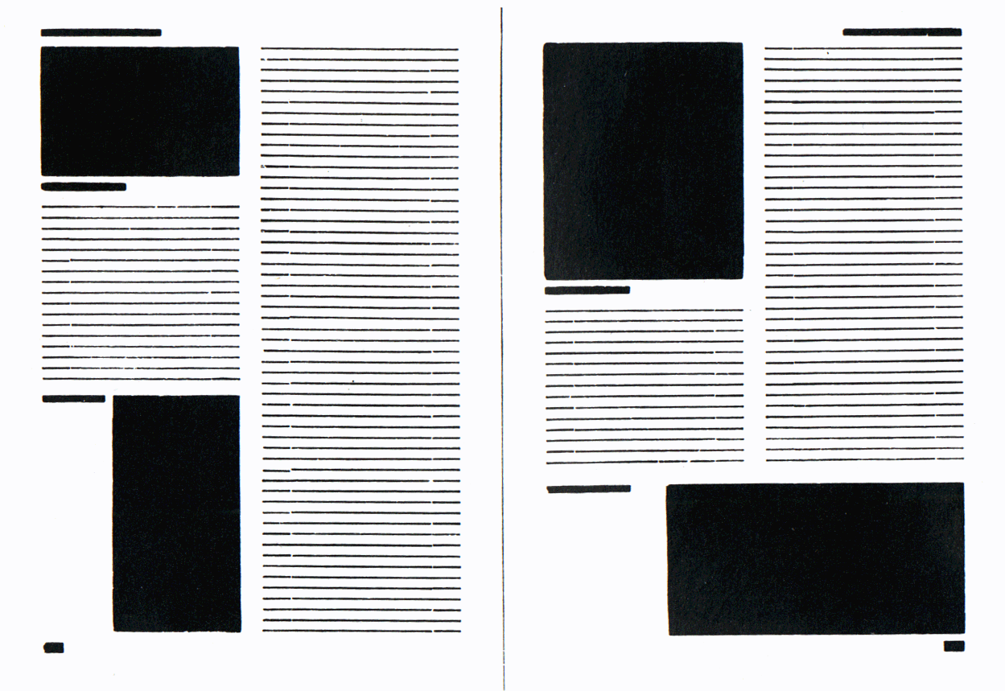
Asymmetric Typography
J A N T S C H I C H O L D
How blocks used to be arranged in magazines. Schematic, thoughtless centering of blocks (= ugly).
The same blocks, correctly arranged in the same type-area. Constructive, meaningful, and economical (= beautiful).
Notes:
Main tenant of modernist design is asymmetric layout.
In books before the Bauhaus, everything was centered.
Harder to read.
[ADVANCE]
Asymmetric: 1) feels more dynamic (energy to the type), 2) don’t have difficult to read narrow columns around the figures.

Slide 30
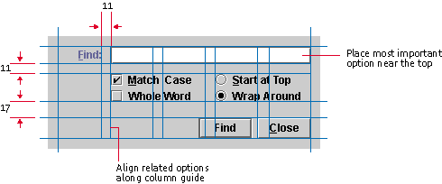
Grid Systems
A key pattern for implementing rationality, modernism, asymmetry
Note that no elements are “centered”
Java Look and Feel Design Guidelines
Notes:
A key way to lay out elements on a page is to use a grid system.
Using the grid gives you consistency and if you use someone else's grid, you get to take advantage of professional designed system.
IN THIS EXMAPLE
Find is easy to see since it is in a column all by itself. Not aligned on the left side of the grid.
Space is consistent between the buttons.
Things that are similar are closer (i.e., the radio buttons “Start at top” and “Wrap Around”).
Bigger space from those to the buttons at the bottom – they are different.

Slide 31
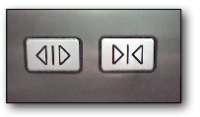

Iconography Differences that Make a Difference
icon — a visual shorthand to the meaning of an object so users do not have to read words (“recognition over recall”)
www.jensondesign.com/1+1=3.pdf
Notes:
Another important visual design element is the icon.
An icon is a visual shorthand to the meaning of an object so you don’t have to read a word. Gives us “recognition over recall”
Left and right has same symbols. Only flipped.
How might you do it better?
[ADVANCE]
Right has greater iconic differences. Also, size and color. Not sure I like the color.
Radical change? ...Get rid of the close button entirely (in the US at least).
There are lots of great online sources of icons (e.g., the noun project). Use them.

Slide 32
Administrivia
Website
must be on web site by studio next week or grade will be docked
problem getting a web site up, talk to your CA now
Design Systems Workshop, Monday Oct. 27th
answer poll on time in #announce slack channel
It will help you for A6
CS 194H
follow-on to CS147
offered this Winter
Not offered this academic year

Slide 33
Administrivia Campus dev workshop resources
Building voice AI agents with Vapi (https://luma.com/po2se9vo)- Nov 3, 6:15pm
Building with Gemini & Google AI Studio (https://luma.com/6g7mhtbm)- Nov 4, 6:15pm
Building with Replit (https://luma.com/t372k0rb)- Nov 6, 6:15pm
Building with Vercel & v0 (https://luma.com/br3320yj)- Nov 18, 6:15pm
Building voice agents with ElevenLabs (https://luma.com/cwrgi9e2)- Nov 19, 6:15pm
Notes:
Thanks to Abbie for finding these other campus workshop resources that may accelerate your development process!

Slide 34
Administrivia: Assignment 4 Grades/Feedback
A4 Concept Video: -: 0% ✓- -: 0% ✓-: 0% ✓: 35% ✓+: 65% ✓ ++: 0%
We liked
“Cross-comparisons of market competitors”
“Use of annotations and color in storyboards to show emotion/transitions”
“Tasks were identifiable in concept videos”
“Extensive discussion on ethical implications and mitigation strategies”
“Great use of music to capture emotional change in actors”
We wished
“Competitor analysis included implications for design”
“Labelling of tasks were grounded in frequency not difficulty”
”Tasks were less feature-driven and more focused on user goals”
“Stronger link between tasks and the problem identified in needfinding”
“Concise value prop that is unique to solution”
“Clearer depiction of how the solution solves the user pain”

Slide 35
Good A4 Examples
Traverse
Notes:
Again, will save videos for next week.
Traverse from Abbie’s 1:30 studio on Agents of Change had ?

Slide 36
Good A4 Examples
Tether
Notes:
Again, will save videos for next week.
Tether from Charlotte’s 1:30 studio on Designing for Mental Wellbeing had clear emotion transitions, detailed captions, and markings of scenes / tasks. all key scene are clearly labeled.

Slide 37
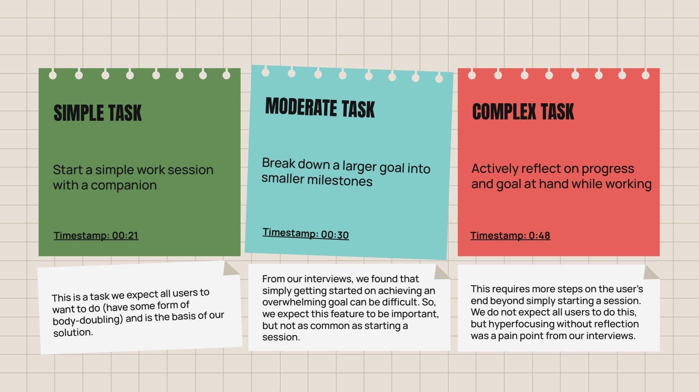
Good A4 Examples
Theo
Notes:
Theo from Alan’s studio on Empowering Learnings with AI did a great job writing clear tasks, and justifying which are simple/moderate/complex

Slide 38
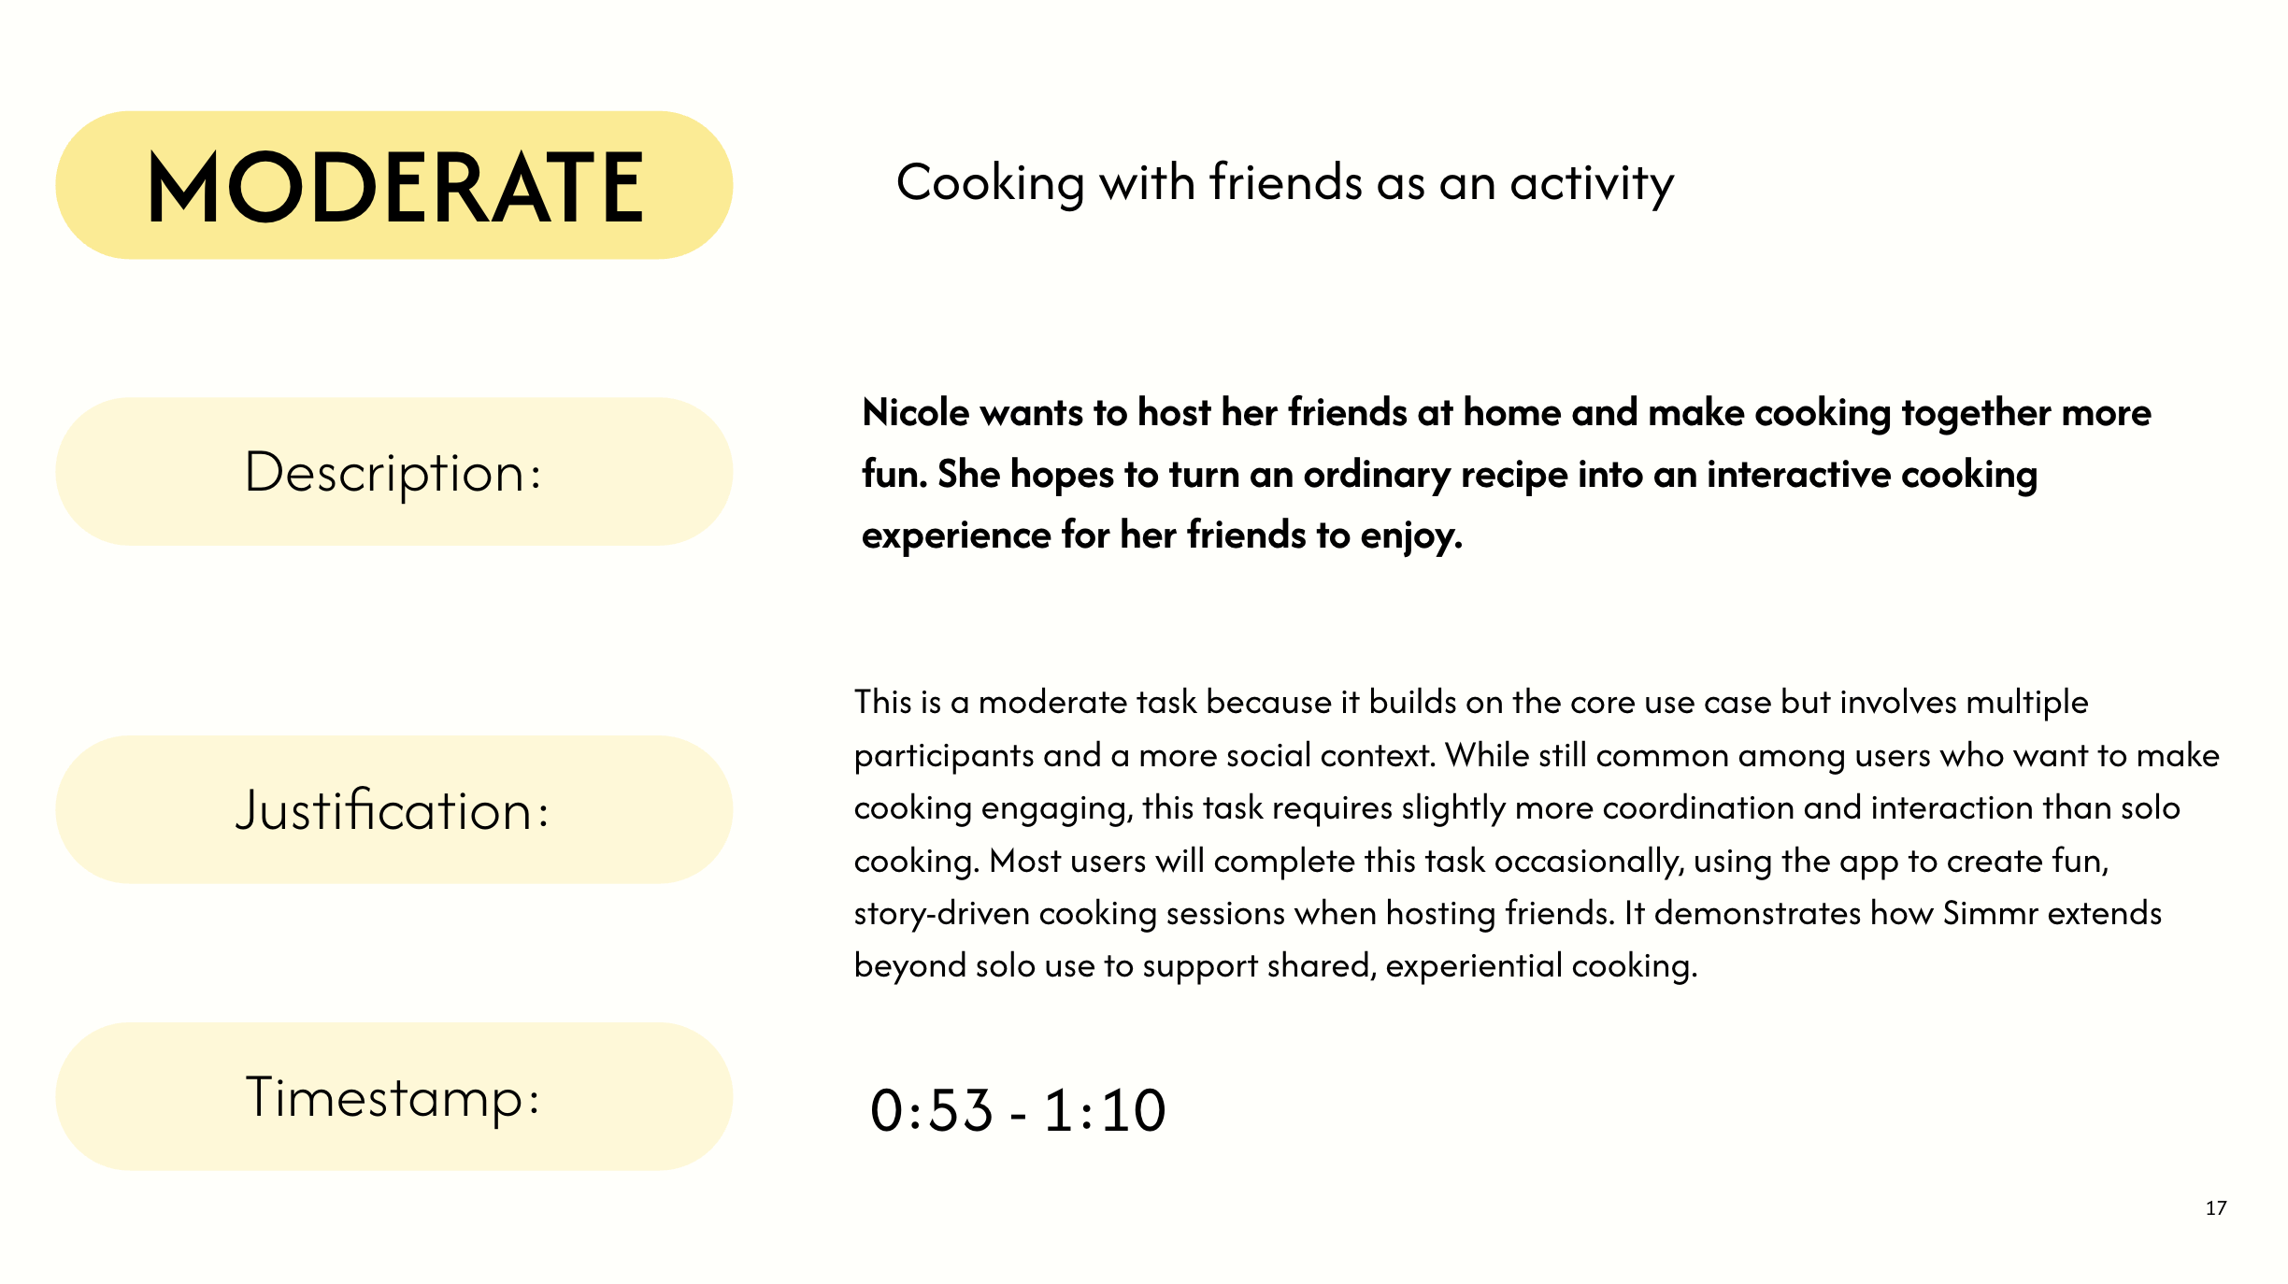
Good A4 Examples
Simmr
Notes:
Simmr from Naima’s 12:30 studio on Designing for Voice did a great job writing clear tasks, and justifying why

Slide 39
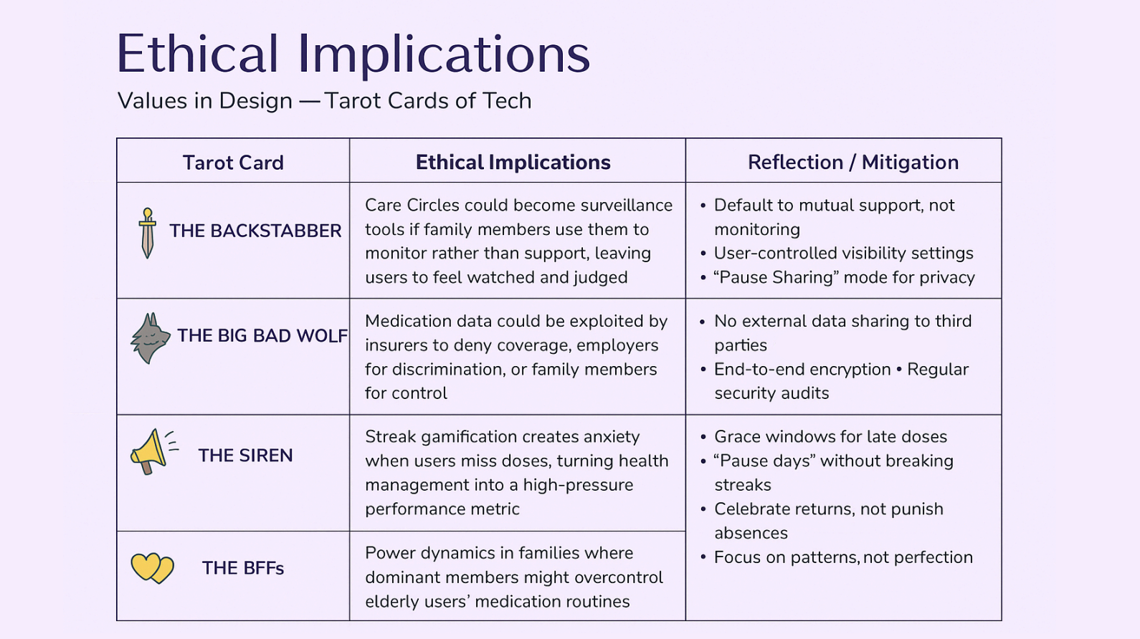
Good A4 Examples
Pill Pal
Notes:
Pill Pal from “N-EYE-ma”’s 2:30 studio on Designing for Voice outlined several tarot cards of tech and discussed their implications plus possible mitigations for each

Slide 40
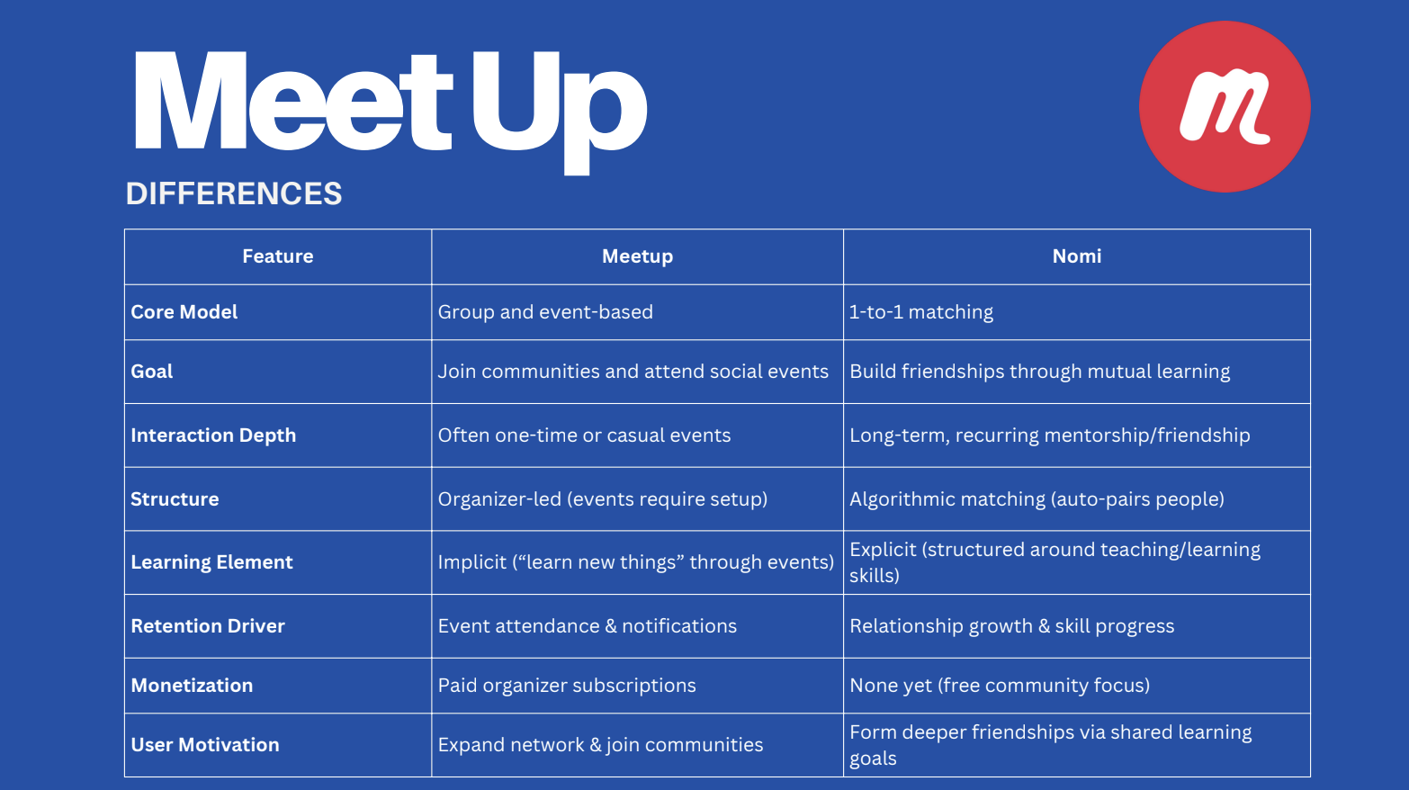
Good A4 Examples
Nomi
Notes:
Nomi from Candi’s 12:30 studio on Adulting Made Easier had very thorough market research on competing products.

Slide 41
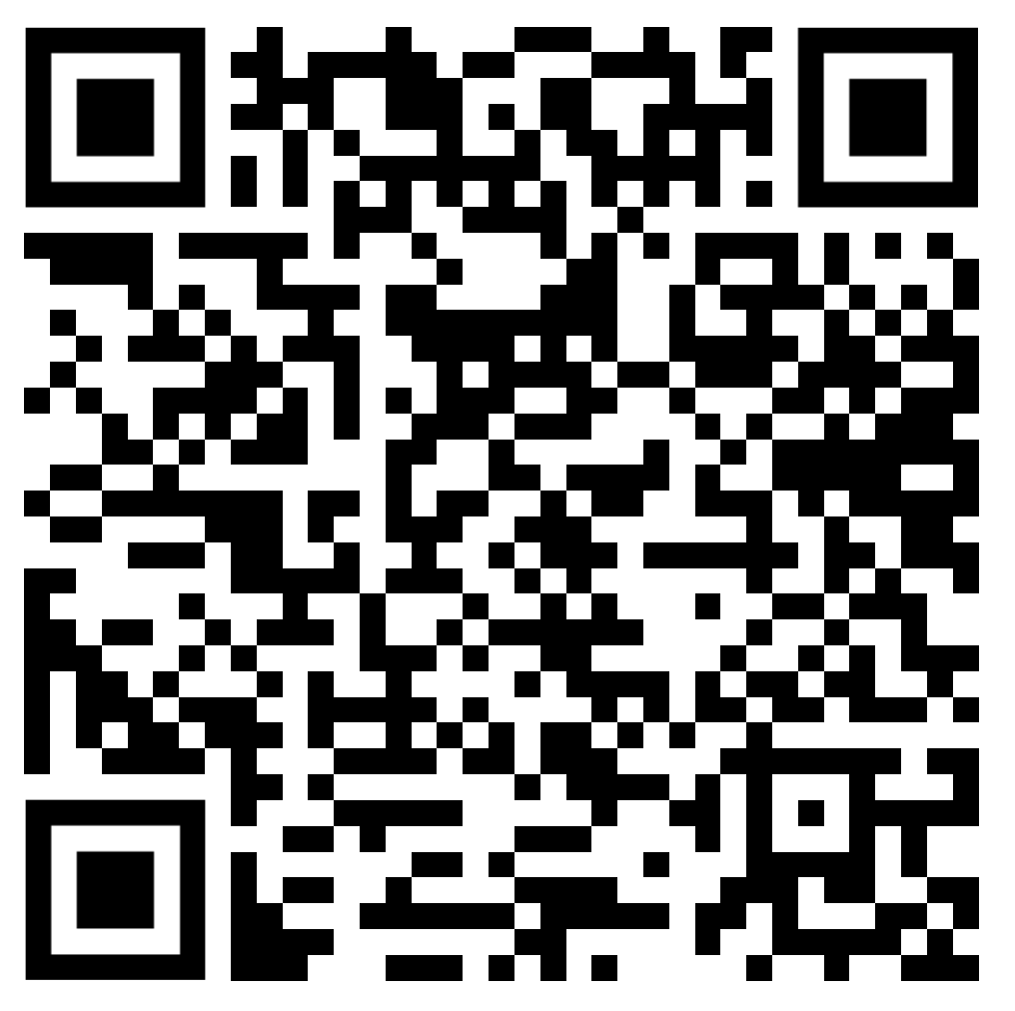
Administrivia
Midway team check-in survey (required)
due Sunday 10/26 at 11:59 PM hci.st/cs147-25au-midway-team-checkin

Slide 42
Assignment Grading Buckets
✔++
Far exceeds expectations: Reserved for ~ the top 1-3 submissions that can be used as examples in class. This is an A+, often a perfect or > 97% score.
✔+
Fulfills the expectations in the spec and some elements exceed expectations. Strong engagement with the design process. Excellent presentation of the work. This is an A range grade (93 - 97%).
✔
Fulfills the expectations in the spec. Students engaged with the design process, though maybe some small issues remain. Presentation understandable. This is a B+/A- range grade (88 - 92%).
✔-
Relatively complete, but there are components of unsatisfactory quality. Presentation may fall short (e.g., poor image resolution, too much text). This is a B range grade (83 - 87%).
✔- -
Incomplete or multiple parts are of unsatisfactory quality. Shows sub-par engagement with the design process. Presentation likely falls short in many ways. This is a C+/B- range grade (78 - 82%).
-
Missing substantial assignment components and/or mostly poor quality. Does not represent engagement with the design process. This is a C range grade or lower (< 78%).
Notes:
I wanted to go over this slide again that I showed you two weeks ago as the Cas tell me there are some real misconceptions. Especially on what a Check or Check- means.
A “check ++” is like an A+
A “check plus” is a solid A
A “check” is in the B+ to A- range. It is a solid grate. It is NOT a C.
And see the rest going down…

Slide 43
TEAM break
(FINISH LOW-fi Prototype OR SLIDES)
Notes:
Got here at:
57 min so took 20 min break and restart at 2:50 PM leaving only 30 min to finish so will jam through color.
-------
If get here by 40 min, can take a 25 min team break
Last year:
broke at 54 min in so took a 20 min break (return at 2:45)
This was enough time to do 8 min exercise and jam through last slides, but very fast.
Should have taken only 15 min break.
I think need to be able to do this 1st half in 45 min. Take 25 min break. And can finish in 40 min with 10 min exercise.
*** 2 years ago ***
Got here at 48 min so took a 22 min break (until 2:40)
last year got here at 30 min so took 25 min team break *** (restart at 2:25) [think of moving break to after icons and start second half with color]
[note: 1) how many have already run a low-fi test? How many did it on paper? How many used an electronic tool? 2) you can change low-fi prototype between experiments 3) low-fi report this year is shorter so don't be fooled by good examples from last year]
If get here by 40 min, can take a 25 min team break
*** 3 years ago ***
20 minutes
Broke 45 minutes in

Slide 44
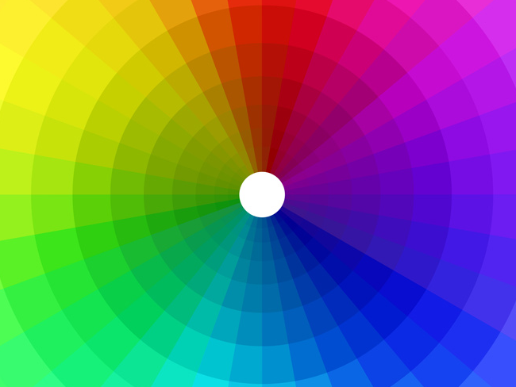
Color
Notes:
Color is often difficult to get right. It plays a major role in stimulating a person’s reaction or attitude which may vary from individual to individual and yet across cultures, colors have different meanings.

Slide 45
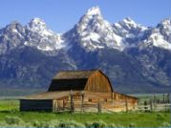
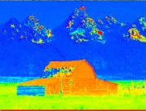
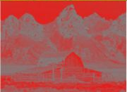
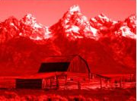
Color Definitions (digital)
Hue is gradation of color (i.e., name: “yellow”)
Saturation is purity of the hue (vividness)
how much gray is mixed in
Luminance is the brightness in an image
Photo Hue Saturation Luminance
Notes:
Hue is …
Saturation is …
Luminance is…
Let’s see how we use these components in design.

Slide 46
Color: Edward Tufte – by hue
IMAGE REMOVED DUE TO EDWARD TUFTE’S UNCLEAR UNDERSTANDING OF FAIR USE
Color sets that vary primarily by luminance are much easier for us to order. This image uses two color sets: browns for height above the land, blues for depth below the ocean. The questions I mentioned before are now much easier to answer. The much more muted colors also much easier to read the information.
[Eastern Sea, not Japan Sea]
Cartographers have been doing this for 2000 years.
The key is to know: under water or not under water? Then, how far for each case?
Our perception system can’t use hue for how much! But, we can use intensity. As I go deeper, the color gets darker. Intensity is a great axis for presenting quantitative info.
Notes:
While it is certainly true that hues have a physical order via their wavelength, and that every kindergartener knows the rainbow ordering, our visual system has a very difficult time treating hue in an ordered way. As we see in this image, it is clear that each area is *different*, but none of the areas have an intuitive relationship between each other. This is supposed to convey height above sea level.
Where is above ground? Where is below? What’s the highest point? These questions are hard to answer.
This is how most computer scientist would design a map.

Slide 47
Color: Edward Tufte – by luminance
IMAGE REMOVED DUE TO EDWARD TUFTE’S UNCLEAR UNDERSTANDING OF FAIR USE
Color sets that vary primarily by luminance are much easier for us to order. This image uses two color sets: browns for height above the land, blues for depth below the ocean. The questions I mentioned before are now much easier to answer. The much more muted colors also much easier to read the information.
[Eastern Sea, not Japan Sea]
Cartographers have been doing this for 2000 years.
The key is to know: under water or not under water? Then, how far for each case?
Our perception system can’t use hue for how much! But, we can use intensity. As I go deeper, the color gets darker. Intensity is a great axis for presenting quantitative info.
Notes:
Color sets that vary primarily by luminance are much easier for us to order. This image uses two color sets: browns for height above the land, blues for depth below the ocean. The questions I mentioned before are now much easier to answer. The much more muted colors also much easier to read the information.
[Eastern Sea, not Japan Sea]
Cartographers have been doing this for 2000 years.
The key is to know: under water or not under water? Then, how far for each case?
Our perception system can’t use hue for how much! But, we can use intensity. As I go deeper, the color gets darker. Intensity is a great axis for presenting quantitative info.

Slide 48
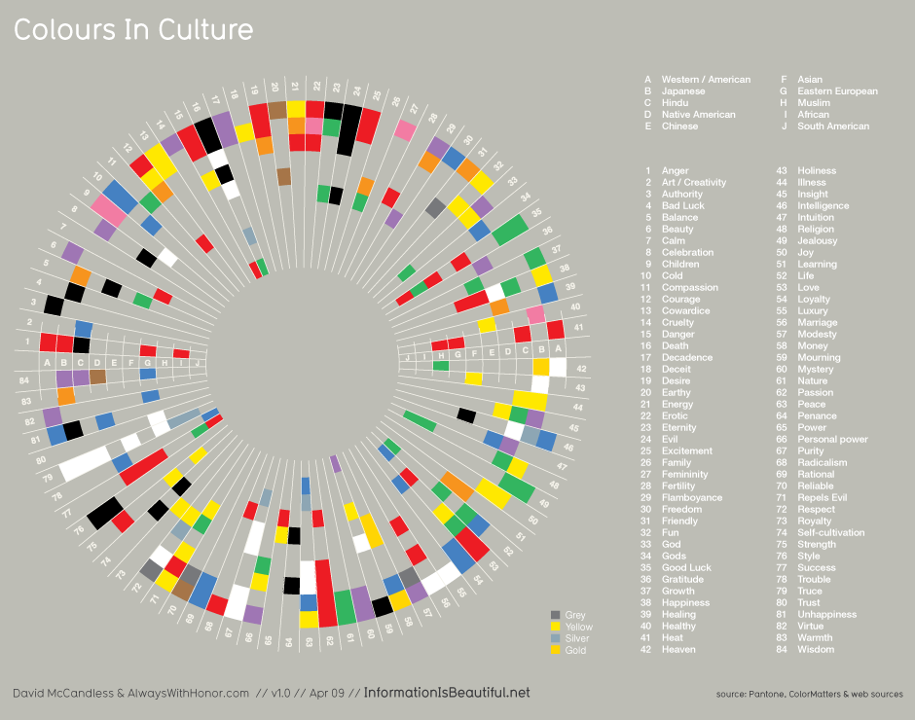
Notes:
This is a diagram of what colors mean for different cultures again from Dave McCandless’ Information is Beautiful.
key to note is the set of colors & their order in each slice differ!

Slide 49
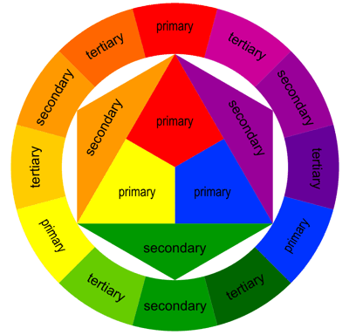
The Basics of the Color Wheel
WARM
COOL
Notes:
One thing is similar across cultures with color at its most basic level. We can separate color into “warm” and “cool” colors which have a very similar emotional response to all people as the theory is based on our innate understanding of the natural world.

Slide 50
Color Harmonies
“A pleasing arrangement of parts, whether it be music, poetry, color, or an ice cream sundae.”
Notes:
What is harmony?

Slide 51

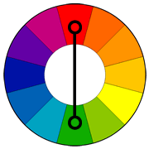
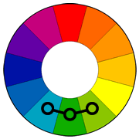
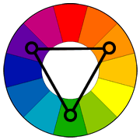
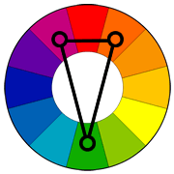
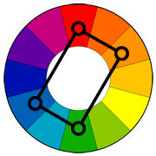
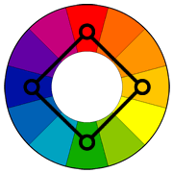
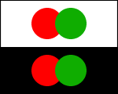
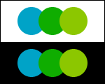
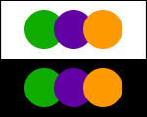
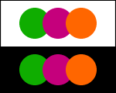
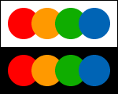
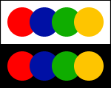
Using Appropriate Color “Harmonies”
?
Complementary
Analogous
Triad
Split Complementary
Rectangle
(Tetradic)
Square
Notes:
So how to we pick the right colors?
While my suggestion for beginners is to stick to one color or “monochrome” pallets, there is the odd occasion where information must have multiple colors to be distinguishable, such as in graphs. In these cases, Color harmonies are particularly useful. They involve picking a primary color and using a color wheel to determine the best colors to go along with it.
For beginners, I suggest using these two (analogous and split-complimentary) as they are hard to get wrong and tend to work with lots of designs.
[ADVANCE]
Complementary works, but can be garish. So I would AVOID it. Let me show you some examples.
see: http://www.tigercolor.com/color-lab/color-theory/color-harmonies.htm

Slide 52
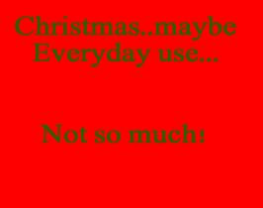
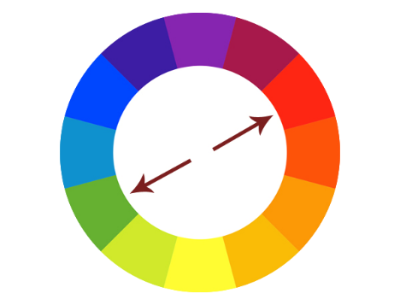
Complimentary
Hard on the eyes
Not so good for text
This color scheme must be managed well so it is not jarring. Bad with Text!!
Notes:
Complimentary colors provide extreme contrast. This high creates a vibrant look especially when used at full saturation.
Complementary colors are tricky to use in large doses, but work well when you want something to stand out.
Complementary colors are really bad for text.
[ADVANCE]
as you can see here.
Complementary colors are pairs of colors which, when combined, cancel each other out. This means that when combined, they produce a grey-scale color like white or black. When placed next to each other, they create the strongest contrast for those particular two colors. But lots of refocusing. Try to avoid complimentary color harmony.

Slide 53
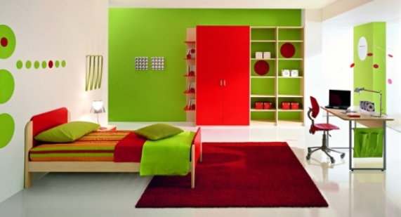
Complimentary (e.g., Children’s Bedroom)
Notes:
We often use complimentary colors in children’s products and services. The high contrast makes things easier to distinguish
though makes it hard to discern what is actually important.

Slide 54
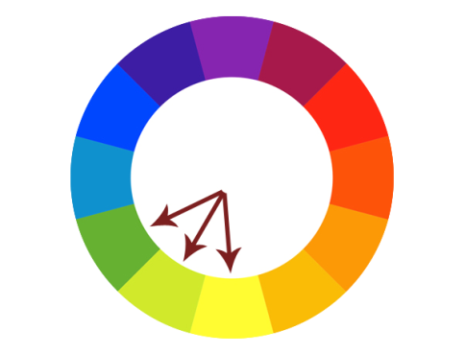
Analogous
Always easy on the eyes,
this type of color scheme
always looks “natural”
Notes:
Analogous colors tend to relate closely to what we find in nature and thus are easiest on the eyes. Visual designs using these colors are always pleasant to look at yet have enough difference in color to be distinguishable in terms of priority. But the colors don’t show as much difference as we sometimes need.

Slide 55

Analogous (e.g., Beyond Oil)
Notes:
BP, who propose that they are a company beyond oil choose an analogous scheme as it invokes nature. The mixture of green and yellow here, not to mention its flower like shape, is comforting and rather powerfully suggests an oil company cares about the environment.

Slide 56
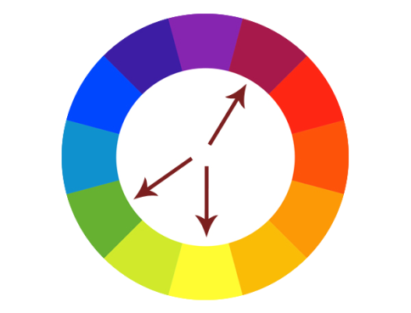
Split Complimentary
Often a good choice for beginners, because it is difficult to mess up.
Notes:
Split complimentary colors are often used when the elements of a design have a stronger need for distinction. This color scheme has the same strong visual contrast as the complementary color scheme, but has less tension. I tend to like this color scheme the best.

Slide 57
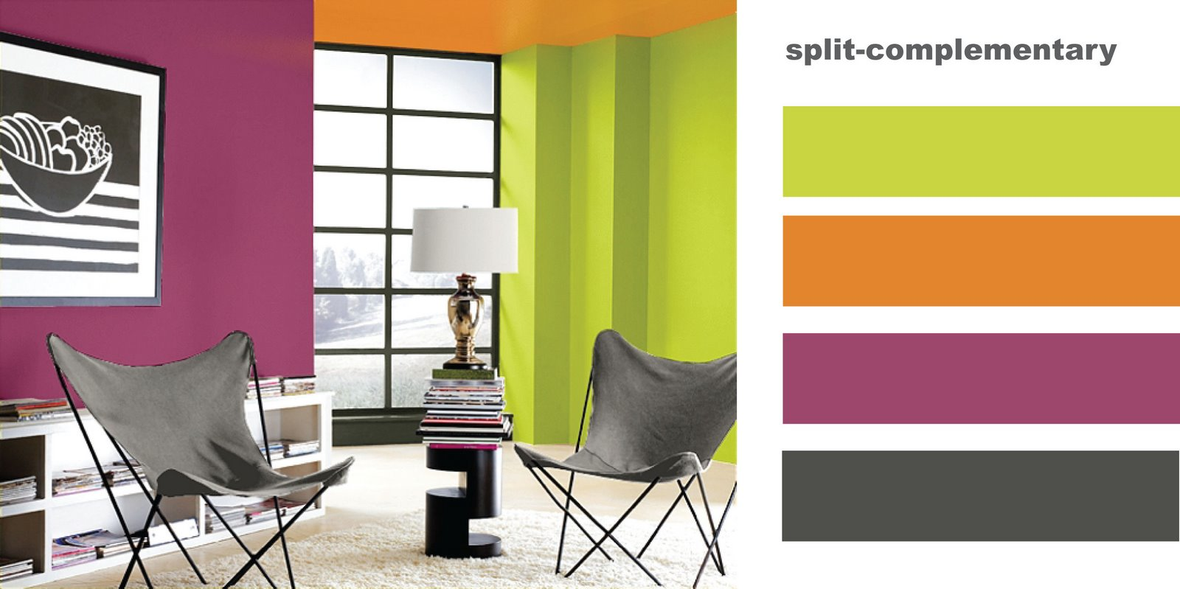
EG Split Complimentary
Split Complimentary

Slide 58
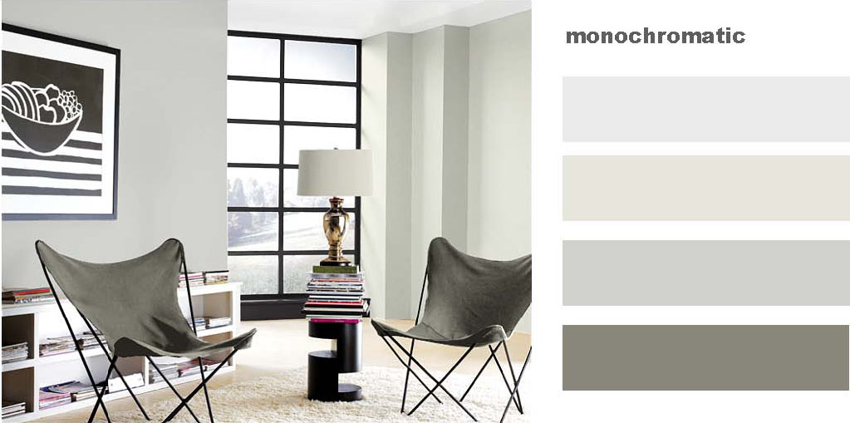
Monochromatic or Grayscale
Notes:
Regardless of what color you are going to use, its always best to begin designs in gray scale

Slide 59
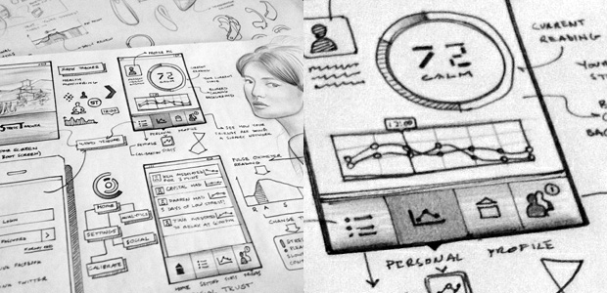
Start with Greyscale
… then accent or enhance with color
Notes:
Regardless of what color you are going to use, its always best to begin designs in gray scale
The high contrast of greyscale allows you to really focus on getting the best layout and hierarchy of elements to then be accented or enhanced with color.

Slide 60

Notes:
The noun project is a very good example of an interface without any color. Here, the layout design and discovery is done so well that color is not needed at all to navigate. In fact this web interface feels to me better than many others using color
Also has good use of SMALL MULTIPLES

Slide 61

Action + Passive Colors
Notes:
A recent trend in design, most noticeable in things like iOS is the use of the isolation effect. In this example, color harmonies are near irrelevant. These types of designs are so focused in their layouts that color is only used to describe an element that is “actionable”. It turns out that more often than not, this results in a user experience that is very easy to understand.

Slide 62


Poor Use of Color
Notes:
This is an example of poor color use. The colors don’t match to any particular task or function and as a result, it is near impossible to figure out what to do – and as a result, a horrible user experience perhaps more hindering than any functionality.

Slide 63


Redesigned to Use 3 Actionable Colors
Notes:
The designer (Luke)’s goal was to pick a color harmony that was relaxing while only ever using 3 colors. Anything that is colored is actionable (tappable, important). Anything grey is a “passive” color and requires the user to explore this information. The blue and purple here are [ADVANCE] ANALOGOUS

Slide 64


Action
Immediate
Analogous
Notes:
ANALOGOUS

Slide 65
Tools that help with color selection
https://coolors.co/
http://color.adobe.com/
http://www.colourlovers.com
https://paletton.com/
Notes:
These tools are useful for both exploration of colors and for figuring out harmonies. Tools like photoshop, illustrator and most interface design tools also include built-in tools for choosing color harmonies.

Slide 66

Mood Boards
Notes:
One way to organize your design styles in with a mood board.
Mood boards are collages that arrange images, text, fonts, colors, and other design elements into a format that's representative of the final design's style. It helps you to explore that style and then to set it for a later design system, which is a bit more formal (will learn more about that in our workshop this week).
What mood does this board communicate to you?
[do fast]
natural, somber, vintage (50s)

Slide 67


Mood Boards
Notes:
What mood does this board at left communicate to you?
bold, daring, generational or vintage again (almost 70-80s)
[do fast]
[ADVANCE]
How about this one at right?
soothing, adventurous, hip, cool
[do fast]

Slide 68


Mood Boards – Team Exercise (10 min)
Define the Vibe: Brainstorm 3-5 adjectives that describe your design's feel (e.g., playful, modern) and write them down
Search for Visuals: Each team member finds images that reflect these adjectives using:
Unsplash in Figma
Optionally, try Cosmos for AI moodboards
Use WhatFont to identify fonts on websites
Build the Moodboard: Combine images onto a single team slide
Pick Colors: Choose primary and secondary colors for your prototype from the moodboard images
Use Randoma11y for high-contrast color combos
Save & Share: Copy your completed slide to the team folder: http://hci.st/cs147-25au-mood-boards
Notes:
--- this year ---
got here at 3:10 (only 10 min left) so took only 7 min this year
-------------
If get here with less than 25 min left, then cut time down to 8 min as would like at least 15 min for final content
*** last year ***
Got here with 18 min left and gave 10 min so only had 8 min to finish. Should have cut to 8 min.
** two years ago ** got here at 2:53pm, so took 10 min to 3:03 so had 17 min to finish
If get here with less than 25 min left, then cut time down to 8 min as would like at least 15 min for final content
*** three yeas ago ***
10 min exercise started at 1:02 -> 1:12 (leaving 8 minutes to finish class)

Slide 69
Visual Design that is
Interesting
[the wow factor]
Notes:
This is perhaps the most difficult thing to achieve in visual design. It’s very easy to use templates for data graphs, websites and applications – and for the most part they do very well. The following techniques for most are difficult to do right, but when done well create interest.

Slide 70
Non Conventional Layouts
Hard to get right & easy to overdo!
Try new shapes
circular charts
hexagonal objects
Like all techniques (color, etc) – restrict unconventional layouts to the most important information

Slide 71


Wilfred Castillo: Tide Prediction: http://www.wilfredcastillo.com/Tide-Prediction
Notes:
For example, Wilfred Castillo’s Tide Prediction
http://www.wilfredcastillo.com/Tide-Prediction
Shows how the high tides and low tides relate to the moon’s phases (full moon and new moon are when they are strongest – aligned with the sun)

Slide 72


Partly Cloudy
iOS App
Notes:
Reminiscent of the tide chart…

Slide 73
Dynamic Movement / Animation
Hard to get right & easy to overdo!
Animation is best used to connect information & create “flow”
Like size, color & unusual shapes, animation draws attention to the eye & suggests importance
Notes:
Having information change dynamically has taken off recently and again, is difficult to do correctly. The best way for me to consider animation is to only use it to connect an input to a display of the information the input is modifying.
This connects to a usability principle that will be discussed in the next week’s lecture “Heuristic Evaluation” where information that adapts instantly gratifies the user that the system is working for them, not against them.

Slide 74

Metaphors (using the real world to describe info)
Hard to get right & easy to overdo!
Very useful to provide meaning and connect information to logic
The more direct or specific a metaphor, the more contextually relevant it is to a generation or time
Notes:
Metaphors are perhaps one of the hardest “interesting techniques” to get right. In information graphics, metaphors are very useful however in interfaces they can often cause more confusion than success.

Slide 75

Metaphors
Notes:
This shows changes in global emissions of CO2 and uses the metaphor of clouds of smoke coming out of a factory
http://awesome.good.is/transparency/web/0911/globalemissions/flat.html

Slide 76
The best designs balance the techniques you have seen
and
The less techniques used, the easier it is to balance them
Notes:
We have discussed now what may seem is an overwhelming amount of techniques designers use all the time.
This is how it should seem – Overwhelming. It is exactly the way customers will feel if they see too many of these techniques being used at once.
Again, we are brought back to the number one skill – Balance.
The hardest part is knowing what to remove and the only way to really get a good feel for these techniques is to practice with them repetitively.

Slide 77
Overwhelming Use of Different Techniques
Notes:
Again, easy to see when it is bad!

Slide 78
In other words,
Keep it Focused

Slide 79
relevant meaningful new
interestingness
proof of concept
experiment
ugly
truth consistency honesty accuracy
successful visual design
easiness usefulness usability fit
integrity
useless
rubbish
function
boring
eye candy
sketch
form
Based on David McCandless
beauty structure appearance
http://www.informationisbeautiful.net
Notes:
Let’s see an example that hits all 4 of these areas: interestingness, integrity, function, and form.

Slide 80

Form
Interestingness
Integrity
Function
Notes:
Daisy disk for mac
Anyone here use this application? Quite good for seeing where you are using your disc space..

Slide 81
Summary
Start with context – what is the nature of the information? What is the most important?
Design first in grayscale to focus on hierarchy
Small changes help us see key differences
e.g., small multiples
Avoid clutter, focus on the essence of your tasks
Use color properly – not for ordering!
Only use 1-2 colors at a time, unless absolutely necessary

Slide 82
Further Reading/Resources
Kevin Mullet and Darrell Sano, Designing Visual Interfaces
Edward Tufte’s books and course
Robin Williams, The Non-Designer’s Design Book
Typography
Jan Tschichold, The New Typography
Robert Bringhurst, The Elements of Typographic Style
Typography on the web
http://www.adobe.com/type/
http://www.microsoft.com/typography/
Elizabeth Lin’s Art of Visual Design (online) course
https://www.artofvisualdesign.com/

Slide 83
Next Time
Studio on Friday
present low-fi prototype/user study results – key things learned
work on sketching out new designs
Mon
Conceptual Models & Interface Metaphors
Read
“The Psychology of Everyday Things" (Ch 1) from The Design of Everyday Things by Donald Norman
Notes:
Studio
- key things learned
Mon
- one of the most popular books ever written about design and HCI. Easy and fun read.

Slide 84

Exit Ticket
http://hci.st/cs147-25au-exit-5-782

