Slide 1
Human Abilities: Vision & Cognition
October 20, 2025
Music: https://soundcloud.com/dansuneroquette
Notes:
Goal, fast to get to break by 40 min & take only 25 min break leaving 45 min to finish
--- This year ---
got to break at 47 (2:17) min so only took 23 min break to 2:40
Still not enough. Cut more MHP slides!!!
5 min over and skipped stroop effect experiment. Also jammed through the memory and summary slide after it
-- Last year ---
got here at 41 min and took a 29 min break to 2:40 PM leaving 40 min to finish
Not enough. Definitely need 45 to finish. Skipped last 4-5 slides and the interference experiment.
---- 2 years ago ---
got to break at 53 minutes… way too late. Had to skip second in class experiment and all the interference memory slides at the end -> cut some 1st half content and do HoF/S faster to get first half done in 40 min
--- 3 years ago ---
Ended exactly on time and had a 20 min break
------4 years ago -----
Plan: 40 min + 20 min break + 45 min after break including 2 exercises (last year went 5 min over. Cut 2 slides somewhere)

Slide 2

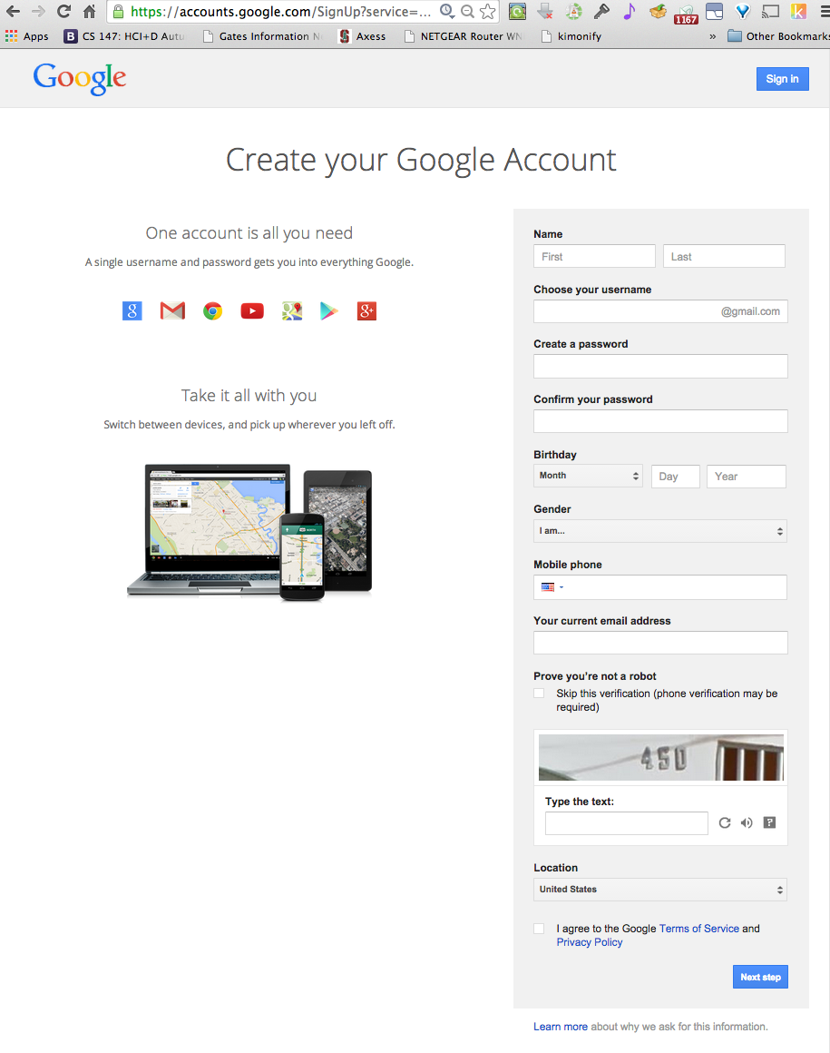
Hall of Fame or Shame?
Notes:
I was trying to create a google account a couple of years ago... and I guess I didn't get the fields right
[ADVANCE]

Slide 3
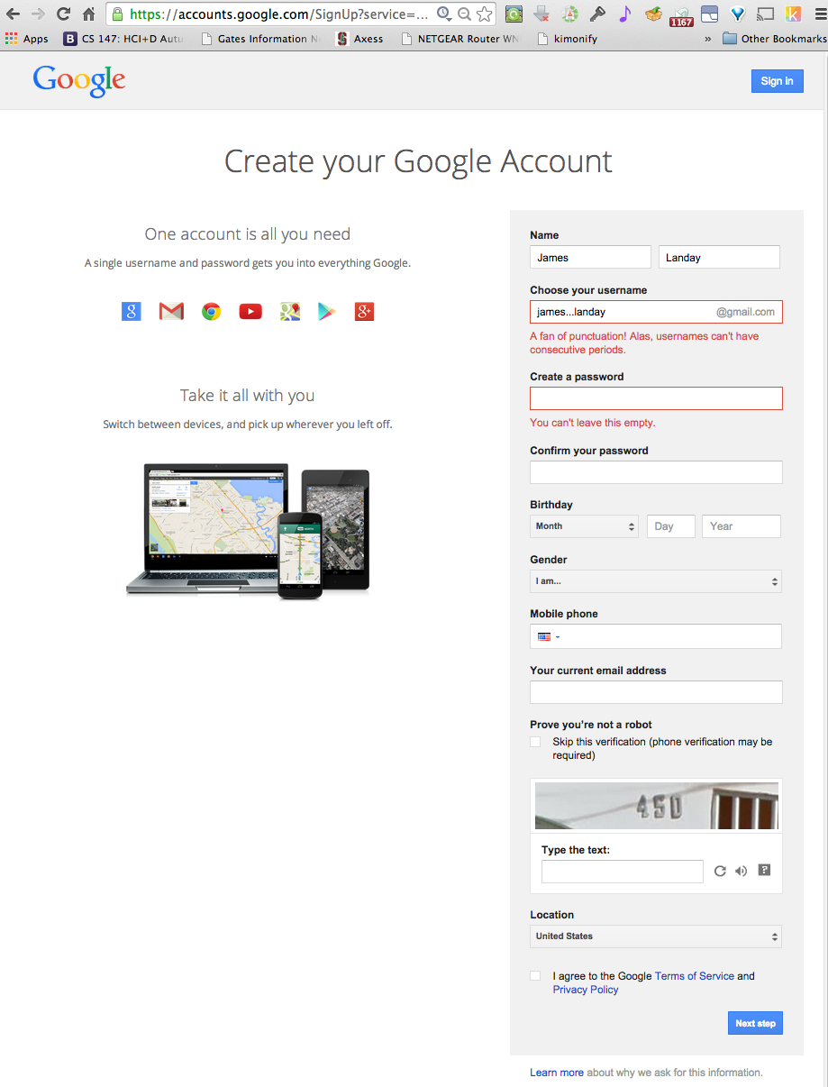
Hall of Fame or Shame?
Notes:
What do we like?
What could be improved?

Slide 4

Hall of Fame! (but still some issues…)
Clearly highlights error (red text & box)
Tells me what I did wrong/how to fix it
In user’s language
(but, be careful w/ humor)
Red may be an issue when used alone, more later...

Slide 5
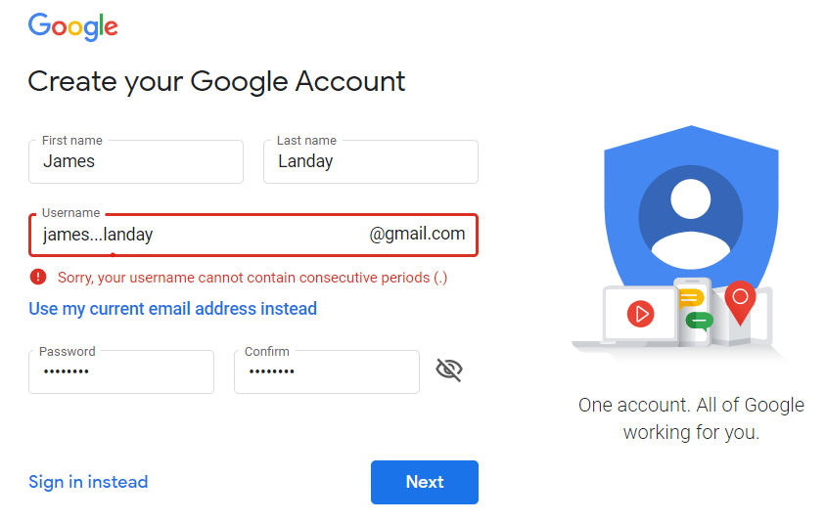
Hall of Fame!
Clearly highlights error (red text & box)
Tells me what I did wrong/how to fix it
In user’s language
(but, be careful w/ humor)
Red may be an issue when used alone, more later...
New version fixes these 2 problems
- adds caution icon & removes the humor
Notes:
When I tried it again last year it was much improved
(the current version is different again, but similar to this in terms of the error handling)

Slide 6
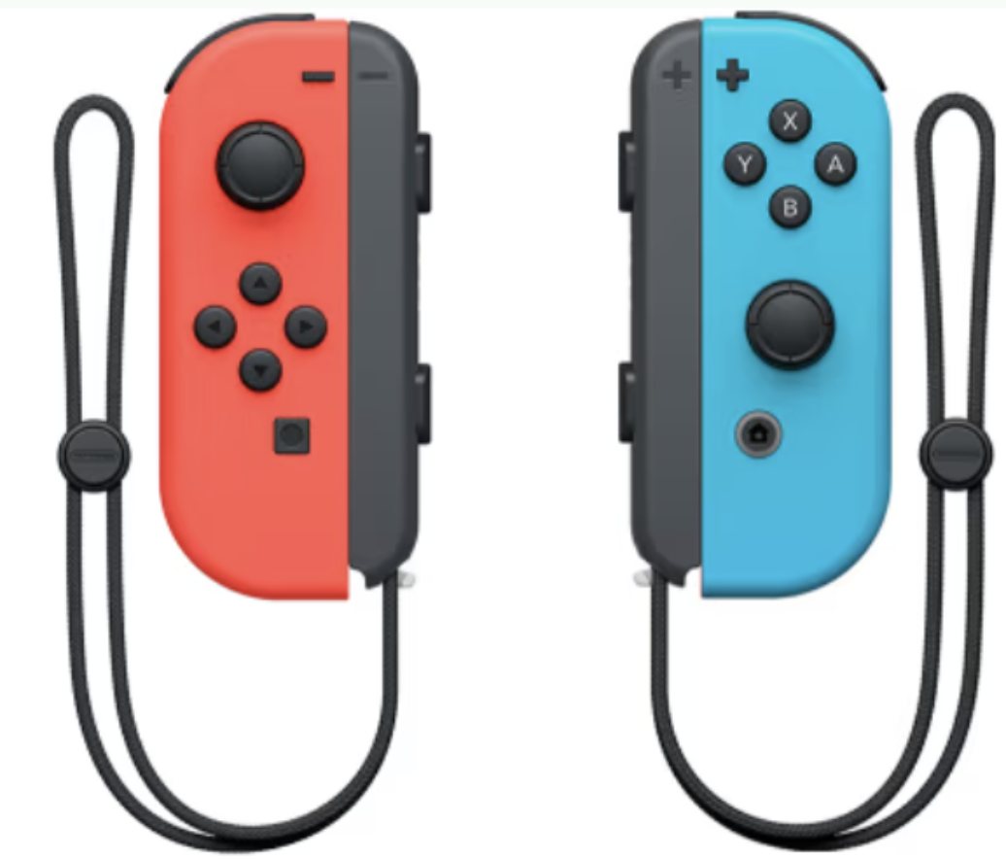
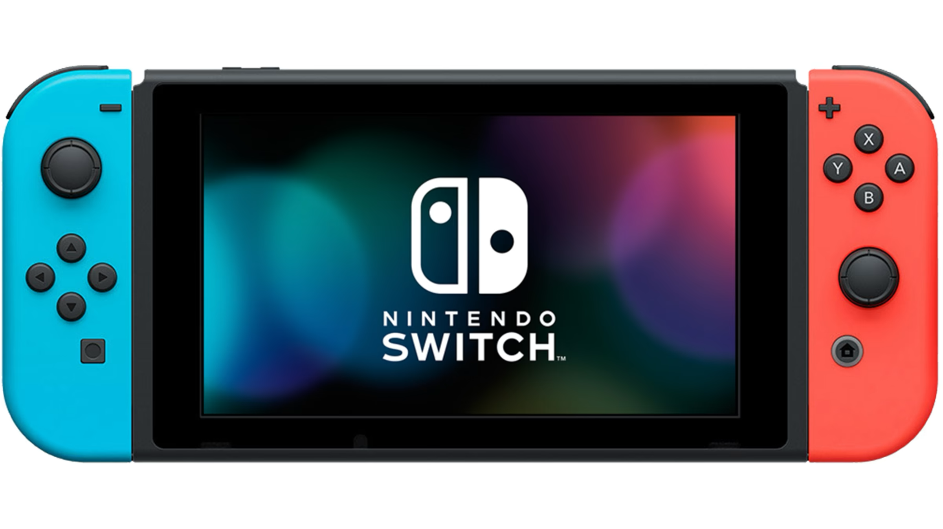
Hall of Fame or Shame?
Nintendo Switch
Connects to TV and use detachable controllers
or
Use as a single all in one device
or
Give another person a controller & share the screen
Notes:
3 main ways to use:
Connects to TV and use detachable controllers
or
Use as a single all in one device
or
Give another person a controller & share the screen

Slide 7
Hall of Fame!
Multiple configurations reduces # of physical steps for any one mode
Detachable controllers caters to different play styles/physical abilities
Controller optimizes button placement for minimal movement (Fitts’ Law)
Notes:
Multiple configurations reduces # of physical steps for any one mode
Detachable controllers caters to different play styles/physical abilities
Controller optimizes button placement for minimal movement (Fitts’ Law)

Slide 8

Hall of Fame or Shame?
Notes:
I had to return some shoes to zappos.com
They didn’t give me full credit so I had to fill out a form
What do we like?
What could be improved?

Slide 9

Hall of Shame!
Like
error message prominent with different color & shape
Wish
where is the error?
what’s wrong with it?
parse & fix it yourself!

Slide 10
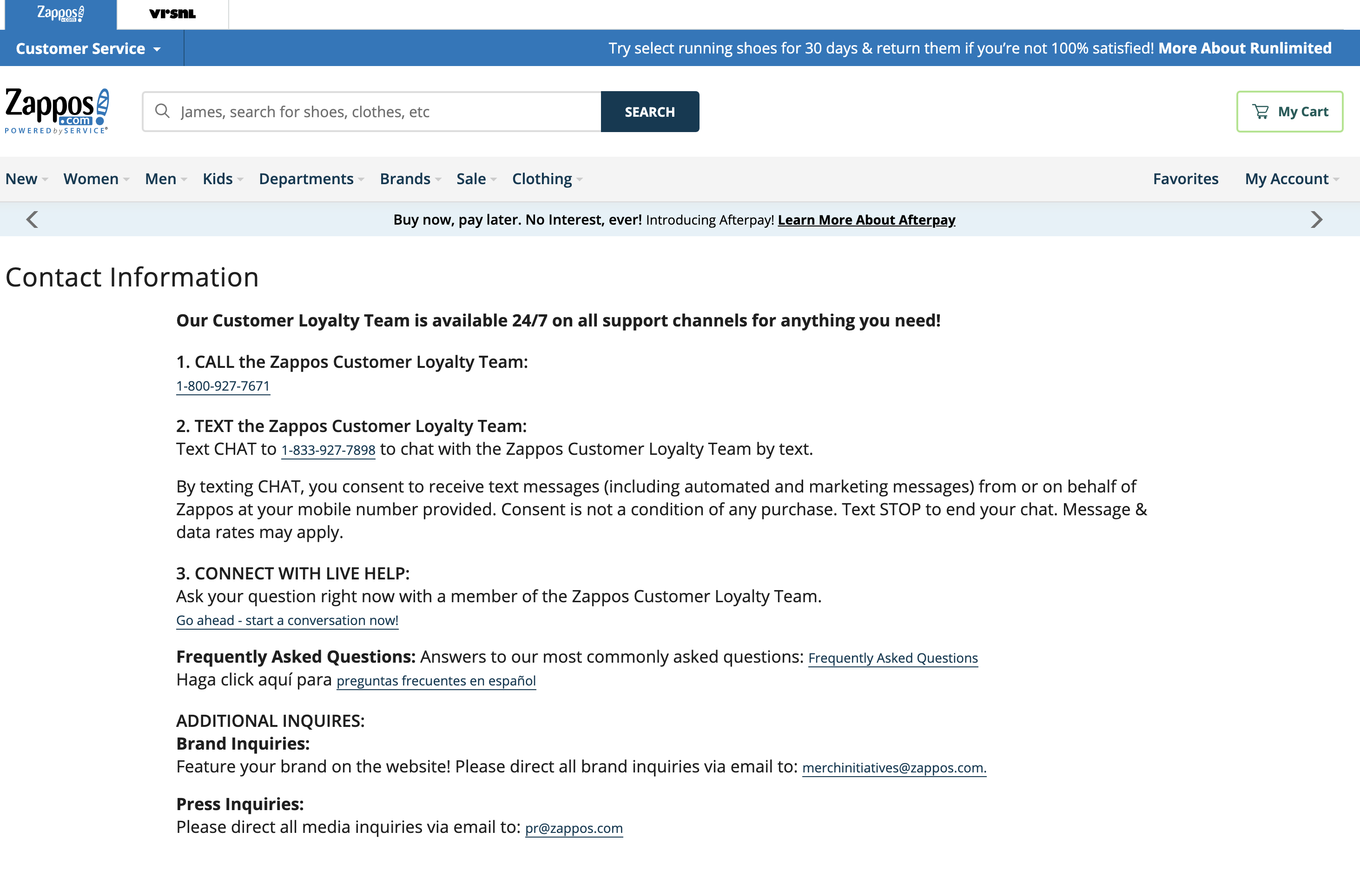
Hall of Shame!
Update (today)
- no longer have that form (uses phone, SMS, live chat)
Notes:
Newer version. They got rid of the form.

Slide 11
Human Abilities: Vision & Cognition
October 20, 2025
Music: https://soundcloud.com/dansuneroquette
Notes:
Goal: 40 min + 25 min break + 45 min
First: Wow. Some of the videos I’ve seen are really great! You’ll get to see the best ones and vote on some awards in next week.
Why are we learning about human abilities? We can give you guidelines on what to do and what not to do (and there was some of this in the visual design lecture on Wed and there will be more here), but it is important to understand some of the human machinery that UNDERLIES these design guidelines. We will give you some of that today. You could take an entire course on these topics, visual perception, human memory, and the human motor system, but we are going to give you a quick summary today.

Slide 12
Outline
Human visual system
Guidelines for design
Team Break
Models of human performance (MHP)
Two in class experiments
Memory

Slide 13
Why Study Color?
Color can be a powerful tool to improve user interfaces by communicating key information
Inappropriate use of color can severely reduce the performance of systems we build

Slide 14
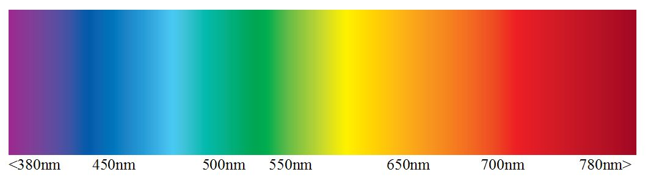
Visible Spectrum
There is an order to the colors… ROY G. BIV
UV
IR
Wavelength (nm)
Do not use that ordering to order data!
(next lecture: example of how unusable a map is using this ordering for elevation)
Notes:
Here is an image of the visible spectrum, from 380nm on the left, violet, to 780nm on the right, red.
[ADVANCE]
And there is an ordering of the colors that maps to the wavelengths…
From Right to Left people use the pneumonic Roy G. Biv: red, orange, yellow, --- green --- blue, indigo, violet
But do not use that to order data!

Slide 15
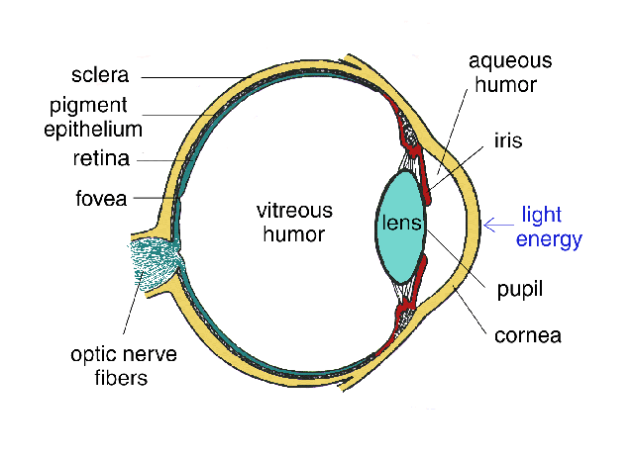
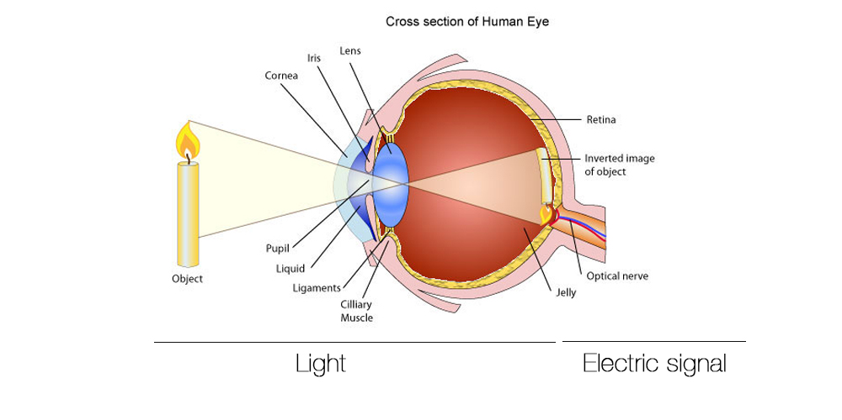
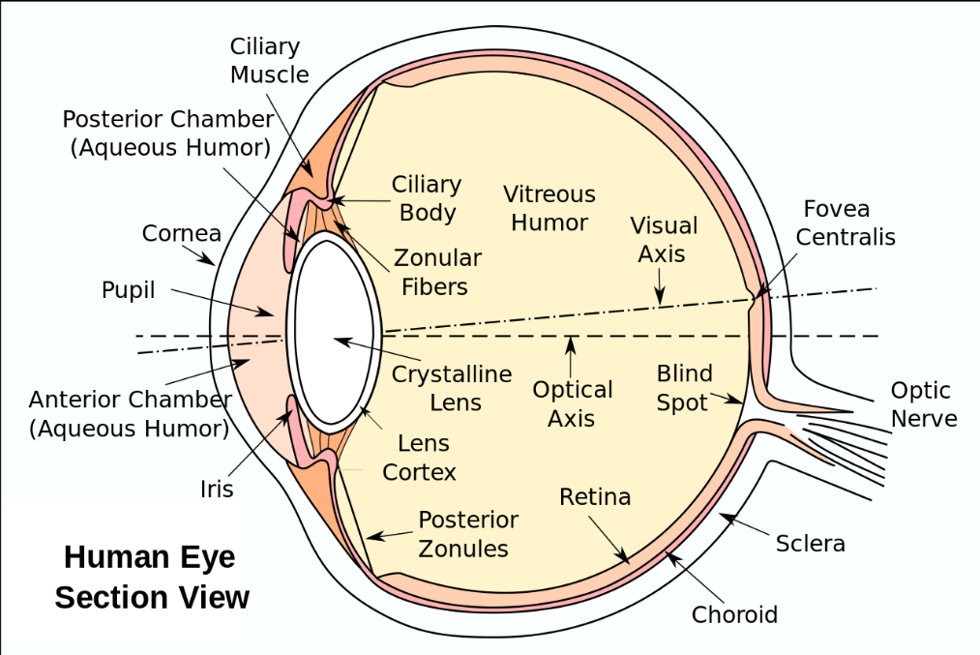
Human Visual System
Light passes through lens
Focused on retina
http://obsessive-coffee-disorder.com/wp-content/uploads/2014/11/eye1.jpg
Notes:
This is how the human visual system works.
You may remember how lenses work from high school or college physics.
Light passes through the lens...

Slide 16
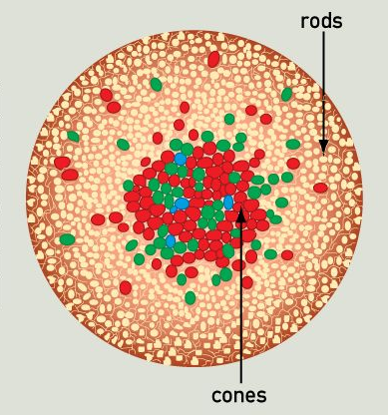
Retina
Retina covered with two types of light-sensitive receptors called?
rods
primarily for night vision & perceiving movement
sensitive to broad spectrum of light
can’t discriminate between colors
sense intensity or shades of gray
cones
used to sense color
http://www.webexhibits.org/causesofcolor/1G.html
Notes:
[ADVANCE]
[ADVANCE]
Anyone notice anything interesting about the distribution of the rods and cones?

Slide 17
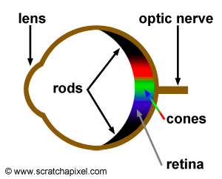
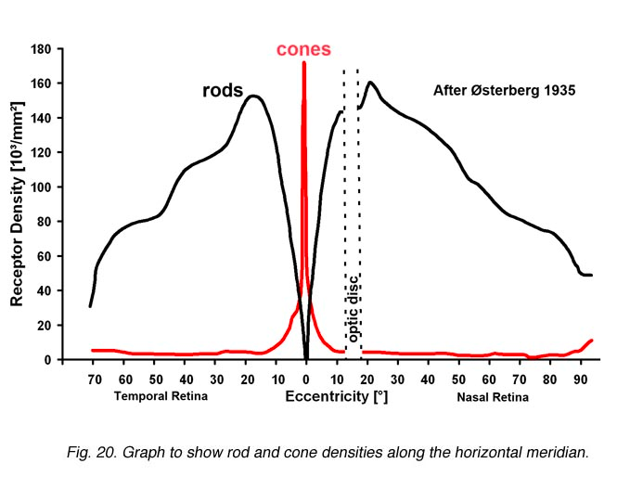
Retina
Center of retina has most of the cones →
allows for high acuity of objects focused at center
Edge of retina is dominated by rods →
allows detecting motion of threats in periphery
http://www.webexhibits.org/causesofcolor/1G.html
http://webvision.med.utah.edu/imageswv/Ostergr.jpeg
Notes:
Here are a couple of other ways of seeing the distribution of the rods and cones. Middle shows where the color perception is. Graph at right shows density of each based on degrees away from center of eye. See the gap of the optic nerve? Our brain makes up for the missing information.
What is the implication of center of retina having most of the cones?
[ADVANCE]
Acuity is the ability to see fine details in an image
[ADVANCE] Edge of retina is dominated by rods... implying?

Slide 18
Color Perception via Cones
“Photopigments” used to sense color
3 types: blue, green, “red” (really yellow)
each sensitive to different band of spectrum
ratio of neural activity of the 3 → color
other colors are perceived by combining stimulation
http://www.webexhibits.org/causesofcolor/1G.html

Slide 19
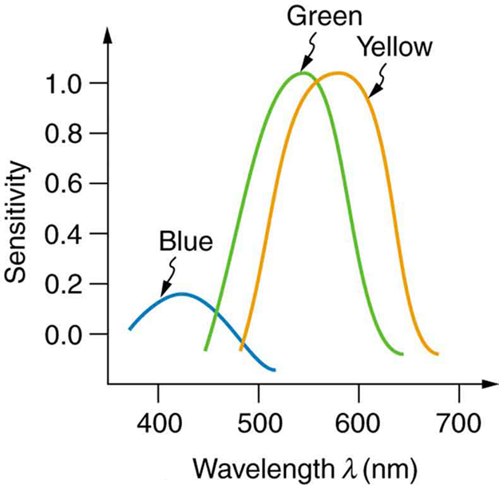
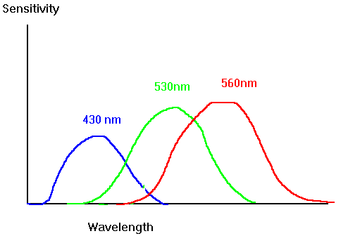
Color Sensitivity
AKA Red
lots of overlap
not as sensitive to blue
https://www.siggraph.org/education/materials/HyperGraph/color/images/colorspc.gif
http://archive.cnx.org/contents/d42c807d-a9fa-4e3d-83d0-0f7c745b51a0@4/color-and-color-vision#import-auto-id1844887
Notes:
See anything interesting here?
We are NOT as sensitive to blue
[ADVANCE]
2) There is lots of overlap between the 3 photopigments
[ADVANCE]
Image from: http://archive.cnx.org/contents/d42c807d-a9fa-4e3d-83d0-0f7c745b51a0@4/color-and-color-vision#import-auto-id1844887

Slide 20
Color Sensitivity
AKA Red
https://www.siggraph.org/education/materials/HyperGraph/color/images/colorspc.gif
http://archive.cnx.org/contents/d42c807d-a9fa-4e3d-83d0-0f7c745b51a0@4/color-and-color-vision#import-auto-id1844887
Notes:
If I underlay that spectrum from the earlier slide, you can see clearly that the "red” cone sensitivity is clearly centered on YELLOW (though due to the long tail, probably more of the area under the curve is in the red).
Image from: http://archive.cnx.org/contents/d42c807d-a9fa-4e3d-83d0-0f7c745b51a0@4/color-and-color-vision#import-auto-id1844887

Slide 21
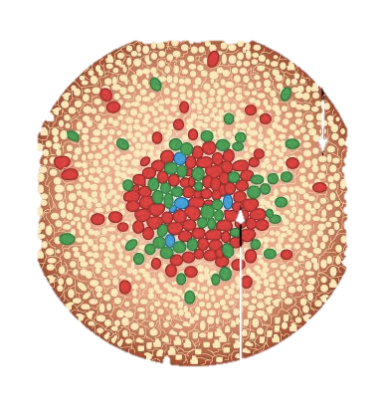
Distribution of Photopigments
Not distributed evenly – mainly reds (64%) & very few blues (4%) →
insensitivity to short wavelengths (blue)
Few blue cones in retina center (high acuity) →
“disappearance” of small blue objects you fixate on
As we age lens yellows & absorbs shorter wavelengths →
sensitivity to blue is even more reduced
Implication
don’t rely on blue for text or small objects!
http://www.webexhibits.org/causesofcolor/1G.html
Notes:
Let's talk more about the distribution of the photopigments across Red, Green, and Blue. They aren't distributed evenly at all!
Mainly reds and very few blues.
[ADVANCE]
insensitivity to blue light
[ADVANCE]
Few of the blue ones are in the center. Where we have high acuity.
[ADVANCE]
Disappearance of small blue objects.
[ADVANCE]
As we age the lens yellows... absorbs shorter wavelengths
[ADVANCE]
Sensitivity to blue gets even worse!
[ADVANCE]
Don't use blue for small objects, e.g., text.
Original choice of blue links on the web was a bad idea!

Slide 22
Focus
Different wavelengths of light focused at different distances behind eye’s lens
need for constant refocusing → ?
causes fatigue
be careful about nearby color combinations
Notes:
different wavelengths will focus at different distances through a lens... so we use little muscles to change the shape of the lens.
call that refocusing
[ADVANCE]
it causes fatigue
[ADVANCE]
so be careful about color combinations physically near each other that cause this refocusing constantly

Slide 23
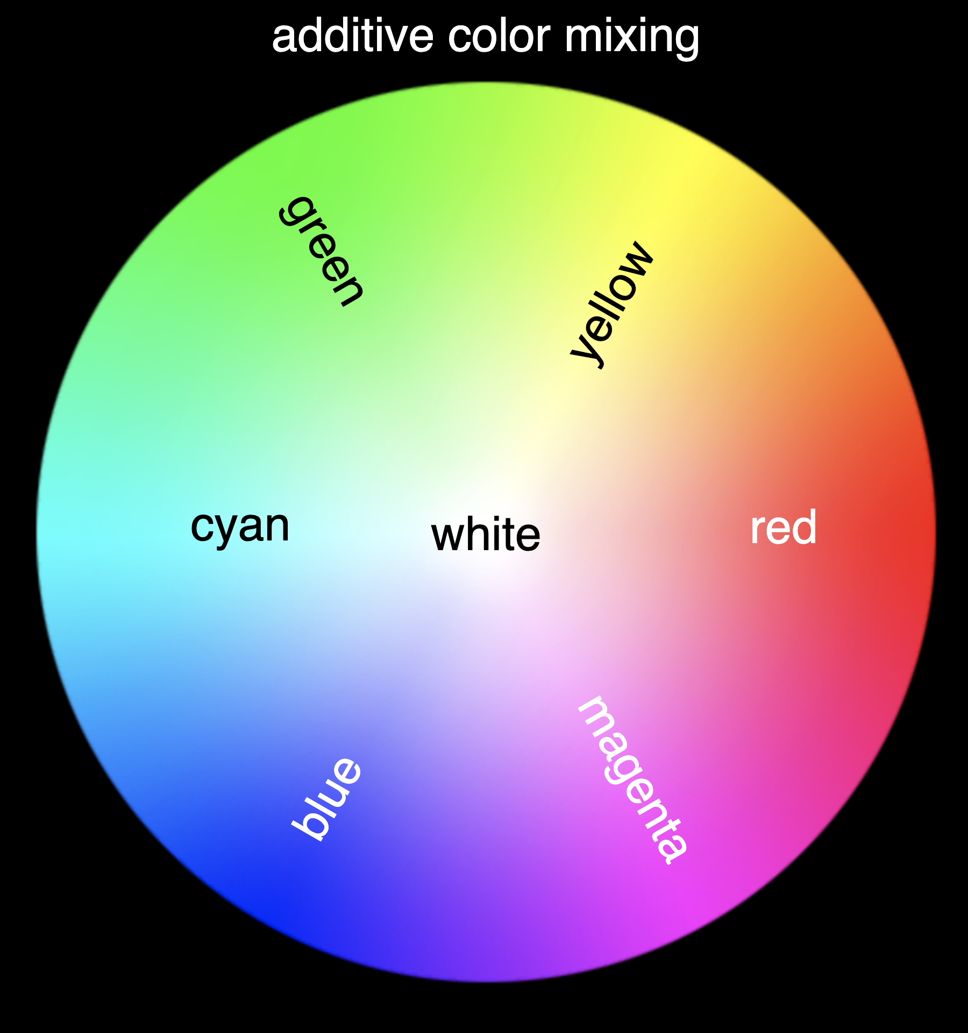
Focus
Different wavelengths of light focused at different distances behind eye’s lens
need for constant refocusing → ?
causes fatigue
be careful about nearby color combinations
Pure (saturated) colors require more focusing than less pure (desaturated)
don’t use saturated colors in UIs unless you really need something to stand out
https://physics.info/color/
Notes:
Look at this color wheel. The pure or saturated colors are on the outside. As you move towards the center they are being mixed with gray and become desaturated. Those lighter colors are CLOSER together in frequency space if you look back on the color spectrum and thus when used together require less refocusing and thus less strain on the eye.

Slide 24
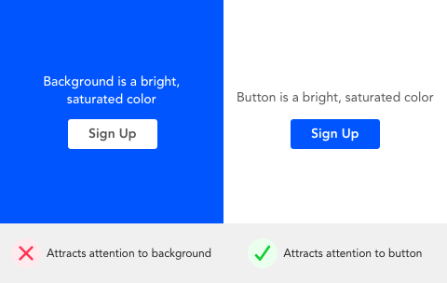

Focus
Different wavelengths of light focused at different distances behind eye’s lens
need for constant refocusing → ?
causes fatigue
be careful about nearby color combinations
Pure (saturated) colors require more focusing than less pure (desaturated)
don’t use saturated colors in UIs unless you really need something to stand out
http://www.pallasweb.com/color.html
saturated bg desaturated bg
Notes:
In the Left image, the background is saturated, the right is desaturated (how much gray)
Decreasing lightness helps, but much better on right with desaturated colors than saturated
(sweater will still “pop”)
[ADVANCE]
or see this example with the button. Using the saturated color for the button and the desaturated color for the background causes the button to pop

Slide 25

Color Deficiency (Also known as “color blindness”)
Trouble discriminating colors
besets about 4.5% of population (~8% men, ~½% women)
Two main types
different photopigment response – most common
reduces capability to discern small color diffs
red-green deficiency – best known
lack of either green or red photopigment → can’t discriminate colors solely dependent on Red & Green
Key is to avoid single color distinctions
Difficult pairs for severe red deficient person to discern
https://www.color-blindness.com/red-green-color-blindness/
Notes:
4.5% of population, mostly men
[ADVANCE]
Two types
[ADVANCE]
different photopigment response most common
[ADVANCE]
red-green deficiency (widely known). missing a photopigment.
[ADVANCE]
There are web sites where you can check your color palette for red/green color deficiency to ensure your colors won’t cause a problem.
Key is to avoid single color distinctions

Slide 26
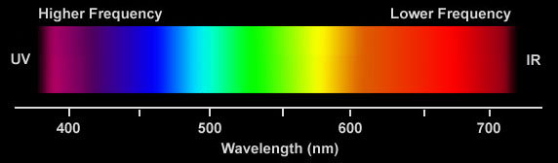
Color Guidelines
Avoid simultaneous display of highly saturated, spectrally extreme colors
e.g., no cyans/blues at the same time as reds, why?
refocusing!
desaturated combinations are better → pastels
A Bad Color Combo
bad
Notes:
Now based upon what we know about human vision, here are Some guidlines
Avoid simultaneous...
why?
see how far they are in frequency space?
constant refocusing!

Slide 27
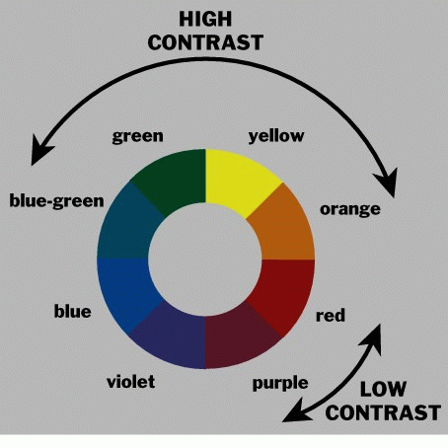
Use the Hue Circle
Pick non-adjacent colors
opponent colors go well together
red & green
or yellow & blue
Notes:
Pick non-adjacent colors so you get some contrast. But don't pick spectrally extreme colors like we just talked about. Opponent colors go well together but aren't the best. There are even better schemes than opponent colors (we'll see that in the visual design lecture), but being across the circle means they are closer to each other in frequency and thus require less refocusing.

Slide 28

Color Guidelines (cont.)
Avoid pure blue for text, lines & small shapes
Avoid adjacent colors that differ only in blue
Blue makes a great background color
TO BLUE
Notes:
Mainly an issue for lots of text
blue makes a fine background color

Slide 29
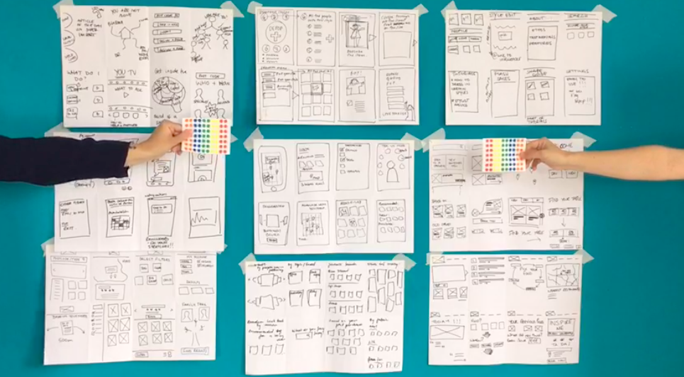
Administrivia
Assignment #5 – Low-fi Prototype & Pilot Usability Test
10-15 rough sketches of 3 different design realizations
everyone on team contributes
use different modalities (e.g., visual, speech, watch) or different visual UIs input techniques (gestures, taps, etc.)
Notes:
Let’s talk about your next assignment
You are going to be making low-fi prototypes like I showed you last wed and then test them in your assignment due on Thursday/Friday.

Slide 30
Administrivia
Assignment #5 – Low-fi Prototype & Pilot Usability Test
10-15 rough sketches of 3 different design realizations
everyone on team contributes
use different modalities (e.g., visual, speech, watch) or different visual UIs input techniques (gestures, taps, etc.)
pick top 2 realizations & storyboard/task flow more
pick best realization & add details to task flow
build low-fi prototype of the best & test it w/ at least 1 target (non-Stanford) participant/team member (e.g., four)
Notes:
Let’s do some administrivia.
You are going to be making low-fi prototypes like I have shown and then test them in your next assignment due a week from this Thursday/Friday.
Remember: focus especially on what was surprising!

Slide 31
T E A M B R E A K
Notes:
If get here at 40 min take 25 min break. For every min over 40 take 1 min less break. Need to restart at 2:35 PM.
---- this year ---
got here at 47 (2:17) min so only took 23 min break to 2:40
--- last year –-
got here at 41 min and took a 29 min break to 2:40 PM leaving 40 min to finish
Not enough. Definitely need 45 to finish. Skipped last 4-5 slides.
goal: break at 40-45 minutes, 20-minute break (need 45 min to finish)
if have less than 65 min left, reduce accordingly
--- 2 yeas agor –
broke at 52 min (restart at 2:45)
20 min break
--- 3 years ago ---
broke at 49min -- took 21 min break (restart at 2:40 PM)
--- 4 years ago ----
broke at 40 minutes
For 20 minutes – if have less than 65 min left, reduce accordingly
Need 45 min to finish
-----

Slide 32
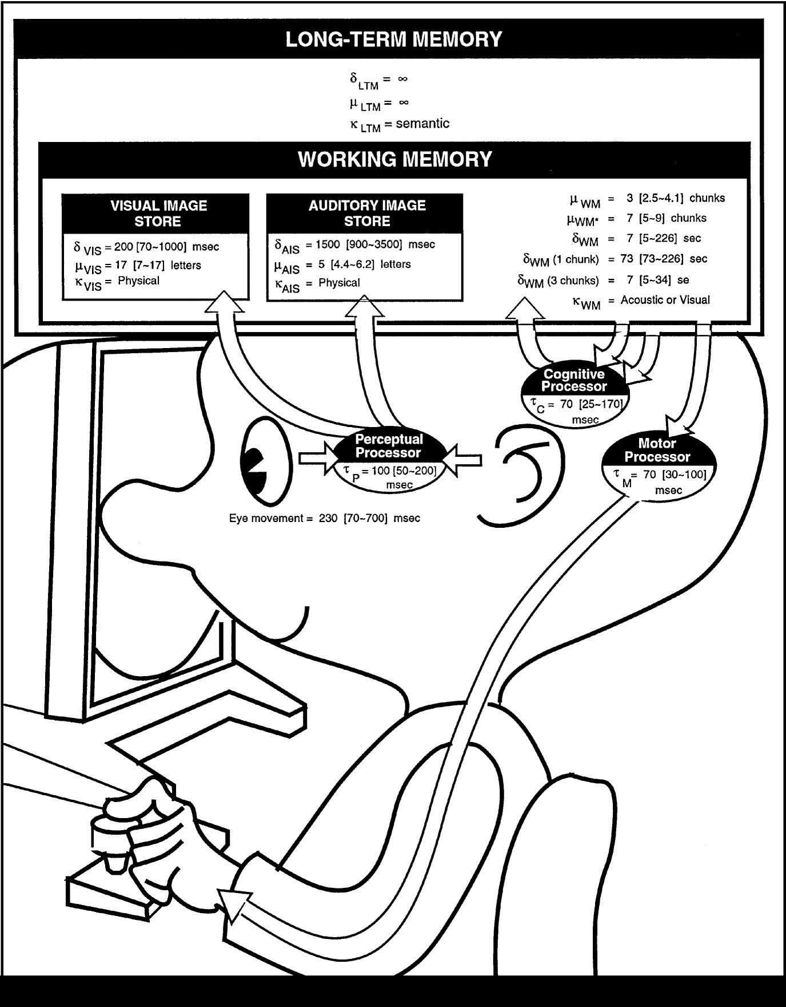
The Model Human Processor
Developed by Card, Moran & Newell (’83)
based on empirical data
Model can help us test understanding & make predictions
Underlies other usability techniques
GOMS, KLM, tools, etc.
The Psychology of Human-Computer Interaction by Card, Moran & Newell
Notes:
Now we are going to talk more about cognition and motor control.
We model human performance to test understanding and
To predict the influence of new technology.
This is the classic image from the book “The Psychology of Human-Computer Interaction”, which gave the field of HCI it’s name

Slide 33
The Model Human Processor
Long-term Memory
Working Memory
sensory
buffers
Visual Image
Store
Auditory Image
Store
Eyes
Perceptual
Processor
Motor
Processor
Cognitive
Processor
Ears
Fingers, etc.
Notes:
I’ll use this simpler model.
Memory and 3 processors
Perceptual processor: takes in from eyes & ears and puts that information in the visual and auditory image stores, respectively that are part of working memory.
Motor processor that takes commands from working memory and controls our body. e.g., has our fingers click on a mouse or trackpad button.
Cognitive processor. Think of this as the CPU. Takes instructions from working memory. Can get more information from long-term memory and then operates on it and stores a result back in working memory.

Slide 34
MHP Basics
Sometimes serial, sometimes parallel
serial in action & parallel in recognition
pressing key in response to light (serial)
driving, reading signs & hearing at once (parallel)
Parameters
processors have cycle time (T) ~ 100 ms
memories have capacity, decay time & type

Slide 35
MHP Basics
Parameters
processors have cycle time (T) ~ 100 ms
memories have capacity, decay time & type
Notes:
Some basic parameters of these processors and memories.
cycle time: ~100ms (key think to remember)
memory capacity, decay time, & type

Slide 36
What is missing from MHP?
Long-term Memory
Working Memory
sensory
buffers
Visual Image
Store
Auditory Image
Store
Eyes
Perceptual
Processor
Motor
Processor
Cognitive
Processor
Ears
Fingers, etc.
Notes:
Missing? (these answers on next slide): 1) Haptic input & haptic image store
2) Moving from sensory memory to working memory
3) Moving from working memory to long-term memory

Slide 37
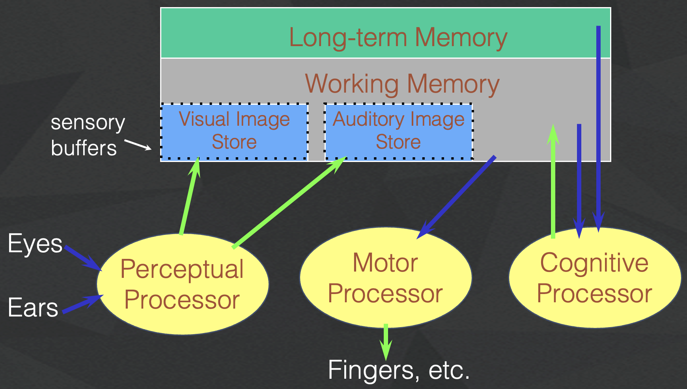
What is missing from MHP?
Haptic memory
for touch
Moving from sensory buffers (memory) to WM
attention filters stimuli & passes to WM
Moving from WM to LTM
elaboration
Notes:
Perception of Touch… Other senses as well: Smell… Taste….
moving from sensory buffers to WM (attention)
moving from WM to LTM
- elaboration / attention

Slide 38
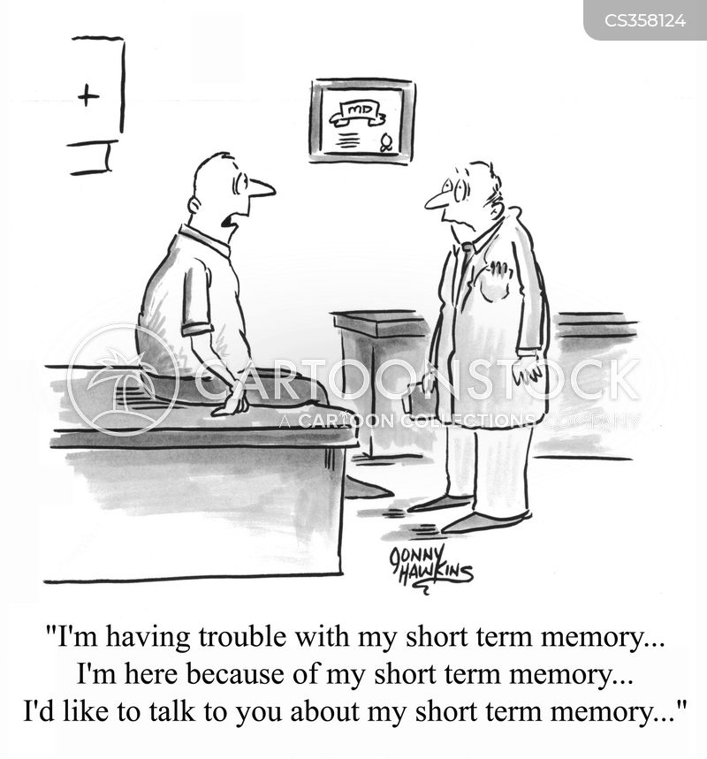
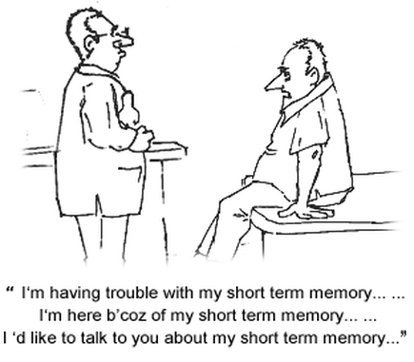
Notes:
Why do we care about memory…
It underlies many of the issues in the usability of visual interfaces
IMAGE: © Jonny Hawkins / CartoonStock

Slide 39
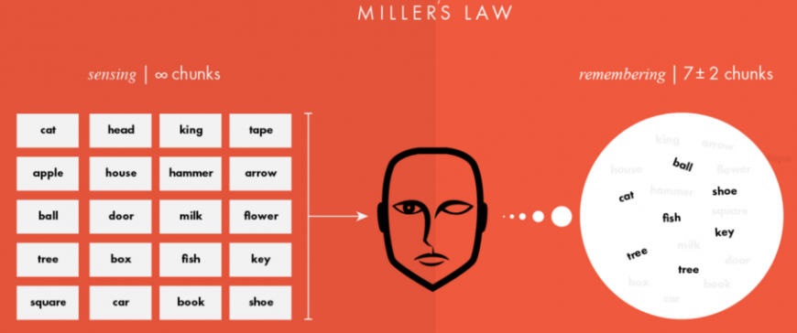
Memory
Working memory (short term)
small capacity (7 ± 2 “chunks”)
6174591765 vs. (617) 459-1765
NBCIBMGMC vs. NBC IBM GMC
rapid access (~70ms) & decay (~200 ms)
pass to LTM after a few seconds of continued storage
Long-term memory
huge (if not “unlimited”)
slower access time (~100 ms) w/ little decay
Notes:
working memory is
- small (7+-2 chunks), fast, but decays quickly
long-term memory is
- huge (unlimited?)
- slower with little/no? decay

Slide 40
MHP Principles of Operation
Recognize-Act Cycle of the CP
on each cycle contents in WM initiate actions associatively linked to them in LTM
executed actions modify the contents of WM
Notes:
How does the MHP operate
recognize-act cycle
- WM initiates actions associatively lined in LTM
- executed actions modify contents of WM

Slide 41
MHP Principles of Operation
Long-term Memory
Working Memory
sensory
buffers
Visual Image
Store
Auditory Image
Store
Eyes
Perceptual
Processor
Motor
Processor
Cognitive
Processor
Ears
Fingers, etc.
Notes:
Let’s see this in action
[ADVANCE]
some operation (like an instruction) goes from working memory to the cognitive processor and is executed
[ADVANCE]
this grabs action linked from the Long-term memory
[ADVANCE]
This is executed or used in an operation and then the result is put back in working memory.

Slide 42
MHP Principles of Operation
Recognize-Act Cycle of the CP
on each cycle contents in WM initiate actions associatively linked to them in LTM
executed actions modify the contents of WM
Discrimination Principle
retrieval is determined by candidates that exist in memory relative to retrieval cues
interference by strongly activated chunks

Slide 43
Motor Processor Experiment
Task: Quickly tap each target 50 times accurately
Conditions:
Two ½” diameter targets 6” apart
Two ½” diameter targets 24” apart
Two 2” diameter targets 24” apart
Two 2” diameter targets 24” apart (no accuracy required)
Turn to neighbor: discuss what will happen
Notes:
Ok let's talk about motor processsing: Draw two circles on the board
both around 1/2 inches in diameter
1) distance of 6 inches
2) Repeat by extending the distance to 24 inches
Ask volunteer to put mark in circle 50 times each quickly, but accurately (outside of circle at most 4 times)
Now do it 24" apart and still 1" diameter
TURN to a partner and discuss what you think will happen and WHY????
ID=Log2(d/w+1) : try easy ID of 4 and hard of ID 8
log2 (13)=3.7
Log2 (49)=5.6
Now try it again with 24 inches but make the target 2 inches wide
3) log2 (13)=3.7
Now try again asking the person to go as fast as they can independent of accuracy (should get more speed but see spread of circles outside)
Results:
1) 18s
2) 30s
3) 22s
4) 16s
Last year:
30 sec
48 sec
31 sec (as predicted, almost the same as #1)
21 sec (lots of spread)

Slide 44
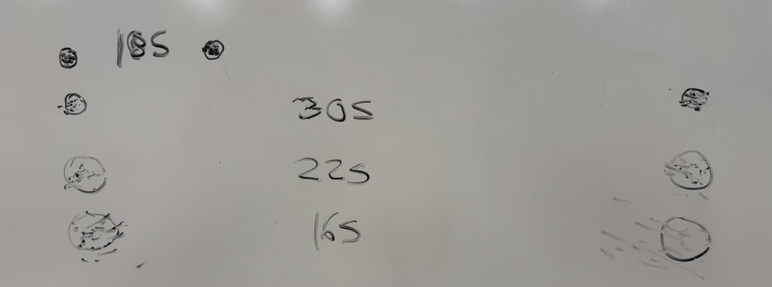
Experimental Results (2025au)
Task: Quickly tap each target 50 times accurately
Notes:
Draw two circles on the board
both around 1/2 inches in diameter
1) distance of 6 inches
2) Repeat by extending the distance to 24 inches
Ask volunteer to put mark in circle 50 times each quickly, but accurately (outside of circle at most 4 times)
TURN to a partner and discuss what you think will happen and WHY????
ID=Log2(d/w+1) : try easy ID of 4 and hard of ID 8
log2 (13)=3.7
Log2 (49)=5.6
Now try it again with 24 inches but make the target 2 inches wide
3) log2 (13)=3.7
) Now try again asking the person to go as fast as they can independent of accuracy (should get more speed but see spread of circles outside)
Results:
30 sec
48 sec
31 sec (as predicted, almost the same as #1)
21 sec (lots of spread)

Slide 45
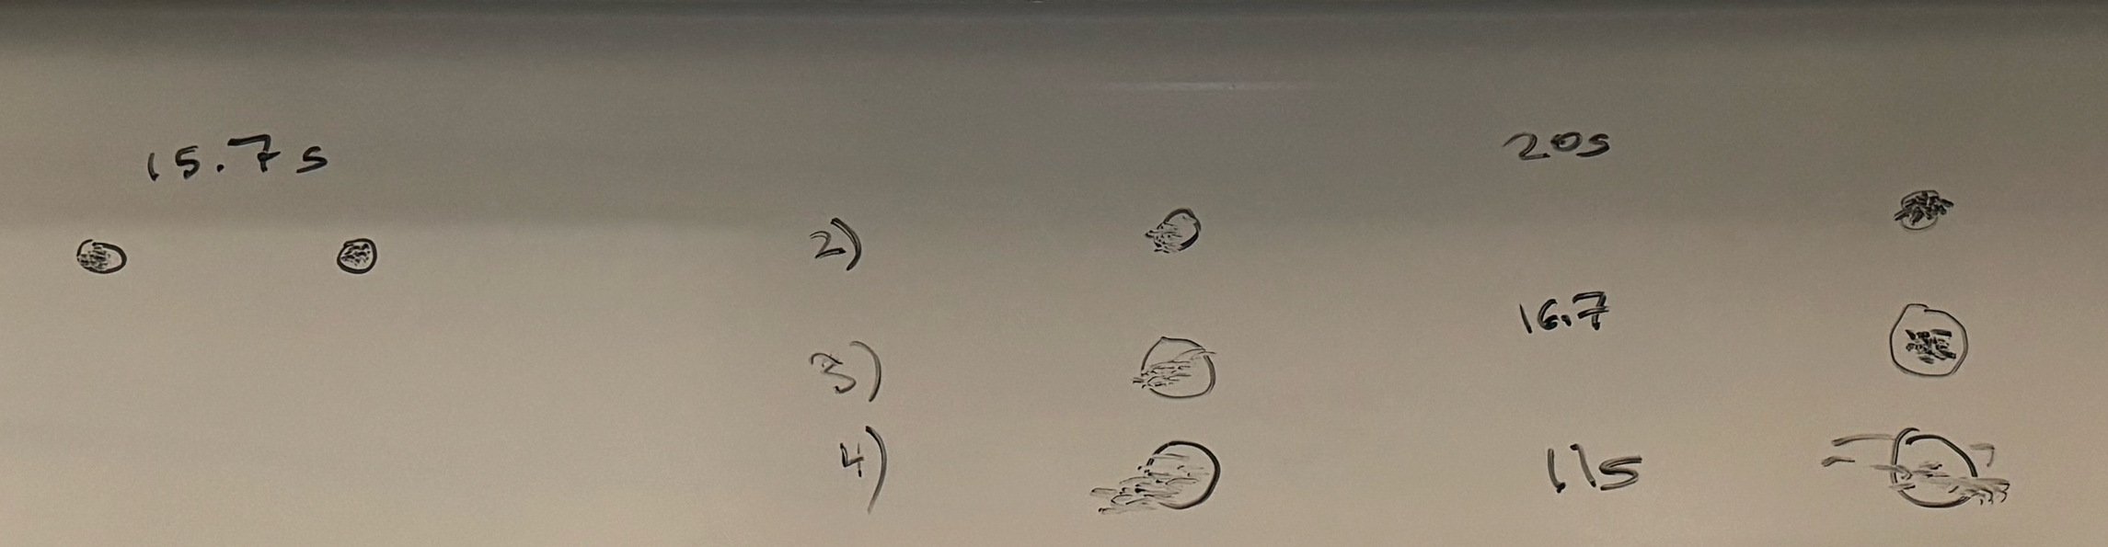
Experimental Results (2024au)
Task: Quickly tap each target 50 times accurately
Notes:
Draw two circles on the board
both around 1/2 inches in diameter
1) distance of 6 inches
2) Repeat by extending the distance to 24 inches
Ask volunteer to put mark in circle 50 times each quickly, but accurately (outside of circle at most 4 times)
TURN to a partner and discuss what you think will happen and WHY????
ID=Log2(d/w+1) : try easy ID of 4 and hard of ID 8
log2 (13)=3.7
Log2 (49)=5.6
Now try it again with 24 inches but make the target 2 inches wide
3) log2 (13)=3.7
) Now try again asking the person to go as fast as they can independent of accuracy (should get more speed but see spread of circles outside)
Results:
30 sec
48 sec
31 sec (as predicted, almost the same as #1)
21 sec (lots of spread)

Slide 46
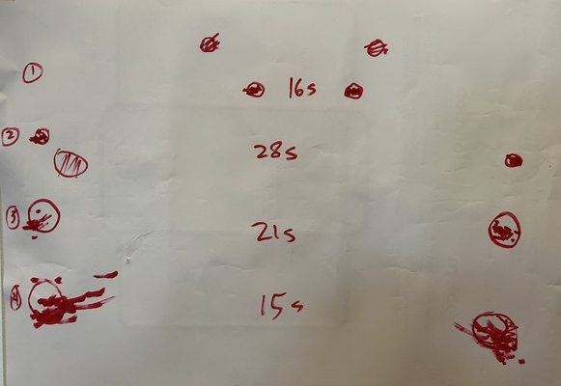
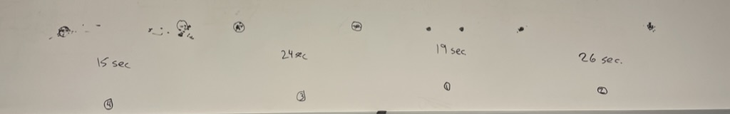
Experimental Results (2023au)
Task: Quickly tap each target 50 times accurately
Notes:
Draw two circles on the board
both around 1/2 inches in diameter
1) distance of 6 inches
2) Repeat by extending the distance to 24 inches
Ask volunteer to put mark in circle 50 times each quickly, but accurately (outside of circle at most 4 times)
TURN to a partner and discuss what you think will happen and WHY????
ID=Log2(d/w+1) : try easy ID of 4 and hard of ID 8
log2 (13)=3.7
Log2 (49)=5.6
Now try it again with 24 inches but make the target 2 inches wide
3) log2 (13)=3.7
) Now try again asking the person to go as fast as they can independent of accuracy (should get more speed but see spread of circles outside)
Results:
30 sec
48 sec
31 sec (as predicted, almost the same as #1)
21 sec (lots of spread)

Slide 47
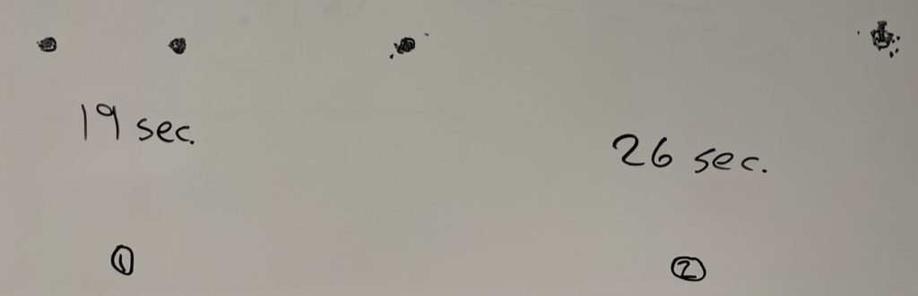
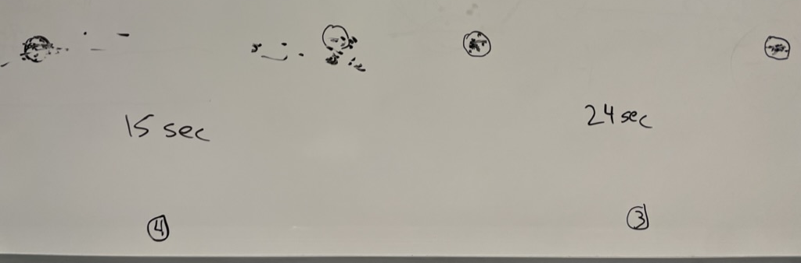
Experimental Results (last year)
Task: Quickly tap each target 50 times accurately
Notes:
Draw two circles on the board
both around 1/2 inches in diameter
1) distance of 6 inches
2) Repeat by extending the distance to 24 inches
Ask volunteer to put mark in circle 50 times each quickly, but accurately (outside of circle at most 4 times)
TURN to a partner and discuss what you think will happen and WHY????
ID=Log2(d/w+1) : try easy ID of 4 and hard of ID 8
log2 (13)=3.7
Log2 (49)=5.6
Now try it again with 24 inches but make the target 2 inches wide
3) log2 (13)=3.7
) Now try again asking the person to go as fast as they can independent of accuracy (should get more speed but see spread of circles outside)
Results:
30 sec
48 sec
31 sec (as predicted, almost the same as #1)
21 sec (lots of spread)

Slide 48
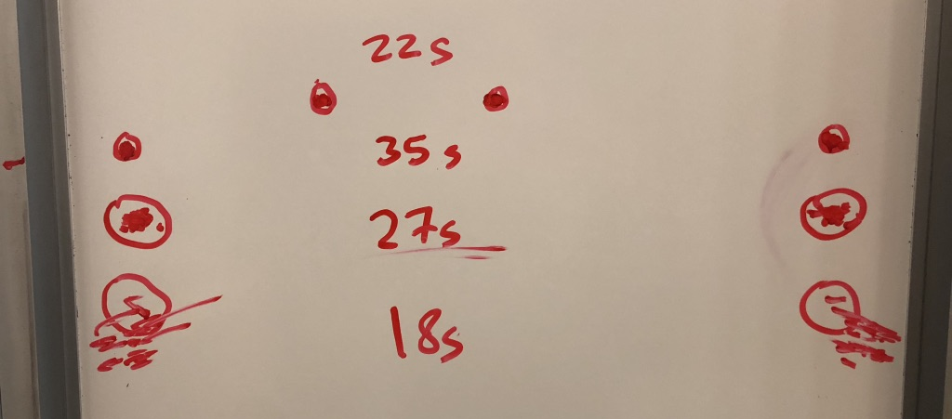
Experimental Results (pre-covid)
Task: Quickly tap each target 50 times accurately
Notes:
Draw two circles on the board
both around 1/2 inches in diameter
1) distance of 6 inches
2) Repeat by extending the distance to 24 inches
Ask volunteer to put mark in circle 50 times each quickly, but accurately (outside of circle at most 4 times)
TURN to a partner and discuss what you think will happen and WHY????
ID=Log2(d/w+1) : try easy ID of 4 and hard of ID 8
log2 (13)=3.7
Log2 (49)=5.6
Now try it again with 24 inches but make the target 2 inches wide
3) log2 (13)=3.7
) Now try again asking the person to go as fast as they can independent of accuracy (should get more speed but see spread of circles outside)
Results:
30 sec
48 sec
31 sec (as predicted, almost the same as #1)
21 sec (lots of spread)

Slide 49
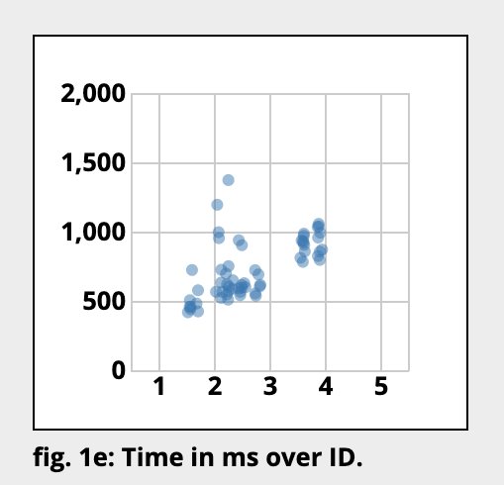
If we plot the data…
Index of Difficulty: ID = log (D/W) + 1
D = distance to target, W = width of target (or size)

Slide 50
Run This Experiment On Your Own
http://simonwallner.at/ext/fitts/
Notes:
I go to the link and show them
-- then say:
take a minute to do this and then stop after 4-5 rounds and take a look at the graphs below

Slide 51
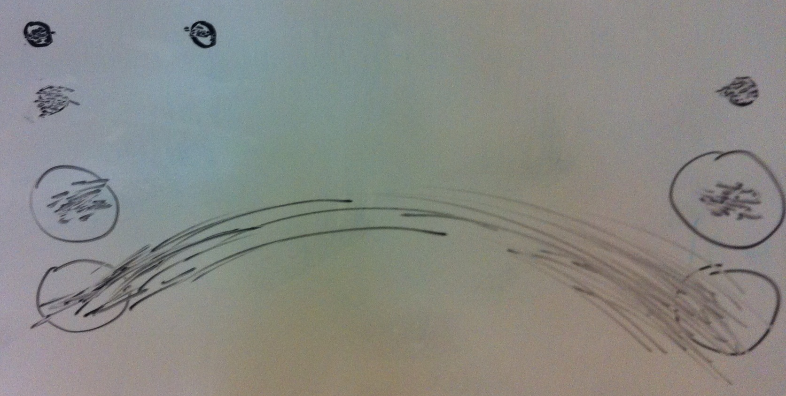
Experimental Results (2 years ago)
Task: Quickly tap each target 50 times accurately
30 sec
48 sec
31 sec
21 sec (lots of spread)
Notes:
Draw two circles on the board
both around 1/2 inches in diameter
1) distance of 6 inches
2) Repeat by extending the distance to 24 inches
Ask volunteer to put mark in circle 50 times each quickly, but accurately (outside of circle at most 4 times)
TURN to a partner and discuss what you think will happen and WHY????
ID=Log2(d/w+1) : try easy ID of 4 and hard of ID 8
log2 (13)=3.7
Log2 (49)=5.6
Now try it again with 24 inches but make the target 2 inches wide
3) log2 (13)=3.7
) Now try again asking the person to go as fast as they can independent of accuracy (should get more speed but see spread of circles outside)
Results:
30 sec
48 sec
31 sec (as predicted, almost the same as #1)
21 sec (lots of spread)

Slide 52
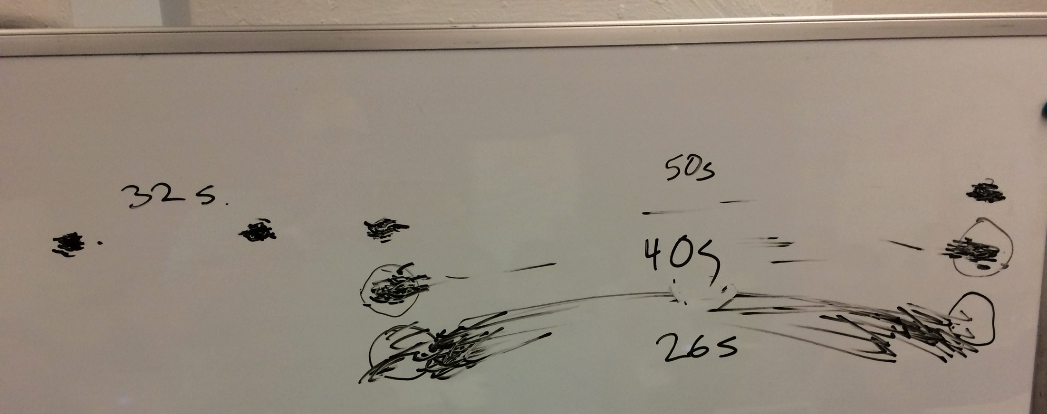
Experimental Results (3 years ago)
Task: Quickly tap each target 50 times accurately
Notes:
Draw two circles on the board
both around 1/2 inches in diameter
1) distance of 6 inches
2) Repeat by extending the distance to 24 inches
Ask volunteer to put mark in circle 50 times each quickly, but accurately (outside of circle at most 4 times)
TURN to a partner and discuss what you think will happen and WHY????
ID=Log2(d/w+1) : try easy ID of 4 and hard of ID 8
log2 (13)=3.7
Log2 (49)=5.6
Now try it again with 24 inches but make the target 2 inches wide
3) log2 (13)=3.7
) Now try again asking the person to go as fast as they can independent of accuracy (should get more speed but see spread of circles outside)
Results:
30 sec
48 sec
31 sec (as predicted, almost the same as #1)
21 sec (lots of spread)

Slide 53
Principles of Operation (cont.)
Fitts’ Law
moving hand is a series of microcorrections
correction takes Tp + Tc + Tm = 240 msec
time Tpos to move the hand to target size S, which is distance D away is given by:
Tpos = a + b log2 (D/S + 1)
summary
time to move hand depends only on the relative precision (D/S) required
Notes:
So what’s going on here.
Fitts’ Law
Understand both D/S and relative position.
further distance takes longer.
smaller target takes longer.
and vice versa -> closer and larger target is faster to hit.

Slide 54
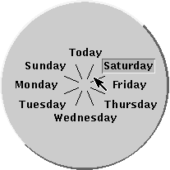
Fitts’ Law Example
Pop-up Linear Menu
Pop-up Pie Menu
Today
Sunday
Monday
Tuesday
Wednesday
Thursday
Friday
Saturday
Which will be faster on average?
pie menu (bigger targets & less distance)
Notes:
linear menu. standard. mouse pops up at first item and you move to desired item and let mouse up to select it.
pie menu: mouse starts in center and let up button in select slice.
pie slices extend to outer edge of screen
Which will be faster on average? why?
[ADVANCE]
answers

Slide 55
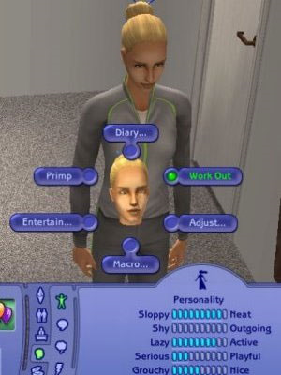
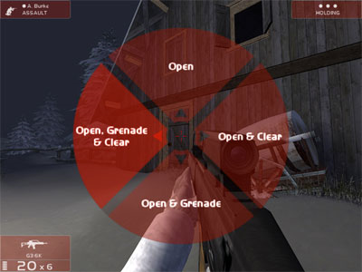
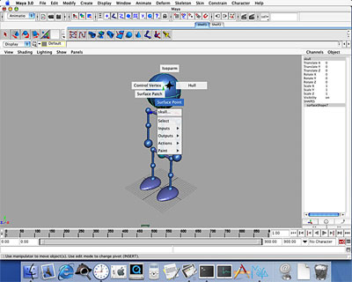
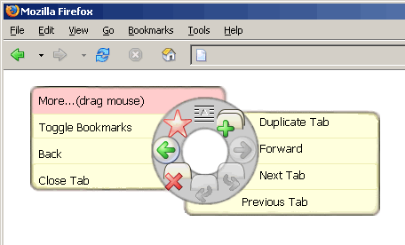
Pie Menus in Use Today
The Sims
Rainbow 6
Firefox
Maya
Notes:
Some from the past

Slide 56
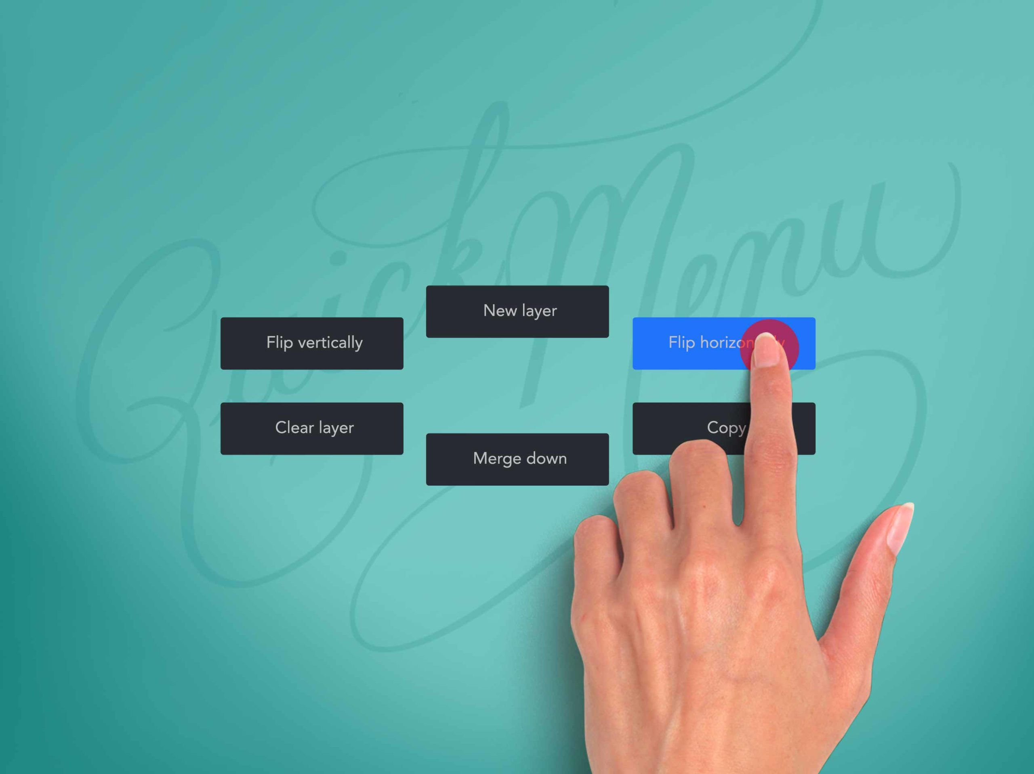
Procreate QuickMenu (2020-present)
Radial menu for fast tool access on iPad
Notes:
Some more recent

Slide 57
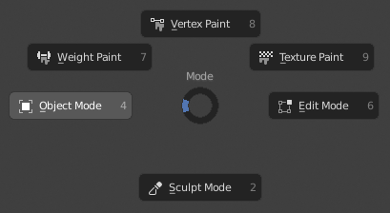
Blender Pie Menus (2019-present)
Radial UI for faster modeling workflow

Slide 58
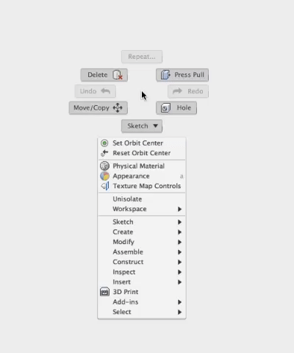
Fusion 360 Marking Menu (c. 2014-present)
CAD radial gesture menu for 3D modeling

Slide 59
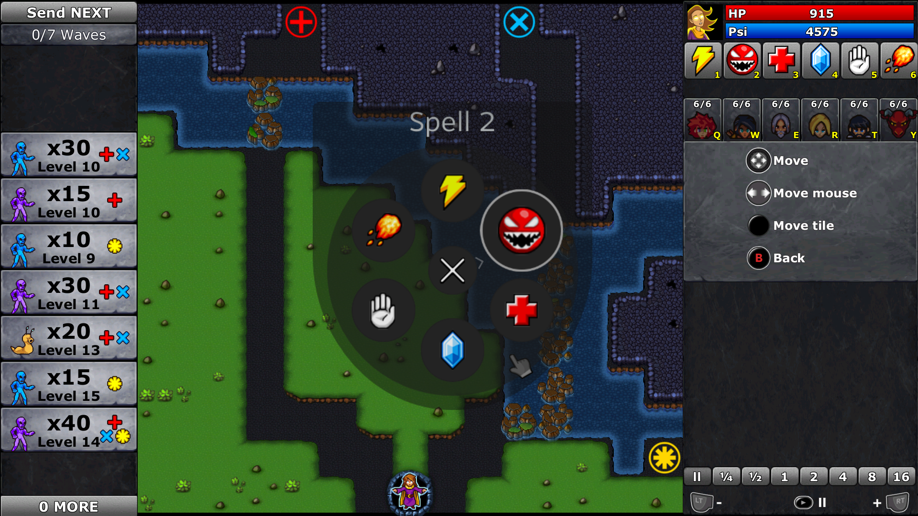
Steam Input Radial Menu (2016-present)
Controller radial menu system for games
Notes:
In many pieces of software, but still haven’t reached ubiquity… why?

Slide 60
Apple Watch Is a Negative Fitts’ Law Example
Notes:
Very hard to accurately tap on icons… leads to errors… example of Fitts’ Law in action
[ADVANCE]
RECENTLY, …

Slide 61
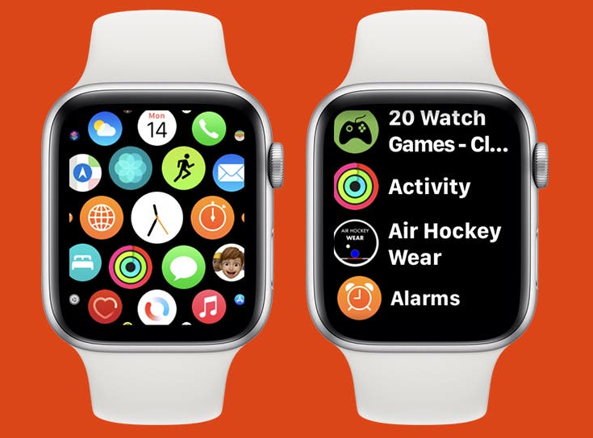
Apple Watch Is a Negative Fitts’ Law Example
Notes:
they redesigned it to go through more of a linear menu (on the right), that is easier to select without error (but doesn’t hold as much information on the screen at once).

Slide 62
Volunteer for Experiment
https://faculty.washington.edu/chudler/java/ready.html

Slide 63
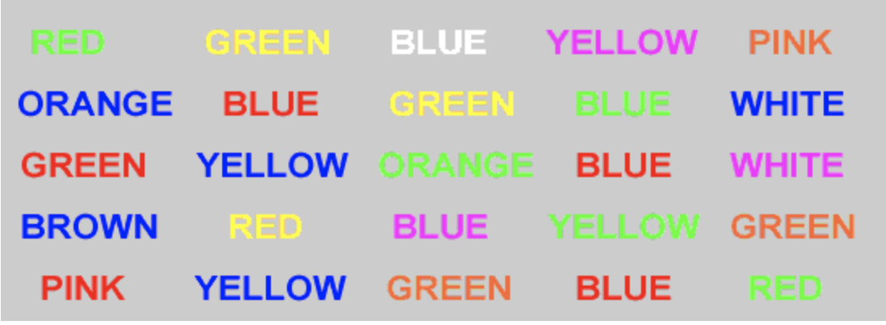
Volunteer for Experiment
Stroop Effect
interference in your working memory
Notes:
This is known as the Stroop Effect. It is a great example of interference in your working memory.
Why are we learning this?
Imagine making icons or labels in your user interface that have interfering triggers into your memory. E.g., a “green” button for cancel? Or a label that says “X” in one place and “Y” in another.

Slide 64
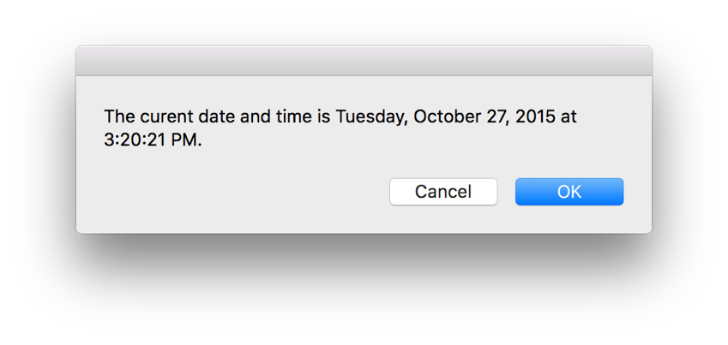
Memory Interference in Action: Cultural
Notes:
Here is the default OSX Dialog box.
What if instead it looked like this? What errors might occur?
[ADVANCE]

Slide 65
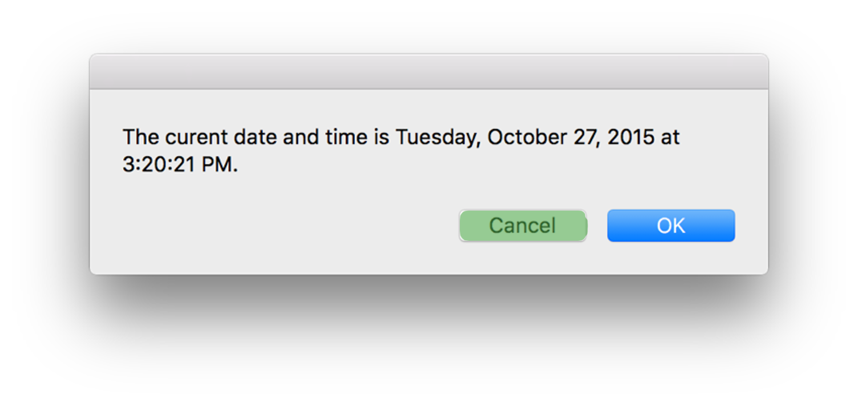
Memory Interference in Action: Cultural
Notes:
What errors might occur?
Green implies Yes or Good in western culture. That color could interfere with the word “Cancel” and cause errors.

Slide 66
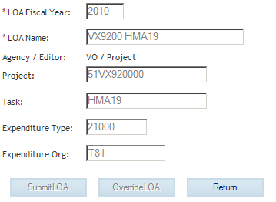
Memory Interference in Action: Labels/Terms
Notes:
Or what if there is interference with what labels normally mean. In this accounting application, “Return” means the same as “Cancel”. But for most people, this is not necessarily what “Return” might mean.
https://www.uxmatters.com/mt/archives/2010/07/achieving-and-balancing-consistency-in-user-interface-design.php

Slide 67
Simple Experiment
Volunteer
Start saying colors you see in list of words
when slide comes up
as fast as you can
Say “done” when finished
Everyone else time it…

Slide 68
Paper
Home
Back
Schedule
Page
Change

Slide 69
Simple Experiment
Do it again
Say “done” when finished

Slide 70
Bandana
Forward
Home
Test
Basket
Paper

Slide 71
Simple Experiment
Do it again
Say “done” when finished

Slide 72
Yellow
White
Black
Blue
Red
Green

Slide 73
Memory
Interference
two strong cues in working memory
link to different chunks in long term memory
Why learn about memory?
know what’s behind many HCI techniques
helps you understand what users will “get”
aging population of users

Slide 74


Design UIs for Recognition over Recall
Recall
info reproduced from memory
e.g., command name & semantics
Recognition
presentation of info provides knowledge that info has been seen before
e.g., command in menu reminds you
easier because of cues to retrieval
cue is related to item or situation learned in
e.g., hints, icons, labels, menu names, etc.

Slide 75
Human Abilities Summary
Color can be helpful, but pay attention to
how colors combine
limitations of human perception
people with color deficiency
Model Human Processor
perceptual, motor, cognitive processors + memory
model allows us to make predictions
Memory
three types: sensory, WM & LTM
interference can make hard to access LTM
cues in WM can make it easier to access LTM
Key time to remember from MHP: ~100 ms cycle time & memory access time

Slide 76
Further Reading Vision and Cognition
Books
The Psychology Of Human-Computer Interaction, by Card, Moran, & Newell, Erlbaum, 1983
Human-Computer Interaction, by Dix, Finlay, Abowd, and Beale, 1998.
Perception, Irvin Rock, 1995.
Pages 66-99 of “Cognitive Aspects in Interaction Design”, from Interaction Design, 3rd Edition by Rogers, Sharp, & Preece
Applying Fitts’ Law to Mobile Interface Design by Justin Smith

Slide 77
Next Time
Lecture
Visual Information Design
Watch Scott Klemmer’s HCIOnline lectures:
6.1 Visual Design (7:37)
6.2 Typography (10:47)
6.3 Grids & Alignment (17:33)
Studio
Low-fi presentations – what was surprising???
Sketching/Visual Design Exercise

