Slide 1

FoodWise
A8: High-fi Prototype
NaYoung, Mai, Ava, Elton

Slide 2
Presentation Outline
Meet the Team
Problem/Solution
Heuristic Evaluation Results
UI Revisions
Usability Goals
Prototype Implementation
Demo

Slide 3
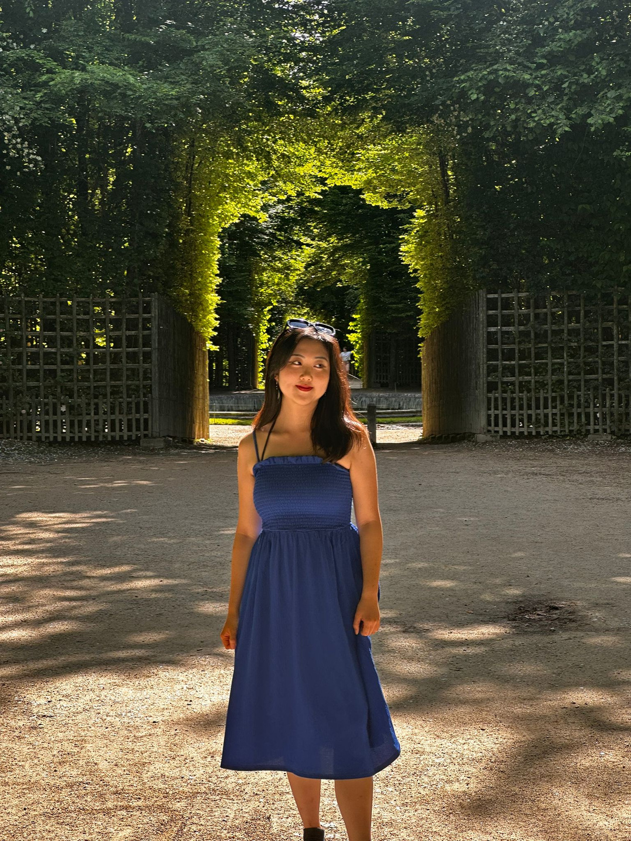
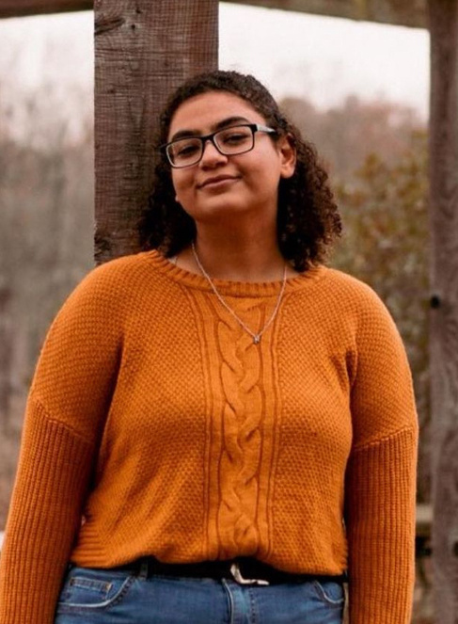


Meet the Team
NaYoung Son
Mai Mostafa
Ava Love
Elton Manchester

Slide 4
Problem
  Eating Disorder is stigmatized and specialized therapy is often inaccessible
  Despite its commonality, ED is not viewed on the same tangent with other mental health topics

Slide 5
Solution
  Cute visuals, interactive features, and game-like elements make recovery fun
  Stage-based process for structured support
  Personalized recovery toolbox to build coping mechanisms and maintain growth

Slide 6
1) Heuristic Evaluation
Results

Slide 7

HE Results Overview
General HE Takeaways: What They Liked
74 Total Violations
  Cute/fun/pleasant UI
  Most tasks easy to navigate (after exploring the roadmap)
  Focuses user energy on themselves and their recovery journey
General HE Takeaways: What They Didn’t Like
  Need to simplify terminology
  Improve consistency of design (buttons, etc.)
  Include error prevention and recovery mechanisms given nonlinear nature of EDs
11 Total Changes

Slide 8
HE Results
Simplified the Survey
6 Violations for
Severity 3-4
  Reduced Questions in Introduction Survey
  Sparser text in the Survey speech bubbles
Added/Changed Buttons
  Toolbox: added a button to delete tool
  All: added (?) button to provide information
  Changed the icon for Quick Help (!) to siren
6 Changes
Clearer Instructions for Tasks
  Simplified visual elements in background
  Added a short tutorial at the beggining

Slide 9
HE Results
Consistent Design
12 Violations for
Severity 1-2
  Removed Shape/Outline for Headers so that it doesn’t look like a button
  Consistent button design: same color, black outline, same shapes
Added/Changed Buttons
  Added a save button for Tracker
5 Changes
(comments were redundant + some due to limitations in Figma implementation)
Clearer Instructions for Tasks
  Added a brief tutorial to explain where each functions (tracker, toolbox, etc.) are located
  Added (?) information buttons across the pages to clarify how to unlock levels

Slide 10

Most Common Violations
H4: Consistency & Standards (4)
Inconsistent Button Designs
Some Text Boxes look like Buttons
H10: Help & Documentation (2)
Lack clear instruction in the beginning regarding how to navigate and unlock levels
H8: Aesthetic & Minimalist Design (2)
Some pages are visually overwhelming and distracting

Slide 11
2) Revised Design

Slide 12
Issue 1:
Survey is too long and visually overwhelming
Simplified the Survey
  Reduced Questions in Introduction Survey
  Sparser text in the Survey speech bubbles
  Removed the picture frames in the background to reduce unnecessary visual elements so users don’t get distracted
  Makes survey less burdensome and more pleasant experience
Violation of
H8: Aesthetic & Minimalist Design

Slide 13
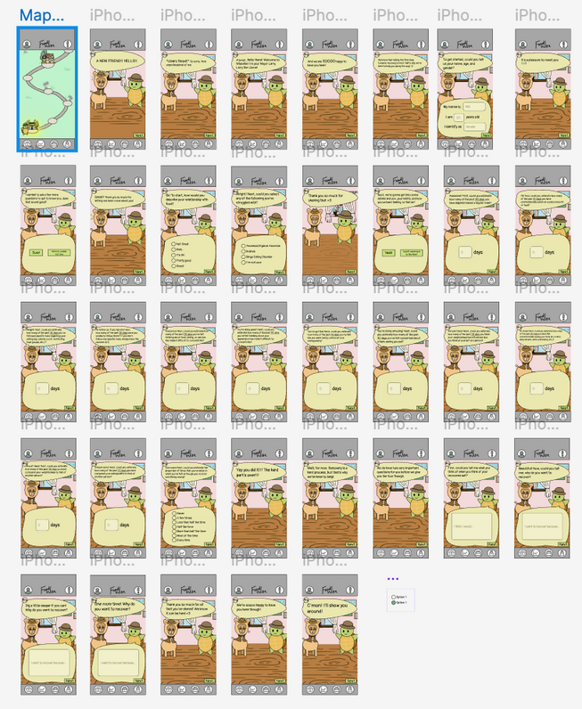

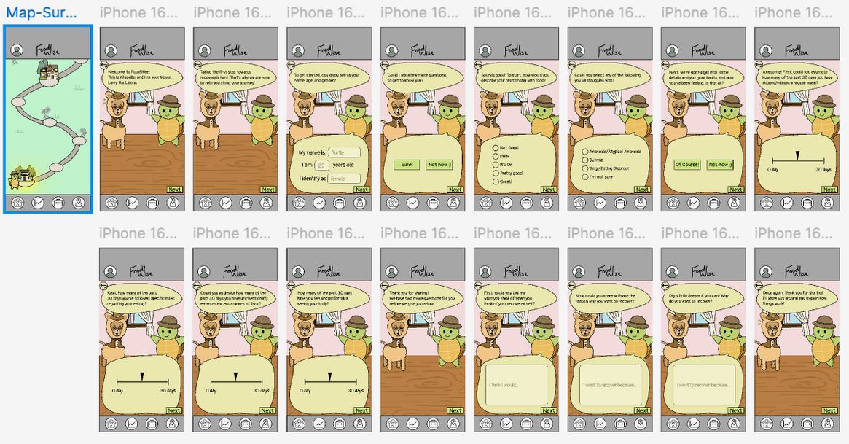
Revised Survey
After
Before

Slide 14
Issue 2:
Some Buttons and Textboxes are indistinguishable
Consistent Button Design
  Removed Shape/Outline for Headers so that it doesn’t look like a button
  Unified button design: same color, black outline, same shapes
  Incorporating more consistency in designs helps reduce user confusion and user errors
  This will in turn create a more pleasant and easy user experience
Violation of
H4: Consistency & Standards

Slide 15
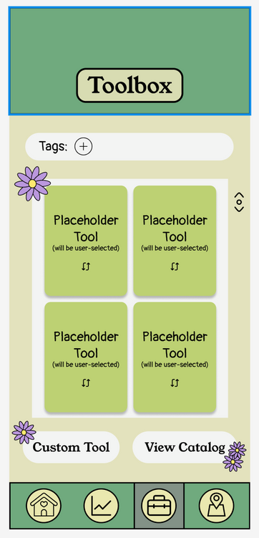
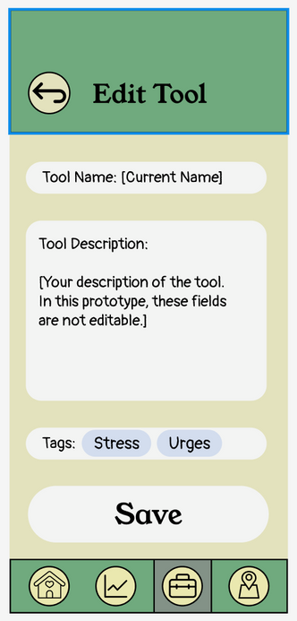

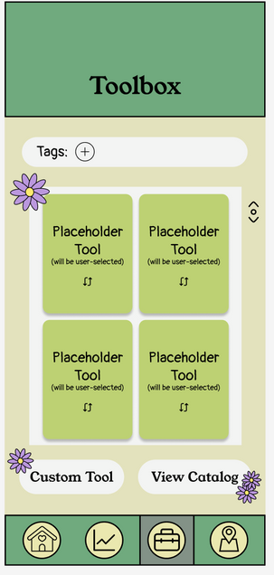
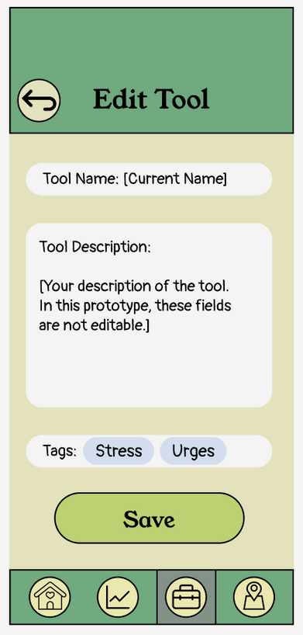
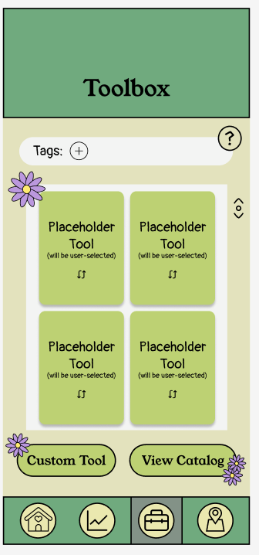
Revised Buttons + Textboxes
Before:
After:
Header Designs
Buttons: Green Fill + Black Outlines

Slide 16
Issue 3:
Lack of clear instructions for how to complete tasks
Present More Information
  Added a brief introduction tutorial that explains what each of the pages contains
    Option to skip to give more control for the users when navigating tasks
    Can revisit this information on the information pop-up in each page
  Added an information (?) button in each main page (present in home page, tracker, toolbox, map, and quick help)
    Quick, simple access as it doesn’t take the user to a separate page
Violation of
H10: Help & Documentations

Slide 17
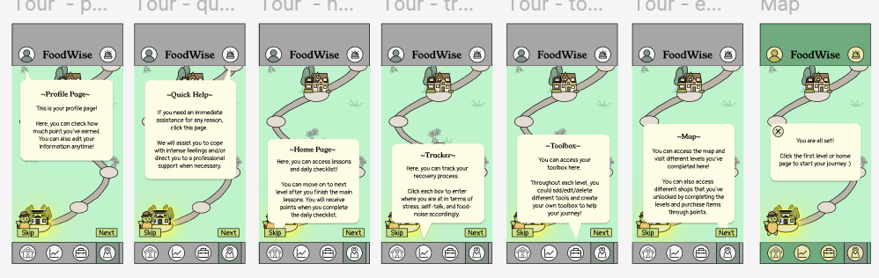
Brief Tutorial

Slide 18
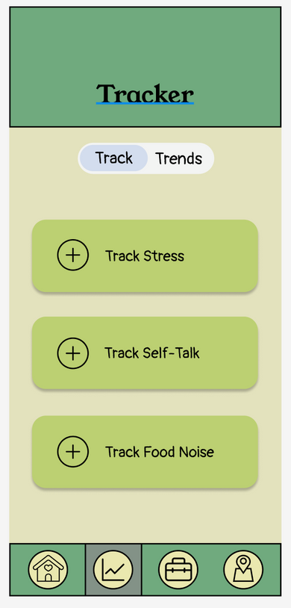
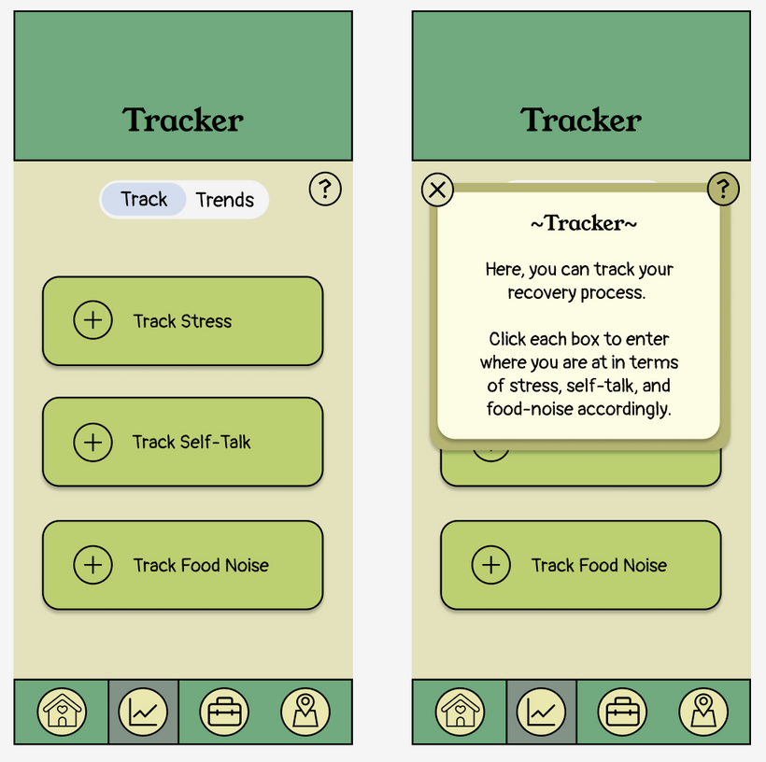
Information
Pop-up for the
5 main pages

Slide 19
Overall...
  Simplified word phrasings and visual designs for clarity and aesthetic purposes
  Consistent design to clearly distinguish interactive buttons and text bubbles
  Added more save and delete buttons and to improve user control over task flow
  Added tutorial and information pop-up to provide clear instructions for smoother user experience

Slide 20
3) Usability Goals

Slide 21
Usability Goal #1
Intuitive navigation and features
  Changed the symbol for the quick help button
  Made button design more consistent
Usability Goal #2
Efficiency and ease of use for tasks
  Scaling down the survey text and requirements for ease of entry
  Providing instructions for each feature
  Providing an introductory tutorial to introduce users to the various features

Slide 22
4) Prototype Implementation

Slide 23




Framework / Tools
Used
React Native
Expo Go
Emulators
  React Native for cross-platform compatibility
  Expo Go and emulators for testing

Slide 24
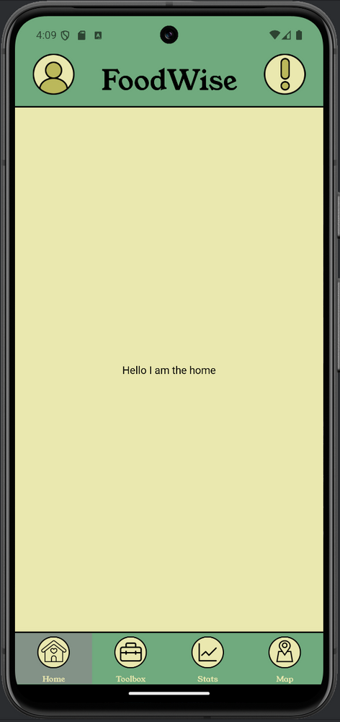
Implemented Features
App Navigation
  Tab bar (always accessible, preserves tab state)
  Consistent palette and styling of action items
  Back buttons on every page other than default screens
Chosen Taskflow:
Toolbox Editing

Slide 25
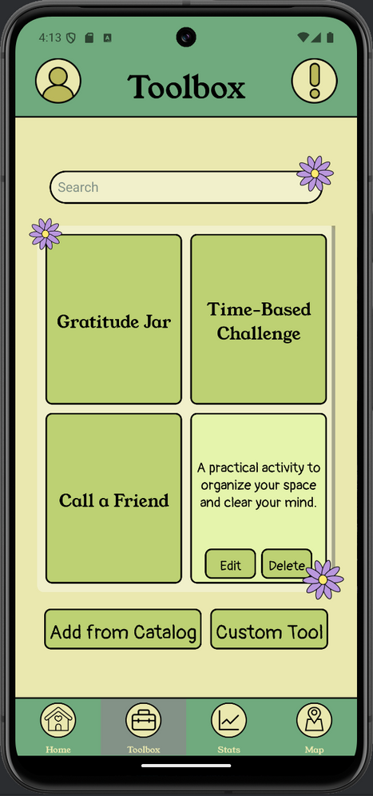
Implemented Features
Toolbox
  Flippable cards
  Ordered by most recent addition
  Search bar
  Premade catalog for easy tool adding
  Custom tools
  Edit/delete tools
  Persistent data
  Back out of any screen
Chosen Taskflow:
Toolbox Editing

Slide 26
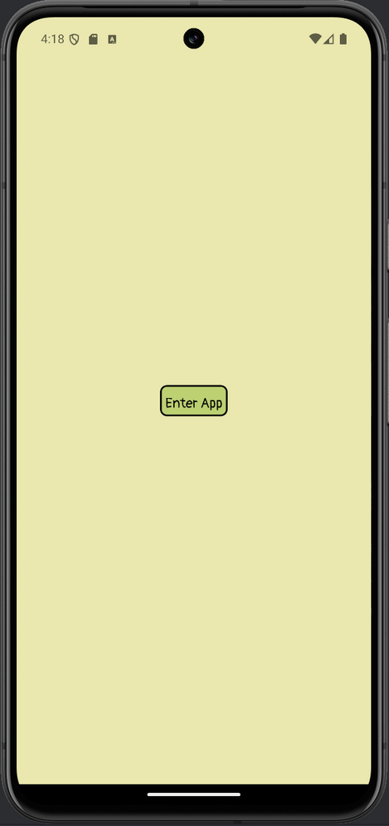
Unimplemented
Features
Remaining Tasks
  Complete the introductory survey about food habits
  Complete a module (including lessons and recurring tasks)
Tasks to still be Implemented

Slide 27
Unimplemented
Features
Extra Functions
  Profile
  Emergency help
  Tracking
  Tags and instruction pages for toolbox
  Guides
*These aren’t required for the tasks, so some of these features may not be fully implemented
Miscellaneous Features

Slide 28
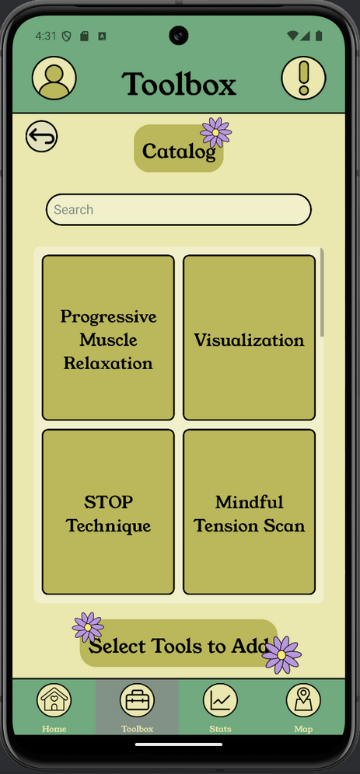
Wizard of Oz / Hardcoded Features
Oz
  Pretends to track whether a user has actually used a tool
  Profile but no account or authentication
Hardcoded
Not much so far!
  Catalog (by design)
  Everything else is customizable

Slide 29
Issues + Questions
Limited Time Frame and Expertise
  Not every feature can be included, so we need to prioritize the necessary features
  The toolbox was very time-consuming; hard to estimate implementation time
  Figma to React Native workflow could be improved
Which is better? A non-functional mockup of an extra feature, or just leaving it out?
Implementation
Priorities

Slide 30
Implementation Plan
The Final Push 😫
Over Break
  Learn how to use React Native
  Finish survey (simplest task, good practice)
  Make progress on A10
Week 10
  Finish A10
  Devote most of the time to the final task and additional features
  Present at the expo!
Happy Thanksgiving

Slide 31
5) Demo

