Slide 1







FoodWise
YOUR ROADMAP TO REAL RECOVERY
Week 6: Medium-Fi Prototyping

Slide 2

Content
Meet the Team
Problem/Solution
Our Design Values
Structure
Autonomy
Growth
Fun
Task Changes
Usability Goals
Revisions
Medium-Fi Task Flows
Prototype Implementation
Our Prototype

Slide 3


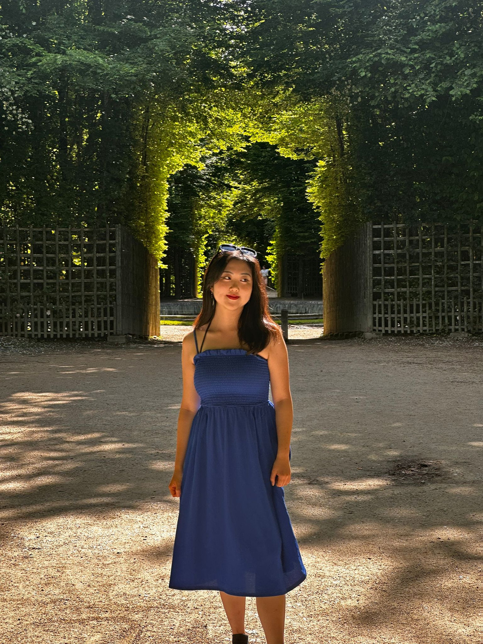
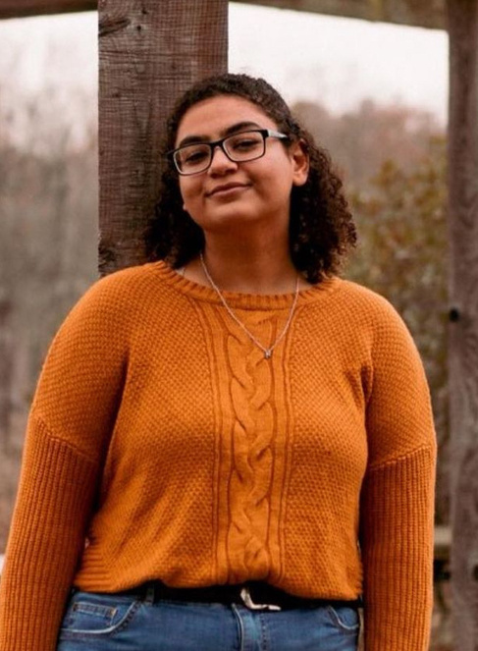


Meet the Team!
Na Young Son
Mai Mostafa
Ava Love
Elton Manchester

Slide 4
  Eating disorders are very difficult to treat on your own
  Therapy for eating disorders is highly inaccessible
  Based on our market research, existing products are intended for use in conjunction with therapy
Problem
  Create an application that seeks to guide the user through recovery in a way that makes it enjoyable. Our value proposition then is to gamify recovery.
Solution

Slide 5
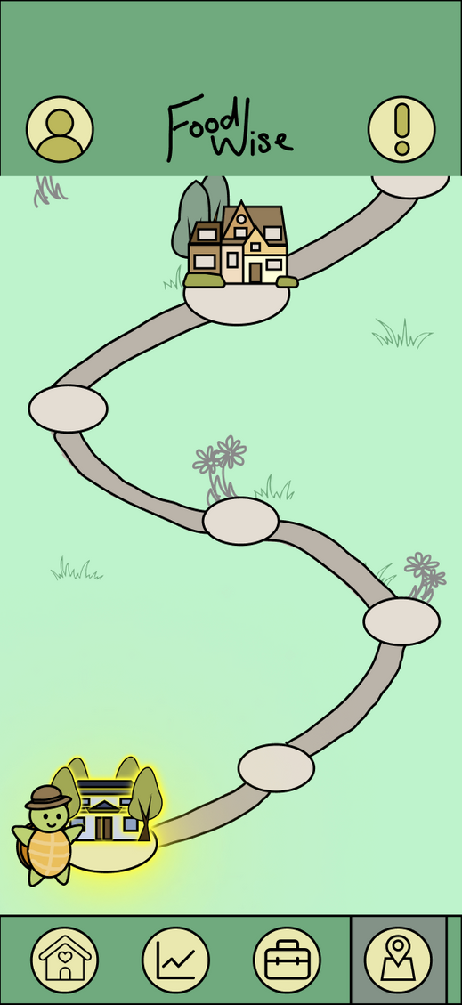
Solution
FoodWise is an app that seeks to guide the user through their recovery in five overarching steps, represented as interactive shops for the user. These are:
  Awareness, Acceptance, and Understanding
  Understanding Triggers and Habits of Emotional Regulation
  Developing New Habits of Emotional Regulation
  Bodily Acceptance and Compassion
  Maintenance
Maintenace is represented as a garden for the user to water regularly. They do this by visiting previous shops and using the skills they’ve learned along the way to maintain their growth.

Slide 6
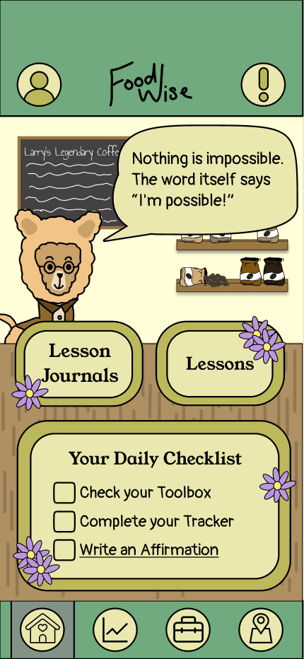
Solution
Each shop has a series of lessons and reflection lesson journals the user can complete to gain points.
As they gain points and complete lessons, they will achieve milestones that allow them to plant a flower in their garden.
Eventually, they will receive enough points to go on to the next stage of their recovery if they so choose.
They can also gain points by completing their daily checklist, and using their toolbox as well as other features that are made to support the user’s journey

Slide 7




Design Values
Structure
Autonomy
Growth
Fun!
  Allows people to see a tangible solution to their problem.
  Empowers the user to regain control of their habits.
  Necessary to instill hope. When you see your progress, you believe it.
  Vital to keep the user motivated to continue their recovery

Slide 8

Structure
Is implemented through the roadmap which guides the user through their recovery in small, manageable steps

Slide 9
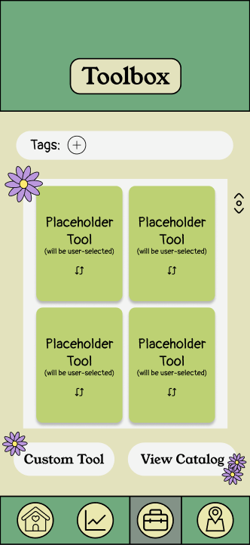
Autonomy
Is emphasized through the toolbox, which helps the user
gain the ability to help themselves on the day to day

Slide 10
Growth
Is given physicality through the garden, as well as being shown through the tracker and the point system

Slide 11
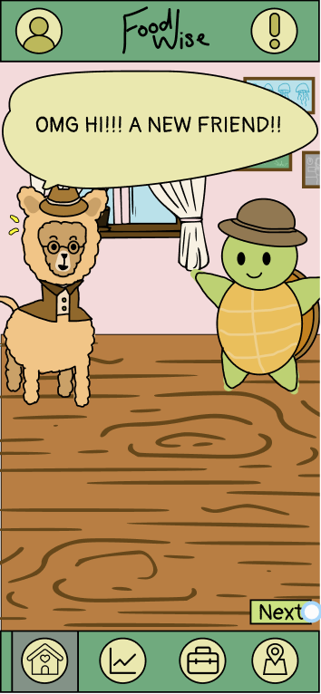
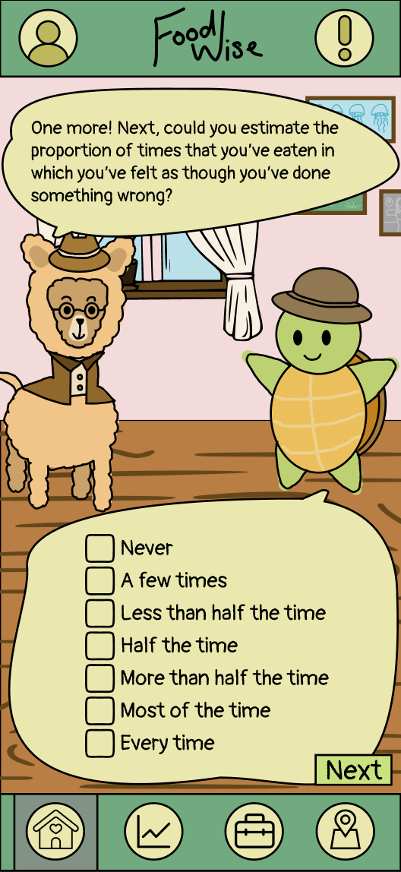
Fun!
Is implemented through it being a game! And a cute one too

Slide 12
Task Changes
Before
After
Task 1 (simple): The Toolbox
Task 1 (simple): The Introductory
Survey
Task 2 (moderate): The First
Module and Tutorial
Task 2 (moderate): The Toolbox
Task 3 (complex): The First Module and Tutorial
Task 3 (complex): Maintenance

Slide 13
Our Usability Goals
Usability Goal #1
Intuitive navigation and features
  User does not need to think about how to reach desired page
  Features require minimal explanation
  Key Measurement #1: Number of clicks required
Usability Goal #2
Efficiency and ease of use for tasks
  Tasks (especially common ones) require a small time investment
  Key Measurement #2: Time taken for each taskflow

Slide 14
Usability Goals Progress
Usability Goal #1
Intuitive navigation and features
  Number of clicks required reduced through fewer screens
  Effective and intuitive navigation bars
Usability Goal #2
Efficiency and ease of use for tasks
  First level taskflow now omits the tutorial, saving time
  Reduction of questions in introductory survey
  Toolbox now has a catalog

Slide 15

Low-fi Revision Sketches

Slide 16
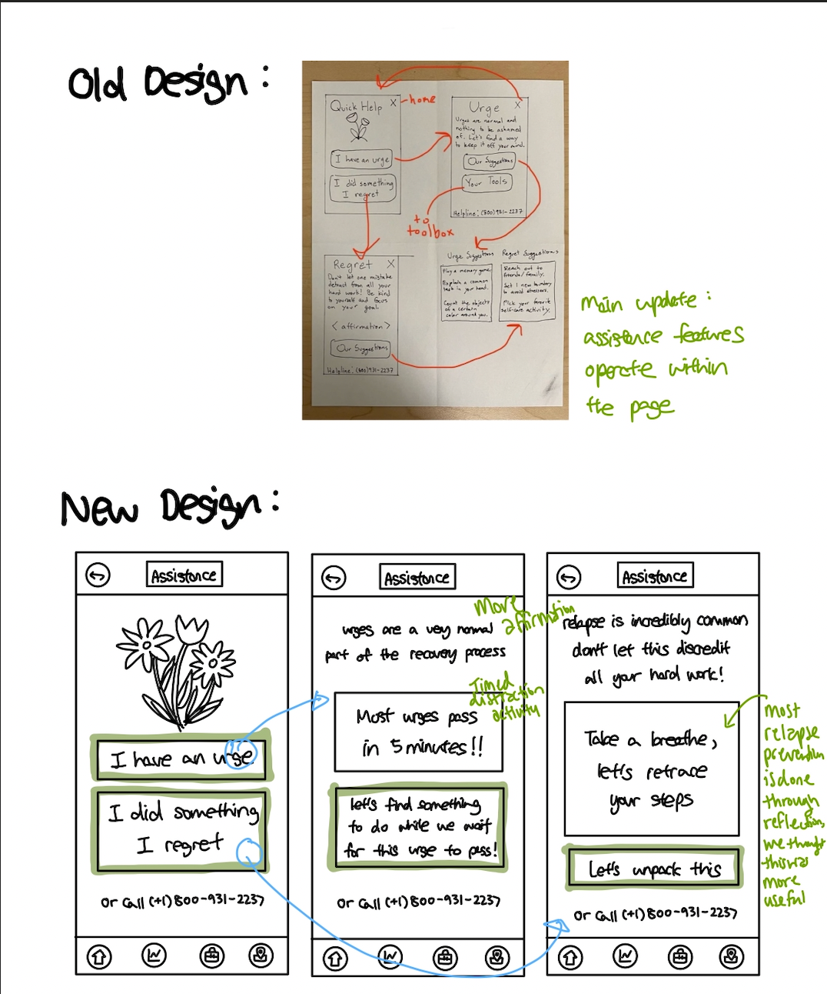
  Changing the Emergency Help Functionality
Previously, the emergency help wasn’t entirely fleshed out. Now, after research, we’ve made it much more helpful for the user by either doing a timed distraction activity for preventing urges or a reflection activity for rehabilitation from relapse. This advances our first usability goal by making the functionality more intuitive

Slide 17
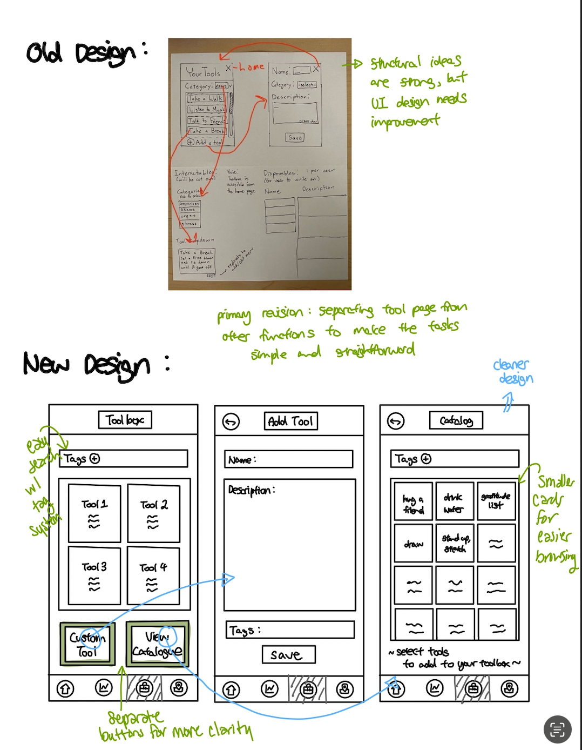
2. Adding a Catalog to the Toolbox
Allows the user to easily search for new tools that may be helpful, making the toolbox less daunting. This advances our second usability goal

Slide 18
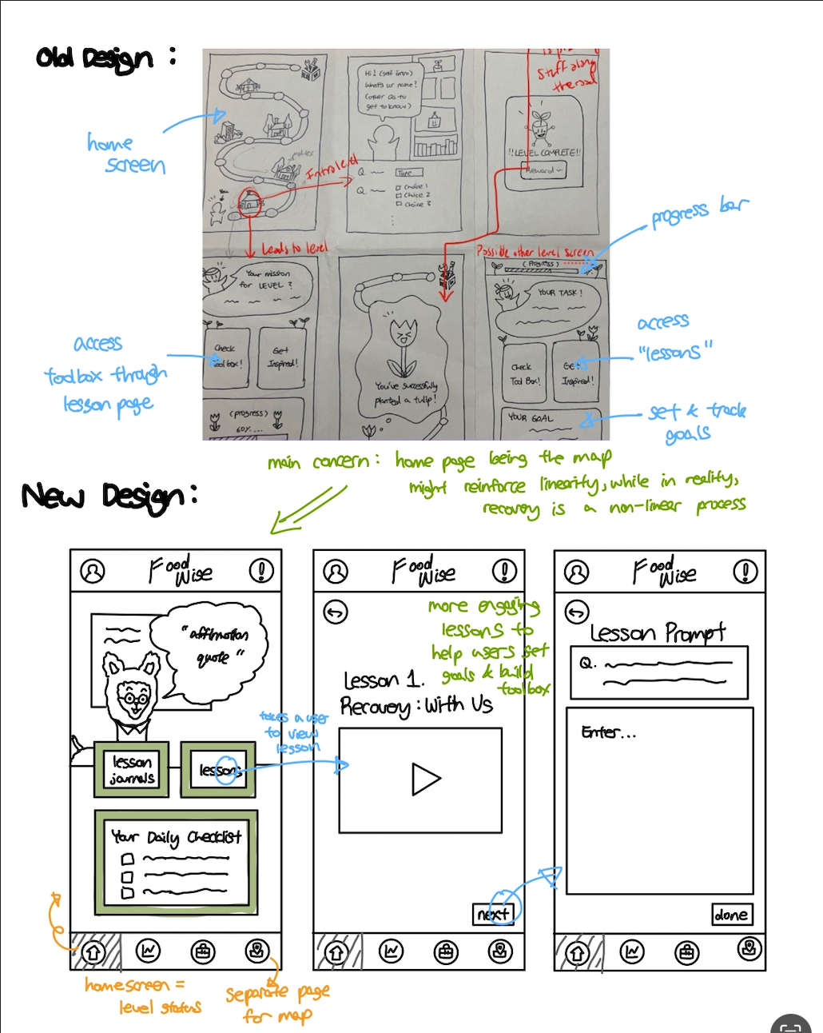
3. Lesson Journals
Actively educates the user and provides them with real knowledge that is immediately applied thereafter. This is much more intuitive than just lessons and another toolbox button, advancing our first usability goal

Slide 19
Task Flows

Slide 20
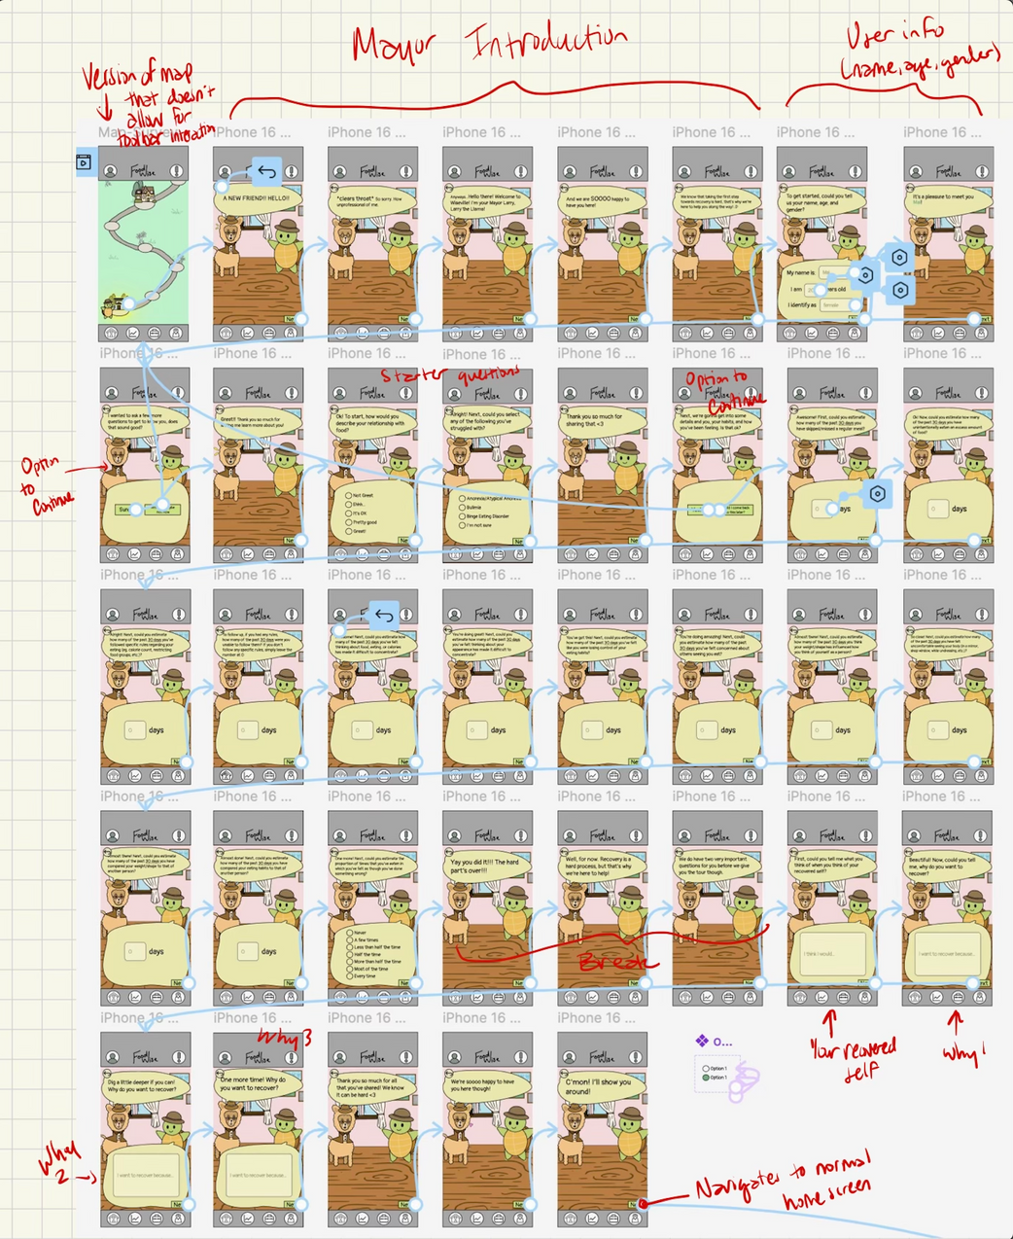
Task 1 (simple): The Introductory Survey

Slide 21
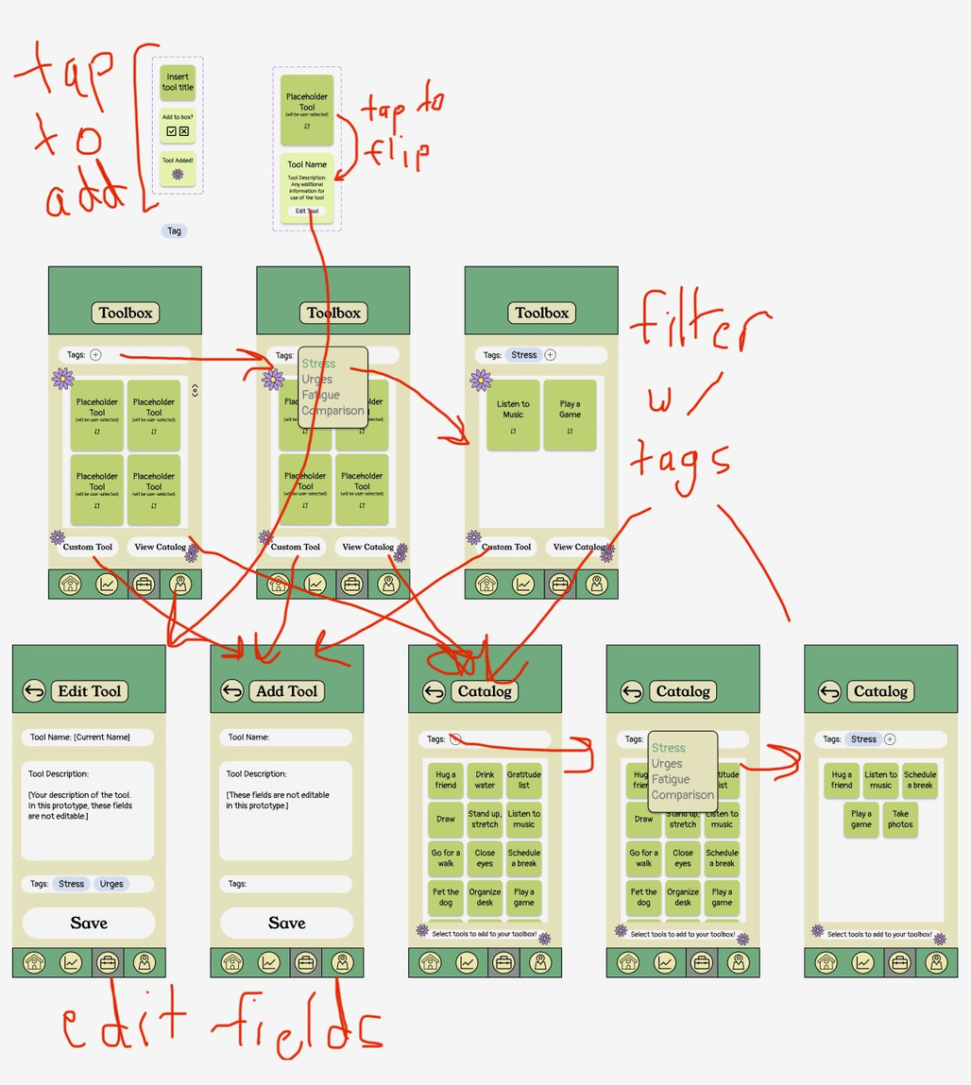
<-- interactive tool components
Task 2 (moderate): The Toolbox
find/add tools from catalog

Slide 22
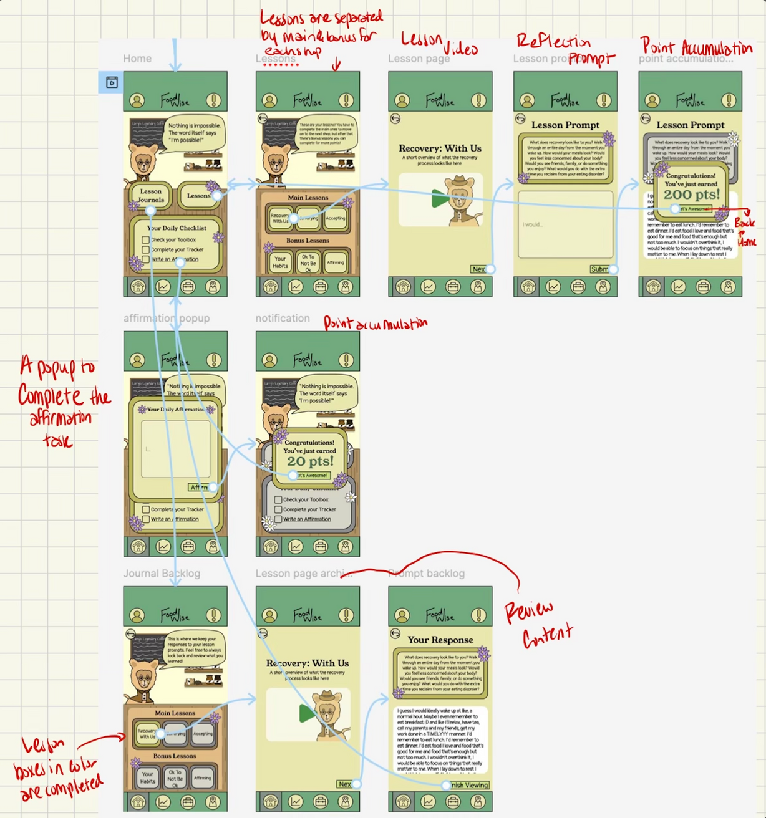
Task 3 (complex): The First Level

Slide 23
Prototype Implementation: Tools
  Made use of various frames to implement scrolling, allowing for a more put together and extensive user experience. However, it is difficult to control in some cases when it stops scrolling
  Implemented multiple choice selection component, however was not able to make it so the user can only select one option
  Implemented a tool card, however it didn’t retain inputted information when flipped to a different side, immediately went back to starter text
  Used a variety of plugins for ease of design (a glowing plugin to make objects glow, an image tracer in order to implement more detailed graphics, an icon-finding plugin for finding icons that look similar but have varying line weights)

Slide 24
Prototype Implementation: Limitations
  Lack of personalization: Because the prototype cannot follow the user over an extended period, most of the personalized features are hard-coded. This makes it difficult to evaluate how effectively it will adapt to users with different needs.
  Limited options: in dropdown menus, there is often only one selectable option. This allows us to show the functionality while only implementing one of the options, helping with prototype efficiency.

Slide 25
Prototype Implementation: Limitations (cont.)
  Lack of in-person accountability/control: Ultimately, there is no human form of the app that can be physically present to keep a user accountable. While we provide education, tools, and tracking abilities to help with recovery, the decisions a user makes in their day-to-day surrounding eating/food is outside of our control.
  Not providing online community: While our app provides essential personal and individual help for ED recovery, a feature it does not include is an online community. While we believe community is important for accountability in recovery, our decision to leave out this feature was due to concerns around privacy, risk of sharing toxic/triggering information, and lack of user engagement due to the inherently sensitive and heavy nature of eating disorders.

Slide 26
Prototype Implementation: Hard Coded Features
  All text inputs (including the intro survey, tool editing, and journaling) are hardcoded. This is helpful for the prototype because it reduces the amount of time the user needs to spend at each screen, and allows them to focus on usability aspects rather than what to enter into the box.
  In the toolbox tag selection, stress is the only selectable option. This allows the prototype to showcase the tag feature while also limiting the scope of the tools that need to be specified.

Slide 27
Prototype Implementation: Wizard-of-Oz Features
  Tracker: Several charts are displayed with magically-generated data. This is necessary because first time users will have no data, so the prototype must pretend the user has been using it for some time.
  Toolbox: the user has some tools magically added for them, even though they did not add any themselves. This is necessary because several features require existing tools to interact with, so the user must already have some in order to experience this.
  Lesson: The one accessible lesson page displays a mockup of a video that does not really exist. Generating an actual video was outside the scope of the prototype, so this mockup is meant to show the desired medium.
  Timer: The emergency help function involves a timer that is not functional at the moment. In implementation it would count down 5 minutes for the user, however making this was out of the scope for this prototype.

Slide 28
Link: Our Prototype

Slide 29
Appendix

Slide 30
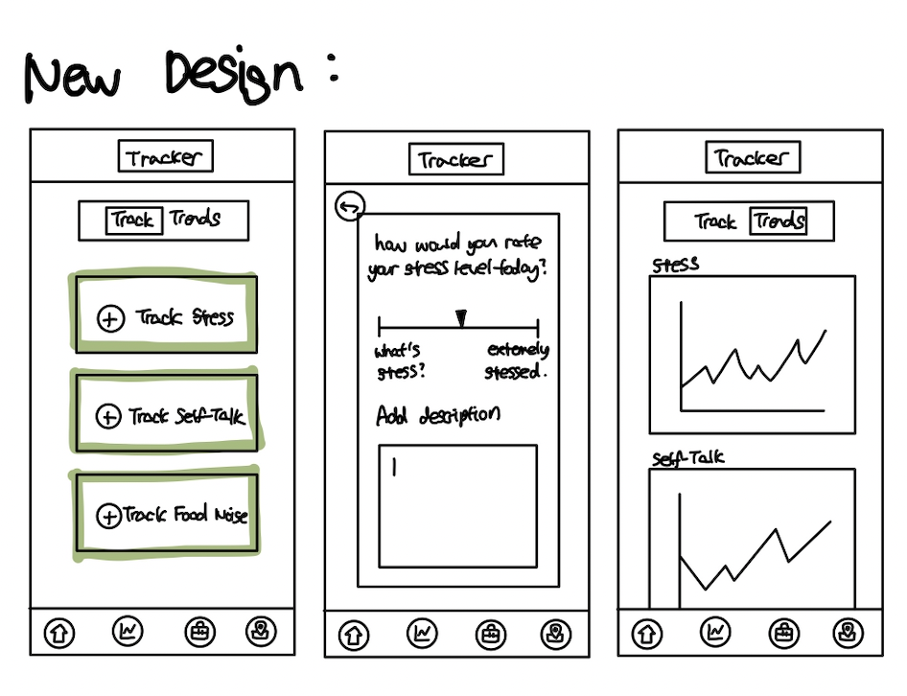
New Design: Tracker

Slide 31
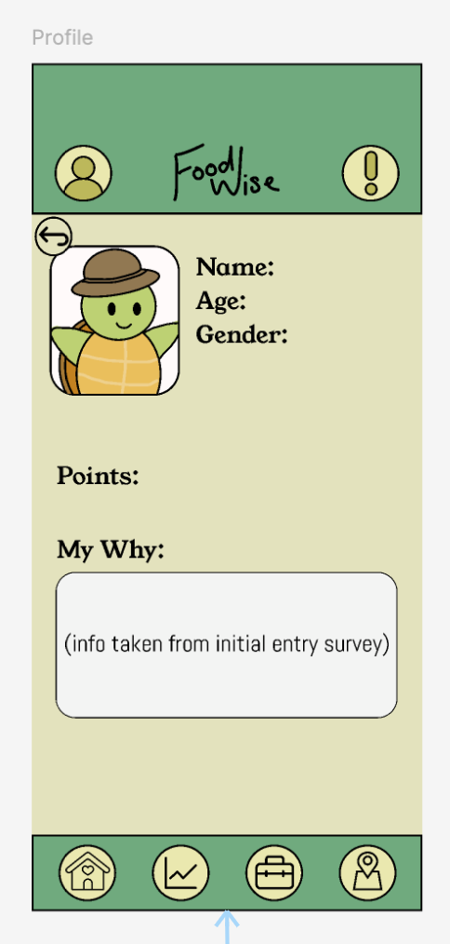
Additional Design: User Profile

Slide 32
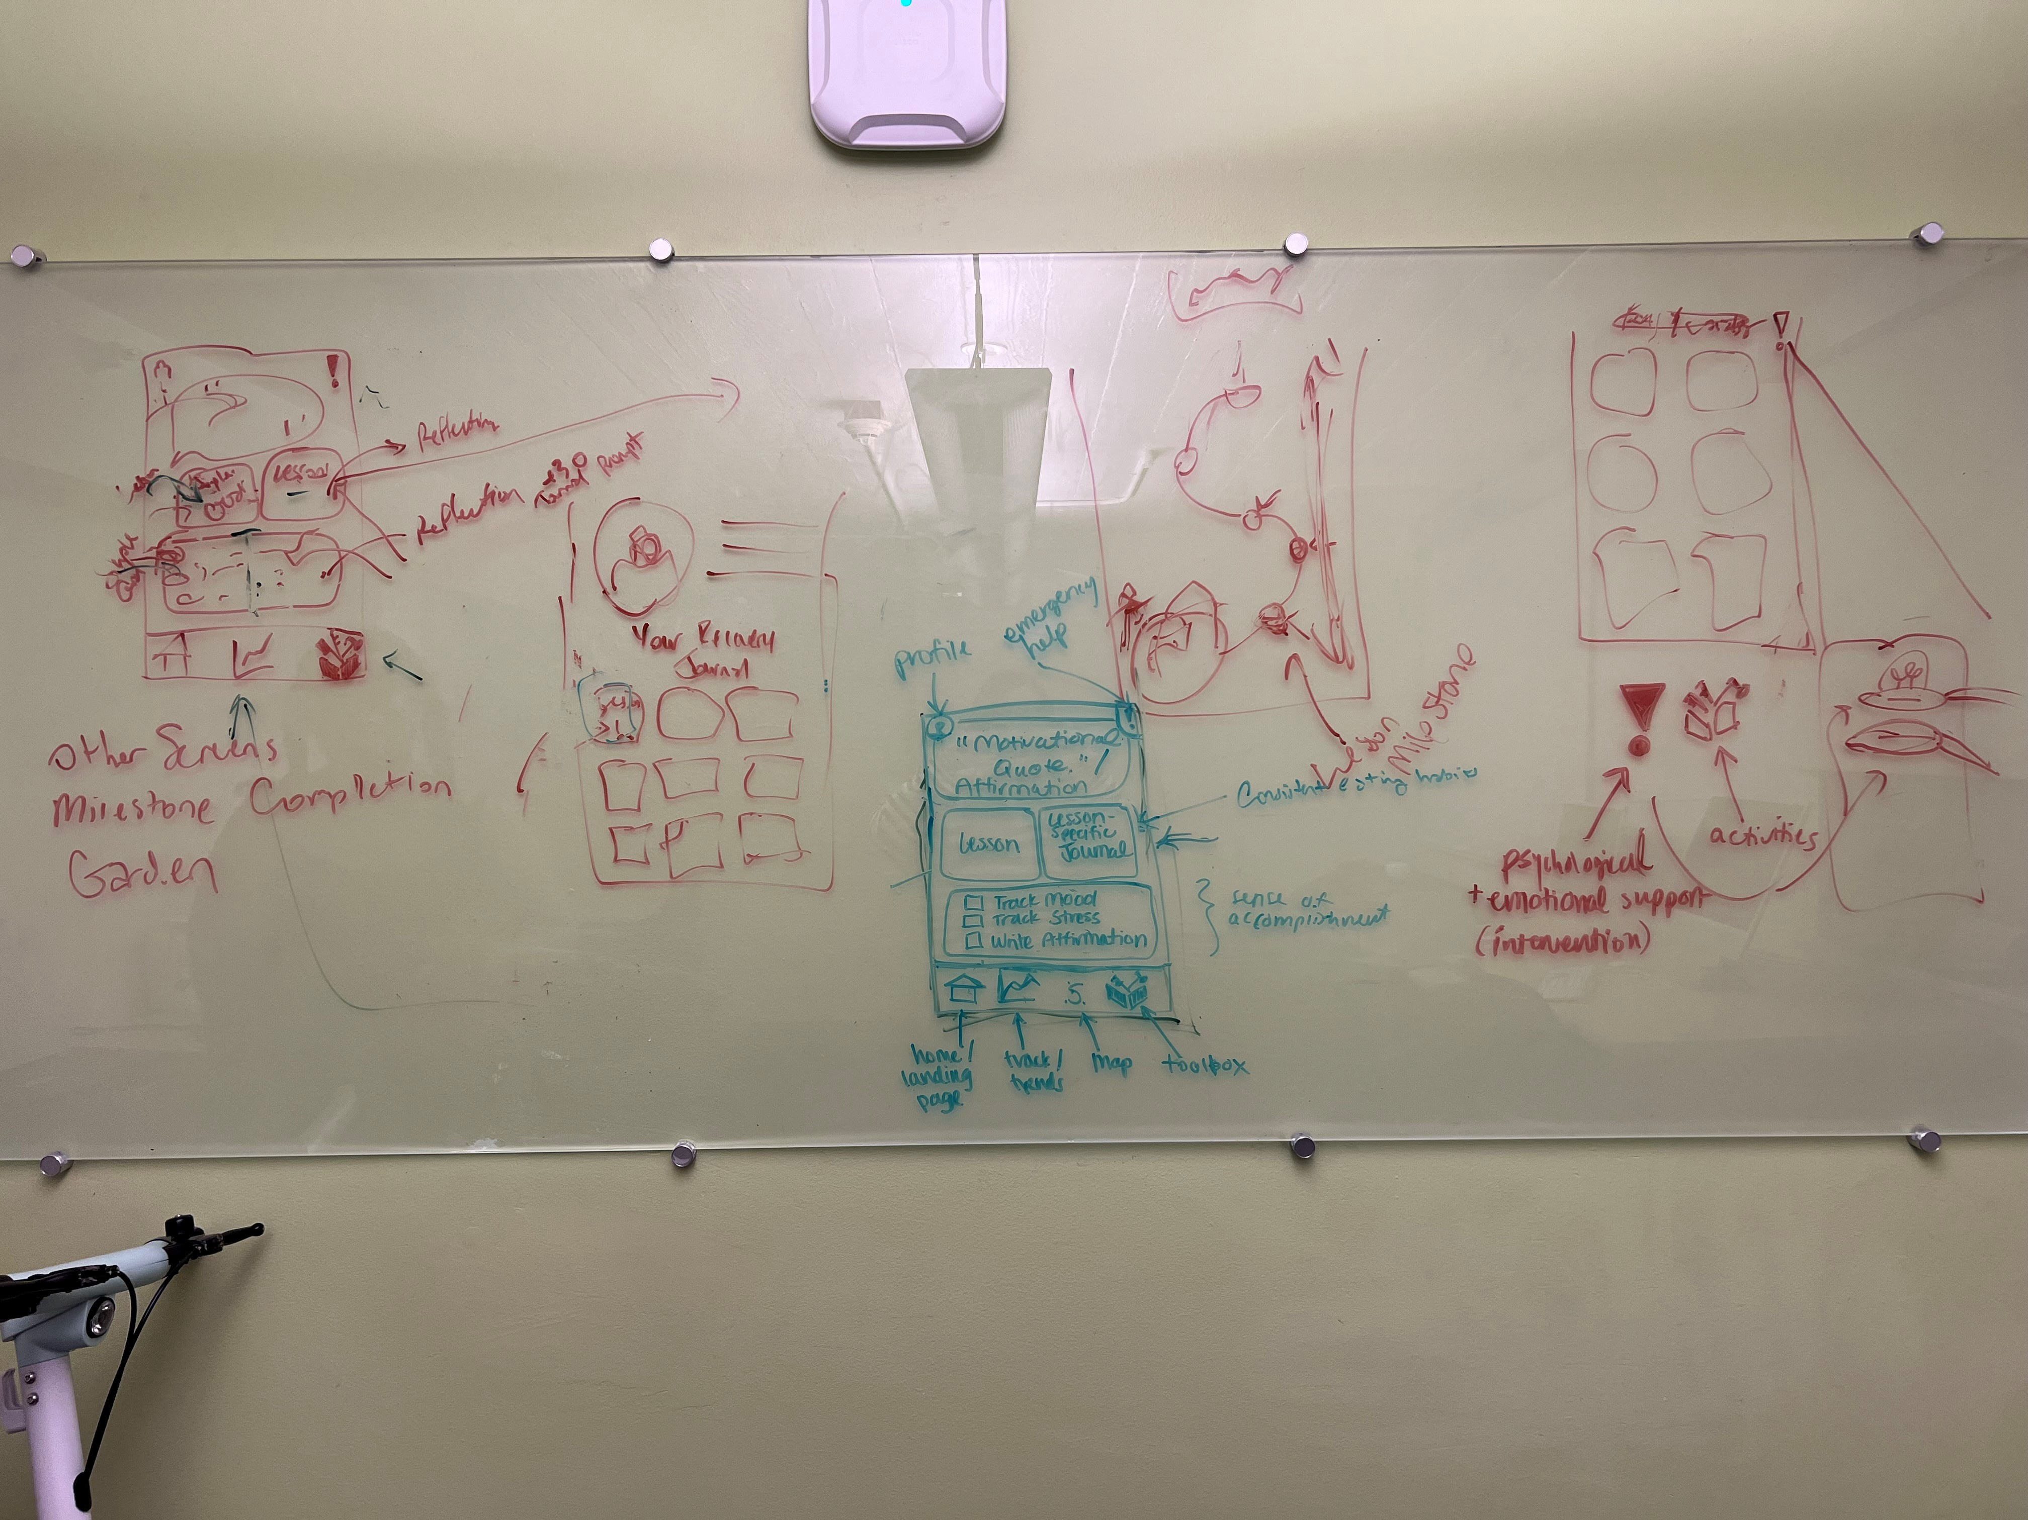
Brainstorming: Various Screens

Slide 33
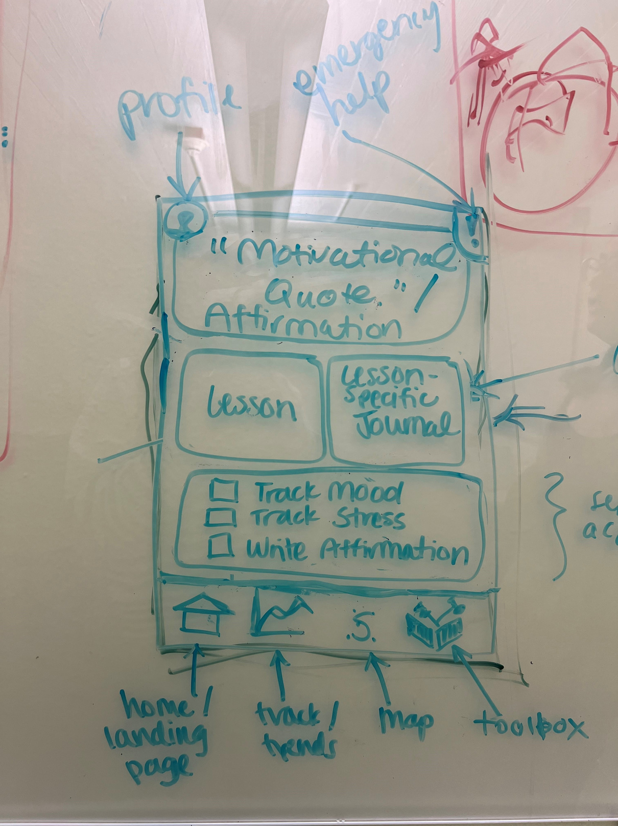
Brainstorming: Home Page

Slide 34
Brainstorming: Profile Page

Slide 35
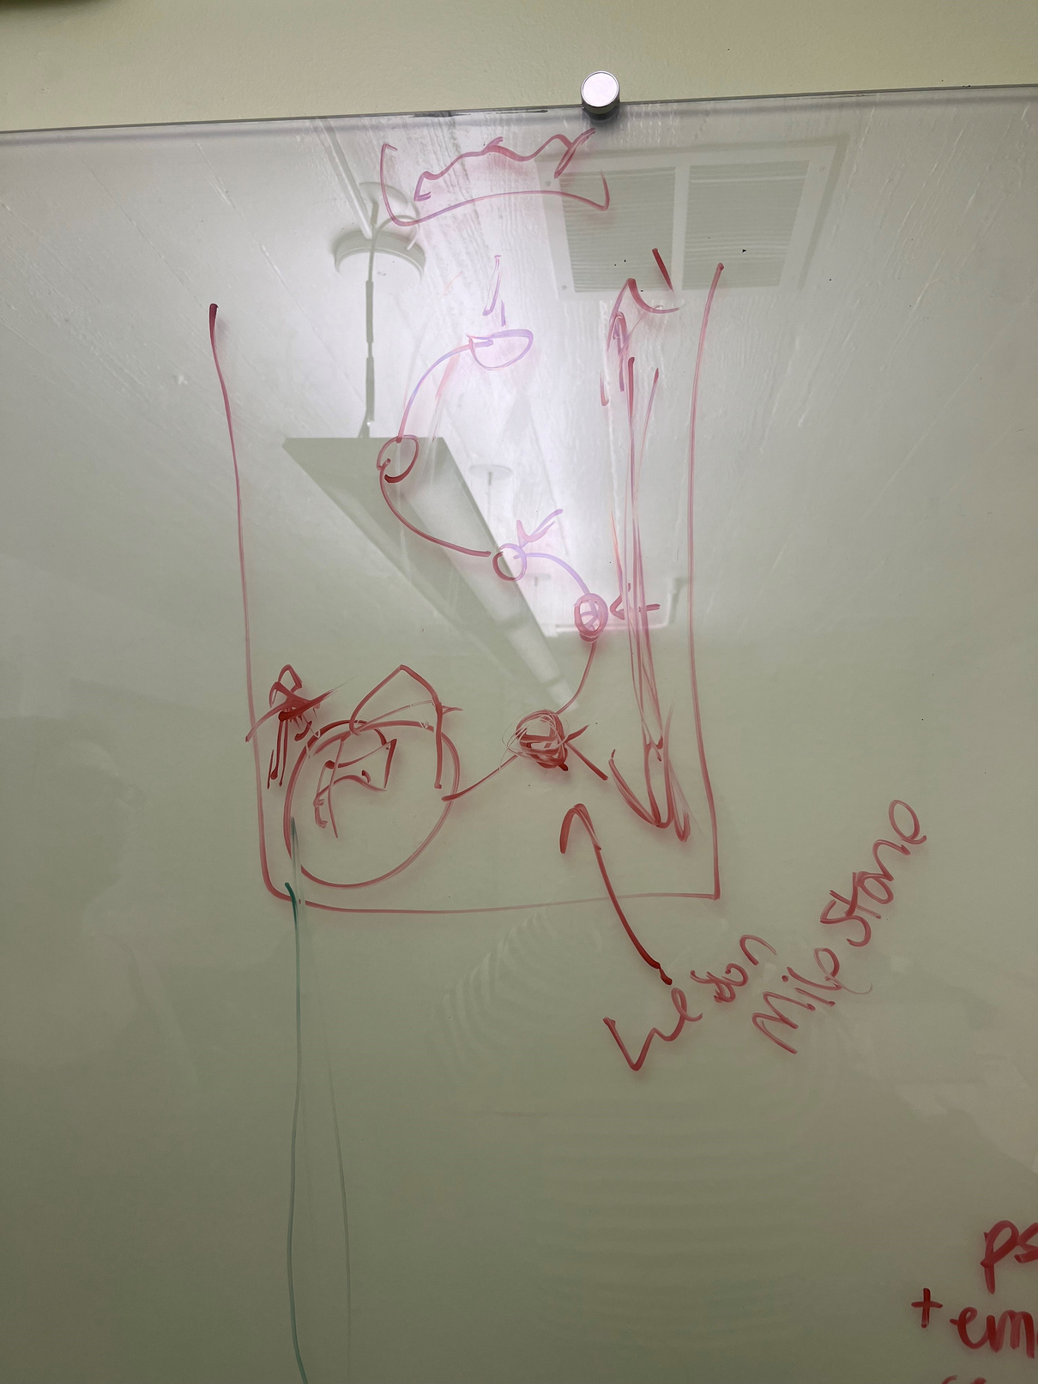
Brainstorming: Roadmap Page

Slide 36
Brainstorming: Toolbox Page

