Slide 1


FoodWise
YOUR ROADMAP TO REAL RECOVERY
Low-fi Prototyping & Usability Testing

Slide 2
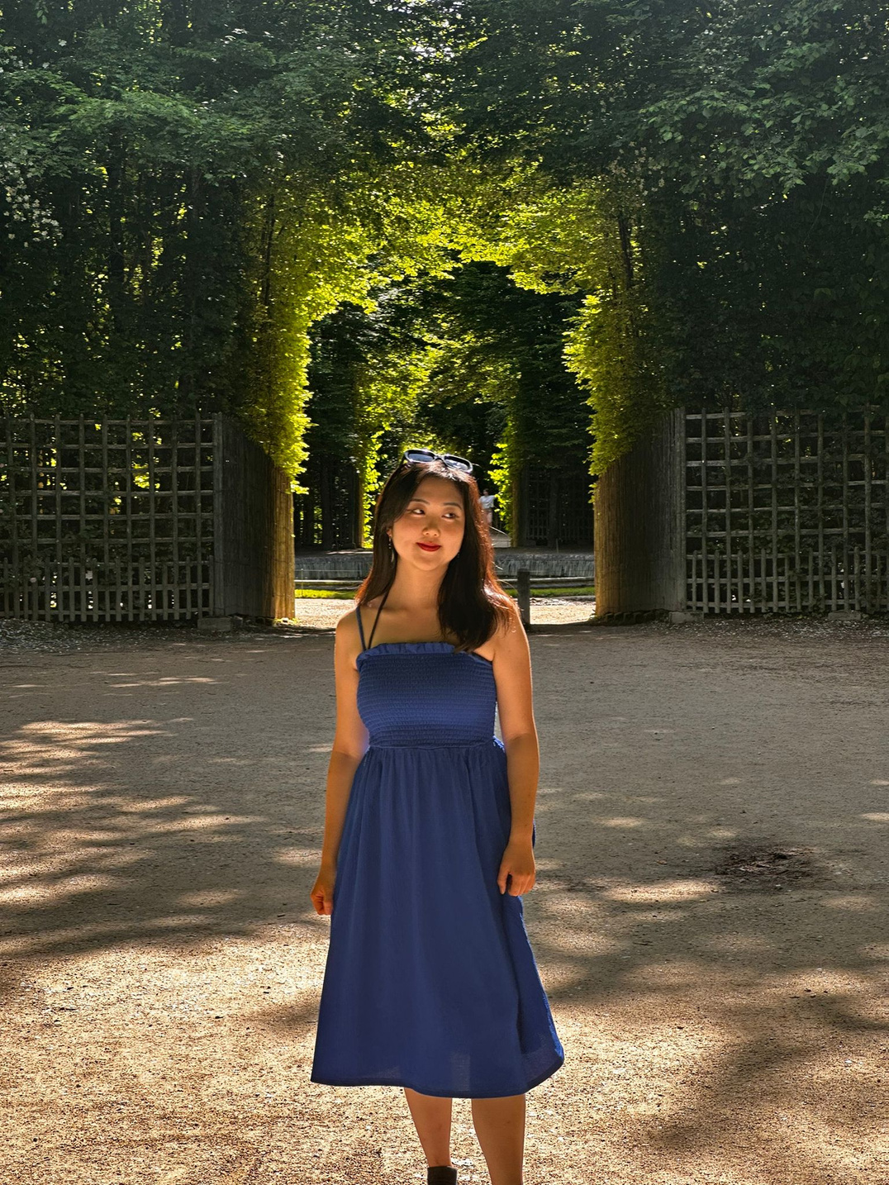
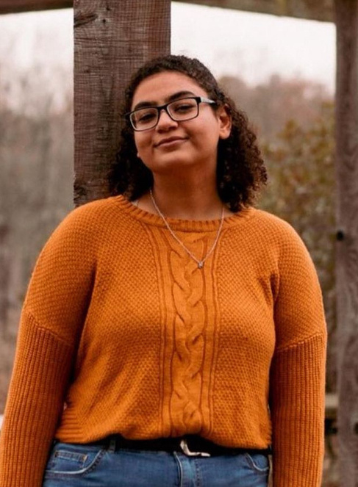
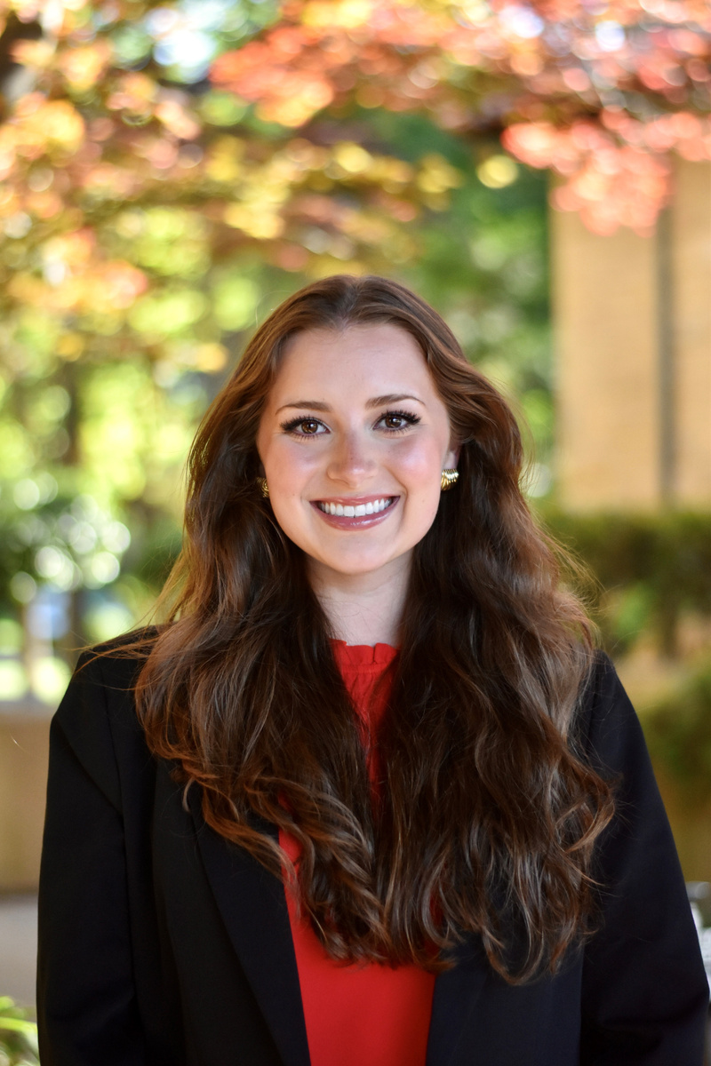
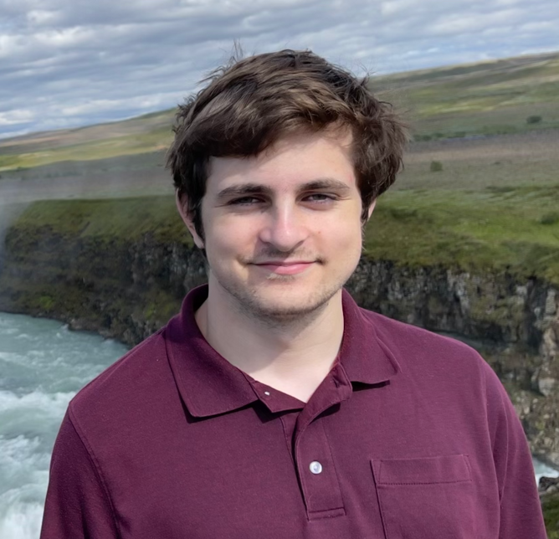

FOOD 4 THOUGHT
Na Young Son
Mai Mostafa
Ava Love
Elton Manchester

Slide 3





OUR VALUES
Structure
Autonomy
Growth
Fun!
Allows people to see a tangible solution to their problem.
Empowers the user to regain control of their habits.
Necessary to instill hope. When you see your progress, you believe it.
Vital to keep the user motivated to continue their recovery

Slide 4
Eating Disorder is stigmatized and specialized therapy is often inaccessible
Despite its commonality, ED is not viewed on the same tangent with other mental health topics
Problem
Cute visuals, interactive features, and game-like elements make recovery fun
Stage-based process for structured support
Personalized recovery toolbox to build coping mechanisms and maintain growth
Solution

Slide 5

1
Sketching Exploration
2
Low-fi Prototype
3
Usability Testing
CONTENTS
4
Discussion

Slide 6
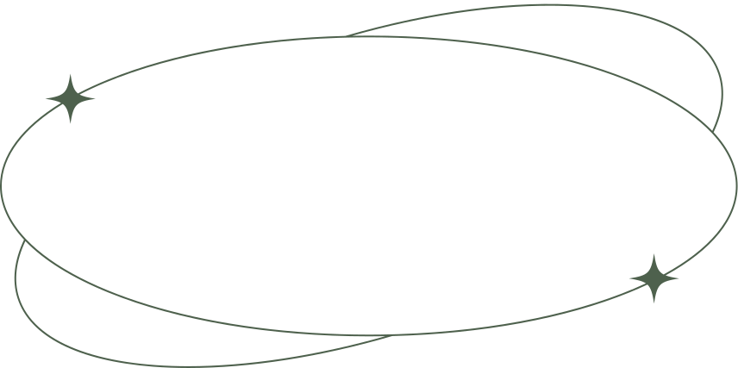
1(a)
Concept Sketches

Slide 7
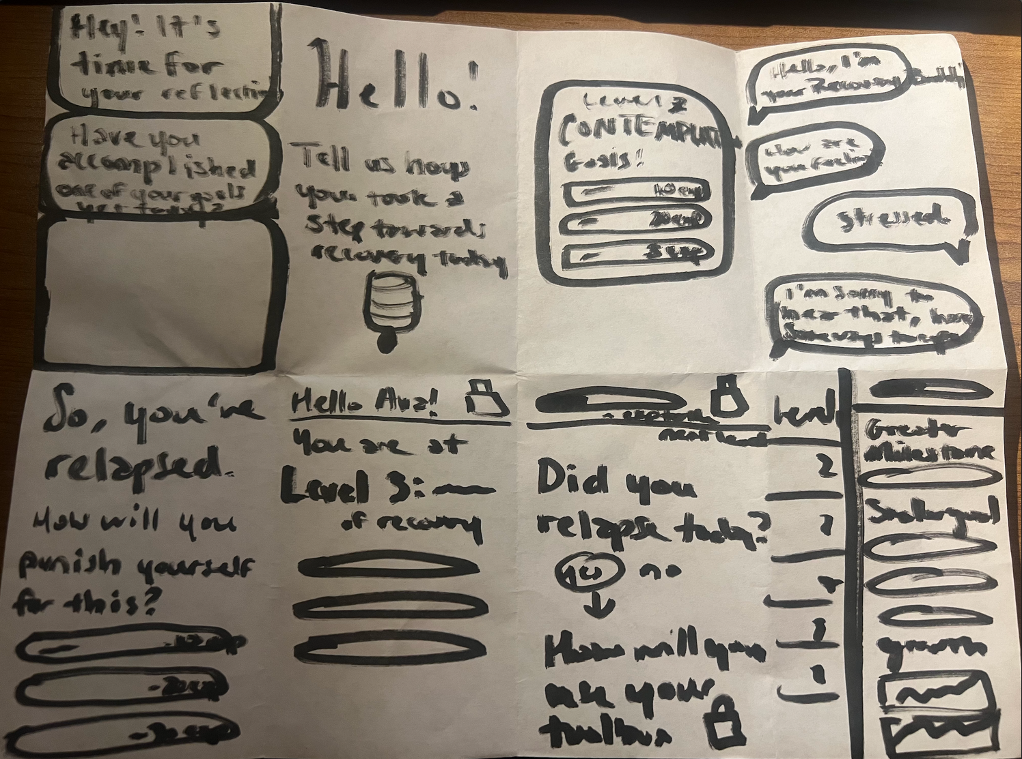
Crazy 8's - Mai

Slide 8
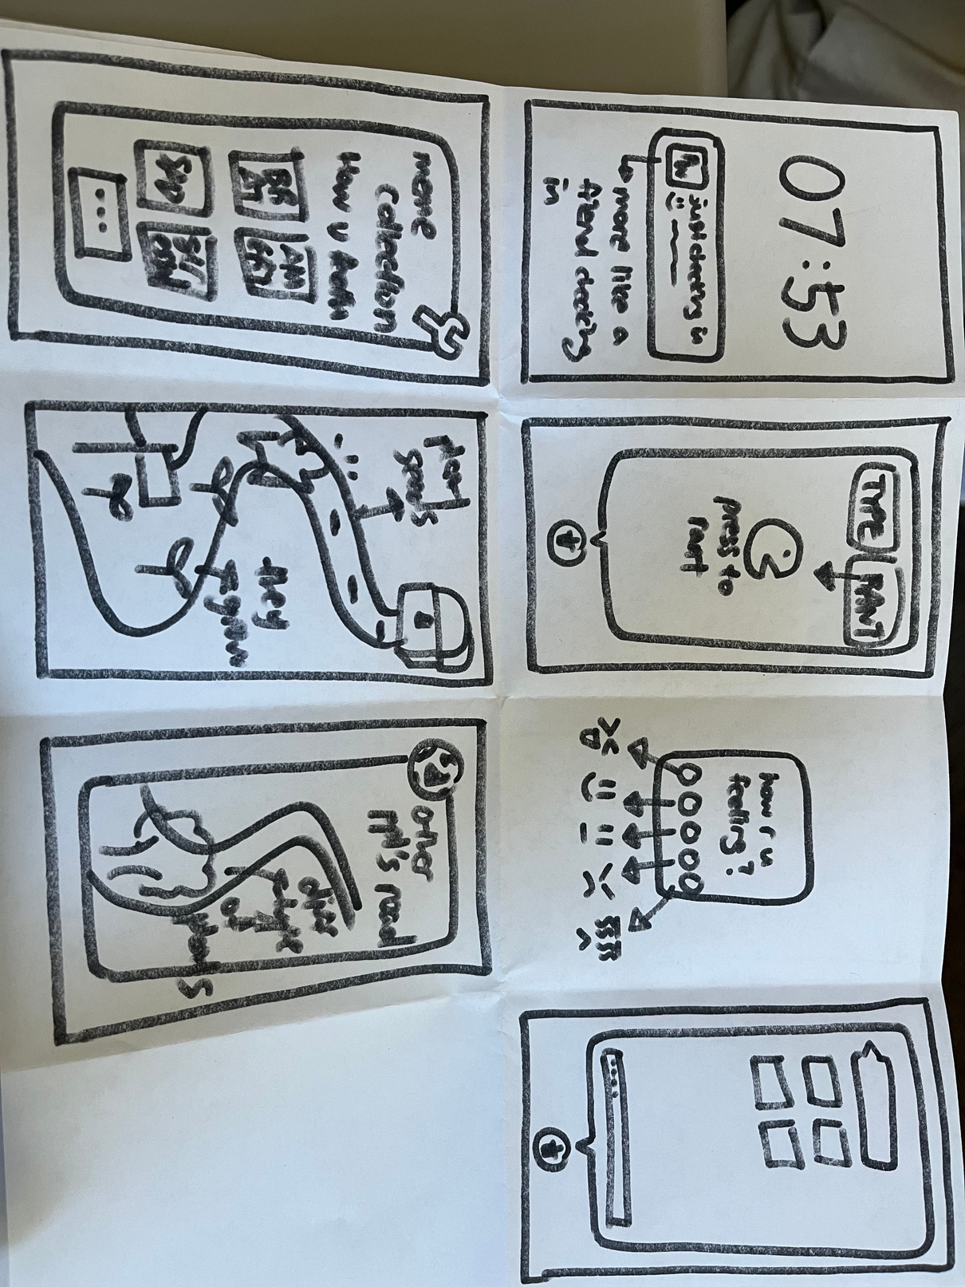
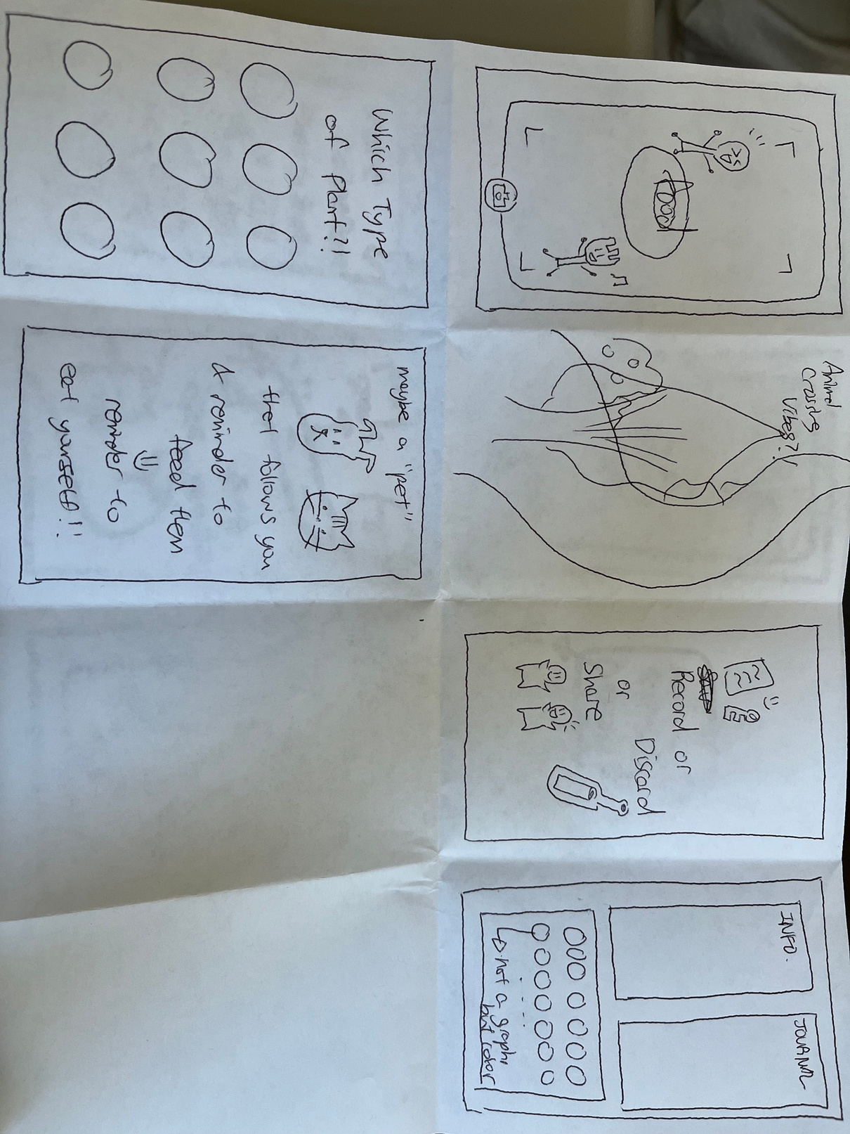
Crazy 8's - Na Young

Slide 9
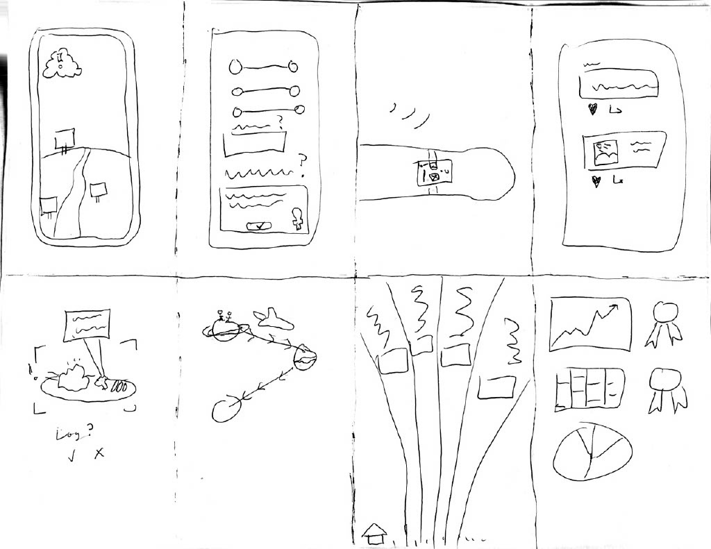
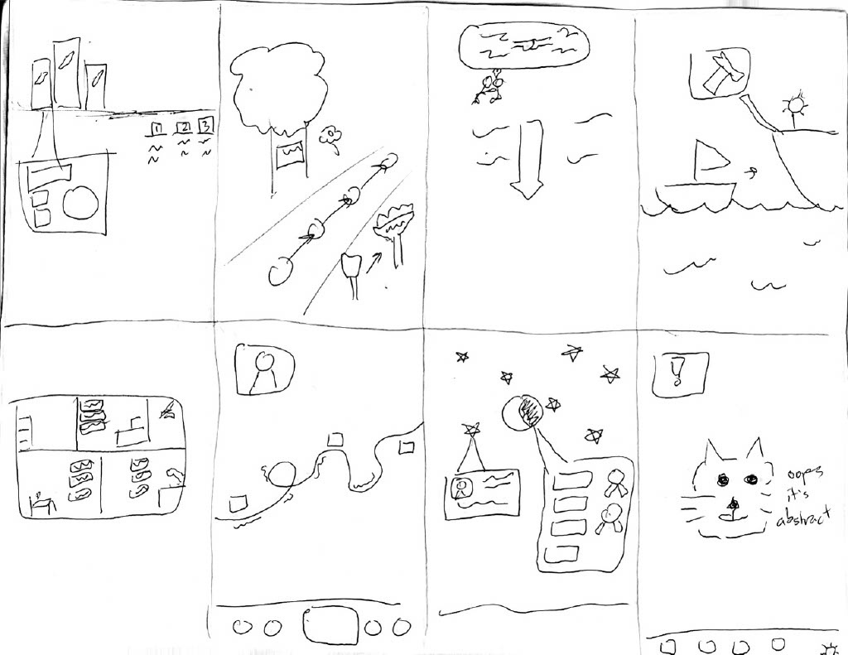
Crazy 8's - Elton

Slide 10
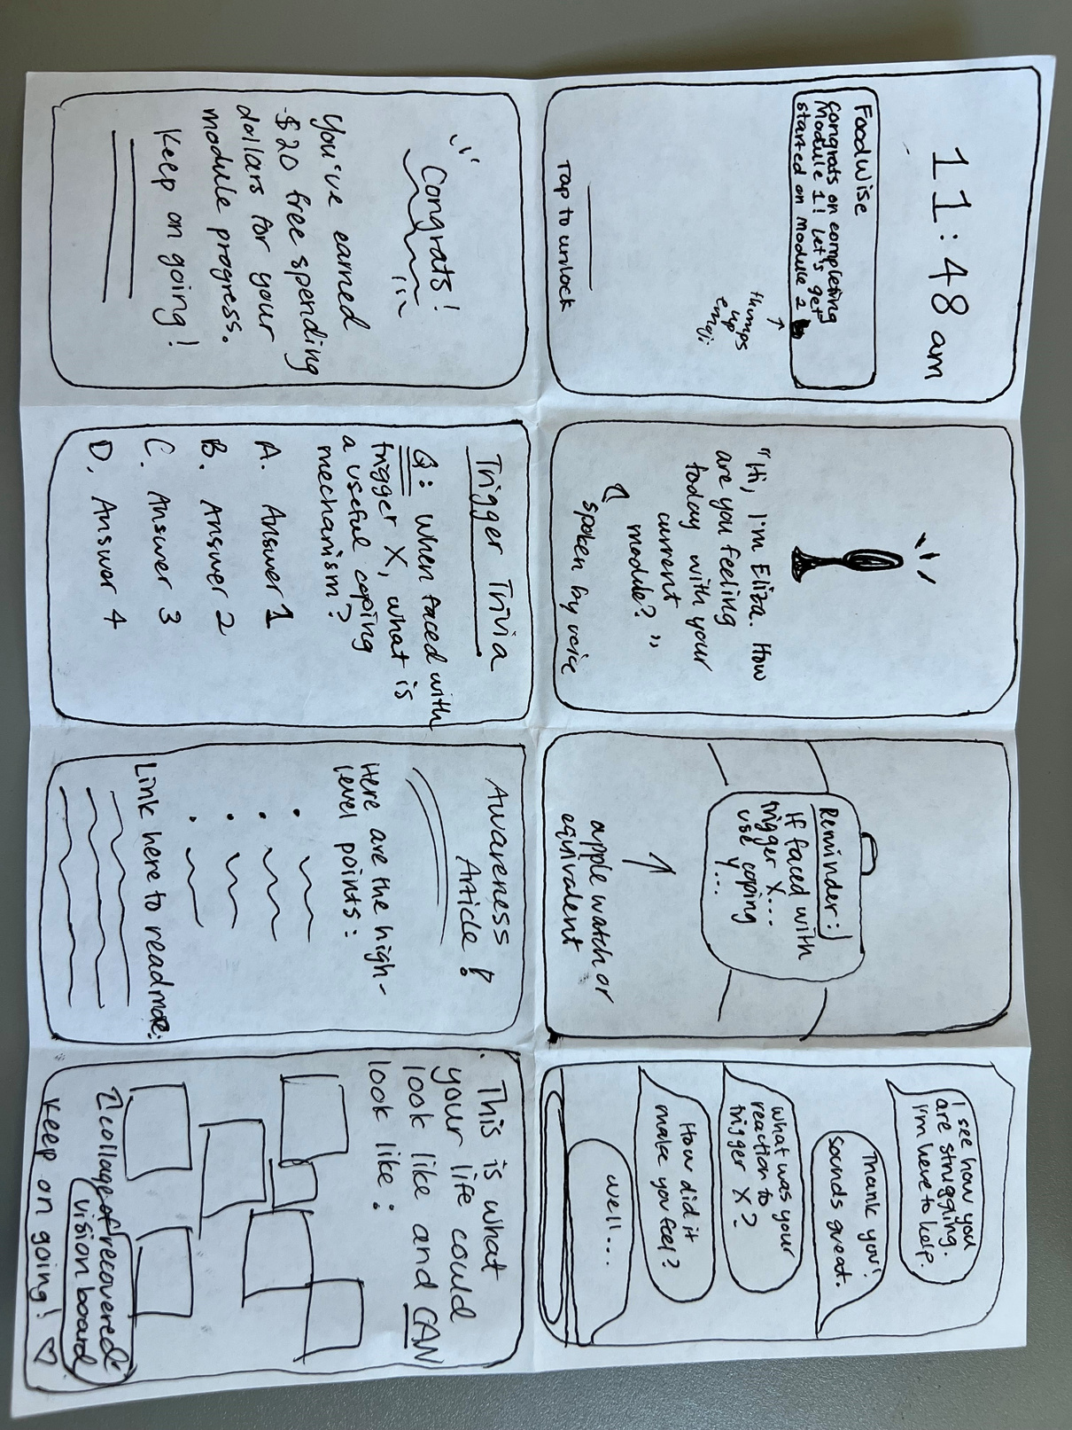
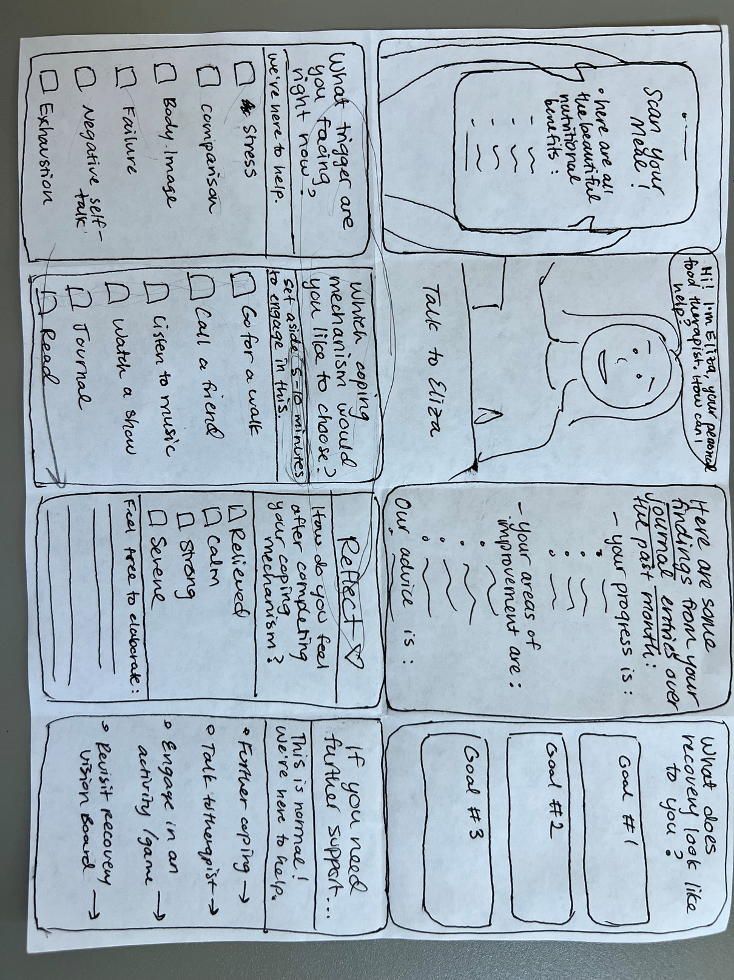
Crazy 8's - Ava

Slide 11
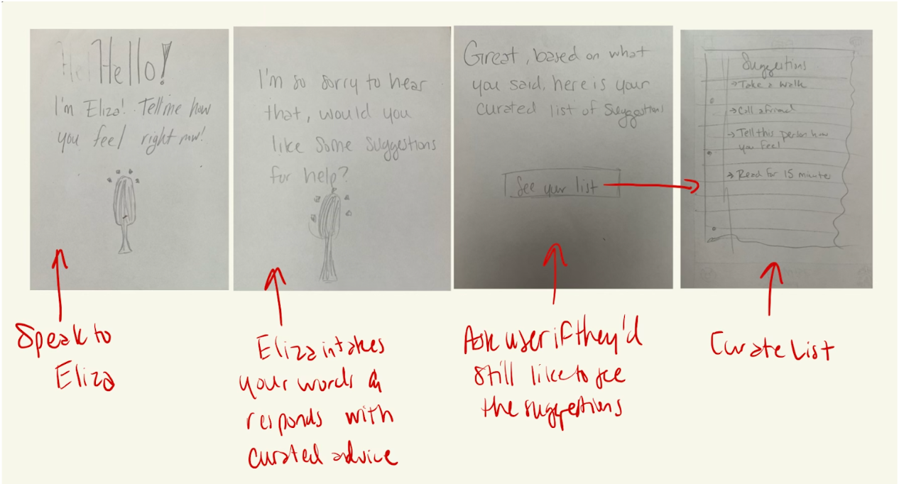
Further Concept Sketches
Vocal Input + AI Assistant

Slide 12
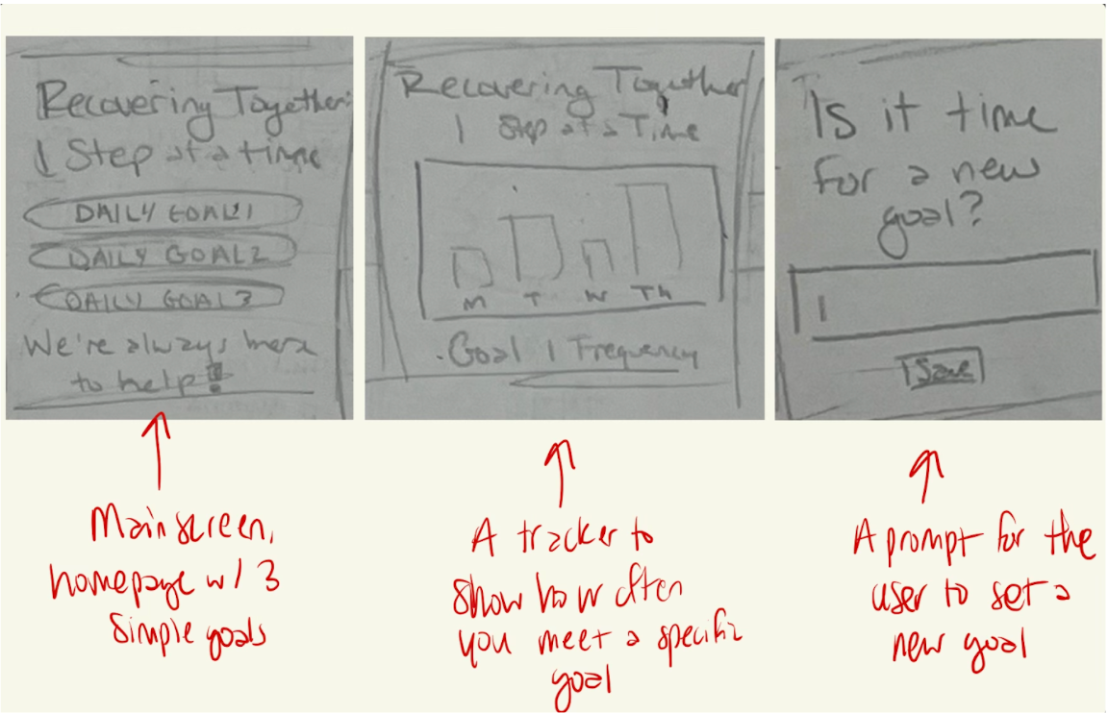
Further Concept Sketches
Smart Watch Application

Slide 13
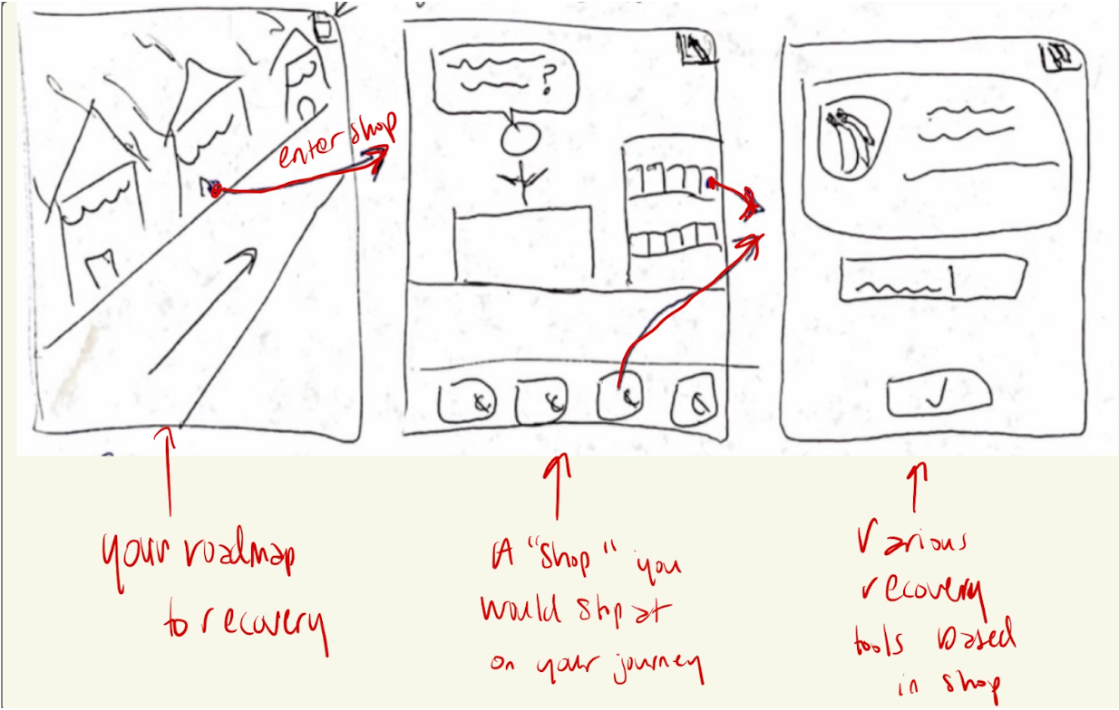
Further Concept Sketches
Recovery Roadmap

Slide 14
1(b)
Chosen Realizations

Slide 15
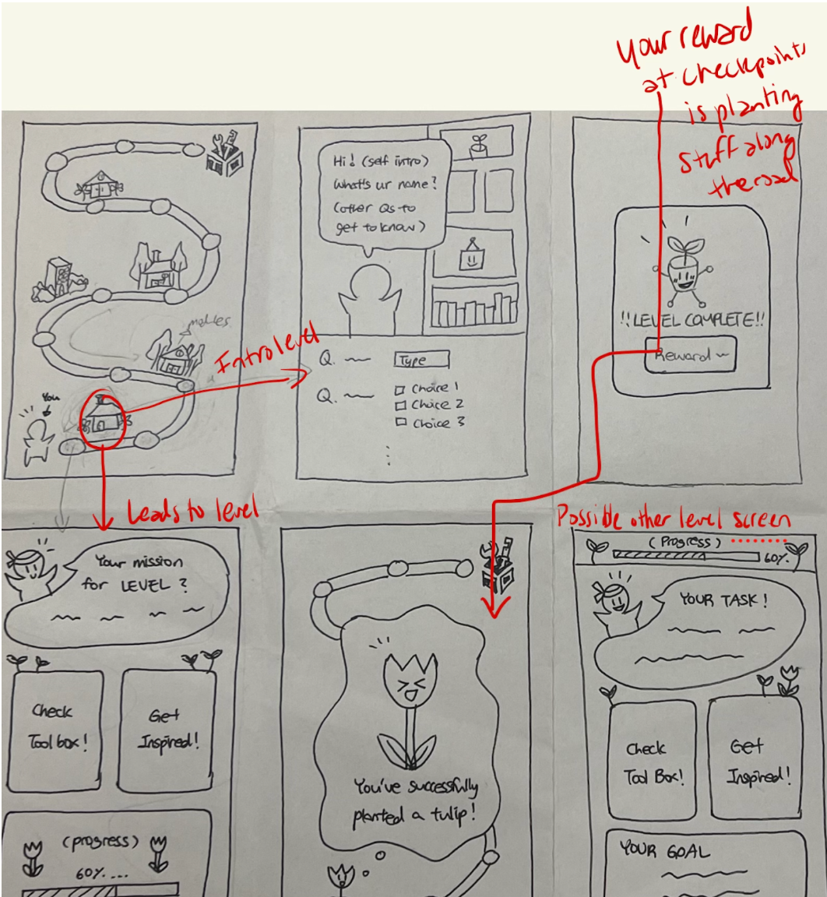
1. Interactive roadmap interface in which various shops/buildings represent a different stage of recovery

Slide 16
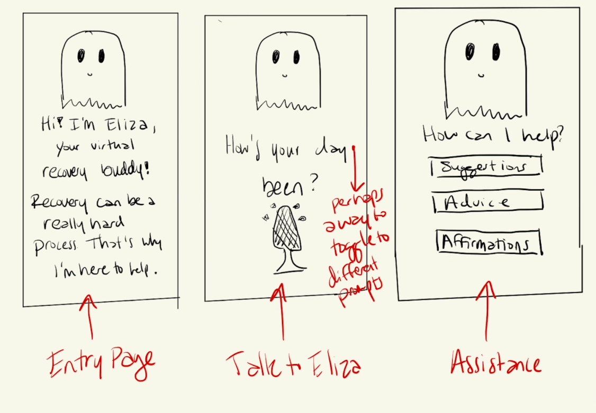
2. An AI assistant which you can speak to while you go through the recovery process

Slide 17
SELECTED OPTION 1: INTERACTIVE ROAD
Shows tangible recovery progression
Adds content stage-by-stage to not overwhelm the user
Sets it apart from existing products
Visually appealing and interesting
Focuses on aspects that don’t require clinical assistance
Pros
Runs the risk of overcomplicating the experience
Harder to implement
Limits the accessibility of later-introduced features
May seem linear, even though recovery process is not
Cons
Notes:
explain why better than other prototypes

Slide 18
2(a)
Low-fi Construction

Slide 19
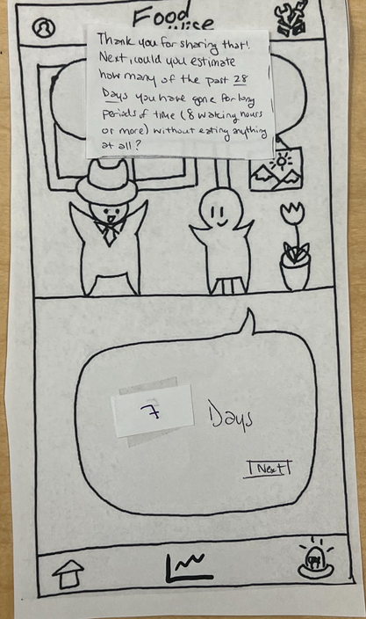
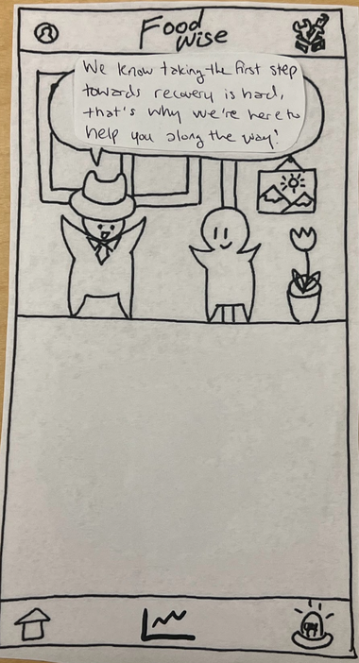
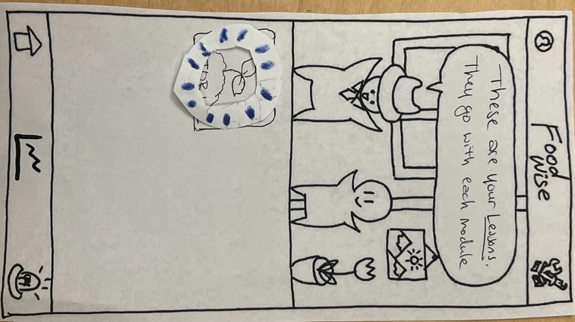
THOUGHT PROCESS
Our approach to constructing the low-fi
Physical Construction
Created paper interfaces to represent each step of an app feature (a bit larger than iPhone size)
Used paper “mouse,” “light-up feature,” and the “mayor” character to guide users through app
Allow users to write on paper (that we would switch out) when typing would be needed

Slide 20
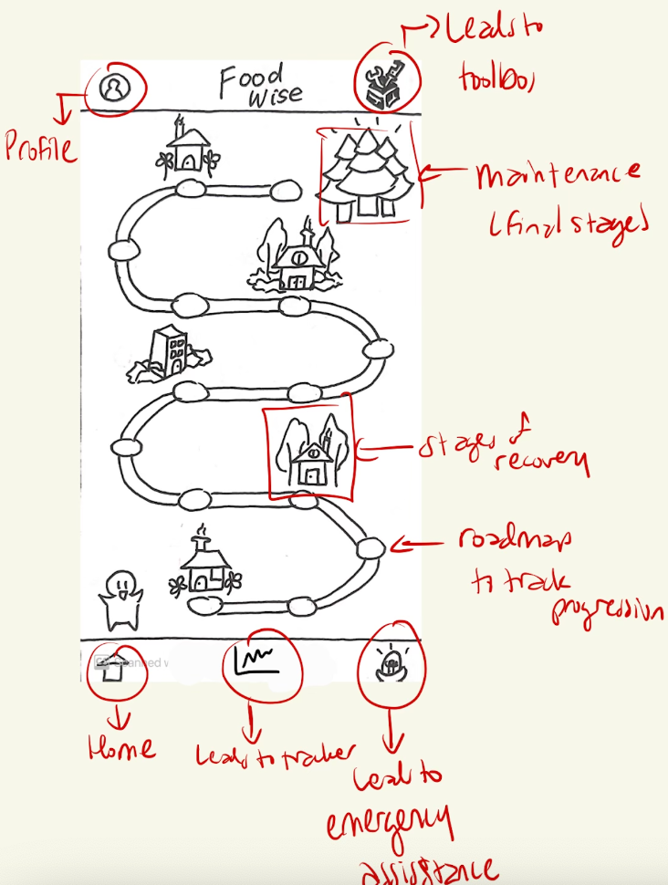
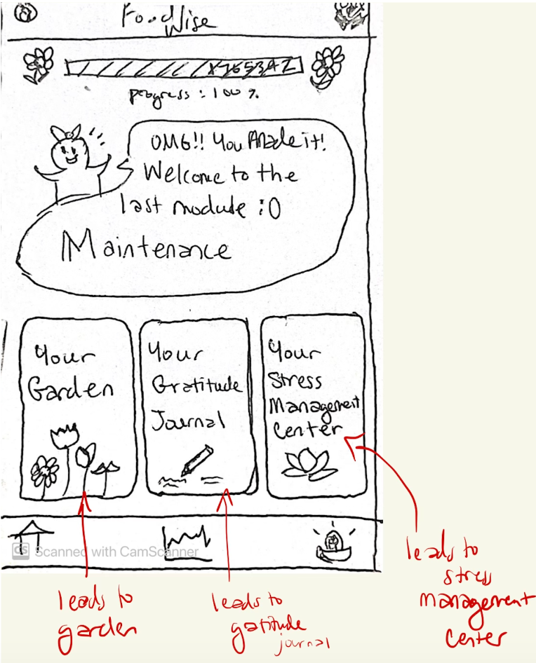

Slide 21
2(b)
Task Flows

Slide 22
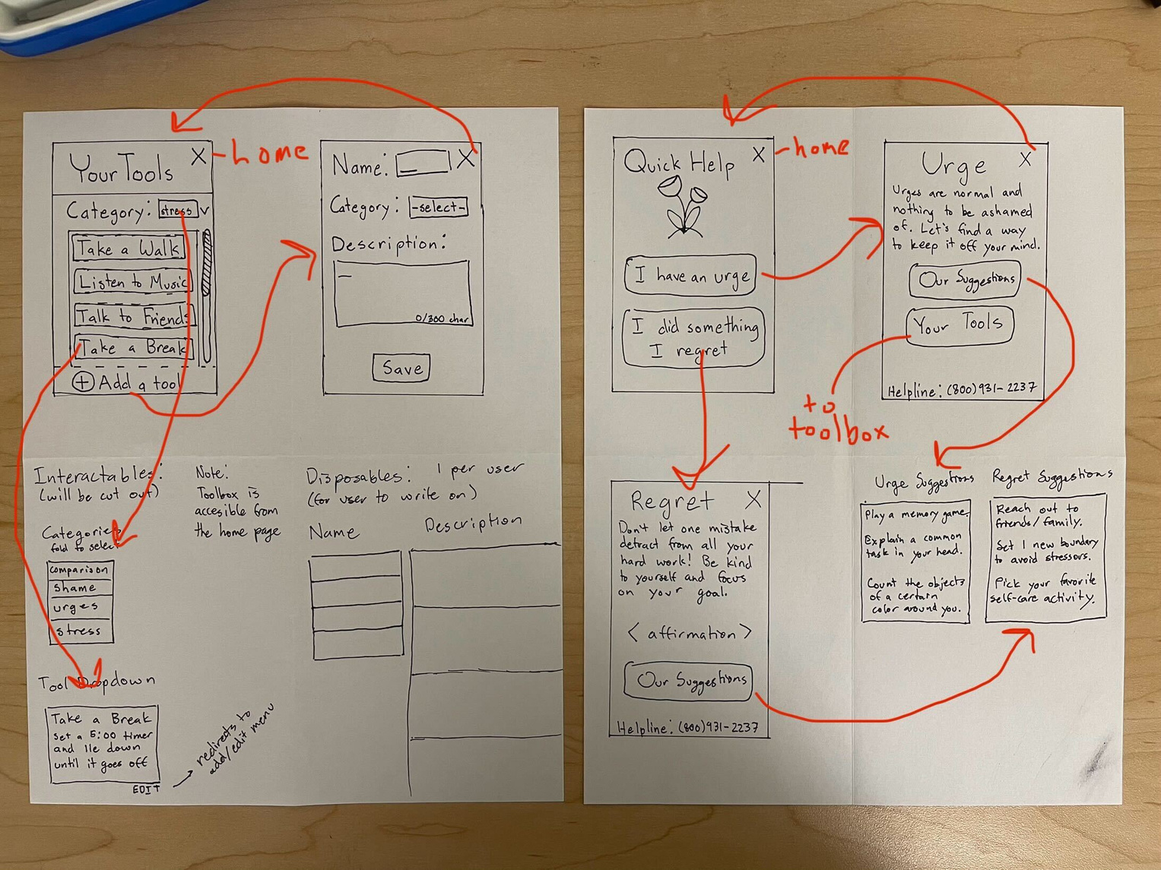

Simple: Toolbox
Add trigger with associated coping mechanisms

Slide 23
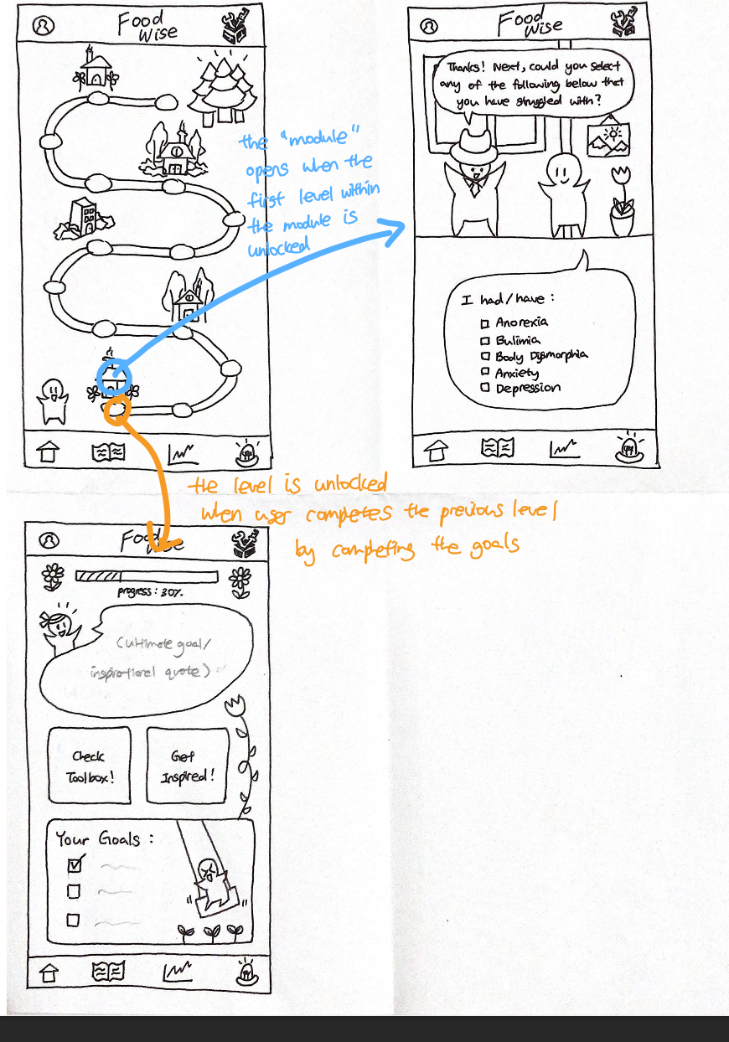

Moderate: First Stage
Intro quiz + setting goals
Progress forward by achieving the set goals in each level
Daily check-in by speaking with the shop owner

Slide 24
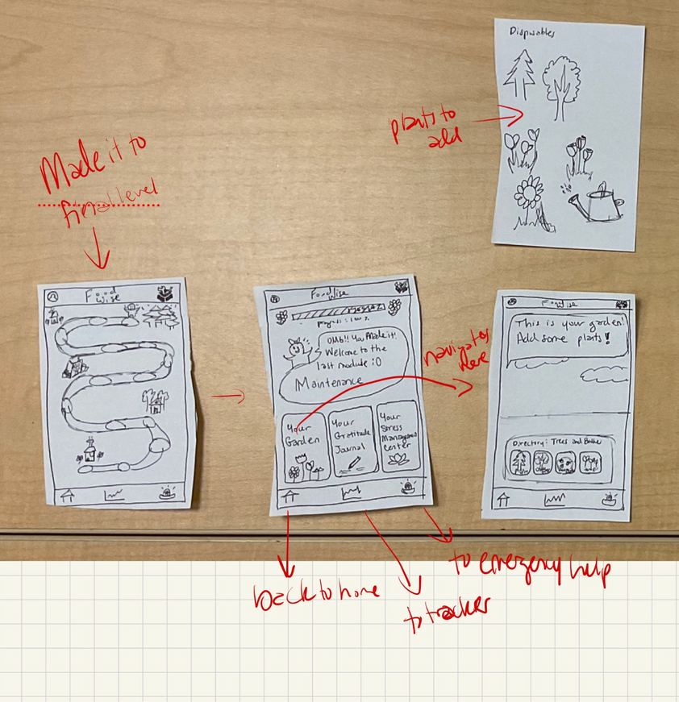
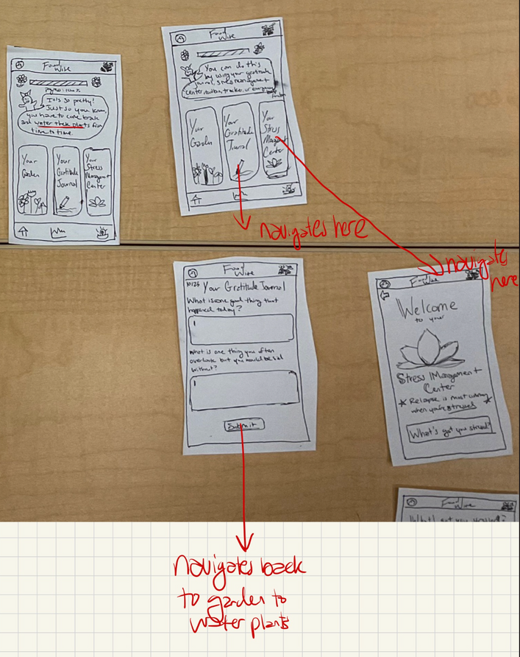
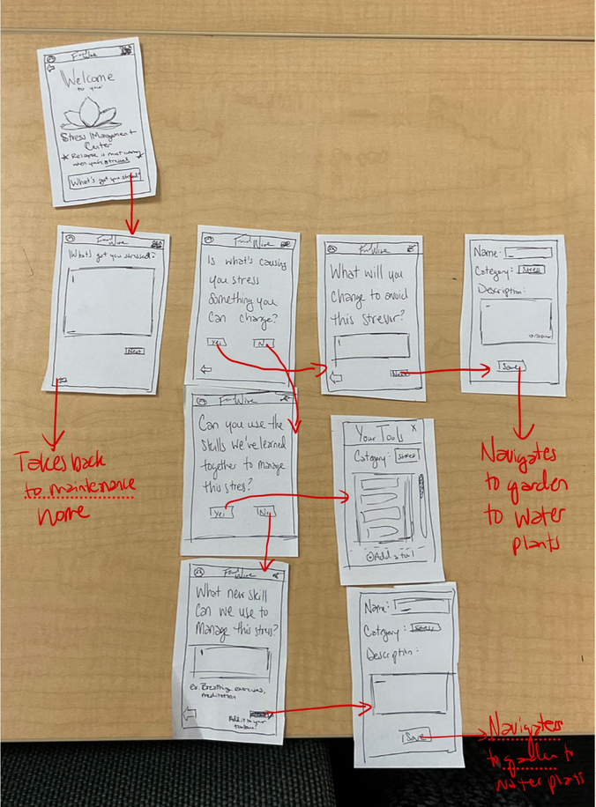
Complex: Maintenance
Maintaining recovery once completed the roadmap

Slide 25
3(a)
Testing Methodology

Slide 26

PARTICIPANTS
Demographic: people who have some sort of experience with disordered eating
Recruitment
Sent out a message to a slack channel
Contacted acquaintances with known disorder

Slide 27
PARTICIPANTS
NOTE:
We received permission to use students to test due to the difficulty in finding people with eating disorders.
As a result, all participants are students.

Slide 28
TEAM MEMBER ROLES
Na Young Son
(note-taker)
Mai Mostafa
(fascilitator)
Ava Love
(observer)
Elton Manchester
(observer)

Slide 29

“Avery”
Background
Experiences with the binge eating side of disordered eating.
Habits tied to strong emotions.
Facilitator: Mai
Observer: Ava

Slide 30

“Jillian”
Background
Experiences with the restrictive side of eating disorders.
Has design experience and gave us feedback on that aspect.
Facilitator: Mai
Observer: Elton

Slide 31

“Marco”
Background
Experienced disordered eating behaviors but was never diagnosed, offering us the unique perspective of a user questioning their status.
Facilitator: Mai
Observer: Elton

Slide 32

“Texas”
Background
Well on the path to recovery, but many of the features were still relevant to him.
Facilitator: Mai
Observer: Elton

Slide 33

Goal: Intuitive navigation and features
User does not need to think about how to reach desired page
Features require minimal explanation
Usability Goal #1
Metrics
Number of clicks required
Qualitative: expressed or demonstrated confusion
Key Measurement

Slide 34

Goal: Efficiency and ease of use for tasks
Tasks (especially common ones) require a small time investment
Users rarely make mistakes when completing tasks
Usability Goal #2
Metrics
Time taken
Qualitative: successful completion of tasks
Key Measurement

Slide 35
3(b)
Testing Results
Notes for each participant are included in the appendix. We will cover key points only for the sake of time.

Slide 36

TASK 1 REFLECTION
Fill out intro/monthly survey
Severity 0
Repeating “Why do you want to recover?” provoked additional thought
Positive reception to cute visuals and friendly dialogue :)
Severity 1
Users preferred proportions/sliding scales to providing a flat number
Clicking in empty space to continue is unclear
Severity 2
Several screens with no interaction in the start
Options could use friendly and more detailed wording
Severity 3
Certain survey questions may unintentionally invalidate certain disorders

Slide 37
TASK 2 REFLECTION
Complete tutorial (includes toolbox function)
Severity 0
Exploratory style helped keep it interactive
Even when confused, users could navigate back to the main page
Severity 1
Icon meanings can be unclear
Buttons like “Add Tool” and x’s on popups should be emphasized
Severity 2
On the flip side of the exploratory style, features may not be sufficiently explained
In quick help, our suggestions should broadened (since users likely use it when they can’t think how to help themselves)
Severity 3
Users got stuck in certain screens or tasks, in particular the layered popups in the toolbox

Slide 38

TASK 3 REFLECTION
Maintenance
Severity 0
Positive reception to watering plants in the garden, customization options
Improvement over tree planting on roadmap, which was seen as arbitrary
Users appreciated guided journaling and interaction with characters
Severity 1
Garden lacked context
Additional customization options (like a character or avatar) desired
Severity 2
Some questions like “What can you do to avoid these stressors?” were hard to answer
An “I don’t know” option would be helpful in these cases
Severity 3
Features like journaling and the garden should not be gated behind finishing the path

Slide 39
GOAL #1: INTUITIVE NAVIGATION
Simple
24
25
23
Avg. 24 clicks
Moderate
27
30
41
Avg. 32.7 clicks
Complex
14
15
18
Avg. 15.7 clicks

Slide 40

METRIC REFLECTION
The complex task had the fewest clicks, which suggests it is actually simpler
Intended for experienced users, but could see use by typical users
The other two tasks required a lot of clicks, so condensing and simplifying them may be valuable

Slide 41
GOAL #2: EFFICIENCY/EASE OF USE
Simple
16'25"
7'40"
8'30"
Avg. 10'51"
Moderate
9'55"
5'25"
10'09"
Avg. 8'29"
Complex
6'50"
3'00"
4'54"
Avg. 4'55"

Slide 42

METRIC REFLECTION
The time to complete tasks was roughly proportional to the number of tasks
Suggests that the average amount of time spent on an action is consistent
There was a lot of variance between times
Need to account for users who prefer to rush or skip through tutorials

Slide 43
4
Discussion

Slide 44

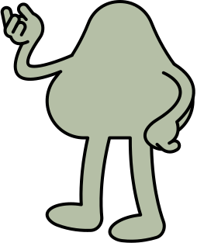
IMPLICATIONS
Since we prioritize user engagement, any points of frustration or boredom are a high priority to address
May seem superficial, but the interaction with characters and activity rewards improved the user experience

Slide 45

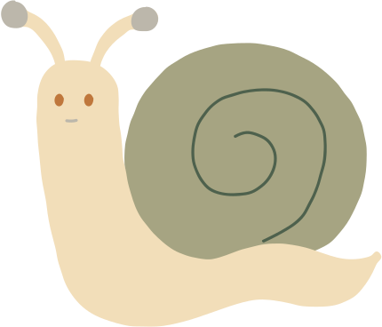
IMPROVEMENTS
Provide more strategies and suggestions because users usually don’t know the best strategies for themself
The tool function is solid, but the interface needs a redesign for clarity and ease of use
Provide earlier access to garden/maintenance

Slide 46
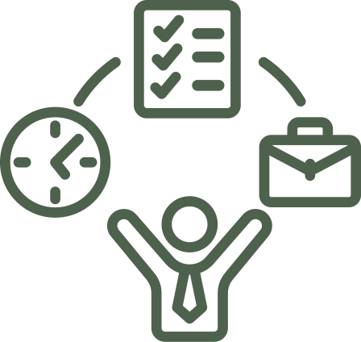

SHORTCOMINGS
(shortcomings)
Using a tutorial helped display many features, but it may have offered too much guidance
The prototype had limited flexibility for different needs and disorders
Unable to simulate use over an extended period

Slide 47
Thank You!
~Q&A~

Slide 48
APPENDIX

Slide 49
Full list of pros and cons for selected interface rationale

Slide 50
VOCAL INTERACTION + AI SUGGESTION
Intuitive, direct access to service
Could provide personalized recommendations to better understand eating disorder and navigate emotions.
Provide structure guidance in reflecting and journaling
Pros
The lack of human-feeling (intonation, facial expression) could make the interaction uncomfortable
Harder to make the user experience intimate
Limited effects: imitates therapy yet couldn’t replace it
Cons

Slide 51
NOTIFICATION + MOOD TRACKING
Regular reminders to track mood/stress throughout the day (adaptable in smart watches)
‘Text/check-in from a friend’ design would make the experience more intimate/caring
Pros
Overlapping concepts/features with existing apps
The notifications could overwhelm/disturb the users
The notifications could be the trigger for stress/addictive cycle of cutting -> binging -> purging
Cons

Slide 52
Script
Hi, thank you so much for participating in testing for our prototype. Just to give you some background, FoodWise is an app for eating disorder recovery. We want to make the process of recovery a more structured, yet still enjoyable experience. This takes the form of a recovery roadmap. As you gain points and complete activities, you will be able to progress through the stages of recovery.
Even though the prototype is drawn on paper, you can interact with it as you would a touchscreen, or say aloud what you would like to do. We cannot answer any questions about how to use the app while the test is taking place, but feel free to share your thoughts at any time.
(Each task was explained before the user attempted it, but this was not included in the script)

Slide 53
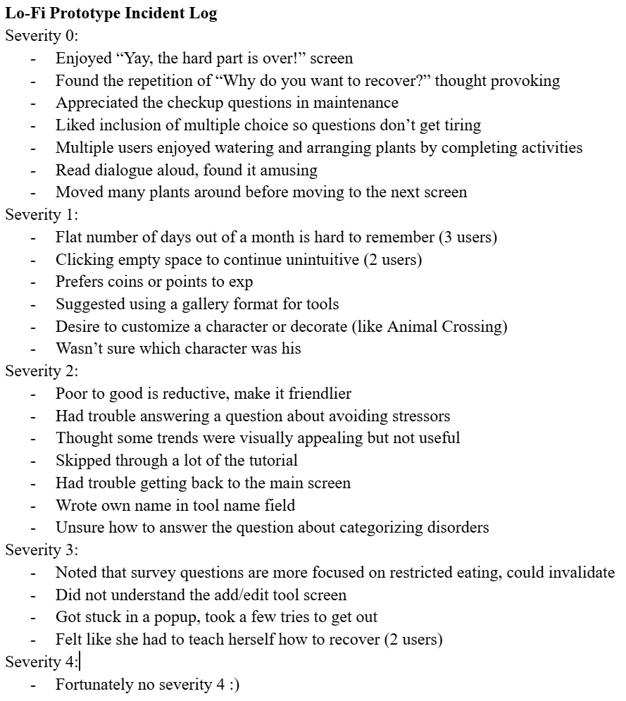
Critical Incidents
Note: a more thorough (but less organized) account can be found in the full notes document, which was too long to include in this presentation.
View it here

Slide 54
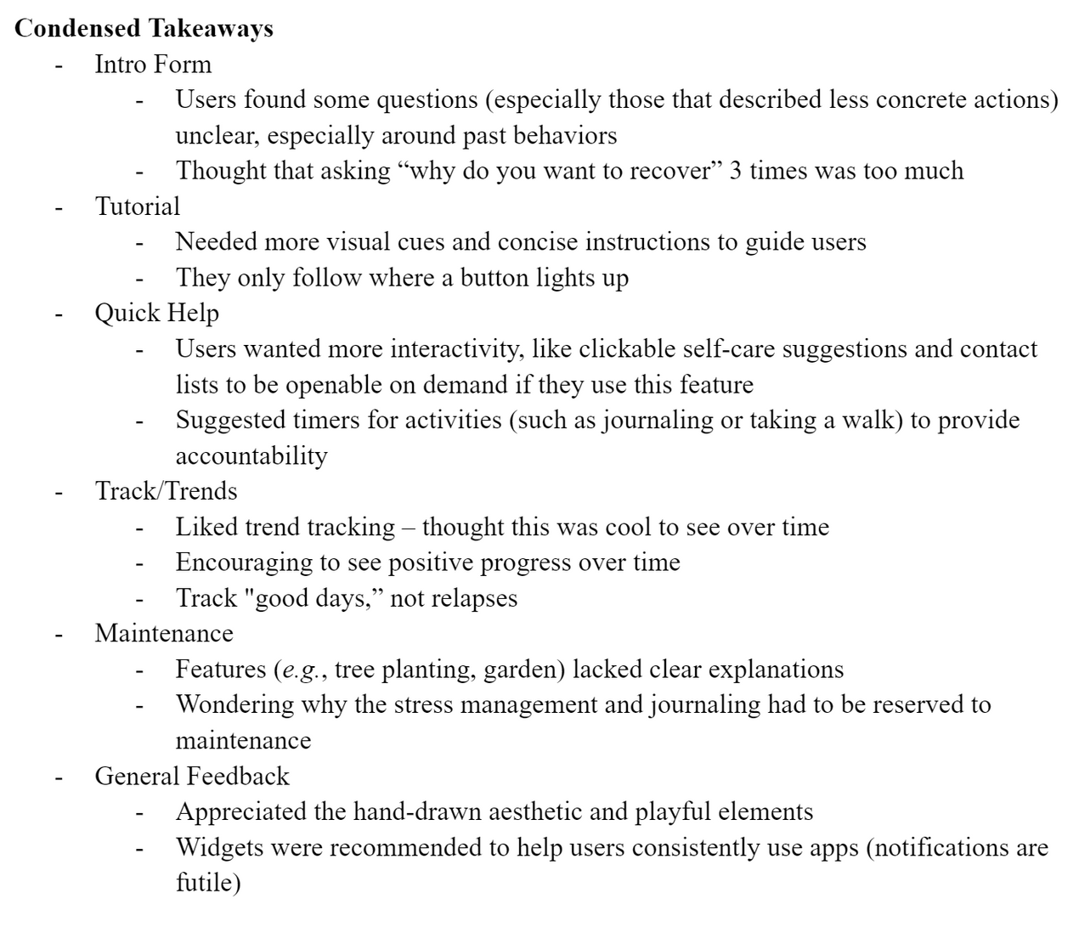
Feature-based Takeaways
Other notable takeaways and areas of attention based on specific app functions/features.
Note: this is a condensed version of the notes from prototyping. You can view the full list here.

