Slide 1

AVA, ELTON, MAI, NAYOUNG
FoodWise
WEEK 4: CONCEPT VIDEO

Slide 2
FOODWISE
ORIGINAL IDEA
SOLUTION
MARKET RESEARCH
Content
DESIGN VALUES
STAKEHOLDERS AND ETHICAL IMPLICATIONS
TASKS
STORYBOARD
VIDEO

Slide 3




FOODWISE
Our Original Solution
HOWEVER, WE REALIZED THIS WAS DIFFICULT TO MANAGE
WAS A COMMUNITY ORIENTED JOURNALING APP
AND NOT VERY DIFFERENT FROM WHATS OUT THERE

Slide 4
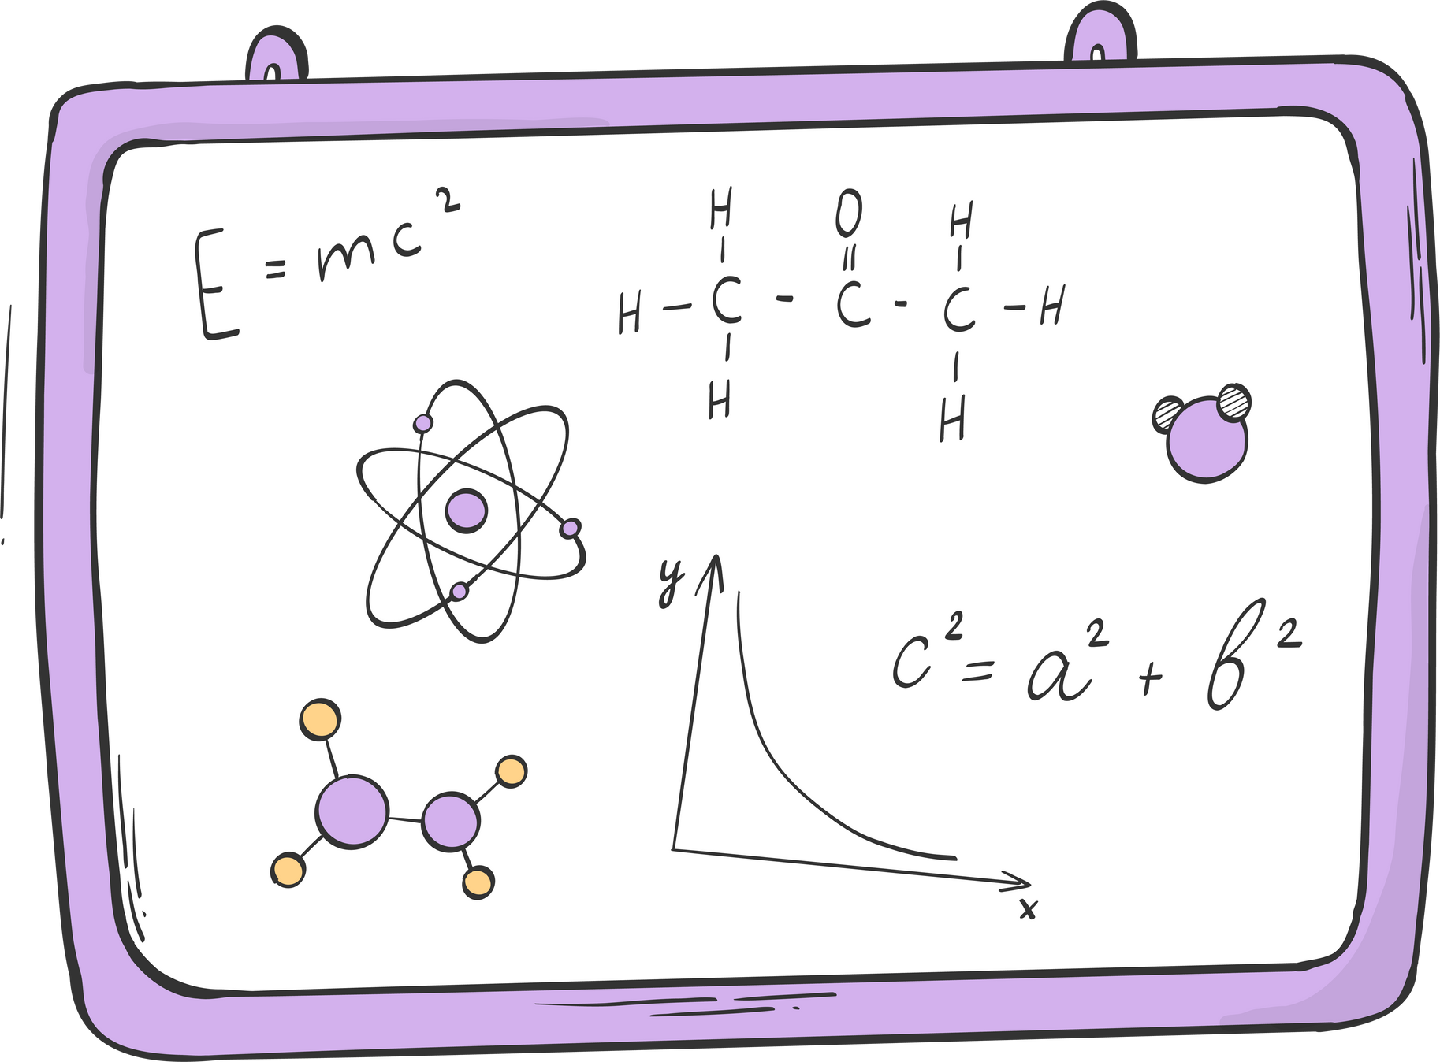
FOODWISE
So, we had to go back to the drawing board

Slide 5
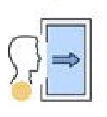





Our New Solution
FOODWISE
STAGE-BASED RECOVERY
A HOLISTIC RECOVERY ROADMAP, BASED ON ETM, THAT STILL ALLOWS FOR USER-PERSONALIZATION
ENTRANCE
PRE-CONTEMPLATION
GAMIFY THE PROGRESS
THROUGH SMALL GOAL SETTING AT EACH STAGE, USERS GAIN EXP THAT CAN TAKE THEM TO THE NEXT LEVEL OF RECOVERY BY CHOICE
CONTEMPLATION
PREPARATION
MAINTAIN USER GROWTH
WITH A FINAL MAINTANENCE STAGE THAT WILL ENCOURAGE THE USER TO CONTINUE USING THIS APP AS A RECORD FOR THEIR MOODS AND RECOVERY METHODS
ACTION
MAINTENANCE

Slide 6
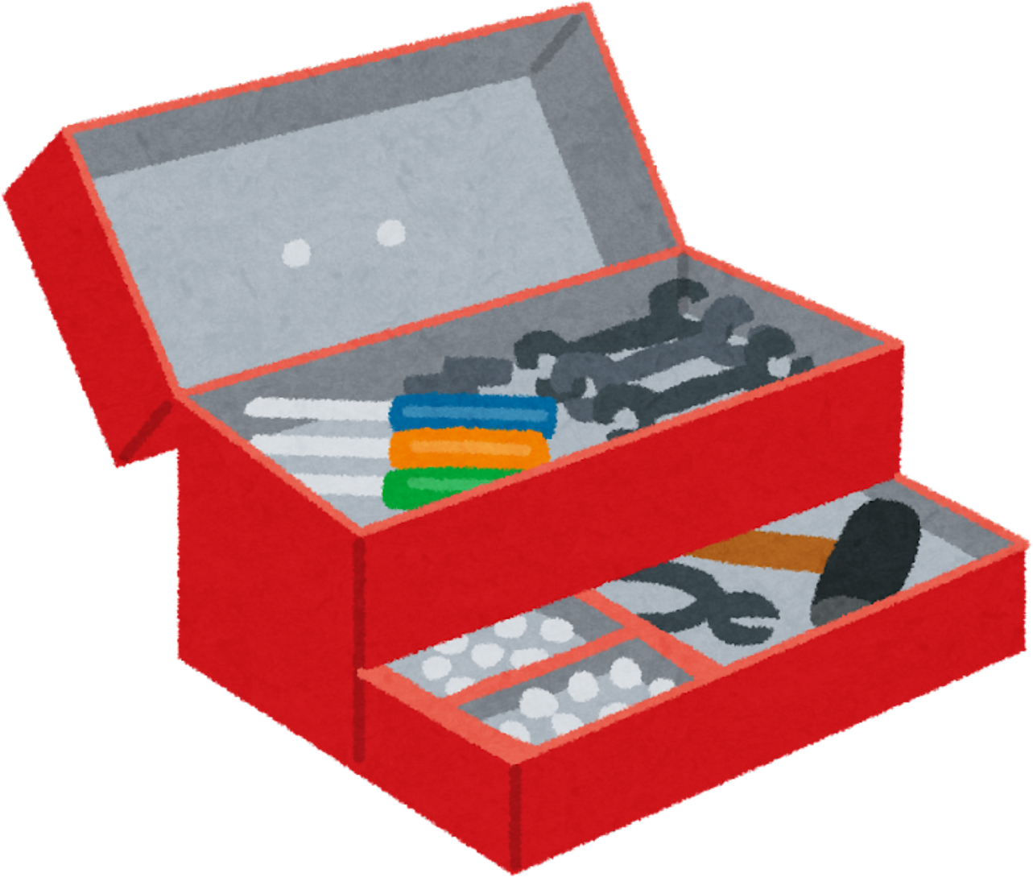
Our New Solution
FOODWISE
YOUR RECOVERY TOOLBOX
USERS WILL GAIN NEW SKILLS THAT THEY CAN CALL BACK TO AS THEY GO THROUGH THEIR JOURNEY
A LIST OF COPING MECHANISMS THAT THE USER CAN SELF-CURATE FOR ANY TRIGGERING SITUATION THEY ENCOUNTER
THESE SKILLS ARE STORED IN THE RECOVERY TOOLBOX

Slide 7

This App is Called
FOODWISE
FoodWise
your roadmap to real recovery

Slide 8
FOODWISE
Market Research

Slide 9
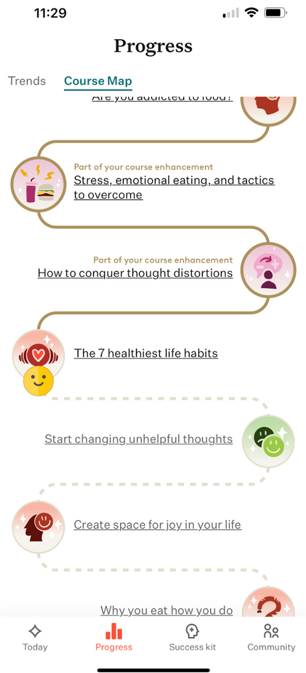
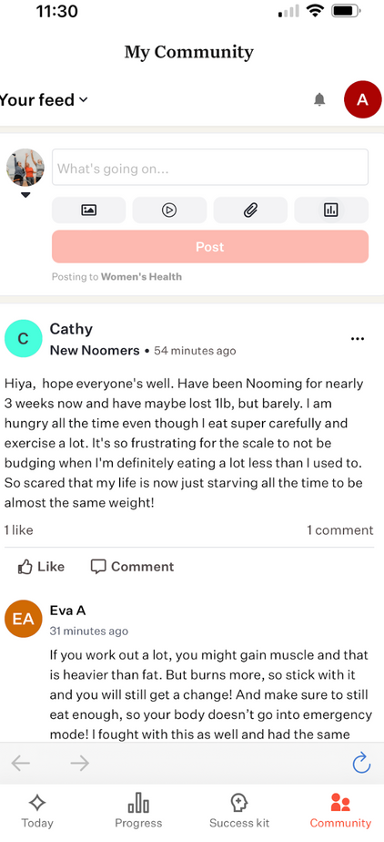
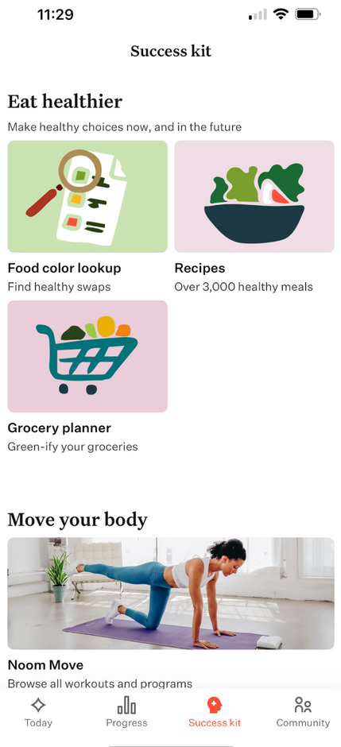
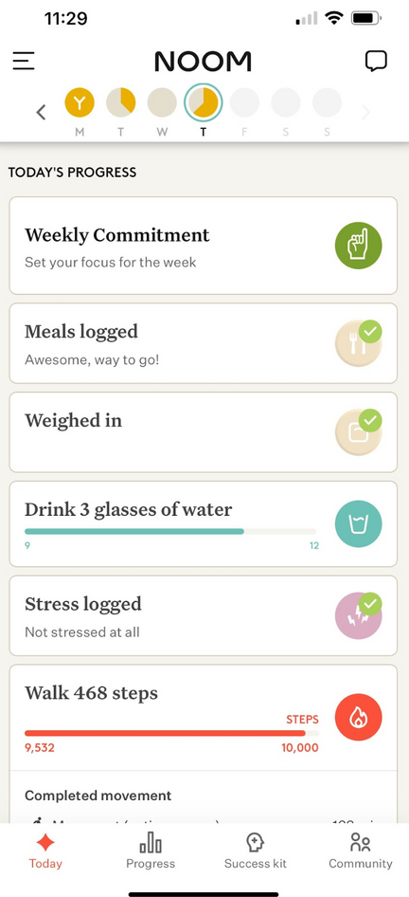
FOODWISE
AVA STUDIED: NOOM
LOSE WEIGHT AND KEEP IT OFF

Slide 10
FOODWISE
AVA STUDIED: NOOM
LOSE WEIGHT AND KEEP IT OFF
FEATURES
A COMPREHENSIVE APPROACH
to behavior change around eating to instill a healthy relationship with food. This includes features like small daily goals, weekly focuses, as well as your traditional recovery logging
PSYCHOLOGY DRIVEN
they include mini lessons, personalized coaching (if purchased), food-tracking, stress and mood-tracking, recipes, grocery planner
HABIT DRIVEN
Primarily seeks to help users incorporate new habits into their daily routines without it feeling like a burden
IMPLICATIONS
LACK OF EMOTIONAL REGULATION
Noom does not have anything regarding how to deal with triggers and coping mechanisms for stress that leads to eating disorders
FOR WEIGHT LOSS RATHER THAN RECOVERY
While they focus on building healthy relationships with food as one of their primary functions, their product is geared more towards healthy weight loss and not eating disorder recovery

Slide 11
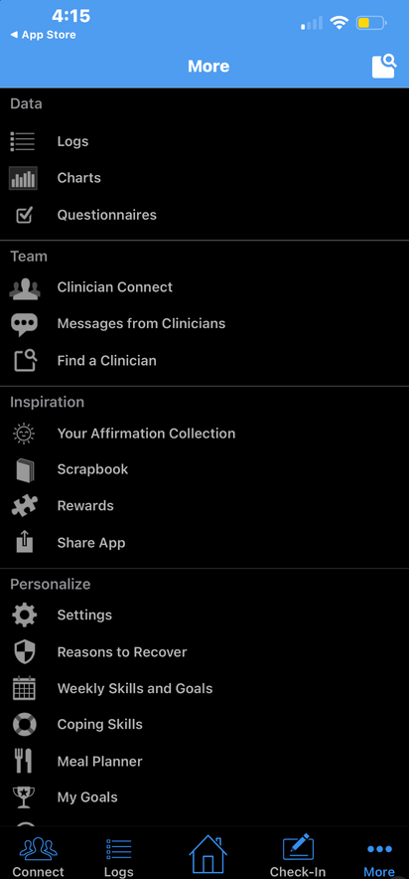
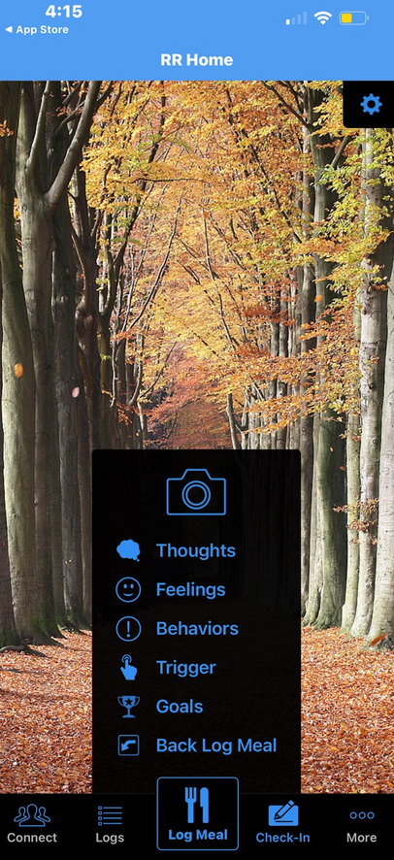
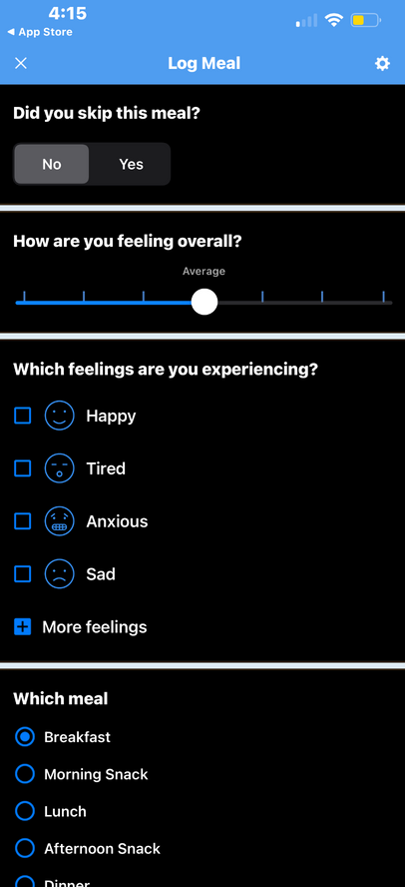
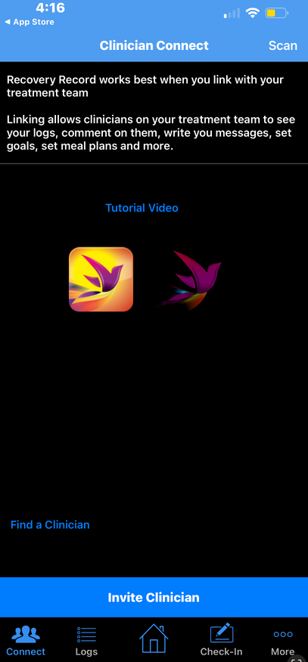
FOODWISE
ELTON STUDIED: RECOVERY RECORD
BEST PRACTICE FOR EATING DISORDERS TREATMENT

Slide 12
FOODWISE
ELTON STUDIED: RECOVERY RECORD
BEST PRACTICE FOR EATING DISORDERS TREATMENT
FEATURES
USER AUTONOMY
Allowing the user to decide which activities and coping mechanisms are most effective to them in their recovery journey
keeping record of your recovery
IS absolutely its primary function. This involves logging thoughts, feelings, company, food, percentage of meal eaten, etc.
INSPIRATION SECTION
A UNIQUE FEATURE where users can share affirmations with one another as they recover together
IMPLICATIONS
INFORMATION OVERLOAD
While every service provided is most definitely useful, it overwhelms the user, both due to the amount but also due to the poor interface
Presence of a professional
THE app emphasizes that it is best used alongside a medical professional, which as we learned through our needfinding, is very inaccessible

Slide 13
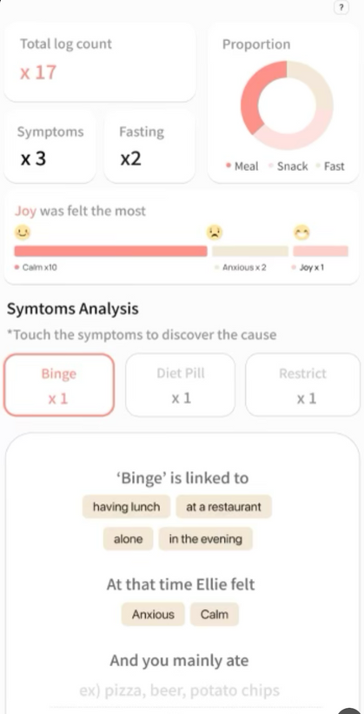
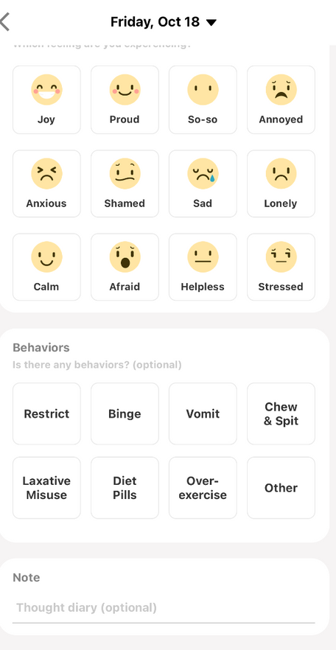
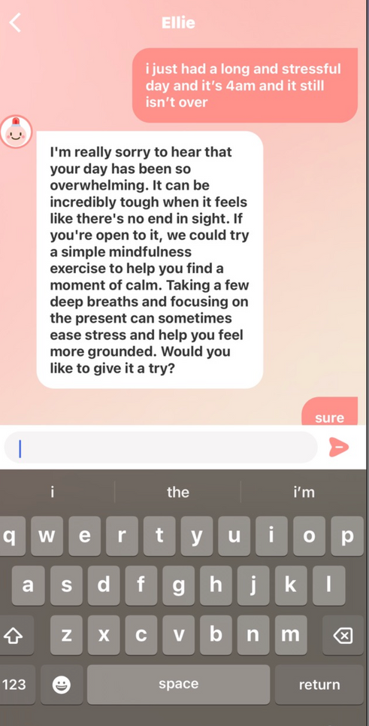
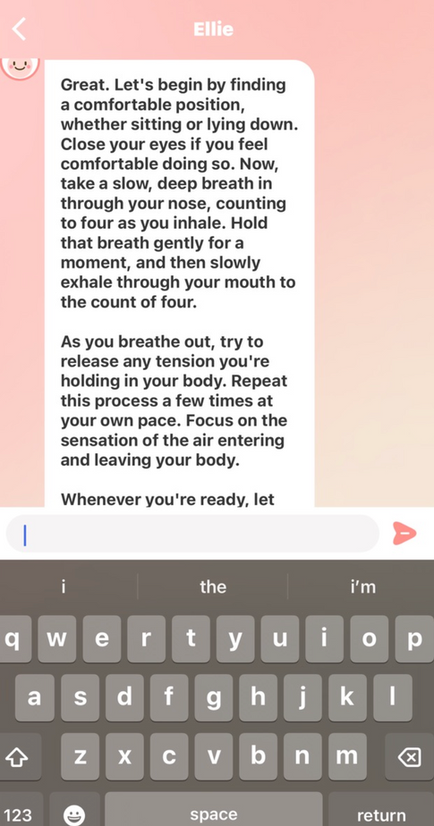
FOODWISE
MAI STUDIED: POMELLOW
THE DAILY CARE APP FOR EATING DISORDERS

Slide 14
FOODWISE
MAI STUDIED: POMELLOW
THE DAILY CARE APP FOR EATING DISORDERS
FEAUTURES
A FOOD DIARY
So the user can record their meals, how much they ate, what time, with whom they ate, their mood as they ate, and if any harmful behaviors were practiced with this meal.
Uses the data gained from this as well to try to identify patterns in your behavior (triggers and responses)
A THERAPEUTIC CHATBOT
Named Ellie who is meant to help you process your emotions as you go through your recovery
A “FRIENDING” FUNCTION
Where you can invite other people to the app, but as people who are your support system in recovery
IMPLICATIONS
THE HUMAN EXPERIENCE
While Ellie has the intention of helping you deal with your emotions, she seems to consistently always try to offer you a solution immediately. While this is absolutely helpful in some situations, other times you may just want to talk.
Lack of Autonomy
THE USER IS NOT THE ONE IDENTIFYING PATTERNS IN THEIR OWN BEHAVIOR, THE APP IS. HOWEVER, THIS TAKES AWAY A VERY NECESSARY PART OF RECOVERY FROM THE USER, REFLECTION AND AUTONOMY.

Slide 15
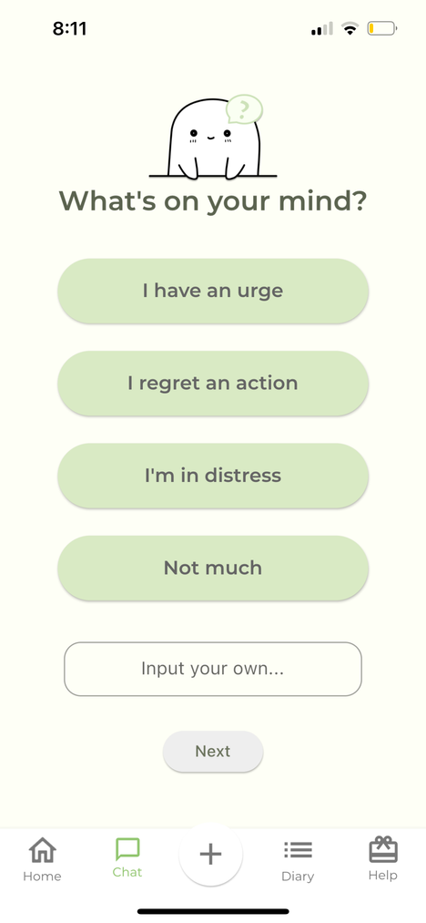
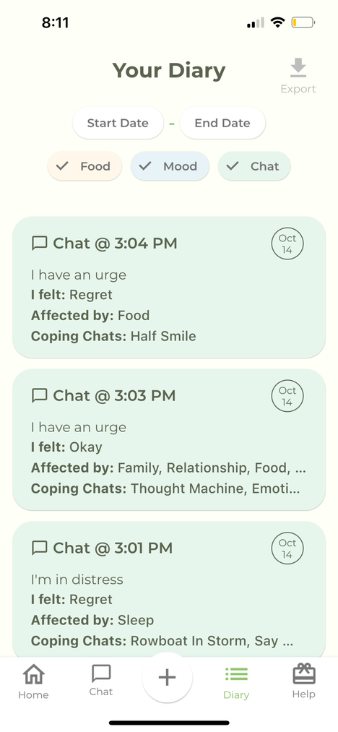
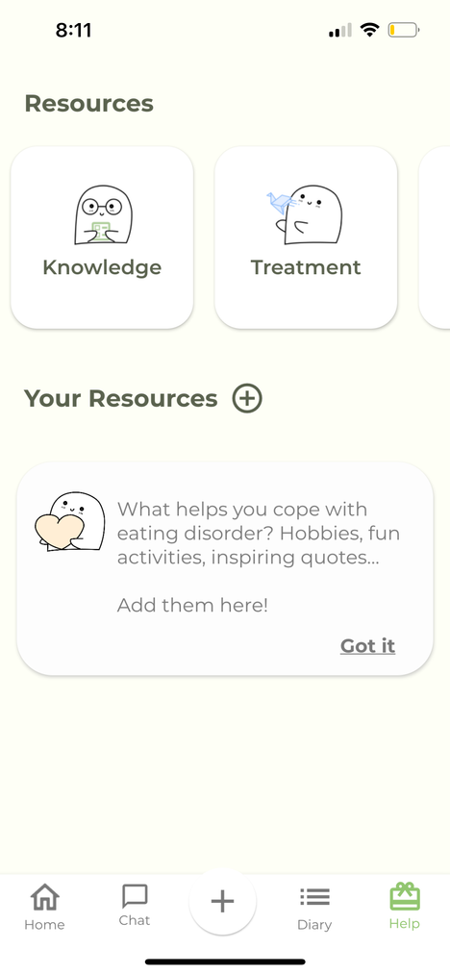
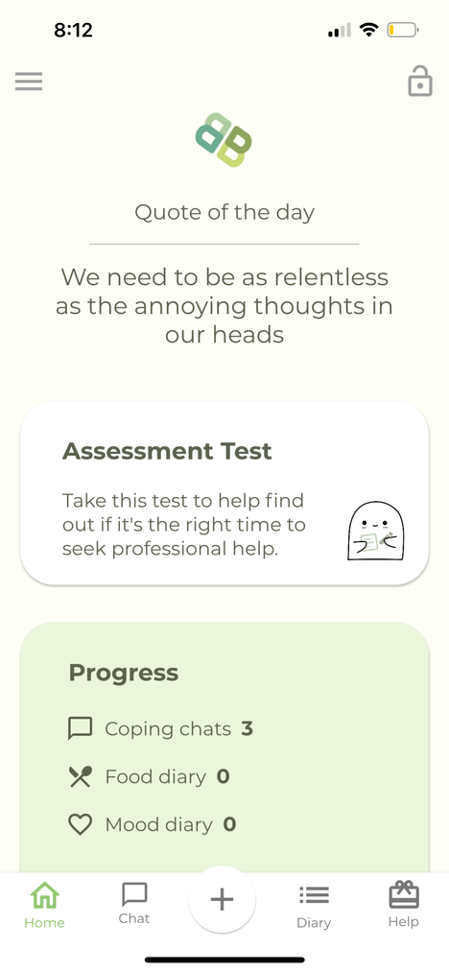
FOODWISE
NAYOUNG STUDIED: BRIGHTER BITE
EVERY STEP COUNTS

Slide 16
FOODWISE
NAYOUNG STUDIED: BRIGHTER BITE
FEATURES
UNIQUE OPENING INTERFACE
Prompts the user, asking if they:
Have an urge, regret an action, are in distress, or are simply feeling fine. The user may also input their own response
It then recommends several coping mechanisms based on the user’s responses
FOOD & MOOD DIARY
WHERE YOU Record meals/snacks with options to leave some notes and pictures, as well as your emotions and urges to track what caused certain types of feelings or events
RESOURCE PAGE
WHERE The user could learn more about eating disorders and eating disorder recovery
EVERY STEP COUNTS
IMPLICATIONS
MANAGING EMOTIONS Is one of the primary aspects of eating disorder recovery
It could service this better if there is more structure to guide the user’s recovery and show tangible growth
COPING MECHANISMS could be curated with more focus towards the user
Rather than giving users coping mechanisms, it could help them identify what their greater triggers are and ask them what they can do to combat them, making the user more involved in their own recovery

Slide 17

Our Competitor Comparison Matrix
FOODWISE
NOOM
BB
POMELLOW
RR
FOCUSES PRIMARILY ON ED RECOVERY
EMPHASIZES USER AUTONOMY
HELPS USER DEVELOP COPING MECHANISMS
INVOLVES MEAL TRACKING

Slide 18
FOODWISE
Design Values

Slide 19




FOODWISE
Our Core Values
STRUCTURE
AUTONOMY
GROWTH
FUN!
ALLOWS PEOPLE TO SEE A TANGIBLE SOLUTION TO THEIR PROBLEM
EMPOWERS THE USER TO REGAIN CONTROL OF THEIR HABITS
IS NECESSARY TO INSTILL HOPE. WHEN YOU SEE YOUR PROGRESS, YOU BELIEVE IT
IS VITAL TO ENSURE THE USER CONTINUES THEIR RECOVERY

Slide 20
FOODWISE
Stakeholders and Ethical Implications

Slide 21
FOODWISE
Stakeholders
WE RECOGNIZE THIS PRODUCT HAS A WIDE REACHING IMPACT, HERE WE HAVE IDENTIFIED SOME WHO MAY BE INTERESTED
DIRECT STAKEHOLDERS: people who may directly partner with us
Health and mental health organizations, those who specialize with psychiatrists, psychologists, therapists, nutritionists, and dietitians
Peer support communities that service our primary users, such as Overeaters Anonymous and the Emily Program
INDIRECT STAKEHOLDERS: people who may use our app, but not directly partner with us
Advocacy organizations whose primary focus is awareness, such as the National Eating Disorders Association (NEDA)
Counselors and school wellness programs which likely will not directly interact with us, but could recommend the app to those who are seeking help

Slide 22
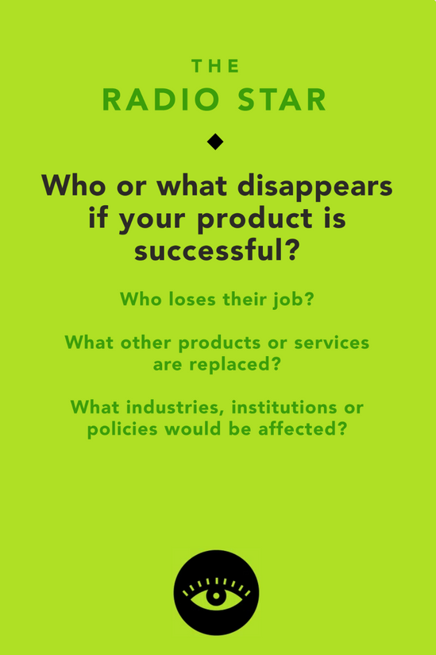
FOODWISE
Ethical Implications: Our Tarot Cards of Tech
NUMBER 1: VIDEO KILLED THE RADIO STAR
IN THE EVENT THIS PRODUCT IS INCREDIBLY SUCCESSFUL, SOME PEOPLE MAY GO OUT OF BUSINESS.
For instance, our app uniquely uses techniques from addiction recovery and adapts it to fit eating disorder recovery. So, one can conclude that if all goes well, people will look to this as a new, innovative, and ideal way to treat an eating disorder. This may put CBT therapists out of a job.
Institutions can also certainly be impacted by this. Primarily medical and therapeutic ones. This could innovate the way we treat eating disorders

Slide 23
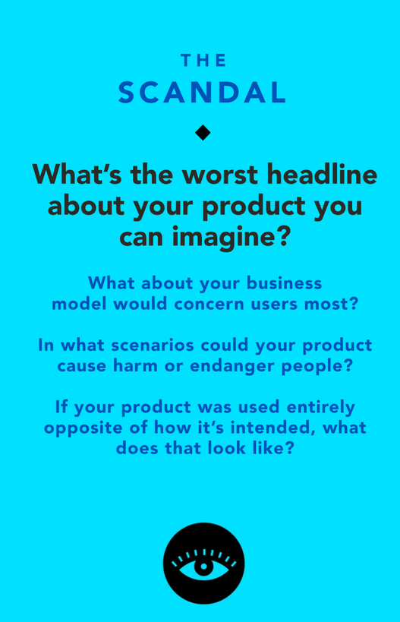
FOODWISE
Ethical Implications: Our Tarot Cards of Tech
NUMBER 2: OH MY, WHAT A SCANDAL!
“NEW APP DUMBS DOWN ED RECOVERY, INCREDIBLY TONE DEAF”
We understand that in trying to make recovery structured in such a way where it fits every kind of ED patient is an incredibly difficult task. There is a reason many people don’t use apps, it’s hard to make it work for you.
However, we do believe that in providing structure, we ultimately provide a more accessible, yet still personalizable, route to recovery. Of course we can see how structure may in fact induce stress in a user, especially if they feel as though they are not sticking to their recovery goals. But we hope that in making it fun, lighthearted, positive, and without excessive tracking, the user will feel safe in the structured environment

Slide 24
FOODWISE
Tasks

Slide 25




FOODWISE
Simple
Moderate
Complex
A RECURRING USER WANTS PERSONALIZED RECOVERY GUIDANCE BASED ON THEIR STRESSORS AND SYMPTOMS
A USER WHO HAS COMPLETED THEIR RECOVERY JOURNEY WANTS MAINTAINABLE STRATEGIES BASED ON THE STEPS THEY TOOK TO HEAL
A USER WANTS TO IDENTIFY THEIR TRIGGERS IN ORDER TO AVOID THEM

Slide 26
FOODWISE
Storyboarding

Slide 27
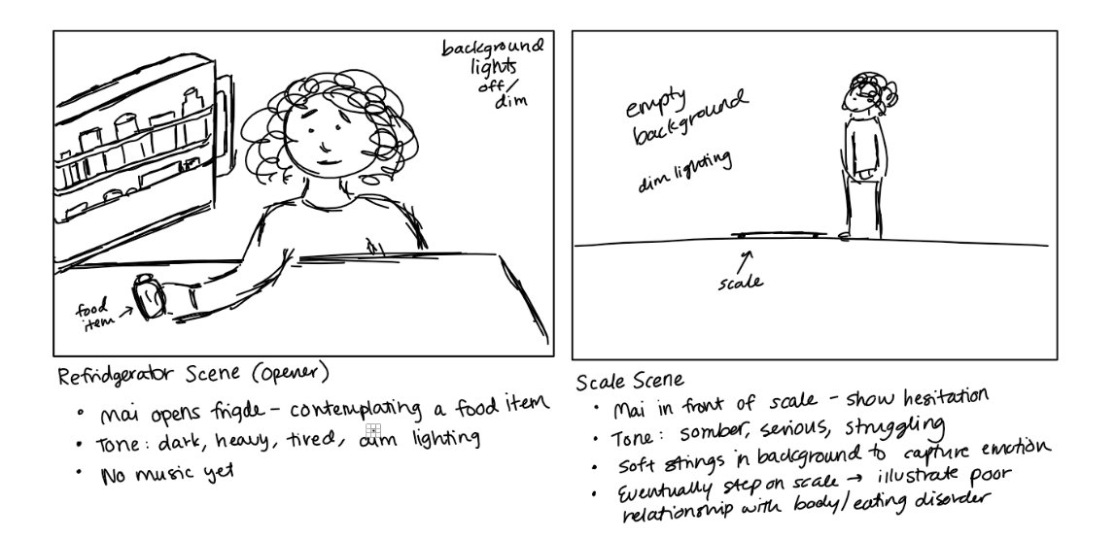
FOODWISE

Slide 28
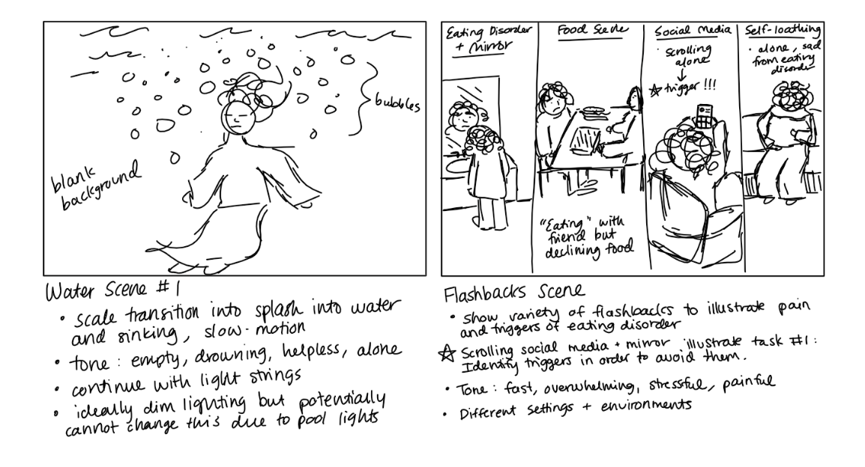
FOODWISE

Slide 29
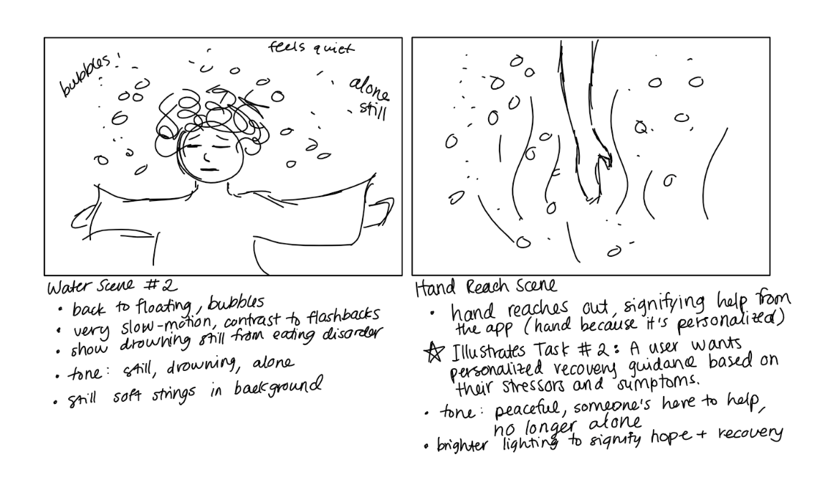
FOODWISE

Slide 30
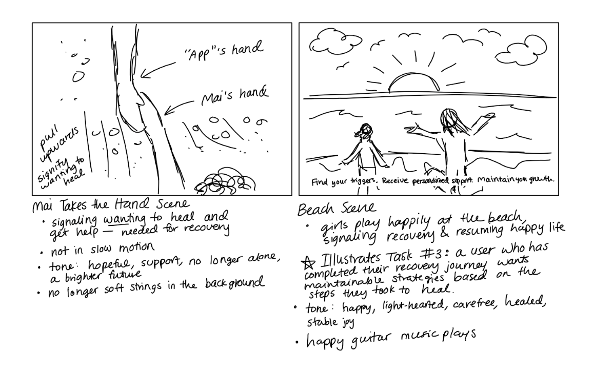
FOODWISE

Slide 31
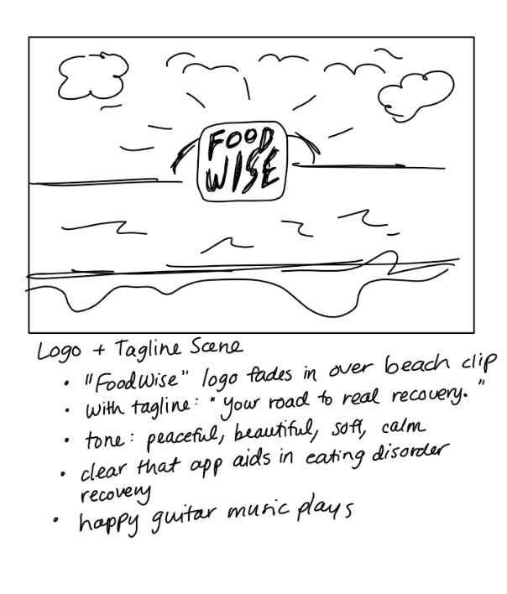
FOODWISE

Slide 32
FOODWISE
Concept Video

Slide 33

FOODWISE

Slide 34
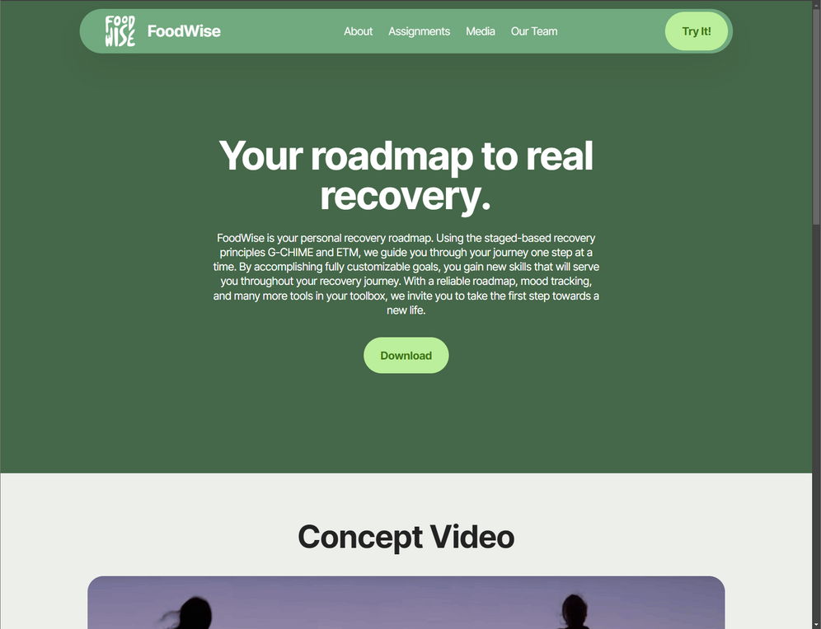
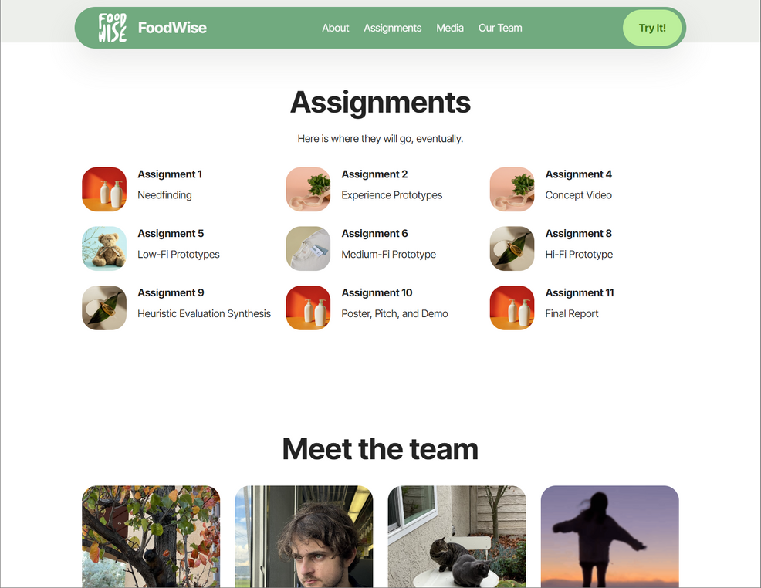
FOODWISE
Website

