Slide 1
Food for Thought
A2: ADDITIONAL NEEDFINDING, POVS, HMWS, BRAINSTORMING & EXPERIENCE PROTOTYPES
Ava Love, Mai Mostafa, Na Young Son, Elton Manchester

Slide 2
AGENDA
Two Additional Interviews
Original → Focused Problem Domain
POV Development
10 HMWs for Each POV
10-15 Solutions for Each HMW (appendix)
Prototyping Overview, Process, & Results
Ethical Implications + Community Impact
Top Solution Moving Forward

Slide 3
Two New Interviews

Slide 4

2 NEW INTERVIEWEES
W
S
Interviewer: Mai Mostafa
Notes: Ava Love
Junior at San Jose State, studying Architecture, recently fell into bad eating habits as a result of his busy college schedule, however has seemingly made a miraculous recovery over summer
Interviewer: Na Young Son
Notes: Ava Love
Sophomore in King’s College, now taking a LoA to work as a PT instructor, history of childhood obesity and bulking-up during high school

Slide 5
INTERVIEWEE 1 JAMBOARD
“I want to look kind of like a statue, I wanted my body to be perfectly proportionate”
His mom used to force him to eat a lot of fruit when he was young, grew a distaste towards it
used to restrict carbs, now doesn’t restrict but does priortize protein
works out every single day, heavily prioritizes gaining weight and muscle mass
has begun cutting down on vitamins
enjoys
baking
He is currently at the lowest weight he has been since he was 12 and he’s not entirely sure why
he finds a lot of joy in baking breads and pastries and used this as a primary method for recovery
takes liquid iv to help with hydration
he has learned to completely priortize 3 meals a day
whenever he doesn’t feel well, he goes through a list of possible causes (did I sleep enough, did I eat, did I drink water)
Mentioned being a part of a food education organization in high school
Used to take many supplements, in particular a variety of vitamins, to make up for lack of meals
used to strive for an idealized body, specifically that of a short, skinny queer man
is more than willing to invest his time and energy into his health and recovery
During first two years of school, said that he would often forget to eat for 2 or 3 days at a time
SAY
DOES
found the queer dating scene to be harmful to his mental health, made him feel like he had to look like an ideal gay man
views cutting and bulking as not useful to his goals since he generally is prioritizing gaining weight
still feels the need to change his body to some extent
THINK
FEEL
Tries not to think of any food as inherently unhealthy
felt like he had to lose weight because when he was skinnier he was receiving more romantic attention
often confuses the feelings of hunger, cravings, and thirst
Still actively dealing with the desire to look like a perfectly proportionate person, like a sculpture, but refuses to not priortize his health
has issues feeling hunger as a result of his poor eating habits freshman and sophomore year
considers podcasts too be a great source of health information
Actively has to remind himself to eat since his body has trouble recognizing hunger
felt as though any pressures to change his body or eating habits from his family were rooted in health concerns, both parents are doctors
feels like he’s recovered a lot
finds joy in the creation and sharing of food and used this to aid in recovery
prior to being here, hadn’t really thought about his body image

Slide 6
INTERVIEWEE 1 JAMBOARD
“I want to look kind of like a statue, I wanted my body to be perfectly proportionate”
His mom used to force him to eat a lot of fruit when he was young, grew a distaste towards it
used to restrict carbs, now doesn’t restrict but does priortize protein
works out every single day, heavily prioritizes gaining weight and muscle mass
has begun cutting down on vitamins
“I want to look like a statue, I want my body to be perfectly proportionate”
enjoys
baking
he finds a lot of joy in baking breads and pastries and used this as a primary method for recovery
He is currently at the lowest weight he has been since he was 12 and he’s not entirely sure why
During first two years of school, said that he would often forget to eat for 2 or 3 days at a time
he finds a lot of joy in baking breads and pastries and used this as a primary method for recovery
takes liquid iv to help with hydration
he has learned to completely priortize 3 meals a day
whenever he doesn’t feel well, he goes through a list of possible causes (did I sleep enough, did I eat, did I drink water)
Mentioned being a part of a food education organization in high school
Used to take many supplements, in particular a variety of vitamins, to make up for lack of meals
used to strive for an idealized body, specifically that of a short, skinny queer man
is more than willing to invest his time and energy into his health and recovery
During first two years of school, said that he would often forget to eat for 2 or 3 days at a time
SAY
DOES
found the queer dating scene to be harmful to his mental health, made him feel like he had to look like an ideal gay man
views cutting and bulking as not useful to his goals since he generally is prioritizing gaining weight
still feels the need to change his body to some extent
found the dating scene to be harmful to his mental health, made him feel like he had to look like an ideal queer man
THINK
FEEL
felt like he had to lose weight because when he was skinnier he was receiving more romantic attention
often confuses the feelings of hunger, cravings, and thirst
Tries not to think of any food as inherently unhealthy
has issues feeling hunger as a result of his poor eating habits freshman and sophomore year
Still actively dealing with the desire to look like a perfectly proportionate person, like a sculpture, but refuses to not priortize his health
prior to being here, hadn’t really thought about his body image
has issues feeling hunger as a result of his poor eating habits freshman and sophomore year
considers podcasts to be a great source of health information
Actively has to remind himself to eat since his body has trouble recognizing hunger
felt as though any pressures to change his body or eating habits from his family were rooted in health concerns, both parents are doctors
feels like he’s recovered a lot
prior to being here, hadn’t really thought about his body image
feels very happy when he can make something and share it with others

Slide 7
INTERVIEWEE 1 TAKEAWAYS
Insight
His busy schedule caused him to largely neglect his health, which also became motivated by the increased romantic attention he was getting due to his new physique. While his eating habits seem to have recovered, he still cares a lot about his physique.
Need
A way to find self confidence in something other than physical appearance

Slide 8
INTERVIEWEE 2 JAMBOARD
consumes more carb for bulking
most of his family members are heavy weight drinkers
enjoys cooking for himself
he counts calories all the time
considers protein, carb, and calories when he orders/cook food
regularly takes health-related supplements
consumes more carb for bulking
consumes lots of food/diet information online
everyone he knew commented on his weight when he had obesity growing up
he doesn’t have personal restrictions on food
lost 50kg in high school by going on a cut
his family enjoys spicy and greasy food, so he was affected by it growing up
avoids monosaccharide foods instead of avoiding all types of carbohydrate
socializing culture (eating and drinking together) in Korean companies makes it harder to maintain ha ealthy eating habit
he used to have a terrible eating habit, but managed to improve it
adapted a habit of searching of and prioritizing protein all the time
his diet changes drastically depending on whether he’s on a cut or a bulking phase
drinks a lot when he’s not on ‘diet’
SAY
DOES
THINK
FEEL
felt the pressure to cut his weight because of the comments he was receiving from people around him
thinks bulking/cutting as part of his health goals along with his body image goals
considers carb as useful energy source for improving his training performance
he views food is just divided into healthy and unhealthy
having gym buddies help him keep motivated and enjoy working out
felt embarrassed with his weight/body image when he had obesity
thinks one should have ‘proper’ knowledge before engaging with food/health contents on social media
he struggled with pressures with bulking up as he joined the school rugby team
considers social media helpful in finding more information about food/diet/health
has more pressure to have a certain body image as a PT instructor, but is less stressed than when he was initially getting into body building
supplements are helpful for health/building muscles
he has better relationship with food now
considers fried, greasy, and monosaccharide food bad for his health
feels more satisfied when he consumes food he cooked himeself

Slide 9
INTERVIEWEE 2 JAMBOARD
consumes more carb for bulking
most of his family members are heavy weight drinkers
enjoys cooking for himself
he counts calories all the time
considers protein, carb, and calories when he orders/cook food
regularly takes health-related supplements
avoids monosaccharide foods instead of avoiding all types of carbohydrate
consumes more carb for bulking
consumes lots of food/diet information online
everyone he knew commented on his weight when he had obesity growing up
he doesn’t have personal restrictions on food
lost 50kg in high school by going on a cut
his family enjoys spicy and greasy food, so he was affected by it growing up
socializing culture (eating and drinking together) in Korean companies makes it harder to maintain ha ealthy eating habit
he used to have a terrible eating habit, but managed to improve it
adapted a habit of searching of and prioritizing protein all the time
his diet changes drastically depending on whether he’s on a cut or a bulking phase
drinks a lot when he’s not on ‘diet’
SAY
DOES
THINK
FEEL
felt the pressure to cut his weight because of the comments he was receiving from people around him
thinks bulking/cutting as part of his health goals along with his body image goals
considers carb as useful energy source for improving his training performance
he views food is just divided into healthy and unhealthy
having gym buddies help him keep motivated and enjoy working out
felt embarrassed with his weight/body image when he had obesity
has more pressure to have a certain body image as a PT instructor, but is less stressed than when he was initially getting into body building
thinks one should have ‘proper’ knowledge before engaging with food/health contents on social media
he struggled with pressures with bulking up as he joined the school rugby team
considers social media helpful in finding more information about food/diet/health
supplements are helpful for health/building muscles
he has better relationship with food now
considers fried, greasy, and monosaccharide food bad for his health
feels more satisfied when he consumes food he cooked himeself

Slide 10
INTERVIEWEE 2 TAKEAWAYS
Insight
social pressures such as from his family, friends, and rugby team were the trigger for him to start cutting and body building
Need
healthier motivation for body-building
balanced control and sustainable food habits

Slide 11
Domain Updates

Slide 12
DOMAIN CHANGES
Original Domain
Focused Domain
Poor relationships with food
Eating disorders only
Originally, our scope included anyone who experiences a poor relationship with food and views food in a negative light--whether this be with past food experiences from childhood, food preferences and rules, inconsistent/unhealthy eating habits, etc.
After further need finding, we have narrowed our scope to include only those who experience a very poor relationship with food, specifically those with eating disorders (focusing on anorexia and bulimia) who are beginning or are on their road to recovery. We found that this domain experienced a more severe pain point and was most in need of a solution to support their recovery.
→

Slide 13
POV Progression

Slide 14
POV FROM STUDIO 2 (JH)
Our original POV for JH from studio 2 was too broad and needed to be more specific.
We met...
We were surprised to realize...
We wondered if this means...
It would be game-changing to...
JH, a college senior from Korea with a history of eating disorder (bulimia, binge eating and purging).
Medication and therapy helped in the recovery process, even though eating disorder is not as commonly associated with mental illness – specifically, she can better regulate her emotions (and, in turn, eating disorder) with medication and therapy.
Unhealthy relationships with food are closely tied to mental and emotional wellbeing (or lack thereof).
Reduce the stigma associated with eating disorders and support the mental side of the road to recovery.

Slide 15
POV REVISED (JH, POV 1)
To fix this, we broke our POV for JH into 2 POVs, where each one is more specific. POV 1 for JH focused more on the cyclical nature of an eating disorder.
We met...
We were surprised to realize...
We wondered if this means...
It would be game-changing to...
JH, a college senior from Korea, who has a history of bulimia brought about by pressures of female beauty standards.
She puts extreme pressure on herself to lose weight and, as a result, has an all-or-nothing mentality when it comes to food restrictions. When breaking food rules, she feels guilt that causes her to fall into a cycle of binging and purging.
Her eating disorder behaves like an addiction in that it is largely triggered by common life stress and acts as an obsession with an body standard.
Provide healthy interventions that prevent triggering a relapse into the addiction of an eating disorder.

Slide 16
POV REVISED (JH, POV 2)
Our POV 2 for JH focuses more on the community aspect of an eating disorder.
We met...
We were surprised to realize...
We wondered if this means...
It would be game-changing to...
JH, a college senior from Korea, who has a history of bulimia brought about by pressures of female beauty standards.
Even though she struggled with comparing herself to others, her eating habits improved when she had company.
The presence/company of trusted friends/community can help prevent her falling back into eating disorder habits (binging and purging).
Improve access to others who are also on a road to recovery to act as a reliable support system in her recovery.

Slide 17
ADDITIONAL POV (J)
We also compiled an additional POV for one of our interviewees, J.
We met...
We were surprised to realize...
We wondered if this means...
It would be game-changing to...
J, a college junior from Philadelphia, who has a history of anorexia and, more recently, developed bulimia. At her lowest, she was eating around 300 calories per day and walking around 12 miles per day.
Despite viewing her eating disorder as morally incorrect, when asked for what she believes is her healed, happy self, she identified a target weight (that she compared to someone in her sorority).
She finds self-worth with how skinny she is and focuses on where she feels she doesn’t meet beauty standards. Hence, her comparison to others is a driving force of her eating disorder.
Shift her motivation for recovery to focus on health rather than weight/body image.

Slide 18
HMWs

Slide 19
HMWS FOR JH, POV 1
HMW instill healthy thought processes + coping mechanisms for preventing relapse and for times of crisis?
HMW we help someone regulate their emotions (which are linked to eating behaviors)?
HMW remove triggers/frequency of triggers?
HMW break the cyclical nature of the eating disorder?
HMW break someone out of their negative spiral by looking at the stages of stress, binging, and purging?
HMW we incentivize someone to track/record their stress and eating habits in a non-oppressive way?
HMW discourage comparison with others?
HMW manage the all-or-nothing mentality?
HMW healthily encourage portion control?
HMW decrease personal stigma regarding eating disorders?
HMW regulate feelings after relapse and cut short negative feelings of guilt and self-hatred?
HMW help recovery after the relapse/purging?

Slide 20
HMWS FOR JH, POV 2
HMW involve other people (such as a community) in one’s recovery from an eating disorder?
HMW increase on-demand access to a supportive community in times of crisis (verge of relapse)?
HMW ensure that this community is healthy and reinforcing positive behaviors as opposed to negative ones?
HMW help someone to call on physical or virtual company to accompany one while eating (i.e. for a meal0?
HMW break down shame and hesitancy to partake in a community that is striving for recovery from and eating disorder?
HMW create authentic community that connects at a deeper, emotional level?
HMW create consistent engagement with such a community?
HMW create a community that collectively strives for an upward trajectory from an eating disorder?
HMW provide support to prevent relapse when a person is by themselves and there is no immediate, external intervention available?
HMW ensure that the community toward recovery is a safe space?
HMW incentivize people to join and share in this community space?
HMW provide support to prevent binging specifically and help with food portion regulation (not restriction)?

Slide 21
HMWS FOR J’S POV
HMW make thinking/feeling about a food a positive/uplifting experience instead of oppressing?
HMW combat the glorification of unhealthy (overly skinny) bodies?
HMW we totally change beauty standards?
HMW provide messaging to combat toxic, unhealthy messaging around eating habits and food?
HMW use positive messaging and accurate information to change one’s mindset in recovery from an eating disorder?
HMW instill the belief that happiness does not come from appearance (or weight)?
HMW instill a half-glass-full mentality around self-perception and self-image?
HMW eliminate shame/stigma around eating disorders and seeking help/therapy for them?
HMW increase accessibility to food therapy specifically?
HMW encourage someone to seek professional help when signs of declining health from an eating disorder (such as losing one’s menstrual cycle) occur?
HMW re-establish beauty standards as defined by healthiness, not “being skinny”?
HMW instill confidence beyond just appearance (i.e. find confidence in friends, skills, experiences, etc.)?
HMW seek out and provide regulated health information?
HMW shift the mentality away from appearance-oriented toward health-oriented?
HMW eliminate body comparison to others’ bodies?

Slide 22
Top Three HMWs

Slide 23
TOP HMW FOR JH, POV 1
We met...
We were surprised to realize...
We wondered if this means...
It would be game-changing to...
JH, a college senior from Korea, who has a history of bulimia brought about by pressures of female beauty standards.
She puts extreme pressure on herself to lose weight and, as a result, has an all-or-nothing mentality when it comes to food restrictions. When breaking food rules, she feels guilt that causes her to fall into a cycle of binging and purging.
Her eating disorder behaves like an addiction in that it is largely triggered by common life stress and acts as an obsession with an body standard.
Provide healthy interventions that prevent triggering a relapse into the addiction of an eating disorder.
Top HMW:
HMW break the cyclical nature of the eating disorder?

Slide 24
TOP HMW FOR JH, POV 2
We met...
We were surprised to realize...
We wondered if this means...
It would be game-changing to...
JH, a college senior from Korea, who has a history of bulimia brought about by pressures of female beauty standards.
Even though she struggled with comparing herself to others, her eating habits improved when she had company.
She feels social inhibitions around others that prevent her from engaging in harmful behaviors such as binging and purging.
Provide her with this positive social pressure and support even when she is eating alone.
Top HMW:
HMW involve other people (such as a community) in one’s recovery from an eating disorder?

Slide 25
TOP HMW FOR J’S POV
We met...
We were surprised to realize...
We wondered if this means...
It would be game-changing to...
J, a college junior from Philadelphia, who has a history of anorexia and, more recently, developed bulimia. At her lowest, she was eating around 300 calories per day and walking around 12 miles per day.
Despite viewing her eating disorder as morally incorrect, when asked for what she believes is her healed, happy self, she identified a target weight (that she compared to someone in her sorority).
She finds self-worth with how skinny she is and focuses on where she feels she doesn’t meet beauty standards. Hence, her comparison to others is a driving force of her eating disorder.
Shift her motivation for recovery to focus on health rather than weight/body image.
Top HMW:
HMW use positive messaging and accurate information to change one’s mindset in recovery from an eating disorder?

Slide 26
Three Best Solutions
See additional solutions in appendix

Slide 27
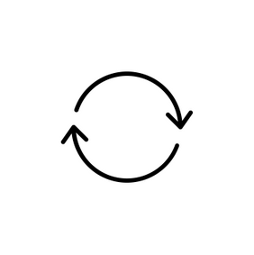
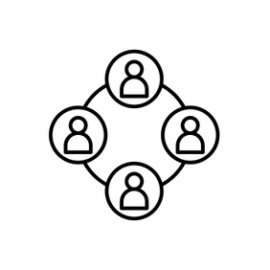

THREE BEST SOLUTIONS
Breaking the
Creating
Improving
Cyclical Nature
Community
Info & Messaging
By pushing notifications to encourage healthy eating habits (such as a reminder to eat meals throughout the day to prevent EOD binging), we believe we can help mitigate the emotionally driven decisions that bring someone back into the cycle of their eating disorder.
By creating easy access to a Q&A channel and forum of like-minded individuals who are on their road to recovery, we believe we can eliminate loneliness around and provide the support needed to successfully recover from an eating disorder.
By providing carefully curated health/eating information that is personalized to one’s eating disorder history, as well as making this fun through things like trivia games, we believe we can combat and replace the falsified, toxic food and eating information out there with healthy, digestible information.

Slide 28
Experience Prototypes

Slide 29
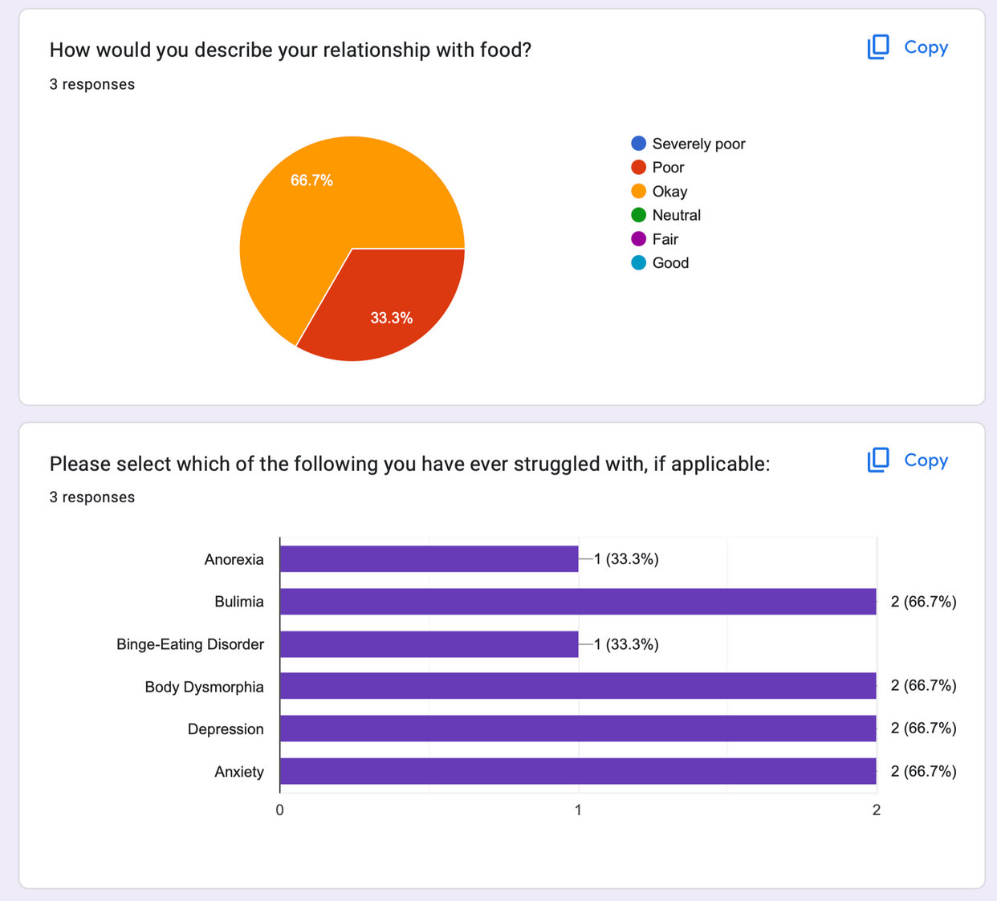
METHODOLOGY: INTRO FORM
Participants first filled out a short Google intro form so we could obtain background information and the experience prototype(s) they wished to participate in.
We prioritized finding people who had issues with eating in the past, along with ensuring one of the participants was an interviewee.
As such, none of the participants had a relationship with food they described as being better than “Okay”, and all had experiences with an eating disorder.

Slide 30
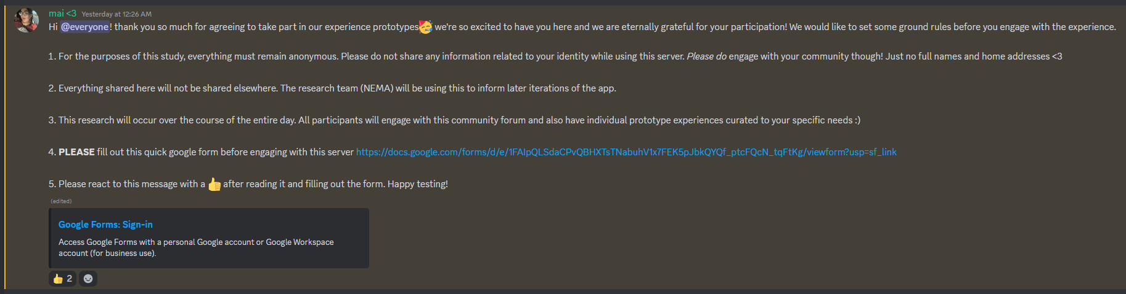
METHODOLOGY: DISCORD
Based on Google form responses, participants were then placed into different experience prototypes. These prototypes took place either in an anonymous Discord server or in direct messages on Discord.
After testing, participants filled out a reflection form to collect their opinions on each activity they participated in, as well as general thoughts.

Slide 31
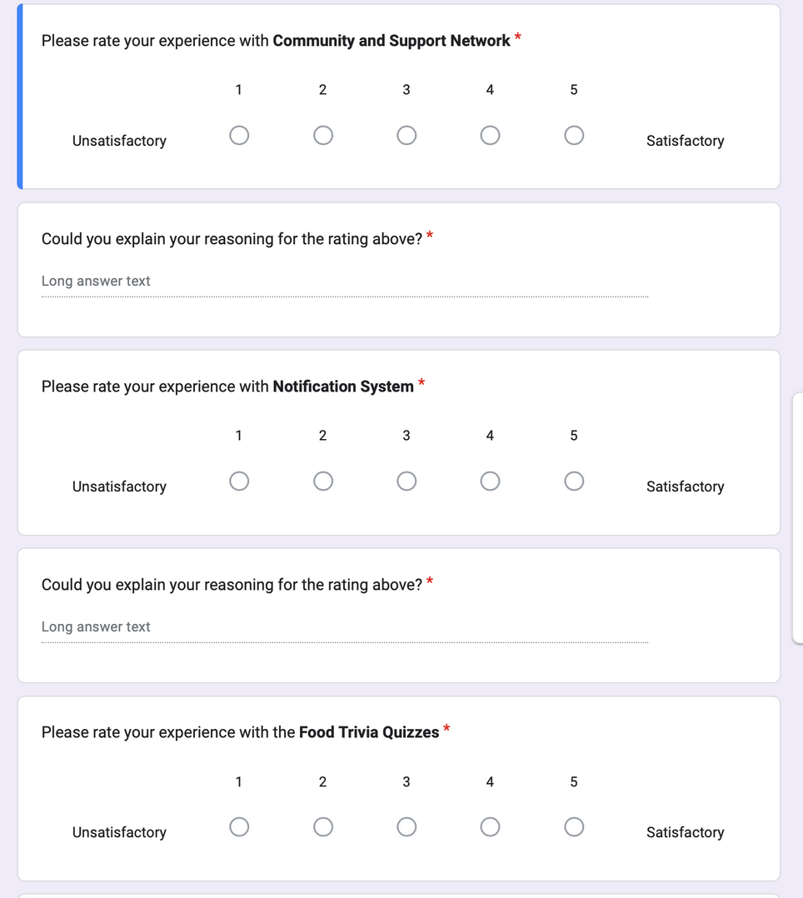
METHODOLOGY: REFLECTION FORM
Participants, at the end of their experience, filled out a Google Form to provide us with their reflections, insights, and feedback.
We asked them to rate each experience on a scale from 1-5, unsatisfactory- satisfactory, and to explain each of these ratings.
We then asked them which aspect they liked the most and which could be most improved.

Slide 32
EXPERIENCE PROTOTYPE 1: NOTIFICATIONS
Addressing the cyclical nature of eating disorders
Critical Assumptions
Description
+ Setup
Participants
Results
Go-forward
Takeaway
If one is reminded to eat/snack throughout the day, it could prevent them from not eating and/or later binging (and purging)
We reminded the participant throughout the day to eat their meals through Discord
Flamingo
Penguin
Found this to be ineffective, one participant stated she viewed this as another notification to ignore
Simple notifications are not sufficient to change habits. It is worth noting that some interviewees did forget to eat, and the notifications did not help prevent this.

Slide 33
EXPERIENCE PROTOTYPE 2: COMMUNITY
Providing community support through Q&A forum
Critical Assumptions
Description
+ Setup
Participants
Results
Go-forward
Takeaway
Having access to people who are also going through the process of recovery could aid in emotional regulation, solidarity, and support.
We placed three people in an anonymous Q&A/forum Discord server and prompted them with some questions to encourage discussion.
Flamingo
Peacock
Penguin
This prototype received the most positive response.
Even with a tiny test community, there was connection between users. However, it is unclear whether users would consistently interact over a larger time frame.
The test was not a resounding success but still supports the assumption. However, we weren’t able to test during times of stress, so the emotional regulation aspect is not confirmed. Worth further consideration!
(screenshot on next slide)

Slide 34
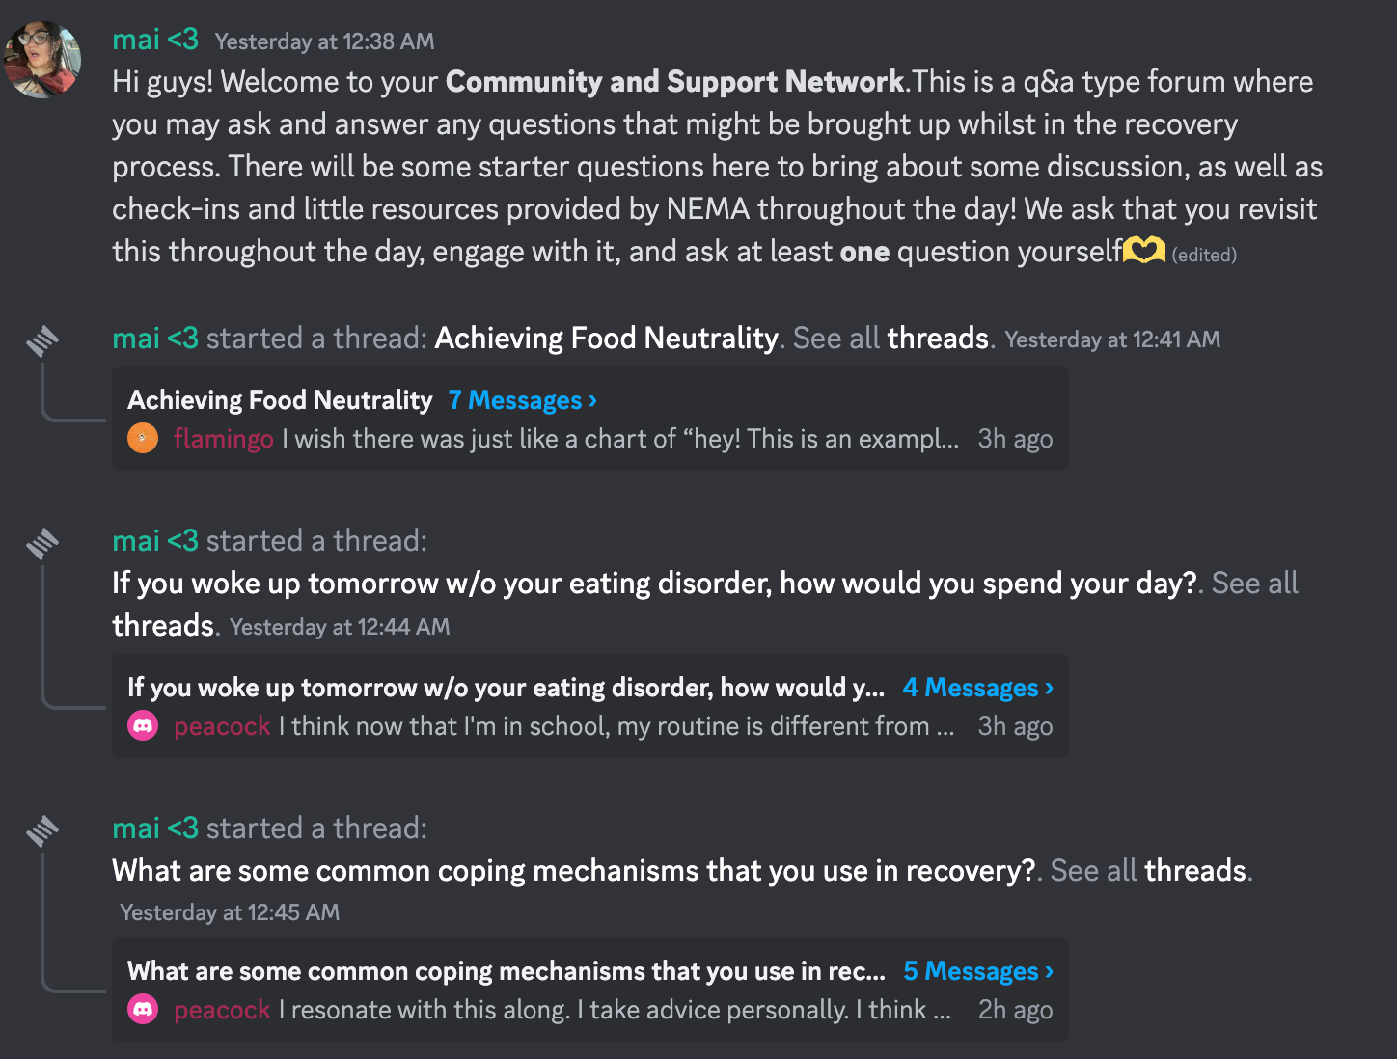
EXPERIENCE PROTOTYPE 2: COMMUNITY
(conversation logs in appendix)

Slide 35
EXPERIENCE PROTOTYPE 3: INFO + TRIVIA
Improving mindset through educational information
Critical Assumptions
Description
+ Setup
Participants
Results
Go-forward
Takeaway
Access to well-regulated, curated, and engaging food information will aid in shifting the mindset of the participant in a way that supports recovery.
We prompted participants with quizzes related to food information and myths. After they answered, we provided them with a source for the answer.
Flamingo
Penguin
Execution was not ideal; Flamingo did not believe any of the fallacies and felt tricked. She did not learn from the activity. However, Penguin did find the experience more fun and educational.
The prototype failed to adequately test the assumption, but provided important feedback. Information is most helpful when tailored to the user’s specific misconceptions, which was not exactly accomplished in this case.

Slide 36
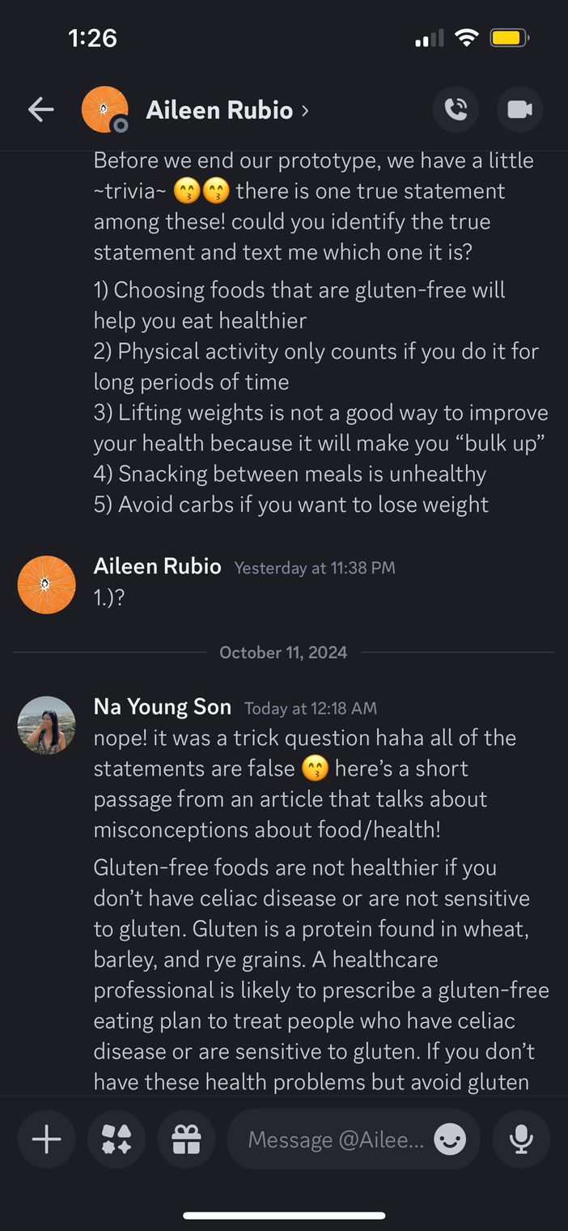
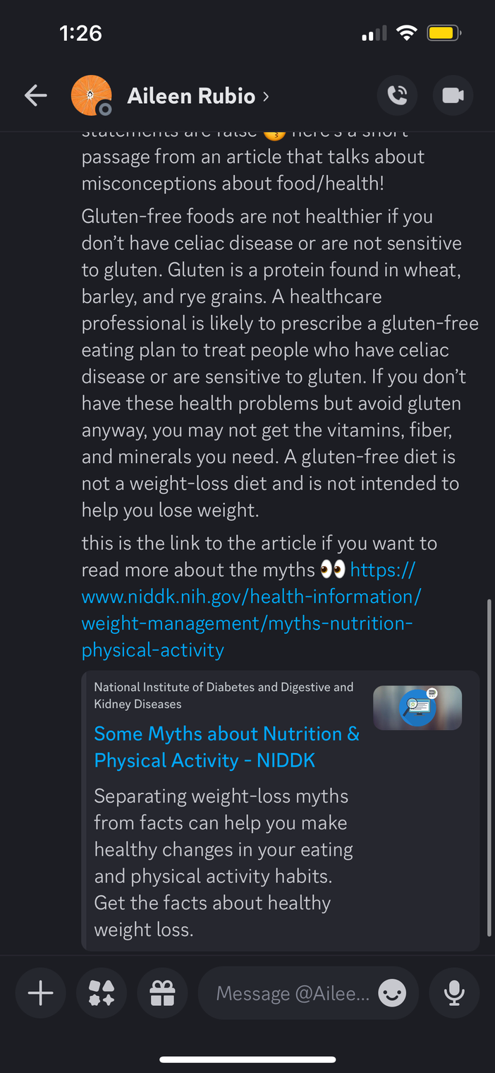
EXPERIENCE PROTOTYPE 3: INFO + TRIVIA

Slide 37
Ethical Implications + Communities Impact

Slide 38
EXPERIENCE PROTOTYPE 1: NOTIFICATIONS
Ethical implications & communities impact
The language, tone, and delivery of the notification could have the potential to benefit or harm one’s relationship with food and eating disorder (i.e. sounding like an anonymous robot or a warm, empathetic human)
This solution is designed for communities who have the time and bandwidth to be checking their phone in order to read the notifications and act accordingly
The solution explicitly excludes communities that do not have access to technology throughout the day (especially consistently)
The solution implicitly excludes those who do not have the ability to be on their phone throughout the day--whether this be due to working a demanding job or simply not having time--as well as those who do not have the flexibility to act on the notification

Slide 39
EXPERIENCE PROTOTYPE 2: COMMUNITY
Ethical implications & communities impact
Like any anonymous forum, the solution has the potential to become an unsafe space with risks of language and certain harmful messages sent
The solution should implement an option to delete their own message and report someone’s message, flexibility over what information to share, and regulations to ensure it is a safe space
The solution is designed for those who find comfort in sharing their experiences and engaging with the experiences of others, in particular in the digital space
The solution implicitly excludes those who are not comfortable participating in a community forum or are not at a stage in recovery to where they are ready to share with others
The solution explicitly excludes those who do not have access to community forums like Discord, for example
The solution fails to consider that some people may feel as though they are harming others by sharing their experiences and giving unprofessional advice

Slide 40
EXPERIENCE PROTOTYPE 3: FOOD INFO + TRIVIA
Ethical implications & communities impact
This solution operates based on the introductory survey, which is not a full representation of the user’s knowledge and needs
Depending on the information presented, the user may already know and have an understanding of the topics the question targets; if we could specifically target the user’s biases, these would be significantly more effective
This is designed for communities who do not already have access to food information or the time to look up the information themselves, ideally having them engage with food news on a daily basis would shift their mindset from being one about appearance, to being one about health
This implicitly excludes those who don’t have the time nor energy to read the article sent. If there was a summary provided along with a citation, this may be more helpful
This also may not consider the fact that there are plenty of people who do understand food and health information, but this simply is not enough to combat their unhealthy eating habits and mentality

Slide 41
What’s Next?

Slide 42


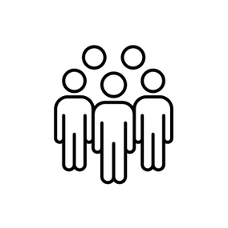
SOLUTION MOVING FORWARD: COMMUNITY
Reasons for
Notable
Steps for
Creating Community
Ethical Implications + Communities Impact
Moving Forward
Highest user preference and positive feedback
Addresses critical problem of loneliness in recovery
Easily adaptable to the user’s specific needs
Easily accessible and allows users to engage at their own discretion
In engaging with communities, users reduce personal stigma
Narrow scope of top three purposes of the community (i.e. Q&A, blog-type interactions, open journaling, etc.)
Crafting a more thorough introductory survey to better captures a user’s specific needs
Brainstorm ways to increase engagement in the community forum
This would only be useful for those who feel comfortable participating in an online forum with people they don’t know
Risk of harmful content or messages spread anonymously (requires regulation)

Slide 43
Thank you!

Slide 44
Appendix

Slide 45
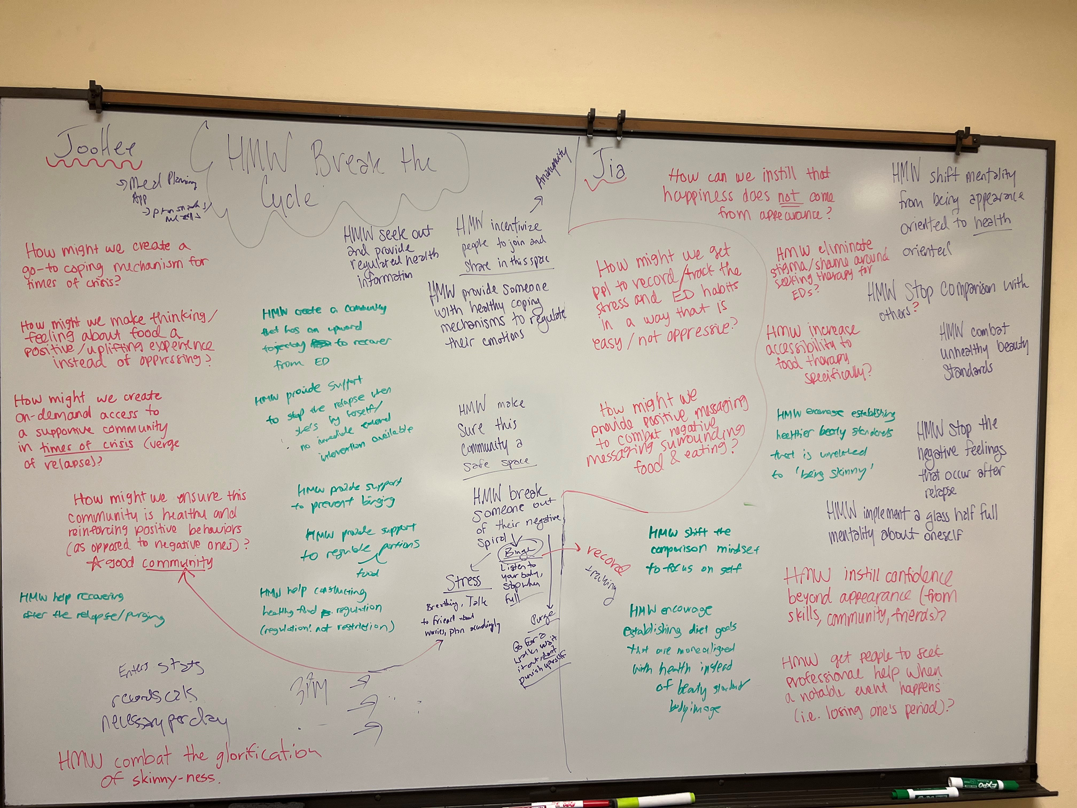
BRAINSTORMING PHOTOS: ORIGINAL HMWS

Slide 46
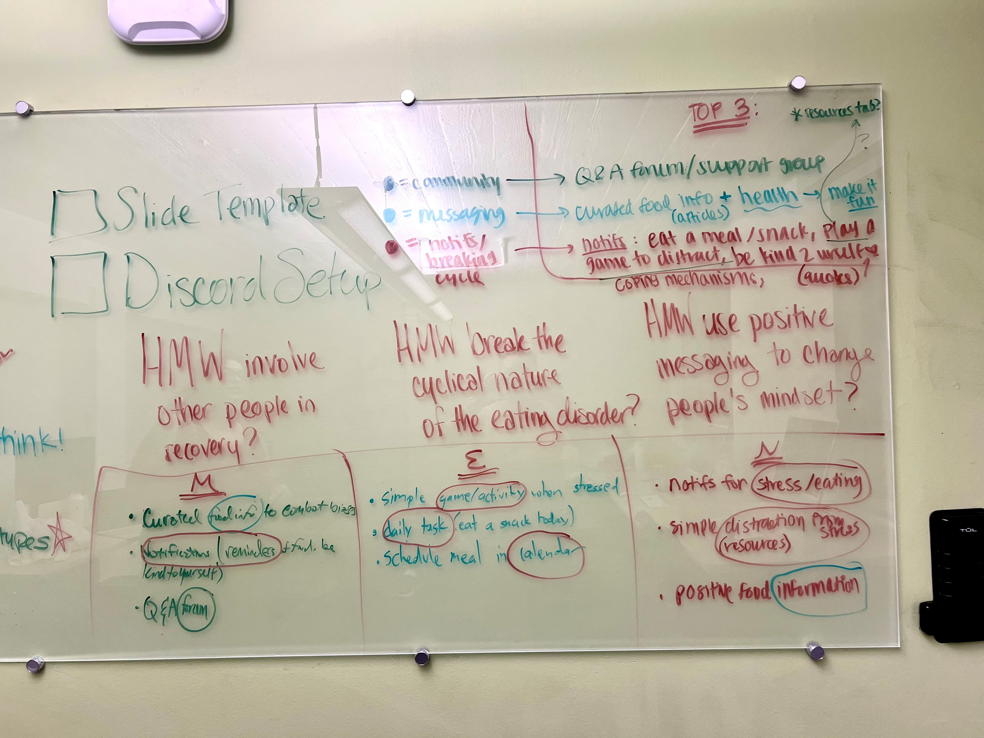
BRAINSTORMING PHOTOS: FINAL HWS WITH SOLUTIONS
Note: This is from our second round of solution brainstorming, where we narrowed down to the final three. Solutions from the original brainstorm are compiled on the next slide.

Slide 47
BRAINSTORMING SOLUTIONS
Breaking the
Creating
Improving
Cyclical Nature
Community
Info & Messaging
Send reminders for snacking/eating regularly → focus on dividing food consumption across the day instead of eating once a day.
Create a list for what helps decrease stress so the user can address it when the user becomes stressed
Create a list for what causes stress that especially leads to binge eating
Distract the user through simple games such as 2048/solitaire
Motivational speech/music
(Non-stressful) challenges that make eating more fun. (Like eat a food that you haven’t eaten in at least a month).
Calendar that automatically sets meal-times between your commitments
Access to a variety of coping mechanisms for different emotions and urges that could trigger some sort of relapses
Some sort of meal tracking that ensures you are eating the right amount of food per day
Providing emotional regulation (via meditation for example) after an eating disorder behavior
Group users based on recovery goals
Daily/weekly check-in with fellow users
Connect people with EDs with those who have finished the recovery process
Social app based on body positivity/depicting a wide range of healthy bodies.
Connecting people with similar appetites to reduce comparison
Cooking app (learning techniques, sharing recipes) specifically aimed at healing food relationships
Regulated, anonymous forum (could use discord for prototype)
Q&A type forum with recovering people
Group of friends to eat with
Group therapy
News-like system that provides modern research and recommendations in a palatable form
Trivia game that challenges fallacies regarding food
Notifications sent throughout the day targeted to the person’s specific needs
Encouraging quotes here throughout the day
Access to recent food studies, and good food education, perhaps curated towards their specific biases.
Fund and post new studies specifically for EDs
Debunk TikTok nutrition videos
AI answers food questions
Access to experts
Encourage and help users to implement tactics to get off social media (which is often a source of toxic food info)

Slide 48
BRAINSTORMING PHOTOS: FINAL HWS (ZOOMED IN)

Slide 49
BRAINSTORMING PHOTOS: SOLUTIONS (ZOOMED IN)

Slide 50
BRAINSTORMING PHOTOS: SOLUTIONS (ZOOMED IN)

Slide 51
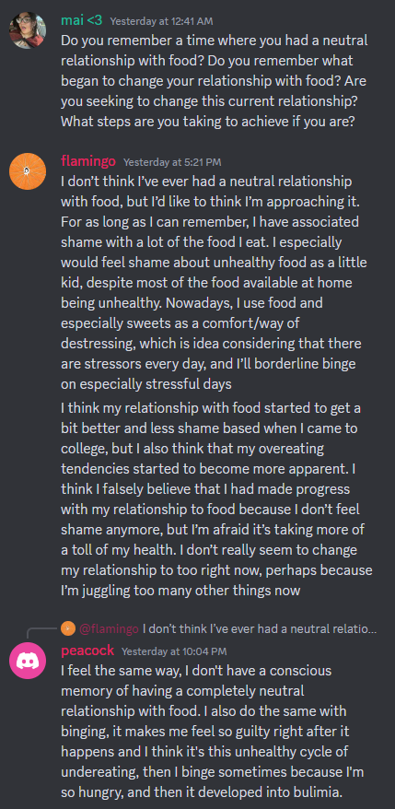
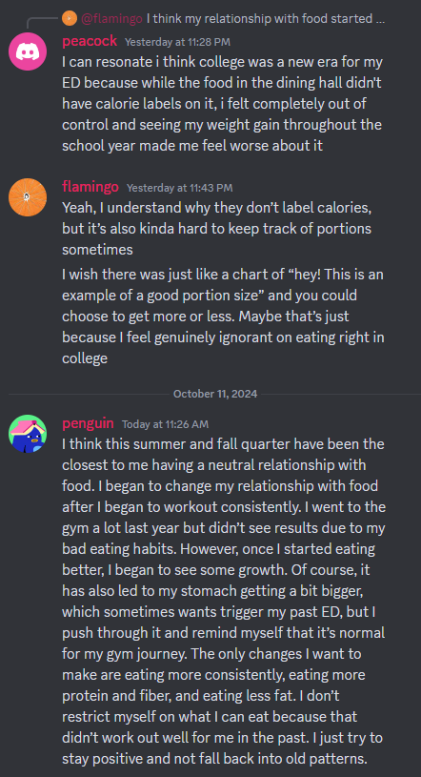
Q&A FORUM QUESTION LOG (PROTOTYPE 2)
*NOTE: Only one question was shown here; there were two other questions used in the prototype.

Slide 52
HEALTH MISCONCEPTIONS USED (PROTOTYPE 3)
Choosing foods that are gluten-free will help you eat healthier
Gluten-free foods are not healthier if you don’t have celiac disease or are not sensitive to gluten. Gluten is a protein found in wheat, barley, and rye grains. A healthcare professional is likely to prescribe a gluten-free eating plan to treat people who have celiac disease or are sensitive to gluten. If you don’t have these health problems but avoid gluten anyway, you may not get the vitamins, fiber, and minerals you need. A gluten-free diet is not a weight-loss diet and is not intended to help you lose weight.
SOURCE: National Institutes of Health (https://www.niddk.nih.gov/health-information/weight-management/myths-nutrition-physical-activity)
Physical activity only counts if you do it for long periods of time
You don’t need to be active for long periods to get the amount of regular physical activity recommended in the Physical Activity Guidelines for Americans, which is at least 150 minutes, or 2 hours and 30 minutes, of moderate-intensity physical activity each week. An example of moderate-intensity activity is brisk walking. You can spread these sessions out over the week and even do short, 10-minute spurts of activity 3 times a day on 5 or more days a week.
SOURCE: National Institutes of Health (https://www.niddk.nih.gov/health-information/weight-management/myths-nutrition-physical-activity)

Slide 53
HEALTH MISCONCEPTIONS USED (PROTOTYPE 3) CONT.
Lifting weights is not a good way to improve your health because it will make you “bulk up.”
Lifting weights or doing other activities 2 or 3 days a week that may help you build strong muscles, such as push-ups and some types of yoga, will not bulk you up. Only intense strength training, along with certain genes, can build large muscles. Like other kinds of physical activity, muscle-strengthening activities will help improve your health and also may help you control your weight by increasing the amount of energy-burning muscle.
SOURCE: National Institutes of Health
Snacking between meals is unhealthy.
Snacks are not unhealthy as long as the food itself has nutritional value. Snacks can give you energy in the middle of the day or decrease your hunger in between meals. Enjoy healthy snacks such as fruits, nuts, carrots, low-fat yogurt, or string cheese.
SOURCE: MedlinePlus (https://medlineplus.gov/ency/quiz/002436_43.htm?quiz=3)
Avoid carbs if you want to lose weight
The low-carb diet is a fad diet that has continued to make an appearance over the years. It gives carbohydrates — fruit and whole grains included — a bad reputation. Individuals who followed this diet had success with weight loss. But anytime anyone eliminates highly processed carbohydrates foods, such as chips, cookies, white bread and potatoes smothered in butter and gravy, they would be expected to have the same results. Any diet or eating program that eliminates an entire food group gets a red flag from me as you likely will miss out on vital nutrients.
SOURCE: MayoClinic

