Slide 1
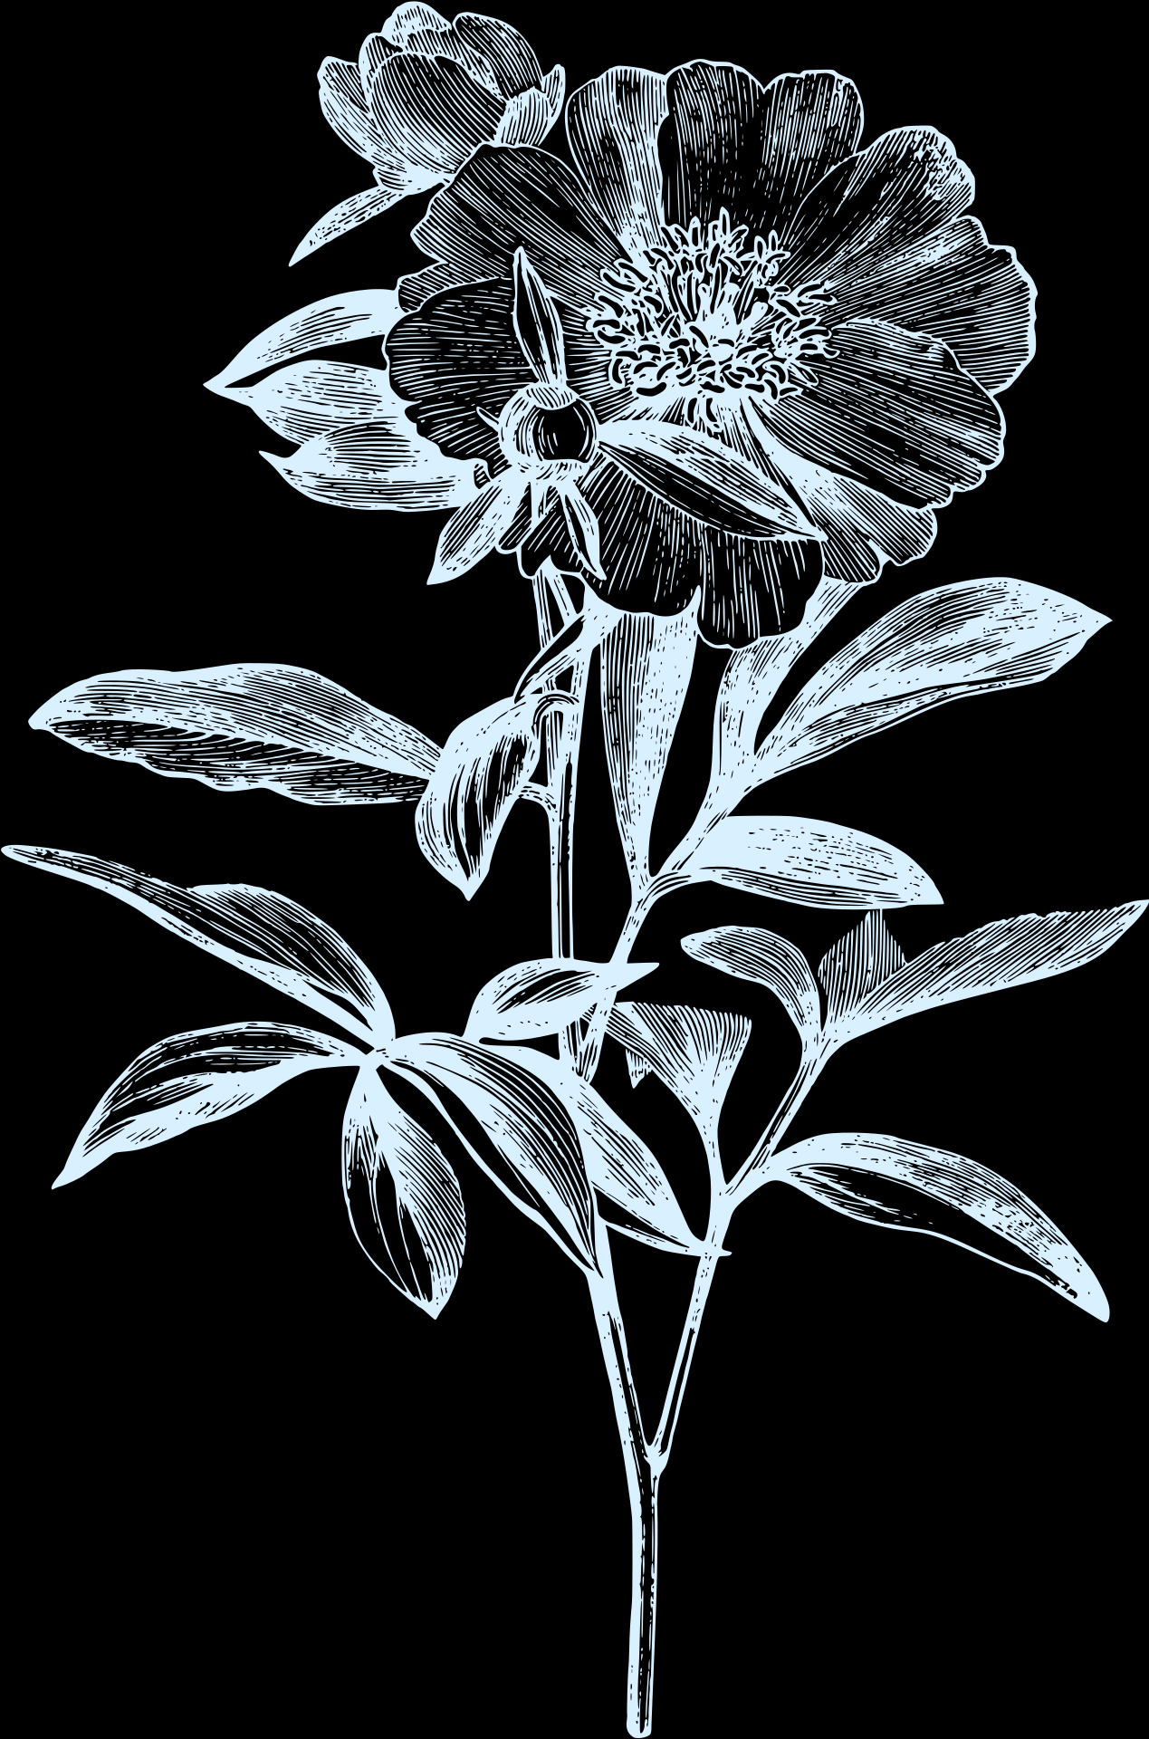
Food For Thought
Needfinding Report

Slide 2



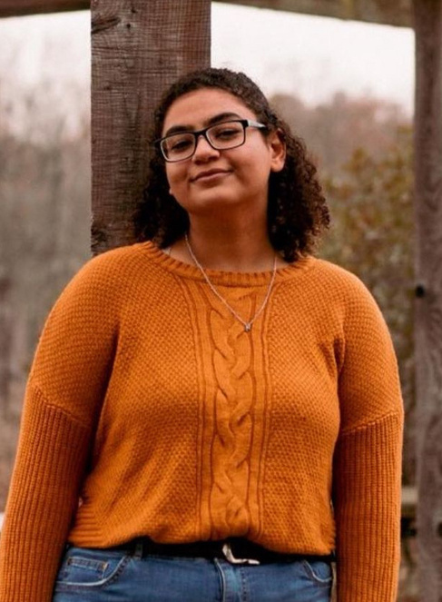
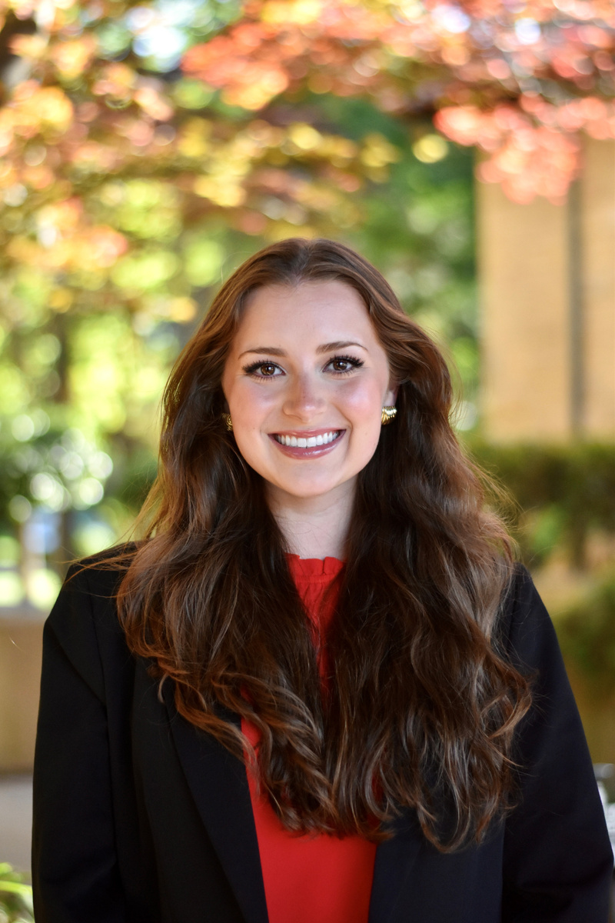
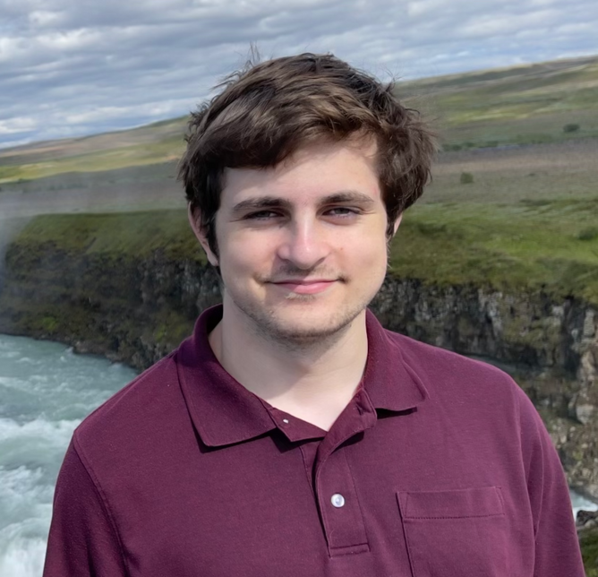

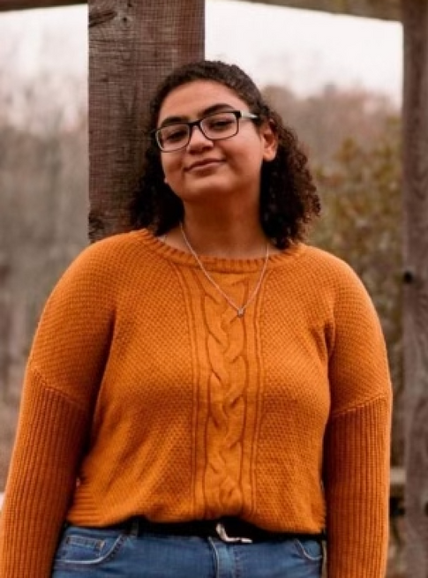
Meet the Team
Na Young Son
‘25
Music Major
CS Minor
Mai Mostafa
‘26
SymSys Major
Education Minor
Ava Love
‘25
SymSys Major
Elton Manchester
‘26
CS Major
Music Minor

Slide 3
Domain Selection
We wanted something we....
Felt Was Underserviced
Is there already a variety of resources out there?
Had a Passion For
Do we care deeply about this topic?
Thought Would Be Challenging
We wanna see what we can do!

Slide 4
Finding Participants
Not all Stanford students!!
We need to get out of our bubble!
People who have/had some sort of struggle with food
This is our target audience, we need to get their point of view!
A diversity of experiences
Recovery is so different for everyone, we need to see how different people are approaching it!

Slide 5
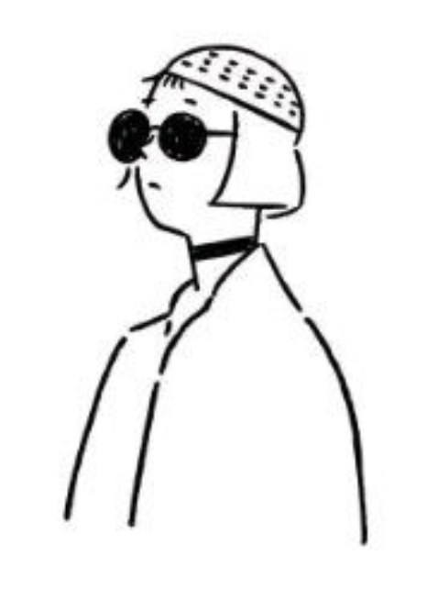
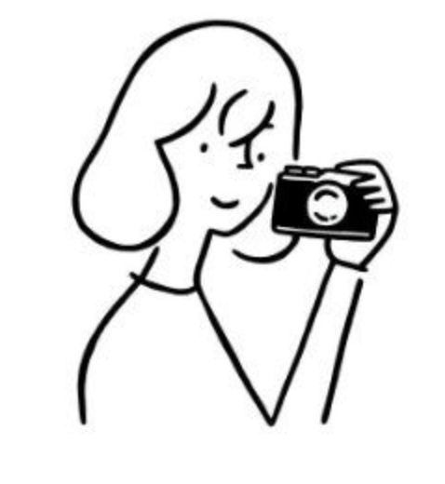
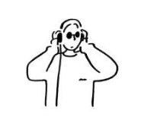
We Spoke To...
Z
Senior in High School
Menlo Park, CA
In the midst of getting ice cream with a friend
J
Junior at Stanford
Philadelphia, PA
Recently returned from an international internship
JH
Senior at WashU
Korea
Studying design, has two siblings (brother and sister)

Slide 6
And We Asked...
Did anyone close to you growing up exhibit unhealthy eating habits?
Do you put any dietary restrictions on yourself today?
Have you ever taken or considered taking dietary supplements?
Did you ever/do you currently count your caloric intake?
Has anyone close to you ever made comments on your appearance?
Where do you currently get your health information?
Have you ever been formally diagnosed with an eating disorder?
Have you ever sought out professional help? Was it helpful?
Do you view any food groups as “bad” for you?
What are your thoughts on health related social media content?
What does a recovered you look like?

Slide 7
Z
Interviewer: Mai
Notes: Na Young
17 Years Old
Long History of Food-Related Trauma
On University Ave., 20 minutes

Slide 8
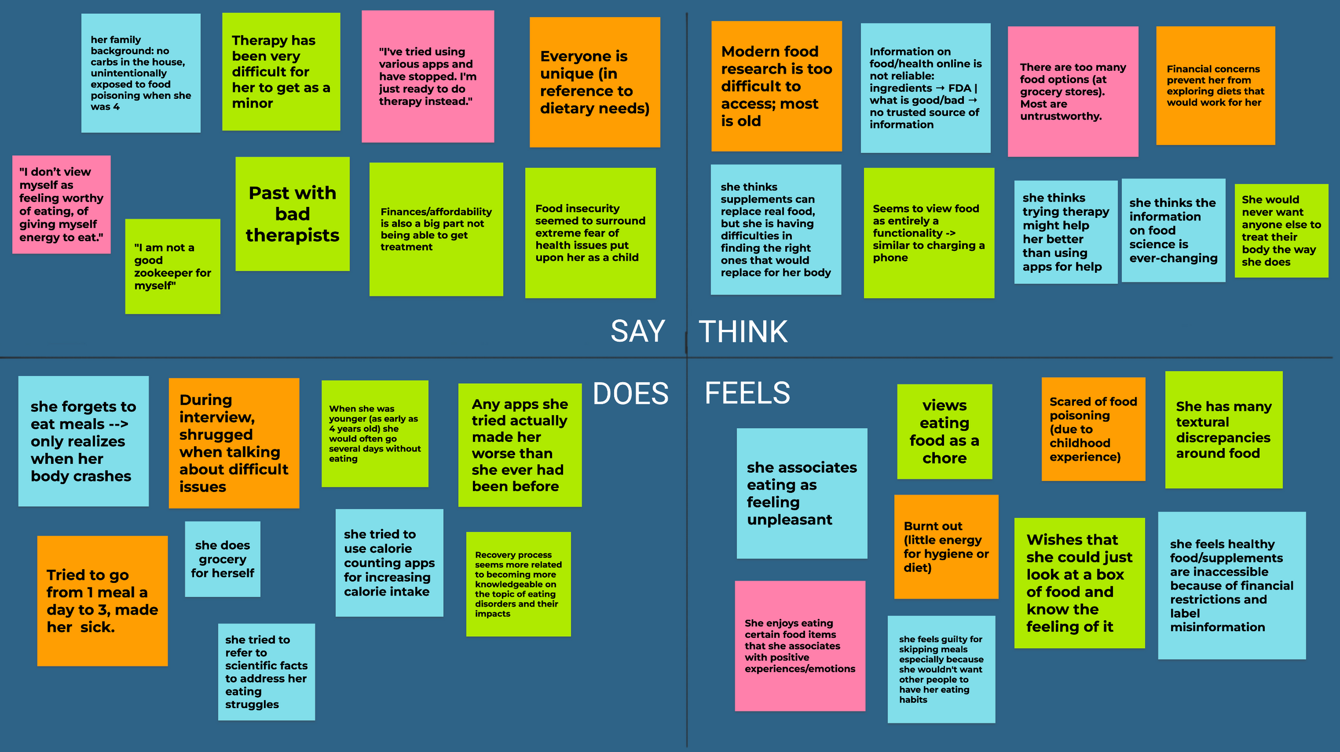

Slide 9
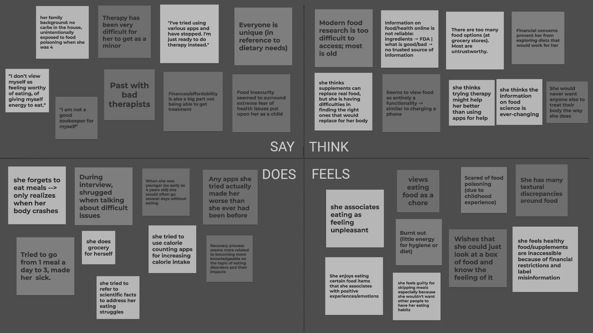
“I don’t view myself as worthy of eating, of giving myself energy to eat”
There is simultaneously too much information and not enough. It is difficult to figure out what exactly could work for you
Care is inaffordable and inaccessible
Any apps that she tried using actually made her condition much worse
Associates the feeling of eating as unpleasant, views eating as a chore
Often forgets to eat for an entire day and only realizes when her body “crashes”
Has many issues with the textures of foods

Slide 10
Insight
She felt a lot of frustration and overwhelm towards the inaccessibility of trustworthy food information
Need
Trustworthy food information curated to her tastes (texture, flavor, nutritional value)

Slide 11
Insight
She feels that taking care of herself is a great hassle
Need
A way to make acts of self-care feel more manageable in a busy and stressful environment

Slide 12
J
Interviewer: Mai
Notes: Elton
20 Years Old
Has Anorexia/Bulimia; Recently Relapsed; Extreme User
My Dorm Room, 1 Hour

Slide 13
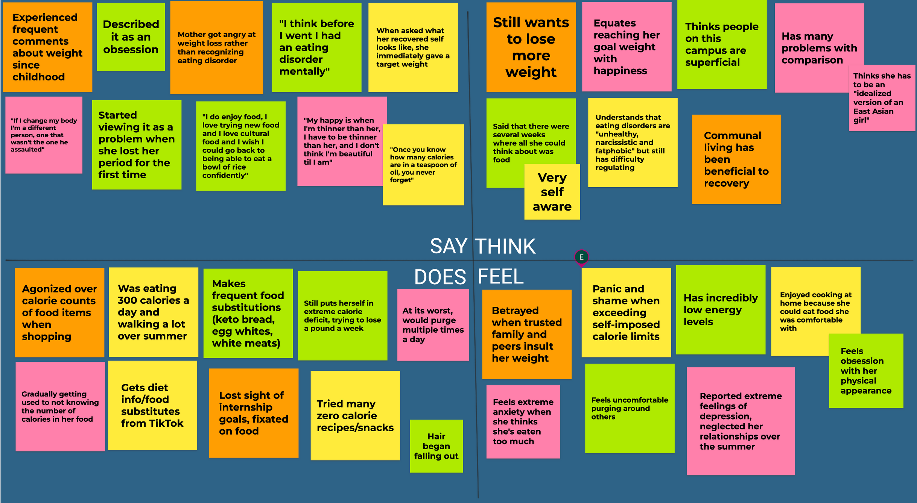

Slide 14
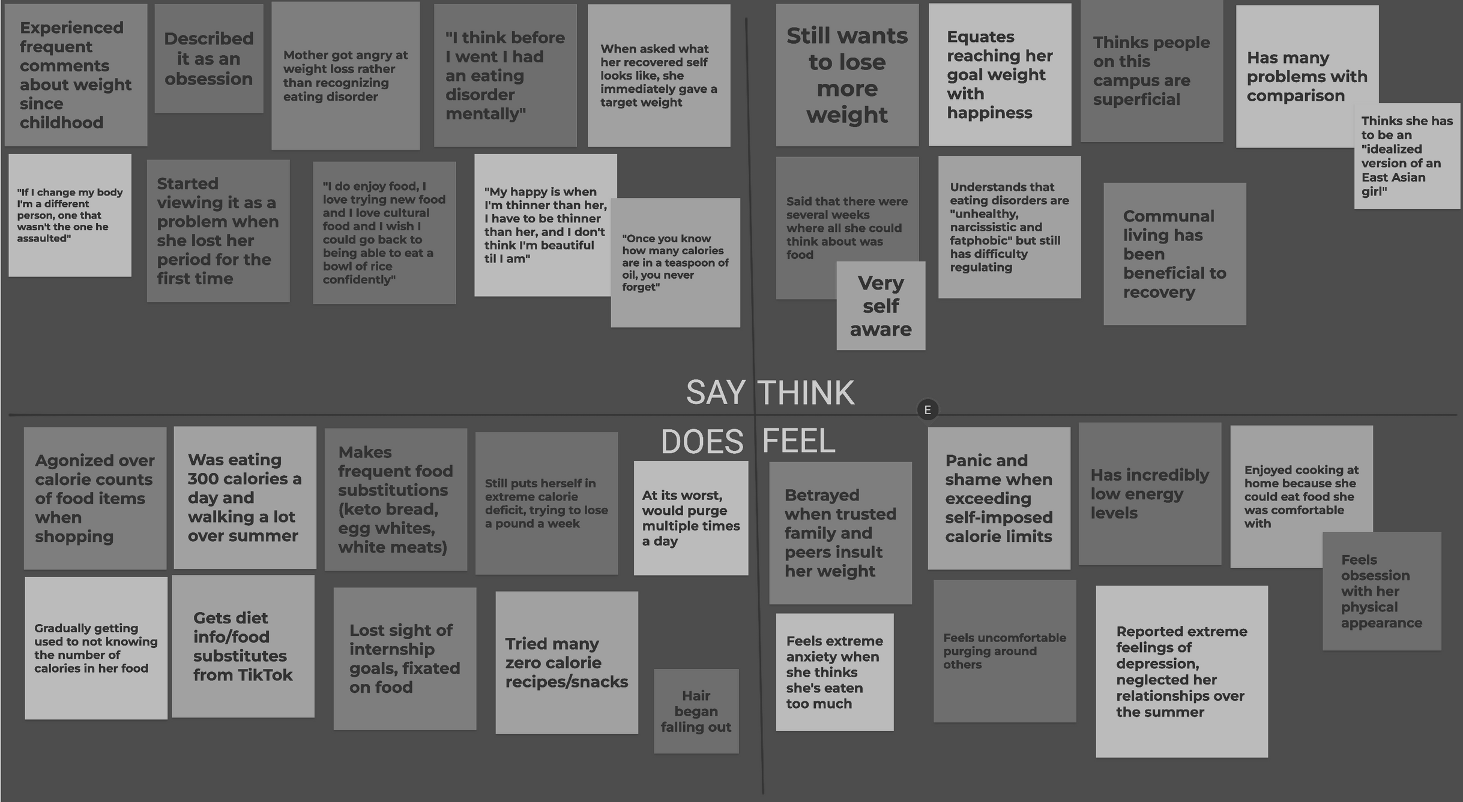
Described her eating disorder as an obsession
Tends to compare herself to others often, especially in relation to size
“Once you know how many calories are in a teaspoon of oil, you never forget”
When asked what recovery looked like, she immediately gave a target weight she wanted to be at
Very much aware that this is not healthy, but can’t seem to stop
Makes frequent food substitutions (keto bread, egg whites, artificial sugars)
Feels uncomfortable purging when living with others
Feels a great amount of guilt, shame, and anxiety when she goes over her calorie limit
At its worst, would purge multiple times a day, in particular whenever she felt she had gone over her caloric limit

Slide 15
Insight
She seems to lack any effective coping mechanisms for regulating her emotions
Need
Coping mechanisms that work for her and help her begin the path to recovery

Slide 16
Insight
She has reached a point where she views food as either fuel or the enemy
Need
A way to find joy in food again without feelings of anxiety or guilt diminishing it

Slide 17
JH
Interviewer: Na Young
Notes: Ava
21 Years Old
Has Bulimia; Currently In Therapy; Says She’s Doing Much Better
Zoom, 30 Minutes

Slide 18
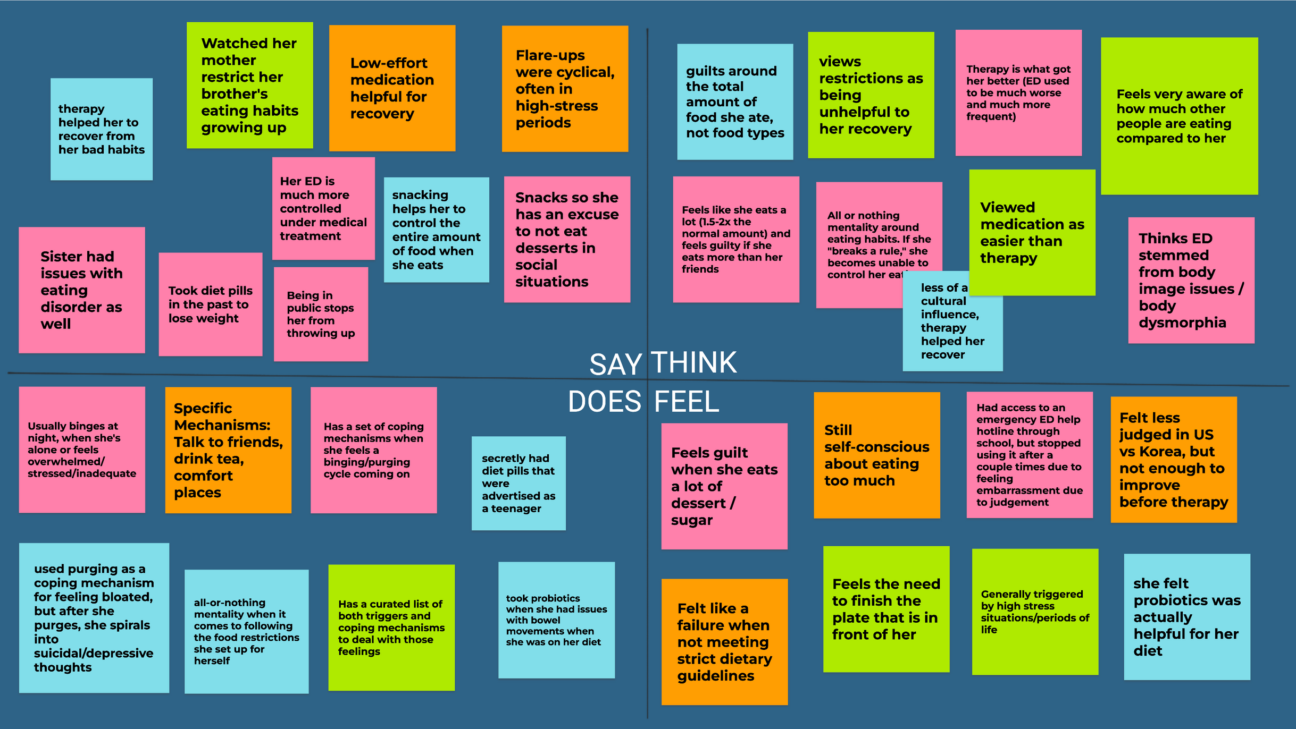

Slide 19
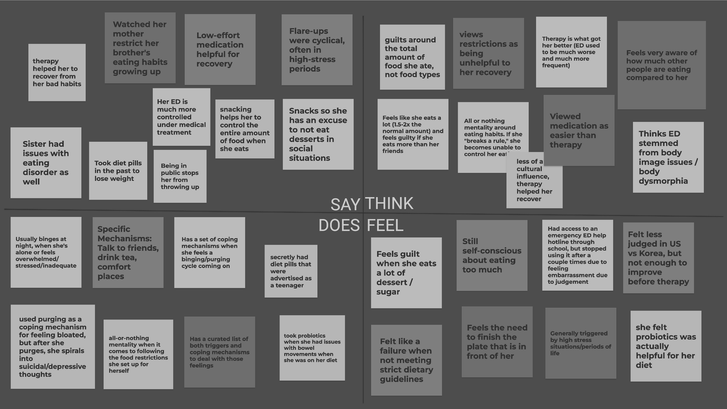
Views restriction as being very unhelpful to recovery
Found that both medication and therapy were helpful to her recovery, but definitely appreciated the ease of medication
Has an all-or-nothing mentality when it comes to eating
Has a specific list of triggers and coping mechanisms to deal with each trigger accordingly
Very conscious of the amount of food others are eating
Usually triggered by high stress situations/periods of life

Slide 20
Insight
She tends to be more likely to relapse when under a lot of stress
Need
A way to regulate or manage her stress so she isn’t as susceptible.

Slide 21
Insight
She has a very all-or-nothing mentality when it comes to food. If she doesn’t eat as “healthily” as she would’ve liked, she tends to binge.
Need
A way to prevent or avoid the feeling of failure that leads to binging

Slide 22
Summary
Our Participants Agreed
Therapy is essential
Recovery is nearly impossible without it
Stress impacts their ability to recover
Whether it is information overload or stress from class, it certainly is not helpful in the recovery process
There is a lot of (mis)information out there
Its hard to know whats right for you when there’s so much out there, especially when not all of it is trustworthy

Slide 23
Summary
However...
Therapy is inaccessible
It is incredibly difficult to get a therapist, this process can take a very long time and most find themselves without any resources while they wait
Regulating emotions can be very difficult
Especially if you have an eating disorder, regulating your emotions around food is really hard, and you need to be prepared for whatever may trigger you
There is no regulation of food information online
Getting dietary information from social platforms is both incredibly tempting and incredibly inaccurate

Slide 24
Next Steps
Future Interviews:
Experts, Different Genders
To get a different point of view!
Research Available Tools
So we don’t make the same thing twice!
Brainstorming
Using HMW statements!

Slide 25

Thank you!

