Slide 1
Hi-fi Prototyping
Team 2: Eliza Bazakas, Hera Lasseau, Ngoc Tran, Renn Su

Slide 2
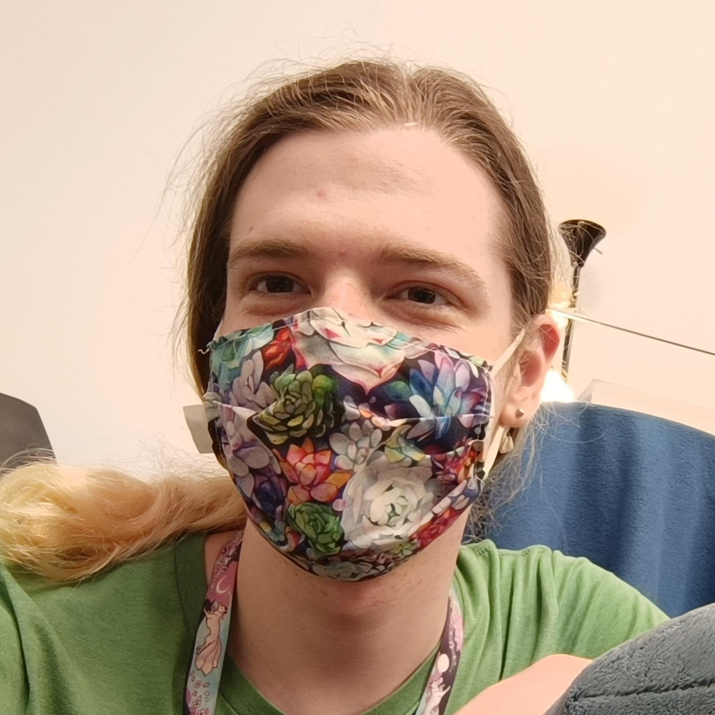
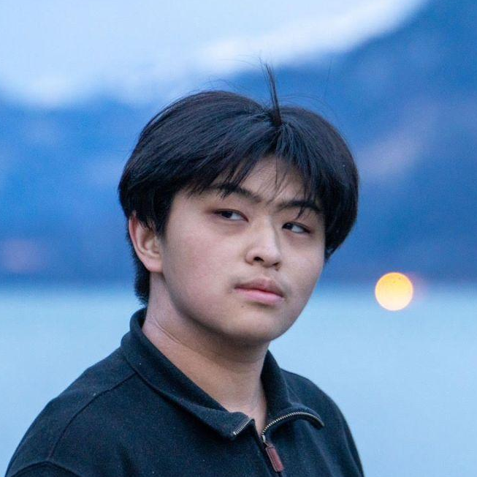
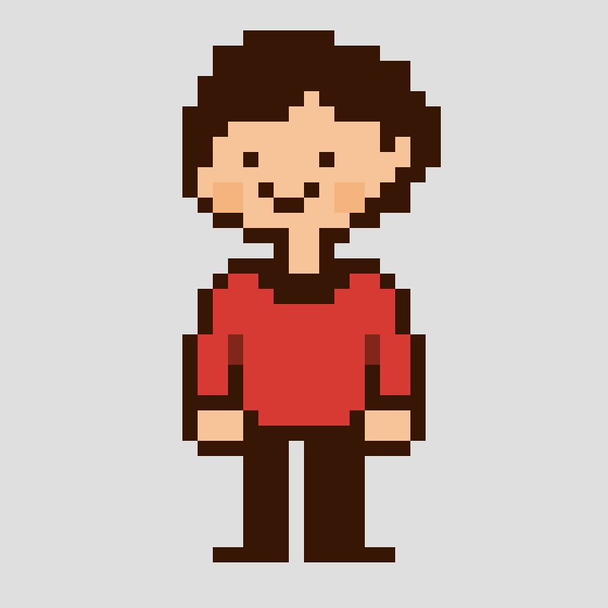

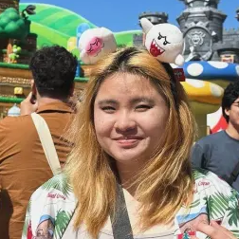
Team Lore
Hera Lasseau
Renn Su
Computer Science ‘25
Motueka, NZ
Computer Science ‘26
Vancouver, Canada
Ngoc Tran
Eliza Bazakas
Computer Science ‘26
Austin, TX
Computer Science MS ‘26
ChemE B.S. (MIT)
Berkeley, CA

Slide 3

Unpack your memories: life stories in timeline form

Slide 4
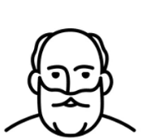

The Problem
?
I’m curious!
Lived experiences
Wisdom
Cultural knowledge
Notes:
Problem
Older adults have had long and varied lives, and younger people want to know the ‘lore’ of their elders, but these stories are going untold due to an absence of infrastructure connecting the generations.

Slide 5
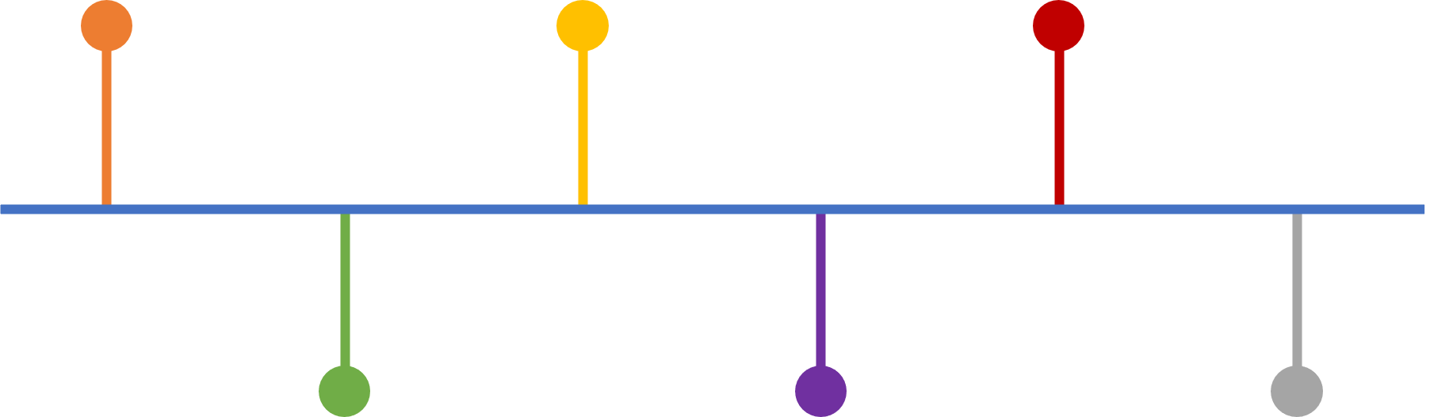
Our Solution
Lived experiences
Cultural knowledge
Wisdom
Notes:
Solution
Lore, an app which gives older adults a platform to record and share their stories, and young people the opportunity to learn about the way things were at various places and times.

Slide 6
Value Proposition
Lore facilitates the sharing and exploring of life stories in a chronological and spatial context.

Slide 7
Talk Outline
01
02
03
04
Heuristic Evaluation
Revisions
Concept sketches, pros and cons
Defining our tasks, drawing out the interface
Hi-Fi Status
Hi-Fi Demo
Finding participants across a range of ages, observing as they completed the tasks
Analyzing testing results, assessing next steps

Slide 8
Heuristic Evaluation

Slide 9
Summary
Severity | Level 1 | Level 2 | Level 3 | Level 4 | Total
Violations | 18 | 27* | 8 | 3 | 56*
Revisions | 7 | 15 | 7 | 2 | 31
Violation | H1 | H2 | H3 | H4 | H5 | H6 | H7 | H8 | H9 | H10 | H11 | H12
Count | 5* | 3 | 4 | 6 | 2 | 3 | 5 | 7 | 1 | 8 | 9* | 3*
* There were 2 violations which were given twice (included in count, one as H12, one as H1 and H11)
Notes:
Hard-coded and Wizard-of-Oz features

Slide 10
Level 4 Violations
Violation | Addressed? | Justification
Simple task (share story) doesn’t feel like main focus of home page. | Yes | This was addressed by changing “post a story” to the complex task, rather than the simple task.
Where do you go to see the saved stories? | Yes | Added a button for “Saved Stories” in the profile page
The user is unsure what task the home page timeline pertains to. | No | The homepage timeline is the main way of interacting with stories from your subscribed authors. Rather than relating to a specific task, it it more focused on basic app functionality.

Slide 11
Level 3 Violations
Violation | Addressed? | Justification
No error checking or confirmation for public or circle only selection. | Yes | We plan to add some sort of pop-up asking a user to confirm that they would like to post their story to whichever group they have selected.
There is no option to add a location when posting a story. | Yes | This was an oversight, we will be adding a selection to choose a location.
On the "Take a clear photo of your written story" page, there is no way to retake the photo. | No | Once you scan the document, you are taken to a page that has auto-transcribed it to check over. Hitting back will allow you to retake the photo.

Slide 12
Level 3 Violations cont.
Violation | Addressed? | Justification
When viewing the timeline (1950-1958) of "Subscribed Authors" closer, no way to return to main timeline. | Yes | Due to Figma limitations, we planned to make our timeline more intractable when making the hi-fi prototype (pinch in/out to zoom timeline, scrollable).
In My Profile, the posted stories do not indicate whether it is shared to the public or the user's circle. | Yes | We plan to add some sort of icon or label to easily show who the story is shared with.
Feature to expand timeline is unclear. | Yes | See above.

Slide 13
Level 3 Violations cont.
Violation | Addressed? | Justification
There is no "view profile" button when looking at another user's post- the only way to navigate to the screen is by clicking the profile picture. | Yes | We have added a “View Profile” button to the story header.
It is confusing as to what the "Subscribed authors" tag is there for on the home page. | Yes | We have changed this to be more descriptive - “Unviewed stories from subscribed authors”

Slide 14
Revisions

Slide 15
Task Changes
SIMPLE
SIMPLE
Post a Story
View a Story
MODERATE
MODERATE
View your Stories
Respond to a Story
COMPLEX
COMPLEX
Search for Stories
Post a Story

Slide 16
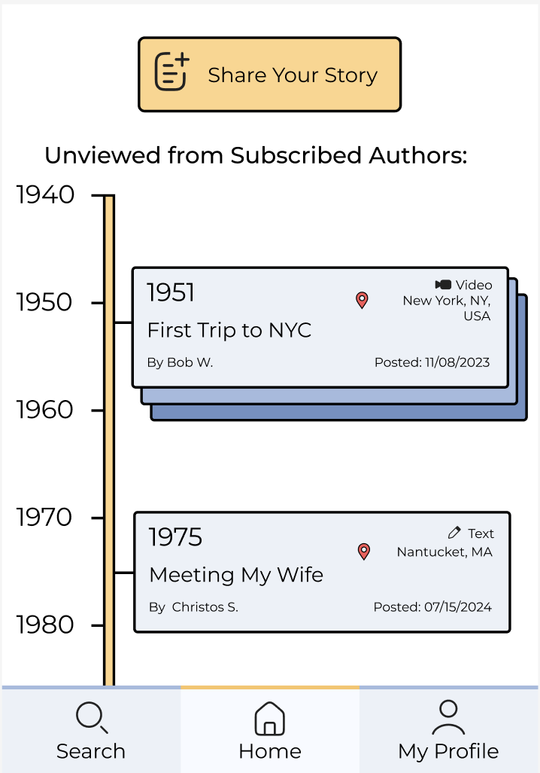
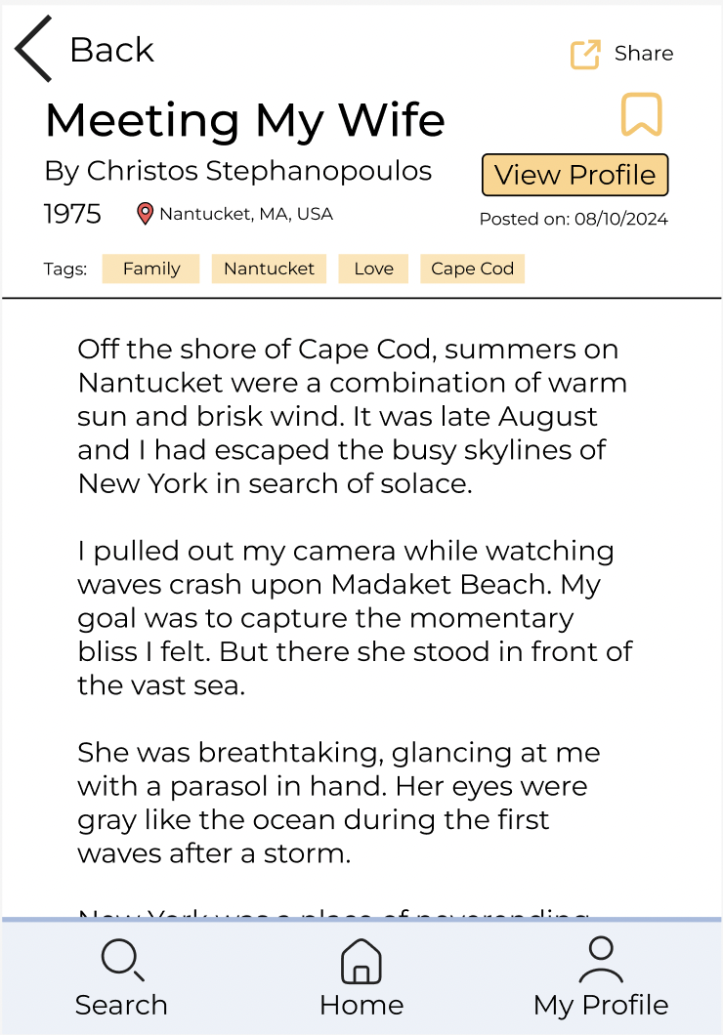
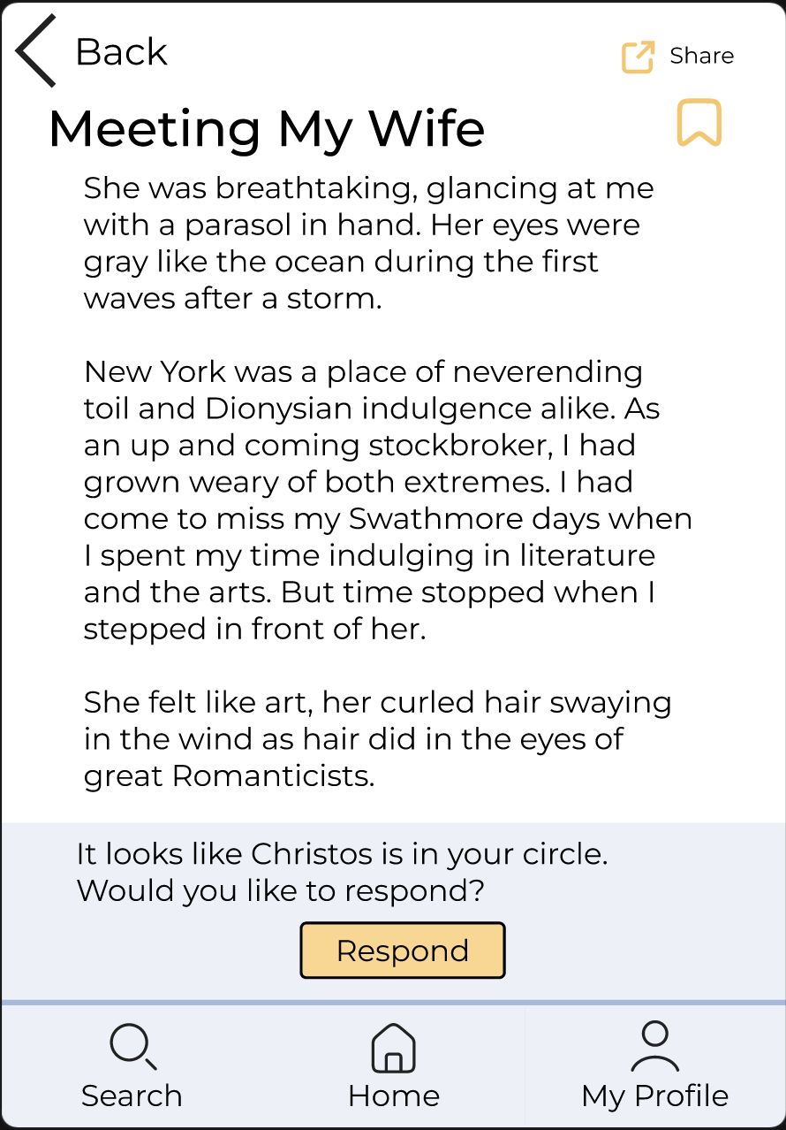
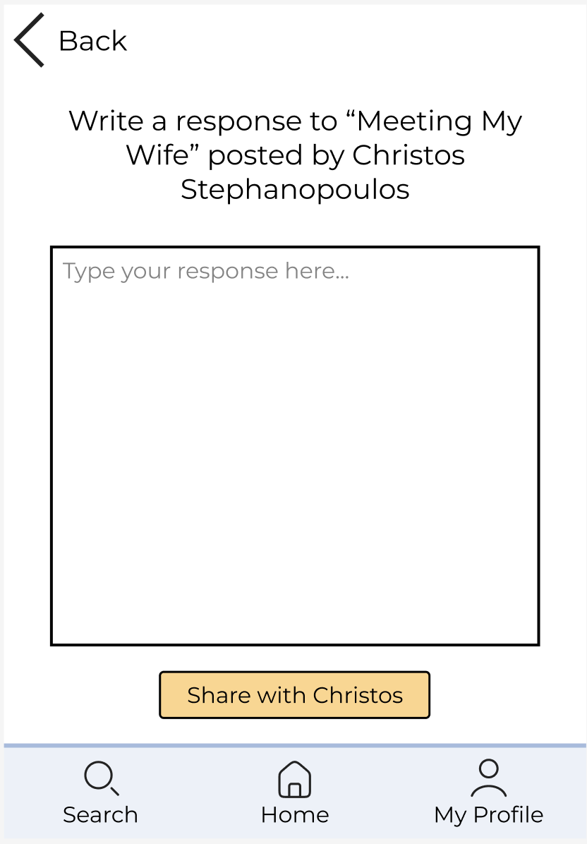
Task Flow 2: Respond to a Story

Slide 17
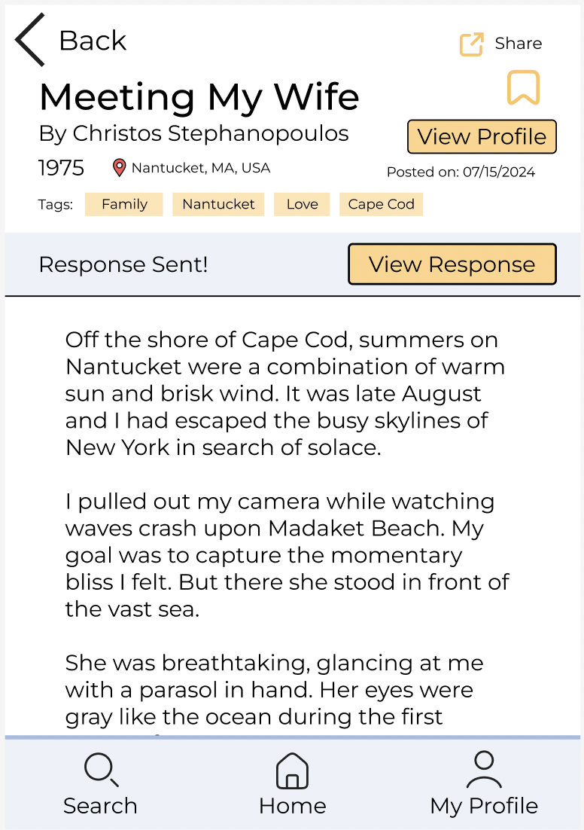
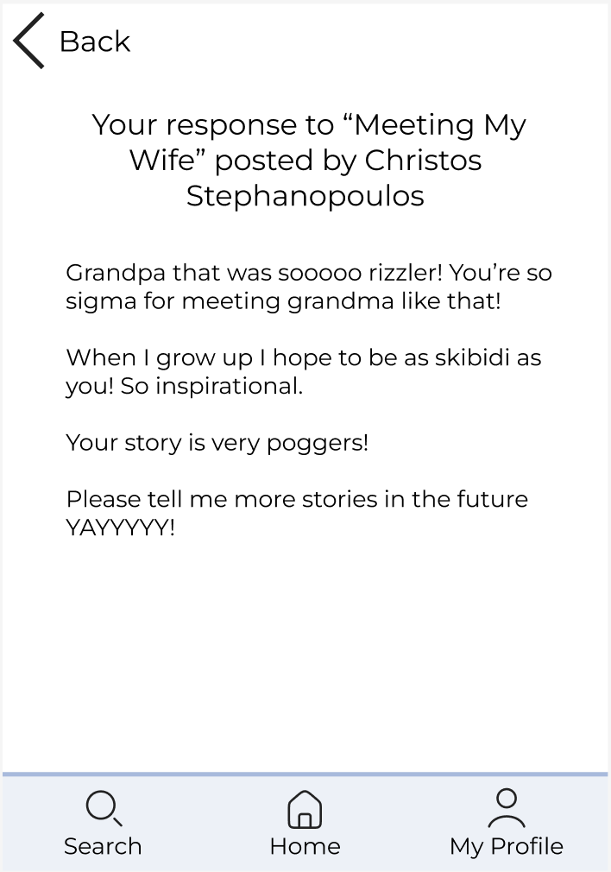
Task Flow 2: Respond to a Story

Slide 18
Rationale
Our medium and complex tasks were too similar.
More people will be viewing stories than posting them, so it made more sense to have posting a story be the complex task.
We were given feedback that the task of posting a story did not feel like the main task.
We wanted to have some sort of interaction between users, but also wanted to limit opportunities for trolling.
Responding is only available for those in your circle

Slide 19
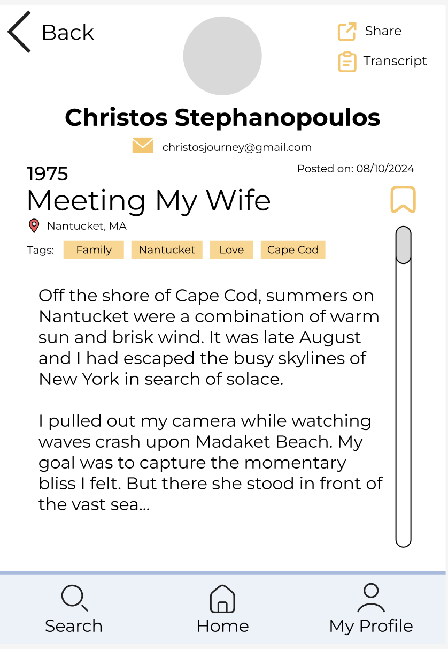
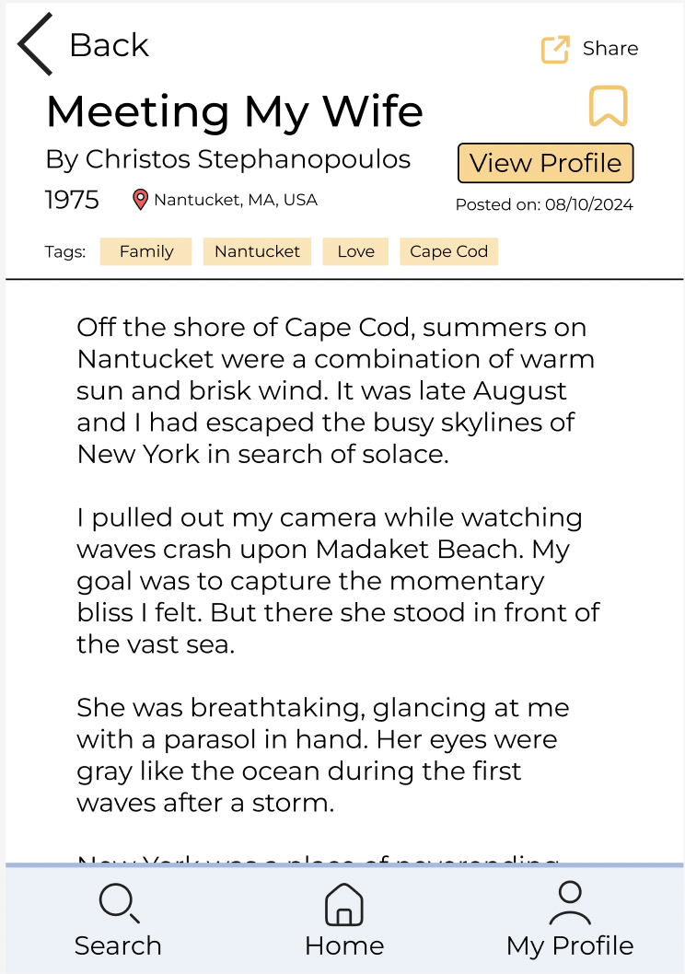
Revised Story Header

Slide 20
Rationale
Wanted to make the header cleaner and easier to parse for relevant information
Emphasize the story rather than the metadata - metadata scrolls with the story, so only the title remains visible
Removed unnecessary elements such as the profile picture and email address
Auto transcription of audio/video stories below (don’t need to click a button)

Slide 21
Minor UI Changes
Added “Saved Stories” button
Changed “My Followers” to “My Subscribers”
Changed “About You” to “About Me”
Removed back button from search page
Added a “View Profile” button in the story header
Change sizings of buttons on story format choice page

Slide 22
Progress Towards Goals
Speed
Confidence
Independence
Easier to process information associated with a story due to header layout change.
Transcription of audio and video stories appears below the story automatically, which makes it easier to quickly preview the content
Language is more clear and descriptive
“Subscribed Authors” → “Unviewed from Subscribed Authors”
Specific “View Profile” button
Addition of “View Profile” button in the story header to reduce confusion on how to access the authors profile
Notes:
Usability goals & key measurements
b. How is your product progressing towards hitting these goals?

Slide 23
Hi-Fi Status

Slide 24
Framework and Tools
App: React Native & Expo Go
Using React Native Framework to build app
Using Expo Go to visualize & test app
Version Control: GitHub
Using Git / GitHub to work collaboratively across our team
Package Manager: yarn
Using yarn to install, update, and configure packages

Slide 25
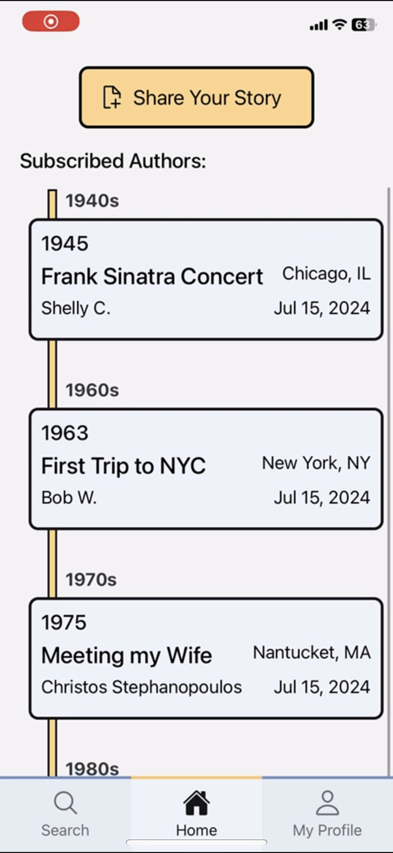
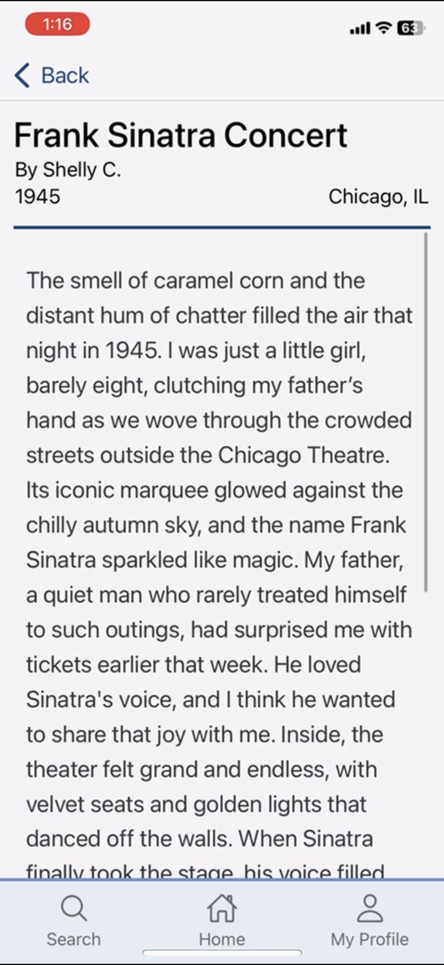
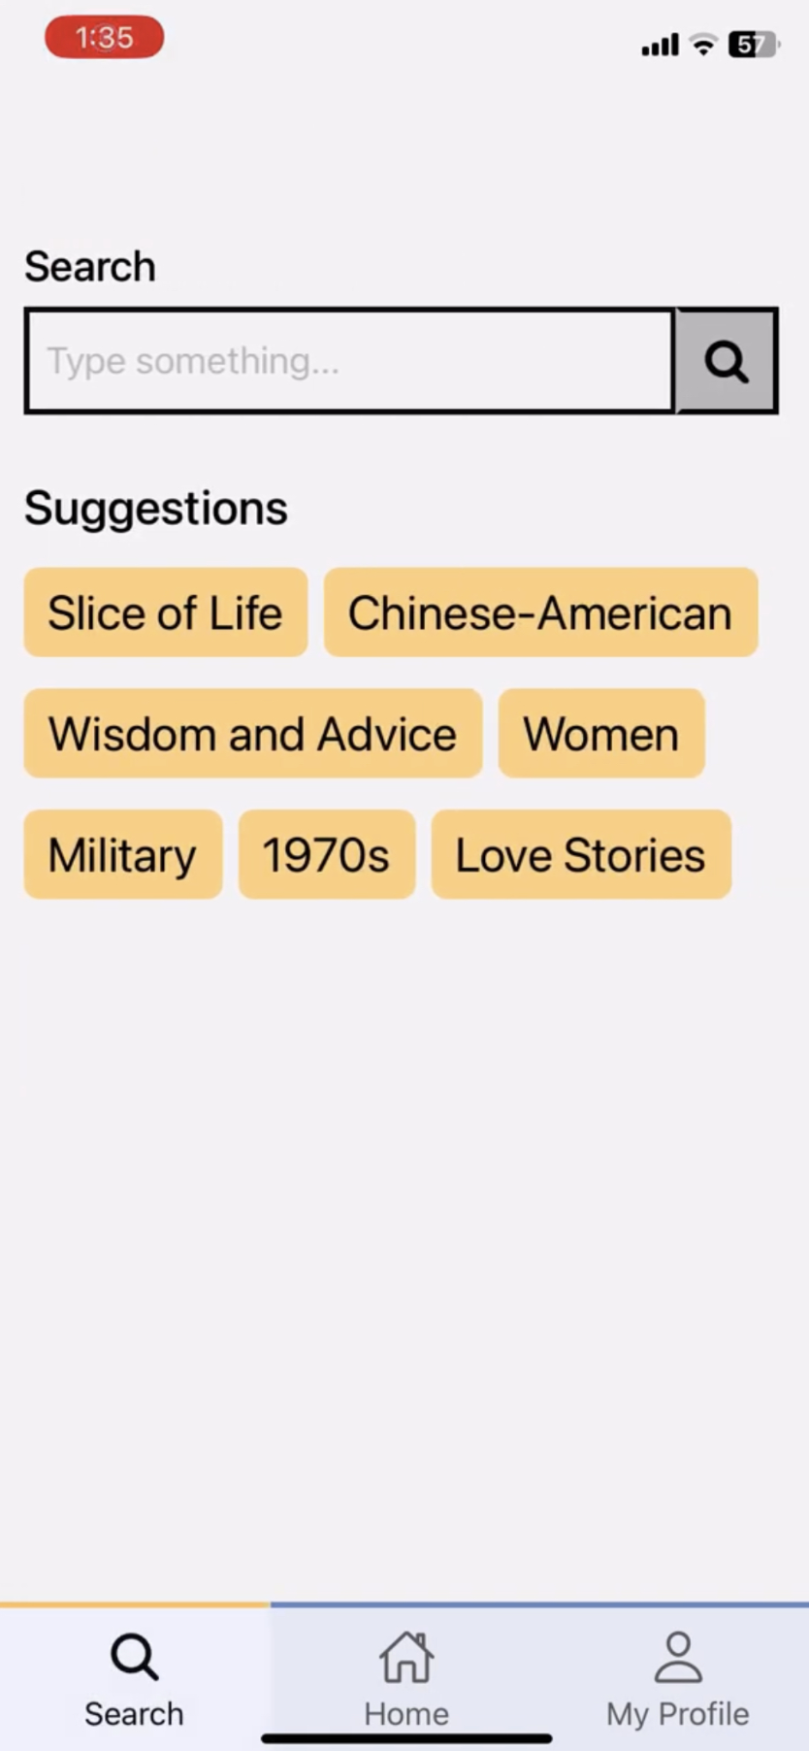
Implemented Features ✅
Home Screen
View Story Screen
search input
Search Screen
share your story button
timeline
back button
navbar functionality
placeholder hard-coded tags
text stories for now

Slide 26
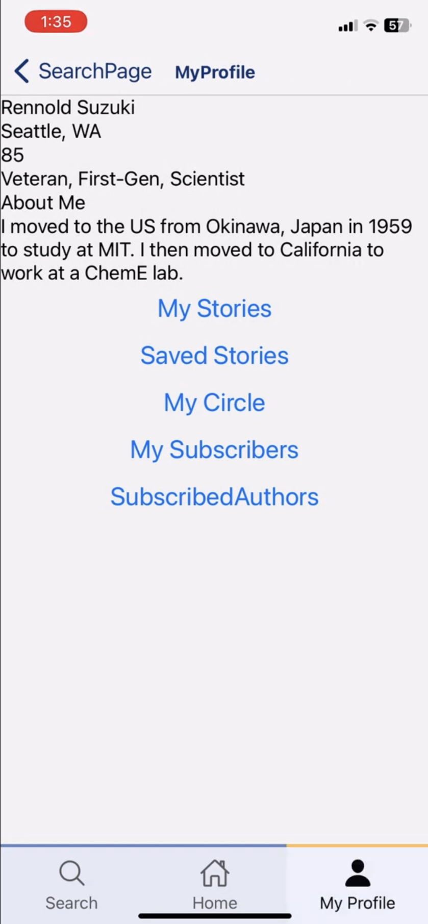
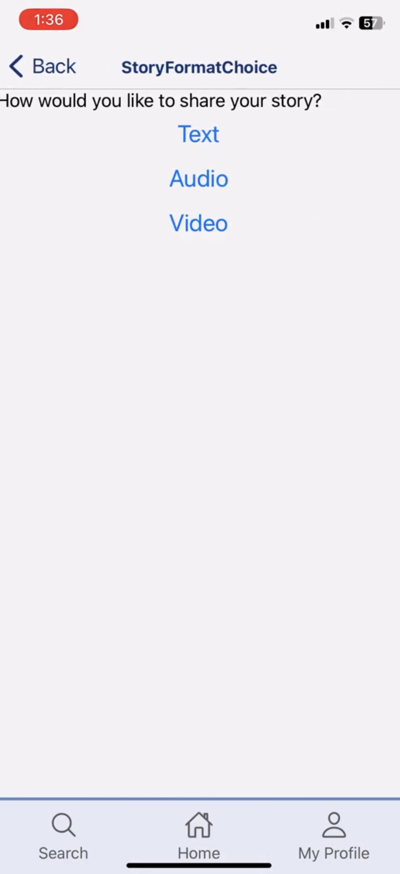
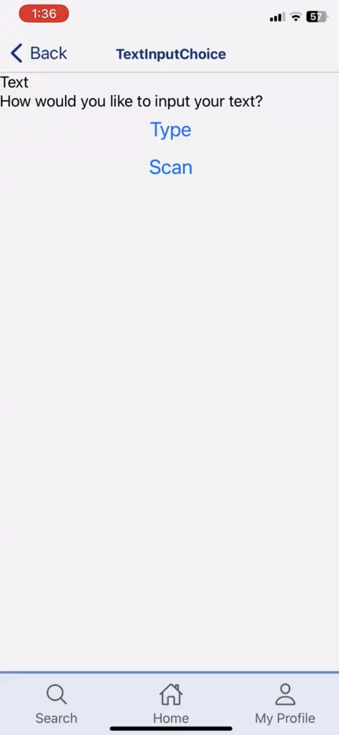
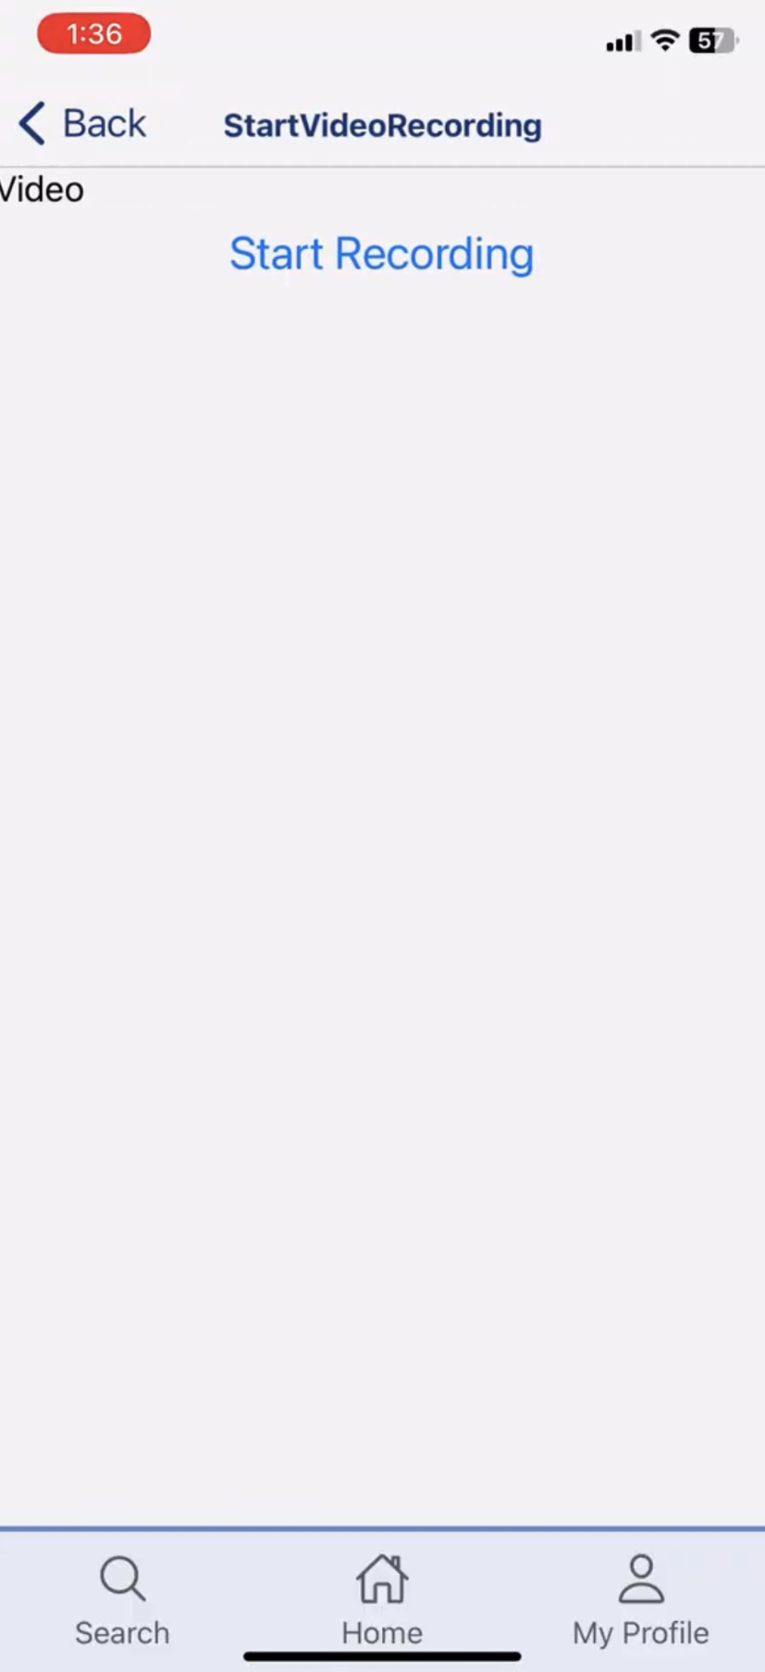
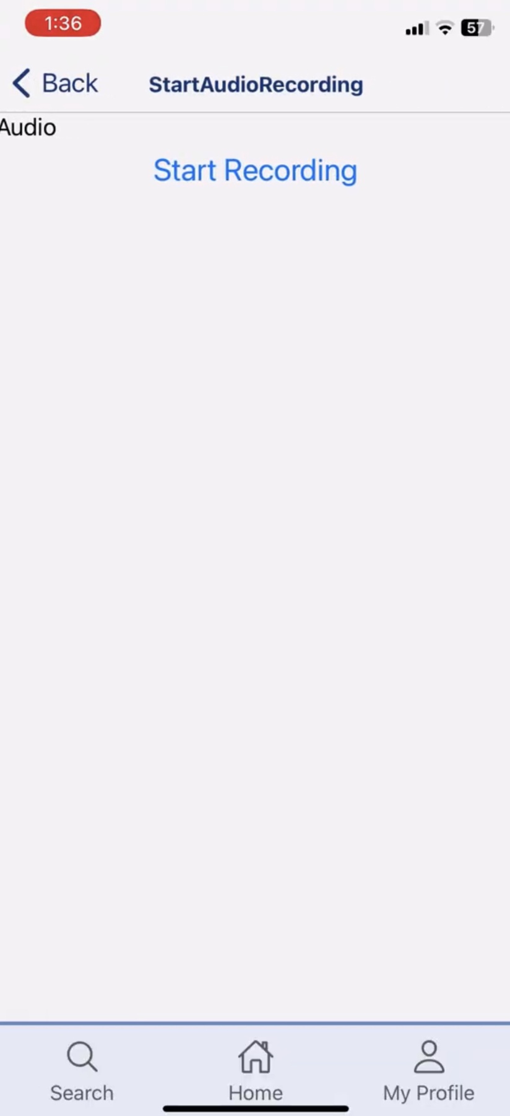
Implemented Features ✅
My Profile Screen
Posting a Story Screens
scaffolding for profile page
scaffolding for posting

Slide 27
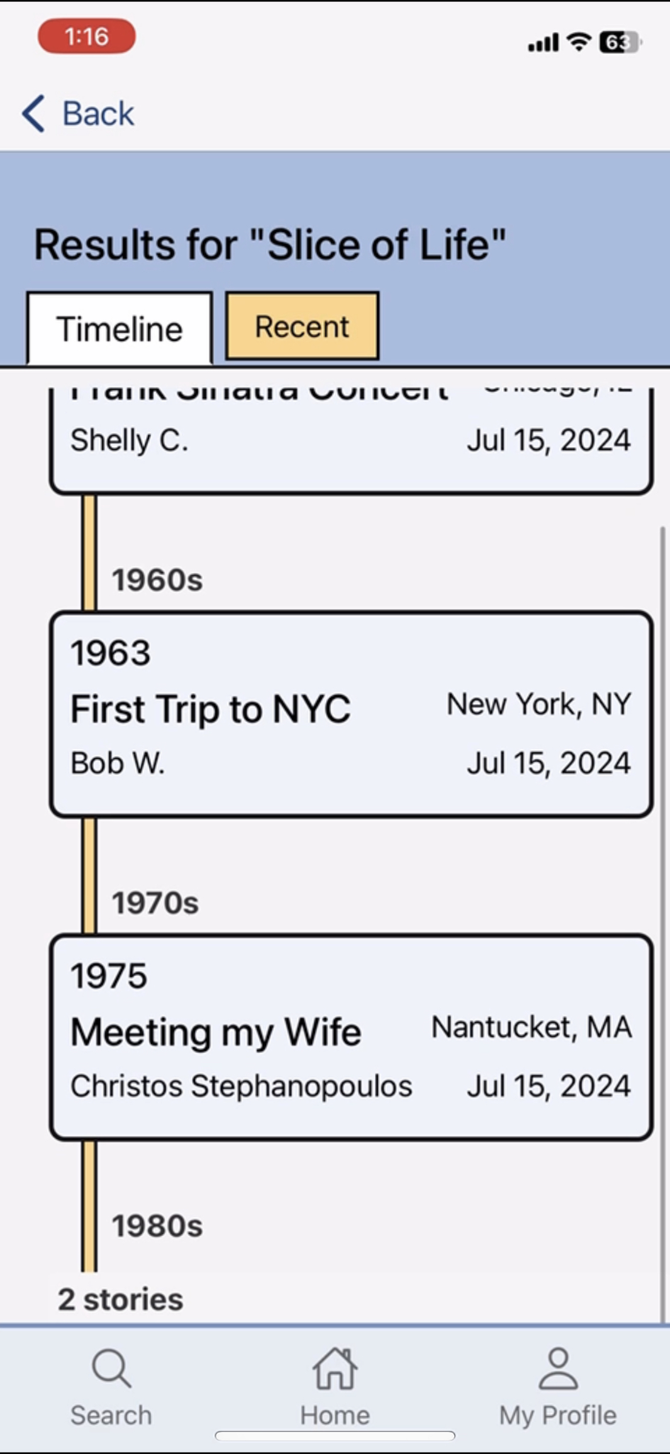
Unimplemented Features ⚙️
Home Screen
View Story Screen
Search Screen
fix story card styling + add icons (location, story type)
searching for user profiles
fix header to look more like Figma (button to view profile)
make all search queries have this layout
implement pinch to zoom in and out of timeline
different kinds of stories (video / audio)
recent view & rendering logic

Slide 28
Unimplemented Features ⚙️
implement ability to record audio and video & scanning
My Profile Screen
Posting a Story Screens
style user info & buttons on my profile → style the pages that they link to
style all buttons
error prevention on posting flow

Slide 29
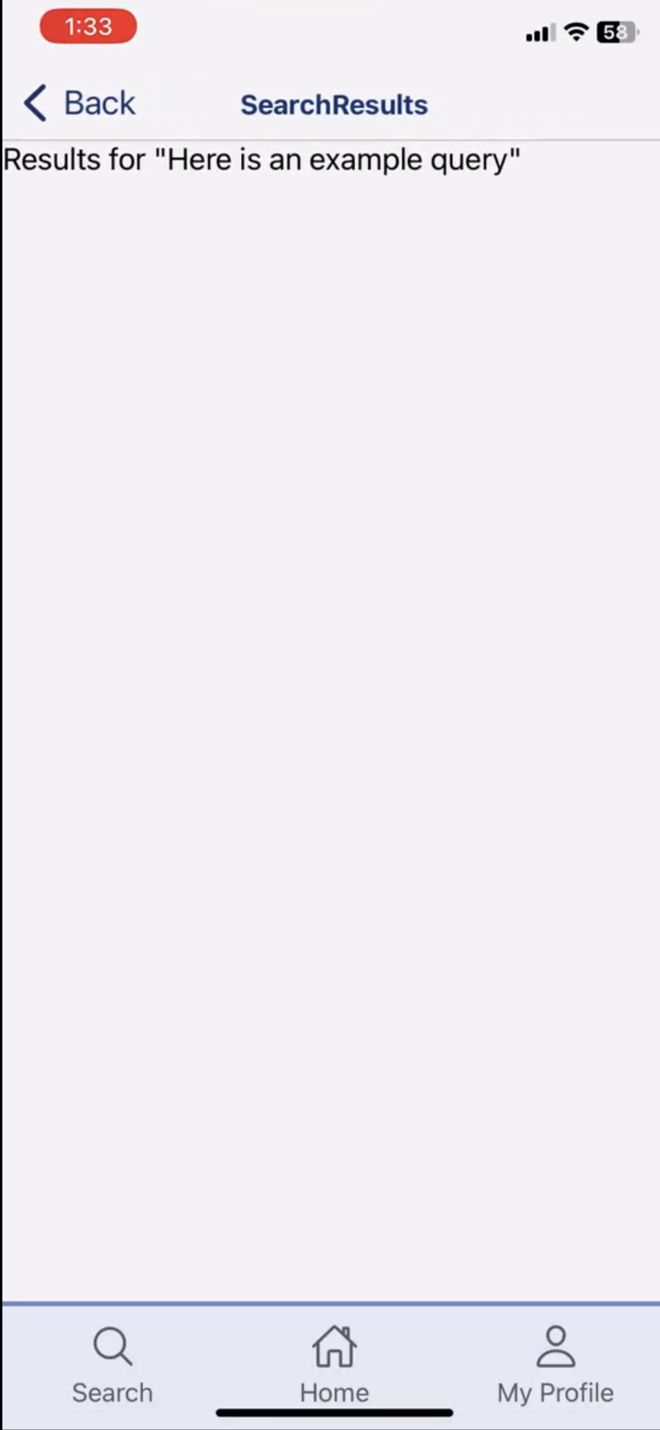
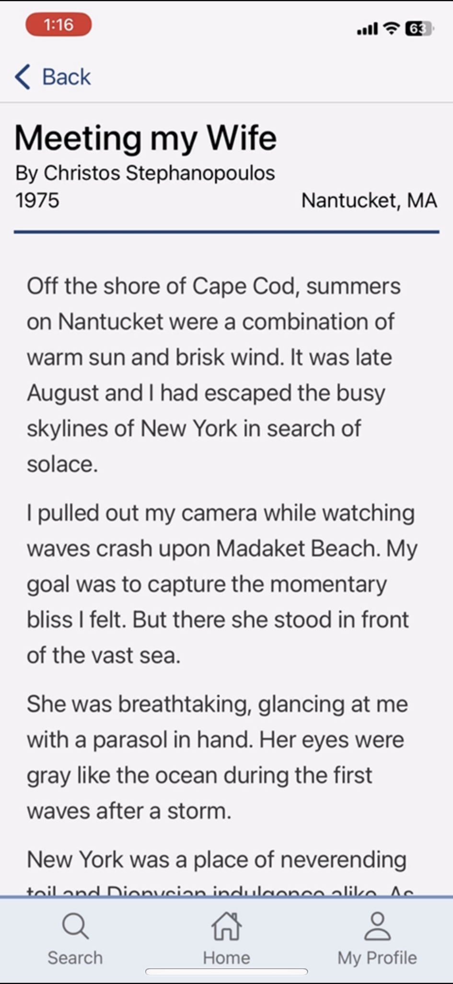
Simple Task Flow
type and enter a search query
Search Screen
Placeholder Screen For Search Results
“Slice of Life” Search Results Screen
tap story to view
tap slice of life
Story Screen
tap story to view
Home Screen
tap search on navbar
Story Screen

Slide 30
Hard Coded Aspects
User Data and Stories
Fake stories to populate our app, as we do not have any data from real users.
Fake profiles to view for people in your subscribed authors list, circle, bookmarks, and followers.
For testing purposes, users can log into a fake profile for an older adult named “Rennold Suzuki.”
Suggested Tags
We want tags to be suggested per user interests on the search page, but at the moment tags are all hard-coded and based on Rennold’s interests.

Slide 31
Issues
Timeline
Pinching to zoom in and out of the timeline to configure range of years
Figuring out logic for stacks of stories
Currently just expands, rather than zooms into timeline
Video, Audio, & Scanning Support
Posting stories via video and audio, as well as scanning text may be more challenging to figure out (might have to look into some libraries + React Native documentation)
Transcribing videos & audio
Searching and Tagging
Fix searching to work & display relevant stories
Profiles should show up in searching as well
Tagging system needs to be made and synced with different task flows

Slide 32
Changes Based On Feedback
MAKING POST: Add confirmation when posting, option to add location to stories, error messages for incomplete stories, update story display on metadata page, support image upload/display, save as draft feature for stories
MY PROFILE: Ability to search own stories, add way to edit profile data (about, tags, etc)
MY STORIES: Something to indicate who your stories are shared with (circle or public)
STYLE: Make tags a lighter color, minor stylistic changes
HOME PAGE: A way to go back after clicking into a stack of stories (pinch and zoom functionality), add recent tab to homepage, wording & clearer language
VIEWING STORIES: Remove posted date for other people stories and have 'new' or 'unviewed' tag instead
Notes:
List of features we hope to implement on the Hi-Fi based on our heuristic evaluation

Slide 33
Plans for Finishing
SIMPLE TASK: View Stories
Create more fake stories to populate search queries
Fix & edit timeline view to accommodate for issues
Logic for bookmarking stories
Auto-transcript for stories
Sharing stories
MODERATE TASK: Respond to Story
Logic for when you can respond (in circle or not)
Screens for responding to a story
Screen for after successfully responding to a story
Screens for viewing someone’s responses to your story

Slide 34
Plans for Finishing cont.
COMPLEX TASK: Posting a Story
Support for audio and video posting
Support for scanning written story
Making edits to previous posts
Error screens & prevention
Save as draft
ADDITIONAL PLANS:
Login flow (using info for Rennold’s Account)
Lots of styling for entire app!
Make buttons consistent
Add in some icons (e.g. location, bookmarks)

Slide 35
Hi-Fi Demo

Slide 36
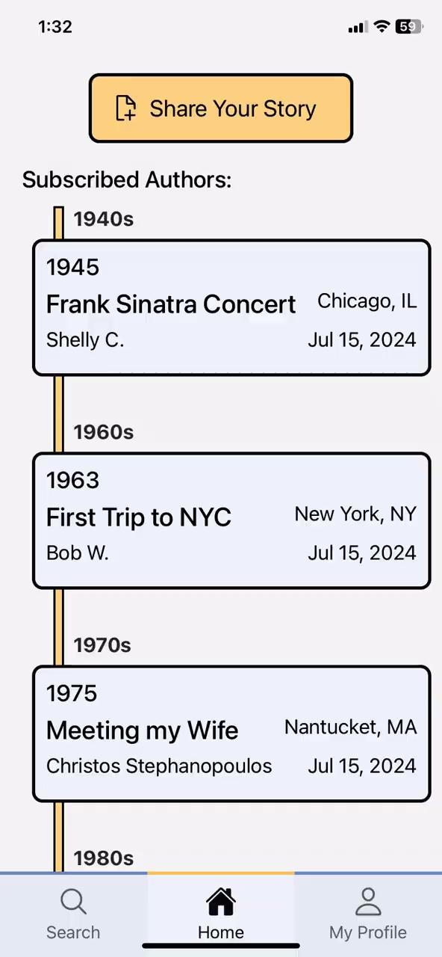
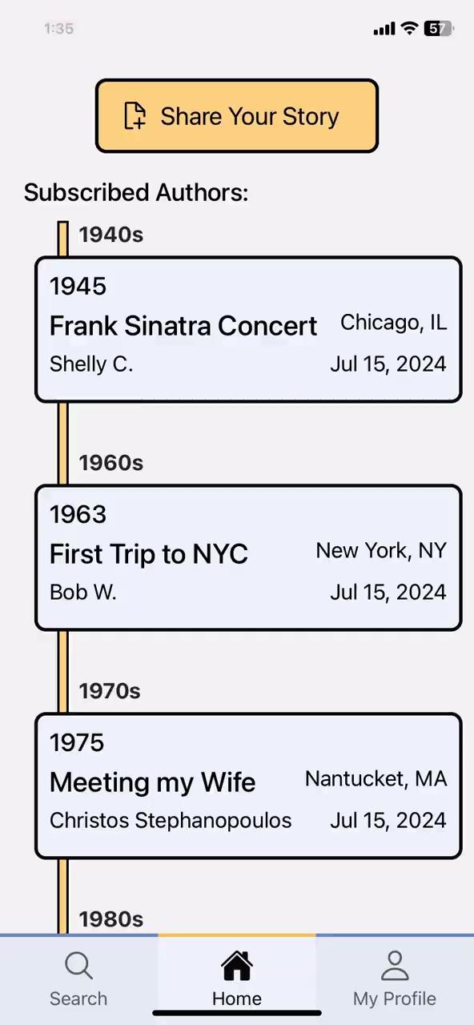
Video Demo ( 1 min 30 sec)
SIMPLE TASK: view a story
EXTRA: other features implemented
Notes:
List of features we hope to implement on the Hi-Fi based on our heuristic evaluation

Slide 37
05
Appendix
Extra content, Sources

Slide 38
Figma

Slide 39
GitHub Repo

Slide 40
Image and Graphic References
Slide Theme: Design Thinking Workshop Slides - SlidesGo
Notion-Style Profile Photos
Team member photos provided by team

