Slide 1
Med-fi Prototyping
Team 2: Eliza Bazakas, Hera Lasseau, Ngoc Tran, Renn Su

Slide 2
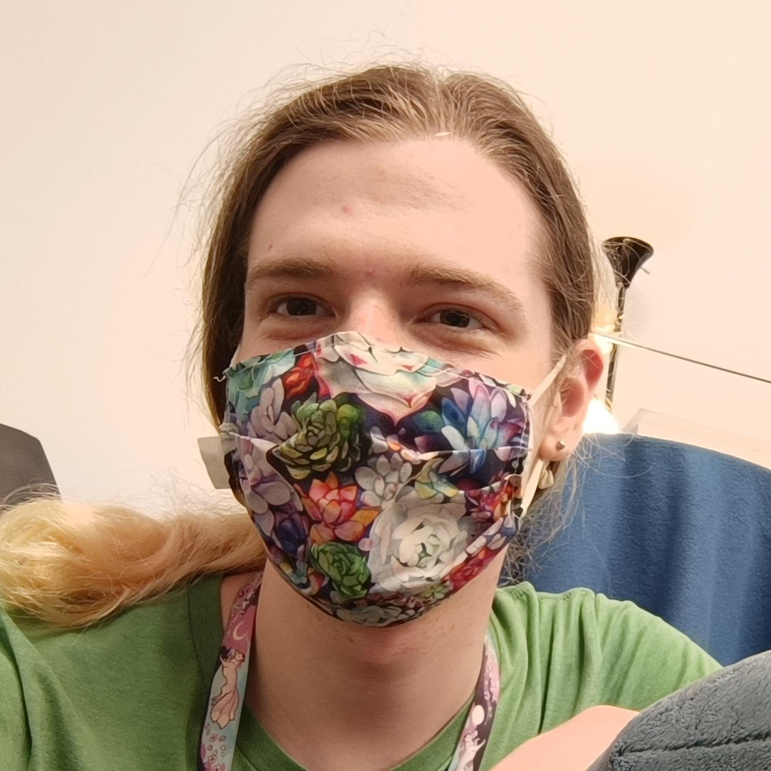

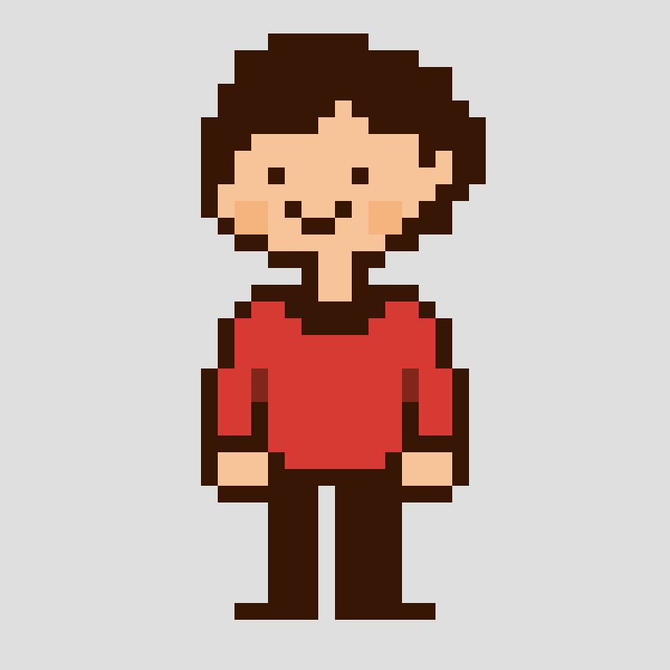
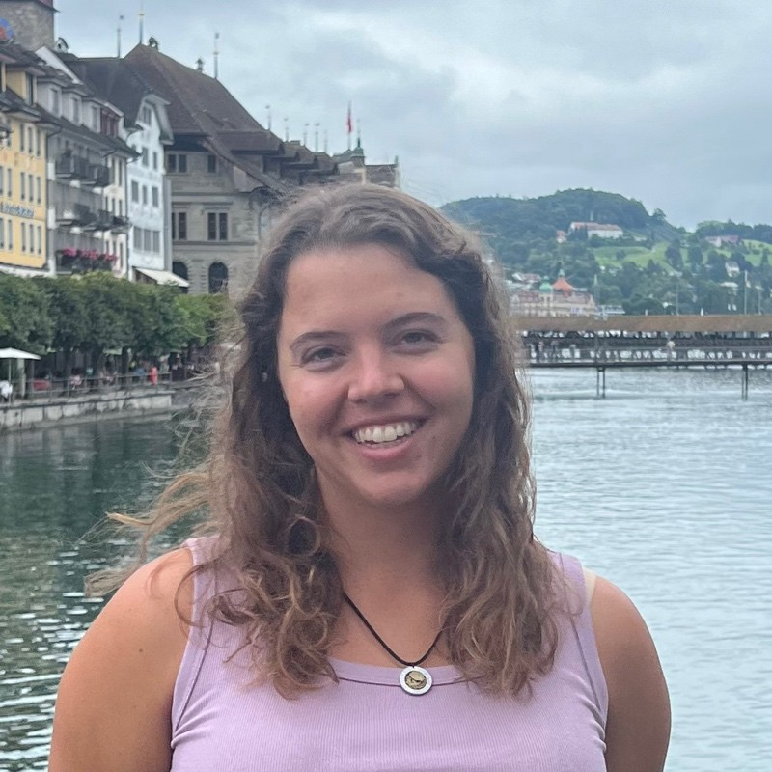
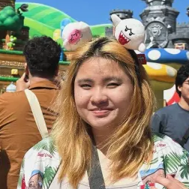
Team Lore
Hera Lasseau
Renn Su
Computer Science ‘25
Motueka, NZ
Computer Science ‘26
Vancouver, Canada
Ngoc Tran
Eliza Bazakas
Computer Science ‘26
Austin, TX
Computer Science MS ‘26
ChemE B.S. (MIT)
Berkeley, CA

Slide 3

Unpack your memories: life stories in timeline form

Slide 4
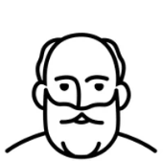

The Problem
?
I’m curious!
Lived experiences
Wisdom
Cultural knowledge
Notes:
Problem
Older adults have had long and varied lives, and younger people want to know the ‘lore’ of their elders, but these stories are going untold due to an absence of infrastructure connecting the generations.

Slide 5
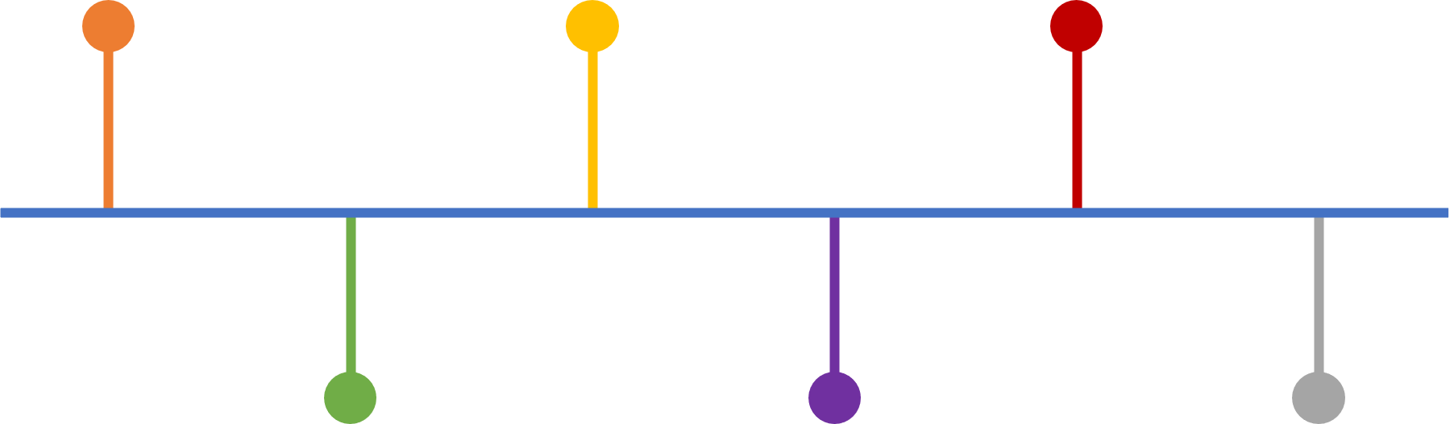
Our Solution
Lived experiences
Cultural knowledge
Wisdom
Notes:
Solution
Lore, an app which gives older adults a platform to record and share their stories, and young people the opportunity to learn about the way things were at various places and times.

Slide 6
Value Proposition
Lore facilitates the sharing and exploring of life stories in a chronological and spatial context.

Slide 7
Our Solution
Notes:
Solution
Lore, an app which gives older adults a platform to record and share their stories, and young people the opportunity to learn about the way things were at various places and times.

Slide 8
Our ‘Lore’
What we’ve learned
Older adults have had long and varied lives, and younger people want to know the ‘lore’ of their elders, but stories are going untold due to an absence of infrastructure connecting the generations.
What we’ve built
Lore, an app which gives older adults a platform to record and share their stories, and young people the opportunity to learn about the way things were at various places and times.

Slide 9
Values in Design
Accessibility
● 40% of US residents ages 65+ who have at least one disability
● lack of accessibility could prevent stories from being shared
● incorporated features: large buttons and easy-to-read fonts
● value tensions: minimal text may not be explanatory for the visually impaired
Generational Wisdom
● we want older adults to feel that their experiences are valuable and worth sharing
● incorporated features: personalized timelines, historical and geographical context, multimedia support
● value tensions: younger users also need to feel engaged by the platform
Notes:
https://www.census.gov/newsroom/archives/2014-pr/cb14-218.html
Accessibility
We want to make sure our application is usable to a wide variety of people with different abilities.
Though many accessibility features are built into mobile operating systems and keyboards already, so we didn’t feel the need to make voice-to-text or text-to-voice features, two accessibility features that we chose to incorporate were large, easily-pressed buttons and sans-serif, easy-to-read fonts.
Generational Wisdom
We want to make our older adult userbase feel that their experiences are valuable and worth sharing; our designs aim to celebrate the wisdom they have to share.
TODO: write how we’re incorporating this into our design

Slide 10
Tasks

Slide 11
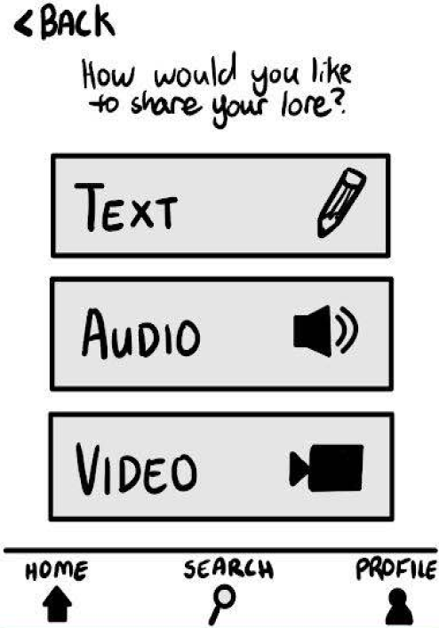
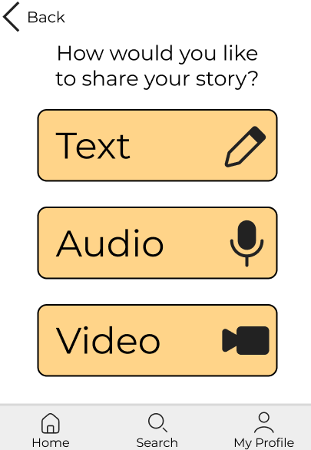
Post a Story
Simple flow: Recording a story via text, audio or video, and publishing it with a title to a group of their choice (public or their circle)

Slide 12
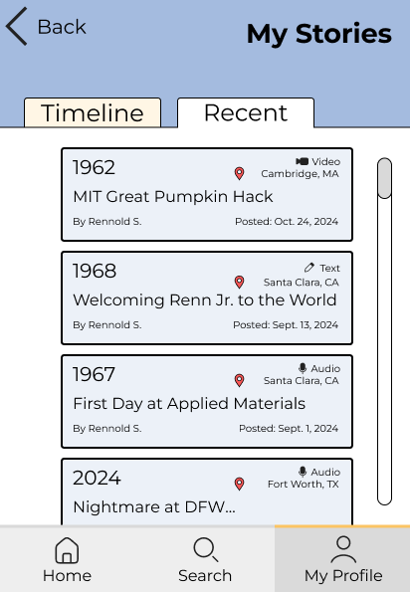
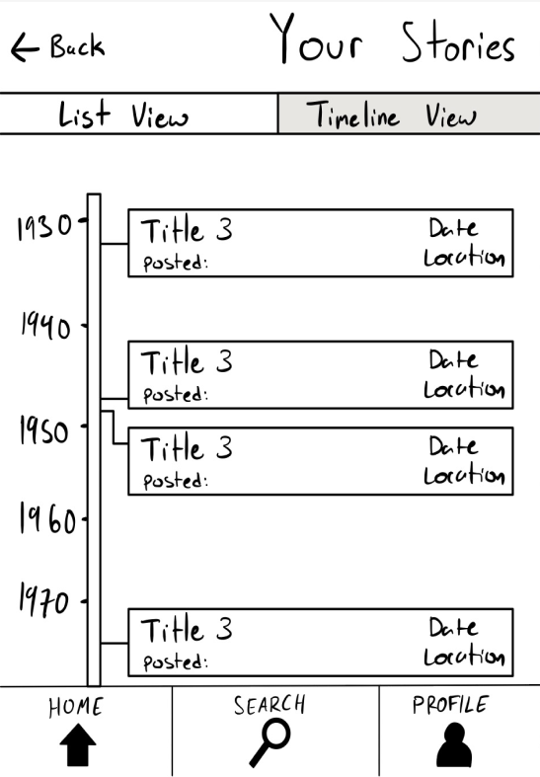
View All Your Stories
Moderate flow: Navigating to their profile and finding their posts

Slide 13
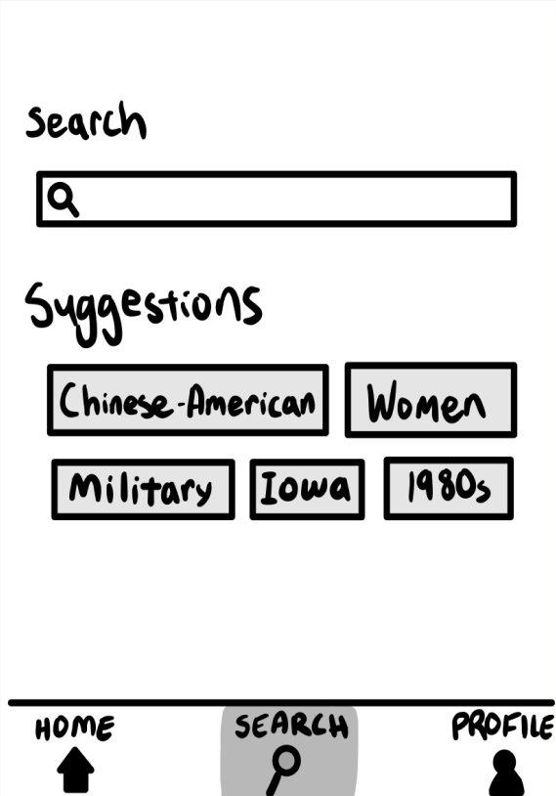
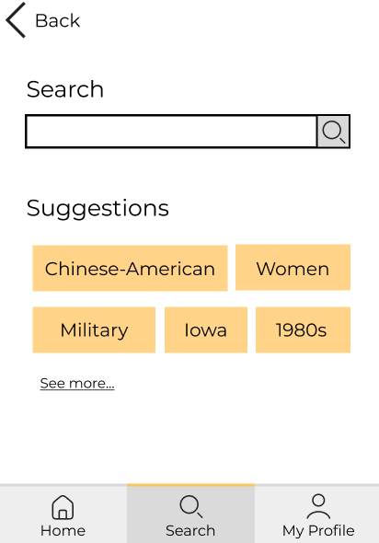
View Stories by Time; Place; Topic
Complex flow: Being able to search for a particular category that they are interested in

Slide 14
Goals & Measurements

Slide 15
Established Metrics From A5
Speed
Confidence
Independence
Length of time to complete tasks
Certainty in choice of options
Able to complete tasks with minimal help

Slide 16
Progress Towards Goals
Speed
Confidence
Independence
Fitt’s Law: our buttons/pressable components are now larger for ease of access
Condensed timeline: found a way to condense stories on the timeline for speed of navigation
Language is more clear and less reliant on tech-specific jargon
“Share your lore” → “share your story”
“Profile” → “My Profile”
“List view” → “Recent”
Added clearer tabs to emphasize which view is selected
Addition of transcript function to increase independence for those with auditory processing difficulties
Clearer tagging and year selection functions for self-efficacy in making stories discoverable
Notes:
Usability goals & key measurements
b. How is your product progressing towards hitting these goals?

Slide 17
Revised
Sketches

Slide 18
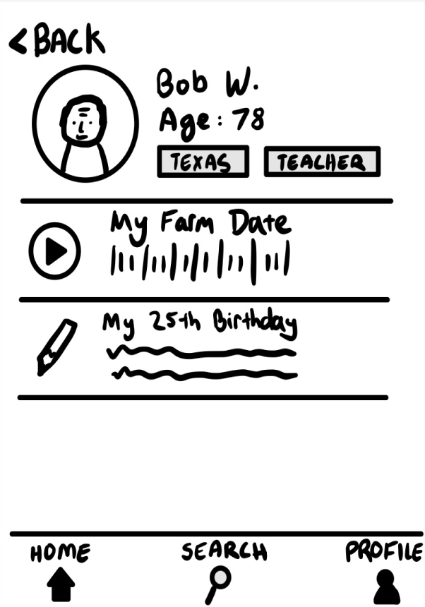
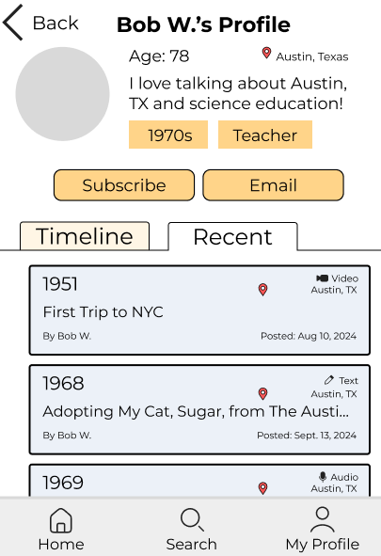
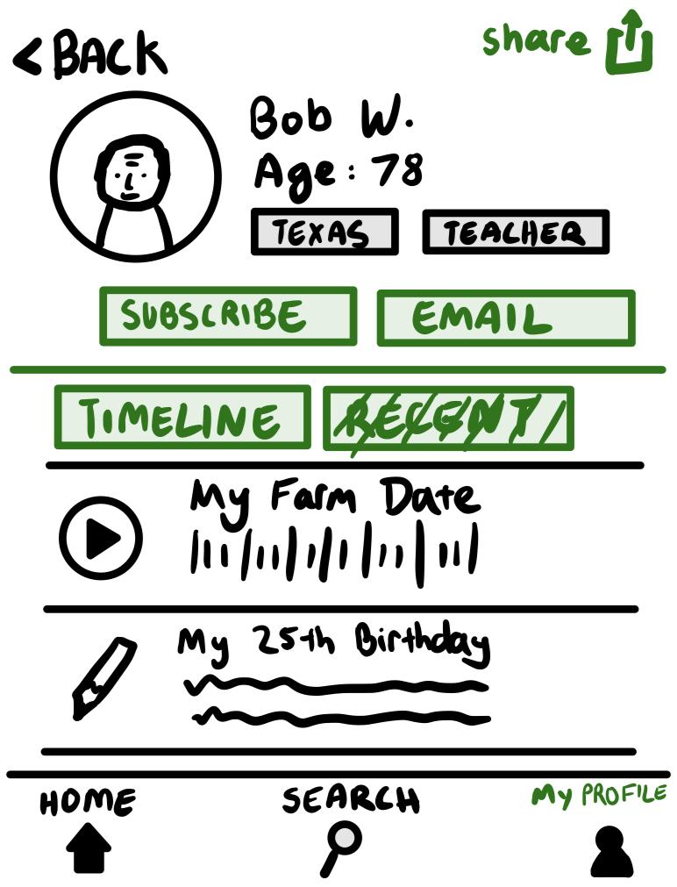
Change 1: Viewing Other Profiles
Others’ Profile View
An option to subscribe and contact the user
A way to toggle between timeline and recent on others’ pages
Option to share profile
Rationale
More interactivity between users on the app increases sharing of generational wisdom
Low-fi interviews suggested a desire for out-of-app sharing
Original Low-Fi
Revised Low-Fi
Notes:
Revised interface sketches
a. Major changes – 3 biggest changes between original and revised sketches

Slide 19
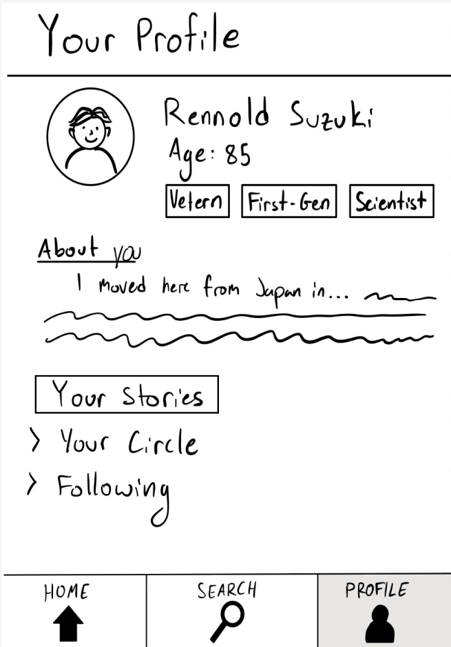
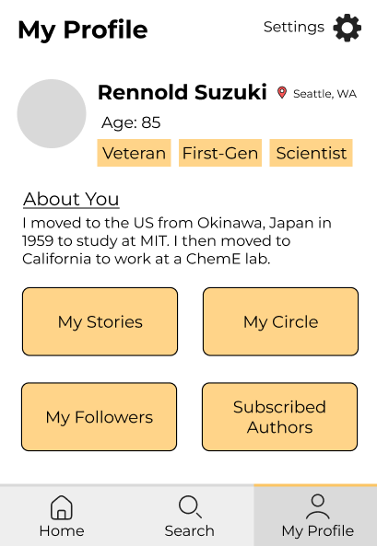
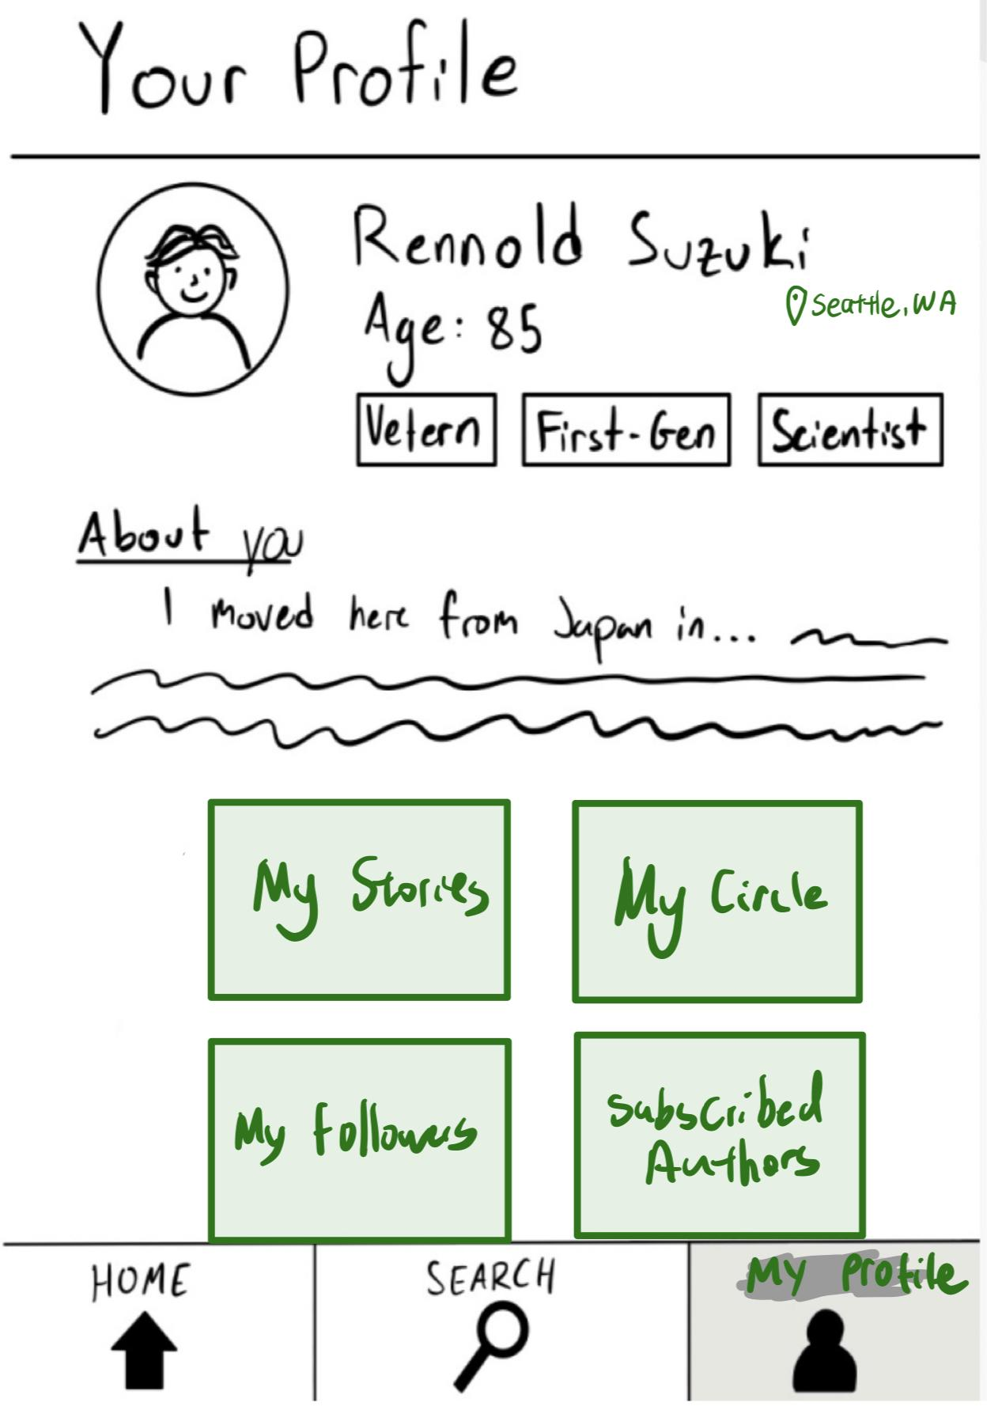
Change 2: “My Profile” Page
“My Profile” Page
Larger, more intuitive buttons for the user to navigate
Location of user is more prevalent
Nav Bar: “Profile” → “My Profile”
Rationale
Larger buttons rather than drop down menus increase accessibility and intuitiveness
Low-fi users were sometimes confused by the ‘profile’ wording
Place-based belonging conveys to people that their stories are part of something bigger
Original Low-Fi
Revised Low-Fi
Notes:
All changes highlighted in green
Revised interface sketches
a. Major changes – 3 biggest changes between original and revised sketches

Slide 20
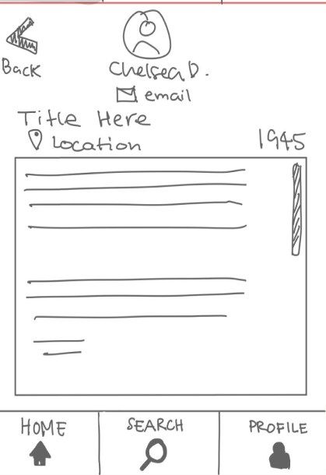
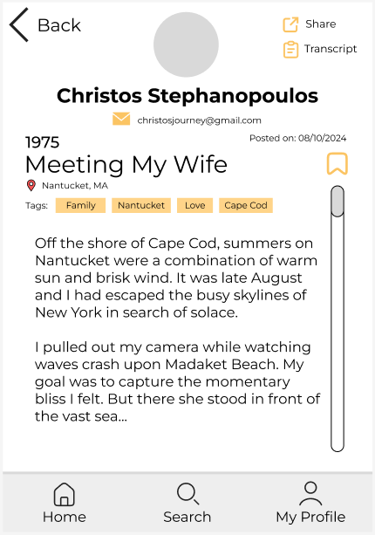
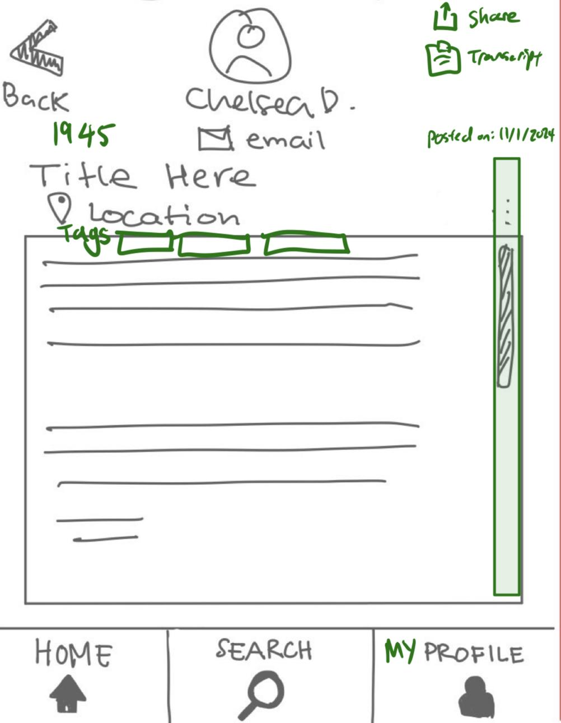
Change 3: Story View
Story View
Tags and posting date are more prevalent on the page
Scroll bar uses the entire page
New share and transcript options
Rationale
Transcripts and the larger scroll bar* would help increase accessibility
Share and tag functions increase the spread of generational wisdom
Original Low-Fi
Revised Low-Fi
Notes:
Larger scroll bar would increase the area on which text would flow, which would make it easier to read due to larger text and increased ease of scrolling
Revised interface sketches
a. Major changes – 3 biggest changes between original and revised sketches

Slide 21
Task Flow

Slide 22
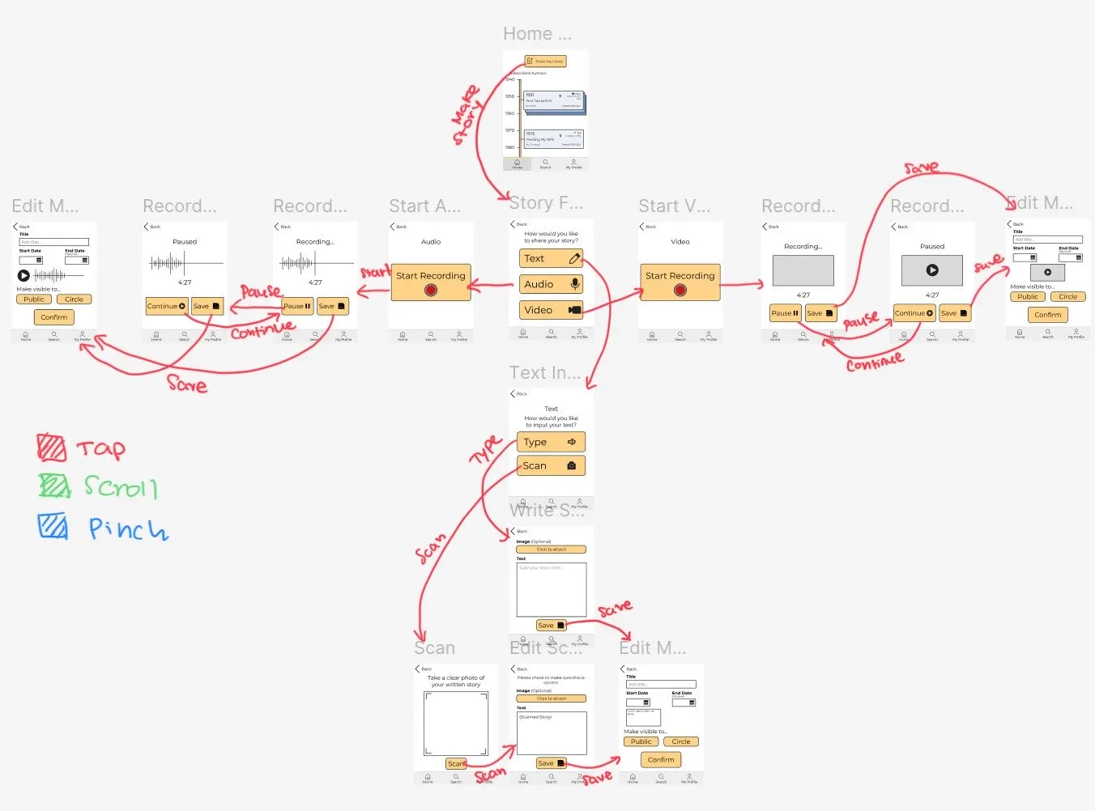
Task Flow 1: Post a Story
Notes:
Medium-fi task flows
a. 1 task flow per task
b. Annotated screenshots from your medium-fi prototype (arrows indicating
transitions, relevant labeling, captioning, etc.)

Slide 23
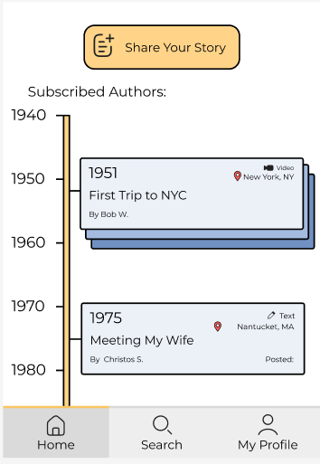
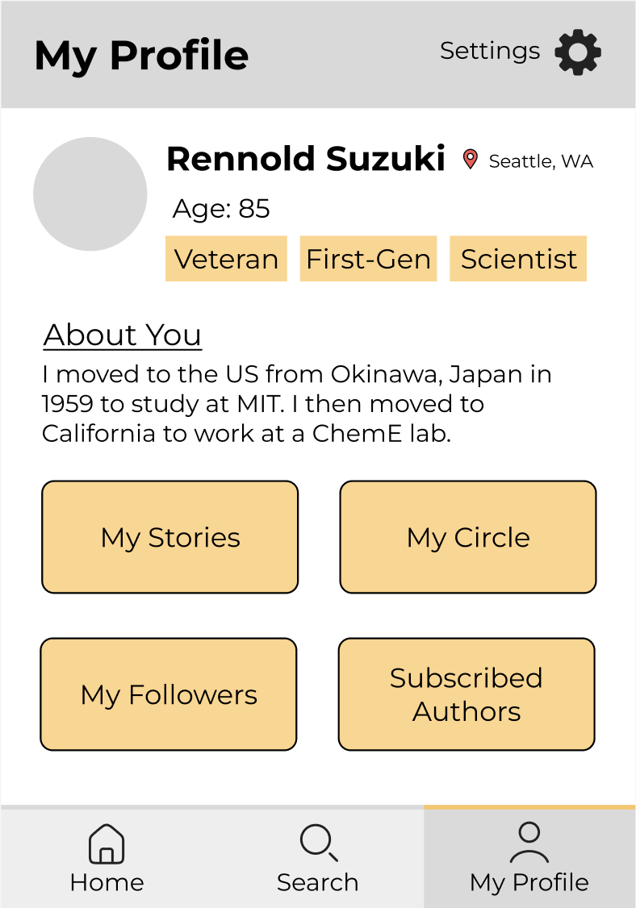
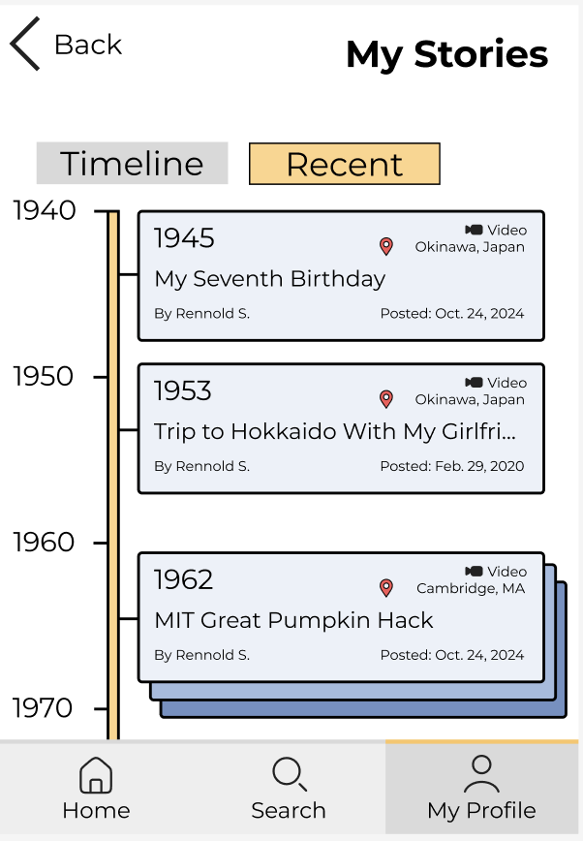
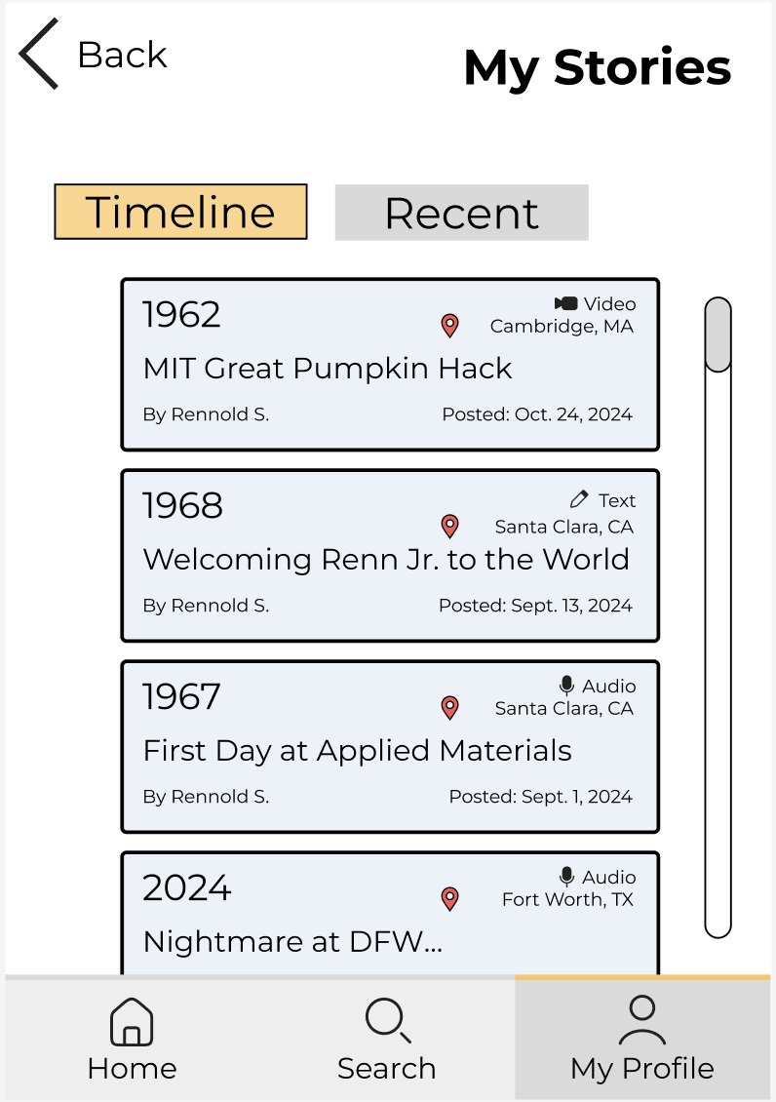
Task Flow 2: View All Your Stories

Slide 24
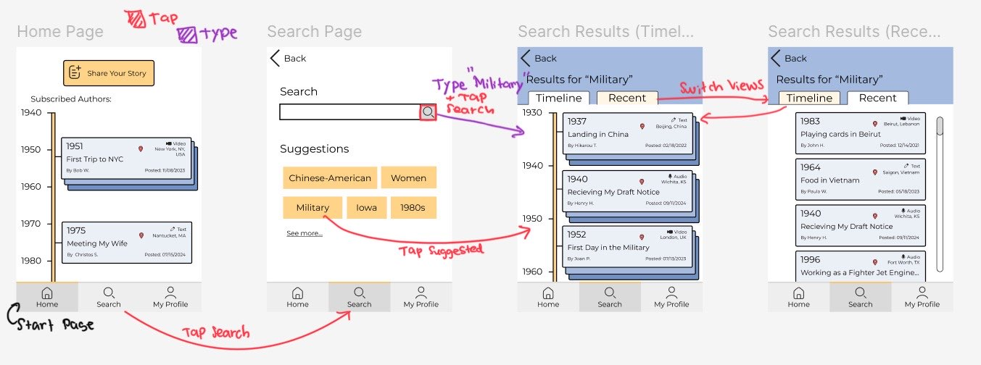
Task Flow 3: Look for Stories
Notes:
Medium-fi task flows
a. 1 task flow per task
b. Annotated screenshots from your medium-fi prototype (arrows indicating
transitions, relevant labeling, captioning, etc.)

Slide 25
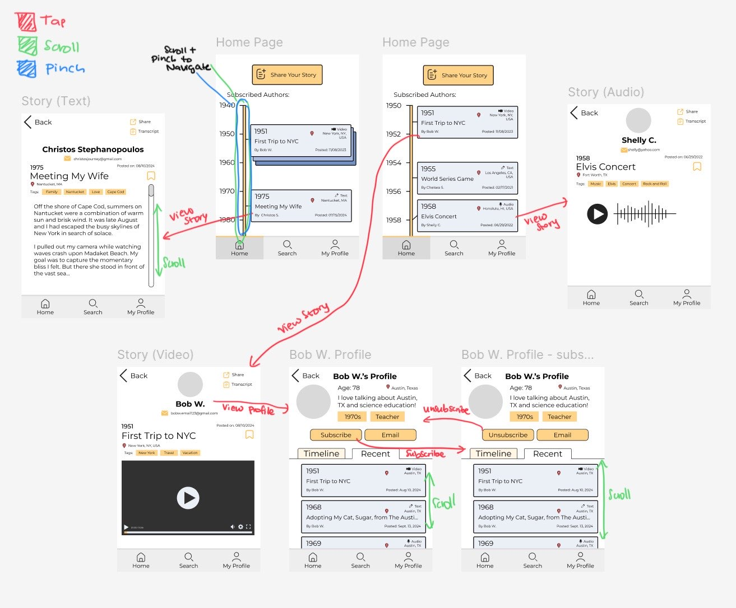
Task Flow 4: Viewing an Author
Notes:
Medium-fi task flows
a. 1 task flow per task
b. Annotated screenshots from your medium-fi prototype (arrows indicating
transitions, relevant labeling, captioning, etc.)

Slide 26
Prototype Implementation

Slide 27
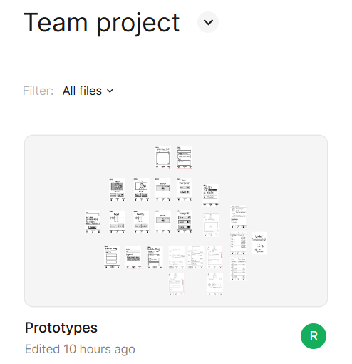

Tools Used
Most of our medium fidelity prototype was built in Figma.
To coordinate, we used Zoom, Discord, and Slack.
For UI design, we used
  paletton.com (color palettes)
  Procreate (logo design)
  Google Fonts (typefacing)
Notes:
Tools: What did you use? Pros and cons of using this tool(s)?

Slide 28
Tool Pros and Cons
Pros:
Easy to visualize where screens fit and adjust the overall styling of our app
Figma allows for flexible visual changes and adjustments without requiring code
Device dimension frames allow us to better visualize size of elements for accessibility
Cons:
Difficult to test interactions such as video and audio recording
Wireframing does not always reflect more feed-related experiences such as scrolling and post discovery
No database or data storage

Slide 29
Limitations
Video & Audio Recording
Emulating Text Input
No camera/microphone recording feature that can be easily emulated via Figma
Cannot easily store testers’ text inputs as stories
Lack of Databases
Limited Content
There is no way to store information such as subscribed and bookmarked stories
Users can only access a selection of sample stories at the moment, rather than a populated feed

Slide 30
Cheats
Hard-coded and Wizard-of-Oz features
Accounts & Stories
Onboarding Flow
Account Networking
Making them dynamic would require the use of a database or some form of data storage which Figma doesn’t support
Onboarding flows tend to be standardized and this was not central to the app’s central functionality
Tangential to the app’s main focus, but being a large amount of work relative to how important they are
Notes:
Hard-coded and Wizard-of-Oz features

Slide 31
05
Appendix
Extra content, Sources

Slide 32
Figma

Slide 33
Task Flow 2: Your Profile
Notes:
Medium-fi task flows
a. 1 task flow per task
b. Annotated screenshots from your medium-fi prototype (arrows indicating
transitions, relevant labeling, captioning, etc.)

Slide 34
Values in Design
Accessibility
  We want to make sure our application is usable to a wide variety of people with different abilities.
  Though many accessibility features are built into mobile operating systems and keyboards already, so we didn’t feel the need to make voice-to-text or text-to-voice features, two accessibility features that we chose to incorporate were large, easily-pressed buttons and sans-serif, easy-to-read fonts.
Generational Wisdom
  We want to make our older adult userbase feel that their experiences are valuable and worth sharing; our designs aim to celebrate the wisdom they have to share.
  TODO: write how we’re incorporating this into our design

Slide 35
Image and Graphic References
Slide Theme: Design Thinking Workshop Slides - SlidesGo
Notion-Style Profile Photos
Team member photos provided by team

