Slide 1
Creating Solutions
Team 2: Eliza Bazakas, Hera Lasseau, Ngoc Tran, Renn Su

Slide 2
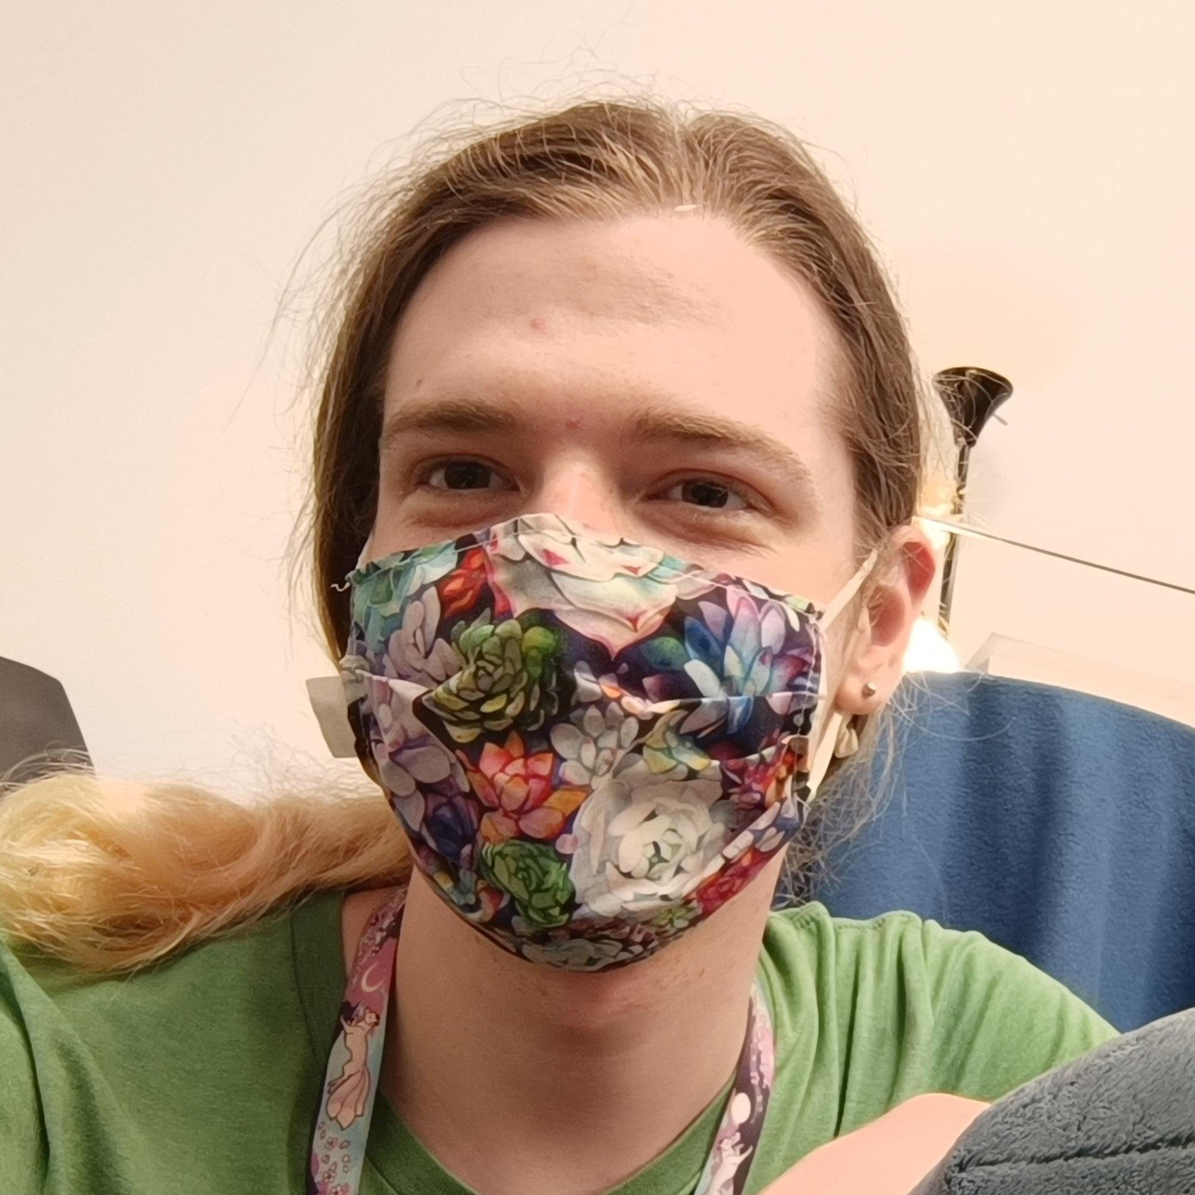

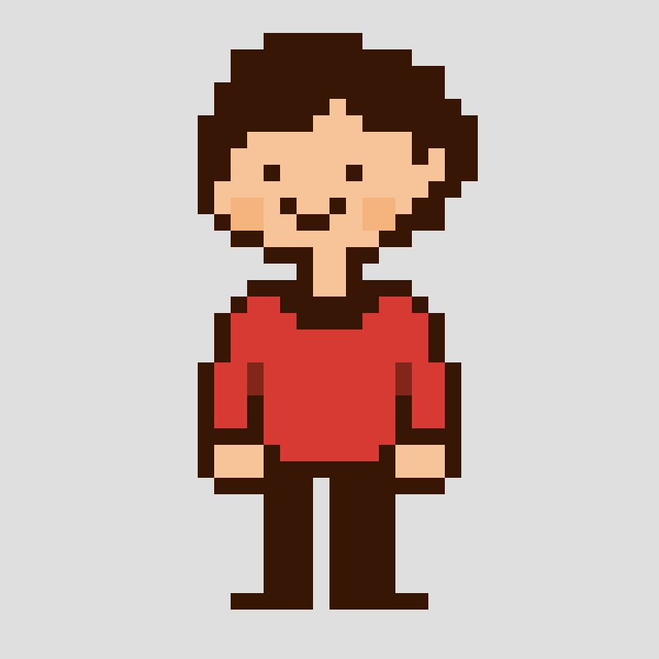
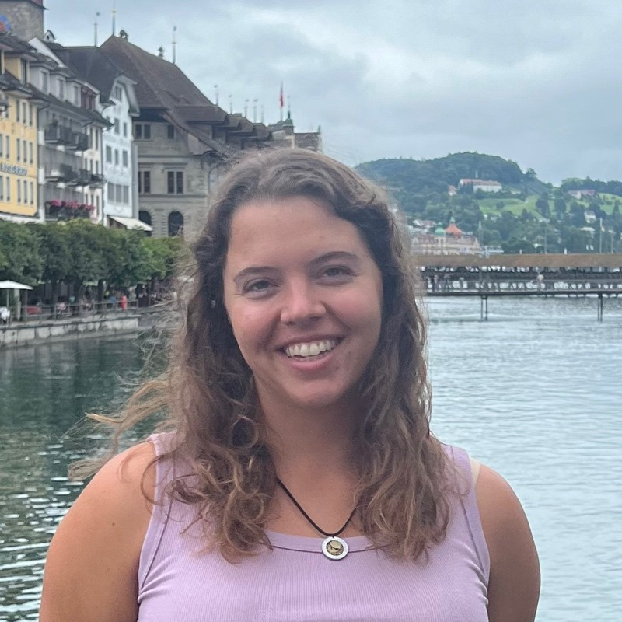
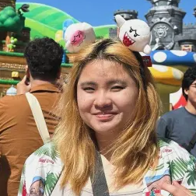
Team Mountain Lion
Hera Lasseau
Renn Su
Computer Science ‘25
Motueka, NZ
Computer Science ‘26
Vancouver, Canada
Ngoc Tran
Eliza Bazakas
Computer Science ‘26
Austin, TX
Computer Science MS ‘26
ChemE B.S. (MIT)
Berkeley, CA

Slide 3
Overview
Table of Contents
Domain Narrowing | Slide 4
Needfinding Interviews | Slide 5
POV Development | Slide 10
HMWs & Solutions | Slide 14
Experience Prototyping | Slide 17
Appendix | Slide 38

Slide 4
Domain Narrowing
Multi-generational
Connection
Older adults wanted to both share and listen to others
Young people were open to providing help to older adults
There is unshared wisdom as there are few structured ways to share it to strangers across generations.
Reciprocal Mentorship

Slide 5
01
Needfinding Interviews
Additional week 2 interviews and learnings

Slide 6




This Week in Interviews
Daisy and Patrick
Abigail
Sasha
Ages 89 and 86
Southern California
Retired clinical psychologist and IBM worker
Age 22
Berkeley, CA
First year PhD student
Age 74
Cupertino, CA
Art educator at public schools and Stanford

Slide 7
We learned that…
Daisy and Patrick
Abigail
Sasha
Lived in a very social senior center but wanted to connect with young people other than their grandchildren
Attended garden party of elderly neighbours but felt awkward about initiating contact with them
Felt many current apps were confusing and wishes that digital content was more focused

Slide 8
Interviews at a glance…
10 participants, 7 interviews
6 women
3 adults w/ disabilities
4 men
Jane (helps older adults w/ tech)
Sasha (art educator)
Isabella (tech literacy expert)
David (son to 80 y/o man)
Patrick (IBM worker)
22
65+
80
89
21
48
74
86
Abigail (Berkeley student)
Helen and Harold (retired engineers)
William (older adult from SC)
Rose (retired clinical psychologist)
ages from 21 – 89
5 in-person, 2 zoom interviews

Slide 9
Week 2 Findings
1
For older adults, apps should have a clear purpose, and content should be focused and catered.
2
Older adults felt disconnected from society even when they had strong social ties with other older adults, and wanted to hear from younger people
3
Young people are open to learning more about their older neighbours

Slide 10
02
POV Development
POV statements

Slide 11

POVs
“Jane”
74 y/o woman who volunteers at the United Effort Organization for Hope’s Corner
We met…
a retired lawyer whose volunteer work helping people navigate digital paperwork adds to her vibrant social life
We were surprised to notice…
she texts older adults about in-person plans, so her phone helps fulfill social needs without social media
We wonder if this means…
she sees digital connections as a means to physical connections because she feels that they are more meaningful.
It would be game changing…
to facilitate creating new opportunities for meaningful physical connection.

Slide 12

POVs
“Helen”
65+ y/o woman who is a retired engineer
We met…
an older adult who used to be an engineer and had strong opinions about user interfaces.
We were surprised to notice…
that she didn't like looking up things on Google, and felt that it was not a useful resource despite knowing how to use it.
We wonder if this means…
she believes Google answers are unintuitive or hard to follow, and she would prefer a person to explain things to her.
It would be game changing…
to give Helen a way to access a broad range of information while emphasizing human connection.

Slide 13
POVs
“Abigail”
22 y/o first year Berkeley PhD
We met…
A first gen student in the first year of her PhD in bioengineering at UC Berkeley.
We were surprised to notice…
she liked interacting with her older neighbors and thought it was interesting talking to them, but would not initiate contact.
We wonder if this means…
she feels a social disconnect with people not of her generation, making her unsure how to approach them.
It would be game changing…
to allow Abigail’s interactions and meetings with older generations to feel more facilitated and structured.

Slide 14
03
HMW & Solutions
How Might We Help Statements, proposed solutions

Slide 15


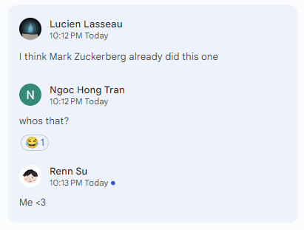

Dishonorable Mentions…

Slide 16
We voted for our top 3 solutions:
Abigail
Jane
Jane
HMW make older adults seem less intimidating or distant?
HMW help people socially connect others who do not want to rely on technology?
HMW make digital connections more meaningful?
Storytelling
Penpals
Hobby Matching
A storytelling app where older adults can share their life, tips, and advice and also pairs older adults with younger ones via video for storytelling sessions
A penpal matching app where users are digitally matched with someone to correspond via physical letters
Connect people with common interests like chess, cooking, gardening, etc. for in-person meetups.

Slide 17
04
Experience Prototypes
HMW Statements, proposed solutions

Slide 18

storytelling
PROTOTYPE 1:
mentorship via recounting lived experiences

Slide 19
Cross-Generation Stories
HMW make older adults seem less intimidating or distant?
Proposed Solution: a tool for older adults to talk about their lives and impart advice; also pairs older adults with younger ones via video for storytelling sessions
Family stories/oral tradition
- e.g. Storyworth
- stays within family
Forum/Reddit stories
- Impersonal, anonymous
-Decentralized
Cross-Generation Stories App
Memoirs and advice videos
-Authors + gurus
-Rarely regular people

Slide 20
\
ASSUMPTION VALIDATION
ASSUMPTION:
Older adults want to share their personal life and experiences and younger people find value in listening to them.
PROTOTYPE OVERVIEW:
Storytelling Cards: A set of 6 open-ended prompts for older adults to answer
Audience: A selection of younger people who listen to the recorded video of the older adults in question
Questionnaire: Ask both storyteller and audience participants to complete a survey about their experiences telling or listening to the story

Slide 21
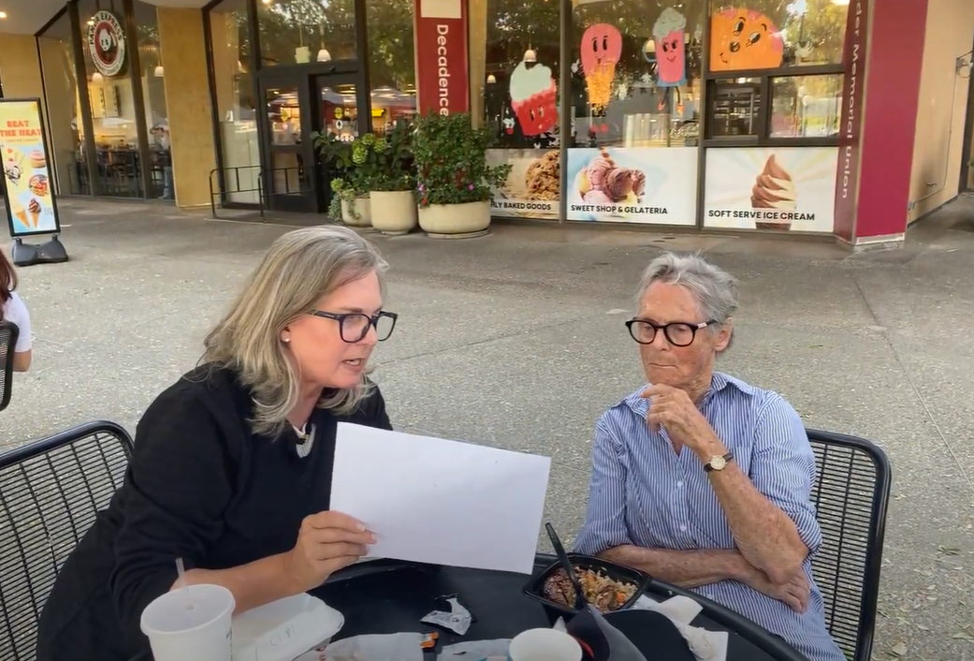
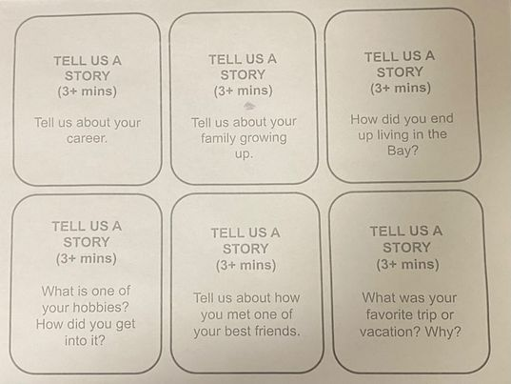
participants
1
Edith - Grandmother (88 yrs) with a lifetime of stories
A descendant of the mason who built Jordan Hall, she likes to share stories with her daughter.
2
Vanessa - Writer (56 yrs) who enjoys fiction
Creating interesting narratives is part of her career and she is interested in the act of storytelling
3
Corinne - Dancer and college student (22 yrs)
She is interested in learning about the stories of other people.

Slide 22

Results
Corrine
“I wanna know [older adults’] lore… like I don’t know too much about my grandparents.”
What Worked?
● Older adults expressed they rarely had similar opportunities to share stories to strangers
● Young adults enjoyed hearing stories from their elders even though they did not want to approach them
● Improved mood: “This is lovely! Thank you for this.” - Edith
What Didn’t?
● Some people expressed anxieties being recorded when telling their stories.
● Video and audio quality affected audience ability to understand some parts of the story
● Language barriers: “I dunno, my grandparents don’t speak English” - Corrine
Result:
Our assumption was proven, since there is demand for story exchanges from both younger and older participants.
However, not everyone has the ability or willingness to share personal stories to strangers.

Slide 23


penpal tool
PROTOTYPE 2:
sharing tangible wisdom

Slide 24
Penpal Matching System
HMW help people socially connect others who do not want to use technology?
Proposed Solution: Tool that digitally matches penpals and handles the logistics of mailing physical letters
Digital Penpal Apps
-i.e. Slowly
- still fully digital
- complicated UI
Sending snail mail
- no consistent matching service
Online Penpal-Matching,
Physical Letters

Slide 25
\
ASSUMPTION VALIDATION
ASSUMPTION:
People of different generations find more depth to writing to a pen pal compared digital emails or text messages
PROTOTYPE OVERVIEW:
Physical Letter: A physical letter from a hypothetical person
Digital Message: A text-based message on a computer from another hypothetical person with the same structure, length, and level of detail compared to the physical letter.
Questionnaire: Ask participants to respond about their opinions about each form of communication experience, desire to continue the correspondence, and willingness to share in each case.

Slide 26
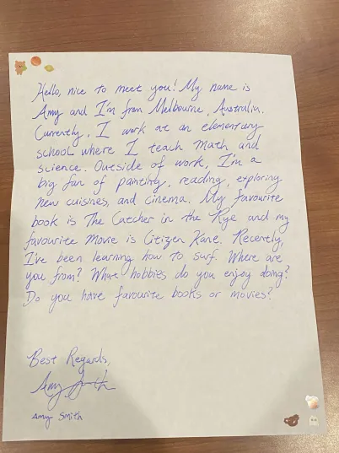
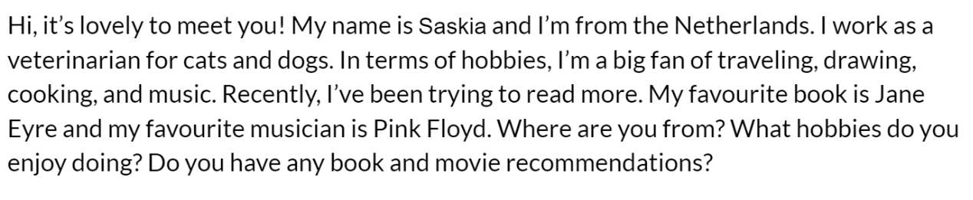
participants
1
Jeremy (22) - Poet who writes long emails to close friends
He enjoys writing but does not send physical mail.
2
Ellie-Mae (87) - Retired information services worker
A professional who regularly used digital-textual communication for her job, and expressed a pragmatic preference for it in professional contexts, but preferred to use physical mail for more personal communications, especially when communicating within the country and with people inside of her age group.

Slide 27

Results
Jeremy
“I don’t wanna write letters all the time… [but] it is more sentimental than a text for sure”
What Worked?
● There exists demand for penpals, even if people were not active penpallers
● Ellie-Mae noted that letters feel more “social” and “intimate” as text/email was associated with her professional life
● People enjoyed the physicality of the text and decorations
What Didn’t?
● Sending mail overseas “can be expensive” if you have multiple penpals - Ellie-Mae
● High time investment to write a letter to a stranger without a sentimental reason
● There are concerns about the penpal matching process, as some preferred other ways to meet penpals
Result:
Our assumption was proven, as participants believed letters held more sentimental value than text.
There are concerns about the time and monetary cost.
Existing solutions already worked for participants.

Slide 28

hobby-based friends
PROTOTYPE 3:
sparking conversation through shared interests

Slide 29
Hobby-Based Friends
HMW make digital connections more meaningful?
Proposed Solution: Connect people with common interests like chess, cooking, gardening, etc. for in-person meetups.
Online Hobby Forums
- impersonal setting
- 1 hobby at a time
Hobby Meetups
- in person only
Our Hobby-Centric Friend System
How-to Blogs
- centered on hobby-specific skills, not wisdom

Slide 30
\
ASSUMPTION VALIDATION
ASSUMPTION:
Common interests are a stronger motivator for people to meet new connections compared to age
PROTOTYPE OVERVIEW:
Character Profiles: cards of 18 different people spanning from ages 18-90 who have a range of different interests
Hobby Questionnaire: Ask participants to discuss their own age and their hobbies
Data: Participants are asked to select up to 5 profiles of people they are most interested in interacting with. They are also asked to provide reasoning for their decisions

Slide 31
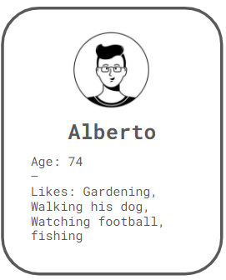
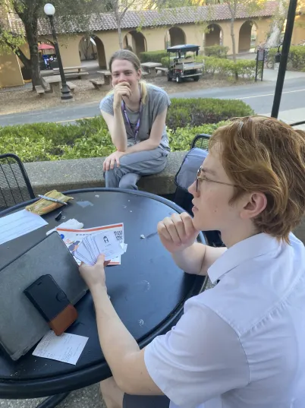
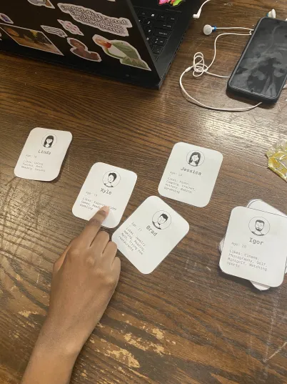
participants
1
Matt (19 yrs) - student
A teenage student who already possessed a healthy social circle, he didn’t want to make new friends through an app at all, nevermind outside of his age group.
2
Derrick (60 yrs) - retired aerospace engineer
An ex-NASA engineer and sports car collector who came to Stanford to attend a talk, he told us that his people-meeting needs were already filled by the events he attends.
3
Samantha (20 yrs) - student
A student anxious about talking to older adults as she grew up as a minority in the South

Slide 32

Results
Samantha
“A lot of older people are conservative, religious, queerphobic… especially back home”
What Worked?
● Older adults were receptive to befriending young people with common interests
● We found common interests to be a motivator for friendship
What Didn’t?
● Young people prioritized age above common interests
● Some younger people viewed older people as safety threats or likely to turn 1-on-1 friendships inappropriate due to perceived mental decline.
● Young people and older adults found existing ways to meet new people more effective
Result:
Our assumption was false, since younger participants felt more connected to people of their age.
Existing solutions and in-person meetings already work for people.

Slide 33
What do our results suggest?

Slide 34
\
SOLUTION SELECTION
MOVING FORWARD - STORYTELLING:
Older adults wish to tell stories
Younger adults willing to listen
This solution got the most positive, receptive feedback and has space for novel innovation.
ETHICAL IMPLICATIONS:
User privacy, safety and interests of older adults
Triggering or sensitive content for audiences and users
Possible toxicity and nefarious actors
Notes:
7. What’s next?
a. Which solution (or combination) will move forward?
b. What are the ethical implications of this solution?
c. Who does it serve? Who might it leave out?

Slide 35
WHO DOES IT SERVE?
Serves
● older adults with the willingness and ability to tell stories
● younger people who wish to learn from other generations
● people who wish to connect with other generations outside of close family
Leaves Out
anybody who lacks the dexterity, knowledge, or presence of mind to use technology and/or tell stories
● people with physical ability limitations
● people with neurodegenerative diseases or memory problems
● those with traumatic pasts

Slide 36

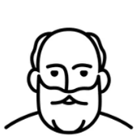

New Considerations
Younger people who grew up in traditionalist areas found older generations to be intolerant, unaccepting, judgmental.
Perspectives on elders were culture-dependent.
YET… young people still wanted to help reduce elder loneliness.
Our design of features, mechanisms, interfaces
Our younger participants mentioned interest in learning about the lives and wisdom of older adults.
BUT… some young people find the insights and approaches of older generations outdated or misguided.

Slide 37
Any questions?
Thank you for listening!

Slide 38
05
Appendix
Extra content, Sources

Slide 39
Additional Assign 2 Deliverables
Assign 2 Consent Forms
Brainstorm Images
Assign 2 Empathy Maps
Link
Link
Link

Slide 40
Additional Assign 2 Deliverables
Updated Interview Plan
A2 Solutions
Assumptions
Link
Link
Link

Slide 41
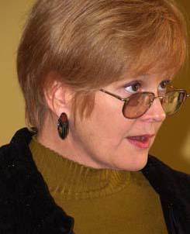
“Sasha”
Insight
As an older adult, Sara found that she would only stick to using apps that only had necessary functionalities, as too much information confused her.
Need
For older adults, apps should have a clear purpose, and content should be focused and catered.
Zoom, 60 mins
74 y/o, art educator
(avg. user)
Notes:
“One thing that a lot of them struggle with when you have an iPad– like, we know when we use an iPad, we know how to type, how to swipe, [etc.]. A lot of what they struggle with is that they don’t know how hard they have to tap.”

Slide 42
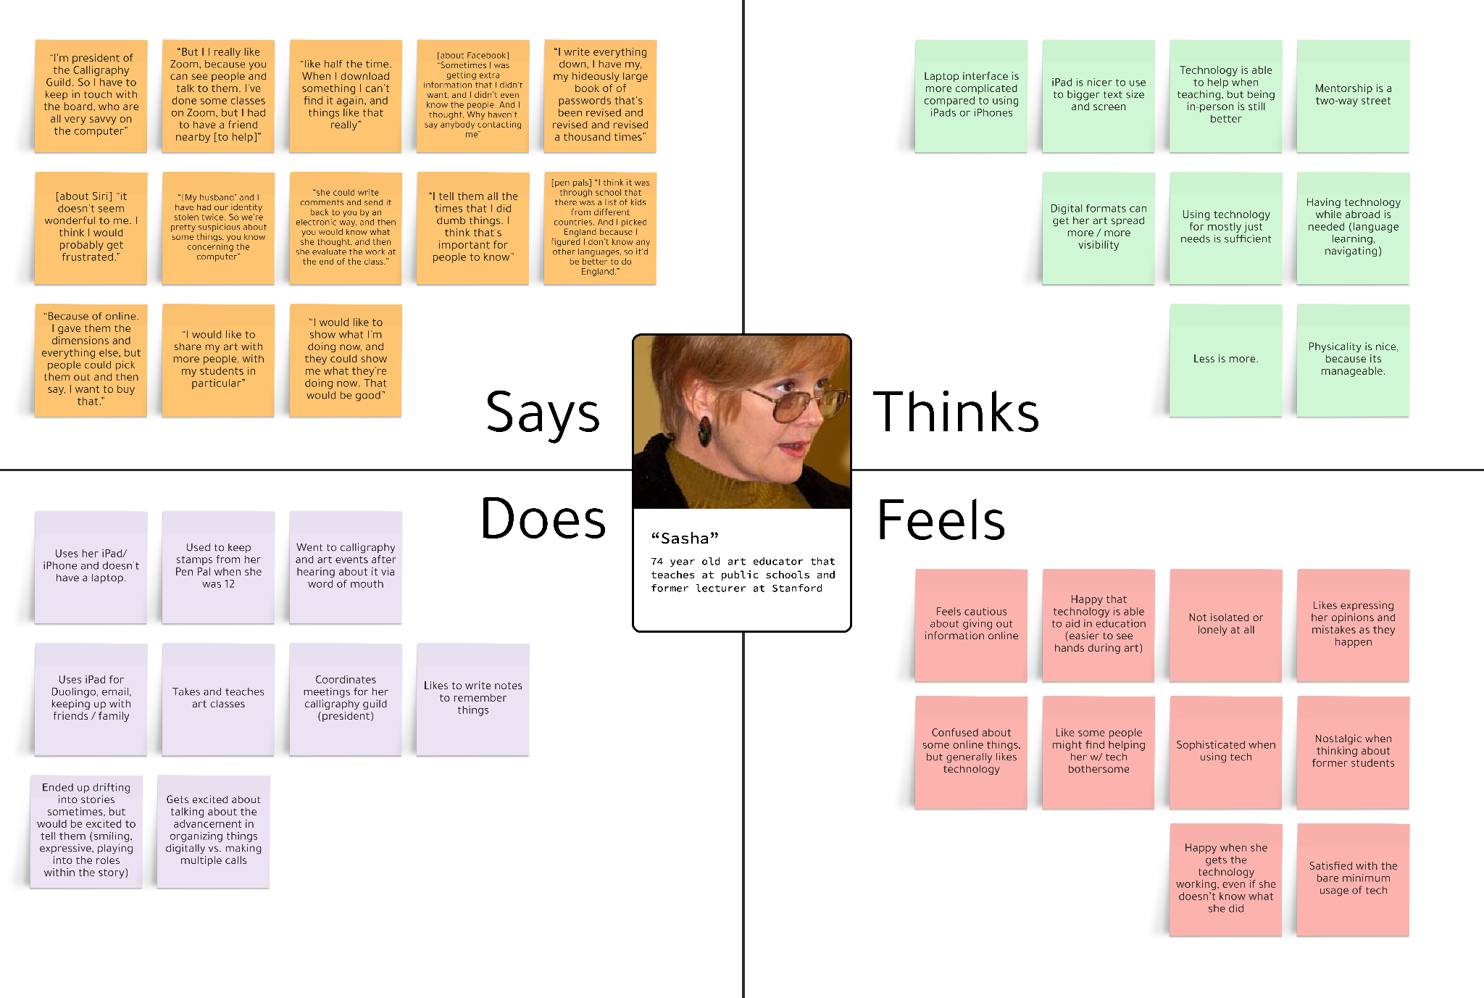
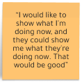
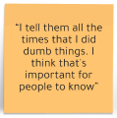
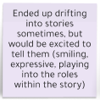
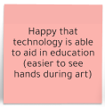

Empathy Maps - “Sasha

Slide 43
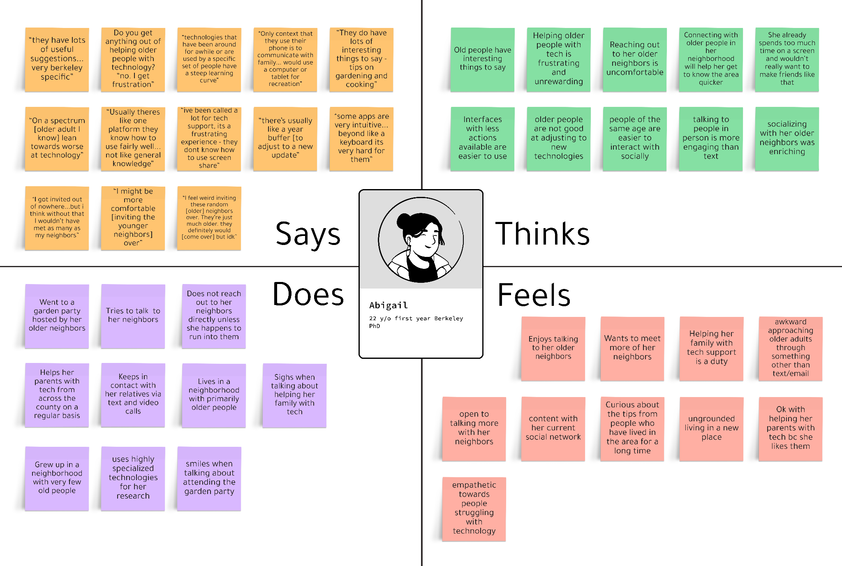
Empathy Maps - Abigail

Slide 44
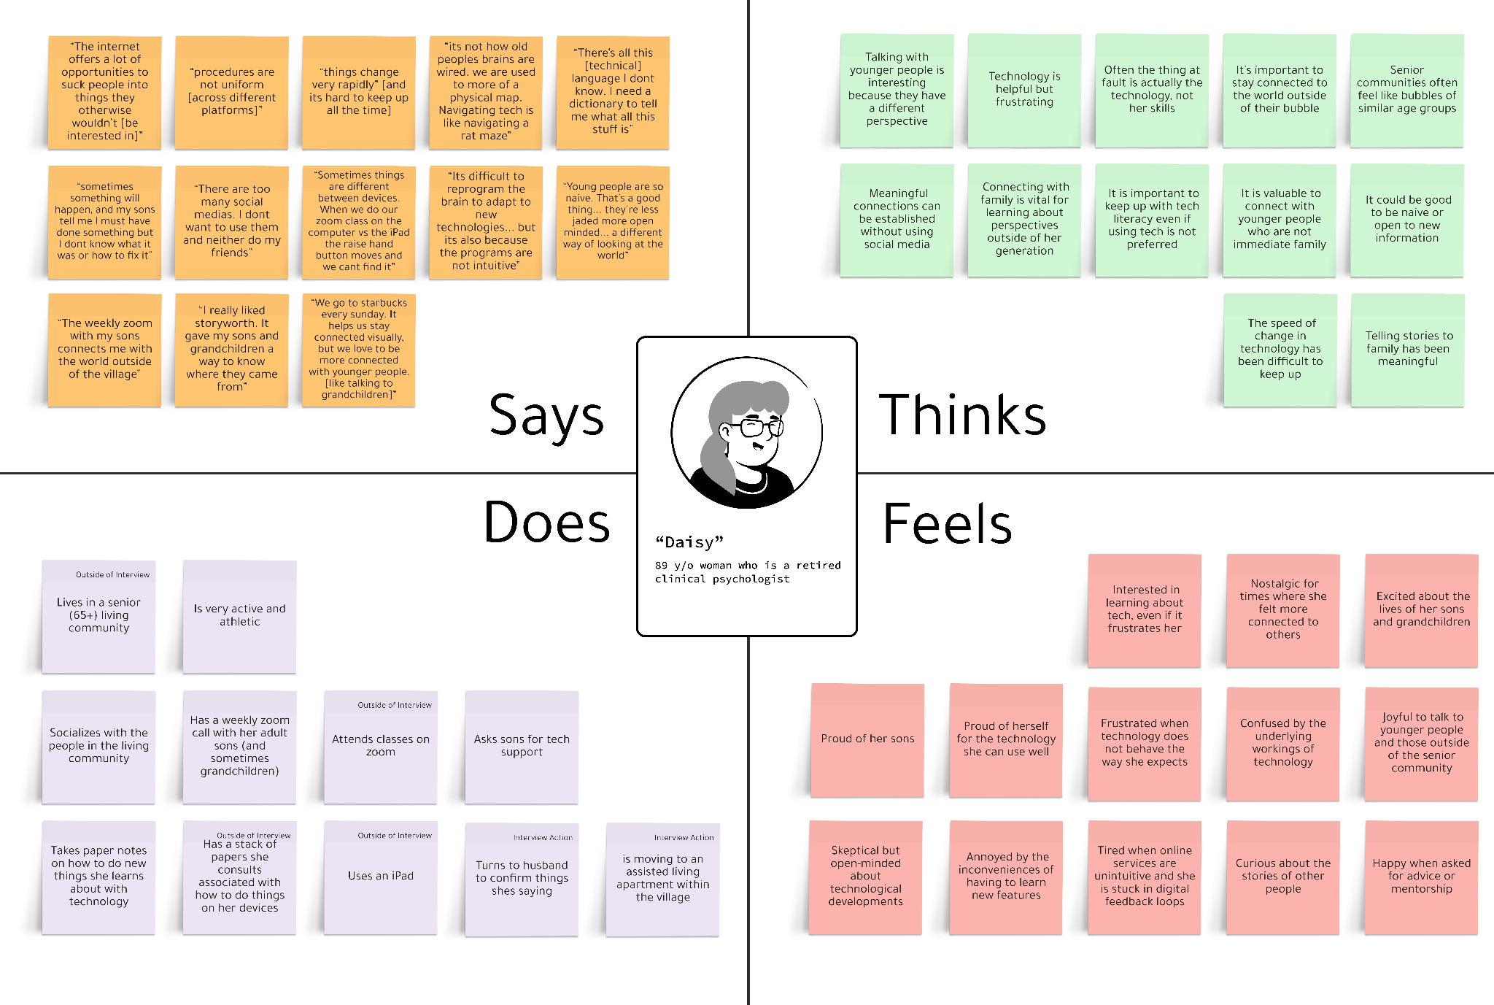
Empathy Maps - Daisy

Slide 45
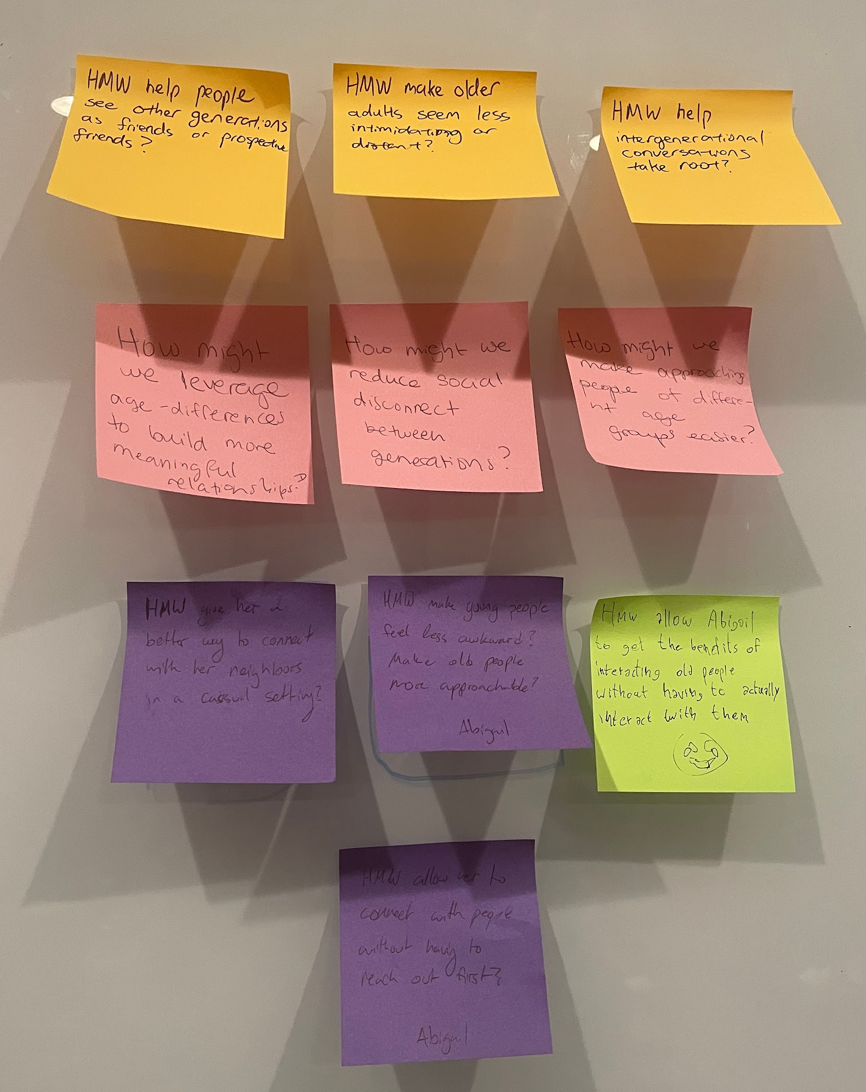
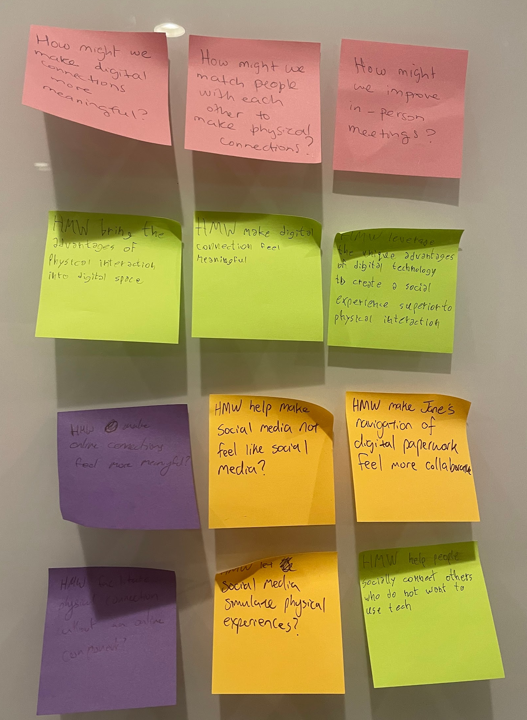
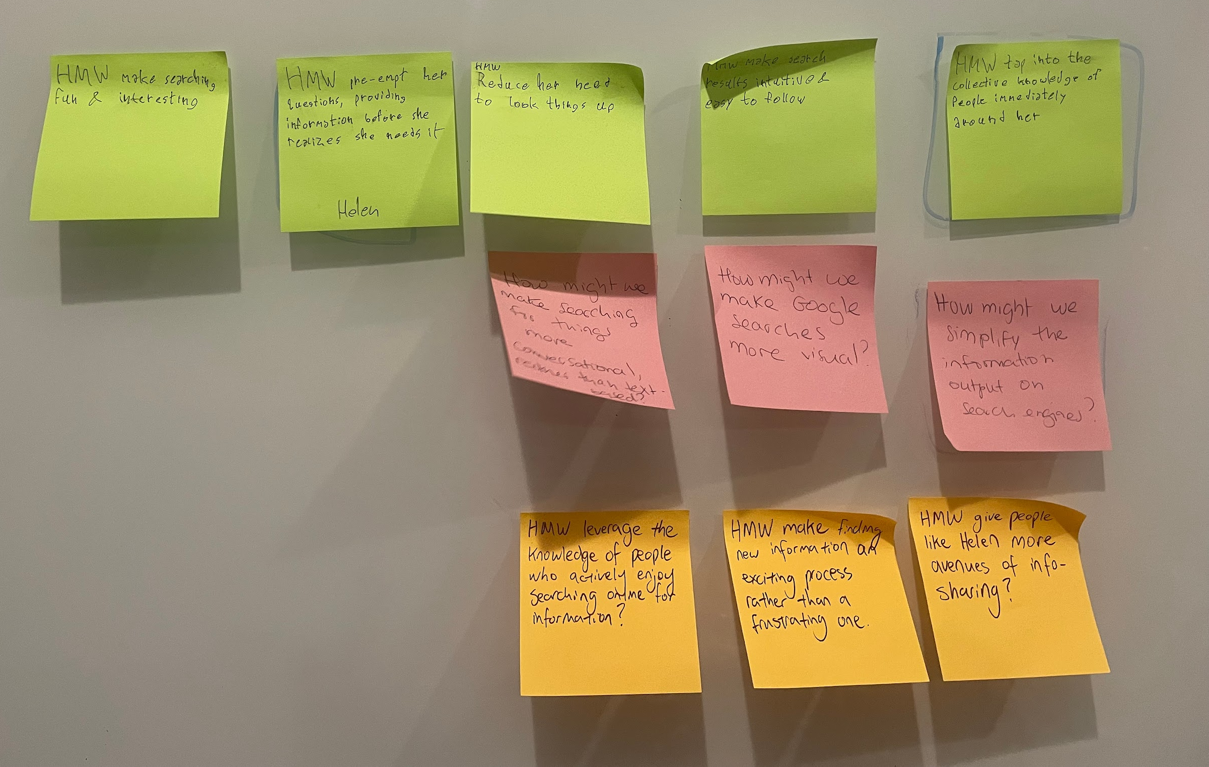
How might we?
HELEN
ABIGAIL
JANE

Slide 46
POVs - extra
“Harold”
65+ y/o man who works in teaching, wears hearing aids and has vision problems
We met…
an elderly man who had a background in tech and has disabilities that obstruct his use of technology.
We were surprised to notice…
that he sometimes helps his mother with her own tech problems, despite being technologically challenged himself.
We wonder if this means…
Harold wants to help people his own age overcome the same struggles with technology that they are facing.
It would be game changing…
to give Harold the tools to help others of their demographics with technical problems.

Slide 47
Image and Graphic References
Placeholder Images for Interviewees: Figma Notion-Style Drawkit
Slide Theme: Design Thinking Workshop Slides - SlidesGo
Team member photos provided by team
Interviewee photos provided by interviewees and used with permission

