Slide 1
Needfinding for Older Adults
Team 2: Eliza Bazakas, Hera Lasseau, Ngoc Tran, Renn Su

Slide 2
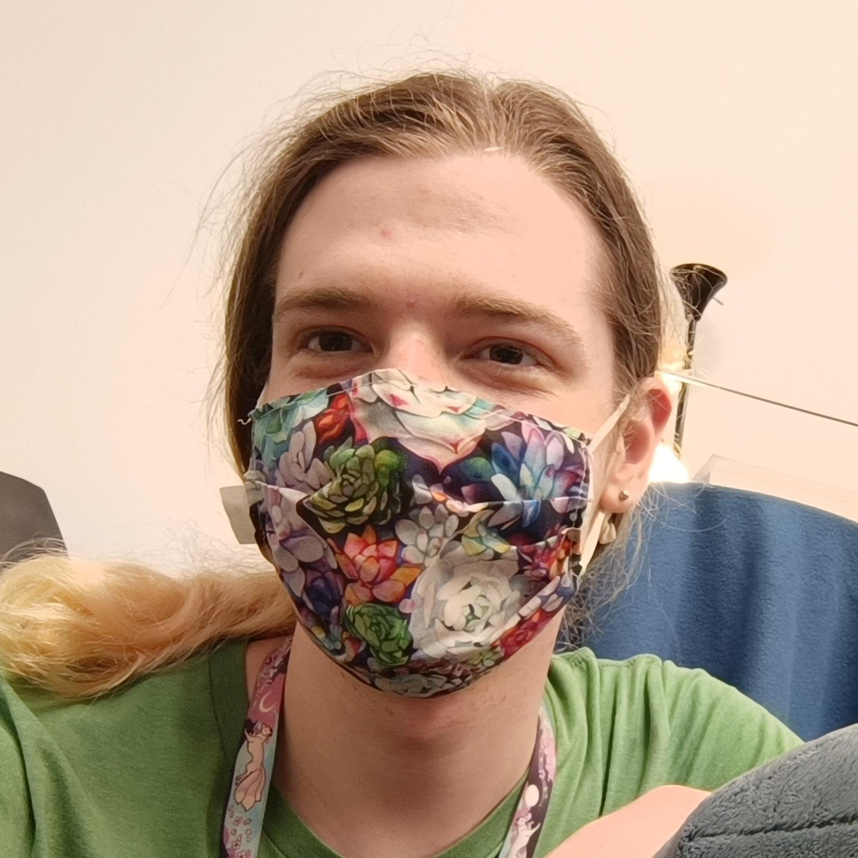


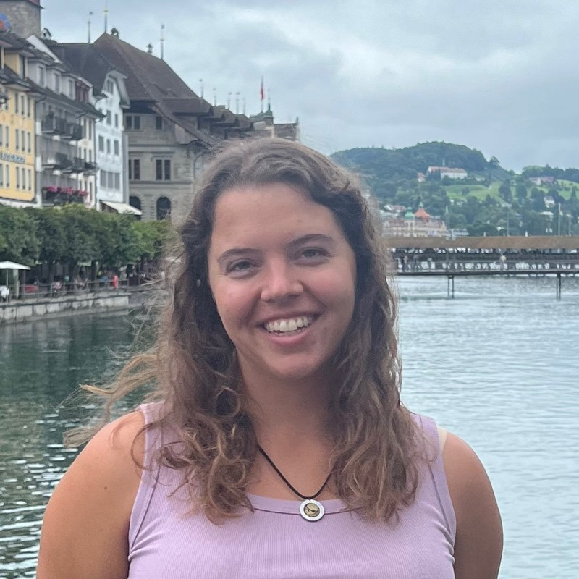
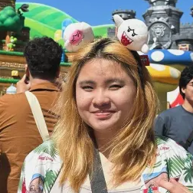
Meet Our Team
Hera Lasseau
Renn Su
Computer Science ‘25
Motueka, NZ
Computer Science ‘26
Vancouver, Canada
Ngoc Tran
Eliza Bazakas
Computer Science ‘26
Austin, TX
Computer Science MS ‘26
ChemE B.S. (MIT)
Berkeley, CA

Slide 3
01
Needfinding methodology
Finding participants, guiding questions, types of users / demographics, team roles, apparatus

Slide 4
Domain Selection
What types of ideas do we find relevant to our lives and to those around us?
How can we more effectively help older adults in particular?
Target Audience
Relevance
Multi-generational
Communication and Tech Literacy
What are we most passionate about addressing?
Interest

Slide 5
Finding Participants
Unique needs and extreme users
Our Participants
Varying tech backgrounds
A variety of ages and generations

Slide 6
Finding Participants
Location of Interviews: in-person, Bay Area-based
Disability needs: hearing impairments, visual impairments, mobility concerns
People who the status quo works for
Unique needs and extreme users
Our Participants
Varying tech backgrounds
A variety of ages and generations
Older Adults (ages 65+)
Non-technical people
Tech literacy experts
Those in tech: Current or former engineers, tech workers,
Children of older adults
Younger people

Slide 7
Guiding Questions
Connection through Tech
Tech Experiences
Desires in Tech
How do you use technology to connect with your generation or other generations?
What specific types of technology do you feel confident using, and which ones do you avoid?
Are there any technological devices or features that you wish existed?
Personal Experiences
Tech Difficulties
What are the most challenging parts about trying to communicate with older relatives? What is the easiest part?
What are the most common complaints about technology from older people?

Slide 8
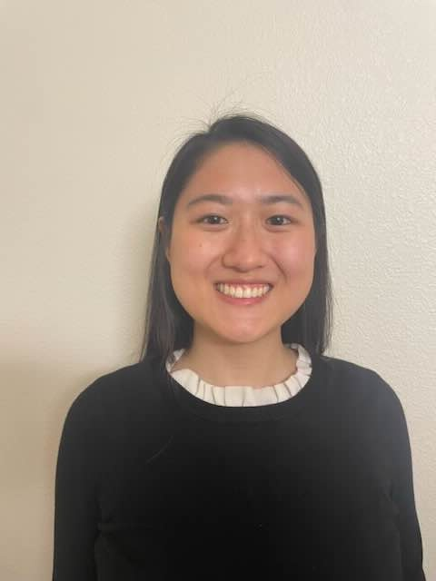



Our Participants / Interviewees
“Isabella” (avg. / non-user)
“Harold” (extreme user)
21 y/o woman who does a tech literacy project @ Veterans Affair (VA) Hospital
65+ y/o man who works in teaching, wears hearing aids and has vision problems
“Jane” (avg. user)
“Helen” (avg. user)
74 y/o woman who volunteers at the United Effort Organization* for Hope’s Corner
* Non-profit organization that helps with homelessness and housing
65+ y/o woman who is a retired engineer

Slide 9
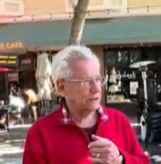
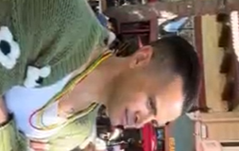
We also talked to…
“William” (avg. user)
“David” (non-user)
80 y/o man from South Carolina, father of David, 10 minute interview
48 y/o man living in California, son of William, 10 minute interview

Slide 10
02
Interview results & Analysis
Results: Pictures, relevant artifacts, key quotes, and surprises
Analysis: Empathy maps, highlights, observations, and inferences

Slide 11

“Isabella”
“You can make the text larger, but that doesn’t always apply to every app on the iPad. For the keyboard it’s hard, because it’s really hard to increase the size of the keyboard. It’s really hard for them to see the text, and so if they’re able to find the microphone button, that’s what we try to do, but sometimes they have trouble speaking as well.”
“I mean, even if you look at Facebook… like the UI here is flawed. Even I struggled with like finding Facebook marketplace. Like what are all these symbols? … Like how do I find my messages? … Like I have to dig around the app just to find that. Even for me, who doesn’t struggle with technology, I was confused. So the people I try to help are even more confused. They don’t even know what the messages are suppose to look like, let alone what they’re not suppose to look like.”
in-person, 35 mins
21 y/o, tech literacy expert
(avg. / non-user)
Notes:
“One thing that a lot of them struggle with when you have an iPad– like, we know when we use an iPad, we know how to type, how to swipe, [etc.]. A lot of what they struggle with is that they don’t know how hard they have to tap.”

Slide 12
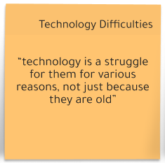
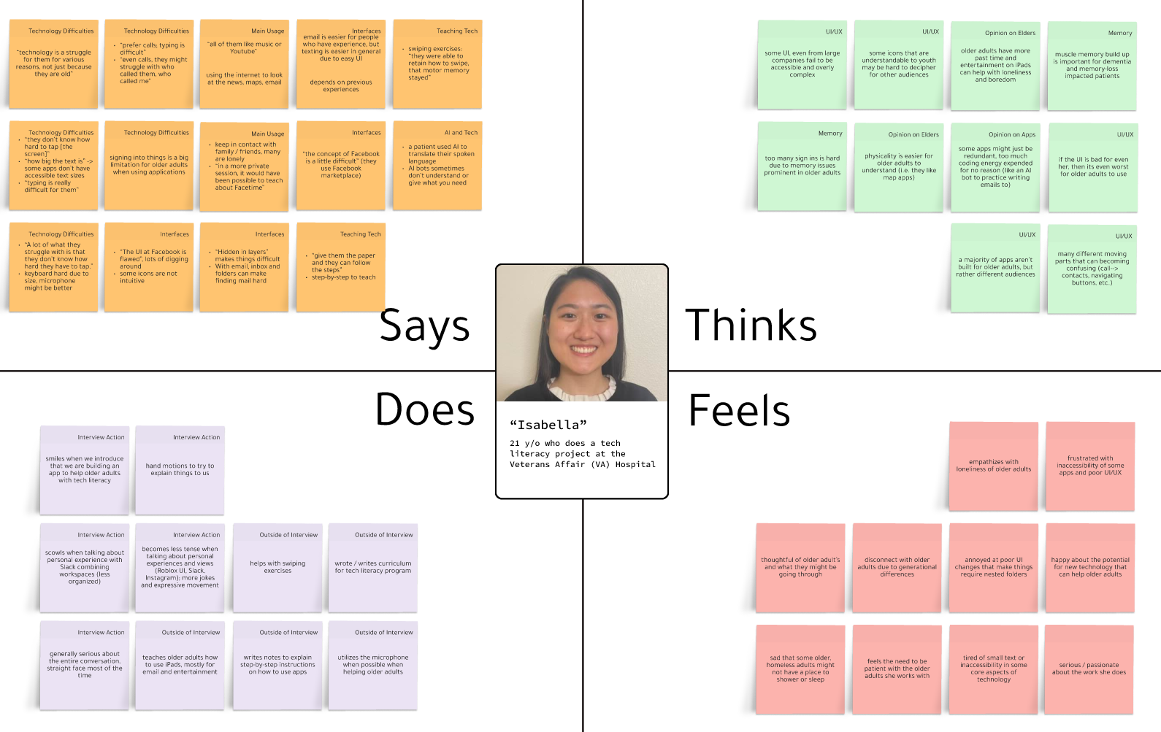
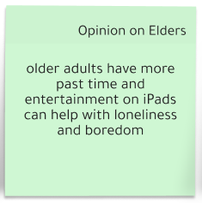
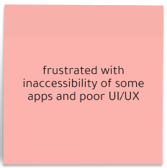

Slide 13
“Isabella”
Insight
The key issues older adults have with technology are: font size, screen-responsiveness, and navigating apps. These issues stem from vision impairment, mobility and able-bodiedness, memory-loss, and confusing UI.
Need
Interfaces must cater to needs of older adults that may suffer from any of the listed issues by having bigger fonts, more intuitive UI (less buttons, not nested functionality), and flexibility with microphone options.
in-person, 35 mins
21 y/o, tech literacy expert
(avg. / non-user)
Notes:
“One thing that a lot of them struggle with when you have an iPad– like, we know when we use an iPad, we know how to type, how to swipe, [etc.]. A lot of what they struggle with is that they don’t know how hard they have to tap.”

Slide 14
“Jane”
Do you find it frustrating? “Oh constantly, so constantly… different companies are better or worse at making their websites user-friendly but [during an automatic payment experience]... they gave me all these different options and none of them gave me the [correct one].”
Everything wants you to create an account, even if you’re going to do just one transaction or something. How many usernames and passwords can you possibly create? Why do I need an account just to do this?
in-person, 60 mins
74 y/o, volunteer at United Effort Organization
(avg. user)

Slide 15
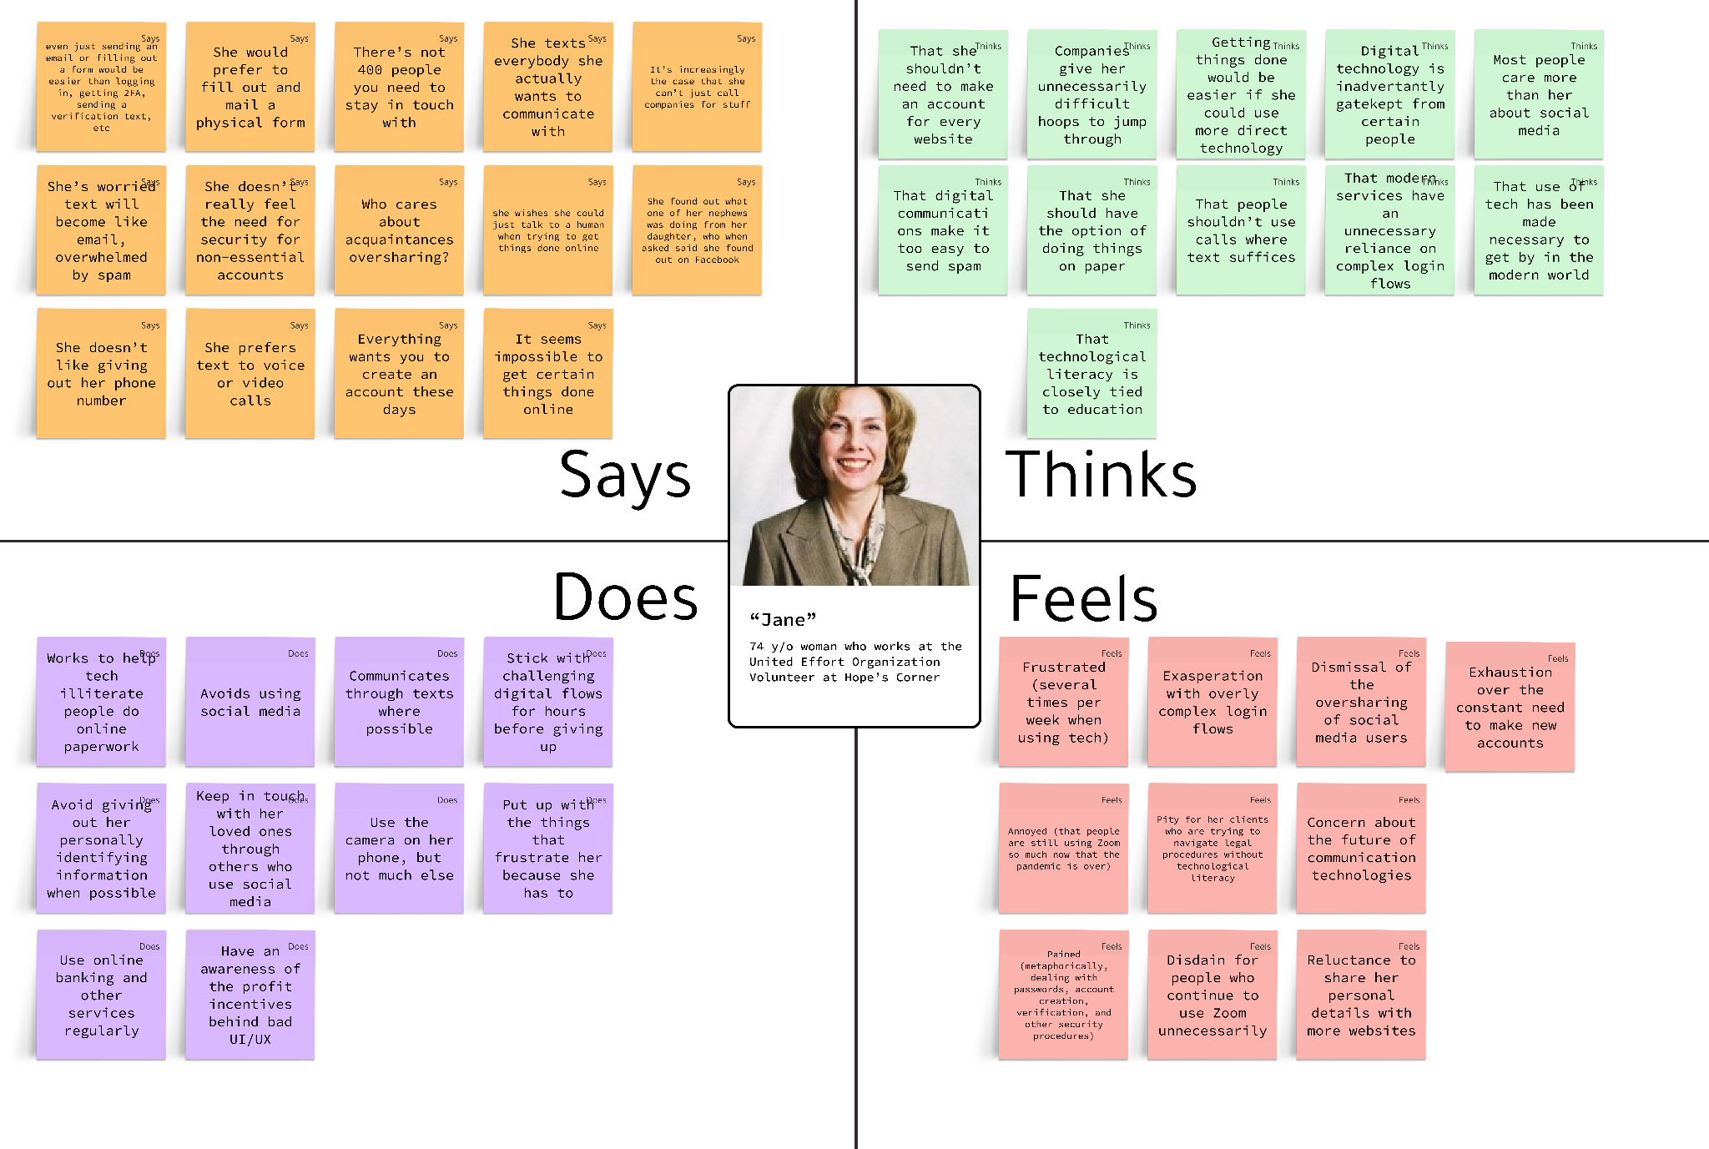
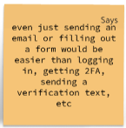
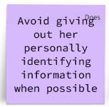


Slide 16
“Jane”
Insight
Complex digital procedures like login and sign up flows are often exclusionary and frustrating, especially as there are so many different websites / apps that require them.
Need
Digital flows should be simplified to the greatest extent possible.
in-person, 60 mins
74 y/o, volunteer at United Effort Organization
(avg. user)

Slide 17
“Harold”
“Things are designed now for cell phones, for children who have grown up on them. And have little fingers and lots of practice… and lots of time to go exploring… I’m not living in a dorm, I’m not in school where I have people around me all the time [to help with my tech problems].”
“Can you see this button on your screen? No I cannot... yes we can try but I can’t see what you’re seeing.”
in-person, 30 minutes
65+ y/o man who works in teaching, wears hearing aids and has vision problems
(extreme user)

Slide 18
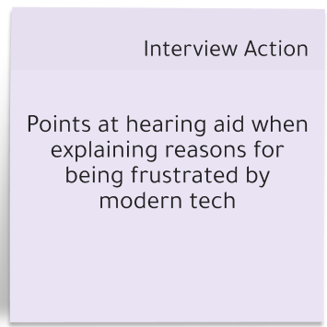
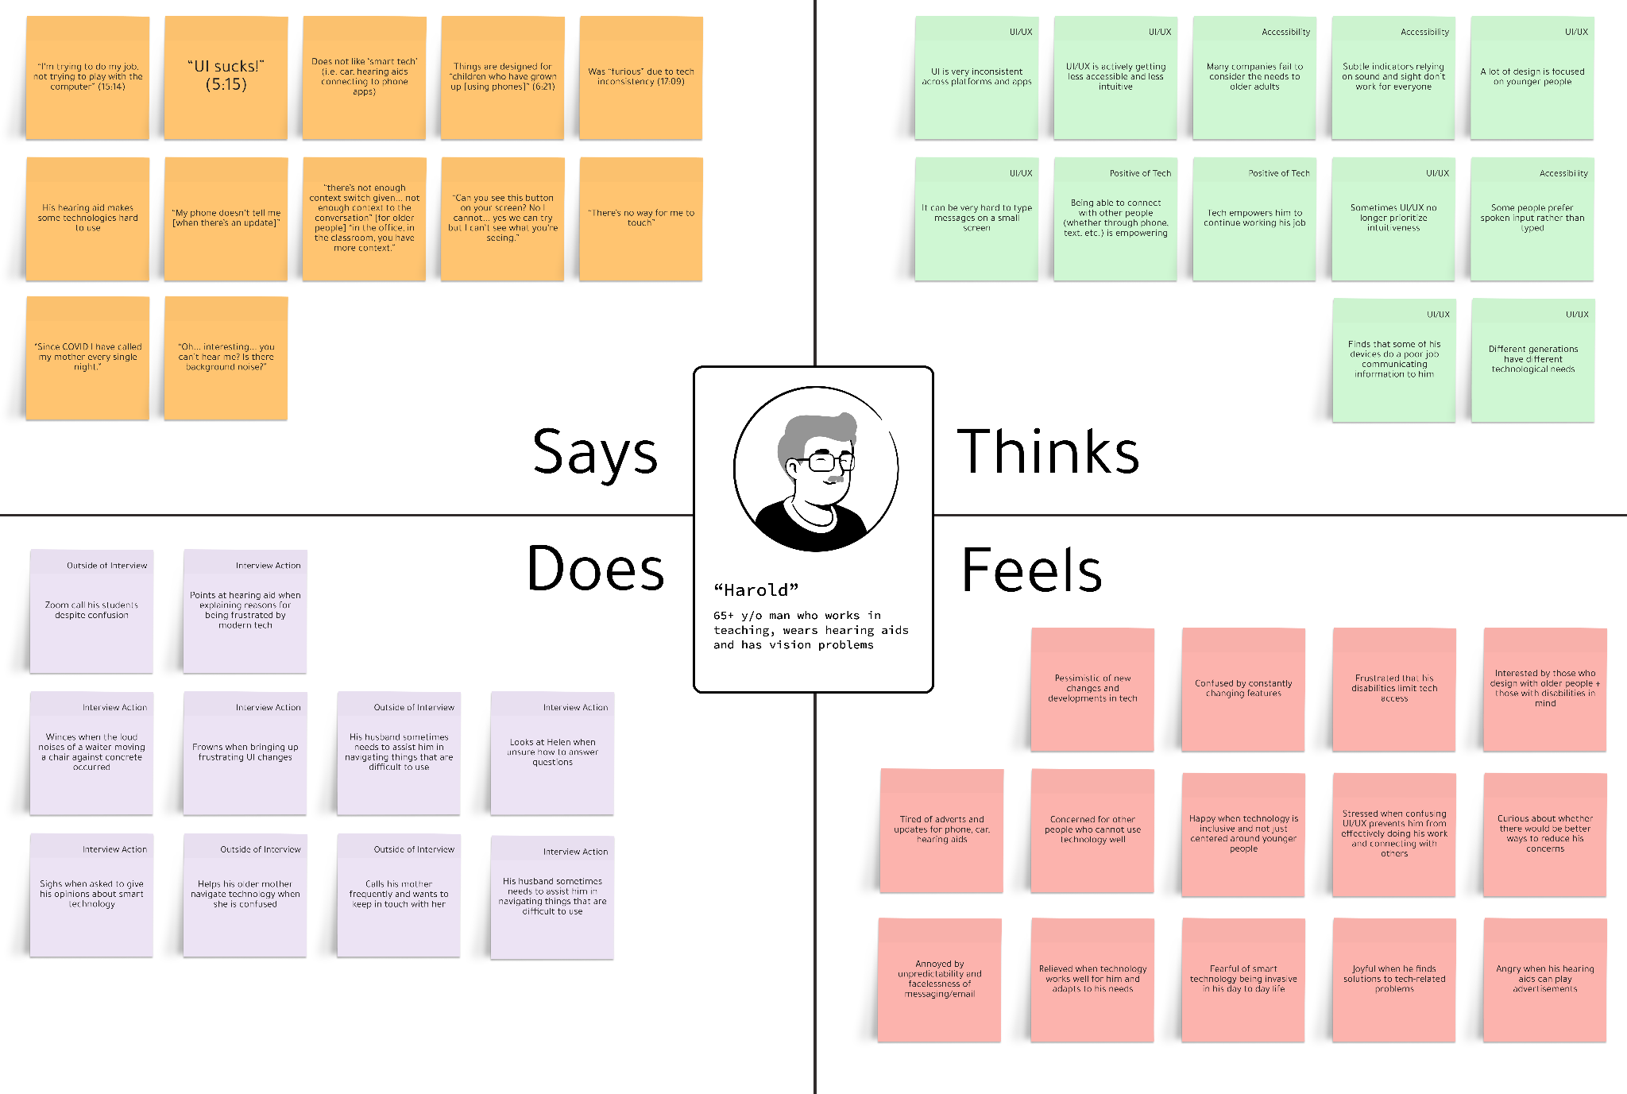
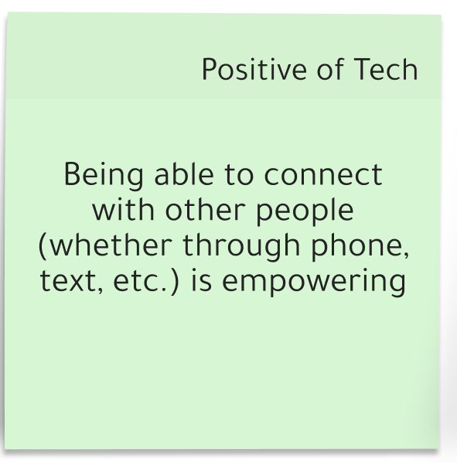
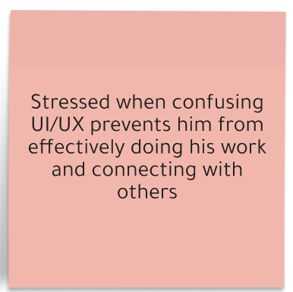

Slide 19
“Harold”
Insight
Accessible design can empower those with disabilities to feel more capable of seeking connection and community. Older adults and those with disabilities may feel that technology is not designed with them in mind.
Need
Older adults with disabilities want reassurance that the technology they use supports their needs, and that there are support systems in place for their questions and concerns.
in-person, 30 minutes
65+ y/o man who works in teaching, wears hearing aids and has vision problems
(extreme user)

Slide 20
“Helen”
“I don’t have challenges with other folks [who have different] tech backgrounds... sometimes [it’s] a lot faster to just talk. There’s too much press to not pick up the phone and just talk… With family meetings we’ll do Zoom... it’s nice to see a face.”
in-person, 30 mins
65+ y/o woman who is a retired engineer
(avg. user)

Slide 21
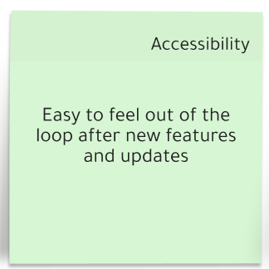
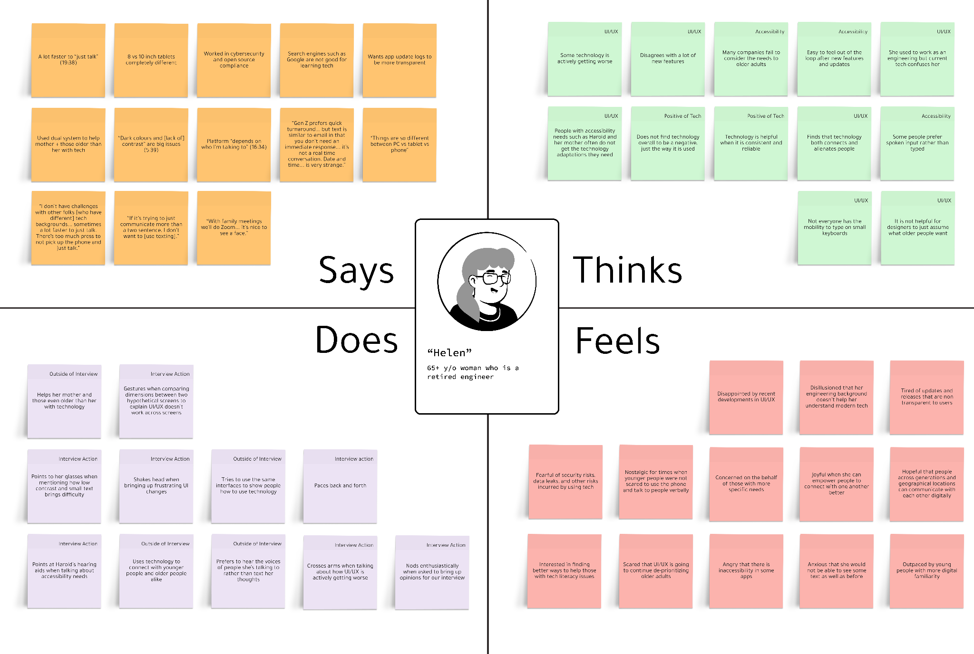
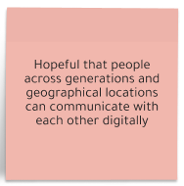
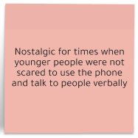

Slide 22
“Helen”
Insight
Conventional forms of communication among younger people such as texting or emailing can feel impersonal and alienating to older generations. There is more connection and fulfillment when hearing a voice and seeing a face.
Need
Older adults want ways to see and hear people when interacting with them.
in-person, 30 mins
65+ y/o woman who is a retired engineer
(avg. user)

Slide 23
1. Current technology makes it easy to stay in touch w/his son
2. “More bang for [his] buck” to use video call vs phone or text
3. Feels that existing options “work for [him]” (e.g. Zoom)
1. Able to help with his father’s technology concerns despite living far away from him
2. Believes clear instructions to be important for older users
“William” (avg. user)
“David” (non-user)
80 y/o man from South Carolina, father of David, 10 minute interview
48 y/o man living in California, son of William, 10 minute interview

Slide 24
Week 1 Findings
1
Accessible UI should include microphone options, bigger fonts, and less nested folders / less clicks to do a task.
2
Older adults like physicality– the physical presence of things – for not only human interactions, but also for things like papers and documents.
3
Older adults with disabilities want to be heard and considered when technology is being designed.
4
Overly complex digital flows are difficult and exclusionary for older adults, especially for those who may not have their own devices.

Slide 25
What’s Next? – Future Steps
1
Expand our scope to consider different demographics of older adults, with different needs (language barriers, other forms of disabilities, etc.)
2
Narrow down the direction of our app and how it can fit the needs we found this week.
3
Generate HMW statements and begin the next steps towards experience prototyping.

Slide 26
03
Summary
Key learnings and future steps

Slide 27
Summary of This Week
We had three longer interviews with a young tech literacy expert, an older tech literacy volunteer, and with two retired engineers.
We had two shorter interviews with an older adult and his son.
We learned what older adults need in technology and what they find difficult.
We identified ways we can address these needs.

Slide 28
04
Appendix
Sources

Slide 29
Additional Assign 1 Deliverables
Consent Forms
Empathy Maps Folder
Link
Link

Slide 30
Image and Graphic References
Placeholder Images for Interviewees: Figma Notion-Style Drawkit
Slide Theme: Design Thinking Workshop Slides - SlidesGo
Team member photos provided by team
Interviewee photos provided by interviewees and used with permission

