Slide 1

CS 147 · Stanford University
Nov 22 2024
Lunar
Closer connections, no matter the hour
A8: High-Fi Prototype
Evelyn Hur, Sejoon Chang, Sarah Yao, Christina Ba

Slide 2

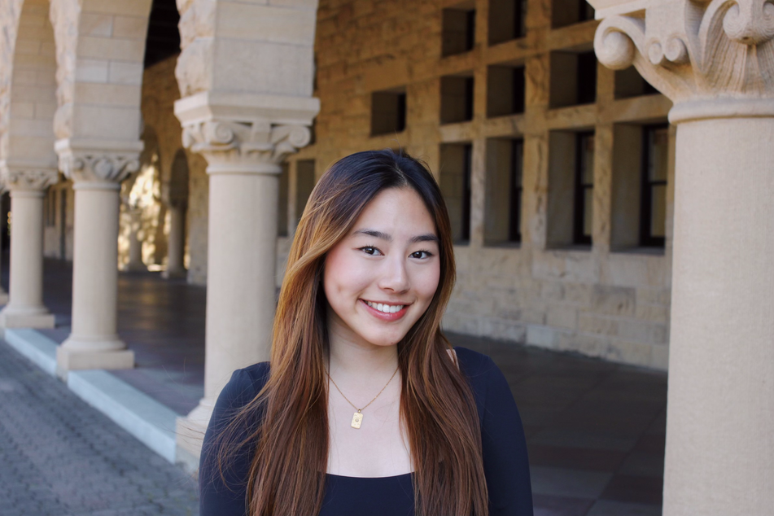
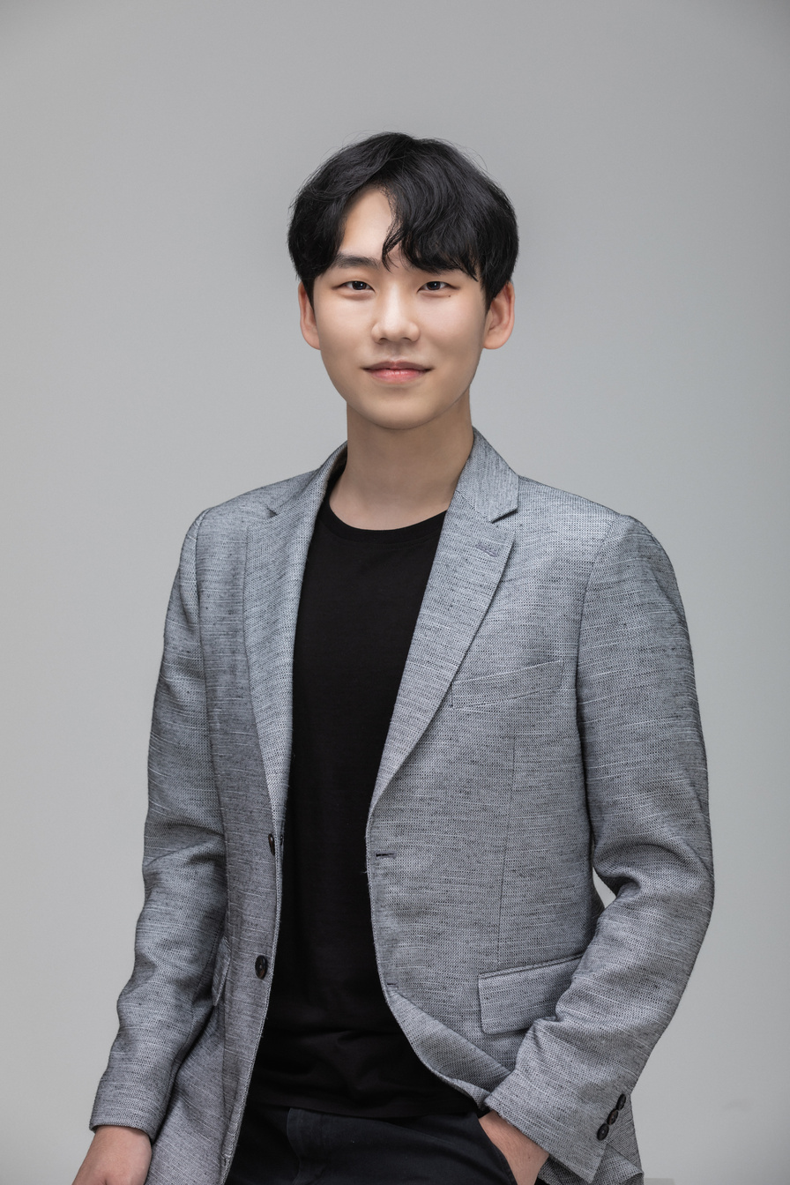
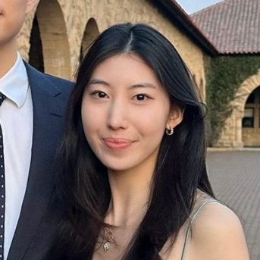
CS 147 · Stanford University
Oct 11 2024
Meet the Team!
Sarah Jade Yao
CS + PD ‘25
Christina Ba
CS + Art ‘26
Sejoon Chang
CS + PD ‘25
Evelyn Hur
CS + PD ‘25

Slide 3


Nightshift workers are often lonely, believe that work and personal life can’t go hand in hand, and that they have little to no time to care for connections with others
Our Solution
An online community of night shift workers with similar backgrounds, work schedules, situations etc. to share resources, tips, and support each other
Problem Statement

Slide 4
CS 147 · Stanford University
Nov 1, 2024
Presentation Roadmap
1
2
3
4
Heuristic
Eval. Results
Major UI + Product Revisions
Prototype Implementation Status
Demo of Current Prototype

Slide 5
Heuristic Evaluation Results
1

Slide 6
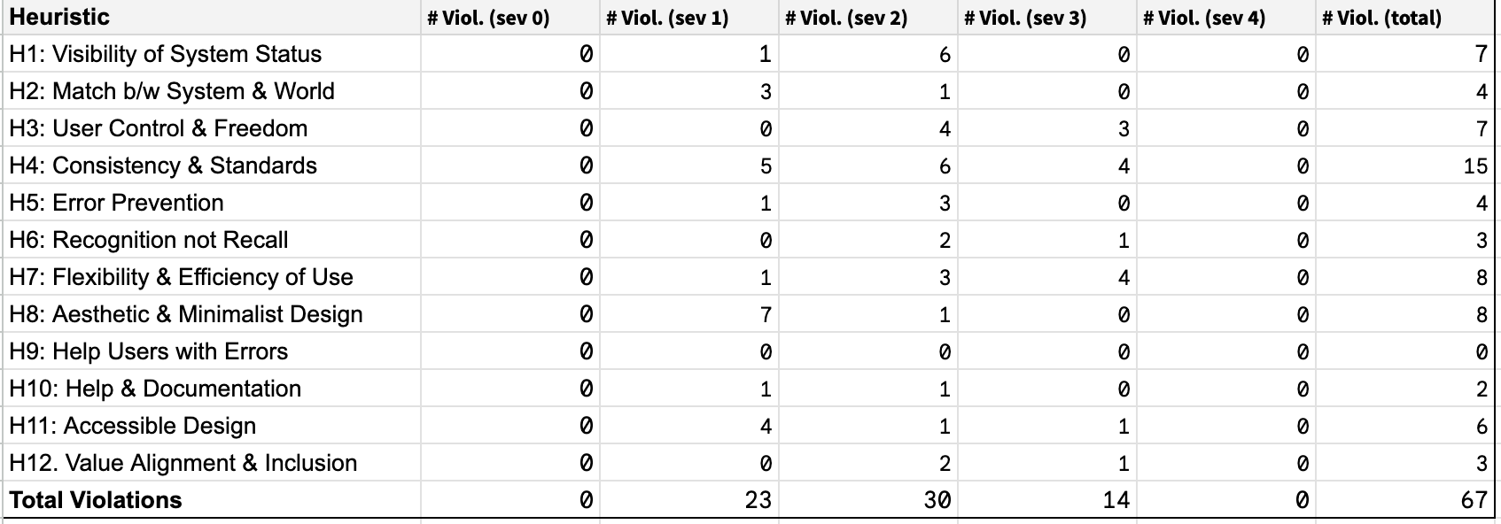
Quantitative Summary
Most common violations:
H4 Consistency and standards, then
H7, H8, H1, H3 in order
Severity breakdown:
Most common was severity 2,
then severity 1, severity 3
Total violations:
67
Total revisions:
40 / 67

Slide 7
High Level Summary
Fixed
No fix
  Consistency in visual design
    Text, icons, buttons, spacing etc
  Consistency in functionality
    Back button, navigation, pins pop-up
  Readability and accessibility
    Adjusting text and color for better readability
  Error prevention
    Fixed ‘cancel, ‘exit’, ‘back’ buttons
    Allow user to edit and delete posts and reminders
  Matching user expectation
    Match user expectation of drop downs, text inputs etc.
  Issues unrelated to tasks or largely out of scope
    Profile
    Fully functional search
    Showing integrated calendar
  Issues from hard-coding (“Wizard of Oz”) or from not following prototype steps in order in README
  Searching for pinned posts: similar platforms don’t have search for pinned/saved posts. Just shows all posts in chronological order/in collections
  Allowing user to post to multiple groups at once: we wanted to prevent mass posting/spamming to foster tight-knit/intimate community per group
  Minor fixes requiring tradeoff with aesthetic design

Slide 8
Severity 3 Revisions
HE | Task | Description | Fixed | Rationale
3 | Simple | There is no cancel button in the pin pop-up and you can't just click the rest of the screen to get out of the pop-up either | Yes | Fixed so user can tap background to exit if they accidentally click pin icon
7 | Simple | No option to search for posts | Yes | Combined search for groups, posts, hashtags so users can easily search for desired content without having to manually scroll. We combined this into a single search bar because it looked too cluttered with two or more search bars
7 | Simple | No way to search for pinned posts | No | Similar platforms purposely don’t include search for pinned/saved posts since user is most likely going to search for most recently pinned posts in chronological order
6 | Moderate | When I post anonymously, the post still shows up as “me” as the poster | No | Hardcoded - we said in README to post as "Jane", not anonymous
3 | Moderate | There's no way to delete a post or delete a comment once it's posted | Yes | Added three dots icon in top right corner to edit/delete post
Note: Did not have any severity 4 violations so did not include

Slide 9
Severity 3 Revisions
HE | Task | Description | Fixed | Rationale
7 | Moderate | While there are posts on the app, the app creation process appears to be rather hidden (at least took me a while to figure out) | No | Based on similar platforms, the “+” button is intuitive and once found, can be easily navigated to again. There’s also an aesthetic design tradeoff if we include the text “create post” inside the circular floating button so we didn’t make any changes
4 | Complex | After adding a new calendar, it adds a new reminder to the screen too | No | This was hardcoded - in README, user is meant to add reminder FIRST, then add calendar AFTER
11 | Complex | Difference in icon colors is not noticable to colorblind people on reminders page | Yes | Changed icon colors to darker colors with higher saturation and contrast so users (esp colorblind) can see icons better
12 | All tasks | Verifying ID with Clear in onboarding | Yes | Changed from CLEAR to work email verification to be more inclusive of users
7 | All tasks | There are different tags, pins and users on the platform, however the search functionality appears to be only present for groups | Yes | Combined search for groups, posts, hashtags so users can easily search for desired content without having to manually scroll (same as prev page)
Note: Did not have any severity 4 violations so did not include

Slide 10
Severity 3 Revisions
HE | Task | Description | Fixed | Rationale
3 | Extra Violation | Iin the onboarding, once i reach the CLEAR verification, the back button does not bring me back anymore | Yes | Fixed back button functionality so users can go back to edit response
4 | Extra violation | Able to skip the CLEAR verification without agreeing or disagreeing | No | CLEAR verification is NOT mandatory so we should keep the ‘skip' button
4 | Extra violation | Back button from Night Nurses group always leads back to home page, no matter what navigation section you are in (ie: explore) | Yes | Fixed back button functionality so users can go back to correct page (prev page)
12 | All tasks | Verifying ID with Clear in onboarding | Yes | Hardcoded - we said in README to post as "Jane", not anonymous
4 | Extra violation | In the second part of the onboarding process, particularly in the screens "How would you describe yourself?" and "Join Groups from your interests", there are a series of selectable tile options however only some of them are populated, others appear empty. | No | Not essential part of tasks
Note: Did not have any severity 4 violations so did not include

Slide 11
All Major UI & Product Revisions
2

Slide 12
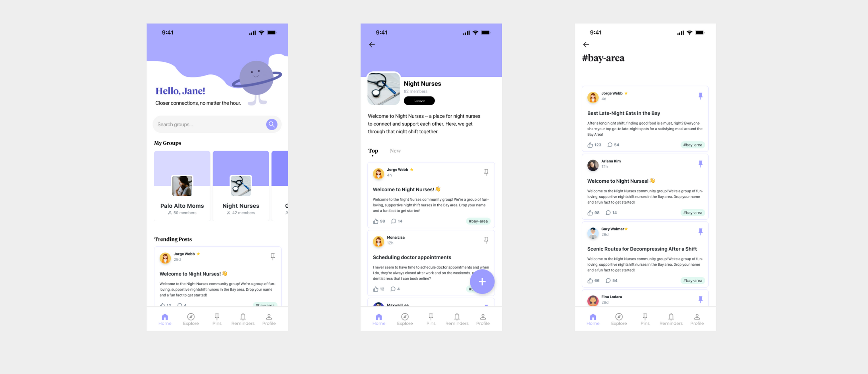
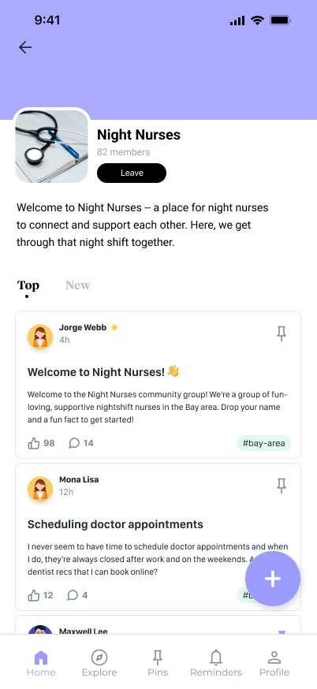
Design Revisions: Simple Task
Before
After
Violation
Revision & Rationale
Usability Goals
H4 Sev 3: Back button from Night Nurses group always leads back to home page, no matter what navigation section you are in (ie: explore)
Functionality:
Fixed button functionality in Figma by re-wiring button to itself for “back” action so users can go back to correct page
Commission fewer errors:
Users can go back to correct page they were previously on
H8 Sev 1: The text is barely cut off at the bottom in the night nurses group description
Visual:
Expanded textbox to greater height for group description component so user can fully see description (not cut off)
Greater pleasure and satisfaction:
Previously cut-off text is fully shown, making the page more aesthetic and legible

Slide 13
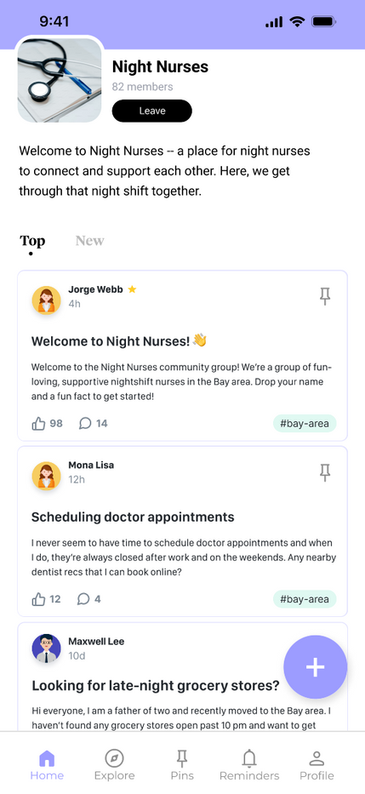
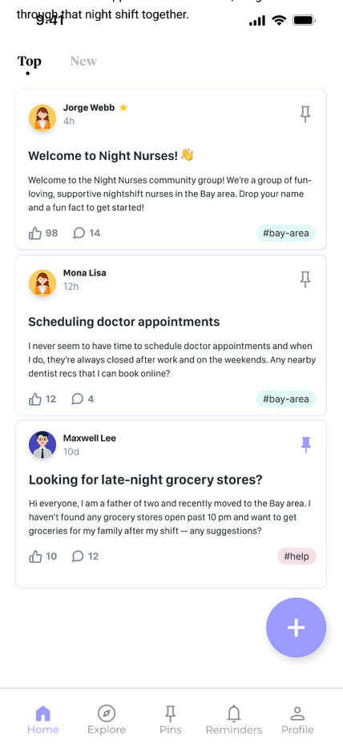
Design Revisions: Simple Task
Before
After
Violation
Revision & Rationale
Usability Goals
H5 Sev2: Within a group, error-prone "new post" button blocking pin button of final post in scroll
Visual:
Expanded white space at end of vertical scroll so last post is fully visible (‘+’ button not blocking it)
Commission fewer errors:
Users can accurately view and pin last post

Slide 14
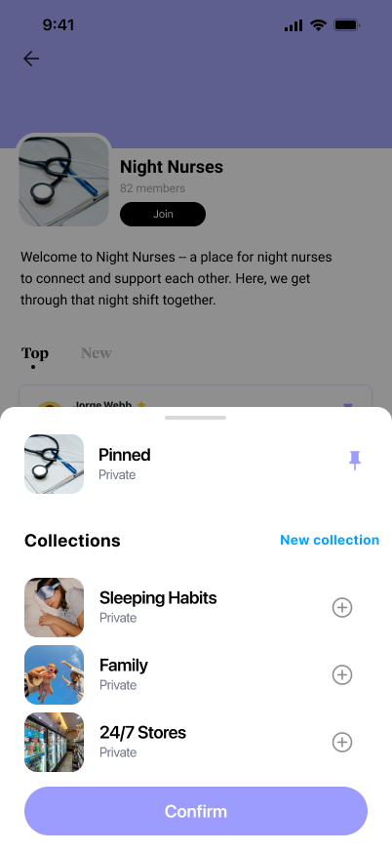
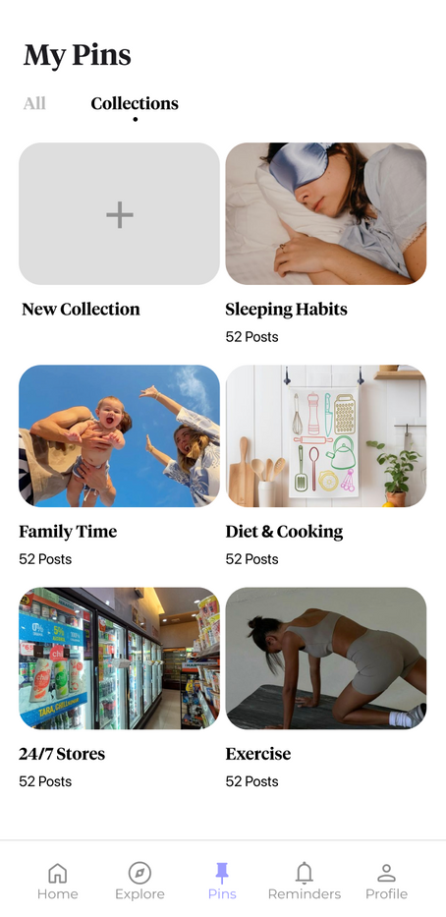
Design Revisions: Simple Task
Before
After
Violation
Revision & Rationale
Usability Goals
H3 Sev3: There is no cancel button in the pin pop-up and you can't just click the rest of the screen to get out of the pop-up either.
Functionality:
Made background clickable so users can exit from pins pop-up
Commission fewer errors:
Users can cancel/exit from pin pop-up if they accidentally clicked it or change their mind
H4 Sev2: When user clicks on "New Collection" they are taken to the wrong page, and there is no way to add a new collection.
Functionality:
When ‘New Collection’ is clicked, it goes to the My Pins page where you can add a new collection, allowing for greater flexibility.

Slide 15
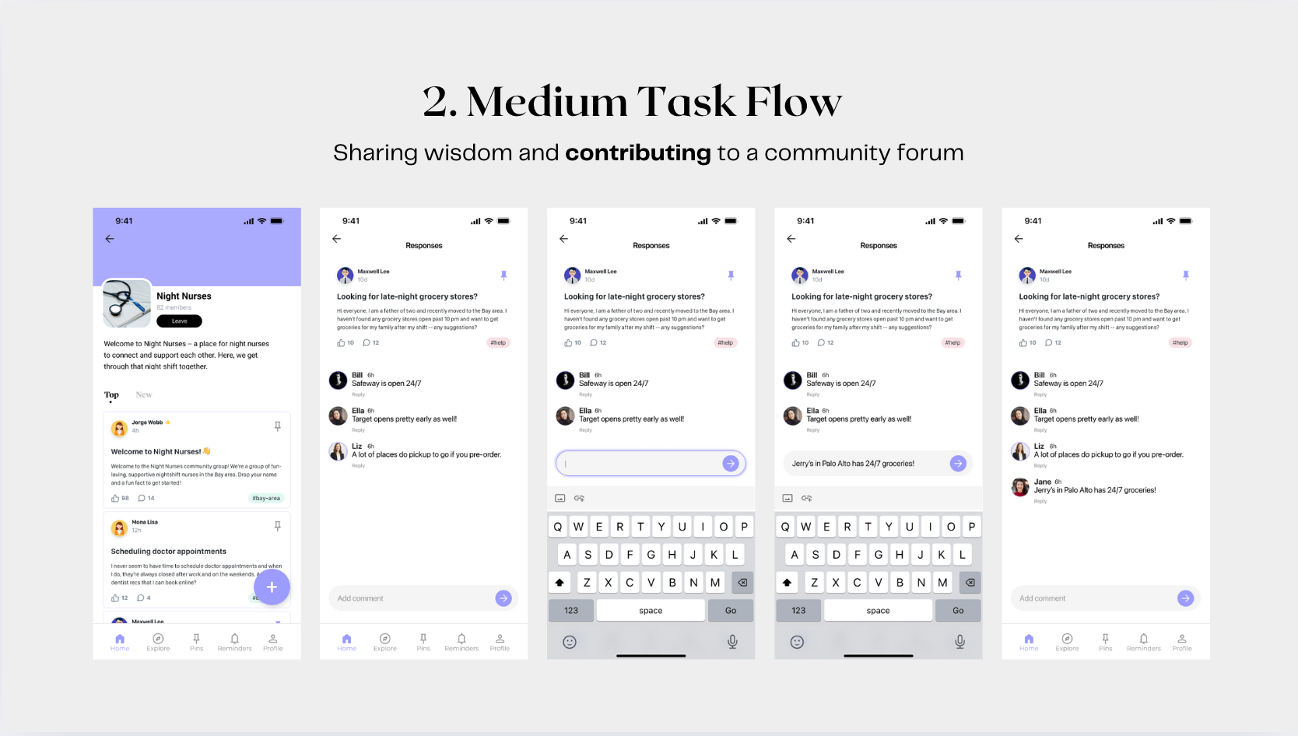
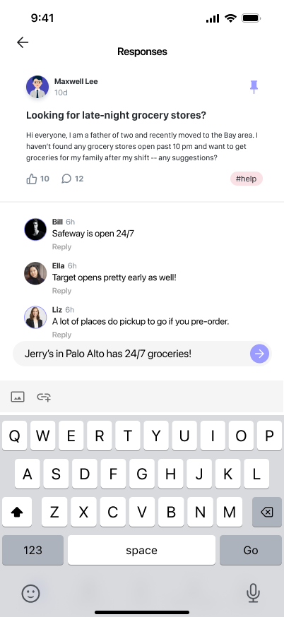
Design Revisions: Moderate Task
Before
After
Violation
Revision & Rationale
Usability Goals
H8 Sev1: On the response page of a post, there’s no visual differentiation between the post and the responses and each response
Visual:
Added a thin grey line between post and responses, but not responses due to aesthetic design
Greater pleasure and satisfaction:
Distinct separation of post and comments is easier on the eye
H4 Sev2: Comment section profile pics are larger than poster’s profile
Visual:
Made poster’s profile pic larger to match size of commenter profile pics for aesthetic consistency
Greater pleasure and satisfaction:
Consistent sizing means more aesthetic design that’s visually pleasing for the user

Slide 16
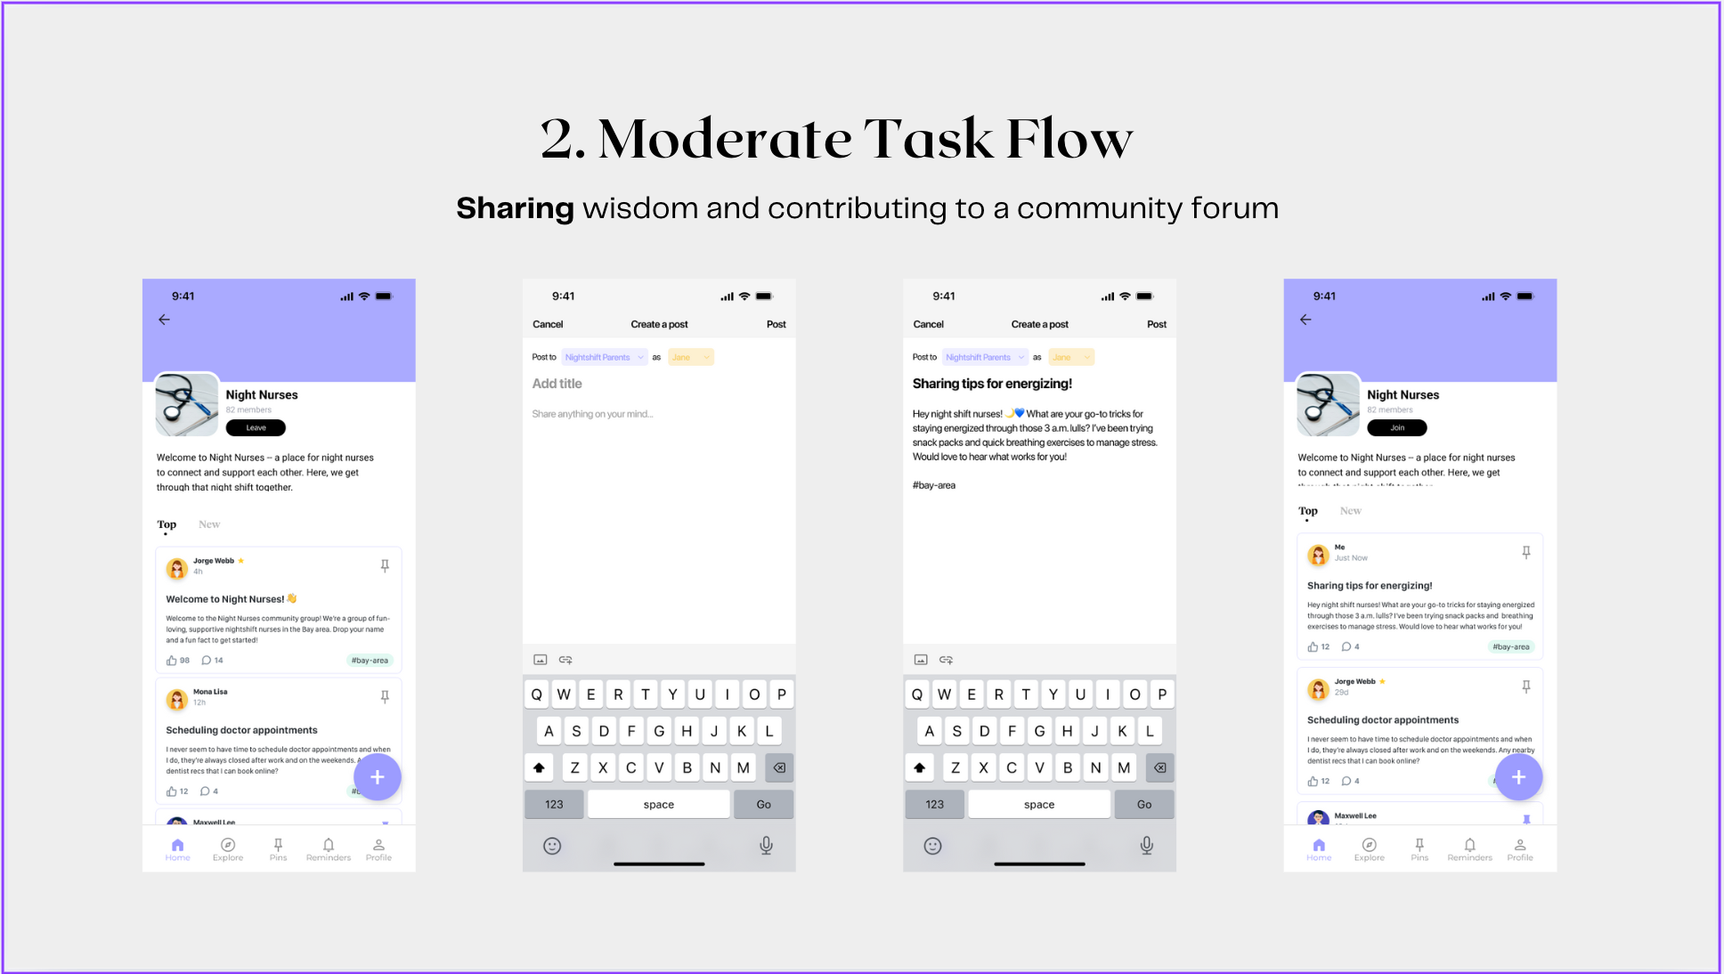
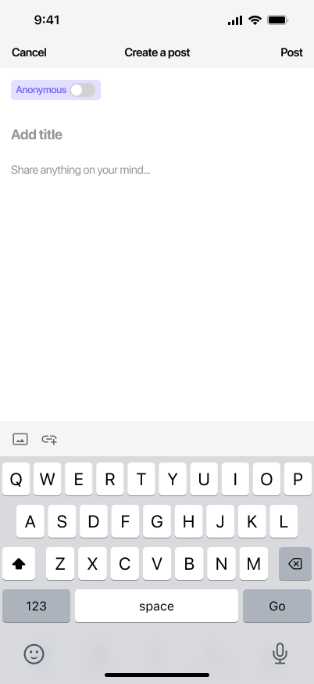
Design Revisions: Moderate Task
Before
After
Violation
Revision & Rationale
Usability Goals
H4 Sev 2: Arrow that looks like a dropdown doesn’t actually drop down
Functionality:
Remove dropdown and change to toggle since only there’s two options (anonymous vs. not anonymous)
Efficiency
Dropdown requires two clicks vs. toggle requires one
H11 Sev 1: The light yellow background with yellow text and light purple background with purple text are not very readable.
Visual:
Made “anonymous” text a darker shade of purple so more legible (esp for color blind users)
Greater pleasure and satisfaction:
Users can more easily read “anonymous” toggle and toggle it accordingly
H5 Sev 1: When you’re on the posting page and you’ve filled in the post, clicking on the bottom where the footer should be still takes you to those places.
Functionality:
Removed prototype wiring of navigation bar on this page. Still, this isn’t a huge deal since this functionality issue that’s exclusive to Figma prototypes
Commission fewer errors:
Users won’t accidentally click hidden navigation bar in background while pressing keyboard

Slide 17
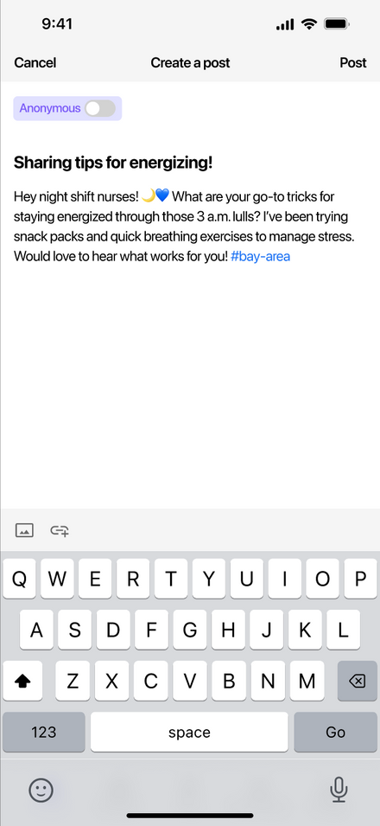
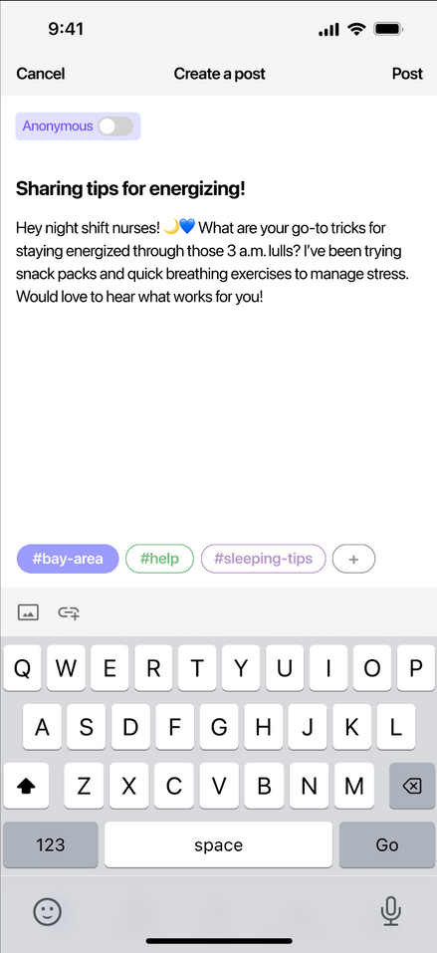
Design Revisions: Moderate Task
Before
After
Violation
H10 Sev 2:
Unclear on how to include hashtags in the post—there are no specific instructions.
Revision & Rationale
Usability Goals
Functionality:
Added a section above the keyboard on adding a hashtag (recommended hashtags dependent on the group added in)
Efficient App Navigation
Removes the hassle of self-adding hashtags within the text box, and adds a clear and intuitive method to add hashtags

Slide 18
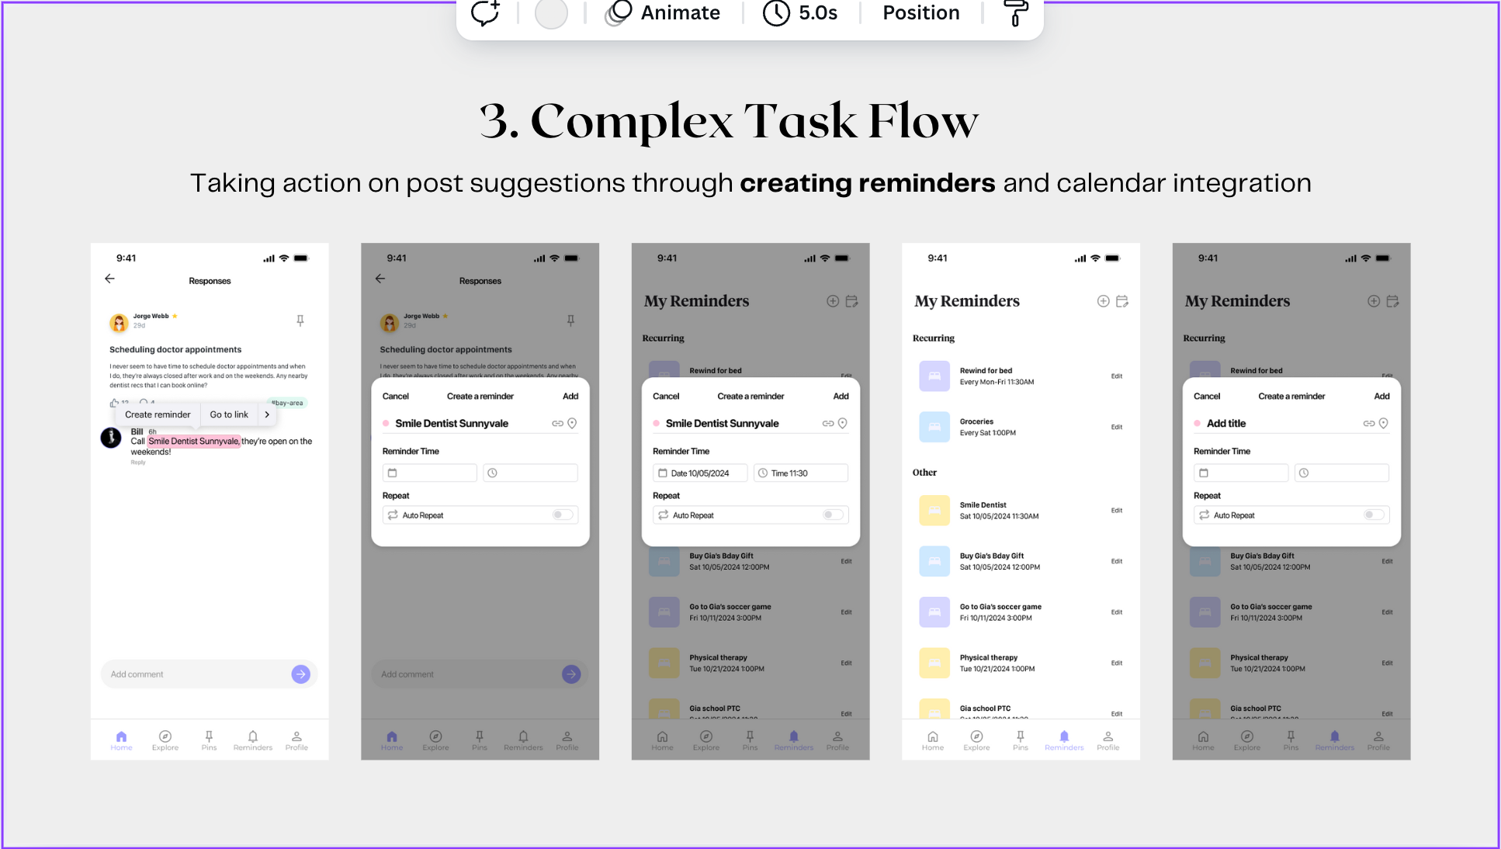
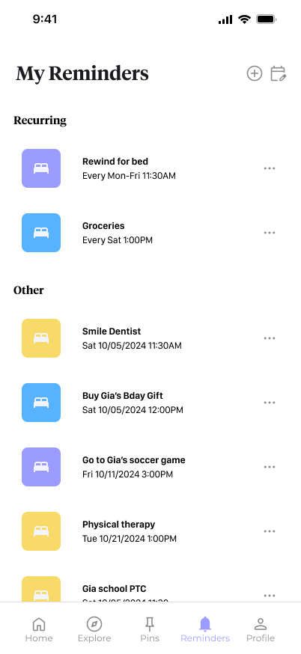
Design Revisions: Complex Task
Before
After
Violation
Revision & Rationale
Usability Goals
H11 Sev 3: Difference in icon colors is not noticable to colorblind people
Visual:
Increased saturation of icon colors to make darker so distinguishable to colorblind users
Greater pleasure and satisfaction:
Icons are easier on the eyes and more distinguishable by color
H11 Sev 2: The yellow color on the icon for Physical Therapy and Gia school PT in the Other section is super harsh
Visual:
Changed light yellow to dark yellow for better contrast with white background
Greater pleasure and satisfaction:
Icons are easier on the eyes and more distinguishable by color
H4 Sev 1: Used icons for almost every button, but the edit button on the reminders page just says "edit"
Visual:
Changed “edit” to three dots “...” icon to keep consistent with edit button for posts
Commission fewer errors:
Consistency in edit button means users will be less confused on how to edit posts, reminders etc. This will allow them to easily edit and delete reminders

Slide 19
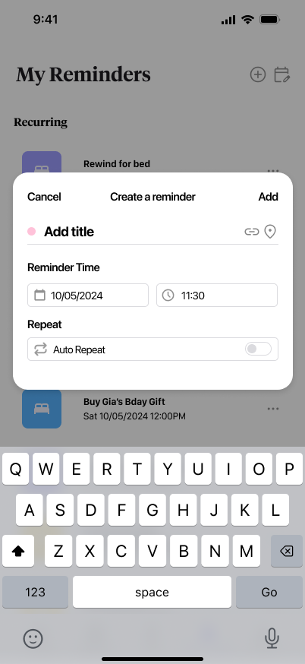
Design Revisions: Complex Task
Before
After
Violation
Revision & Rationale
Usability Goals
H8 Sev 1: Date and time format under reminders is wordy and has no separation between date and time
Visual:
Remove “Date” and “Time” text next to icons
Greater pleasure and satisfaction:
“Create a reminder” pop-up looks less wordy and cluttered which is easier on the eye + more aesthetic

Slide 20
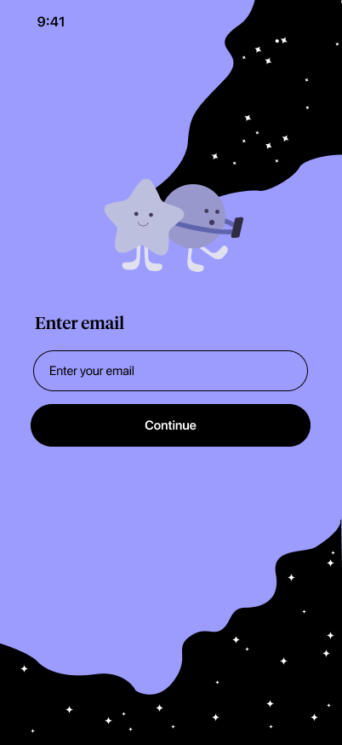

Design Revisions: Extra Violations
Before
After
Violation
Revision & Rationale
Usability Goals
H3 Sev 2: Can’t go back to sign in/sign up page
Functionality:
Add back button to all sign in / sign up pages
Commission fewer errors:
Users can go back to previous page if they make an error or want to change something

Slide 21
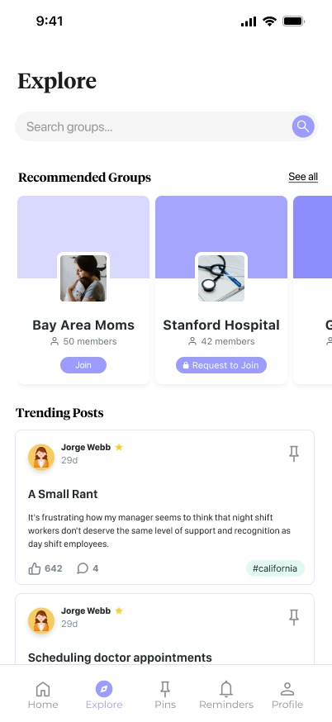
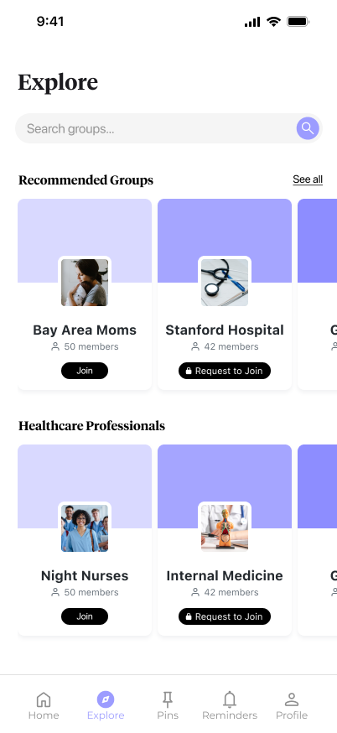
Design Revisions: Extra Violations
Before
After
Violation
Revision & Rationale
Usability Goals
H4 Sev 1: “Join,” “leave,” request” button not same style as seen in group page (diff color)
Visual:
Changed “join”, “leave,” “request” button to black to keep consistent with group page buttons
Commission fewer errors:
Fixing consistency issues will make users less confused and less likely to make errors
Functionality:
Instead of “trending posts” section similar to home page, added another horizontal scroll section showing more groups in a category
Greater pleasure and satisfaction: allows users to explore/join more groups in “explore” page. Explore page has distinct function from home page.
H8 Sev 2: Explore and home page feel redundant

Slide 22
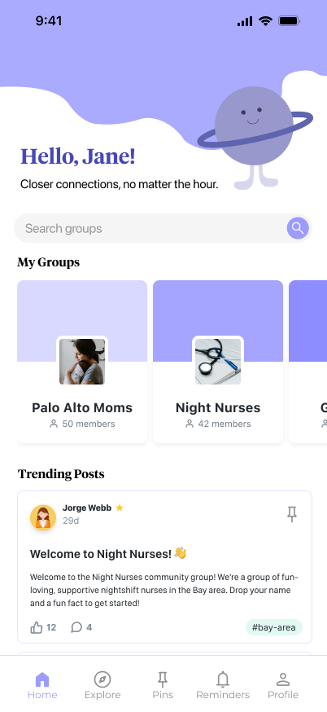

Design Revisions: Extra Violations
Before
After
Violation
Revision & Rationale
Usability Goals
H7 Sev 3: No option to search for posts
Functionality:
Combined search for groups, posts, hashtags etc. (similar to other social media platforms). We decided to combine search since it looks too cluttered with two or more search bars in a single page.
Efficient App Navigation:
Can directly search for posts, hashtags, groups etc without manually scrolling through them.

Slide 23
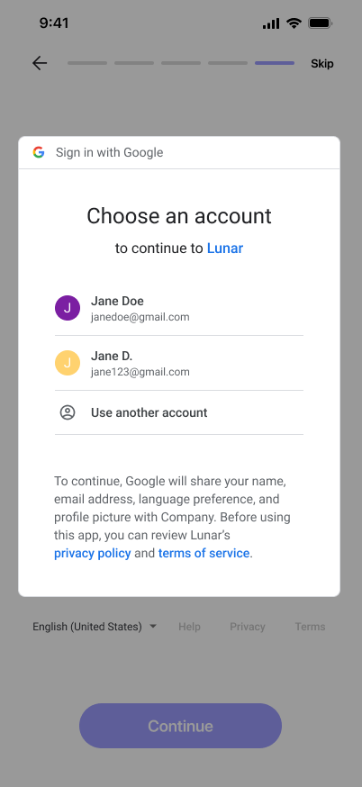
Design Revisions: Extra Violations
Before
After
Violation
Revision & Rationale
Usability Goals
H3 Sev 2: Can’t go back or exit out of “choose an account” in onboarding
Functionality:
Make dark background clickable to exit from sign-in pop-up
Commission fewer errors:
User can undo/go back to select calendar page if they make a mistake or change their mind

Slide 24
Prototype Implementation
3

Slide 25






Framework and Tools
Application Framework
Cloud Storage
+ Navigation
Onboarding Verification

Slide 26
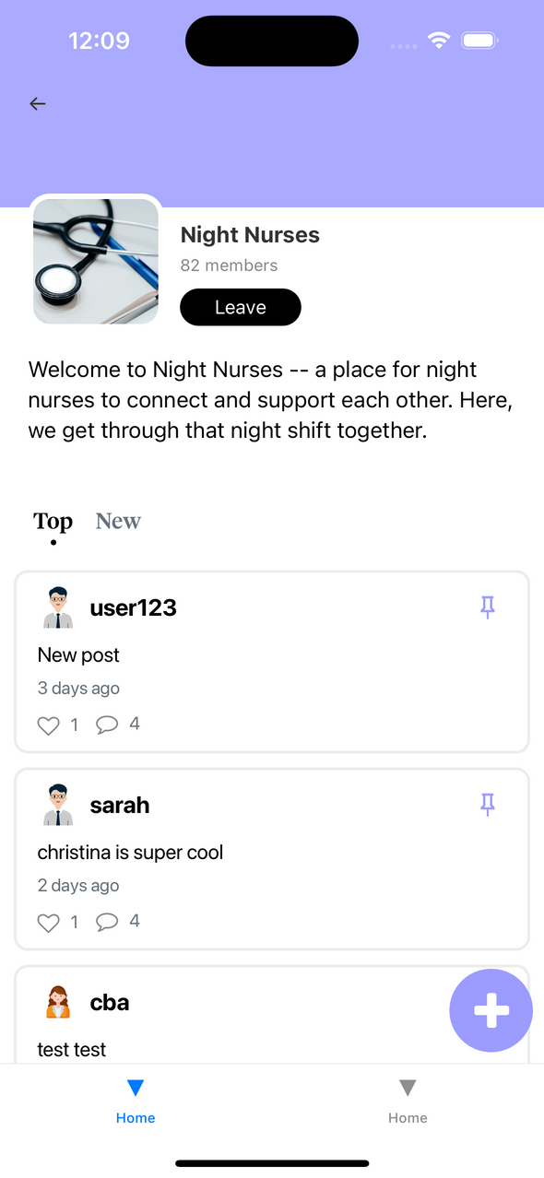
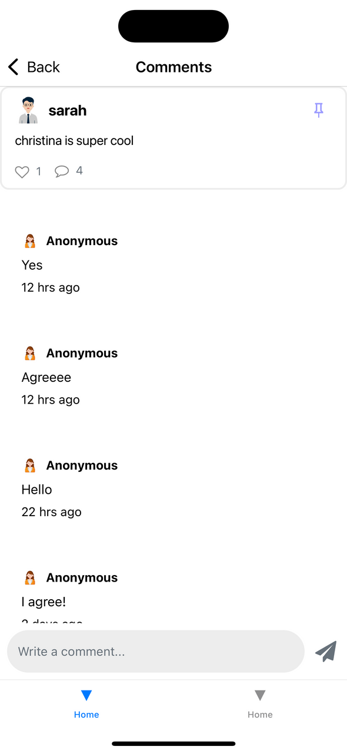

Implemented Moderate Task
Moderate: Actively contributing to community forums and answering questions

Slide 27
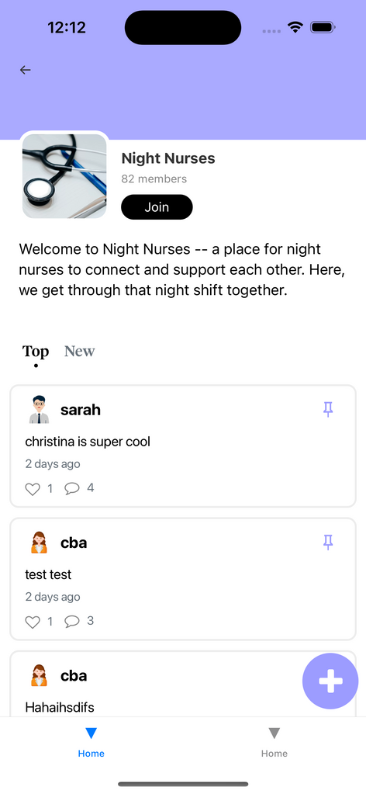
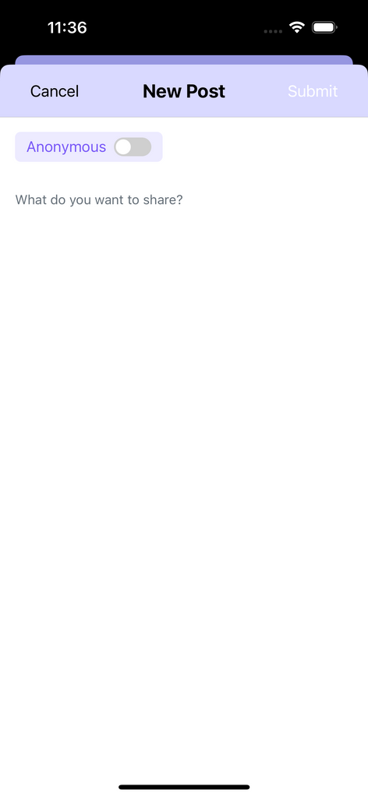
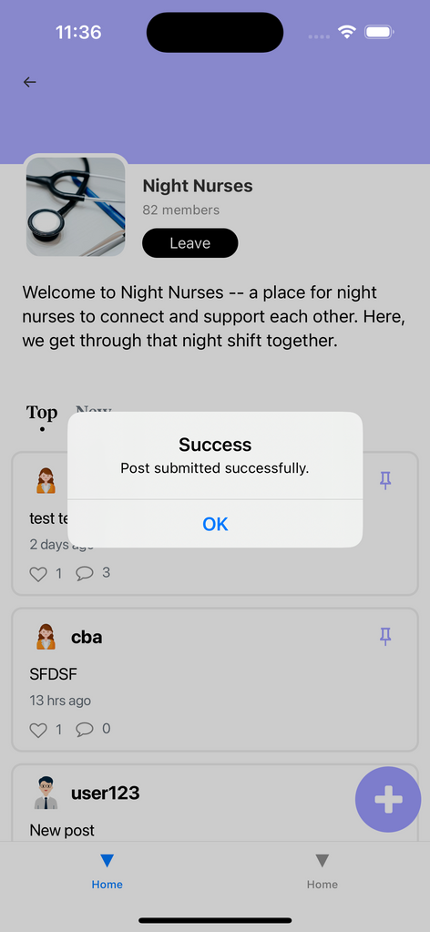
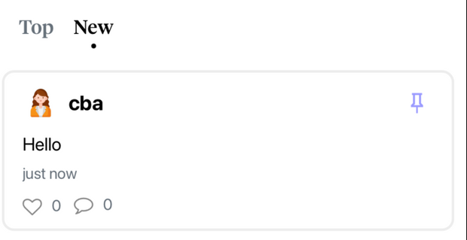
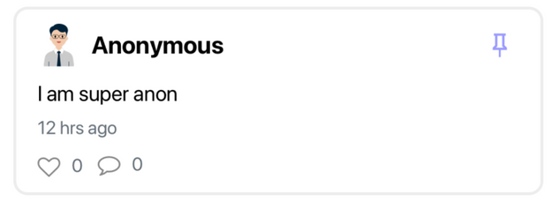
Implemented Moderate Task

Slide 28


Additional Implementation - Leaving Group

Slide 29
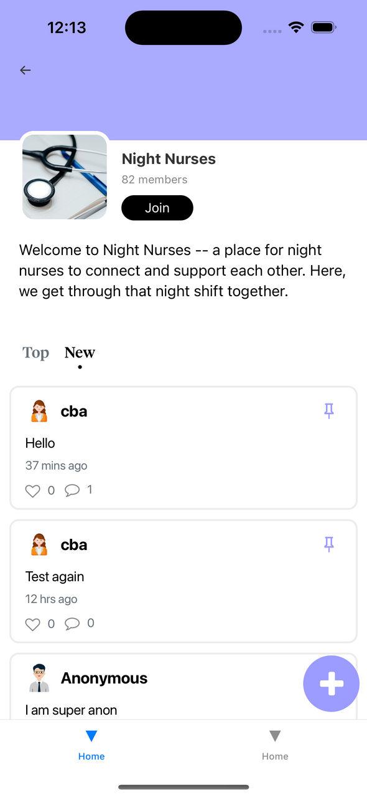

Additional Implementation - Top/New Posts

Slide 30


Additional Implementation - Pin Toggle

Slide 31

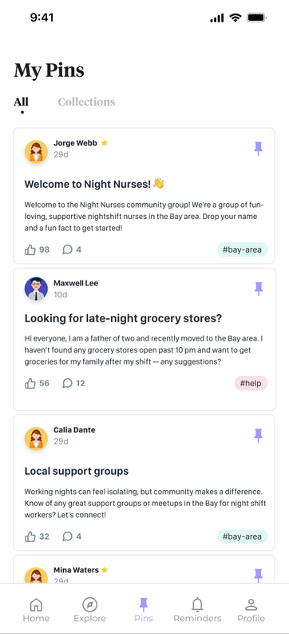
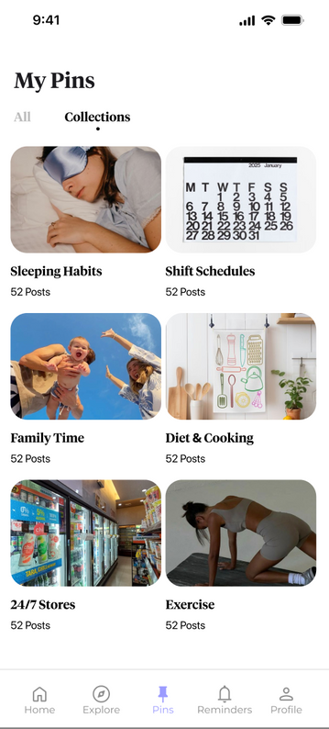

Unimplemented Features - Simple Task
Viewing and pinning relevant resources within a night shift community group
Adding Posts to Collection
Viewing Pinned Posts
Viewing Collections
Plan To Finish:
  Implement pinning to posts
  Implement collections half sheet
  Create page for viewing pinned posts
  Create page for viewing collections

Slide 32
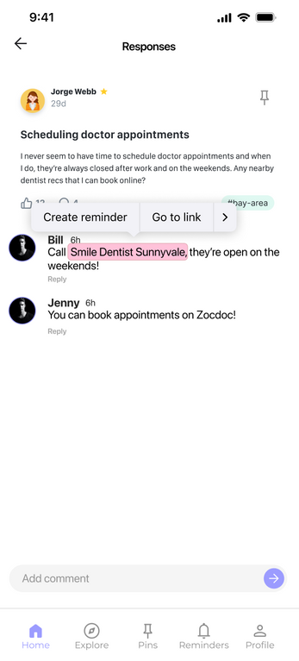
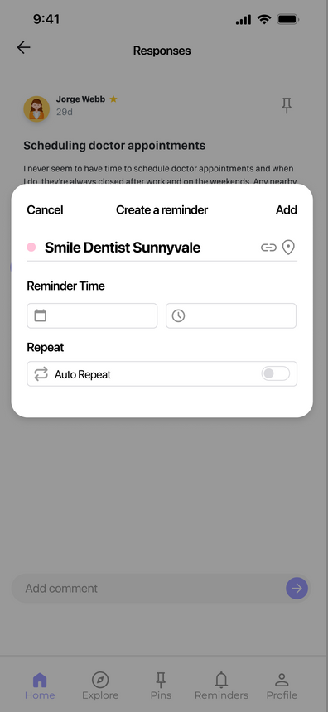
Unimplemented Features - Complex Task
Taking action on post suggestions through calendar and reminders integration
Creating Reminder
Plan To Finish:
  Utilize Chrononode to implement selecting and highlighting text
  Implement half sheet popup with details
Hold + Select using Chrononode

Slide 33
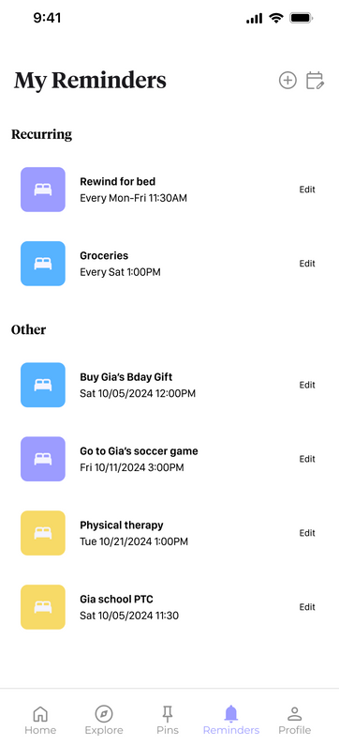
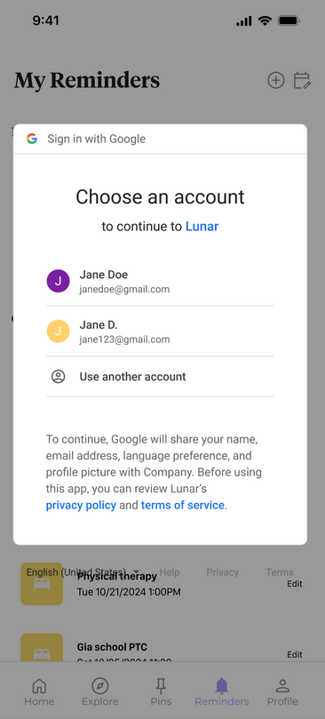
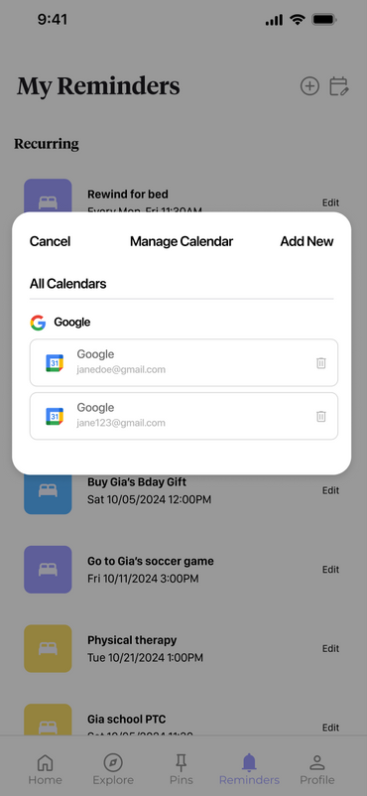
Unimplemented Features - Complex Task
Taking action on post suggestions through calendar and reminders integration
Viewing Reminders
Adding to 3rd Party Calendar
Plan To Finish:
  Create new page for viewing reminders as a list
  Use Expo Calendar to implement syncing with 3rd party calendar
3rd Party Calendar Using Expo Calendar

Slide 34
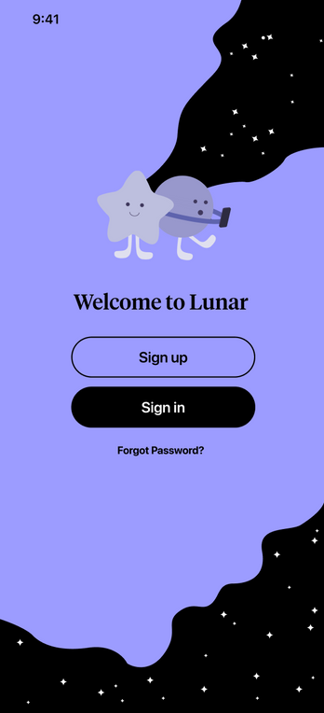
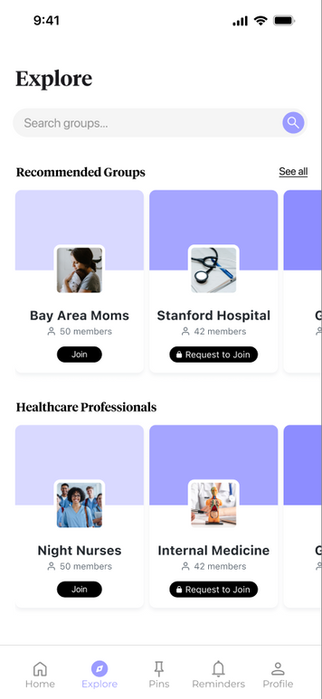
Additional Unimplemented Features
Onboarding Flow
Explore Page
Plans To Finish (If Time Allows):
  Implement Clear verification
  Implement onboarding flow
Plans To Finish (If Time Allows):
  Utilize WoO techniques to implement groups

Slide 35
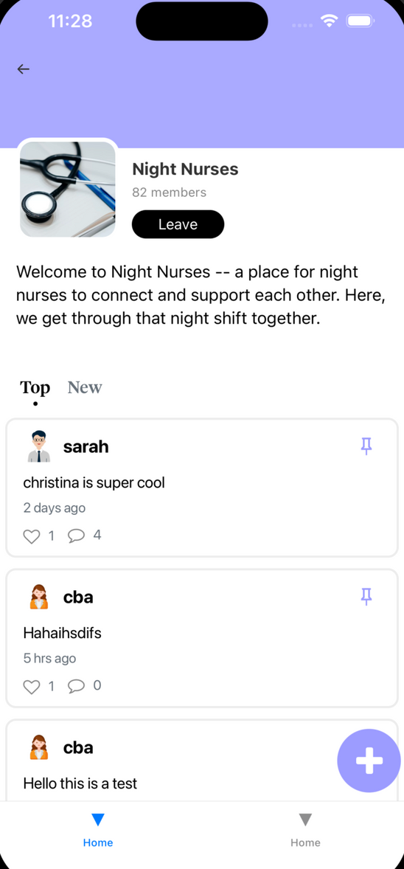
Wizard of Oz Techniques
Group Membership
  Prototype begins at Group page for the “Night Nurses” group, which auto-populates despite the user not going through onboarding.
  This effectively “wizard of Oz”es the process of selecting a group based on traits and circumstances, which we will later implement.

Slide 36
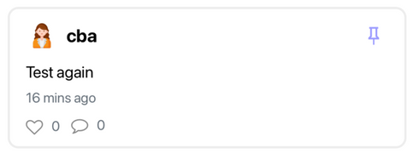
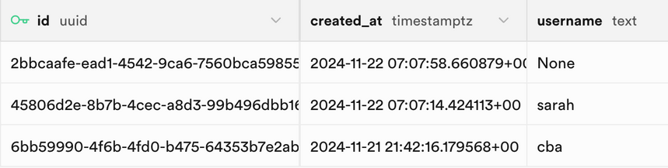
Hard-Coded Aspects
Group Navigation
  Choosing a group to navigate to from home page -- home page currently not implemented as medium flow starts at Group view
  Join/Leave group button is currently a Pressable placeholder
Group Page
  Member count
  Photo
  Description
User identification
  user_id UUID hard-coded as a const to extract relevant posts, likes, and comments without onboarding implemented

Slide 37
Issues/Questions
1
2
Dynamic Collections Feature
Clear Verification
Implementing the Clear identity verification API call vs. hard-coding the verification step in onboarding
Implementing our Med-Fi prototype for what the collections page would look like and having it be fully customizable and dynamic based on user input.

Slide 38
Discussion to Finish
Build out the simple and complex tasks and ensure it flows with the moderate task interface. Reuse the React components that were are already built and used.
1
Complete the onboarding section, built with intuitive and aesthetic animations to impress the user when entering the app for the first time.
2
Ensure consistent aesthetic features across the app by standardizing colors, typography, and components, fixing spacing and layout issues with proper margins and alignment.
3
4
After reaching a consensus on which areas will use Wizard of Oz, hard-coded solutions, or actual implementation, proceed with their development.

Slide 39
Demo!
4

Slide 40
Appendix
Heuristic Evaluation Spreadsheet
Figma prototype
Readme doc
Lunar Website

