Slide 1

CS 147 · Stanford University
Nov 1 2024
Lunar
Closer connections, no matter the hour
A6: Medium-Fi Prototype
Evelyn Hur, Sejoon Chang, Sarah Yao, Christina Ba

Slide 2


Nightshift workers are often lonely, believe that work and personal life can’t go hand in hand, and that they have little to no time to care for connections with others
Our Solution
An online community of night shift workers with similar backgrounds, work schedules, situations etc. to share resources, tips, and support each other
Problem Statement

Slide 3
Values in Design
1

Slide 4
Values Encoded
Trust
Personalization
Compatibility
Users should be able to build trust and rapport by receiving genuine responses and authentic insights from others that can empathize with them.
Everyone on Lunar should be able to get an experience specifically tailored to their needs and unique positions
Users should be able to intuitively and seamlessly integrate Lunar’s functionalities into their existing organization systems.

Slide 5
Design Decisions
Trust
Personalization
Compatibility
Users should be able to build trust and rapport by receiving genuine responses and authentic insights from others that can empathize with them.
Everyone on Lunar should be able to get an experience specifically tailored to their needs and unique positions
Users should be able to intuitively and seamlessly integrate Lunar’s functionalities into their existing organization systems.
Intimate Community Groups
Limit member count in community groups to encourage closer small-group connections.
Verified Users
Users must verify identity + contact during onboarding
“Star” Contributors
Frequent and trusted discussion contributors will earn star status, increasing trust for their posts
Custom Onboarding
Users can control degree of personalization by choosing how much information to provide during onboarding
Specific Group Themes
Onboarding data suggests tailored groups for user to join, based on their needs
App Integration
Posts suggesting specific actions have an option to integrate with Google Calendar, Reminders app, etc.
Flexible “Add to” Options
Lunar can host a variety of “add to” options depending on user’s existing digital workflow: e.g. iOS vs Android, Watch vs Phone app.

Slide 6


Value Conflicts
Address By:
Creating multiple smaller communities for broader groups -- for example, three 50-person “Nightshift Nurses” instead of one 150-person one
PERSONALIZATION:
Custom Onboarding
Specific Group Themes
TRUST:
Intimate Community Groups
Verified Users
Star Contributors
COMPATIBILITY:
App Integration
Flexible “Add To” Options
Potential Conflict:
Users who choose to provide less information in onboarding are put in broader community groups, which are capped

Slide 7
Value Conflicts
Address By:
Including a question in onboarding about user’s workflow and adapting answer into post integration options (e.g. paper to-do list or digital calendar?)
PERSONALIZATION:
Custom Onboarding
Specific Group Themes
TRUST:
Intimate Community Groups
Verified Users
Star Contributors
COMPATIBILITY:
App Integration
Flexible “Add To” Options
Potential Conflict:
Reminder/calendar compatibility is limited to most commonly used apps, which may make Lunar less personalized to users with unique preferences.

Slide 8
Tasks
2

Slide 9
Our Tasks
Simple
Viewing and pinning relevant resources within a night shift community group
Moderate
Sharing wisdom and contributing to a community forum
Complex
Taking action on post suggestions through calendar and reminders integration

Slide 10
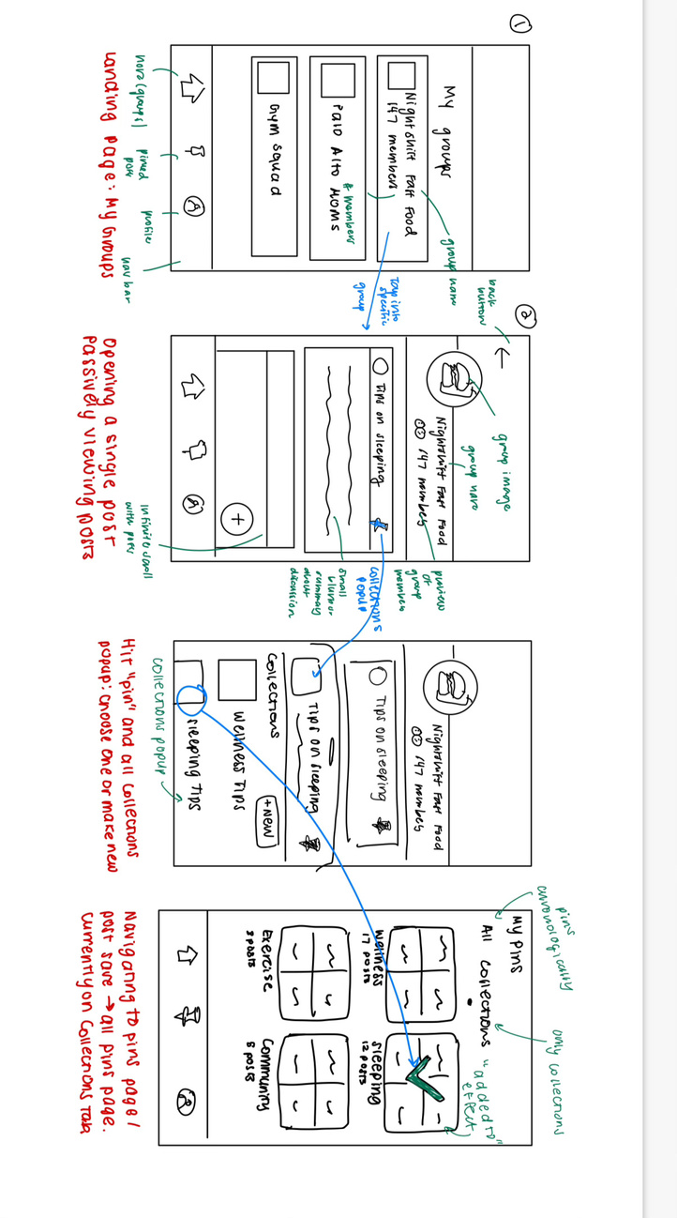
Simple Task
Viewing and pinning relevant resources within a night shift community group
Lofi Prototype
Changes Made
Added pinning/adding to collections as a part of simple taskflow: users often first passively browsed posts and built private collections together in tests
Implemented consistent “pin” icon instead of both pins and bookmarks: users were confused about the difference between icons
Made task flow start at landing page instead of including onboarding based on TA feedback
Added half sheet save to collections feature based on existing social media app flows to improve intuition and reduce user friction

Slide 11
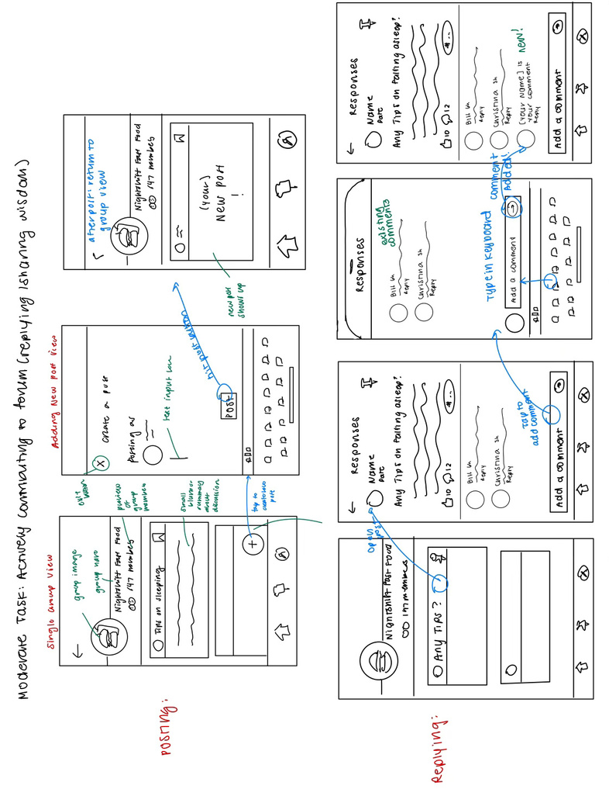
Moderate Task
Sharing wisdom and contributing to a community forum
Lofi Prototype
Changes Made
Combined posting and replying into one task flow (contributing to forum) based on CA/professor feedback
Added clearer post and upload comment buttons based on user interviews - users were confused on how to actually upload their content
Added like and comment counts to highlight crowd favorites, satisfying user request for insight into community engagement on each post
Ordered posts by like count so users don’t need to spent time scrolling through every post chronologically

Slide 12
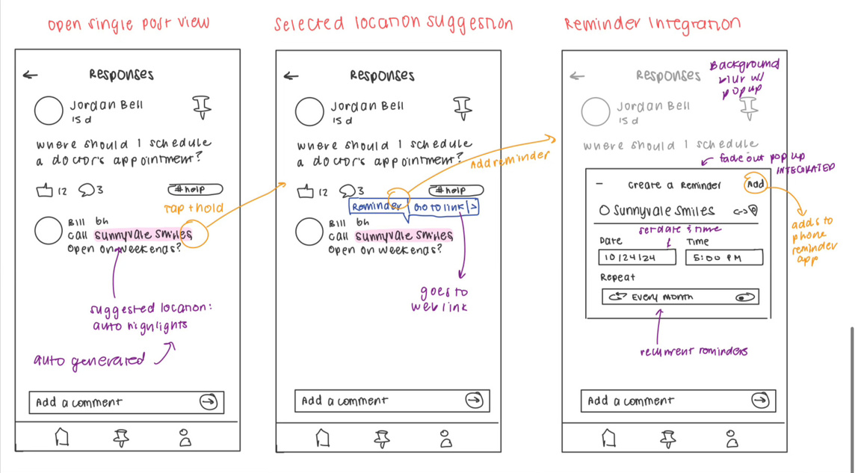
Complex Task
Taking action on post suggestions through calendar or reminders integration
Lofi Prototype
Changes Made
Separated pinning/post collections (simple task) from taking action on post suggestions (complex task) to simplify process of navigating to complex task: initially had to go through pins page
Iterated on popup and highlight designs, implementing an Apple-inspired auto-highlight and in-page popup to create a familiar interface for users (found prior design unintuitive)
Removed in-app calendar and reminders tab, opting for integration with user’s existing apps: users wanted something more adaptable into their lives

Slide 13
Usability Goals & Key Measurements
3

Slide 14
Usability Goals + Key Measurements
Current Goals + Refined Key Measurements
3. Greater Pleasure and Satisfaction
1. Efficient App Navigation
2. Commission Fewer Errors
Key measurements: Ease of finding right pages (community groups, pins etc)
Previous Objective Metrics:
Time it takes to complete tasks
Number of errors
Additional Objective Metrics
Reduced Clicks and Taps:
On shift fatigue makes lowering amount of taps vital for nightshift workers
Quick Returns to Previous Tasks:
Nightshift workers have to respond to other duties without starting over if bouncing between tasks
Rationale: Positive user experiences directly impact job satisfaction, productivity, and mental well-being
Refined Subjective Measurements:
Clarity and Prominence of Reminders
We plan to ask “how noticeable and clear are alert or notifications that appear during your shift”
This can help mitigate alerts missed due to fatigue
Community Connectedness
We plan on asking “how often did you feel connected with a group online”
This subjective metrics provides us insight degree of community orientation
Key measurements: Lowering error rate, time to correct errors
Additional Objective Metrics:
Error Rate per Task
Identifying this metric allows us to create a straightforward, dependable interface that workers can use when they’re tired
Backtrack Rate
A high backtrack rate allows us to ensure that users are finding what they need, especially for workers that are trying to find something on the first attempt

Slide 15
Usability Goals + Key Measurements
Progress Towards Usability Goals + High Level Design Changes
Goal 1: Efficient App Navigation
Goal 2: Commission Fewer Errors
Goal 3: Greater Pleasure and Satisfaction
High-Level Design Changes
High Level Design Changes
High Level Design Changes
Adding separate “reminders” column
Combining posting and replying into one task flow
Creating Home View to combine groups and top posts as shortcuts for users to navigate to select groups and trending posts
Emblem consistency for pinned and saved
Leverage toggles and sliders for turning on and off reminders
Cutting down on excessive information on screen
Title text (black / white) is in high contrast with main purple color
Integration with 3rd party calendar apps
Progress
Progress
Progress
Significant progress to simplify and address high-level design
Status: Complete, with minor refinements as needed in user testing
Refined all minor design changes to address errors from initial testers
Status: Complete
Major changes to integrate with 3rd party apps and change color scheme
Status: Complete

Slide 16
Limitations
Was there anything that the testing couldn’t reveal?
1
2
3
Although we were able took gauge users’ initial impressions of our project, this is not indicative of long-term use and behaviors of the actual app. For example, how often a user would post or return to a post.
We had features such as swiping up on a specific post which expanded a view or sharing elements, and those cannot replicate the nuances of a real touch gesture on the phone.
Although we introduced the idea of integrating with user’s calendar or reminders, we were not able to test follow-through with those integrations or evaluate how helpful they actually were within our user’s workflow.

Slide 17
Revised interface sketches
4

Slide 18
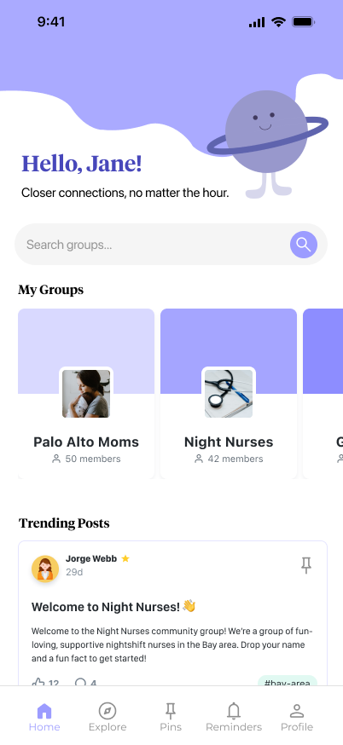
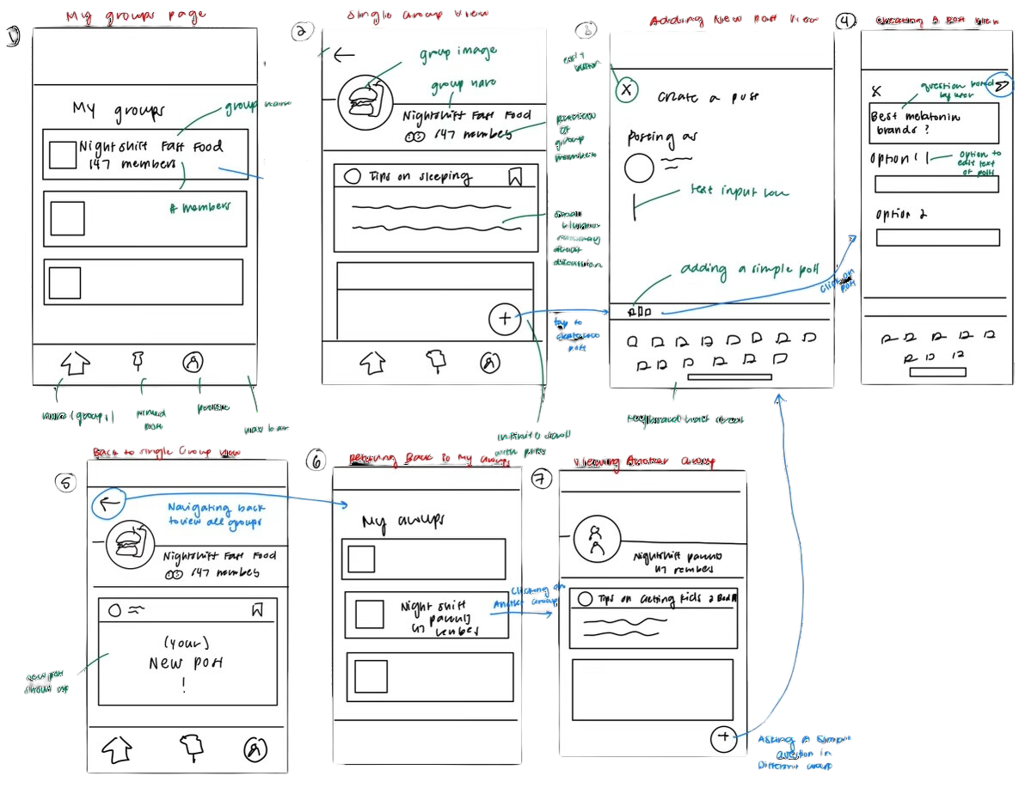

Major Design Change #1
Home Page Layout & Navigation

Slide 19
Too Modular
Trending Posts
All 3 users frustrated with having to tap into every group to see posts, and only opened top few groups.
Home allows for both group exploration and top posts across groups, suggested based on number of likes and relevant hashtags.
Scroll Search
Search Bar
Users that join many groups may find it tedious to only access a group through scrolling to it
Added a search bar to search for a group, reducing size taken up by group tabs and search friction
Chronological Feed
Most Liked Feed
User tests demonstrated preference for opening most relevant/liked posts within a group, didn’t want to scroll through every post
Changed feed within groups and in “Trending Posts” to be organized by number of likes instead to stimulate interaction through social influence
Stuck in onboarding groups
Explore Page
Guest feedback indicated no way to join + explore new groups, giving users a stale experience
Added explore groups page so users and search for and join new groups after initial onboarding

Slide 20



Progress toward Usability Goals
Efficient App Navigation
Commission Less Errors
Greater Satisfaction
Trending Posts
Search Bar
Most Liked Feed
Explore Page
Allows user to get an “all in one” look at recent updates on Lunar without having to navigate through each group separately.
Prevents user from having to scroll through every group to find one in mind with easy to use and intuitive search bar flow.
Users already interacted with highest-liked posts most, so sorting by relevancy (number of likes with relevant tags) suggests them more applicable results for increased user satisfaction.
Users whose relevant situations have changed or may have made errors in initial onboarding can “revert” those errors by joining other groups
Satisfies specific user-test request for such a feature and suggests more tailored posts to the user.
Prevents deterministic onboarding stress since users can change/ join groups later

Slide 21
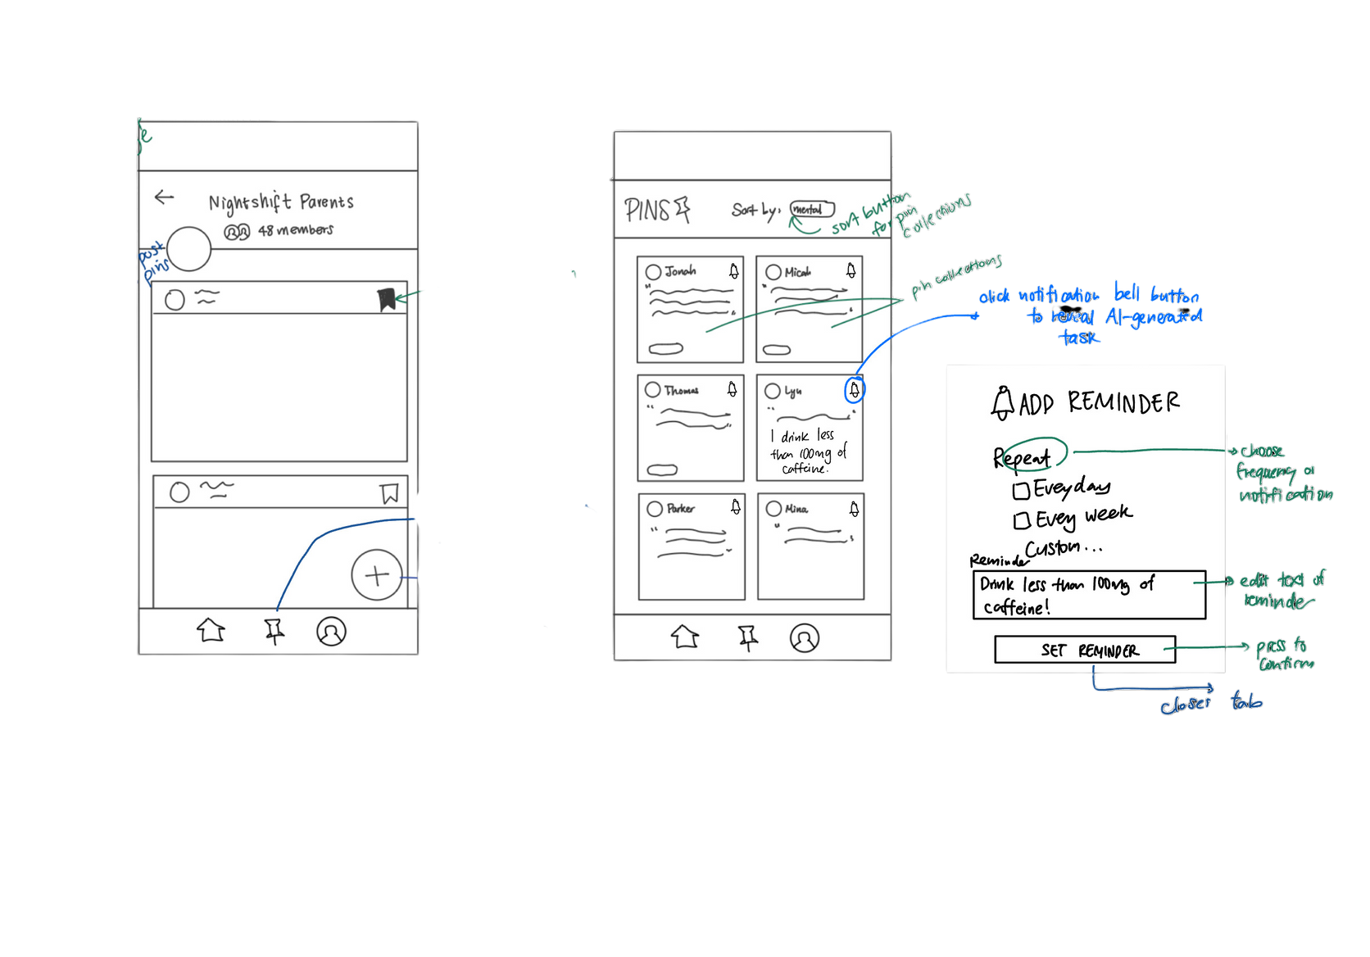
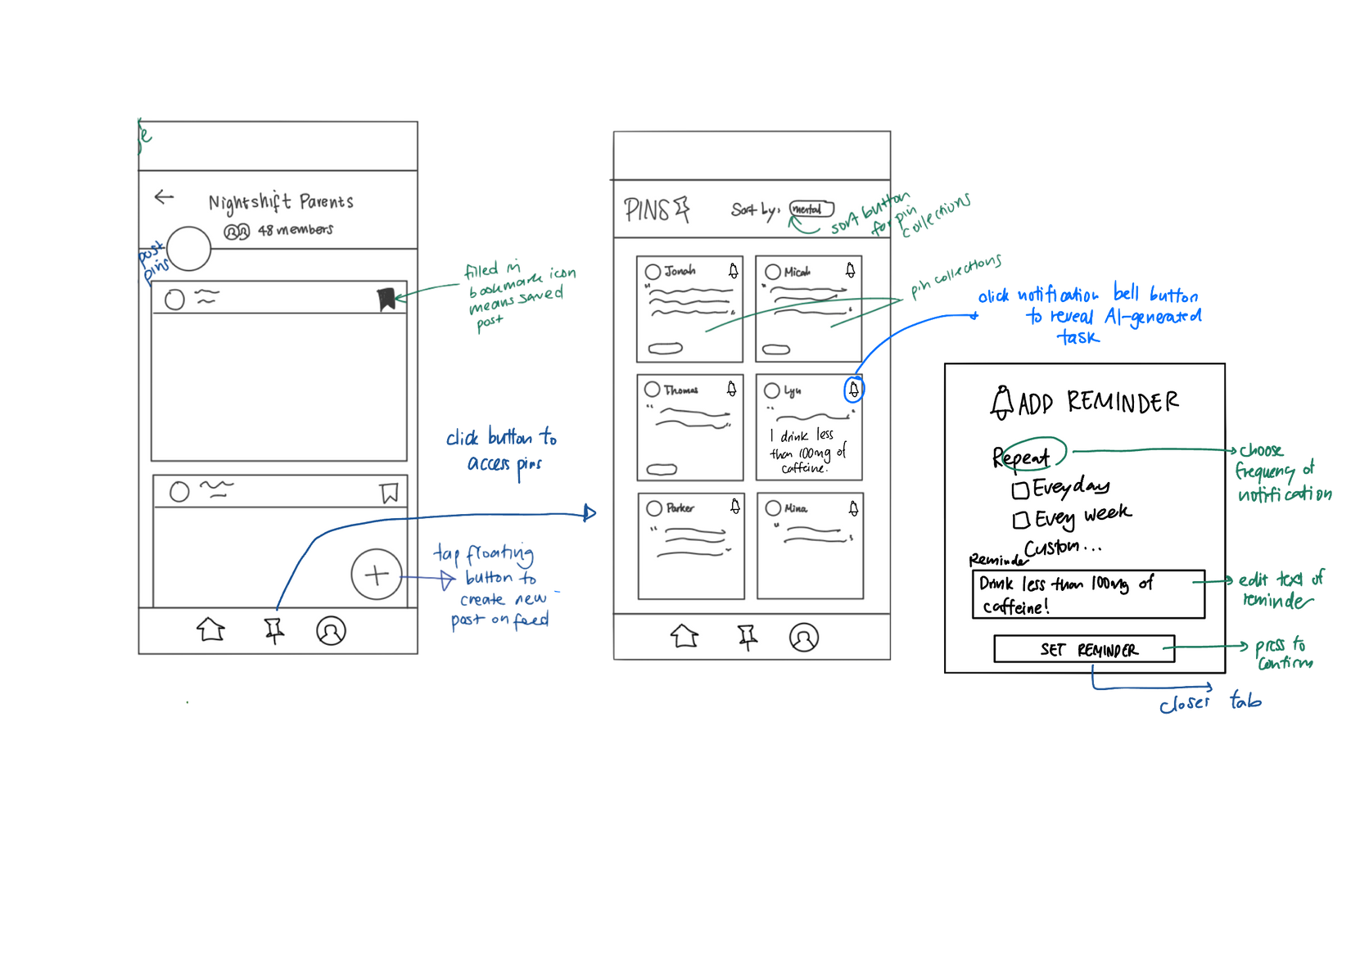
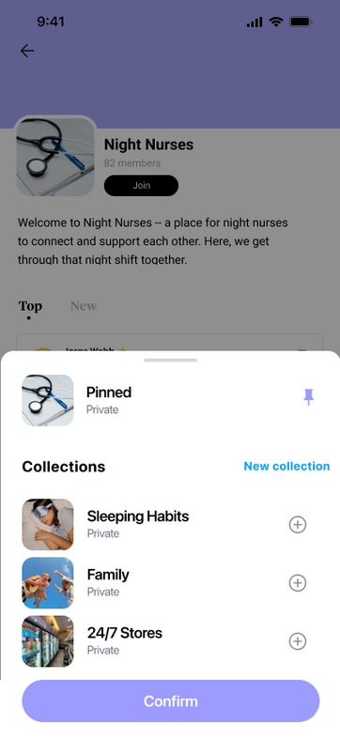
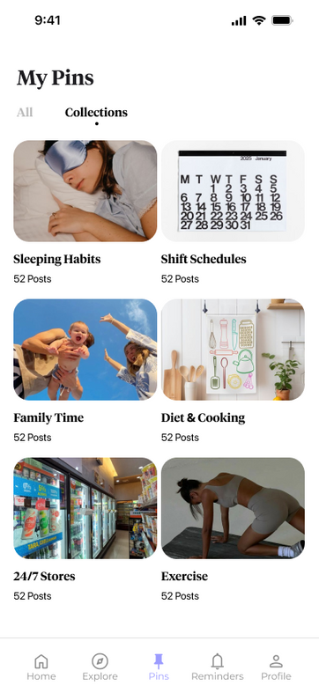

Major Design Change #2
Pinned Page and Collections

Slide 22
Confusing Icons
Consistent Pin Icon
One user indicated the presence of both bookmarks and pins were confusing, since they referred to the same thing.
We changed all pin-related icons to an actual pin and kept terminology consistent on relevant pages..
“Sort By”
Collections
Pins would save chronologically and could be sorted by tags (“sleep”, “health” etc). Users found this tedious and hard to follow when pin count increased, and old pins would get buried.
When pinning, users can choose a collection to add it to and look through pins either chronologically or by collection, allowing clearer distinction between groups. Tab switch between “All” and “Collections” allows for both use cases..
Auto Save to “All”
Default Collection Save
When users pin, it automatically saves to “all pins” and tags can be added for sorting later on. User tests indicated users didn’t usually refer back to past pins to add documentation, so this approach didn’t make sense and would lead to lots of pin backup.
When pinning, users are default asked to add to a collection to encourage pin organization and ease of browse and reference later on in the Pins page.

Slide 23
Progress towards Usability Goals
Efficient App Navigation
Commission Less Errors
Greater Satisfaction
Consistent Pins
Collections
Default Collection Save
Prevents icon confusion on the user’s part -- users asked “what’s the difference between the two?”. Improved intuition of icons and frictionless flow pickup.
Users can more easily access a specific “tag” (now a “collection”) by tapping on an album, instead of having to sort through posts they need to separately tag.
By setting saving to a collection as default, users are encouraged to keep their pins more organized, so when app use increases there isn’t backlog from too many pins.
Better organizational UI and familiar social media saved-posts interface so users can more easily adapt to Lunar’s interface.

Slide 24
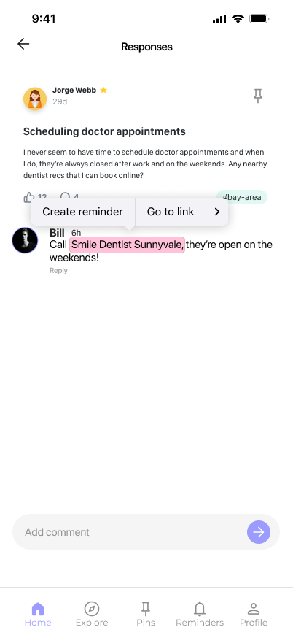
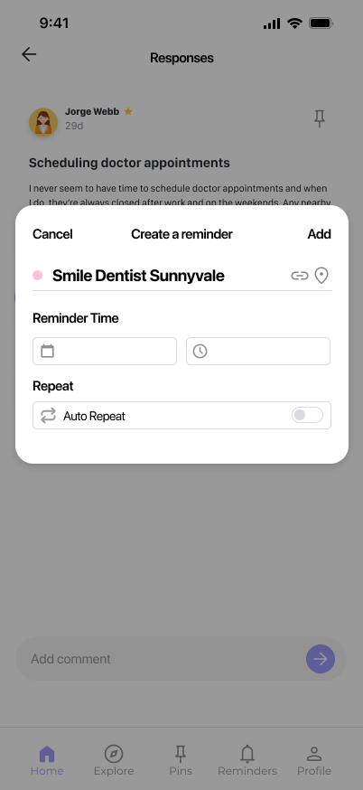
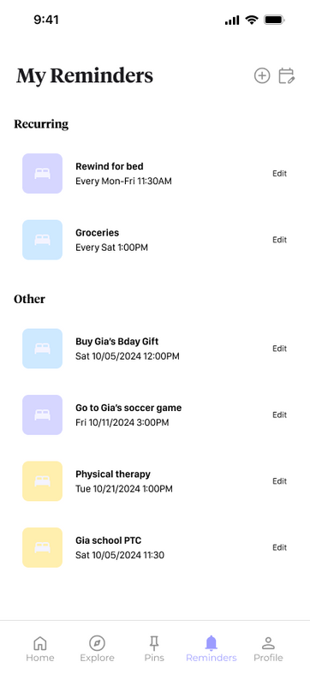
Major Design Change #3
Reminder Suggestions & Flow

Slide 25
Remind from Pins
Remind from Post
Users indicated pinning a post and setting a reminder from it didn’t always correlate, and having to pin first created unnecessary friction.
Changed reminder/calendar invite functionality to start from auto-suggested locations and times in posts for simplified UX flow
Manual Input
Auto Suggestions
Requiring manual reminder name input after selecting it from a relevant post seemed repetitive to 2/3 interviewees.
Posts correlating to a potential reminder are auto-highlighted and name of reminder is automatically taken from highlighted text, similar to Apple’s iMessage reminder interface.
Reminders App Integration Only
In-App Reminders
To make the use case flow clearer, we created a separate in-app page that held reminders created from Lunar apps that also supports adding custom reminders and integrating into existing calendars.
Originally, reminders could only be made into user’s existing reminders app. This was not clear to all 3 testees, who asked us where their reminders went.

Slide 26
Progress toward Usability Goals
Efficient App Navigation
Commission Less Errors
Greater Satisfaction
Remind from Post
Auto Suggestions
In-App Reminders
Users are able to see all Lunar-created reminders together, improving organization and distincts between iPhone Reminders app additions and Lunar-created ones.
Setting a reminder from a specific place/time in a post reduces confusion on what exactly the reminder is for -- for example, the whole post vs. a segment of it.
Users can more efficiently create reminders by not having to manually input text that’s already on the post.
A UI similar to Apple’s iMessage suggestions gives users more flow familiarity and ease of adoption.
Reduces need to pin a post, then create a reminder from it - tap count and effort to remind cut in half, making navigation more efficient.
Eliminates user confusion on “where reminders go”, especially since reminders app vary by phone model.
User confusion between Lunar reminders page and actual Reminders app reduced.

Slide 27
Medium-fi Task Flows
5

Slide 28
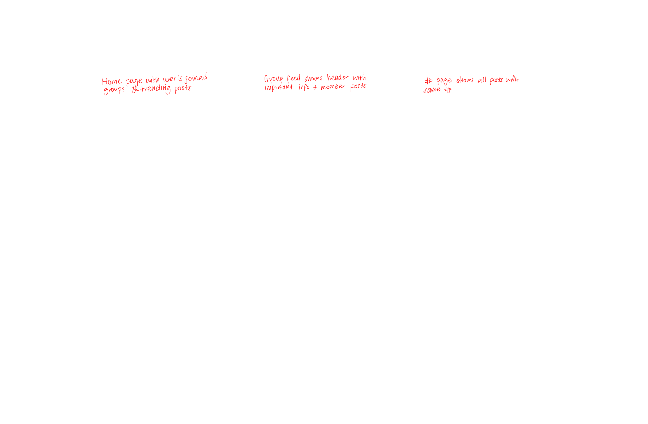
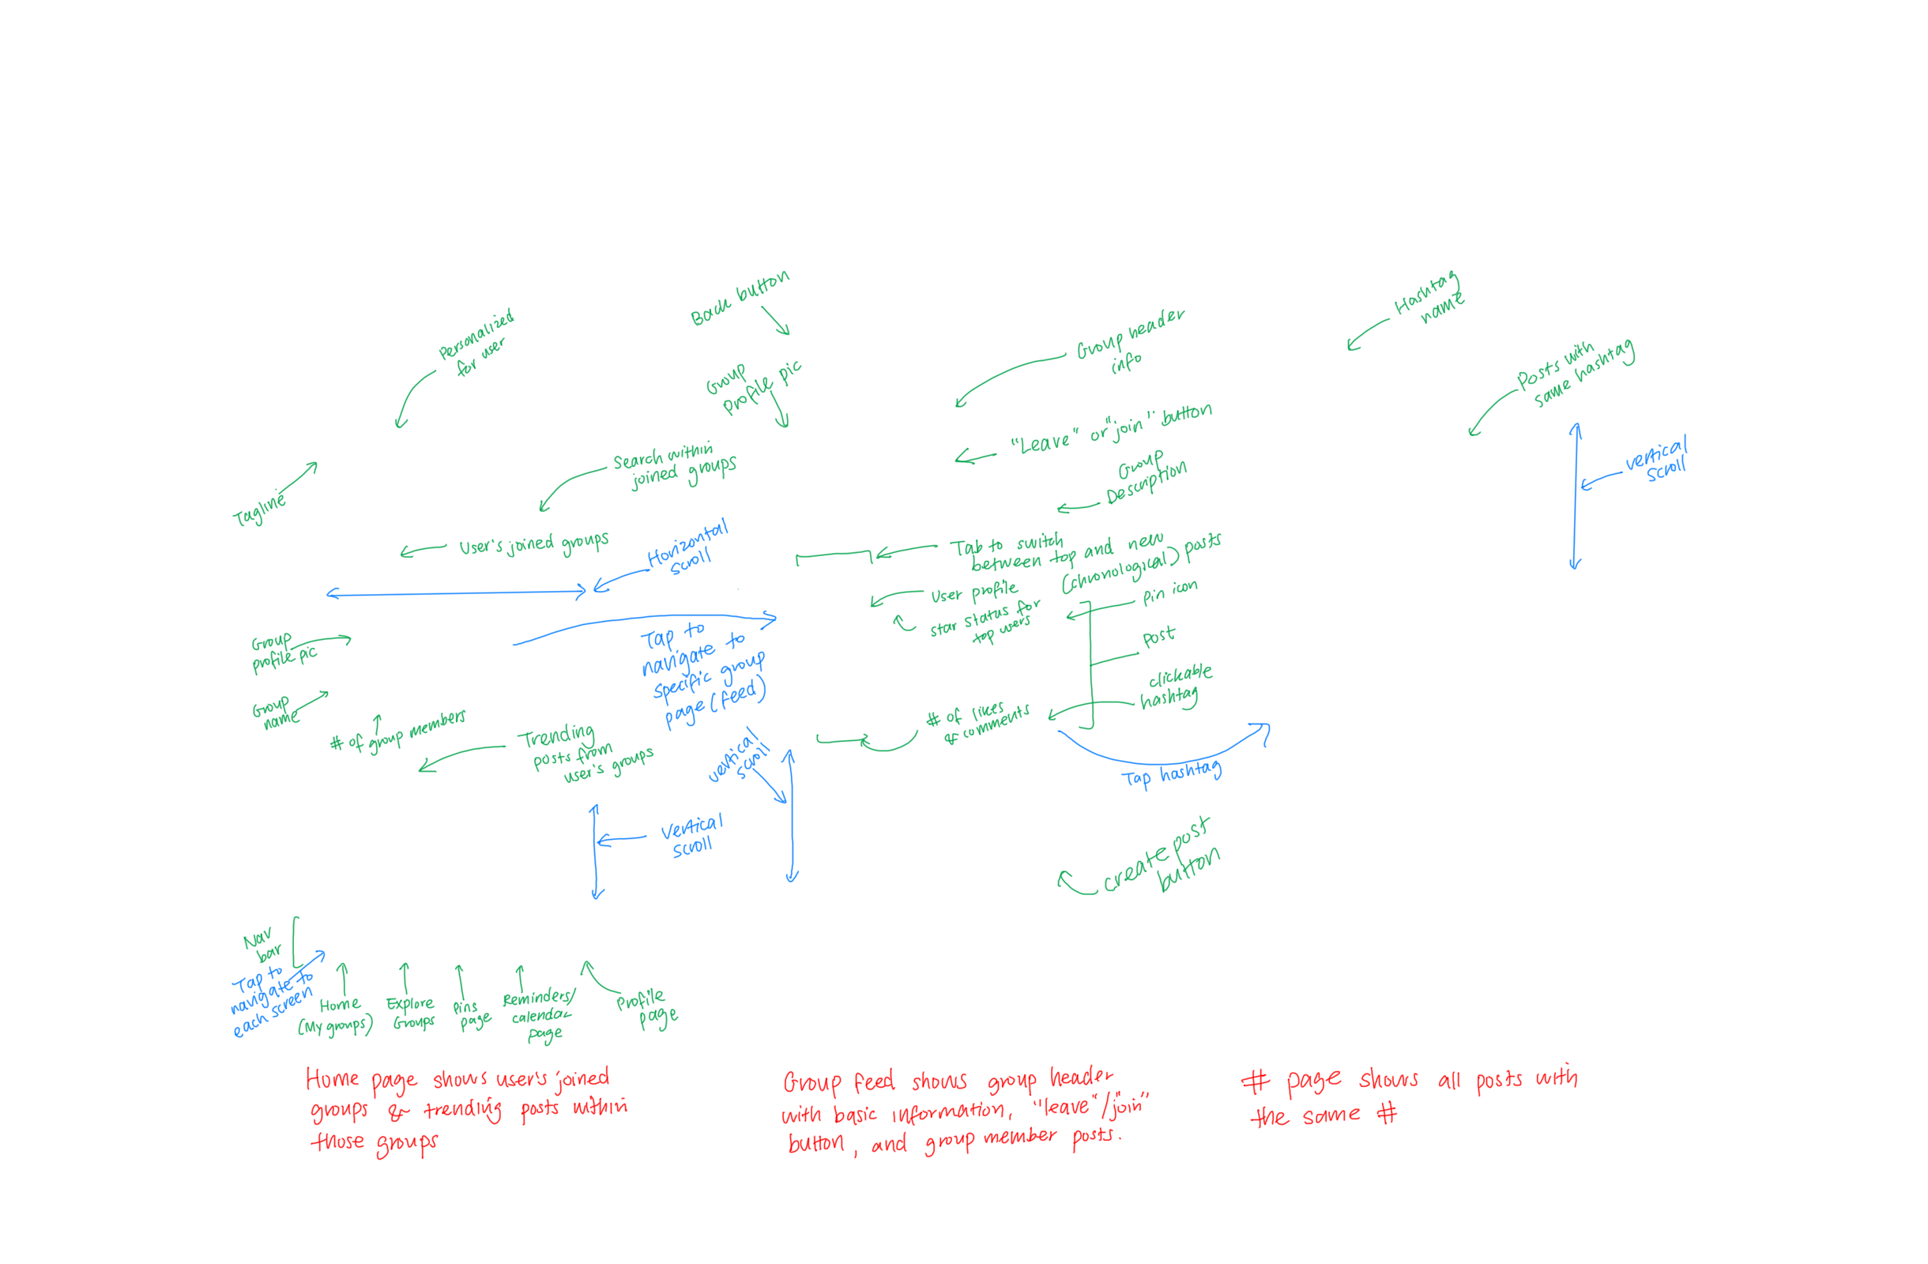

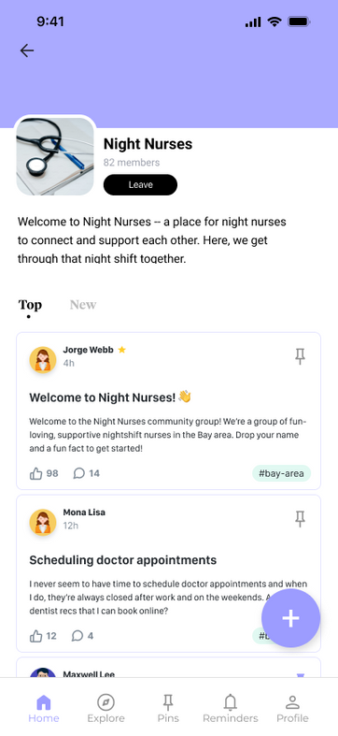
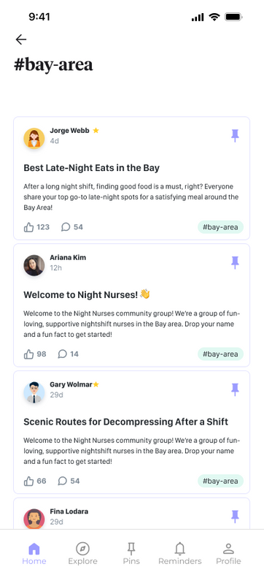
1. Simple Task Flow
Viewing and pinning relevant resources within a night shift community group

Slide 29
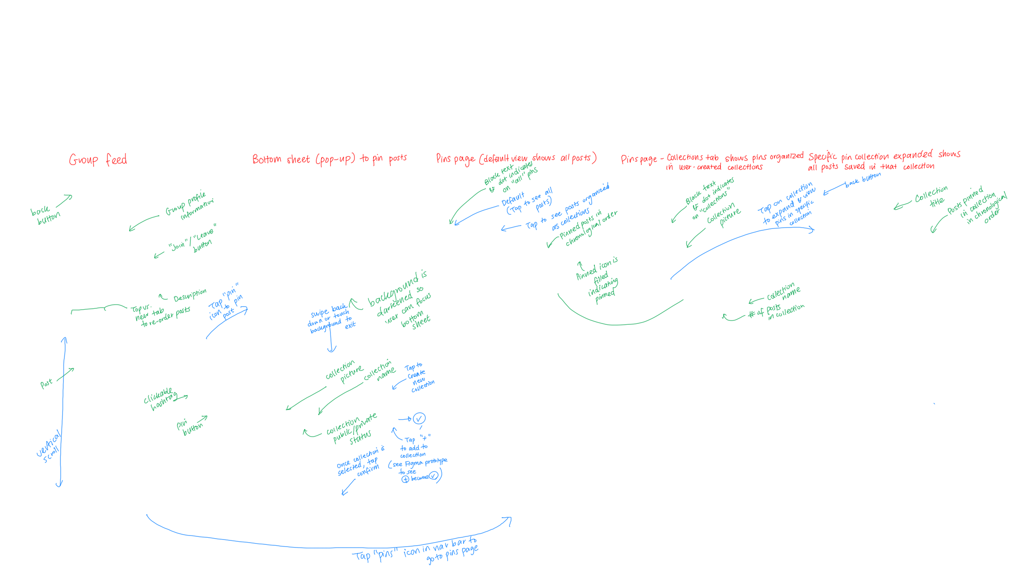


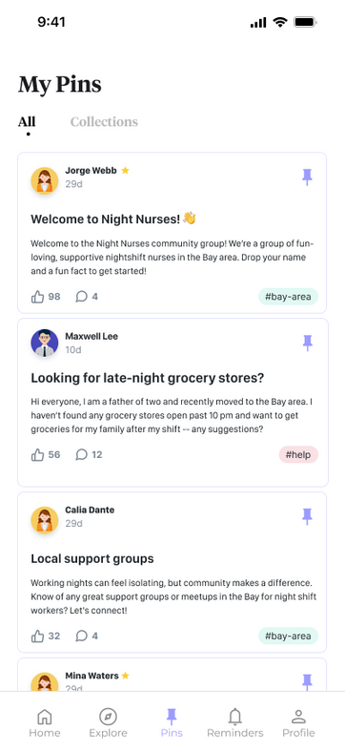
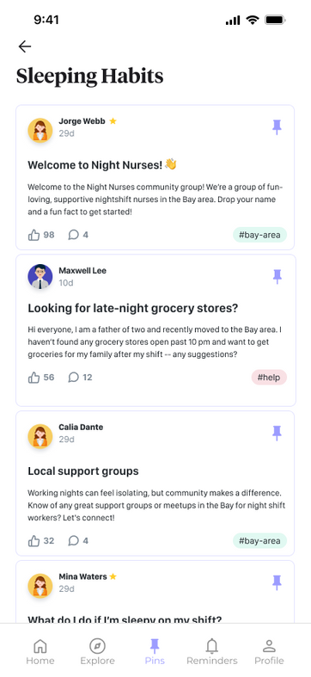
1. Simple Task Flow
Viewing and pinning relevant resources within a night shift community group

Slide 30
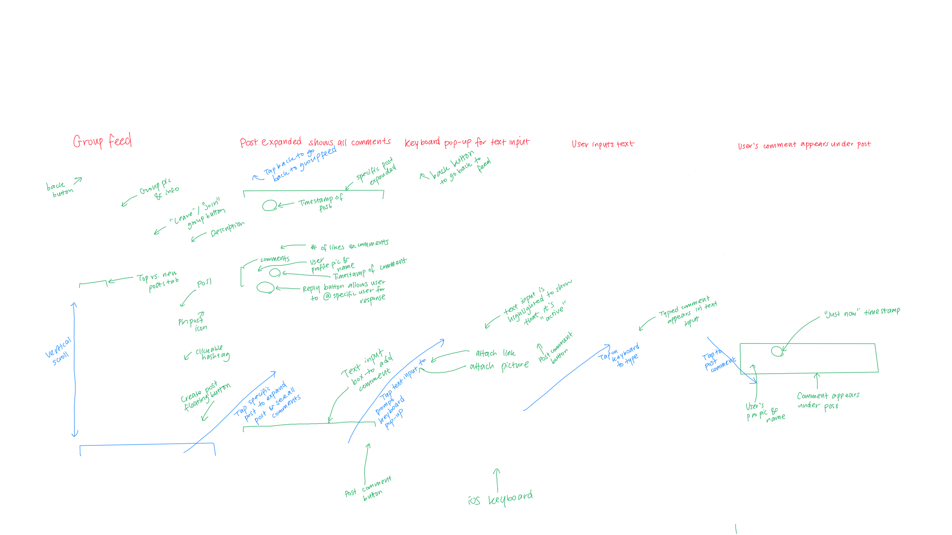
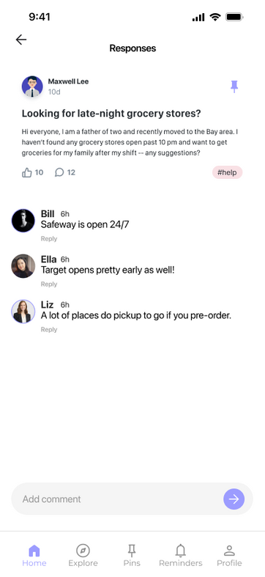
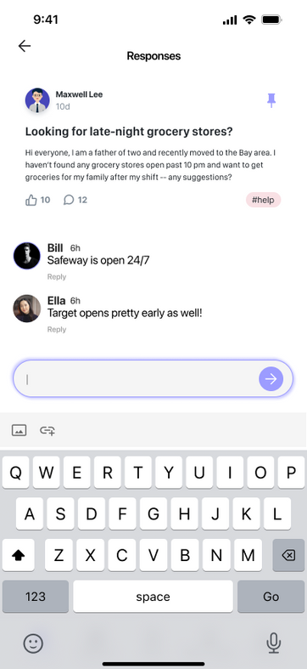
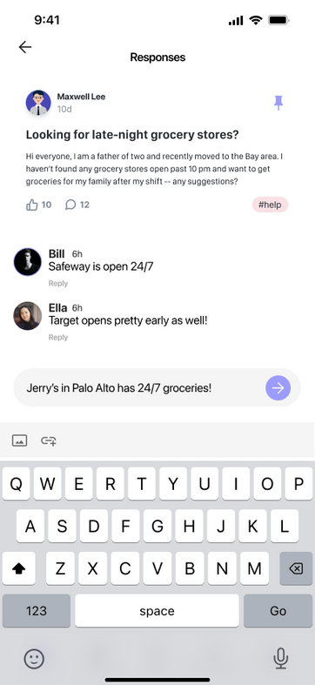
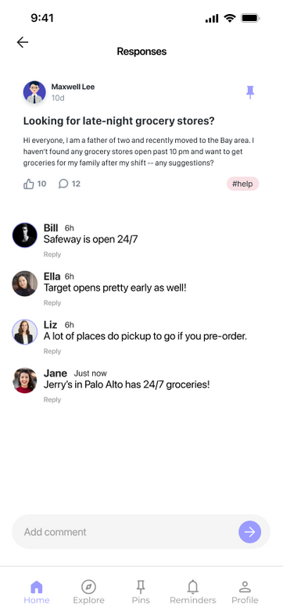
2. Moderate Task Flow
Sharing wisdom and contributing to a community forum

Slide 31
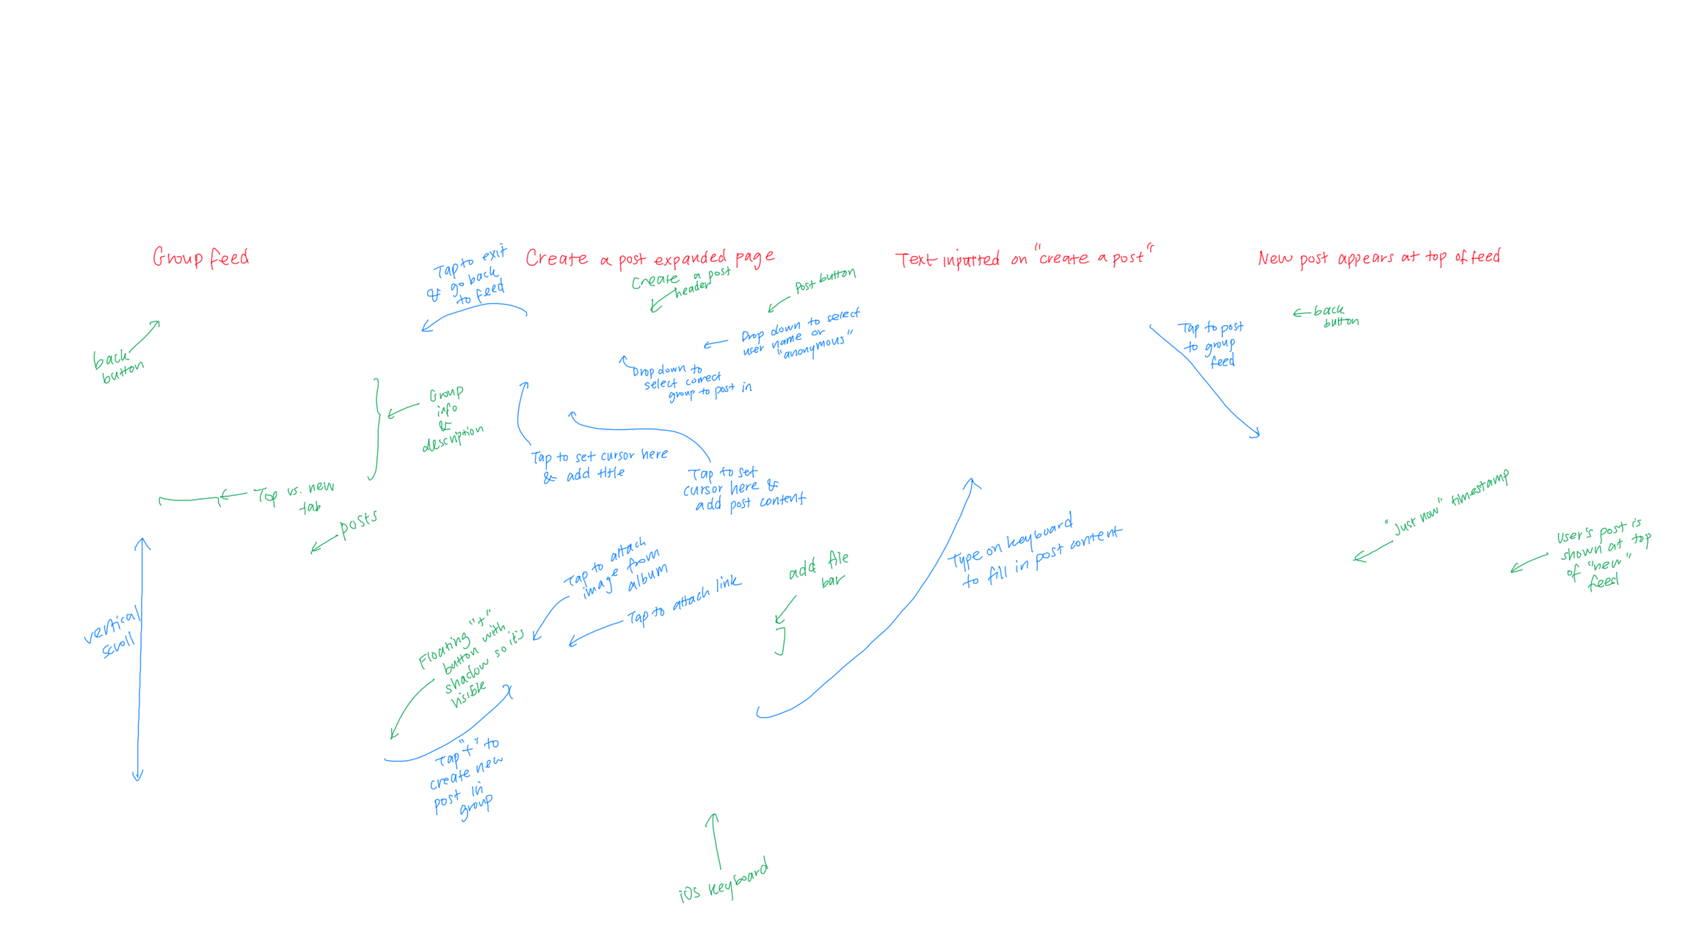
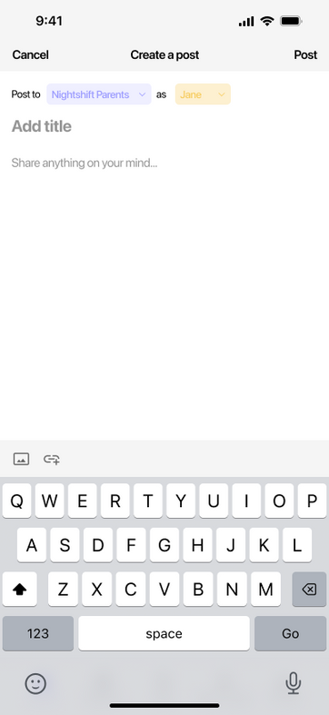
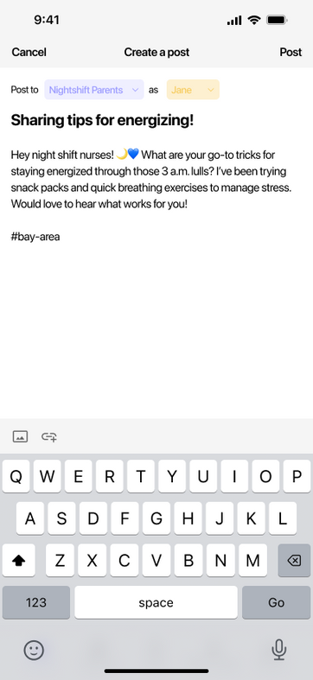

2. Moderate Task Flow
Sharing wisdom and contributing to a community forum

Slide 32
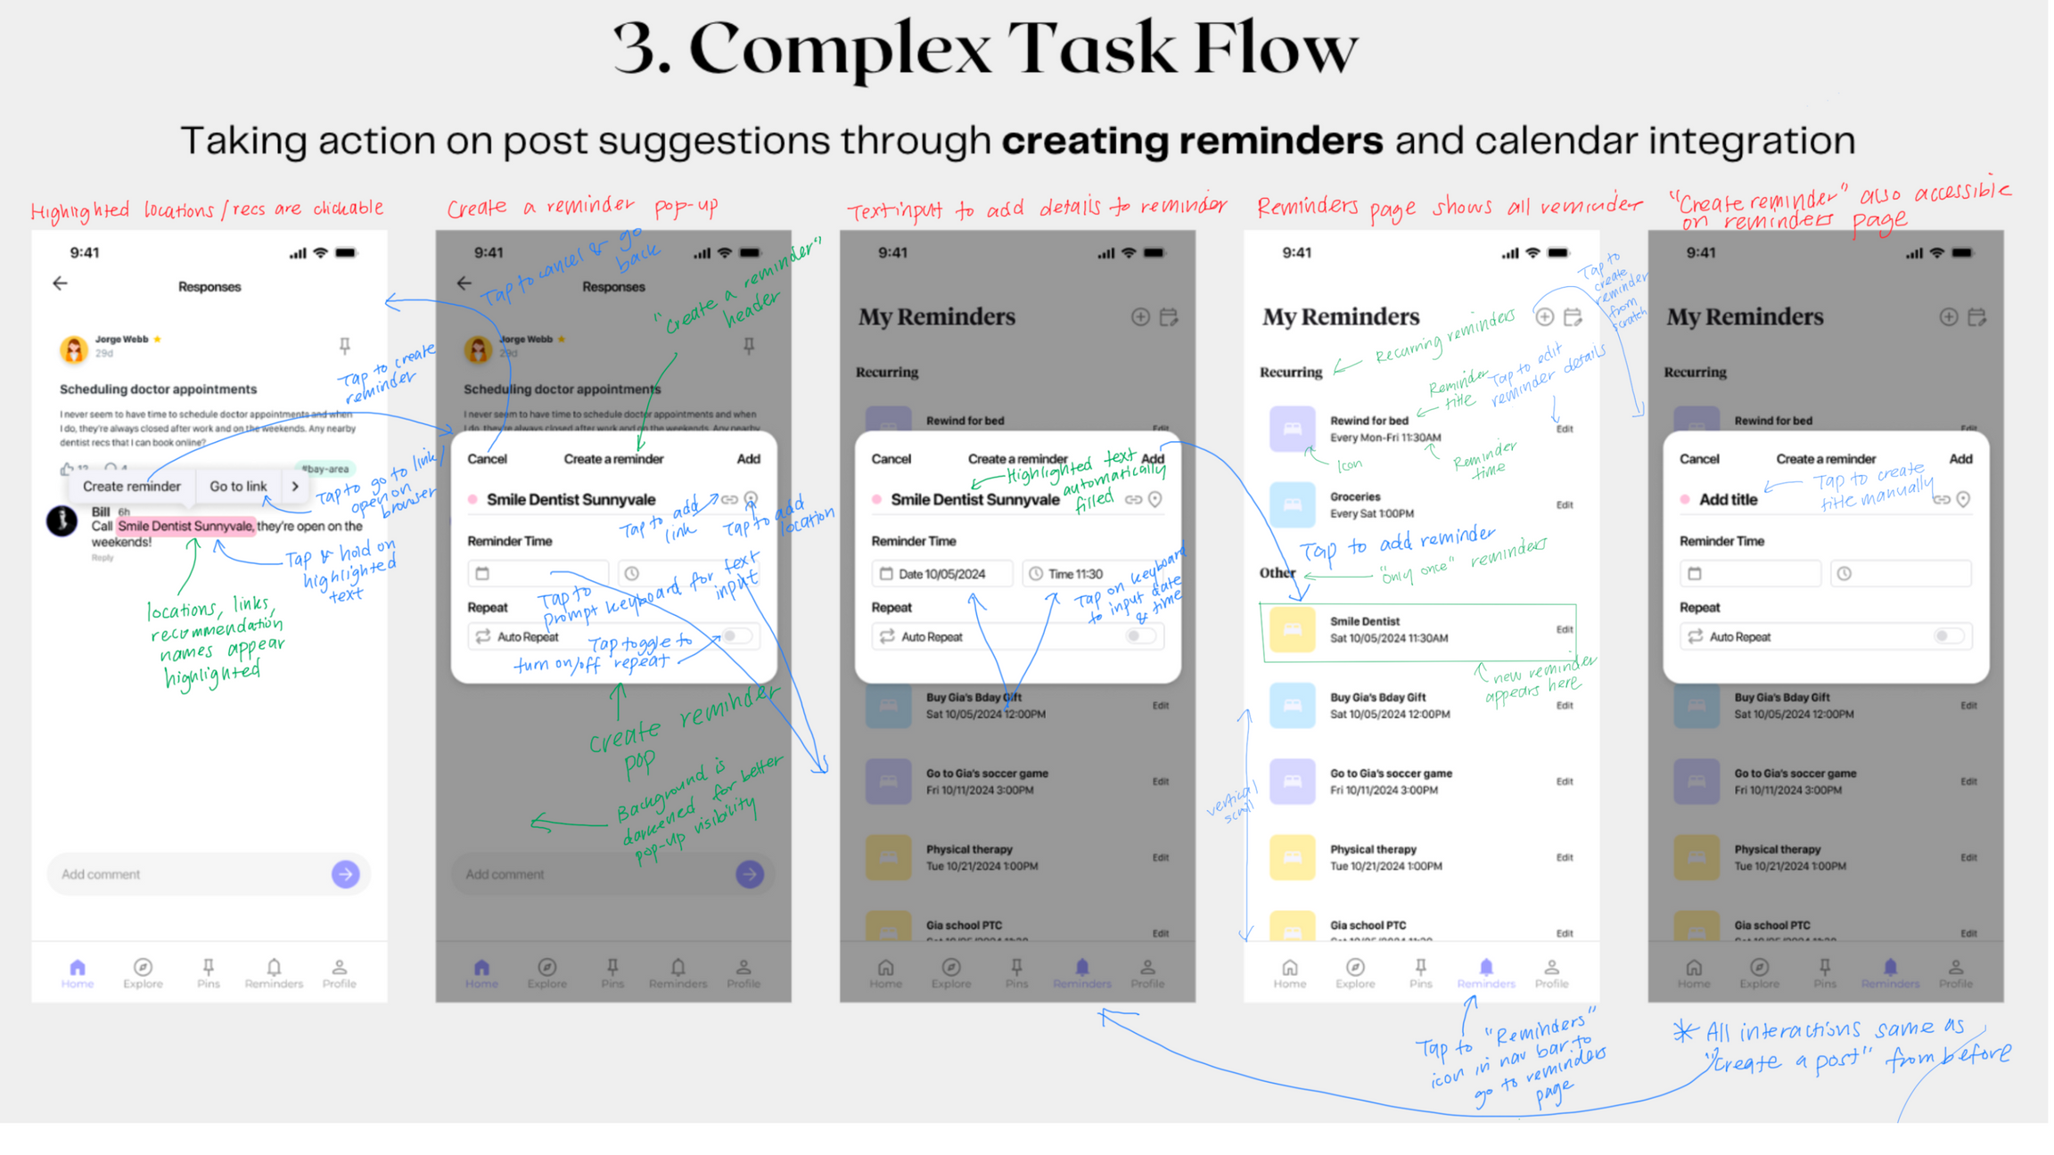
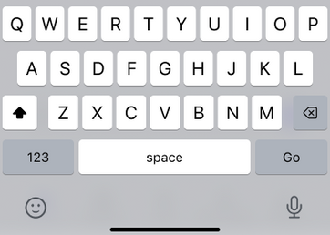
3. Complex Task Flow
Taking action on post suggestions through creating reminders and calendar integration

Slide 33
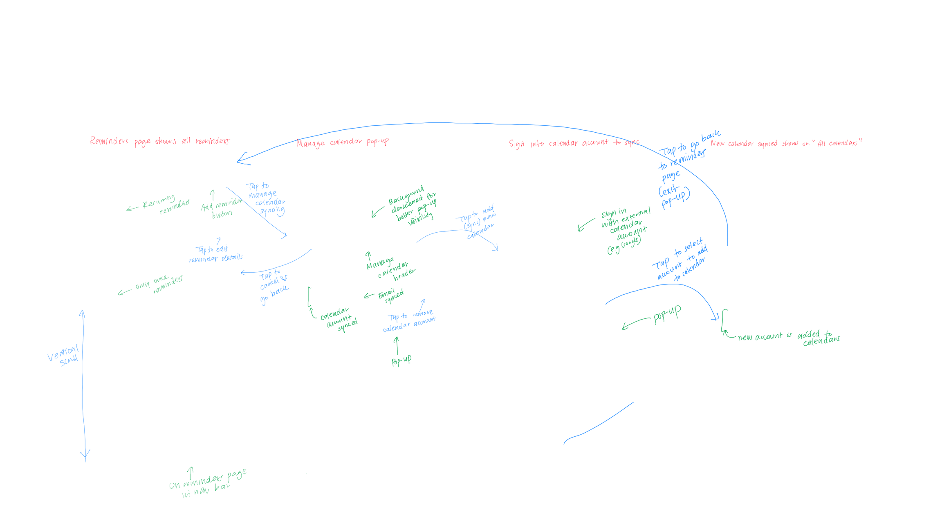
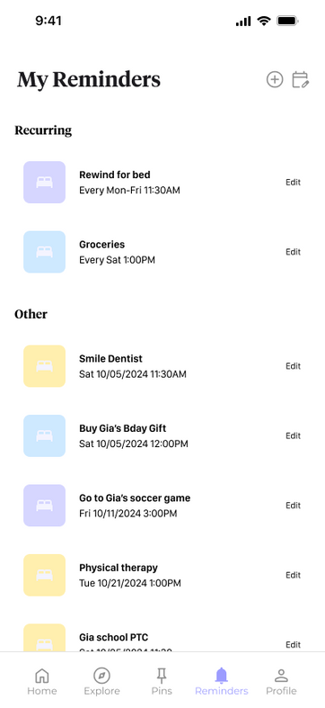
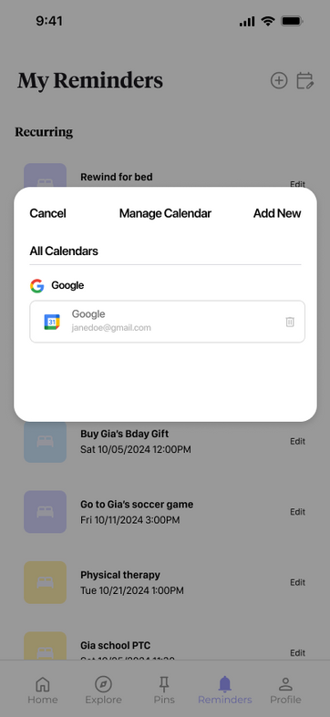
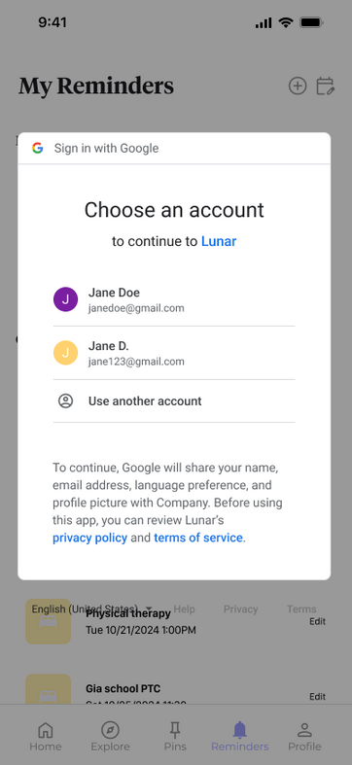
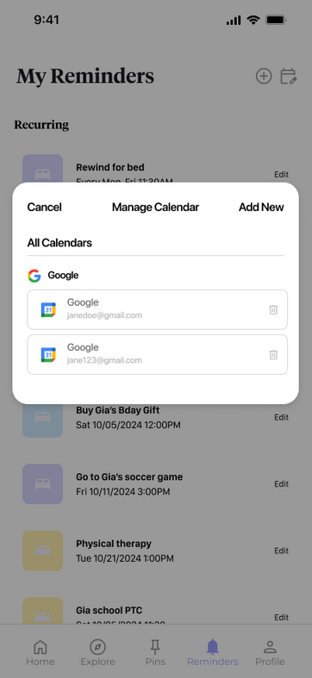
3. Complex Task Flow
Taking action on post suggestions through creating reminders and calendar integration

Slide 34
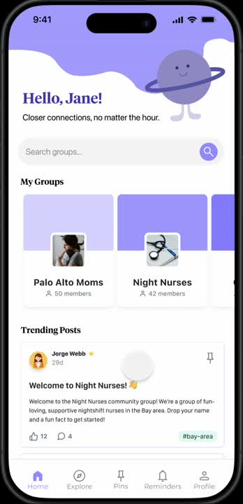
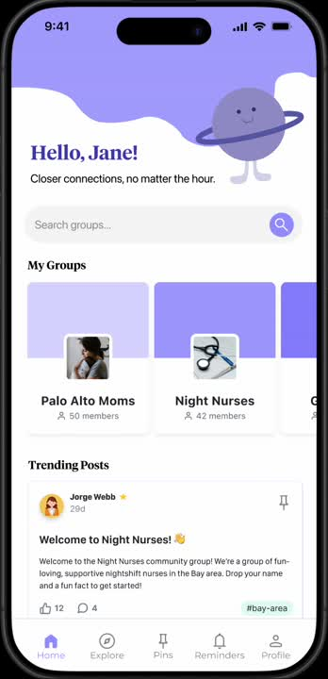
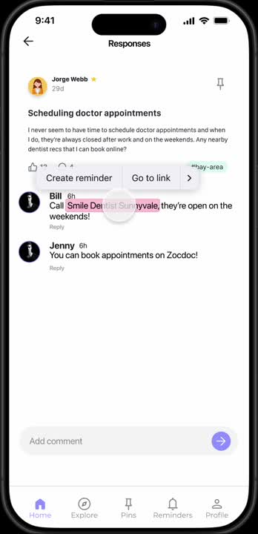
Link to Figma
Prototype Demos
Simple Task
Medium Task
Complex Task
Your paragraph text
Your paragraph text
https://youtube.com/shorts/nBzbqF9hrbg
https://youtube.com/shorts/I0_5Eh_MVfU
https://youtube.com/shorts/WKlfje3X_Jk

Slide 35
Prototype Implementation
6

Slide 36
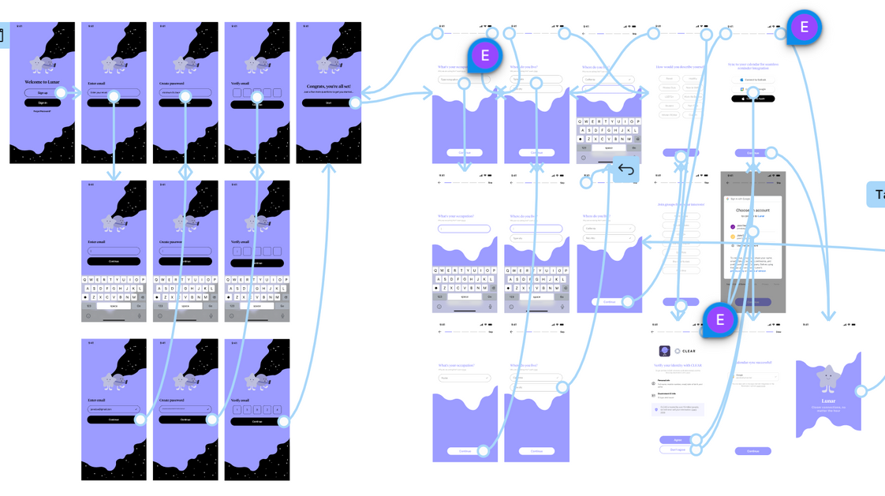
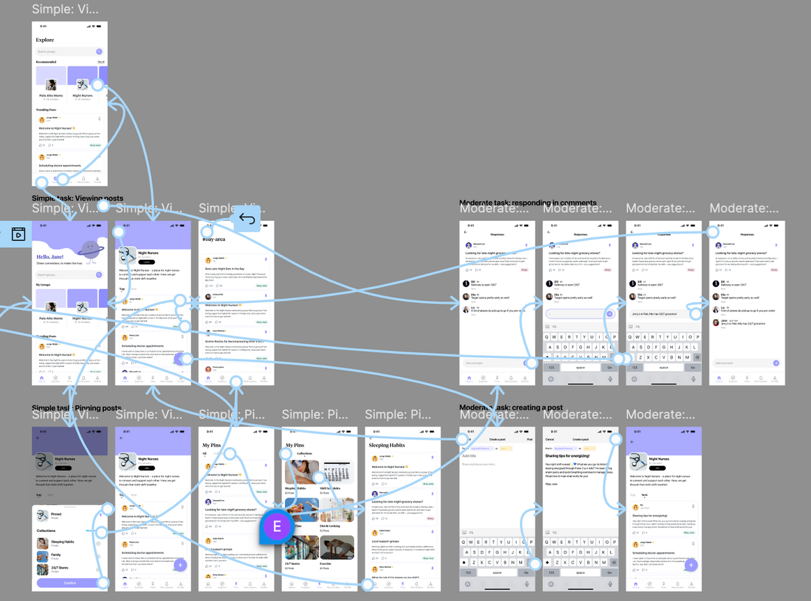
Selected Tool
We decided to use Figma as a tool due to the ease of collaboration and wireframing.
Pros:
Unified design system emphasizes consistency
Mimics coding structures through components, constraints, etc.
Cons:
Falls short when creating complex interactions
Potential problems when coding (ex. converting auto-layout to flex box)
Adobe Illustrator was used to develop some graphics and logos.

Slide 37


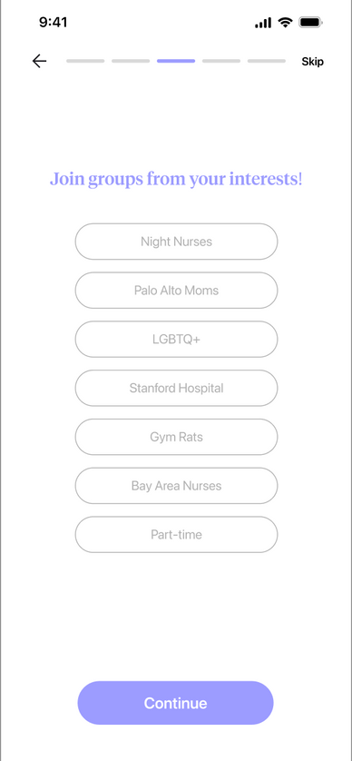
Limitations of Figma
Trending posts are not based on user recommendations. We can still test engagement even without full personalization.
Preventing expression of complex interactions
each interaction is limited to one action
limited animation (most could only do smart animation)
Requires extensive hard-coding, resulting in a lack of certain interactions, such as input typing
While some interactions are technically feasible, they necessitate considerable effort on the design end
Lack of integration of third-party apps (Google Calendar)
Recommended groups don’t actually correlate with their stated interests. It can still help to clarify what users expect from recommendations.
Wizard of Oz Techniques

Slide 38

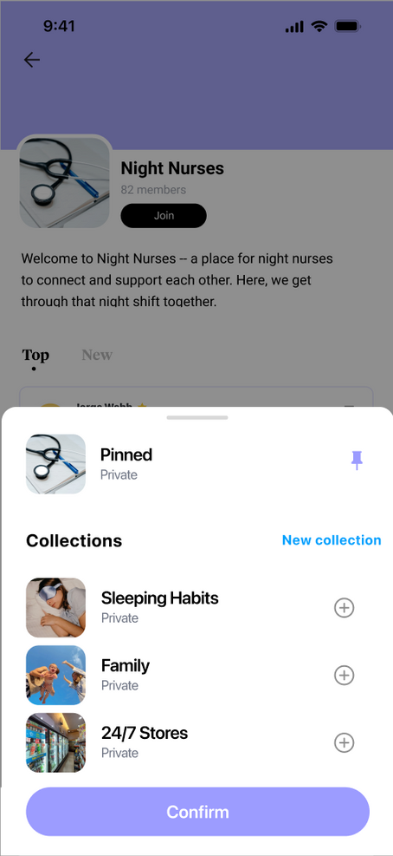
Hard-Coded Features
Users are restricted to predefined responses and cannot type desired input: forced choice experience
Any slide where it shows an updated post or comment is hard coded
When you pin a post, Figma prevents from having two actions— showing overlay, pinning—hence, requires hard coding to show both actions

Slide 39
Appendix
Figma prototype
Readme doc
Lunar Website
Additional Med-Fi Slides: Onboarding Flow

