Slide 1


CS 147 · Stanford University
Oct 25 2024
Low-Fi Prototyping
Evelyn Hur, Sejoon Chang, Sarah Yao, Christina Ba

Slide 2

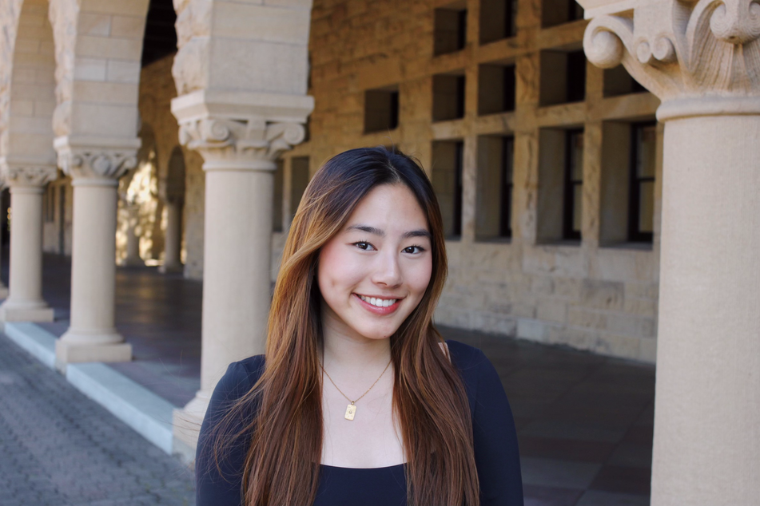
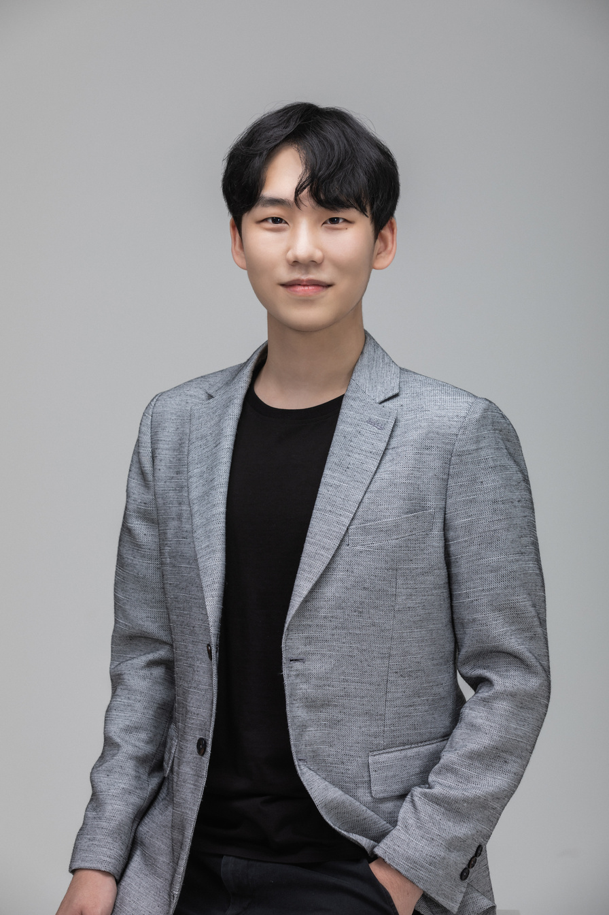

CS 147 · Stanford University
Oct 25 2024
Lunar
Closer connections, no matter the hour
Sarah Jade Yao
CS + PD ‘25
Christina Ba
CS + Art ‘26
Sejoon Chang
CS + PD ‘25
Evelyn Hur
CS + PD ‘25

Slide 3

Nightshift workers are often lonely, believe that work and personal life can’t go hand in hand, and that they have little to no time to care for connections with others
Final Solution
An online community of night shift workers with similar backgrounds, work schedules, situations etc. to share resources, tips, and support each other
Problem Statement

Slide 4

CS 147 · Stanford University
Oct 25 2024
Presentation Roadmap
1
2
3
4
5
6
Concept
Sketches
Selected
Solution
Task Flows
Low-Fi Prototype
Testing
Results +
Discussion

Slide 5
CS 147 · Stanford University
Oct 25 2024
Concept Sketches
1

Slide 6
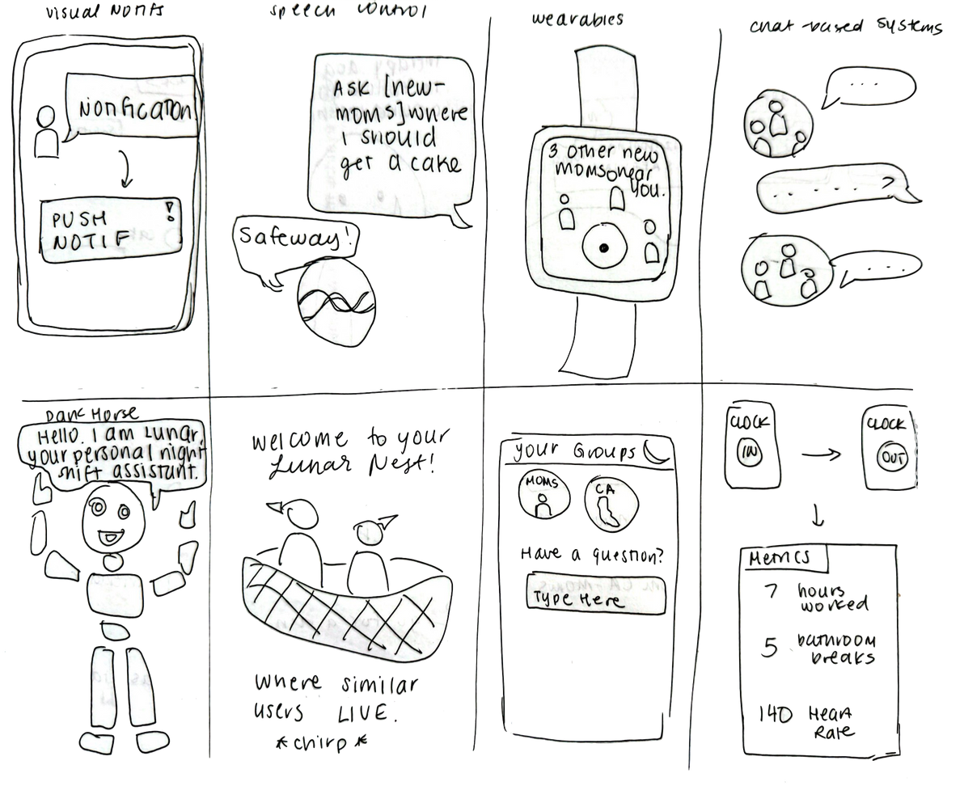
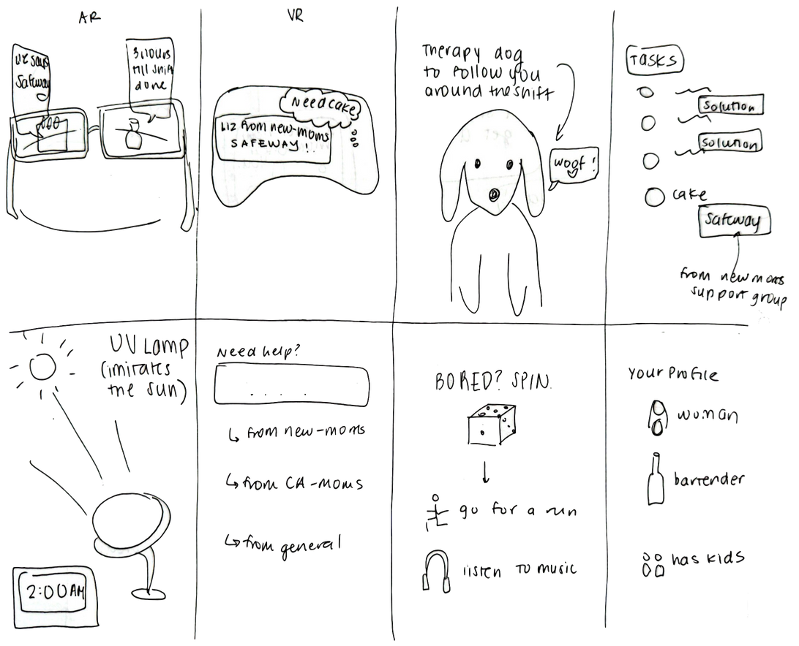
Concept Sketches

Slide 7
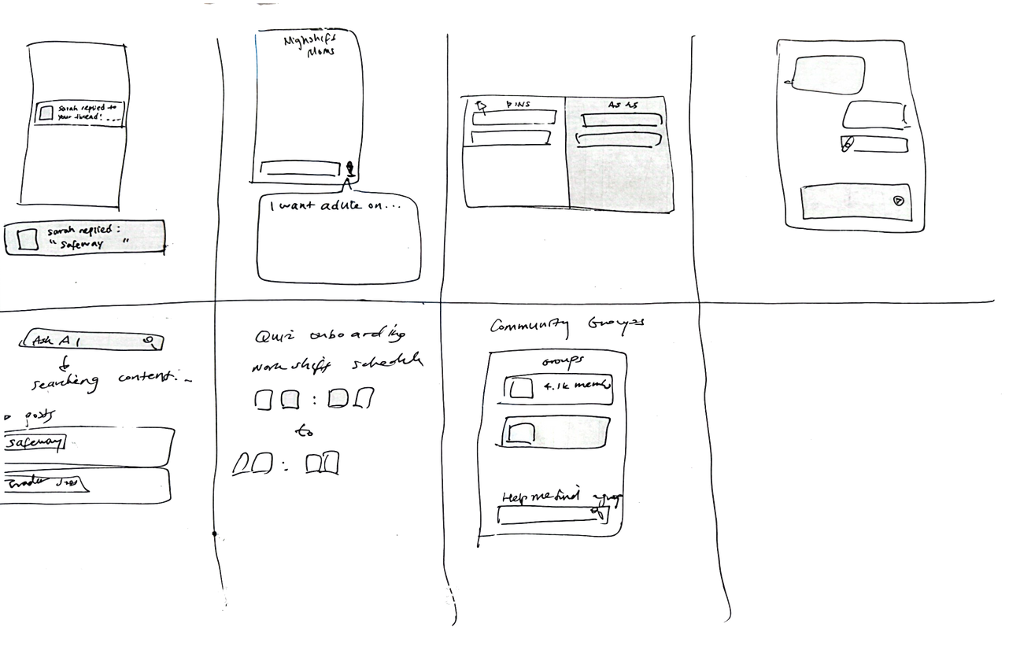
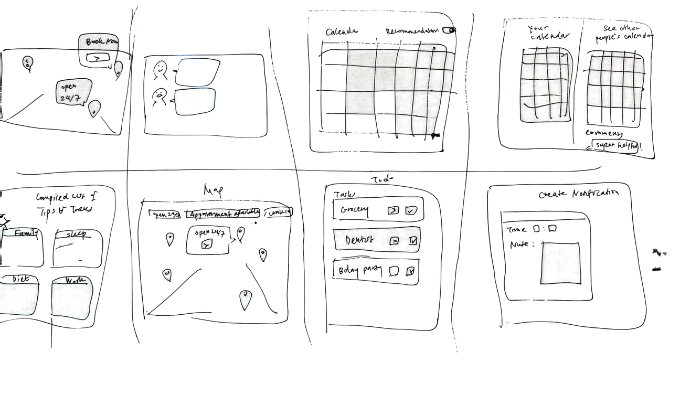
Concept Sketches

Slide 8
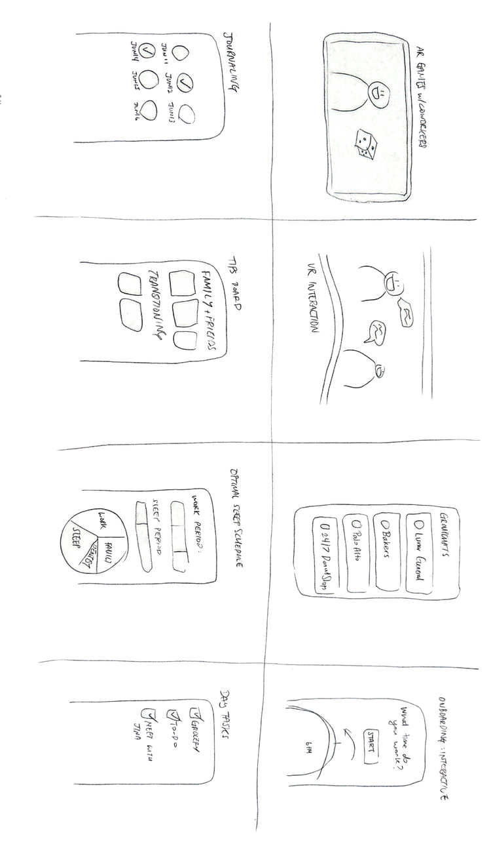
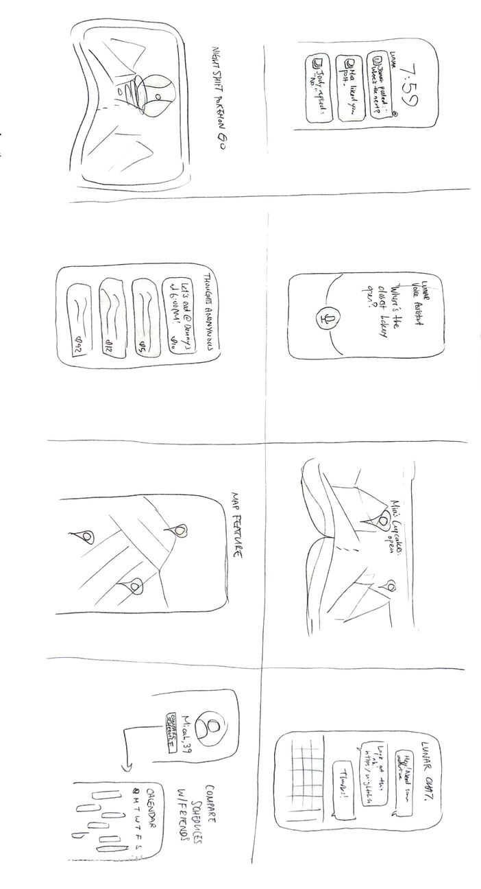
Concept Sketches

Slide 9
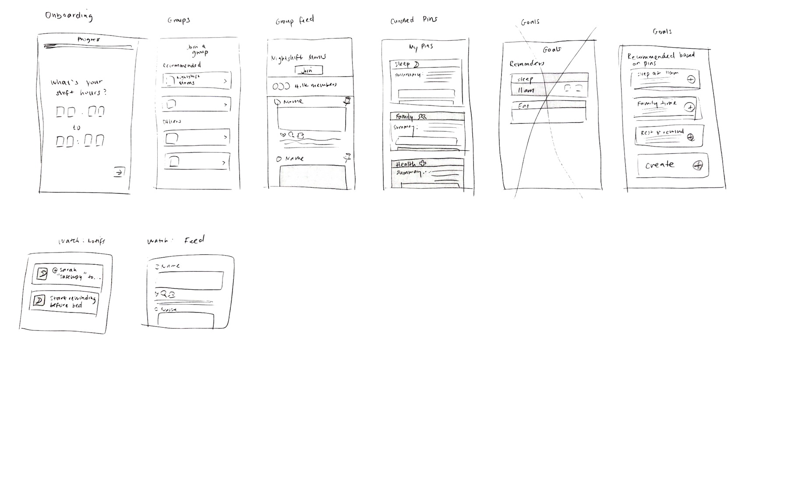
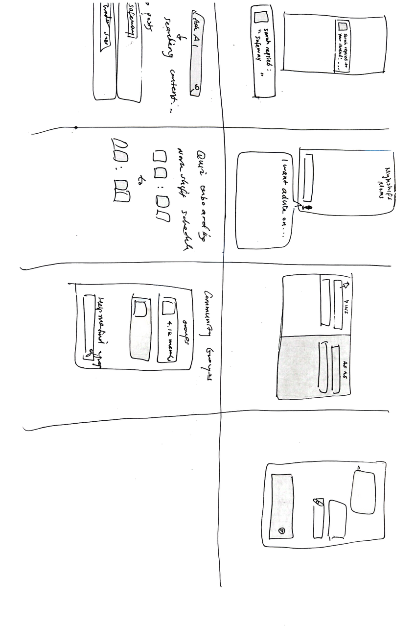
Final Realization Sketches

Slide 10
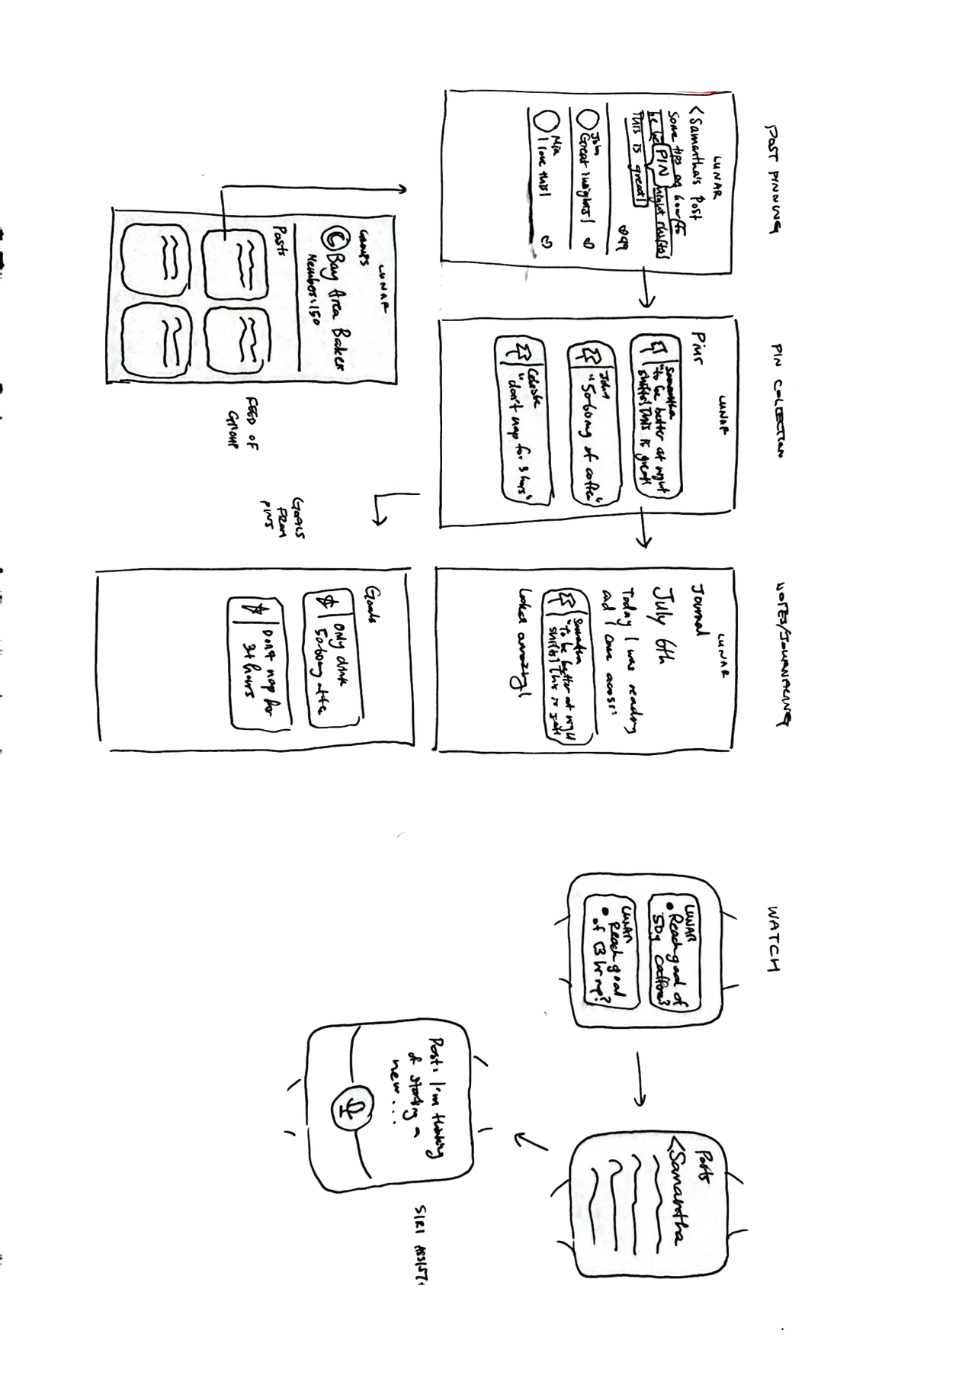
Final Realization Sketches

Slide 11
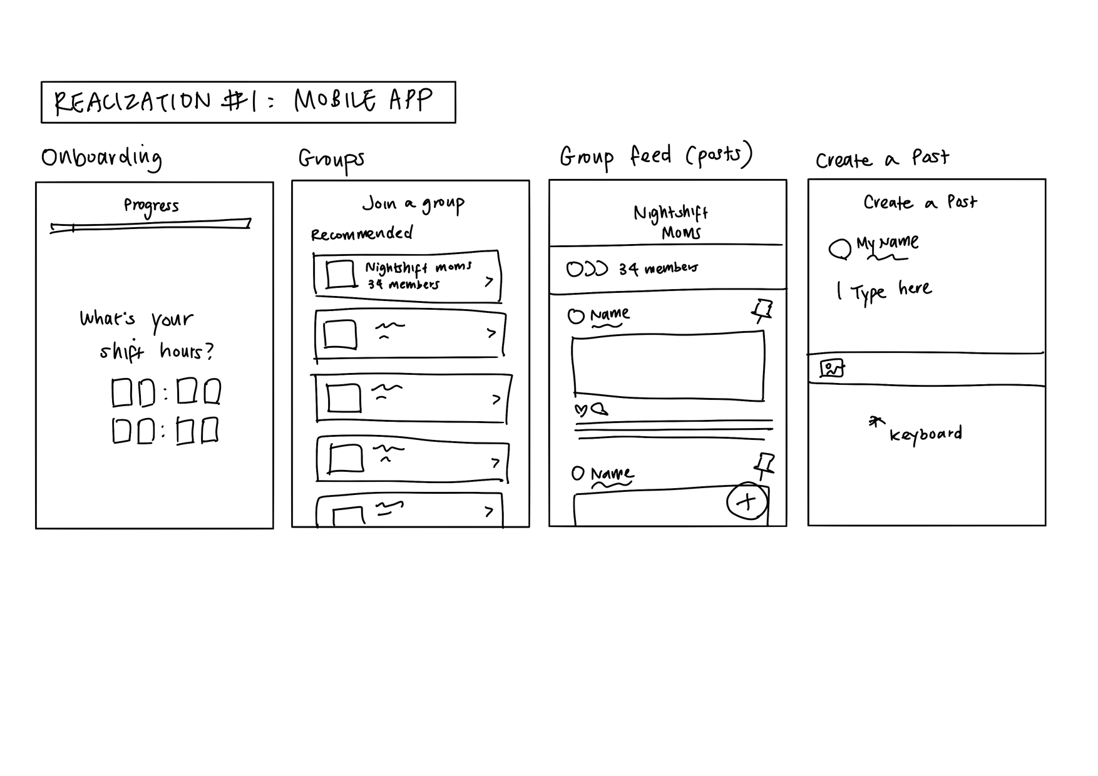
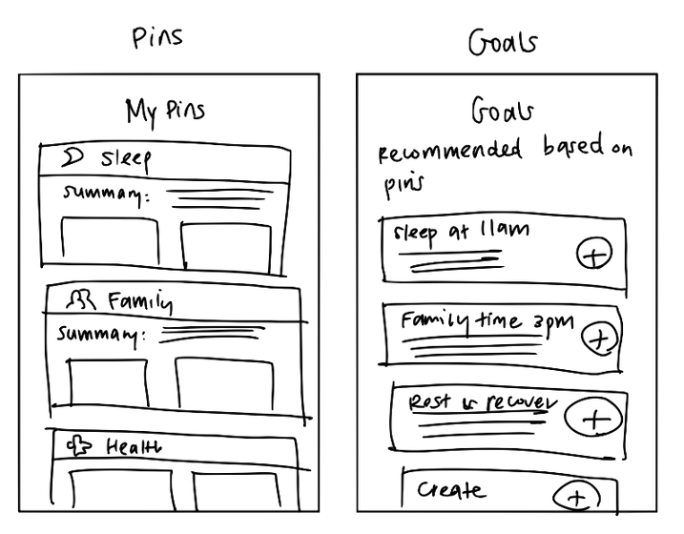
Realization #1: Mobile App

Slide 12
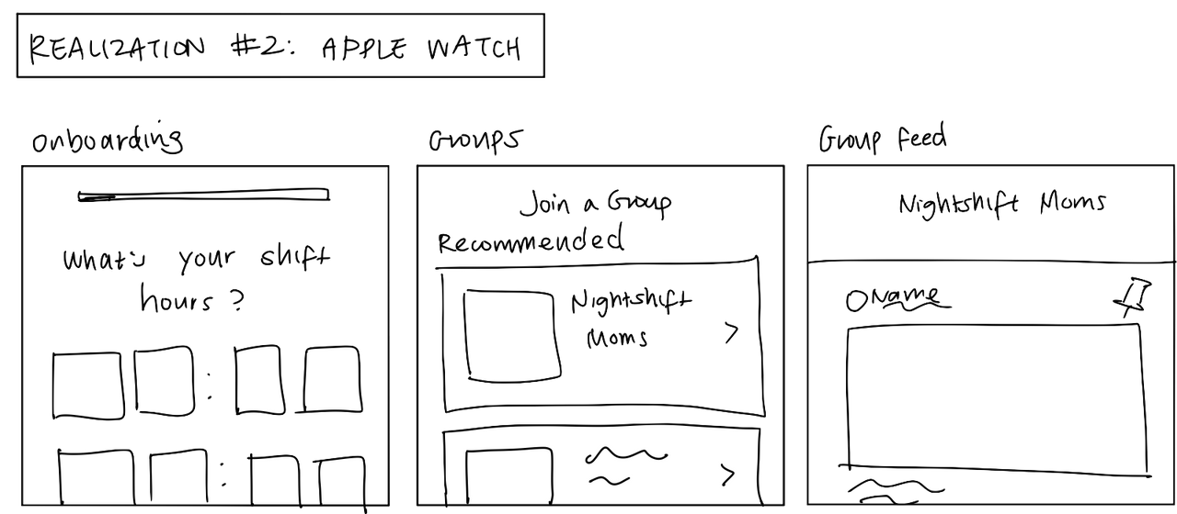
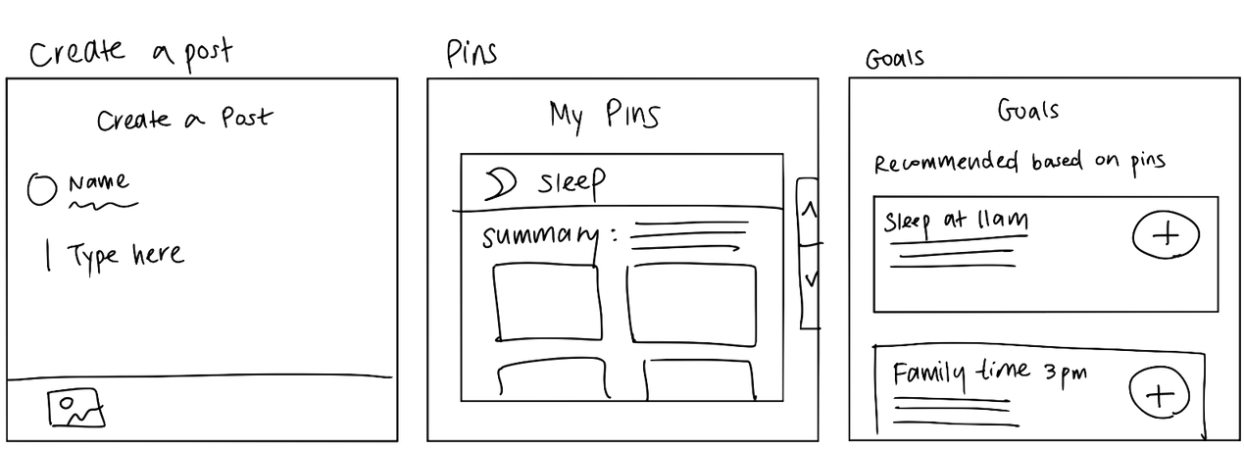
Realization #2: Apple Watch

Slide 13
CS 147 · Stanford University
Oct 25 2024
Selected Solution
2

Slide 14
Realization #1: Mobile App
Pros
Cons
Rich Information Density: Summaries, goals, and posts to be visible at once
Greater Flexibility: Larger screen offers more room for customization and more features (E.g. adding and editing pins, creating detailed posts)
Better User Input Capabilities: Typing is easier on a mobile app due to the presence of a full keyboard. This makes it ideal for detailed posts or more complex inputs
Enhanced Visualization: Pins, groups, and goals have ample space to showcase graphics, summaries, and more visual elements that help users process the information quickly.
Multi-Tasking Potential: Users can navigate between different parts of the app, such as onboarding, group feeds, and goals.
Bulkier Experience: The mobile app might require more time and attention from users, which can be less convenient during quick tasks or while multi-tasking (such as during a shift).
Battery and Storage Considerations: Constant interaction with a mobile app could drain battery life and require more storage, which may be a concern for users already juggling shift work.
Less Wearable and Accessible: Mobile phones are more cumbersome to access on the go compared to wearable devices like a watch.

Slide 15
Realization #2: Apple Watch
Pros
Cons
Quick Access: The Apple Watch interface allows users to quickly access important information (like group updates or shift hours) without having to pull out their phones, ideal for people on-the-go during night shifts.
Wearable Convenience: Since the watch is worn at all times, users can easily check notifications or reminders at a glance, increasing accessibility in a hands-free, mobile format.
Simplified Interface: The more compact UI ensures that only the most essential information is shown, reducing cognitive load, which is ideal for busy users.
Health and Fitness Integration: The Apple Watch’s focus on health-related features (like tracking heart rate, sleep, etc.) fits well with the nightshift workers’ health needs.
Limited Interaction and Input: Creating a post could be challenging on a small Apple Watch screen. It’s not ideal for tasks requiring more text or detailed input, such as writing group posts or summaries.
Reduced Content Visibility: Due to smaller screen size, users might need to scroll more to access information, limiting the amount of content that can be shown at once
Lack of Access: Not every night shift worker owns a smartwatch, and would be associated with night shift workers that have enough money to afford one
Dependency on Mobile for Complex Tasks: The watch interface might still require users to switch to their phone for more complex tasks, limiting the device’s overall usefulness in certain scenarios.

Slide 16

Why Mobile App?
More Information Displayed: Displays detailed summaries, multiple pins, and goals at once (less scrolling required)
Ease of Input (Typing): Full keyboard allows for easier creation of posts and interaction in groups.
Flexible Features: Better for navigating different sections and managing content.
Customization: Offers more options for personalizing the user experience.
In-Depth Use: Ideal for longer engagements and managing complex tasks.
Clear Visuals: Displays complex visuals and information clearly (e.g. screenshots of people’s calendar, websites linked from posts)
Mobile App
We chose to design a mobile app for our solution based on our user base’s needs and good design principles and practices

Slide 17
CS 147 · Stanford University
Oct 25 2024
Task Flows
3

Slide 18
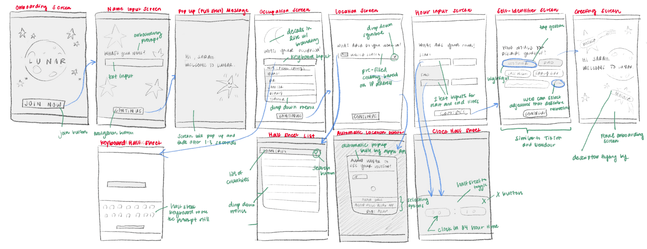
Simple Task
Viewing relevant community post groups and asking questions within them

Slide 19
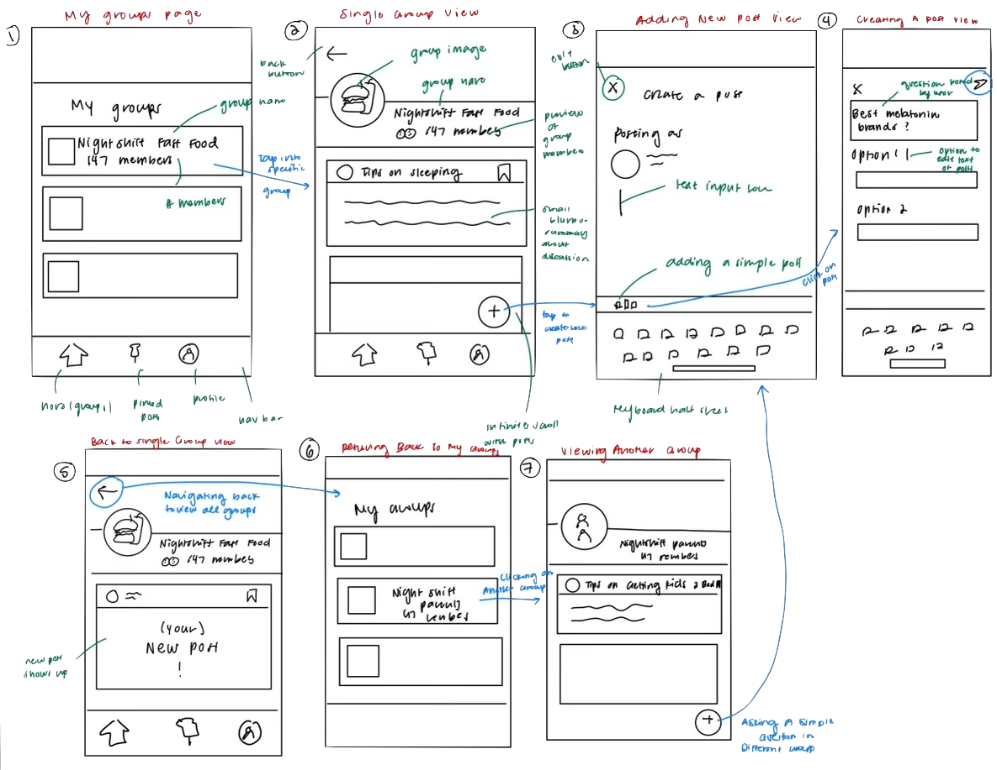
Simple Task
Viewing relevant community post groups and asking questions within them

Slide 20
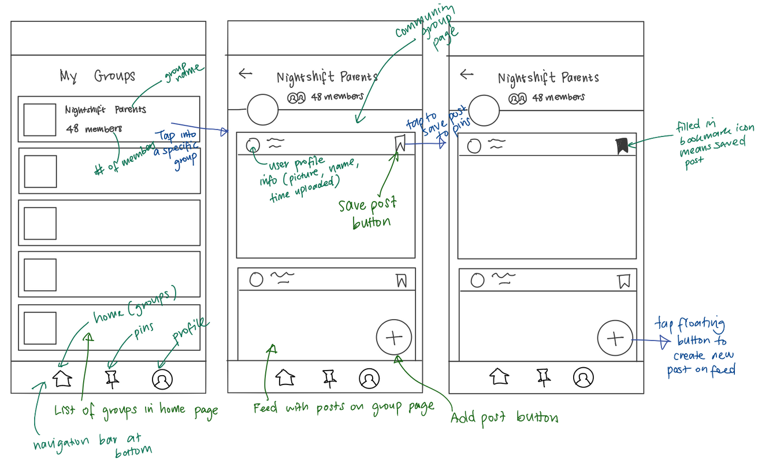
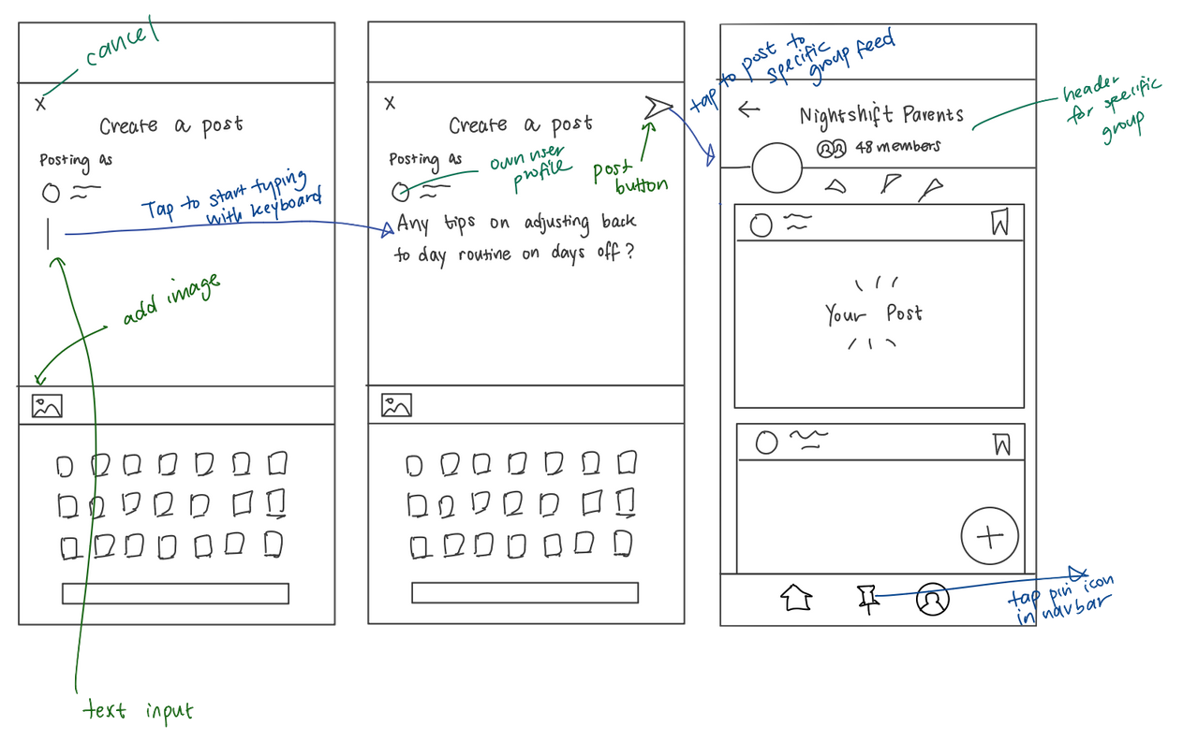
Moderate Task
Actively contributing to community forums and answering questions

Slide 21
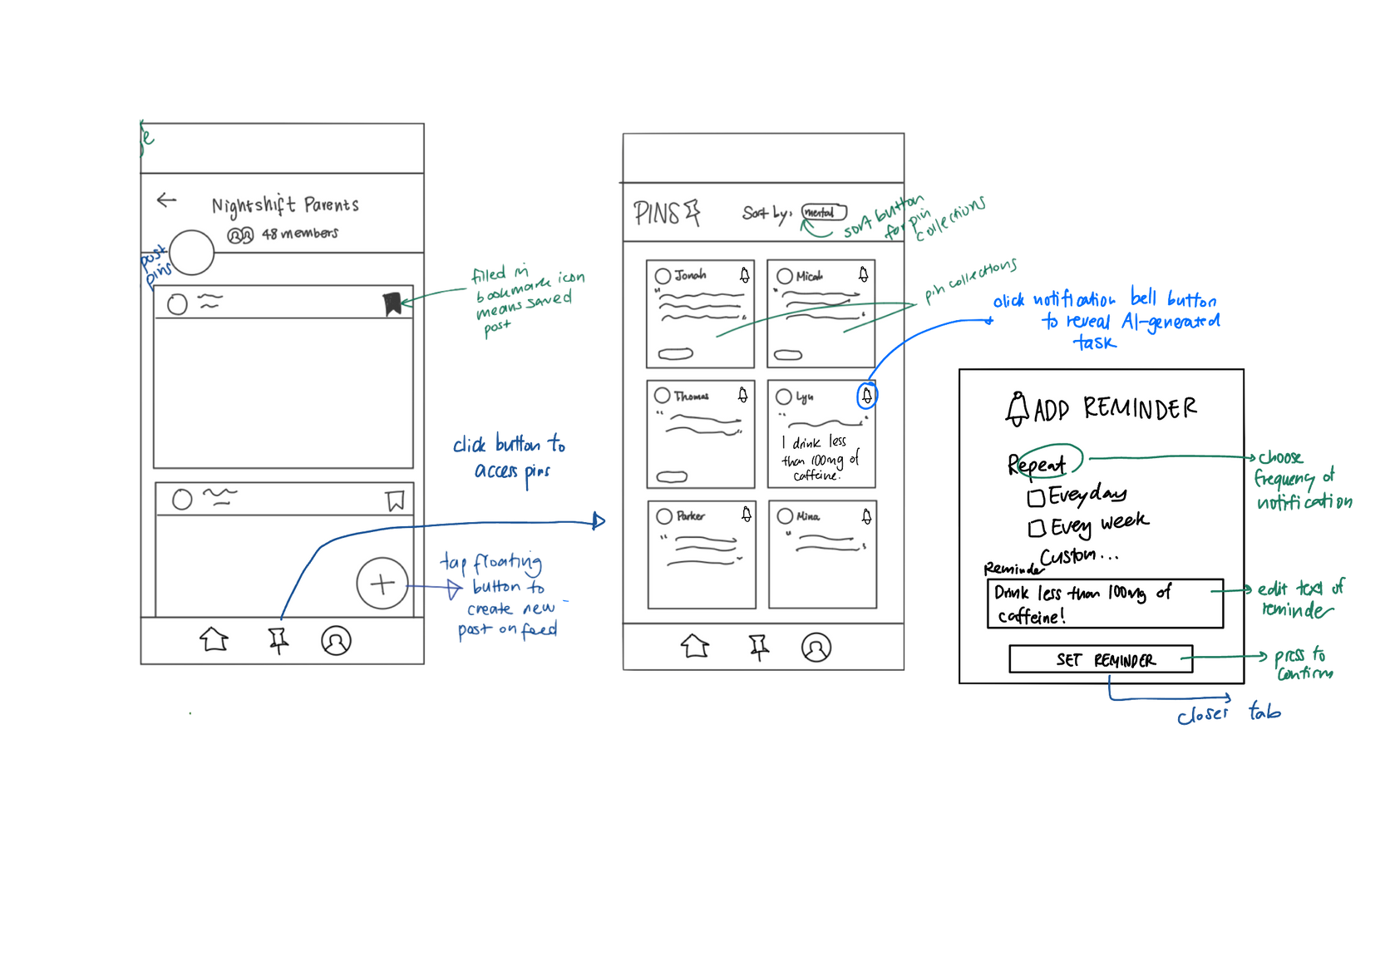
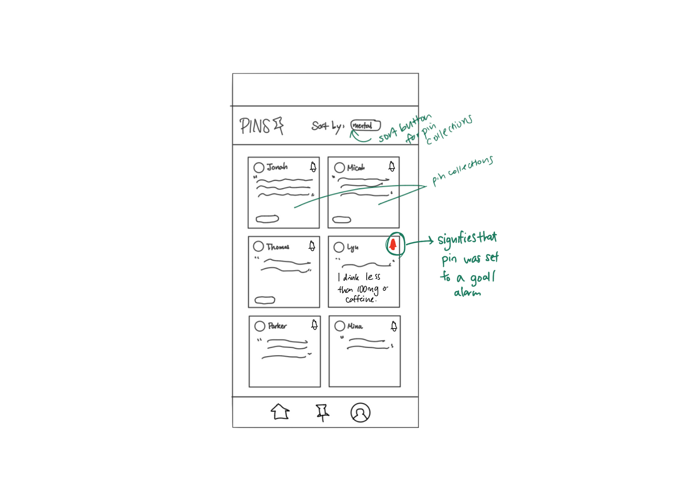
Complex Task
Taking action to book and pin specific tips (add to calendar, call service, etc)

Slide 22
CS 147 · Stanford University
Oct 25 2024
Low-Fi Prototype
4

Slide 23
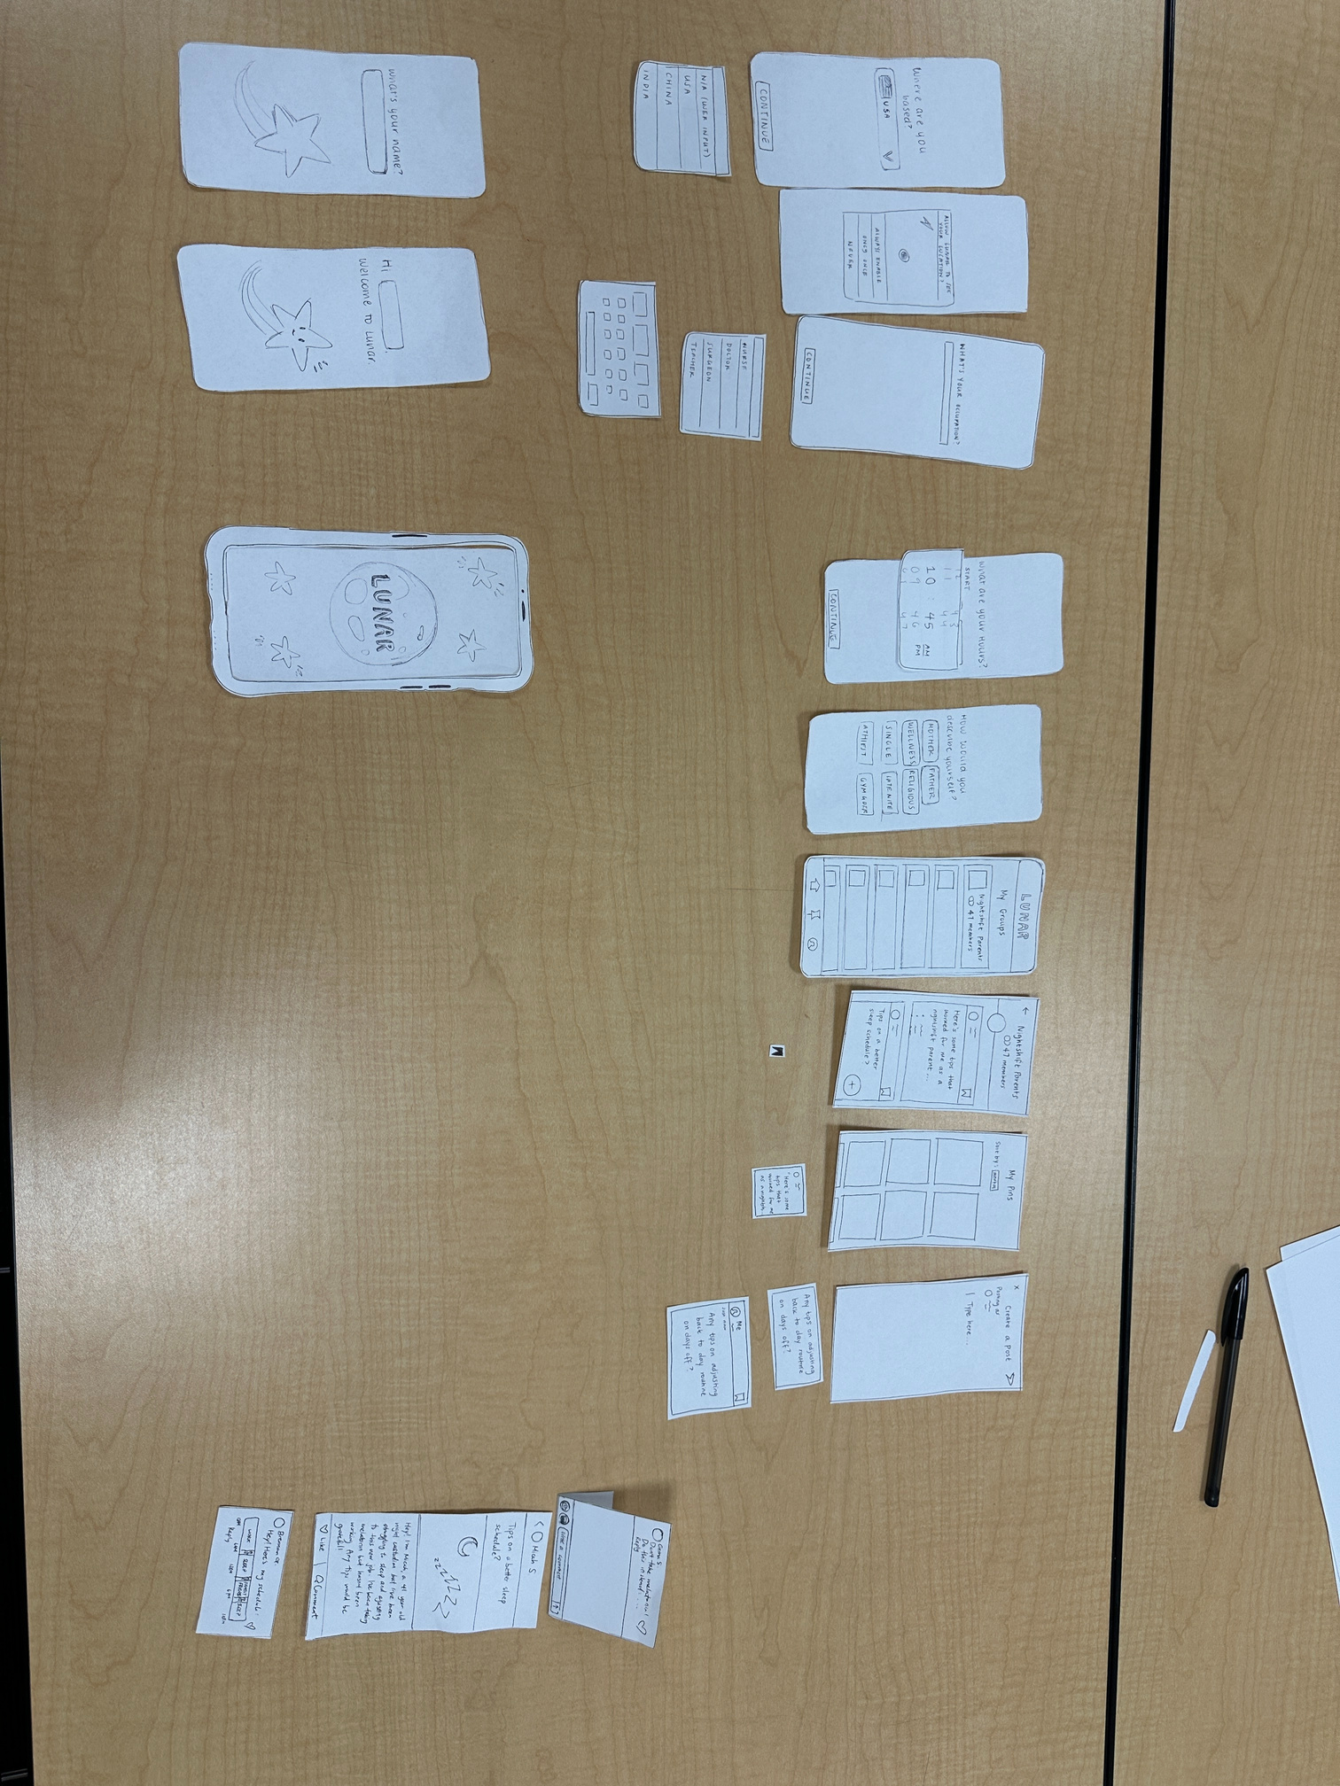
CS 147 · Stanford University
Oct 25 2024

Slide 24
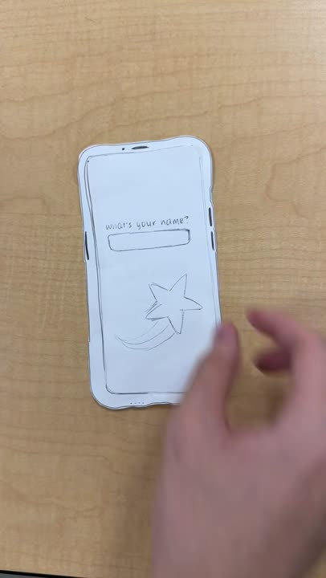
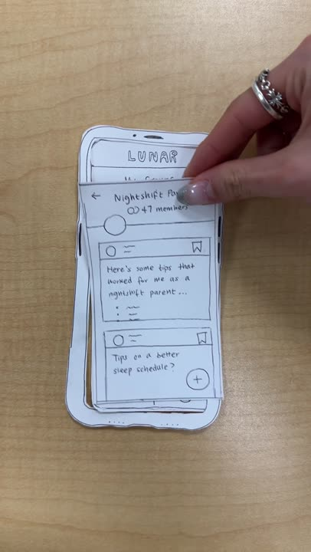
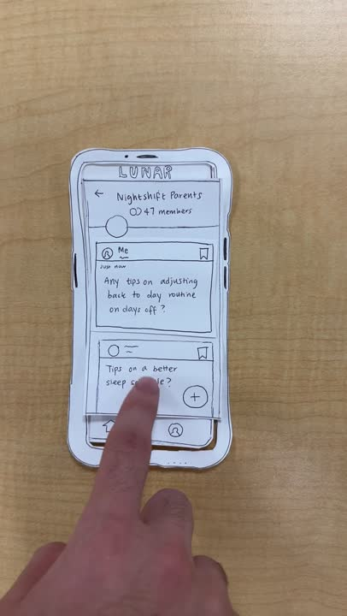
CS 147 · Stanford University
Oct 25 2024

Slide 25
CS 147 · Stanford University
Oct 25 2024
Prototype Tests
5

Slide 26
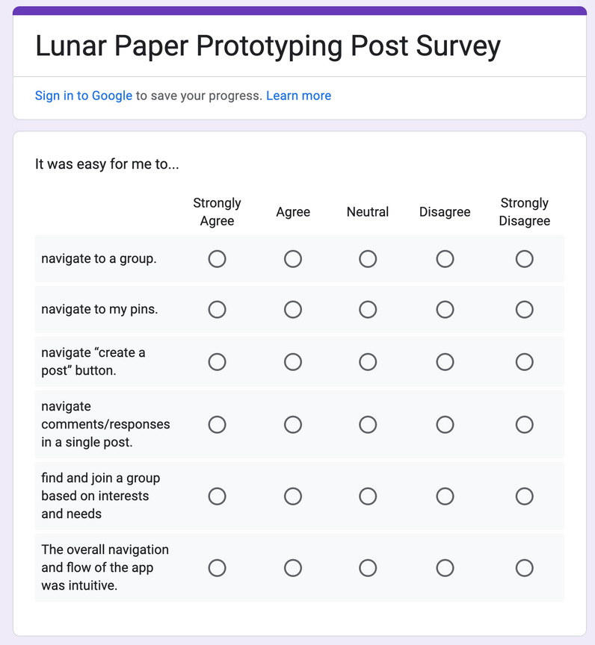
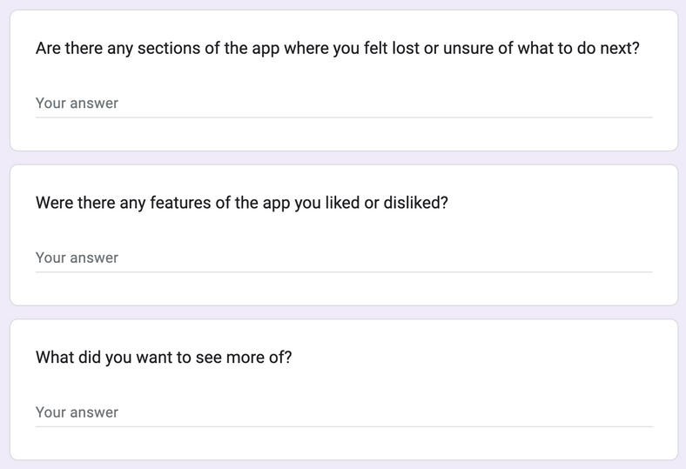

Pre-Testing Preparation
Usability Goals
1. Efficient App Navigation: Used objective metrics on time it took to complete each task, and subjective metrics on how easy they thought the navigation was
2. Commission of Fewer Errors: Used objective metrics on number of errors
3. Greater Pleasure or Satisfaction: Used subjective metrics through survey responses and conversation
Script and Test Log
Wrote script for test procedure, facilitator and notetaker role (took turns), overviewed each task and emphasized talking out loud (on-site)
Noted each critical incident, divided them into a scale of 0-4 depending on severity
*full details in appendix

Slide 27
Pre-Testing Preparation
Testing Roles
Notetaker
Facilitator
Computer/
Notetaker
Facilitator

Slide 28
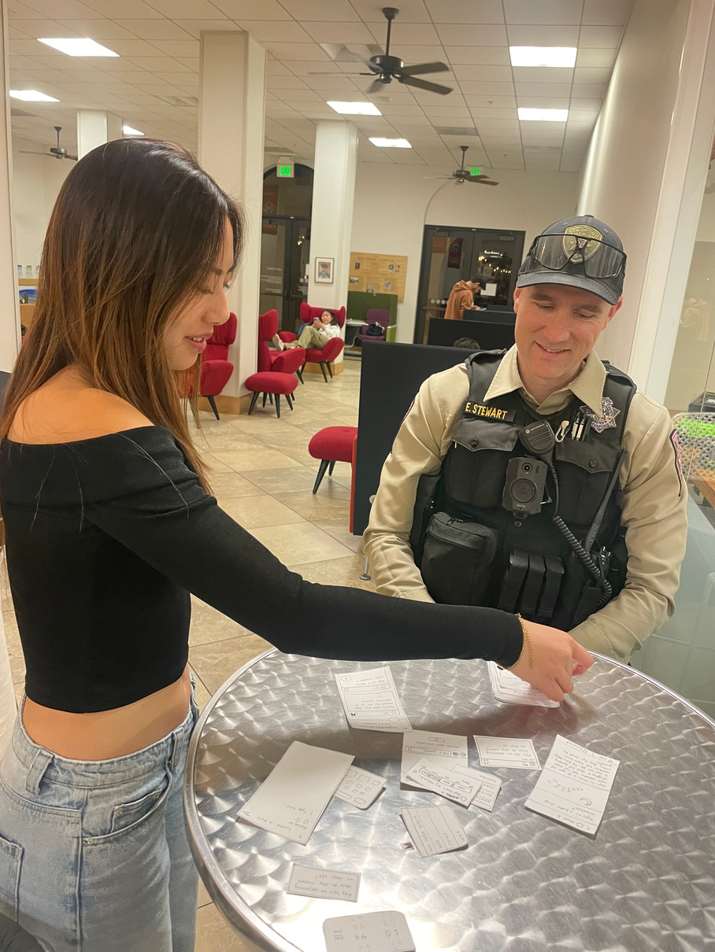
Deputy Emerson
Stanford Police Department Deputy Sheriff
Test Log Summary
General user flow, intuition of buttons to press to navigate
Suggested integration with smart watch
Selected “never” to share location
0
1
2
3
4
Sometimes clicked back to main page, when direct navigation was possible
“USA” location was already populated but was prompted again
Options for self-classification didn’t really apply to him
Would prefer not to have to scroll through every post (upvote feature)
“Posting schedule” auto generated the rest of his schedule without prompt
Unsure of how often he’d refer back to the app after initial knowledge gain
Critical user base difference: those seeking community, those seeking tips
Unsure how to narrow down group assignments without too much onboarding friction
Fundamentally “not an app person”. Would use reminder integrations (e.g. with smartwatch) more

Slide 29
Deputy Emerson
Stanford Police Department Deputy Sheriff
Objective Metrics
Subjective Metrics + Summary
Simple Task
Task Time: 1:16 (low)
Number of errors: 1 (low)
Moderate Task
Task Time: 1:10 (avg)
Number of errors: 2 (avg)
Complex Task
Task Time: 0:48 (avg)
Number of errors: 3 (high)
Thought UI flow generally made sense, had no trouble navigating to pages based on icon representations
Was confused on some integrated posting features: for example, uploading a schedule didn’t prompt him to input his entire schedule outside of work hours
Thought having to scroll past every post chronologically was tiresome: would prefer some crowdsourcing upvoting method
Identified different applications of the app: he personally wouldn’t use it that much, but lonely night-shifters in isolation might
Fundamentally not an app person. Would like to see it more integrated into his existing workflow.
*See appendix for full details

Slide 30
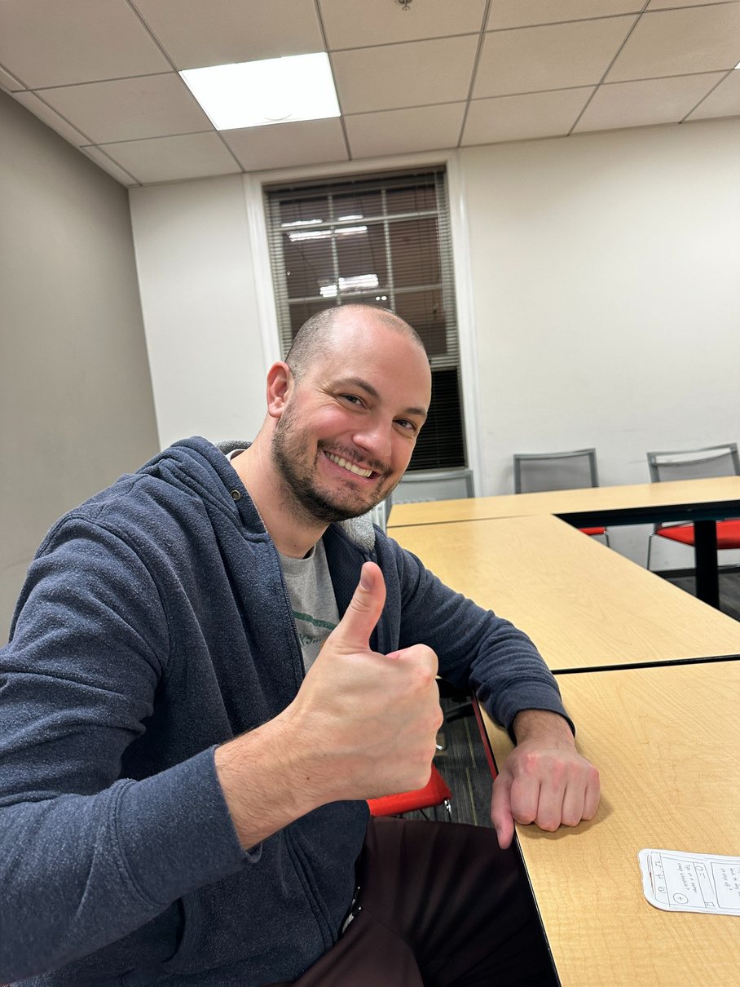
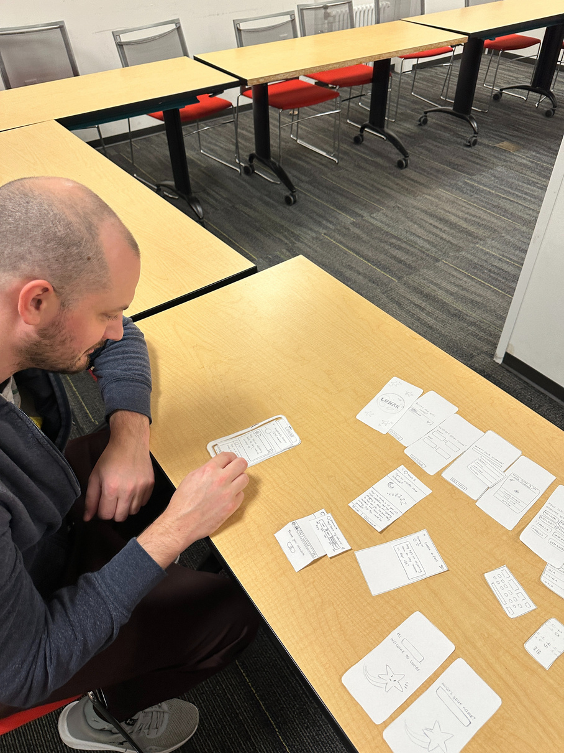
Dr. James
Stanford Hospital Physician
Test Log Summary
Flow of onboarding / getting started with app was easy and intuitive
Navigating group feed (similar to platforms like Reddit)
Create a post
Scrolling to see additional information, more posts etc.
0
1
2
3
4
Navigating to different screens in navigation tab (took a second to find pins)
Selecting different interest groups to join
Commenting/replying to a posts
N/A
Was expecting a back button but couldn’t find one (had to use navigation tab to switch screens instead)
Unsure of where to find “share calendar” button and what this would upload (screenshot, google calendar sync? etc)

Slide 31
Dr. James
Stanford Hospital Physician
Objective Metrics
Subjective Metrics + Summary
Onboarding (answering basic background questions) was straightforward and intuitive
Navigating feed and posts on community groups felt familiar (user was familiar with similar community platforms like Reddit)
Took a second to find “pins” screen in navigation tab. Wished there was a back button instead of only using navigation tab
Would like pins to be organized/sorted into customizable collections or boards so it’s easier to later search for them
Creating a post felt intuitive and familiar
Confused about where to find, use case, and media type for the “share calendar” button feature (screenshot, google calendar sync? etc)
Simple Task
Task Time: 1:42 (avg)
Number of errors: 0 (low)
Moderate Task
Task Time: 1:20 (low)
Number of errors: 2 (low)
Complex Task
Task Time: 0:47 (avg)
Number of errors: 3 (high)
*See appendix for full details

Slide 32
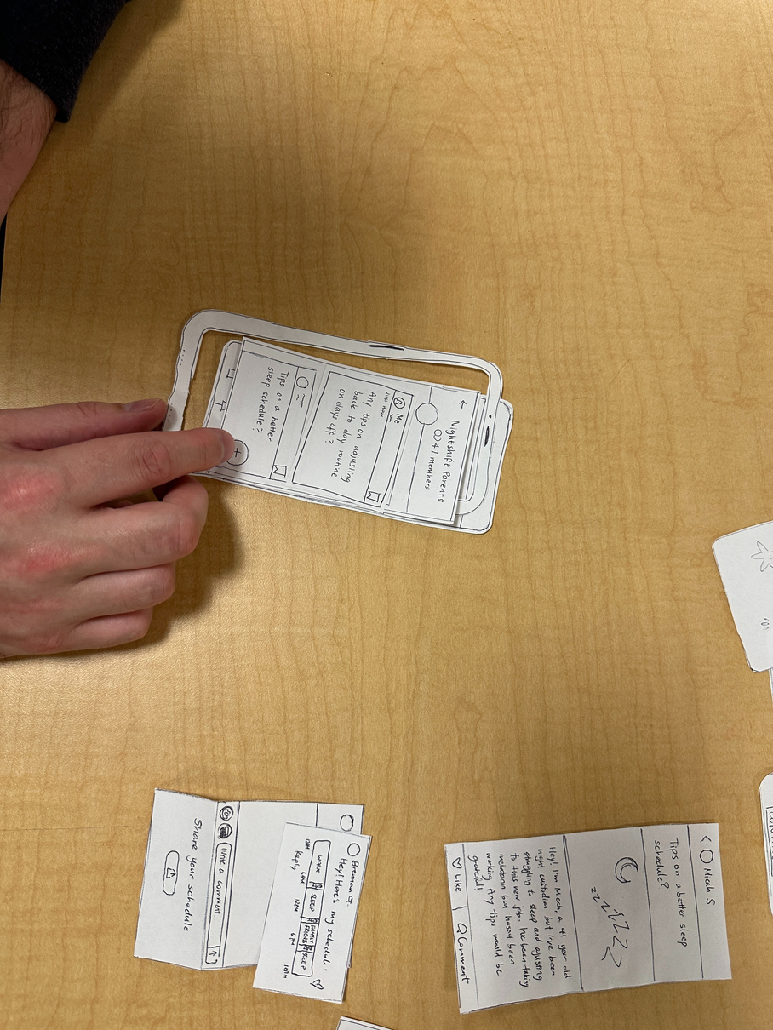
Steven
Worked Previous Night Tutoring Shifts
Test Log Summary
0
1
2
3
4
Liked the design and thought that it was in line with the product
Expressed enthusiasm at the benefit for the users, especailly for users who were working full-time
Got confused as to why it was important to list their occupation
Flagging when you’re on a post and clicking and reading it
Generally understood the flow of the onboarding process though recognized that the steps seemed arduous and unnecessary
Found that longer onboarding created friction
Took a while to navigate to the “saved” pins section as the emblems were different
Plus looks like its adding to a specific post versus putting it on the home page

Slide 33
Steven
Worked Previous Night Tutoring Shifts
Objective Metrics
Subjective Metrics + Summary
Simple Task
Task Time: 1:21 (low)
Number of errors: 1 (low)
Moderate Task
Task Time: 1:10 (avg)
Number of errors: 1 (low)
Complex Task
Task Time: 0:42 (avg)
Number of errors: 3 (high)
Thought there was too much friction in the onboarding process, though the design was aligned well with product
Thought that prompt to list occupation had no clear motivation in onboarding
Was confused why the pin and the flag were different emblems if they represented the same function
Thought that users should be able to flag posts while navigating through a specific post
Was confused about the “+” button and its functionality (whether it was adding a new post or adding to the existing post that the user was looking at)
*See appendix for full details

Slide 34
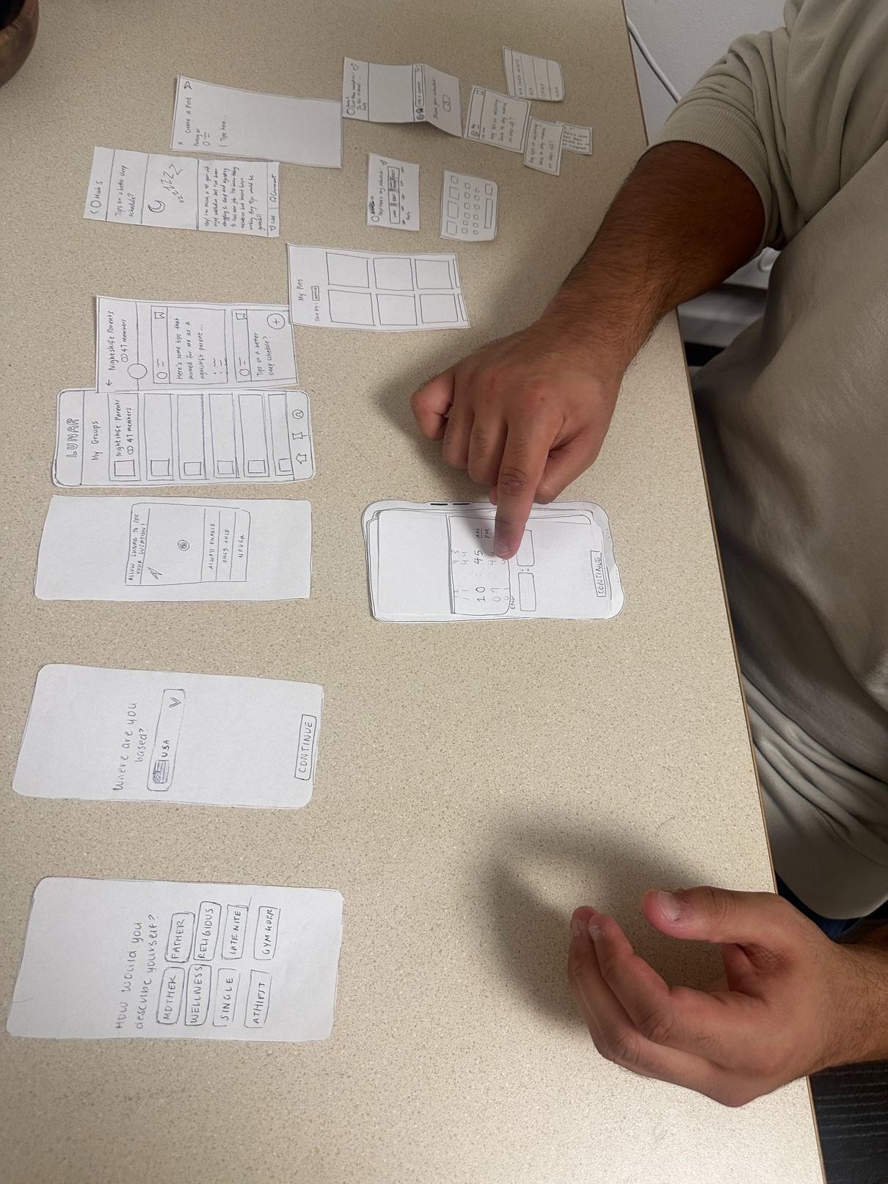
Rahul
RD&E Night Shift Worker
Test Log Summary
0
1
2
3
4
Quickly found essential features, such as pinning/saving
Smooth and streamlined onboarding process, intuitively knew whether to select vs. type
No button to post when finished writing out the text
Asked if he could post to multiple groups, and do it anonymously
Wanted more options more classification, or an “other” section
Tried to filter/search to see posts (like the pin filter), but couldn’t
Adding the reminder was not as intuitive, such as selecting the time (thought something could’ve been better than a checkbox)
Had trouble figuring out how to edit the reminder
Asked “is there a place where I can see all the reminders?”
He couldn’t find how to add a reminder for quite a while, said the button was too small

Slide 35
Rahul
RD&E Night Shift Worker
Objective Metrics
Subjective Metrics + Summary
Simple Task
Task Time: 1:34 (low)
Number of errors: 1 (low)
Moderate Task
Task Time: 1:42 (avg)
Number of errors: 4 (high)
Complex Task
Task Time: 1:40 (avg)
Number of errors: 3 (high)
Thought the interface was easy and quick to navigate
Several confusing buttons such as the pin/save (obvious yet confusing) and the reminder
Rated strongly agree or agree for most of the survey responses (except for adding a reminder), found it easy to use
Had some stronger opinions regarding some of the features he wanted to see:
Wanted an anonymous feature because sometimes he wants to “rant” about his work and find support
Potentially a way to verify to prevent trolls
Wanted a feature where he can ask people for help (ex. set up a dentist appointment)
*See appendix for full details

Slide 36
CS 147 · Stanford University
Oct 25 2024
Discussion
6

Slide 37
Implications
Lunar would be most helpful for those newly transitioning to night shifts or isolated workers looking for community. For night-shifters outside of these categories, it may not be as useful to refer back to as often (less engagement)
1
Overall flow of sub-tasks such as onboarding, locating group feed, and creating a post felt familiar and intuitive since they were similar to popular community platforms like Reddit (low error count)
2
Lunar could improve clarity of certain navigation elements such as making the navigation tab at the bottom more clear, adding a back, cancel, or exit button to undo actions.
3
Users strongly care about a sense of trust and privacy. They want companionship and support among night shift workers, offering a safe space where users can connect, vent, and seek help (features such as anonymous interactions, task assistance/request)
4

Slide 38
Features to Keep
Future Design Changes
Bookmarking option and ability to pin specific posts
Onboarding process, but simplify + specify
Being able to see an expanded view of a specific post
Pinned posts page but with increased customizability
General UI flow and icons used -- made sense to all testees
Features to Change
Combine “pinning” and “bookmarking” into one feature to make clear
Include crowdsourced upvoting to prevent extended scrolling
Ensure that “+” create post button has high contrast with existing posts and is not contained into a specific post (e.g. by adding shadow to give a floating effect)
Clarify purpose of the app in onboarding (be transparent) before collecting so much data about the user
Allow bookmarking when a post is expanded instead of only on minimized version

Slide 39
Limitations
Was there anything that the testing couldn’t reveal?
1
2
3
Although we were able took gauge users’ initial impressions of our project, this is not indicative of long-term use and behaviors of the actual app. For example, how often a user would post or return to a post.
We had features such as swiping up on a specific post which expanded a view or sharing elements, and those cannot replicate the nuances of a real touch gesture on the phone.
Although we introduced the idea of integrating with user’s calendar or reminders, we were not able to test follow-through with those integrations or evaluate how helpful they actually were within our user’s workflow.

Slide 40
Appendix
List of Pros and Cons
Low-Fi Prototype Videos
Interview Script + Critical Incidents Log
Post-Interview Form

Slide 41
CS 147 · Stanford University
Oct 25 2024
That's a wrap!
Thank you for listening.

