Slide 1


CS 147 · Stanford University
Oct 18 2024
A4: Concept Video
Evelyn Hur
Christina Ba
Sejoon Chang
Sarah Yao

Slide 2




CS 147 · Stanford University
Oct 18 2024
Lunar
Sarah Jade Yao
CS + PD ‘25
Christina Ba
CS + Art ‘26
Sejoon Chang
CS + PD ‘25
Evelyn Hur
CS + PD ‘25

Slide 3

CS 147 · Stanford University
Oct 18 2024
Presentation Roadmap
1
2
3
4
5
6
Our Problem & Solution
Market
Research
Stakeholders
& Ethical
Implications
Tasks
Storyboard
Concept Video

Slide 4
CS 147 · Stanford University
Oct 18 2024
Problem & Solution Recap
1

Slide 5
Nightshift workers believe that work and personal life can’t go hand in hand, believing they have little to no time to care for connections with friends and family
Problem Statement

Slide 6
Key Quotes and Insights
“I recently got out of a relationship because my partner would never see me after work and it was just hard...”
“I try to at least spend more time with my daughters... but work is work”
“Because of night shifts, my social life is basically non-existent”
Dr. Pooja, Stanford Hospital physician in Nocturnists team
Bradley, Nightshift custodian and single parent
Drew, Stanford Hospital healthcare worker

Slide 7


Solution: How we Pivoted
Old Solution
Final Solution
An online community of night shift workers with similar backgrounds, work schedules, situations etc. to share resources, tips, and support each other
Automated appointment scheduler and sleep schedule recommender

Slide 8
Lunar
“Closer connections, no matter the hour”

Slide 9
CS 147 · Stanford University
Oct 18 2024
Market Research
2

Slide 10

r/Nightshift
Reddit thread
An online community of night shift workers where anonymous users post memes, ask for help, and share advice.
What worked...
What didn’t work
Implications....
  Since the thread is on a bigger platform, lots of users are engaged
  Tags for different types of posts (“Help”, “Discussion”) make it easy to filter through posts
  Anonymous users encourage more participation on the platform and removes the pressure of having identity associated
  Anonymity removes the emotional connection between users going through the same things
  No way to join a smaller group of only similarly-situated individuals - can only post to the entire thread
  Entire-thread posting also eliminates geographically-specific suggestions
  There is a tradeoff between high volume of posts and intimacy of posts, toggled by the presence of anonymity
  Although r/Nightshift is great for general tips, it doesn’t provide as much personalized advice -- something Lunar is uniquely positioned to do

Slide 11

Picniic
Family Organizer App
An app for couples to communicate more lovingly, store memories easily, and share schedules
What worked...
What didn’t work
Implications....
  Strong market size (~20 million users) with general family organizer app CAGR increasing around 10-15%
  Users really liked being able to simplify grocery shopping and meal prep
  Users liked the ability to personalize lists and schedules according to family’s unique needs and structure
  Some users reported problems with syncing the apps to Google and Apple calendar, leading to missed appointments / double entries
  High learning curve for features for those who aren’t particularly tech-savvy
  Premium features differ significantly in utility compared to free features
  Picniic should prioritize adding value into the free version of the app to increase user engagement
  Address performance issues in outside calendar compatibility

Slide 12

Nightshift Family Support
Facebook Group for Nightshift family members
An online community of those working night shifts with family or family working night shifts
What worked...
What didn’t work
Implications....
  Large community (1.7K followers) of night shift working families
  Situation-related posts asking for peer advice
  Relatable memes and news related to night shifts
  Sparse, intermittent posting
  Less long-lasting conversations, more public posts
  Often spammed with memes, links to studies on night shift work that’s not necessarily helpful
  Lack of permanent, tight-knit community with regular interaction and support
  Too large of a community can cause over-spamming with irrelevant posts, greater reluctancy to post intimate questions/advice
  Our solution will make sure that groups and content posted are curated, personalized, and meaningful/applicable

Slide 13

NextDoor
Online Community for Neighbors
An app for neighborhoods where you can get local tips, buy and sell items, and more.
What worked...
What didn’t work
Implications....
  Private groups allow users to connect people with similar interests, backgrounds etc
  Posts on feed allow users to request and recommend / promote businesses, services etc.
  Explore allows users to become more connected with community
  Low incentive to create smaller, tight community groups with strangers
  Passive contribution with larger groups
  Difficult to find tailored groups based on preferences beyond background, interests and basic similarities
  Focused on requesting/selling services more than fostering sense of community
  Privacy concerns and negative posting
  Nextdoor is good for getting to know your neighbors and simple services such as requesting/selling but low sense of tight-knit community
  Our solution will focus on sharing advice through tips, tricks, and storytelling with more intimate groups of nightshift workers

Slide 14
CS 147 · Stanford University
Oct 18 2024
Stakeholders & Ethical Implications
3

Slide 15
STAKEHOLDERS
Direct
Indirect
Nightshift workers
Specific group members
Group moderators/ admins
Employers with night shift workers
Healthcare Providers
Partners of night shift workers
Childcare providers
App developers/ designers
Community contributors
Family members / friends of nightshift workers
Labor organizations
Workforce management solutions

Slide 16
Ethical Implications
Card: The Big Bad Wolf
Card: The Forgotten
  If a malicious user were to use our app, they could provide harmful advice or scrape the contacts of those in similar demographics for ulterior purposes.
  Our app is designed for users who share night shift experiences with others. For those with niche occupations or extremely individualized situations, the app may not be as useful.
  This card points to Lunar being more privacy-aware in how it parses responses and handles user data.
  All tips and groups are crowdsourced, meaning there is also an initial period where only the most mainstream demographics will probably be represented
  Stakeholders to consider: elderly or non-tech savvy workers may be more prone to scams / privacy invasion
  Stakeholders to consider: 1-2X a month night shift workers, free-lance night shift workers
Solution Redesign
Solution Redesign
  Including initial responses to overcome cold start problem
  Generalize niche situations to applicable but different ones in terms of groups joined
  Keeping displayed user data minimal and implementing norms and sanity checks in types of permitted responses.

Slide 17
CS 147 · Stanford University
Oct 18 2024
Tasks
4

Slide 18
Tasks
Simple
Moderate
Complex
  Joining a support group with people in similar demographics and occupations
  Moderately active on the app: posting questions and commenting after joining a support group
  Veteran night shift worker actively contributing on the platform with their wisdom (answering questions, posting frequently, helping others)
  Passively view posts in the support group
Shown in Video
Shown in Video
Shown in Video
  People walking past the “Lunar” bulletin board viewing the post and responses
  The mom, Sarah, posting a question on the bulletin board and passerby interacting
  The other mom, Christina (or “Liz”), seeing the board and actively posting a response

Slide 19
CS 147 · Stanford University
Oct 18 2024
Storyboard
5

Slide 20
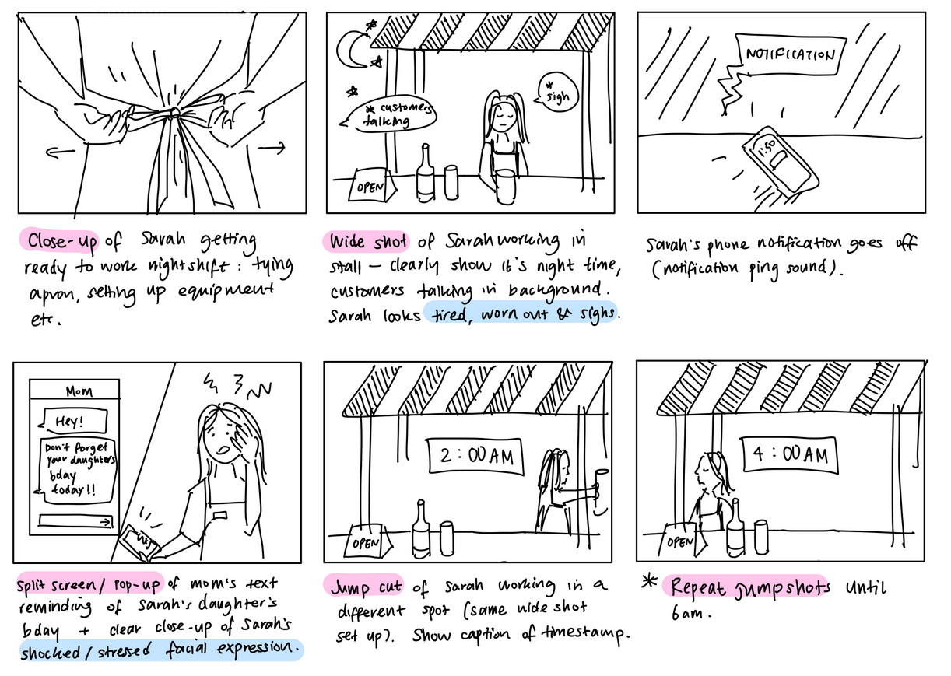
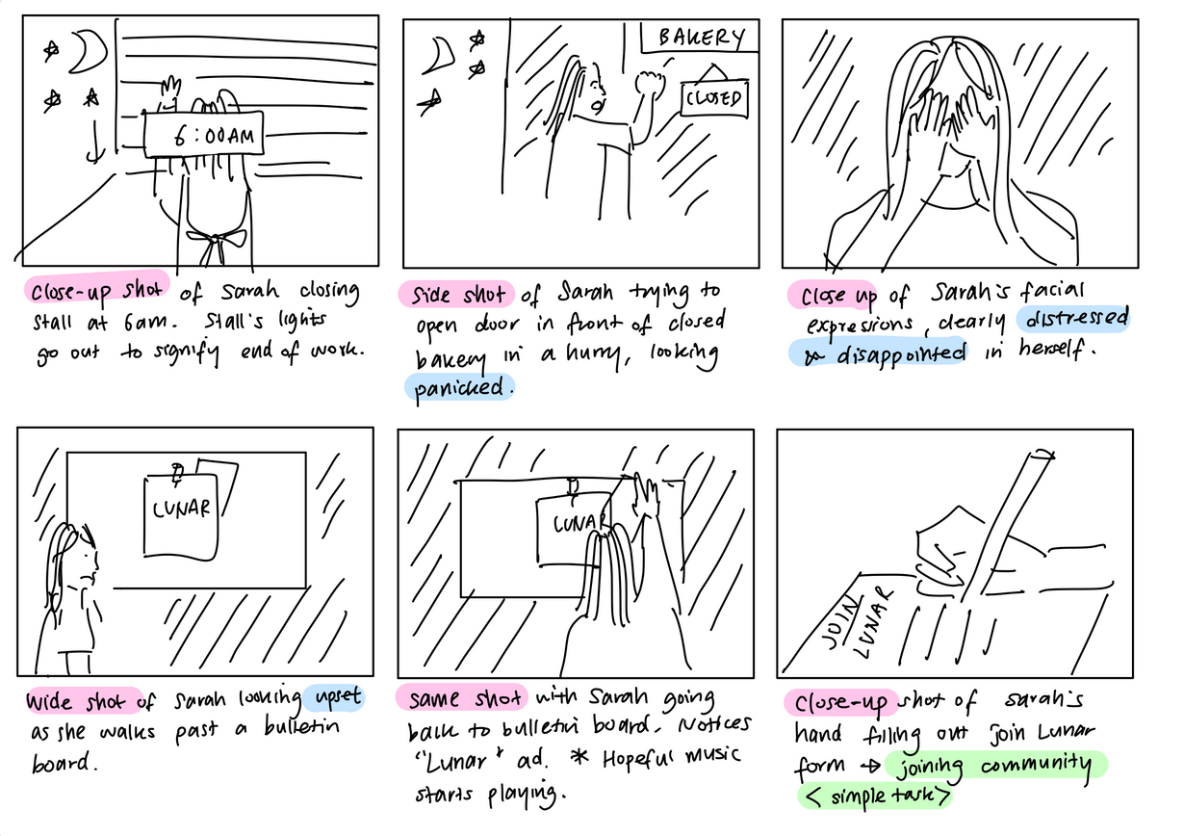
Storyboard

Slide 21
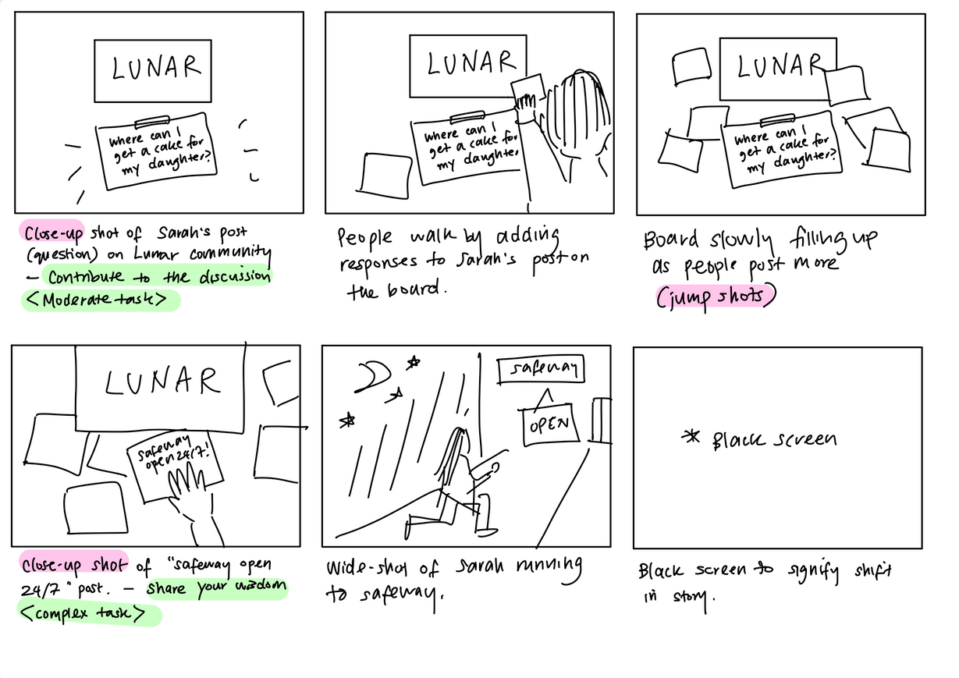
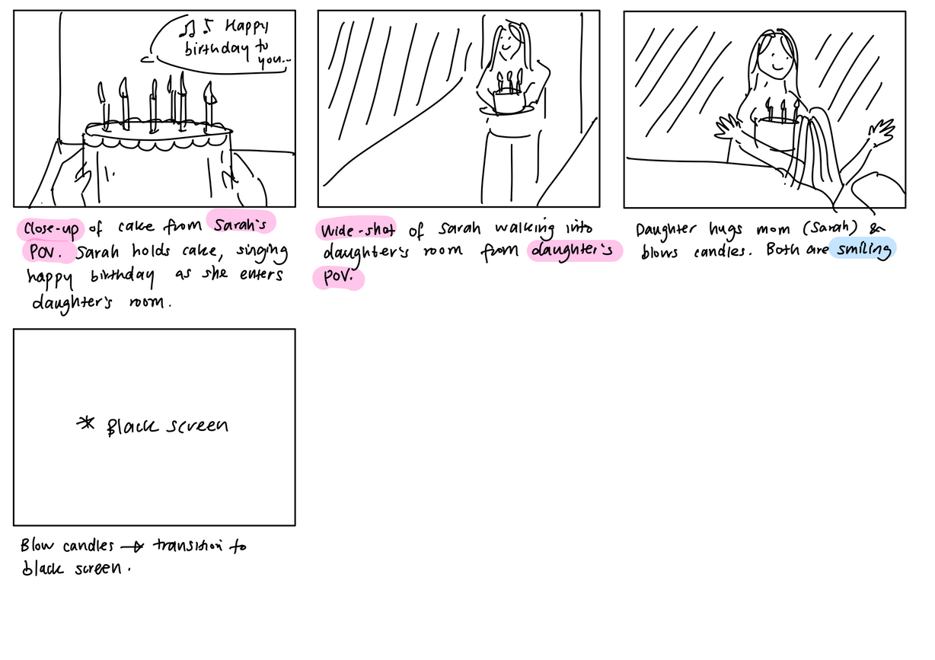
Storyboard

Slide 22
CS 147 · Stanford University
Oct 18 2024
Concept Video
6

Slide 23
Link to Video

Slide 24

CS 147 · Stanford University
Oct 18 2024
Thank you!
Happy
weekend!

