Slide 1


CS 147 · Stanford University
Oct 11 2024
POVs, HMWs, Solutions & Prototypes
Evelyn Hur, Sejoon Chang, Sarah Yao, Christina Ba

Slide 2




CS 147 · Stanford University
Oct 11 2024
Twilight Taskforce
Sarah Jade Yao
CS + PD ‘25
Christina Ba
CS + Art ‘26
Sejoon Chang
CS + PD ‘25
Evelyn Hur
CS + PD ‘25

Slide 3

CS 147 · Stanford University
Oct 11 2024
Presentation Roadmap
1
2
3
4
5
6
Additional
Needfinding
POV’s
HMW’s
Solutions
Experience
Prototypes
Ethical
Considerations

Slide 4
CS 147 · Stanford University
Oct 11 2024
Additional Needfinding
1

Slide 5
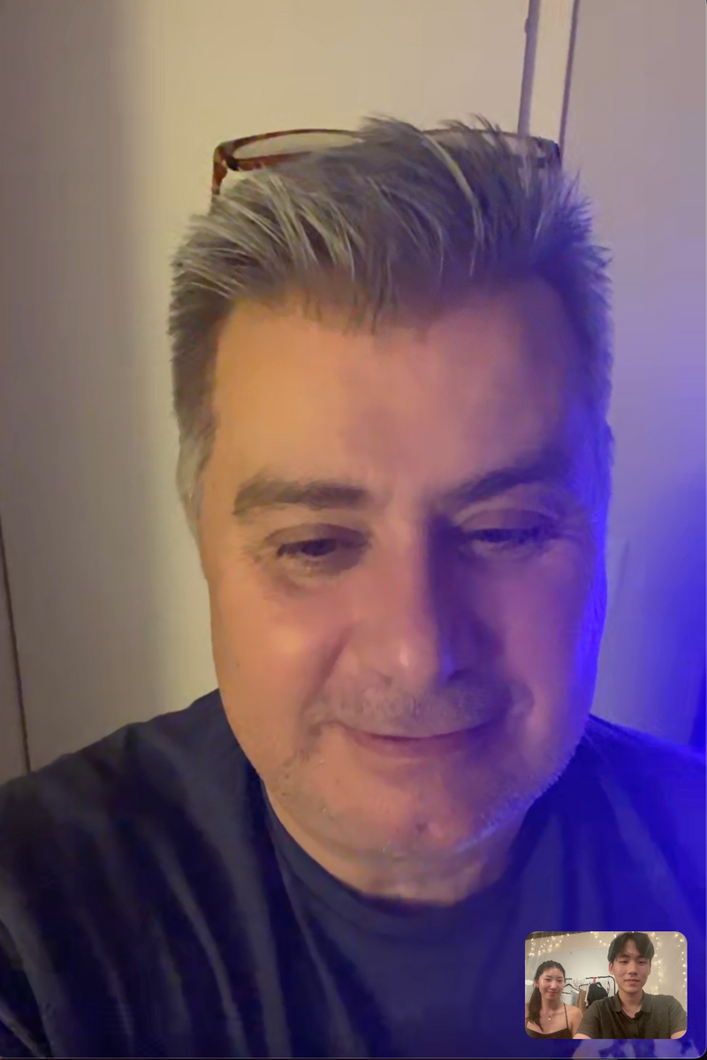
CS 147 · Stanford University
Oct 11 2024
Bradley
Bradley, a school custodian and single parent who worked night shifts at a school for 5 years in New York.
“It’s sometimes lonely... you would walk down these big corridors that were just completely empty”

Slide 6
Says
Thinks
  Worked 5 years on night shifts before switching to day shifts to spend more time with his daughters
  Night shifts provided a stable income, crucial for raising his daughters as a single parent
  The peacefulness and quietness of working at night were appreciated, but it could also be lonely
  Faced challenges such as parking and carrying his daughters into the house
  Experienced health issues like diabetes later in life
  Emphasizes the importance of paying the bills.
  Happy to have a job and prioritized taking care of his children over social life
  Describes his schedule as inconsistent but emphasizes the importance of earning money for his family
  Mentions that he found it difficult to adjust to daytime sleep patterns after night shifts
  Social life is a nice to have but caring for his family is a priority
  Money for family over sleep and wellbeing
  It’s his duty as a parent to financially support his family
  It’s important to put in extra effort/time to earn extra money
  Work itself is somewhat manageable and flexible
  Wishes he could spend more time with his daughters
  Loneliness and boredom are things that can be alleviated (chatting with co-workers, watch vids on games)
  He should take better care of his health
  “It is what it is” mentality to his night shift work and schedule
  It’s ok even if his schedule his “all over the place” as long as his work is paying the bills
Does
Feels
  Worked from 3 to 11:30 PM, arriving home around 1:30 AM
  Chats with co-workers, often chatting even with people he wasn't particularly fond of
  Him and his colleagues would leave the radio on to add some life to the school at night
  Relies on caffeine from soda to stay awake
  Takes naps in break room
  Watches videos on his phone to stay entertained
  Would work overtime whenever available to earn extra money
  Uses blackout curtains for sleeping during the day
  Uses eye mask for sleeping
  Used to take naps on public transportation on the way home, which helped him stay alert
  A sense of duty to financially support his family
  Overall satisfied with work conditions and flexibility
  Grateful to have a job that can support his family
  Accepting of sacrifices (lack of social life) made for his family
  A sense of responsibility to work extra hours to earn extra money
  Exhausted after work in the morning
  Appreciates peace and quiet during work hours
  Sometimes lonely from emptiness of school halls
  Sometimes depressing since less people are around at night
  Occasionally scared from noise in corridors at night
  A sense of camaraderie with his co-workers
  A sense of yearning / wistfulness to be more involved with daughters’ lives and spend more time with them

Slide 7
Says
Thinks
  Worked 5 years on night shifts before switching to day shifts to spend more time with his daughters
  Night shifts provided a stable income, crucial for raising his daughters as a single parent
  The peacefulness and quietness of working at night were appreciated, but it could also be lonely
  Faced challenges such as parking and carrying his daughters into the house
  Experienced health issues like diabetes later in life
  Emphasizes the importance of paying the bills.
  Happy to have a job and prioritized taking care of his children over social life
  Describes his schedule as inconsistent but emphasizes the importance of earning money for his family
  Mentions that he found it difficult to adjust to daytime sleep patterns after night shifts
  Social life is a nice to have but caring for his family is a priority
  Money for family over sleep and wellbeing
  It’s his duty as a parent to financially support his family
  It’s important to put in extra effort/time to earn extra money
  Work itself is somewhat manageable and flexible
  Wishes he could spend more time with his daughters
  Loneliness and boredom are things that can be alleviated (chatting with co-workers, watch vids on games)
  He should take better care of his health
  “It is what it is” mentality to his night shift work and schedule
  It’s ok even if his schedule his “all over the place” as long as his work is paying the bills
Appreciates peace and quiet of night but also lonely and sometimes depressing
Happy to have a job and prioritizes taking care of daughters over social life
“It is what is” mentality - accepting of situation to support his family financially
Loneliness and boredom are things that can be alleviated (chatting with co-workers, watch vids on games)
Does
Feels
  Worked from 3 to 11:30 PM, arriving home around 1:30 AM
  Chats with co-workers, often chatting even with people he wasn't particularly fond of
  Him and his colleagues would leave the radio on to add some life to the school at night
  Relies on caffeine from soda to stay awake
  Takes naps in break room
  Watches videos on his phone to stay entertained
  Would work overtime whenever available to earn extra money
  Uses blackout curtains for sleeping during the day
  Uses eye mask for sleeping
  Used to take naps on public transportation on the way home, which helped him stay alert
  A sense of duty to financially support his family
  Overall satisfied with work conditions and flexibility
  Grateful to have a job that can support his family
  Accepting of sacrifices (lack of social life) made for his family
  A sense of responsibility to work extra hours to earn extra money
  Exhausted after work in the morning
  Appreciates peace and quiet during work hours
  Sometimes lonely from emptiness of school halls
  Sometimes depressing since less people are around at night
  Occasionally scared from noise in corridors at night
  A sense of camaraderie with his co-workers
  A sense of yearning / wistfulness to be more involved with daughters’ lives and spend more time with them
Various methods to “add life” to work: turns on radio at work, chats with co-workers, watches vids on phone to pass time
Work overtime or fill in for co-workers’ shifts to earn extra money for his family
A sense of yearning / wistfulness to spend more time with daughters
A sense of gratefulness for job that supports his family, despite sacrifices made in sleep and social life
Notes:
Green: consistent
Red: slight contradict

Slide 8
Says
Thinks
  Worked 5 years on night shifts before switching to day shifts to spend more time with his daughters
  Night shifts provided a stable income, crucial for raising his daughters as a single parent
  The peacefulness and quietness of working at night were appreciated, but it could also be lonely
  Faced challenges such as parking and carrying his daughters into the house
  Experienced health issues like diabetes later in life
  Emphasizes the importance of paying the bills.
  Happy to have a job and prioritized taking care of his children over social life
  Describes his schedule as inconsistent but emphasizes the importance of earning money for his family
  Mentions that he found it difficult to adjust to daytime sleep patterns after night shifts
  Social life is a nice to have but caring for his family is a priority
  Money for family over sleep and wellbeing
  It’s his duty as a parent to financially support his family
  It’s important to put in extra effort/time to earn extra money
  Work itself is somewhat manageable and flexible
  Wishes he could spend more time with his daughters
  Loneliness and boredom are things that can be alleviated (chatting with co-workers, watch vids on games)
  He should take better care of his health
  “It is what it is” mentality to his night shift work and schedule
  It’s ok even if his schedule his “all over the place” as long as his work is paying the bills
Appreciates peace and quiet of night but also lonely and sometimes depressing
Happy to have a job and prioritizes taking care of daughters over social life
“It is what is” mentality - accepting of situation to support his family financially
Loneliness and boredom are things that can be alleviated (chatting with co-workers, watch vids on games)
Does
Feels
  Worked from 3 to 11:30 PM, arriving home around 1:30 AM
  Chats with co-workers, often chatting even with people he wasn't particularly fond of
  Him and his colleagues would leave the radio on to add some life to the school at night
  Relies on caffeine from soda to stay awake
  Takes naps in break room
  Watches videos on his phone to stay entertained
  Would work overtime whenever available to earn extra money
  Uses blackout curtains for sleeping during the day
  Uses eye mask for sleeping
  Used to take naps on public transportation on the way home, which helped him stay alert
  A sense of duty to financially support his family
  Overall satisfied with work conditions and flexibility
  Grateful to have a job that can support his family
  Accepting of sacrifices (lack of social life) made for his family
  A sense of responsibility to work extra hours to earn extra money
  Exhausted after work in the morning
  Appreciates peace and quiet during work hours
  Sometimes lonely from emptiness of school halls
  Sometimes depressing since less people are around at night
  Occasionally scared from noise in corridors at night
  A sense of camaraderie with his co-workers
  A sense of yearning / wistfulness to be more involved with daughters’ lives and spend more time with them
Various methods to “add life” to work: turns on radio at work, chats with co-workers, watches vids on phone to pass time
Work overtime or fill in for co-workers’ shifts to earn extra money for his family
A sense of yearning / wistfulness to spend more time with daughters
A sense of gratefulness for job that supports his family, despite sacrifices made in sleep and social life
Notes:
Green: consistent
Red: slight contradict

Slide 9
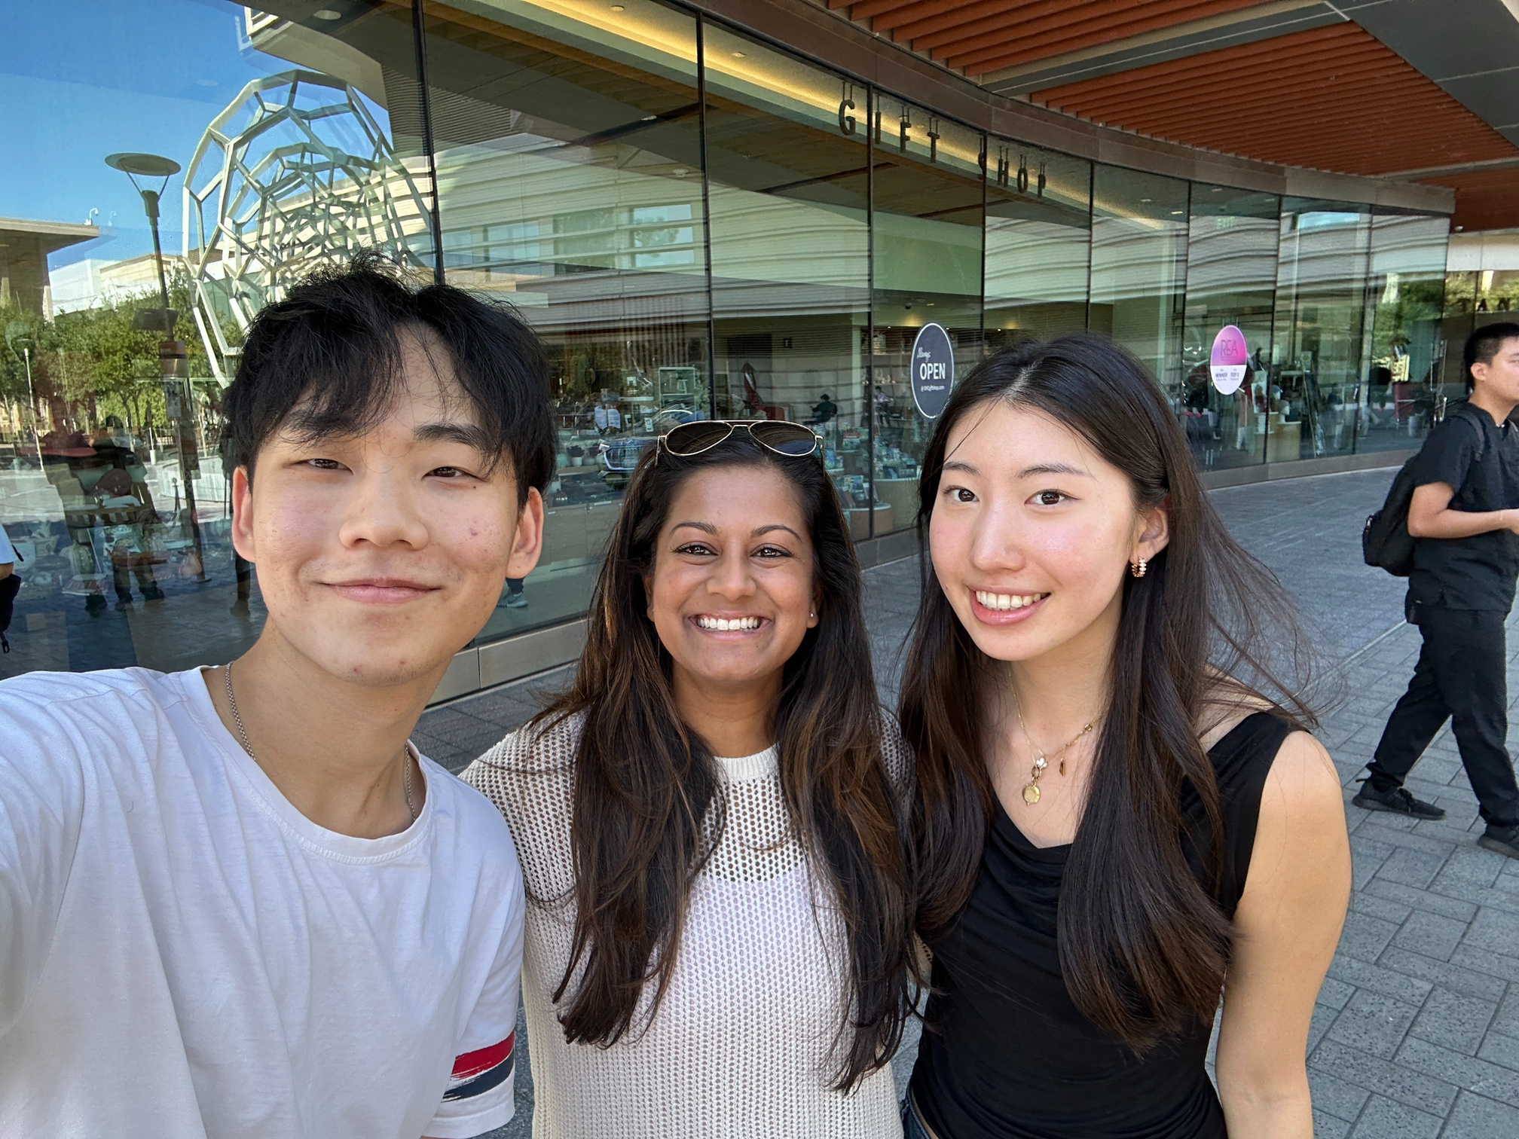
CS 147 · Stanford University
Oct 11 2024
Pooja
Pooja works as a Stanford physician and nocturnist in the Internal Medicine Department
“I enjoy it, but I’ve had problems managing personal and family relationships with a full-time night shift job.

Slide 10
Says
Thinks
  Worked on night shifts for the past two years, for 12 hours, 7 PM to 7 AM
  Says that the hardest part is “adjusting—it's hard on your body after even doing it for a while."
  Initially expected it to be easy, but didn't see “how exhausting it could be doing it full-time/long-term."
  "It takes an hour or two to get to sleep, even when I’m on the bed” and may wake up in the middle of the day “due to the noise outside”
  Complains how it’s hard to “coordinate with family and friends during the night shift."
  Nutrition and eating patterns are “completely off” which makes it difficult health-wise
  "I’ve had headaches and migraines during the day because I should be asleep but I’m awake."
  She says “relationships are difficult to manage” when her partner doesn’t understand.
  Pooja interestingly thinks that the night shift job is relatively satisfactory, given the flexibility and the fact that she ony
  She also likes the tranquility of the hospital at night compared to the chaos that usually ensues during the day (because the work itself is already packed with adrenaline).
  She still finds it difficult to balance her personal life with her night shift schedule.
  She didn’t anticipate how much night shifts would affect her health in the long term.
  Adjusting between night and day schedules takes longer than she expected, making it a constant challenge.
  Despite problems with health and relationships, the flexibility makes it an overall net positive for her.
  Although she appreciates the flexibility of her schedule, she realizes that working night shifts full-time might not be sustainable forever.
  Pooja thinks that she could track her sleep more closely, but doesn’t feel the need to.
Does
Feels
  She stays up from 2-5 AM watching Netflix on my off days because her body is still on night mode.
  She’s had trouble coordinating things like dental appointments because of schedule.
  "I don’t track my sleep, but I try to get a good number of hours."
  During her night shift she can get a little nap in, but she sets an alarm for 30 minutes later.
  Works 3-4 night shifts a week, with 3 days on, 1 off, then 3 days on.
  Wraps up her night shift by 6 AM and clocks out by 7 AM.
  Groups night shifts so she can spend more time with family and friends later in the month.
  Sleeps for five hours during the day after a shift, though it’s hard to flip back to normal.
  Tries to plan her sleep so that she can still attend day events and appointments.
  Struggles with eating during her shift—has lunch around 2 AM.
  Juggles household chores like laundry and dishes on her days off, though things get staggered.
  Feels adrenaline during the night shift due to constant emergency calls (no need for caffeine)
  A sense of calm during night shifts because the hospital is quieter at night.
  She feels supported by her fellow hospital workers who understand her difficult schedule.
  Frustration at not being able to attend social or family events due to her schedule.
  A sense of disconnection from family and friends (especially those in New York with a time difference) due to the difficulty of making time for them.
  Isolated because not many people outside of the medical field understand her challenges. She’s sad that she had to break up with previous partner due to her schedule.
  She feels grateful for the flexibility to group shifts together for time off, but also aware of the toll it takes.
  Constantly overwhelmed by how difficult it is to manage personal relationships with such an irregular schedule.

Slide 11
Says
Thinks
  Worked on night shifts for the past two years, for 12 hours, 7 PM to 7 AM
  Says that the hardest part is “adjusting—it's hard on your body after even doing it for a while."
  Initially expected it to be easy, but didn't see “how exhausting it could be doing it full-time/long-term."
  "It takes an hour or two to get to sleep, even when I’m on the bed” and may wake up in the middle of the day “due to the noise outside”
  Complains how it’s hard to “coordinate with family and friends during the night shift."
  Nutrition and eating patterns are “completely off” which makes it difficult health-wise
  "I’ve had headaches and migraines during the day because I should be asleep but I’m awake."
  She says “relationships are difficult to manage” when her partner doesn’t understand.
  Pooja interestingly thinks that the night shift job is relatively satisfactory, given the flexibility and the fact that she ony
  She also likes the tranquility of the hospital at night compared to the chaos that usually ensues during the day (because the work itself is already packed with adrenaline).
  She still finds it difficult to balance her personal life with her night shift schedule.
  She didn’t anticipate how much night shifts would affect her health in the long term.
  Adjusting between night and day schedules takes longer than she expected, making it a constant challenge.
  Despite problems with health and relationships, the flexibility makes it an overall net positive for her.
  Although she appreciates the flexibility of her schedule, she realizes that working night shifts full-time might not be sustainable forever.
  Pooja thinks that she could track her sleep more closely, but doesn’t feel the need to.
Eats lunch at 1-2 AM, so nutrition and sleeping patterns are completely off
She actually enjoys working a night shift, mainly because she works only 12 days a months
Has lots of flexibility with her night shift, she can group all at once or spread them out
Was surprised to see how exhausting it was in the long term after doing it for two years
Despite problems with health and relationships, the flexibility makes it an overall net positive for her
Does
Feels
  She stays up from 2-5 AM watching Netflix on my off days because her body is still on night mode.
  She’s had trouble coordinating things like dental appointments because of schedule.
  "I don’t track my sleep, but I try to get a good number of hours."
  During her night shift she can get a little nap in, but she sets an alarm for 30 minutes later.
  Works 3-4 night shifts a week, with 3 days on, 1 off, then 3 days on.
  Wraps up her night shift by 6 AM and clocks out by 7 AM.
  Groups night shifts so she can spend more time with family and friends later in the month.
  Sleeps for five hours during the day after a shift, though it’s hard to flip back to normal.
  Tries to plan her sleep so that she can still attend day events and appointments.
  Struggles with eating during her shift—has lunch around 2 AM.
  Juggles household chores like laundry and dishes on her days off, though things get staggered.
  Feels adrenaline during the night shift due to constant emergency calls (no need for caffeine)
  A sense of calm during night shifts because the hospital is quieter at night.
  She feels supported by her fellow hospital workers who understand her difficult schedule.
  Frustration at not being able to attend social or family events due to her schedule.
  A sense of disconnection from family and friends (especially those in New York with a time difference) due to the difficulty of making time for them.
  Isolated because not many people outside of the medical field understand her challenges. She’s sad that she had to break up with previous partner due to her schedule.
  She feels grateful for the flexibility to group shifts together for time off, but also aware of the toll it takes.
  Constantly overwhelmed by how difficult it is to manage personal relationships with such an irregular schedule.
Groups night shifts so she can spend more time with family and friends later in the month
Tries to plan her sleep so that she can still attend day events and appointments, but it’s difficult
Feels adrenaline during the night shift due to constant emergency calls (no need for caffeine)
Disconnected from family and friends due to the difficulty of making time for them
Sad that she had to break up with previous partner due to her schedule
Notes:
Green: consistent
Red: slight contradict

Slide 12
Says
Thinks
  Worked on night shifts for the past two years, for 12 hours, 7 PM to 7 AM
  Says that the hardest part is “adjusting—it's hard on your body after even doing it for a while."
  Initially expected it to be easy, but didn't see “how exhausting it could be doing it full-time/long-term."
  "It takes an hour or two to get to sleep, even when I’m on the bed” and may wake up in the middle of the day “due to the noise outside”
  Complains how it’s hard to “coordinate with family and friends during the night shift."
  Nutrition and eating patterns are “completely off” which makes it difficult health-wise
  "I’ve had headaches and migraines during the day because I should be asleep but I’m awake."
  She says “relationships are difficult to manage” when her partner doesn’t understand.
  Pooja interestingly thinks that the night shift job is relatively satisfactory, given the flexibility and the fact that she ony
  She also likes the tranquility of the hospital at night compared to the chaos that usually ensues during the day (because the work itself is already packed with adrenaline).
  She still finds it difficult to balance her personal life with her night shift schedule.
  She didn’t anticipate how much night shifts would affect her health in the long term.
  Adjusting between night and day schedules takes longer than she expected, making it a constant challenge.
  Despite problems with health and relationships, the flexibility makes it an overall net positive for her.
  Although she appreciates the flexibility of her schedule, she realizes that working night shifts full-time might not be sustainable forever.
  Pooja thinks that she could track her sleep more closely, but doesn’t feel the need to.
Eats lunch at 1-2 AM, so nutrition and sleeping patterns are completely off
She actually enjoys working a night shift, mainly because she works only 12 days a months
Has lots of flexibility with her night shift, she can group all at once or spread them out
Was surprised to see how exhausting it was in the long term after doing it for two years
Despite problems with health and relationships, the flexibility makes it an overall net positive for her
Does
Feels
  She stays up from 2-5 AM watching Netflix on my off days because her body is still on night mode.
  She’s had trouble coordinating things like dental appointments because of schedule.
  "I don’t track my sleep, but I try to get a good number of hours."
  During her night shift she can get a little nap in, but she sets an alarm for 30 minutes later.
  Works 3-4 night shifts a week, with 3 days on, 1 off, then 3 days on.
  Wraps up her night shift by 6 AM and clocks out by 7 AM.
  Groups night shifts so she can spend more time with family and friends later in the month.
  Sleeps for five hours during the day after a shift, though it’s hard to flip back to normal.
  Tries to plan her sleep so that she can still attend day events and appointments.
  Struggles with eating during her shift—has lunch around 2 AM.
  Juggles household chores like laundry and dishes on her days off, though things get staggered.
  Feels adrenaline during the night shift due to constant emergency calls (no need for caffeine)
  A sense of calm during night shifts because the hospital is quieter at night.
  She feels supported by her fellow hospital workers who understand her difficult schedule.
  Frustration at not being able to attend social or family events due to her schedule.
  A sense of disconnection from family and friends (especially those in New York with a time difference) due to the difficulty of making time for them.
  Isolated because not many people outside of the medical field understand her challenges. She’s sad that she had to break up with previous partner due to her schedule.
  She feels grateful for the flexibility to group shifts together for time off, but also aware of the toll it takes.
  Constantly overwhelmed by how difficult it is to manage personal relationships with such an irregular schedule.
Groups night shifts so she can spend more time with family and friends later in the month
Tries to plan her sleep so that she can still attend day events and appointments, but it’s difficult
Feels adrenaline during the night shift due to constant emergency calls (no need for caffeine)
Disconnected from family and friends due to the difficulty of making time for them
Sad that she had to break up with previous partner due to her schedule
Notes:
Green: consistent
Red: slight contradict

Slide 13
CS 147 · Stanford University
Oct 11 2024
POV’s
2

Slide 14
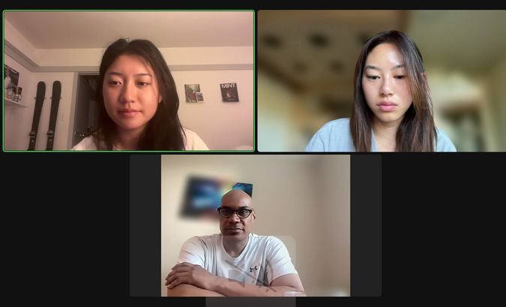
CS 147 · Stanford University
Oct 11 2024
POV #1: David
We met...
We were surprised to realize...
We wonder if this means...
It would be game-changing to...
David, who is a current night-shift worker at Stanford Hospital. He has been working there since 2012, which is when he transitioned from working for RD&E.
David has a “it is what it is” mentality, considering his personal life practically non-existent
David’s sense of financial dependency for his job makes him believe work and personal life can’t go hand in hand
Help David manage the smaller tasks in life so he has more time to care for his personal life.

Slide 15

CS 147 · Stanford University
Oct 11 2024
POV #2: Rena
We met...
We were surprised to realize...
We wonder if this means...
It would be game-changing to...
Rena, a physician and Nocturnists Section Chief at Stanford Hospital. She worked night shifts for 7 years, then transitioned to day shifts and part-time night shifts for 3 years.
Rena says she’s in good control of her health, but still often experiences daytime fatigue even 3 years out of full-time night shifts
Rena perceives her health based on individual efforts made rather than objective health improvement
Encourage Rena to be more aware of and take actions to improve her wellbeing, even if she thinks she feels “OK”.

Slide 16
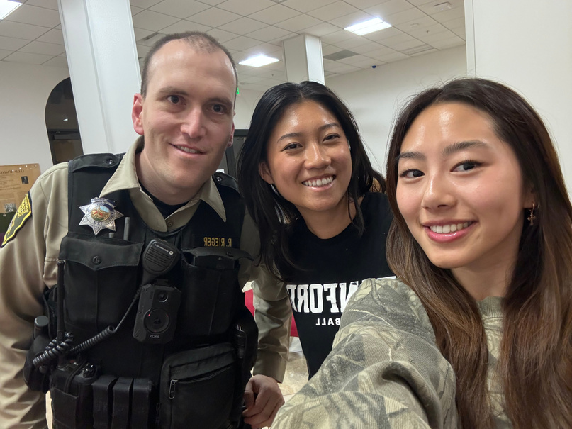
CS 147 · Stanford University
Oct 11 2024
POV #3: Ryan
We met...
We were surprised to realize...
We wonder if this means...
It would be game-changing to...
Ryan, working a 6-month graveyard shift for the Stanford Police Department. This is his eighth month in the department, and he switches between night and day shifts twice a year.
Despite struggling to adjust early in his shift, Ryan refuses to touch any sleep or wake aids, such as caffeine, even when others in his cohort are heavily reliant on such substances.
Ryan is confident in his long term health and adjustment strategies as opposed to short term relief from wake aids, having seen firsthand coworkers substance dependent.
Help night-shift workers to be in better control of their substance habits when it comes to sleep or wake aids.

Slide 17
CS 147 · Stanford University
Oct 11 2024
HMW Questions
3

Slide 18
CS 147 · Stanford University
Oct 11 2024
HMW integrate personal health data to provide feedback on managing sleep and health?
HMW we allow a user to schedule calls with FAF in accordance with their schedule?
HMW #1
David
HMW rethink what creates connection between someone and their FAF?
HMW allow a user to schedule multiple appointments at once?
HMW remove the frustrations of scheduling an appointment?
HMW allow users to complete errands without needing to be physically in the space?
HMW introduce a social community outside of FAF to connect with?
HMW group together completing errands to optimize for time and efficiency?
HMW allow a user to schedule appointments after business hours?
HMW provide alternate ways of checking in with their friends and family?
HMW automate scheduling routine tasks and errands?

Slide 19
CS 147 · Stanford University
Oct 11 2024
HMW integrate personal health data to provide feedback on managing sleep and health?
HMW we allow a user to schedule calls with FAF in accordance with their schedule?
HMW #1
David
HMW rethink what creates connection between someone and their FAF?
HMW allow a user to schedule multiple appointments at once?
HMW remove the frustrations of scheduling an appointment?
HMW allow users to complete errands without needing to be physically in the space?
HMW introduce a social community outside of FAF to connect with?
HMW group together completing errands to optimize for time and efficiency?
HMW allow a user to schedule appointments after business hours?
HMW provide alternate ways of checking in with their friends and family?
HMW automate scheduling routine tasks and errands?

Slide 20
CS 147 · Stanford University
Oct 11 2024
HMW create a positive reinforcement cycle for maintaining healthy habits?
HMW track nutrition over the duration of someone’s shift? When they’re not working their shift?
HMW #2
Dr. Rena
HMW connect her to a community to recommend methods for adjusting?
HMW give someone a more holistic run-down and look at their scheduling for the month?
HMW create an accountability tool to keep her consistent with her routine?
HMW recommend optimal times to sleep, eat, and exercise?
HMW prepare her for day to night (or vice versa) schedule switch/reset?
HMW offer suggestions for new healthy habits based on individual routine?
HMW make her feel more refreshed and alert during work hours?
HMW personalize her routine based on most alert hours and schedule?

Slide 21
CS 147 · Stanford University
Oct 11 2024
HMW create a positive reinforcement cycle for maintaining healthy habits?
HMW track nutrition over the duration of someone’s shift? When they’re not working their shift?
HMW #2
Dr. Rena
HMW connect her to a community to recommend methods for adjusting?
HMW give someone a more holistic run-down and look at their scheduling for the month?
HMW create an accountability tool to keep her consistent with her routine?
HMW recommend optimal times to sleep, eat, and exercise?
HMW prepare her for day to night (or vice versa) schedule reset?
HMW offer suggestions for new healthy habits based on individual routine?
HMW make her feel more refreshed and alert during work hours?
HMW personalize her routine based on most alert hours and schedule?

Slide 22
CS 147 · Stanford University
Oct 11 2024
HMW enable night shift workers naturally regulate their sleep cycle without sleep aids?
HMW #3
HMW remind officers throughout their shift to engage in healthy habits?
HMW establish support from the police department to provide institutional night-shift transitory resources?
Deputy Ryan
HMW reduce dependency on caffeine for graveyard shift officers?
HMW document the deputy’s tested adjustment methods and adapt them for wider use?
HMW provide alternative attention techniques throughout the shift to encourage focus?
HMW foster a supportive community of officers for developing healthier habits?
HMW provide an actionable plan to help with the initial transitory period?
HMW provide non-substance-based energy management techniques during off shift?
HMW reduce understaffing to prevent officers from having to work consistent overtime?
HMW improve holistic wellness, like eating and exercising well, within night-shift workers to improve attention on shift?

Slide 23
CS 147 · Stanford University
Oct 11 2024
HMW enable night shift workers naturally regulate their sleep cycle without sleep aids?
HMW #3
HMW remind officers throughout their shift to engage in healthy habits?
HMW establish support from the police department to provide institutional night-shift transitory resources?
Deputy Ryan
HMW reduce dependency on caffeine for graveyard shift officers?
HMW document the deputy’s tested adjustment methods and adapt them for wider use?
HMW provide alternative attention techniques throughout the shift to encourage focus?
HMW foster a supportive community of officers for developing healthier habits?
HMW provide an actionable plan to help with the initial transitory period?
HMW provide non-substance-based energy management techniques during off shift?
HMW reduce understaffing to prevent officers from having to work consistent overtime?
HMW improve holistic wellness, like eating and exercising well, within night-shift workers to improve attention on shift?

Slide 24

CS 147 · Stanford University
Oct 11 2024
Final HMWs
1
2
3
HMW allow users to complete errands without needing to be physically in the space?
HMW prepare users for day to night shift (or vice versa) reset?
HMW share user tested adjustment methods for wider use?

Slide 25
CS 147 · Stanford University
Oct 11 2024
Solutions
4

Slide 26
CS 147 · Stanford University
Oct 11 2024
1
HMW allow users to complete errands without needing to be physically in the space?
A grocery delivery box outside of someone’s house to allow for secure, refrigerated groceries to be delivered
A grocery system that pre-packages groceries for pick-up in lockers after hours.
At-home vital testing system (blood pressure, heart rate, etc.) to get vitals tracked before any doctor appointment
An app that recommends recipes for meal prepping based on the groceries you order / have in your house
An app that calls/makes appointments in the day for you based on user-inputted details
An app where you can input your available times so if daytime workers cannot reach your cell during sleep, your voicemail will list times for scheduling
An app that will automatically remind you and schedule appointments for you (groceries, appointments)
Any pick-up errands (groceries, prescription, packages) are bundled together into one central location for convenience
An app that allows you to schedule appointments after hours without needing to consult a real person.
An app that allows for users to hire someone to help run their errands for them, for example getting groceries and picking up medications.

Slide 27
CS 147 · Stanford University
Oct 11 2024
2
HMW prepare users for day to night shift (or vice versa) reset?
App that tells you ideal sleep and wake up time when switching/resetting day to night shift
App that helps you rewind and practice healthy habits before bed
Use wearables to detect optimal time to wake up and sound alarm
Create a community that shares methods/schedules for day to night shifting/reset
App that tells you optimal alertness periods to help plan your switch day (when to wake up, run errands etc)
Calendar that gives overview of switch days to help schedule/prepare ahead
App that personalizes reset routine based on your level of tiredness and other surveyed factors
An app that allows users to set a sleep transition goal and follow a process to gradually adjust their sleep schedule.
Using haptics or any wearables to remind a user to follow healthy goals, such as standing up or drinking water.
An app that reminds you of healthy habits for transitioning from daytime to nighttime schedules or vice versa.

Slide 28
CS 147 · Stanford University
Oct 11 2024
3
HMW share user tested adjustment methods for wider use?
Mentorship Q&A platform where new night shift workers can ask about proven techniques to stay energized
Create a digital pamphlet or module based on the user’s adjustment methods for distribution through the Police department.
A dynamic sleep adjustment app that takes into account user’s existing caffeine, exercise, and tracks use and timing of each factor.
Fostering development of peer-to-peer resources to encourage growth of community and sharing of tips for adjustment.
Enlist the user and any other regular night shift workers to create video tutorials to educate new night-shift workers on how best to adjust.
Provide online modules or in-person workshops within the police department to go over how best to adjust to night shifts.
A platform that provides real-time notification tailored to a night shift schedule, reminders for reduced caffeine intake or break time alerts.
Develop a platform where night-shift workers can share their own strategies that were effective, users can try, comment, upvote.
Use wearable devices to sync their sleep schedules through shared database, automatically sharing sleep routines based on night shift times
Feature stories and highlights of night shift workers on a community platform to motivate others and adopt similar approaches

Slide 29
CS 147 · Stanford University
Oct 11 2024
Top 3 Solutions
1
2
3
An app that finds open appointment times automatically based on user availability input
An app that gradually prepares users to transition day/night shift routine before bed for better recovery and reset
A platform to foster development of peer-to-peer resources to encourage growth of community and sharing of tips for sleep adjustment.

Slide 30
CS 147 · Stanford University
Oct 11 2024
Experience Prototypes
5

Slide 31
CS 147 · Stanford University
Oct 11 2024
Key Assumption: Users want to have appointments scheduled for them based on their availability
How we tested it: We requested participants select schedule availability on a pre-filled Google Form. Then, we sent them hypothetical appointments throughout their day based on their schedule. Users accepted or rejected the appointment. At the end, they filled out a survey about their experience.
Solution 1:
Experience Prototype

Slide 32

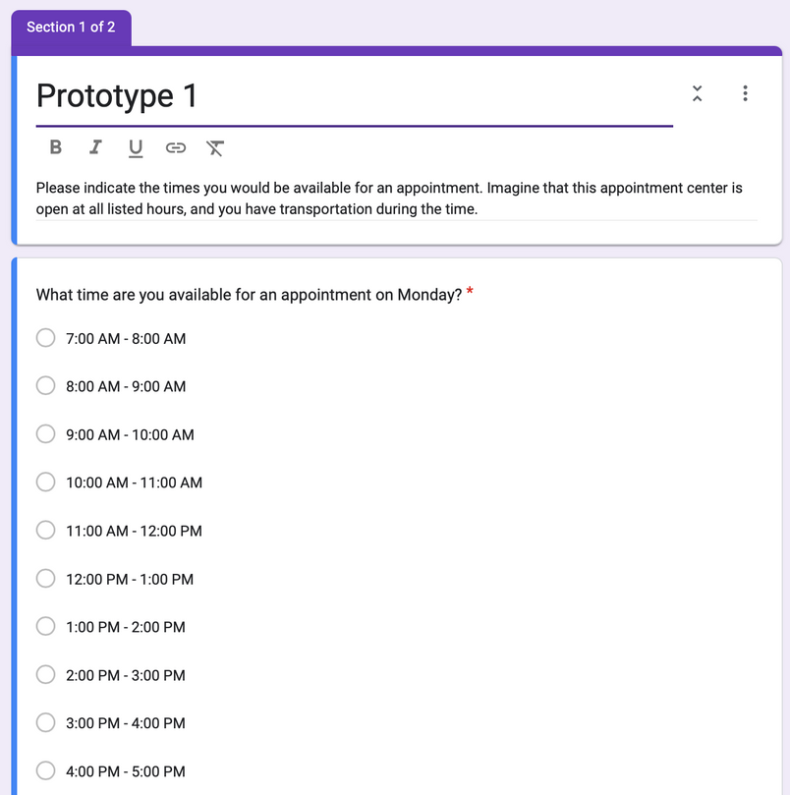
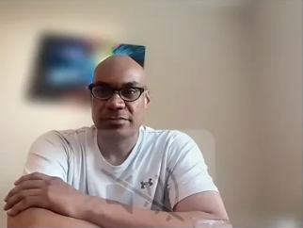
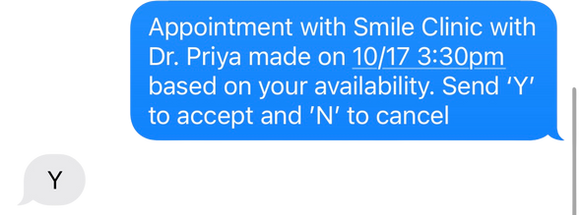
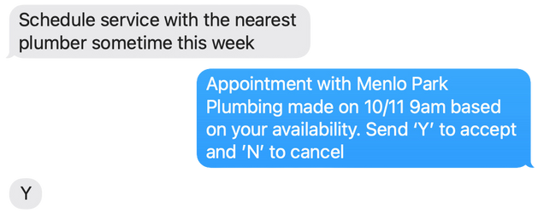
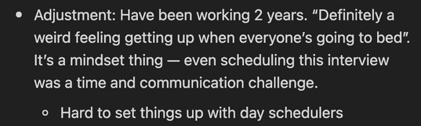
CS 147 · Stanford University
Oct 11 2024
Test Setup
Schedule Input
Insights
Appointments

Slide 33




Testing Insights
What worked?
  Made head feel free of clutter after graveyard shift, thinking about errands and available times
  Easy to accept/cancel appointments
  It was user-friendly in that a time was just given
Validated
Devin
What didn’t work?
Deputy who works a graveyard shift in patrolling
  Some appointments could not consider external factors. Even if the user was available at that time, it was a time they wanted to block out (to rest, get ready, transit time, etc). User said he was technically free one of the times, but would’ve wanted to rest.
1
Devin said this would “reduce lots of mental stress” from manually looking for non-conflicting slots
KEEP
GOING
Going Forward
2
Providing a scheduled time has its pros and cons: it helps reduce clutter, but it might also take up free time that the user wants to use for something else.
  Rather than hypothetical scenarios, potentially actually book the appointment for the user
  Need a way we can know when they are not working but preferably would want to block out to rest

Slide 34
CS 147 · Stanford University
Oct 11 2024
Key Assumption: Users will consistently and accurately follow recommended times for sleeping and waking up.
How we tested it: Create a goal sleep schedule, gave it to someone newly adjusting to a night shift, and evaluated the results
Solution 2:
Experience Prototype

Slide 35
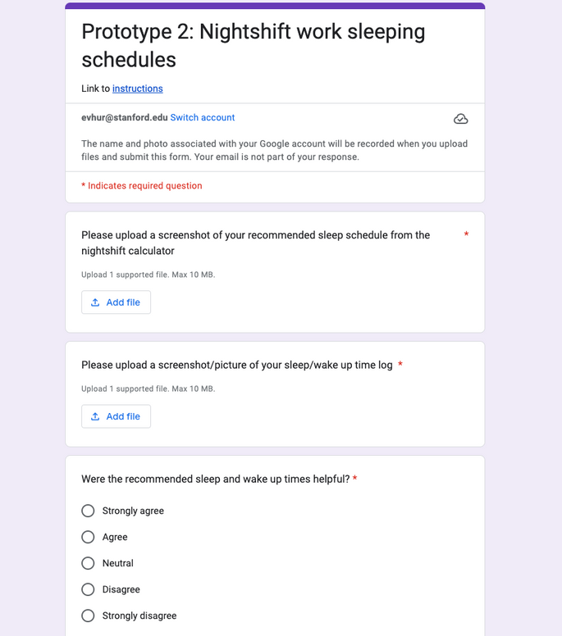
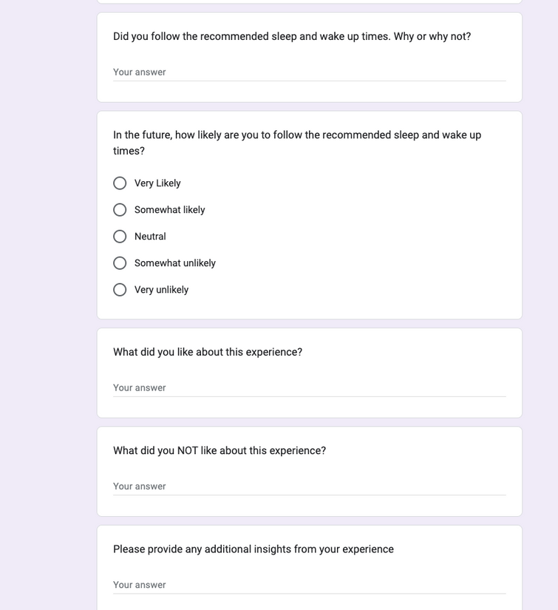
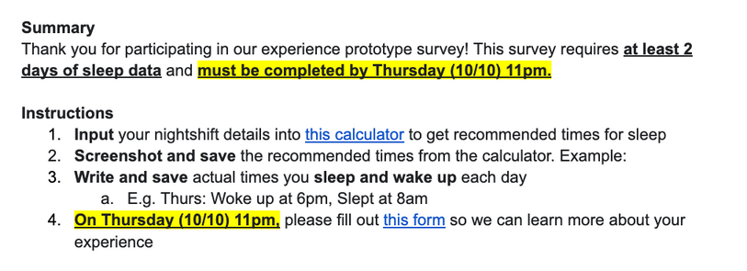
CS 147 · Stanford University
Oct 11 2024
Test Setup
Feedback
Instructions

Slide 36

Testing Insights
What worked?
  User felt that being told recommended times helped him be more aware of his poor sleeping habits, motivating him to set goals
  Felt more refreshed after following recommended sleep time when possible, even if he thought it been a placebo effect
Brian
Partially validated
Stanford senior who sleeps at 5-7 AM on weekends
What didn’t work?
1
User liked how the proposed sleep schedule put sleeping habits and wellbeing top of mind for him
  Even if he wanted to sleep at recommended times, he had work to finish. Some recommended times were not realistic.
  Recommended sleep times were not suitable for his body
2
User realized there were significant differences in his current sleep schedule to an ideal one
KEEP
GOING
Going Forward
3
User felt the recommended times were sometimes unrealistic given his variable schedule
  Consider recommendations as a guide to make users more self-aware of their wellbeing
  Focus on personalized goal setting instead of following given generalized recommendations
  Reconsider a solution that makes an individual’s body feels “best” rather than putting it in generalized conditions

Slide 37
CS 147 · Stanford University
Oct 11 2024
Key Assumption: New night shift workers are willing and able to adopt existing methods that are proven to work.
How we tested it: We created a pamphlet documenting Deputy Ryan’s transition methods and evaluated adoption of tips on new night shift workers. Then, we collected feedback on helpfulness and willingness to adopt the tips.
Solution 3:
Experience Prototype

Slide 38
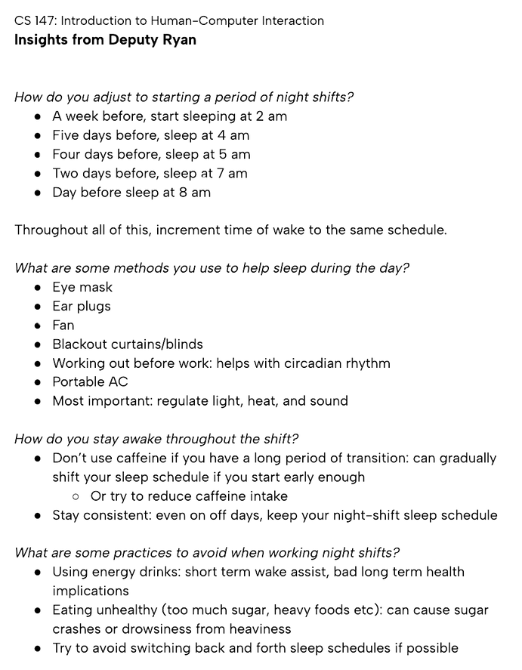
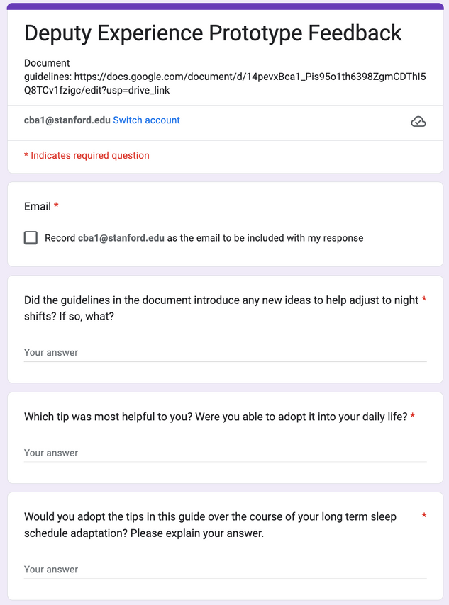
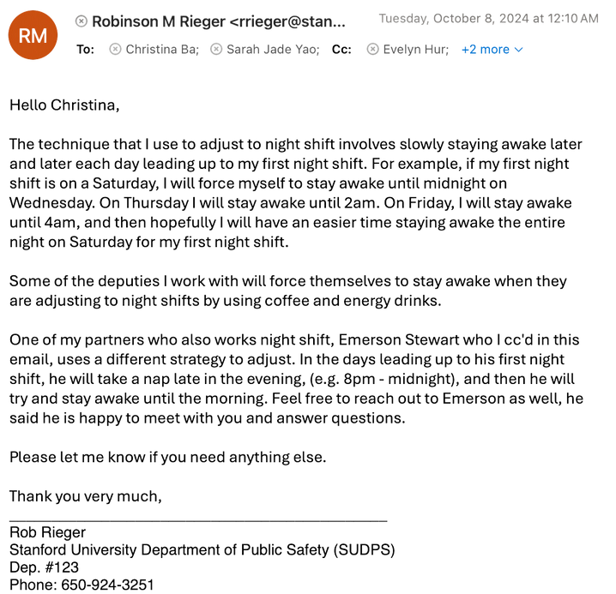
CS 147 · Stanford University
Oct 11 2024
Test Setup
Pamphlet
Feedback
Insights

Slide 39
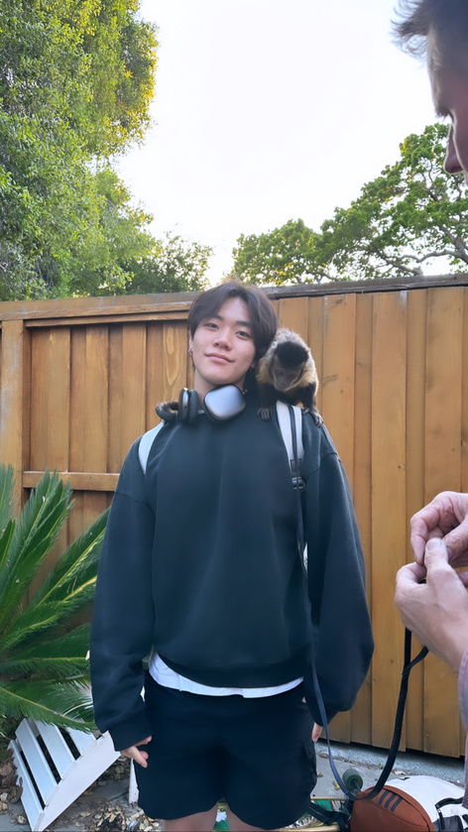
Testing Insights
What worked?
  Giving the user a visual of what a general adjustment plan would look like
  Listing highly specific non-chemical sleep aids the deputy used
Andrew
Student that regularly sleeps at 7 AM
Partially validated
What didn’t work?
1
User was most drawn to the tip about sleep aid tools - eye masks, fans, etc for daytime sleep
  Thought that deputy’s recommended sleep times were not applicable to his personal schedule
  Felt it was hard to stick to a consistent sleep routine due school work and his usual biphasic sleep pattern
2
User was somewhat inspired to create his own concrete, comprehensive plan to follow
User mentioned that specific sleep times weren’t as helpful since he has his own biphasic sleep schedule. His schedule is more subject to spontaneous changes due to school work
KEEP
GOING
Going Forward
3
  Test over a period of a few weeks instead of a few days for concrete results analysis
  Provide tips that are actionable within a week, instead of having to be adopted over more time
  Incorporate more flexible tips applicable to diverse users’ situations

Slide 40
Prototype Summary
1
Users felt motivated and inspired seeing a concrete plan, but adoption of exact recommended plan was difficult for those with inconsistent schedules
2
Users stated that they became more aware of own sleeping habits and wellbeing when they saw a recommended sleep schedule
3
Users liked having appointments scheduled for them because it helped with reducing brain clutter, especially after work. They found the system of accept/cancel easy and intuitive
4
Moving forward? Based on our additional needfinding with Bradley and Pooja + prototype testing, Prototype #1 addresses the most pressing issue and was the most successful based on feedback

Slide 41
CS 147 · Stanford University
Oct 11 2024
Ethical Considerations
6

Slide 42
Solution 1
Ethical Analysis
Communities Designed For
Communities Excluded/Inaccessible
Other Points
Night-Shift workers on a consistent schedule
Workers with frequent last-minute scheduling changes
Difficult to create realistic times especially since majority of people work 9-5
New to night shifts; difficulty accomodating for regular life
Workers with a regularly inconsistent schedule

Slide 43
Solution 2
Ethical Analysis
Communities Designed For
Communities Excluded/Inaccessible
Other Points
Workers with full time night shifts, including weekends
Workers with part time night shifts
Users who have additional work beyond work hours
Solution doesn’t account for follow-through with plan, adoption could vary across communities
Users who are used to following a routine and specific schedule
Workers who are mentally challenged and find consistency/ routine difficult

Slide 44
Solution 3
Ethical Analysis
Communities Designed For
Communities Excluded/Inaccessible
Other Points
As pamphlet was created from one person, what works for him might be skewed to his role and specific demographic
Full-time night shift employees
Students and temp workers with variable schedules
Those financially unable to accomodate physical tools
Beginner night-shift workers unsure of where to start

Slide 45
Appendix
  Prototype 1 Document
  Prototype 2 Document
  Prototype 3 Document
  Interview Questions
  Bradley Interview Transcript
  Pooja Interview Transcript

Slide 46
CS 147 · Stanford University
Oct 11 2024
That's a wrap!
Thank you for listening.

