Slide 1


CS 147 · Stanford University
Oct 4 2024
Needfinding
After Hours: Understanding Night Shift Workers
Evelyn Hur, Sejoon Chang, Sarah Yao, Christina Ba

Slide 2

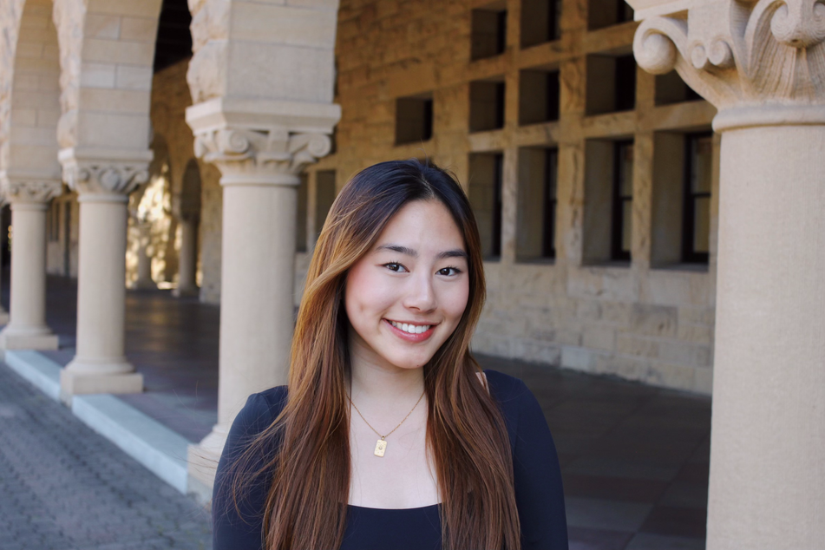

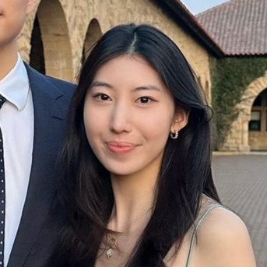
CS 147 · Stanford University
Oct 11 2024
Meet the Team!
Sarah Jade Yao
CS + PD ‘25
Christina Ba
CS + Art ‘26
Sejoon Chang
CS + PD ‘25
Evelyn Hur
CS + PD ‘25

Slide 3
CS 147 · Stanford University
Oct 4 2024
Why?
We wanted to address an underserved population’s needs— there’s currently no solutions in the market. Because we were thinking about health, we realized that this population could be most heavily impacted by our work.
How?
There’s existing sleep tracking apps on the market, but often require a physical device or aren’t tailored to understanding night shift schedules. We want to create a solution that is specifically for this underserved population.
Problem Domain

Slide 4
CS 147 · Stanford University
Oct 4 2024
Participants and Location
Needfinding Methodology
  Recruited participants with cold emailing and NextDoor posts
  Night shift workers in various locations (three in person, one Zoom), including on-campus and off-campus
  Prioritized diverse group of occupancies (medicine, police, tutors, healthcare workers)
  Part-time vs. full-time night night shift workers
  Eliminated participants who were busy working on shift (fast food workers)

Slide 5
CS 147 · Stanford University
Oct 4 2024
Extreme User
  Tutor: someone that balances school work in the day while working at night
Roles and Equipment
  Conducted 4 interviews: each team member was an interviewer/note taker exactly once. In one interview, we used OtterAI, an online tool for transcription
  Compensated one interviewee via NextDoor
Needfinding Methodology

Slide 6
CS 147 · Stanford University
Oct 4 2024
Interview Structure
  Background
  Typical Night Shift Routine
  Life outside of Work
  Impact on Overall Health
  Follow-up Questions
Interview Questions

Slide 7
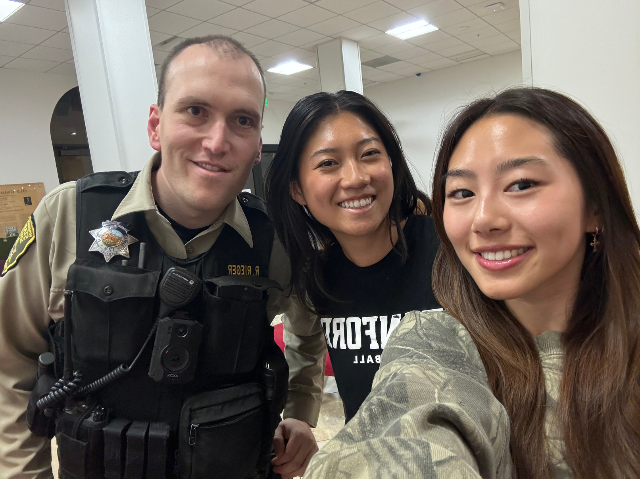
CS 147 · Stanford University
Oct 4 2024
Deputy Ryan R.
Deputy Ryan works with the Stanford Police Department, working a 6-month graveyard shift
“Working a graveyard shift never gets easier“

Slide 8

Says
Thinks
  Works long hours - shift from 6:30 pm to 4:30 am + 2 hours overtime
  6 month rotation system: 6 months day shift, 6 months night shift
  Works 4x a week, 3x off days
  Other officers will try to get back to regular circadian rhythm on off-days, and transition back and forth each week
  He has found being consistent with his schedule has helped the most
  “Working night shifts is hard no matter what you do”
  “The entire world runs on a daytime schedule.”
  No one great way to address the 2-3 week adjustment period
  Found his transition routine through trial and error: gradually staying up later
  “The hardest part about night shifts is the little things: explaining to your friend you can’t do 11 am brunch, for example.”
  Discipline and consistency is most important to working these cycles
  Experience working night shifts is the best way to adjust
  Finds it hard to explain what the night shift life is like to day-shifters
  Thinks that caffeine is awful for you and would never use it
  Believes that the initial two week transition to night shifts is most frustrating
  There is no one perfect solution to transitioning to working at night
  The human body isn’t made to work night shifts, and must take additional measures to adjust
  It is on him to personally adjust to the shift, no resources from department
  Working night shifts is necessary for work reasons but the tradeoff is the convenience of living life during the day
  There aren’t any long term effects of working night shifts on his health
Does
Feels
  Doesn’t drink caffeine / use any other sleep medications
  Has a strict routine easing into/out of night shift periods
  Struggles to schedule business appointments within traditional 9-5 hours
  Uses devices like blackout curtains, eye masks, portable AC to help him sleep during the day
  Does not use any chemical supplements to help adjust (melatonin, caffeine)
  Tries to get a full 8 hours of sleep every day
  Is used to taking the extra effort to make time for his personal life
  Job entails proactive patrol and response to emergency calls
  Feel more alert in the beginning of the shift, and finds it hard to stay awake later on (4/5 am)
  Work a staggered schedule: other night shifters work different nights
  Frustrated going through 2 week transition period
  Optimistic about sleep tracking to help the transitory process
  “It is what it is” mentality about working night shifts
  Accepting of the fact that he’s giving up the convenience of a day job
  Values consistency and routine; believes it is the key to his upkept health
  Feels he can assess for himself his wakefulness; currently doesn’t track sleep
  Scared of the “stuff that’s in energy drinks”, relies on his personal circadian rhythm
  Used to this biannual day shift to night shift switch
  A sense of unavoidable disconnect with “day-shifters”
  A sense of duty to his job to the point where he is willing to sacrifice a regular life for 6 months of the year.

Slide 9
Says
Thinks
  Works long hours - shift from 6:30 pm to 4:30 am + 2 hours overtime
  6 month rotation system: 6 months day shift, 6 months night shift
  Works 4x a week, 3x off days
  Other officers will try to get back to regular circadian rhythm on off-days, and transition back and forth each week
  He has found being consistent with his schedule has helped the most
  “Working night shifts is hard no matter what you do”
  “The entire world runs on a daytime schedule.”
  No one great way to address the 2-3 week adjustment period
  Found his transition routine through trial and error: gradually staying up later
  “The hardest part about night shifts is the little things: explaining to your friend you can’t do 11 am brunch, for example.”
  Discipline and consistency is most important to working these cycles
  Experience working night shifts is the best way to adjust
  Finds it hard to explain what the night shift life is like to day-shifters
  Thinks that caffeine is awful for you and would never use it
  Believes that the initial two week transition to night shifts is most frustrating
  There is no one perfect solution to transitioning to working at night
  The human body isn’t made to work night shifts, and must take additional measures to adjust
  It is on him to personally adjust to the shift, no resources from department
  Working night shifts is necessary for work reasons but the tradeoff is the convenience of living life during the day
  There aren’t any long term effects of working night shifts on his health
Shift from 6:30 pm to 4:30 am + 2 hours of overtime every working night
“The entire world runs on a daytime schedule.”
There is no one perfect solution to transitioning to night shifts
The human body isn’t built to work overnight, and the hardest part is the first two weeks of transition
Does
Feels
  Doesn’t drink caffeine / use any other sleep medications
  Has a strict routine easing into/out of night shift periods
  Struggles to schedule business appointments within traditional 9-5 hours
  Uses devices like blackout curtains, eye masks, portable AC to help him sleep during the day
  Does not use any chemical supplements to help adjust (melatonin, caffeine)
  Tries to get a full 8 hours of sleep every day
  Is used to taking the extra effort to make time for his personal life
  Job entails proactive patrol and response to emergency calls
  Feel more alert in the beginning of the shift, and finds it hard to stay awake later on (4/5 am)
  Work a staggered schedule: other night shifters work different nights
  Frustrated going through 2 week transition period
  Optimistic about sleep tracking to help the transitory process
  “It is what it is” mentality about working night shifts
  Accepting of the fact that he’s giving up the convenience of a day job
  Values consistency and routine; believes it is the key to his upkept health
  Feels he can assess for himself his wakefulness; currently doesn’t track sleep
  Scared of the “stuff that’s in energy drinks”, relies on his personal circadian rhythm
  Used to this biannual day shift to night shift switch
  A sense of unavoidable disconnect with “day-shifters”
  A sense of duty to his job to the point where he is willing to sacrifice a regular life for 6 months of the year.
Doesn’t use any sleep or wake aids (caffeine, melatonin, energy drinks)
Maintains his overnight schedule even on his off days. Believes consistency is the key to adjustment.
A sense of unavoidable disconnect with “day-shifters”: explaining special situations, etc
Feels he can assess for himself his degree of wakefulness, but would enjoy a tailored sleep tracker
Notes:
Green: consistent
Red: slight contradict

Slide 10
Says
Thinks
  Works long hours - shift from 6:30 pm to 4:30 am + 2 hours overtime
  6 month rotation system: 6 months day shift, 6 months night shift
  Works 4x a week, 3x off days
  Other officers will try to get back to regular circadian rhythm on off-days, and transition back and forth each week
  He has found being consistent with his schedule has helped the most
  “Working night shifts is hard no matter what you do”
  “The entire world runs on a daytime schedule.”
  No one great way to address the 2-3 week adjustment period
  Found his transition routine through trial and error: gradually staying up later
  “The hardest part about night shifts is the little things: explaining to your friend you can’t do 11 am brunch, for example.”
  Discipline and consistency is most important to working these cycles
  Experience working night shifts is the best way to adjust
  Finds it hard to explain what the night shift life is like to day-shifters
  Thinks that caffeine is awful for you and would never use it
  Believes that the initial two week transition to night shifts is most frustrating
  There is no one perfect solution to transitioning to working at night
  The human body isn’t made to work night shifts, and must take additional measures to adjust
  It is on him to personally adjust to the shift, no resources from department
  Working night shifts is necessary for work reasons but the tradeoff is the convenience of living life during the day
  There aren’t any long term effects of working night shifts on his health
Shift from 6:30 pm to 4:30 am + 2 hours of overtime every working night
“The entire world runs on a daytime schedule.”
There is no one perfect solution to transitioning to night shifts
The human body isn’t built to work overnight, and the hardest part is the first two weeks of transition
Does
Feels
  Doesn’t drink caffeine / use any other sleep medications
  Has a strict routine easing into/out of night shift periods
  Struggles to schedule business appointments within traditional 9-5 hours
  Uses devices like blackout curtains, eye masks, portable AC to help him sleep during the day
  Does not use any chemical supplements to help adjust (melatonin, caffeine)
  Tries to get a full 8 hours of sleep every day
  Is used to taking the extra effort to make time for his personal life
  Job entails proactive patrol and response to emergency calls
  Feel more alert in the beginning of the shift, and finds it hard to stay awake later on (4/5 am)
  Work a staggered schedule: other night shifters work different nights
  Frustrated going through 2 week transition period
  Optimistic about sleep tracking to help the transitory process
  “It is what it is” mentality about working night shifts
  Accepting of the fact that he’s giving up the convenience of a day job
  Values consistency and routine; believes it is the key to his upkept health
  Feels he can assess for himself his wakefulness; currently doesn’t track sleep
  Scared of the “stuff that’s in energy drinks”, relies on his personal circadian rhythm
  Used to this biannual day shift to night shift switch
  A sense of unavoidable disconnect with “day-shifters”
  A sense of duty to his job to the point where he is willing to sacrifice a regular life for 6 months of the year.
Doesn’t use any sleep or wake aids (caffeine, melatonin, energy drinks)
Maintains his overnight schedule even on his off days. Believes consistency is the key to adjustment.
A sense of unavoidable disconnect with “day-shifters”: explaining special situations, etc
Feels he can assess for himself his degree of wakefulness, but would enjoy a tailored sleep tracker
Notes:
Green: consistent
Red: slight contradict

Slide 11
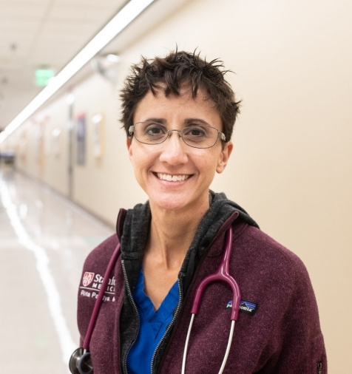
CS 147 · Stanford University
Oct 4 2024
Dr. Rena R.
Rena is a physician and Nocturnist Section Chief at Stanford Hospital
“I try to block out 4-5 hours to sleep at night but I still find myself waking up”

Slide 12
Says
Thinks
  Worked nightshifts for 7 years, working an average of 15 nights a month
  Eventually transitioned to daytime work 3 years ago due to fatigue and burnout
  Still does 2-3 night shifts a month but night shifts are now more exhausting due to increased patient volumes and busier nights
  Shift lasts from 7pm to 7am, with the post-shift period involving finishing notes and signing out to the next team.
  Commute and sign-out time take away additional time
  Weekend routine is similar to weekday routine because she also works on weekends
  Initially ate unhealthy at hospital cafeteria, but started bringing in own food
  After transitioning, hard to function during day and think clinically, thinks better at 3-4am
  Early on in career, had so much energy: used to exercise and walk her dog after shift
  When transitioned to day shifts, had very hard time figuring out when to exercise
  Most night shift workers quit after a while (not sustainable)
  Sleep is important, especially for night shift workers
  Advises others to prioritize it, even if they don't feel tired, to maintain a normal circadian rhythm.
  She is in good control of her diet/nutrition since she brings her own food to work
  Transitioning from full-time to part-time night shifts was challenging
  After transition, difficult functioning and thinking clinically during day
  After transition, difficult adjusting to a normal sleep schedule
  She is not a morning person
  Previous studies on health effect of night shift work aren’t the best due to variability in night shift schedules and difficulty of conditions conducting good research
  Need better research on health effects of night shift work
  Believes maintaining a normal circadian rhythm is important
Does
Feels
  Before each shift starts, signs in and takes over pager coverage, leading to immediate interruptions for lab results and emergencies.
  After the shift, Rita goes home, takes care of their dog, does laundry, and tries to sleep for a few hours, usually managing 3-4 hours of sleep
  If multiple days off in a row, would sometimes sleep 18+ hours
  Spent a lot of time outside to mitigate vitamin D deficiency
  Now, eats own small meals every 3-4 hours
  Sometimes grabs snacks from vending machines or eat leftover food
  Now, tries to block out 4-5 hours of sleep, but still finds herself waking up at night
  Even now, wakes up in the middle of the night to eat
  After transition to day shifts, tried working out at night around 11pm but didn’t work out
  Now, exercises at 5am
  Initially found nightshifts manageable and even enjoyable but eventually became fatigued and burnout by 4th year
  Refreshing to even nap for 20 minutes during shift
  Sometimes exhausted, leading to excessive sleep (18+ hours) without feeling rested after
  Nutrition-wise, feels in control by bringing in her own food to her shifts
  Can be tough/difficult to eat well since food availability is different at night time
  Unadjusted to transitioning from night to day shifts, even after 3 years
  Uncertain of when to eat, exercise, sleep etc. after transitioning to day shifts
  Concerned and empathetic towards her night shift team since she understands the negative health effects of night shift work long term
  Concerned towards night shift workers who have family and personal relationships to maintain

Slide 13
Says
Thinks
  Worked nightshifts for 7 years, working an average of 15 nights a month
  Eventually transitioned to daytime work 3 years ago due to fatigue and burnout
  Still does 2-3 night shifts a month but night shifts are now more exhausting due to increased patient volumes and busier nights
  Shift lasts from 7pm to 7am, with the post-shift period involving finishing notes and signing out to the next team.
  Commute and sign-out time take away additional time
  Weekend routine is similar to weekday routine because she also works on weekends
  Initially ate unhealthy at hospital cafeteria, but started bringing in own food
  Even after transitioned to day shifts, thinks better at 3-4am
  Early on in career, had so much energy: used to exercise and walk her dog after shift
  When transitioned to day shifts, had very hard time figuring out when to exercise
  Most night shift workers quit after a while (not sustainable)
  Sleep is important, especially for night shift workers
  Advises others to prioritize it, even if they don't feel tired, to maintain a normal circadian rhythm.
  She is in good control of her diet/nutrition since she brings her own food to work
  Transitioning from full-time to part-time night shifts was challenging
  After transition, difficult functioning and thinking clinically during day
  After transition, difficult adjusting to a normal sleep schedule
  She is not a morning person
  Previous studies on health effect of night shift work aren’t the best due to variability in night shift schedules and difficulty of conditions conducting good research
  Need better research on health effects of night shift work
  Believes maintaining a normal circadian rhythm is important
Worked nightshifts for 7 years, then transitioned to daytime due to fatigue and burnout
“Hard to function during day and to think clinically. Even now, I still find that I think better at 3, 4am”
“I had a hard time figuring out when I should be exercising”
Sleep and normal circadian rhythm are important, even if you don’t think you feel tired
She is in good control of some aspects of her health such as diet, vitamin D maintenance, exercise etc.
Does
Feels
  Before each shift starts, signs in and takes over pager coverage, leading to immediate interruptions for lab results and emergencies.
  After the shift, Rita goes home, takes care of their dog, does laundry, and tries to sleep for a few hours, usually managing 3-4 hours of sleep
  If multiple days off in a row, would sometimes sleep 18+ hours
  Spent a lot of time outside to mitigate vitamin D deficiency
  Now, eats own small meals every 3-4 hours
  Sometimes grabs snacks from vending machines or eat leftover food
  Now, tries to block out 4-5 hours of sleep, but still finds herself waking up at night
  Even now, wakes up in the middle of the night to eat
  After transition to day shifts, tried working out at night around 11pm but didn’t work out
  Now, exercises at 5am
  Initially found nightshifts manageable and even enjoyable but eventually became fatigued and burnout by 4th year
  Refreshing to even nap for 20 minutes during shift
  Sometimes exhausted, leading to excessive sleep (18+ hours) without feeling rested after
  Nutrition-wise, feels healthy by bringing in her own food to her shifts
  Can be tough/difficult to eat well since food availability is different at night time
  Unadjusted to transitioning from night to day shifts, even after 3 years
  Uncertain of when to eat, exercise, sleep etc. after transitioning to day shifts
  Concerned and empathetic towards her night shift team since she understands the negative health effects of night shift work long term
  Concerned towards night shift workers who have family and personal relationships to maintain
After nightshifts, would run errands, then sleep 3-4hrs. After transitioning to day, sleeps 4-5hrs but keeps waking up at night
Initially ate unhealthy at cafeteria due to limited food availability at night, but started bringing in own food
Tried exercising at night, but found that exercising at 5am works best
Initially found night shifts manageable and enjoyable until felt fatigue and burnout in 4th year
Overall, feels unadjusted to transition and difficult to function during the day. Sometimes feels exhausted, even after excessive sleep

Slide 14
Says
Thinks
  Worked nightshifts for 7 years, working an average of 15 nights a month
  Eventually transitioned to daytime work 3 years ago due to fatigue and burnout
  Still does 2-3 night shifts a month but night shifts are now more exhausting due to increased patient volumes and busier nights
  Shift lasts from 7pm to 7am, with the post-shift period involving finishing notes and signing out to the next team.
  Commute and sign-out time take away additional time
  Weekend routine is similar to weekday routine because she also works on weekends
  Initially ate unhealthy at hospital cafeteria, but started bringing in own food
  Even after transitioned to day shifts, thinks better at 3-4am
  Early on in career, had so much energy: used to exercise and walk her dog after shift
  When transitioned to day shifts, had very hard time figuring out when to exercise
  Most night shift workers quit after a while (not sustainable)
  Sleep is important, especially for night shift workers
  Advises others to prioritize it, even if they don't feel tired, to maintain a normal circadian rhythm.
  She is in good control of her diet/nutrition since she brings her own food to work
  Transitioning from full-time to part-time night shifts was challenging
  After transition, difficult functioning and thinking clinically during day
  After transition, difficult adjusting to a normal sleep schedule
  She is not a morning person
  Previous studies on health effect of night shift work aren’t the best due to variability in night shift schedules and difficulty of conditions conducting good research
  Need better research on health effects of night shift work
  Believes maintaining a normal circadian rhythm is important
Worked nightshifts for 7 years, then transitioned to daytime due to fatigue and burnout
“Hard to function during day and to think clinically. Even now, I still find that I think better at 3, 4am”
“I had a hard time figuring out when I should be exercising”
Sleep and normal circadian rhythm are important, even if you don’t think you feel tired
She is in good control of some aspects of her health such as diet, vitamin D maintenance, exercise etc.
Does
Feels
  Before each shift starts, signs in and takes over pager coverage, leading to immediate interruptions for lab results and emergencies.
  After the shift, Rita goes home, takes care of their dog, does laundry, and tries to sleep for a few hours, usually managing 3-4 hours of sleep
  If multiple days off in a row, would sometimes sleep 18+ hours
  Spent a lot of time outside to mitigate vitamin D deficiency
  Now, eats own small meals every 3-4 hours
  Sometimes grabs snacks from vending machines or eat leftover food
  Now, tries to block out 4-5 hours of sleep, but still finds herself waking up at night
  Even now, wakes up in the middle of the night to eat
  After transition to day shifts, tried working out at night around 11pm but didn’t work out
  Now, exercises at 5am
  Initially found nightshifts manageable and even enjoyable but eventually became fatigued and burnout by 4th year
  Refreshing to even nap for 20 minutes during shift
  Sometimes exhausted, leading to excessive sleep (18+ hours) without feeling rested after
  Nutrition-wise, feels healthy by bringing in her own food to her shifts
  Can be tough/difficult to eat well since food availability is different at night time
  Unadjusted to transitioning from night to day shifts, even after 3 years
  Uncertain of when to eat, exercise, sleep etc. after transitioning to day shifts
  Concerned and empathetic towards her night shift team since she understands the negative health effects of night shift work long term
  Concerned towards night shift workers who have family and personal relationships to maintain
After nightshifts, would run errands, then sleep 3-4hrs. After transitioning to day, sleeps 4-5hrs but keeps waking up at night
Initially ate unhealthy at cafeteria due to limited food availability at night, but started bringing in own food
Tried exercising at night, but found that exercising at 5am works best
Initially found night shifts manageable and enjoyable until felt fatigue and burnout in 4th year
Overall, feels unadjusted to transition and difficult to function during the day. Sometimes feels exhausted, even after excessive sleep

Slide 15
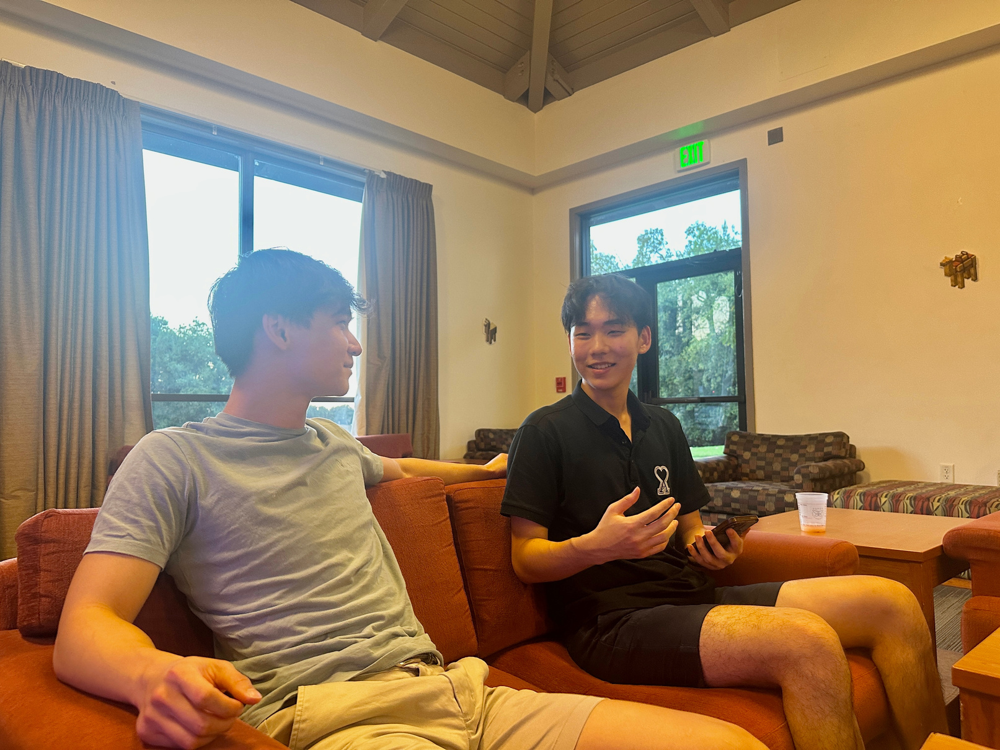
CS 147 · Stanford University
Oct 4 2024
“Balancing schoolwork and tutoring at night, My sleep becomes fragmented.”
Calvin C.
Calvin is a senior at Stanford studying Econ/Data Science who works as a high school tutor with most clients based internationally in Asia.

Slide 16
Says
Thinks
  Says that Scheduling conflicts, their nights (and my very early morning)."
  He’s been tutoring ACT and AP Economics in Asia well over 100 hours for the past 8 months, which has been the main
  "My sleep becomes fragmented” — says that he would do three hour “naps” 1-2 times a day
  Despite excessive consuming of caffeine, he still is somehow always exhausted.
  "I cannot fall asleep at night because of how fragmented my sleep schedule is"
  He needs to continuously drink caffeine to balance both school works
  "It’s pretty bad to focus in class."
  "Melatonin is not working."
  Despite his strenuous work, he really wants to go back to a normal sleep schedule: "I really want to go back to a circadian rhythm."
  Wants to find a way where he can “perform in school better with this sleep schedule
  Believes that the night shift is detrimental to his health and academic performance.
  Thinks fragmented sleep is an unfortunate but unavoidable consequence of his schedule.
  Considers caffeine a necessary evil for survival during shifts.
  Desires a return to a normal circadian rhythm and structured meals.
  May feel pressured to keep up with both work and academic responsibilities.
  Feels frustrated with the ineffectiveness of melatonin for sleep.
  Recognizes the impact of night shifts on social life and relationships.
  Acknowledges the need for tools to help manage sleep better.
  Understands the link between physical health and sleep quality.
  Believes that improved sleep could enhance his overall life satisfaction.
Does
Feels
  Doesn’t use any sleep medications because they don’t work (does drink caffeine)
  Has a strict routine easing into/out of night shift periods
  Struggles to schedule social/business appointments within traditional 9-5 hours
  Uses devices like blackout curtains, eye masks, portable fan to help him sleep during the day, otherwise he struggles to sleep even with melatonin
  Tries to get 7 hours of sleep every day, but very fragmented
  Is used to taking the extra effort to make time for his personal and social life
  Feel more alert at the beginning of the shift, and finds it hard to stay awake later on (4/5 am)
  Stays in his dorm most of the time instead of going out and socializing with friends
  Uses his Apple Watch to track his heart levels (not his sleep because it’s bad at tracking it), and it increased by 20%
  Exhaustion from inconsistent sleep patterns.
  He’s constantly frustated over not being able to fall asleep easily.
  Lots of anxiety about academic performance due to fatigue.
  Stress from balancing work and personal life.
  He feels some sadness over missing social opportunities with friends, and wishes to have more chances to do so.
  Overwhelmed by the need to manage multiple responsibilities.
  Disappointment in the ineffectiveness of sleep aids like melatonin.
  Hopefulness for a potential return to a healthier sleep schedule.
  He feels concern about the long-term health implications of night shifts.
  I can tell he feels some real desperation for a more structured daily routine.

Slide 17
Says
Thinks
  Says that Scheduling conflicts, their nights (and my very early morning)."
  He’s been tutoring ACT and AP Economics in Asia well over 100 hours for the past 8 months, which has been the main
  "My sleep becomes fragmented” — says that he would do three hour “naps” 1-2 times a day
  Despite excessive consuming of caffeine, he still is somehow always exhausted.
  "I cannot fall asleep at night because of how fragmented my sleep schedule is"
  He needs to continuously drink caffeine to balance both school works
  "It’s pretty bad to focus in class."
  "Melatonin is not working."
  Despite his strenuous work, he really wants to go back to a normal sleep schedule: "I really want to go back to a circadian rhythm."
  Wants to find a way where he can “perform in school better with this sleep schedule
  Believes that the night shift is detrimental to his health and academic performance.
  Thinks fragmented sleep is an unfortunate but unavoidable consequence of his schedule.
  Considers caffeine a necessary evil for survival during shifts.
  Desires a return to a normal circadian rhythm and structured meals.
  May feel pressured to keep up with both work and academic responsibilities.
  Feels frustrated with the ineffectiveness of melatonin for sleep.
  Recognizes the impact of night shifts on social life and relationships.
  Acknowledges the need for tools to help manage sleep better.
  Understands the link between physical health and sleep quality.
  Believes that improved sleep could enhance his overall life satisfaction.
His schedule is completely flipped, which causes him to rely heavily on caffeine (pre- workout)
His inability to sleep at night is a major frustration that affects both his physical and mental well-being.
Believes that a better sleep schedule and circadian rhythm would significantly improve his academic performance and overall quality of life.
He thinks fragmented sleep is his biggest hurdle and wishes he could find a more effective solution for managing it, such as better sleep tracking or cycles.
Does
Feels
  Doesn’t use any sleep medications because they don’t work (does drink caffeine)
  Has a strict routine easing into/out of night shift periods
  Struggles to schedule social/business appointments within traditional 9-5 hours
  Uses devices like blackout curtains, eye masks, portable fan to help him sleep during the day, otherwise he struggles to sleep even with melatonin
  Tries to get 7 hours of sleep every day, but very fragmented
  Is used to taking the extra effort to make time for his personal and social life
  Feel more alert at the beginning of the shift, and finds it hard to stay awake later on (4/5 am)
  Stays in his dorm most of the time instead of going out and socializing with friends
  Uses his Apple Watch to track his heart levels (not his sleep because it’s bad at tracking it), and it increased by 20%
  Exhaustion from inconsistent sleep patterns.
  He’s constantly frustated over not being able to fall asleep easily.
  Lots of anxiety about academic performance due to fatigue.
  Stress from balancing work and personal life.
  He feels some sadness over missing social opportunities with friends, and wishes to have more chances to do so.
  Overwhelmed by the need to manage multiple responsibilities.
  Disappointment in the ineffectiveness of sleep aids like melatonin.
  Hopefulness for a potential return to a healthier sleep schedule.
  He feels concern about the long-term health implications of night shifts.
  I can tell he feels some real desperation for a more structured daily routine.
He tries to fit homework and tasks around his irregular schedule but still struggles with fatigue, productivity, and social life.
Constantly uses caffeine and technology (like his Apple Watch) to compensate for lack of sleep, showing an effort to manage his health despite the circumstances.
He feels exhausted and frustrated from not being able to get enough restorative sleep, leading to frequent brain fog and sluggishness during work.
He experiences anxiety and stress from feeling like his night shift work is affecting his ability to balance academics, social life, and physical health.

Slide 18
Says
Thinks
  Says that Scheduling conflicts, their nights (and my very early morning)."
  He’s been tutoring ACT and AP Economics in Asia well over 100 hours for the past 8 months, which has been the main
  "My sleep becomes fragmented” — says that he would do three hour “naps” 1-2 times a day
  Despite excessive consuming of caffeine, he still is somehow always exhausted.
  "I cannot fall asleep at night because of how fragmented my sleep schedule is"
  He needs to continuously drink caffeine to balance both school works
  "It’s pretty bad to focus in class."
  "Melatonin is not working."
  Despite his strenuous work, he really wants to go back to a normal sleep schedule: "I really want to go back to a circadian rhythm."
  Wants to find a way where he can “perform in school better with this sleep schedule
  Believes that the night shift is detrimental to his health and academic performance.
  Thinks fragmented sleep is an unfortunate but unavoidable consequence of his schedule.
  Considers caffeine a necessary evil for survival during shifts.
  Desires a return to a normal circadian rhythm and structured meals.
  May feel pressured to keep up with both work and academic responsibilities.
  Feels frustrated with the ineffectiveness of melatonin for sleep.
  Recognizes the impact of night shifts on social life and relationships.
  Acknowledges the need for tools to help manage sleep better.
  Understands the link between physical health and sleep quality.
  Believes that improved sleep could enhance his overall life satisfaction.
His schedule is completely flipped, which causes him to rely heavily on caffeine (pre- workout)
His inability to sleep at night is a major frustration that affects both his physical and mental well-being.
Believes that a better sleep schedule and circadian rhythm would significantly improve his academic performance and overall quality of life.
He thinks fragmented sleep is his biggest hurdle and wishes he could find a more effective solution for managing it, such as better sleep tracking or cycles.
Does
Feels
  Doesn’t use any sleep medications because they don’t work (does drink caffeine)
  Has a strict routine easing into/out of night shift periods
  Struggles to schedule social/business appointments within traditional 9-5 hours
  Uses devices like blackout curtains, eye masks, portable fan to help him sleep during the day, otherwise he struggles to sleep even with melatonin
  Tries to get 7 hours of sleep every day, but very fragmented
  Is used to taking the extra effort to make time for his personal and social life
  Feel more alert at the beginning of the shift, and finds it hard to stay awake later on (4/5 am)
  Stays in his dorm most of the time instead of going out and socializing with friends
  Uses his Apple Watch to track his heart levels (not his sleep because it’s bad at tracking it), and it increased by 20%
  Exhaustion from inconsistent sleep patterns.
  He’s constantly frustated over not being able to fall asleep easily.
  Lots of anxiety about academic performance due to fatigue.
  Stress from balancing work and personal life.
  He feels some sadness over missing social opportunities with friends, and wishes to have more chances to do so.
  Overwhelmed by the need to manage multiple responsibilities.
  Disappointment in the ineffectiveness of sleep aids like melatonin.
  Hopefulness for a potential return to a healthier sleep schedule.
  He feels concern about the long-term health implications of night shifts.
  I can tell he feels some real desperation for a more structured daily routine.
He tries to fit homework and tasks around his irregular schedule but still struggles with fatigue, productivity, and social life.
Constantly uses caffeine and technology (like his Apple Watch) to compensate for lack of sleep, showing an effort to manage his health despite the circumstances.
He feels exhausted and frustrated from not being able to get enough restorative sleep, leading to frequent brain fog and sluggishness during work.
He experiences anxiety and stress from feeling like his night shift work is affecting his ability to balance academics, social life, and physical health.

Slide 19
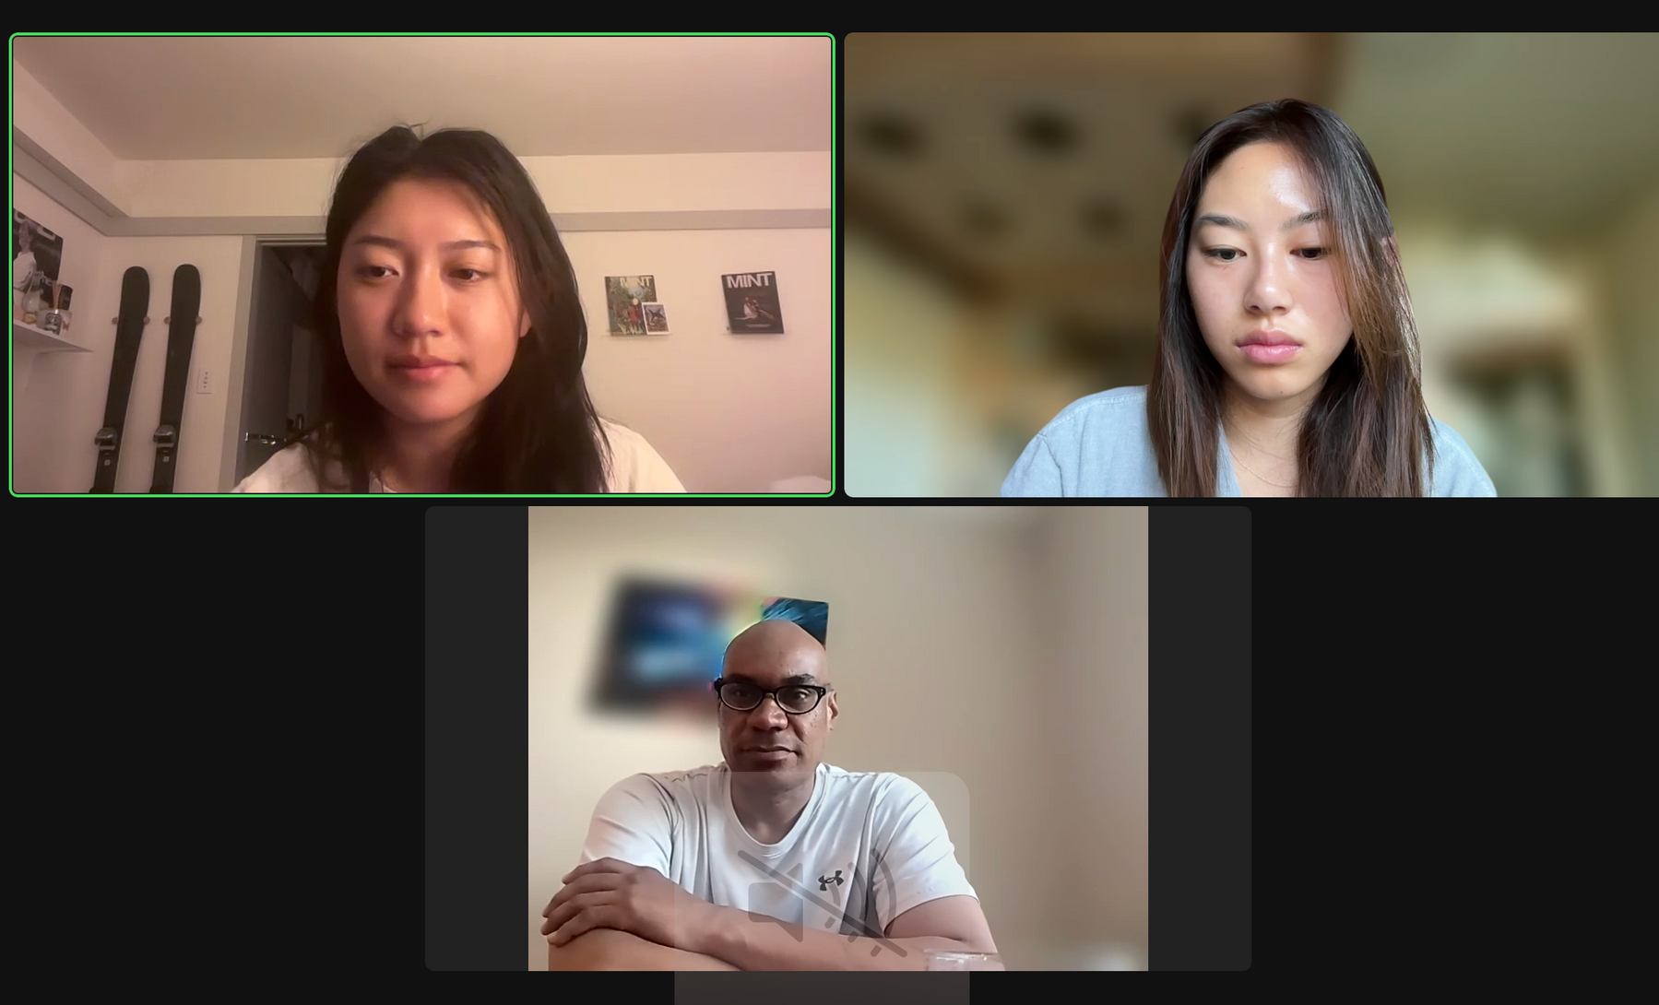
CS 147 · Stanford University
Oct 4 2024
Drew D.
Drew works patient transport at Stanford Hospital 5 nights a week
“If I could go back to day shifts, I would in a heartbeat.”

Slide 20
Says
Thinks
  Main pull to job is financial: bonus $500-800 for working night shift
  Has been with Stanford facilities since 2012: housing covered, used to work @ Lakeside Dining. Patient transporter for 21 months.
  Works 5 night shifts a week, more than other average night shift jobs
  It is hard to accomodate family and other personal responsibilities.
  “Definitely a weird feeling getting up when everyone’s going to bed. It’s hard to explain.”
  On off days, does meal prep, chores, shopping, appointments, family visit, workout. ““Odd to do these at like 3 am”.
  “I had an interview at work at 12 pm in the daytime and it was hard to focus”.
  Sleep pattern is “just unnatural for your body”. Hard to adjust during/after time off.
  “I use a few meditation VR apps to help calm down and sleep during the day.”
  “My social life is basically nonexistent at this point.”
  “I would go back to a daytime schedule in a heartbeat.”
  Trying to get out of this job, it is not ideal for him at all
  He has to work this job for financial reasons, and that is the only thing keeping him there
  He hasn’t fully adjusted -- there is much room for improvement in his current cycle
  But, his sleep cycle is better than before (when he had sleep apnea).
  Caffeine is an issue -- tries to stay away from having too much of it, especially in that environment
  He has it easier than other night shift workers with families and wives -- he doesn’t have
  A caffeine tracker would be a helpful feature to have in the app.
  Alertness wanes throughout shift but hours are decent
  It would be impossible to keep switching in and out of a night schedule because of his 5x a week workday
  Not using his rest days -- just sleeping through them
  The job has helped him out physically since its physically demanding
Does
Feels
  Works 10:30 pm to 7 am, 5x a week with 2 weekend days (Wednesday and Thursday)
  Barely sees his family and friends, with a almost none social life
  Tries to keep a consistent sleep schedule on off days, because otherwise there is a lasting effect
  Still not feel completely adjusted to night shifts, and it’s been 2 years
  Find it difficult to set things up logistically with day-shifters due to time differences
  Uses stretching and VR meditation apps to help him calm down and sleep during the day
  Physically healthier as a result of actual job, not hours/cycle
  Use Google Fit minimally, has other apps but doesn’t use them as much
  Had sleep apnea a few years ago
  Has caffeine but tries not to take too much. It is helpful to push through nights of short staff and overtime.
  Use Reddit, NYT games, etc to keep himself alert throughout his shift.
  A sense of dependency on the job, financially and because Stanford gives him housing
  Concern for his physical health: left previous job due to health reasons, tracks health
  Disconnect from the daytime world, and separation from the rest of the world
  His situation puts him in a hard spot for any regular activities
  Difficulty balancing his professional and personal lives
  Pressure from his work environment to take large amounts of caffeine
  A lack of financial freedom. Shackled to a job he doesn’t prefer because of financial reasons
  Optimistic for an app to help him adjust
  Relieved he is not working this job with other responsibilities (family, etc)
  Accepting of his current situation, but seems more than happy to leave it.

Slide 21
Says
Thinks
  Main pull to job is financial: bonus $500-800 for working night shift
  Has been with Stanford facilities since 2012: housing covered, used to work @ Lakeside Dining. Patient transporter for 21 months.
  Works 5 night shifts a week, more than other average night shift jobs
  It is hard to accomodate family and other personal responsibilities.
  “Definitely a weird feeling getting up when everyone’s going to bed. It’s hard to explain.”
  On off days, does meal prep, chores, shopping, appointments, family visit, workout. ““Odd to do these at like 3 am”.
  “I had an interview at work at 12 pm in the daytime and it was hard to focus”.
  Sleep pattern is “just unnatural for your body”. Hard to adjust during/after time off.
  “I use a few meditation VR apps to help calm down and sleep during the day.”
  “My social life is basically nonexistent at this point.”
  “I would go back to a daytime schedule in a heartbeat.”
  Trying to get out of this job, it is not ideal for him at all
  He has to work this job for financial reasons, and that is the only thing keeping him there
  He hasn’t fully adjusted -- there is much room for improvement in his current cycle
  But, his sleep cycle is better than before (when he had sleep apnea).
  Caffeine is an issue -- tries to stay away from having too much of it, especially in that environment
  He has it easier than other night shift workers with families and wives -- he doesn’t have
  A caffeine tracker would be a helpful feature to have in the app.
  Alertness wanes throughout shift but hours are decent
  It would be impossible to keep switching in and out of a night schedule because of his 5x a week workday
  Not using his rest days -- just sleeping through them
  The job has helped him out physically since its physically demanding
Trying to get out of the job because it is unideal for him
Doesn’t think rest days are truly leisure days but rather uses it to catch up on sleep
“This sleep pattern is unnatural for your body”
“I would go back to daytime shifts in a heartbeat.”
Does
Feels
  Works 10:30 pm to 7 am, 5x a week with 2 weekend days (Wednesday and Thursday)
  Barely sees his family and friends, with a almost none social life
  Tries to keep a consistent sleep schedule on off days, because otherwise there is a lasting effect
  Still not feel completely adjusted to night shifts, and it’s been 2 years
  Find it difficult to set things up logistically with day-shifters because of time differences
  Uses stretching and VR meditation apps to help him calm down and sleep during the day
  Physically healthier as a result of actual job, not hours/cycle
  Use Google Fit minimally, has other apps but doesn’t use them as much
  Had sleep apnea a few years ago
  Has caffeine but tries not to take too much. It is helpful to push through nights of short staff and overtime.
  Use Reddit, NYT games, etc to keep himself alert throughout his shift.
  A sense of dependency on the job, financially and because Stanford gives him housing
  Concern for his physical health: left previous job due to health reasons, tracks health
  Disconnect from the daytime world, and separation from the rest of the world
  His situation puts him in a hard spot for any regular activities
  Difficulty balancing his professional and personal lives
  Pressure from his work environment to take large amounts of caffeine
  A lack of financial freedom. Shackled to a job he doesn’t prefer because of financial reasons
  Optimistic for an app to help him adjust
  Relieved he is not working this job with other responsibilities (family, etc)
  Accepting of his current situation, but seems more than happy to leave it.
Uses stretching and VR meditation app to help him calm down before he sleeps
Keeps himself awake through playing NYT games and Reddit (scrolling apps)
A sense of dependency for the job financially and because of housing
Feels optimistic about an app that might help him adjust

Slide 22
Says
Thinks
  Main pull to job is financial: bonus $500-800 for working night shift
  Has been with Stanford facilities since 2012: housing covered, used to work @ Lakeside Dining. Patient transporter for 21 months.
  Works 5 night shifts a week, more than other average night shift jobs
  It is hard to accomodate family and other personal responsibilities.
  “Definitely a weird feeling getting up when everyone’s going to bed. It’s hard to explain.”
  On off days, does meal prep, chores, shopping, appointments, family visit, workout. ““Odd to do these at like 3 am”.
  “I had an interview at work at 12 pm in the daytime and it was hard to focus”.
  Sleep pattern is “just unnatural for your body”. Hard to adjust during/after time off.
  “I use a few meditation VR apps to help calm down and sleep during the day.”
  “My social life is basically nonexistent at this point.”
  “I would go back to a daytime schedule in a heartbeat.”
  Trying to get out of this job, it is not ideal for him at all
  He has to work this job for financial reasons, and that is the only thing keeping him there
  He hasn’t fully adjusted -- there is much room for improvement in his current cycle
  But, his sleep cycle is better than before (when he had sleep apnea).
  Caffeine is an issue -- tries to stay away from having too much of it, especially in that environment
  He has it easier than other night shift workers with families and wives -- he doesn’t have
  A caffeine tracker would be a helpful feature to have in the app.
  Alertness wanes throughout shift but hours are decent
  It would be impossible to keep switching in and out of a night schedule because of his 5x a week workday
  Not using his rest days -- just sleeping through them
  The job has helped him out physically since its physically demanding
Trying to get out of the job because it is unideal for him
Doesn’t think rest days are truly leisure days but rather uses it to catch up on sleep
“This sleep pattern is unnatural for your body”
“I would go back to daytime shifts in a heartbeat.”
Does
Feels
  Works 10:30 pm to 7 am, 5x a week with 2 weekend days (Wednesday and Thursday)
  Barely sees his family and friends, with a almost none social life
  Tries to keep a consistent sleep schedule on off days, because otherwise there is a lasting effect
  Still not feel completely adjusted to night shifts, and it’s been 2 years
  Find it difficult to set things up logistically with day-shifters because of time differences
  Uses stretching and VR meditation apps to help him calm down and sleep during the day
  Physically healthier as a result of actual job, not hours/cycle
  Use Google Fit minimally, has other apps but doesn’t use them as much
  Had sleep apnea a few years ago
  Has caffeine but tries not to take too much. It is helpful to push through nights of short staff and overtime.
  Use Reddit, NYT games, etc to keep himself alert throughout his shift.
  A sense of dependency on the job, financially and because Stanford gives him housing
  Concern for his physical health: left previous job due to health reasons, tracks health
  Disconnect from the daytime world, and separation from the rest of the world
  His situation puts him in a hard spot for any regular activities
  Difficulty balancing his professional and personal lives
  Pressure from his work environment to take large amounts of caffeine
  A lack of financial freedom. Shackled to a job he doesn’t prefer because of financial reasons
  Optimistic for an app to help him adjust
  Relieved he is not working this job with other responsibilities (family, etc)
  Accepting of his current situation, but seems more than happy to leave it.
Uses stretching and VR meditation app to help him calm down before he sleeps
Keeps himself awake through playing NYT games and Reddit (scrolling apps)
A sense of dependency for the job financially and because of housing
Feels optimistic about an app that might help him adjust

Slide 23
CS 147 · Stanford University
Oct 4 2024
Key
Insights
  Workers agreed that night shift work has somewhat impacted their quality of life with varying degrees
  Workers agreed that for those with family and friends, social life is difficult to maintain
  Workers find it most difficult to transition from night to day shifts (both part-time switching and full transitions)
  Workers seek consistency or routine
  No one perfect solution: Workers had various and highly personalized methods and routines to maintain their health and wellbeing

Slide 24
CS 147 · Stanford University
Oct 4 2024
What’s Next?
1
Develop POVs based on interview findings
3
Brainstorm HMWs based on empathy maps
2
2 additional interviews for further insights
4
Evaluate “how might we...” ideas as a team

Slide 25
CS 147 · Stanford University
Oct 4 2024
  Interview Questions
  Interview Notes - Ryan R, Deputy
  Interview Notes - Rena R, Physician
  Interview Notes - Drew D, Hospital worker
  Interview Notes - Calvin, Tutor
Appendix

Slide 26

CS 147 · Stanford University
Oct 4 2024
That's a wrap!
Thank you for listening.

