Slide 1
Usability Testing
November 18, 2024
Notes:
-- Last year --
full lecture so shot for 80 min with ample 30 min team break
Wow… only a 15 min break!!!! Also had to jam through last 5 slides (did only 15 min activity). First part of lecture was 10 min too slow by far
----------
two years ago, midterm review so goal 45-50 min, 15 min team break, 30 min review (skipped the 15 min activity this year)
Still took 83 min. Need to cut 15-20 min at least!!!! (if midterm review in same lecture)
---- last year ----
This year no midterm review (as after midterm). So, goal 80 min with 30 min team break
5 min over (25 min team break and only 15 min exercise). Go a little faster in first half.
--------
Last year: 82 minutes 1st half including a 20 min activity + (midterm review slides with remaining 28 minutes)
(should have been 60 minutes… went WAY long – cut 3-5 more slides)

Slide 2

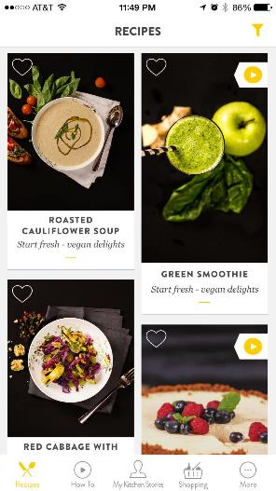
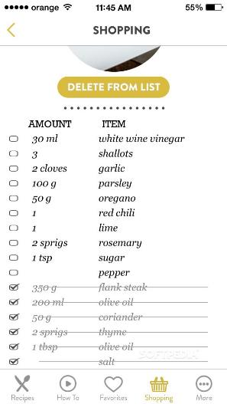
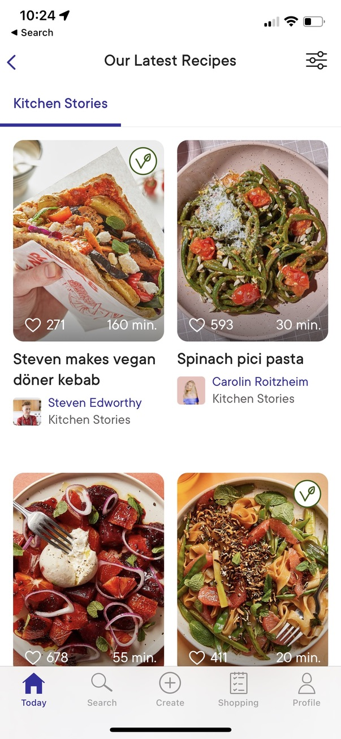
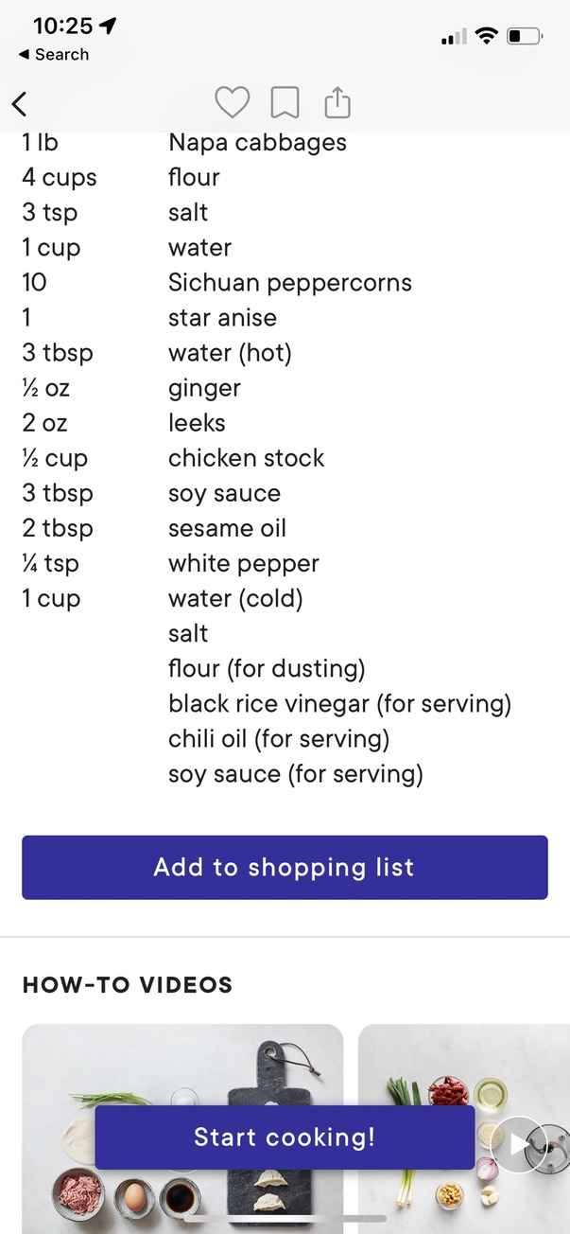
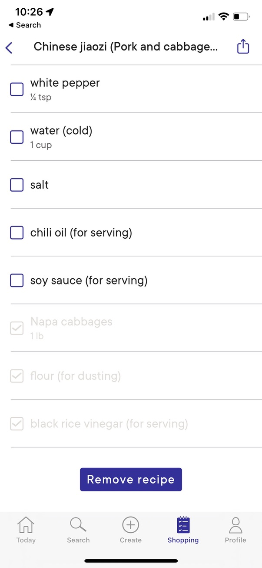
Hall of Fame or Shame?
Kitchen Stories
Notes:
This is a site sent to me by a student.
It is a cooking site.
You can see pictures of recipes. I find one I like for Jiaozi & tap on it
[ADVANCE]
I scroll down and see the ingredients.
I can say add it to my shopping list. I press that button and
[ADVANCE]
And when I am the grocery store I can select things as I put them in my cart (or things I already have) and they grey out.
What do we think?

Slide 3

Hall of Fame!
Kitchen Stories
Like
  large pictures of recipes
  photos & videos
  shopping list that marks off as you purchase
Wish
  fonts hard to read for long list
  why the tab for “Kitchen Stories”?
Notes:
why this tab for "kitchen stories" and fonts hard to read for long list of ingredients

Slide 4
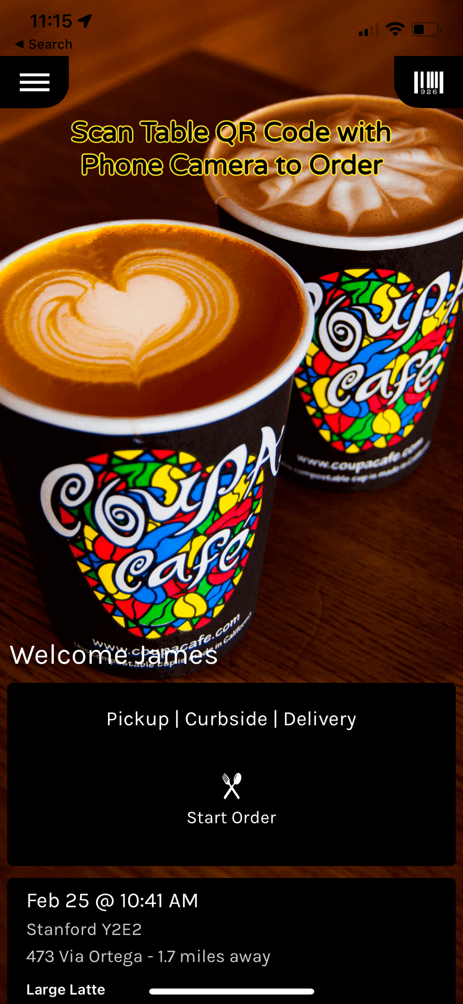
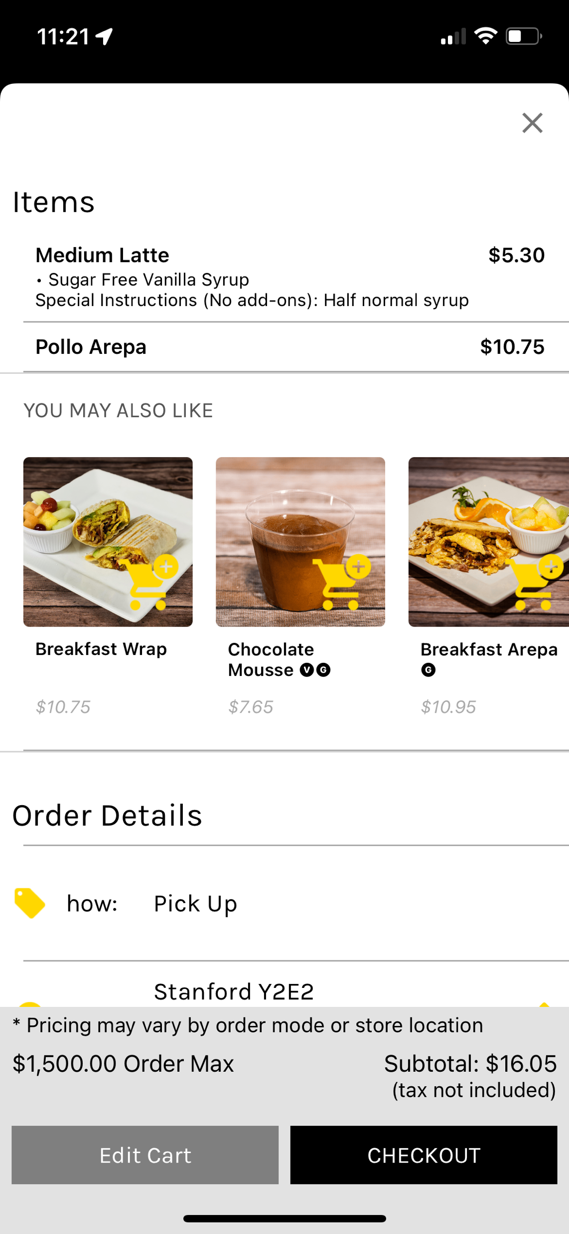
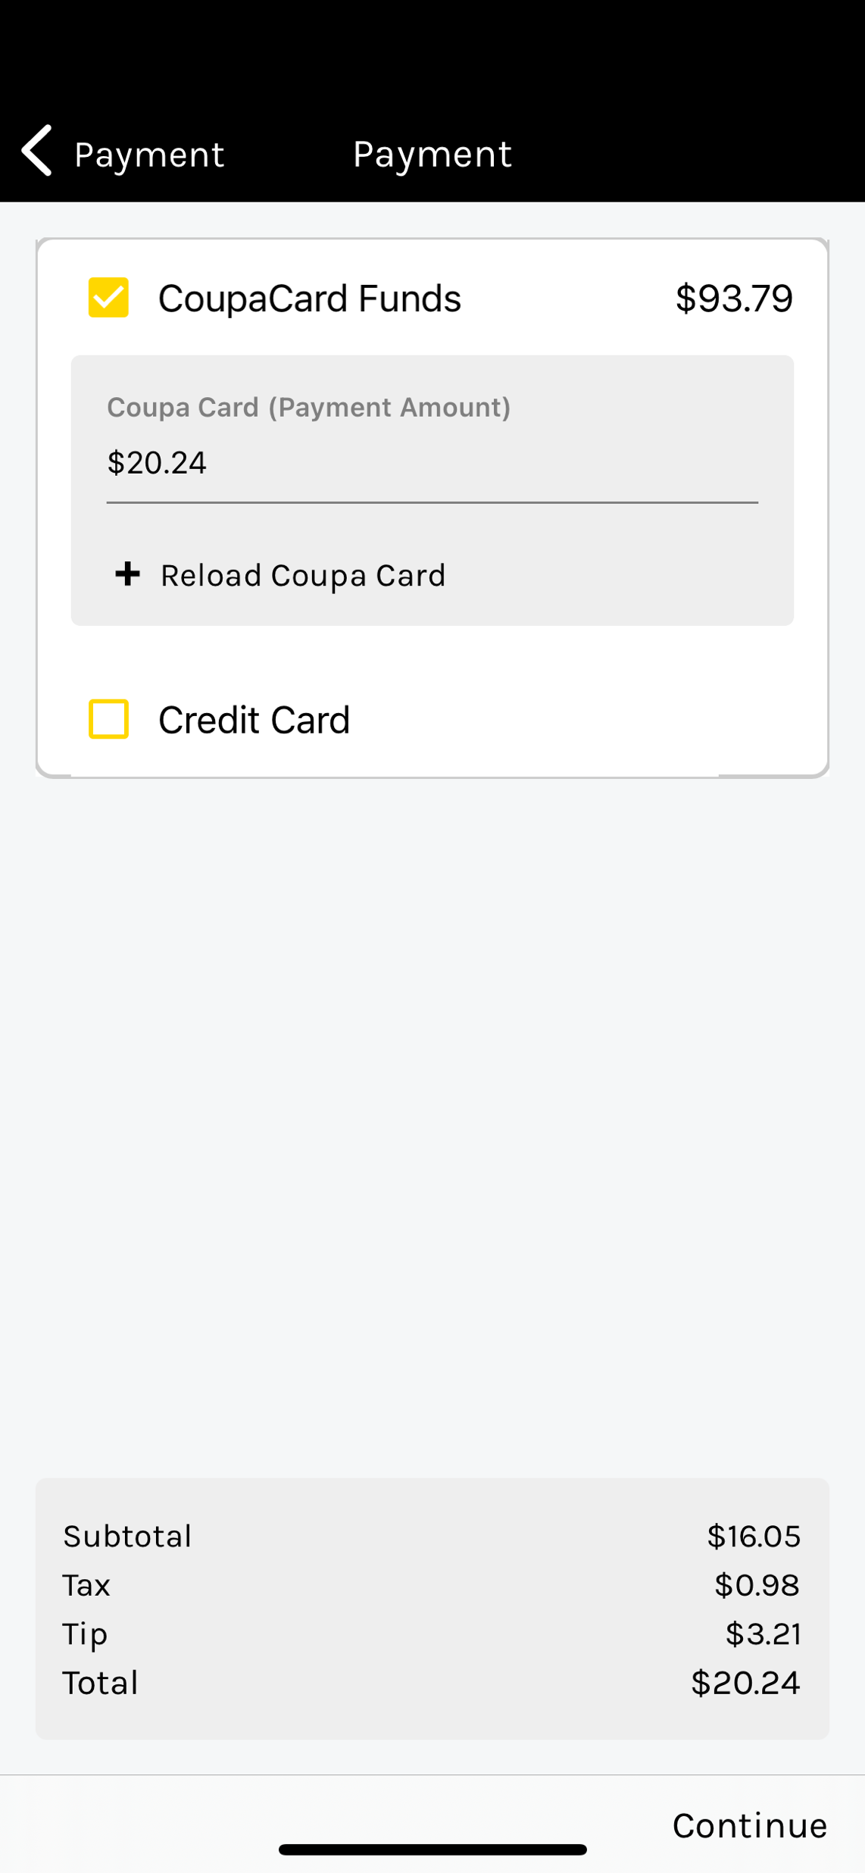
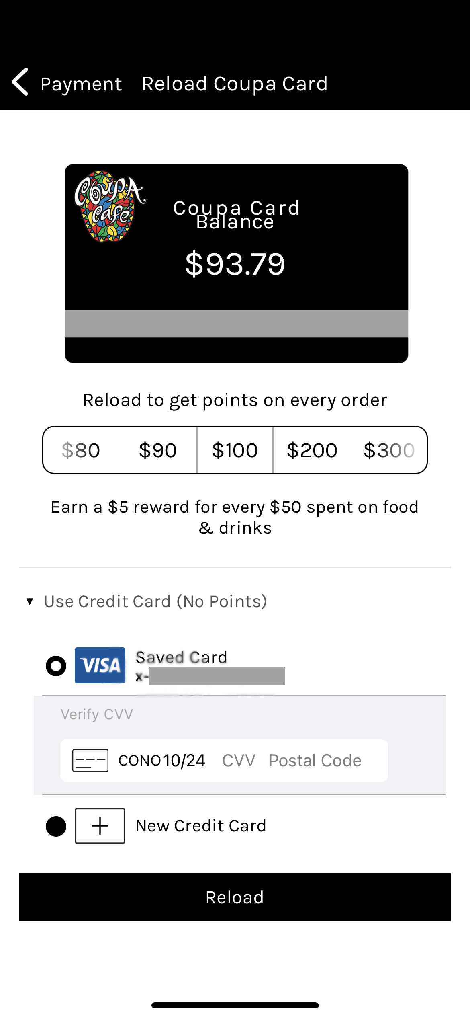
Hall of Fame or Shame?
Coupa Café
Notes:
This is one I’ve run into several times How many of you ever go to Coupa Café?
Their app remembers my recent orders and my common cafes when I click on Start order
[ADVANCE]
I’ll skip some steps, but I added two items for lunch to my cart last night.
A latte and an arepa.
Sometimes I’m not sure if I’ve added or not as the button you add with has poor feedback
But let’s assume I added and I go to checkout
[ADVANCE
I see I have enough money on my card, but lets say I want to add some to be safe.
[ADVANCE]
I get this screen How much am I adding?
Before they had a dot below the numbers that you could barely see.
Now…
What do you like? What do you wish?

Slide 5

Hall of Shame!
Coupa Café
Like
  remembers my usual café
Wish
  how much money am I adding?
  lots of steps to order & checkout

Slide 6
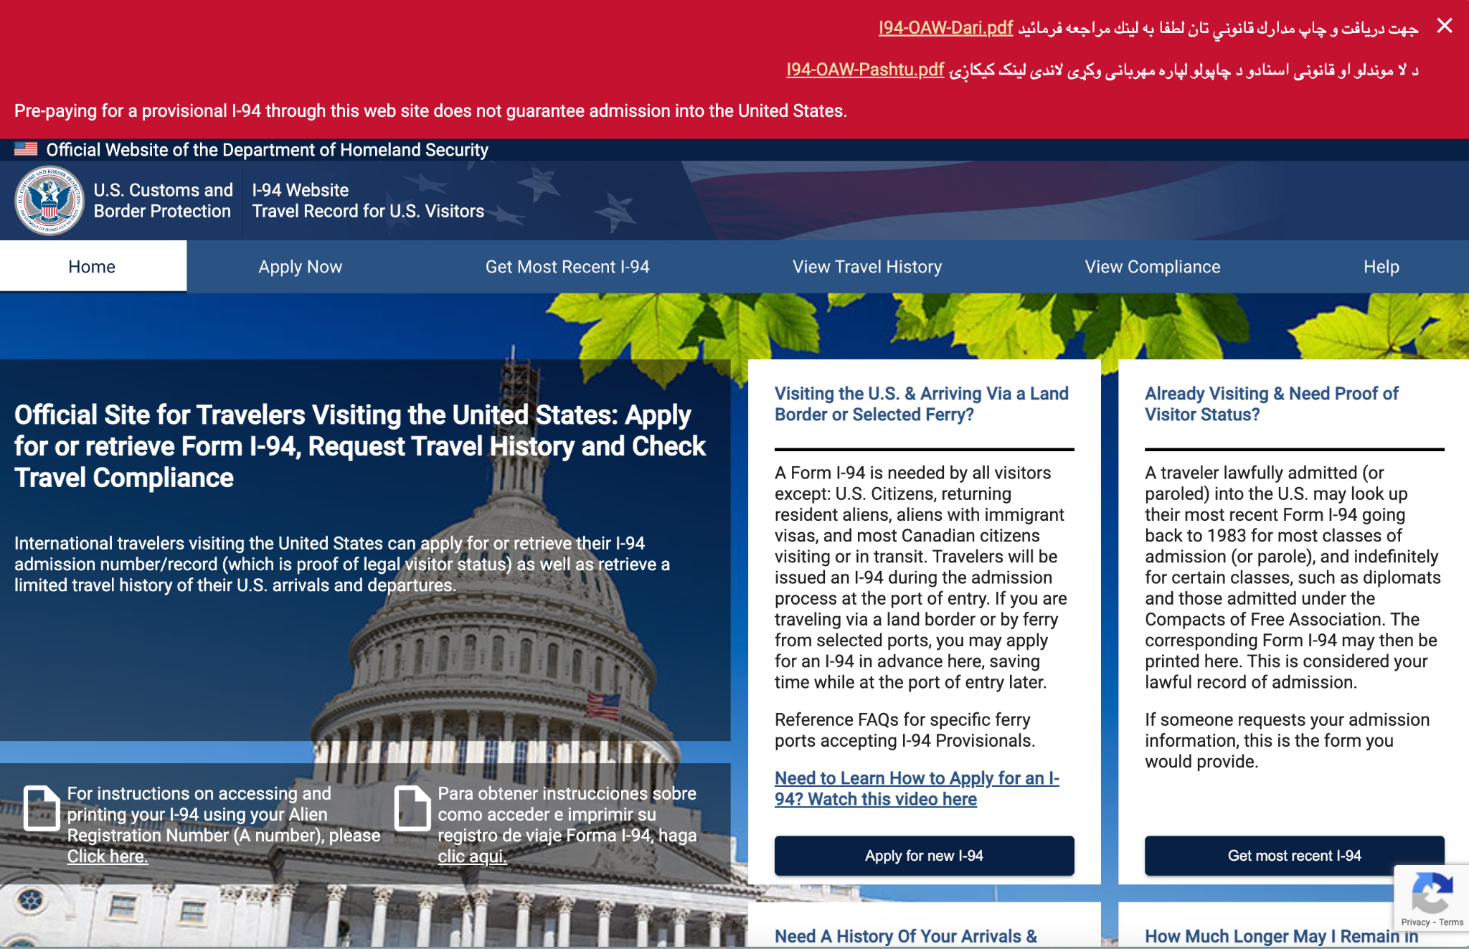
Hall of Fame or Hall of Shame?
U.S. I-94 Website
I-94: A document that gives you your travel history to and from the U.S.
Notes:
i-94 is a document that gives you your travel history to and from the U.S.

Slide 7
Hall of Shame!
Obscure PDFs and use of Dari/Pashto at the top grab attention, but unclear what they are (to non-Afghan users)
“Get most recent I-94” should be central action but is one of many tabs
Distracting background
Black overlay behind text doesn’t provide enough contrast
Too much going on
Notes:
There are two PDF links provided, one labeled "I94-OAW-Dari.pdf" and the other "I94-OAW-Pashtu.pdf", resources in the Dari and Pashto languages (spoken in Afghanistan) that provide information or instructions for individuals who may be applying for a provisional I-94.

Slide 8
Usability Testing
November 18, 2024
Notes:
Today we will talk about usability testing.
Why are we learning this?
This is the gold standard in seeing whether a system or application you have built actually achieves its goal in working for your intended users. There are a lot of ways you can run tests right and run them wrong and I want you to know about the key ideas here, even though we won't get a chance to apply this on your CS147 projects. If you take CS194H next year or CS377U, this will be one of the first things you do (perform a usability test on your CS147 project).

Slide 9
Outline
Why do usability testing?
Choosing participants
Ethical considerations
Designing & conducting the test
Using the results
Experimental options & details
Notes:
I'll start by motivating it...

Slide 10
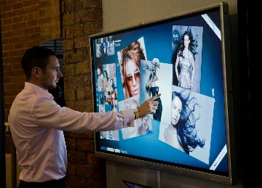
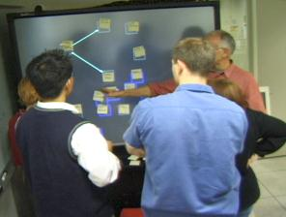

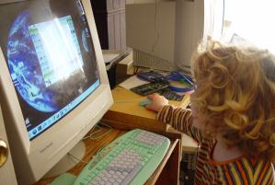
Why do Usability Testing?
Can’t tell how good UI is until?
  people use it!
Expert review methods (e.g., HE) are based on evaluators who may?
  know too much
  not know enough (about tasks, etc.)
Hard to predict what real users will do

Slide 11
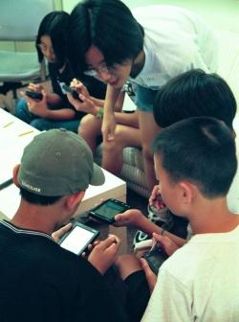
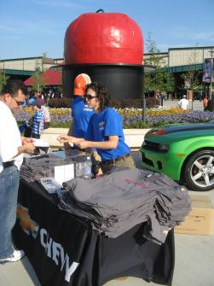
Choosing Participants
Representative of target users. How so?
  job-specific vocab / knowledge
  tasks
Approximate if needed
  system intended for doctors?
    get medical students or nurses
  system intended for engineers?
    get engineering students
Use incentives to get participants
  t-shirt, mug, free coffee/pizza
Notes:
Michigan State Image from http://www.nytimes.com/2009/01/01/business/01student.html

Slide 12

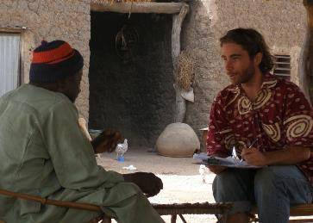
Ethical Considerations
Usability tests can be distressing
  users have left in tears
Testing/fieldwork can be coercive if there is a power imbalance (e.g., in under resourced communities)
People may feel no option but to speak to you or give you their time even though they may not get anything of value in return.
http://centread.ucsc.edu/CenTREAD%20photos/BrianDowd2.JPG
Notes:
It can be distressing
[ADVANCE]
Doing fieldwork in under resourced communities has a number of pitfalls for researchers coming from an empowered group (whether by race, education, or other institutional privilege).
[ADVANCE]
You cannot just drop in to some rural village wearing your African shirt. It just isn’t ethical.
Even paying money can be coercive because the intended participants may NOT be able to turn you down

Slide 13
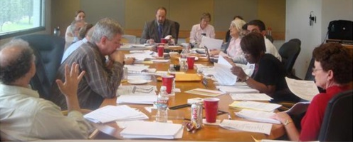
Ethical Considerations
You have a responsibility to alleviate these issues
  make voluntary with informed consent (form)
  avoid pressure to participate
  let them know they can stop at any time
  stress that you are testing the system, not them
  make collected data as anonymous as possible
Often must get human subjects approval (IRB)
https://www.unthsc.edu/north-texas-regional-irb/institutional-review-board-meeting/

Slide 14
Usability Test Proposal
A report that contains
  objective
  description of system being testing
  task environment & materials
  participants
  methodology
  tasks
  test measures
Get approved & then reuse for final report
Seems tedious, but writing this will help “debug” your test

Slide 15

Selecting Tasks
Tasks from low-fi design can be used
  may need to shorten if
    they take too long
    require background that test user won’t have
Don’t train unless that will occur in real deployment
Avoid bending tasks in direction of what your design best supports
Don’t choose tasks that are too fragmented ?
  fragmented = does not represent a complete goal someone would try to accomplish with your application
  e.g., phone-in bank test or login/create account as a task
Check if your friend has called, find out what time he will be going to the club.

Slide 16


Two Types of Data to Collect
Process data
  observations of what users are doing & thinking
  qualitative
Bottom-line data
  summary of what happened
    time, errors, success
  i.e., the dependent variables
  quantitative
http://allazollers.com/discovery-research.php
http://www.fusionfarm.com/content/uploads/2012/10/analyzing-data.jpg

Slide 17
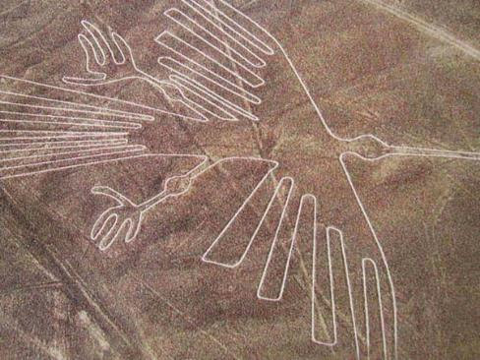
Which Type of Data to Collect?
Focus on process data first
  gives good overview of where problems are
http://www.redicecreations.com/ul_img/24592nazca_bird.jpg
Notes:
At this stage you want to see things at a high level to understand the big picture
“It's hard to see things when you're too close. Take a step back and look.”
One of the most mysterious places on Earth, the Nazca Lines in Peru are pictographs etched in the desert.
http://www.azquotes.com/quote/1137013

Slide 18
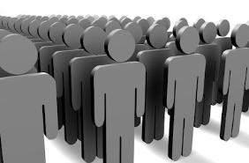
Which Type of Data to Collect?
Focus on process data first
  gives good overview of where problems are
Bottom-line data doesn’t tell you ?
  where to fix
  just says: “too slow”, “too many errors”, etc.
Hard to get reliable bottom-line results
  need many users for statistical significance
http://netbreak-ph.blogspot.com/2012/09/Hitleap-get-traffic-views-on-site.html

Slide 19

The “Thinking Aloud” Method
Need to know what users are thinking, not just what they are doing
Ask users to talk while performing tasks
  tell us what they are thinking
  tell us what they are trying to do
  tell us questions that arise as they work
  tell us things they read
I’ll click on the checkout button

Slide 20
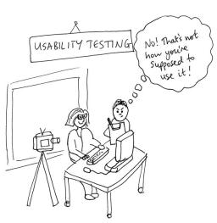
Thinking Aloud (cont.)
Prompt the user to keep talking
  “tell me what you are thinking”
Only help on things you have pre-decided
  keep track of anything you do give help on
Make a recording & take good notes
  make sure you can tell what they were doing
  use a digital watch/clock
  record audio & video
    or even event logs
http://jennycham.co.uk/wp-content/uploads/2011/08/200911221250225481.jpg

Slide 21
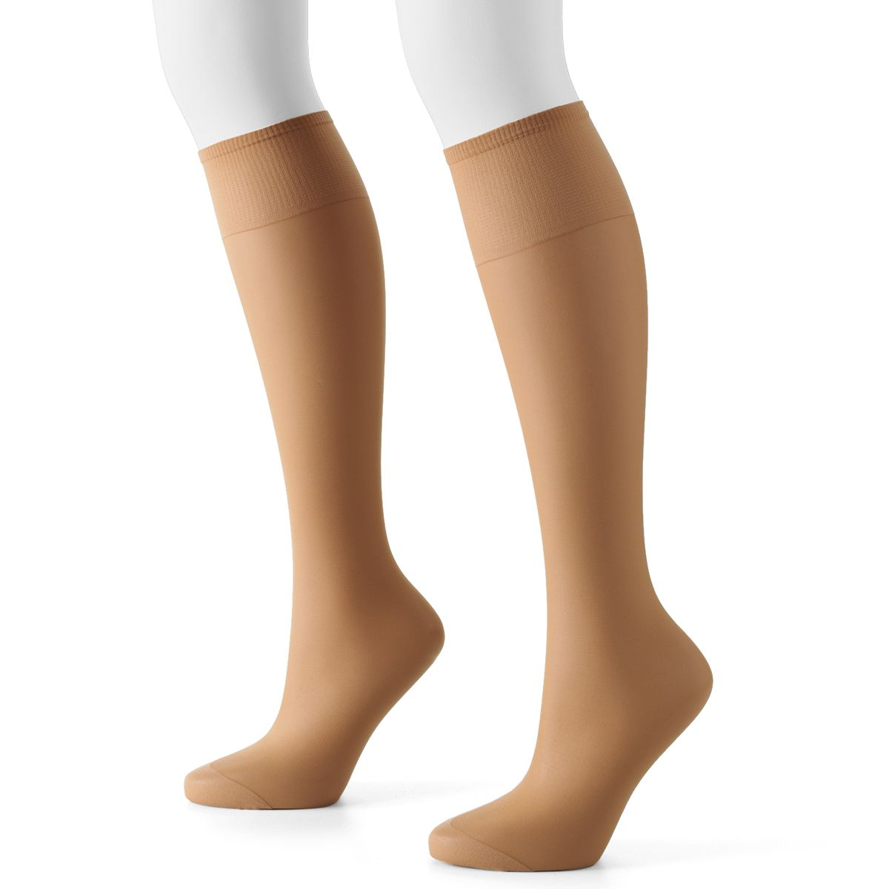
Will thinking out loud give the right answers?
Not always
If you ask, people will always give an answer, even it is has nothing to do with facts
  panty hose example
→Try to avoid specific questions
(especially that have binary answers)
Notes:
Market researchers did an experiment: had someone sit outside a supermarket with 2 pairs of pantyhose and asked which was more sheer
There was a statistically significant difference in participants selections between the one on the right and one on the left
…but they were the same product!
Moral: be careful what you ask – people will try to give you the answer they think you want

Slide 22

Accessibility Issues with Thinking Out Loud
May be less comfortable or accessible for certain users
Factor in time/resources you need to support these interviewees
  interpreters
  more time for the interview
    e.g., someone using sign language can’t give feedback while interacting with your prototype
https://blog.gettinghired.com/hubfs/GettingHired_November2019/Images/CSD%20blog93019660x440%20jpeg.jpeg

Slide 23
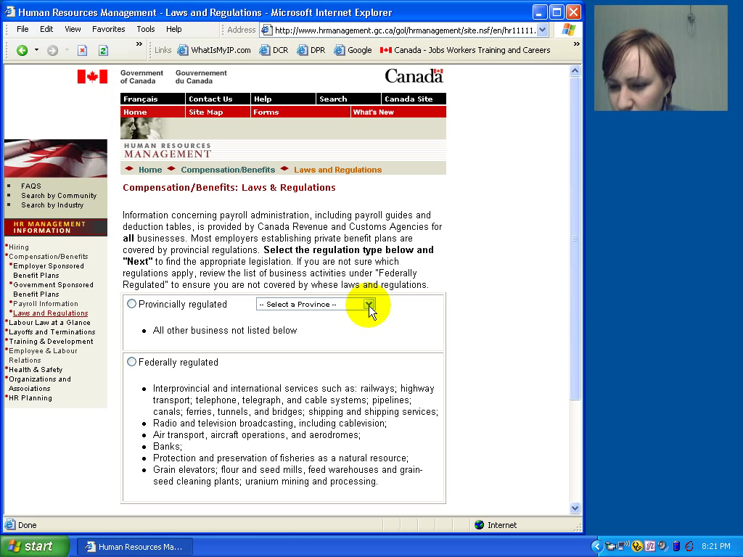
Notes:
Here is an example recording of someone doing a usability test (this is the type of recording you might make -- capturing the screen and the user's face so we can see expressions).
Watch her face and listen to the tone of her voice. These are the types of things you cannot get with A/B testing or other more automated methodologies that we will talk about later.

Slide 24
Try it out!
Use the think aloud protocol to test one task in your medium-fi prototype.
In a moment, we will break you out into your teams. You have 3 minutes to identify which task to study. Select one person to rotate into the group next to you to serve as their participant. If possible, this should be someone who has not done a HE on that team’s prototype.
When they are ready, ask your participant to complete the task while speaking their thought process aloud. Take notes!
Notes:
Got here at 41 min in and took 15 min (restart at 2:30)
-----
Need to be here by 55 min in if you want to take 20 min for this
-----
last year got here at 65 min in, so only took 15 min for activity
(but no review so felt I had the time)
---------
Last year: Got here at 55 in, so took only 15 min for the activity
Two years ago: Got here at 30 minutes into lecture and took 20 minutes to do the activity
Afterwards:
What worked well? What was hard? (about the usability testing process)

Slide 25

Using the Test Results
Summarize the data
  make a list of all critical incidents (CI)
    positive & negative
  include references back to original data
  try to judge why each difficulty occurred
What does data tell you?
  UI work the way you thought it would?
    users take approaches you expected?
  something missing?
https://cdn.careerfoundry.com/en/wp-content/uploads/old-blog-uploads/data-analyst-skills-and-tasks.jpeg

Slide 26
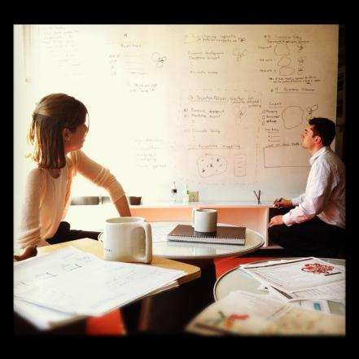
Using the Results (cont.)
Update tasks & rethink design
  rate severity & ease of fixing CIs
  fix both severe problems &
  make the easy fixes
http://www.thetomorrowplan.com/exchange/policies-prairie-chickens-and-parking/

Slide 27
Administrivia
Group project grades (60% of your overall grade)
  your project grade can be impacted by your contribution to the team ➞ pull your weight!
  midway due studio this week (show >= 1 task working!)
Web sites now linked from class projects page
  let @stardoby know if you updated your tagline or project name (check)
Assignments due the final week
  Poster & pitch slide drafts (Mon) & finals (Wed at noon)
  Video demo (Wed)
  Prototype (Fri)
  Report (Sun)
Notes:
This has come up as a question to TAs again and I mentioned in our introductory lecture and multiple times since then.
Your project grade is 60% of your overall grade.
If you don’t pull your weight on your team, you won’t get that full amount of your project grade.
If you haven’t stepped up yet, you need to step up strong on these last assignments.
[ADVANCE]
Web sites linked…
[ADVANCE]
Lots of assignments coming up in the next week....
Make sure you are allocating time [Poster/Pitch assignment is online now]

Slide 28
TEAM BREAK
Work on (or plan for) building your hi-fi prototype
Notes:
2024au:
got here at 2:44 PM so took 16 min and return at 3pm
----
last year:
Got here at 88 min in so took 10 min break (to 3:08)
------
Get here by 60 min. Take 30 min team break. 20 min to finish.
Last year:
got here at 83 min! so only took 10 min break1!!!
--------
If get here past 60 min, cut 15 min break down to 10. Need at least 45 min after break for midterm review
--- last year -----
Got here at 80 min in for 30 min team break so cut to 25 min
*** NOTE *** WE HAVE 116 people signed up to come to our project expo! Its going to be fun. Indoor/Outdoor at the d.school… Dinner on us! Judges who are in important positions in industry! Invite your industry managers!
---
Let’s cut to 20 min and more if get here past 70 min in.
Got here at 2:35 PM (65 min in -- though started 5 min late). Gave a 15 min break.

Slide 29
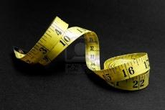
Measuring Bottom-Line Usability
Situations in which numbers are useful
  time requirements for task completion
  successful task completion %
  compare two designs on speed or # of errors
Ease of measurement
  time is easy to record
  error or successful completion is harder
    define in advance what these mean
Do not combine with thinking-aloud. Why?
  talking can affect speed & accuracy

Slide 30

Analyzing the Numbers
Example: trying to get task time ≤ 30 min.
  test gives: 40, 5, 20, 90, 10, 15
  mean (average) = 30
  median (middle) = 17.5
  looks good!
Did we achieve our goal?
Wrong answer, not certain of anything!
Factors contributing to our uncertainty?
  small number of test users (n = 6)
  results are very variable (standard deviation = 32)
    std. dev. measures dispersal from the mean

Slide 31
Analyzing the Numbers (cont.)
This is what basic statistics can be used for
Crank through the procedures and you find
  95% certain that typical value is between 5 & 55
Notes:
95% (or alpha=5%) is the standard confidence interval used in HCI

Slide 32
Analyzing the Numbers (cont.)

Slide 33
Analyzing the Numbers (cont.)
This is what basic statistics can be used for
Crank through the procedures and you find
  95% certain that typical value is between 5 & 55
Usability test data is highly variable
  need lots to get good estimates of typical values
  4x as many tests will only narrow range by 2x
    breadth of range depends on sqrt of # of test users
  this is when online methods become useful
    easy to test w/ large numbers of users

Slide 34
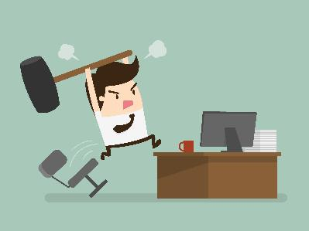
Measuring User Preference
How much users like or dislike the system
  can ask them to rate on a scale of 1 to 10
  or have them choose among statements
    “best UI I’ve ever…”, “better than average”…
  hard to be sure what data will mean
    novelty of UI, unrealistic setting …
If many give you low ratings → trouble
Can get some useful data by asking
  what they liked, disliked, where they had trouble, best part, worst part, etc.
  redundant questions are OK

Slide 35

Comparing Two Alternatives
1
2
Between groups experiment
  two groups of test users
  each group uses only 1 of the systems
Within groups experiment
  one group of test users
    each person uses both systems (cheaper)
    can’t use the same tasks or order (learning)
  best for low-level interaction techniques
    e.g., new mouse, new swipe interaction, …
1
2

Slide 36
Comparing Two Alternatives
Between groups requires many more participants than within groups
See if differences are statistically significant
  assumes normal distribution & same std. dev.
Online companies can do large AB tests
  look at resulting behavior (e.g., buy?)

Slide 37
Experimental Details
Order of tasks
  choose one simple order (simple → complex)
    unless doing within groups → counterbalance order
Training
  depends on how real system will be used
What if someone doesn’t finish
  assign very large time & large # of errors or remove & note
Pilot study
  helps you fix problems with the study
  do two, first with colleagues, then with real users
Notes:
Only use when have extra time

Slide 38
Instructions to Participants
Describe the purpose of the evaluation
  “I’m testing the product; I’m not testing you”
Tell them they can quit at any time
Demonstrate the equipment
Explain how to think aloud
Explain that you will not provide help
Describe the task
  give written instructions
  one task at a time
Check if your friend has called, find out what time he will be going to the club.
Notes:
Try to get the variance down by being consistent in how you do these things.

Slide 39
Details (cont.)
Keeping variability down
  recruit test users with similar background
  brief users to bring them to common level
  perform the test the same way every time
    don’t help some more than others (plan in advance)
  make instructions clear
Debriefing test users
  often don’t remember, so demonstrate or show video segments
  ask for comments on specific features
    show them screen (online or on paper)
Notes:
Only use when have extra time

Slide 40
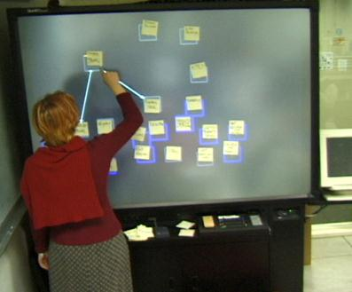
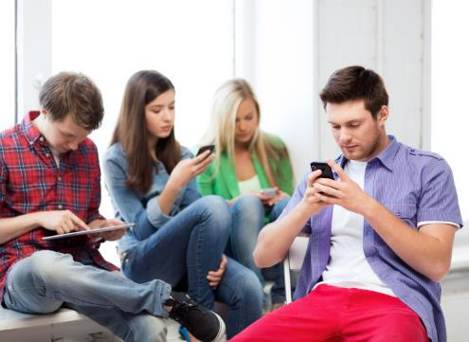
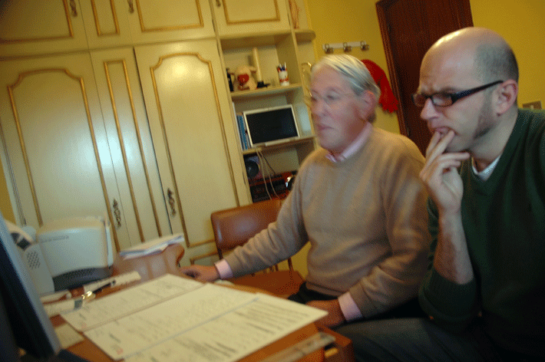
Reporting the Results
Report what you did & what happened
Images & graphs help people get it!
Video clips can be quite convincing

Slide 41
Heuristic Evaluation vs. User Testing
HE is much faster
  2-4 hours each evaluator vs. days-weeks
HE doesn’t require interpreting user’s actions
User testing is far more accurate (by def.)
  takes into account actual users and tasks
  HE may miss problems & find “false positives”
Good to alternate between HE & user testing
  find different problems
  don’t waste participants

Slide 42
Summary
User testing is important, but takes time/effort
Use ????? tasks & ????? participants
  real tasks & representative participants
Be ethical & treat your participants well
Want to know what people are doing & why? collect
  process data
Bottom line data requires ???? to get statistically reliable results
  more participants
Difference between between & within groups?
  between groups: each subject participates in only one of n conditions
  within groups: everyone participates in multiple conditions

Slide 43
Further Reading on Ethical Issues With Community-based Research
Children and Families “At Promise, Beth B. Swadener, Sally Lubeck, editors, SUNY Press, 1995, http://www.sunypress.edu/p-2029-children-and-families-at-promis.aspx
“Yours is better!” Participant Response Bias in HCI, Proceedings of CHI 2012, by Nicola Dell, et al., http://research.microsoft.com/pubs/163718/CHI2012-Dell-ResponseBias-proc.pdf
“Strangers at the Gate: Gaining Access, Building Rapport, and Co-Constructing Community-Based Research”, Proceedings of CSCW 2015, by Christopher A. Le Dantec & Sarah Fox, http://dl.acm.org/citation.cfm?id=2675133.2675147&coll=DL&dl=ACM
“Imperialist Tendencies” blog post by Jan Chipchase, http://janchipchase.com/content/essays/imperialist-tendencies/
“To Hell with Good Intentions” by Ivan Illich, speech to the Conference on InterAmerican Student Projects (CIASP), April 20, 1968, https://www.southwestern.edu/live/files/1158

Slide 44
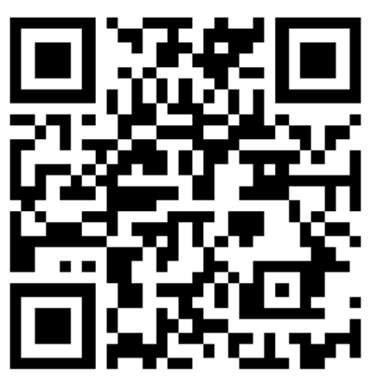
Exit ticket
https://tinyurl.com/2024au-exit-ticket-9-372

Slide 45
Next Time
Design Patterns
  Read from the Design of Sites
    “Making the Most of Web Design Patterns” (Ch 2)
    “Up-Front Value Proposition” (Pattern C2)
    “Process Funnel” (Pattern H1)
    “Meaningful Error Messages” (Pattern K13)
Studio
  A8 midway – show at least 1 of your tasks implemented

