Slide 1
CS 147 Course Midterm Review
Design Thinking for User Experience Design, Prototyping & Evaluation
November 11, 2024
Notes:
65 min then took 10 min break for them to formulate questions. Then 25 min of questions but they gave up after 15.
-- Last year ---
Goal 50 min plus 30 min for questions
[went 90 min and then took questions for 20 but took some questions along the way]
--- two years ago ---
60 minutes total including 5 min for questions at the end because I hid some slides we aren’t testing on this year. Generally probably want 40-45 min total for this plus 15 min for questions [lost 5 min do to a power outage but went 10 min longer].

Slide 2
Administrivia
Assignment #6 Medium-fi Prototype
A6 Prototype Grade: ✓--: 0% ✓-: 7% ✓: 38% ✓+: 48% ✓++: 7%
A6 Slides Grade: ✓--: 0% ✓-: 24% ✓: 62% ✓+: 14% ✓++: 0%
A6 Prototype Average: 93%
A6 Slides Average: 90%
A6 Overall Average: 91%
Notes:
Here you can see the averages for the medium-fi prototype assignment
TWO check++s this year on the prototype, and lots of check pluses. Slightly better than last year. So good job on that

Slide 3
Administrivia
Heuristic Evaluation Grades
  hope to have A7 grades by Monday night & A9 by Tuesday night (so you know if you need to practice before the midterm)
OAE: have you gotten email from us & confirmed?
Course grades
  in the past, ~67% of class has gotten A+, A, or A-
  most of the remainder B+ or B. Few B- and Cs, generally where student did not carry their share of project work

Slide 4

Balance
design
technology
Notes:
You need to find a balance between:
design & technology, human-centered approaches & CS approaches
Especially now HCI needs to find a balance between careful controlled experiments of existing technologies or minor tweaks on technology and building major new systems that can solve important world problems.
East: more family centric… west; individualistic… balance

Slide 5


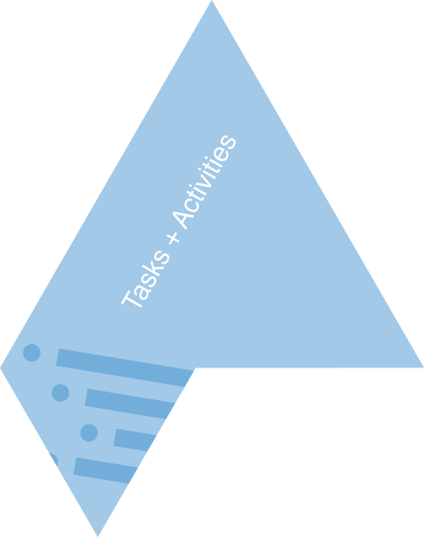


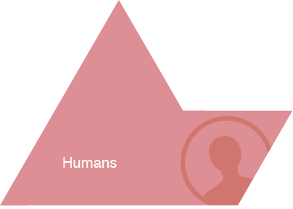
HCI Approach to UX Design
Notes:
Give Examples of Tasks/Activities:
activity:
learning history
high level taskl:
- writing a paper
-drawing a picture
low level task (operation):
- copying a word from one paragraph to another
- coloring a line

Slide 6
How to Design and Build Good UIs
Iterative development process
Usability goals
User-centered design
Design discovery
Rapid prototyping
Evaluation
Programming
Notes:
[ADVANCE]
Focus of CS147 is on these first 6. We use programming to create a prototype, but if you don’t know how to build apps you need to learn it in CS147L or an equivalent course. (this may change in the future).

Slide 7
Iteration
At every stage!
Design
Prototype
Evaluate
Sketch
Paper
Video
Tool
Program
Gut
Crit
Expert Eval
Lo-fi Test
User Study

Slide 8
Usability/User Experience Goals
Set goals early & later use to measure progress
Goals often have tradeoffs, so prioritize
Example goals(?)
  Learnable
    faster the 2nd time & so on
  Memorable
    from session to session
  Flexible
    multiple ways to do tasks
  Efficient
    perform tasks quickly
  Robust
    minimal error rates
    good feedback so user can recover
  Discoverable
    learn new features over time
  Pleasing
    high user satisfaction
  Fun
Notes:
Ask people to tell me some

Slide 9
Design Process: Discovery
Assess Needs
understand client’s expectations
determine scope
of project
characteristics of customers & tasks
evaluate existing practices & products
Discovery
Design Exploration
Design Refinement
Production
Notes:
We call this design discovery needfinding in the design thinking parlance…

Slide 10
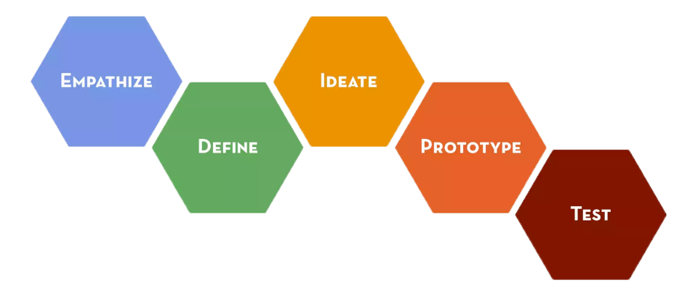
Design Thinking Process
Notes:
We organize our work in CS147 with the Design Thinking Process popularized by ideo and the Stanford d.school
All our assignments so far have been following this process. Make sure you know the assignments and how to do everything you had to do to complete them.

Slide 11
User-centered Design
“Know thy User”
Cognitive abilities
  perception (e.g., color)
  physical manipulation (e.g., Fitts’ Law to predict speed)
  Memory (working vs. long term)
  Fitts’ Law, MHP: processors? cycle & decay times?
Organizational / educational job abilities
Keep users involved throughout
  developers working with target customers
  think of the world in users’ terms
Notes:
`

Slide 12
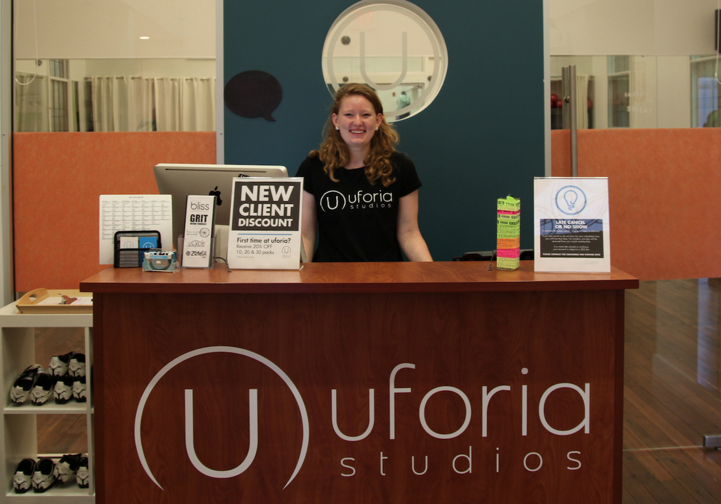
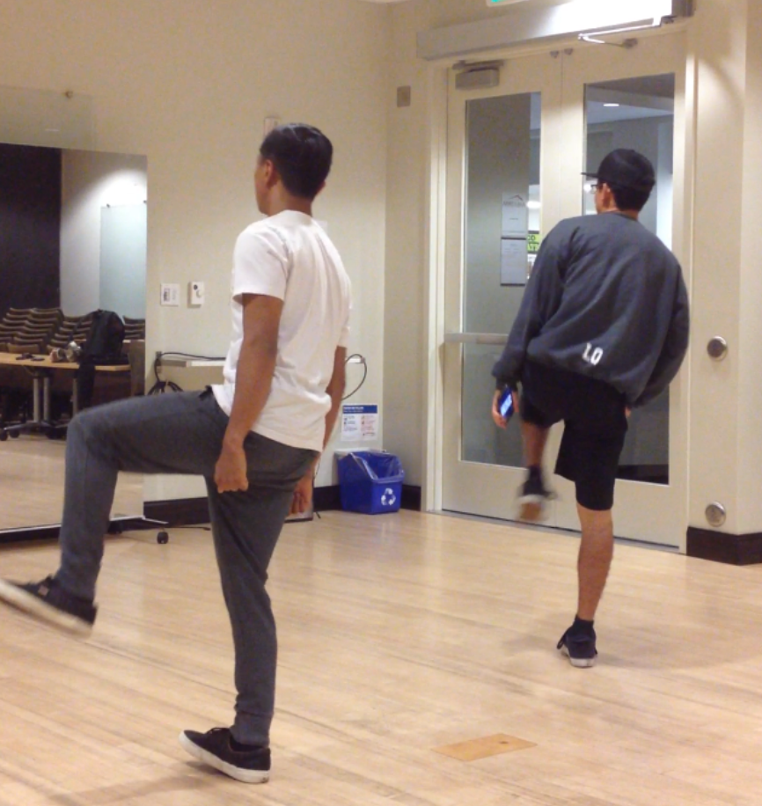
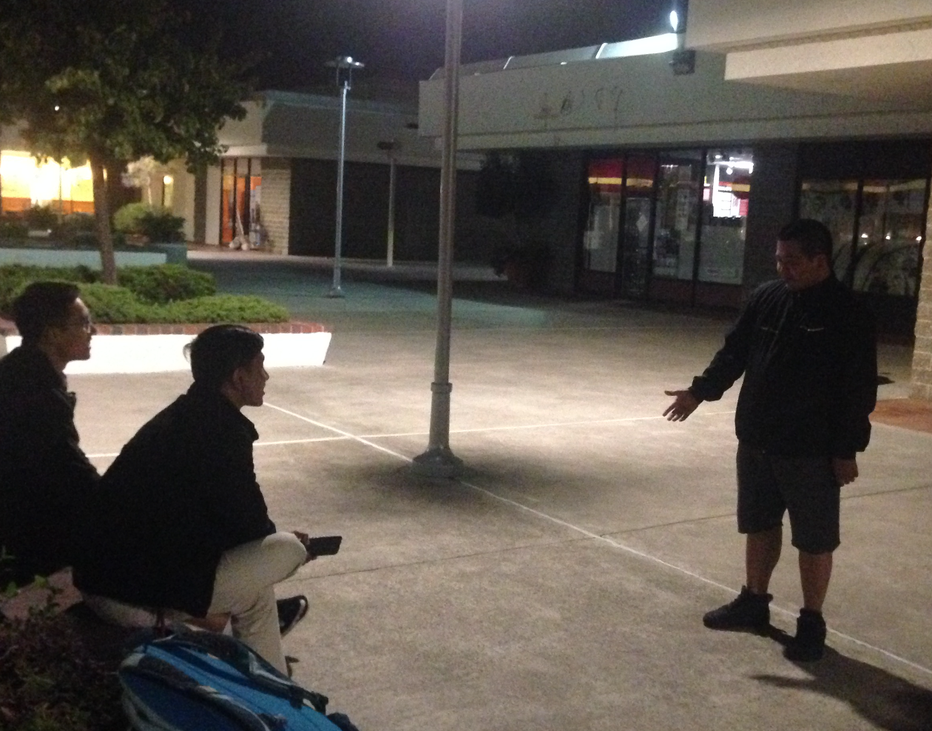
Design Discovery
Needfinding & Task Analysis
Observe existing practices for inspiration
Make sure key questions answered
Ethical questions in design w/ underserved communities
ChoreoLab observed/interviewed dancers in studios…. and out in the streets ...

Slide 13
Focus by Writing a “Point of View”
WE MET . . .
(person you are inspired by)
WE WERE SURPRISED TO NOTICE. . .
(tension, contradiction, or surprise)
WE WONDER IF THIS MEANS. . .
(what did you infer? need—verb reflecting user needs)
IT WOULD BE GAME-CHANGING TO. . .
(Frame up an inspired challenge for your team.
NOT a reason for the need! Not a solution, but a more informed problem)
Notes:
Focus our needfinding by writing a POV
4 straight-forward sentences.
We met: “What specific person did you meet that inspires your work?”
We were surprised to notice: “Tell us something we didn’t know or wouldn’t have thought about before we started this project. What unique new perspective do you have now? What tension, contradiction, or surprise did you find?”
We wonder if this means: What was your leap? What did you infer? This is your need!
It would be game-changing to: “This is your call to action. Build on your insight and take an aspirational stance on what you can do as a team. This isn’t your solution -- it is the problem to be solved. A problem with a more informed perspective.”
[you should know how to do this if I asked you to on a test]

Slide 14
Ideate: From POV to How Might We
POV: We met Janice, a harried mother of 3, rushing through the airport only to wait hours at the gate. We were surprised at the many games she makes up to to entertain her children so they don’t irritate frustrated fellow passengers. It would be game changing to bring the other passengers and the airport facilities into helping families have a better travel experience.
How Might We Generators http://dschool.stanford.edu/wp-content/uploads/2012/05/HMW-METHODCARD.pdf
  Break POV into pieces
  Amp up the good/Remove the bad
  Explore the opposite
  Question an assumption
  Go after adjectives
  Identify unexpected resources
  Create an analogy from need or context
  Change a status quo
Notes:
In our first use of ideation, we go from a POV to generate many How Might We statements.
Use these generators to generate HMWs.
You should be able to do this. Note: you don’t have to memorize this list of generators.

Slide 15
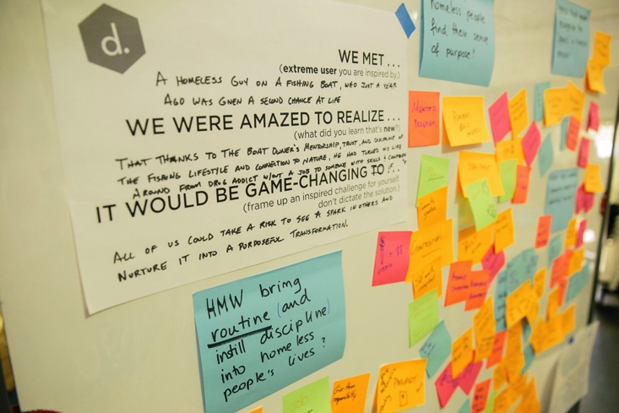
Brainstorm: “How Might We’s” → Solutions
Notes:
We met a homeless guy on a fishing boat, who just a year ago was given a second chance at life
We were amazed to realize that thanks to the boat owner’s mentorship, trust, and display of the fishing lifestyle and connection to nature, he has turned around his life from drug addict without a job to someone with success and compassion
It would be game-changing if all of us could take a risk to see a spark in others and nurture it into a purposeful transformation.
We use ideation AGAIN to go from How Might Wes to Solutions.
You should be able to do that as well and be able to pick a good solution to design for.

Slide 16
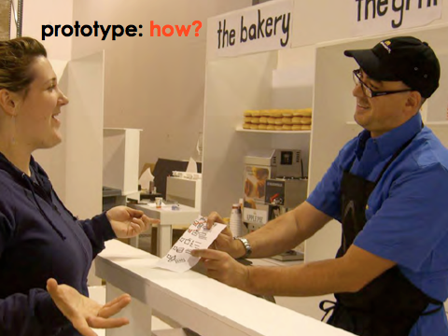
EXPERIENCE PROTOTYPE
INTERACTS LIKE
Notes:
So how can we get from all the ideas we generated in our brainstorm to making a prototype that helps us learn from users
You can prototype what something INTERACTS like.
[ADVANCE]
We also call these EXPERIENCE prototypes. In these, we test how users interact with our ideas– what they think and how they feel during that experience.
This is a picture of a team testing PART of a new fast food counter concept. They are actually letting the users experience the process the team has developed.
Don’t just tell users about an idea that you have—a experience prototype is an opportunity for you to create an experience for your user.
You get to observe how the user acts, and also ask them about the experience they had.
Let the user react to something they are doing, rather than just intellectually judging something you describe.
But we do this really as another needfinding technique. We use it to test an assumption. We do not test an entire prototype.
You should know how to suggest an experience prototype to test a key assumption if I were to give you a proposed design solution.

Slide 17
Design Process: Exploration
Expand Design Space
brainstorming
sketching
storyboarding
prototyping
Discovery
Design Exploration
Design Refinement
Production
Notes:
Expand design space:
brainstorming, sketching, storyboarding, prototyping

Slide 18
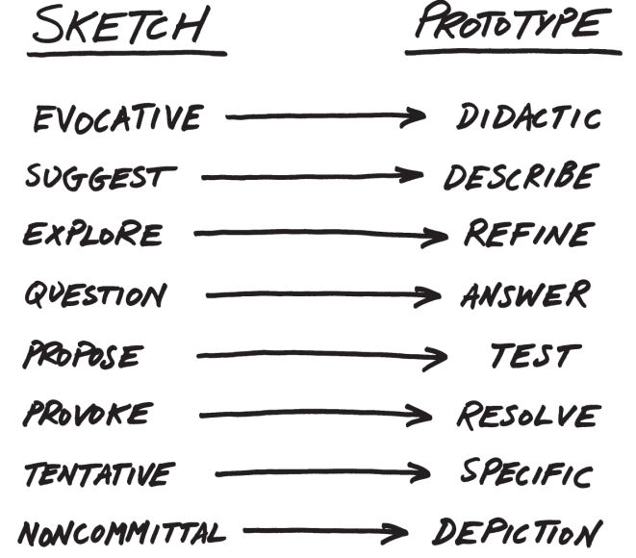
From Sketch to Prototype
Difference in intent rather than in form
Courtesy Bill Buxton
Notes:
This is a continuum, not an either/or proposition
[ADVANCE SLIDES]
The difference between the two is as much a contrast of purpose, or intent, as it is a contrast in form
You should understand when you would want something to be a sketch vs. a prototype, and understand it is not simply about the form (papers vs. computer).

Slide 19
Design Exploration Summary
Sketching allows exploration of many concepts in the very early stages of design
As investment goes up, need to use more and more formal criteria for evaluation
Experience prototyping lets us quickly test the assumptions behind many ideas & learn more about the problem & solution space (prototype to learn)

Slide 20
Concept Videos
Illustrate context of use rather than specific UI
Quick to build
Inexpensive
Forces designers to consider details of how users will react to the design
More important when context is not traditional work scenario

Slide 21
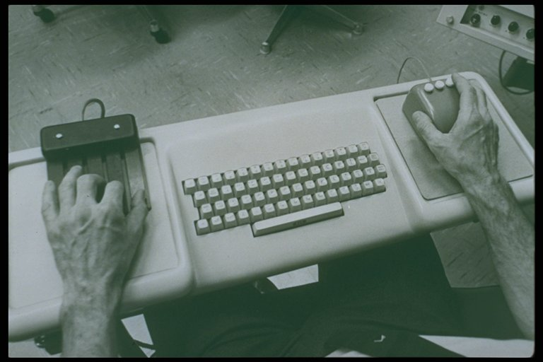
Augmenting Human Intellect – Engelbart (1968)
The NLS Hardware
Notes:
the computer of the 1940s, 50s, and 60s, were very large machines essentially for manipulating math and billing
A few pioneers had a different vision.
NLS was for solving important complex problems by expert users! (two hands working at once!)
1:45 sec video

Slide 22
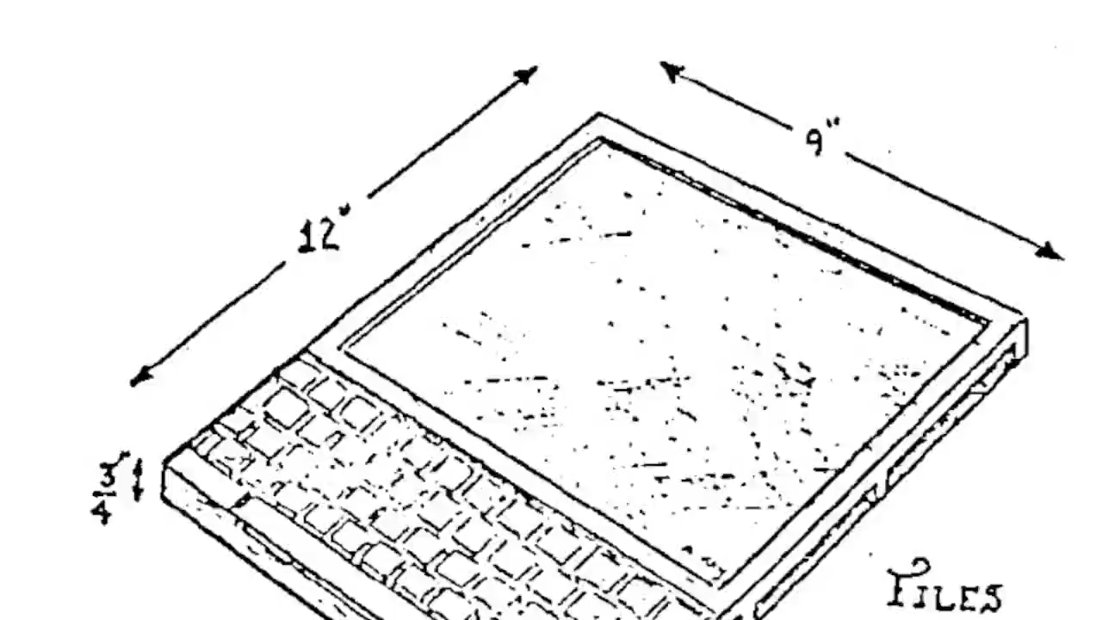
Dynabook – Kay (1974)
Notes:
What does it look like that you are familiar with today?
Invented 1968, over 40 years before the iPad, but wasn’t realizable
1:15 video
[skip the video]

Slide 23
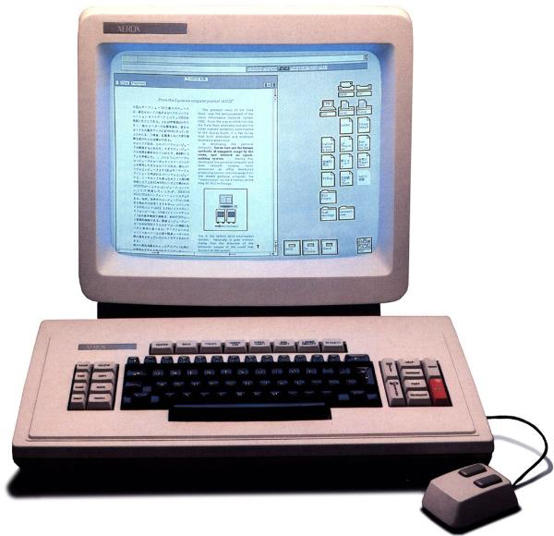
Xerox Star – 1st Commercial GUI (1981)
Notes:
The key computer that led to the Apple Macintosh in 1984 (Jobs saw the Alto – prototype of the Star)
Invented:
Icons
WYSIWYG (with bitmapped display)
Dragging icons to cause actions
1:30 sec video

Slide 24
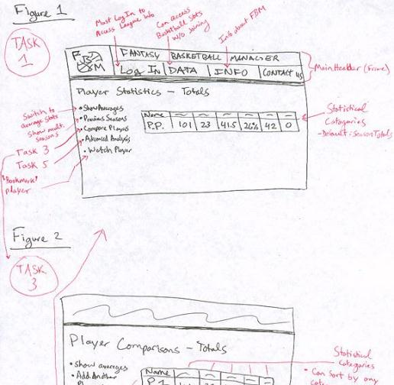
Rapid Prototyping
Fantasy Basketball
Build a mock-up of a design so
you can test it
Low fidelity techniques
  paper sketches
  cut, copy, paste
  low-fi testing allows us to quickly iterate
  get feedback from users & change right away
Interactive prototyping tools
  SketchFlow, Balsamiq, Axure, proto.io, Marvel, Invision, Figma, etc.
UI builders
  Expression Blend + Visual Studio, Xcode Interface Builder, etc.
Notes:
Low-fi is fast.
Can change easily.
Can do it early in the design process.

Slide 25
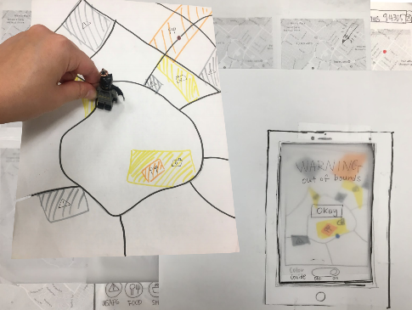
Evaluation
Wanderlust
Test with real customers (participants)
  w/ interactive prototype
  low-fi with paper “computer”
Low-cost techniques
  expert evaluation
  walkthroughs
  online testing
Notes:
All about trying to measure what works and what does not
HE is a low cost technique. It gives you different results from low-fi or usability testing.

Slide 26
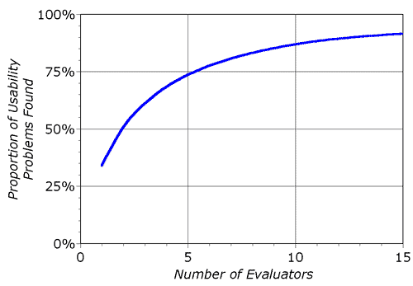
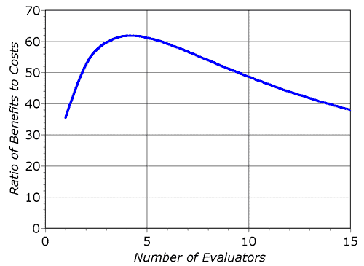
Heuristic Evaluation Decreasing Returns
problems found
benefits / cost
* Caveat: graphs for a specific example
Notes:
Why 3-5 evaluators? These curves.

Slide 27
Heuristic Evaluation Summary
Have evaluators go through the UI twice
Ask them to see if it complies with heuristics
  note where it doesn’t & say why
  exact heuristic less important than finding the problem
Combine the findings from 3 to 5 evaluators
Have evaluators independently rate severity
Alternate with user testing
Notes:
You should all be good at this now and able to do this on a test.

Slide 28


User Testing Data
Process data
  observations of what users are doing & thinking
  qualitative
Bottom-line data
  summary of what happened
    time, errors, success
  i.e., the dependent variables
  quantitative
http://allazollers.com/discovery-research.php
http://www.fusionfarm.com/content/uploads/2012/10/analyzing-data.jpg
Notes:
[SLIDE hidden since this lecture comes after the midterm this year]
Usability testing gives us two types of data. Usually in the early stages of design we focus on process data.
Bottom line data is better when we are trying to systematically compare two alternatives.

Slide 29
User Testing Summary
User testing is important, but takes time/effort
Use ????? tasks & ????? participants
  real tasks & representative participants
Be ethical & treat your participants well
Want to know what people are doing & why? collect
  process data
Bottom line data requires ???? to get statistically reliable results
  more participants
Difference between between & within groups?
  between groups: everyone participates in one condition
  within groups: everyone participates in multiple conditions
Notes:
[SLIDE hidden since this lecture comes after the midterm this year]
You should know these tradeoffs and why.

Slide 30
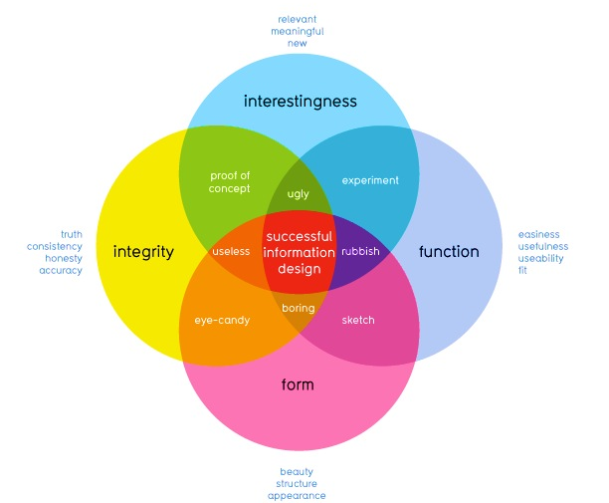
How well does it communicate?
How well does it work?
David McCandless
http://www.informationisbeautiful.net
Notes:
This graphic illustrates what should be balanced to achieve a design that can convey useful information to its observers by creating desire in the information itself.
This middle part (integrity and function) refers to the information itself, whether the data is accurate or useful. Arguably you are all rather talented at this part.
We focused our visual design lecture on the other two – giving guidelines as to how to achieve designs that successfully allow the user to perform such functions without having to force themselves to do so

Slide 31
The Art of Balance
Promotion & demotion of important objects
First Question for any design
What are the most important things?
Information should be prioritized based on its importance to the user
Notes:
I’ve mentioned several times before that good design is about balance – visual design is no exception.
Information should be prioritized based on its importance or relationship to other information
: color, size, position and the other things we have discussed are methods to suggest this.
If we look at objects on a scale of importance, we can decide best how to use those techniques.
Scott Klemmer’s video gave you good examples of how Typography, Layout, and Color give you a good idea of visual hierarchy
You should know these ideas and be able to use them either to create a good design or to critique and back up you rcritique on a design.

Slide 32
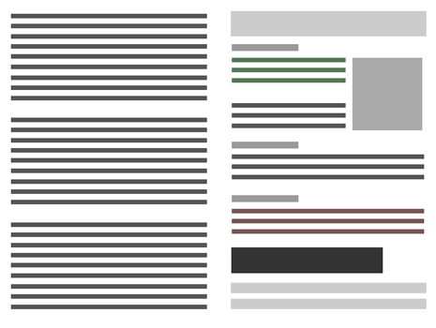
Visual Hierarchy and Reading Order
Weak visual hierarchies
provide little or no guidance on what is important.
Strong visual hierarchies
guide visual & logical progression by showing what is important.
Strong visual hierarchies create a sense of order and balance
Notes:
Strong visual hierarchies can guide people to look where you want, in the order you want them to.
If you don't have this hierarchy, they don't know where to go with their eyes
[ADVANCE]
A strong visual hierarchy creates a sense of order and balance.

Slide 33
Using Proximity to Indicate Relationships
“The whole is greater than the sum of the parts.”
– David Hothersall
Gestalt Psychology in information design
Information blocks should be grouped together if related, but unrelated elements should be located at some distance from each other.
Notes:
The principles of Gestalt psychology are based on the humans’ ability to perceive and generate visual forms.
One of the six Gestalt Principles we talked about was “The Proximity principle”, which is often used in information design.
We can use proximity to describe how elements are related to each other.
You should know this and understand how to use it.

Slide 34


Gestalt Principles of Perception Group Information
Proximity Similarity Continuation Closure
Elements close together
Similarity of shape, size, or color
Aligned along a line or curve
Individual elements form a single object
Notes:
Here are 4 of those principles that you will often use in design. (image from Luke Wrobelski at lukew.com)
We mainly talked about the first two.

Slide 35
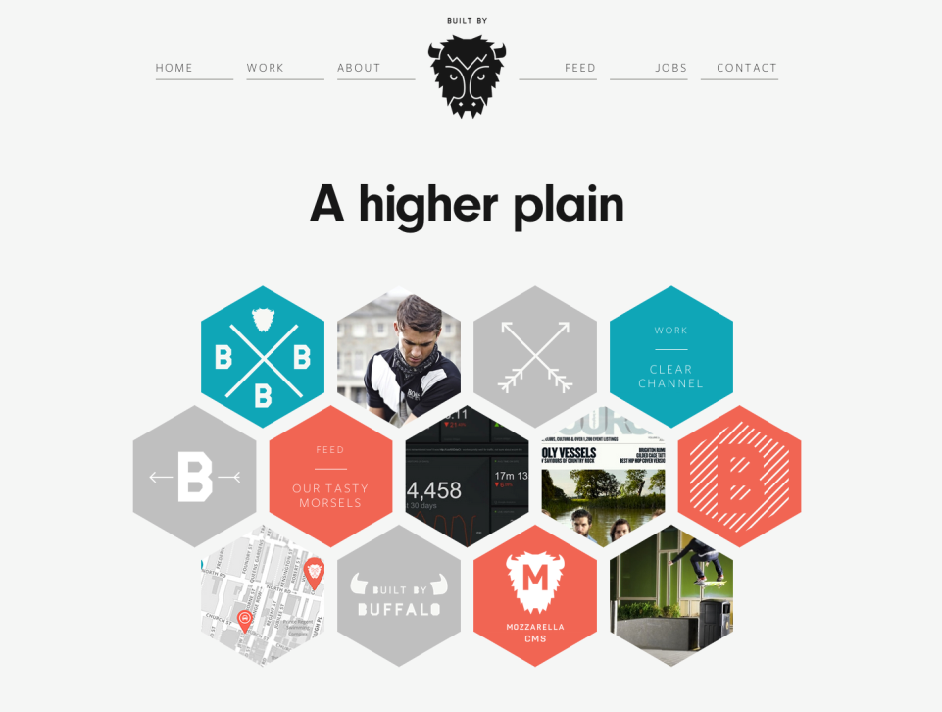
http://builtbybuffalo.com/
White Space = Value
Notes:
Web design provides good examples of the proximity rule where good layouts will organize related items into groups such as seen here with the menu and project elements grouped together.
White space and proximity is how you show what is related.

Slide 36

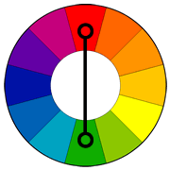
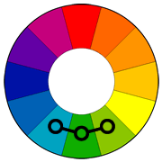
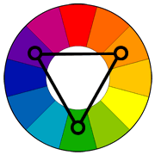
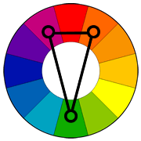
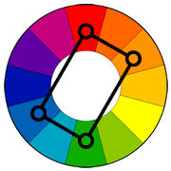
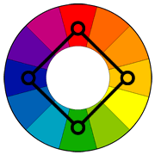
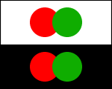
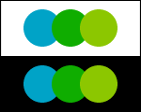
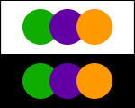
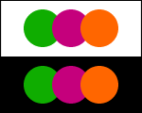
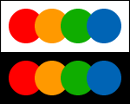
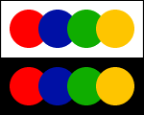
Using Appropriate Color “Harmonies”
Beginners should use these
Complementary
Analogous
Triad
Split
Complementary
Rectangle
(Tetradic)
Square
Notes:
So how do we pick the right colors?
While my suggestion for beginners is to stick to one color or “monochrome” palettes, there is the odd occasion where information must have multiple colors to be distinguishable, such as in graphs. In these cases, Color harmonies are particularly useful. They involve picking a primary color and using a color wheel to determine the best colors to go along with it. The names connote either the direction across the color wheel or the shape made by drawing a line between the combination of colors.
[ADVANCE]
For beginners, I strongly suggest using these two (analogous and split-complimentary) as they are hard to get wrong and tend to work with lots of designs.
see: http://www.tigercolor.com/color-lab/color-theory/color-harmonies.htm

Slide 37
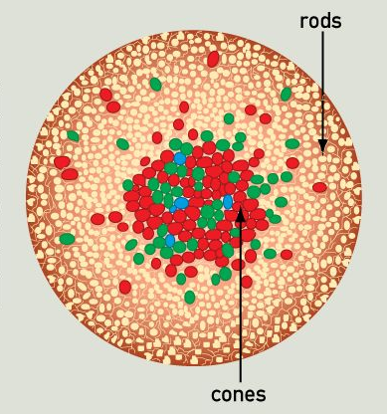
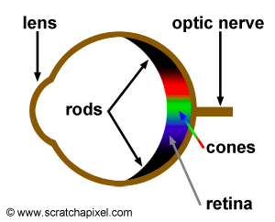
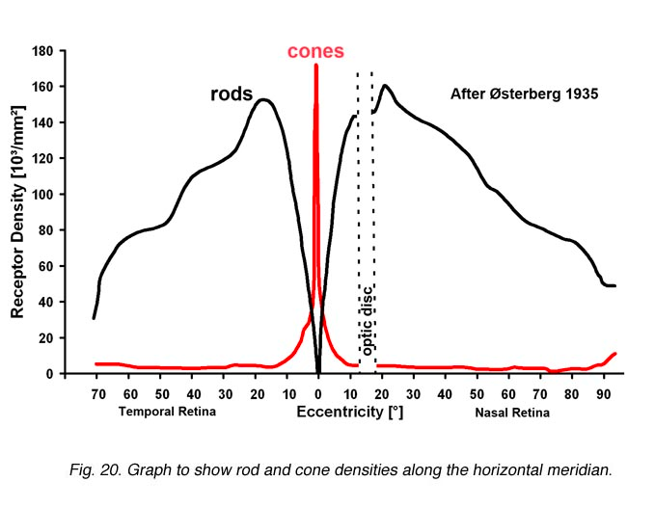
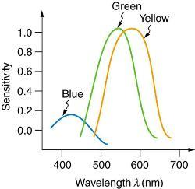
Human Abilities: Retina
Distribution & types of cones in the retina has major impact on our visual abilities
http://www.webexhibits.org/causesofcolor/1G.html
http://webvision.med.utah.edu/imageswv/Ostergr.jpeg
Notes:
Because of these facts we talked about avoiding blue for small objects (e.g., text) and also how some of these properties underly how you should pick the color combinations on the previous slide.

Slide 38
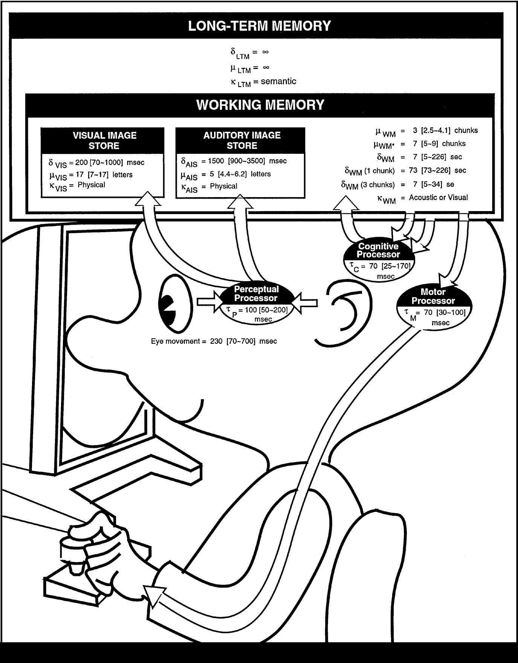
The Model Human Processor
Developed by Card, Moran & Newell (’83)
  based on empirical data
Basic model underlies other HCI techniques
Allows us to make predictions w/o users
  e.g., GOMS modeling
Know the processors, memories, cycle times, & decay times
  100ms Is a good enough approx. for times
Notes:
We model human performance to test understanding and
To predict the influence of new technology.
This is the classic image form the book “The Psychology of Human-Computer Interaction”
I would never expect you to know the details about this other than the basic model of a cognitive processor, perceptual processor, motor processor, working memory and long-term membory, and that the processor times are about 100ms.

Slide 39
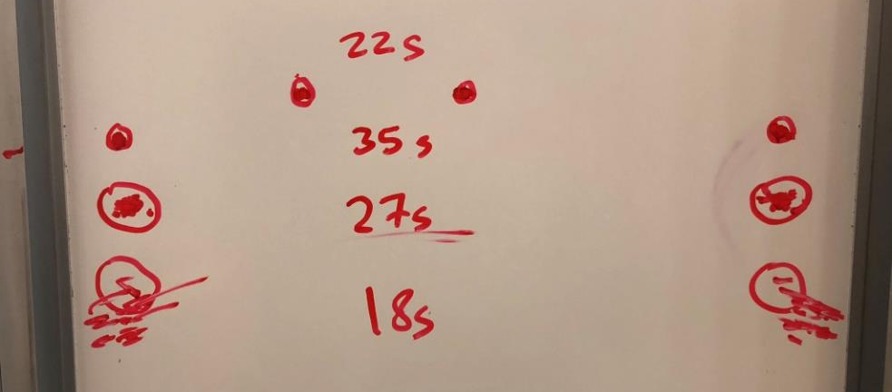
Experimental Results
Task
Quickly tap each target 50 times accurately
Notes:
Fitts’ Law is a part of the Model Human Processor that I would expect you to know a bit better as you can use it to back up your design decisions and critiques.
Remember: We drew two circles on the board
both around 1/2 inches in diameter
1) distance of 6 inches
2) Repeat by extending the distance to 24 inches
The time went up as expected.
We increased the diameter of the circle while maintaining the distance and the time went back down.
We threw away the need for accuracy and the time really went down.
Results:
30 sec
48 sec
31 sec (as predicted, almost the same as #1)
21 sec (lots of spread)

Slide 40
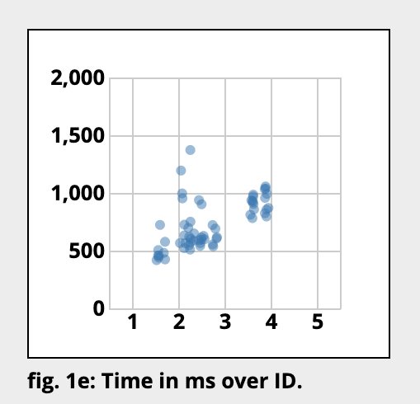
Online Experimental Results
Index of Difficulty: ID = log (D/W) + 1
D = distance to target, W = width of target (or size)
Notes:
We can graph the performance and you see something like this. A straight line showing the relationship between difficulty, which is really about the Distance divided by the Width or SIZE of the target, and the resulting time to hit the target.

Slide 41
Principles of Operation (cont.)
Fitts’ Law
  moving hand is a series of microcorrections
    correction takes Tp + Tc + Tm = 240 msec
  time Tpos to move the hand to target size S,
  which is distance D away is given by:
    Tpos = a + b log2 (D/S + 1)
  summary
    time to move the hand depends only on the relative precision required
Notes:
Understand both D/S and relative position.
Be able to use it to reason about designs.

Slide 42
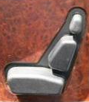
Conceptual Models
Conceptual model?
  mental representation of how the object works & how interface controls effect it
Design model should equal customer’s model?
  mismatches lead to slow performance,
  errors, & frustration
Design guides?
  use customer’s likely conceptual model to design
  make things visible
  map interface controls to customer’s model
  provide feedback
Design Model
Customer Model
System Image
Notes:
Remember what this is?

Slide 43
What Makes a Good Answer (H/W or Test)?
Easy to understand
  legible, well-annotated, good explanations, visual presentation instead of just listing bullets, clear structure (such as well designed visual hierarchy)
Grounded in your prior work
  e.g., needfinding, POV, HMW, EP results, usability results, data driven (if possible)
Ideas/designs are novel
  beyond what is heard/seen or already exists to push for something that feels new & exciting
Backed by evidence
  from your work or from principles of design, humans cognitive/perceptual/motor attributes
Goes beyond just facts
  based on some reasonable inference and integration, not straightforward and superficial
  points made are insightful & point to a bigger picture as opposed to just stating the facts
User-centered
  findings and insights tie back to the user, keeping user experience in mind, ensuring a diverse set of participants and reasons why they were important
Covers everything that was asked for
Notes:
Someone asked last year or the year before, what makes a good answer? (whether on H/W or a test).
Here are some things I could say:

Slide 44
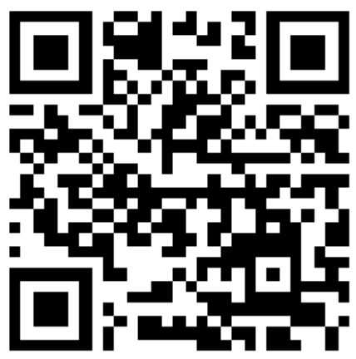
Exit ticket
https://tinyurl.com/cs147-2024au-exit-ticket-8-281
Due at 3:30 PM Tue, 11/12
Notes:
got here at 2:35 PM (65 min in). 10 min break and then took questions for 35 min

Slide 45
QUESTIONS?
Notes:
That is what we’ve covered so far in the class as well as your project assignments.
Did moderately fast: 45 min until Q&A

