Slide 1
Conceptual Models &
Interface Metaphors
October 28, 2024
Notes:
This year –
Did 20 min break even though a bit over on time and then ended 1-2 min late… so pretty good by being fast on part 2. recommend getting to break 5 min earlier to have full 20 min break.
--- last year ---
2 min over and had to skip consistency (did about 18 min break). Need to cut a couple more slides to have a 20 min break.
Maybe some things in part ii?
--- Last year ---
4 min over… and only 15 min break. go faster in first half (have to be done with first half at 55min). Cut mPESA?
two years ago: started 7 min late. Broke for 15 min team break. Ended on time.
Two years ago: Broke at 55 min in for 20 min team break, Ended perfectly on time (5 min early)
Must add gulf of execution and gulf of evaluation next year

Slide 2

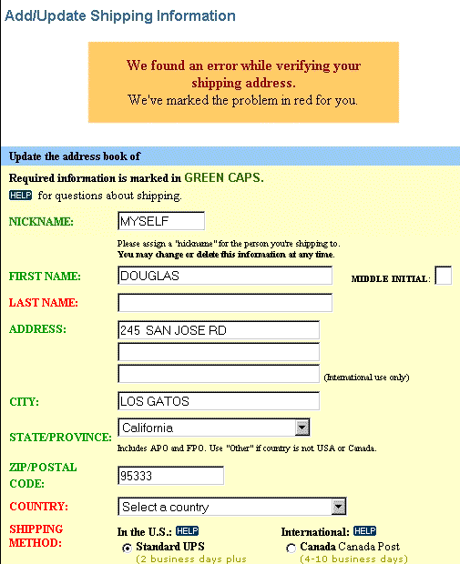
Hall of Fame or Shame?
Design based on a top retailer’s site

Slide 3

Hall of Shame!
Design based on a top retailer’s site
Color deficiency
  can’t distinguish between red & green
In study, user could not get by this screen!
How to fix?
  redundant cues

Slide 4
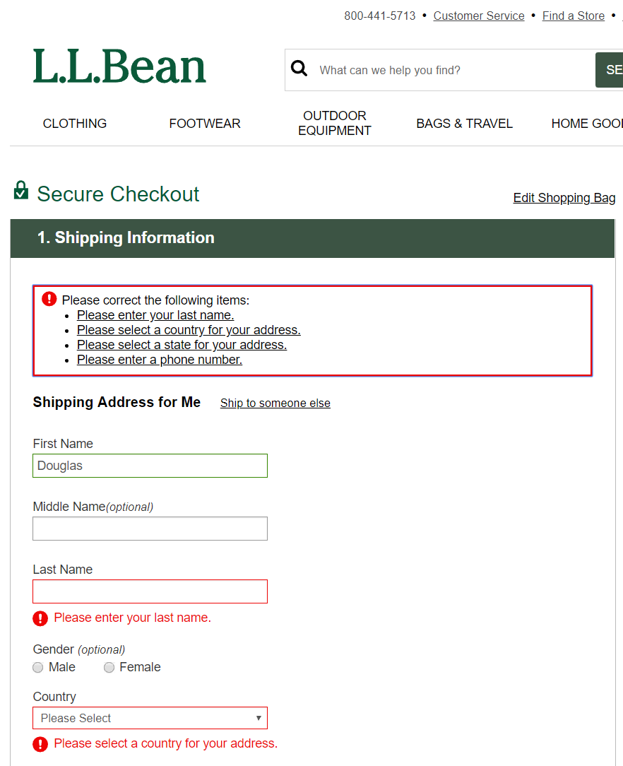
A Better Design
Instructions at the top for all errors
Redundant exclamation icons
Changed color on boxes around input fields with errors
Instructions on what to fix near each error

Slide 5
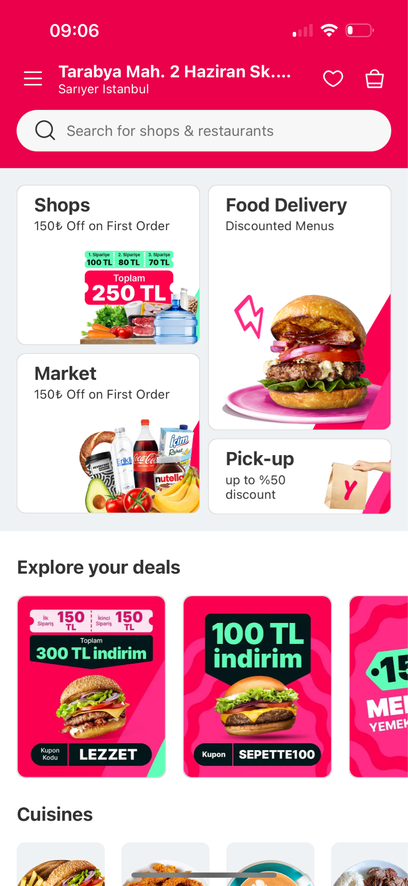
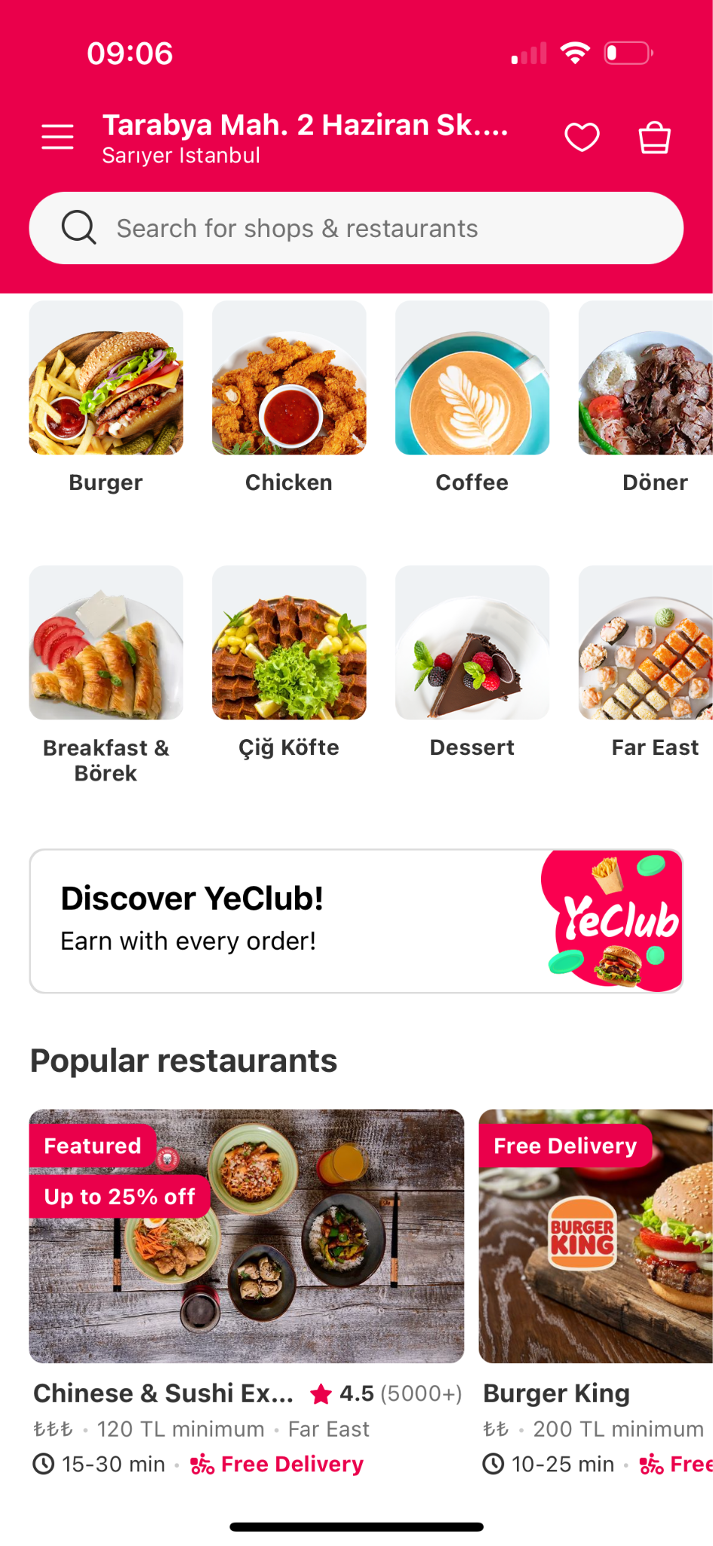
Hall of Fame or Shame?
YemekSepeti
Top food delivery app in Turkey
Notes:
What do we like?
What could be improved?

Slide 6
Hall of Fame or Shame?
Good
Clear grouping of categories (Gestalt)
Main actions visible above the fold
Large touch targets for easy tapping
Bad
Liberal use of highly saturated colors
Visual clutter from numerous deal cards and icons
Notes:
Has some good
Some things they could improve (especially visuals/color).
I’ll call this a hall of fame/shame tie.

Slide 7
Hall of Fame or Shame?
M-Pesa mobile payments
Common in Africa
http://africanbusinessmagazine.com/wordpress/wp-content/uploads/2014/07/mobile-payment.png
http://blog.unibulmerchantservices.com/m-pesa-by-the-numbers/
Notes:
Started in Kenya but big across Africa
Why?
64% of Nigerians do not have a bank account
Over 80% have a mobile phone (originally feature phones)
[ADVANCE]

Slide 8
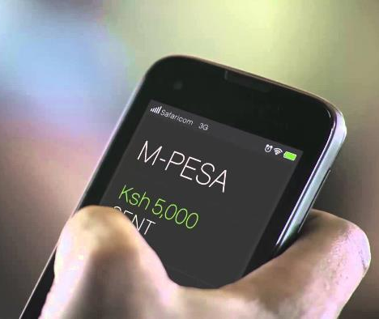
Hall of Fame or Shame?
M-Pesa mobile payments
Common in Africa
https://techweez.com/2017/04/27/is-our-over-dependence-on-mpesa-a-dangerous-move-can-something/
http://africanbusinessmagazine.com/wordpress/wp-content/uploads/2014/07/mobile-payment.png
Notes:
Closeup
[ADVANCE]
Now as more people have smartphones it works on those as well
What do we like?
What do we wish?
[ADVANCE]

Slide 9

Hall of Fame!
M-Pesa mobile payments
Common in Africa
Simple UI but brings banking services to the unbanked!
Good example of H12 – Value Alignment & Inclusion
http://africanbusinessmagazine.com/wordpress/wp-content/uploads/2014/07/mobile-payment.png
http://blog.unibulmerchantservices.com/m-pesa-by-the-numbers/
Notes:
This is an important application, and the simple UI is appropriate

Slide 10
Conceptual Models &
Interface Metaphors
October 28, 2024
Notes:
Why are we learning this?
The underlying conceptual model of an interface is what helps a user understand what they are supposed to do to operate it – how it works! Metaphors are one common way that has been used to communicate the model. How your design communicates its model will be a large factor in whether people are effective in learning and using your design.

Slide 11
Outline
Design of Everyday Things
Conceptual models
Team break
Design guides for conceptual models
Interface metaphors
UI consistency

Slide 12
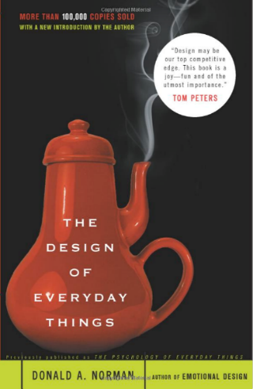
Design of Everyday Things
By Don Norman
  UCSD, Apple, HP, NN Group, NU, UCSD
Design of everyday objects illustrates problems faced by designers of systems
Explains conceptual models
  doors, washing machines, digital watches, phones
Resulting design guides
→ Highly recommended
Notes:
This lecture tries to give some of the high-level ideas in this book (and the 1st chapter you read gives a taste)

Slide 13
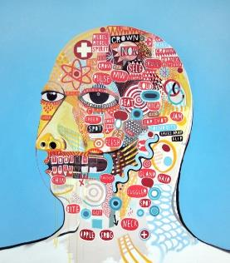
Conceptual Model?
Def. Mental representation of how an artifact works & how interface controls affect it
People may have preconceived models that
are hard to change
  (4 + 5) vs. (4 5 +) on a calculator
  dragging to trash?
    deletes file but ejects disk
Interface must communicate model
  visually, possibly physically or using sound
David Shillinglaw
Notes:
Also sometimes called a “Mental Model”
Shouldn’t need online help or documentation to communicate the model

Slide 14
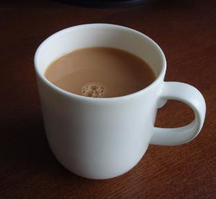
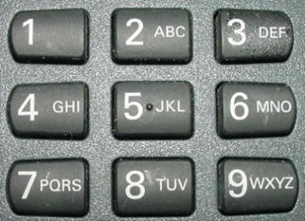
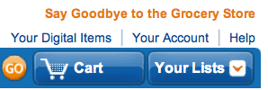
Affordances as Perceptual Clues
Well-designed objects have affordances
  clues to their operation
  often visual, but not always (e.g., speech)
What affordances do you see here?
Gibson: “actionable possibilities”
iOS7
iOS7 w/ “button shapes”
iOS6
Notes:
In DOET, affordances are visual. But affordances are more than that. Affordances can be physical or audio
Coined originally by Gibson as “actionable possibilities” in an environment. This cup’s handle affords picking it up. The concept was further popularized by Norman’s book.
[ADVANCE]
What affordances do you see on this telephone keypad?
[ADVANCE]
How about in this upper right portion of Amazon's web site?
[ADVANCE]
See how it has changed over time in iOS
Buttons in IOS… IOS7, iOS7 with “button shapes” accessibility turned on, and iOS6. People have now learned it, so when is the right time to lose the affordance?
This last example is related to the idea of Flat UI design that started to come out in around 2015. The idea is we didn’t have to have these 2.5d buttons and controls anymore as people had learned them. Key was to use very little color so that color could show which items are active or take input. What do you think about it?
(from http://blog.teamtreehouse.com/affordances-web-design)

Slide 15
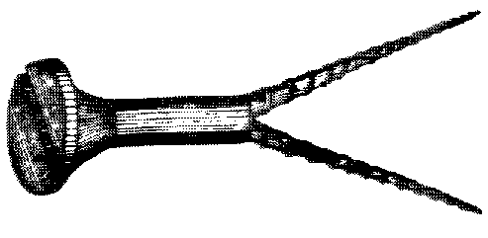
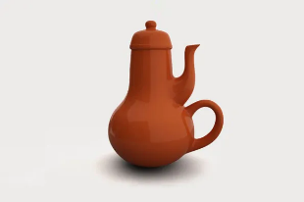
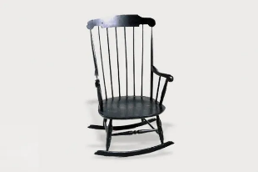
Affordances as Perceptual Clues
Poorly-designed objects
  no clues or misleading clues
Jacques Carelman, Catalogue d’Objets Introuvables
Crazy design for a screw punch!
Notes:
Misleading or false affordances.
This example of a screw punch is a purposeful extreme. From the famous “Catalogue of Impossible Objects” by the late French artist Jacques Carelmen.
[ADVANCE]
This screw punch that will make a 2nd hole where you don’t want it.
[ADVANCE]
The famous coffee pot for masochists. And a rocking chair that wants to rock sideways.

Slide 16
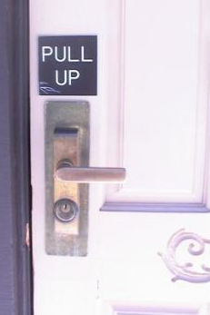
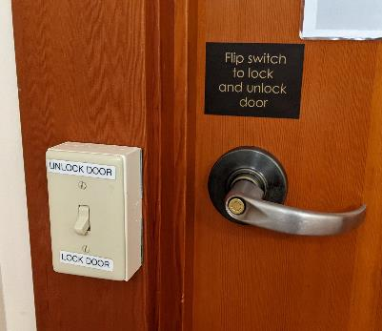
Affordances as Perceptual Clues
Poorly-designed objects
  no clues or misleading clues
“Norman doors”
https://99percentinvisible.org/article/norman-doors-dont-know-whether-push-pull-blame-design/” (5:31)
Notes:
Sometimes now called “Norman doors”
[ADVANCE]
Or this bar with a sign for a pull on what is normally a push (bar)
Signs should be a hint something is wrong.
[ADVANCE]
or this great one that a student submitted a couple years ago here at Stanford
https://99percentinvisible.org/article/norman-doors-dont-know-whether-push-pull-blame-design/

Slide 17
Affordances as Perceptual Clues
Poorly-designed objects
  no clues or misleading clues
http://alistapart.com/article/flat-ui-and-forms
Notes:
What is wrong here?
[ADVANCE]
See how this second one makes it a bit clearer you should type in the box?
[ADVANCE]
See how this last one is even better. The white background & the box make it clear what to do -- type into the field.

Slide 18
Refrigerator
freezer
fresh food
Problem: freezer too cold, but fresh food just right
Notes:
Now let’s discuss conceptual models. We will start with an example.
Don’s fridge problem…

Slide 19
Refrigerator Controls
Normal Settings C and 5
Colder Fresh Food C and 6-7
Coldest Fresh Food B and 8-9
Colder Freezer D and 7-8
Warmer Fresh Food C and 4-1
OFF (both) 0
A B C D E
9 8 7 6 5 4 3 2 1
What is your conceptual model?
Spend 60 sec. drawing a diagram showing your model
  where the cooling units are & how they are controlled
Share with your neighbor & put a picture in the slack channel
Notes:
Here is the control panel inside the fridge.
[ADVANCE]
What is your conceptual model of how the fridge works. What cools the fridge? What cools the freezer? How do these controls impact those cooling mechanisms..
[ADVANCE]
Take 60 seconds to draw it, share with your neighbor, take a picture, and put in the slack channel

Slide 20
A Common Conceptual Model
A B C D E
cooling
unit
9 8 7 6 5 4 3 2 1
cooling
unit
independent cooling units
Notes:
In slack, How may of you came up with a conceptual model like this?

Slide 21
Actual Conceptual Model
A B C D E
cooling
unit
9 8 7 6 5 4 3 2 1
Can you fix the problem?
Possible solutions
  make controls map to customer’s model
  make controls map to actual system
Notes:
Here is the actual conceptual model. One cooling unit (controlled by A-E) and a valve whose position is controlled by 1-9. How many came up with a model like this?
Neither is BETTER than the other.
[ADVANCE]
Why was Don confused? Can you fix the problem?
How?
[ADVANCE]

Slide 22
Design Model & Customer Model
Design Model
Customer Model
System Image
Customers get model from prior experience & usage of new
  through system image
What if the two models don’t match?
Notes:
The designer’s conceptual model is embedded in the system you design.
[ADVANCE]
The customer get’s their model from prior experience with similar artifacts and through experience with your system.
[ADVANCE]
What happens if the two models do not match?

Slide 23
Conceptual Model Mismatch
Mismatch between designer’s & customer’s conceptual models leads to…
  slow performance
  errors
  frustration
  ...

Slide 24
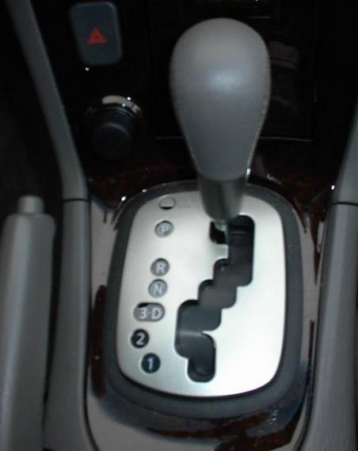
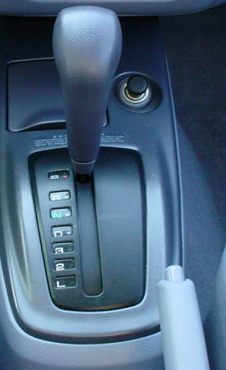
Model Mismatch: Car Automatic Shifter
Notes:
Car shifter. Move to change to Reverse, Neutral, Drive
What might go wrong?
Image at left seems obvious, but many first time users of this design don’t notice the difference between “3 and D” and in fact put the car in third gear when they mean to put it in Drive.
[ADVANCE]
The more standard gear shift distinguishes these more directly.
On the other hand, the newer design (on left) has more PHYSICAL feedback

Slide 25
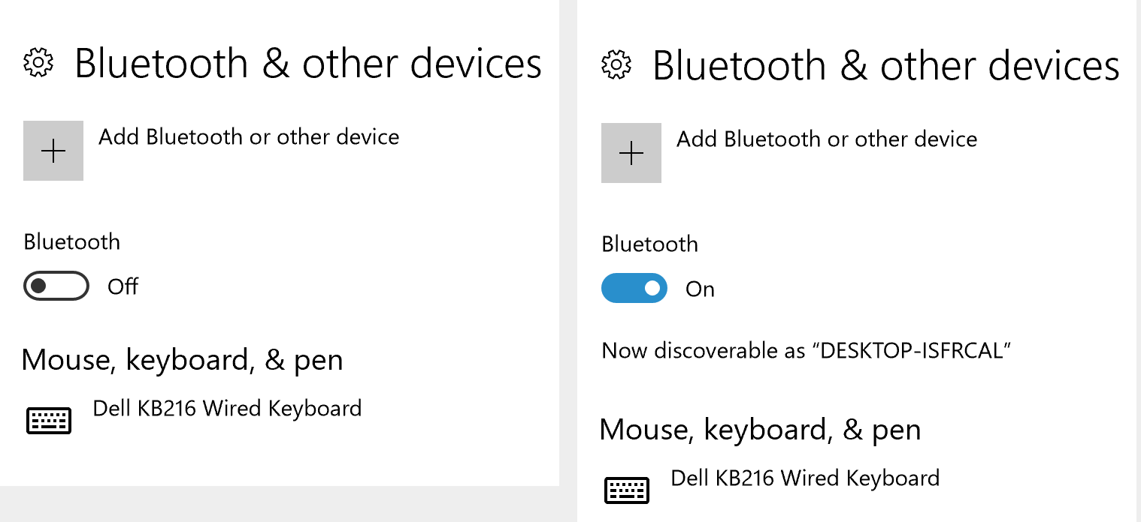
Model Mismatch: Windows 10 Bluetooth
Is Bluetooth on or off?
Often switches show the state that sliding towards will execute
Example and images from https://www.nngroup.com/articles/two-ux-gulfs-evaluation-execution/
Notes:
Is Bluetooth on or off? How many vote on? How many vote off?
The author of the article referenced below spent a long time trying to figure out why their new Bluetooth headset wasn’t working with their laptop.
[ADVANCE]
Often switches show the state that sliding towards will execute. But NOT HERE!

Slide 26
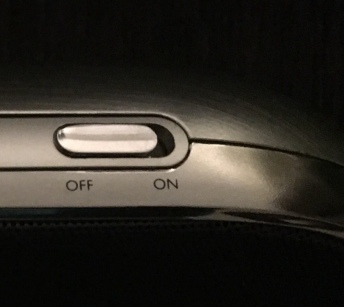
Model Mismatch: Windows 10 Bluetooth
Is Bluetooth on or off?
Often switches show the state that sliding towards will execute
Example and images from https://www.nngroup.com/articles/two-ux-gulfs-evaluation-execution/
Notes:
For example, on this speaker we clearly see one end is the off state and the other end is ON.

Slide 27
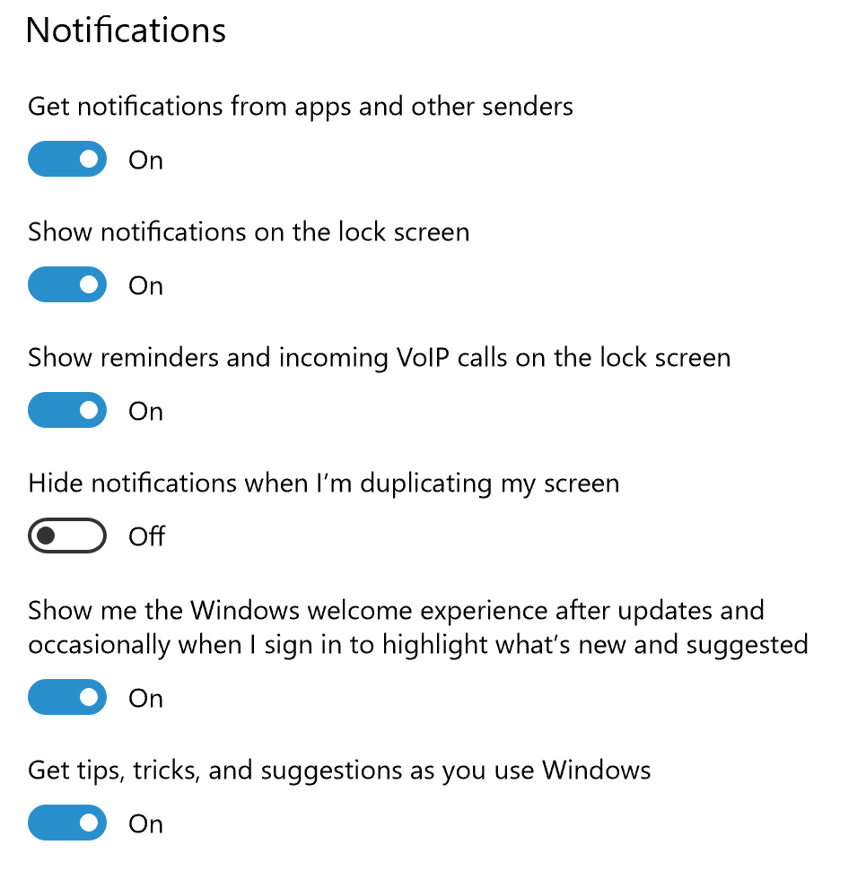
Model Mismatch: Windows 10 Bluetooth
Is Bluetooth on or off?
Often switches show the state that sliding towards will execute
We see how it works when we see several switches
Example and images from https://www.nngroup.com/articles/two-ux-gulfs-evaluation-execution/
Notes:
If we have many switches together, we might get how it works. But with one alone the mistake is easy to make.

Slide 28
Model Mismatch: Windows 10 Bluetooth
Is Bluetooth on or off?
Often switches show the state that sliding towards will execute
We see how it works when we see several switches
The system state is visible, but we fail to evaluate the state correctly
Example and images from https://www.nngroup.com/articles/two-ux-gulfs-evaluation-execution/
Notes:
As Nielsen’s first heuristic (which you will learn on wed) says, the system state is VISIBLE, but we do NOT EVALUATE the system state correctly.

Slide 29
5-min activity: Conceptual models
Instructions
Think about how a light switch works.
Spend 30 seconds drawing a quick sketch of your idea.
Share your drawing with the person next to you.
Discuss: Did you both draw the same thing? How could different designs affect how people use the switch?
What you're practicing: You’re applying the concept of conceptual models — how users mentally picture how an object works. This exercise helps you see how different people can have varied mental models for the same object.
Notes:
got here at 50 min so took 4 min

Slide 30
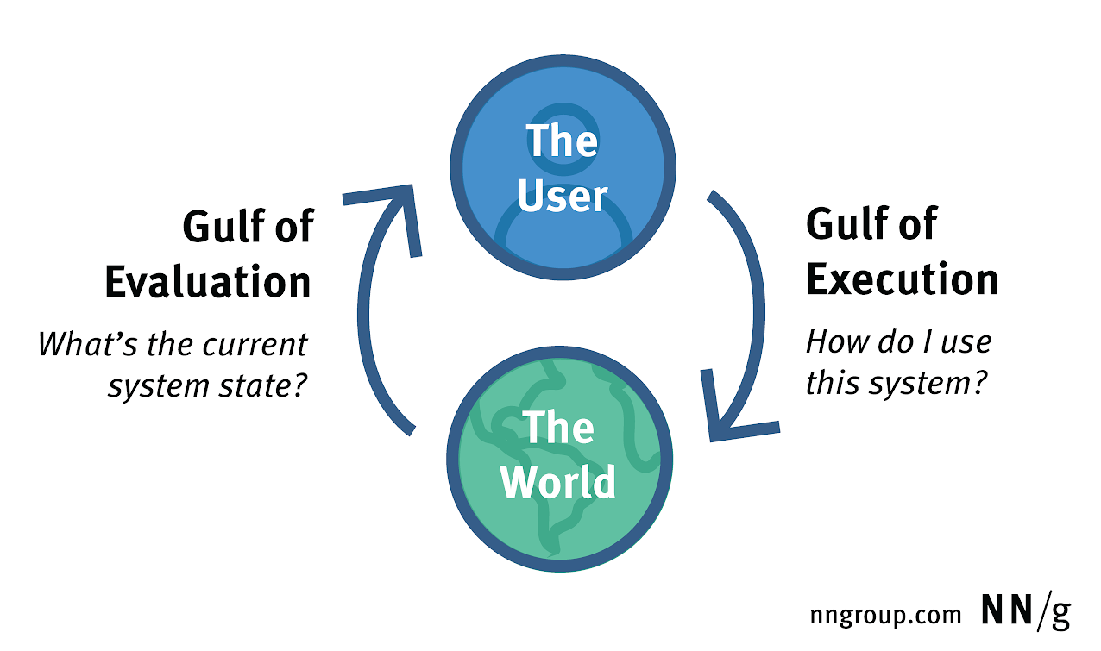
Gulf of Evaluation & Gulf of Execution
reduce the gulf through design
Example and images from https://www.nngroup.com/articles/two-ux-gulfs-evaluation-execution/
Notes:
Norman and colleagues in the book that first defined “User-Centered Design” gave a name for this and it is an important concept in the field of HCI:
The Gulf of Evaluation and the Gulf of Execution.
The Gulf of Evaluation is the problem she was having with this Bluetooth switch.
What is the current state? Is it on or off? She thought it was on when it was not. This was an error of evaluation.
The Gulf is the gap between what the user thinks is the state and what the actual state is.
[ADVANCE]
We want to reduce that gulf.
We could redesign the switch so that she didn’t make that evaluation error.
Having a match between the user’s mental model and the actual design model reduces the gulf.
The gulf of execution is knowing what to do to change the state or get the system to do what you want.
Is this case, once we know the state of that switch and how it operates, it is easy to change it.
So the gulf of execution is not hard in this case.
Furthermore, both of these challenges are composed of lower-level operations which users must accomplish. For example, successful evaluation requires not just perceiving the system-status indicator, but also interpreting what it means. Similarly, execution requires both planning an action based on an understanding how the controls work, and actually manipulating the controls. This type of granular, specific analysis of the interaction is important because success at one suboperation doesn’t necessarily mean success at the others.
You should know these concepts.

Slide 31
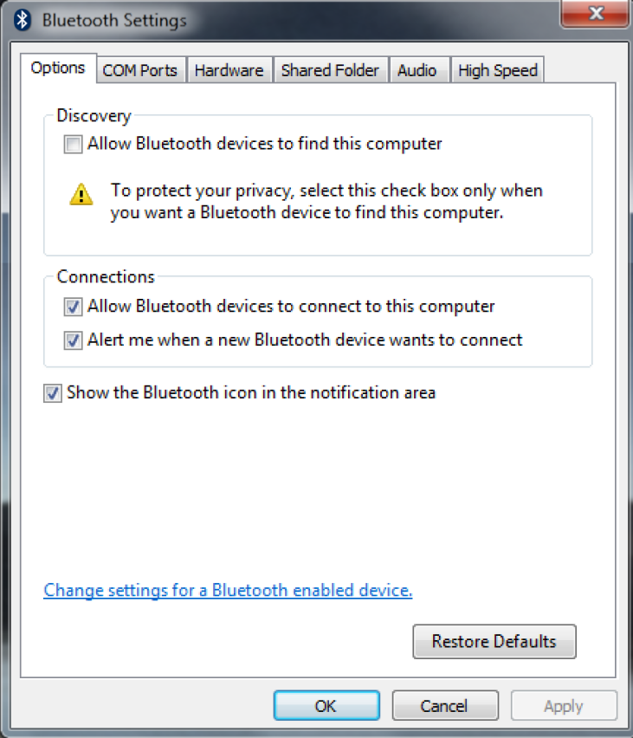
Gulf of Evaluation & Gulf of Execution
reduce the gulf through design
Example and images from https://www.nngroup.com/articles/two-ux-gulfs-evaluation-execution/
Notes:
This Windows 7 design (at right) might reduce the gulf. Though the text isn’t too great

Slide 32
Administrivia
Questions about Medium-fi Prototype assignment?
  both the Figma Basics & Design Systems workshops are online. Check them out now for this & following assignments!
2nd to last workshop – Accessibility – link to recording online
  we will give a few bonus points for projects that do a good job of addressing accessibility
Last workshop – Prototyping with AI – will be next Wed, 11/6 at 6:30 PM, location TBD

Slide 33
Administrivia
If you aren’t in CS147L & want to learn React Native
  see CS147L home page for links to CS147L assignments 1-3 & Lectures 1-10
  https://hci.stanford.edu/courses/cs147l/2024/au/
Keep up w/ readings/HW on class website
  http://cs147.stanford.edu/
  midterm coming up in week 8 (weeks 7-8 have lighter work)
Notes:
Midterm in two weeks from Wed (on 11/13). Partly in class and partly take home.
Let’s talk about the midterm a bit…
[ADVANCE]

Slide 34
Midterm
Scope: Everything through Designing the Future: Early and Future Visions of HCI (Week 7 - Lecture 13) including Reading/Videos/Podcasts, Lectures, Assignments.
Format: Will primarily be a multi-part design problem (but know and be able to demonstrate all aspects of the design process & use facts for reasoning for your answers), with some multiple choice/short answer on knowledge of HCI as well.
Place: Hybrid exam – part I in class & part II (design problem) at home (Gradescope)
Time: This midterm will take place during a 24-hour window starting in class Wed., Nov. 13, at 1:30 pm Pacific time. You will have ~1:30 for part I in class and ~2 hour for part II at home.

Slide 35
TEAM BREAK
Talk about how to build your medium-fi prototype
Notes:
--This year -- got here at 65 min -- so took break until 2:55 PM (leaving 25 min -- ot long enough!)
Take at most 20 min break and only if you cut some second half material as you need 35 minutes to finish (so if have less than 35 min, then reduce break in 5 min increments)
Need to be here by 55 min for a 20 min break (adjust down if late)
--- last year
got here at 62 min so took a 16 min break (restart 2:50)
=== tow years ago ---
got here at 65 min in so only took 15 min team break
---- 3 years ago ---
Got here at 55 min in for 20 min team break
---
Let’s cut to 15 min and more if get here past 60 min in.
Got here at 2:35 PM (65 min in -- though started 5 min late). Gave a 15 min break.

Slide 36
Design Guides
Provide good conceptual model
  customer wants to understand how controls affect object
Make things visible
  if object has function, interface should show it
Map interface controls to customer’s model
  infix vs. postfix calculator – whose model is that?
Provide feedback
  what you see is what you get! (WYSIWYG)
Notes:
Now in this half of lecture we will talk about how to use the ideas from the DOET to produce design guidelines
The first is to provide a good conceptual model. This is key. Some of the following ideas will help with this.
[ADVANCE]
Make things visible…
[ADVANCE]
Map interface controls to the customer’s model
[ADVANCE]
Provide feedback
Now, Let’s talk about each of these in more detail

Slide 37
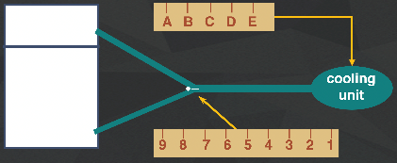
Make Things Visible
Refrigerator?
  make the 1..9 dial something about percentage of cooling between the two compartments?
Functions available on watch
w/ 4 buttons? Is there an issue?
  too many & they are not visible!

Slide 38
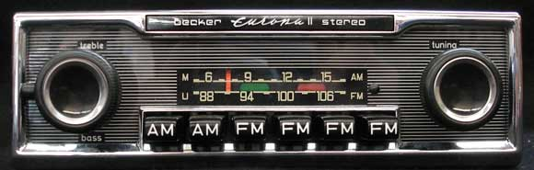
Make Things Visible
http://www.brucesallan.com/wp-content/uploads/2013/03/Becker-Car-Stereo.jpg
Compare to controls on old & new car radios
  #controls = #functions
  controls are labeled (mostly) and grouped together
Notes:
ASIDE: Where the term "radio button" comes from
http://www.brucesallan.com/wp-content/uploads/2013/03/Becker-Car-Stereo.jpg

Slide 39
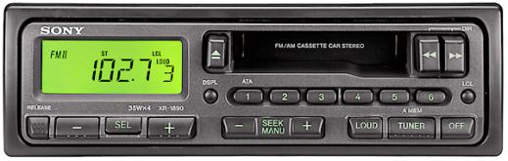
Make Things Visible
Compare to controls on old & new car radios
  #controls = #functions
  controls are labeled (?) and grouped together
Notes:
A 90s car stereo…
Start to have a few more things that are less obvious how to get to, but generally a button per function

Slide 40
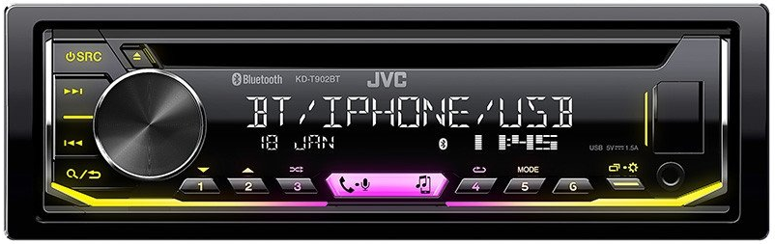
Make Things Visible
Compare to controls on old & new car radios
  #controls = #functions
  controls are labeled (?) and grouped together
Notes:
A very recent 2021 car stereo… starts to have modes to get to more functions
https://automotivesuperstore.com.au/media/product/c53/jvc-kd-t902bt-single-din-cd-receiver-with-bluetooth-head-unit-kd-t902bt-719.jpg

Slide 41
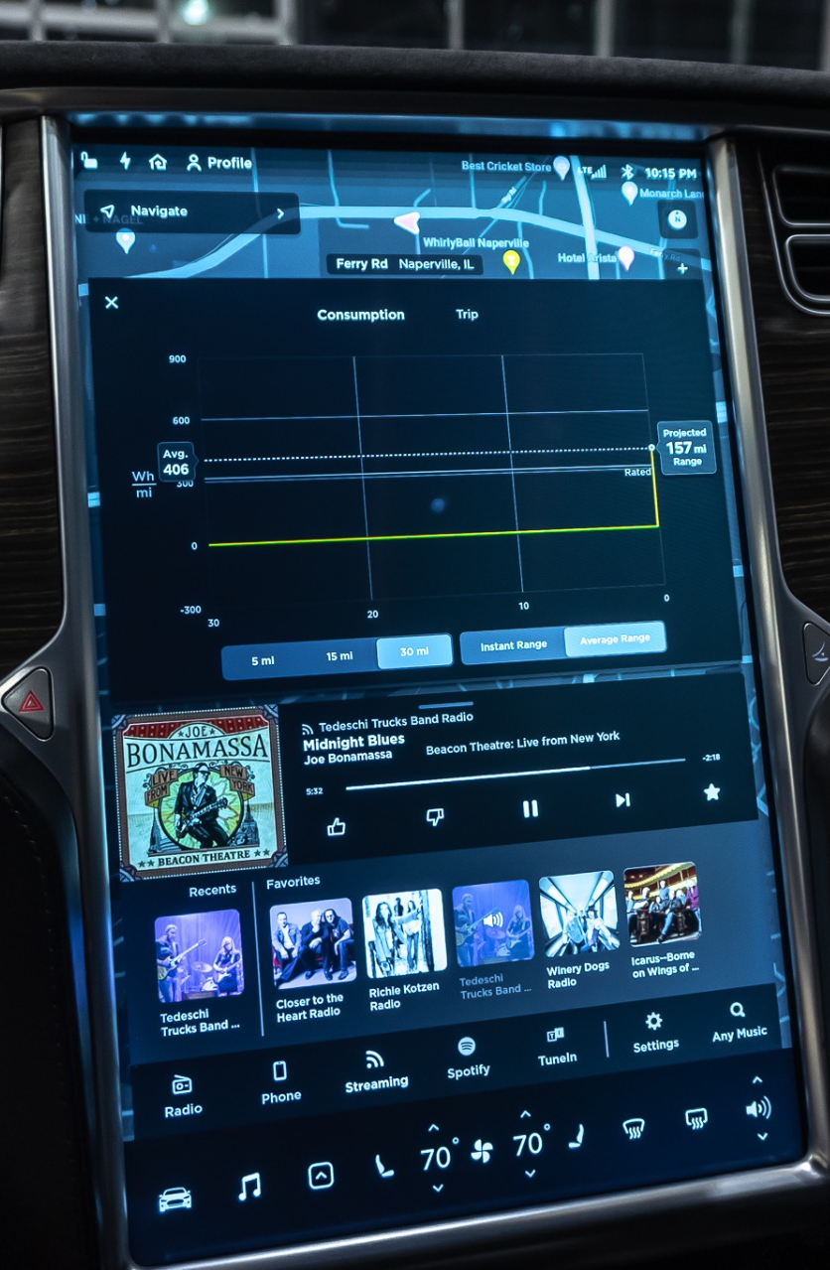
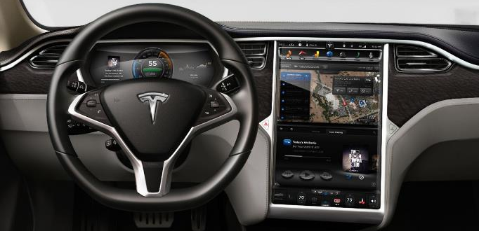
Make Things Visible
Compare to controls on old & new car radios
  #controls = #functions
  controls are labeled (?) and grouped together
  tradeoffs of the “glass UI” (e.g., Tesla)?
Notes:
A pure glass UI – e.g., Tesla. Everything can change. No hardware knobs/buttons.
What are the tradeoffs?
[ADVANCE]
ASK THE CLASS
YOU NEED TO LOOK AT IT TO USE IT!

Slide 42
Map Interface Controls to Customer’s Model
Which is better for car dashboard speaker front / back control?
Control should mirror real-world
Dashboard
1
2
Notes:
Why?
Because it maps better to the real-world

Slide 43
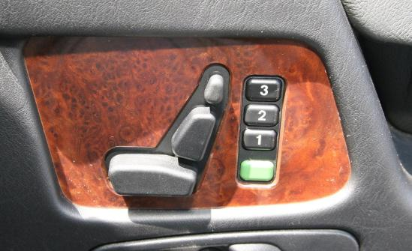
Map Interface Controls to Customer’s Model
Which is better for car dashboard speaker front / back control?
Control should mirror real-world
Mercedes Benz Seat Control maps to real world
Notes:
I also liked this control in some Mercedes Benz cars. The seat controls map to the real world. Like a little voodoo doll of the seat.

Slide 44
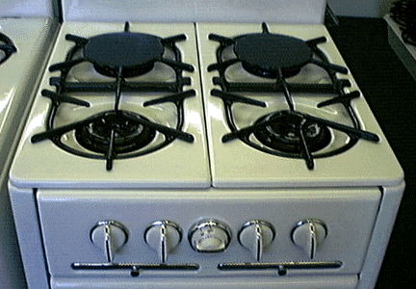
Map Interface Controls to Customer’s Model
Problem?
Which knob controls which burner?
Notes:
Here is a standard gas stove with 4 gas burners and the 4 controls laid out in a line across the front panel
What’s the problem?
[ADVANCE]
Which knob controls which burner!

Slide 45
Map Interface Controls to Customer’s Model
Possible fixes?
Notes:
What are the possible fixes?
[ADVANCE]
Two obvious possibilities

Slide 46
Metaphor
Definition ?
  “The transference of the relation between one set of objects to another set for the purpose of brief explanation.”
Lakoff & Johnson, Metaphors We Live By
  “...the way we think, what we experience, and what we do everyday is very much a matter of metaphor.”
  in our language & thinking – “argument is war”
    … he attacked every weak point
    … criticisms right on target
    … if you use that strategy
We use metaphor in UI design to leverage existing conceptual models
Notes:
Now let’s switch gears and talk about Metaphor.
What’s a metaphor?
[ADVANCE]
The transference…
[ADVANCE]
Lakoff & Johnson…
[ADVANCE]
In our language & thinking
[ADVANCE]
We use metaphor in UI design to leverage existing conceptual models

Slide 47
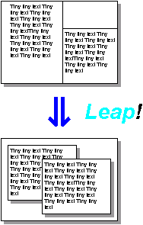
Desktop Metaphor
⇓ Leap!
Engelbart’s windows
In today’s Emacs
Notes:
Let’s talk about one of the most famous metaphors.
The Desktop Metaphor
The first image is the windows as invented by Engelbart (we will learn more about him soon)
[ADVANCE]
Or a modern equivalent today in an editor like Emacs

Slide 48
Desktop Metaphor
Suggests a conceptual model
  not really an attempt to simulate a real desktop
  a way to explain why some windows overlapped
  leverages knowledge about files, folders & trash
⇓ Leap!
Xerox PARC’s overlapping windows
Notes:
The next big leap was when Xerox PARC added overlapping windows. This is what we all have on our laptops and desktop computers today.
When you push a metaphor TOO far is when it gets interesting & maybe problematic

Slide 49
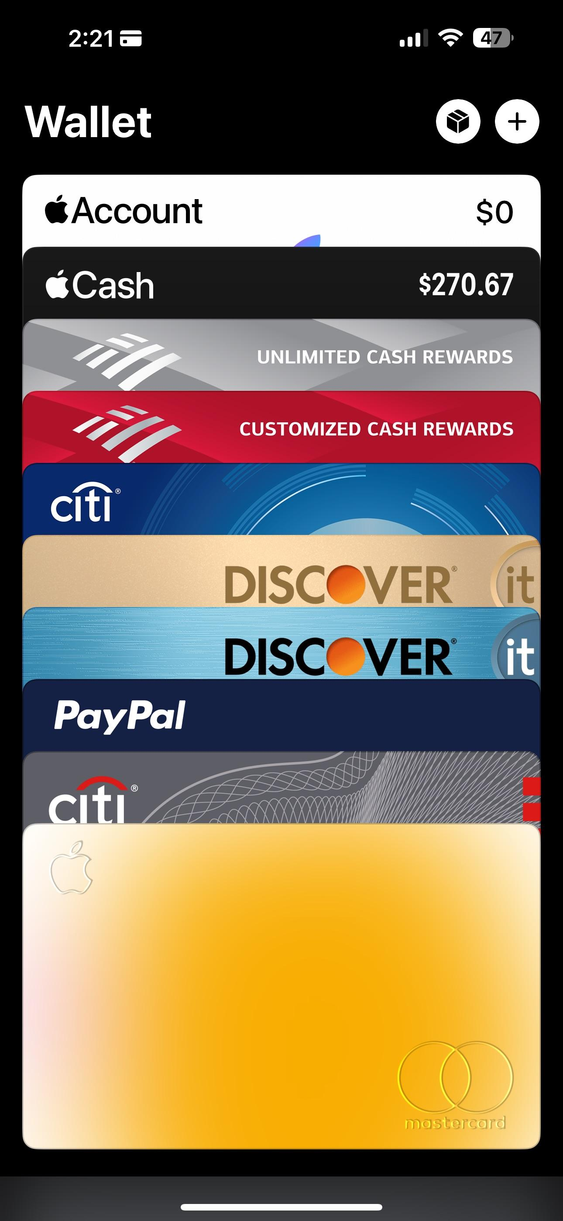
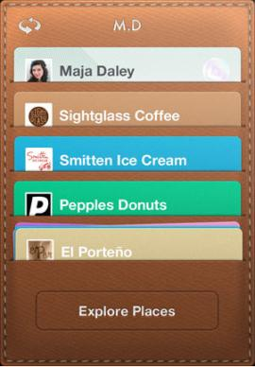
Example Metaphors
Global metaphors
  personal assistant, wallet, clothing, cards
Data & function
  to-do list, calendar, documents, find, assist
Collections
  drawers, files, books, newspapers,
  photo albums
Square Card Case
Notes:
There are different types of metaphors. This is just a small set of possibilities.
Global metaphors: personal assistant, wallet, clothing, cards
Data & function: to-do list, calendar, documents, find, assist
Collections: drawers, files, books, newspapers, photo albums

Slide 50
How to Use Metaphor
Develop interface metaphor tied to conceptual model
Communicate that metaphor to the user
Provide high-level task-oriented operations, not low-level implementation commands
Notes:
50
Develop interface metaphor or conceptual model
Communicate that metaphor to the user
Provide high-level task-oriented operations not low-level implementation commands

Slide 51

Avoid Metaphor for Metaphor’s Sake
Skeuomorphism
  “making items resemble their real-world counterparts” or
  “a physical ornament or design on an object made to
  resemble another material or technique”
Argument against: takes up space
& leads to inconsistent look
Argument for: helps people learn
Apple iBooks2
Notes:
51
Pushback on use of metaphor. If it doesn’t help, why have it?
http://blog.tmcnet.com/blog/rich-tehrani/assets_c/2012/01/ibooks-thumb-500x717-10426.png
Skeuomorphism is the design concept of making items represented resemble their real-world counterparts. Skeuomorphism is commonly used in many design fields, including user interface (UI) and Web design, architecture, ceramics and interior design.
The shutter-click sound emitted by many phones when taking a picture is an auditory skeuomorph: it does not come from a mechanical shutter, which camera phones lack, but from a sound file in the phone's operating system.
Why bad? Why good?
[ADVANCE]

Slide 52
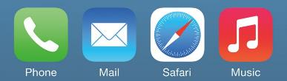
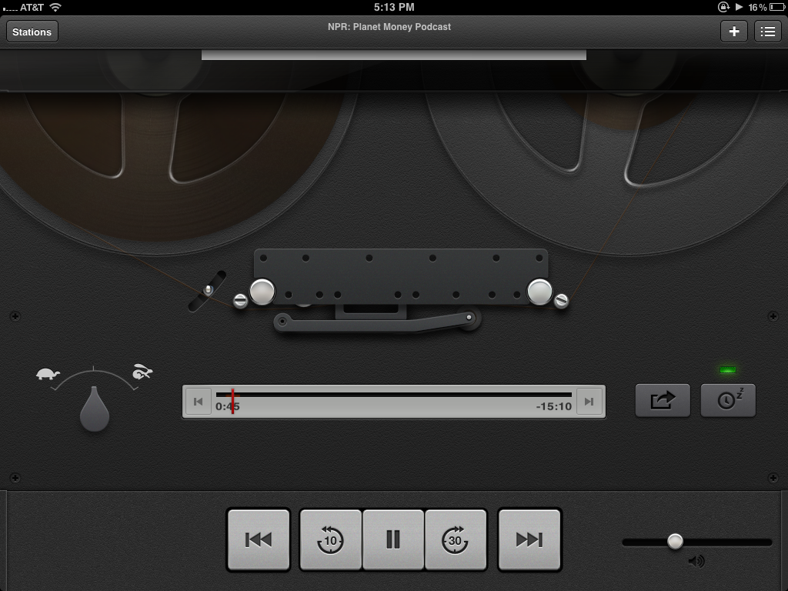
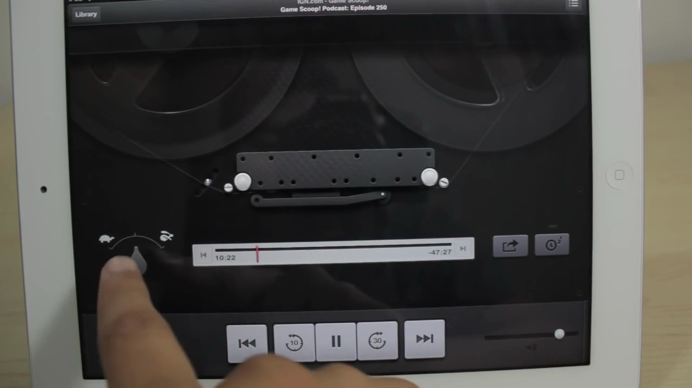
Avoid Metaphor for Metaphor’s Sake
Metaphors can become dated
iPhone metaphors dated?
iPad Podcast app – ever seen a reel-to-reel tape deck?
Notes:
52
Metaphors also become dated
How many of you have ever used a phone like this one in the green? How much mail do you get that isn’t email?
[ADVANCE]
This is the original iPad Podcast app (it was short lived). Looked very cool (used to be in my hall of shame, but became unsure you’d even get it).
[ADVANCE]
[ADVANCE at end of video]
How many of you have ever seen a reel-to-reel tape deck?
[note: this is not a cassette player]

Slide 53
Ways of Being Consistent
Interfaces should be consistent in a meaningful way
  e.g., ubiquitous use of same keys for cut/copy/paste
  H4: Consistency & Standards
Types of consistency
  consistent internally
    e.g., same terminology & layout throughout app
  consistent with other apps
    e.g., works like MS Word, uses same keyboard conventions
    design patterns (across many apps)
  consistent with physical world
Notes:
The last topic I want to talk about today is about being consistent.
We will talk briefly about this again as this is one of Nielsen's 10 heuristics (H4…)

Slide 54
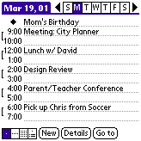
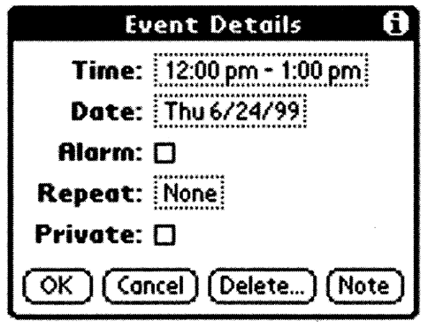
Is Consistent Always Better?
NO
Palm PDA example: should “new appointment” & “delete appointment” be in the same place?
New (add) is common, but delete is not
Notes:
I told you previously that consistency is a good thing in UIs. It is also one of Nielson’s heuristics.
But is it always better?
Consistency of having add(new)/delete together always, vs. making it faster for common task

Slide 55
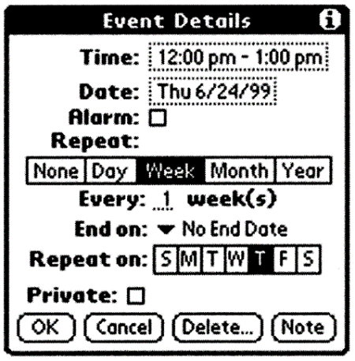

Is Consistent Always Better?
NO
Early Palm design
(like desktop version)
Streamlined design
Notes:
Consistency with desktop (early design) vs. making it better for mobile

Slide 56
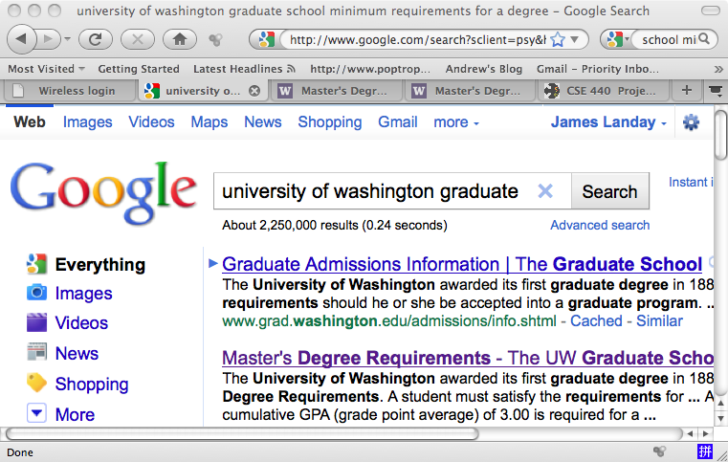
Is Consistent Always Better?
NO
Firefox 3 Back/Forward Buttons
Notes:
[ADVANCE]
Why is one bigger?
?
Fitts' Law

Slide 57
Is Consistent Always Better?
NO
More Recent Firefox Back/Forward Buttons
Notes:
This feature went away but recently they brought back the idea of making it more prominent.
[ADVANCE]
See this circle around the Back button?
Checked last year. Looks like they got rid of it again! (this example was from three years ago)

Slide 58

Summary
Conceptual model?
  mental representation of how the object works & how interface controls effect it
Design model should equal customer’s model?
  mismatches lead to errors
  use customer’s likely conceptual model to design
Design guides?
  provide good conceptual model
  make things visible
  map interface controls to customer’s model
  provide feedback
Design Model
Customer Model
System Image

Slide 59
Further Reading
Design of Everyday Things, Donald Norman
Design as Practiced, Donald Norman
  Talks about failure to make changes to Macintosh
  http://www.jnd.org/dn.mss/Design_as_Practiced.html
Computing the Case Against User Interface Consistency, Jonathan Grudin
  Talks about why interfaces should not always be consistent
  https://www.semanticscholar.org/paper/The-Case-Against-User-Interface-Consistency-for-can-Jonathan-Grudin/71cc342910a4add7ee522c5510769a1c51df2ebd

Slide 60
Next Time
Lecture
  Heuristic Evaluation (w/ in-class exercise)
Read
  How to Conduct a Heuristic Evaluation by Nielsen/Norman Group
Studio
  This week: Half-way review w/ outside experts

