Slide 1
Human Abilities: Vision & Cognition
October 21, 2024
Music: https://soundcloud.com/dansuneroquette
Notes:
Goal, fast to get to break by 40 min
---- Last year ---
got to break at 53 minutes… way too late. Had to skip second in class experiment and all the interference memory slides at the end -> cut some 1st half content and do HoF/S faster to get first half done in 40 min
--- two years ago ---
Ended exactly on time and had a 20 min break
------three years ago -----
Plan: 40 min + 20 min break + 45 min after break including 2 exercises (last year went 5 min over. Cut 2 slides somewhere)

Slide 2

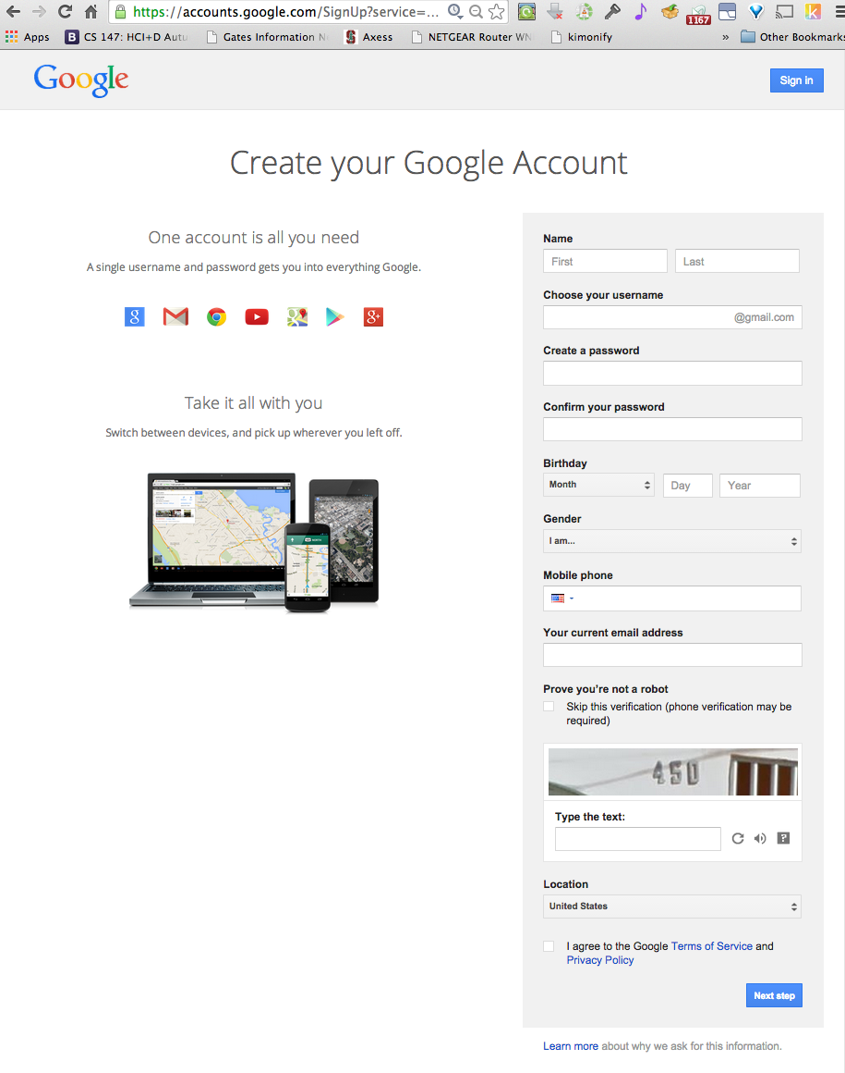
Hall of Fame or Shame?

Slide 3
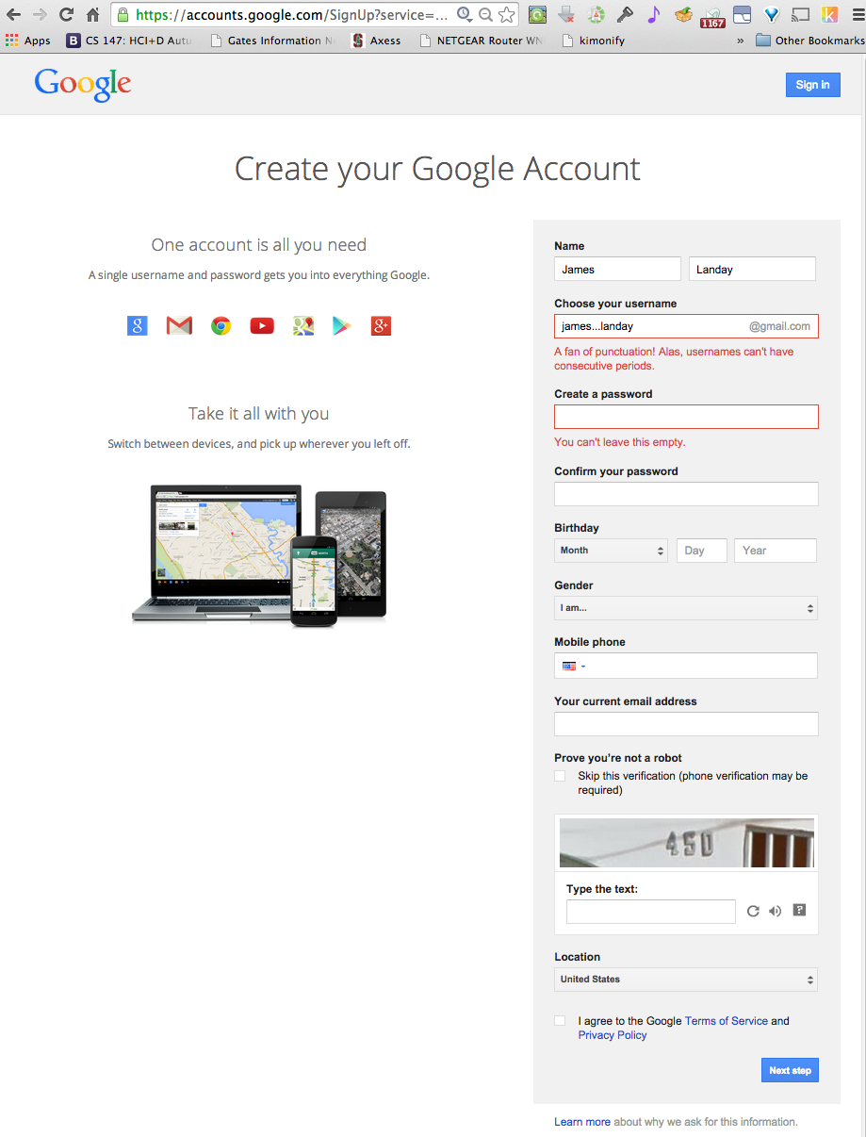
Hall of Fame or Shame?
Notes:
What do we like?
What could be improved?

Slide 4

Hall of Fame! (but still some issues…)
Clearly highlights error (red text & box)
Tells me what I did wrong/how to fix it
In user’s language
(but, be careful w/ humor)
Red may be an issue when used alone, more later...

Slide 5
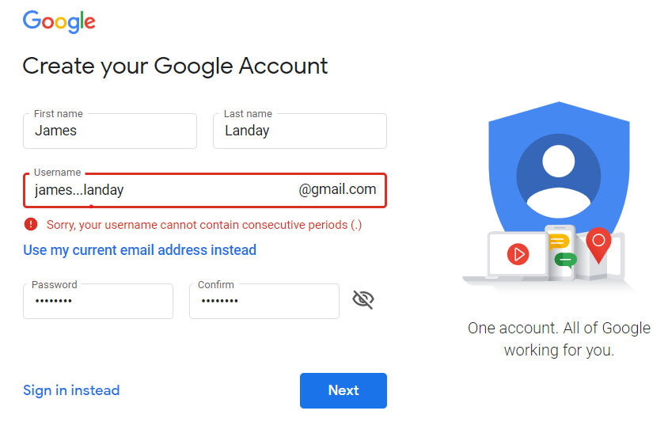
Hall of Fame!
Clearly highlights error (red text & box)
Tells me what I did wrong/how to fix it
In user’s language
(but, be careful w/ humor)
Red may be an issue when used alone, more later...
New version fixes these 2 problems
- adds caution icon & removes the humor
Notes:
When I tried it again last year it was much improved
(the current version is different again, but similar to this in terms of the error handling)

Slide 6
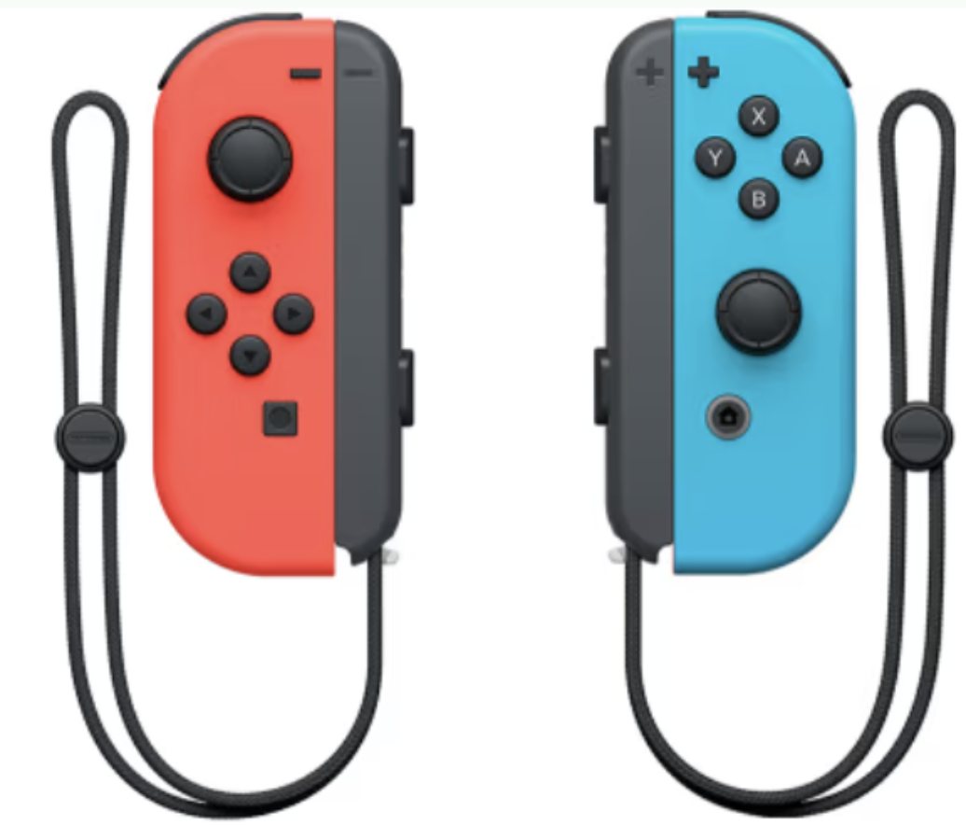
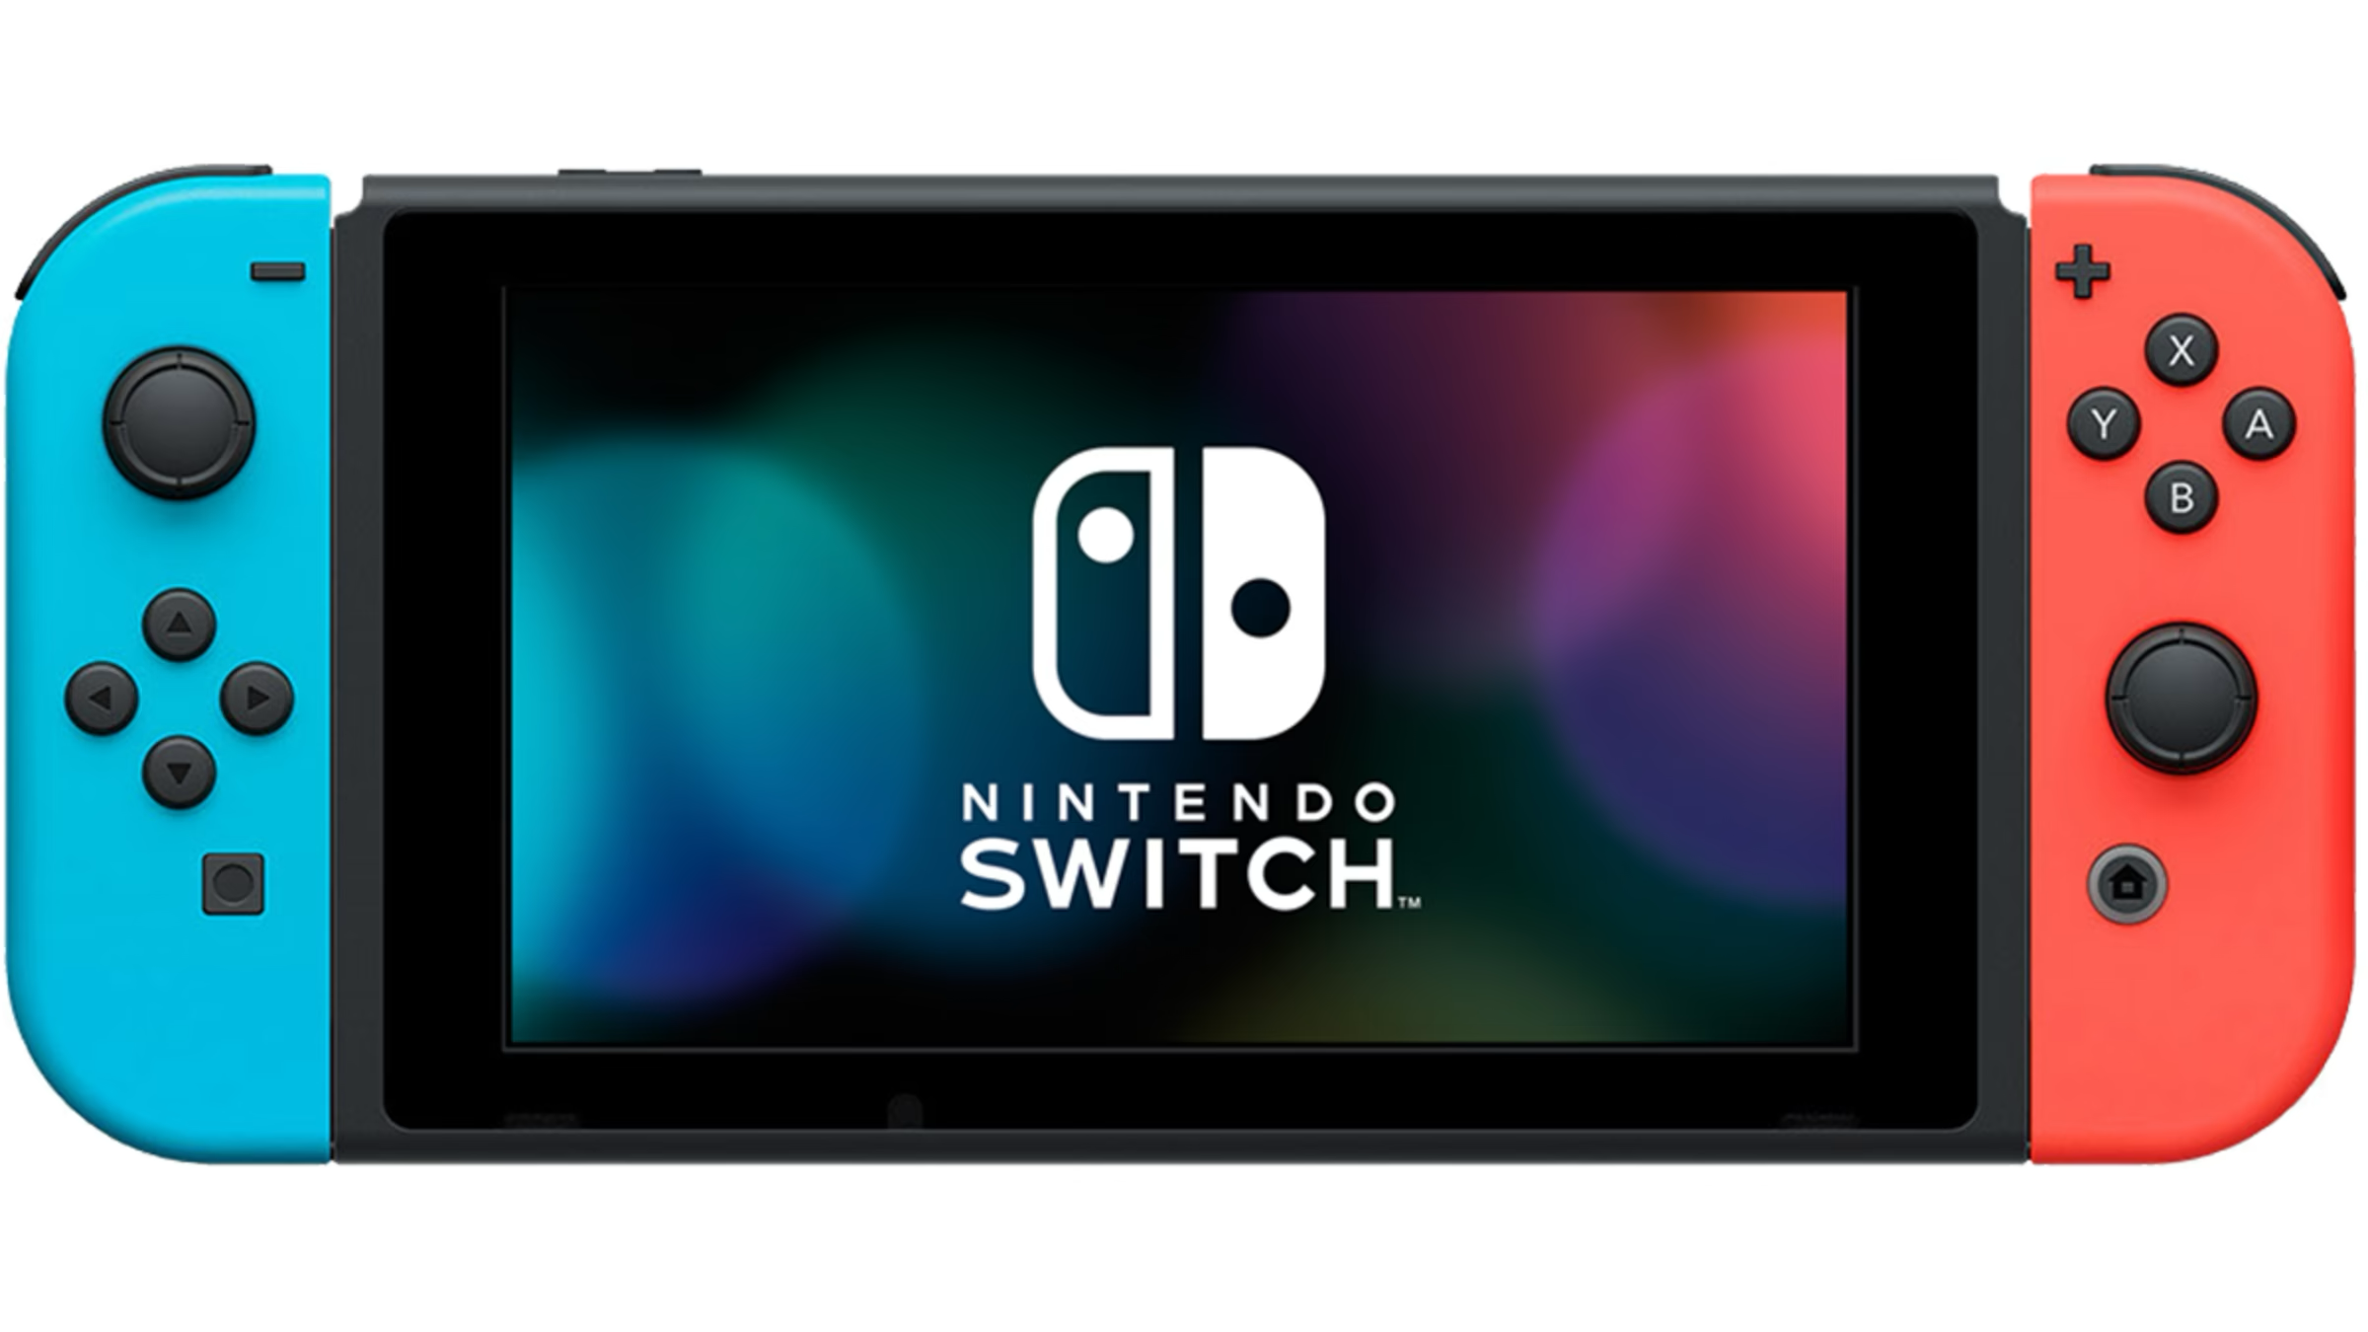
Hall of Fame or Shame?
Nintendo Switch
Connects to TV and use detachable controllers
or
Use as a single all in one device
or
Give another person a controller & share the screen
Notes:
3 main ways to use:
Connects to TV and use detachable controllers
or
Use as a single all in one device
or
Give another person a controller & share the screen

Slide 7
Hall of Fame!
Multiple configurations reduces # of physical steps for any one mode
Detachable controllers caters to different play styles/physical abilities
Controller optimizes button placement for minimal movement (Fitts’ Law)
Notes:
Multiple configurations reduces # of physical steps for any one mode
Detachable controllers caters to different play styles/physical abilities
Controller optimizes button placement for minimal movement (Fitts’ Law)

Slide 8
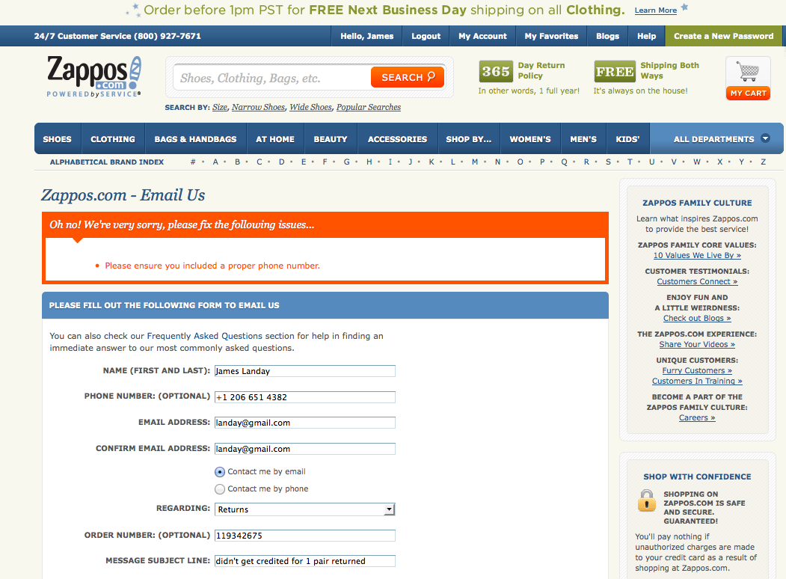
Hall of Fame or Shame?
Notes:
I had to return some shoes to zappos.com
They didn’t give me full credit so I had to fill out a form
What do we like?
What could be improved?

Slide 9

Hall of Shame!
Like
  error message prominent with different color & shape
Wish
  where is the error?
  what’s wrong with it?
  parse & fix it yourself!

Slide 10
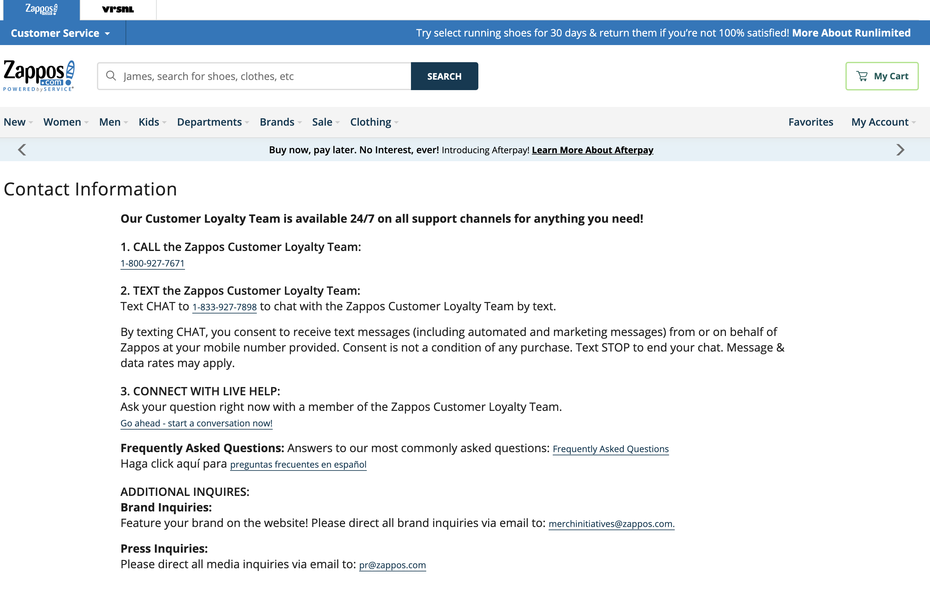
Hall of Shame!
Update (today)
- no longer have that form (uses phone, SMS, live chat)
Notes:
Newer version. They got rid of the form.

Slide 11
Human Abilities: Vision & Cognition
October 21, 2024
Music: https://soundcloud.com/dansuneroquette
Notes:
Goal: 45 min + 20 min break + 45 min
First: Wow. Some of the videos I’ve seen are really great! You’ll get to see the best ones and vote on some awards in 2 weeks.
Why are we learning this? We can give you guidelines on what to do and what not to do (and there was some of this in the visual design lecture next Monday and there will be more here), but it is important to understand some of the human machinery that UNDERLIES these design guidelines. We will give you some of that today. You could take an entire course on these topics, visual perception, human memory, and the human motor system, but we are going to give you a quick summary today.
--- last year ---
Ended exactly on time and had a 20 min break
---- last year ---
45 min + 15 min break + 45 min after break including 2 exercises (but went 5 min over. Cut 2 slides somewhere)

Slide 12
Outline
Human visual system
Guidelines for design
Team Break
Models of human performance (MHP)
Two in class experiments
Memory

Slide 13
Why Study Color?
Color can be a powerful tool to improve user interfaces by communicating key information
Inappropriate use of color can severely reduce the performance of systems we build

Slide 14
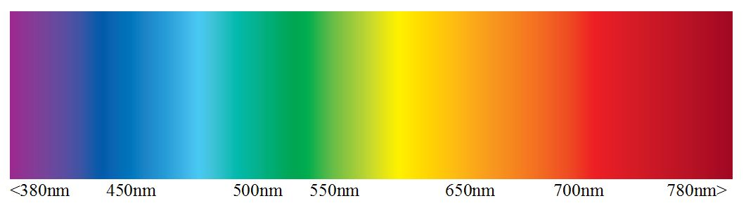
Visible Spectrum
There is an order to the colors… ROY G. BIV
UV
IR
Wavelength (nm)
Do not use that ordering to order data!
(next lecture: example of how unusable a map is using this ordering for elevation)
Notes:
Here is an image of the visible spectrum, from 380nm on the left, violet, to 780nm on the right, red.
[ADVANCE]
And there is an ordering of the colors that maps to the wavelengths…
From Right to Left people use the pneumonic Roy G. Biv: red, orange, yellow, green, blue, indigo, violet
But do not use that to order data!

Slide 15
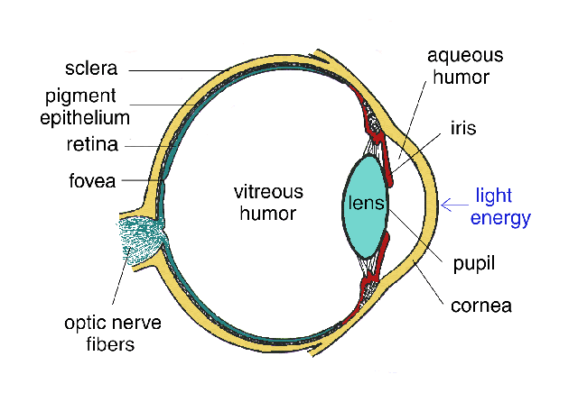
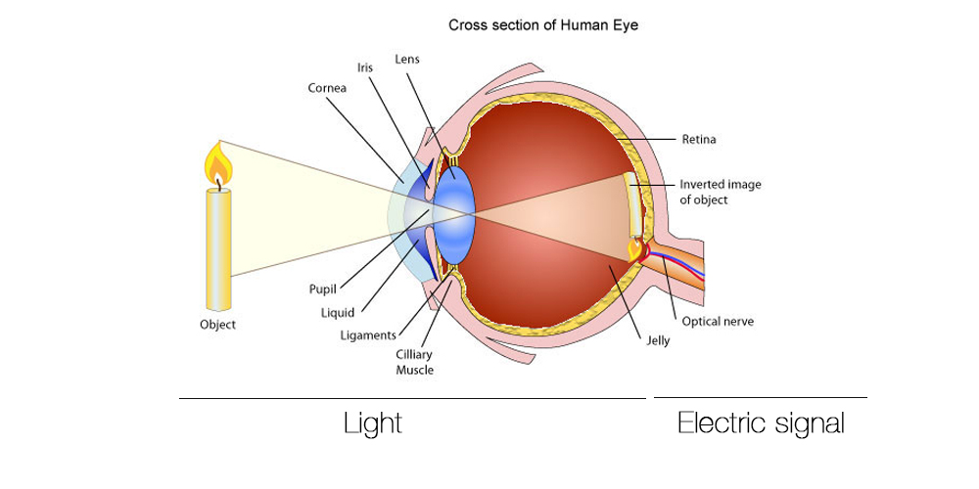
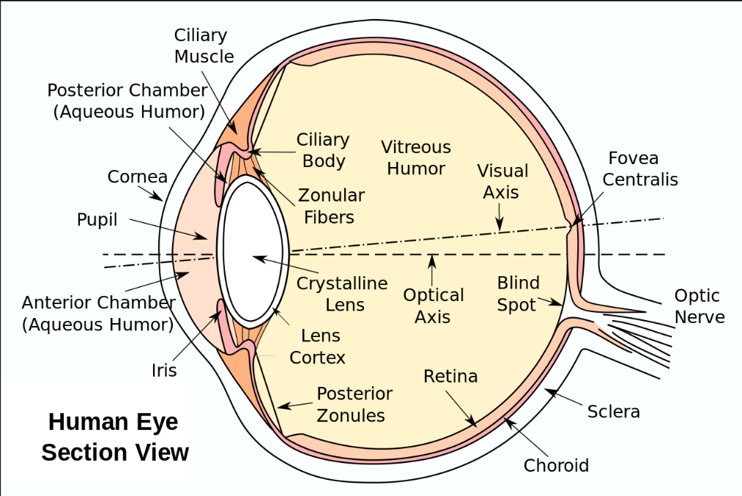
Human Visual System
Light passes through lens
Focused on retina
http://obsessive-coffee-disorder.com/wp-content/uploads/2014/11/eye1.jpg
Notes:
This is how the human visual system works.
You may remember how lenses work from high school or college physics.
Light passes through the lens...

Slide 16
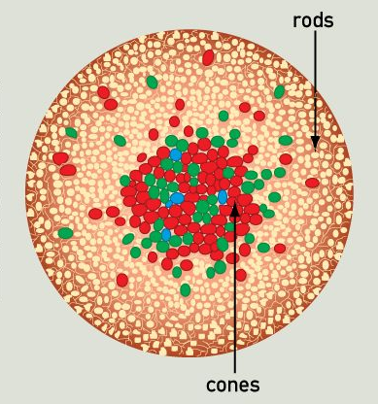
Retina
Retina covered with two types of light-sensitive receptors called?
  rods
    primarily for night vision & perceiving movement
    sensitive to broad spectrum of light
    can’t discriminate between colors
    sense to intensity or shades of gray
  cones
    used to sense color
http://www.webexhibits.org/causesofcolor/1G.html
Notes:
[ADVANCE]
[ADVANCE]
Anyone notice anything interesting about the distribution of the rods and cones?

Slide 17
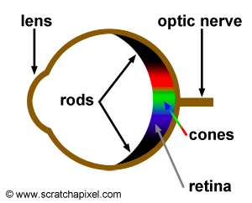
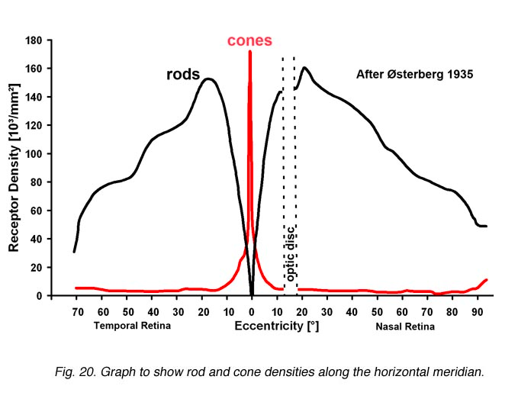
Retina
Center of retina has most of the cones →
  allows for high acuity of objects focused at center
Edge of retina is dominated by rods →
  allows detecting motion of threats in periphery
http://www.webexhibits.org/causesofcolor/1G.html
http://webvision.med.utah.edu/imageswv/Ostergr.jpeg
Notes:
Here are a couple of other ways of seeing the distribution of the rods and cones
[ADVANCE]
Acuity is the ability to see fine details in an image
[ADVANCE]

Slide 18
Color Perception via Cones
“Photopigments” used to sense color
3 types: blue, green, “red” (really yellow)
  each sensitive to different band of spectrum
  ratio of neural activity of the 3 → color
    other colors are perceived by
    combining stimulation
http://www.webexhibits.org/causesofcolor/1G.html

Slide 19
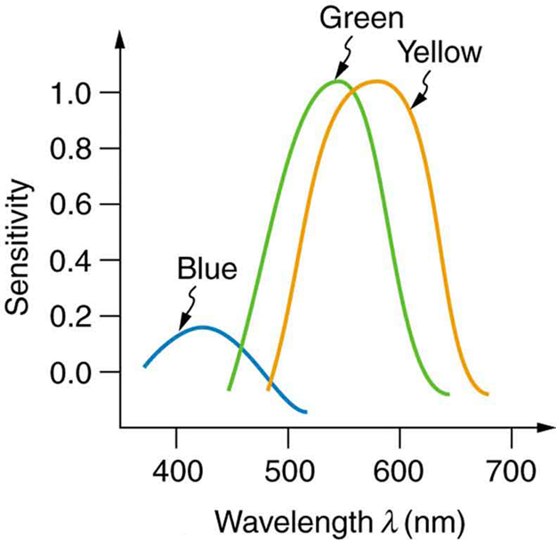
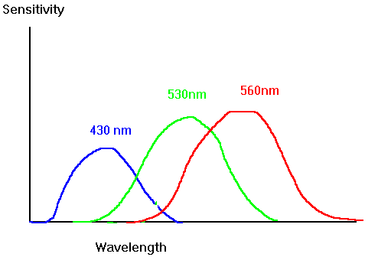
Color Sensitivity
AKA Red
lots of
overlap
not as sensitive
to blue
https://www.siggraph.org/education/materials/HyperGraph/color/images/colorspc.gif
http://archive.cnx.org/contents/d42c807d-a9fa-4e3d-83d0-0f7c745b51a0@4/color-and-color-vision#import-auto-id1844887
Notes:
See anything interesting here?
We are NOT as sensitive to blue
[ADVANCE]
2) There is lots of overlap between the 3 photopigments
[ADVANCE]
Image from: http://archive.cnx.org/contents/d42c807d-a9fa-4e3d-83d0-0f7c745b51a0@4/color-and-color-vision#import-auto-id1844887

Slide 20
Color Sensitivity
AKA Red
https://www.siggraph.org/education/materials/HyperGraph/color/images/colorspc.gif
http://archive.cnx.org/contents/d42c807d-a9fa-4e3d-83d0-0f7c745b51a0@4/color-and-color-vision#import-auto-id1844887
Notes:
If I underlay that spectrum from the earlier slide, you can see clearly that the "red” cone sensitivity is clearly centered on YELLOW (though due to the long tail, probably more of the area under the curve is in the red).
Image from: http://archive.cnx.org/contents/d42c807d-a9fa-4e3d-83d0-0f7c745b51a0@4/color-and-color-vision#import-auto-id1844887

Slide 21
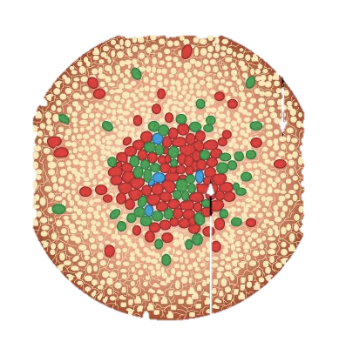
Distribution of Photopigments
Not distributed evenly – mainly reds (64%) &
very few blues (4%) →
  insensitivity to short wavelengths (blue)
Few blue cones in retina center (high acuity) →
  “disappearance” of small blue objects you fixate on
As we age lens yellows & absorbs shorter wavelengths →
  sensitivity to blue is even more reduced
Implication
  don’t rely on blue for text or small objects!
http://www.webexhibits.org/causesofcolor/1G.html
Notes:
Let's talk more about the distribution of the photopigments across Red, Green, and Blue. They aren't distributed evenly at all!
Mainly reds and very few blues.
[ADVANCE]
insensitivity to blue light
[ADVANCE]
Few of the blue ones are in the center. Where we have high acuity.
[ADVANCE]
Disappearance of small blue objects.
[ADVANCE]
As we age the lens yellows... absorbs shorter wavelengths
[ADVANCE]
Sensitivity to blue gets even worse!
[ADVANCE]
Don't use blue for small objects, e.g., text.
Original choice of blue links on the web was a bad idea!

Slide 22
Focus
Different wavelengths of light focused at different distances behind eye’s lens
  need for constant refocusing → ?
    causes fatigue
  be careful about color combinations
Notes:
different wavelengths will focus at different distances through a lens... so we use little muscles to change the shape of the lens.
call that refocusing
[ADVANCE]
it causes fatigue
[ADVANCE]
so be careful about color combinations physically near each other that cause this refocusing constantly

Slide 23
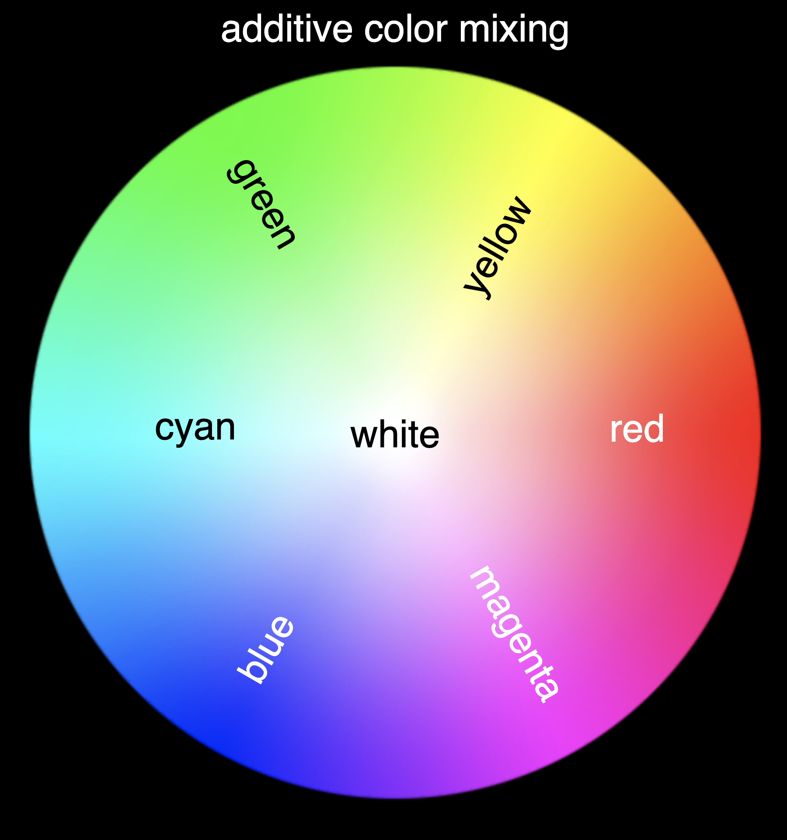
Focus
Different wavelengths of light focused at different distances behind eye’s lens
  need for constant refocusing → ?
    causes fatigue
  be careful about color combinations
Pure (saturated) colors require more
focusing than less pure (desaturated)
  don’t use saturated colors in UIs unless
  you really need something to stand out
https://physics.info/color/
Notes:
Look at this color wheel. The pure or saturated colors are on the outside. As you move towards the center they are being mixed with gray and become desaturated. Those lighter colors are CLOSER together in frequency space if you look back on the color spectrum and thus when used together require less refocusing and thus less strain on the eye.

Slide 24
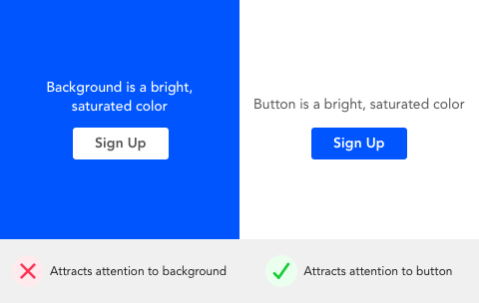

Focus
Different wavelengths of light focused at different distances behind eye’s lens
  need for constant refocusing → ?
    causes fatigue
  be careful about color combinations
Pure (saturated) colors require more
focusing than less pure (desaturated)
  don’t use saturated colors in UIs unless
  you really need something to stand out
http://www.pallasweb.com/color.html
saturated bg desaturated bg
Notes:
In the Left image, the background is saturated, the right is desaturated (how much gray)
Decreasing lightness helps, but much better on right with desaturated colors than saturated
(sweater will still “pop”)
[ADVANCE]
or see this example with the button. Using the saturated color for the button and the desaturated color for the background causes the button to pop

Slide 25

Color Deficiency
(Also known as “color blindness”)
Trouble discriminating colors
  besets about 4.5% of population (~8% men, ~½% women)
Two main types
  different photopigment response – most common
    reduces capability to discern small color diffs
  red-green deficiency – best known
    lack of either green or red photopigment →
    can’t discriminate colors solely dependent
    on Red & Green
Key is to avoid single color distinctions
Difficult pairs for severe red deficient person to discern
https://www.color-blindness.com/red-green-color-blindness/
Notes:
4.5% of population, mostly men
[ADVANCE]
Two types
[ADVANCE]
different photopigment response most common
[ADVANCE]
red-green deficiency (widely known). missing a photopigment.
[ADVANCE]
There are web sites where you can check your color palette for red/green color deficiency to ensure your colors won’t cause a problem.
Key is to avoid single color distinctions

Slide 26
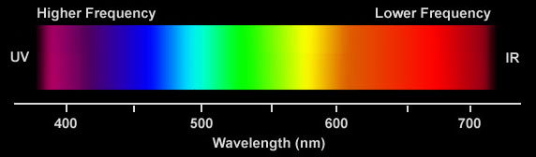
Color Guidelines
Avoid simultaneous display of highly saturated, spectrally extreme colors
  e.g., no cyans/blues at the same time as reds, why?
    refocusing!
  desaturated combinations are better → pastels
A Bad Color Combo
bad
Notes:
Some guildines
Avoid simultaneous...
why?
see how far they are in frequency space?
constant refocusing!

Slide 27
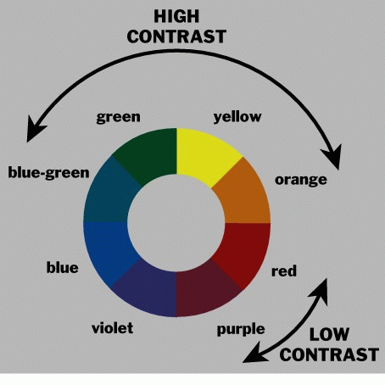
Use the Hue Circle
Pick non-adjacent colors
  opponent colors
  go well together
      red & green
      or
      yellow & blue
Notes:
There are even better schemes than opponent colors (we'll see that in the visual design lecture), but being across the circle means they are closer to each other in frequency and thus require less refocusing.

Slide 28

Color Guidelines (cont.)
Avoid pure blue for text, lines & small shapes
Avoid adjacent colors that differ only in blue
Blue makes a great background color
TO BLUE
Notes:
Mainly an issue for lots of text
blue makes a fine background color

Slide 29
Administrivia
Grading on Assignment #2: POV, HMW, Experience Prototypes
  A2 Group Presentation: -: 0% ✓- -: 0% ✓-: 7% ✓: 83% ✓+: 10% ✓ ++: 0%
  A2 Individual Presentation: -: 0% ✓- -: 0% ✓-: 0% ✓: 48% ✓+: 45% ✓ ++: 7%
Grading
  buckets are weighed in the rubric so two minuses are not equal
  note: each team member’s contribution will be assessed at the end of class & grades adjusted appropriately

Slide 30
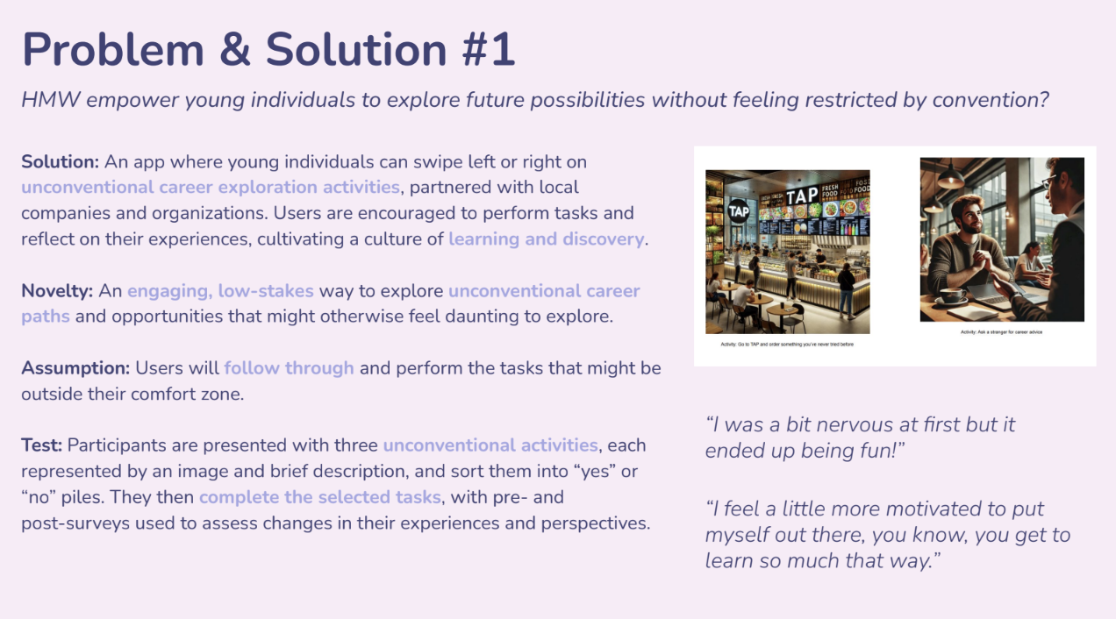
Notes:
Here is a nice experience prototype from A2 from the LevelUp team in the Paige’s studio

Slide 31
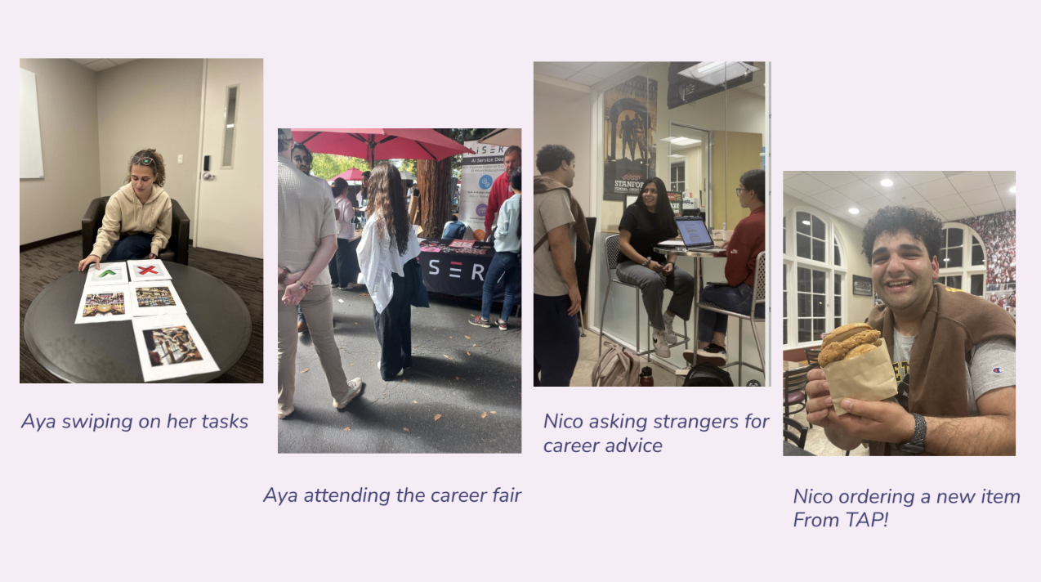
Notes:
Here is a nice experience prototype from A2 from the X team in the Star’s 12:30 Threads studio

Slide 32
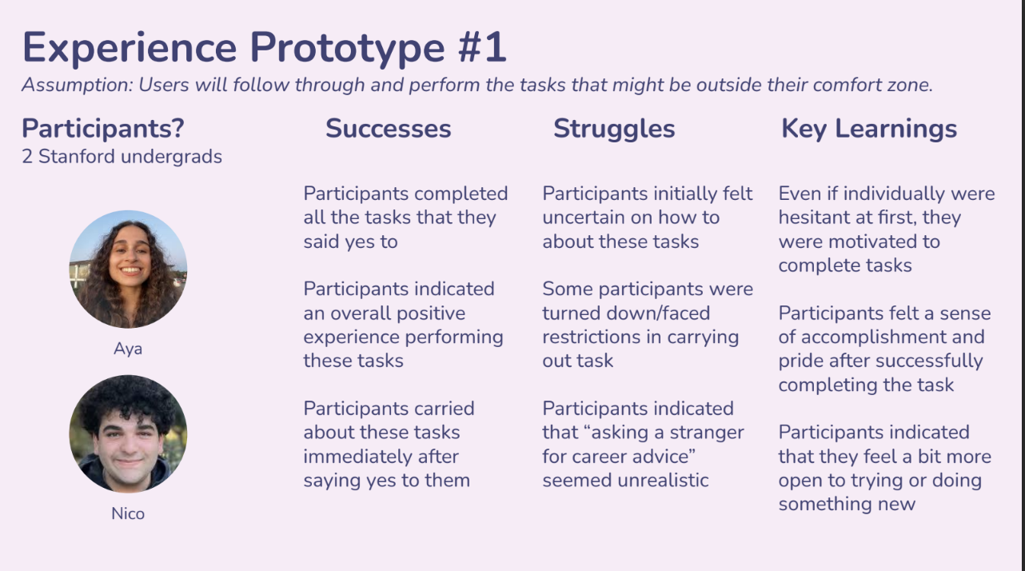
Notes:
Here is a nice experience prototype from A2 from the X team in the Star’s 12:30 Threads studio

Slide 33
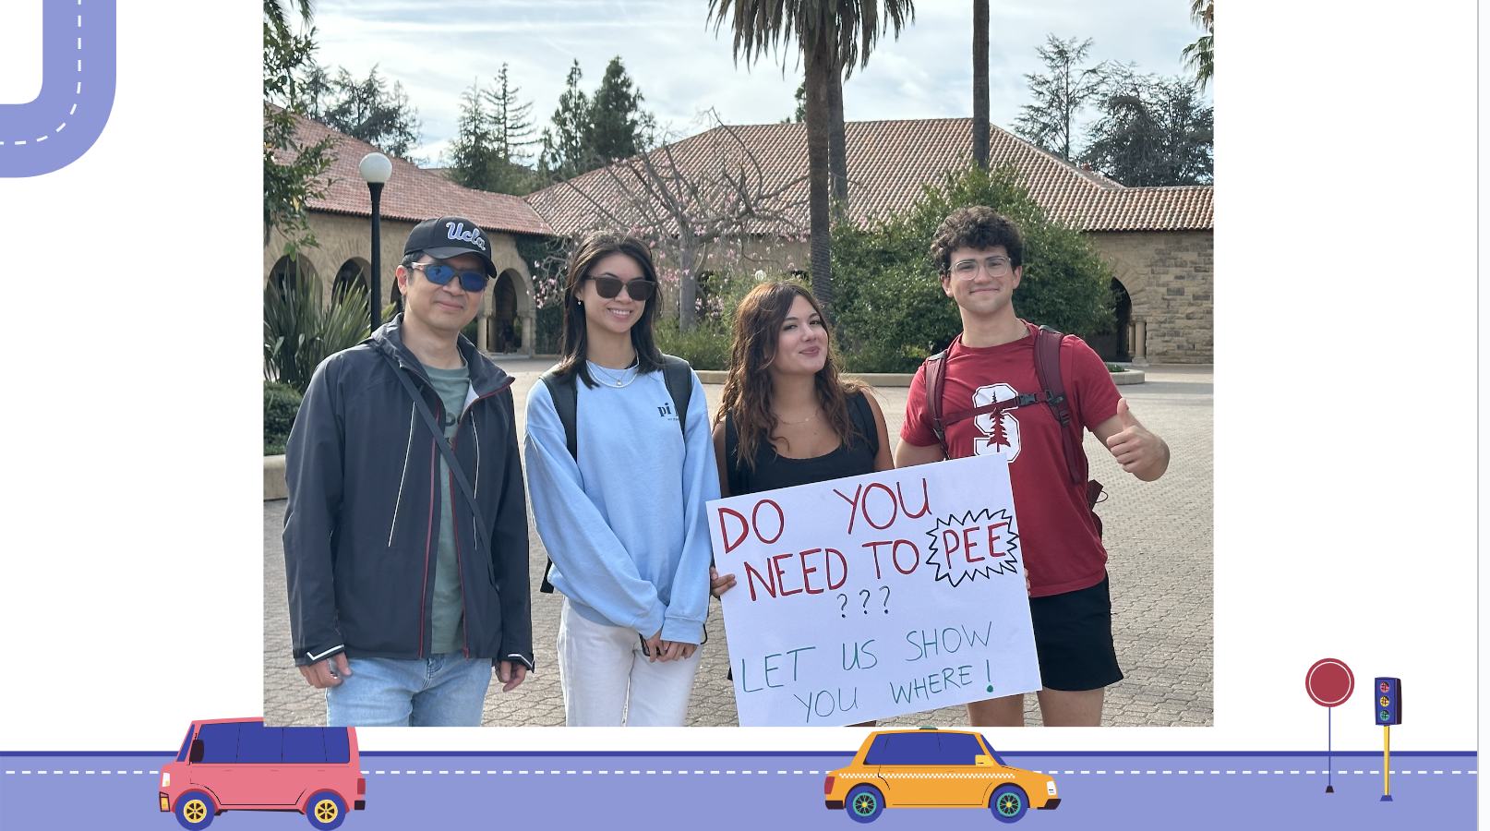
Notes:
Here is an experience prototype from A2 from the Pission team in the Eli’s studio
Assumption: People in new places (e.g., tourists) don't know where public restrooms are and -- if presented -- would utilize any assistance in finding them
What they did: Held up sign and waited to see if anyone came to them. If people came to them, they walked them to nearest public restroom and chatted about their experience finding public utilities in this new area (most people had a really hard time navigating stanford and finding its public utilities).
What happened: They had about a dozen tourists in only the span of a few minutes come up and ask them for help in navigating towards the closest public utilities.
Conclude: people in new areas are looking for assistance to find public utilities and are willing to go through the "friction" of asking others for assistance

Slide 34
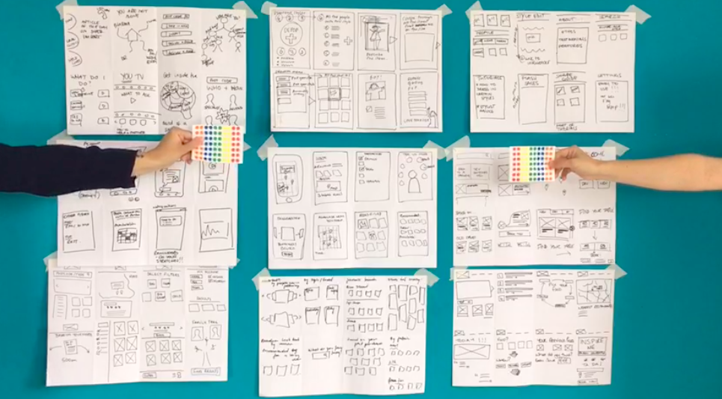
Administrivia
Assignment #5 – Low-fi Prototype & Pilot Usability Test
  10-15 rough sketches of 3 different design realizations
    everyone on team contributes
    use different modalities (e.g., visual, speech, watch) or
    different visual UIs input techniques (gestures, taps, etc.)
Notes:
Let’s talk about your next assignment
You are going to be making low-fi prototypes like I showed you last wed and then test them in your assignment due on Thursday/Friday.

Slide 35
Administrivia
Assignment #5 – Low-fi Prototype & Pilot Usability Test
  10-15 rough sketches of 3 different design realizations
    everyone on team contributes
    use different modalities (e.g., visual, speech, watch) or
    different visual UIs input techniques (gestures, taps, etc.)
  pick top 2 realizations & storyboard/task flow more
  pick best realization & add details to task flow
  build low-fi prototype of the best & test it w/ at least 1 target (non-Stanford) participant/team member (e.g., four)
Notes:
Let’s do some administrivia.
You are going to be making low-fi prototypes like I have shown and then test them in your next assignment due a week from this Thursday/Friday.

Slide 36
T E A M
B R E A K
Notes:
goal: break at 40-45 minutes, 20-minute break (need 45 min to finish)
if have less than 65 min left, reduce accordingly
--- last year –
broke at 52 min (restart at 2:45)
20 min break
--- two years ago ---
broke at 49min -- took 21 min break (restart at 2:40 PM)
--- three years ago ----
broke at 40 minutes
For 20 minutes – if have less than 65 min left, reduce accordingly
Need 45 min to finish
-----

Slide 37
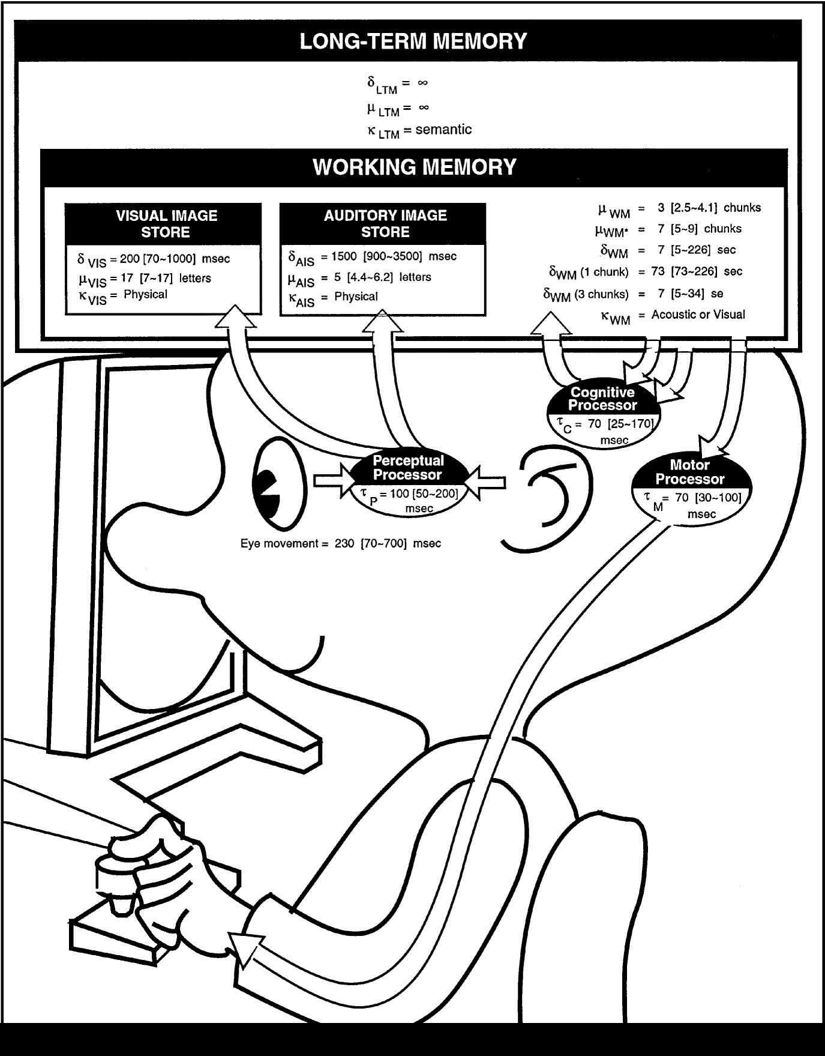
The Model Human Processor
Developed by Card, Moran &
Newell (’83)
  based on empirical data
Model can help us test understanding & make predictions
Underlies other usability techniques
  GOMS, KLM, tools, etc.
Notes:
Now we are going to talk more about cognition and motor control.
We model human performance to test understanding and
To predict the influence of new technology.
This is the classic image from the book “The Psychology of Human-Computer Interaction”

Slide 38
The Model Human Processor
Long-term Memory
Working Memory
sensory
buffers
Visual Image
Store
Auditory Image
Store
Eyes
Perceptual
Processor
Motor
Processor
Cognitive
Processor
Ears
Fingers, etc.
Notes:
I’ll use this simpler model

Slide 39
MHP Basics
Sometimes serial, sometimes parallel
  serial in action & parallel in recognition
    pressing key in response to light (serial)
    driving, reading signs & hearing at once (parallel)
Parameters
  processors have cycle time (T) ~ 100 ms
  memories have capacity, decay time & type

Slide 40
MHP Basics
Parameters
  processors have cycle time (T) ~ 100 ms
  memories have capacity, decay time & type

Slide 41
What is missing from MHP?
Long-term Memory
Working Memory
sensory
buffers
Visual Image
Store
Auditory Image
Store
Eyes
Perceptual
Processor
Motor
Processor
Cognitive
Processor
Ears
Fingers, etc.
Notes:
Haptic input & haptic image store
Moving from sensory memory to working memory
Moving from working memory to long-term memory

Slide 42
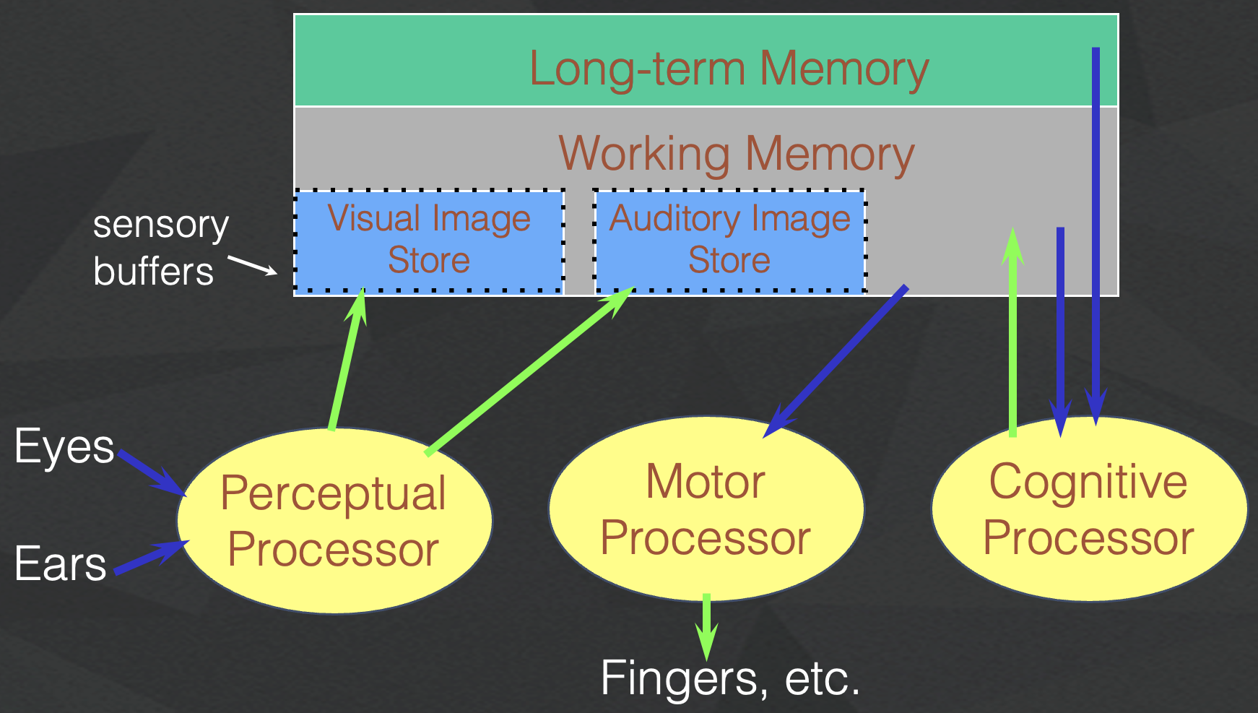
What is missing from MHP?
Haptic memory
  for touch
Moving from sensory memory to WM
  attention filters stimuli & passes to WM
Moving from WM to LTM
  elaboration
Notes:
Perception of Touch… Smell… Taste….

Slide 43
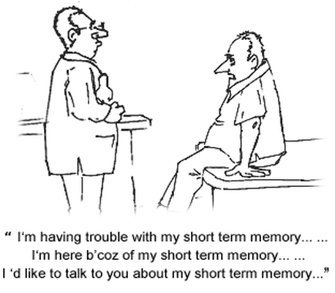
Notes:
Why do we care about memory…
It underlies many of the issues in the usability of visual interfaces

Slide 44
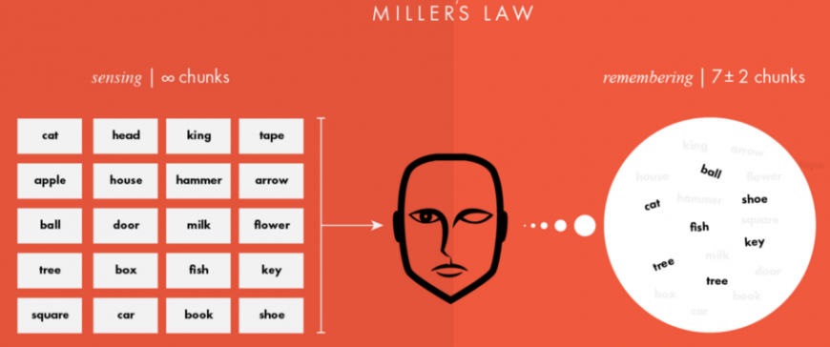
Memory
Working memory (short term)
  small capacity (7 ± 2 “chunks”)
    6174591765 vs. (617) 459-1765
    NBCIBMGMC vs. NBC IBM GMC
  rapid access (~70ms) & decay (~200 ms)
    pass to LTM after a few seconds of continued storage
Long-term memory
  huge (if not “unlimited”)
  slower access time (~100 ms) w/ little decay

Slide 45
MHP Principles of Operation
Recognize-Act Cycle of the CP
  on each cycle contents in WM initiate actions associatively linked to them in LTM
  actions modify the contents of WM

Slide 46
MHP Principles of Operation
Long-term Memory
Working Memory
sensory
buffers
Visual Image
Store
Auditory Image
Store
Eyes
Perceptual
Processor
Motor
Processor
Cognitive
Processor
Ears
Fingers, etc.
Notes:
Let’s see this in action
[ADVANCE]
some operation (like an instruction) goes from working memory to the cognitive processor and is executed
[ADVANCE]
this grabs action linked from the Long-term memory
[ADVANCE]
This is executed or used in an operation and then the result is put back in working memory.

Slide 47
MHP Principles of Operation
Recognize-Act Cycle of the CP
  on each cycle contents in WM initiate actions associatively linked to them in LTM
  actions modify the contents of WM
Discrimination Principle
  retrieval is determined by candidates that exist in memory relative to retrieval cues
  interference by strongly activated chunks

Slide 48
Experiment
Task:
Quickly tap each target 50 times accurately
Conditions:
  Two ½” diameter targets 6” apart
  Two ½” diameter targets 24” apart
  Two 2” diameter targets 24” apart
  Two 2” diameter targets 24” apart (no accuracy required)
Turn to neighbor: discuss what will happen
Notes:
Draw two circles on the board
both around 1/2 inches in diameter
1) distance of 6 inches
2) Repeat by extending the distance to 24 inches
Ask volunteer to put mark in circle 50 times each quickly, but accurately (outside of circle at most 4 times)
Now do it 24" apart and still 1" diameter
TURN to a partner and discuss what you think will happen and WHY????
ID=Log2(d/w+1) : try easy ID of 4 and hard of ID 8
log2 (13)=3.7
Log2 (49)=5.6
Now try it again with 24 inches but make the target 2 inches wide
3) log2 (13)=3.7
Now try again asking the person to go as fast as they can independent of accuracy (should get more speed but see spread of circles outside)
Results:
30 sec
48 sec
31 sec (as predicted, almost the same as #1)
21 sec (lots of spread)

Slide 49
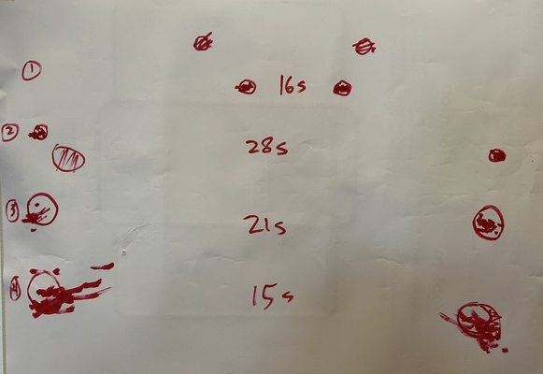
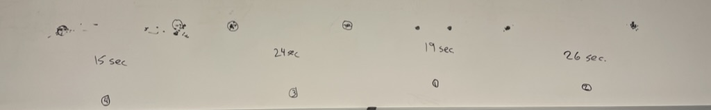
Experimental Results (2023au)
Task: Quickly tap each target 50 times accurately
Notes:
Draw two circles on the board
both around 1/2 inches in diameter
1) distance of 6 inches
2) Repeat by extending the distance to 24 inches
Ask volunteer to put mark in circle 50 times each quickly, but accurately (outside of circle at most 4 times)
TURN to a partner and discuss what you think will happen and WHY????
ID=Log2(d/w+1) : try easy ID of 4 and hard of ID 8
log2 (13)=3.7
Log2 (49)=5.6
Now try it again with 24 inches but make the target 2 inches wide
3) log2 (13)=3.7
) Now try again asking the person to go as fast as they can independent of accuracy (should get more speed but see spread of circles outside)
Results:
30 sec
48 sec
31 sec (as predicted, almost the same as #1)
21 sec (lots of spread)

Slide 50
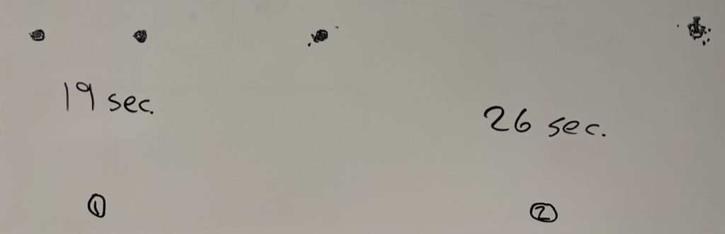
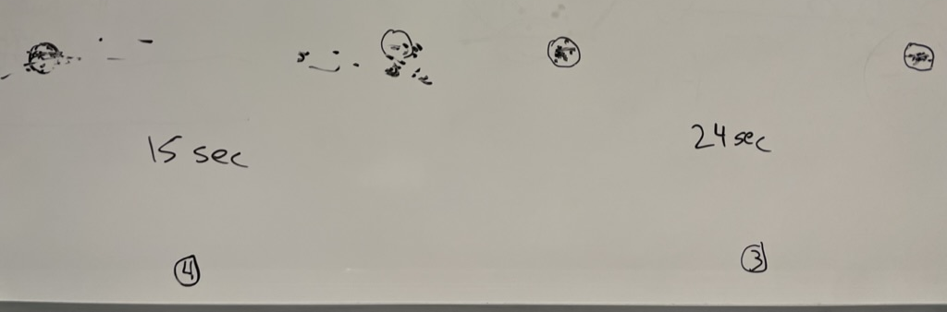
Experimental Results (last year)
Task: Quickly tap each target 50 times accurately
Notes:
Draw two circles on the board
both around 1/2 inches in diameter
1) distance of 6 inches
2) Repeat by extending the distance to 24 inches
Ask volunteer to put mark in circle 50 times each quickly, but accurately (outside of circle at most 4 times)
TURN to a partner and discuss what you think will happen and WHY????
ID=Log2(d/w+1) : try easy ID of 4 and hard of ID 8
log2 (13)=3.7
Log2 (49)=5.6
Now try it again with 24 inches but make the target 2 inches wide
3) log2 (13)=3.7
) Now try again asking the person to go as fast as they can independent of accuracy (should get more speed but see spread of circles outside)
Results:
30 sec
48 sec
31 sec (as predicted, almost the same as #1)
21 sec (lots of spread)

Slide 51
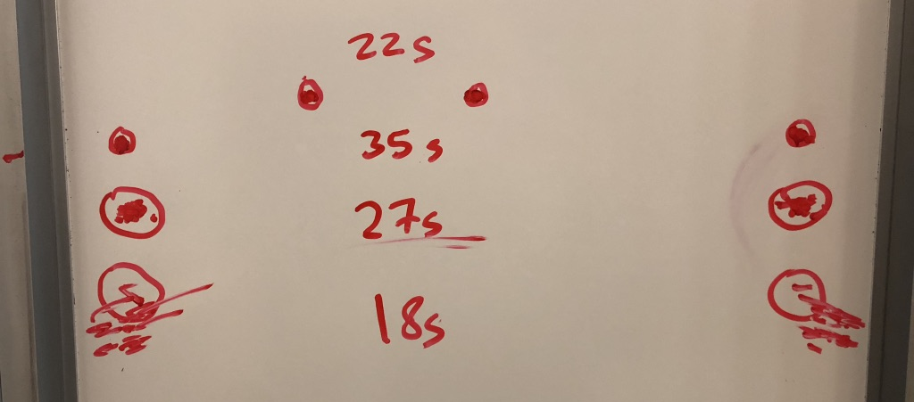
Experimental Results (pre-covid)
Task:
Quickly tap each target 50 times accurately
Notes:
Draw two circles on the board
both around 1/2 inches in diameter
1) distance of 6 inches
2) Repeat by extending the distance to 24 inches
Ask volunteer to put mark in circle 50 times each quickly, but accurately (outside of circle at most 4 times)
TURN to a partner and discuss what you think will happen and WHY????
ID=Log2(d/w+1) : try easy ID of 4 and hard of ID 8
log2 (13)=3.7
Log2 (49)=5.6
Now try it again with 24 inches but make the target 2 inches wide
3) log2 (13)=3.7
) Now try again asking the person to go as fast as they can independent of accuracy (should get more speed but see spread of circles outside)
Results:
30 sec
48 sec
31 sec (as predicted, almost the same as #1)
21 sec (lots of spread)

Slide 52
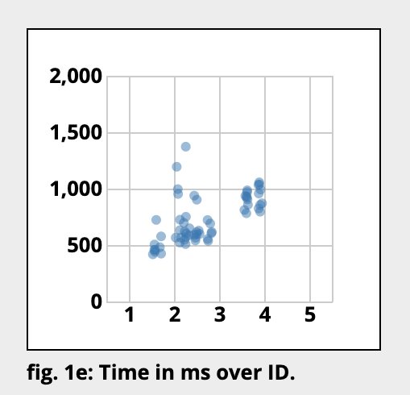
If we plot the data…
Index of Difficulty: ID = log (D/W) + 1
D = distance to target, W = width of target (or size)

Slide 53
Run This Experiment On Your Own
http://simonwallner.at/ext/fitts/
Notes:
I go to the link and show them
-- then say:
take a minute to do this and then stop after 4-5 rounds and take a look at the graphs below

Slide 54
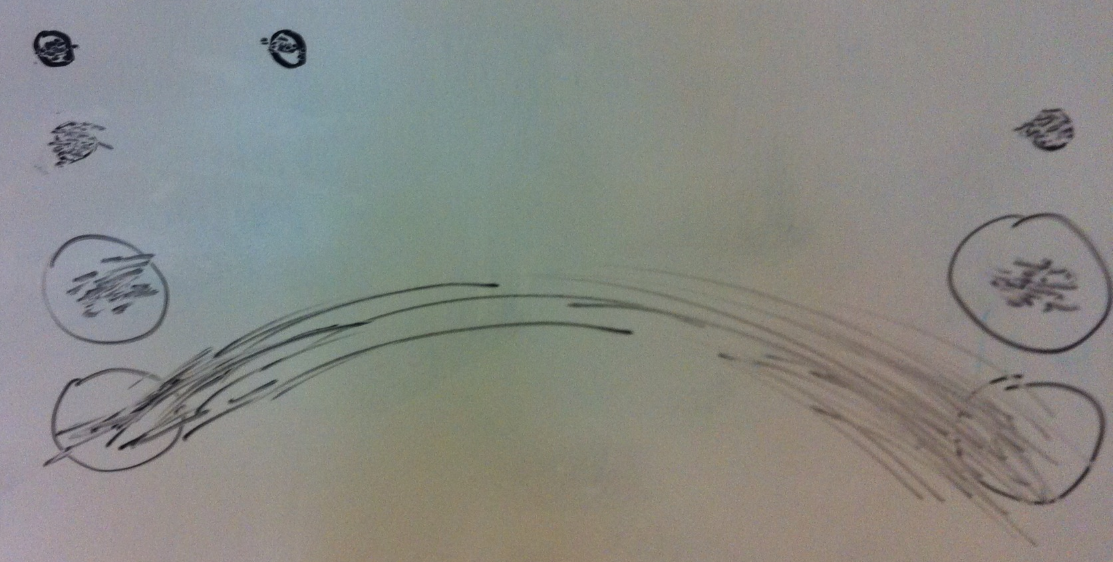
Experimental Results (2 years ago)
Task:
Quickly tap each target 50 times accurately
  30 sec
  48 sec
  31 sec
  21 sec (lots of spread)
Notes:
Draw two circles on the board
both around 1/2 inches in diameter
1) distance of 6 inches
2) Repeat by extending the distance to 24 inches
Ask volunteer to put mark in circle 50 times each quickly, but accurately (outside of circle at most 4 times)
TURN to a partner and discuss what you think will happen and WHY????
ID=Log2(d/w+1) : try easy ID of 4 and hard of ID 8
log2 (13)=3.7
Log2 (49)=5.6
Now try it again with 24 inches but make the target 2 inches wide
3) log2 (13)=3.7
) Now try again asking the person to go as fast as they can independent of accuracy (should get more speed but see spread of circles outside)
Results:
30 sec
48 sec
31 sec (as predicted, almost the same as #1)
21 sec (lots of spread)

Slide 55
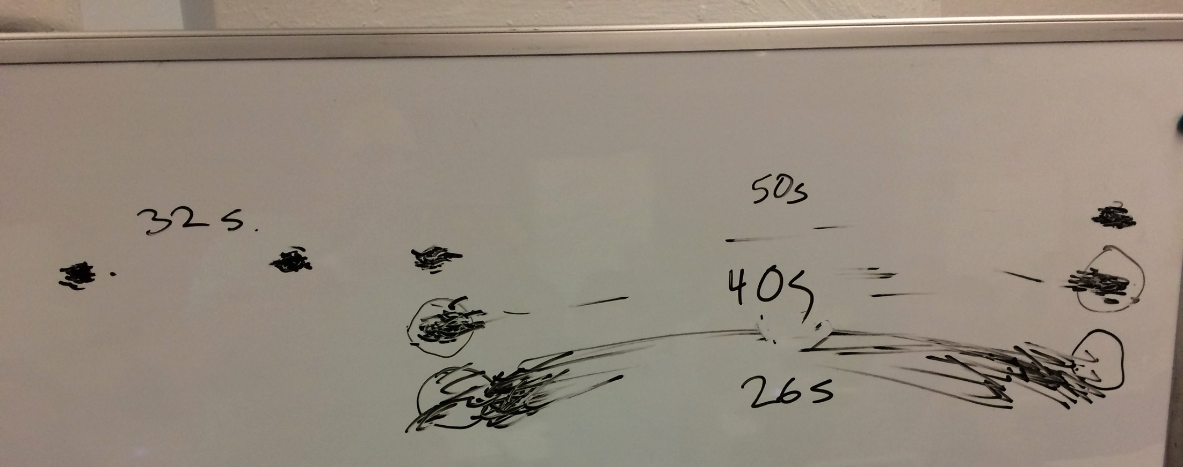
Experimental Results (3 years ago)
Task:
Quickly tap each target 50 times accurately
Notes:
Draw two circles on the board
both around 1/2 inches in diameter
1) distance of 6 inches
2) Repeat by extending the distance to 24 inches
Ask volunteer to put mark in circle 50 times each quickly, but accurately (outside of circle at most 4 times)
TURN to a partner and discuss what you think will happen and WHY????
ID=Log2(d/w+1) : try easy ID of 4 and hard of ID 8
log2 (13)=3.7
Log2 (49)=5.6
Now try it again with 24 inches but make the target 2 inches wide
3) log2 (13)=3.7
) Now try again asking the person to go as fast as they can independent of accuracy (should get more speed but see spread of circles outside)
Results:
30 sec
48 sec
31 sec (as predicted, almost the same as #1)
21 sec (lots of spread)

Slide 56
Principles of Operation (cont.)
Fitts’ Law
  moving hand is a series of microcorrections
    correction takes Tp + Tc + Tm = 240 msec
  time Tpos to move the hand to target size S,
  which is distance D away is given by:
    Tpos = a + b log2 (D/S + 1)
  summary
    time to move hand depends only on the relative precision (D/S) required
Notes:
So what’s going on here.
Fitts’ Law
Understand both D/S and relative position.

Slide 57
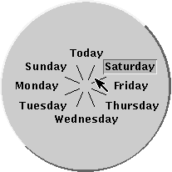
Fitts’ Law Example
Pop-up Linear Menu
Pop-up Pie Menu
Today
Sunday
Monday
Tuesday
Wednesday
Thursday
Friday
Saturday
Which will be faster on average?
  pie menu (bigger targets & less distance)
Notes:
linear menu. standard. mouse pops up at first item and you move to desired item and let mouse up to select it.
pie menu: mouse starts in center and let up button in select slice.
pie slices extend to outer edge of screen
Which will be faster on average? why?
[ADVANCE]
answers

Slide 58
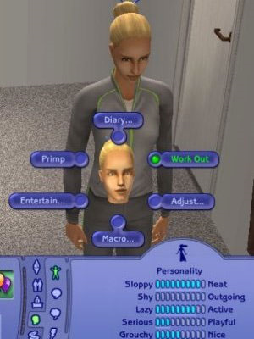
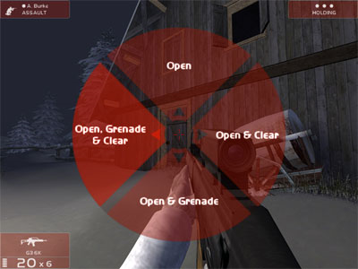
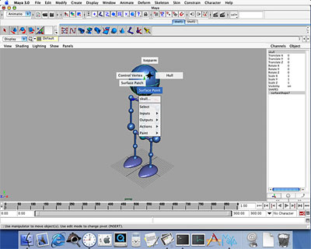
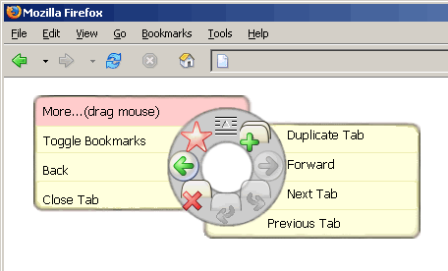
Pie Menus in Use Today
The Sims
Rainbow 6
Firefox
Maya
Notes:
Anyone know of good examples?
In many pieces of software, but still haven’t reached ubiquity… why?

Slide 59
Apple Watch Is a Negative Fitts’ Law Example
Notes:
Very hard to accurately tap on icons… leads to errors… example of Fitts’ Law in action
[ADVANCE]
RECENTLY, …

Slide 60
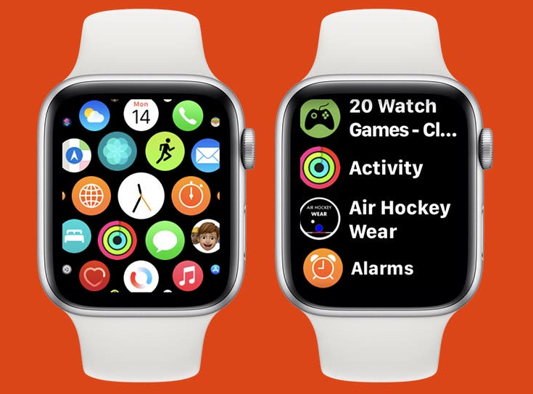
Apple Watch Is a Negative Fitts’ Law Example
Notes:
they redesigned it to go through more of a linear menu (on the right), that is easier to select without error (but doesn’t hold as much information on the screen at once).

Slide 61
Volunteer for Experiment
https://faculty.washington.edu/chudler/java/ready.html

Slide 62
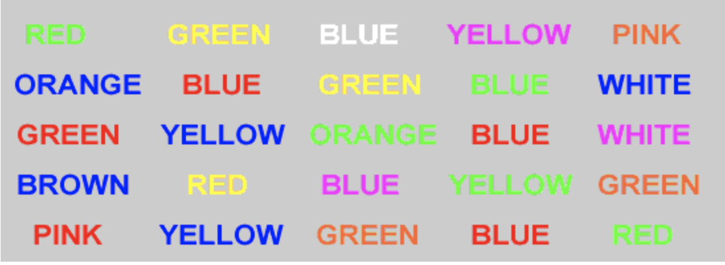
Volunteer for Experiment
Stroop Effect
interference in your working memory
Notes:
This is known as the Stroop Effect. It is a great example of interference in your working memory.
Why are we learning this?
Imagine making icons or labels in your user interface that have interfering triggers into your memory. E.g., a “green” button for cancel? Or a label that says “X” in one place and “Y” in another.

Slide 63
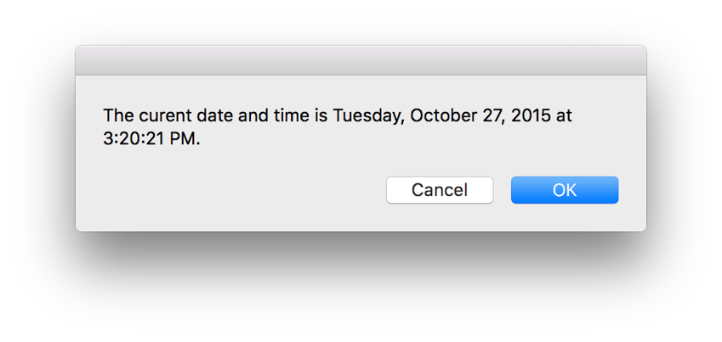
Memory Interference in Action: Cultural
Notes:
Here is the default OSX Dialog box.
What if instead it looked like this? What errors might occur?
[ADVANCE]

Slide 64
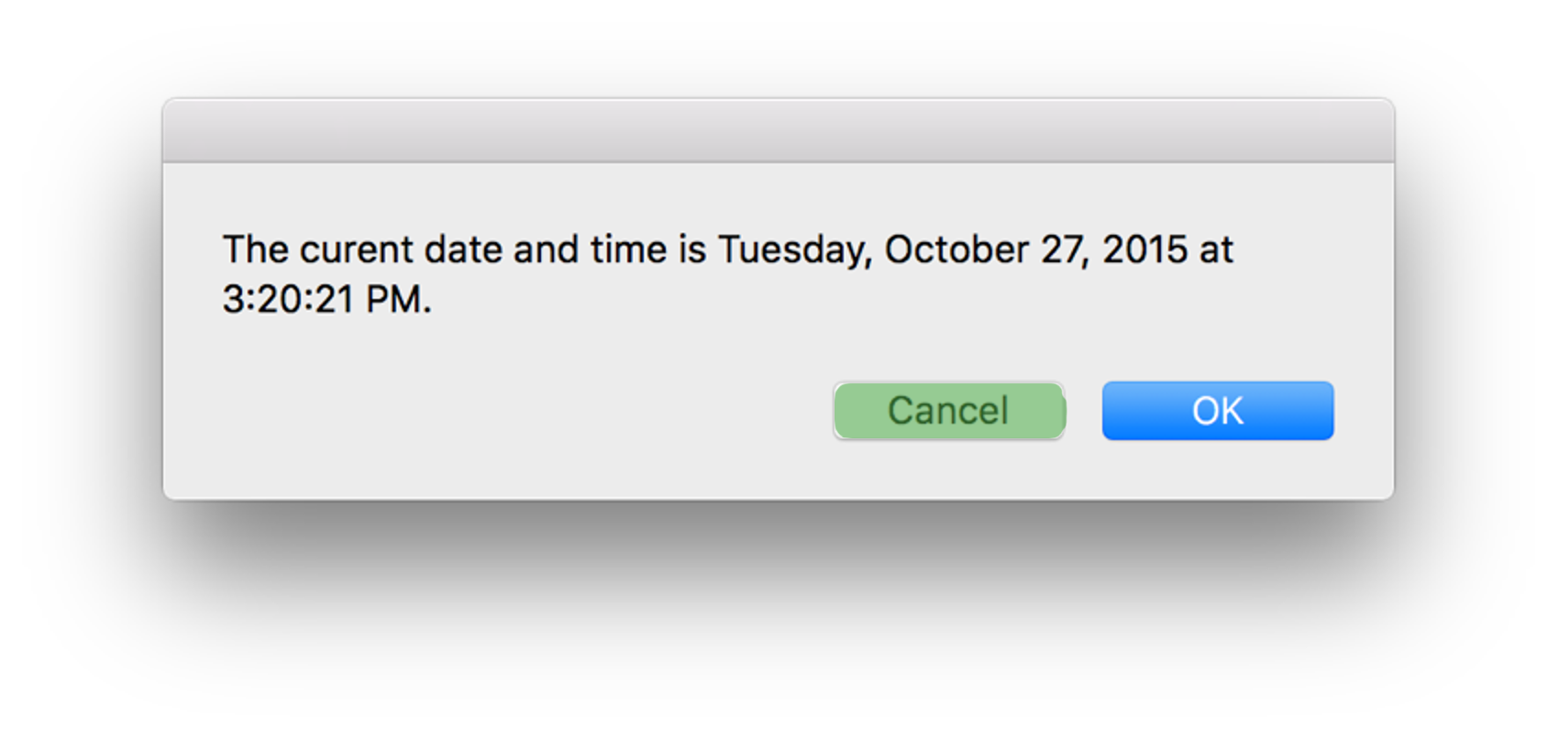
Memory Interference in Action: Cultural
Notes:
What errors might occur?
Green implies Yes or Good in western culture. That color could interfere with the word “Cancel” and cause errors.

Slide 65
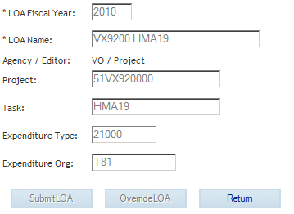
Memory Interference in Action: Labels/Terms
Notes:
Or what if there is interference with what labels normally mean. In this accounting application, “Return” means the same as “Cancel”. But for most people, this is not necessarily what “Return” might mean.
https://www.uxmatters.com/mt/archives/2010/07/achieving-and-balancing-consistency-in-user-interface-design.php

Slide 66
Simple Experiment
Volunteer
Start saying colors you see in list of words
  when slide comes up
  as fast as you can
Say “done” when finished
Everyone else time it…

Slide 67
Paper
Home
Back
Schedule
Page
Change

Slide 68
Simple Experiment
Do it again
Say “done” when finished

Slide 69
Bandana
Forward
Home
Test
Basket
Paper

Slide 70
Simple Experiment
Do it again
Say “done” when finished

Slide 71
Yellow
White
Black
Blue
Red
Green

Slide 72
Memory
Interference
  two strong cues in working memory
  link to different chunks in long term memory
Why learn about memory?
  know what’s behind many HCI techniques
  helps you understand what users will “get”
  aging population of users

Slide 73
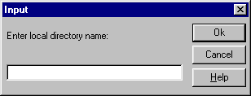
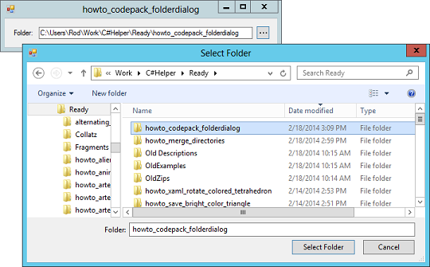
Design UIs for Recognition over Recall
Recall
  info reproduced from memory
  e.g., command name & semantics
Recognition
  presentation of info provides knowledge that info has been seen before
    e.g., command in menu reminds you
  easier because of cues to retrieval
    cue is related to item or situation learned in
    e.g., hints, icons, labels, menu names, etc.

Slide 74
Human Abilities Summary
Color can be helpful, but pay attention to
  how colors combine
  limitations of human perception
  people with color deficiency
Model Human Processor
  perceptual, motor, cognitive processors + memory
  model allows us to make predictions
Memory
  three types: sensory, WM & LTM
  interference can make hard to access LTM
  cues in WM can make it easier to access LTM
Key time to remember from MHP: ~100 ms cycle time & memory access time

Slide 75
Further Reading
Vision and Cognition
Books
  The Psychology Of Human-Computer Interaction, by Card, Moran, & Newell, Erlbaum, 1983
  Human-Computer Interaction, by Dix, Finlay, Abowd, and Beale, 1998.
  Perception, Irvin Rock, 1995.
Pages 66-99 of “Cognitive Aspects in Interaction Design”, from Interaction Design, 3rd Edition by Rogers, Sharp, & Preece
Applying Fitts’ Law to Mobile Interface Design by Justin Smith

Slide 76
Next Time
Lecture
  Visual Information Design
Watch Scott Klemmer’s HCIOnline lectures:
  6.1 Visual Design (7:37)
  6.2 Typography (10:47)
  6.3 Grids & Alignment (17:33)
Studio
  Low-fi presentations
  Sketching/Visual Design Exercise

