Slide 1
Design Exploration
October 9, 2024
Music: https://soundcloud.com/dansuneroquette
* slides marked Buxton are courtesy of Bill Buxton, from his talk “Why I Love the iPod, iPhone, Wii and Google”, remix uk, 18-19 Sept. 2008, Brighton
** values slides based on slides from Dr. Diana Acosta-Navas, Embedded EthiCS Fellow, McCoy Family Center for Ethics in Society - Human-Centered AI
Notes:
Finished exactly on time with 25 min break. Values part still a bit stilted.
-- Last year ---
Finished on time with only light interaction in the new values section. More interaction would lead us to be late. Cut a slide there and make sure break truly limited to 25 minutes
---- 2 years ago ----
Went 3 minutes over
Had to skip last 3-4 value slides (improve notes on those)
End break on time at 25 min (I did more like 28)
---- three years ago ----
Started 3 minutes late because my mic wasn’t on
Took 20 min of planned 30 min break to finish on time
[break can be at most 25 min if online and 20 min or less in person]

Slide 2

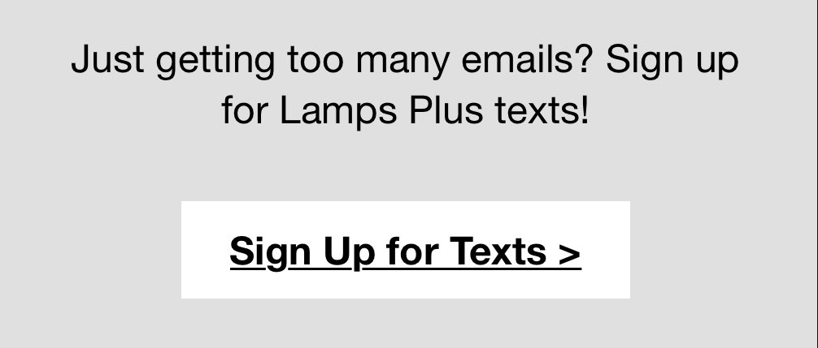
Hall of Fame or Shame?
Lamps Plus
Unsubscribe to email confirmation
As described by former student Kevin Fox @kfury (designer of the original gmail)
Notes:
Lamps Plus after clicking on their email unsubscribe link
What do we like?
What do we wish?

Slide 3

Hall of Fame or Shame?
Lamps Plus
Unsubscribe to email confirmation
Good
  simple & direct text
  a confirmation….
Bad
  I don’t want your info & you suggest to bug me in an even more invasive way?
As described by former student Kevin Fox @kfury (designer of the original gmail)
Notes:
I don’t want your stuff!

Slide 4
Design Exploration
October 9, 2024
Music: https://soundcloud.com/dansuneroquette
* slides marked Buxton are courtesy of Bill Buxton, from his talk “Why I Love the iPod, iPhone, Wii and Google”, remix uk, 18-19 Sept. 2008, Brighton
** values slides based on slides from Dr. Diana Acosta-Navas, Embedded EthiCS Fellow, McCoy Family Center for Ethics in Society - Human-Centered AI
Notes:
Today we will talk about how now that you have a solution idea, how do you explore the possible designs for that solution.

Slide 5
Outline
Another good concept video
Reviewing tasks
Sketching to explore user experiences
Values in design
Notes:
Why are we learning about these topics today?

Slide 6
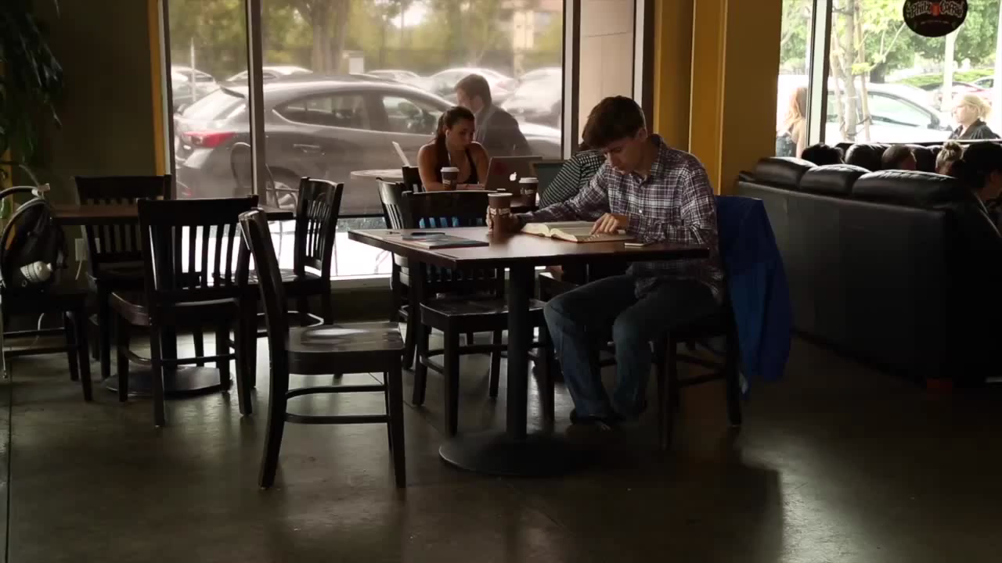
High Fidelity Concept Videos
parqtheapp
Notes:
1 MINUTE!
Music
Closeups
Emotion

Slide 7
Design Process: Discovery
Assess Needs
understand client’s expectations
determine scope
of project
characteristics of customers & tasks
evaluate existing practices & products
Discovery
Design Exploration
Design Refinement
Production
Notes:
[ADVANCE]
Recall in the Discovery stage, you were focused on finding user needs, the characteristics of your customers and designed for their tasks.

Slide 8
Task. The structured set of activities or high-level actions required to achieve a high level user goal.
what a user wants to do
Notes:
I want to quickly review tasks, as this is sometimes one of the harder concepts to get right

Slide 9
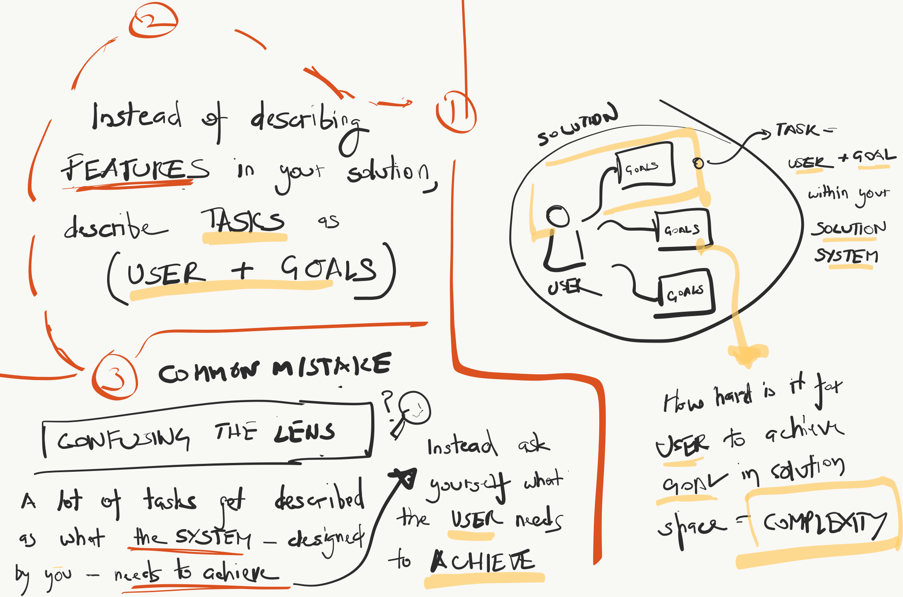
Another Look at Tasks
Sketch by Trijeet Mukhopadhyay
Notes:
According to Trijeet!

Slide 10
Example of Good Tasks: Lyft
Simple: Signaling for a ride
  this is what 90% of people are going to be using the app for, so it should be easy to accomplish and require as few steps as possible.
Moderate: Contacting driver to pick up a forgotten item
  this will happen less often, so it will require a few more steps to contact a previous driver and connect with them to coordinate the return of the item (because the UI is designed to make the simple tasks the most accessible).
Complex: Become a driver for Lyft
  although the goal is still to make this as streamlined as possible, there are multiple levels of screenings and regulations that you have to pass. You must scan and upload documents and register with multiple parties, etc. This is a task that most people will not be doing.
Notes:
Let me give you an example of what some good tasks might be for Lyft (at least the title phrase of the tasks).
Again, user goals.

Slide 11
Design Process: Exploration
Expand Design Space
brainstorming
sketching
storyboarding
prototyping
Discovery
Design Exploration
Design Refinement
Production
Notes:
As you finish your concept videos, we start to have an idea of your general solution.
But now it is time to Expand the design space for the different ways of realizing that solution.
[ADVANCE]
We do that through:
brainstorming, sketching, storyboarding, prototyping

Slide 12
Iteration
At every stage!
Design
Prototype
Evaluate
Sketch
Paper
Video
Tool
Program
Gut
Crit
Expert Eval
Lo-fi Test
User Study
Notes:
and remember, we keep iterating at every stage of the design process
We take our designs out of our head and prototype
[ADVANCE]
we might...
to evaluate
[ADVANCE]
we might...

Slide 13
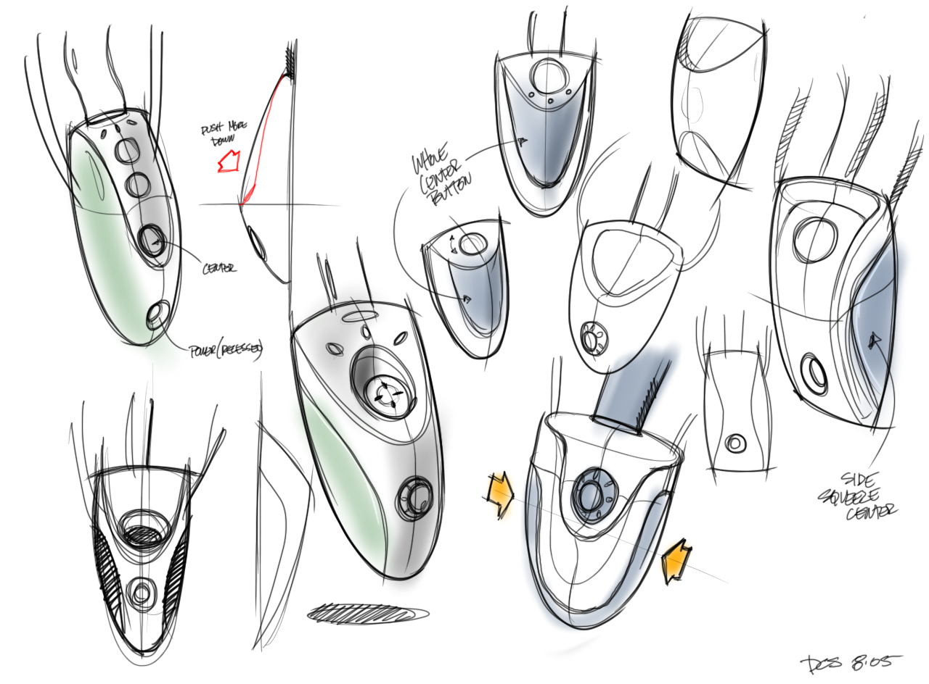
Sketching: A Quintessential Activity of Design
* Courtesy Bill Buxton
Notes:
Design and Innovation comes from sweat. From trying many ideas. Sketching them. Building prototypes.

Slide 14
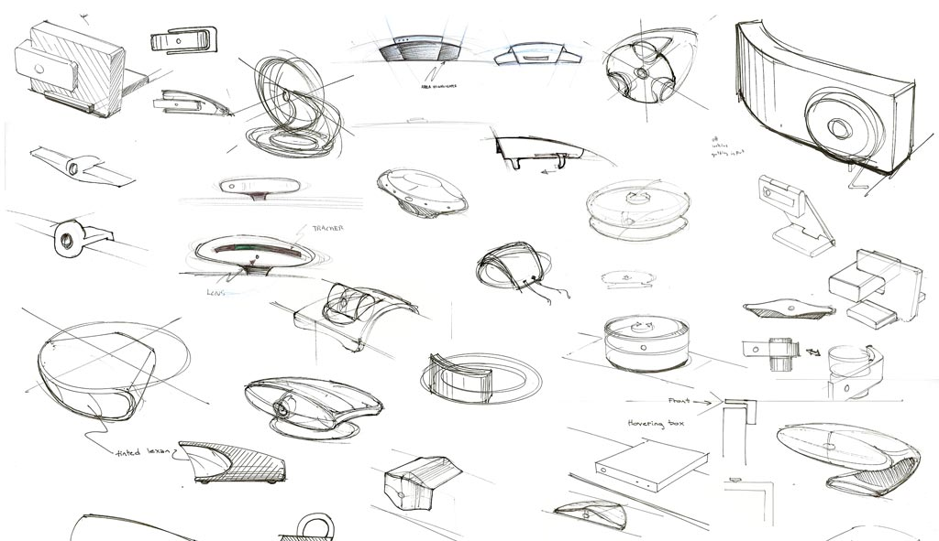
Kicker Studio, www.kickerstudio.com
Notes:
Trying literally dozens and dozens of ideas.

Slide 15
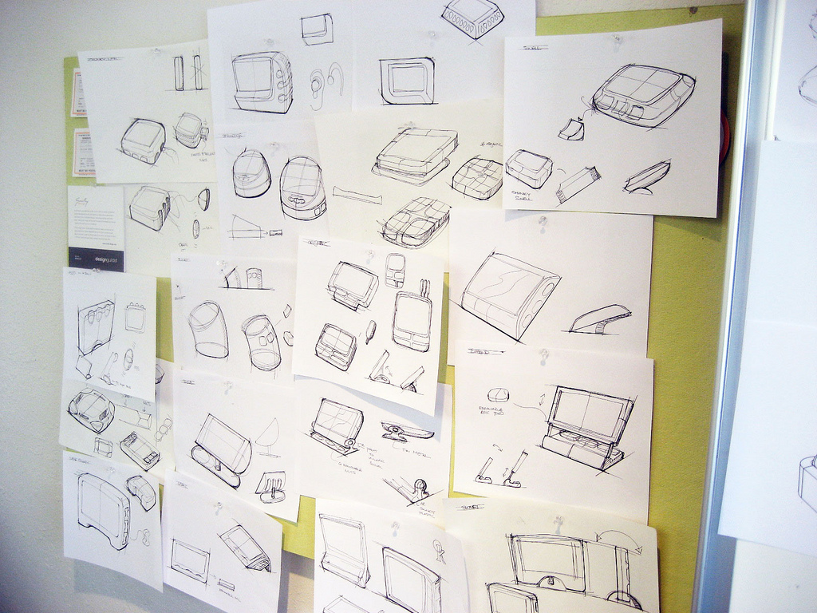
Kicker Studio, www.kickerstudio.com
Notes:
Trying them out with people and observing what occurs.

Slide 16
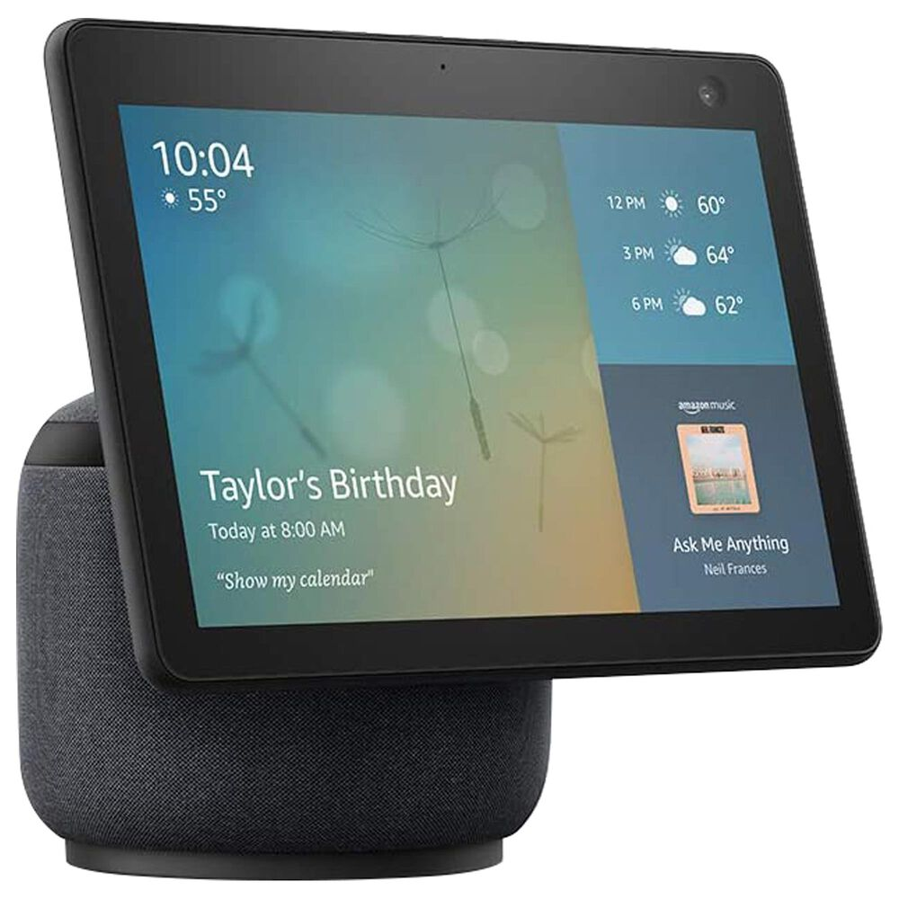
Amazon Echo Show 10
Notes:
Until you find ideas/products/services that evoke an emotional response with your customers. Ideas that give new experiences that people value.
The differences of opinion are on how you might get to this point.

Slide 17
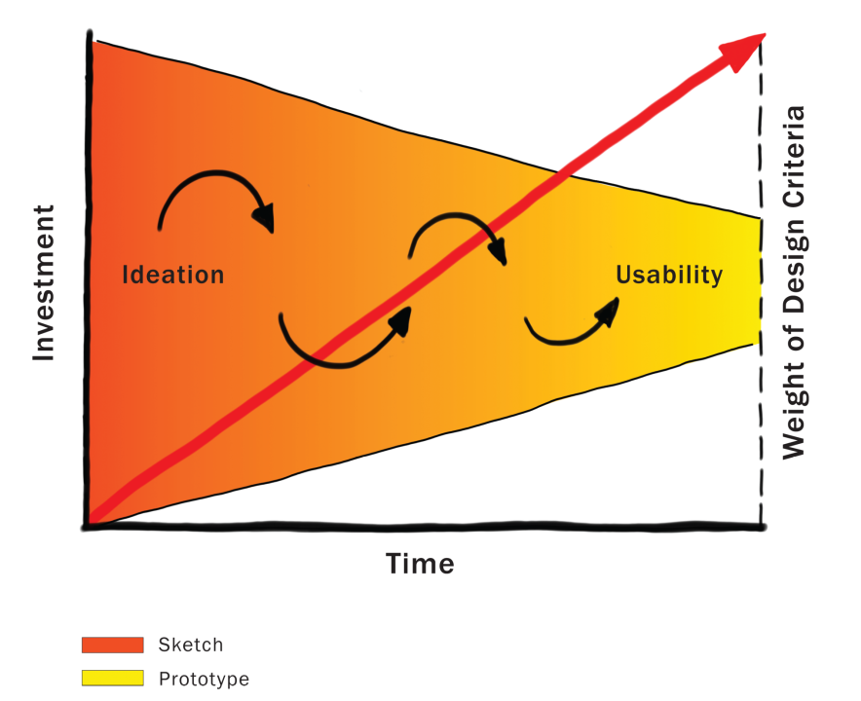
Courtesy Bill Buxton
Notes:
This graph shows the amount of investment and cost for design and usability over the time of a project.
Because investment is low in the early stages, this is the one time in the product pipeline when one can afford to play, explore, learn, and really try and gain a deep understanding of the undertaking.
We move from the left (sketch) to the right (prototype) over time.
The left side (sketching) is where YOUR TEAM WILL be for much of this quarter!!!!

Slide 18
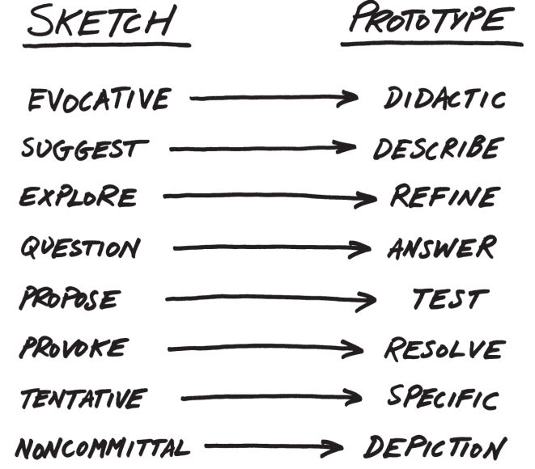
From Sketch to Prototype
difference in intent rather than in form
Courtesy Bill Buxton
Notes:
A sketch is... a prototype is...
This is a continuum, not an either/or proposition
[ADVANCE]
The difference between the two is as much a contrast of purpose, or intent, as it is a contrast in form

Slide 19
The Anatomy of “Sketching”
Quick / Timely
Inexpensive / Disposable
Plentiful
Clear vocabulary. You know that it is a sketch (lines extend through endpoints, …)
No higher resolution than required to communicate the intended purpose/concept
Resolution doesn’t suggest a degree of refinement of concept that exceeds actual state
Ambiguous
Courtesy Bill Buxton

Slide 20

If you want to get the most out of a sketch, you need to leave big enough holes.
There has to be enough room for the imagination.
Courtesy Bill Buxton
Notes:
Ambiguity in sketches is VERY important
[ADVANCE]
If you want to get the most out of a sketch you need to leave big enough holes.
[ADVANCE]
There has to be room for the imagination. Lateral thinking!

Slide 21
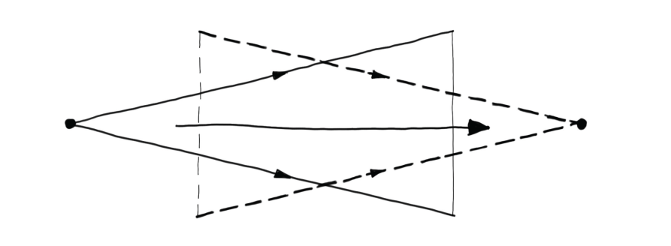
Design as Choice: Generative & Reductive
Elaboration (“Flare”)
Reduction (“Focus”)
Courtesy Bill Buxton
Laseau (1980)
Notes:
Design gives us choices.
Choice is where there are two key places for creativity:
the creativity that you bring to enumerating meaningfully distinct options from which to choose (elaboration or "flare")
the creativity that you bring to defining the criteria, or heuristics, according to which you make your choices (reduction or "focus")
Design is both GENERATIVE and REDUCTIVE

Slide 22
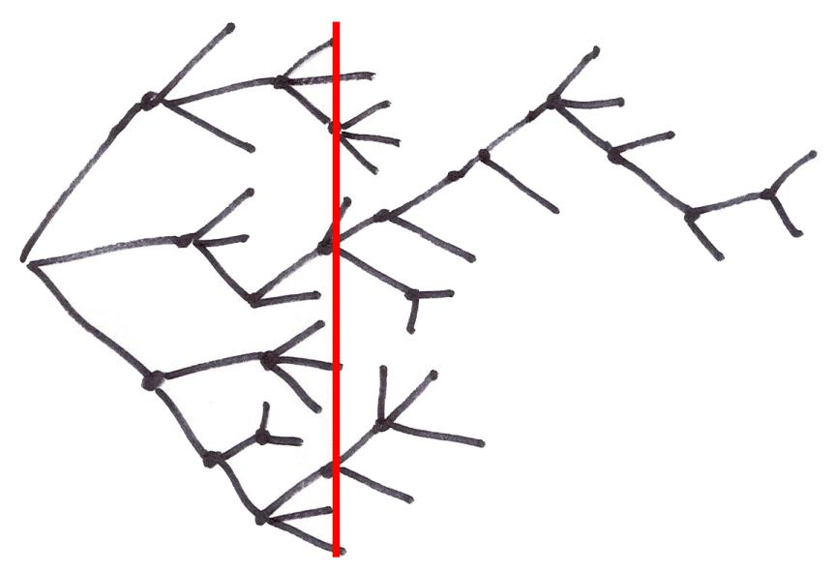
Exploration of Alternatives
Time
… a designer that pitched three ideas would probably be fired. I’d say 5 is an entry point for an early formal review (distilled from 100’s). … if you are pushing one you will be found out, and also fired. … it is about open mindedness, humility, discovery, and learning. If you aren’t authentically dedicated to that approach you are just doing it wrong!
Alistair Hamilton
VP Design
Symbol Technologies
Courtesy Bill Buxton
Notes:
Design is NOT a straight path
We must generate and discard much more than we keep
All of these representations of the design process converge.
Some of the ideas thrown out may be your’s! – you need to learn to embrace this
[ADVANCE]
A designer that pitched 3 ideas…
[ADVANCE]

Slide 23
Exploration of Alternatives
People on a design team must be as happy to be wrong as right. If their ideas hold up under strong (but fair) criticism, then great, they can proceed with confidence. If their ideas are rejected with good rationale, then they have learned something.
…
There are no dumb questions. There are no ideas too crazy to consider. Get it on the table, even if you are playing around. It may lead to something.
Bill Buxton
Sketching User Experiences
pg. 147-149
Courtesy Bill Buxton
Notes:
People on a design team….

Slide 24
Exploration of Alternatives
design rationale for decisions is key
Courtesy Bill Buxton
Notes:
bringing “design rationale” or reasoning for decisions is key to making this work well so that you can learn from these decisions later (in this project or another one).

Slide 25
Exploration of Alternatives
diverse teams make this work better
Courtesy Bill Buxton
Notes:
Having diverse teams help make this work better as well. There is a lot of research on team diversity leading to more innovation & that is why we tried to encourage or create diverse teams in this class

Slide 26
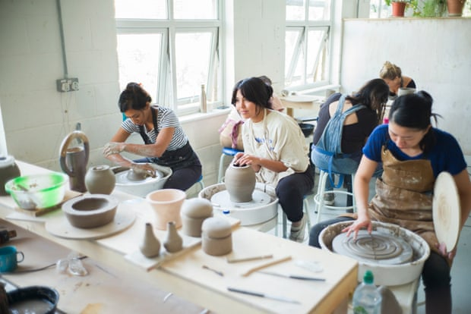
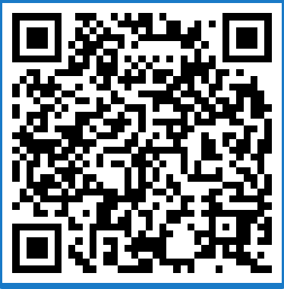
Which Group Produced the Best Ceramic Pots
Group A
  graded by their highest quality pot
Group B
  graded by total number of pots
PollEv.com​/jameslanday032
Photograph: Graeme Robertson/The Guardian
https://www.theguardian.com/artanddesign/2019/aug/25/throws-of-passion-how-pottery-became-a-refuge-from-our-hyperconnected-times
Notes:
Which group in the ceramics class described in the Buxton reading produced the highest quality pots?
James opens: https://www.polleverywhere.com/multiple_choice_polls/gMBpBVlHqlLpmdp72NbQq
Why?

Slide 27
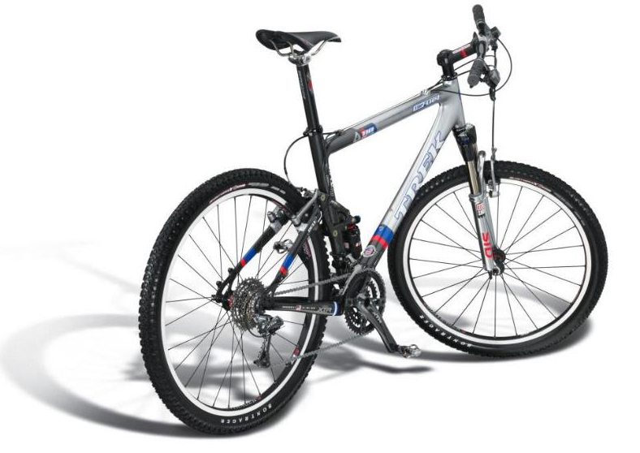
Design
What does the customer want to buy?
Courtesy Bill Buxton
Notes:
Let’s talk more about design exploration.
This clearly shows the DESIGN of the bike…
[ADVANCE]
But, What does the customer want to buy?
The bike owner wants to buy [ADVANCE]

Slide 28

Experience Design
“The experience of even simple artifacts does not exist in a vacuum but, rather, in dynamic relationship with other people, places, and objects”
– Buchenau & Suri 2000
Courtesy Bill Buxton
Notes:
The EXPERIENCE of using the bike. The aspiration (and hopefully the reality) of the experience
Experience depends on the bike, your equipment, the weather, the terrain, your skill, your current state of mind, etc.

Slide 29
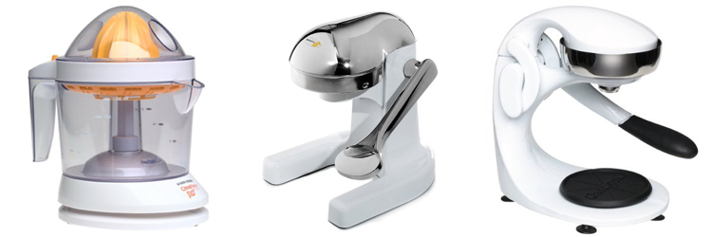
Experience vs. Interface Design
user experience = UI + situation + environment
CitrusMate Plus Mighty OJ Manual Juicer OrangeX Manual Juicer
Notes:
Buxton likes to tell this story about his juicer that illustrates the difference between experience design and interface design.
He loved his first juicer every morning… complained he didn’t have it at the cabin
Then got the gift of the second for his cabin. Quiet!!! Loved the experience and now no longer liked the original!
Complained… then got a gift of the 3rd for home… Same interface as the second…
but DIFFERENT experience. Easy at end of pulling down lever.
[ADVANCE]
USER EXPERIENCE was partly the UI but also the situation and environment
And the relative experience to what had come before!

Slide 30
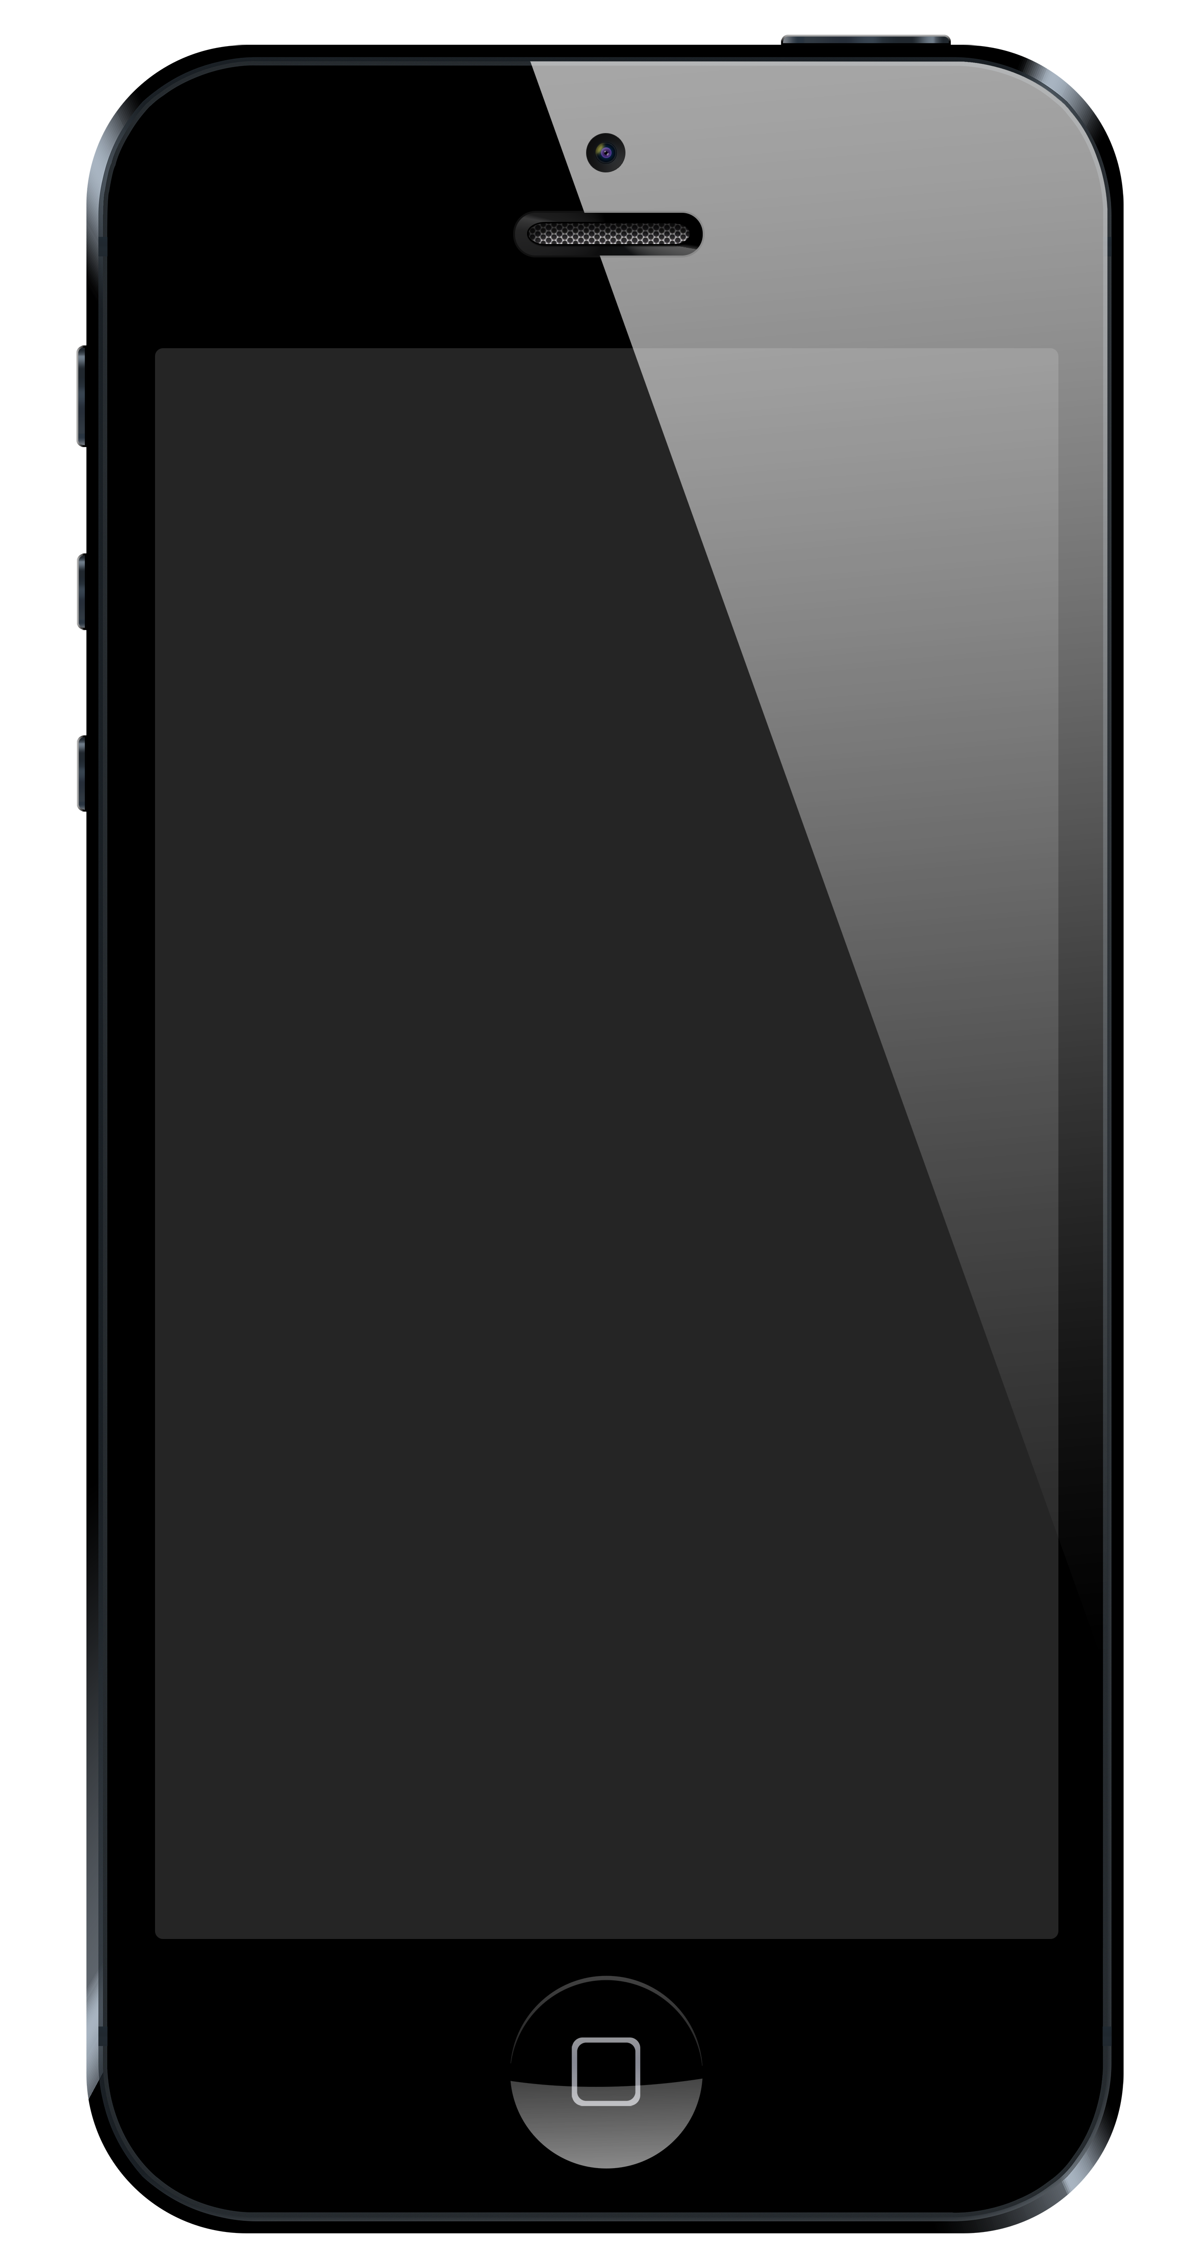
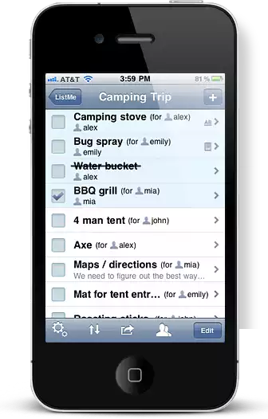
Experience Design for a Phone App?
Draw my phone
Draw my app’s interface
Draw the experience of using my app
Which is the true object of design?
http://www.listmeapp.com/
Courtesy Bill Buxton
Notes:
What is the experience design for a phone app?
How do we show this?
Can draw the phone.
[ADVANCE]
Or Draw the app’s interface
[ADVANCE]
Or Draw the experience using the app
[ADVANCE]
The true object of design is the Experience. How do we show it?

Slide 31
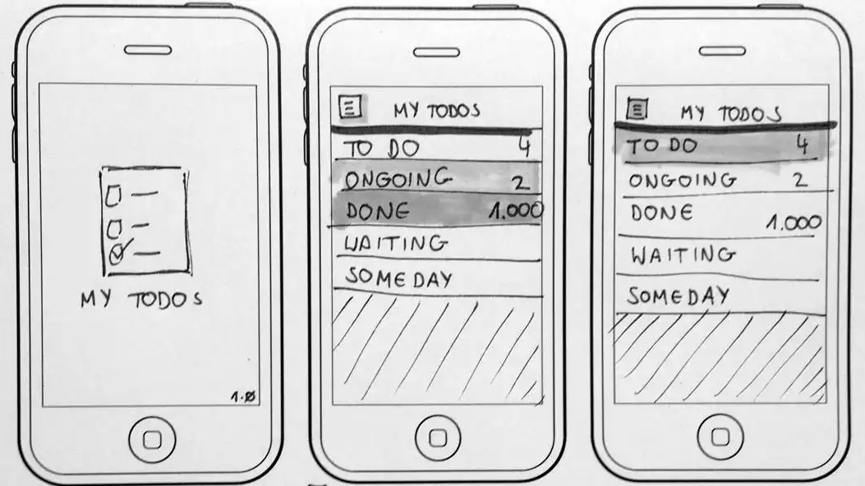
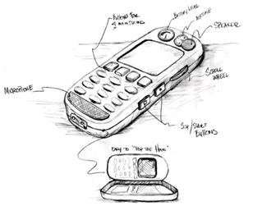
Abstract It with Minimal Detail
Include only what is required to render the intended purpose or concept
http://www.smashingmagazine.com/2013/06/sketching-for-better-mobile-experiences/
Notes:
We Abstract it
Only show what is necessary
This is why you don’t start off designing in a high-fidelity tool like Sketch, Figma, or Illustrator!

Slide 32
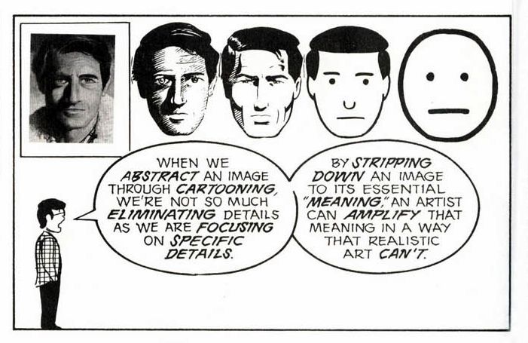
Scott McCloud’s Understanding Comics
People think focusing is about saying “yes.” But…
“Focusing is about saying no.” – Steve Jobs
Notes:
Other mediums understand this idea of abstraction.
Scott McCloud’s Understanding Comics is a book you should read

Slide 33
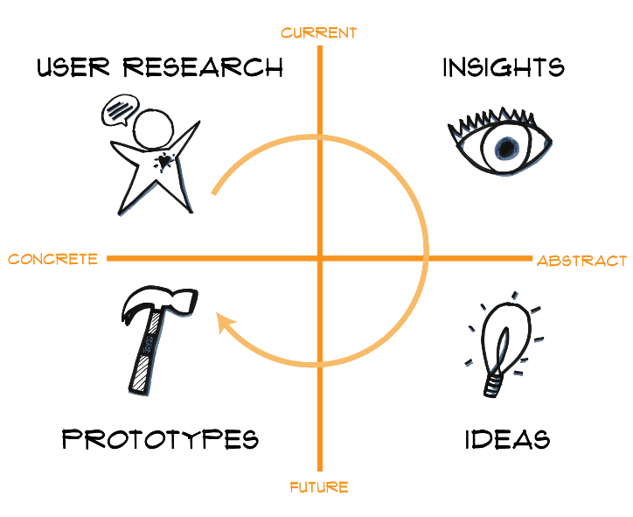
Design Thinking is Iterative
Notes:
The last thing I want to leave you with is again, this message that the design process is iterative.
We go through these stages multiple times with multiple techniques. Always keep that in mind.
We are at an abstract stage now (here on the right), but we will apply similar high-level techniques (user research, prototyping, etc.) to more concrete prototypes as we move the design process forward.

Slide 34
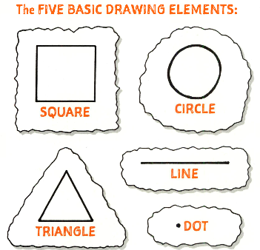
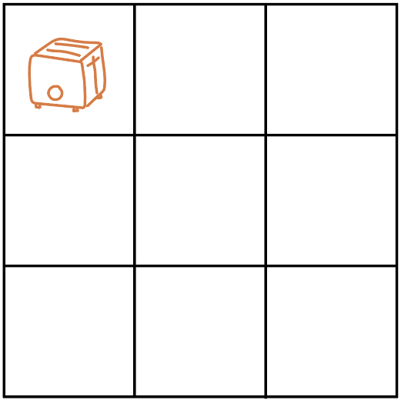
SKETCH FROM THE BASICS!
We’ll practice expressing everyday objects through basic shapes! Grab a pen and a piece of paper and draw a 3 x 3 grid on your paper.
Individually spend 4 minutes drawing as many objects from your kitchen from memory using only the 5 drawing elements to the right as the base. Fill every square in the grid within the 4 minutes!
Post a picture of your grid in the slack thread at the end!
Notes:
5-7 min total (4 min to sketch)

Slide 35
Administrivia
Grades for A1 coming out tonight at latest
After studio this week think about/brainstorm team names (we need it for the web site – you will fill out a form due on Monday night)
Make sure to sign up for 15 minute team check-in
Notes:
Get here by 55 min for a 25 min break
--- last year ---
Got here at 55 min in (2:25 pm), so had 25 min for break and then 30 min for values
------------------- two years ago ------
Got here at 57 min (so had 52 min left)
So took 25 min break (instead of 30)
Restarted at 2:52 PM
----------- three years ago ----------
Planned 20-minute break at 1:08 minutes
If have less than 35 min left after break, cut break by 5 min increments
(so I did a 20 min breakout)

Slide 36
Team Break
Complete your team norms (5-10 min)
This week’s assignment (~10-15 min)
  work on your slides
  CA will come around and give feedback
Notes:
Got here at 51 min in (2:21 pm), so had 24 min for break (return at 2:45 PM) and then 35 min for values
----------last year ------
Got here at 57 min (had 52 min left)
So took 25 min break (instead of 30)
Restarted at 2:52 PM
----------- two years ago ----------
Planned 20-minute break at 1:08 minutes
If have less than 35 min left after break, cut break by 5 min increments
(so I did a 20 min breakout)

Slide 37
Values & Ethics in Design
Introduction
Value Sensitive Design (VSD)
Stakeholder Analysis
Value tensions
Further reading
Notes:
Want to preface this by saying that this is new material, and we hope this can be an open conversation. We want to hear your thoughts on this, and your feedback can make this material for the next year too
Sometimes, when you start thinking about ethics and values in technology, it can be so daunting and overwhelming that you don’t even know where to start
Our goals for today is to introduce some concepts and activities that will give you structure in thinking about values and ethics in design, and hopefully guide you towards solutions that can prevent harms
This is a very rich field and we’re only going to scratch the surface

Slide 38
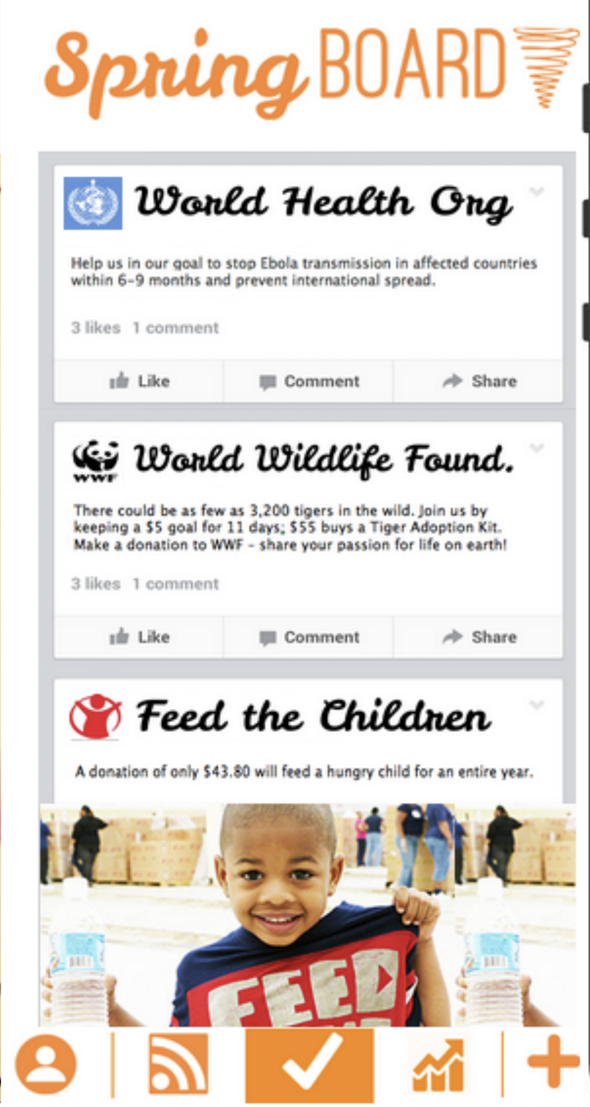
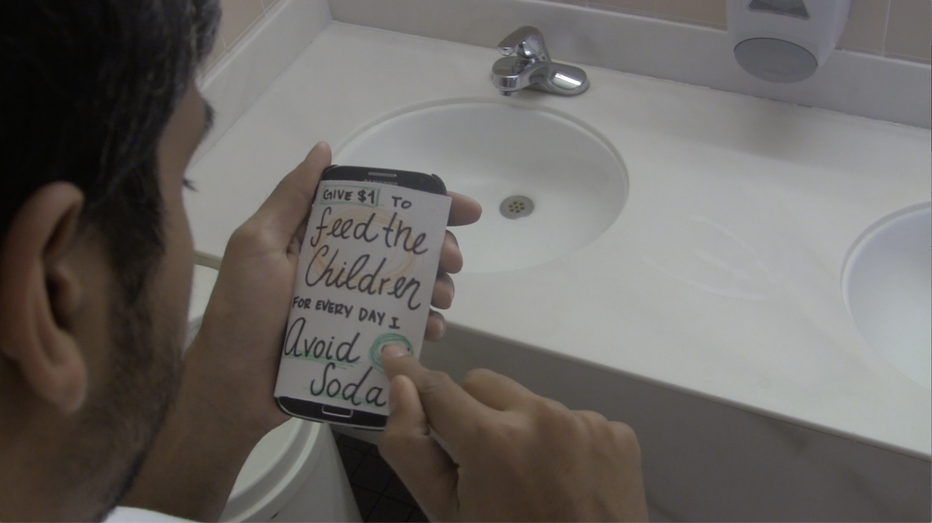
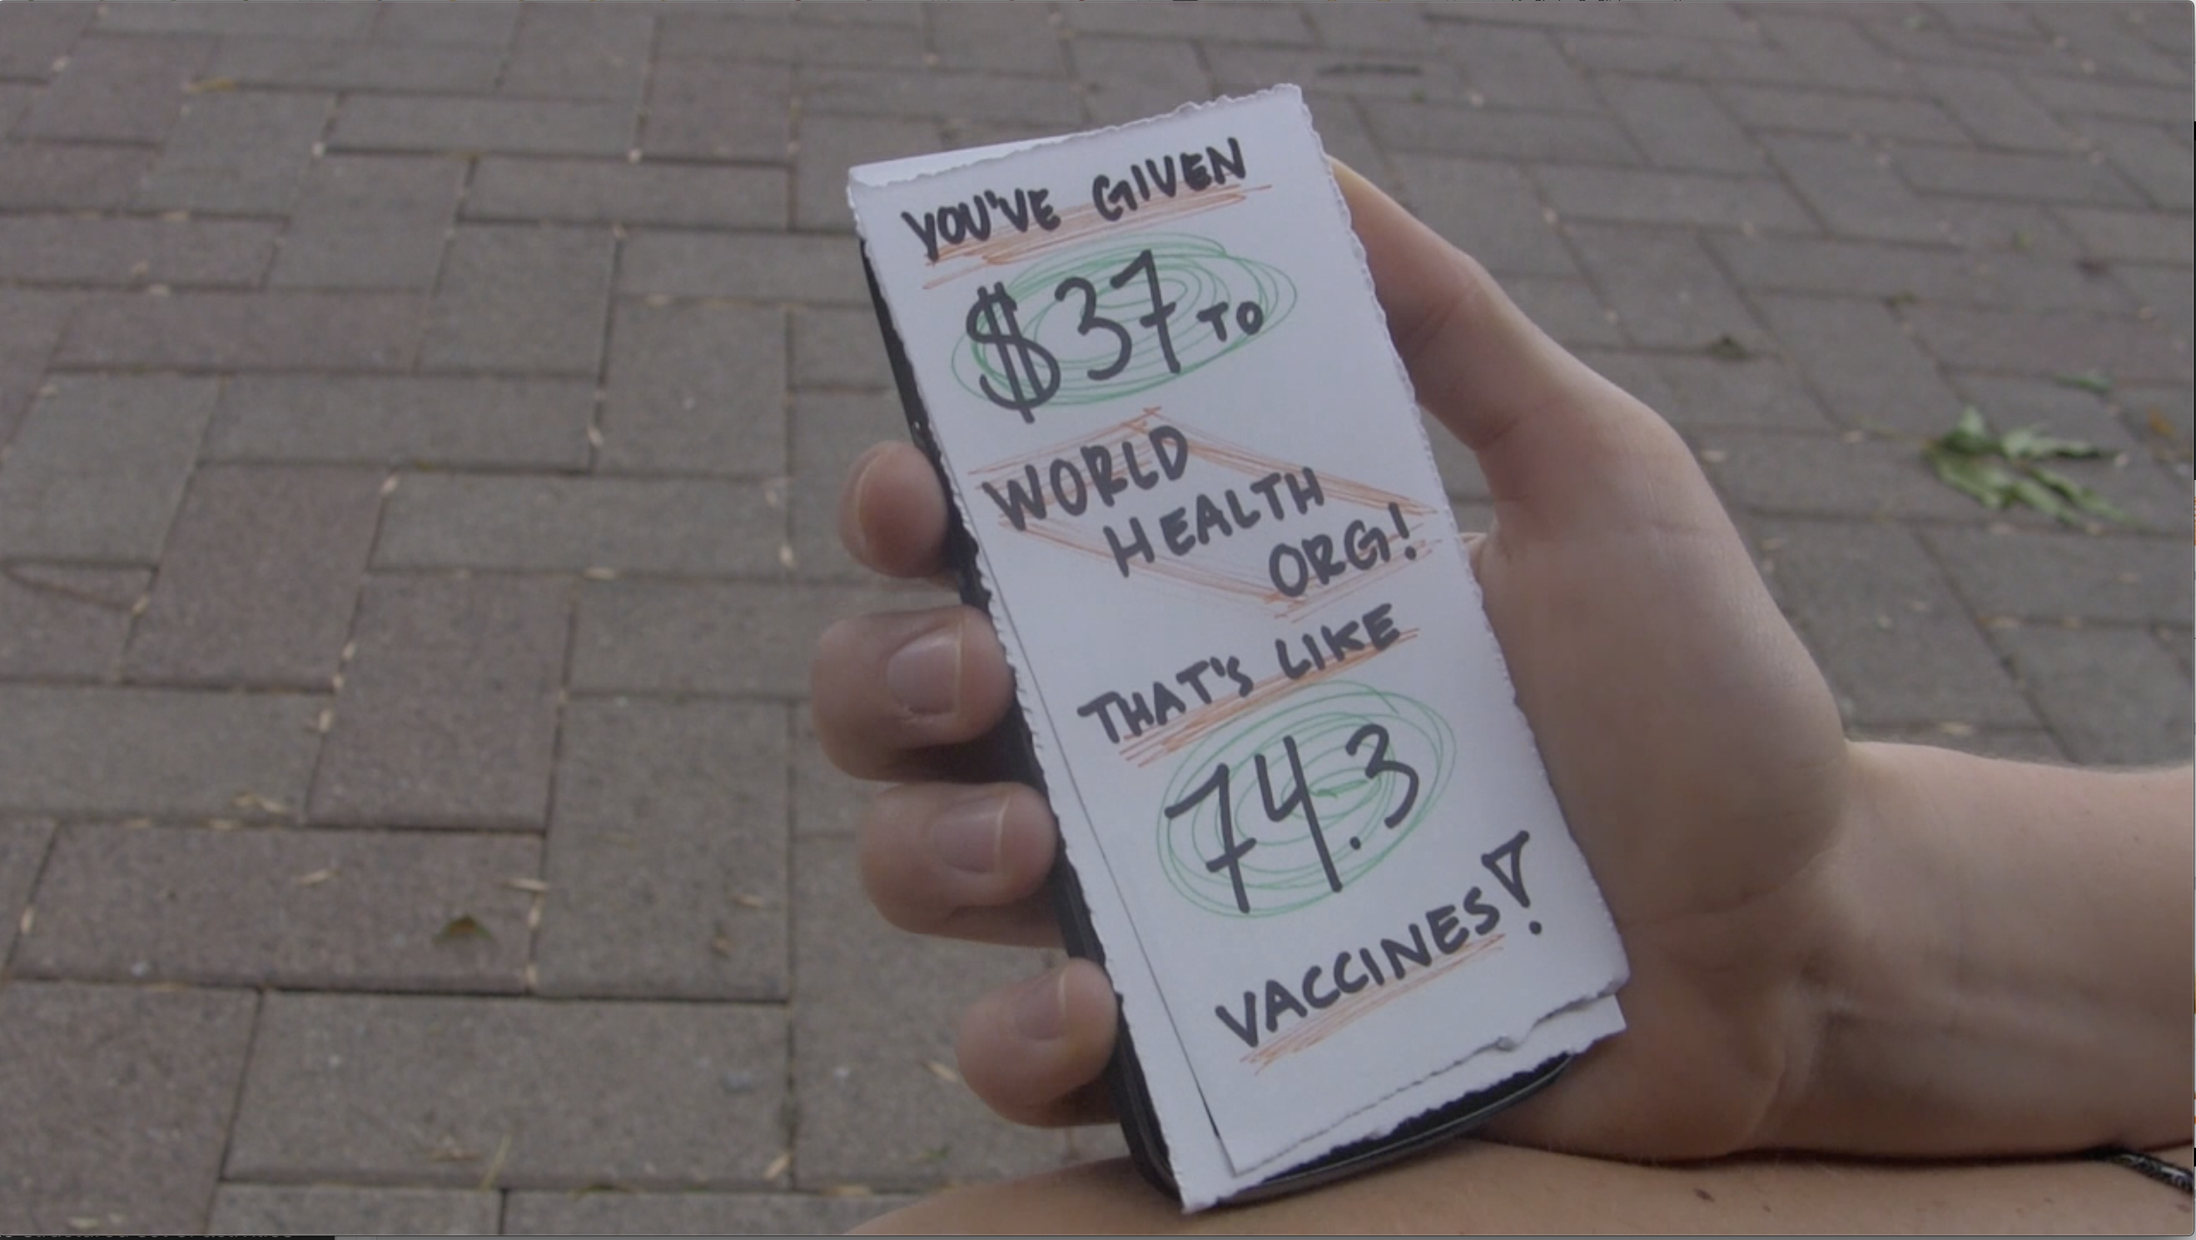

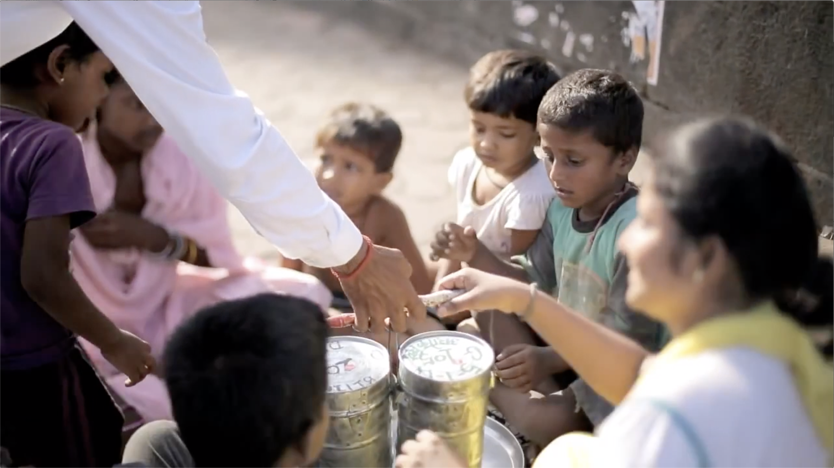



Values in Design
The artifacts we design embed values of the creators
  whether we mean to or not…
Example: Springboard Video (2014)
Notes:
These values come out in who you chose to interview, who you listened to, and your values as you thought what good solutions might be. They are implicit.
Some techniques (such as Value Sensitive Design) try to make them explicit!
The reason I like being a professor is that you learn all the time. From your grad students and undergraduates. I was humbled when two students contacted me a few years ago about the Springboard video that I had shown in class. At first when I read their critique, I was defensive about it. But as I thought about it, I felt I had learned something and missed something.
Recall Springboard for those who didn't watch it: you set goals for some behavior change you want, while also pledging to give to a charity you support when you meet your goal, e.g., stop drinking soda, to help feed hungry children.
[ADVANCE]
Or run 20 times each month to give to the world health org for vaccines
[ADVANCE][ADVANCE][ADVANCE]
What value might be coming across from this video?

Slide 39
Values in Design
The artifacts we design embed values of the creators
  whether we mean to or not…
Example: Springboard Video (2014)
Chimamanda Ngozi Adichie (author) says:
“The single story creates stereotypes… not that they are untrue, but that they are incomplete. They make one story become the only story.”
“The danger of a single story”, TEDGlobal 2009
Notes:
The students pointed me to a great talk on this by the Nigerian author Chimamanda Ngozi Adichie, where she said:
“single story creates stereotypes … not that they are untrue, but that they are incomplete. They make one story become the only story” – Author Chimamanda Ngozi Adichie
Springboard also had things like supporting “Teach for America”. What types of other charities might they have had to balance these stories?
The Springboard video may have lacked a balance of these other charities as well as the story of developing countries.
As you design, try to think explicitly about what values and assumptions you are bringing to your design.

Slide 40
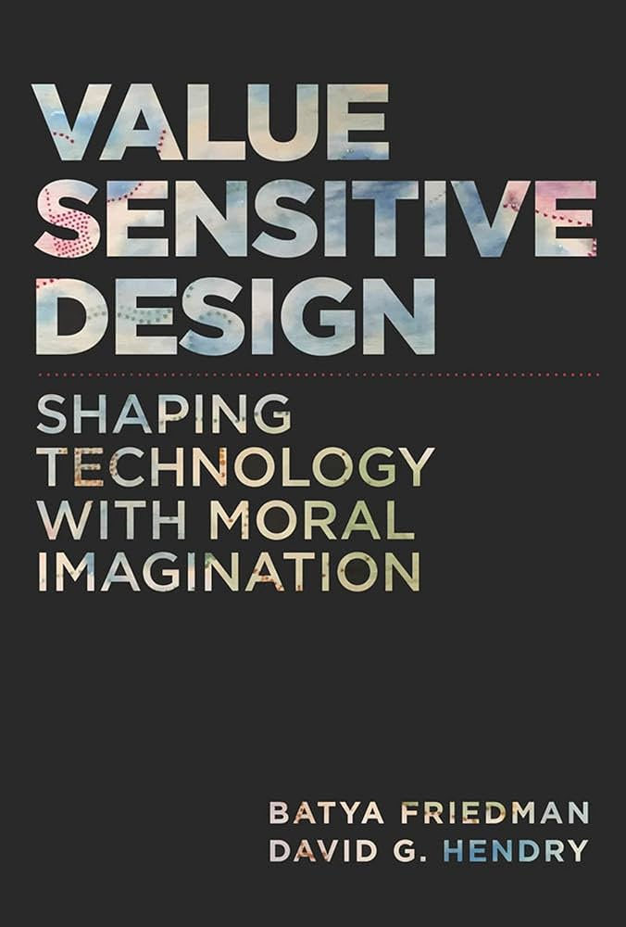

What are values?
“what is important to people in their lives, with a focus on ethics and morality”
Notes:
As a first step towards thinking more critically about values in design, we can start by defining what values are
Now defining values turns out to be a bit contentious, but I like this definition from Batya Friedman, a professor at UW who developed the Value Sensitive Design (VSD) framework and did a lot of pioneering work. She gives the following definition of values:
“what is important to people in their lives, with a focus on ethics and morality “
Briefly, ethics are generally standards that we agree on as a society (like a code of ethics)
While morality refers to our personal or cultural sense of right and wrong
This definition is purposely quite broad, and in doing so, strives to be agnostic to particular ethical theories or normative stances. Philosophers have been debating this for centuries and these are hard questions that are unlikely to be resolved soon.
Instead, VSD tries to position designers and technologists to make progress in the design of ethical technology through foregrounding of human values even as these debates unfold and disagreements go unresolved.

Slide 41
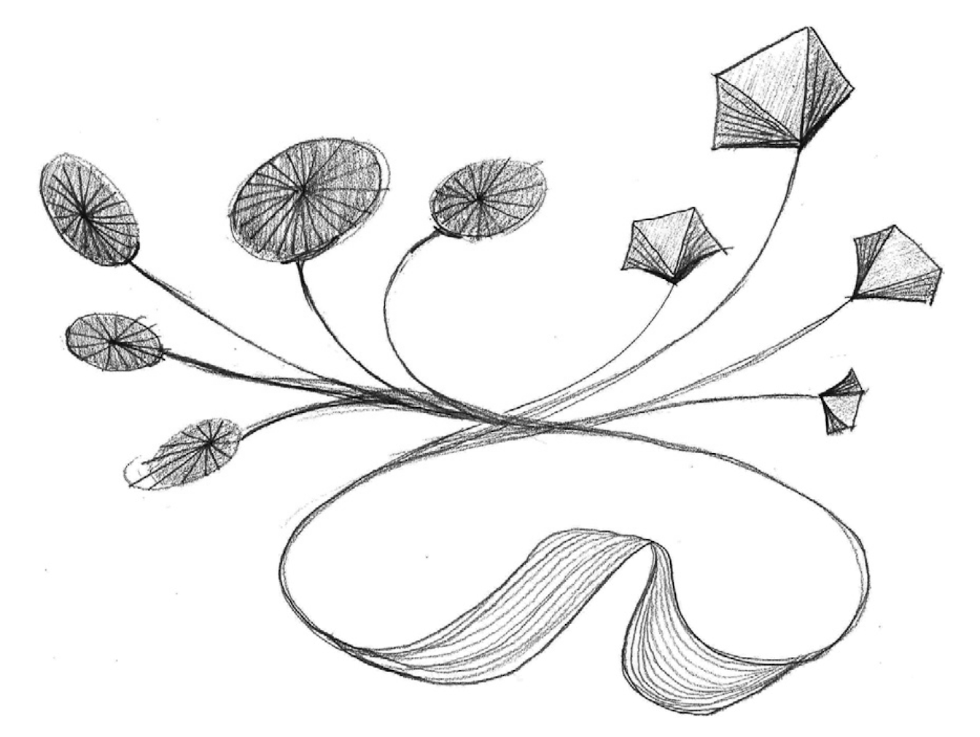
How does technology embed values?
Humans shape the design of technology
Technology in turn shapes human experience and society
Notes:
VSD compels us to think about technology and society as interconnected, where simultaneously
Humans acting as individuals, organizations, or societies intentionally shape the design of technology
And in turn, that technology also shapes human experience and society
The take-away for designers is that foregrounding values matters: the design decisions we make can impact our individual lives, our communities, and our social fabric
But also, the technologies we design are embedded in existing social infrastructures that cannot be ignored
We have to consider both directions
You can design something and embed values into that design (whether intentionally or not), but when your design gets used by others, they will implant their values onto it too and do what they want with it

Slide 42
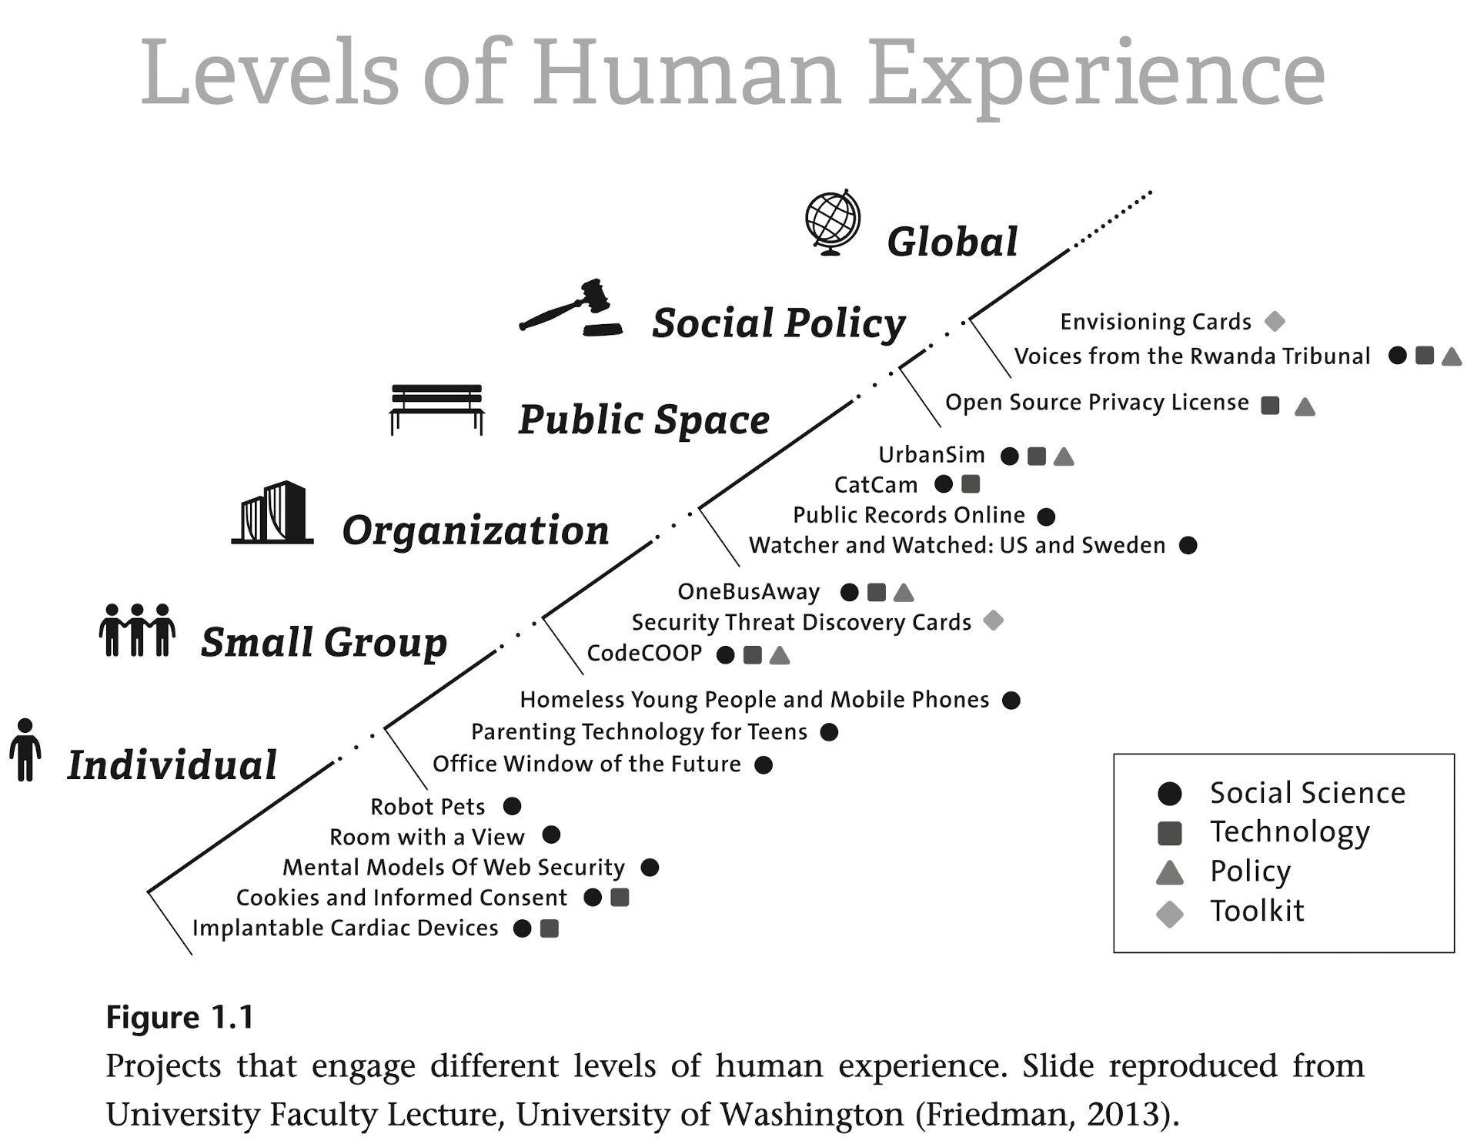
How does technology embed values?
Humans shape the design of technology
Technology in turn shapes human experience and society
This occurs at multiple scales
Notes:
Moreover, this occurs at multiple scales: individual, group, organization, societal, global
So far in this class, we’ve mostly been thinking about single users. But to really think critically about ethics, we need to think bigger

Slide 43
Stakeholder analysis
Whose values are being considered?
Direct stakeholders people interacting directly with a technology
Indirect stakeholders people who are affected by the technology, but don’t interact directly with it
Notes:
To start thinking about all the different people who might be impacted by design, VSD places a large emphasis on stakeholder analysis
It makes explicit whose values are being considered
They make a distinction between direct stakeholders, which are people who directly interact with a technology
And indirect stakeholders, who do not directly interact with the technology, but are affected by it

Slide 44
Stakeholder analysis
Whose values are being considered?
Direct stakeholders people interacting directly with a technology
Indirect stakeholders people who are affected by the technology, but don’t interact directly with it
Example: electronic health record systems
Direct stakeholders doctors, insurance agents, nurses
Indirect stakeholders patients, families
Notes:
For example, let’s consider an electronic health record system
Now if you set out to do great user-centered design for an electronic health record system, you’d interview doctors, insurance agents, nurses, and all the other people who directly interact with the technology
But if you only focused on those direct stakeholders, you’d be missing out on a hugely important indirect stakeholder: the patients, who might never use the EHR system but are greatly affected by it, and their families
This also demonstrates that indirect does not mean less important, if anything, indirect stakeholders might be even more important to consider because they are easily left out

Slide 45
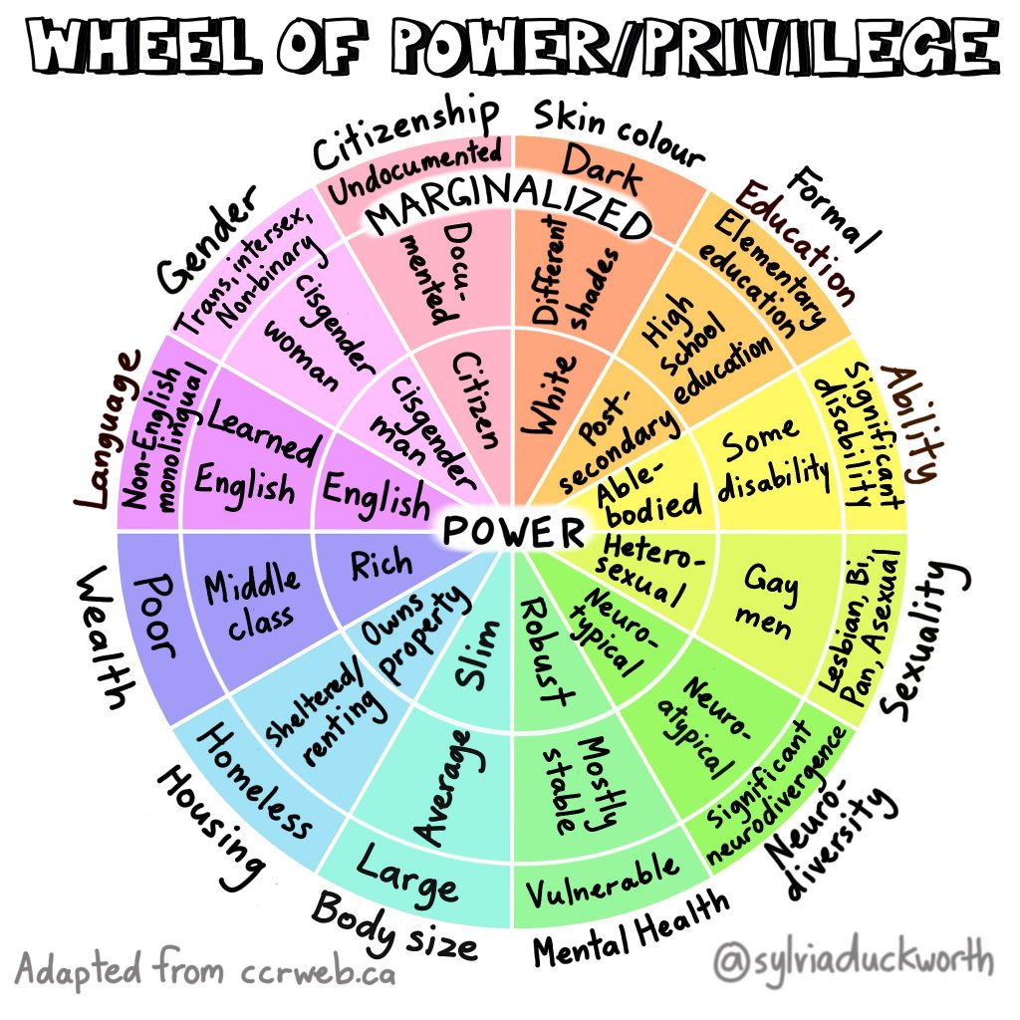
Whose values are being considered?
Notes:
And as we’re think about stakeholders, and particularly if we value equity and inclusion as designers, I think it’s really important to think about different dimensions of stakeholders’ power and privilege
This resource, the wheel of power and privilege, is a great tool to think about who is being included or excluded by your designs. The different slices of the wheel correspond to different categories of power & privilege. The closer you are to the center, the more power and privilege you have

Slide 46
How can we surface values in design?
Value elicitation materials
  value lists
  value scenarios
  card decks
  …
Talk to people! Observe!
Build prototypes and show it to people!
Notes:
Now that we’ve talked about the fact that values are embedded in our designs and that it’s important to consider them from the perspective of multiple stakeholders,
How do we as designers go about surfacing values in design?
As a first step, there are many different value elicitation materials. There are lists of common values, there are value scenarios that you can create, there are card decks you can use (which is what we’ll be doing later today and in A4), and many other resources.
And these elicitation materials are great first steps towards thinking about values.
But we should also mention that just doing these activities within the design team is incomplete. You should go talk to people who might use or be impacted by the technology and ask them what they think is important. Similarly, you should build prototypes and show them to people, which you’ll practice more of later in the course

Slide 47
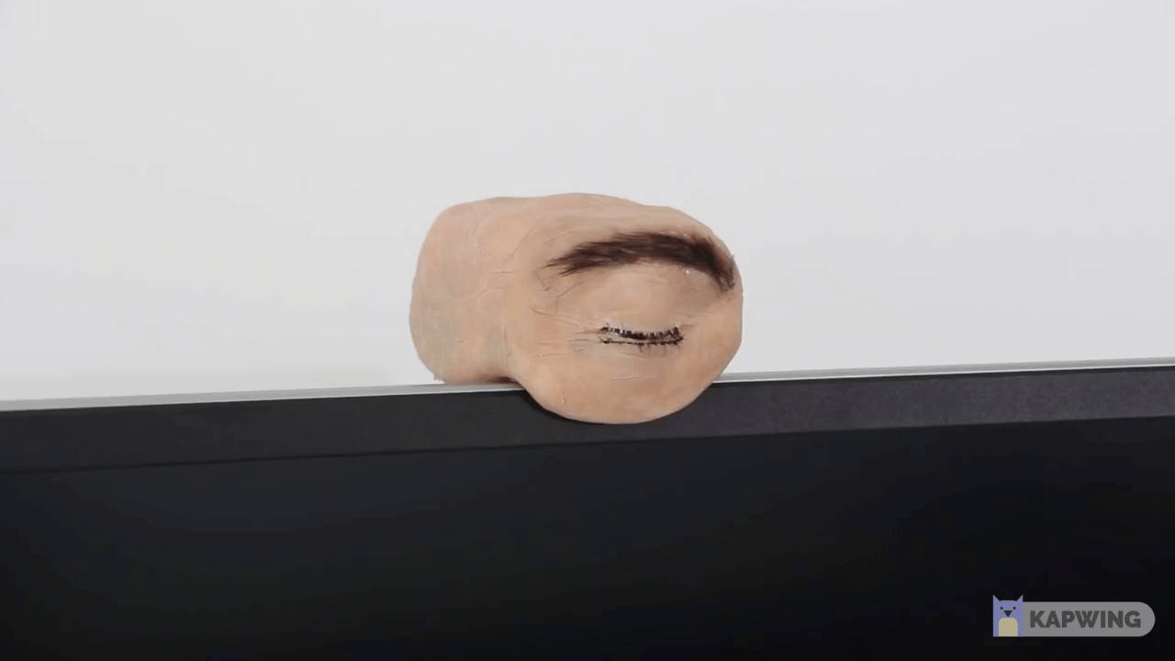
Surfacing Values Using Prototypes
Implication Design
  Embedding an artifact’s ethical implications into its design
  “[prototypes] surface value tensions that can later serve as inspiration for designers … to navigate these tensions.”
Haghighi, Jörke, et al., 2023
Eyecam is a webcam shaped like a human eye. It can see, blink, look around and observe you.
Teyssier et al., 2021
Notes:
What is the point of a prototype?
Understand how they may affect people
Research Prototypes– their role as initial versions of a commercial product vs intended to generate knowledge and ideas
[ADVANCE]
One example is the eyecam which uses prototypes to embed values in the design of the technology.
We used experience protoypes to test design assumptions.
Another role that prototypes can also serve is to surface the values embedded in the artifact

Slide 48
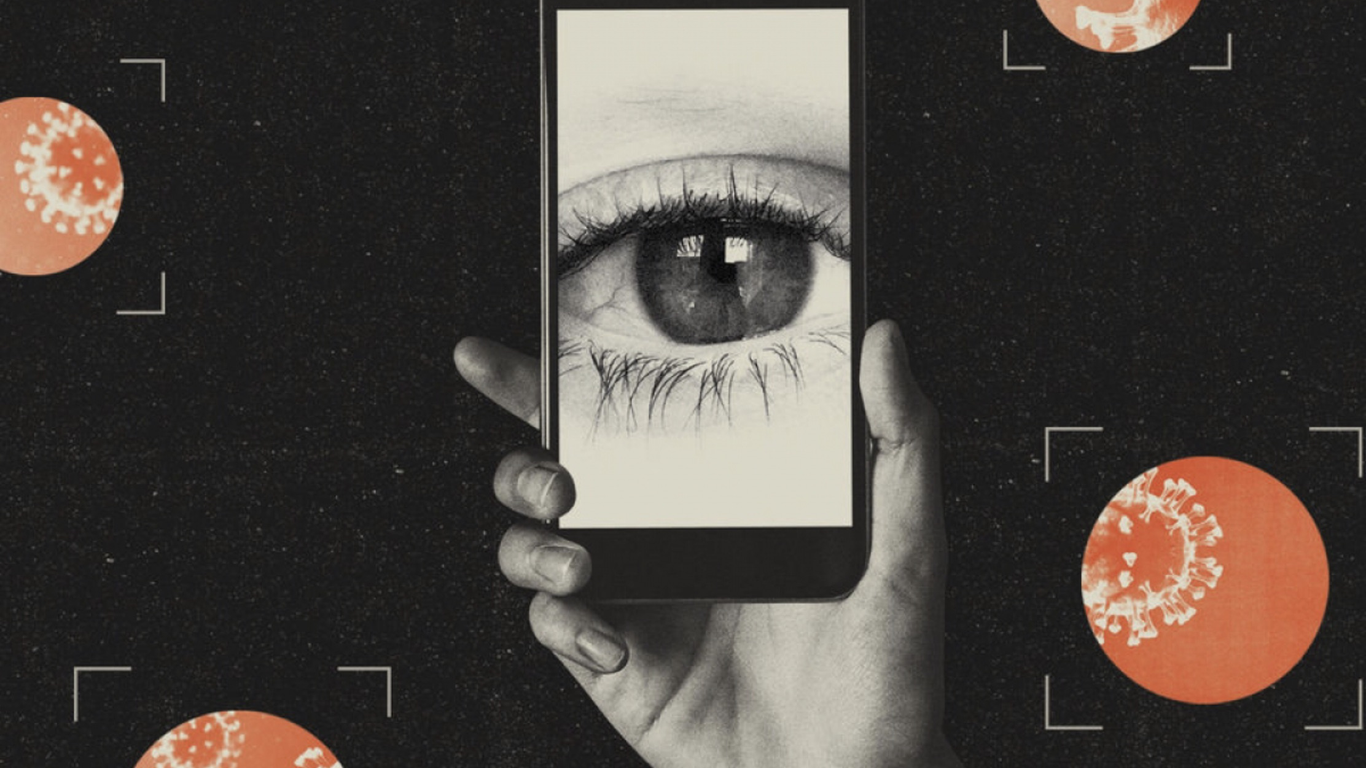
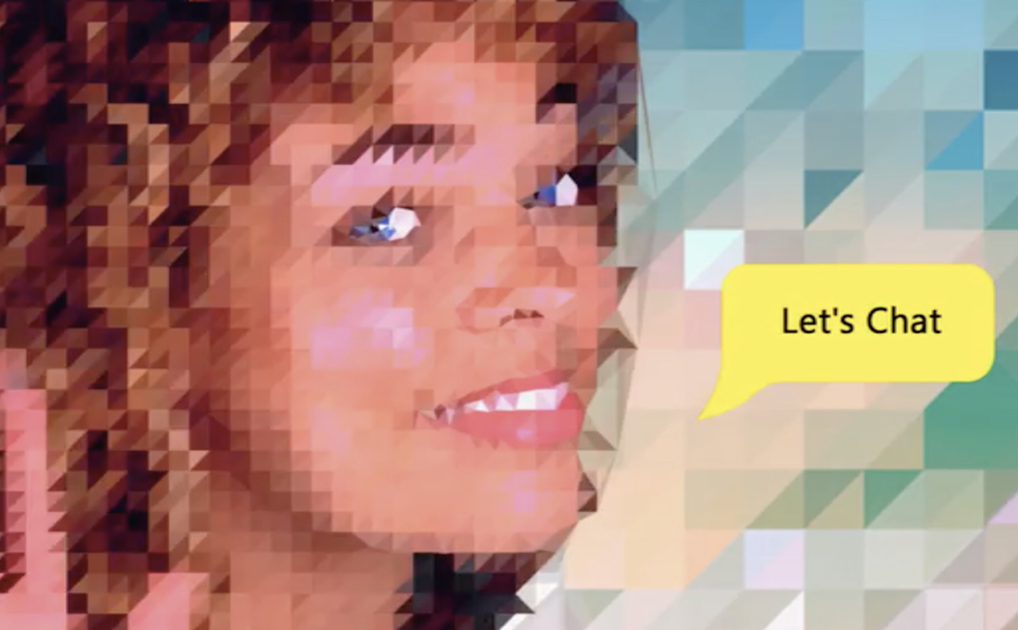

What values are encoded?
Bike-sharing
Contact-tracing
Social Chatbot
Mobility
Health
Sustainability
Inclusion
Health
Safety
Efficiency
Public interest
Wellness
Solidarity
Inclusion
Mobility
Health
Sustainability
Inclusion
Accessibility
Health
Safety
Efficiency
Public interest
Privacy
Wellness
Solidarity
Inclusion
Human connection
Notes:
So as a short activity, let’s think about three example products and the values that they embed in their design
[ADVANCE]
Think about Bike sharing.
Mobility, health, sustainability, inclusion.
Biking available for those who can’t afford it. Or who have to travel long distance to get to a bus stop.
[ADVANCE]
Contact tracing.
Health, safety, efficiency, public interest
[ADVANCE]
Social chatbots.
For those who don’t want to communicate with others or can't.
Maybe it is wellness, solidarity, or inclusion.
But it’s not quite so simple is it?
For each of these use cases, we can also think of other values that we believe to be good things we might also want to support
[ADVANCE]
For bike-sharing, we might value accessibility, but our bike sharing program may not be accessible to people with motor impairments who can’t ride a bike
[ADVANCE]
Our contract tracing application sacrifices user privacy for the public benefit, as it collects all of your location traces and who you interact with. Common for a lot of today and tomorrow's AI systems.
[ADVANCE]
And our social chatbot might cause its users to have fewer social connects with other humans, something else we might value

Slide 49
What did we learn?
Values don’t exist in isolation
Values are interconnected and are often in tension with each other
Notes:
What did we learn in this example?
We learned that values don’t exist in isolation – there are interconnected with one another. Designing for one value might impact many others. We call these value tensions
We call them tensions because it’s not about choosing one value or another. It’s about resolving the tension – sometimes you can find creative designs that address the tension, sometimes you have to find the right balance by talking to stakeholders and iterating on your designs
Some value tensions might exist among different stakeholders: for example, the CEO of a music streaming platform might value engagement and profits, while listeners value content quality and novelty. These values might be in tension if optimizing for engagement starts recommending you the same kind of content over and over again. And there are power dynamics among the stakeholders, since the CEO has the power to make the final call
But sometimes, the same stakeholder can hold conflicting values. In the contact tracing example, you might simultaneously value public health and safety while valuing your personal privacy.
Much like the other kinds of design contradictions we learned about earlier, these value tensions are very useful for designers. They can point to the key ethical implications that you should be considering

Slide 50
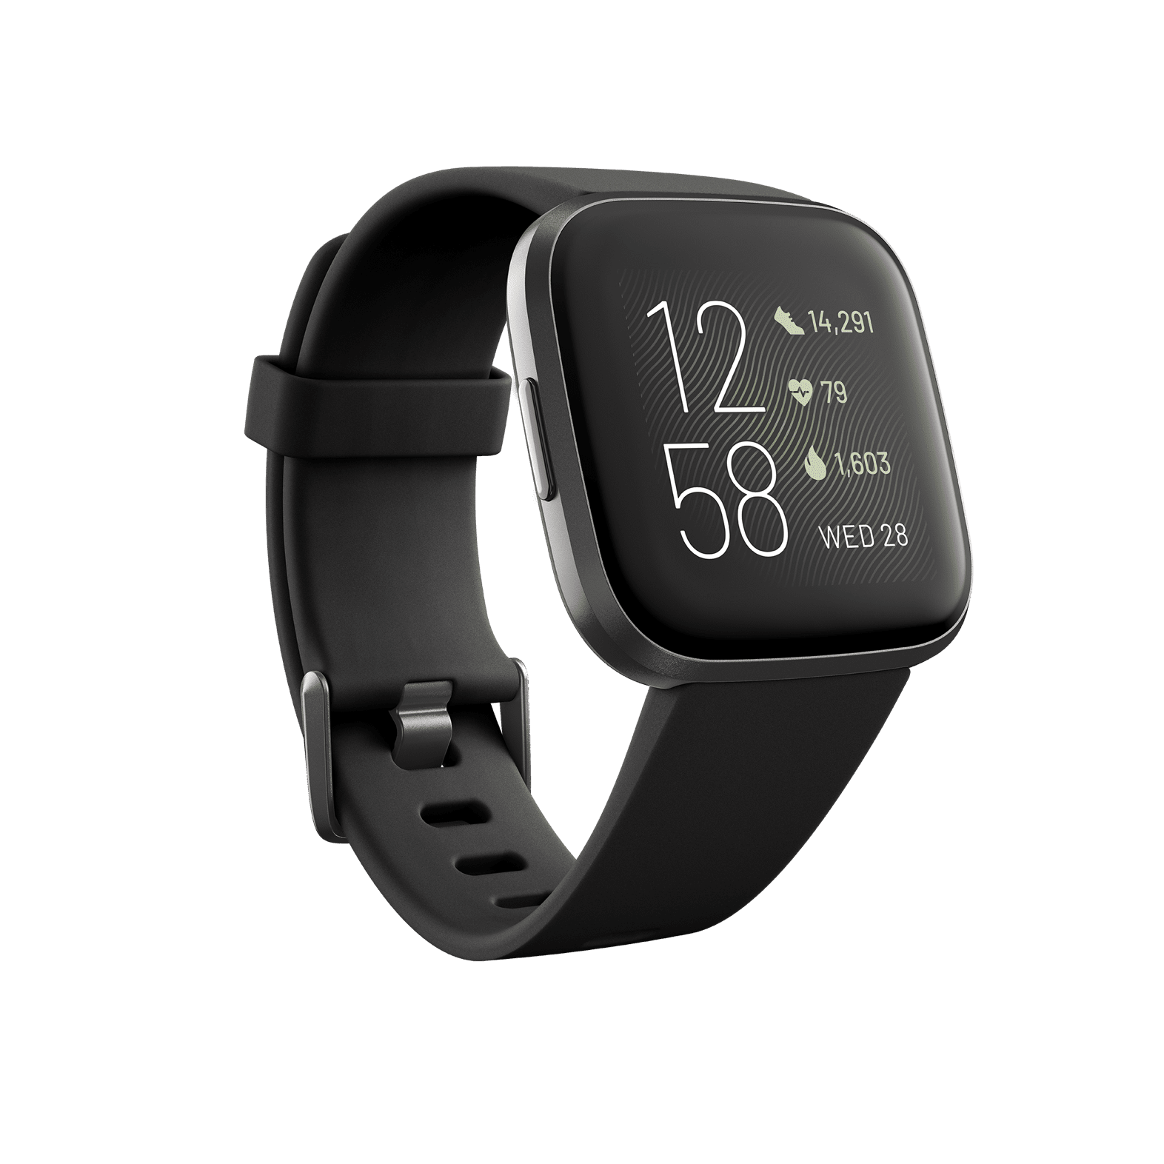
An example
A wearable fitness tracker for older adults that monitors their health, detects falls and injuries, and automatically sends updates to their doctors and loved ones.
Notes:
Alright, so now we’re going to walk you through an example for a specific piece of technology: a wearable fitness tracker
The first step is realizing that just thinking about the tech is NOT SPECIFIC ENOUGH
Let’s ground this in a particular solution scenario
[ADVANCE]
This is a solution that you could have created in your assignment that fills a certain need
What are some value tensions we might identify in this scenario?
Health <-> Privacy
Safety <-> Autonomy

Slide 51
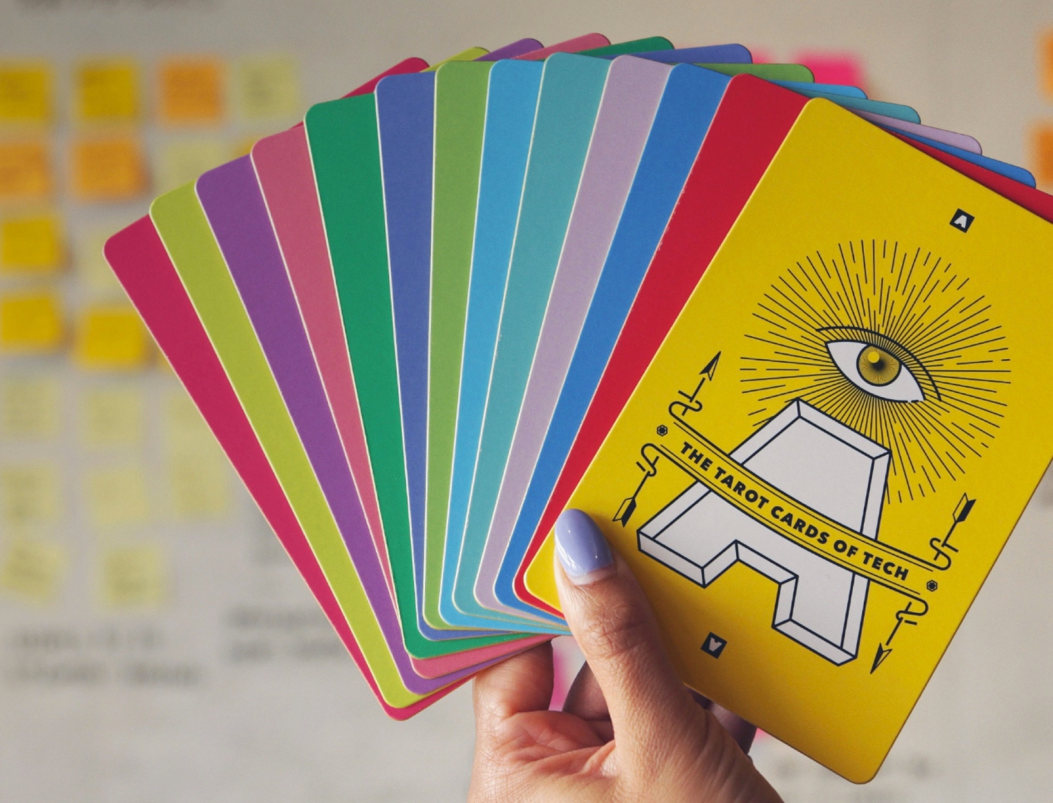
Tarot Cards of Tech
“a set of provocations designed to help creators more fully consider the impact of technology”
→ help designers think of different “risk areas” that can uncover missing stakeholders and value tensions
tarotcardsoftech.artefactgroup.com
Notes:
Now I want to introduce the Tarot cards of tech, which is one of many resources that exists out there for ethics and value focused design
The design group that created them, called Artefact group, describes them as a “set of provocations design to help creators more fully consider the impact of technology”
And we found these cards to be especially useful in our projects and research, because they can help designers and non-designers alike think of different risk areas, uncovering missing stakeholders or value tensions in the process

Slide 52
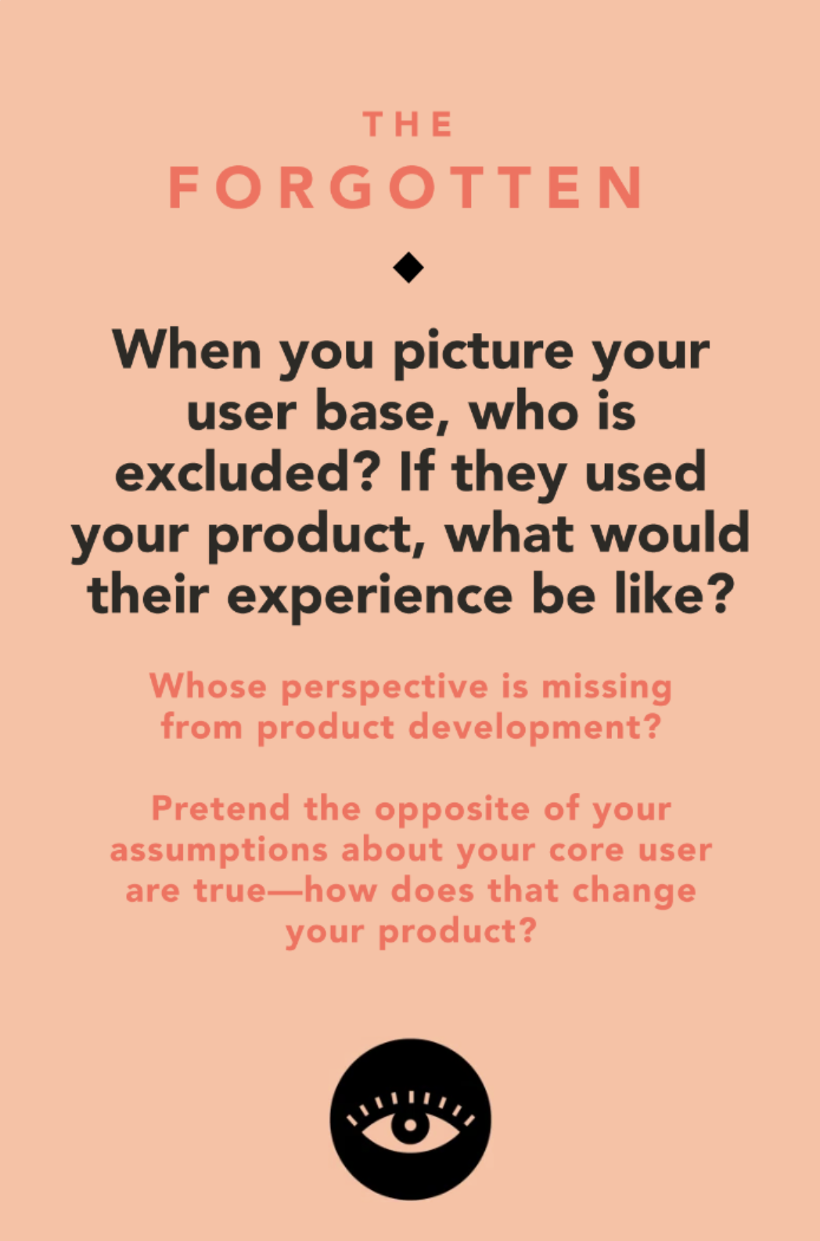
An example
A wearable fitness tracker for older adults that monitors their health, detects falls and injuries, and automatically sends updates to their doctors and loved ones.
Notes:
[Read the card aloud and ask the class to think of ethical implications]
Older adults who are scared of advanced technology
- Information access <-> Comfort
People who cannot afford the technology
-a value: Affordability & Access
People who don’t have loved ones who want to check in on them or care about their safety
People who don't have the dexterity to put this on
In your next assignment, you’re going to be doing one of these activities on your own projects. You’ll have to chance to look at the 16 different cards in the deck

Slide 53
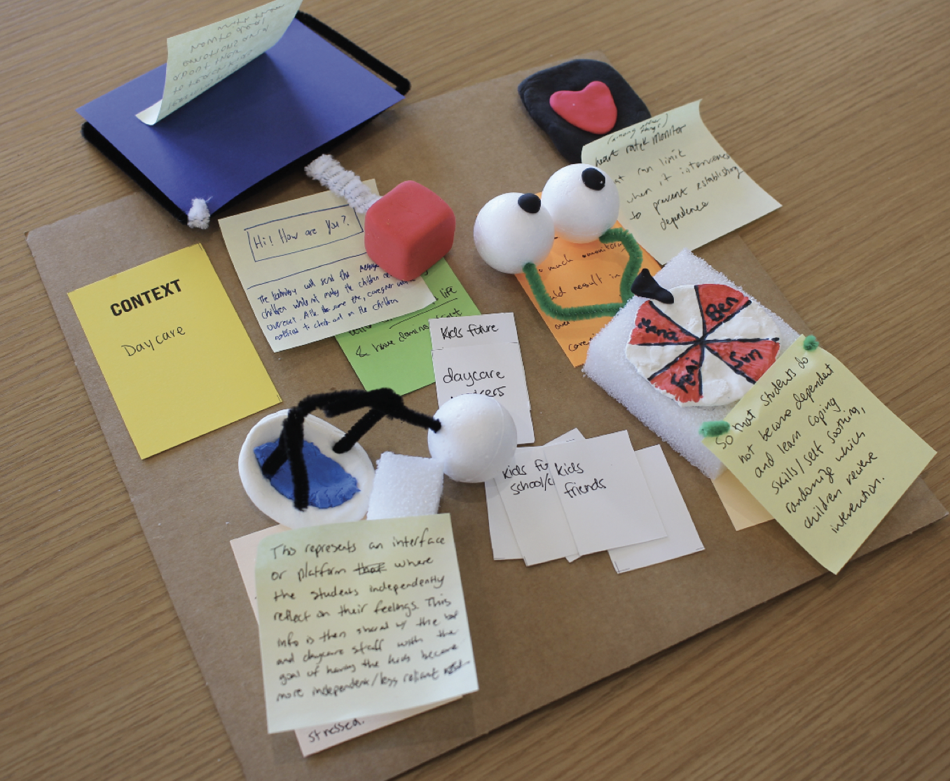
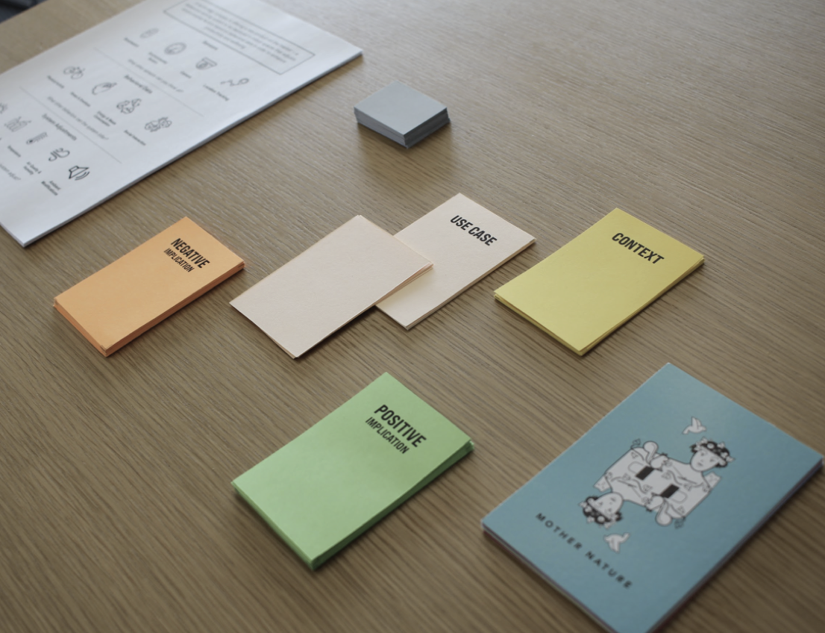
Values & Ethics Design Ethics Research
Once designers have identified values & value tensions, who gets decide how to navigate them?
How might we enable stakeholders to directly participate in navigating value tensions?
https://dl.acm.org/doi/10.1145/3563657.3595992
Notes:
This is a project from our last two head CS147 CAs: Matt Joerke and Nava Haghighi
And the question they wanted to dig deeper on is what to do after you’ve elicited important values and value tensions
Do the designers just get to decide how to address them? That puts them in a position of power
What if stakeholders could directly contribute to this conversation? But how can we enable this if they aren’t designers?
So in this research project, we developed a series of design activities to enable people from various backgrounds, who may not have any design experience, to surface and navigate value tensions. We do this through a game-like activity where participants create artifacts with crafts materials to communicate how a technology could be changed to better serve them
You can find more details about this in our paper

Slide 54
Further Reading
Other frameworks
  Inclusive design
  Design justice
  Participatory design
  Feminist HCI
  Critical race and HCI
  Queer HCI
Other resources
  Building Utopia Deck
  Envisioning Cards
  Judgement Call
  Timelines
  Many, many more
Notes:
We’ve really just scratched the surface of ethics and value focused design. And I also want to emphasize that this is really an open and evolving field.
While we’ve showed you a particular set of tools to guide ethics-focused design, this doesn’t replace your knowledge, experience, and instincts as a designer. It also doesn’t replace the fact that you have to engage with the communities you work with and are building for, and give them a voice in the process.
There are many more frameworks that hone in on particular aspects, like equity & inclusion, civic participation, race, gender, queerness, etc.
There are also many more resources other than the Tarot cards that are great. Come talk to us!

Slide 55
Summary
Sketching allows exploration of many concepts in the very early stages of design
As investment goes up, need to use more and more formal criteria for evaluation
Values are embedded in designs → think critically about which values and whose values you are embedding

Slide 56
Next Time
Lecture
  Figma workshop & work on videos in class
Read for Wed
  “Involving Customers with Iterative Design” (Ch 4) of The Design of Sites
  “Making a Paper Prototype” (Ch 4) from Paper Prototyping by Carolyn Snyder
Watch
  The danger of a single story, Chimamanda Ngozi Adichie,
  TEDGlobal 2009 (20 min.) https://www.ted.com/talks/chimamanda_ngozi_adichie_the_danger_of_a_single_story?language=en

