Slide 1
A8 Fitbud High-Fi Prototype
Christelle Millos-Lopez, Akanshya Bhat, Jake Restiano, Ethan Yuen

Slide 2



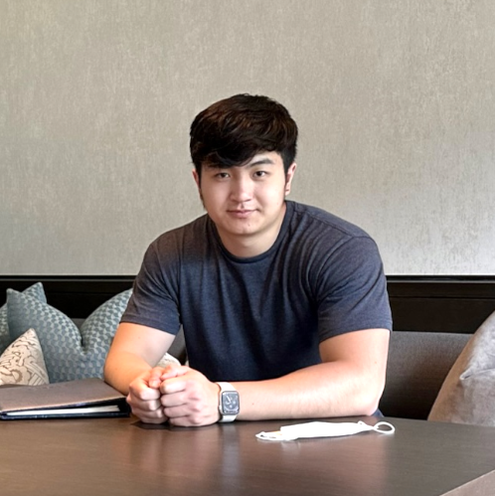
TEAM
Computer Science, Junior
CHRISTELLE MILLOS-LOPEZ
Computer Science, Junior
AKANSHYA BHAT
Computer Science, Co-term
JAKE RESTIANO
Computer Science, Senior
ETHAN YUEN

Slide 3
REVISITING OUR…
PROBLEM
SOLUTION
People, regardless of their current fitness levels or social fitness preferences, don’t actively try to change their fitness-related habits without support as it requires a lot of activation energy, effort, and planning to make it consistent.
Our app provides you with a gamified virtual workout buddy that schedules your workouts, keeps you accountable, and accompanies you through your workout - adapting to your needs and making it easier to exercise.

Slide 4
REVISITING OUR…
PROBLEM
SOLUTION
People, regardless of their current fitness levels or social fitness preferences, don’t actively try to change their fitness-related habits without support as it requires a lot of activation energy, effort, and planning to make it consistent.
Our app provides you with a gamified virtual workout buddy that schedules your workouts, keeps you accountable, and accompanies you through your workout - adapting to your needs and making it easier to exercise.

Slide 5
TABLE OF CONTENTS
01
02
03
04
HEURISTIC EVALUATIONS
UI AND PRODUCT REVISIONS
PROTOTYPE IMPLEMENTATION STATUS
PROTOTYPE DEMO

Slide 6
01
HEURISTIC EVALUATIONS

Slide 7
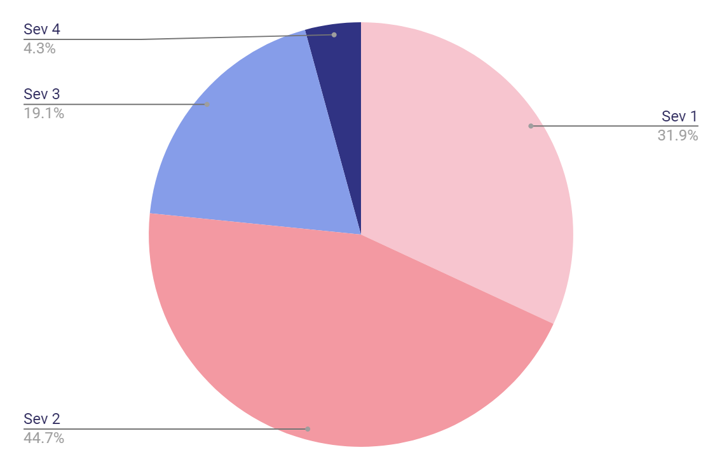
HEURISTIC VIOLATION STATISTICS
Sev 1 (15)
Sev 2 (21)
Sev 3 (9)
Sev 4 (2)

Slide 8
39 changes
out of 41 heuristic violations

Slide 9
MORE ON SEV 3 AND 4 VIOLATIONS
SEV 3
SEV 4
9 violations
2 violations
8 changes
2 changes

Slide 10
MOST VIOLATED HEURISTICS
H4
H8
H1
Consistency & Standards
8 violations
Minimalist & Aesthetic Design
7 violations
Visibility of System Status
6 violations

Slide 11
02
UI AND PRODUCT REVISIONS

Slide 12
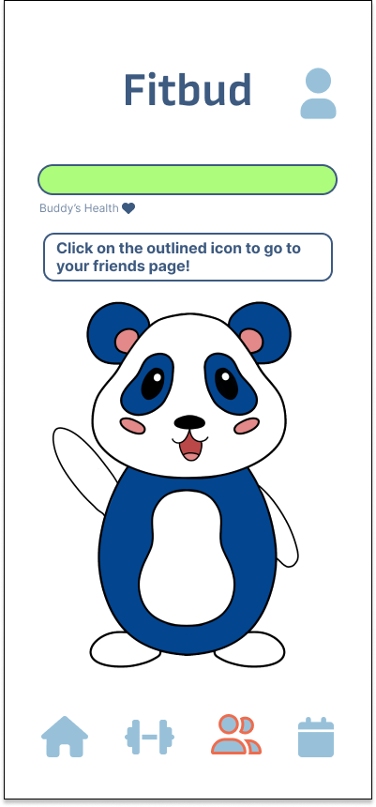
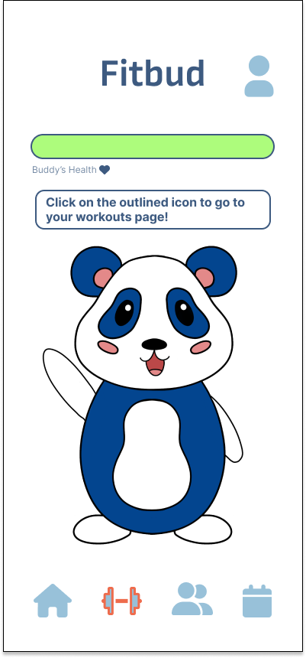
Sev 3
H1: Visibility of System Status
Description: Uncertainty of where to move on from the home screen- especially from onboarding. Home screen is largely dominated by Buddy, who does not mention anything related to fitness upon being pressed.
Fix: Adding a prompt to the homescreen by Buddy showing you what your first steps (welcoming you and looking at your workout plan) should be.
Click to go to page

Slide 13
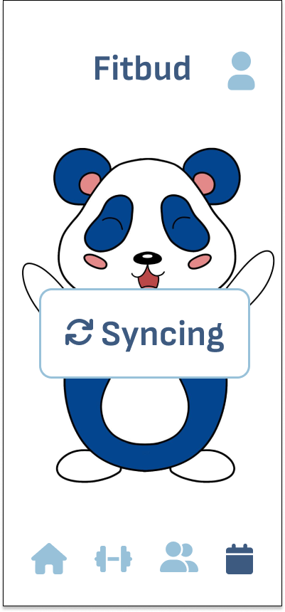
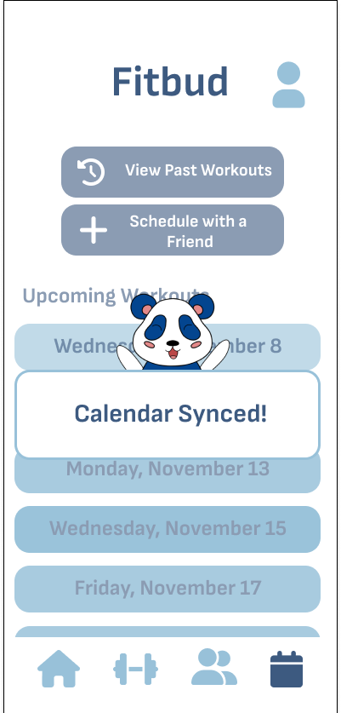
Sev 3
H1: Visibility of System Status
Description: No clear feedback on how my calendar has synced/how my workout calendar has changed after I have synced it- are these tasks aligned with my calendar?
Fix: Adding in a “calendar synced!” notification.
Visible notification

Slide 14
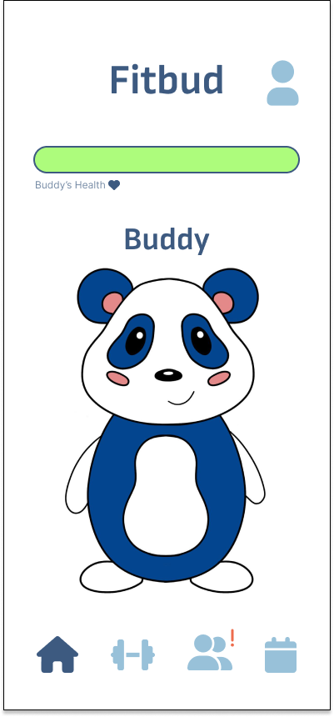
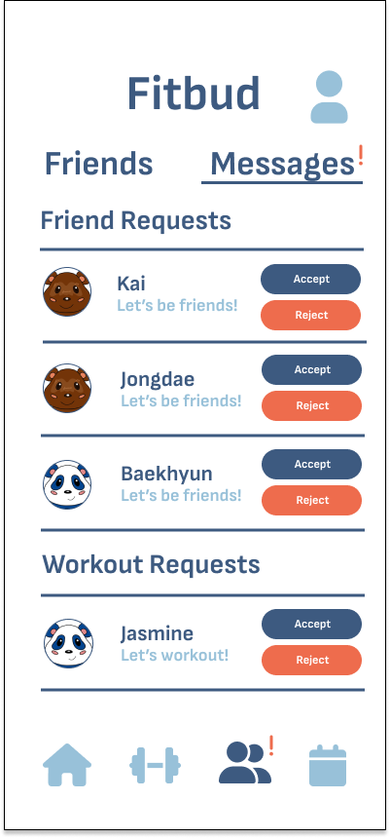
Sev 3
H6: Recognition Not Recall
Description: No correlated notification when a user is sent a workout request in their profile page.
Fix: Add a notification ping on the friends icon on the navbar (new), so users will be alerted to a new request without needing to remember to check their profile.
Notification icon

Slide 15
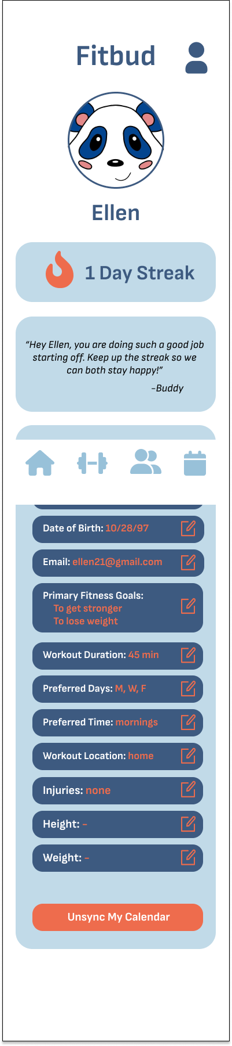
Sev 3
H3: User Control & Freedom
Description: User does not have the ability to undo calendar syncs/remove user data.
Fix: Add a button in the settings page that allows users to remove their calendar/any other form of user data from the application.
Unsync button

Slide 16
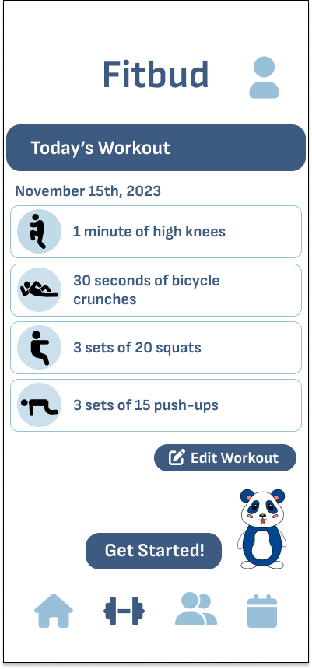
Sev 3
H11: Accessible Design
Smaller icon
Description: Key buttons like “Get Started” on the workout screen are the same size and hierarchy as “Edit Workout” and do not stand out.
Fix: Enlarge the “Get Started!” button and make that a primary read of the screen.
Bigger icon

Slide 17
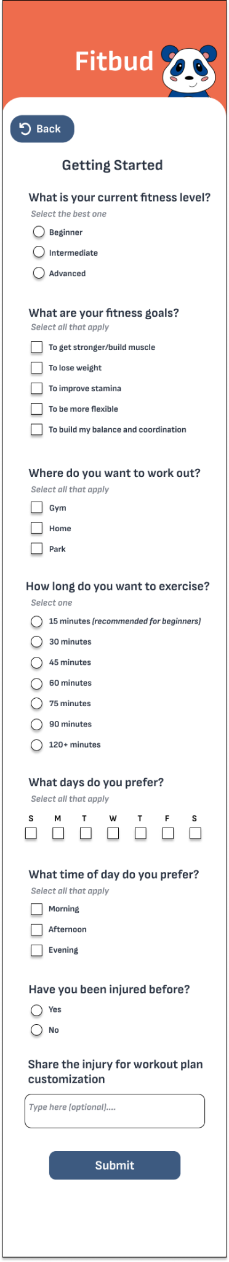
Sev 3
H12: Value Alignment & Inclusion
Description: Fitness goals in onboarding are oriented towards fitness lingo- ex: “build endurance” or “flexibility” versus “balance and coordination”.
Fix: Reword or expand on fitness goals that may align with goals non-fitness oriented users may want- ex: “I want to get stronger/gain muscle”
Changed wording

Slide 18
Sev 3
H12: Value Alignment & Inclusion
Description: No measure of user’s fitness level or satisfaction level taken in intro survey or before/after workouts
Partial Fix: Within the intro questionnaire, respectfully ask question(s) about the user's current fitness level and capabilities. The ability to edit workouts allows the users to adjust the exercise according to their desires.
Personalized workout for user

Slide 19
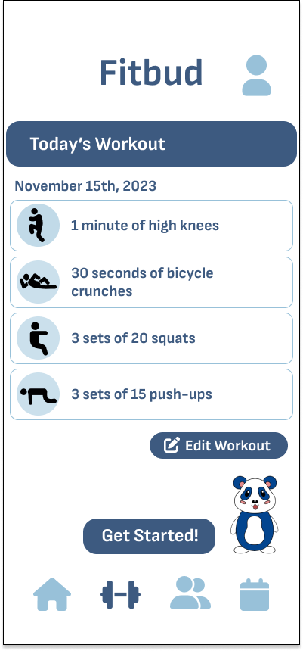
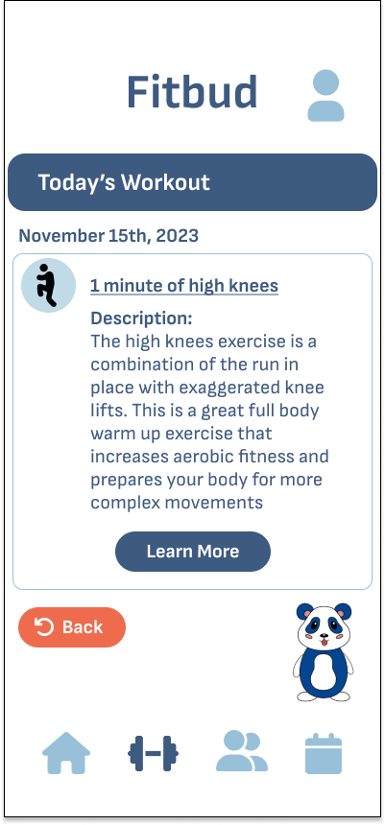
Sev 3
H11: Aesthetic and Minimalist Design
Description: Visuals for workouts are small and can be unclear as to what they are envisioning.
Fix: The visual is only an icon and is not meant to represent the workout. However, we slightly enlarged the icon and then added an information page on the exercise if you click on the icon that explains in more detail what the exercise entails.
Click on icon for more information

Slide 20
Sev 3
H8: Aesthetic and Minimalist Design
Description: Very cluttered interface in past workouts page; would benefit from summarization.
Reason to not fix: Suggestion was not specific enough and we have already simplified a lot of our user interface with previous edits. Simplifying more would take away understanding of the app.

Slide 21
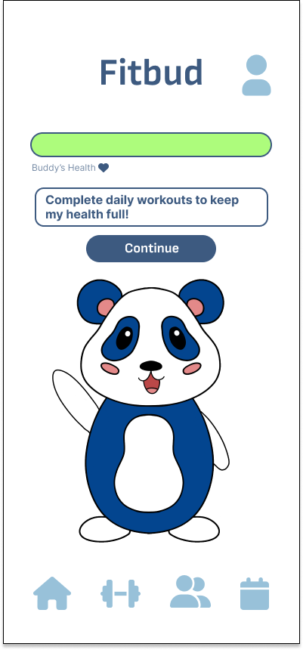
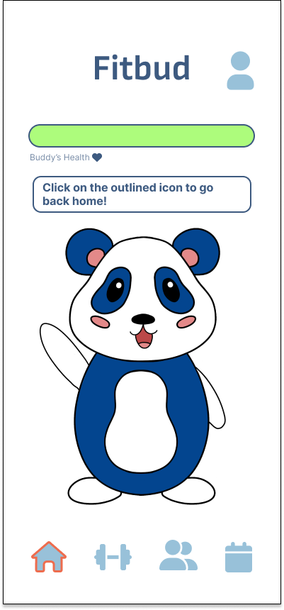
Sev 4
H1: Visibility of System Status
Description: No clear indication for how to change the status of Buddy’s health mentioned on the homescreen, but not mentioned at the end of a workout or anything similar.
Fix: Add a tutorial to show how to use the app for users who sign up. This tutorial contains a message that outlines how to keep up Buddy’s health.
Message

Slide 22
Sev 4
H12: Value Alignment and Inclusion
Product Change
Description: Having workouts associated with Buddy’s health may not be inclusive.
Fix: While this idea is necessary to urge the user to care for the buddy and motivate them to workout, Buddy can be revived after this occurs and give the user a free pass to restart if this does happen.

Slide 23
Usability Goals
EFFICIENCY
FUN
Added friends icon to navbar makes navigation much more intuitive
Tutorial shows the user how to use the app immediately upon signing up
Resizing of important buttons allows for better first read of screens, guiding users to what is more important
Buddy’s chosen name is more visible throughout the app
Buddy holds signs pointing you to different pages instead of just having messages
Buddy can now easily be revived and is more motivating and enjoyable than stressful for the user

Slide 24
03
PROTOTYPE IMPLEMENTATION STATUS

Slide 25



Tools Used
(Application Framework)
Expo
(Software Dev Kit)
VSCode
(IDE)

Slide 26
Task Flows
Simple: Create a workout plan in an environment accessible to me and schedule that works for me
Medium: Have an accountability system for my commitment to fitness
Complex: Connect with friends who are also exercising

Slide 27
Task Flows
Simple: Create a workout plan in an environment accessible to me and schedule that works for me
Medium: Have an accountability system for my commitment to fitness
Complex: Connect with friends who are also exercising

Slide 28
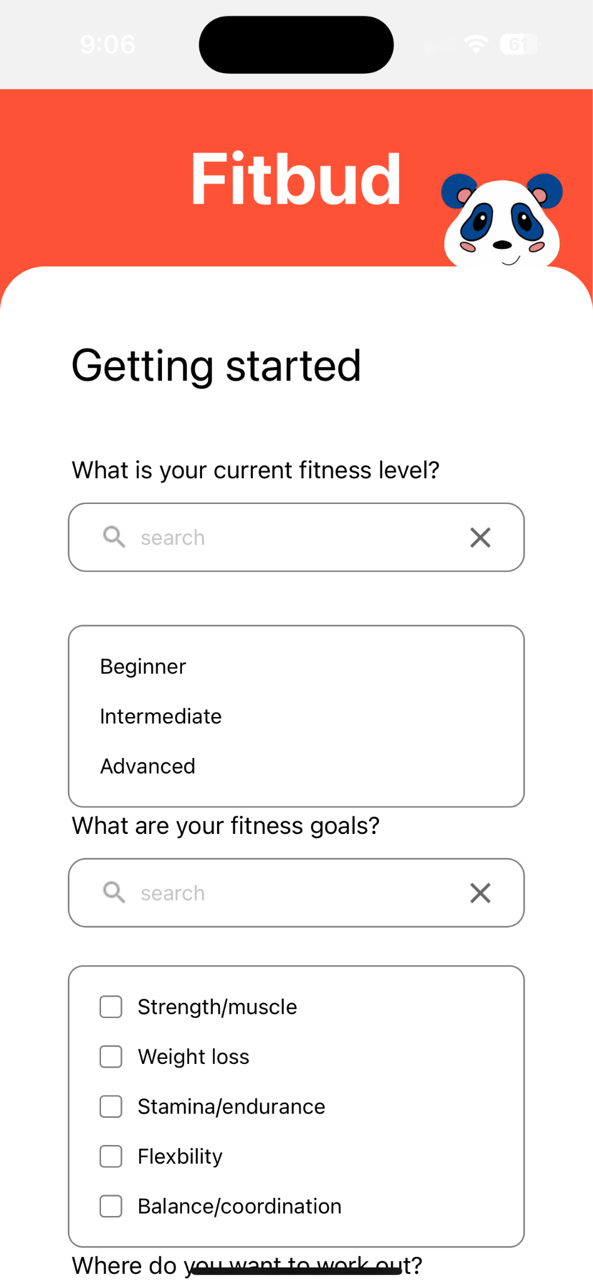
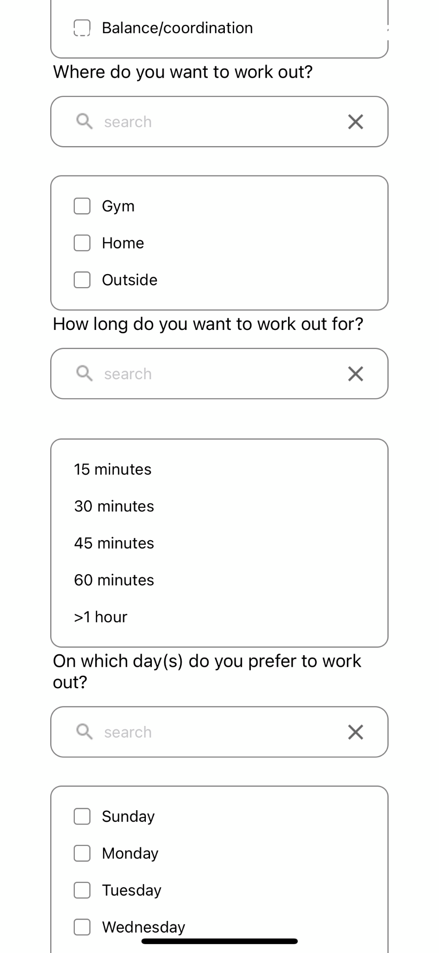
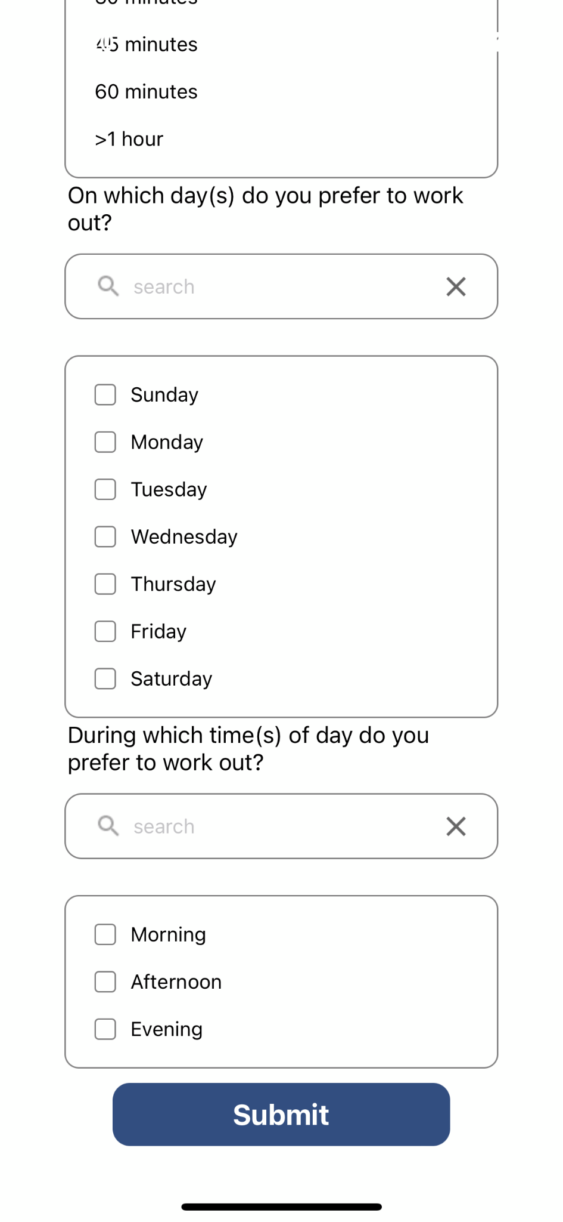
Simple Task Flow (Implemented)
User Scheduling Preferences

Slide 29
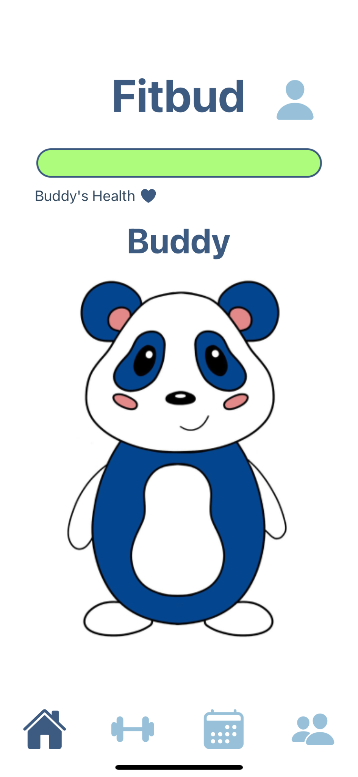
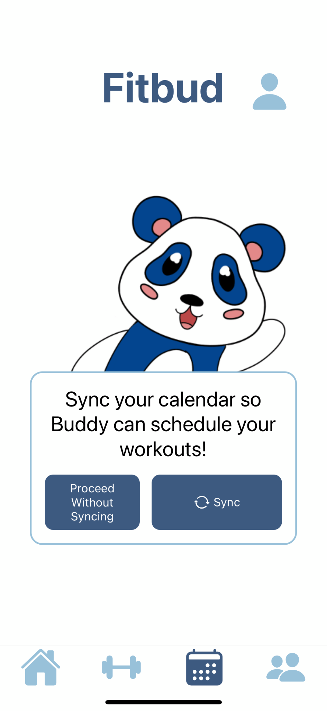
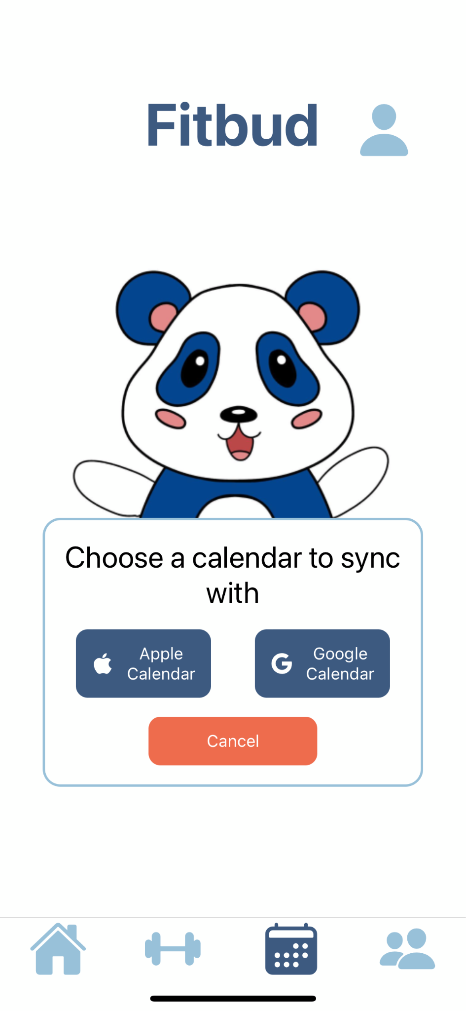
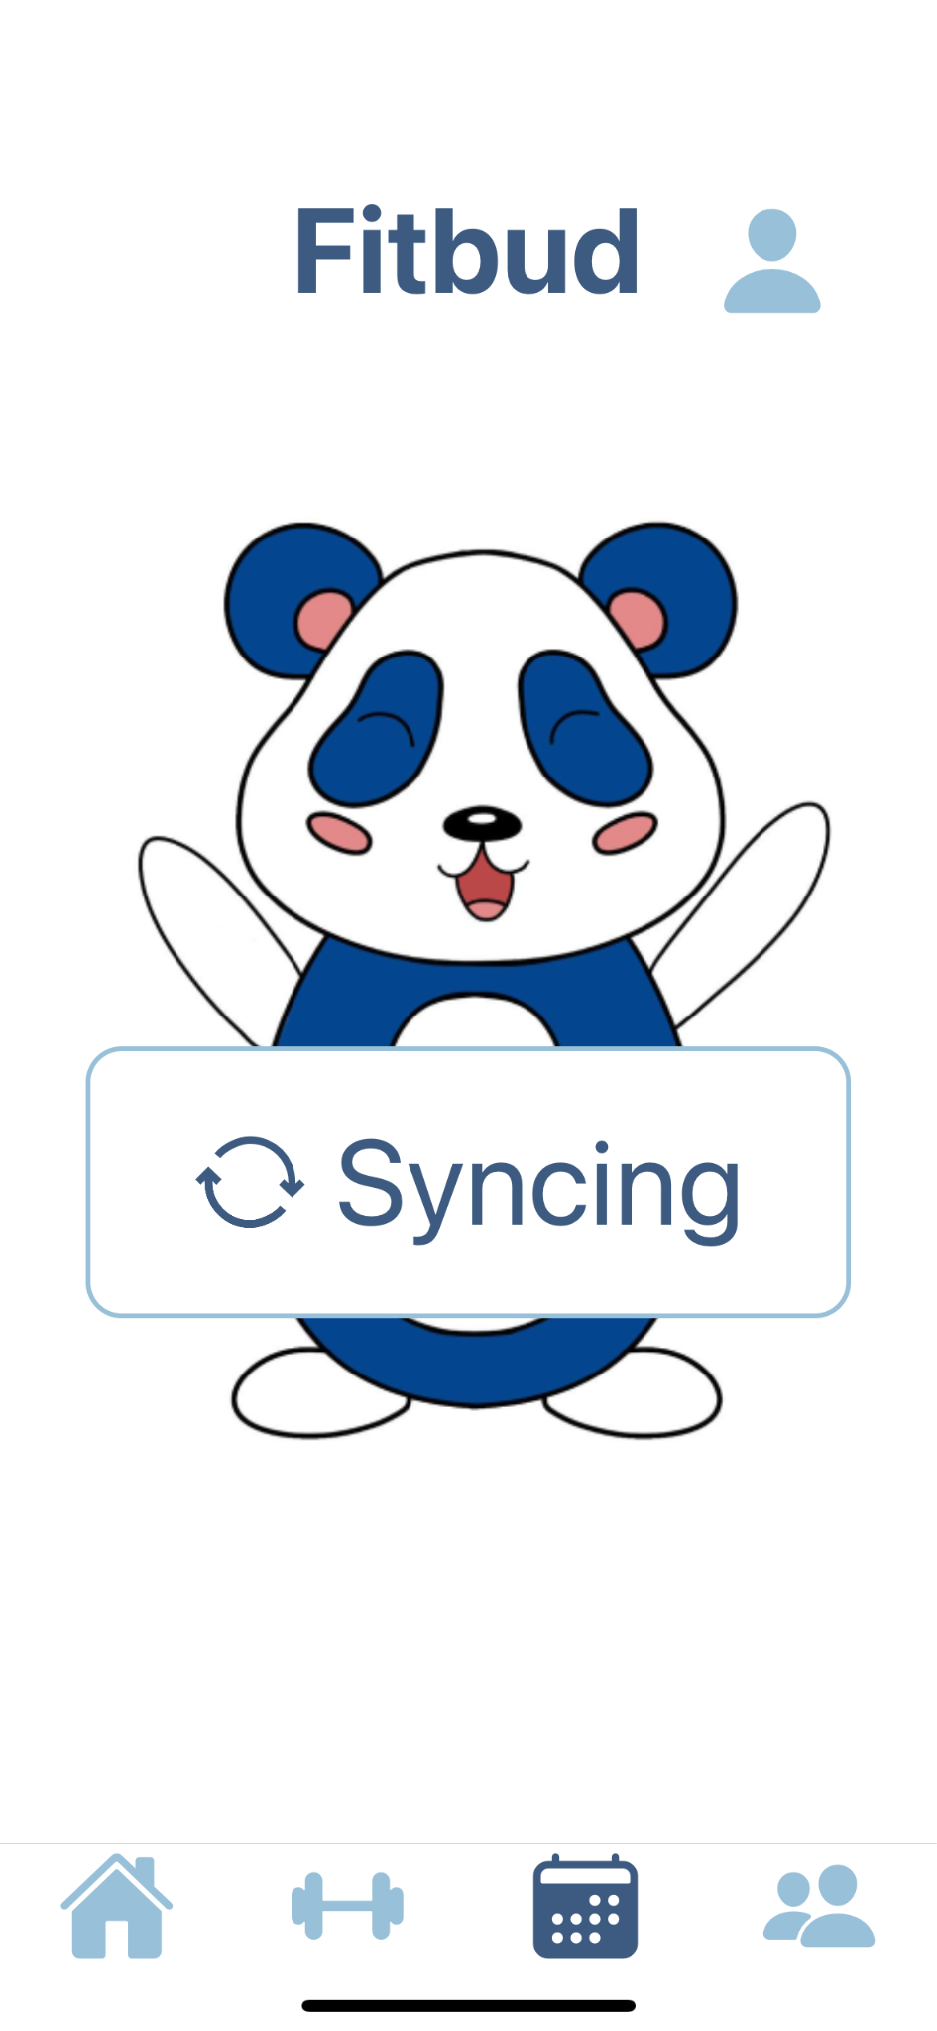
Simple Task Flow (continued)

Slide 30
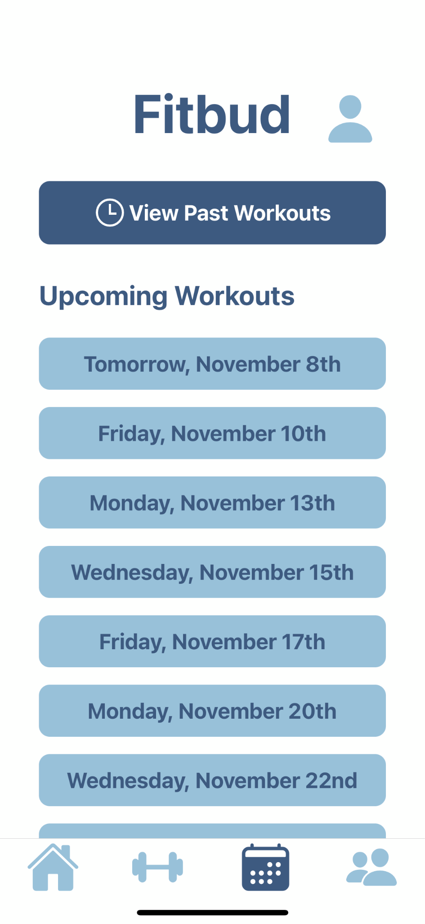
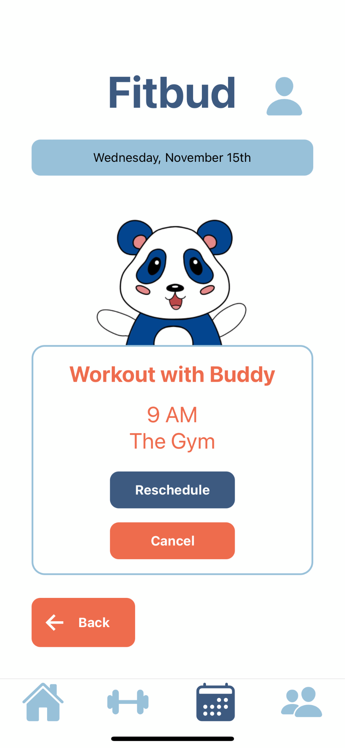
Simple Task Flow (continued)

Slide 31
Not Yet Implemented/In Progress
Medium Task Flow (In Progress)
Start and Complete a Workout
Edit Workouts
Complex Task Flow (In Progress)
Add Friends
Send Friend Requests
Accept Friend Requests
View Friends List
Schedule Workouts With Friends
Message Friends
Other Screens
Workout History
Tutorial
Settings

Slide 32
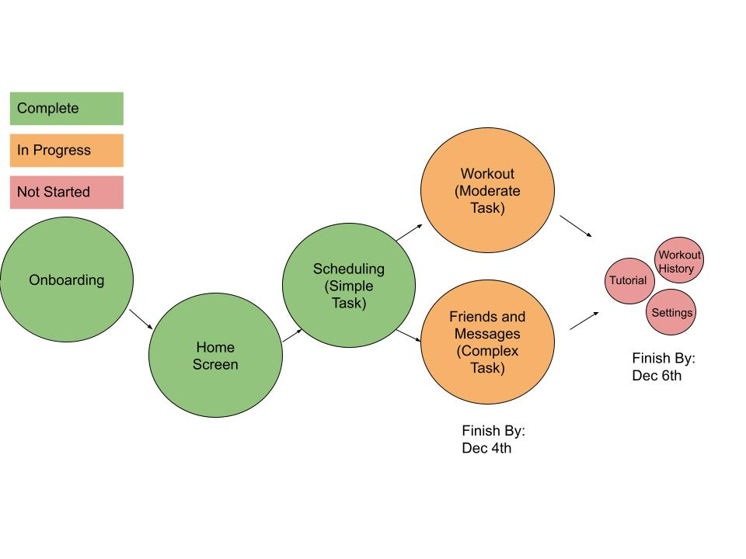
Plan to Finish

Slide 33
Hard-Coded Features
All of the user’s friends and the friend you can add are hard-coded
The exercises in the workouts are hard-coded with a few other hard-coded edits that you can make.
“Buddy” that you can choose

Slide 34
Wizard of Oz
The prototype claims to be syncing the user’s calendar and auto-scheduling a workout using an algorithm, but there is no such algorithm.
A friend request will appear on the user’s profile. This is an artificial friend, no request was actually sent.
The user already has several artificial friends on their friends list (they are not real people).

Slide 35
04
PROTOTYPE DEMO

Slide 36
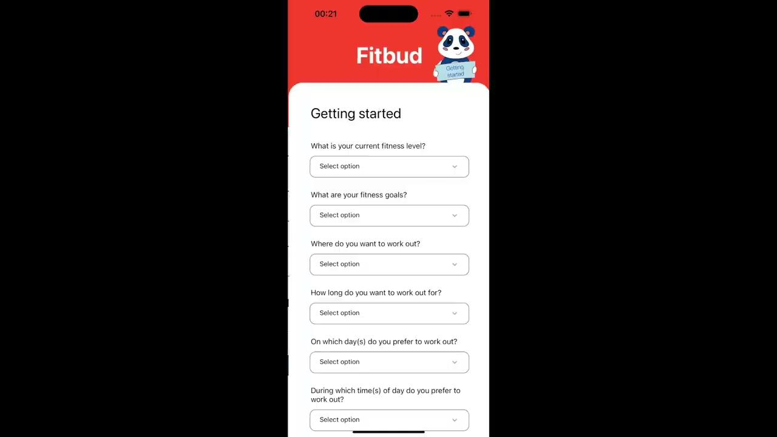

Slide 37
05
APPENDIX

Slide 38
MORE UI AND PRODUCT REVISIONS
(SEV 1 & 2)

Slide 39
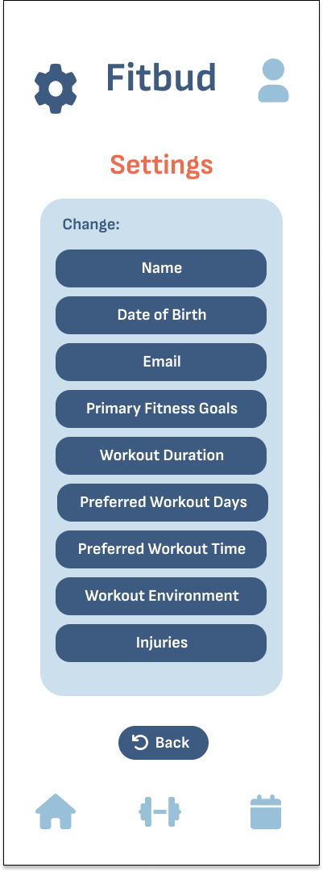
SEV 2
Changed layout of profile page so users could edit onboarding information more easily

Slide 40
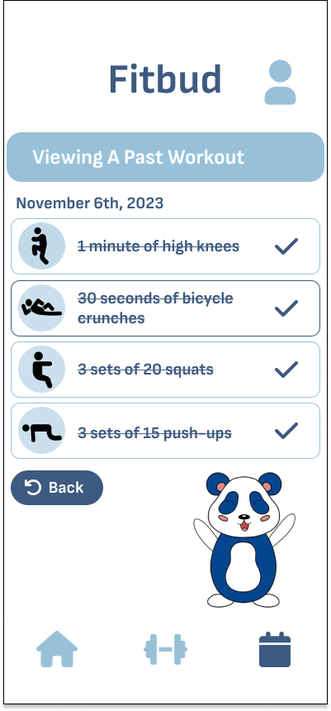
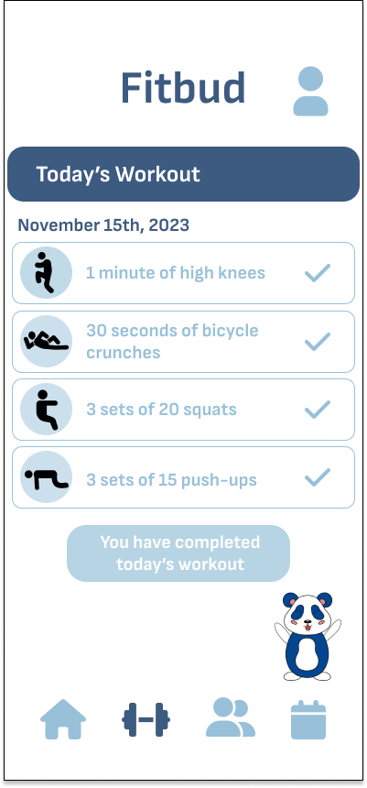
SEV 2
Removed the strikethrough to improve readability
Changed the color according to heuristic eval

Slide 41
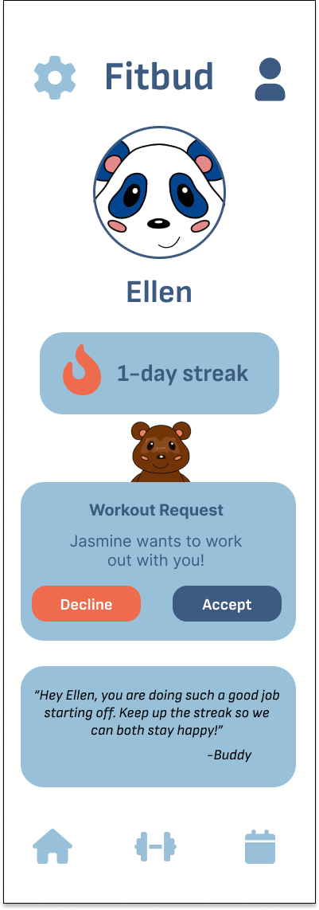
SEV 2
Moved the notifications all to one location under friends (specifically messages) for more intuitive access

Slide 42
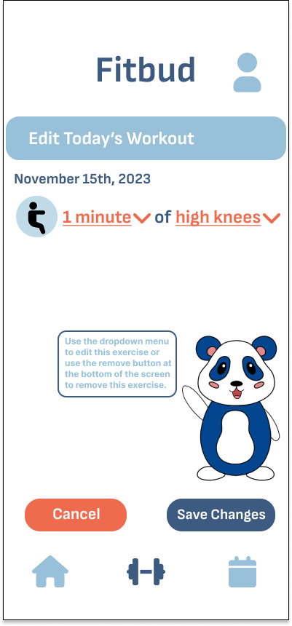
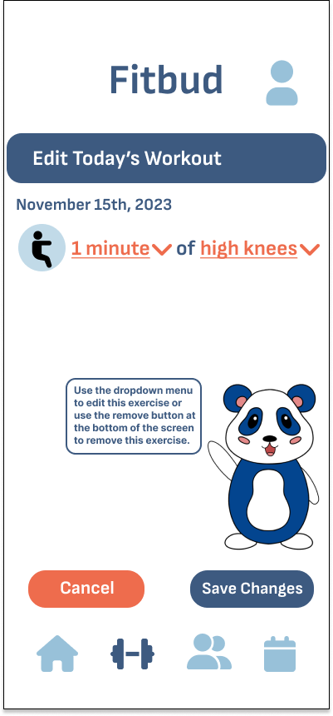
SEV 1
Changed color of Buddy’s speech text to a darker blue for better readability

Slide 43
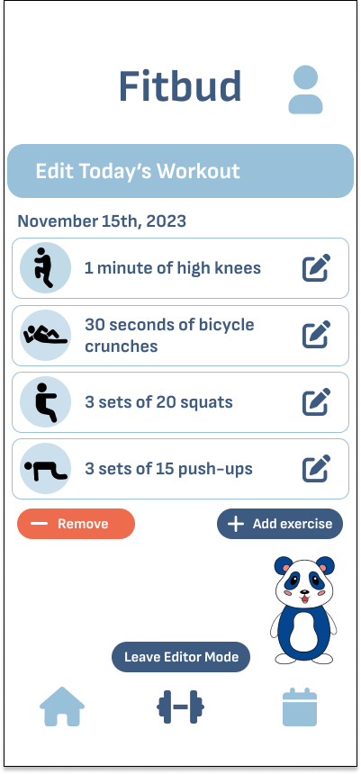
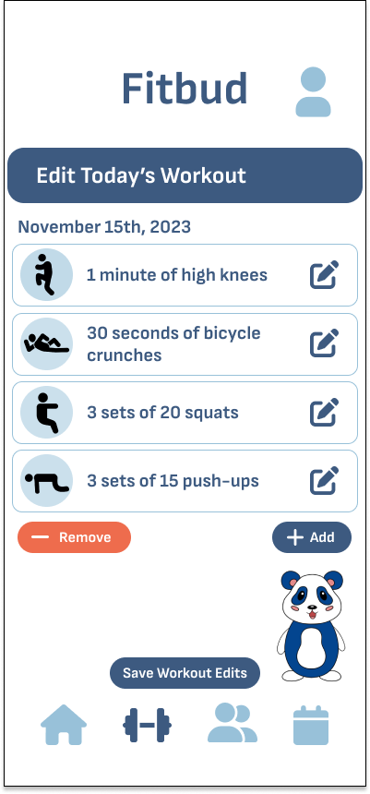
SEV 1
Removed word “exercise” to avoid cluttering

Slide 44
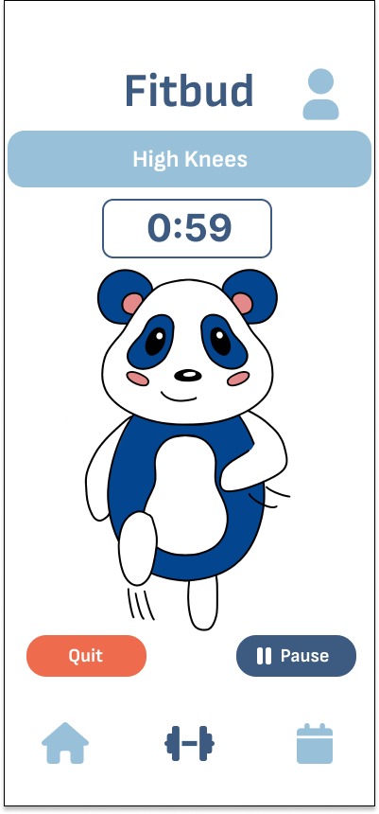
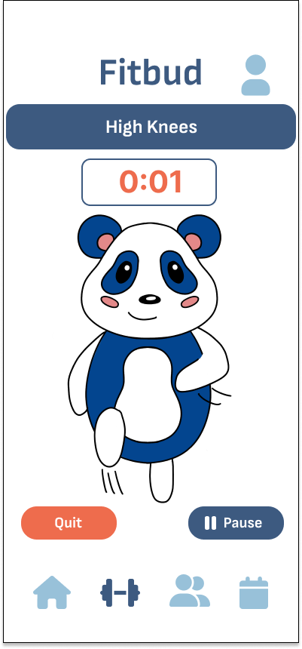
SEV 1
Made headers of workout page (i.e. High Knees) a darker blue for better visibility

Slide 45
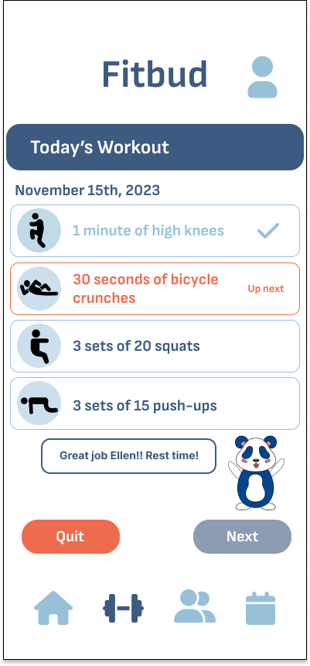

SEV 2
Made next button unavailable for a couple of seconds to give users a forced resting period

Slide 46
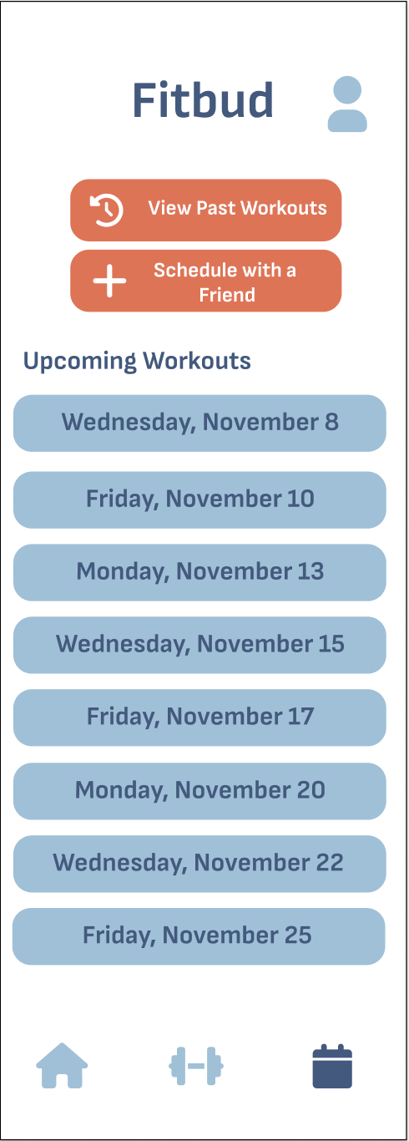
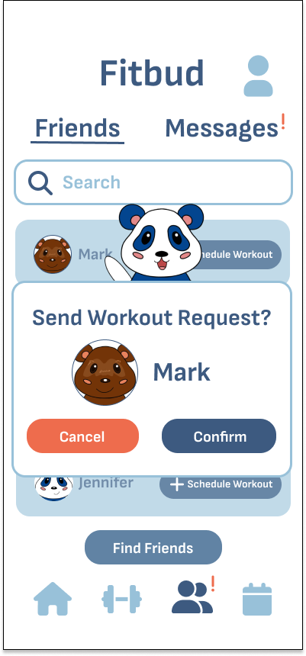
Not a heuristic violation but integrated well with our addition of a friends tab and made the app more intuitive
Removed Schedule with Friends from calendar page and moved to friends tab

Slide 47
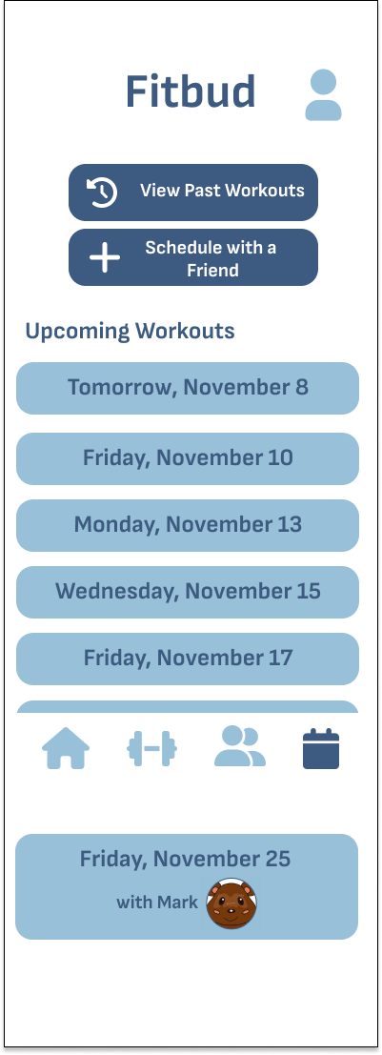
SEV 2
Was unclear what upcoming workouts are with a friend or not

Slide 48
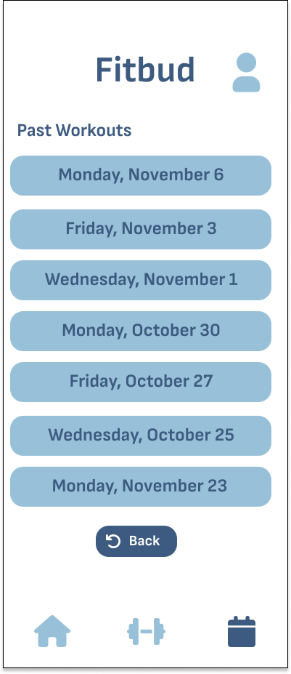
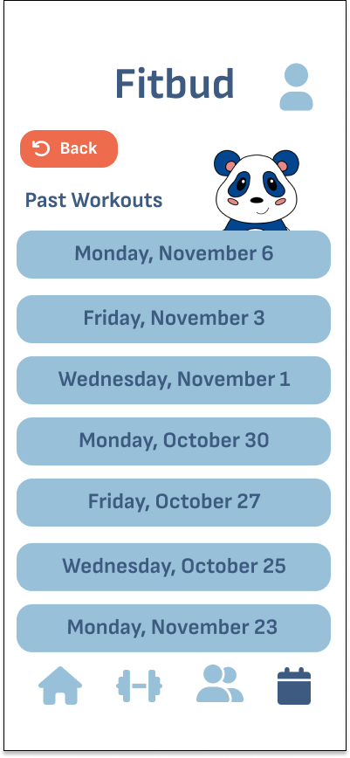
SEV 2
Move up back button on screens with scroll so users can easily see
Make all back buttons orange
Added Buddy for greater prominence in app

Slide 49
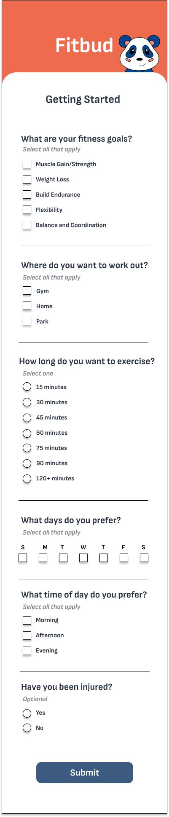

SEV 1
Changed the “box within box” with extra subdivisions
Included a back button to return to personal information screen

Slide 50
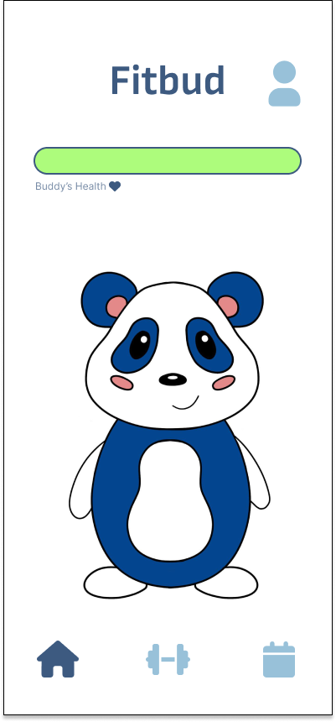
SEV 2
Added Buddy’s name above Buddy so user can see its name

Slide 51
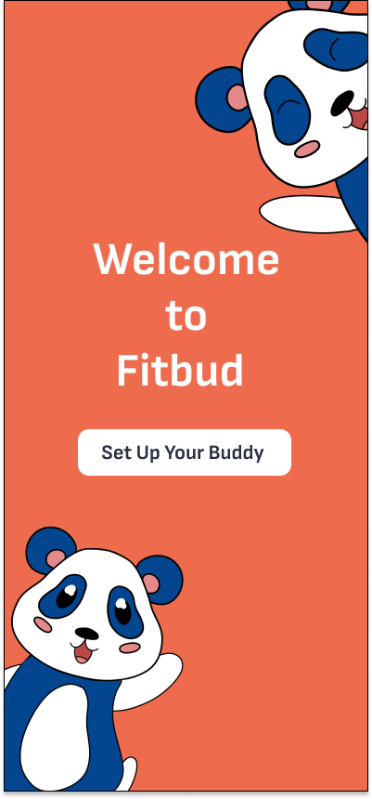
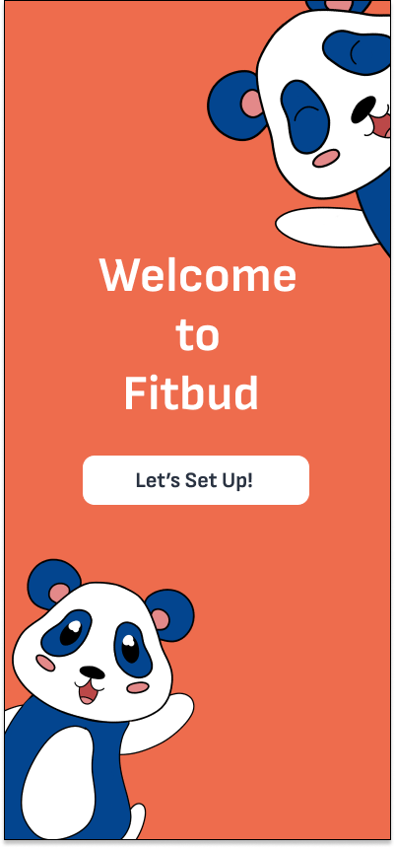
SEV 2
Change Setting Up intro page’s button wording to avoid confusion

