Slide 1

A6: Interactive Medium-Fi Prototype
FitBud

Slide 2




Our Team
CHRISTELLE
AKANSHYA
Junior
Computer Science
Santa Cruz, Bolivia
Junior
Computer Science
Mountain View, CA
ETHAN
JAKE
Senior
Computer Science
Palo Alto, CA
Coterm
Computer Science
San Carlos, CA

Slide 3
FitBud
Your new pal, here to make fitness fun and easy

Slide 4
Problem
Solution
People, regardless of their current fitness levels or social fitness preferences, don’t actively try to change their fitness-related habits without support as it requires a lot of activation energy, effort, and planning to make it consistent.
Our app provides you with a gamified virtual workout buddy that schedules your workouts, keeps you accountable, and accompanies you through your workout - adapting to your needs and making it easier to exercise.

Slide 5
Values in Design

Slide 6
Review of Ethical Considerations
THE SCANDAL: Users who fail their goals could face self-esteem issues
Users who seek out a workout app may already feel subpar in their exercise habits
Failure to meet goals set by the app may worsen their feelings of ineptitude
Could damage body image
THE BACKSTABBER: Misuse of Data and Lack of Privacy Protection
For one of the features, we are asking users to share their calendars
Calendars contain personal information and if this information was leaked or used inappropriately, it would be incredibly wrong
Our users would begin to distrust us and it would pose many ethical problems as well
Similarly, this applies to their health and personal information that they are sharing with us as well
THE SIREN: Gamification of Health
The gamification of exercise could lead to unhealthy exercise habits among users
It may cause individuals to workout far more than is healthy, increasing risk for injuries and harm

Slide 7
Encoded Values
Inclusivity
Flexibility
Inspiration
Safety
Privacy
1
2
5
Users of all fitness backgrounds can benefit from the app
We accommodate and tailor to the user’s schedule and abilities
Users should feel motivated and encouraged at all times
3
4
Ensure protection and physical safety of users
Users should trust that their personal info is secure

Slide 8
Ethics Encoded in Values
Inclusivity
Flexibility
Inspiration
Safety
Privacy
1
2
5
Users should feel that they belong on the app and that the app supports them. This should prevent THE SCANDAL in which users face self-worth issues
By tailoring workouts to a user’s needs/schedule, they should feel ready to face their goals without intimidation or obstacles that could damage self-esteem (prevents THE SCANDAL)
3
4
Users should not feel in any way discouraged by the app. Buddy should constantly be uplifting the user in order to prevent THE SCANDAL in which users face self-worth issues
Users should not feel prompted by workout gamification to overwork themselves or attempt exercises that are beyond their experience level or exercises that may be unsafe given an injury (prevents THE SIREN)
Users share personal info and schedule info so that Buddy can plan their workouts. They should trust that this information is not available to their friends or developers (prevents THE BACKSTABBER)

Slide 9
Value-Aligned Features
Inclusivity
Users fill out questionnaire during registration regarding their fitness level and interests, and workouts are tailored accordingly, making them feel welcome and prepared
Flexibility
Users can customize their workout length and days, helping them feel confident and comfortable with their workouts
Google/Apple calendar can be synced for automatic workout scheduling, removing mental pressure that could make users feel unable to exercise
Users will not feel inadequate due to scheduling difficulties

Slide 10
Value-Aligned Features
Safety
Buddy chooses safe exercises given knowledge of a user’s injury history
The gamification of health could lead to unhealthy exercise habits, so Buddy only schedules one workout per day
Privacy
Group workout feature limited to friends — prevent unwanted behavior
It would be unethical to share a user’s information, thus friends cannot view each other’s calendars, just their scheduled workout time
Inspiration
Companionship of fun and cute virtual buddy provides support and motivation
Keep Buddy healthy by exercising and feel rewarded
Buddies will only offer words of encouragement and motivation to prevent losses of self-worth

Slide 11
Possible Value Tensions
Inspiration vs. Safety and Inclusivity
We decided that Buddy would “die” if users do not maintain their workout goals. This is meant to be motivating and INSPIRATIONAL while also holding users accountable to their goals. However, failing at their goals and facing punishment could lead to self-worth issues for those starting out. This could damage mental health and make users feel unwelcome, presenting a SAFETY and INCLUSIVITY concern.
We should consider striking a balance by having Buddy be reborn after death in an encouraging and inspiring manner
Inclusivity and Flexibility vs. Privacy
In order to promote INCLUSIVITY, users will input workout preferences. In order to promote FLEXIBILITY, users will sync a calendar and allow Buddy to schedule their workouts. This collection of data could cause PRIVACY concerns, as users may feel that their information is at risk by using our product.
In order to prevent the leaking of personal information, friends/other users will not be able to view a user’s personal information or their calendar. They can only view the date/time of scheduled workouts with trusted friends.

Slide 12
3 TASK FLOWS
SIMPLE
Create a workout plan in an environment accessible to me and schedule that works for me
MODERATE
Have an accountability and reward system for my commitment to fitness
COMPLEX
Connect with friends who are also exercising

Slide 13
Usability Goals & Key Measurements

Slide 14
Usability Goal #1: Efficient
Key Measurements
Tasks take little time to complete
UI takes little time to navigate
Average time taken to complete tasks should be under 2 minutes
This will help us evaluate the efficiency with which users can navigate our interface

Slide 15
Usability Goal #2: Fun
Key Measurements
User enjoys working out with the app
more than without
Buddy is motivating and
rewarding
We want users to express joy at least once when interacting with their buddy (i.e. smile, laughter, or comment that shows their enjoyment)
This will allow us to measure the joy that our product brings to the exercise experience

Slide 16
Progress Towards Usability Goals
Efficiency
Workout history moved to calendar tab — more intuitive
Streamlined calendar — no need for duplicate of calendar app
Simpler reward system — no more wardrobe
Fun
New level system with goal of keeping Buddy alive and well
Workout scheduling with friends
Notes:
To keep users safe, Buddy demonstrates how to perform exercises safely and properly, and though originally we had the idea of finding random workout partners, we decided that might do more harm than good and so we’re limiting group workouts to friends. Finally, to keep things fun, we have a level system with workouts rewarding XP, and instead of a wardrobe with layers of customization, which we realized might not be appealing to everyone, we instead have a Buddy that dies on you if you fail to work out with him.

Slide 17
Revised Interface Sketches

Slide 18
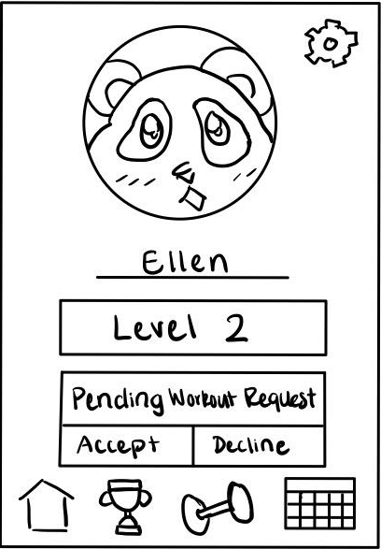
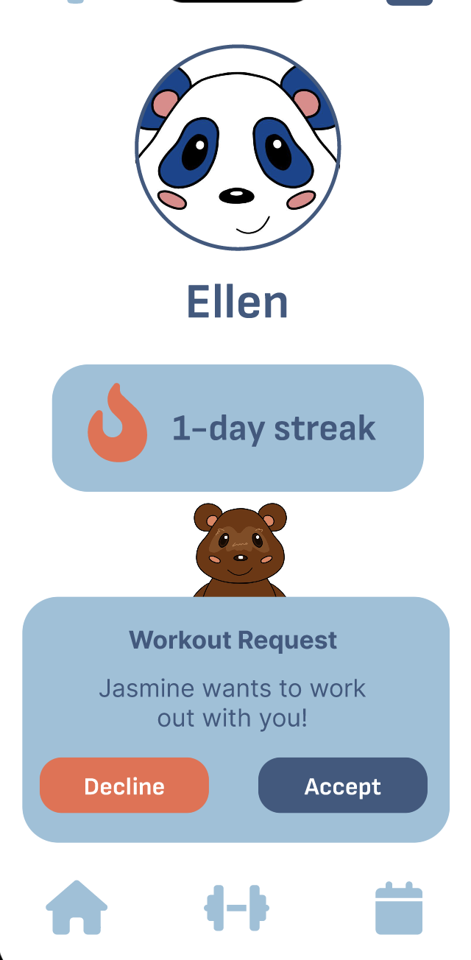
UI Change #1:
Workout Requests
Feedback:
Users wanted more information from workout requests (from whom? when? where?)
Change:
Workout requests now include the name of the requester
Rationale:
Important to know the sender of the request
One of the main points of Fitbud is to abstract away and automate workout scheduling, so not necessary to include time
Usability goals:
Efficiency — user needs to know the sender of the workout request to quickly decide to accept or decline it

Slide 19
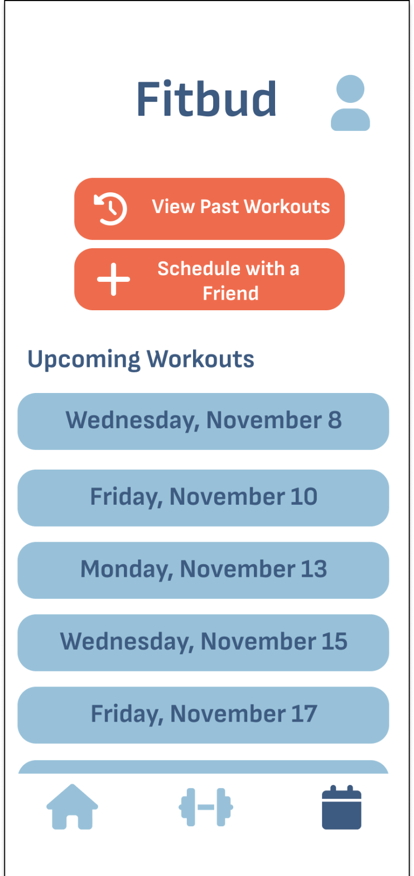
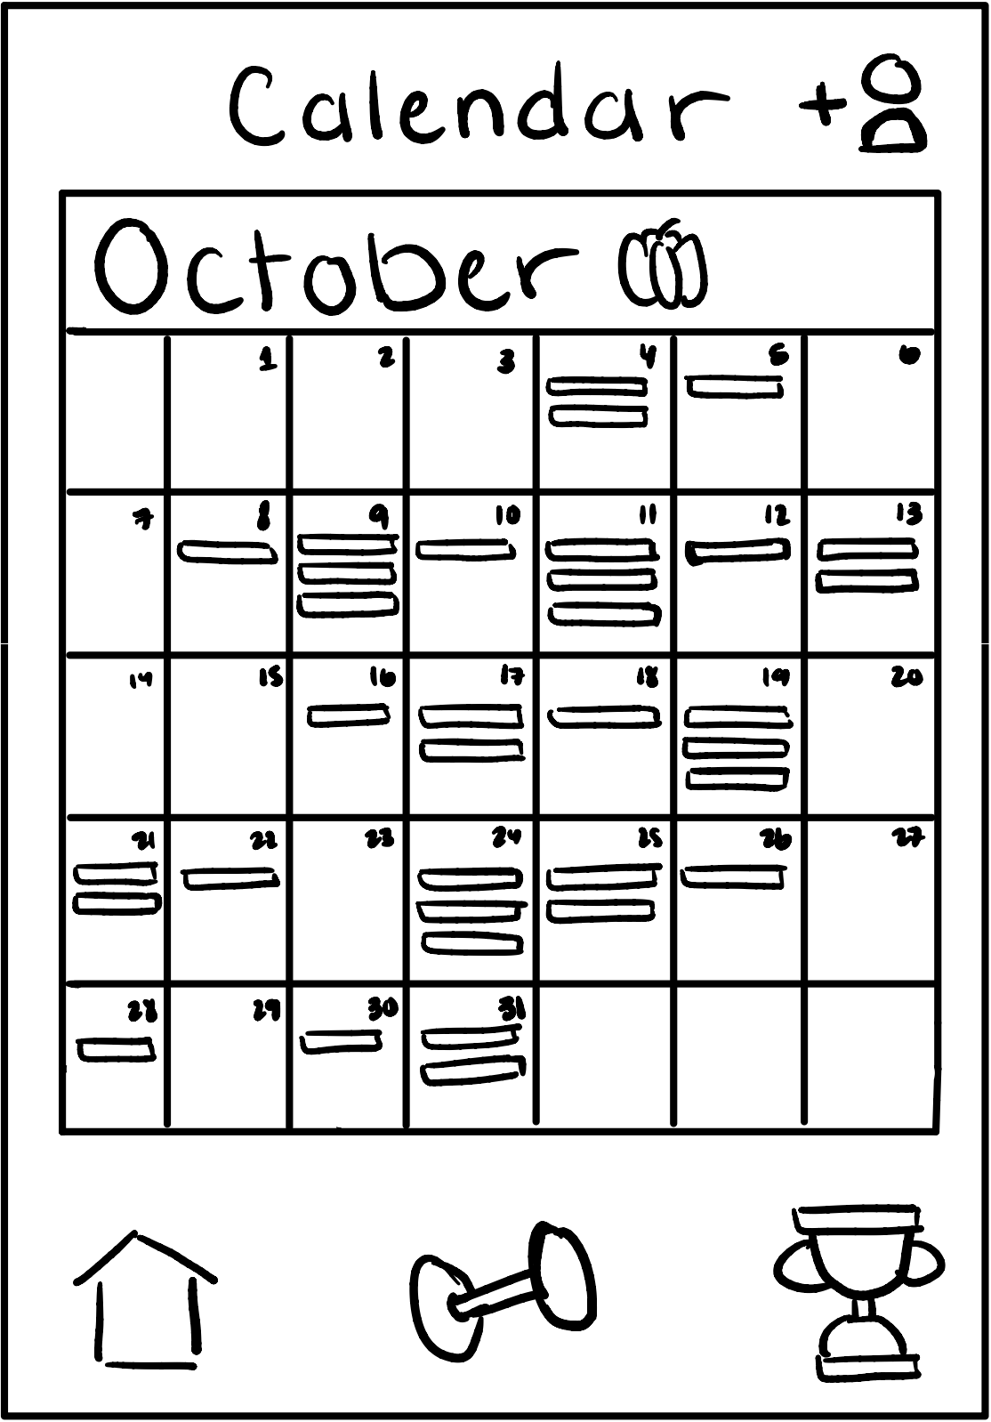
UI Change #2:
Calendar/Schedule
Feedback:
Users found a duplicate of a standard calendar app within Fitbud redundant
Change:
Calendar page removed, replaced by workout scheduler with upcoming workouts, workout history, and group workout scheduling
Rationale:
Implementing a duplicate mobile OS calendar would be an unnecessary hassle — no need to see non-fitness related events in a fitness app
Usability goals:
Efficiency — streamlining and simplifying the app allows the user to stay focused on fitness without cluttering the app

Slide 20
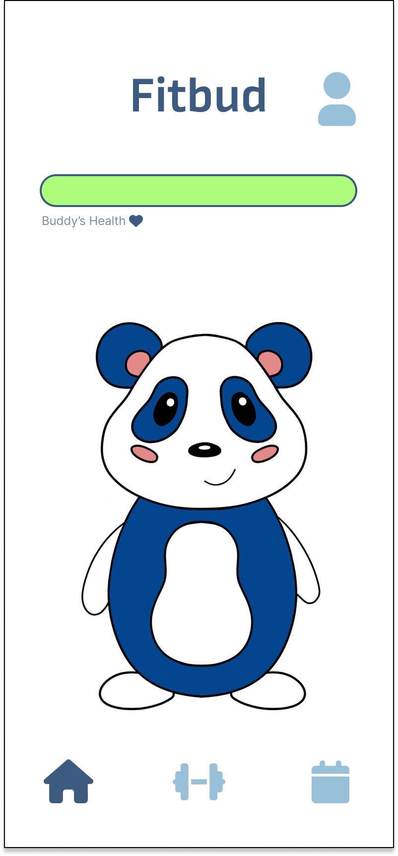
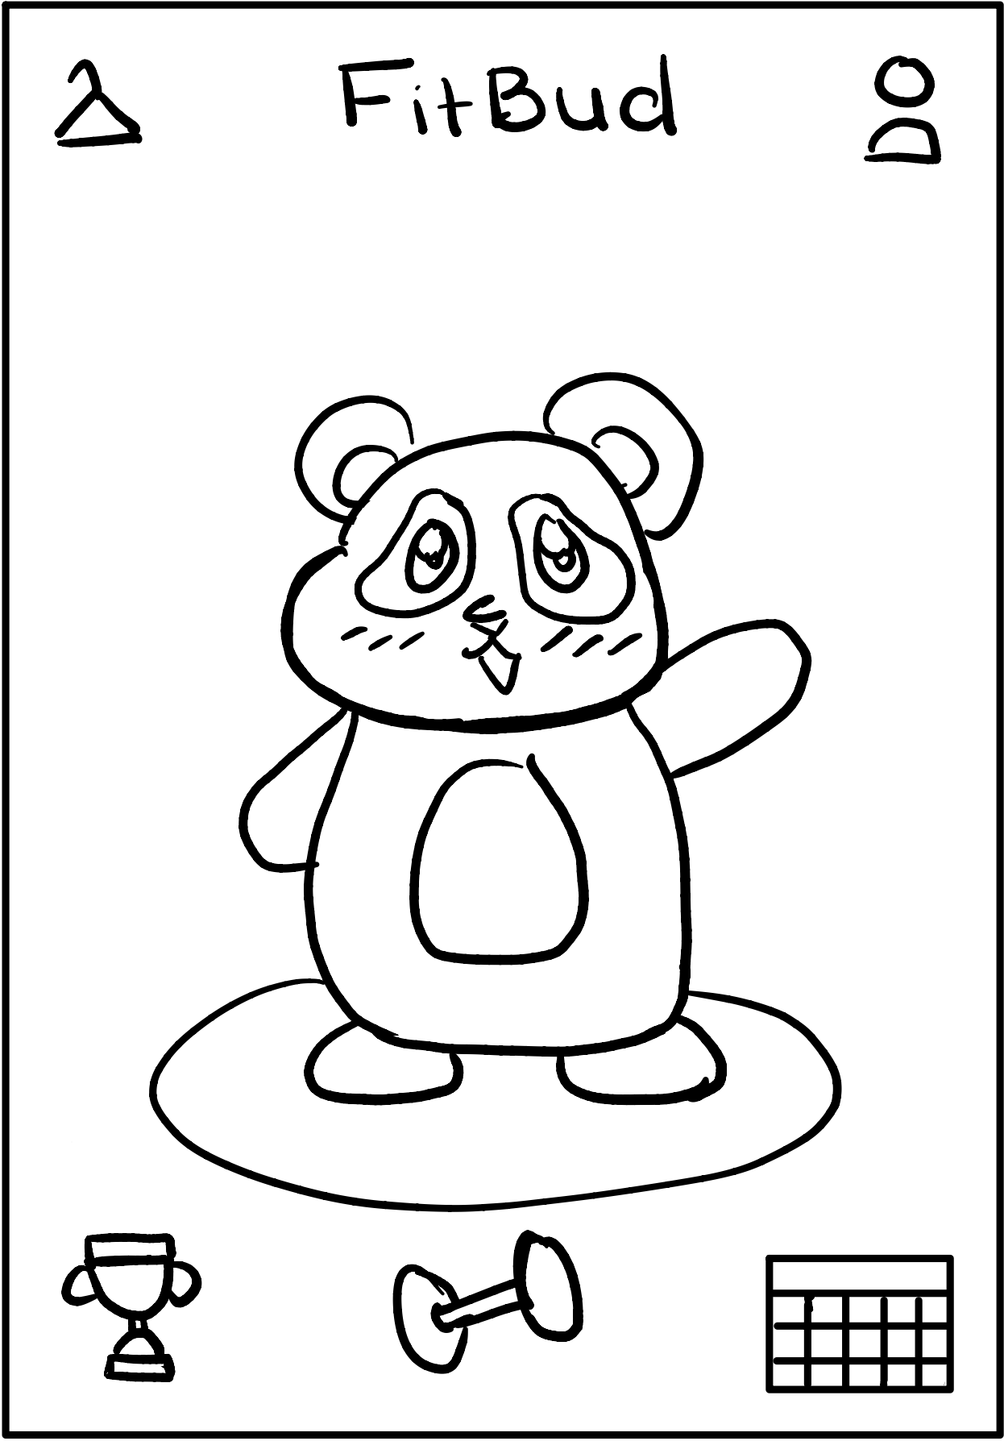
UI Change #3:
Navigation Bar
Feedback:
Users did not like how the nav bar changed depending on which page the user was viewing and sometimes completely disappeared
Users did not understand the purpose of challenges
Change:
Nav bar is always present and contains the same three buttons — home, workout, and schedule — with a darker shade of blue to indicate the currently selected page
Challenges page and button were removed
Rationale:
Maintaining a consistent navigation bar is standard practice — having it change and disappear led to confusion and inefficiency
Challenges were unnecessary and felt out of place with the rest of the app
Usability goals:
Efficiency: navigating the app is now more intuitive and seamless
Old nav bar: since we’re on the home screen, no home button
New nav bar: consistent throughout, selected screen is highlighted with darker color

Slide 21
Medium-Fi Task Flow
Notes:
Now we have a fleshed out task flow for our simple task, which is to Create a workout plan tailored to the user.

Slide 22
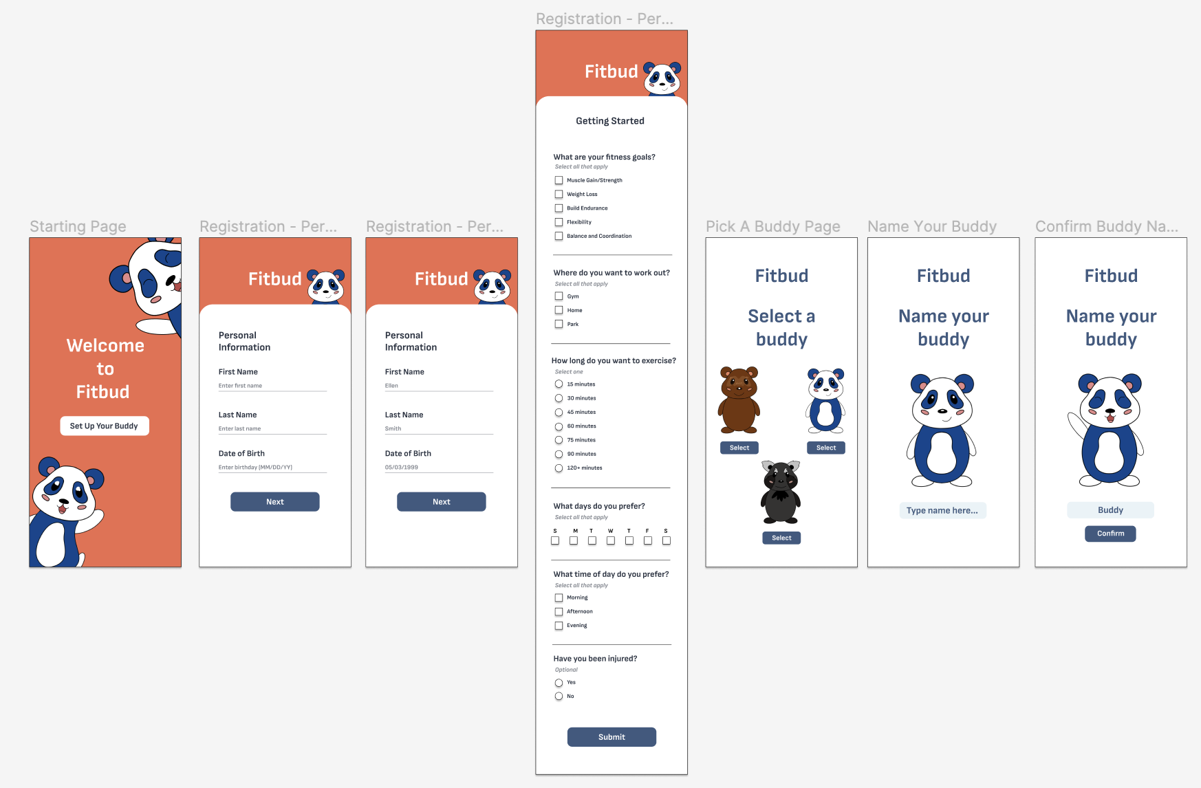
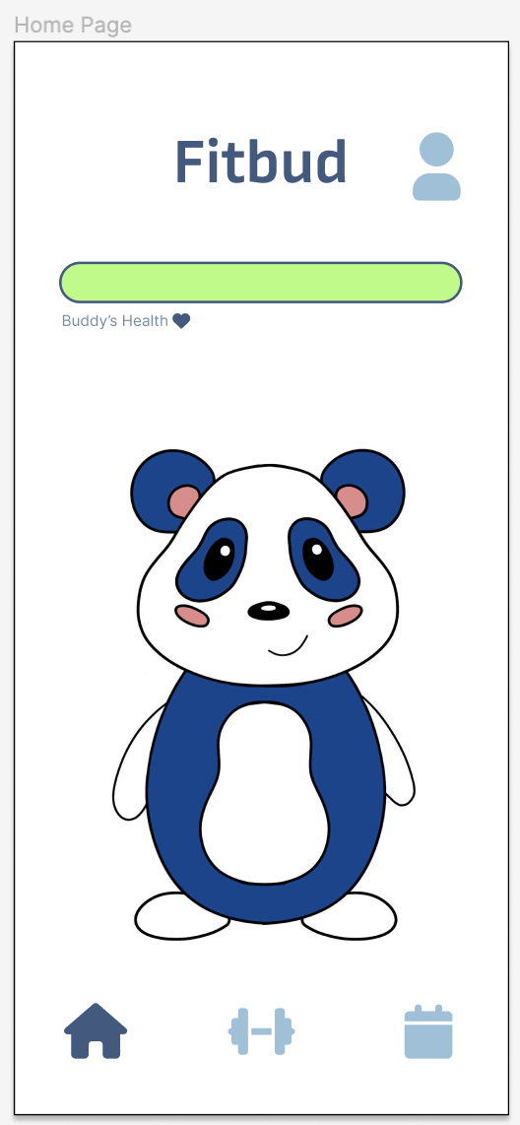
Simple Task Part 1: Set Up Your Buddy
Input workout preferences in order to attune Buddy to personal needs
Enter name and birthday in order to get Buddy familiar with user
Pick and name a Buddy to create personalized workout environment
Notes:
The user signs up, providing their email, password, and personal information, then fills out a questionnaire regarding their fitness goals, location, and time preferences, after which they are taken to the home screen.

Slide 23
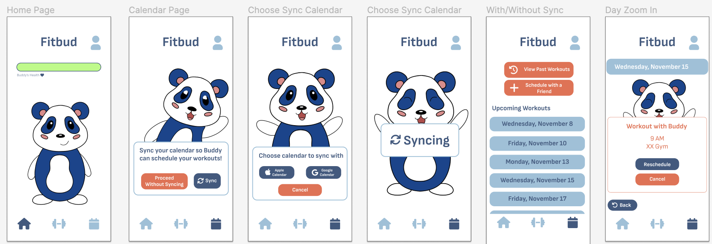
Simple Task Part 2: Workout Scheduling
Home screen
Calendar page: sync Google/Apple calendar
Choose which calendar to sync
From home screen user goes to scheduling page
Sync calendar: Buddy can automatically schedule a workout for the user according to their schedule
Choose which calendar to sync with
Loading screen while syncing
Select an upcoming workout to view details
View workout details and reschedule workout if necessary
Notes:
From the home screen, they click the calendar icon, which takes them to a view of their calendar. They can choose to sync their Apple or Google calendar, after which they can see a calendar view just like in a default calendar app. Clicking on a day (11/15) takes you to a day view, and there we see that Buddy found a free window in their day and automatically scheduled a workout, which can be cancelled if need be.

Slide 24
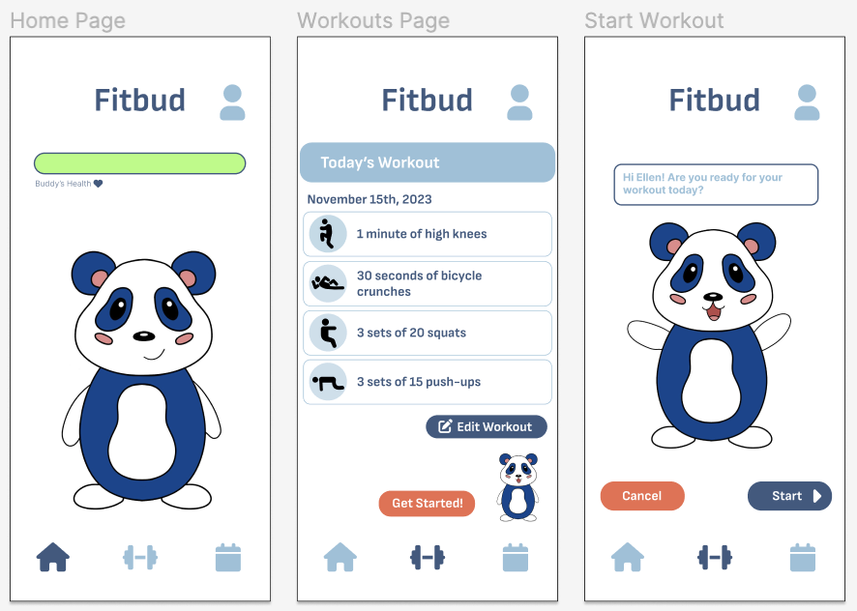
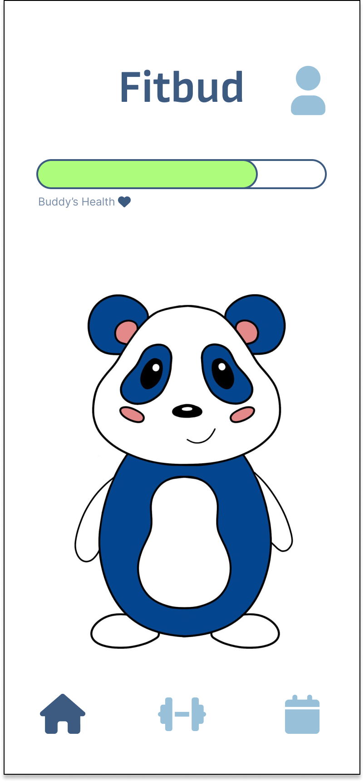
Moderate Task Part 1: Buddy’s Health Motivates User
Buddy’s health needs to be maintained by working out
The user selects the workout button from taskbar
User reviews workout components and starts when ready
User can press start to begin the workout timer

Slide 25
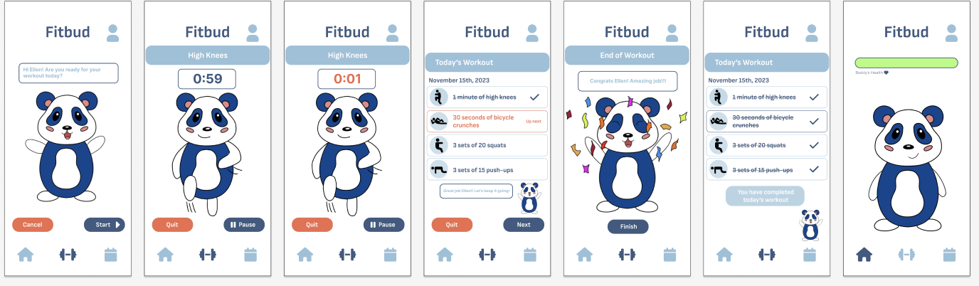
Moderate Task Part 2: User Maintains Buddy’s Health by Completing a Workout
User begins workout and completes exercises with Buddy. In this case, the user performs a high knees exercise until the timer runs out.
User must progress through each scheduled exercise before finishing
Upon completing the workout and returning to the home screen, the user will find that Buddy’s health has been bolstered, ensuring them that their accountability has not gone unnoticed

Slide 26
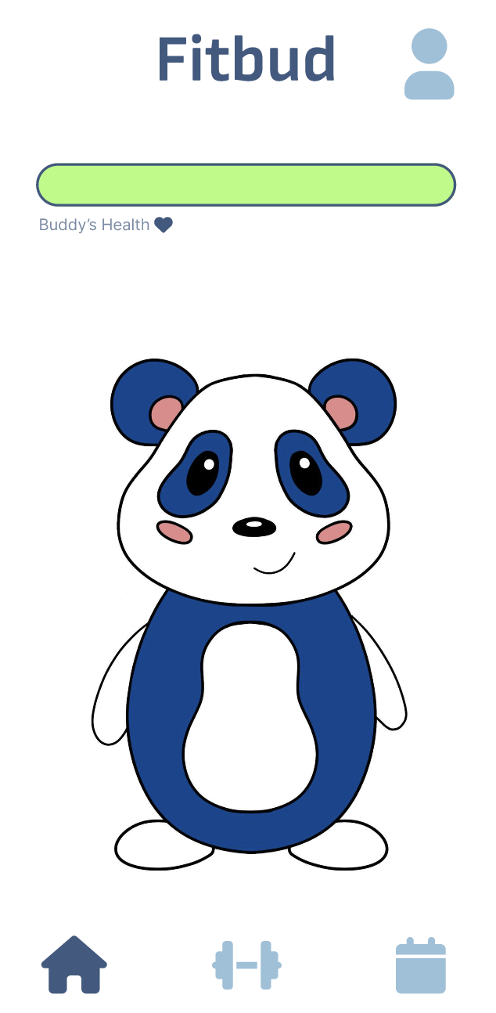
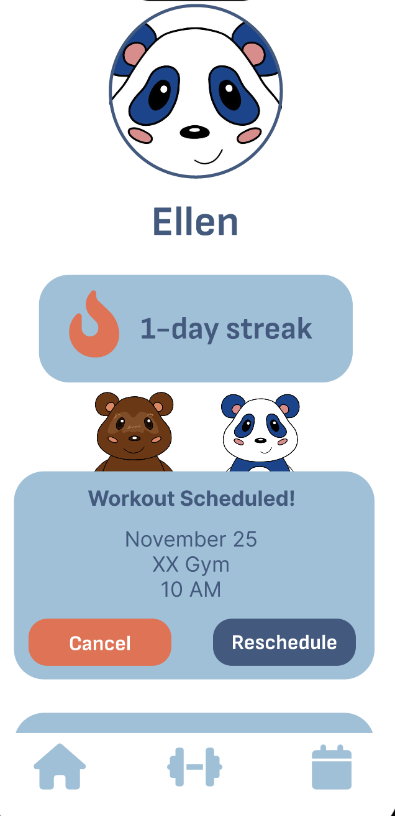
Complex Task Pathway 1: Accept Workout Request
Press profile button to view incoming workout requests
Accept a friend’s workout request from the profile screen
Once accepted, a user can cancel or reschedule the workout

Slide 27
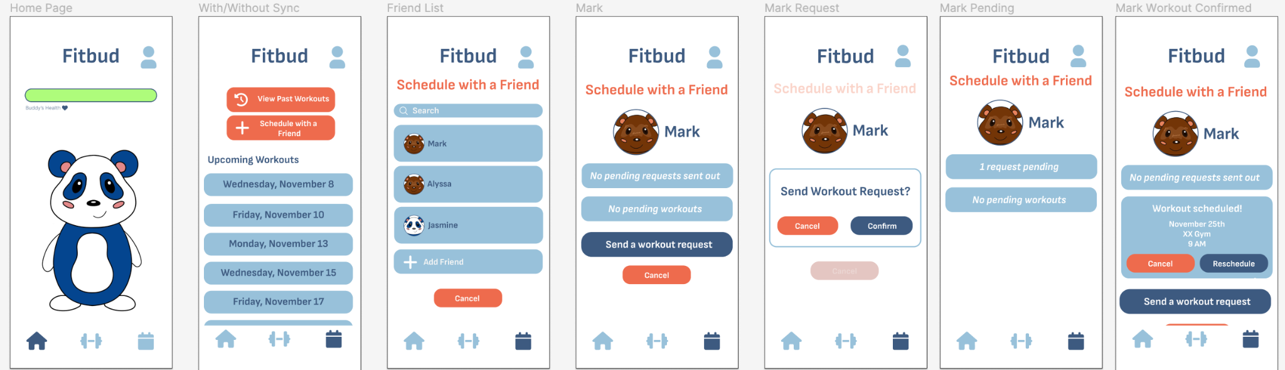
Complex Task Pathway 2: Send Workout Request
User accesses scheduling page from home screen
User selects “schedule with a friend” button
User selects a friend (Mark) from their friends list
User chooses to send their friend (Mark) a workout request
User confirms request, making social interactions feel clear and intentional
Request is submitted, and is shown to be pending
The user’s friend (Mark) has accepted the request, and a scheduled workout is now visible

Slide 28
Prototype Implementation

Slide 29
Tools for Constructing Prototype
We used the Figma wireframing tool to create the Medium-fi prototype
Cons
Figma highlights valid click locations on the prototype, which could interfere with our evaluations by providing test users with an undesired hint
Text boxes and questionnaires must be prefilled, which can limit the individuality of test users and dampen their experience
Figma has no memory, making it difficult to adjust task flows based on previous user changes
Pros
Allowed us to build a fleshed-out, functional UI
Allowing users to experience and execute our task flows without requiring the team to do any technical development

Slide 30
Limitations of Prototype
Previous Figma cons create several limitations:
Text boxes and questionnaires must be prefilled, which can limit the individuality of test users and dampen their experience
Figma does not allow for any sort of memory, so nothing is “saved.” The prototype cannot remember that a workout has been completed or that a calendar has already been synced.
Additional Limitations:
The workout section of the prototype is greatly abbreviated; only one exercise is included and not all modifications are possible.
Including every exercise within a workout would be repetitive and would overcomplicate any testing of a task involving completing a workout.
There is no memory as to whether or not the user chose to sync the calendar and they will have to redo it every time they enter that task flow. This also applies to whether or not you have added the friend that has been hard-coded (they will not appear on the friends list if you revisit the page).

Slide 31
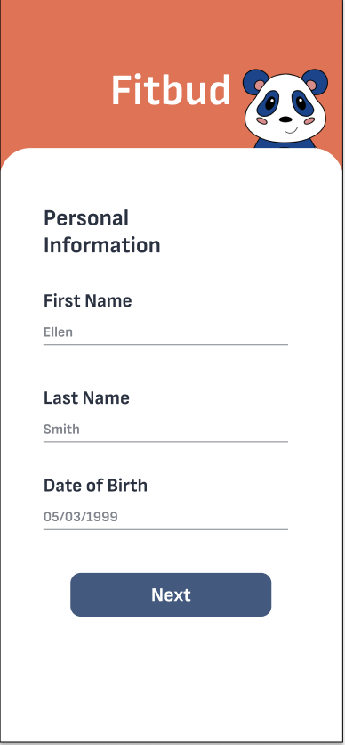
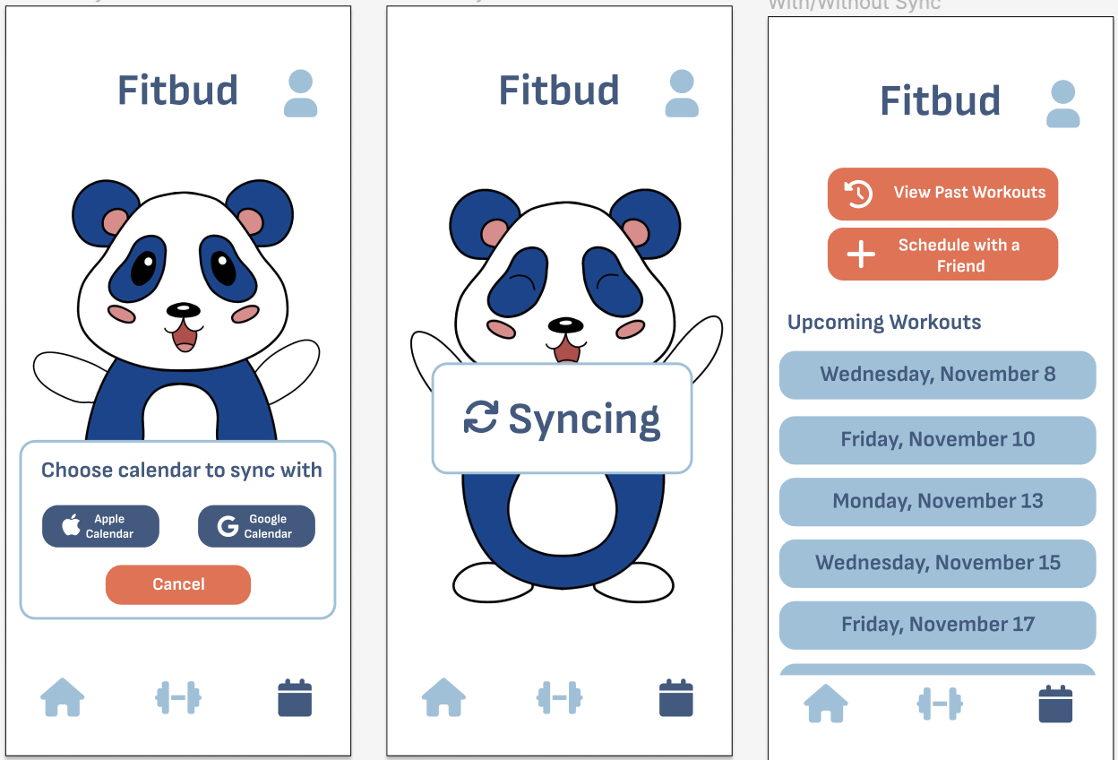
Hard-Coded Features
User data is not customizable
Name, birthday, buddy name, email, and password are all hard-coded as well as the selected Buddy himself.
All of the user’s friends and the friend you can add are hard-coded
Scheduled workouts (past, present, and future) are hardcoded into the user’s schedule

Slide 32
Wizard of Oz Features
The prototype claims to be syncing the user’s calendar and auto-scheduling a workout using an algorithm, but all workouts are actually hard-coded

Slide 33
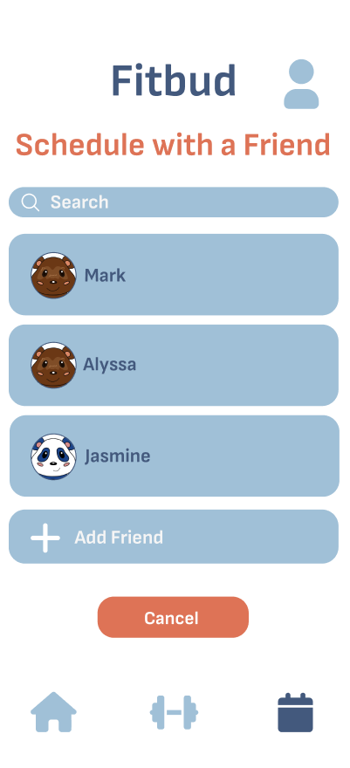
Wizard of Oz Features
A friend request will appear on the user’s profile. This is an artificial friend
The user has several artificial friends on their friends list

Slide 34
Link to Prototype

Slide 35
Appendix

Slide 36
Link to Lo-Fi Changes

Slide 37
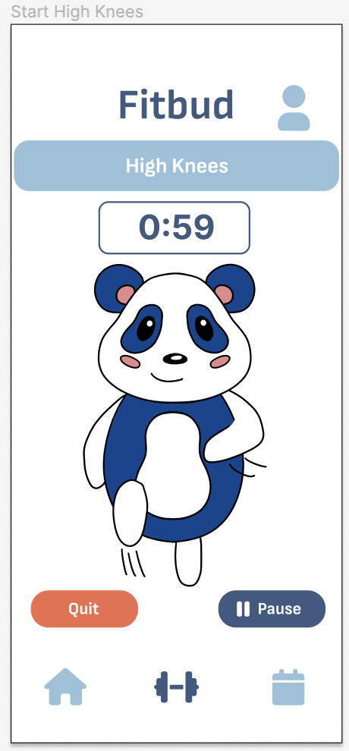
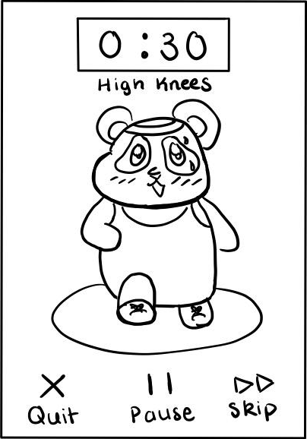
UI Change #4:
No Skip Exercise
Feedback:
Skipping and resuming workouts is confusing and awkward
Change:
Skip button has been removed entirely
Rationale:
The act of skipping an exercise part-way through and resuming later undermines the effectiveness of a workout. It also makes it difficult for the user to keep track of which exercises have been completed. The change of the editing still allows for the basic functionality.
Usability goals:
Efficiency — user must readily know which exercises have been completed at all times, allowing them to finish a workout in a straightforward manner

Slide 38
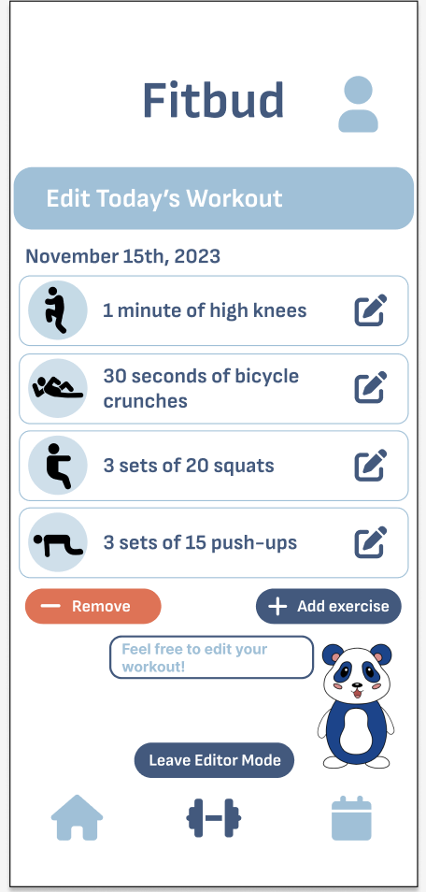
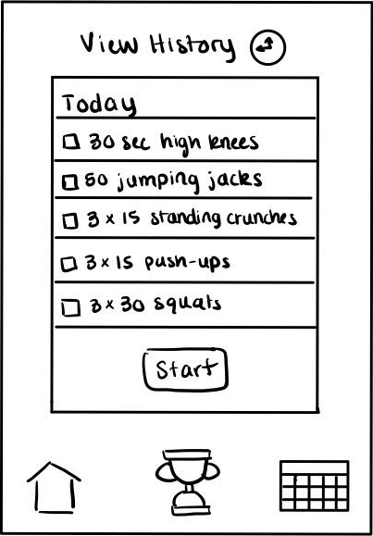
UI Change #5:
Editing Workouts
Feedback:
Users want the ability to edit workouts
Change:
Edit button on “today’s workout” screen, allowing users to ender “editor mode”
Rationale:
Workouts are auto-generated according to the user’s preferences, but user may want to switch it up due to preference, injury, or other reasons
Usability goals:
Fun — allowing the user some freedom to choose the exercises they want to do will make workouts more enjoyable

