Slide 1

A5: Sketching, Low-fi Prototyping & Pilot Usability Testing
FitBud

Slide 2




Our Team
CHRISTELLE
AKANSHYA
Junior
Computer Science
Santa Cruz, Bolivia
Junior
Computer Science
Mountain View, CA
ETHAN
JAKE
Senior
Computer Science
Palo Alto, CA
Coterm
Computer Science
San Carlos, CA

Slide 3
FitBud
Your new pal, here to make fitness fun and easy

Slide 4
Problem
People, regardless of their current fitness levels or social fitness preferences, don’t actively try to change their fitness-related habits without support as it requires a lot of activation energy, effort, and planning to make it consistent.

Slide 5
Problem
Solution
People, regardless of their current fitness levels or social fitness preferences, don’t actively try to change their fitness-related habits without support as it requires a lot of activation energy, effort, and planning to make it consistent.
Our app provides you with a gamified virtual workout buddy that schedules your workouts, keeps you accountable, and accompanies you through your workout - adapting to your needs and making it easier to exercise.

Slide 6
WHAT WE WILL TALK ABOUT…
01 Design Process
02 Chosen Interface Design
04 Results
03 Lo-Fi Prototype & Testing
FitBud concept sketches
What our final interface design was and why
Discussion of our test results
Creating our Low-Fidelity Prototype and testing it

Slide 7
01.
DESIGN PROCESS

Slide 8
Concept Sketches!
Let’s talk…

Slide 9
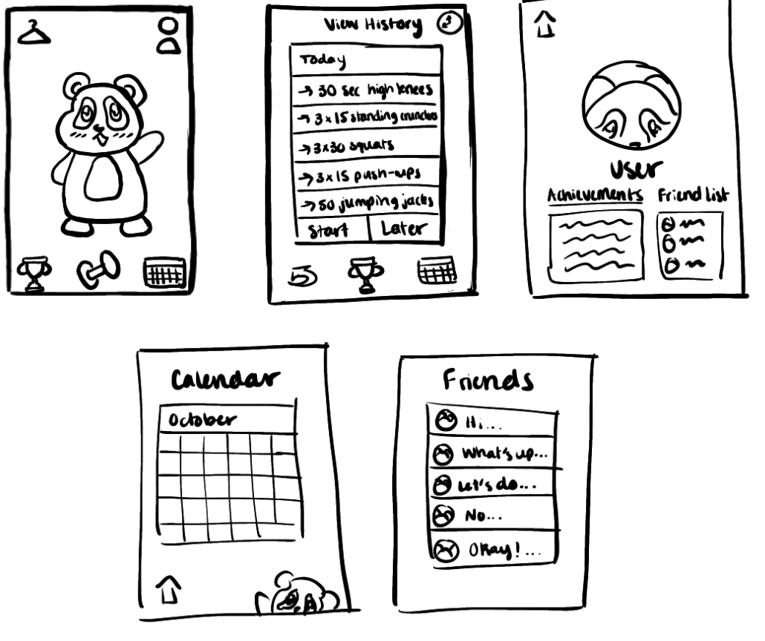
Let’s start simple
Mobile App

Slide 10
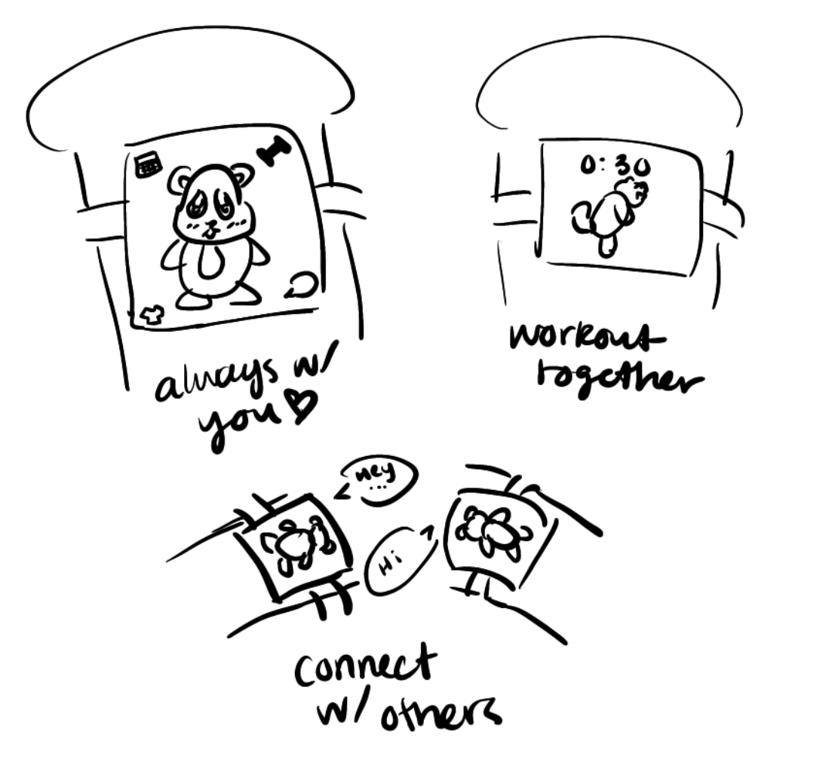
What about this…
Wearable

Slide 11
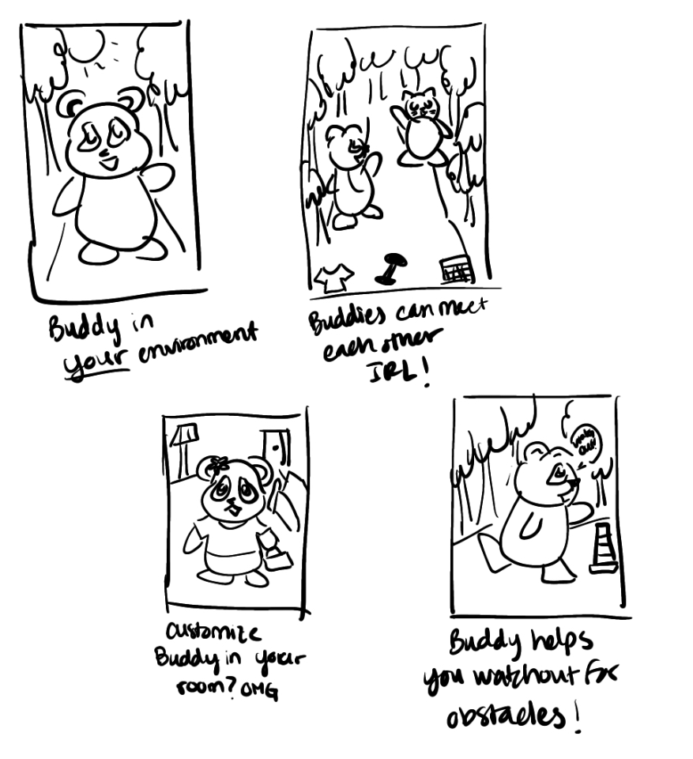
I think maybe!
AR

Slide 12
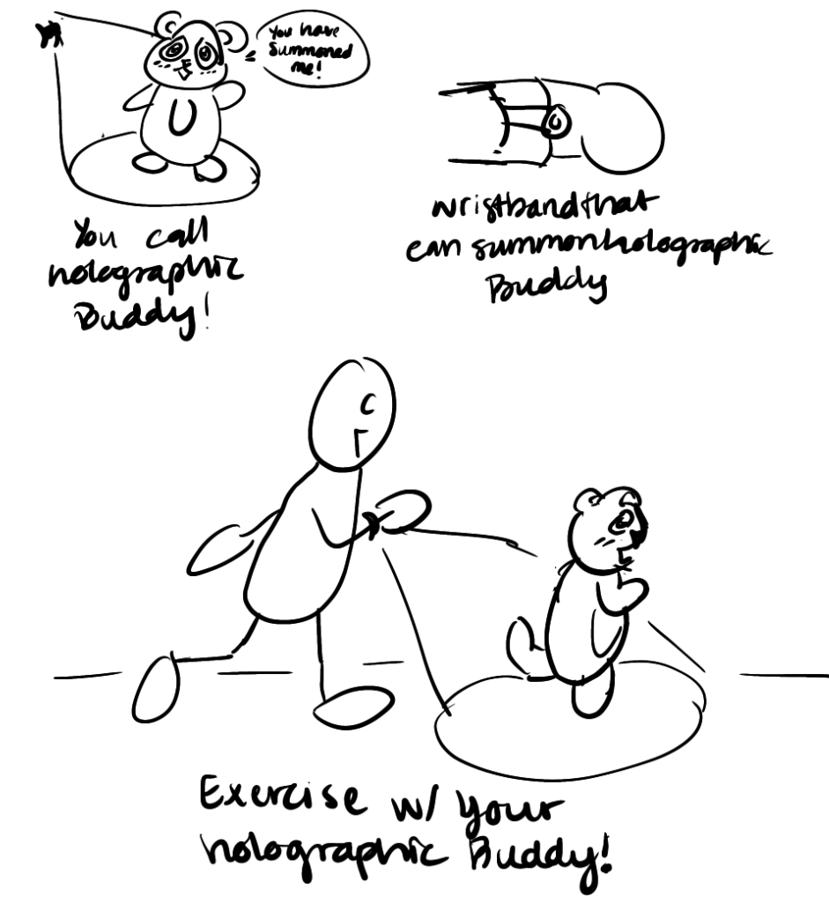
Kind of outrageous…
Hologram

Slide 13
TOP 2 DIVERSE REALIZATIONS

Slide 14
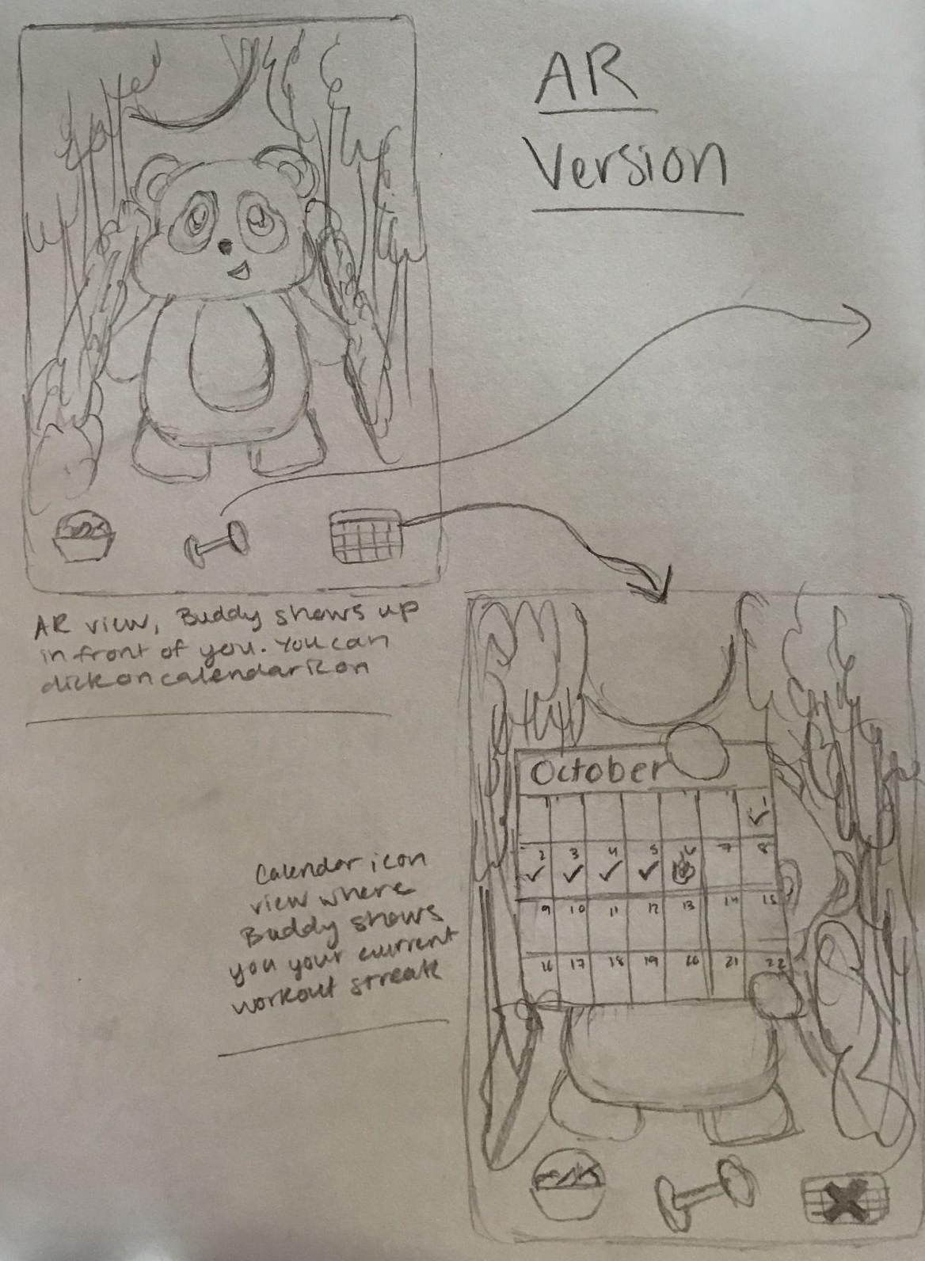
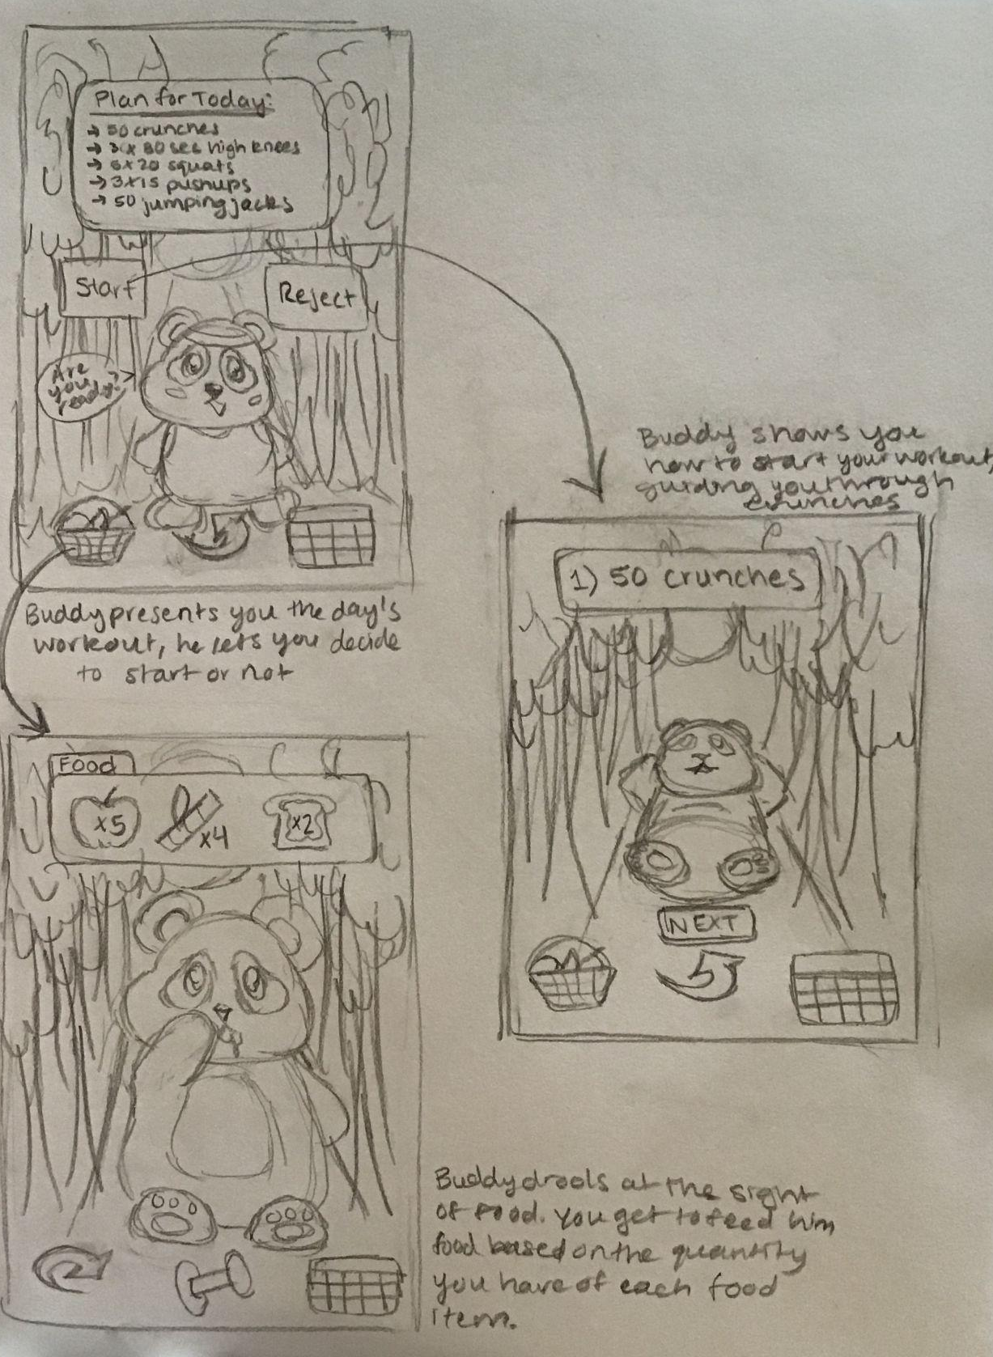
Fleshed out:
AR

Slide 15
AR
PROS | CONS
Could feel more real as it appears in your environment More interactive makes it for an experience more like that with a personal trainer Can also be used to change the location if desired (background) | May be difficult to do it outside if not working out in your room Get too absorbed in your phone and ignore the real world (Pokemon Go effect) Requires a lot more power in terms internet connectivity and storage People aren’t too familiar with the format and may not like it

Slide 16
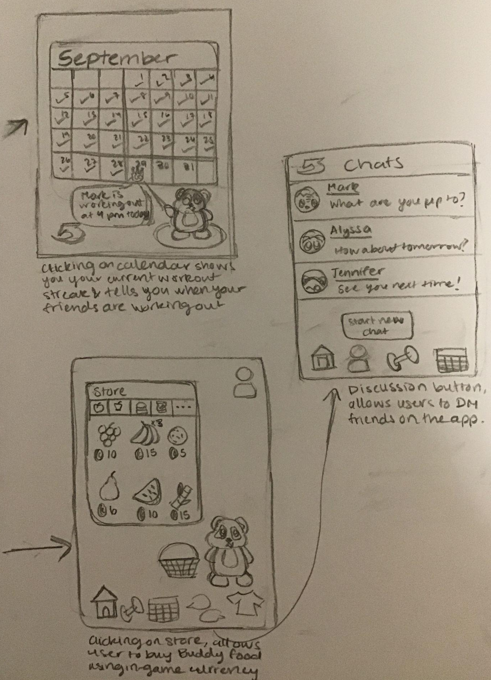
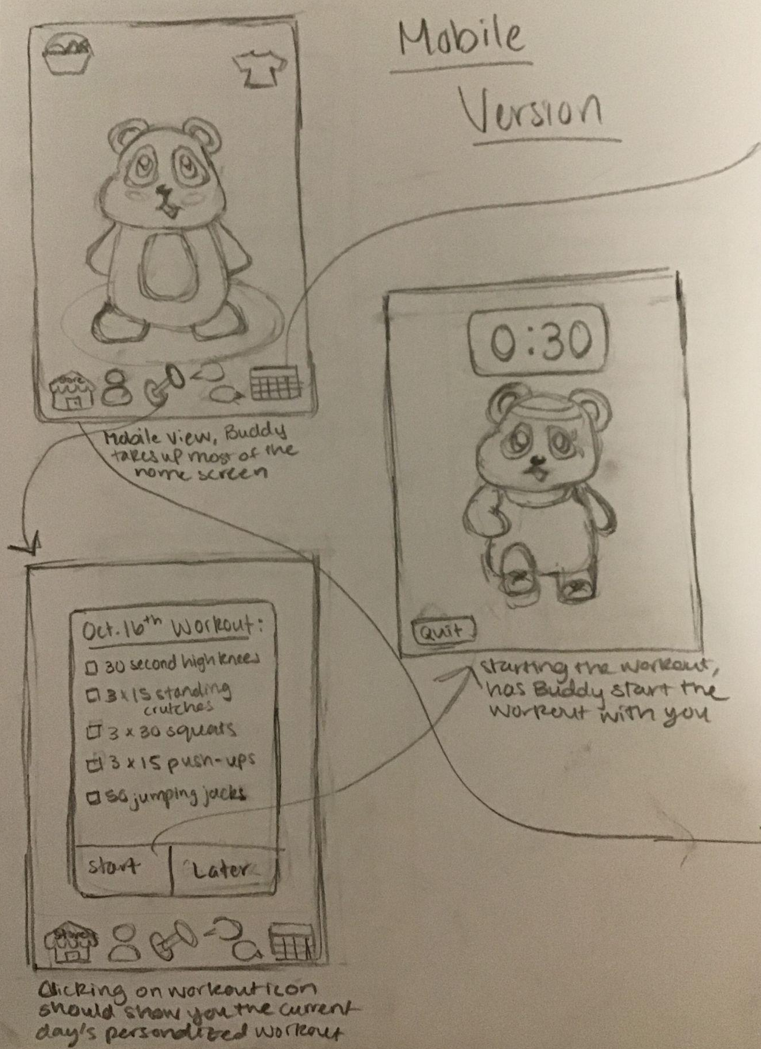
Fleshed out:
Mobile
App

Slide 17
MOBILE APP
PROS | CONS
Very accessible as most people have a smartphone now Convenient to use at any point People are generally more willing to try new apps Allows us to combine many features - visual, audio, chat, etc. | Might feel less immersive and interactive Can be problematic as phones have a lot notifications and other apps - might be distracting for the users

Slide 18
02
CHOSEN INTERFACE

Slide 19
OUR WINNER…
MOBILE APP

Slide 20
WHY MOBILE APP?
MOBILE APP
AR
A mobile app can be just as innovative and fun for a user and could be used at all times despite internet connectivity. Customization and preference changes is yet another plus
Although AR could be a cool and fun platform, it comes with several ethical implications and could possible put people in danger aside from it being costly.

Slide 21
WHY MOBILE APP?
MOBILE APP
AR
A mobile app can be just as innovative and fun for a user and could be used at all times despite internet connectivity. Customization and preference changes is yet another plus
Although AR could be a cool and fun platform, it comes with several ethical implications and could possible put people in danger aside from it being costly.

Slide 22
03
LOW-FI PROTOTYPE

Slide 23
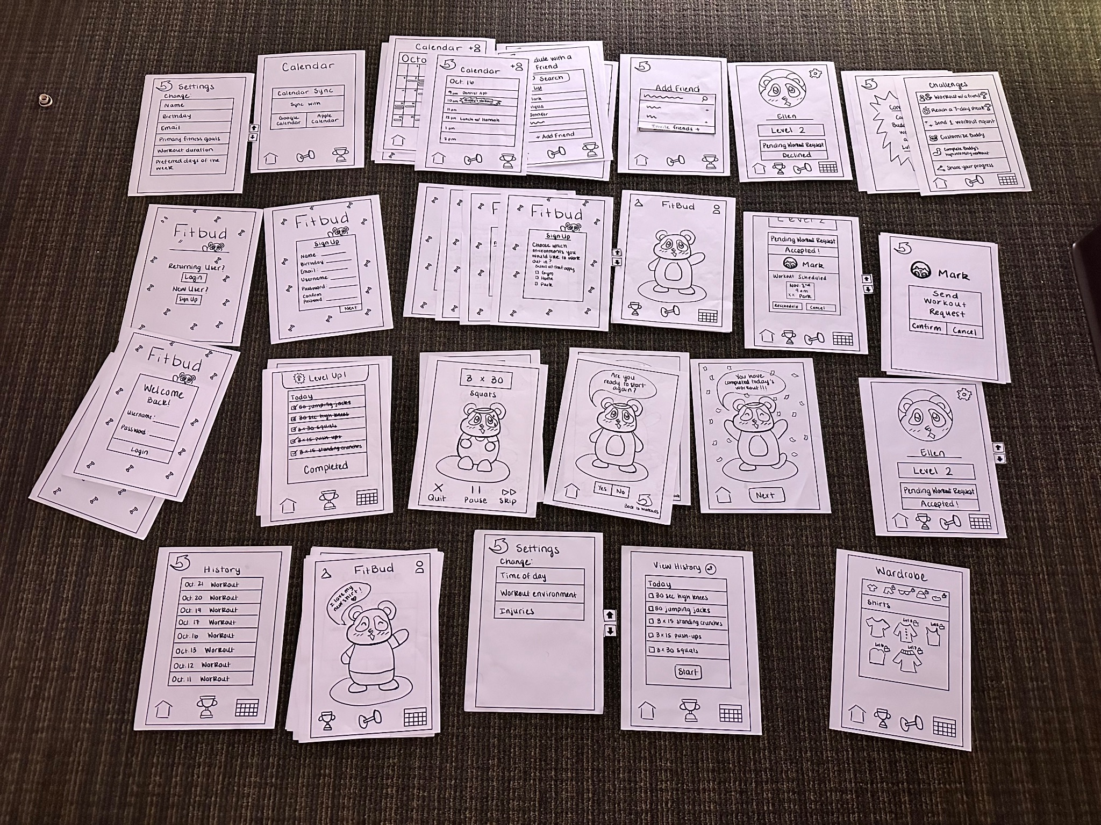

Slide 24
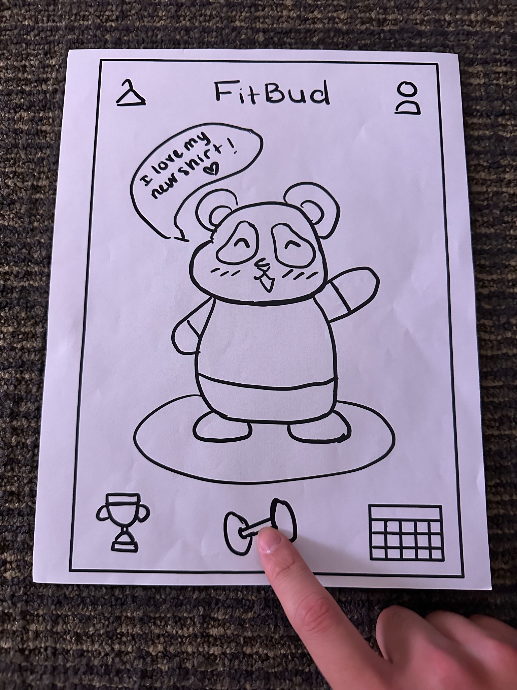
Tap to click
Tap to click on icons and menu items

Slide 25
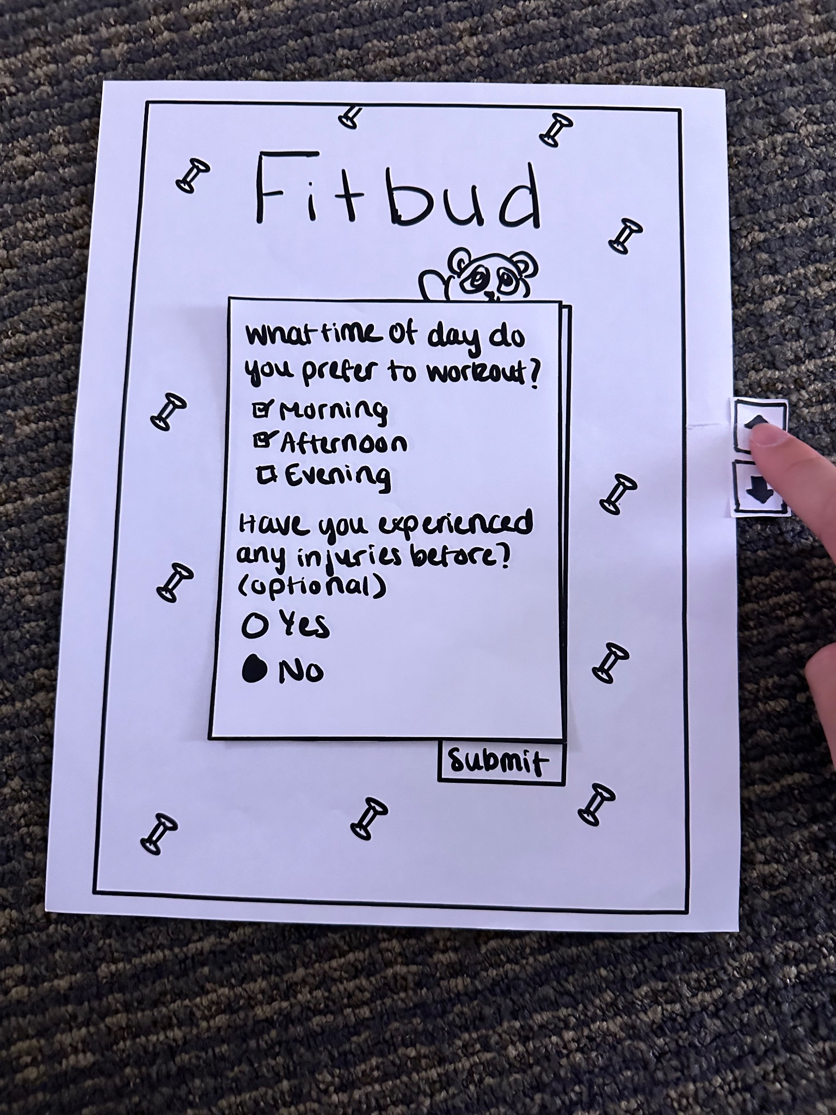
Scroll
Scroll through menus

Slide 26
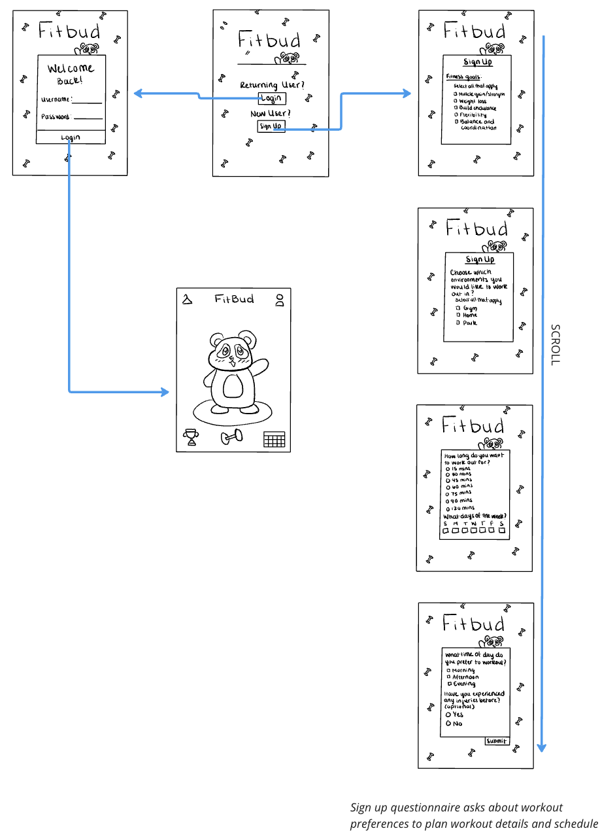
Sign Up/Log In

Slide 27
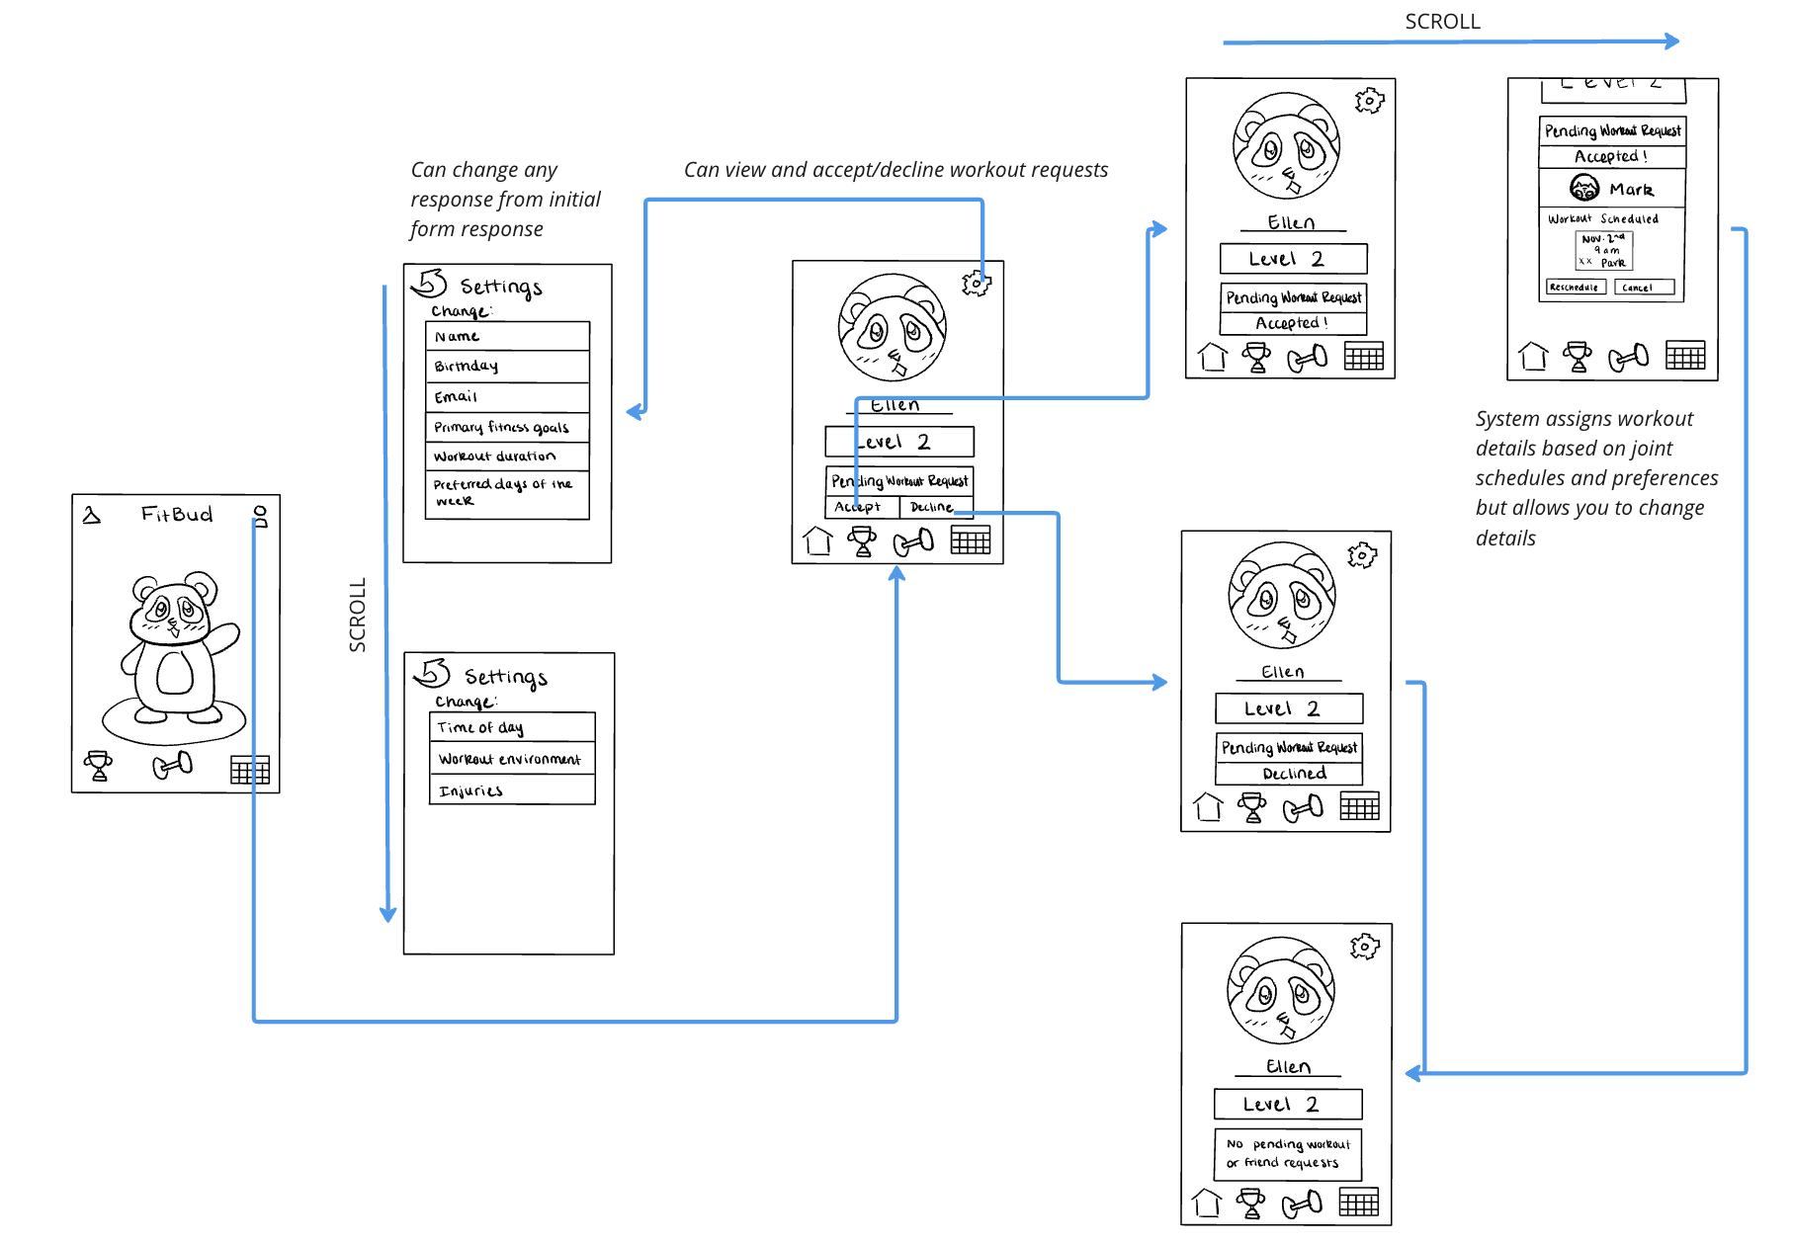
User

Slide 28
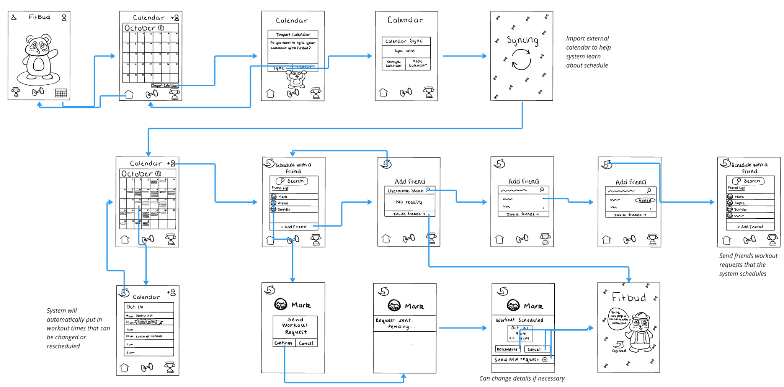
Calendar

Slide 29
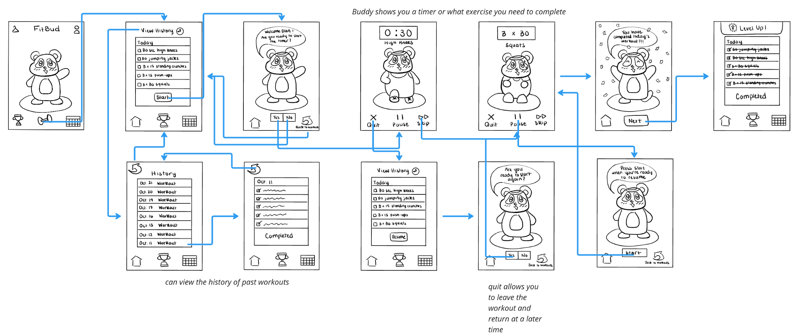
Workout with Buddy

Slide 30
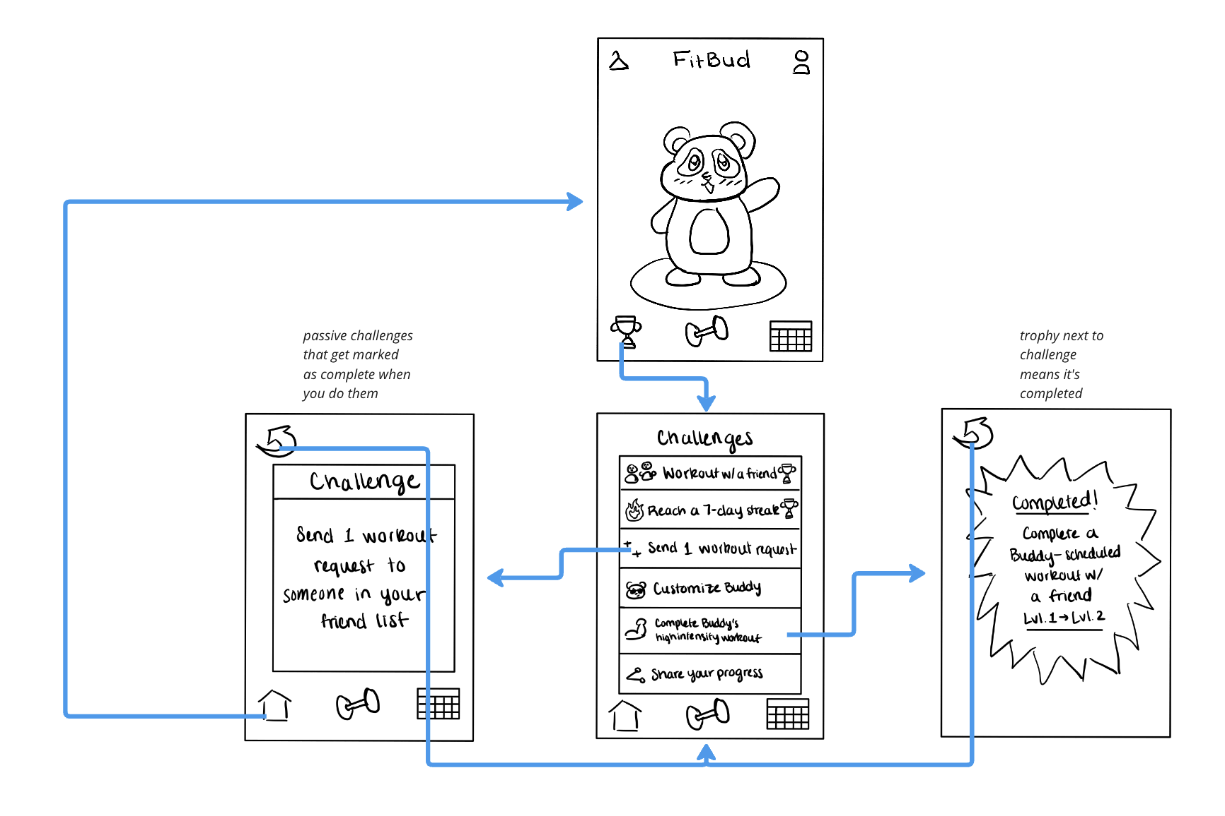
Challenges

Slide 31
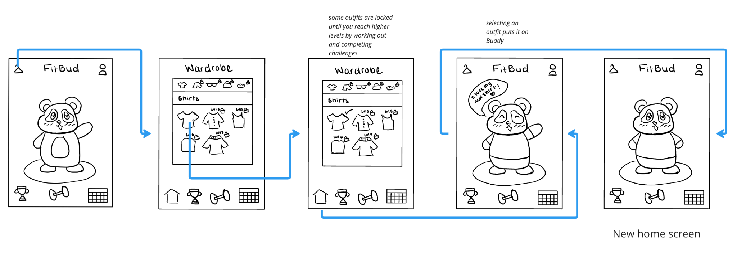
Customization

Slide 32
3 TASK FLOWS
SIMPLE, MODERATE, COMPLEX

Slide 33
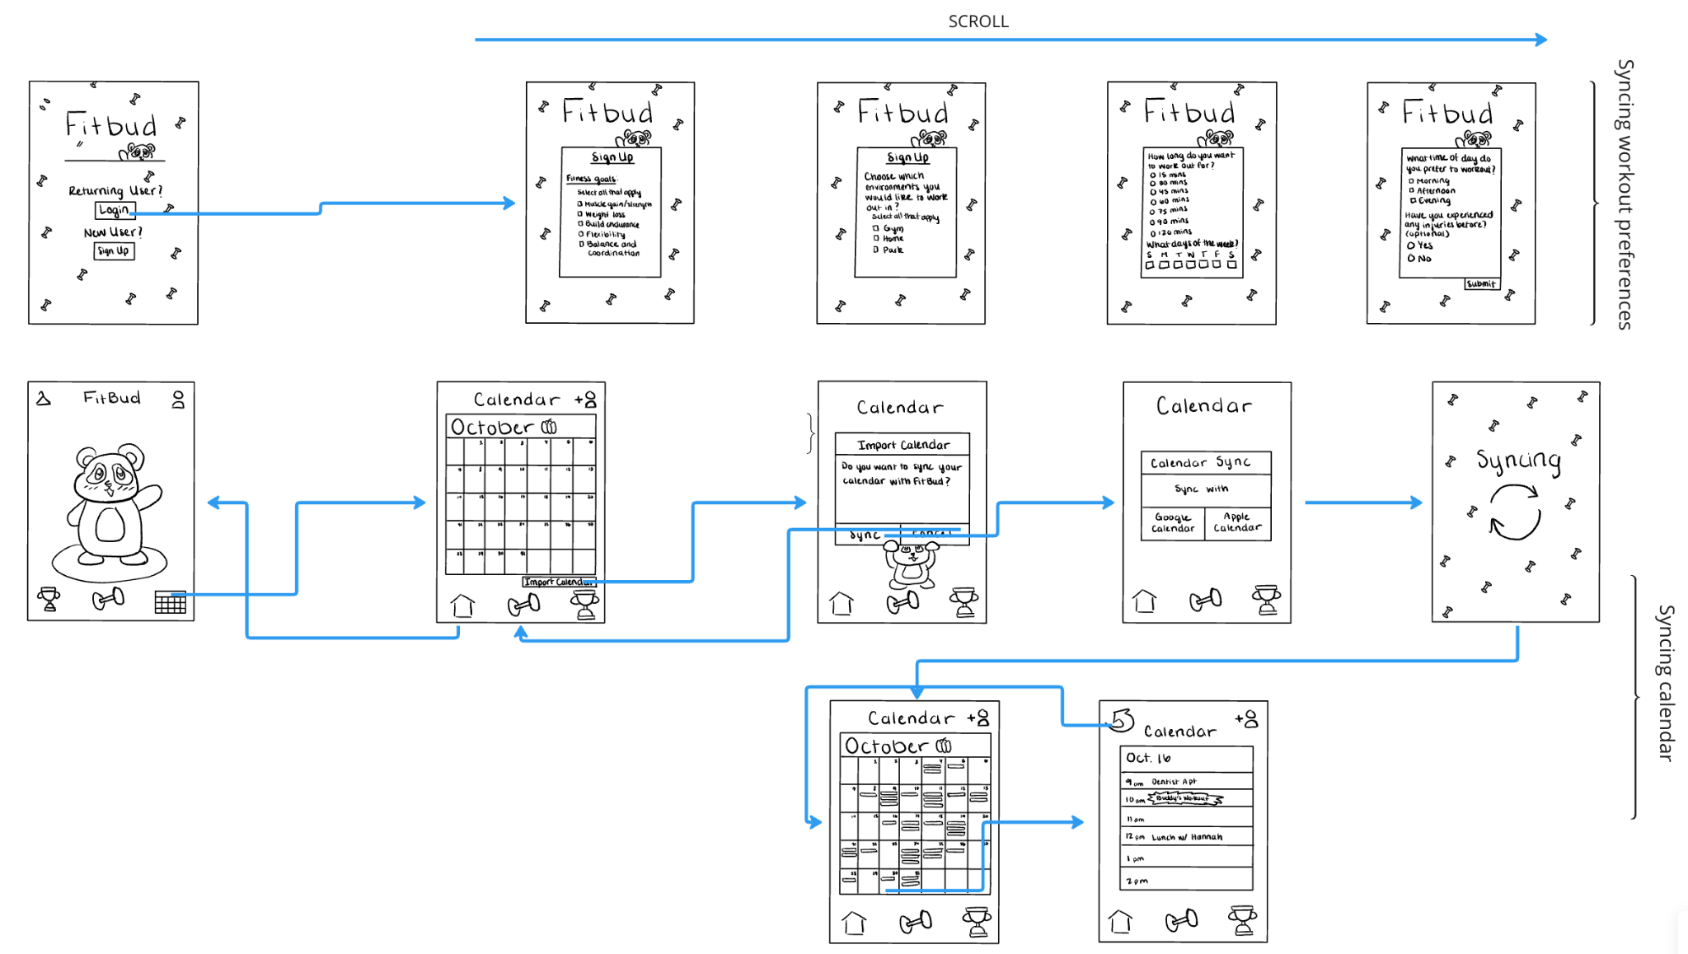
SIMPLE TASK
Create a workout plan in an environment accessible to me and schedule that works for me

Slide 34
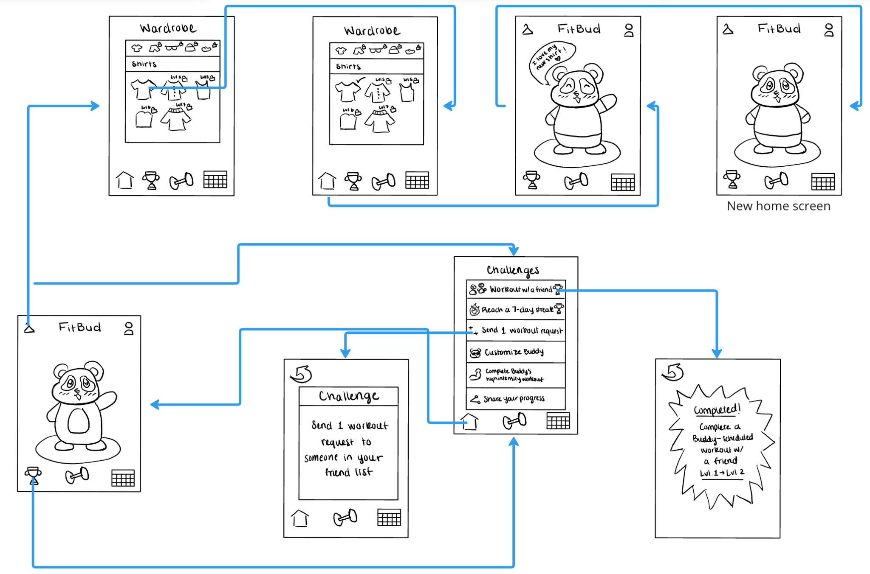
MODERATE TASK
Have an accountability and reward system based on my commitment to fitness

Slide 35
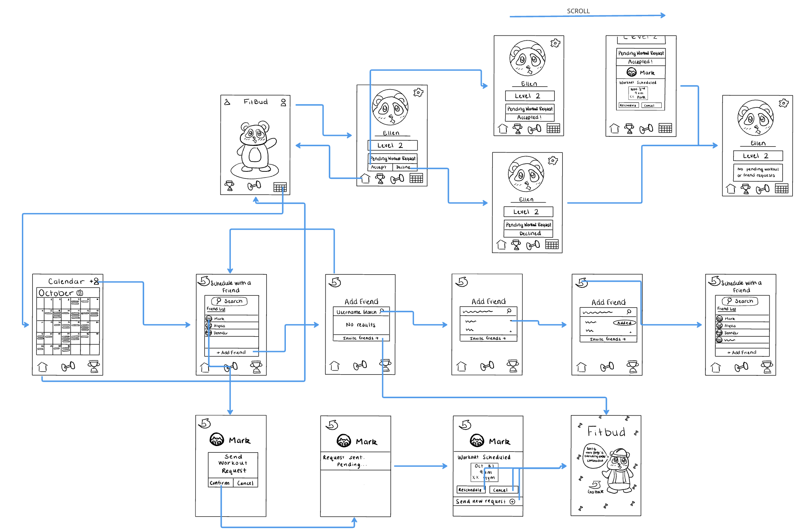
COMPLEX TASK
Connect with friends who are also exercising

Slide 36
USABILITY TESTING

Slide 37

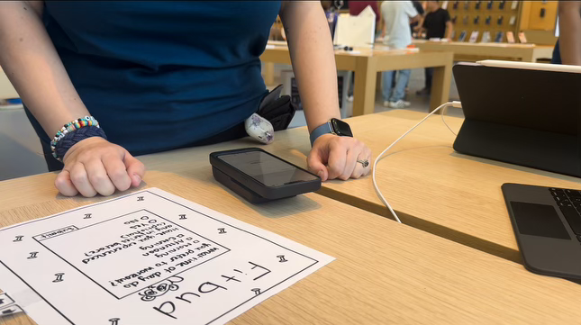
Stina
27, Apple Genius Bar Employee
Occasionally works out

Slide 38
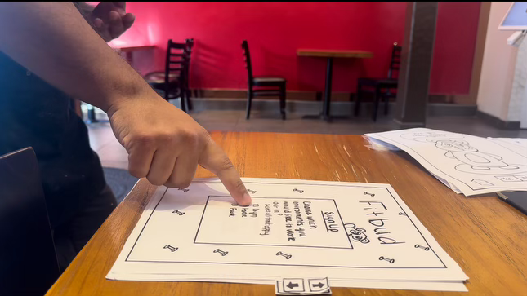
Juan
24, Mr. Sun employee
Does not workout

Slide 39

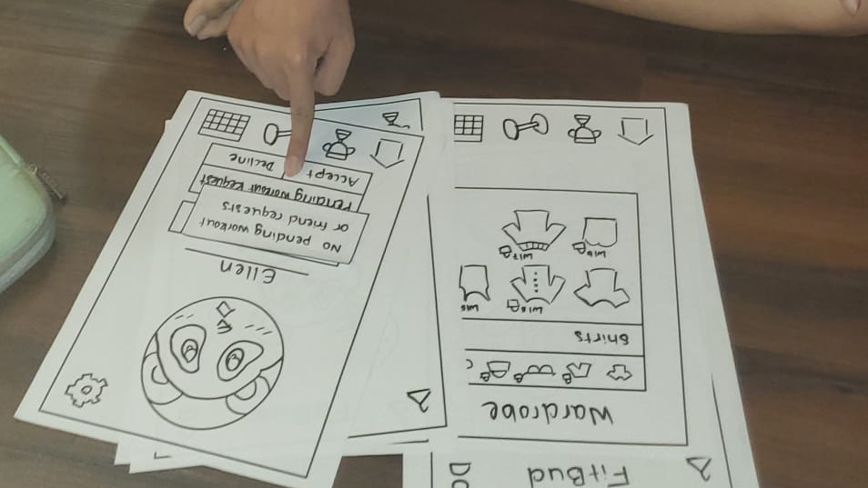
Lucas
25, Google Software Engineer
Moderate gym attendee w/ physical trainer

Slide 40
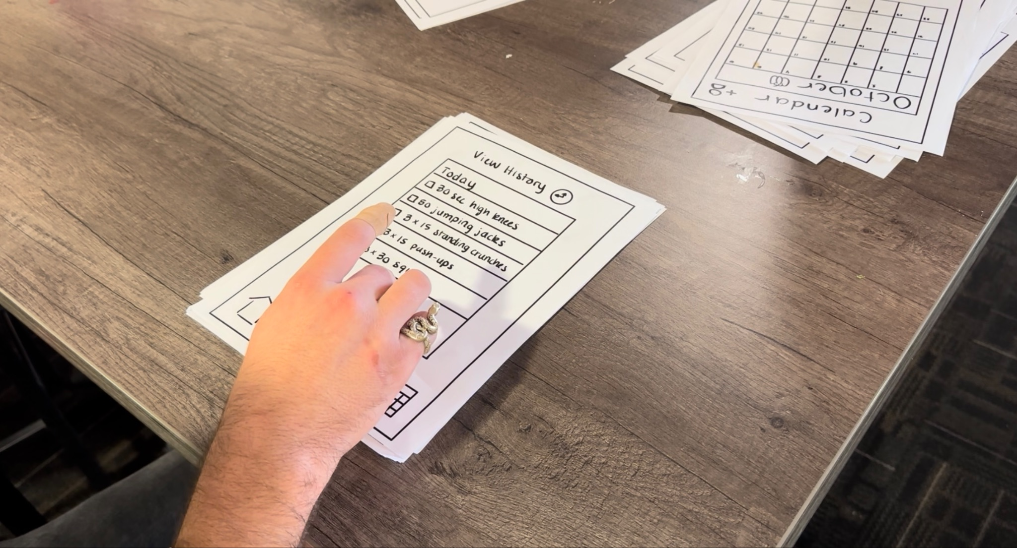
Christian
25, Jamba Juice worker
Does calisthenics (push-ups, sit-ups) at home

Slide 41
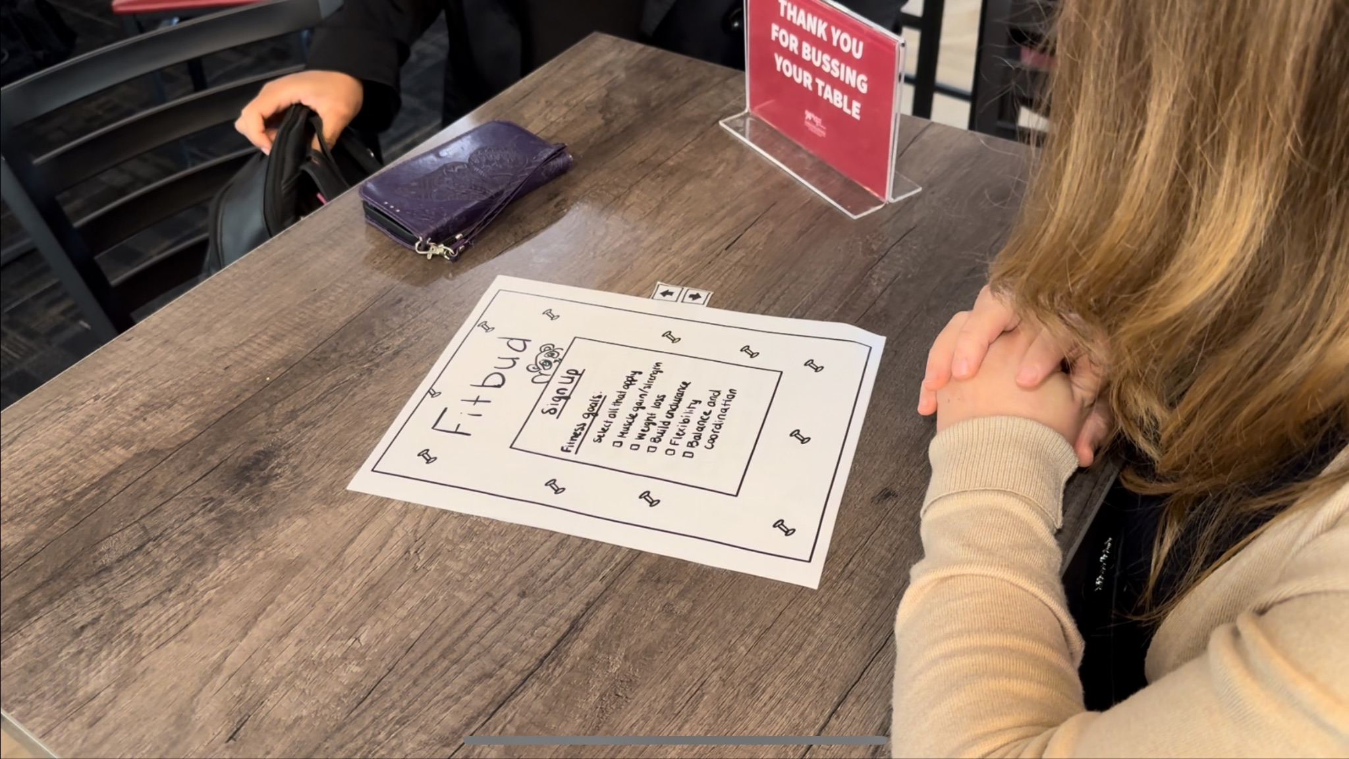
Mariia
34, Bible study volunteer
Frequent walker but little other physical activity

Slide 42
ENVIRONMENT & APPARATUS
ENVIRONMENT
APPARATUS
Laid down prototype on a table/flat surface so participants could try prototype out
Created paper prototype and manually responded to actions

Slide 43
TEAM MEMBER ROLES
CHRISTELLE
AKANSHYA
ETHAN
JAKE
Computer
Facilitator
Greeter/Observer
Observer/Assistant Computer

Slide 44
Procedure
Introduction
Context
UI basics
Tasks
Execution
Final thoughts
1
2
3
Who we are and what the experiment is about
Give participant context about our app and its purpose
Demonstrate how to interact with app
4
5
6
Present user with tasks we want them to complete
Allowed user to find their way to the tasks with as little guidance as possible
Asked participant for thoughts on our app and areas of improvement

Slide 45
USABILITY GOALS
&
KEY MEASUREMENTS

Slide 46
Usability Goal #1: Efficient
Key Measurements
Tasks take little time to complete
UI takes little time to navigate
Average time taken to complete tasks should be under 2 minutes

Slide 47
Usability Goal #2: Fun
Key Measurements
User enjoys working out with the app
more than without
Buddy is motivating and
rewarding
We want users to express joy at least once when interacting with their buddy (i.e. smile, laughter, or comment that shows their enjoyment)

Slide 48
04
RESULTS

Slide 49
PROCESS DATA
Every participant
  had trouble finding workout history
    view history button didn’t look like a button even when found
  confused workout history in “workouts” with the calendar
  struggled distinguishing “add friends” and “invite friends” features

Slide 50
PROCESS DATA
3 participants
  found it difficult to distinguish between completed and incomplete challenges
  weren’t sure how to finish a specific exercise in the workout (with no timer)
2 participants
  pointed out workout requests contained no information
  were confused as to what they were accepting in a workout request

Slide 51
OTHER OBSERVATIONS
Users expressed a desire for:
  Ability to view other users’ profiles
  Ability to edit workouts (adding/removing exercises, adding rest times, etc.)
  Ability to import multiple calendars
  Ability to talk to buddy (click on him for advice, fun fact, etc.)
  More interesting challenges
  XP bar for leveling up and more clarity as to how the level system works
  Ability to save outfit changes for buddy
  Static icon positions

Slide 52
BOTTOM-LINE DATA
Each task took an average of 1-2 minutes to complete, with the exception of viewing workout history, which had an average of 9 minutes
Users had an average of 0-1 misclicks when completing tasks, with the exception of viewing workout history, which had an average of 8 misclicks
Users made an average of 1-3 expressions of joy when using the prototype, especially when exercising with their Buddy and customizing their Buddy

Slide 53
TASKS & USABILITY GOALS
Simple task achieved usability goals quite well
  Setting up profile and importing calendar was simple and users generally completed them in under 1.5 minutes
Moderate task has some room for improvement
  Challenges were not very motivating and were more passive, few expressions of joy were made during these portions
  Interacting with and customizing Buddy should be more prominent, as users made the most expressions of joy while doing so
Complex task achieved goals, but had separate issues
  Completed in under 2 minutes
  Couldn’t see from whom the workout request was received
  Couldn’t view others’ profiles

Slide 54
FINDING IMPLICATIONS
Users enjoy interacting with a virtual Buddy, and it should be intertwined with every feature/task
Features should be accessible from multiple places if logical (users struggled to find workout history)
Users want to know as much information as possible about other users they interact with on the app

Slide 55
FUTURE DESIGN CHANGES
Improve interface mobility
  Make workout history accessible from the calendar
  Make relevant features accessible from their corresponding challenge page
  Make separate tabs for complete and incomplete challenges
Buddy’s prominence and interaction clarity
  People enjoy interacting with their buddy, so buddy should have a constant presence
  Save changes to any changes made to their buddy

Slide 56
FUTURE DESIGN CHANGES
Social interaction less confusing/ominous
  Display more information about who workout requests are from
  Let users view their friend’s profiles
Static icon positions
  Icons like home, workout, calendar should not move around
  Highlight when one is selected instead
Workout Flow
  Make it clear how to progress to next exercise or make changes to provided workout plan

Slide 57
05
Appendix

Slide 58
SHORTCOMINGS OF USABILITY TESTING
Failed to tell us if users would actually even download the app
Difficult to know if all “expressions of joy” were actually about Buddy/the app (ex. smile)
Hard to understand if all task complications or misclicks were due to first-time app use or just a poorly designed feature

Slide 59
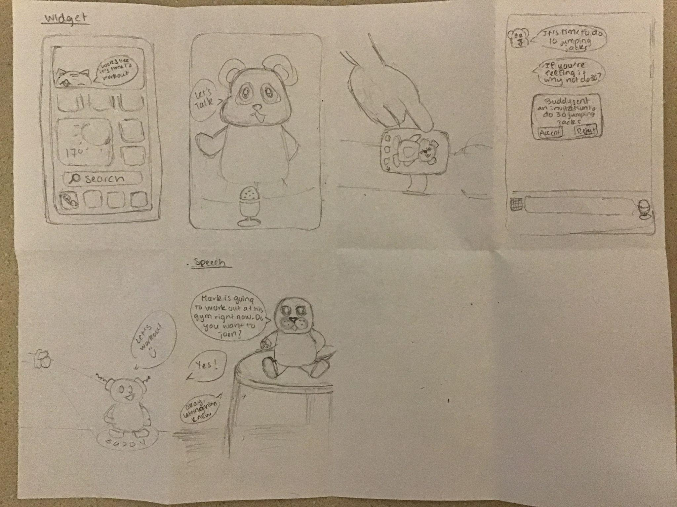
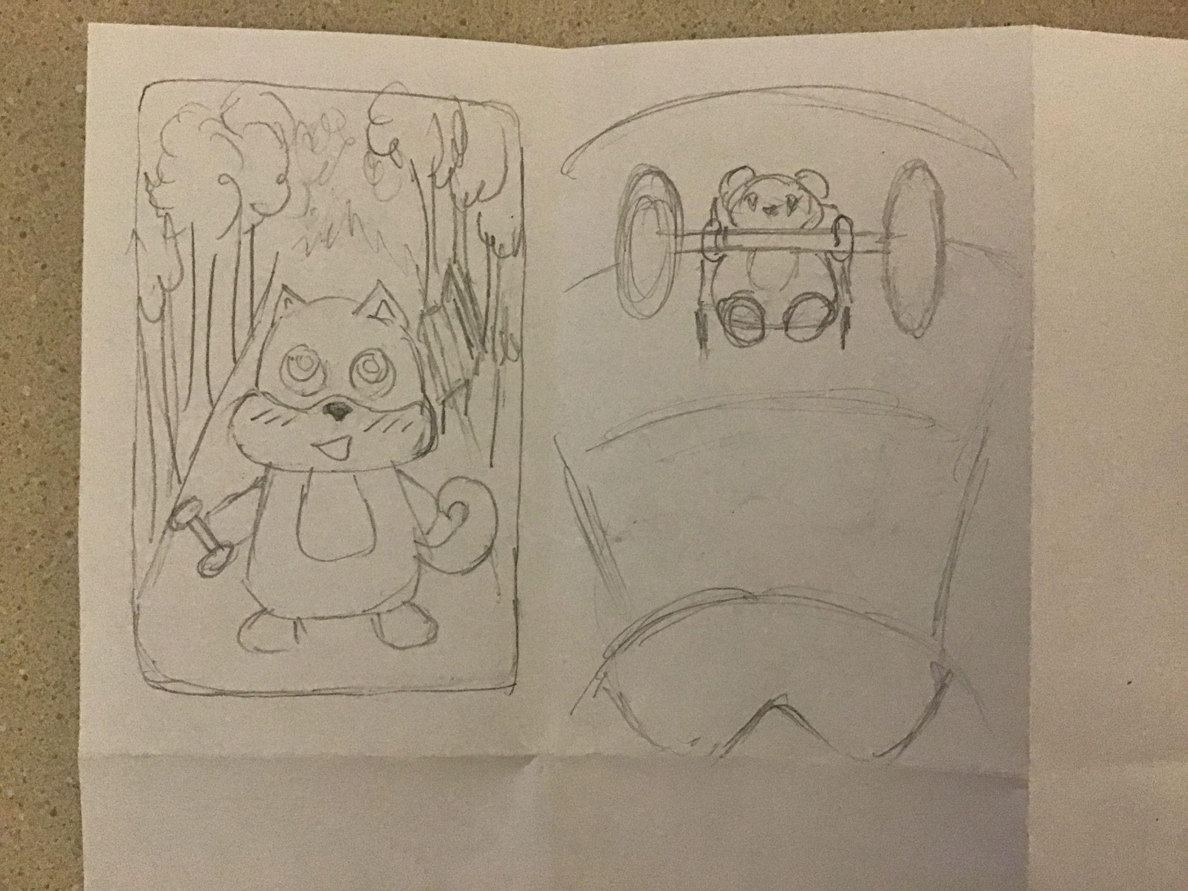
Initial Sketches
Widget
Talking App
Wristband
Chat Bot
AR
VR

Slide 60
AR (continued)
PROS | CONS
Buddy can demonstrate exercises on real-life equipment Seeing buddy in projected in real life could be fun Ability to feed/dress up/pet Buddy in AR like in Pokemon Go Buddy could do exercises together with user | Might take too much time, gymgoers would think user isn’t actually working out Might be more distracting than motivating Could overcomplicate the app — we want it to be simple and efficient Computationally expensive and difficult to implement

Slide 61
MOBILE APP (continued)
PROS | CONS
It’s what people are most familiar with Could interface with other apps (maps to find workout locations, calendar to import, etc.) Low barrier to entry Easiest to implement/develop for | Might result in users being on their phones a lot in the gym, something that is frowned upon Could be distracting and cause accidents (e.g. if someone is looking at their phone while running) Not the most innovative — might have competitors

Slide 62
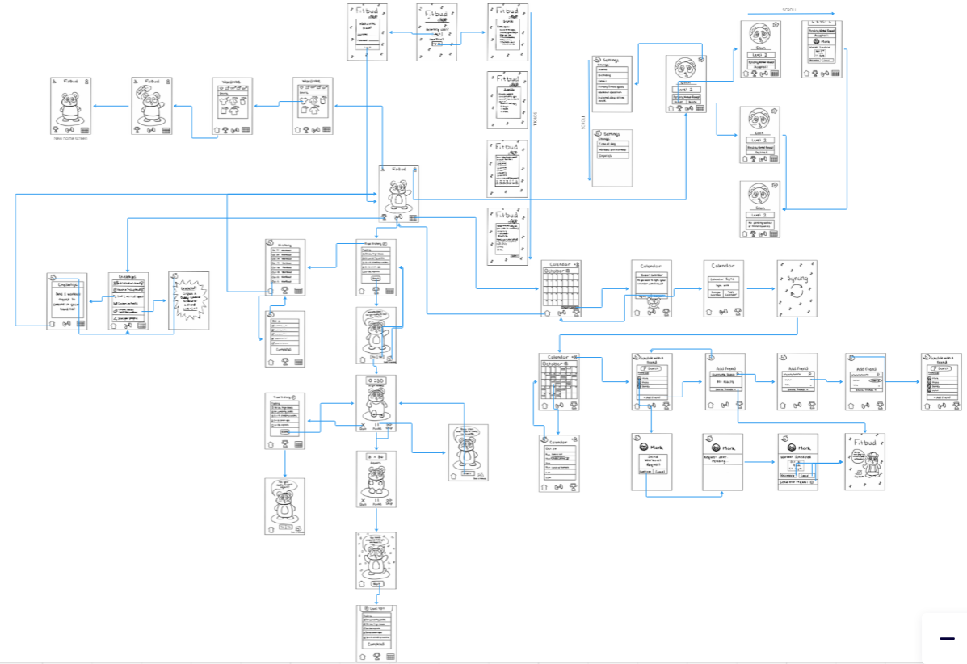
PROTOTYPE BIRD EYE VIEW
LINK: https://tinyurl.com/489d6uep
Notes:
Link is also here in case it doesn’t work there: https://miro.com/welcomeonboard/RXgxVUVjRjlwaXVBbUxSZVJKVmUxWGtJNkVNU1pOZ05GaGk5Z21Pbkd2c3JWUWlmVm5PaDFFUWk0Y1FyWXdYeXwzNDU4NzY0NTY3OTU4OTgwMjY2fDI=?share_link_id=698574520058

Slide 63
TESTING SCRIPT
Hi, we are Stanford students taking a class on user research, user design and interaction, and prototype testing. We are currently looking to test one of our app prototypes. Our app is an app that can allow you to workout with a virtual buddy, and schedule workouts with friends. Before jumping in, we will demonstrate how to use the prototype.
Demonstrate how to press buttons and use scrolling feature.
Next, we will be asking you to complete some tasks. Please try to navigate through the app prototype to the best of your ability
Ask the following questions:
First we would like you to sign up for the app, and then sign in.
Can you check your workout history for October 11?
Can you complete today’s workout with your buddy?
Now we would like you to import your calendar and check your schedule for October 16.
Add a new friend and schedule a workout with Mark.
Can you check a challenge that you have completed?
Can you complete the “customize your buddy” challenge?
Respond to your workout request
Can you tell us what you liked and disliked about this prototype experience?

Slide 64
CRITICAL INCIDENT LOG (STINA)
User struggled to fill in the options before clicking next when signing up | 1 (more to do with the format of the prototype)
User navigated to the calendar when asked to check workout history | 3
User went through the workout in the process of trying to find the workout history | 3
User understood how to go through the workout and the instructions provided by the screen | 0
Very easily was able to find a friend and schedule a workout | 0
Even after demonstration, was struggling with the scroll button | 1
User did not easily understand that the trophy represented completed challenges | 1
User struggled to find what to do next after outfit customization for her Buddy | 2
Exclamation point for notification made it easy for user to identify workout/friend requests | 0

Slide 65
CRITICAL INCIDENT LOG (JUAN)
User struggled a lot to find the workout history | 3
User was able to successfully and easily import the calendar | 0
User saw the view history button multiple times but failed to recognize that it was a button | 3 (but may also have to do with the format of the prototype)
User was unsure how to show that you’ve finished an exercise and didn’t understand the skip button (exercise or workout?) | 3
User found the schedule after importing fairly intuitive | 0
User was easily able to identify where challenges are located | 0
User was confused when they encountered a challenge as in they weren’t sure how to go about completing it | 3
User struggled to add friends if not already in the calendar tab | 2
User believed the reschedule button was schedule | 1

Slide 66
CRITICAL INCIDENT LOG (LUCAS)
User was not sure what he was accepting when they got a workout request | 3
User navigated to the calendar when asked to check workout history | 2
User was confused by the ‘accept’ button being on the right instead of left | 2
User was able to go through workout and finish it | 0
Very easily was able to find a friend and schedule a workout | 0
User understood how to use scroll buttons for different pages | 1
User understood that challenges were represented by the trophy | 0
User understood that customizing buddy required selecting an outfit and then going to home page | 0
Exclamation point for notification made it easy for user to identify workout/friend requests | 0

Slide 67
CRITICAL INCIDENT LOG (CHRISTIAN)
User did not instinctively use the scroller | 2
User navigated to the calendar when asked to check workout history | 3
User did not realize that the “view history” text was a button, seemed to think that it referred to the current page | 2
User attempted to checkbox specific workouts that he wanted to complete during a session (which is not currently a feature) | 1
User was able to go through workout and finish it | 0
User understood that challenges were represented by the trophy | 0
User understood that customizing buddy required pressing the clothing hanger | 0
Exclamation point for notification made it easy for user to identify workout/friend requests | 0

Slide 68
CRITICAL INCIDENT LOG (MARIIA)
User navigated to the calendar when asked to check workout history | 3
User attempted to select a date on calendar without importing calendar | 1 (perhaps this should simply trigger import calendar prompt)
User was able to go through workout and finish it | 0
Was able to find a friend and schedule a workout | 0
User understood that challenges were represented by the trophy | 0
User attempted to go to the customization screen by selecting the customization challenge | 1 (this should probably be an option)
Exclamation point for notification made it easy for user to identify workout/friend requests | 0

