Slide 1
A4: Concept Video
Akanshya, Christelle, Jake, Ethan

Slide 2
Table of contents
01
Intro
02
Market Research
03
Design Values & Tasks
04
Video
Project Name, Problem/Solution
Who are our competitors?
Stakeholders, Ethical Implications, Tasks
Storyboard and Video Link

Slide 3
01
Intro

Slide 4




Our Team
CHRISTELLE
AKANSHYA
Junior
Computer Science
Santa Cruz, Bolivia
Junior
Computer Science
Mountain View, CA
ETHAN
JAKE
Senior
Computer Science
Palo Alto, CA
Coterm
Computer Science
San Carlos, CA

Slide 5
FitBud
Your new pal, here to make fitness fun and easy

Slide 6
How did we choose our name and one-liner?
We wanted a name that emphasized our focus on fitness, as well as the concept that our app will provide a virtual workout friend
We also wanted our slogan to emphasize the gamification aspect of our product that really makes it easy to work out without you having to put in too much effort

Slide 7
Problem
Solution
A gamified virtual workout buddy that schedules your workouts, keeps you accountable, and accompanies you through your workout, making it easier to workout and is adaptable to your needs
People don’t actively try to change their fitness-related habits (regardless of current activity level)
Some like working out with others and others dislike it, but everyone looks for some sort of support when starting out their fitness journey
Fitness, like any other habit, requires a lot of activation energy, effort, planning to make it consistent
Notes:
We aim to help users in need of exercise accountability and motivation and prevent them from being lost and alone come workout time. We will provide a virtual workout buddy that can keep you on schedule and guide you through your workout.

Slide 8
Target Audience
Anyone - the primary goal is to be an adaptable tool/companion for anyone on their fitness journey
Especially helpful for…
Individuals who feel unmotivated to work out
Beginners who need guidance on how to get started
People struggling to find time in their schedule

Slide 9
02
Market Research
You can enter a subtitle here if you need it

Slide 10
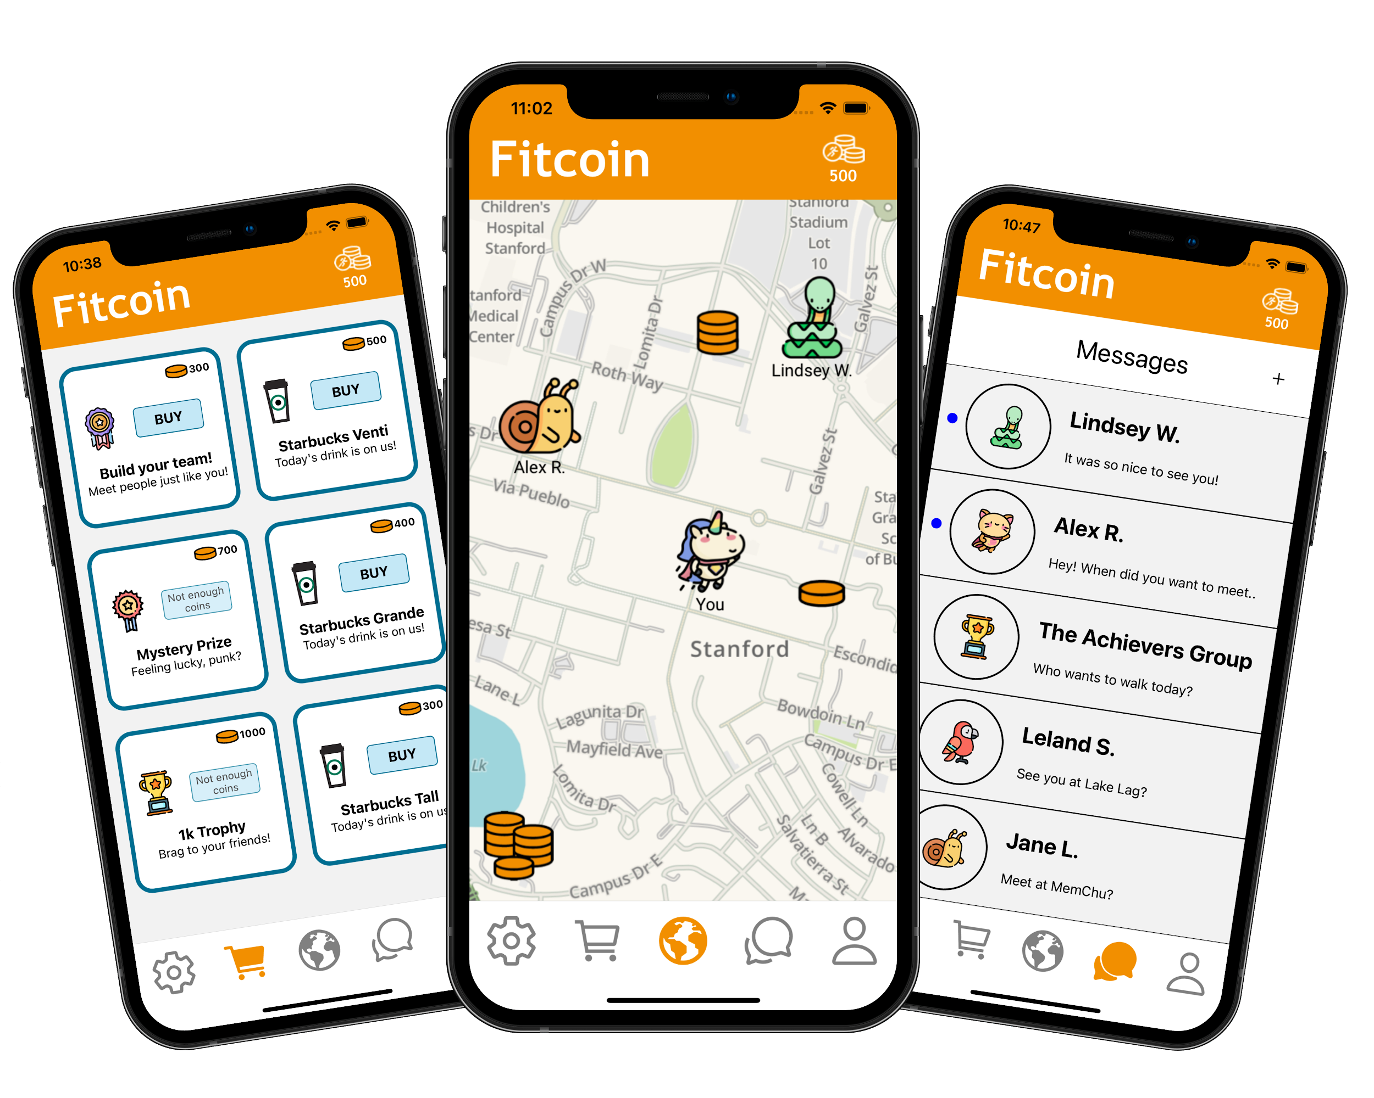
Fitcoin
An app that rewards points (which can be redeemed for rewards) for walking with additional social features
What Worked?
What Did Not Work?
Simple to use
Gamifies fitness goals and offers rewards as a form of motivation
Links users with friends and helps to create a fitness community
Rewards are not plausible (real money)
Focus on just walking, no diversity of workout opportunities
Missed opportunity for customization of avatars

Slide 11
Fitcoin
An app that rewards points (which can be redeemed for rewards) for walking with additional social features
What Can We Learn?
We want our app to encourage people to try a variety of workouts or allow them to participate in the workouts that interest them
Our gamification will offer more feasible rewards that offer both fun and motivation
Good implementation of social features and linking with friends

Slide 12
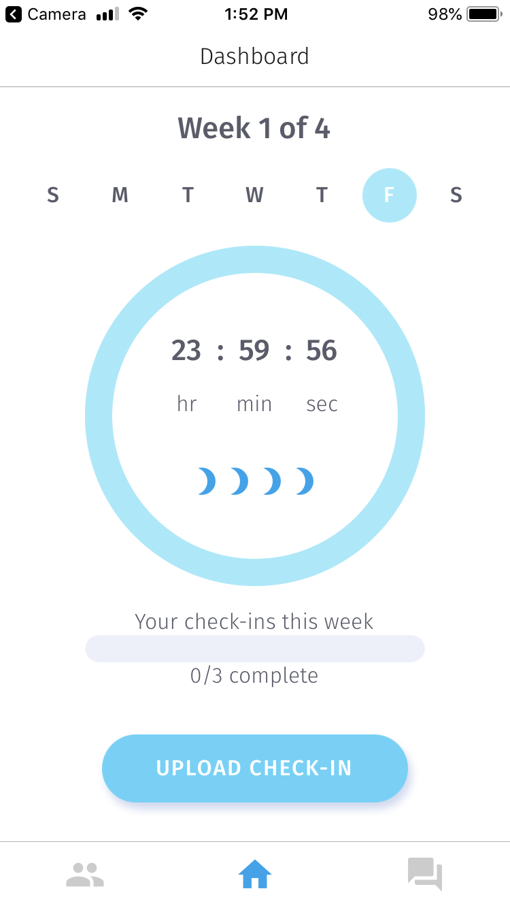
Evolve
An app that uses community as both a form of pressure and encouragement to help people reach fitness goals
What Worked?
What Did Not Work?
Builds discipline and provides initial external motivation to start working out
Uses community and social pressure to motivate individuals
“Elimination” process not too friendly to people who want to build the habit but are struggling
Doesn’t work as well for people who aren’t influenced by peer pressure or don’t like the social aspect of fitness

Slide 13
Evolve
An app that uses community as both a form of pressure and encouragement to help people reach fitness goals
What Can We Learn?
Need to make socializing an option that the user can choose to focus on or not
Be more friendly than focusing on elimination (second chances) but find a balance because you do need accountability

Slide 14
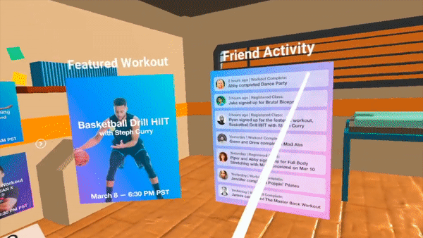
MetaGym
A VR gym that allows you to receive training and community support from anywhere in the world
What Worked?
What Did Not Work?
Provides instruction from experts, allow newcomers to learn techniques
Allows users to build workout communities and socialize
Ability of users to exercise in VR is questionable (not accessible)
Lacks a source of external motivation for struggling beginners (removing activation energy)
Socialization is a requirement, some may want to work out alone

Slide 15
MetaGym
A VR gym that allows you to receive training and community support from anywhere in the world
What Can We Learn?
We won’t be focusing on providing trainors, but we will provide instruction on how to complete exercises so that users won’t be left in the dark
Our gamification will allow for motivation
Will be easily accessible to all

Slide 16
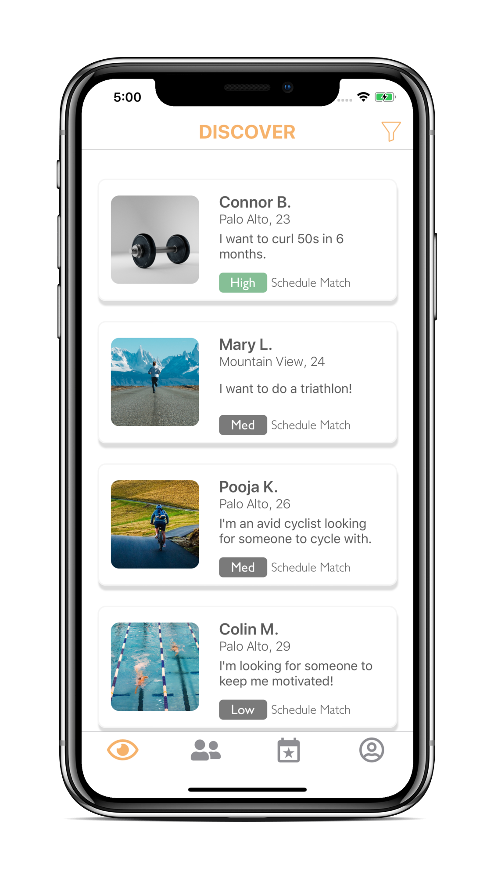
2Fit
An app where you can meet a workout partner
What Worked?
What Did Not Work?
Focuses on building community and finding workout buddies
Schedules workouts with friends to make the process even easier
No assistance for those who want to workout alone
Not as helpful for beginners to ease them into fitness
  How about two beginners - how will they get started?

Slide 17
2Fit
An app where you can meet a workout partner
What Can We Learn?
Similar to evolve, need to make socialization more of an option to also help the audience of individuals who want to workout alone
Scheduling workouts to simplify the process for two people is very helpful (one of our current ideas that seems to work)

Slide 18
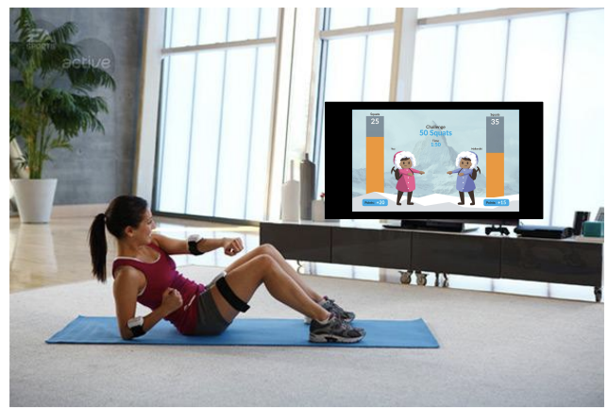
Level One
An app where you can play a video game to level up your fitness skills
What Worked?
What Did Not Work?
Provides guided workouts in the form of a game, offering guidance and motivation all in one
Tracks progress, offering motivation for users seeking to progress further
Allows for users to play with friends
Need to do it at home with the TV - not many options for the outdoors
Does not help with scheduling workouts with friends/finding people to workout with

Slide 19
Level One
An app where you can play a video game to level up your fitness skills
What Can We Learn?
Gamification will support accountability and repeated use
We will help users sync up with friends who may be exercising at the same time
Accessible everywhere

Slide 20
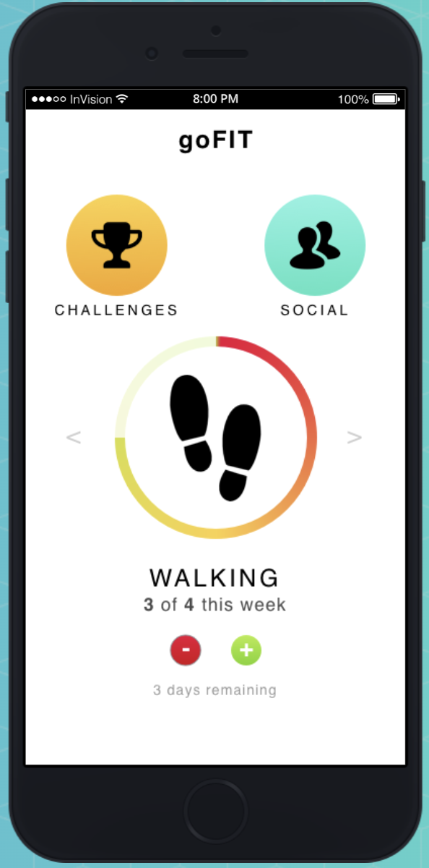
goFIT
An app where you can track goals and share progress with friends
What Worked?
What Did Not Work?
Allows you to set personal fitness goals that vary over different disciplines
Optional social aspect for those who are interested in challenging friends
Good for tracking progress
No guidance for individuals who may not know what to do to progress towards their goals
Very limited functionality - need to be motivated already to use

Slide 21
goFIT
An app where you can track goals and share progress with friends
What Can We Learn?
Need something to support beginners
Keep users engaged with new innovative features
Add features for external motivation or to lower the activation energy

Slide 22
 | Fitcoin | Evolve | MetaGym | 2Fit | Level One | goFIT
Gamification
Provides Motivation for Repeated Use
Offers Community
Allows for solo workouts
Lowers Activation Energy
Customizable goals

Slide 23
03
Values in Design
Stakeholders, Ethics, Tasks

Slide 24
Stakeholders
Direct Stakeholders
Users (our target audience, but also any individual who uses the app)
Us, the developers
(Future) sponsors or investors
Indirect Stakeholders
Other people in the gym
User’s friends and family
Government or other regulatory entities
Health and fitness experts
Competing apps or individuals, such as personal trainers

Slide 25
Ethical Concerns: THE SCANDAL
Users who fail their goals could face self-esteem issues
Users who seek out a workout app may already feel subpar in their exercise habits
Failure to meet goals set by the app may worsen their feelings of ineptitude
Could damage body image
Our Thoughts
We should ensure that users who fail to meet their goals/challenges are met with positive reinforcement rather than scolding/punishments

Slide 26
Ethical Concerns: THE BACKSTABBER
Misuse of Data and Lack of Privacy Protection
For one of the features, we are asking users to share their calendars
Calendars contain personal information and if this information was leaked or used inappropriately, it would be incredibly wrong
Our users would begin to distrust us and it would pose many ethical problems as well
Similarly, this applies to their health and personal information that they are sharing with us as well
Our Thoughts
We should reassure users by informing them that we do not view their calendars or other personal information, it is solely used for their own benefit
We should ensure that users are not able to discern information about their friend’s calendars/fitness level via our scheduling feature
It is also vital that we protect the data given to us by users and ensure that it is kept safe and is only used as we have intended it to be used

Slide 27
Ethical Concerns: THE SIREN
A user might rely too heavily on the app for their workout education
Drawn in by the validation offered by our app, users might start to neglect to learn proper technique
They may also begin to neglect other sources of information on what is best for their bodies
This would undermine our goals of helping users obtain fitness goals
Our Thoughts
We should aim to provide instructions for challenges/workouts when applicable
By suggesting exercising with friends and attempting to link friends together, we hope that they will help each other maintain proper technique

Slide 28
Ethical Concerns: THE SIREN (Part 2)
Gamification of Health
The gamification of exercise could lead to unhealthy exercise habits among users
It may cause individuals to workout far more than is healthy, increasing risk for injuries and harm
Our Thoughts
We should ensure that the workouts we suggest and the challenges we offer will be within healthy limits
After a certain amount of exercise each day, we should recommend that the user stop
We should also prioritize and emphasize the importance of sleep and rest

Slide 29
Tasks (Highlighted in Video)
Have an accountability and reward system based on my commitment to fitness (simple)
  Primary goal of the virtual “pal” is to help build the habit
Create a workout plan in an environment accessible to me (moderate)
  Optional to beginners who need additional guidance on what to do
Connect with friends who are also exercising (complex)
  An optional social component for those who want to meet with friends by allowing them to schedule workouts and finding what workout best meets their individual goals

Slide 30
Tasks (Continued)
Find a time to workout that works with my schedule (simple)
  Main feature that helps reduce activation energy to workout and build fitness habits
Provide workout challenges periodically (complex)
  An additional feature to increase motivation and positive emotions with fitness

Slide 31
04
Video
Storyboard and Video Link

Slide 32
Storyboard

Slide 33
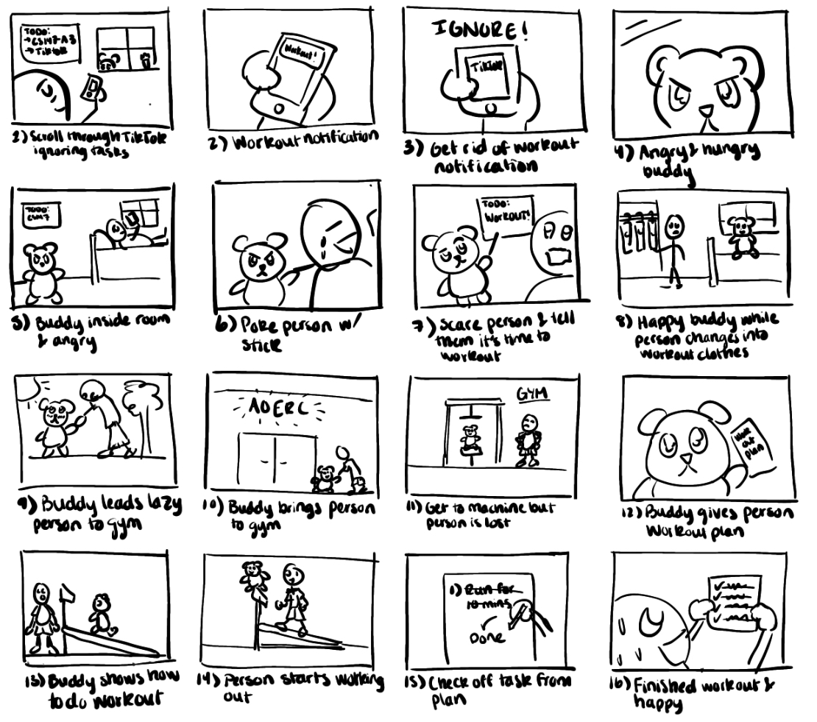

Slide 34
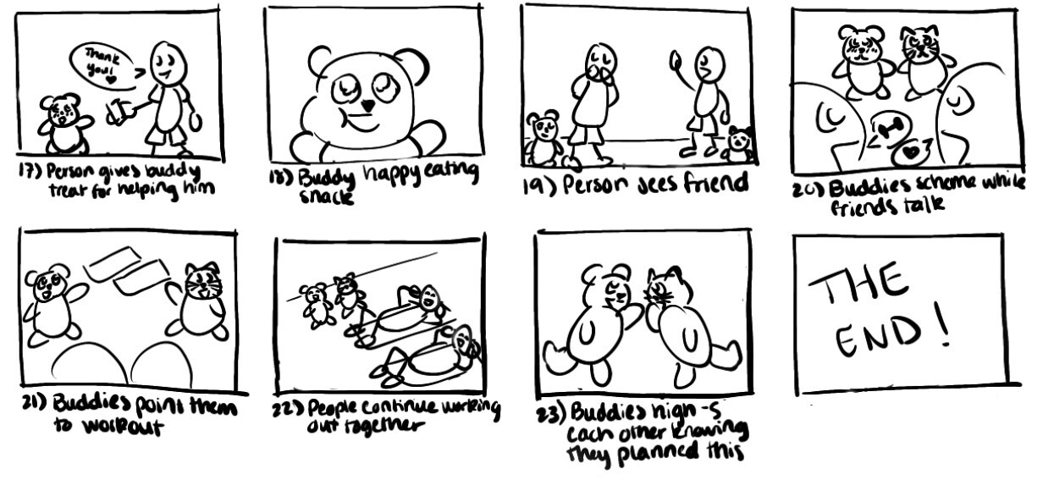

Slide 35
Click here for our video

