Slide 1
TEAM FITBUD
A2: POVs & Experience Prototypes

Slide 2
TABLE OF CONTENTS
01
02
03
04
ADDITIONAL NEEDFINDING
INTRODUCTION
Recap from last time and our revised domain
Adding on to our needfinding interviews
POVs, HMWs, EXPERIENCE PROTOTYPES, RESULTS
CONCLUSIONS
How we solved our problems
Summary of our findings and final solution

Slide 3
01
INTRODUCTION
Who we are + our domain

Slide 4
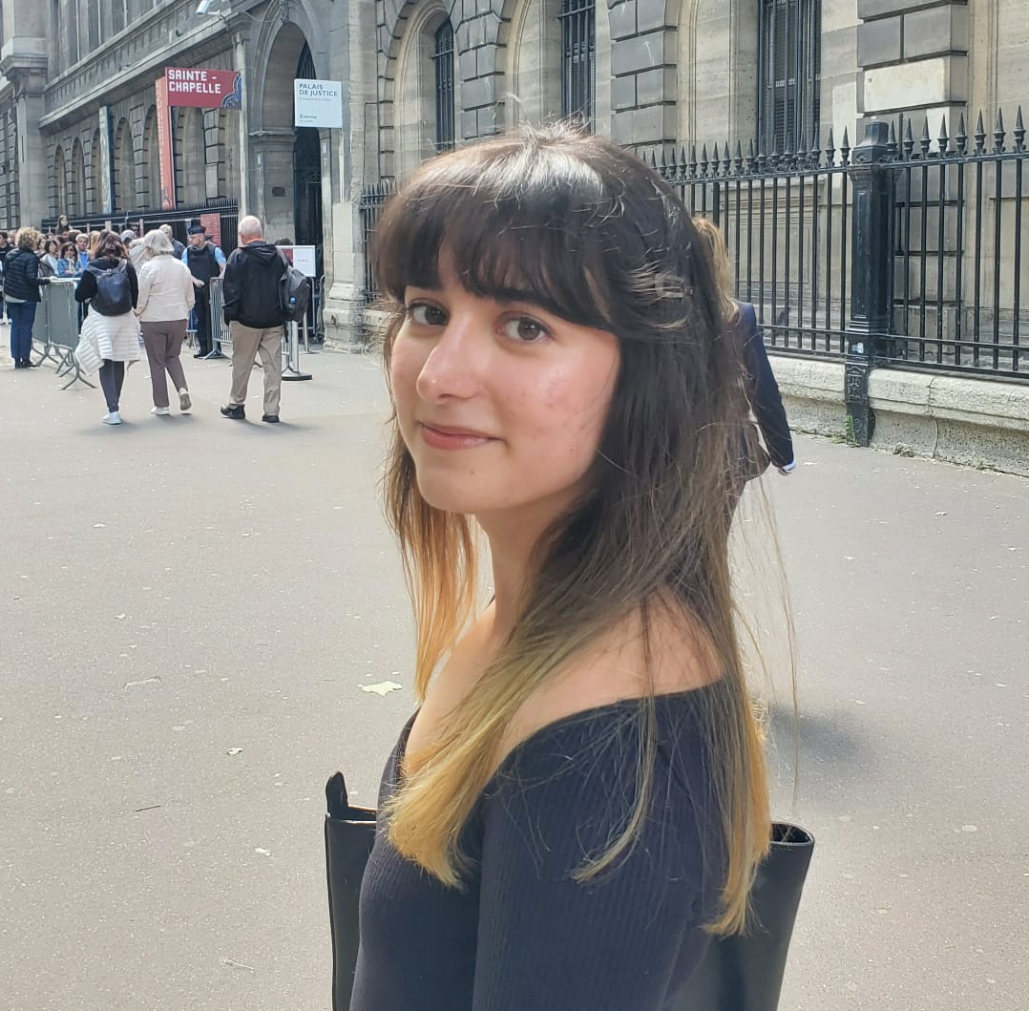

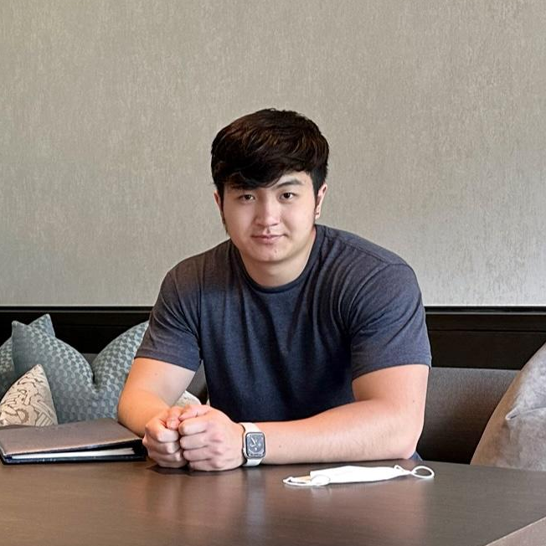
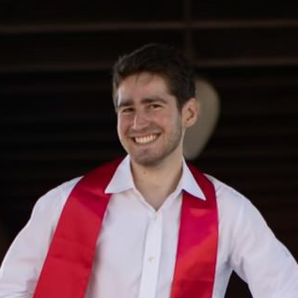
OUR TEAM
CHRISTELLE
AKANSHYA
Junior
Computer Science
Santa Cruz, Bolivia
Junior
Computer Science
Mountain View, CA
ETHAN
JAKE
Senior
Computer Science
Palo Alto, CA
Coterm
Computer Science
San Carlos, CA

Slide 5
RECAP
Domain: fitness
Needs:
  Education and empowerment
  Motivation
  Comforting, welcoming environment
Notes:
Our domain lies in making the achievement of one’s fitness goals accessible to everyone
To do this, from A1 we realized we need to educate people on how best to achieve their goals, motivate them to work towards them, and ensuring an environment conducive to self-betterment
Brings us to.

Slide 6
OUR (REVISED)
DOMAIN
Helping people find motivation and community in exercise

Slide 7
02
NEEDFINDING
Additional needfinding interviews

Slide 8
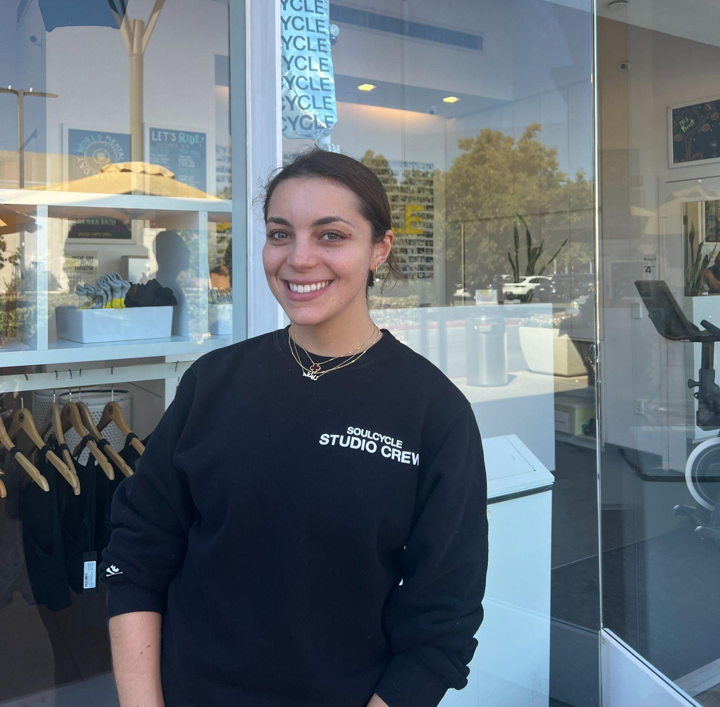
MADELEINE
22-year-old recent grad working at Soul Cycle before going to med school.
Key Insights
Too much misinformation online compared for a society highly-geared towards tech use
Does not enjoy being instructed in her workouts
Joining group classes has helped her find close relationships
Notes:
We have madeleine, a recent grad who expressed displeasure at rampant misinformation in the modern fitness industry and yet does not enjoy being instructed in her workouts

Slide 9
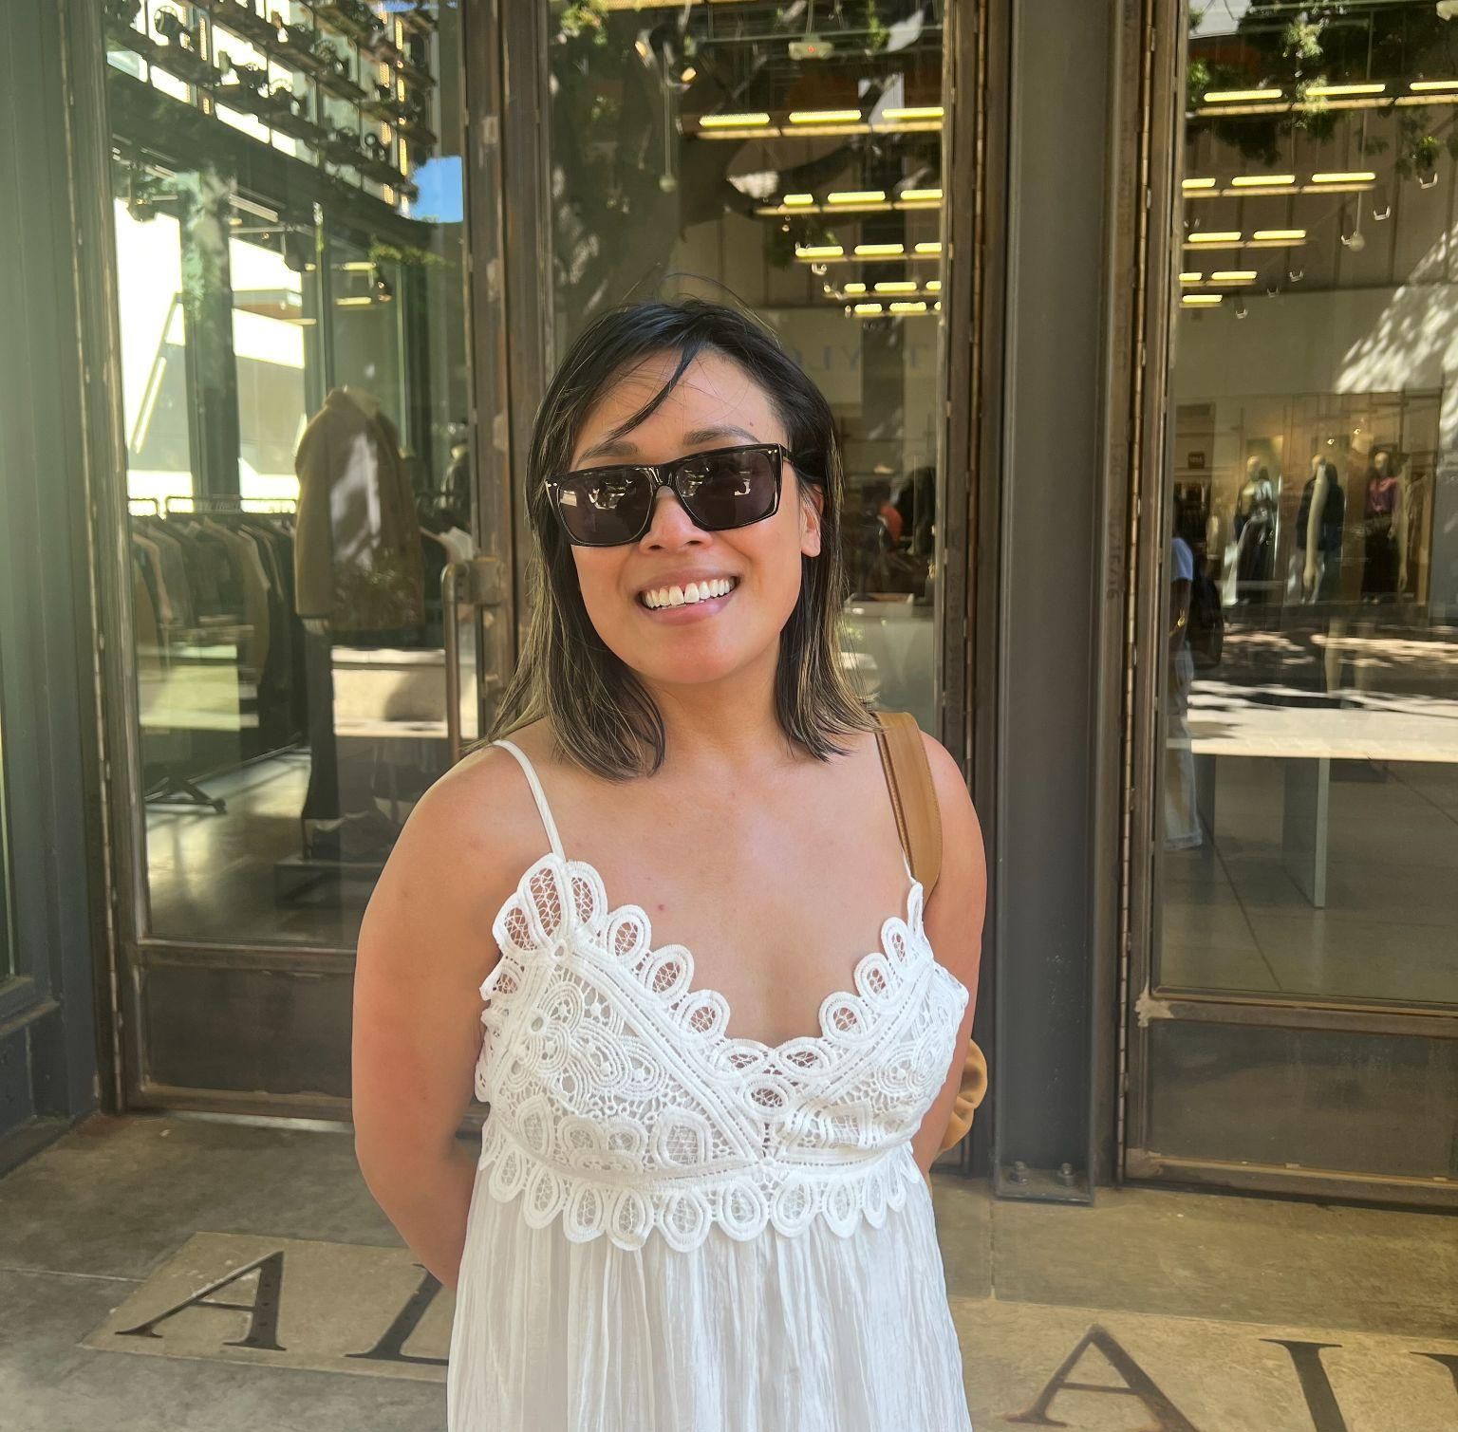
JESSICA
45 year-old nurse manager raised in Daly City and living in San Bruno.
Key Insights
The price of yoga classes discourages her from going to an in-person class
Social networking is the most important aspect of fitness classes at her age
Hard to find people her age at yoga
Notes:
Jessica, a nurse manager who is discouraged by prices of fitness classes but finds the social aspect of fitness important,

Slide 10
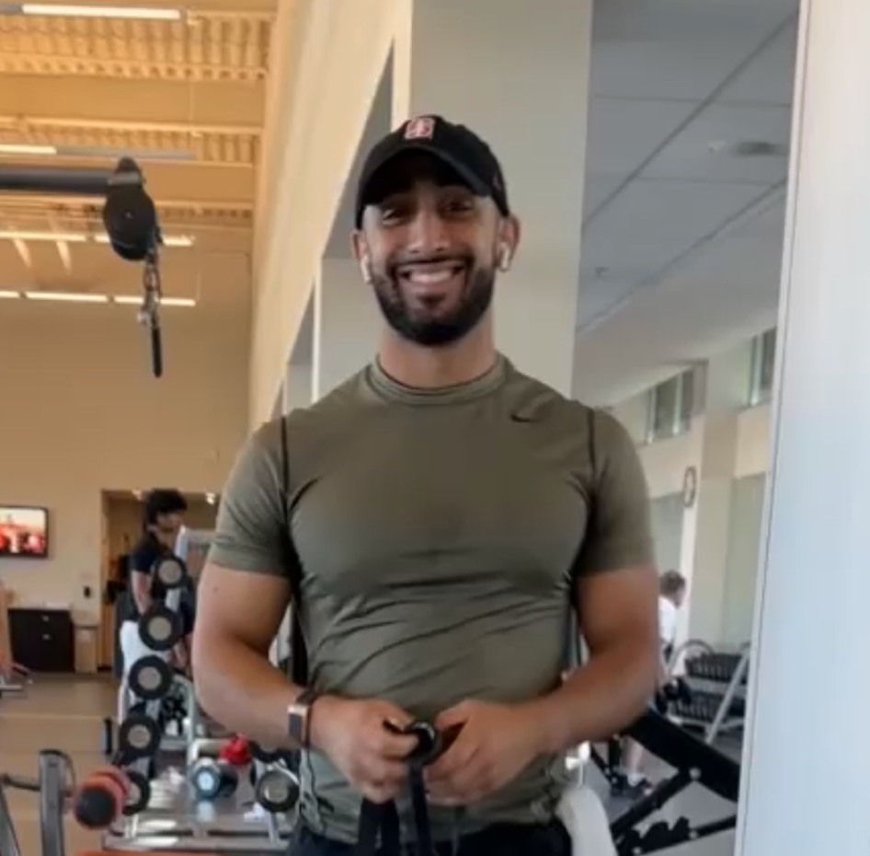
YUSUF
24-year-old kinesiology student at SJSU, research assistant in rehabilitation science lab, avid bodybuilder
Key learnings and needs
Gym is not a place for social interaction
Very specific criteria for a gym buddy
Working out alone not preferred, but necessary
Notes:
And Yusuf, a self-described professional meathead who can’t seem to find himself a gym partner.

Slide 11
03
MEAT & POTATOES
POVs, HMWs, solutions, experience prototypes, results
Notes:
Go through one POV, the HMW that came out of it, the solution we picked, the experience prototype we came up with, and results and findings

Slide 12
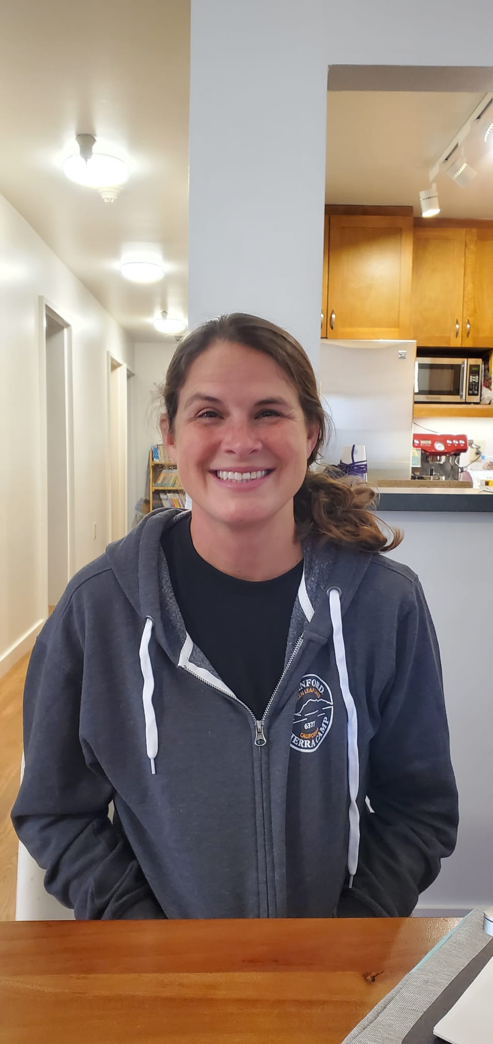
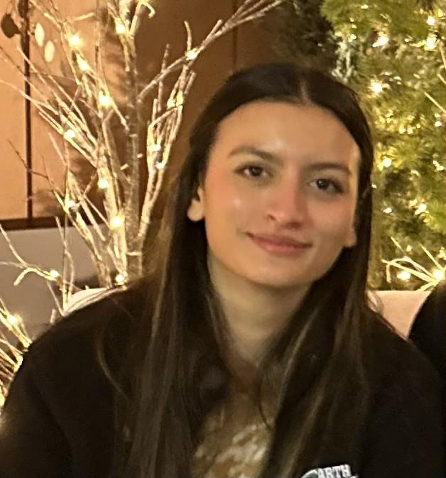
POVs
Yusuf
Jill
Jessica
Anissa
Madeleine

Slide 13
POVs
Yusuf
Jill
Jessica
Anissa
Madeleine

Slide 14
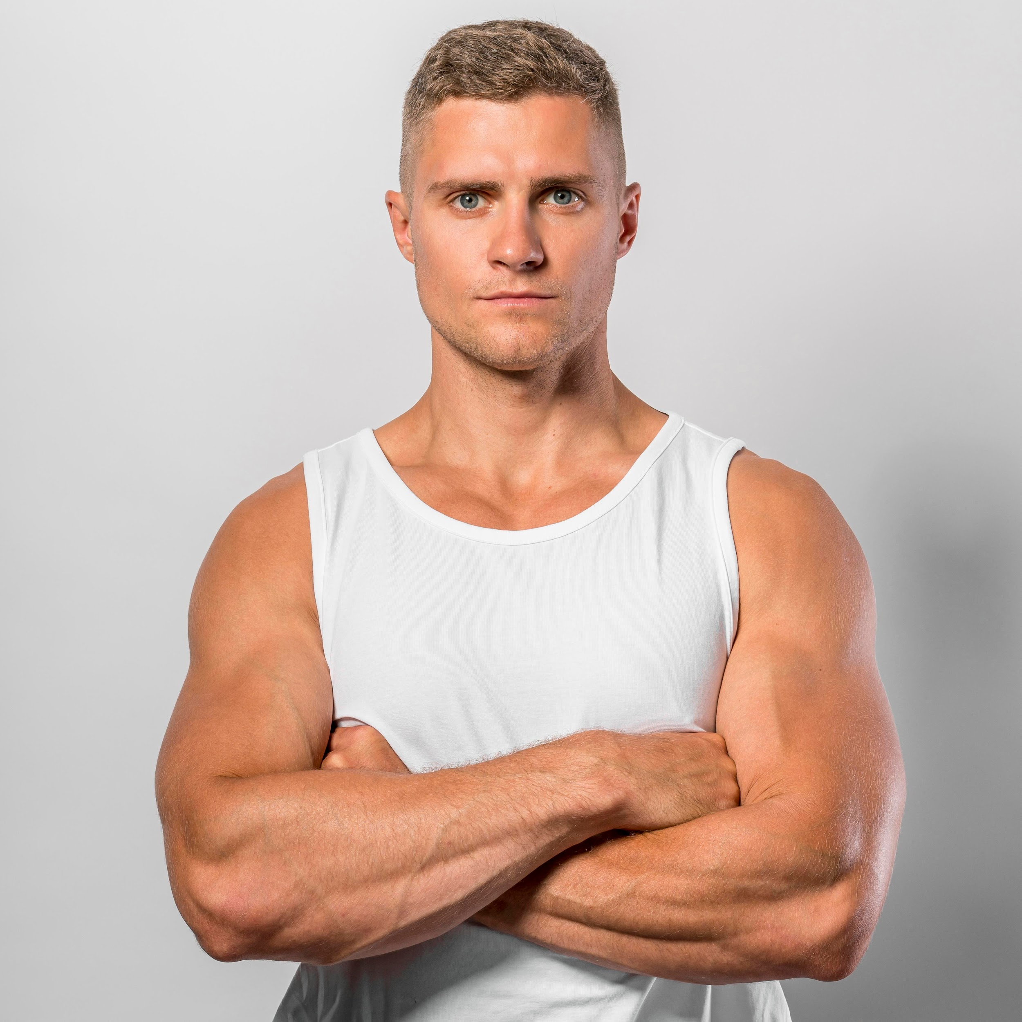
POV #1: Anissa
We met Anissa, a recent college grad working as a physical scientist in San Francisco who does not consider herself to be an active person. We were surprised to notice that she wanted guidance to get started working out, but she had a fear of being judged by strangers. We wonder if this means that she lacks a supportive presence that will help her work towards these goals. It would be game-changing to provide her with a way to meet others that she can exercise with, learn from, and can ease her into working out.
Notes:
skip

Slide 15
POV #1: Anissa
We met Anissa, a recent college grad working as a physical scientist in San Francisco who does not consider herself to be an active person. We were surprised to notice that she wanted guidance to get started working out, but she had a fear of being judged by others. We wonder if this means that she lacks a supportive presence that will help her work towards these goals. It would be game-changing to provide her with a way to meet others that she can exercise with, learn from, and can ease her into working out.
Notes:
Now for second POV. Anissa’s main roadblock to achieving her fitness goals was in her fear of being judged; she needs but can’t find support and guidance to ease her into the workout process.

Slide 16
HOW MIGHT WE
make fitness more accessible and less intimidating?
Notes:
In other words, how can we make fitness more accessible and less intimidating?

Slide 17
SOLUTION
Match people with more experienced fitness buddies to provide guidance
Notes:
Match novices with experienced athletes to provide guidance.

Slide 18
KEY ASSUMPTIONS
Being at the gym alone is scary
Not just showing what to do but why to do it will help demystify fitness
Correcting one’s form and technique will help them stay safe and feel less self-conscious
Notes:
In this solution we assumed that being at the gym alone is scary; if we help educate them on what to do, how to do it correctly and why to do it, they will feel more safe and confident working out

Slide 19
PROTOTYPE: ”PT” MATCHING
Match experienced fitness enthusiasts with beginners. Take them through a workout tailored to their goals
Notes:
Of course, our prototype is personal trainer matching.

Slide 20
EXPERIENCE PROTOTYPE
PARTICIPANT FINDING
WORKOUT
Find lifters with little to moderate lifting experience
Ask about and note their fitness goals and interests
Take participants through a workout (~90 min) tailored to them
Explain and show how and why things should be done
EVALUATION
Have participants fill out a form before and after experience regarding their experience level, workout frequency, whether working out alone or with someone is preferred, level of motivation and comfort in gym
Notes:
First, we found novice to early intermediate lifters and asked them about their fitness goals. We took them through a 90 min workout, explaining and showing them how things ought to be done. They filled out a form both before and after the workout evaluating their level of motivation and comfort in the gym.

Slide 21
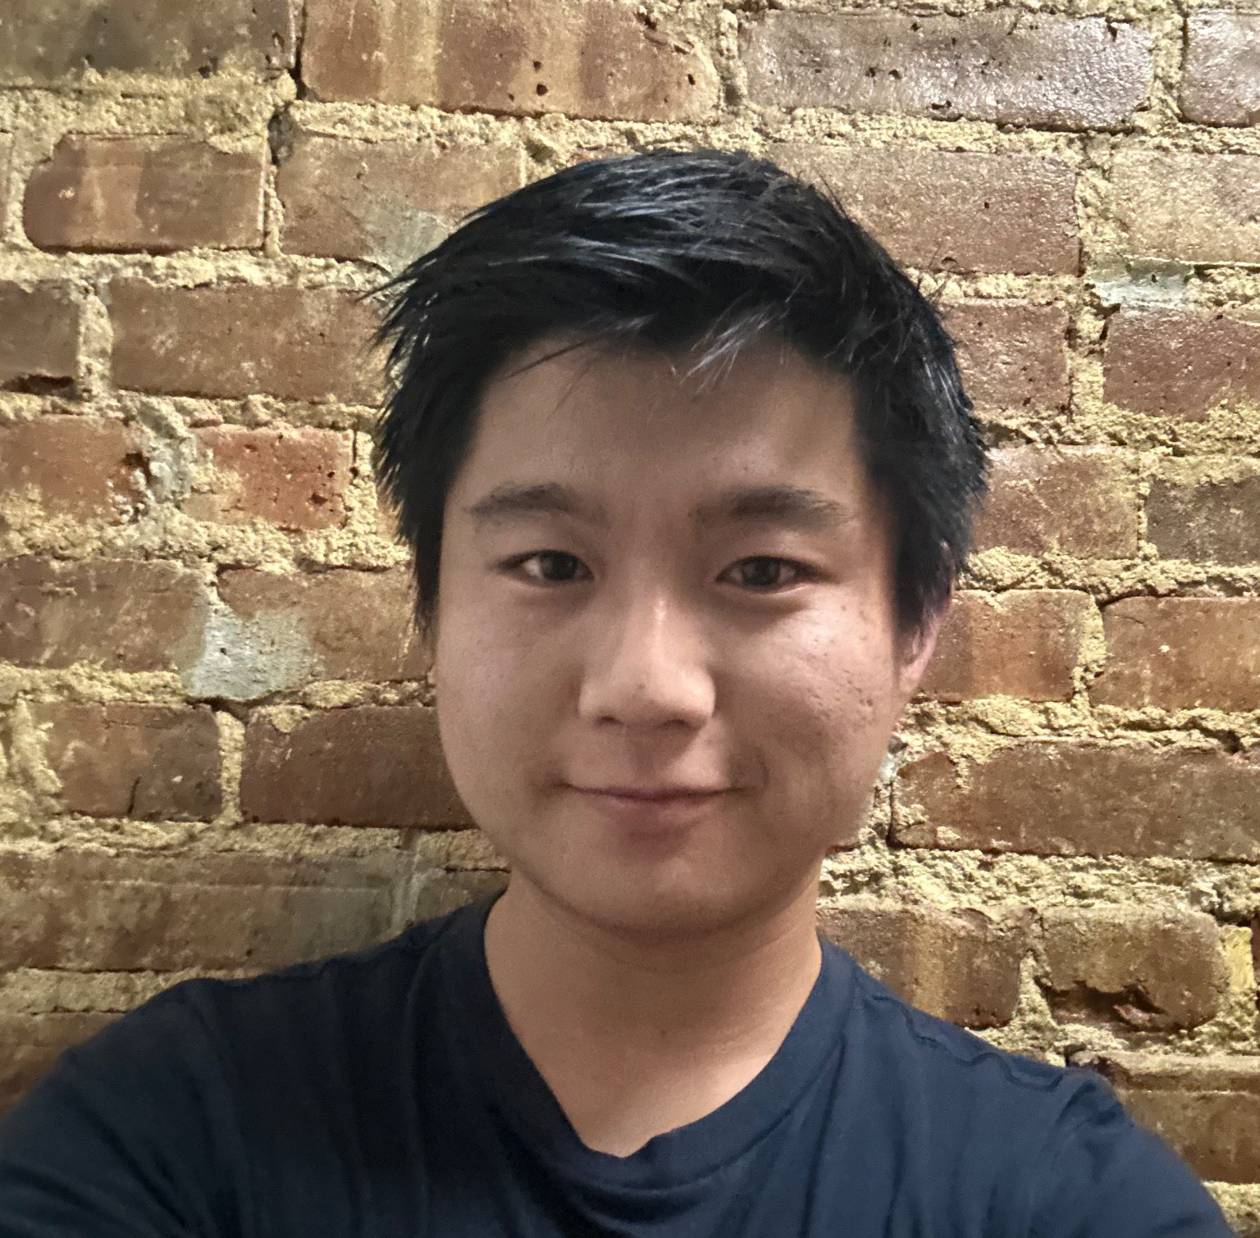
PARTICIPANT: Tobey
Reached through network to find a gym-goer who may appreciate advice
21 years old
Student/TA
San Diego, CA
Slightly active
  Occasional gym-goer
  Looking to get stronger and more active
Notes:
For this prototype we found Tobey, a relatively new gymgoer who would like some guidance on how to get stronger.

Slide 22
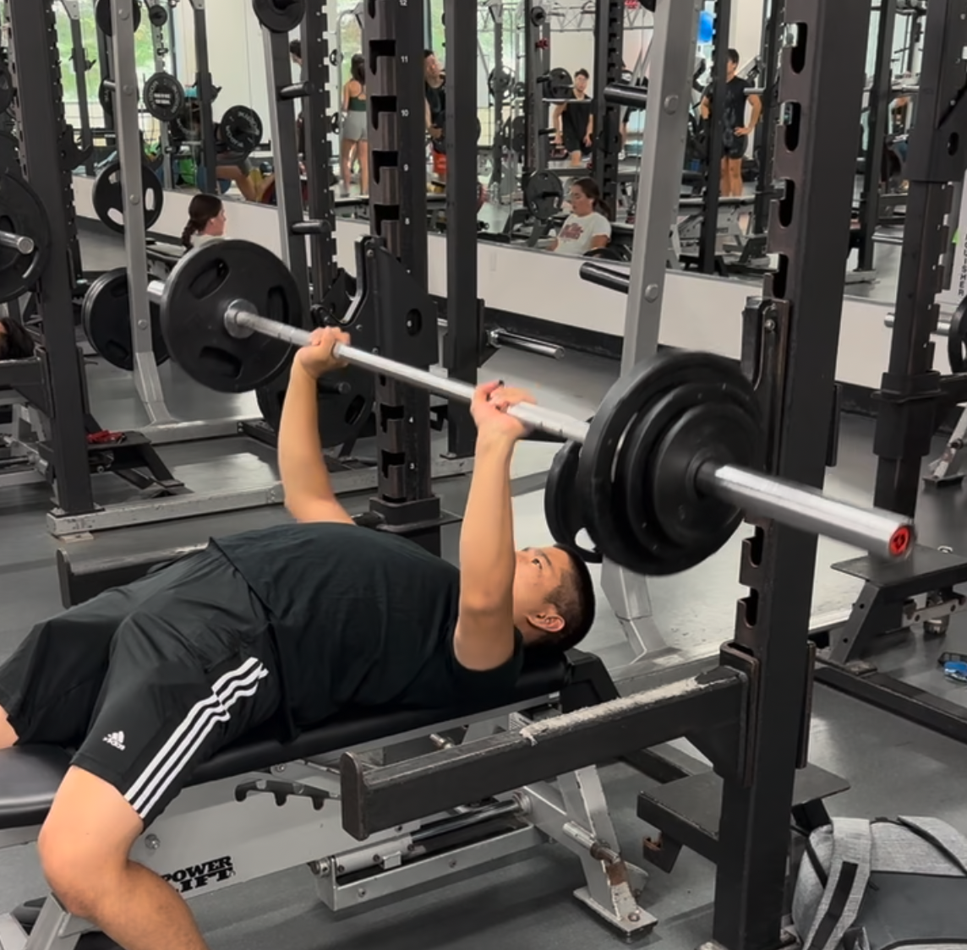
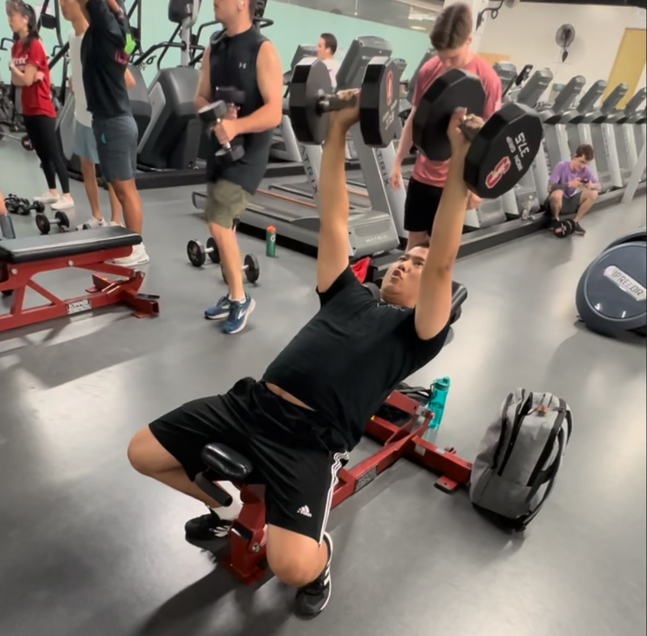
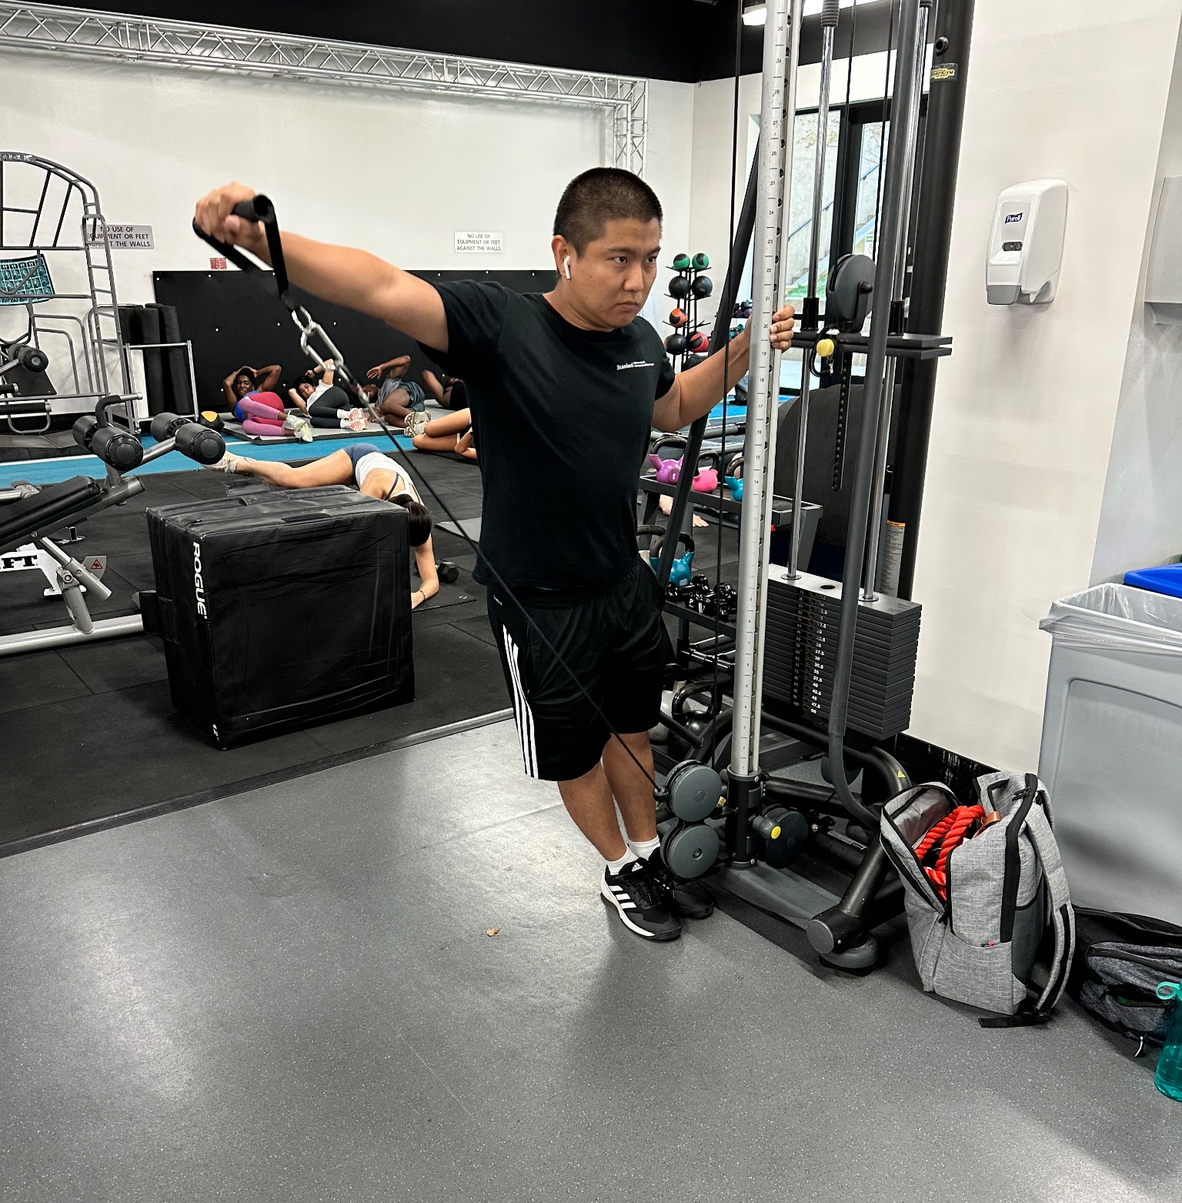
PROCESS
Aligned to his goals
Context: already running a PPL split
Fine-tuned his technique on barbell and dumbbell presses, explaining and demonstrating how to stay tight, recruit more muscles, and stay injury-free
Taught him new isolation exercises and their benefits
Notes:
In this case, I took Tobey through a push day, helping him fine-tune his technique and teaching him some new exercises and explaining their benefits.

Slide 23
RESULTS + INSIGHTS
WHAT WORKED
Motivation and comfort levels in the gym went up
Became more inclined to work out with other people
Having a second pair of eyes was helpful
  Enjoyed and appreciated learning new exercises
WHAT DIDN’T WORK
“Ow”
KEY TAKEAWAYS
Affirmed assumptions
Easy to get off track or reinforce bad habits when working out alone
Having a more experienced “trainer” ensures improvement
Working out alone can be dangerous
Professional/certified personal training is expensive and not accessible!
Notes:
As for what worked, he felt more motivated and comfortable in the gym after our session; he felt more inclined to work out with others; and enjoyed the learning process. As for what didn’t, he complained a bit about muscle soreness, which I think is normal, but I admittedly could have taken it easier on him. This prototype affirmed our assumptions; though its possible to make progress alone, having a more experienced trainer can help expedite progress and help you life more safely. Importantly, professional personal training is prohibitively expensive and not accessible to many.
Making progress towards fitness goals alone is possible, but it’s easy to get off track or reinforce bad habits
Working out alone can be dangerous, especially when lifting heavy; one can more confidently push oneself with a partner/spotter
Professional/certified personal training is prohibitively expensive and not accessible!
Useful to know form details and understand reasoning behind them

Slide 24
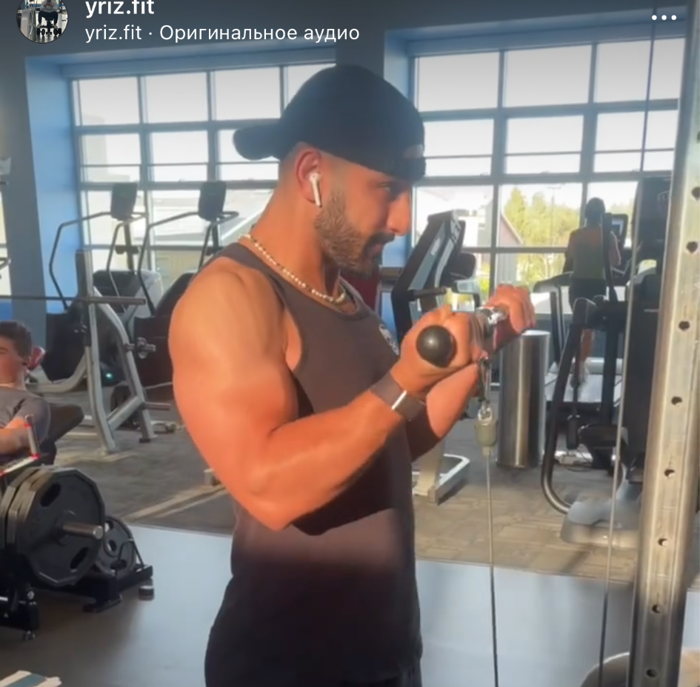
POV #2: Yusuf
We met Yusuf, a kinesiology student, avid bodybuilder, and aspiring physical therapist. We were surprised to notice that, though he has a relatively active social life, he never goes to the gym with anyone despite expressing a desire to do so. We wonder if this means he finds it difficult to find suitable workout buddies to make working out more fun. It would be game changing to help him find a lifting companion who could enhance his workouts.
Notes:
skip

Slide 25
POV #2: Yusuf
We met Yusuf, a kinesiology student, avid bodybuilder, and aspiring physical therapist. We were surprised to notice that, though he has a relatively active social life, he never goes to the gym with anyone despite expressing a desire to do so. We wonder if this means he finds it difficult to find suitable workout buddies to make working out more fun. It would be game changing to help him find a lifting partner who could enhance his workouts.
Notes:
What strikes us about Yusuf is that he’s an outgoing person and a very experienced lifter, but expressed difficulty in finding a suitable workout buddy. We thought it would be game changing to help him

Slide 26
HOW MIGHT WE
find a suitable workout community for people of all fitness backgrounds?
Notes:
From this: how might we find community for people of all fitness levels and backgrounds?

Slide 27
SOLUTION
Have people create a custom profile with their exercising habits and find people that have a certain percentage of similarity
Notes:
The solution that came to mind was to have people create custom profiles with their exercise habits and fitness levels, finding people who are similar enough

Slide 28
PROTOTYPE:
SPEED DATING
Take two strangers and ask rapid-fire questions for 5-7 minutes to learn about their fitness habits and whether or not they are compatible as workout partners
Notes:
Our rudimentary prototype was to ask people rapid-fire questions about their fitness and determine their compatibility as workout partners.

Slide 29
KEY ASSUMPTIONS
There are people who want workout buddies with similar goals and aims but cannot find them
Willing to meet a stranger with similar goals and invest the time in this process
Notes:
Some assumptions we had to make were that people do want but cannot find workout buddies, and that they would be willing to invest some effort into finding said buddy.

Slide 30

PARTICIPANT: Claire
Recruited at Tresidder
33 years old
Professor
St. Louis, MI
Very active individual
  Bikes an average of 100 miles per week
  Dislikes working out with anyone other than one friend
Notes:
Our participant for this prototype was Claire, whom we recruited at Tresidder. She’s a professor, and a particularly active individual.

Slide 31
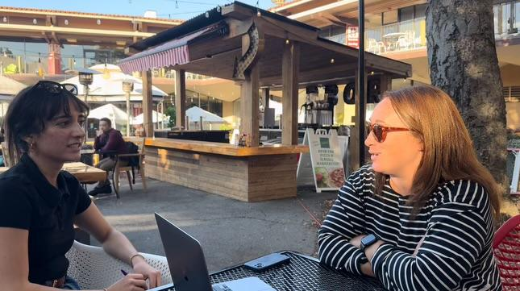
PROCESS
Questions
Not very compatible: both prefer working out alone but should try swimming together (recreationally)
How active are you?
Whom do you usually work out with?
What are your fitness goals?
What’s something you find unfulfilling about your routine?
Are there new activities you’ve been wanting to try?
Share answers to the questions (1-2 minutes max per question)
Determine compatibility
Notes:
In our experience prototype we asked questions regarding the participant’s activity level, workout tendencies, and fitness goals, and compatibility was determined according to their answers.

Slide 32
RESULTS + INSIGHTS
WHAT WORKED
Casual conversation format
Were able to see exactly how their habits aligned
Questions facilitated and guided the conversation efficiently
WHAT DIDN’T WORK
Felt like some answers were telegraphed by the questions
Qualitative not quantitative data
KEY TAKEAWAYS
Only works if the feature is used by people who actually want to find others to workout with
Not like matchmaking for friends/romantic partners
Not sure about the first assumption but the second assumption was true
Notes:
It turned out that asking rapid-fire questions was an efficient way to determine compatibility as a workout partner. Still, the questions may have been overly suggestive, and in many fitness environments its a bit frowned upon to fire questions at a stranger when they’re minding their own business. Of course, this can only work provided that people actually want to find workout partners, but given that they do, it seems to be an effective method.

Slide 33
POV #5: Madeleine
We met Madeleine, a newly grad Stanford student from Palo Alto looking to go to med school who has been working at SoulCycle for 5 years now because of how much she loves cycling. We were surprised to notice that she uses her studies in human biology to inform herself about health and fitness through research papers to avoid misinformation online. We wonder if this means that she does not have a trustworthy information source that could provide this information in an easily-accessible manner. It would be game-changing if we could provide her with information at the tips of her fingers that would be credible and educational in terms of fitness and health.
Notes:
skip

Slide 34
POV #5: Madeleine
We met Madeleine, a newly grad and potential med school Stanford student from Palo Alto who has been working at SoulCycle for 5 years now because of her love for cycling. We were surprised to notice that she uses her studies in human biology to inform herself about health and fitness through research papers to avoid misinformation online. We wonder if this means that she does not have a trustworthy information source that could provide this information in an easily-accessible manner. It would be game-changing if we could provide her with information at the tips of her fingers that would be credible and educational in terms of fitness and health.
Notes:
For our final POV, we chose Madeleine’s, which is centered around misinformation. In this modem era of social media fitness, misinformation is rampant, and she goes to the effort of reading research papers herself to ensure that she’s receiving up to date and accurate information. We thought it would be useful to make credible information more accessible.

Slide 35
HOW MIGHT WE
provide people with trustworthy and helpful guiding information about exercising and fitness?
Notes:
That is, how might we provide people with trustworthy and helpful information about fitness?

Slide 36
SOLUTION
A platform that tracks/provides workout routines and nutrition habits and gives recommended changes
Notes:
Well we could create a platform that tracks one’s workouts and nutrition, giving recommendations accordingly.

Slide 37
KEY ASSUMPTIONS
Some people would like others to critique their workout/nutrition habits
Receiving feedback will empower people to exercise more
Notes:
In this solution we assumed that people would like recommendations regarding their workouts and nutrition, and this feedback would empower people to workout more and better.

Slide 38
PROTOTYPE:
NUTRITION AND FITNESS QUIZ
Find people to take a fun interactive Buzzfeed quiz about their own health and fitness levels and provide them with tailored advice at the end. Give them a snack as a reward for making their first steps towards their health and fitness journey.
Notes:
For our prototype we created a Buzzfeed quiz about their health and fitness levels, providing them with customized advice at the end.

Slide 39
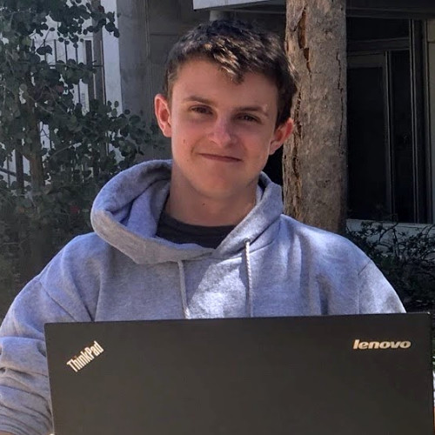
PARTICIPANT: Cale
Reached out through network to find an active participant who might enjoy feedback
22 years old
Software Engineer
Active individual
  Gym 4-5x a week
  Pickleball/Frisbee 1x a week
  Prefers working out alone
Notes:
Our participant here was Cale, a software engineer and also a very active individual who goes to the gym often and plays several sports outside of that.

Slide 40
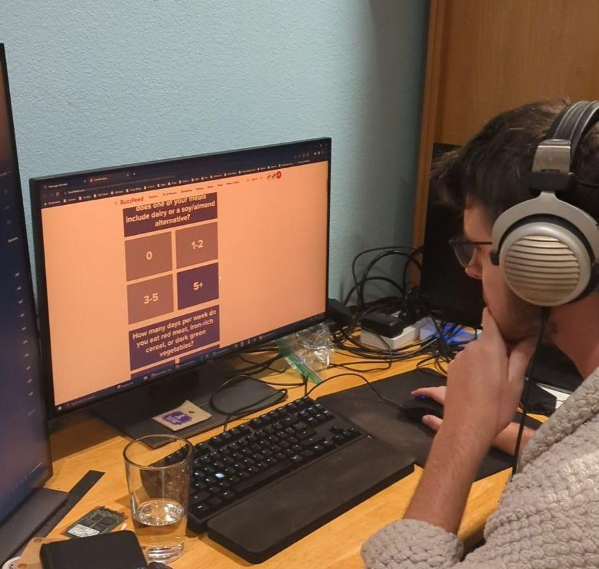
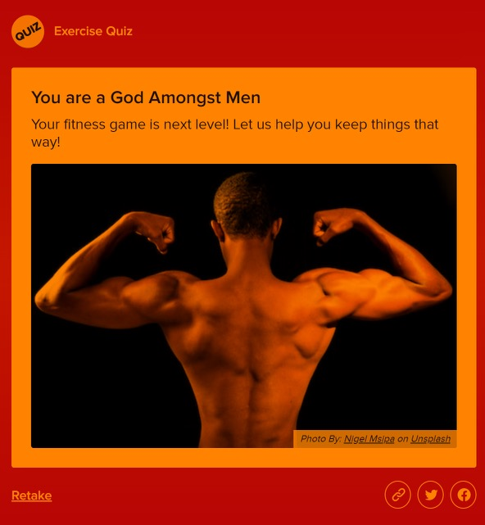
PROCESS
Provide possible improvements in the form of an ideal training routine and meal plan
Answer questions about frequency of workouts and nutrient intake
Determine current fitness level and identify weak points
Notes:
The process went as follows: we had participants answer questions about their workouts and nutrition, determined their fitness level, identified potential areas of improvement, and provided these improvements in the form of a training and meal plan.

Slide 41
RESULTS + INSIGHTS
WHAT WORKED
Was amused and intrigued by the analysis of his health habits
Felt that experience was engaging and succinct
WHAT DIDN’T WORK
Felt response options were too vague/not specific enough
Not confident in accuracy of results
Results did not cause an increase in motivation or happiness
KEY TAKEAWAYS
Difficult to obtain specific/accurate results
  Hard for users to trust a non-human
Assumptions
  People can appreciate being evaluated and receiving feedback
  BUT feedback does not necessarily increase motivation
Notes:
Our participant was intrigued by the prospect of analyzing his habits and enjoyed the experience, but the responses he got were too vague and he wasn’t at all confident that they were trustworthy. We learned that we failed to create an accessible platform of trustworthy advice, and that feedback doesn’t necessarily increase motivation.

Slide 42
04
CONCLUSION
Our results and analysis
Notes:
From these prototypes, we concluded that

Slide 43
FINAL (COMBINATION) SOLUTION:
Speed dating + PT matching
Users will fill out a questionnaire outlining their fitness goals and interests, experience level, and what they are looking for to enhance their workouts (e.g. a lifting partner, a coach/trainer, a running buddy, etc.). A matching algorithm will be used to recommend other pairs and groups of suitable individuals. For individuals who don’t want to work out with others, a gamified feature that will motivate them to build fitness-related habits.
Notes:
Our final solution will be a combination of the first two prototypes: we’ll have users fill out a profile regarding their fitness goals and interests, experience level, and what they’re looking for to enhance their workouts. Then we’ll have two main features: a matching algorithm will find both people of similar experience and interests, or people who can be trainers to help one along their fitness journey.

Slide 44
FINAL SOLUTION
Whom does it serve?
Buddy feature serves everyone who wants a partner or group to exercise with
Trainer feature targeted at novices
Individuals who need motivation
Whom might it leave out?
Advanced fitness enthusiasts or people who already have a set rhythm
How will we recruit trainers and incentivize coaching?
Ethical implications
Need some way to verify users who register to be “trainers”
Misinformation, injuries, predatory behavior are possible risks
Not a dating app
Notes:
We’ll serve everyone who wants a workout partner and novices who want a trainer. We’re still figuring out how we might recruit advanced fitness enthusiasts and incentivize them to actually train novices. In terms of ethical implications, we need to make sure that people who register to be trainers are legit, and we need to limit misinformation, injuries, and otherwise bad behavior. We need to make sure it doesn’t turn into a dating app, and that it remains a safe space for users of all fitness levels.

Slide 45
THANK YOU!
Any questions?
PLEASE KEEP THIS SLIDES FOR ATTRIBUTION

Slide 46
APPENDIX
FEEDBACK FORMS
https://drive.google.com/drive/folders/1r-m0P9gOEsIcIJOghi6HUNDbmpPRvnSR?usp=sharing
VIDEOS OF STUFFED ANIMAL EXPERIENCE PROTOTYPE
https://drive.google.com/file/d/1ofYj39pTSKSuUCTty3jociQU86AYeeVY/view?usp=sharing

Slide 47
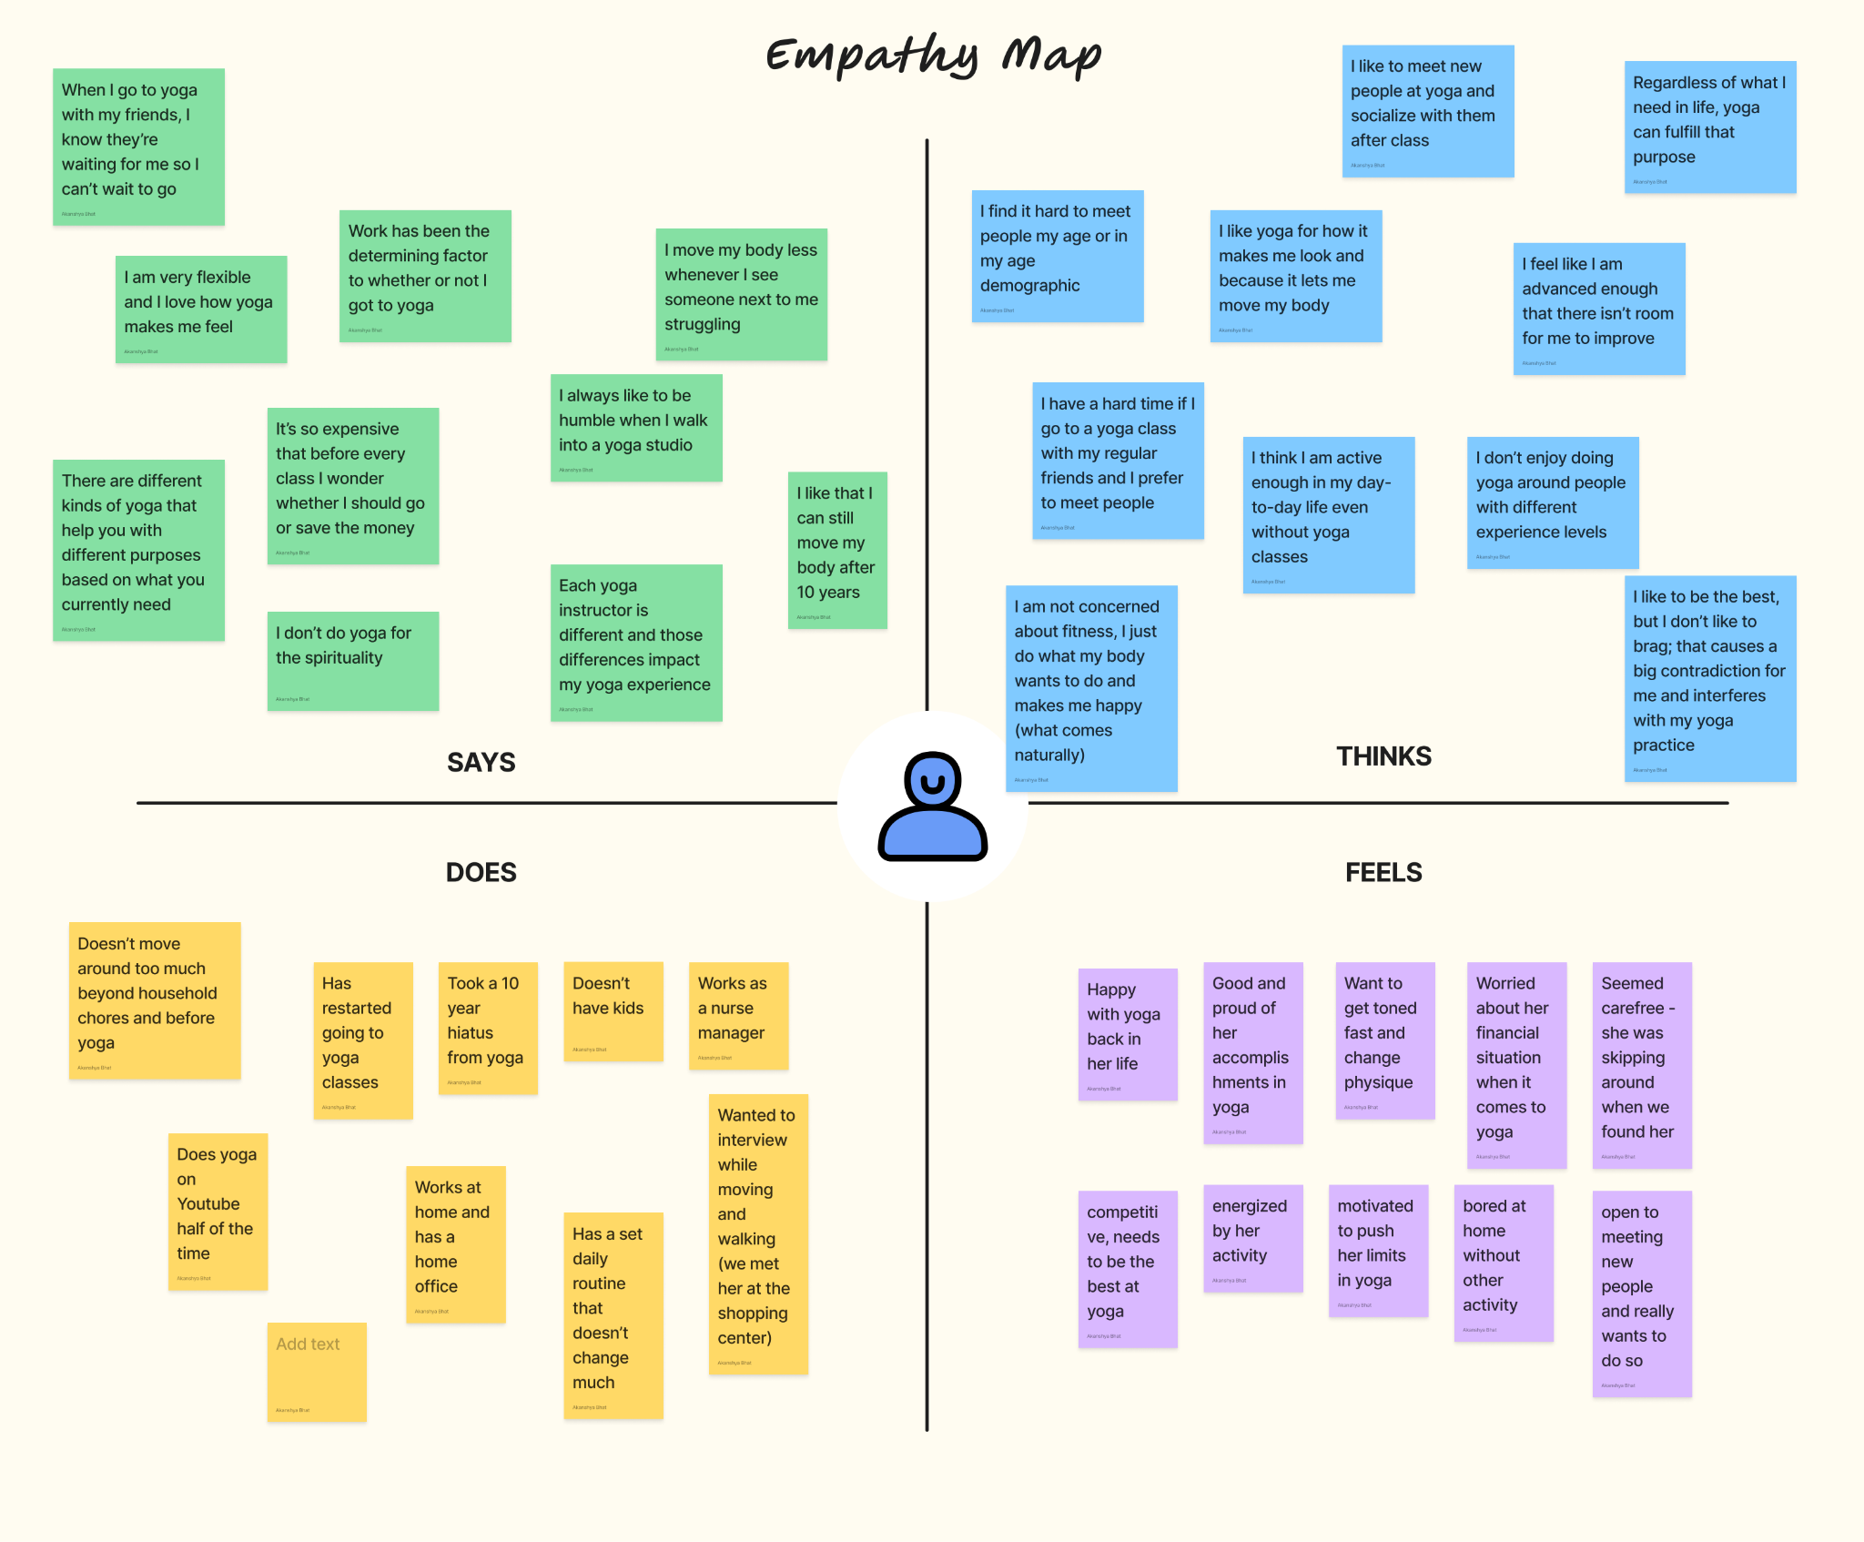
JESSICA’S EMPATHY MAP

Slide 48
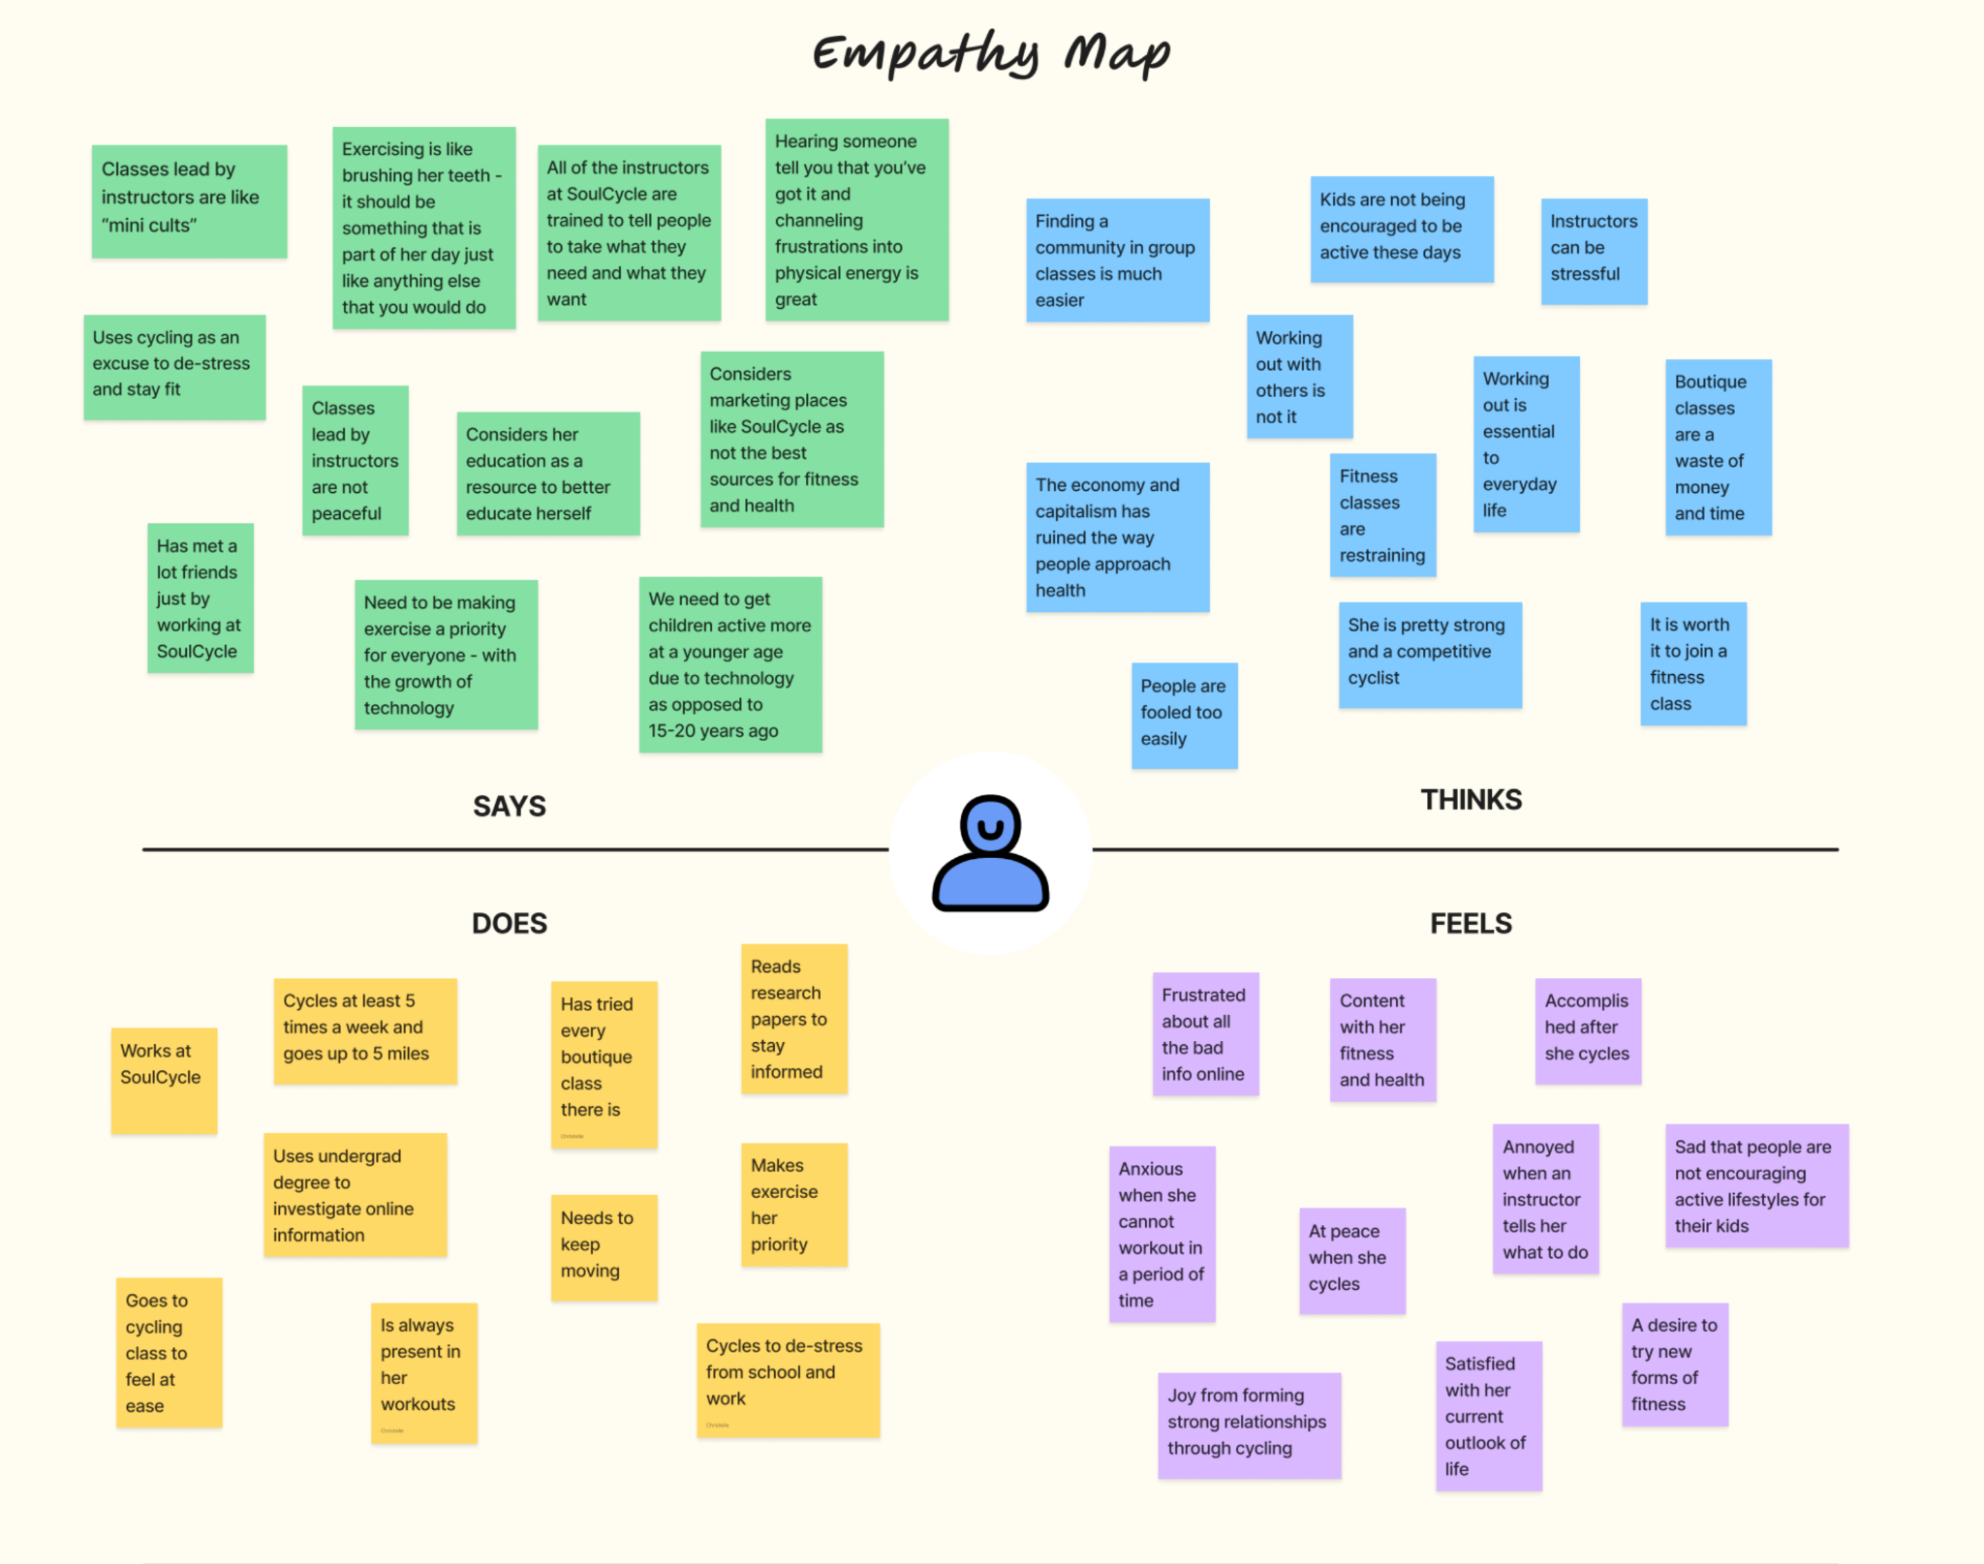
MADELEINE’S EMPATHY MAP

Slide 49
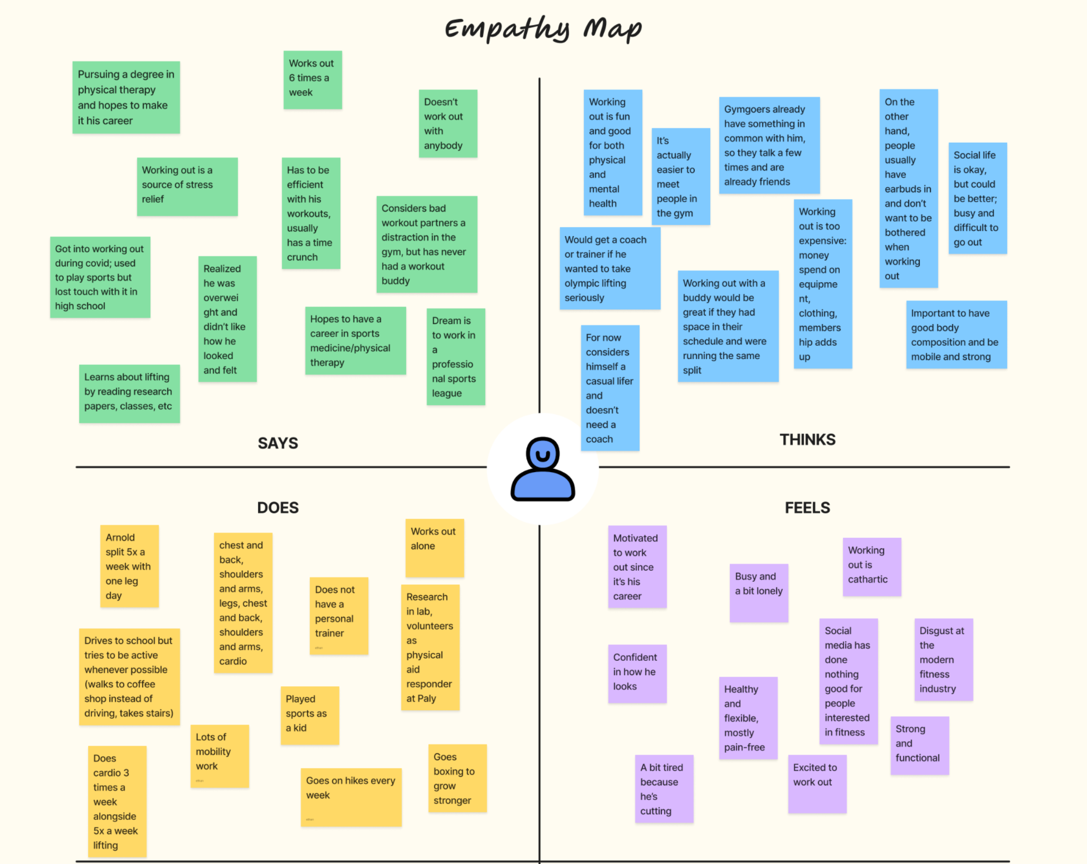
YUSUF’S EMPATHY MAP

Slide 50
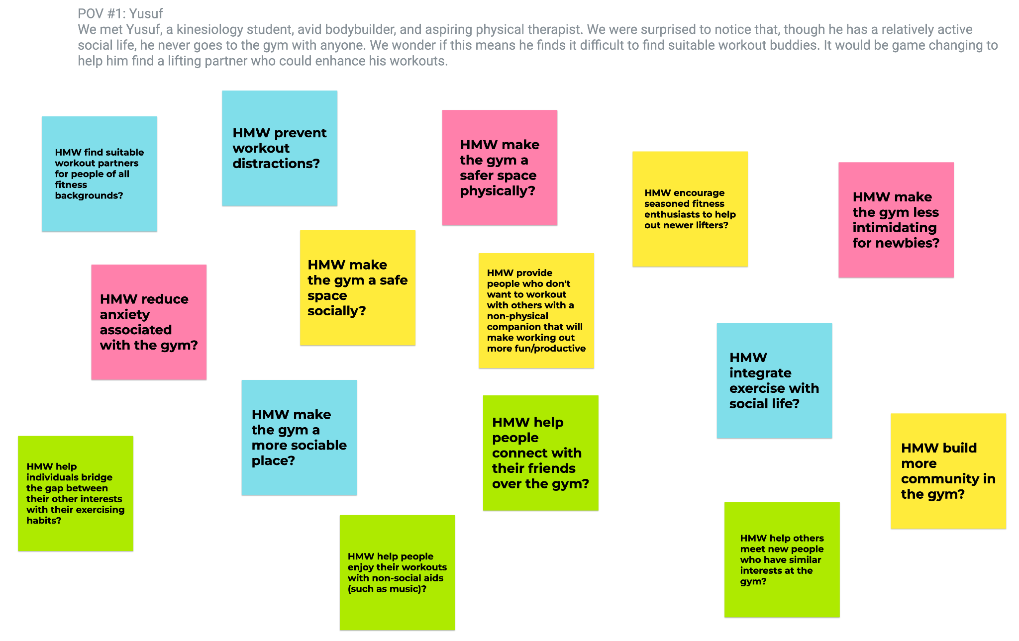
YUSUF’S HMW BRAINSTORM

Slide 51
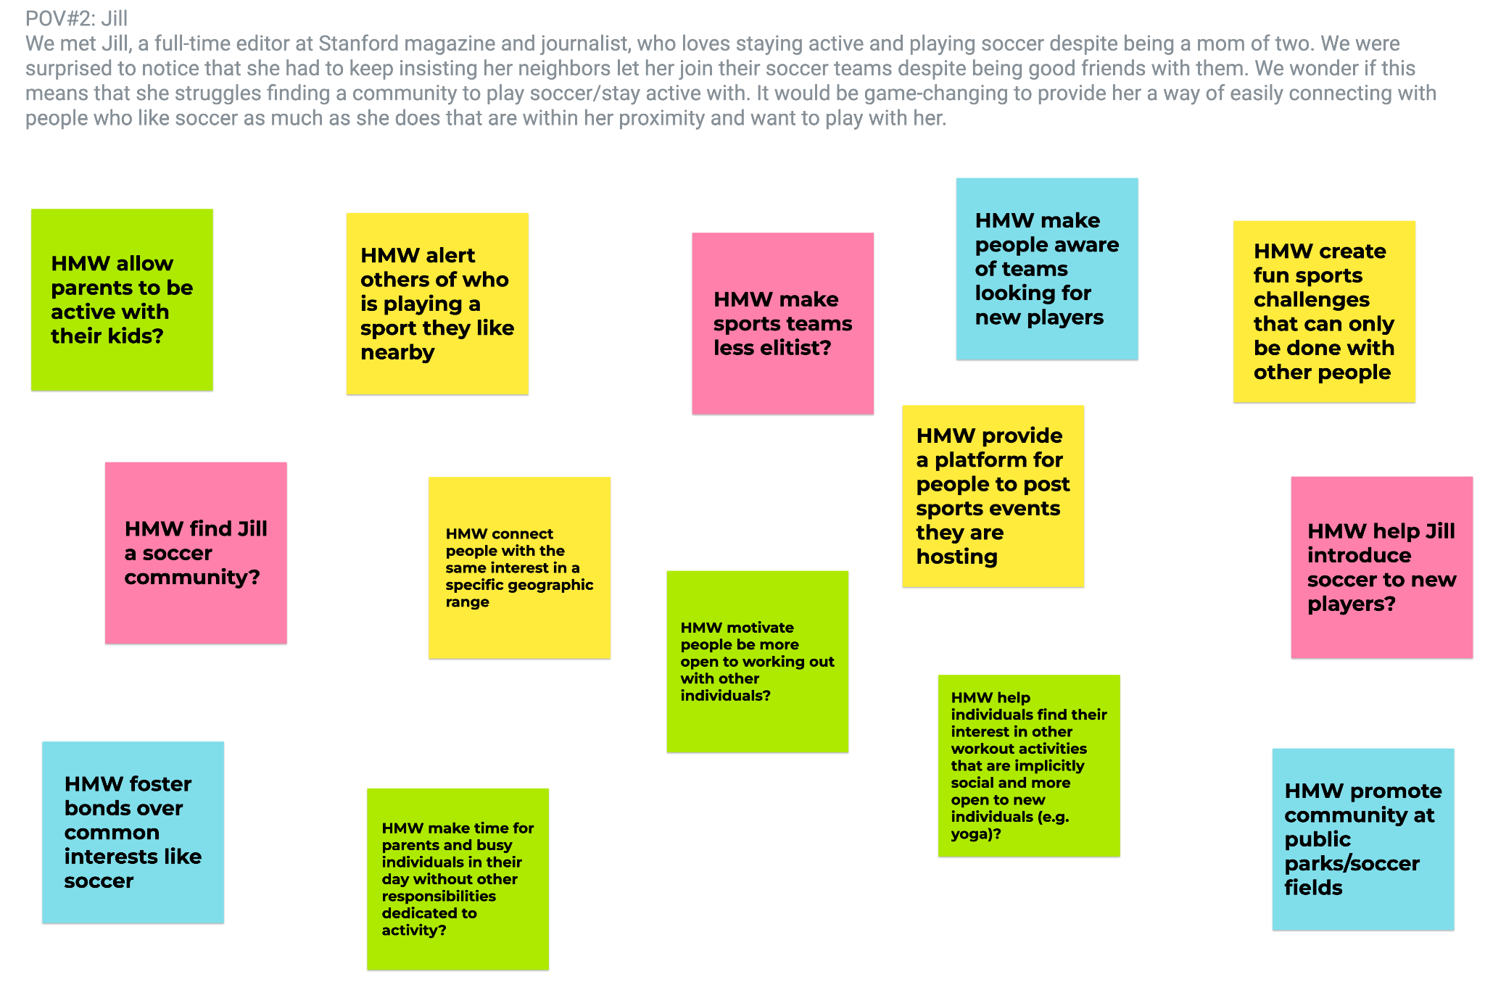
JILL’S HMW BRAINSTORM

Slide 52
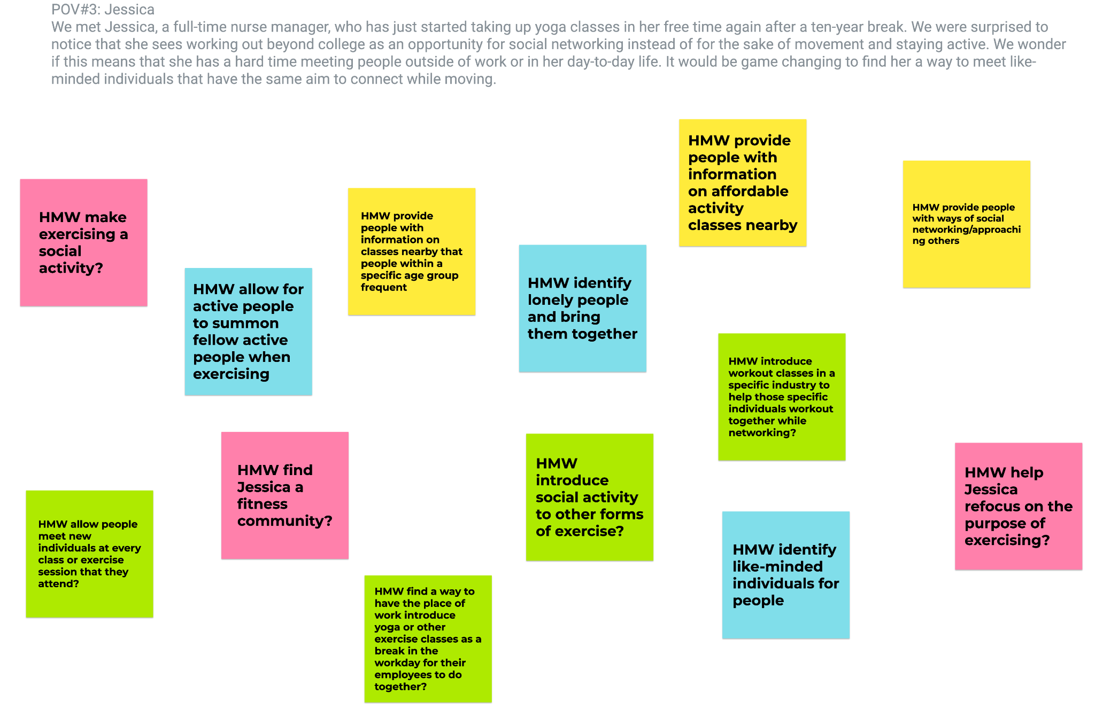
JESSICA’S HMW BRAINSTORM

Slide 53
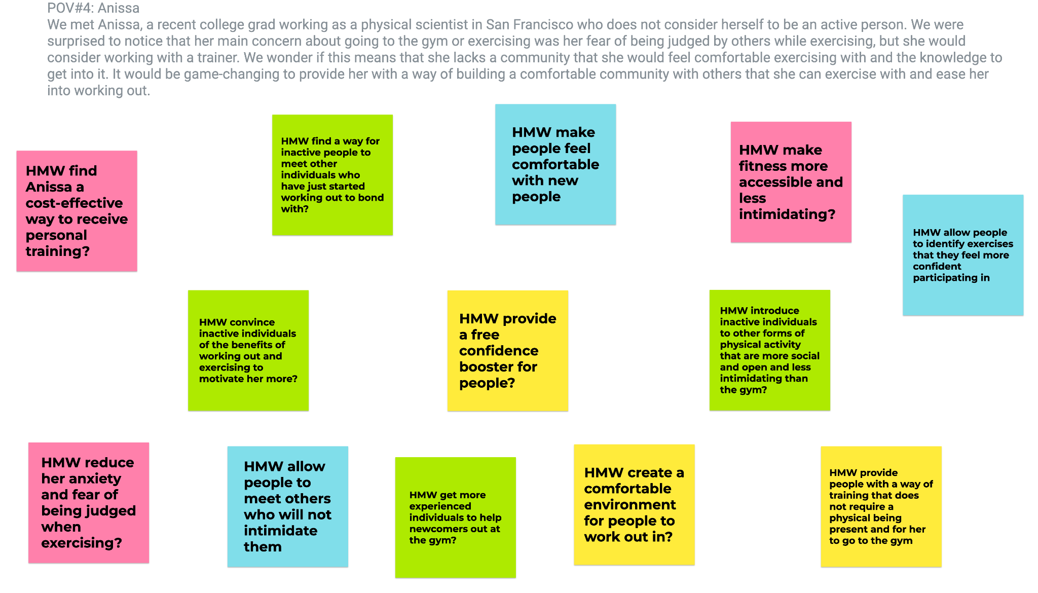
ANISSA’S HMW BRAINSTORM

Slide 54
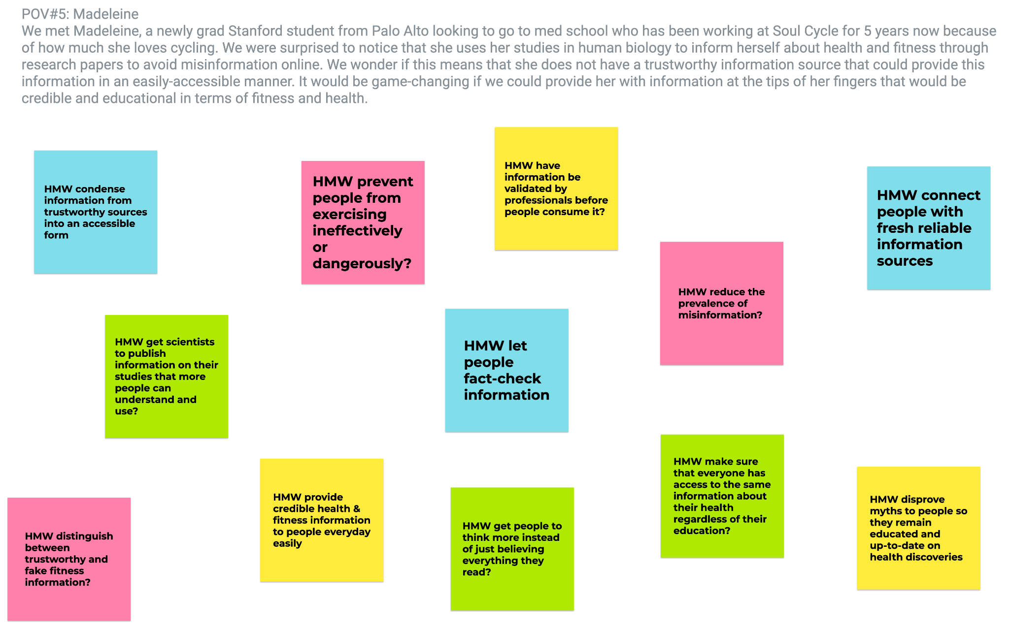
MADELEINE’S HMW BRAINSTORM

Slide 55
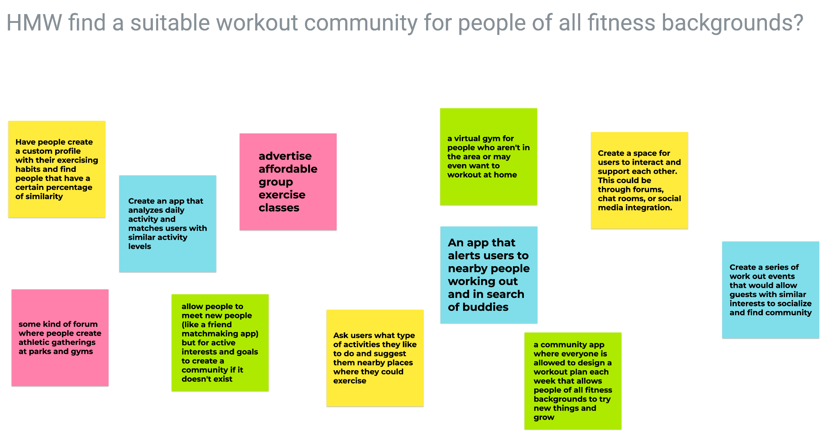
SOLUTION BRAINSTORM #1

Slide 56
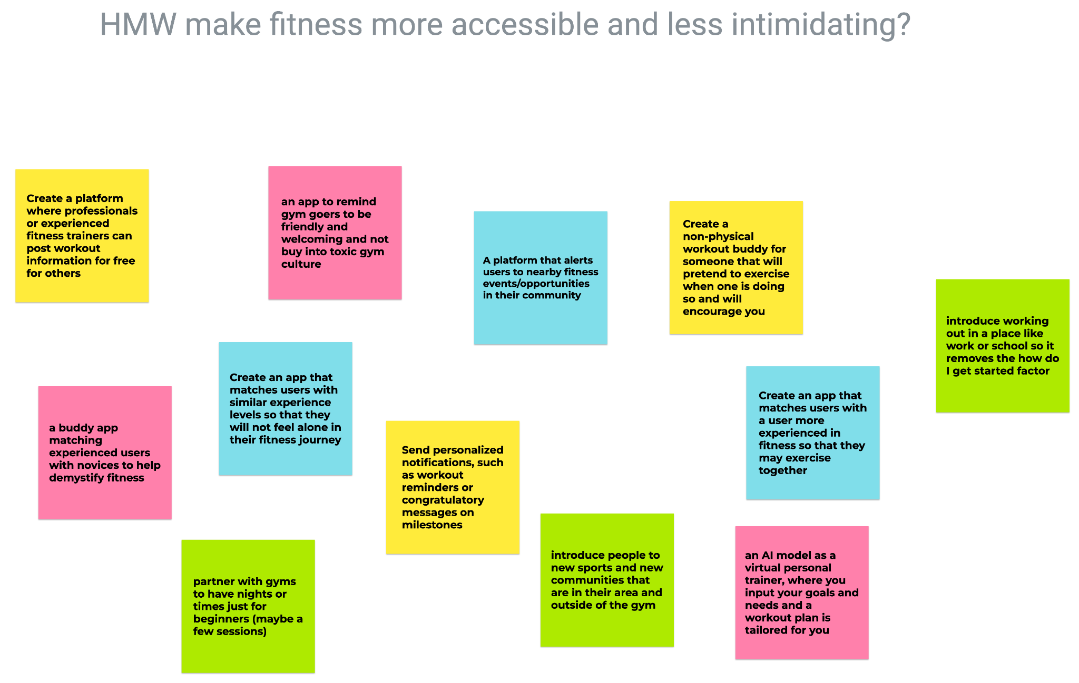
SOLUTION BRAINSTORM #2

Slide 57
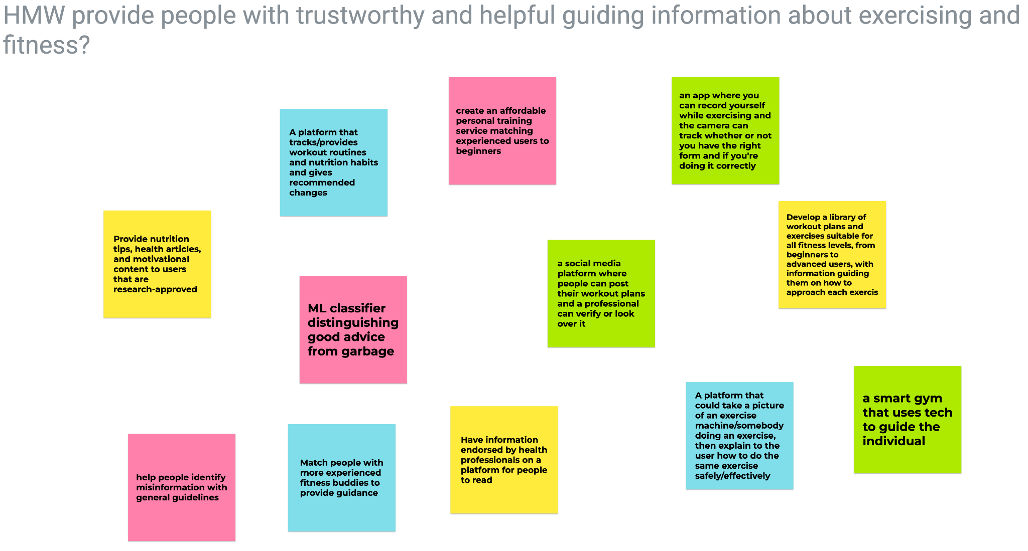
SOLUTION BRAINSTORM #3

Slide 58
POV #4: Jessica
We met Jessica, a full-time nurse manager, who has just started taking up yoga classes in her free time again after a ten-year break. We were surprised to notice that she sees working out beyond college as an opportunity for social networking instead of for the sake of movement and staying active. We wonder if this means that she has a hard time meeting people outside of work or in her day-to-day life. It would be game changing to find her a way to meet like-minded individuals that have the same aim to connect while moving.

Slide 59
POV #3: Jill
We met Jill, a full-time editor at Stanford magazine, who loves staying active and playing soccer despite being a mom of two. We were surprised to notice that she had to keep insisting her neighbors let her join their soccer teams despite being good friends with them. We wonder if this means that she struggles finding a community to play soccer/stay active with. It would be game-changing to provide her a way of easily connecting with people who like soccer as much as she does that are within her proximity and want to play with her.

Slide 60
Solution (for Yusuf’s HMW)
Create a non-physical workout buddy for someone that will pretend to exercise with you and will encourage you as well

Slide 61
Prototype: Stuffed Animal Workout Buddy
Find someone to do a 80 second workout while a stuffed animal of their choosing cheers them on. Let them customize the stuffed animal at the end.

Slide 62
KEY ASSUMPTIONS
Some people don’t enjoy working out with someone else
People find it easier to make new habits when it’s gamified - for everyone, regardless of how they workout

Slide 63
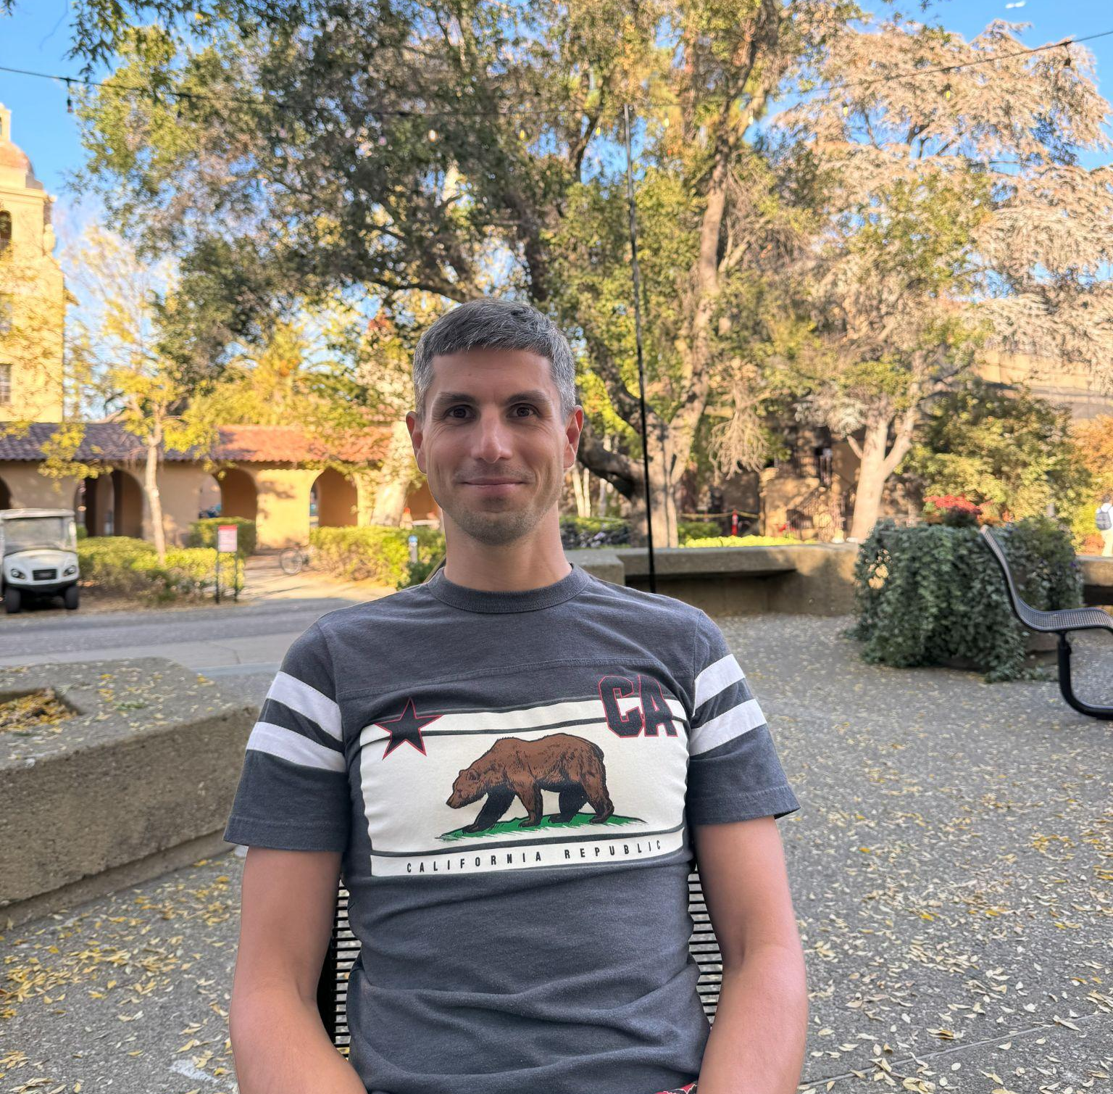
Participant: Igor
Recruited at Tressider
37 years old
Engineering Manager
From Russia
Active individual
  Runs 3x a week
  Tennis 1x a week
  Prefers working out with others

Slide 64

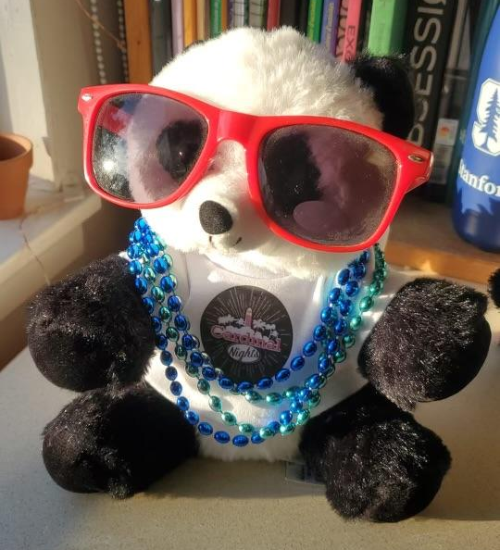
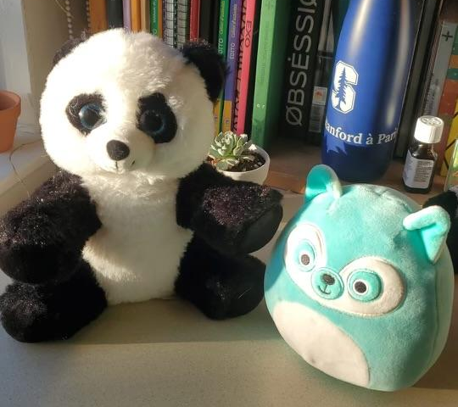
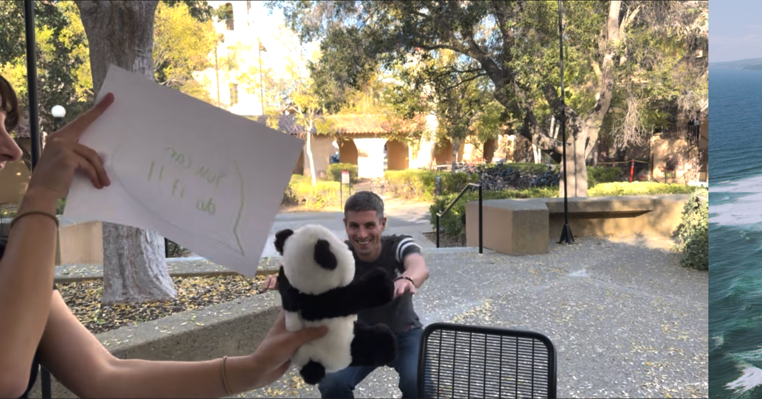
Process
Choose a workout buddy
Do the 2 minute workout
Customize your workout buddy
*text in video says “You can do it!”*
Notes:
Click once to animate and play the video

Slide 65
RESULTS + INSIGHTS
WHAT WORKED
Appreciated the support factor
Felt more positively about working out, especially in the presence of someone else
WHAT DIDN’T WORK
Didn’t like that the interviewers were not working out with him
Hard to find an individual willing to try this out as well as a location
KEY TAKEAWAYS
People won’t enjoy this as much if they already prefer working out others - prefer human interaction more
Customizing the experience made it more fun
The second assumption = true
Weren’t able to test first assumption on an individual who doesn’t like working out with other people, which is our primary audience for this

