Slide 1
Healthy Hustle: Making Moves
CS 147
Needfinding Presentation

Slide 2
Table of contents
01
02
03
04
Introduction
Method
Team and Domain of interest
Methodology for Interviews & Our Participants
Results & Analysis
Key Findings & Summary
Empathy Maps
Insights/Needs & Recap

Slide 3
01
Introduction
Team and Domain of interest

Slide 4
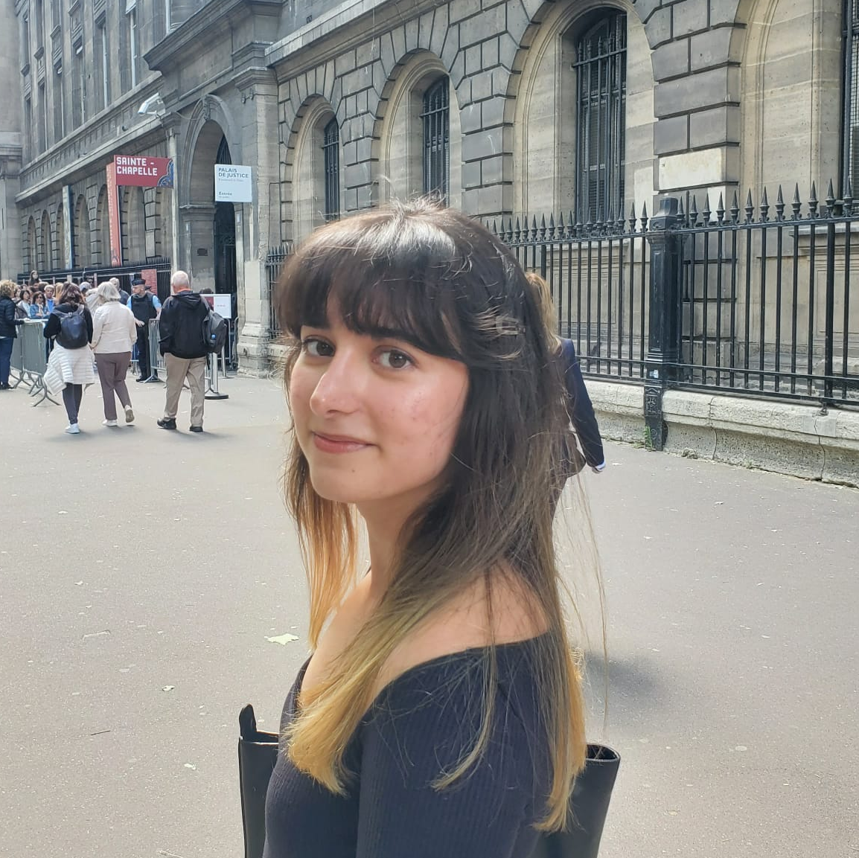
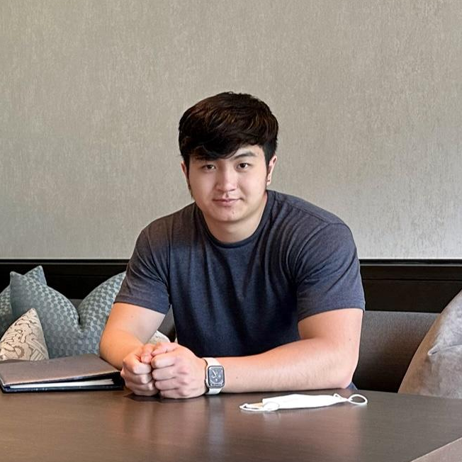

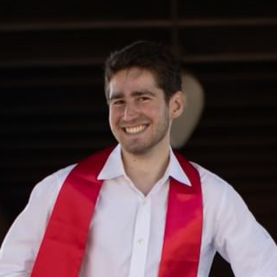
Our team
Christelle Millos-Lopez
Ethan Yuen
Junior
Computer Science
Santa Cruz, Bolivia
Senior
Computer Science
Palo Alto, CA
Akanshya Bhat
Jake Restaino
Junior
Computer Science
Mountain View, CA
Coterm
Computer Science
San Carlos, CA

Slide 5
Domain Selection
Unintentional Good
Relatable and Our Interests
01
03
02
04
Common Personal Goals
Fitness and Activity Levels
Notes:
Why fitness - something a lot of people have in common and can gather a lot of information so many different perspectives, thinking about a broader domain of interest, find common interests and narrow down from there - relatable to all of us -

Slide 6
02
Methodology
How we conducted our interviews

Slide 7
Our participant search
Lifestyle
Diversity
Non-Stanford
Different active lifestyles (sedentary, moderate, intense)
A wide variety of ages (18-65), cultures, and gender identities
Looked for people that were not students at Stanford

Slide 8
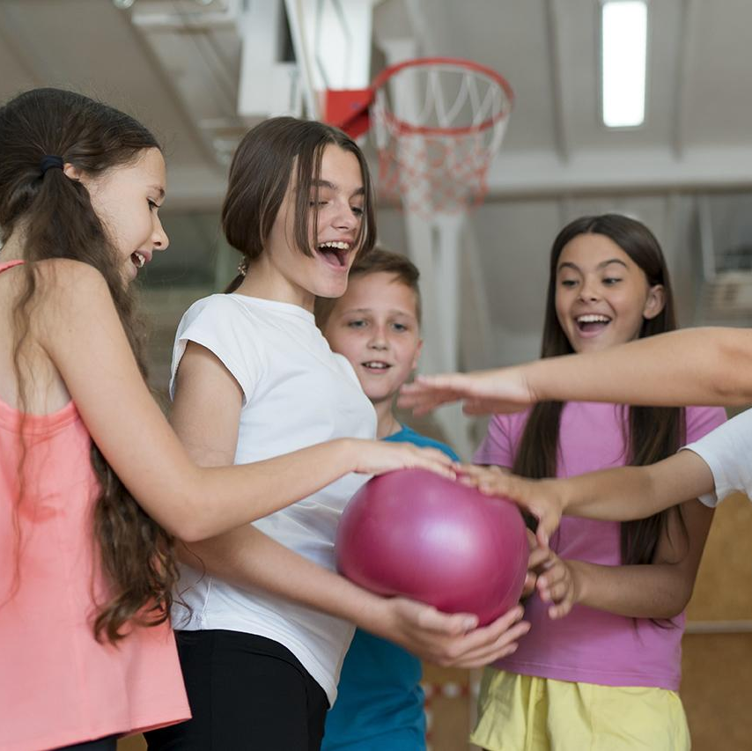
Our Interviews
6 participants
5 in-person, 1 zoom
Each team member led at least one interview
Audio recorded interviews (e.g. Voice Memos) where we had permissions/transcribed

Slide 9

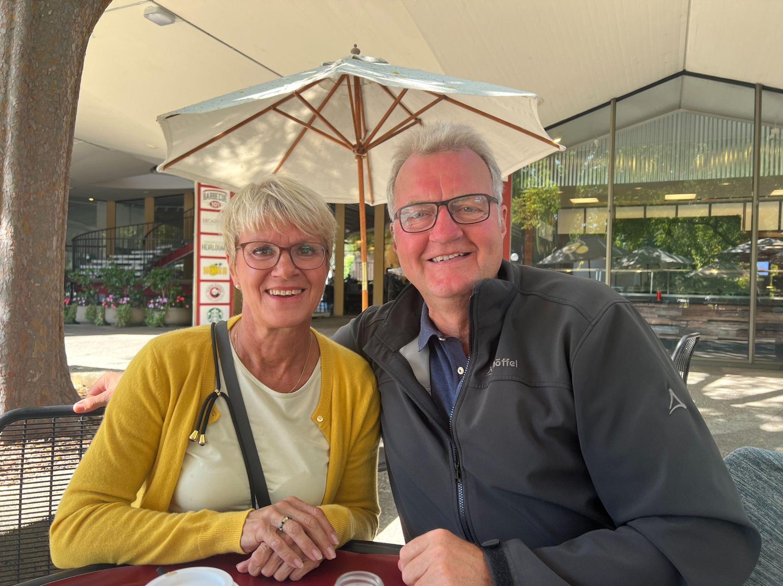
Our interviewees
Bernardino
Sean
Bettina & Achim
Stanford Employee
57 yrs old
San Jose, CA
Banker/DCI Fellow
57 yrs old
Palo Alto, CA
Nurse & Consultant
64 (B), 65 (A) yrs old
Germany

Slide 10
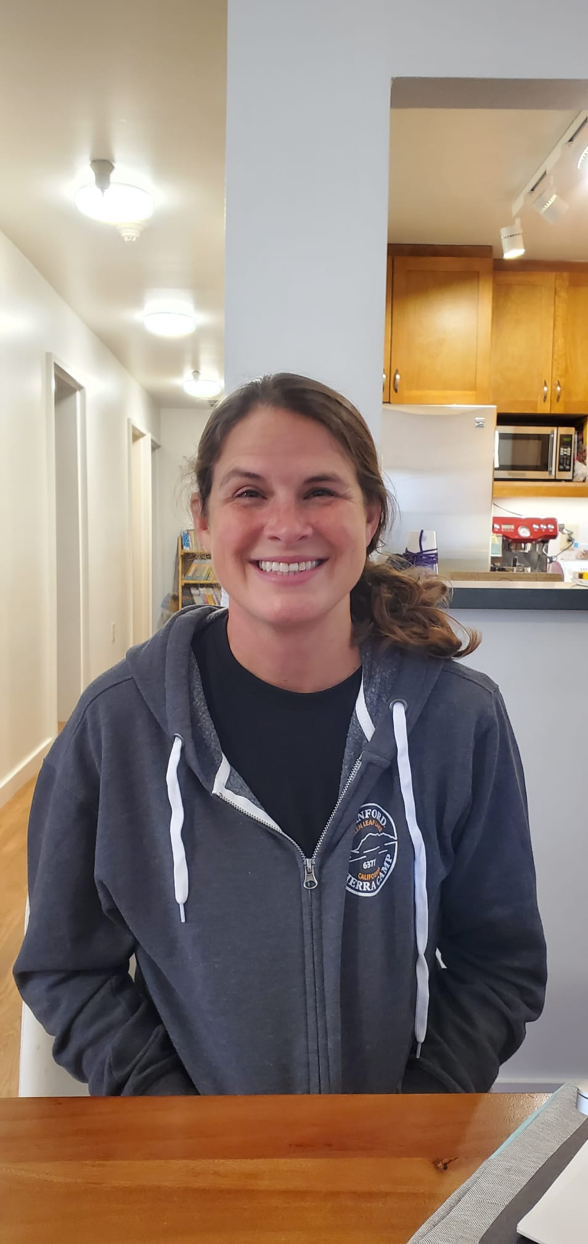
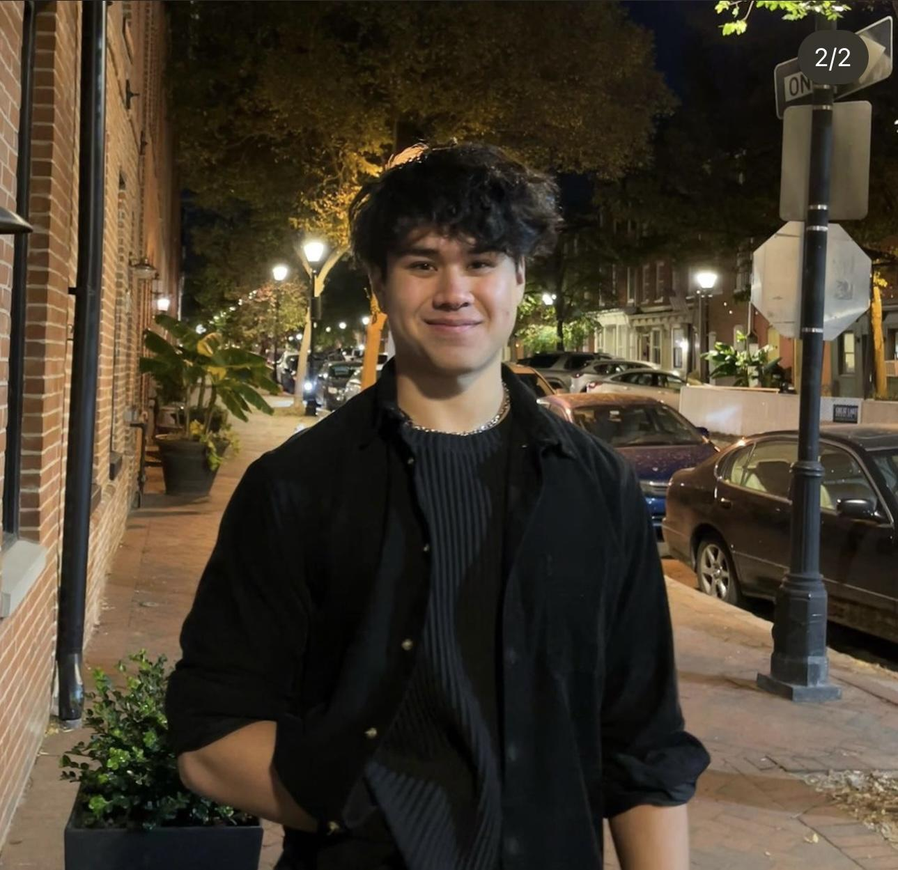
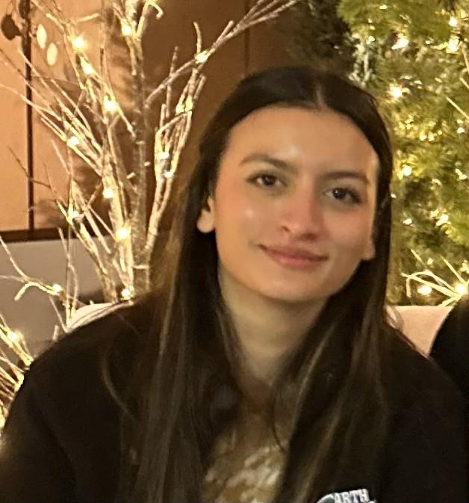
Our interviewees
Jill
Rishi
Anissa
Journalist
45 yrs old
Stanford, CA
Student at JHU
20 yrs old
Baltimore, MD
Physical Scientist
23 yrs old
San Francisco, CA
Notes:
Anissa can be considered an extreme user. She does not consider herself to be an active person and is inexperienced when it comes to the world of exercise. She expressed a lot of apprehension about going to the gym.

Slide 11
We asked them…
Can you tell us about a time you met someone while playing a sport/exercising?
How do you find opportunities to stay active?
Can you walk me through a day in your life?
What do you like/dislike about exercising?
What are some resources you use to take care of your health?
What do you like/dislike about exercising with others?

Slide 12
03
Results/Analysis
Empathy Maps

Slide 13
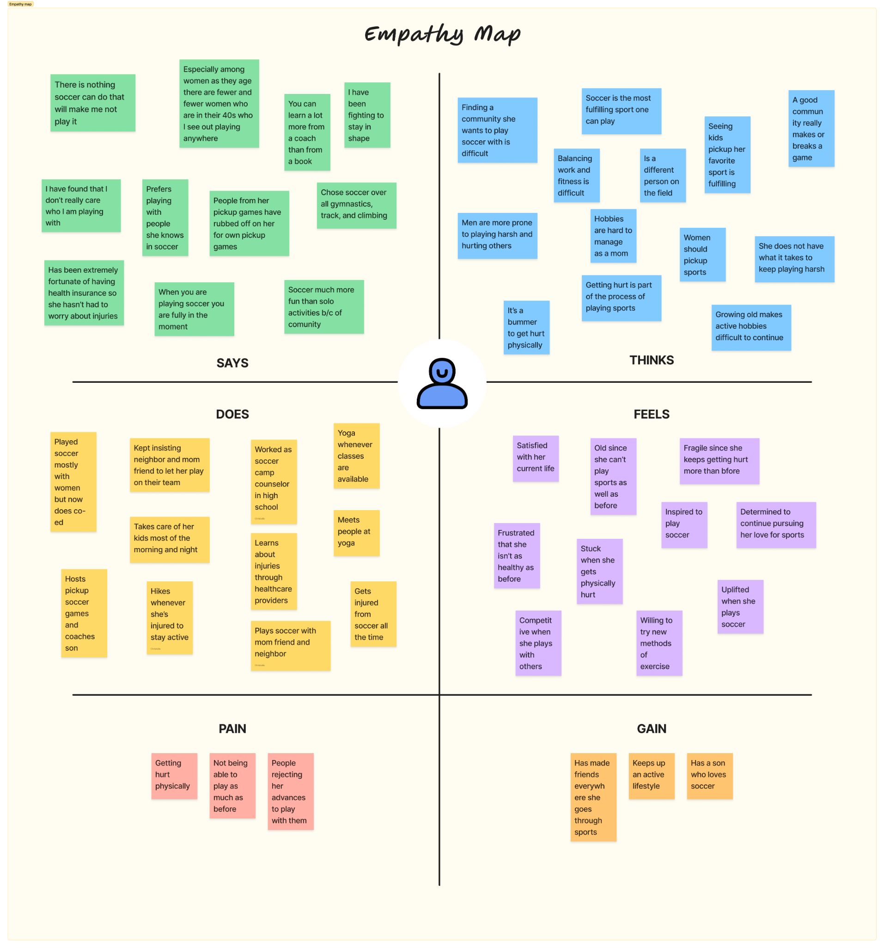
Jill

Slide 14
I have been fighting to stay in shape
Finding a community to play soccer with is difficult
Especially among women as they age, there are fewer and fewer women who are in their 40s who I see out playing anywhere
Does not have what it takes anymore you to continue playing sports like before
SAYS
THINKS
DOES
FEELS
Hikes/climbs whenever she gets injured to stay active
Frustrated that she isn’t as “fit” as before
Kept insisting neighbor to let her play on their team
Determined to continue pursuing her love for sports
Jill

Slide 15
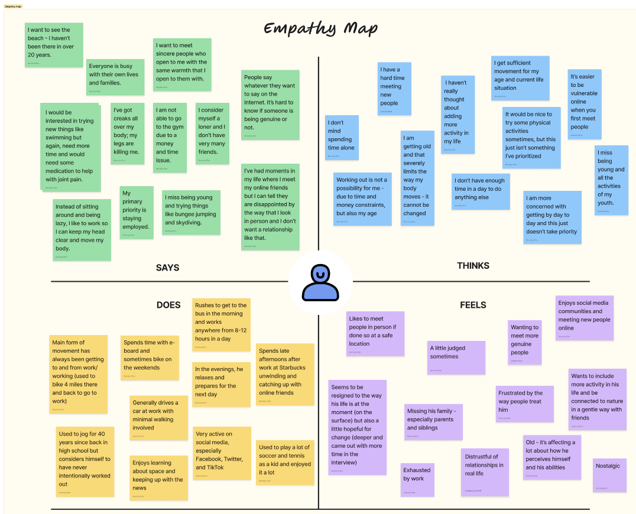
Bernardino

Slide 16
I’m too old to be moving more - everything hurts
I have a hard time socializing and meeting new people
It hasn’t crossed my mind to making movement a priority
Would be nice to try new outdoor activities with friends
SAYS
THINKS
DOES
FEELS
Uninterested in making lifestyle changes
Spends most of his time in a day sitting or driving with limited activity
Rides his bike or e-board on the weekends
Nostalgic of his youth and the activities he used to do/play
Bernardino

Slide 17
04
Key Findings & Summary
Empathy Maps and Insights/Needs

Slide 18
Key patterns
Insight #1
Need #1
The way you perceive your age affects your activity levels.
People need a source of empowerment and education to know what their bodies are capable of.

Slide 19
Key patterns
Insight #2
Need #2
People are not actively looking to make change in their lifestyle; they are content with where they are at the moment.
“It is the way it is.”
People need some way to motivate them or spark interest in their lives that will inspire change.

Slide 20
Key patterns
Insight #3
Need #3
Lack of exercise experience and subsequent fear of being judged are major obstacles for newcomers
People need a comforting, welcoming, and informative environment as beginners to working out.

Slide 21
Key patterns
Insight #4
Need #4
Time and money are obstacles to an active lifestyle.
People need to be informed about other forms of accessible activity available to them.

Slide 22
In summary…
We talked to 6 people about their current lifestyles and relationships with exercise
We found that time, age, and community were common factors that either motivated or prevented people from remaining active
Building relationships with people one can remain active with is paramount to people

Slide 23
Thanks!
Any questions?
Please keep this slide for attribution

Slide 24
05
Appendix
Key Quotes, Artifacts/Pictures

Slide 25
Appendix
Empathy Maps (all in our group submission drive)
Key Quotes, Pictures/Artifacts from each of our interviews (in the next slides)
Extreme User details: Anissa can be considered an extreme user. She does not consider herself to be an active person and is inexperienced when it comes to the world of exercise. She expressed a lot of apprehension about going to the gym. Rishi can also be considered an extreme user in the opposite sense as he is an avid gym user as a bodybuilder. He enjoys making connections in the gym and growing his fitness abilities.

Slide 26
—Jill
“Climbing isn’t as motivating for me–as much as I love doing that activity–because I don’t have a community of people around that I go with and enjoy doing it together, whereas I do have that for soccer.”

Slide 27
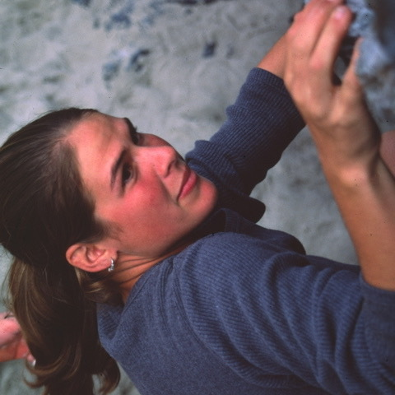
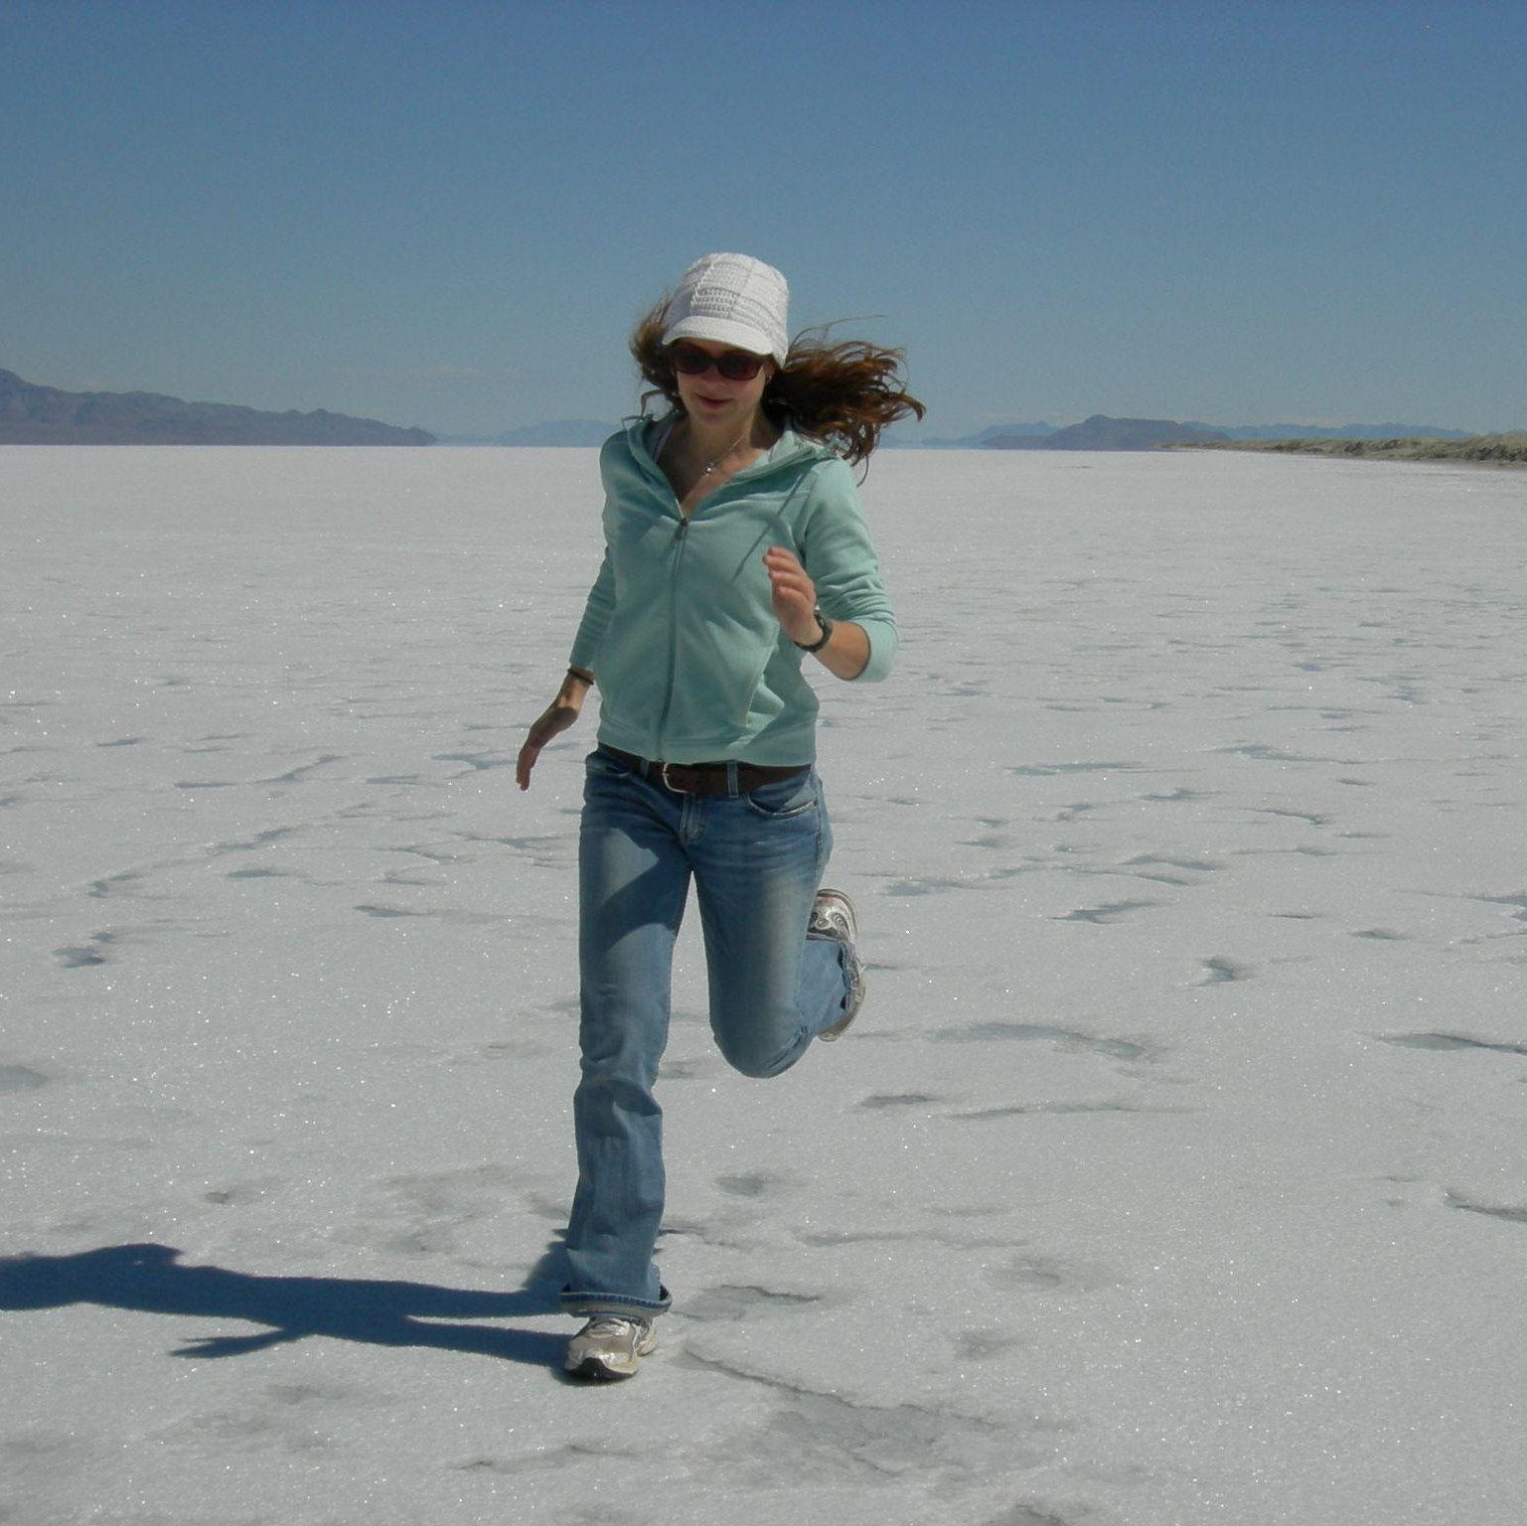
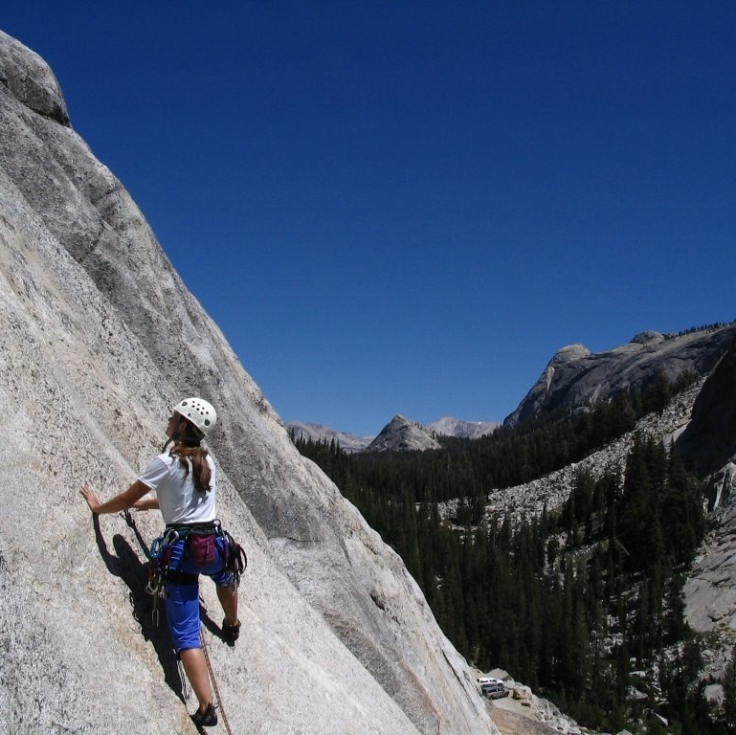
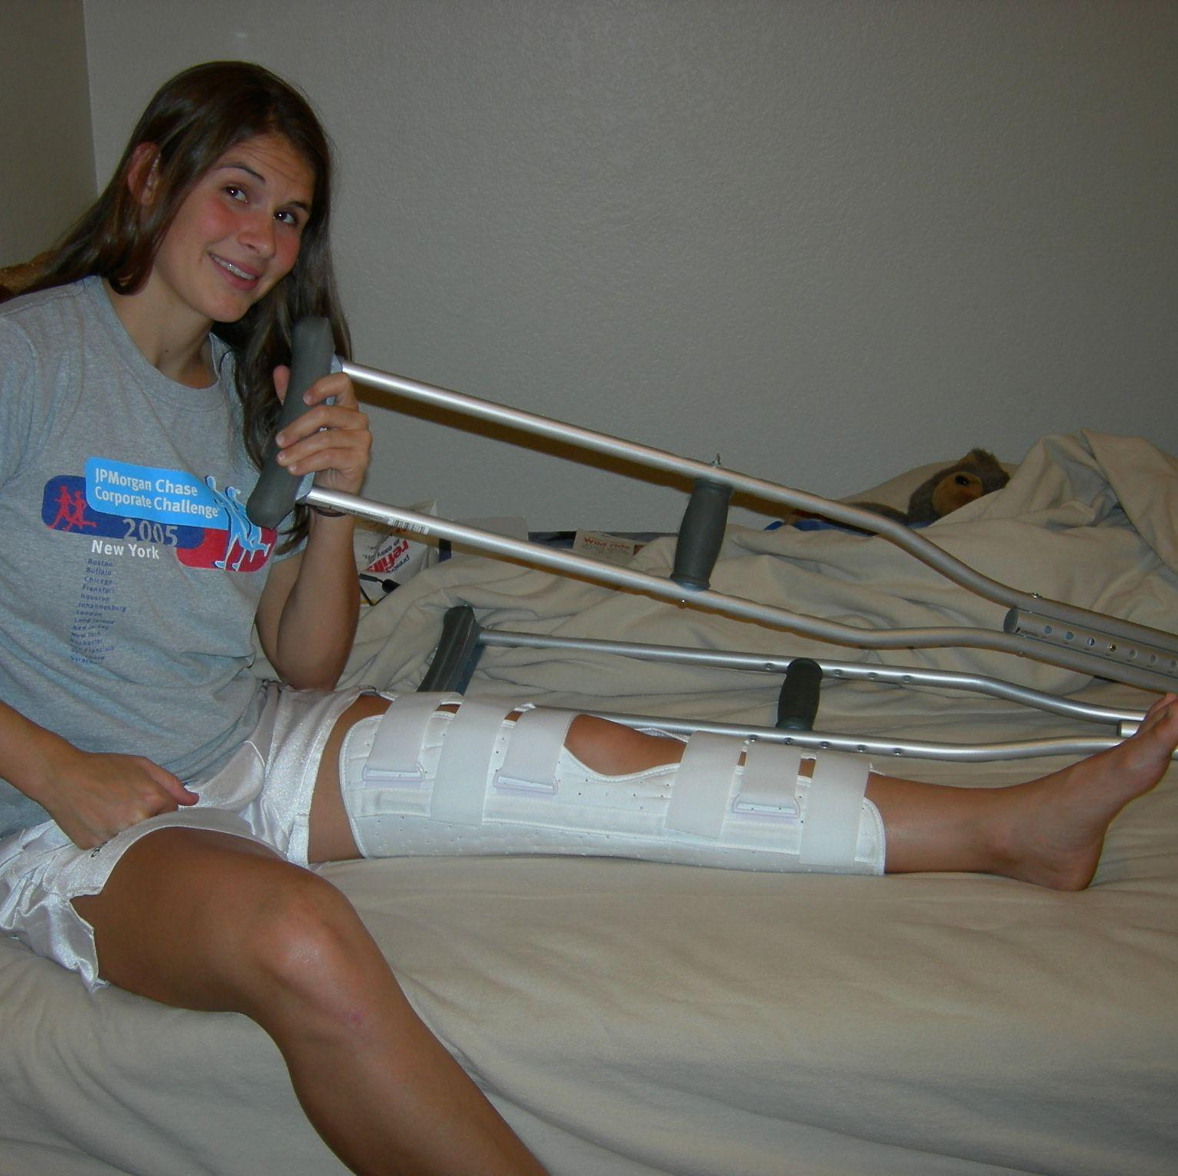

Slide 28
—Bettina & Achim
“We have passed through the Alps two times… together with friends. It’s much better with them because of the joy - we can share the emotions, the successes, and the views across the Alps.”

Slide 29
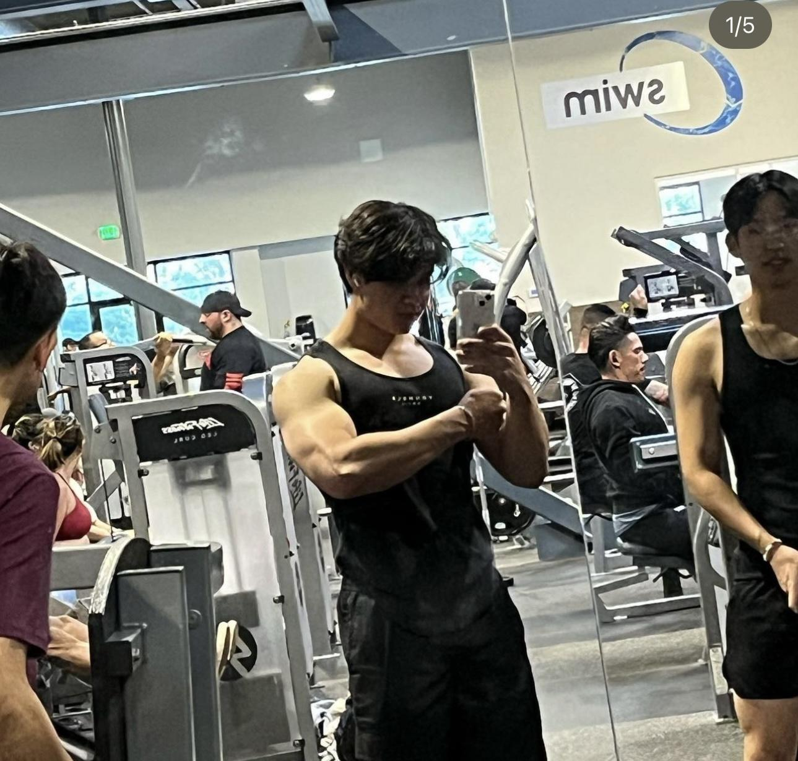
—Rishi
“Working out with the right people can make the experience more motivating and more enjoyable. Speaking for a broader audience, most people who are newer to the gym might feel less anxiety working out with someone else.”

Slide 30
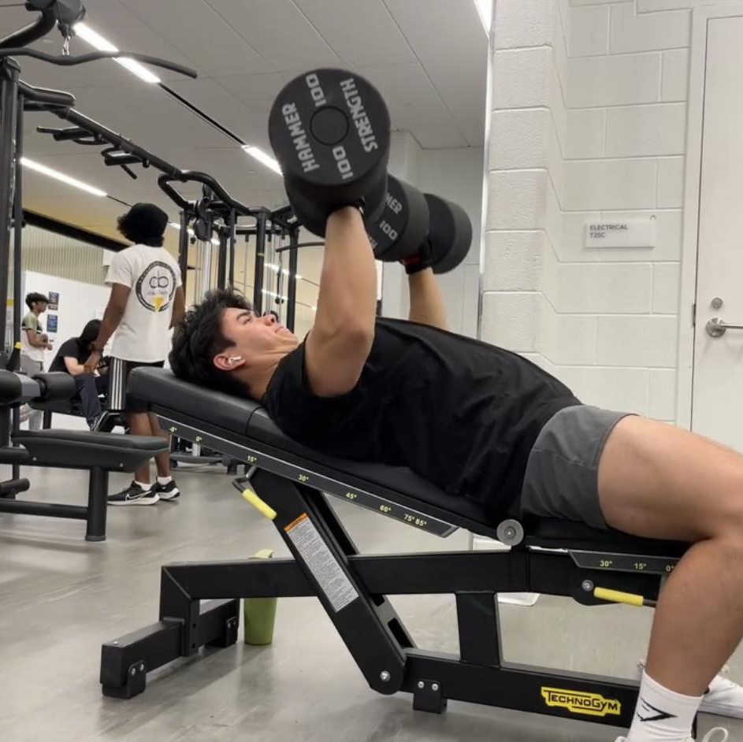
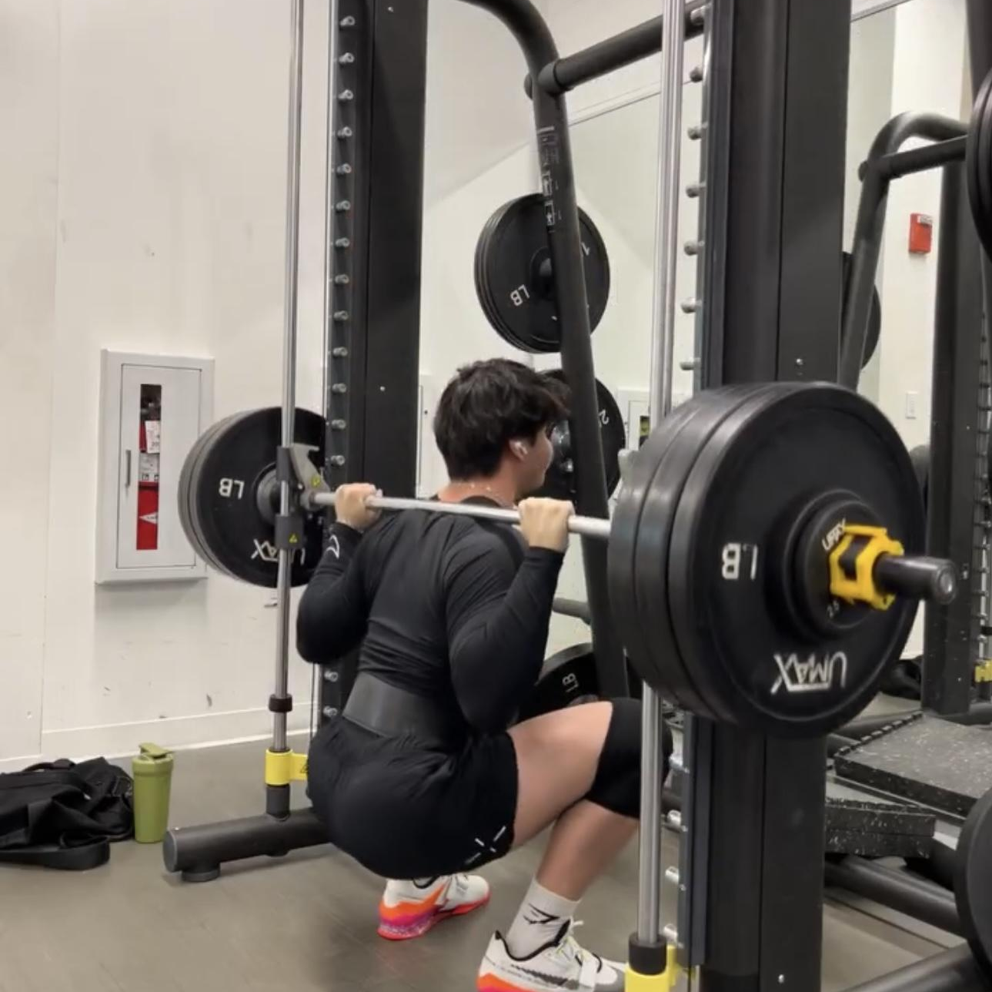
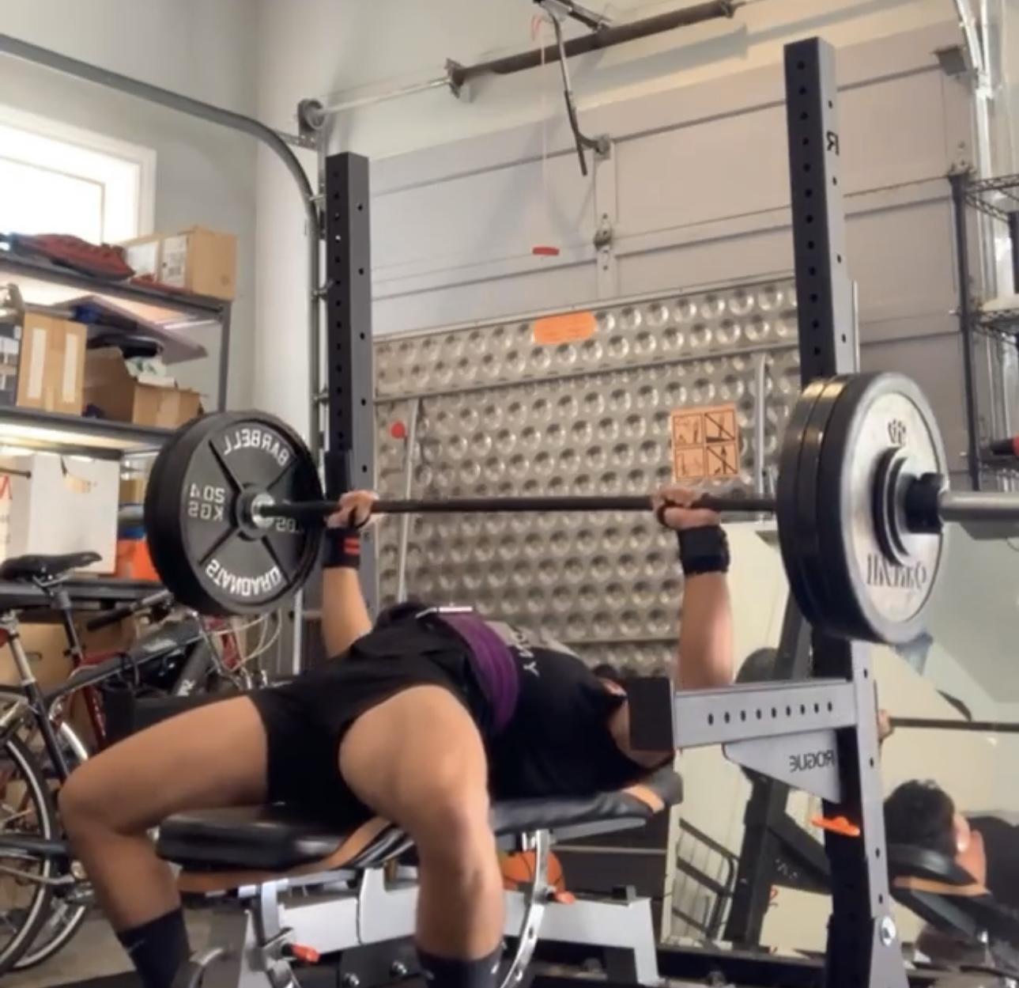

Slide 31
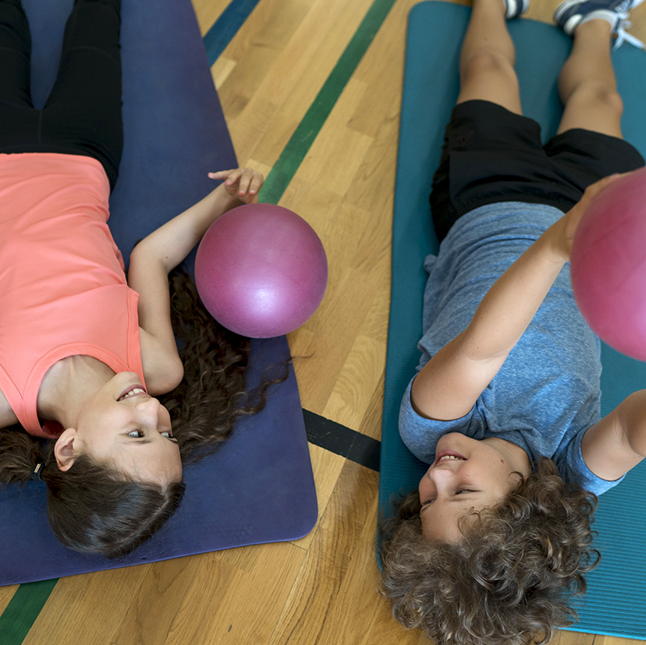
—Sean
“I think I’m addicted to running. Whenever I stop running, I am absolutely miserable.”

Slide 32
—Anissa
“I feel like people are watching or judging me.”
“[Would I work with a trainer?] No, I don’t think so… well, maybe.”

Slide 33
—Bernardino
“My priority is making sure I have a job and staying employed… I don’t have the time or money for things like the gym.”

