Slide 1
A8: kin
Team 3 – Jack Clark, Shuvi Jha, Jasmine Narine, Steven Pu

Slide 2


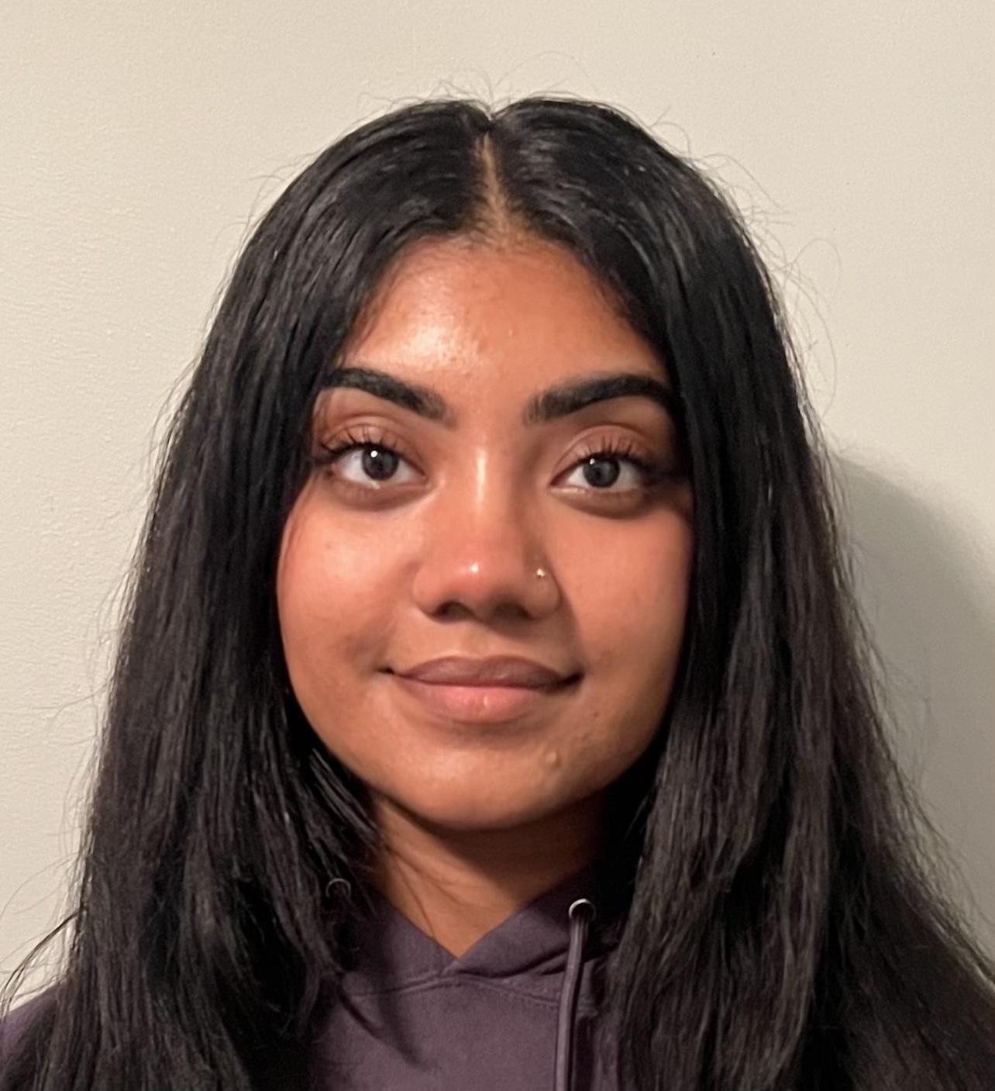
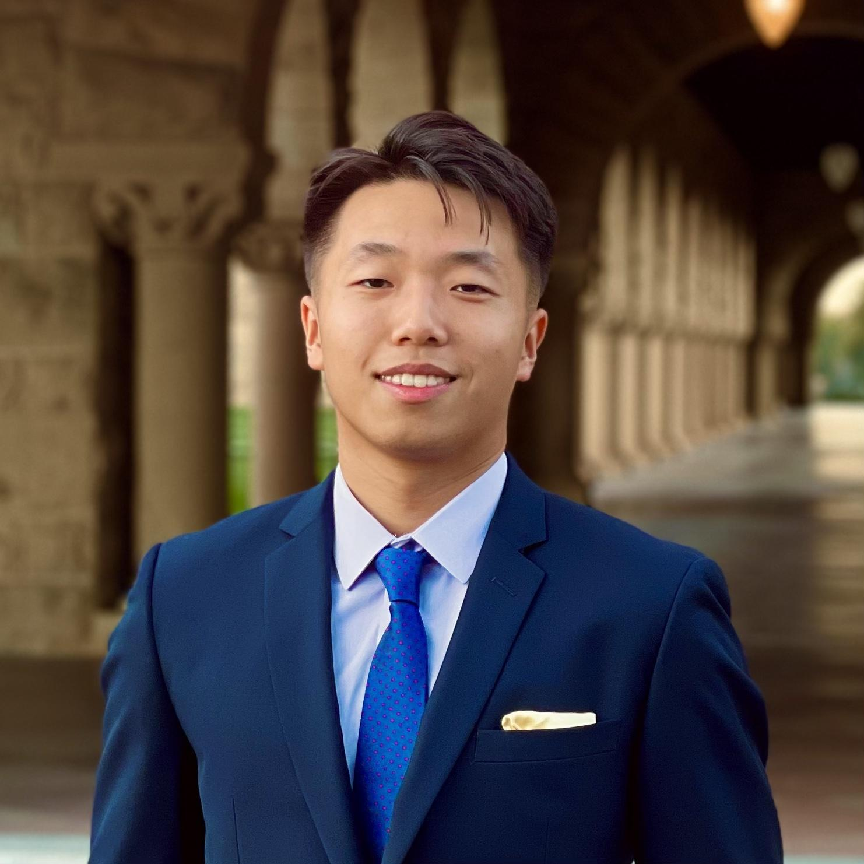
The team
Jack Clark
Shuvi Jha
Jasmine Narine
Steven Pu
MS CS (HCI)
BS MS&E
CS (HCI); Feminist, Gender, & Sexuality Studies
Senior
SYMSYS (HCI)
Senior
SYMSYS (HCI)
Senior

Slide 3
Value Proposition
kin
“Weave your family story one thread at a time”
“kin seeks to make the uncovering of family stories inviting by initiating daily, bite-sized conversations that facilitate and chronicle our familial connections”

Slide 4
Problem and Solution
It can be difficult for people to learn, share, discuss, and preserve family stories in a way that feels engaging and rewarding, especially across generations – specifically, young people and the elderly.
Problem
A tool focused on helping family members share memories through prompts and collaboration. Users can engage with prompts, read family prompts, and add their own prompts to the system to facilitate family interactions and preserve memories.
Solution

Slide 5
Presentation Outline
01
02
03
HE Results
Revised Design
Prototype Implementation

Slide 6
01
HE Results

Slide 7
HE Statistics
Total Violations: 57
Severity 1: 22 violations
Severity 2: 24 violations
Severity 3: 10 violations
Severity 4: 1 violation
Task 1 [Responding to a Prompt]: 36 violations
Severity 1: 11 violations
Severity 2: 15 violations
Severity 3: 7 violations
Severity 4: 1 violation
Task 2 [Responding to Family]: 14 violations
Severity 1: 7 violations
Severity 2: 5 violations
Severity 3: 2 violations
Severity 4: 0 violations
Task 3 [Submitting Prompt]: 7 violations
Severity 1: 4 violations
Severity 2: 4 violations
Severity 3: 1 violation
Severity 4: 0 violations

Slide 8
HE Summary
Design & User Interface
Design emphasis on simplicity makes tasks easy to understand
Audience-friendly design elements like appropriately sized text and icons
Aesthetically pleasing with use of monochromatic color scheme
Usability & Functionality
App needs clearer ways to distinguish between user and family members’ responses
“Propose a Prompt” task is confusing
User Experience Enhancement
Suggestions include adding visible word limit, making icons easier to understand, providing clear error messages
Communication & Community Building
Need for better communication of app’s mission of connecting family members, suggested through addition of an intro page or banner on home screen

Slide 9
HE Changes We Addressed
We prioritized all 11 Severity 3 and 4 Violations in our revised design. Major violations of focus include:
User Control & Clarity Issues: Users may struggle with limited editing options and confusing tasks, such as recognizing logos and understanding prompt instructions.
Accessibility & Interface Consistency Concerns: Visually-impaired users may face difficulties with disappearing messages, and the app shows inconsistent responses to user actions.
Major Error Prevention Issues: A major design issue caused confusion by displaying all response formats in a single box, leading to potential errors in user input.
Many of the Severity 1 and 2 violations were cosmetic & quick to fix, focusing on standardizing terminology & aesthetic.

Slide 10
HE Changes We Didn’t Address
Our evaluators stressed for the need to better communicate the app’s mission of connecting family members. We received the following, non-HE-related suggestions:
Intro Page for Value Proposition: Creating an introductory page to detail Kin's mission of connecting family members.
Banner on Home Screen: Adding a banner on the home screen to emphasize Kin’s values of connecting generations.
We won’t be addressing these changes in the next iteration of our design because we want to prioritize critical usability requirements first, especially within our limited time and current project scope.
We are more interested on focusing on immediate needs as indicated by our evaluators.

Slide 11
02
Revised Design

Slide 12
Tasks - No major structural changes
Simple:
Answer a prompt
Moderate:
Reply to an answer
Complex:
Submit your own prompt
The biggest card on the home page immediately prompts the user and is clickable, allowing them to answer. Answer options are text, photo, file, or Spotify attachment.
The second-biggest section on the home page allows a user to expand other answers and reply to them. Reply options are text, audio, or “likes”
Relatively small and in the bottom right of the home page is the “Propose a prompt” button. This page allows the user to submit their own prompt that has the potential to be asked in the future.
Notes:
Our complex task is proposing a custom prompts. The default on the app will be AI-generated prompts, one per day. At all times on the home page, the “Propose a prompt” button will be in the button right. Anyone in a group can propose a prompt that then will be put into a hopper of potential prompts. Each day, there will be a drawing of sorts where a prompt is randomly chosen.
We prefer that human-generated prompts are asked, so if a human were to submit a prompt, it would virtually never be beaten out by one of the AI-generated ones. In practice, we envision the “propose a prompt” button to essentially add prompts to a queue where the prompt at the front of the queue is removed and then asked each day.

Slide 13
Recall: Our usability goals
Goal #2: Robustness
Goal #1: Efficiency

Slide 14
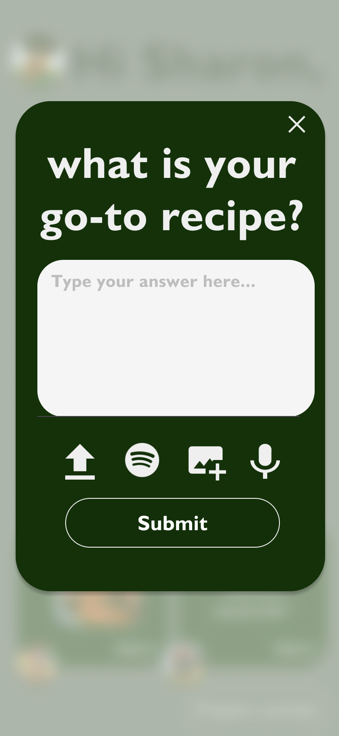
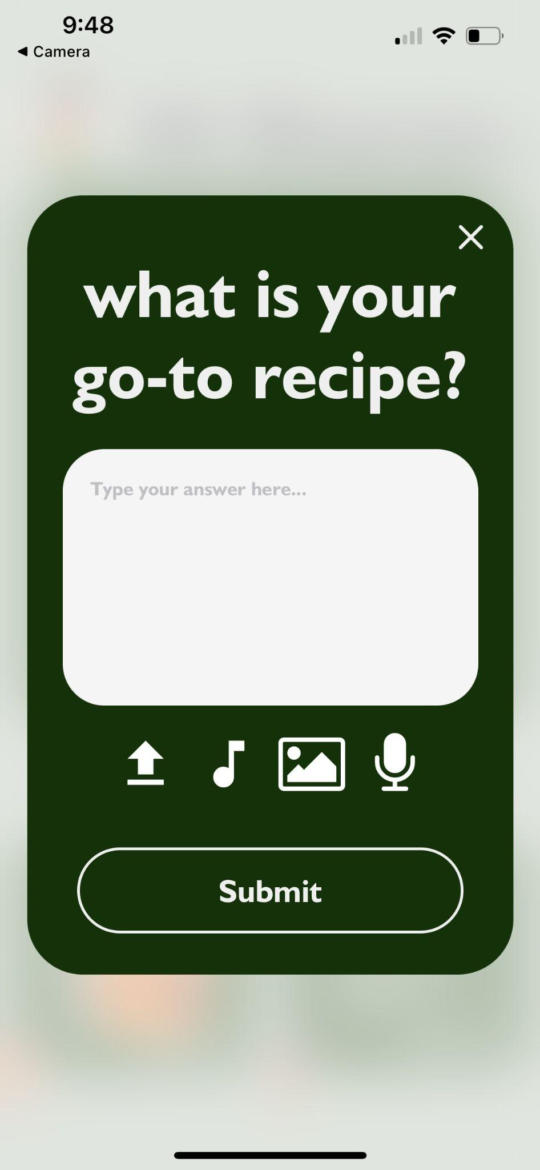
Change #1: Icons
Why?
Spotify is too brand-specific
Want to be as inclusive as possible
Prevent alienation of users
Usability Goal?
Robustness
Reduce error rates for non-Spotify users
before
after

Slide 15
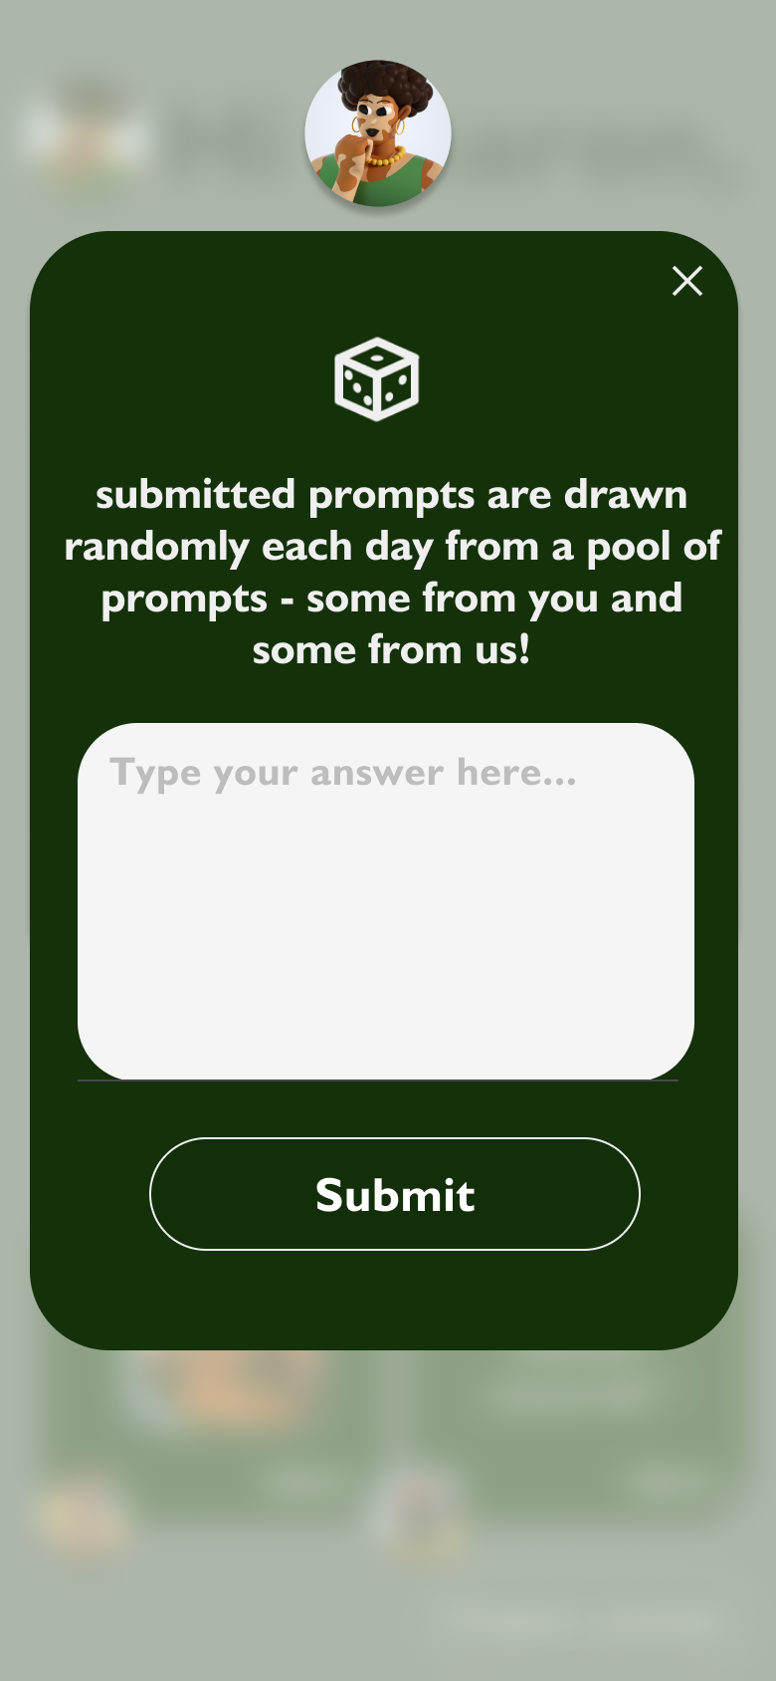
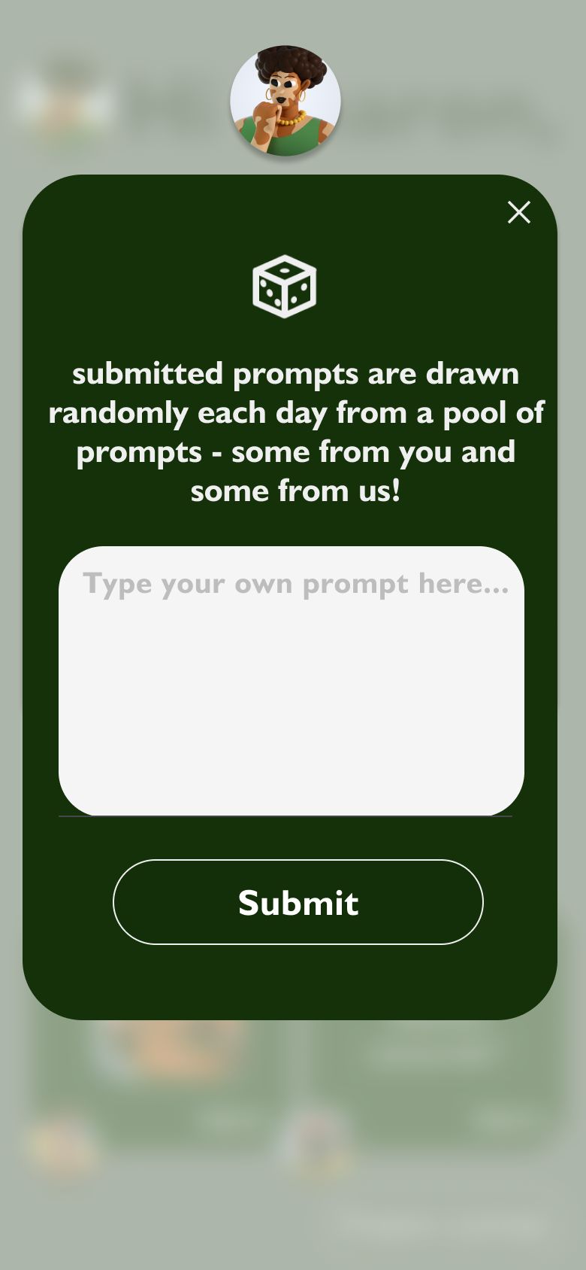

Change #2: Submitting Prompt Wording - TBI
Why?
Felt confusing to refer to original prompt as an “answer” - no question asked
Usability Goal?
Robustness
Reduce user confusion about submission of prompt
before
after

Slide 16
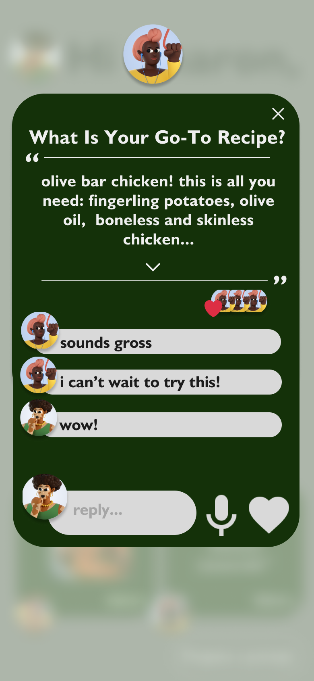
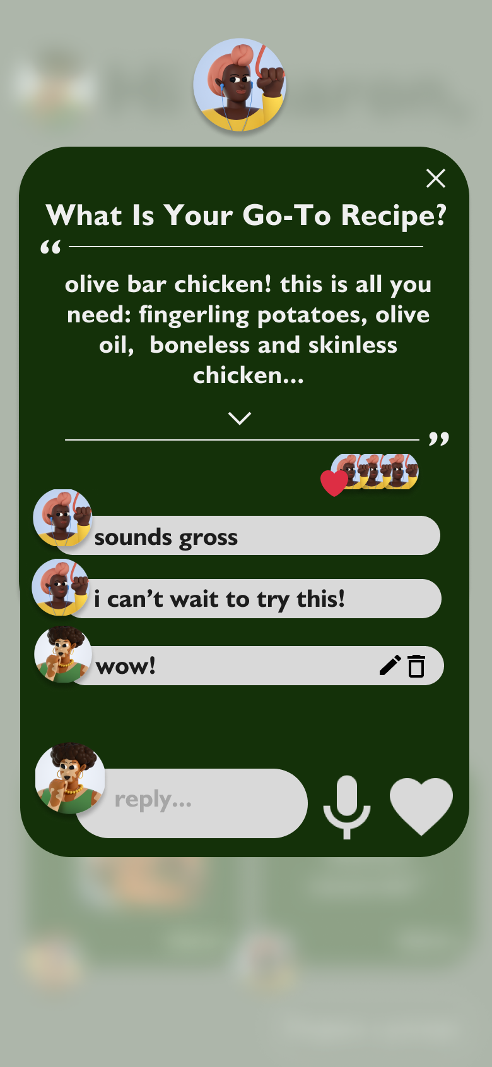
Change #3: Edit/Delete Comments - TBI
Why?
Ensure user freedom
Users have full autonomy over responses, even after submission
Usability Goal?
Robustness
Allow user to recover if they made an error in their comments
before
after

Slide 17

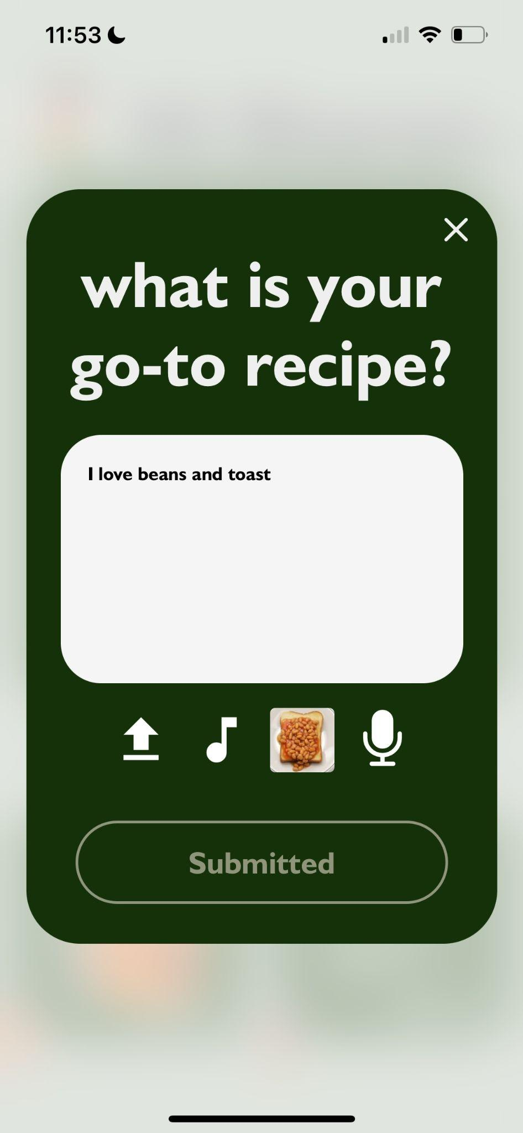
Change #4: Submit
Why?
Confusing -> might make users believe they can submit more than one response
Not the case
Usability Goal?
Robustness
Prevent users from making the error of pressing the submit >1 time
before
after

Slide 18
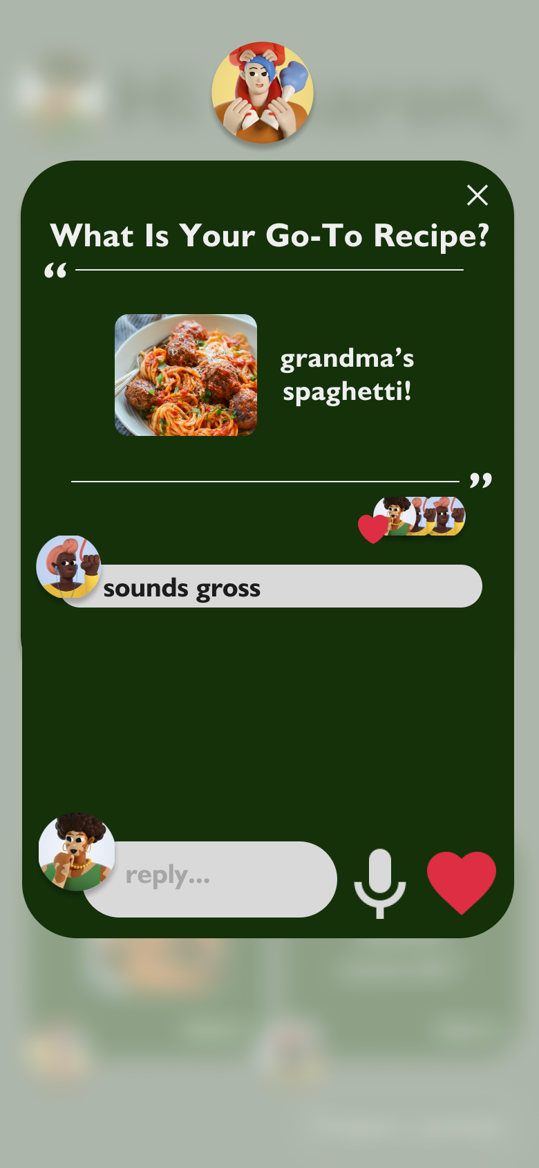
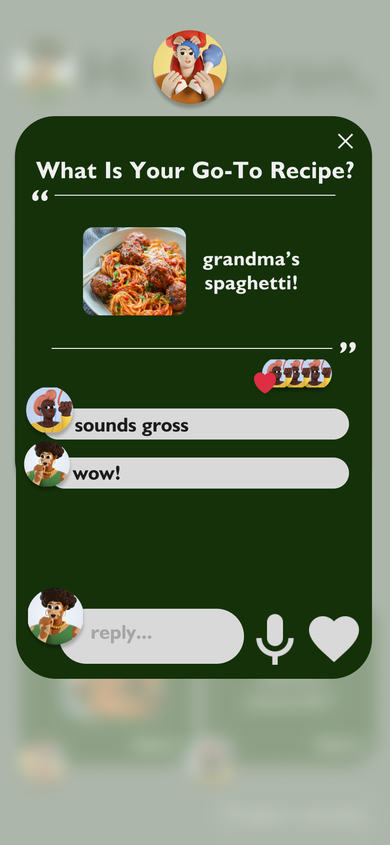
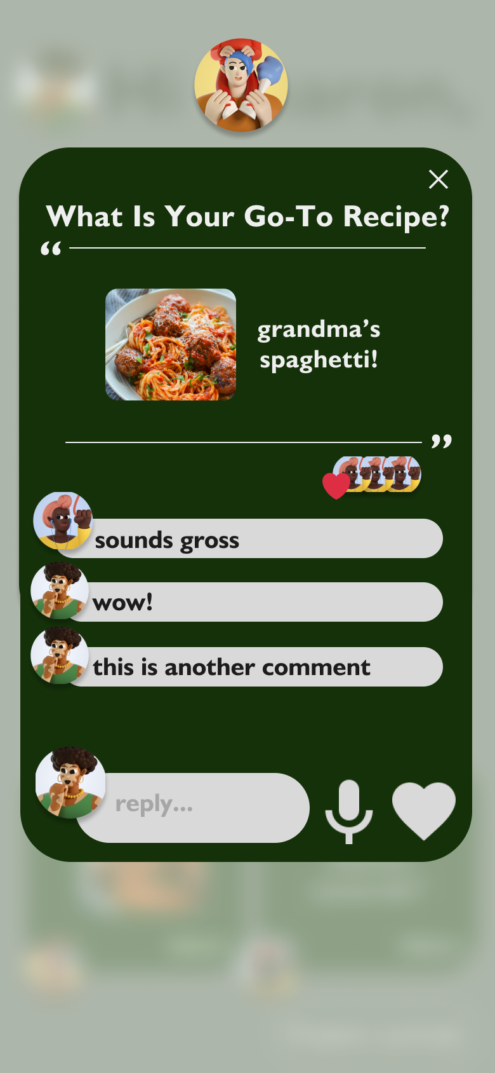
Change #5: Submit Multiple Comments - TBI
Why?
User Freedom
Not limit users to express thoughts in 1 comment submission
Usability Goal?
Efficiency
Users can quickly add as many comments as they’d like
before
after
Notes:
We always intended this to be a feature, but we just never designed it in our Figma.

Slide 19
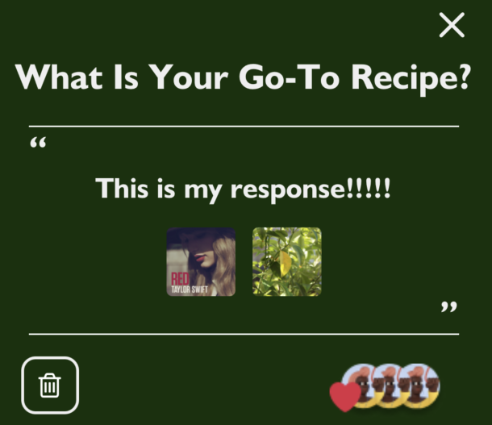
Change #6: Modify upload
Why?
User Freedom
Users can change their mind
Error Handling
Users can correct mistakes in their answer
Usability Goal?
Robustness
Reducing error rates and providing user flexibility
before
after

Slide 20
Heuristic violations we ignored
Allow multiple uploads from the same media type
Allow users to go see prompts they have submitted
Harmful because too many uploads would clutter the otherwise simple interface. Four total attachments (file, song, photo, audio) as a maximum is plenty.
Ruins the lottery type feel of the submission system - ideally, we want users to be pleasantly surprised when they open the app and see a prompt they’ve previously submitted
Notes:
We always intended this to be a feature, but we just never designed it in our Figma.

Slide 21
03
Prototype Implementation

Slide 22
Tools Used
Figma
GitHub
VSCode
We used Figma to design our components and to act as a model when we coded.
We have a central repository where we push our individual updates to. This makes it easier for us to track changes.
VSCode allows us to produce code files and debug errors from Expo.
React Native
Expo
This is our application framework.
Expo allows us to visualize and realize our app in real-time.

Slide 23
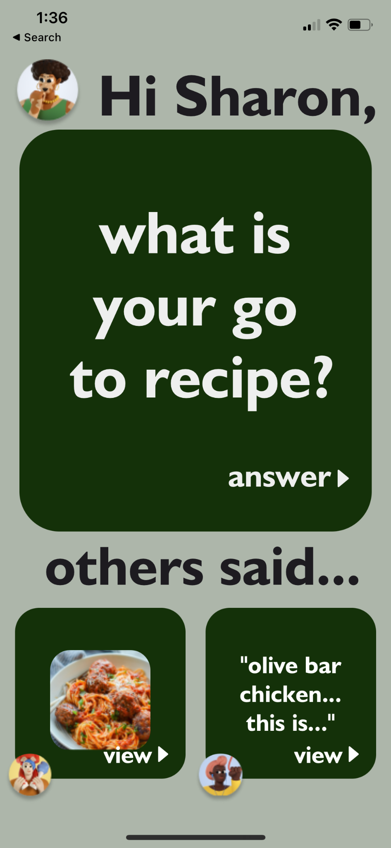
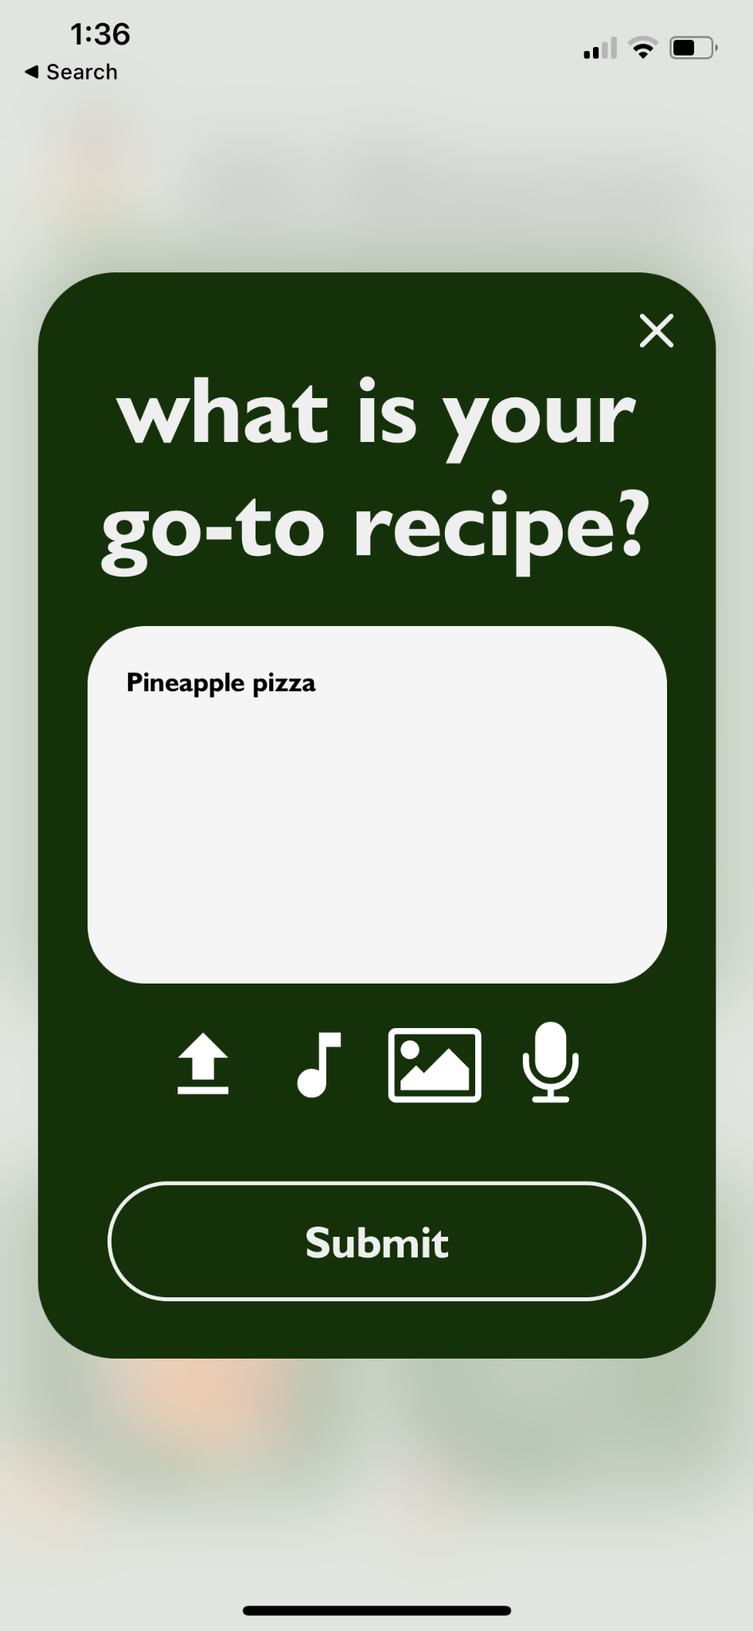
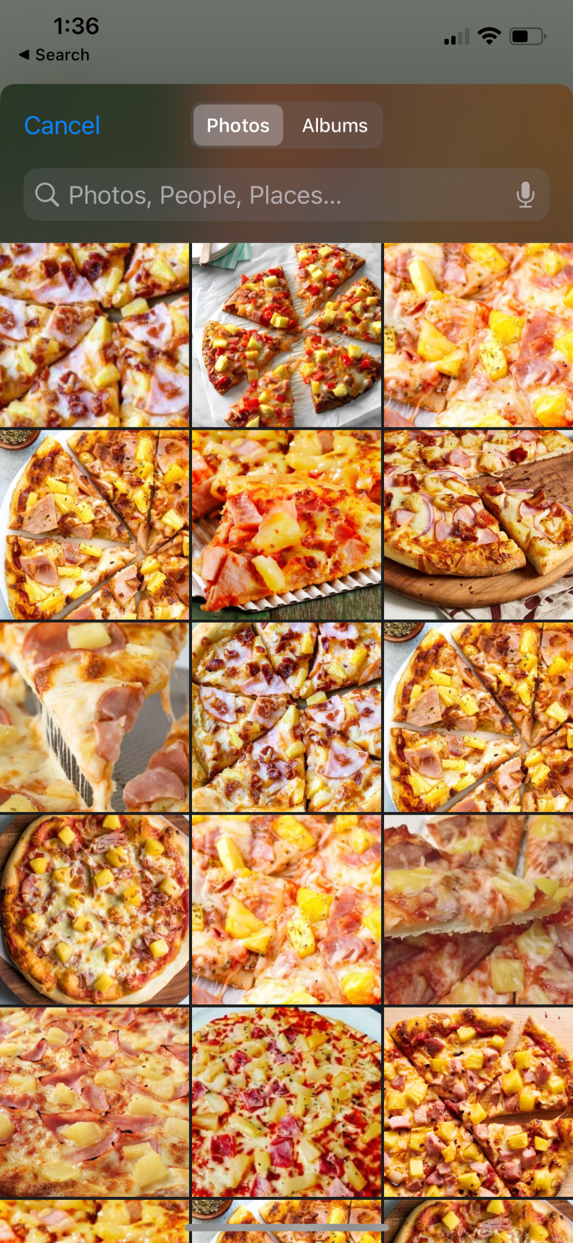
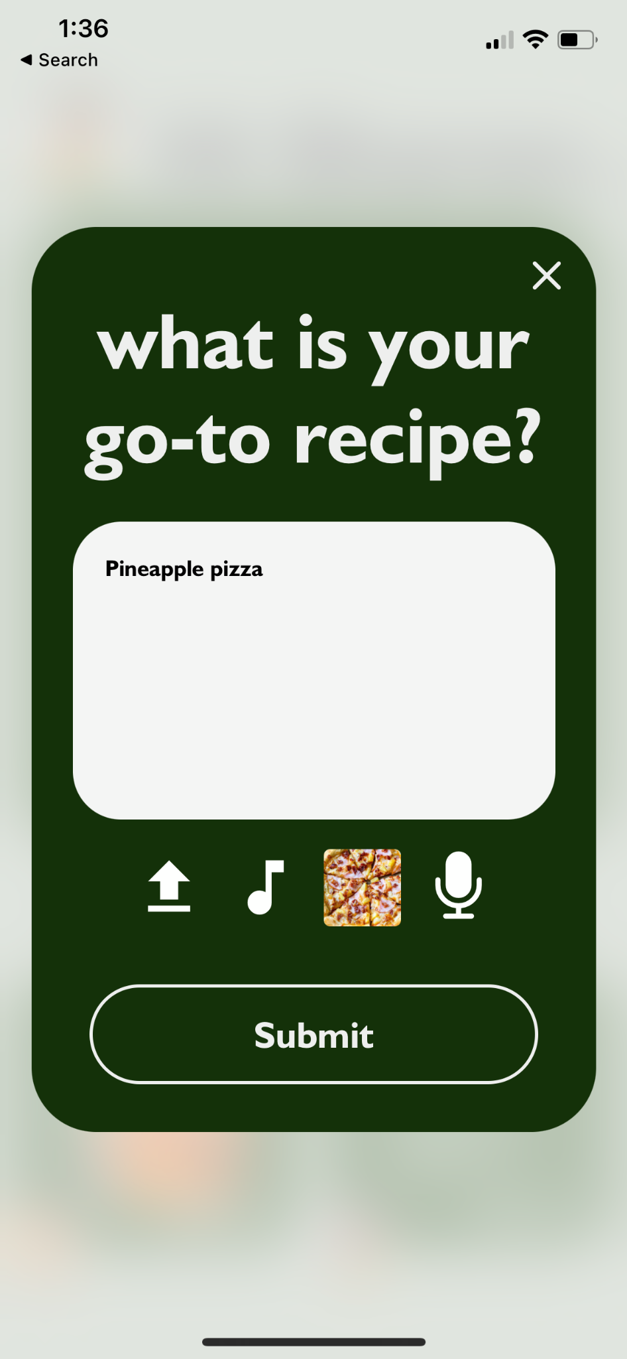
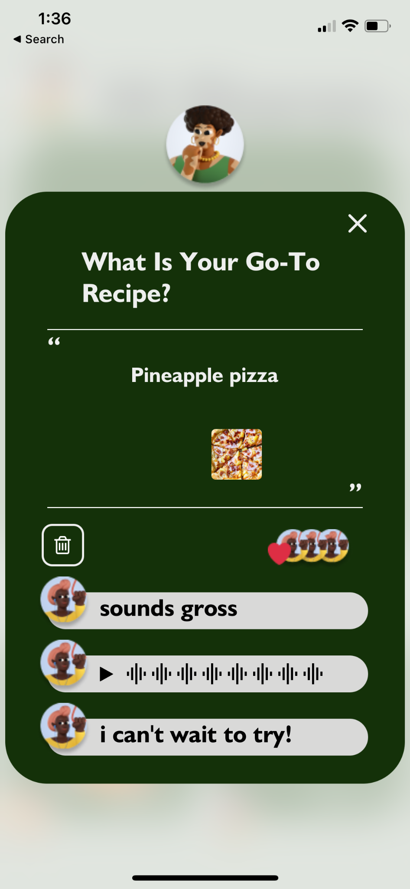
Task 1 Visual Flow

Slide 24
We Implemented Task 1
Functionality
NEW: Users can attach any combination of 5 different forms of media: text, file, music, photo, audio.
NEW: Users can search files and photos through APIs.
NEW: Users can undo an answer and optionally re-answer with different inputs
Users can view likes and replies that others have left on their answers

Slide 25
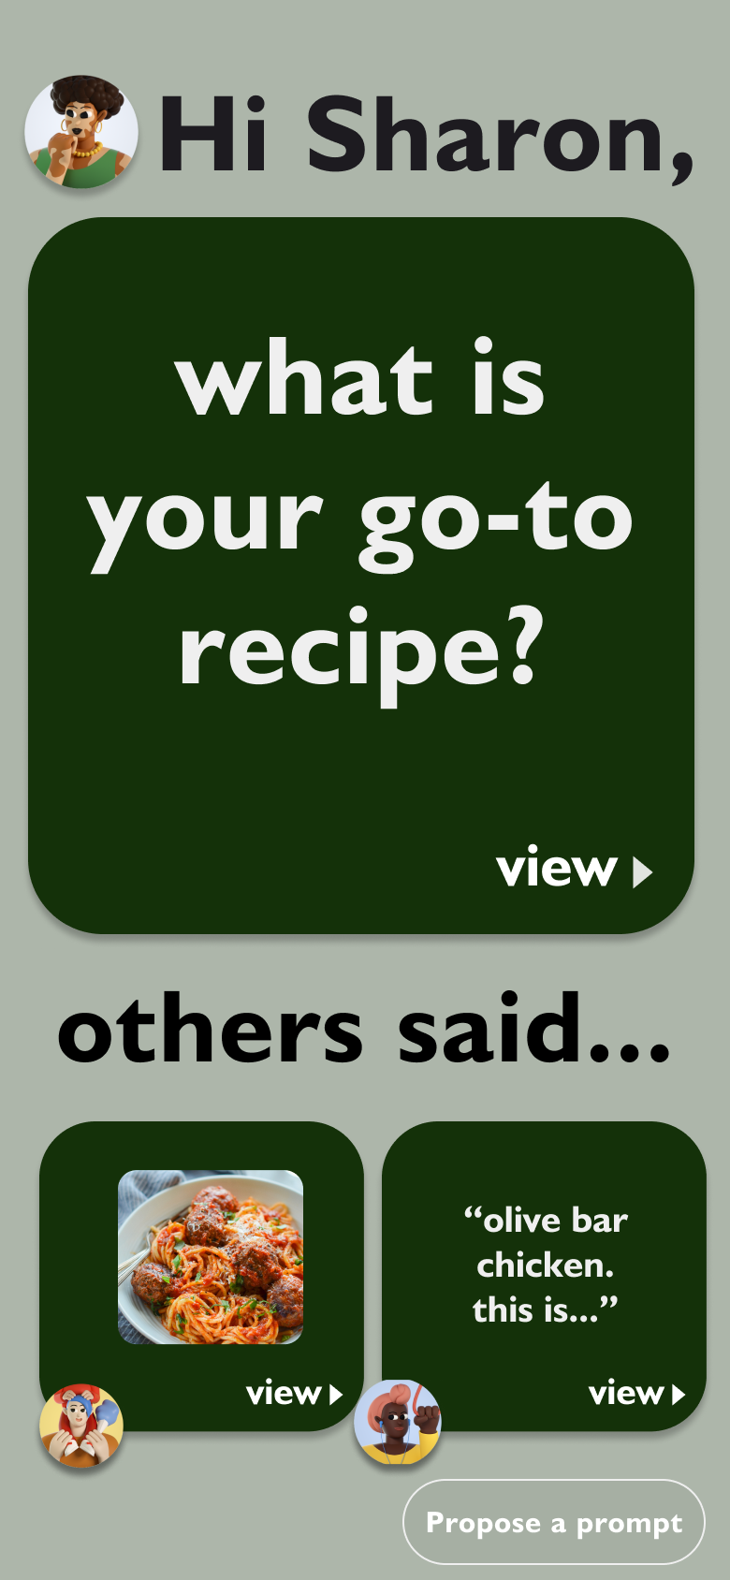
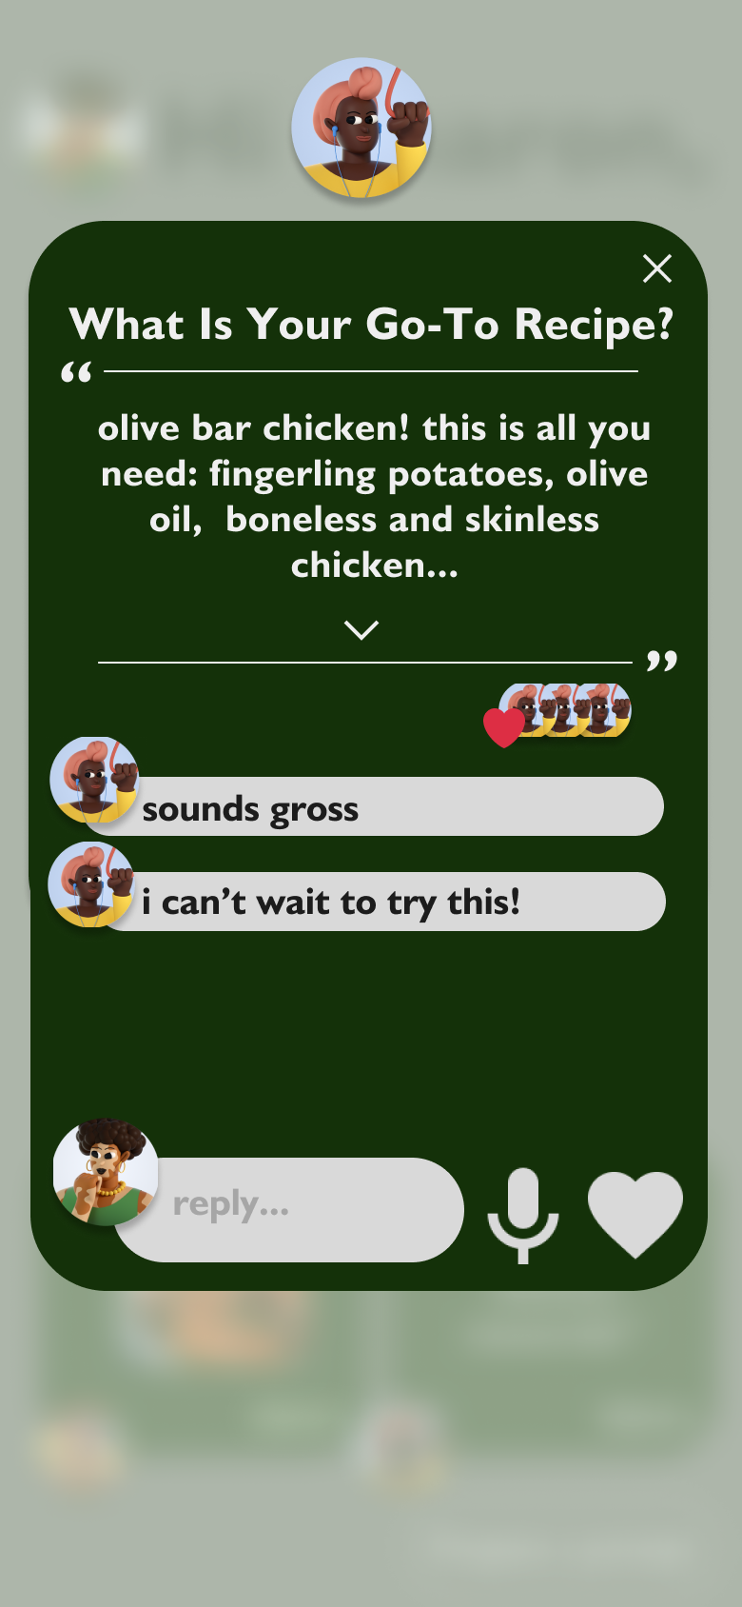
One Unimplemented Feature
Task 2: Reply to an answer
We have the requisite components to implement
Need to add a “reply” field component, add a “like button” component, and reuse the audio reply

Slide 26

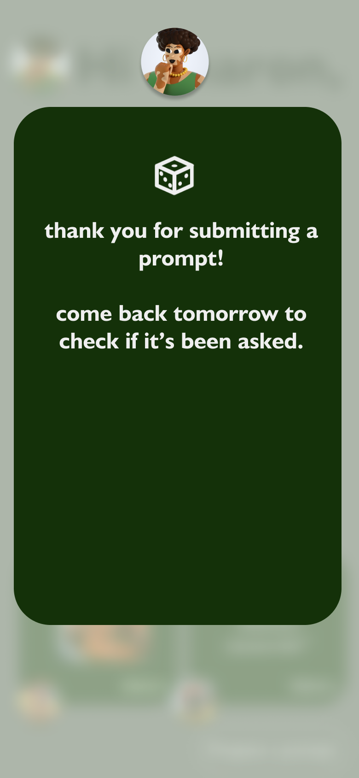
Another Unimplemented Feature
Task 3: Submit your own prompt
We have started to implement, with a functional button and modal already
Can re-use the text input component from Task 1

Slide 27
Plan to Finish
This weekend
Monday and Tuesday
Thursday
Utilize components for Task 1: Answer a prompt to expedite development of Task 2: Reply to an answer
Standardize styling across the application
Add modal animations to make for smoother transitions
Finish implementation of Task 3: Submit your own prompt

Slide 28
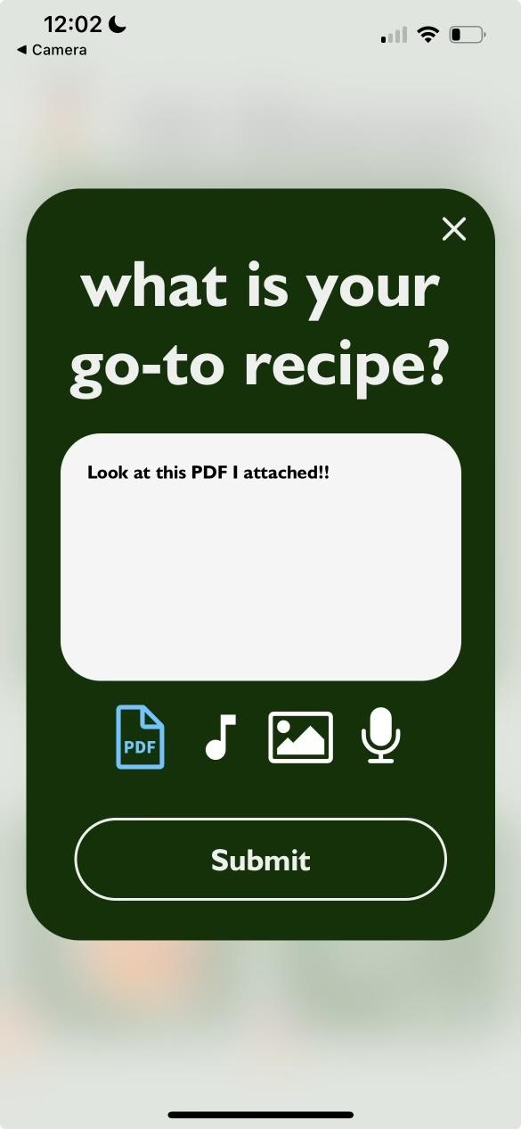
Implemented Wizard of Oz Features
User inputs
Users can write inputs and choose attachments, but the inputs are all stored on the front-end and will be viewable.
Refreshing or closing the app will lose all data.

Slide 29
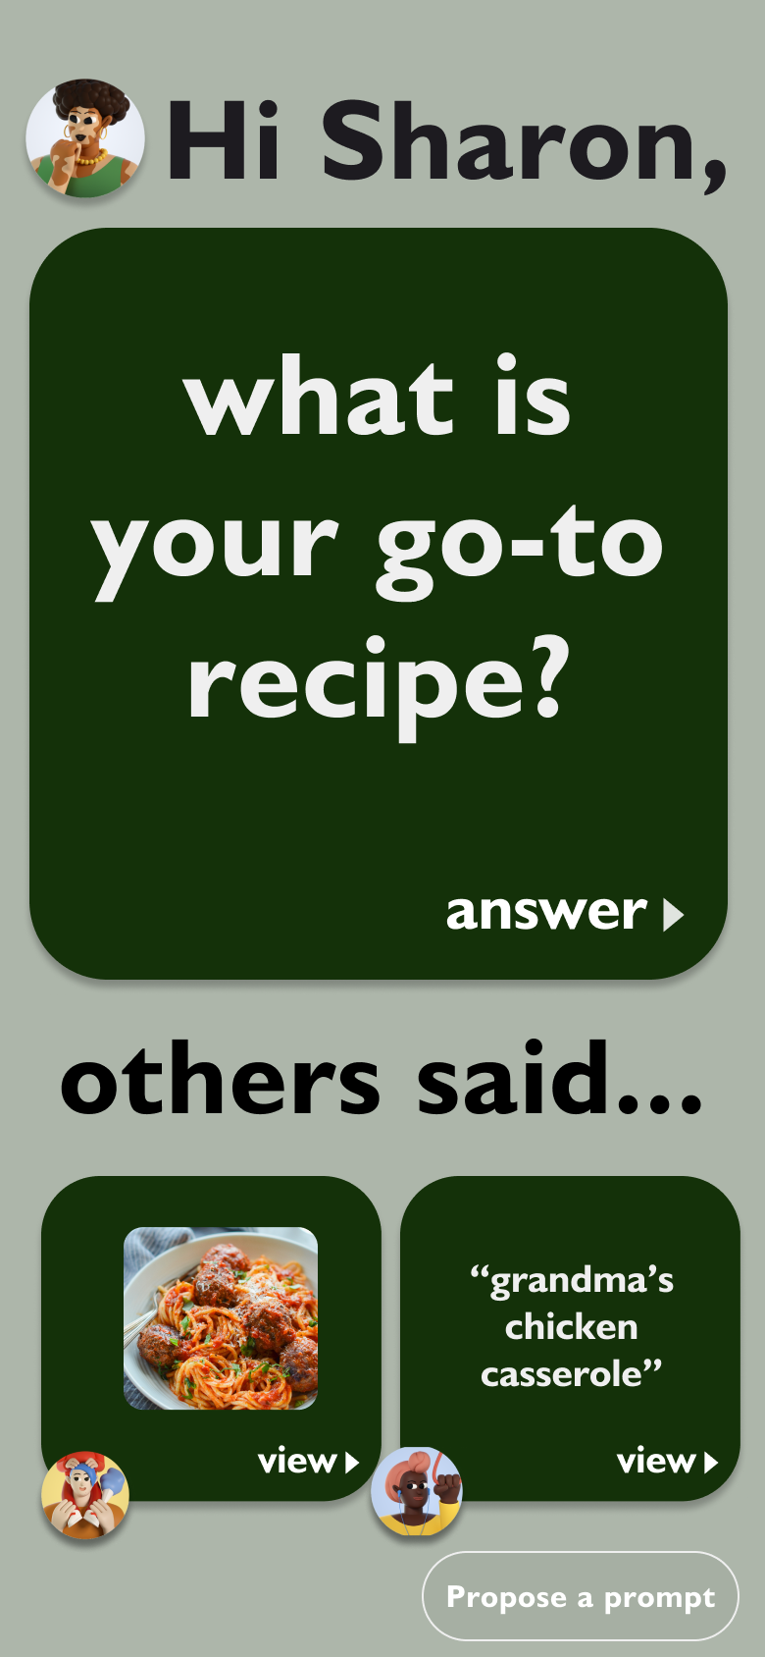
Future Wizard of Oz Features
User comments
Prompt generation algorithm
Prompt submission process
Users can leave comments that will be stored in the frontend. Refreshing or closing the app will lose all data.
We simulated that the generated prompt of the day is “What is your go-to recipe?”
We give the illusion that a submitted prompt has the potential to be asked in a future day, but this demo will have no concept of temporality and the prompt is not being saved.

Slide 30
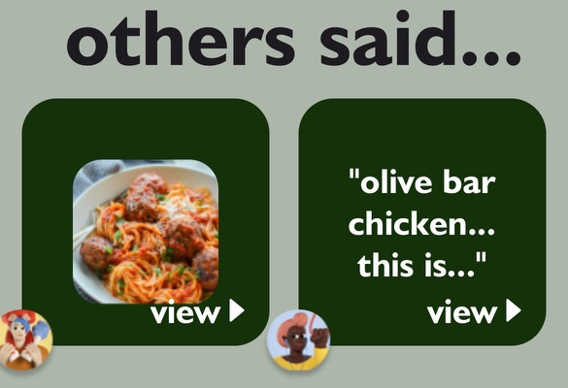
Hard coded Features
Family members
User information
All the user’s family members are hardcoded. The users can’t control who is in their network and what they have said.
All the user information is hardcoded, including profile, pictures, and names.

Slide 31
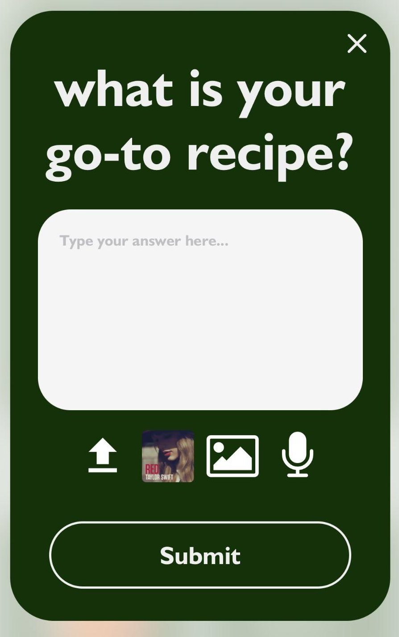
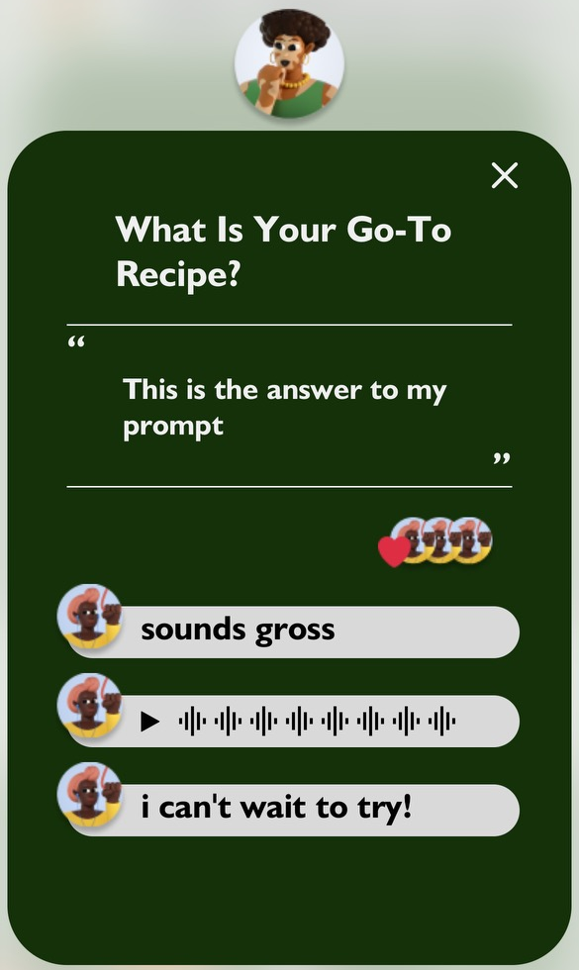
More hard coded Features
Some user inputs
Comments
As of now, song and audio attachment options are pre-determined, but users can actually choose files or photos
User comments on your answer are hard-coded into the frontend. We have the “Submitted” and wait time to help convey a notion of time passing for people to leave comments.

Slide 32
Questions/Issues
Although we haven’t had too much trouble yet with coding up our application, we do think it is important for us to consider the following issues if we were to launch kin to real users and for day-to-day usage.
Privacy Concerns: How can Kin ensure the privacy and security of these sensitive stories?
Data Ownership: Who owns the family stories and memories shared on Kin? Clarifying data ownership and user rights is important.
Integration with Existing Family Dynamics: How can Kin adapt to and enhance each family’s unique dynamics without causing conflicts?
Cultural Sensitivity: How can Kin respect and accommodate diverse cultural perspectives and sensitivities regarding the generation and sharing of family stories?

Slide 33
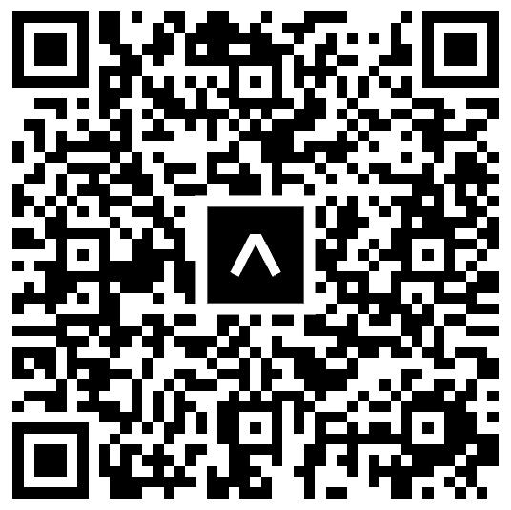
Demo
Please scan this with your phone if you have Expo Go installed

Slide 34
Appendix

Slide 35
HE Revisions

Slide 36
Figma Link

Slide 37
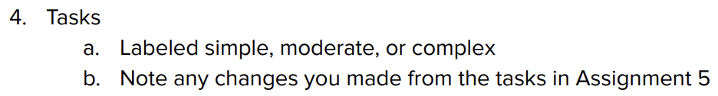

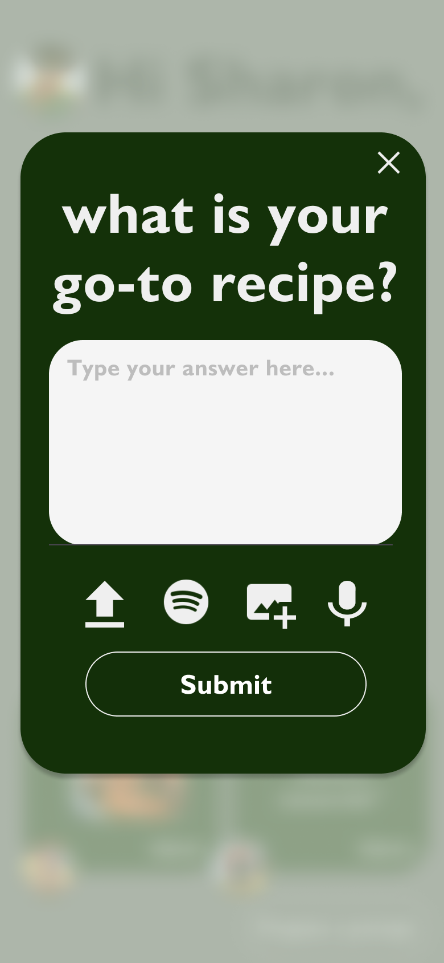
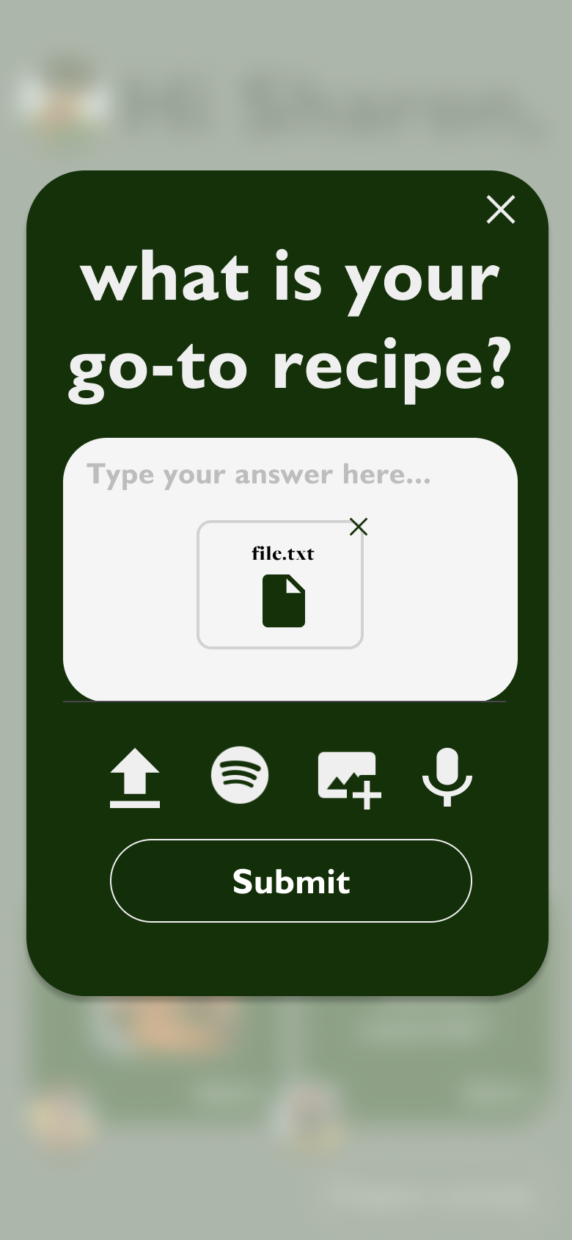
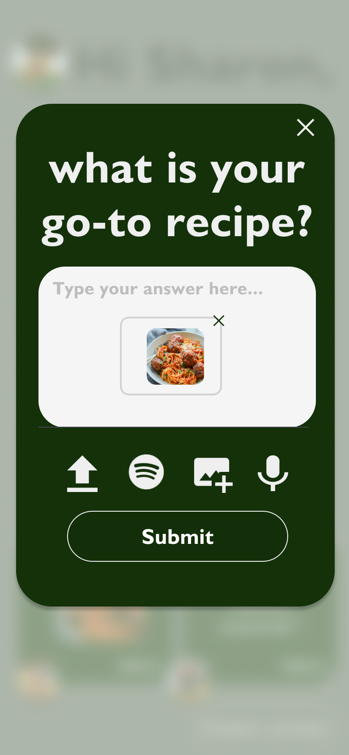


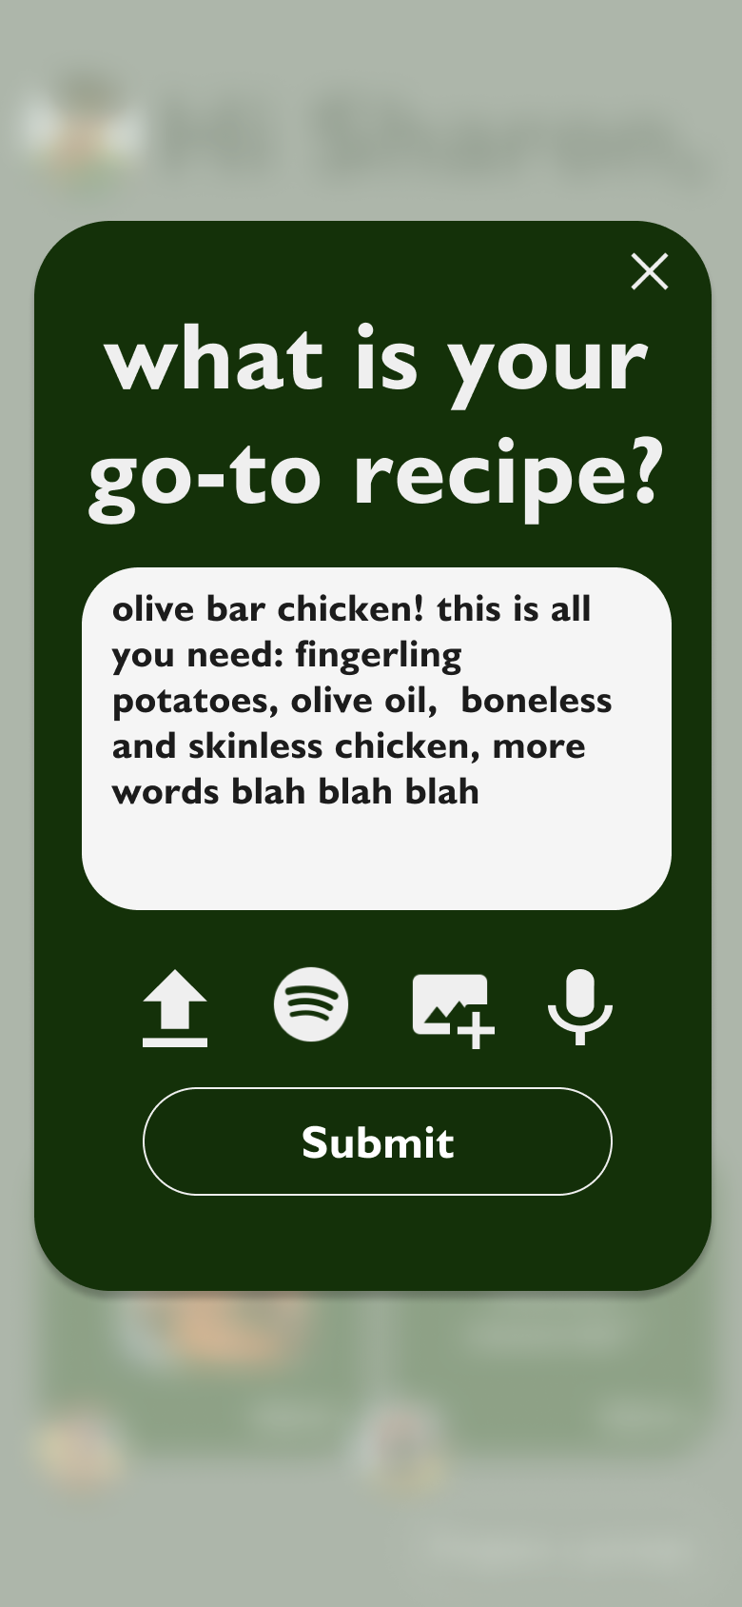
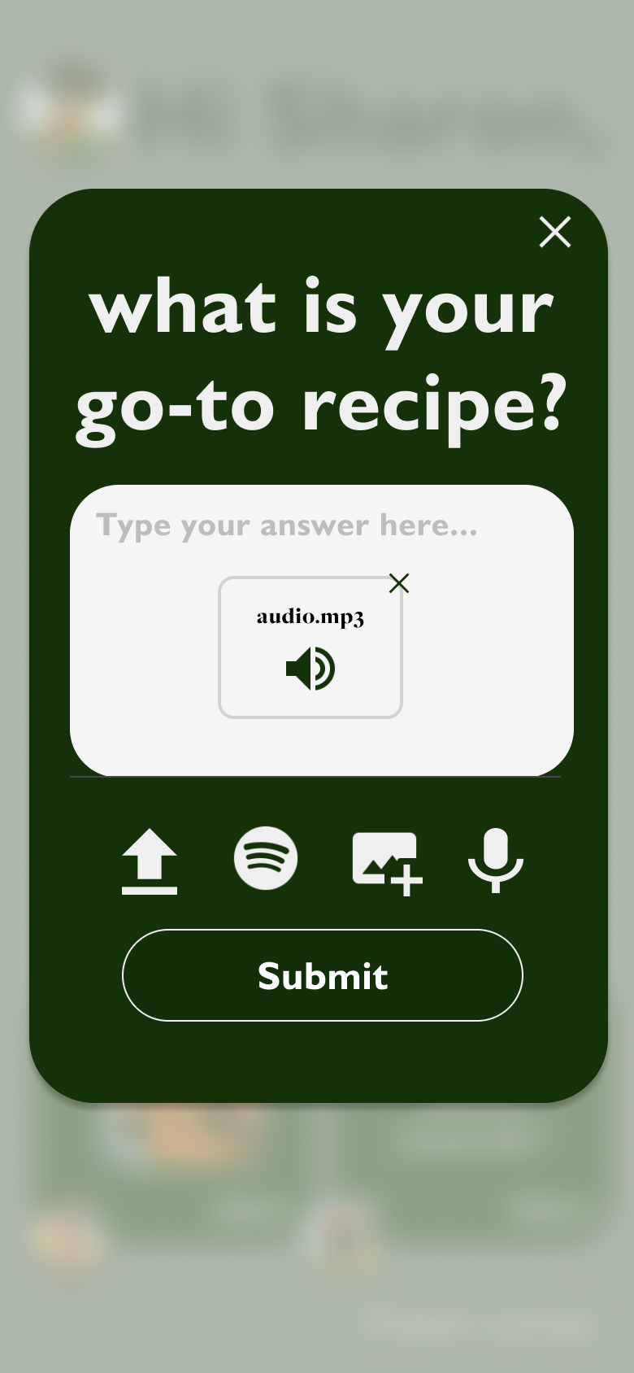
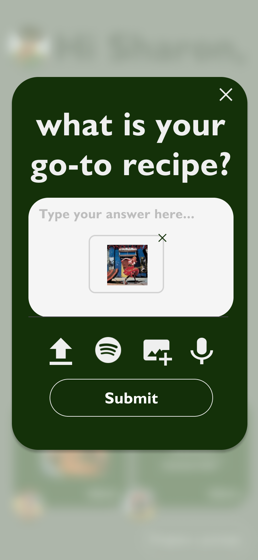
Task 1 - Simple
Notes:
Our simple task it responding to a prompt.
You can choose any of text, file uploads, spotify song embeds, images, or recording audio. You can mix and match these as well.
[Monday 11/6 update] The “Answer” button follows the same format as the “View” button from other people’s answers. Also, tapping anywhere on the card will open the interface, not just tapping on the “Answer” or “View” button
[Monday 11/6 update] Also changed the “X” button to more closely follow other design decisions in the app (e.g. removed the outlining circle)

Slide 38


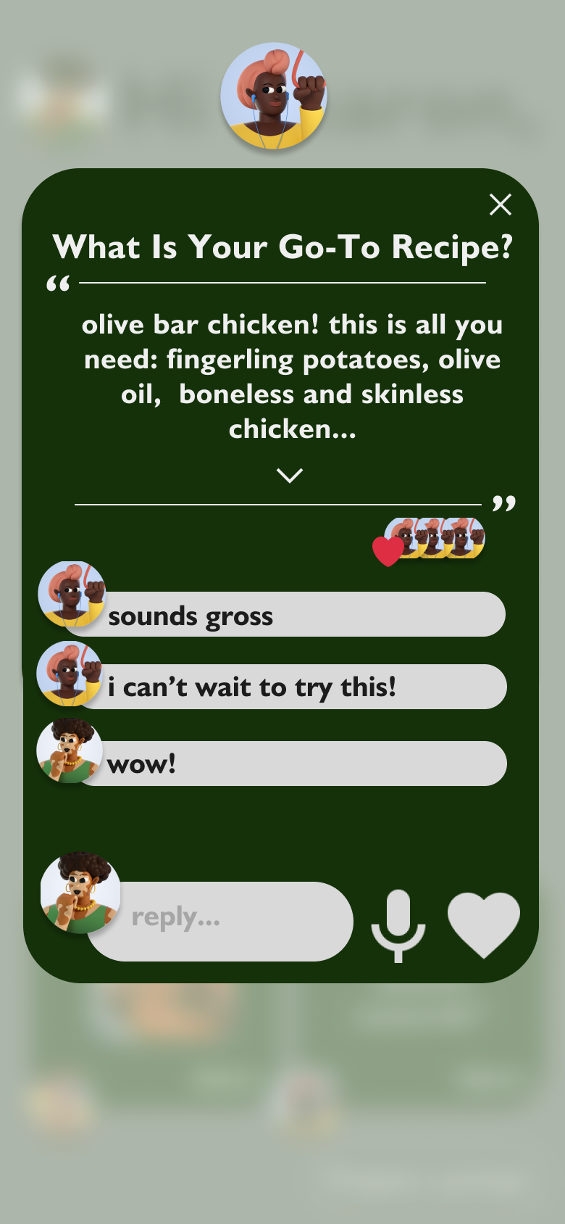
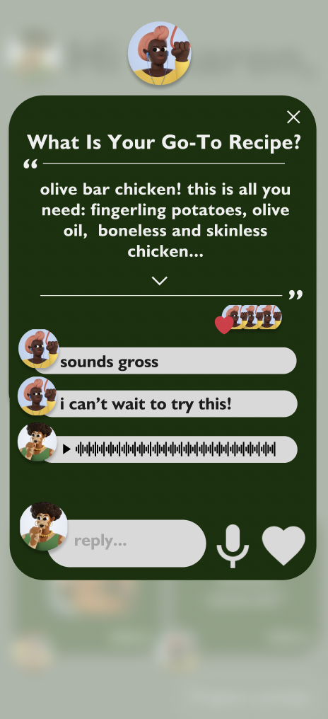
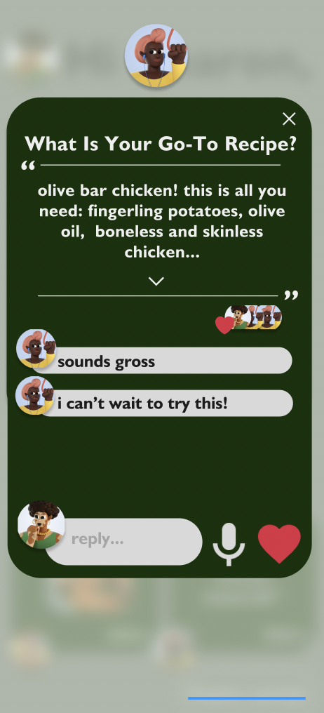
Task 2 - Moderate - Reply to someone’s answer
Notes:
Our moderate task is proposing a replying to another user’s answer. Tapping on a card from the “others said” section of the home page will show an enlarged version of a user’s answer. Reply options are text, audio, or a “like” button.
We envision the “others said” section to be side-scrollable, in that if there are more than two answers from other users, you can scroll horizontally to see more.

Slide 39
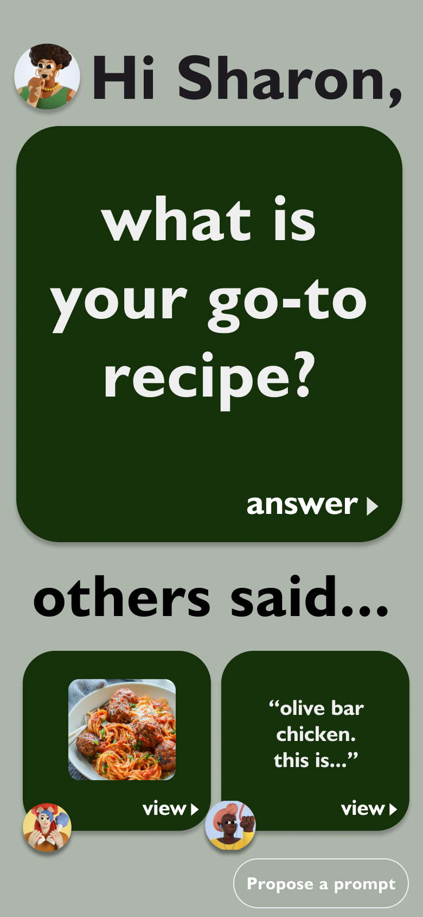

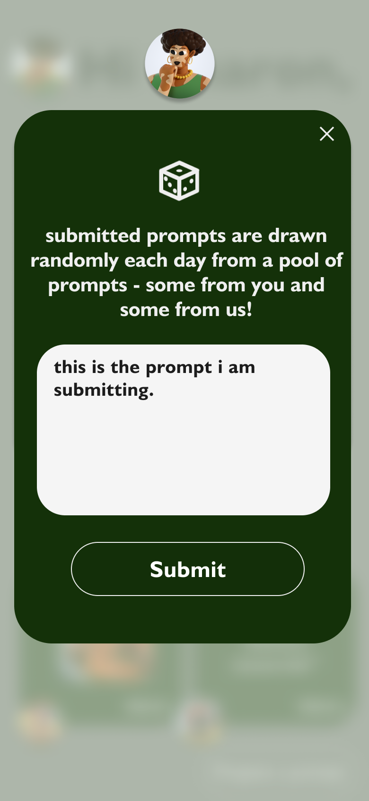
Task 3 - Complex - Propose a custom prompt
3 seconds spent on this screen before the user is brought back to the home screen. Meant to act as an explanation as to how the potentially confusing prompt system functions.
Notes:
Our complex task is proposing a custom prompts. The default on the app will be AI-generated prompts, one per day. At all times on the home page, the “Propose a prompt” button will be in the button right. Anyone in a group can propose a prompt that then will be put into a hopper of potential prompts. Each day, there will be a drawing of sorts where a prompt is randomly chosen.
We prefer that human-generated prompts are asked, so if a human were to submit a prompt, it would virtually never be beaten out by one of the AI-generated ones. In practice, we envision the “propose a prompt” button to essentially add prompts to a queue where the prompt at the front of the queue is removed and then asked each day.

Slide 40
08
Prototype Implementation

Slide 41
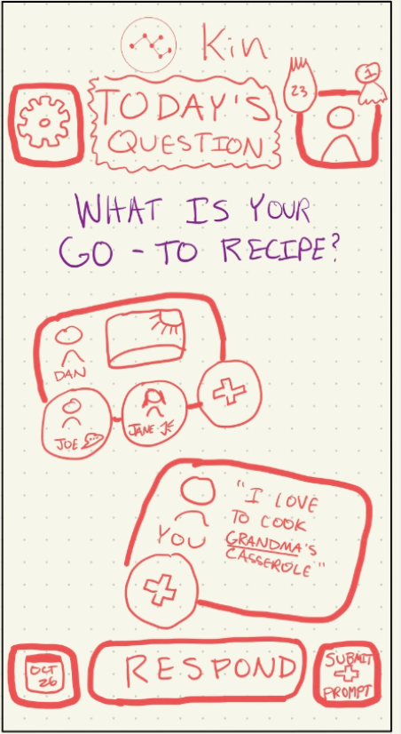
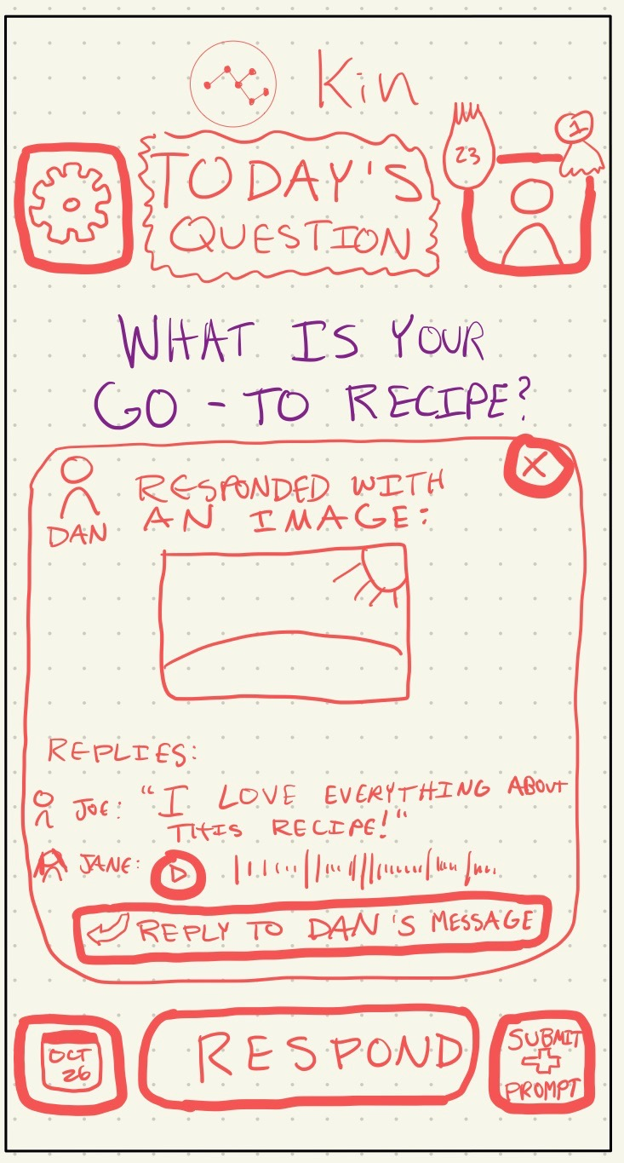
Change 1 - “Respond” -> “Answer”
Notes:
75% of people we interviewed were confused with the terminology of Respond versus Reply.
We changed “Respond” to “Answer”
We also prevented the “Respond” and “Reply” buttons from ever being on the screen at the same time

Slide 42
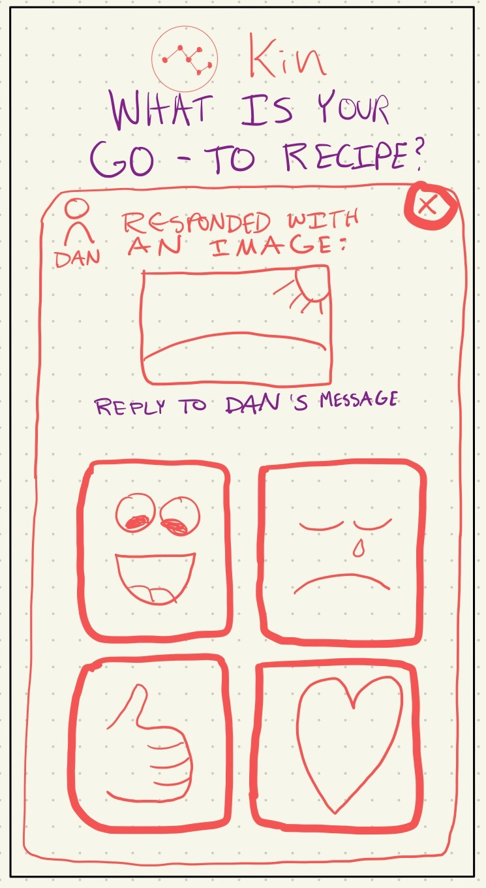
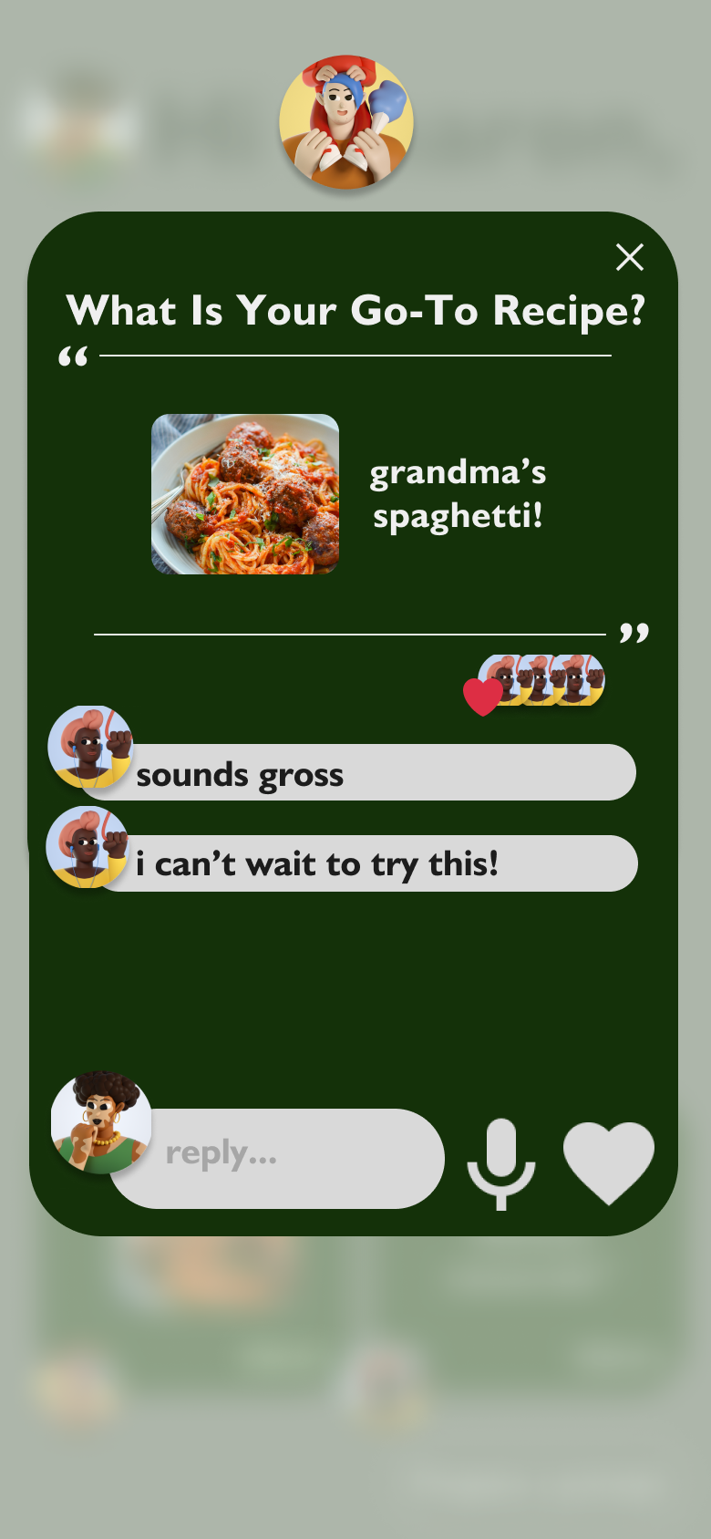
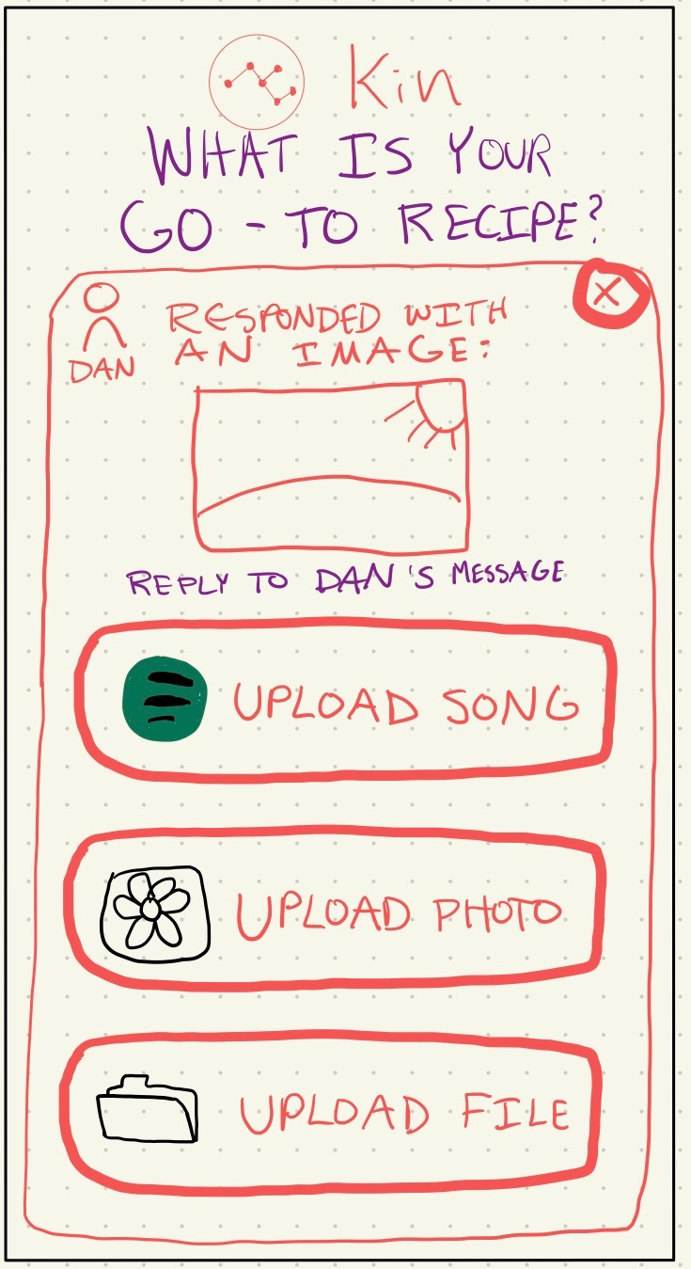
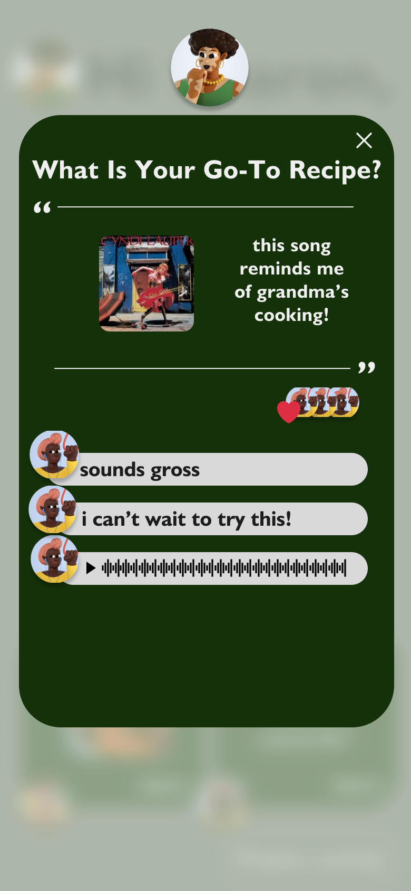
Change 2 - Standardized UI
Notes:
Made the UI more gridlike and standardized, with hopes of making it more accessible to users of all ages.
Menus with different uses all follow the same format
Regardless of whether you’ve answered the prompt or not, the home page looks virtually the same, with the exception of the “Answer” button being changed to “View"

Slide 43

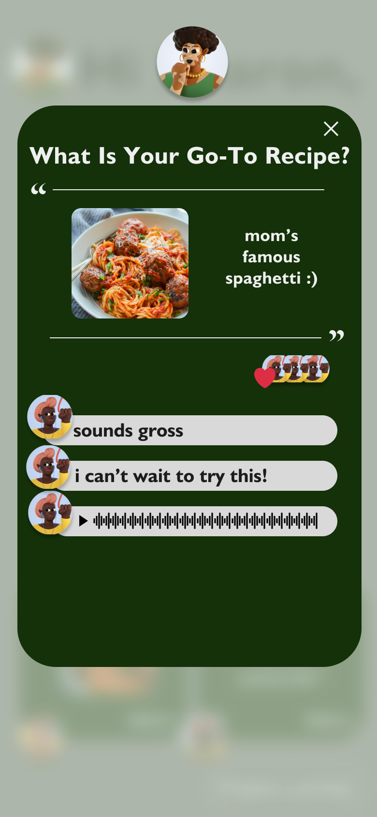

Change 3 - 1 tap to get anywhere
Notes:
There is one core home page. Upon entrance of the app, the top “big card” prompts you and allows you to answer.
After that, the same “big card” is replaced with a place to view your place.
At all times, from the home page, you can access other responses, open them, and reply.

