Slide 1
A6: kin
Team 3 – Jack Clark, Shuvi Jha, Jasmine Narine, Steven Pu

Slide 2
01
Value Proposition

Slide 3


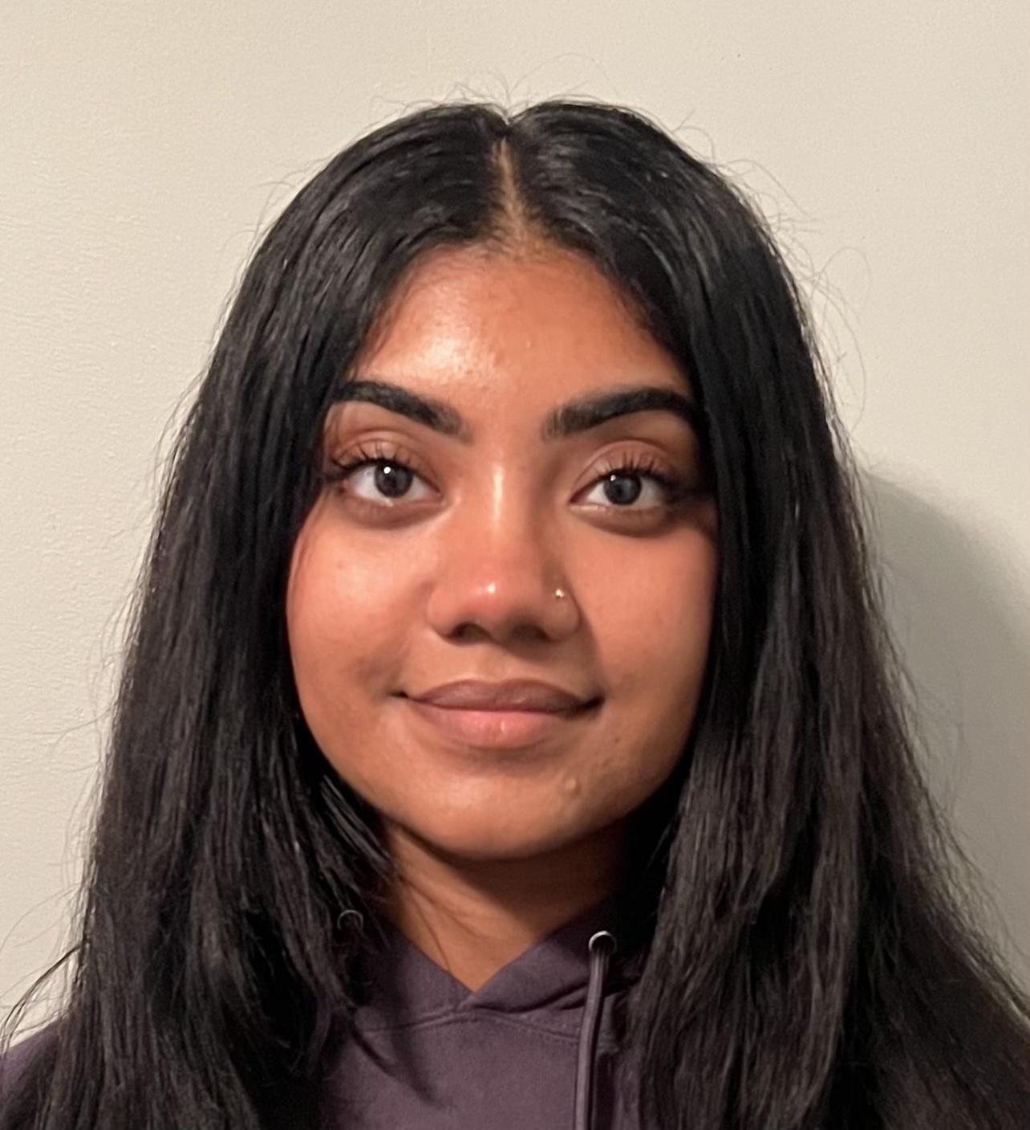
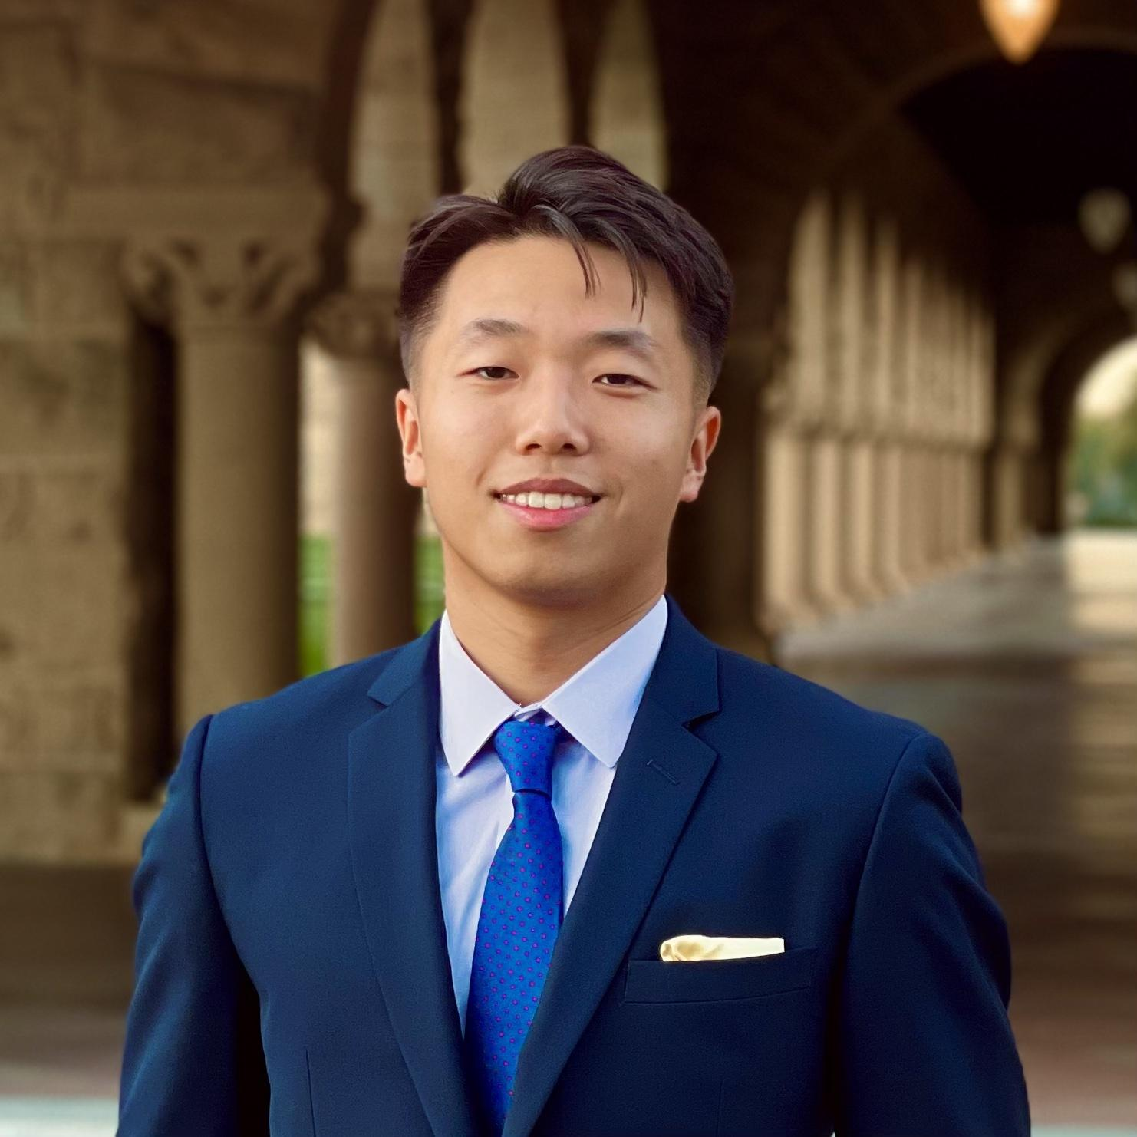
The team
Jack Clark
Shuvi Jha
Jasmine Narine
Steven Pu
MS CS (HCI)
BS MS&E
CS (HCI); Feminist, Gender, & Sexuality Studies
Senior
SYMSYS (HCI)
Senior
SYMSYS (HCI)
Senior

Slide 4
Value Proposition
kin
“Weave your family story one thread at a time”
“kin seeks to make the uncovering of family stories inviting by initiating daily, bite-sized conversations that facilitate and chronicle our familial connections”

Slide 5
02
Problem/Solution Overview

Slide 6
Problem and Solution
It can be difficult for people to learn, share, discuss, and preserve family stories in a way that feels engaging and rewarding, especially across generations – specifically, young people and the elderly.
Problem
A tool focused on helping family members share memories through prompts and collaboration. Users can engage with prompts, read family prompts, and add their own prompts to the system to facilitate family interactions and preserve memories.
Solution

Slide 7
03
Values in design

Slide 8
OUR VALUES
Intuitiveness
Playful
Aesthetics
The platform should be easy and intuitive to use for people of all ages. We want to especially make it easy to use for older people.
It should be lightweight, fun, and enjoyable. It should not cause any unnecessary stress for the users.
The platform should be able to align aesthetically to a wide range of users of different gender identity and ages.

Slide 9
OUR VALUES
Intuitiveness
Playful
Aesthetics
Potential tension:
Prioritizing in the aesthetics of the app might sacrifice the simplicity and intuitiveness of it.
Solution:
We use fonts and color scheme that are both functional, eligible, and aesthetically pleasing.

Slide 10
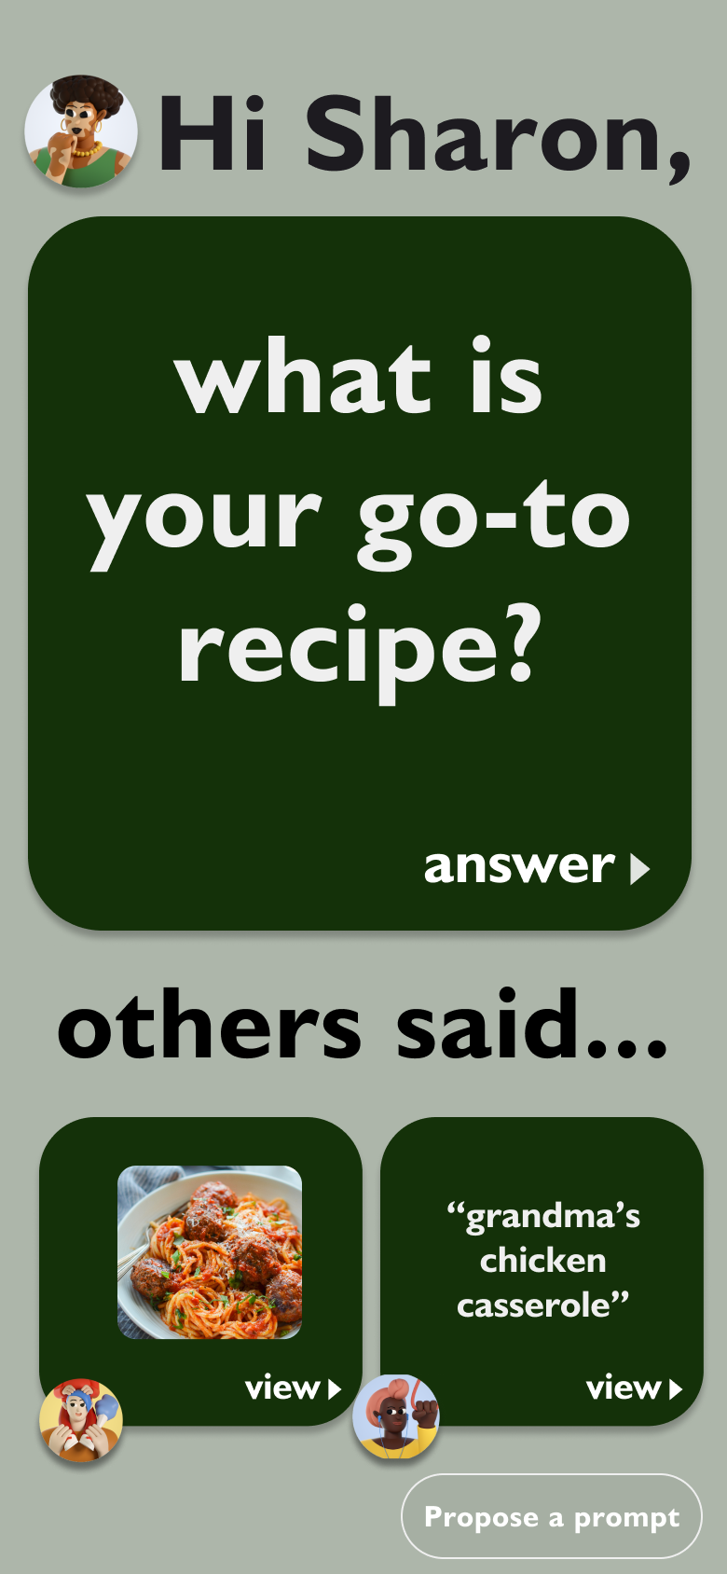
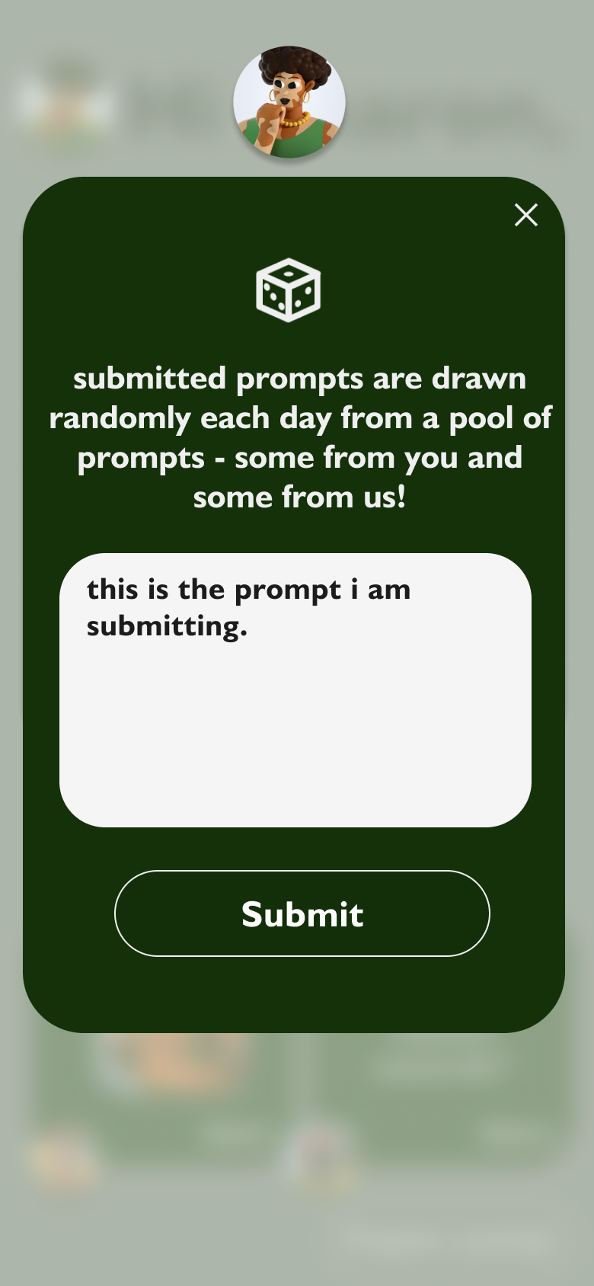
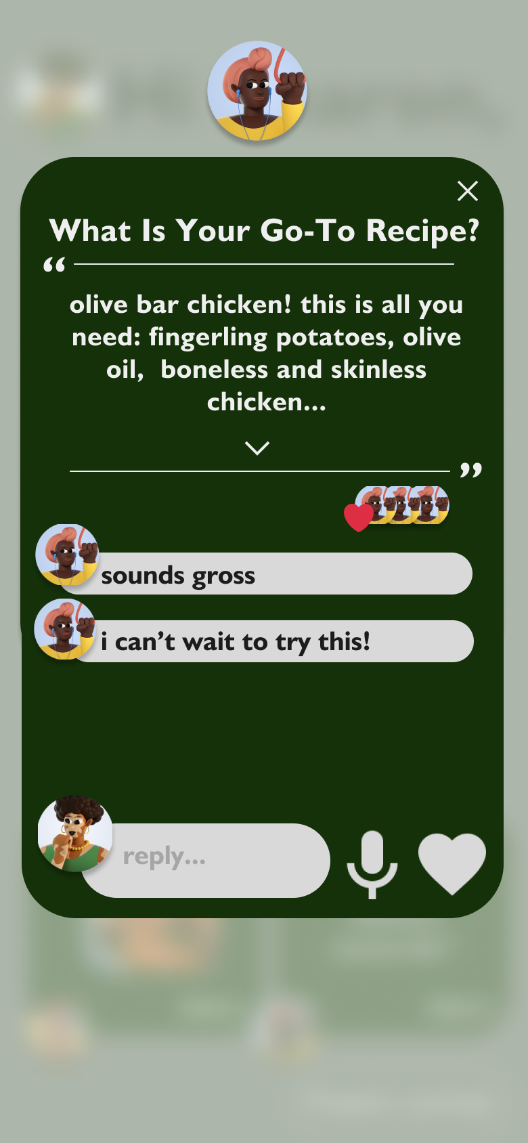
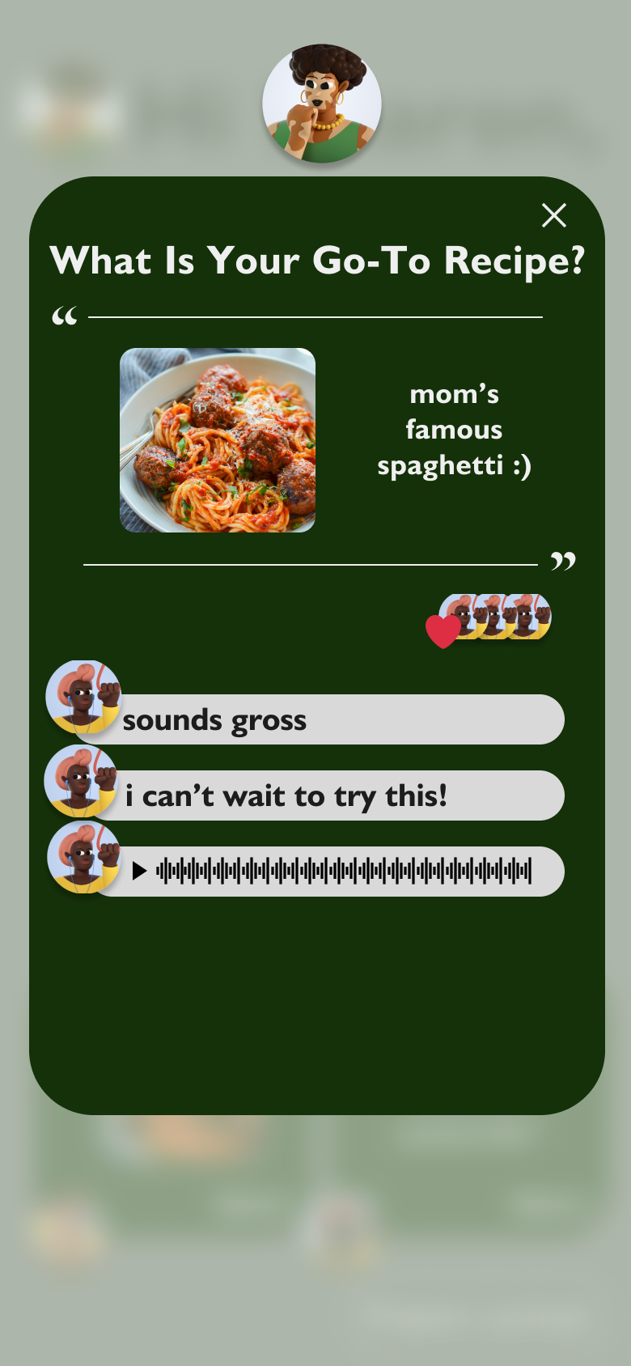
Designs that justify values
Intuitiveness
Playful
Aesthetics
Interface are appropriately sized with minimal unnecessary controls.
Every feature is 1-2 clicks away.
Feature to submit prompt mimics the randomness of playing cards.
Playful conversational features.
Calming earth tones and rounded edges make for a pleasant experience for people of all genders and ages.

Slide 11
04
Tasks

Slide 12
Tasks - No major structural changes
Simple:
Answer a prompt
Moderate:
Reply to an answer
Complex:
Submit your own prompt
The biggest card on the home page immediately prompts the user and is clickable, allowing them to answer. Answer options are text, photo, file, or Spotify attachment.
The second-biggest section on the home page allows a user to expand other answers and reply to them. Reply options are text, audio, or “likes”
Relatively small and in the bottom right of the home page is the “Propose a prompt” button. This page allows the user to submit their own prompt that has the potential to be asked in the future.
Notes:
Our complex task is proposing a custom prompts. The default on the app will be AI-generated prompts, one per day. At all times on the home page, the “Propose a prompt” button will be in the button right. Anyone in a group can propose a prompt that then will be put into a hopper of potential prompts. Each day, there will be a drawing of sorts where a prompt is randomly chosen.
We prefer that human-generated prompts are asked, so if a human were to submit a prompt, it would virtually never be beaten out by one of the AI-generated ones. In practice, we envision the “propose a prompt” button to essentially add prompts to a queue where the prompt at the front of the queue is removed and then asked each day.

Slide 13
05
Usability goals and key measurements

Slide 14
OUR VALUES
Rational:
This is important because we have older users and making this systems as efficient as possible can help with ease of use.
Goal #1: Efficiency
Measurement: Task Completion Time
We count the time to complete a certain task
Rational:
This is important because we want the system to be clear and not confusing to navigate for new users.
Goal #2:
Robust
Measurement: Task Error Rate
We count the number of errors made per tasks.

Slide 15
Progress towards usability goals
Goal #1: Efficiency
Goal #2:
Robust
Progress:
Removed redundant screens and preserve only the necessary ones.
Made the buttons and navigation really clear to use.
Streamlined the response interface.
Progress:
Removed inconsistencies between different button UI.
Reorganized the home screen for clear distinction between prompt and family reponses.

Slide 16
06
Revised Interface Sketches

Slide 17
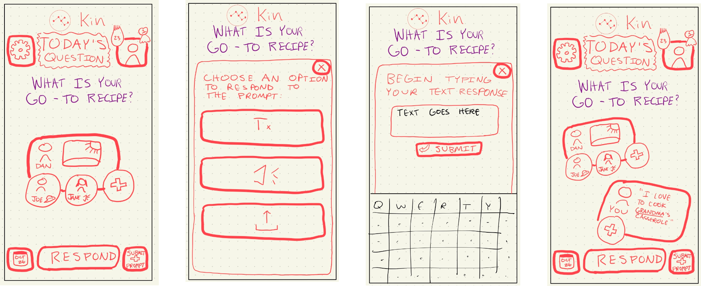
Overview of Original Interfaces
Notes:
Our original simple task

Slide 18
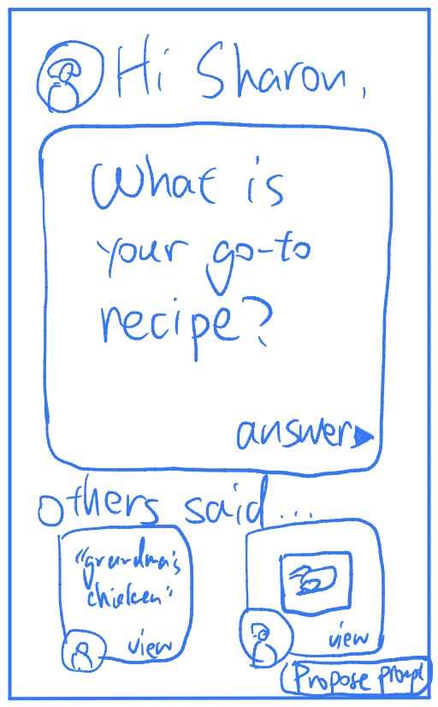
Major Design Change #1: Home page
Before
After
The buttons and response cards are congested.
The prompt is enlarged, unnecessary buttons are removed.
Notes:
There is one core home page. Upon entrance of the app, the top “big card” prompts you and allows you to answer.
After that, the same “big card” is replaced with a place to view your place.
At all times, from the home page, you can access other responses, open them, and reply.

Slide 19
Major Design Change #1: Home page
Before
After
The buttons and response cards are congested.
The prompt is enlarged, unnecessary buttons are removed.
Rational:
Some users consistently clicked on the wrong button during our prototype testing session.
Since it is our goal to increase the robustness and the efficiency of the app, we think it is important to decrease the distractions that the users might encounter.
Notes:
There is one core home page. Upon entrance of the app, the top “big card” prompts you and allows you to answer.
After that, the same “big card” is replaced with a place to view your place.
At all times, from the home page, you can access other responses, open them, and reply.

Slide 20
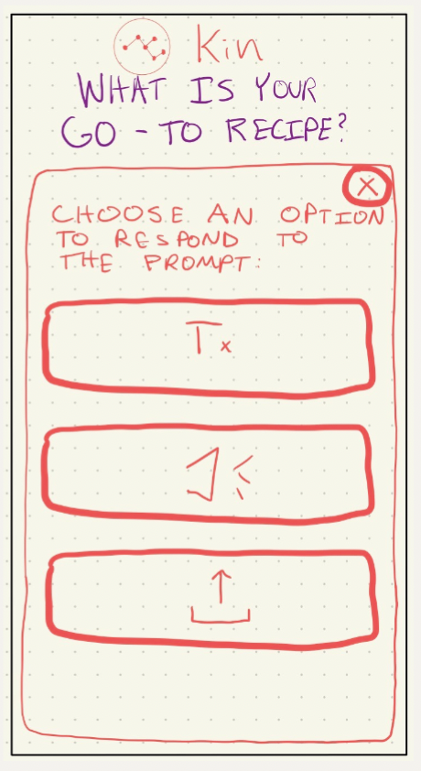
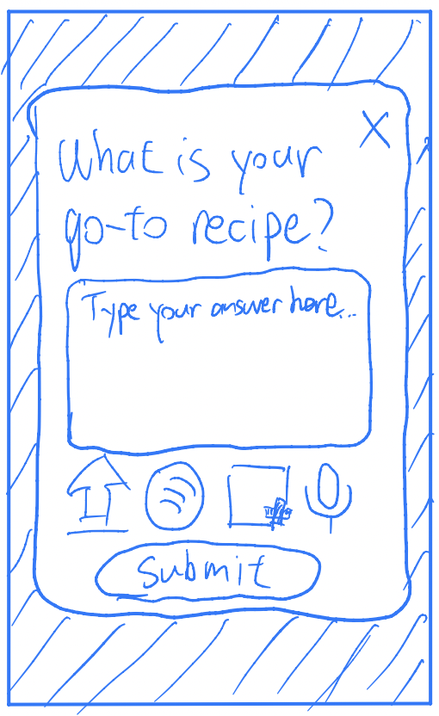
Major Design Change #2: Prompt Input Page
Before
After
The buttons for the input UI take unnecessary space and is not how to use.
The users can also view their inputs immediately, offering a more direct view of the UI.
Notes:
There is one core home page. Upon entrance of the app, the top “big card” prompts you and allows you to answer.
After that, the same “big card” is replaced with a place to view your place.
At all times, from the home page, you can access other responses, open them, and reply.

Slide 21
Major Design Change #2: Prompt Input Page
Before
After
The buttons for the input UI take unnecessary space and is not how to use.
The users can also view their inputs immediately, offering a more direct view of the UI.
Rational:
Some test users reflected that it is difficult to understand the UI on the input page.
The buttons on the input page takes too much space, and does not reflect the current state of response.
We want the input page to be efficient without sacrificing the usability.
Notes:
There is one core home page. Upon entrance of the app, the top “big card” prompts you and allows you to answer.
After that, the same “big card” is replaced with a place to view your place.
At all times, from the home page, you can access other responses, open them, and reply.

Slide 22
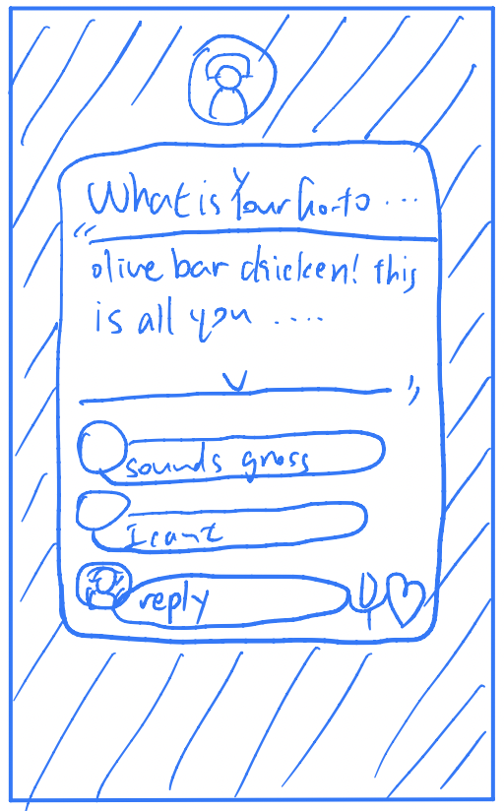
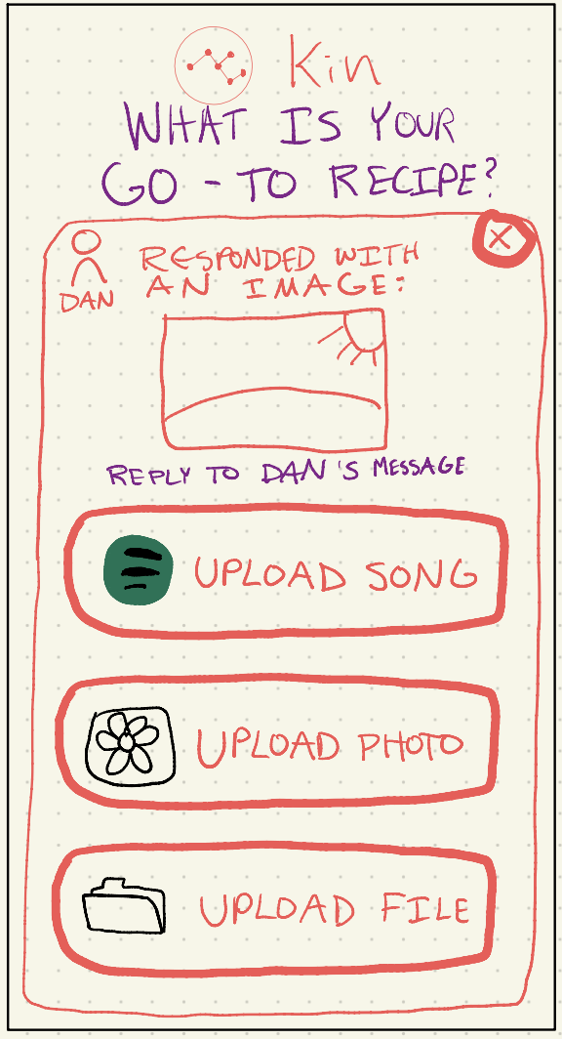
Major Design Change #3: Response Page
Before
After
The users can’t see the existing responses and see their current responses because the buttons are oversized.
The user can see the prompt, the user’s original answer, the existing responses at the same time.
Notes:
There is one core home page. Upon entrance of the app, the top “big card” prompts you and allows you to answer.
After that, the same “big card” is replaced with a place to view your place.
At all times, from the home page, you can access other responses, open them, and reply.

Slide 23
Major Design Change #3: Response Page
Before
After
The users can’t see the existing responses and see their current responses because the buttons are oversized.
The user can see the prompt, the user’s original answer, the existing responses at the same time.
Rational:
Some test users are generally confused and had a lot of errors on the response page than expected.
We think that in mimicking a familiar messaging app UI would help the user by making the interface more intuitive.
In the improved UI, the user can also see the immediate responses, making them easy to edit.
Notes:
There is one core home page. Upon entrance of the app, the top “big card” prompts you and allows you to answer.
After that, the same “big card” is replaced with a place to view your place.
At all times, from the home page, you can access other responses, open them, and reply.

Slide 24
07
Med-fi prototype

Slide 25
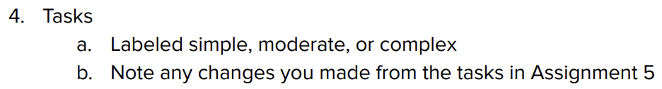

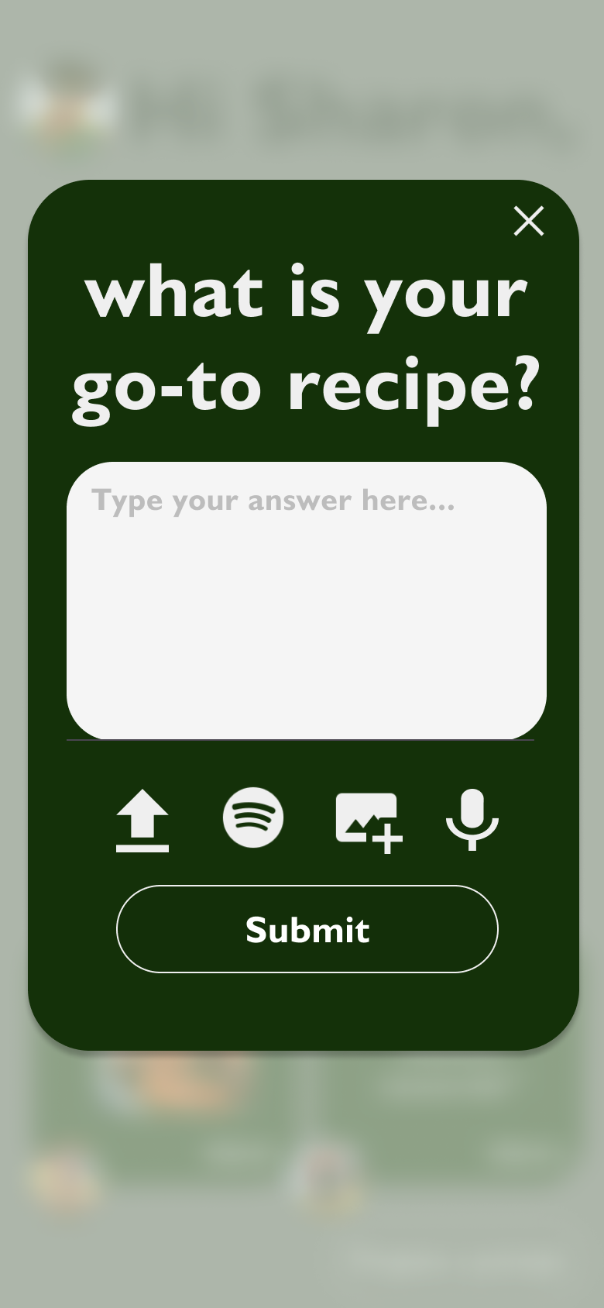
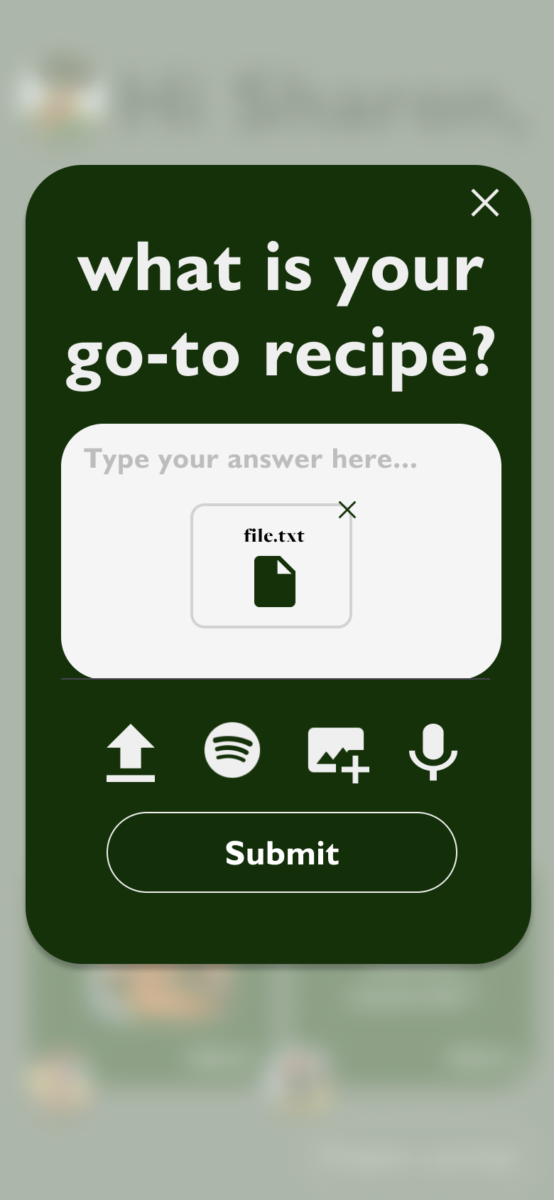
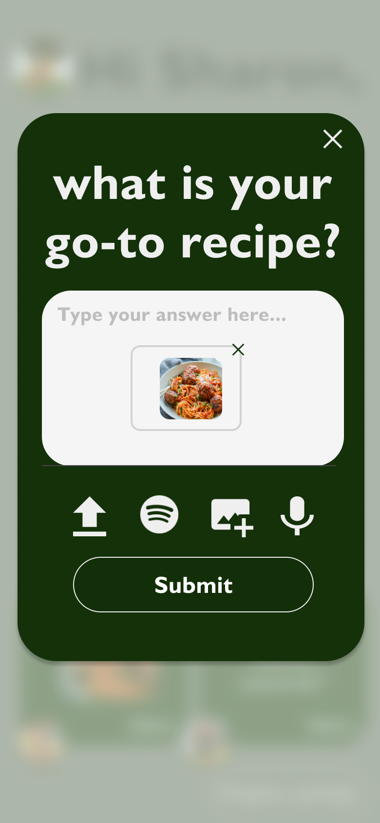
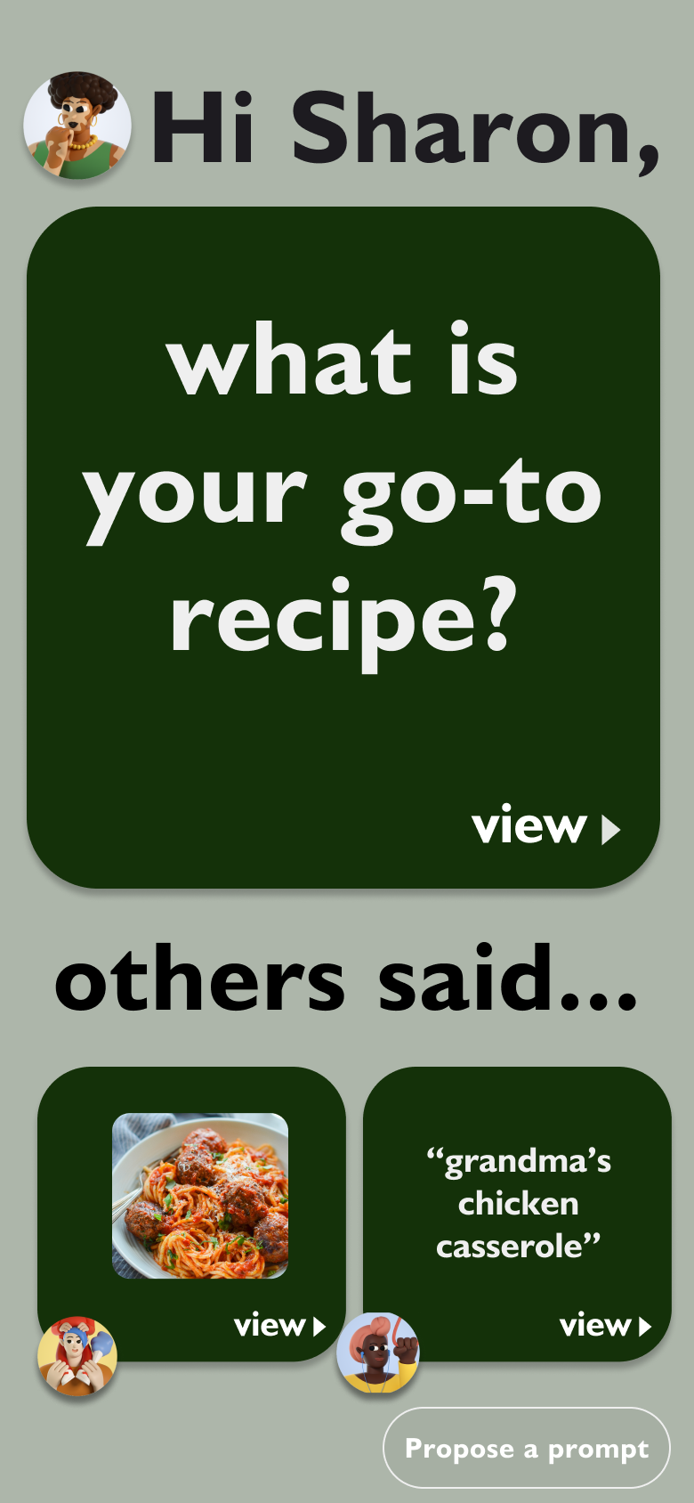

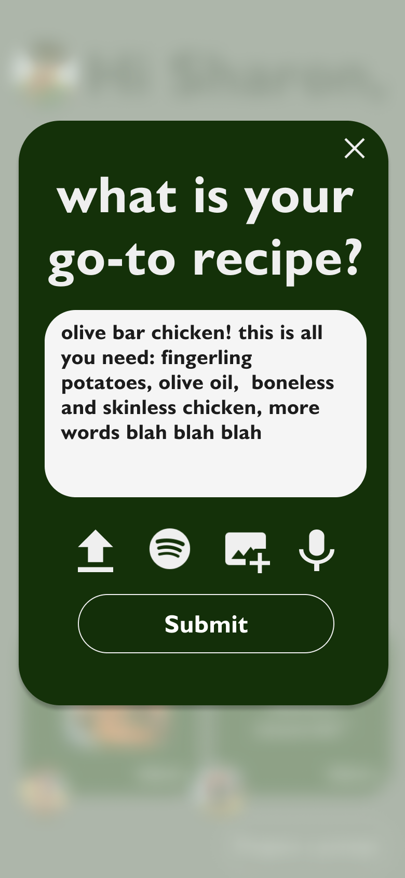
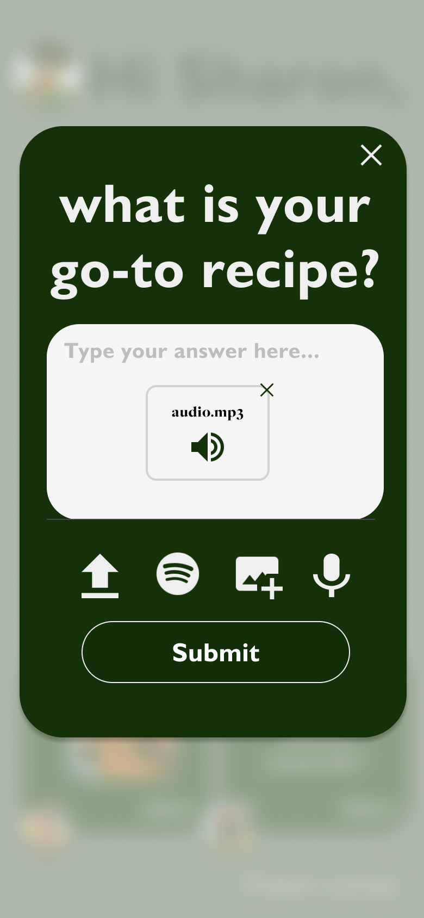
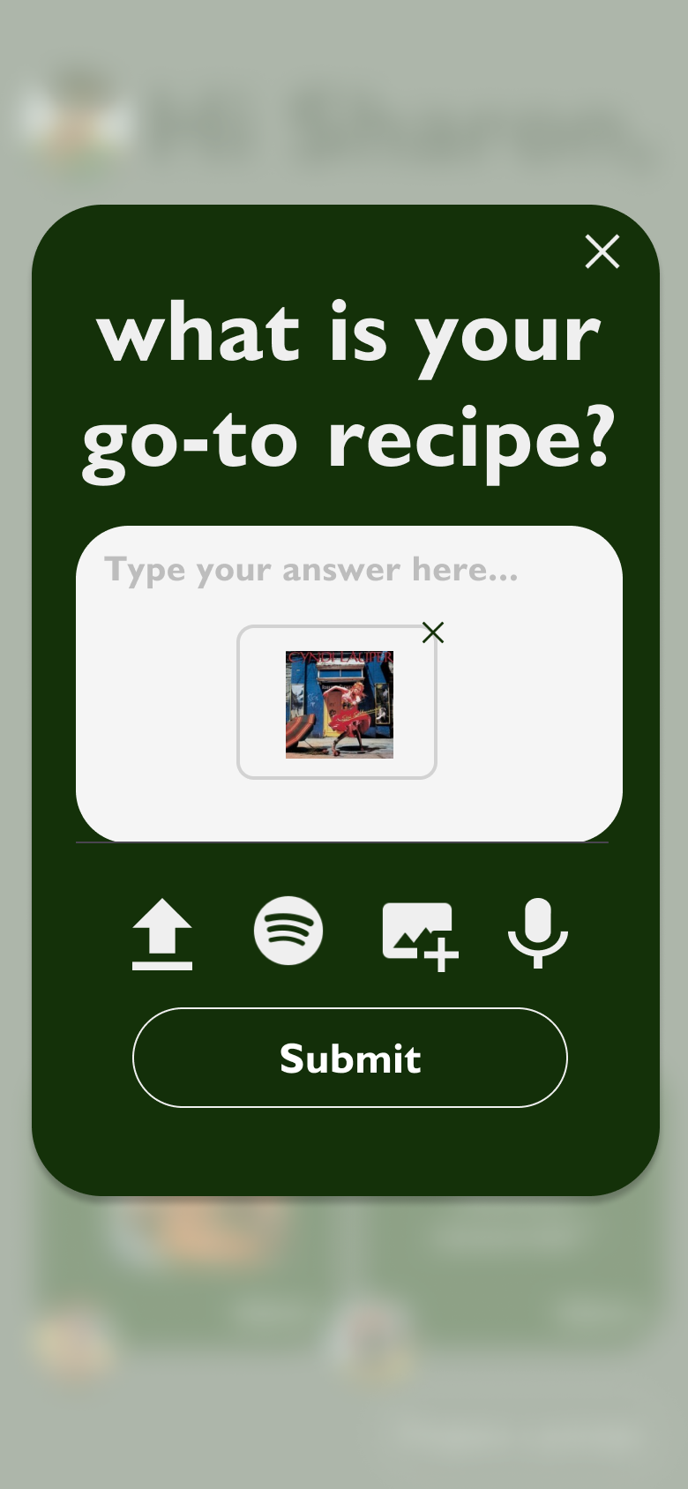
Task 1 - Simple
Notes:
Our simple task it responding to a prompt.
You can choose any of text, file uploads, spotify song embeds, images, or recording audio. You can mix and match these as well.
[Monday 11/6 update] The “Answer” button follows the same format as the “View” button from other people’s answers. Also, tapping anywhere on the card will open the interface, not just tapping on the “Answer” or “View” button
[Monday 11/6 update] Also changed the “X” button to more closely follow other design decisions in the app (e.g. removed the outlining circle)

Slide 26


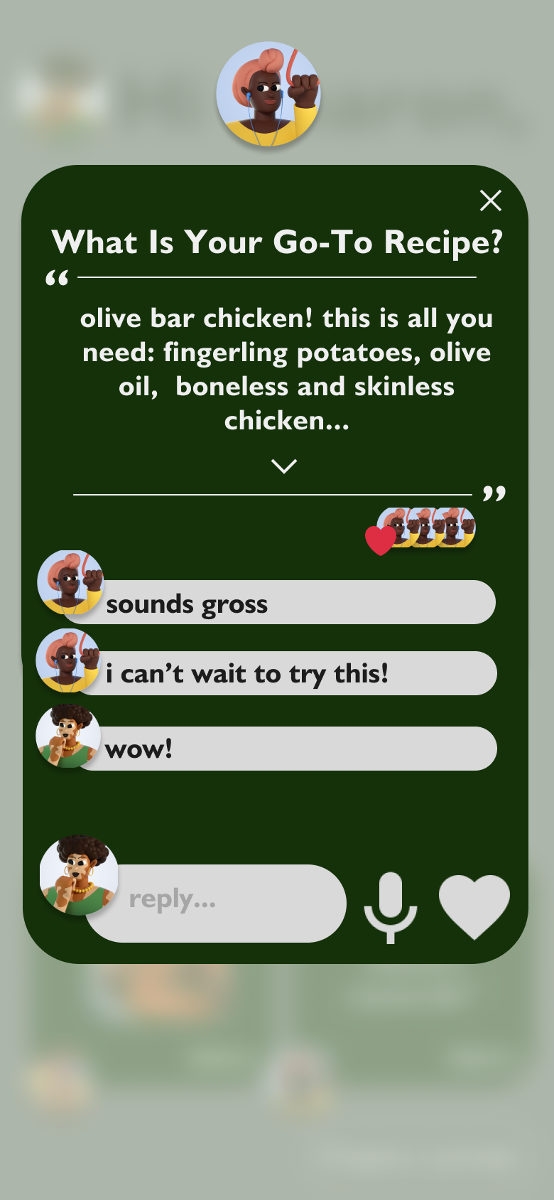
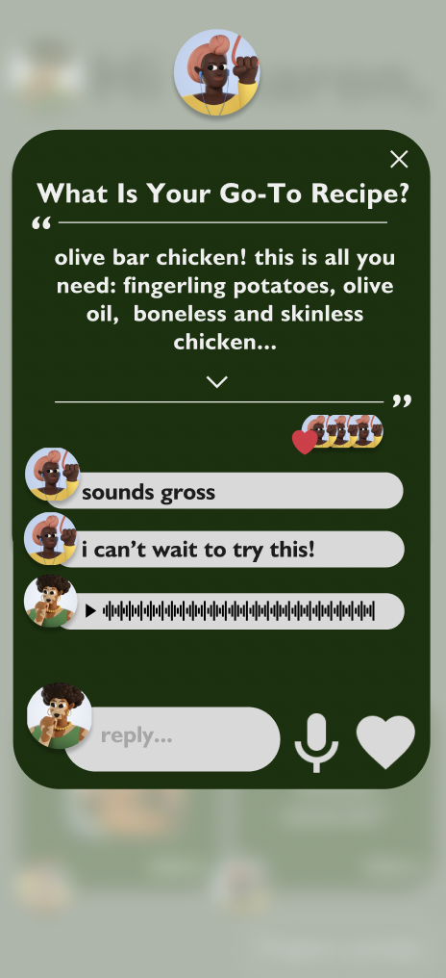
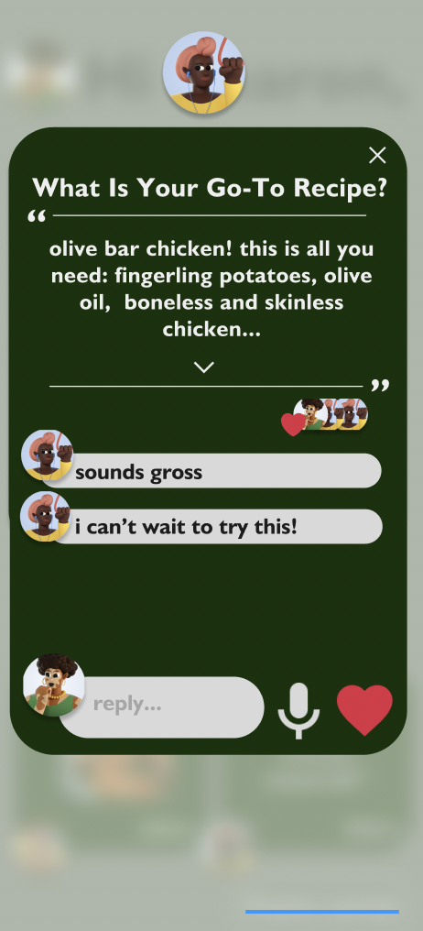
Task 2 - Moderate - Reply to someone’s answer
Notes:
Our moderate task is proposing a replying to another user’s answer. Tapping on a card from the “others said” section of the home page will show an enlarged version of a user’s answer. Reply options are text, audio, or a “like” button.
We envision the “others said” section to be side-scrollable, in that if there are more than two answers from other users, you can scroll horizontally to see more.

Slide 27
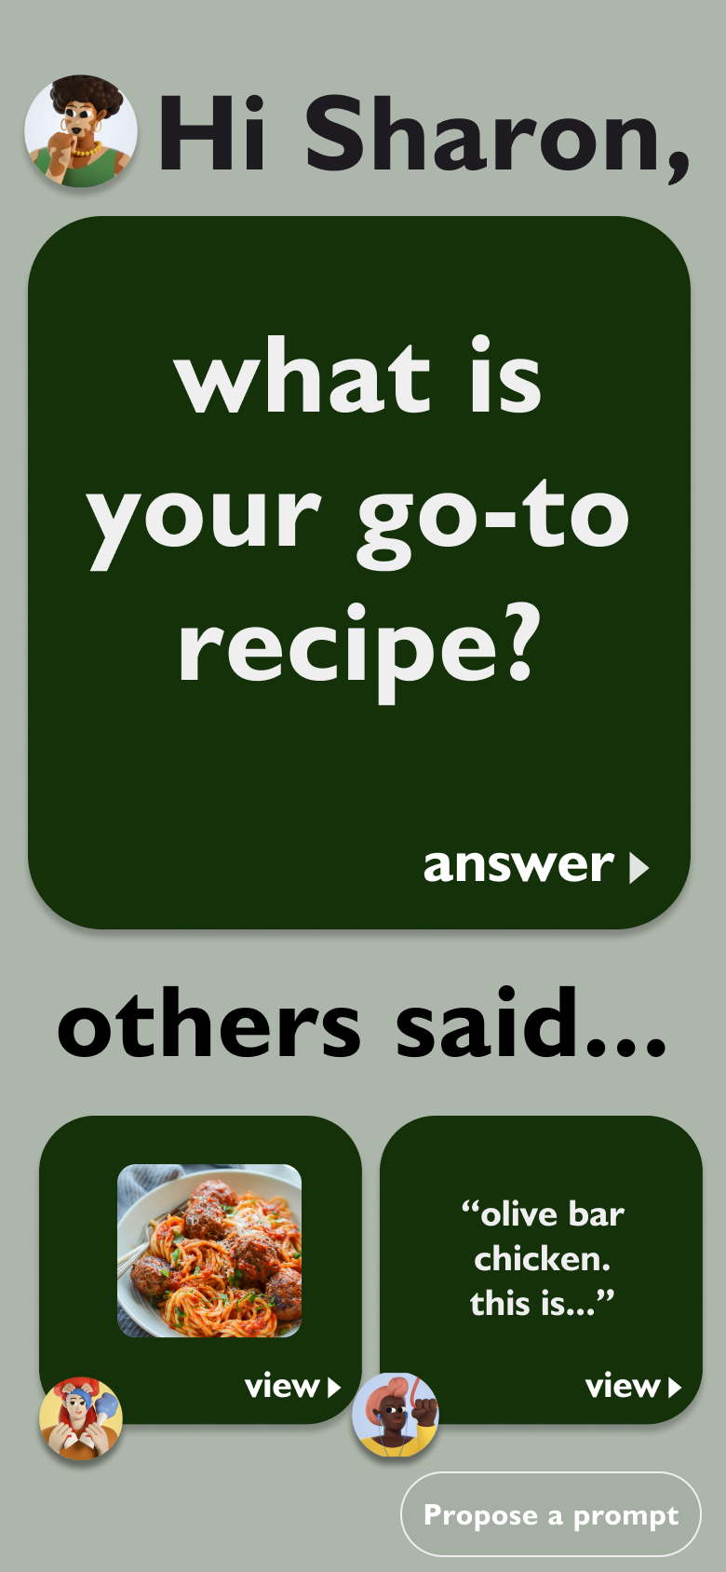
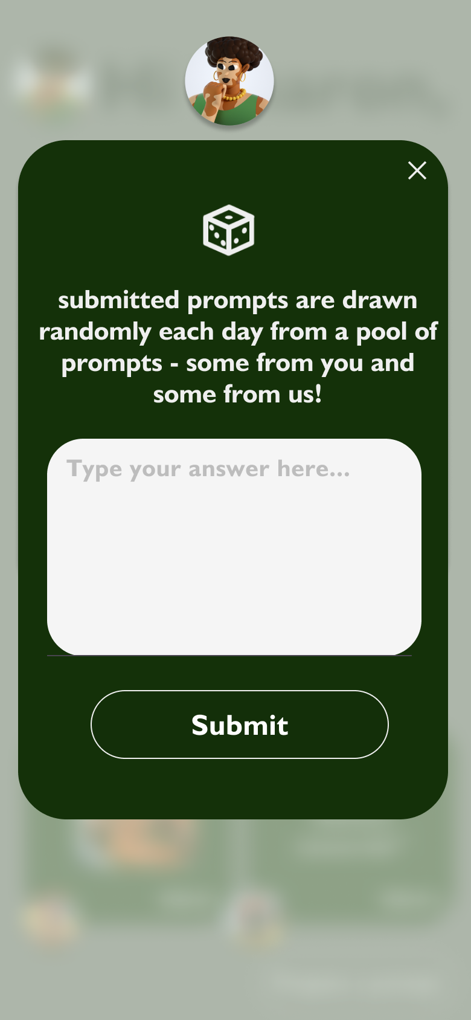

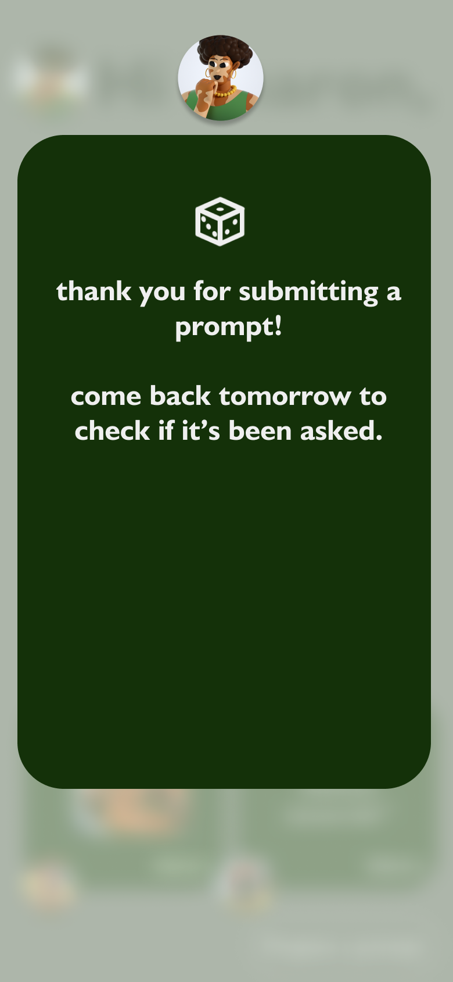
Task 3 - Complex - Propose a custom prompt
3 seconds spent on this screen before the user is brought back to the home screen. Meant to act as an explanation as to how the potentially confusing prompt system functions.
Notes:
Our complex task is proposing a custom prompts. The default on the app will be AI-generated prompts, one per day. At all times on the home page, the “Propose a prompt” button will be in the button right. Anyone in a group can propose a prompt that then will be put into a hopper of potential prompts. Each day, there will be a drawing of sorts where a prompt is randomly chosen.
We prefer that human-generated prompts are asked, so if a human were to submit a prompt, it would virtually never be beaten out by one of the AI-generated ones. In practice, we envision the “propose a prompt” button to essentially add prompts to a queue where the prompt at the front of the queue is removed and then asked each day.

Slide 28
08
Prototype Implementation

Slide 29
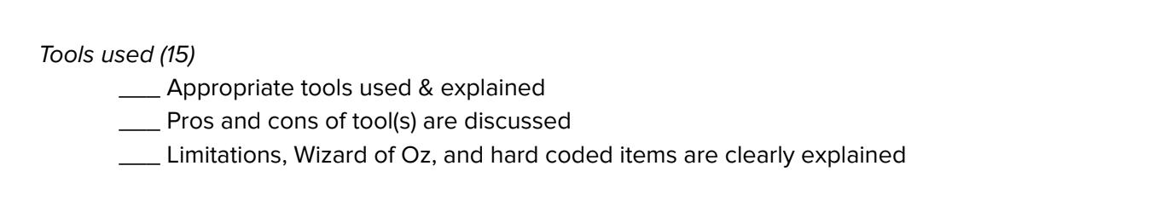

Prototyping tools
For early sketches, we used Goodnotes. Goodnotes is a sketching platform on iPad that allows users to quickly produce sketches that are scalable.
Pro
Con
Fast and easy to use
Low friction, good for iteration
Easy to produce copies of the same drawing and iterate
Invites the user to be creative and have more freeform ideations
Not collaborative
Difficult to interact with
Does not mimic closely with real world use cases

Slide 30
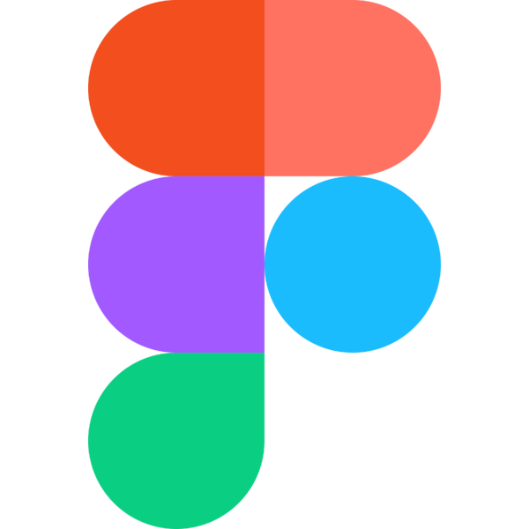
Prototyping tools
For later stages, we moved to Figma. Figma is an interface prototyping tool that helps with producing med-fi prototypes.
Pro
Con
Easy to create industry-level interfaces
Able to mimic closely to real world usage
Easier to collaborate with teammates and brainstorm together
Creating wireframing with ease
The components are difficult to manage if there are too many copies of them
A lot of permutations are required in order to mimic a set of workflow

Slide 31
Limitations
Users can’t experience the onboarding flow
History timeline feature is not complete
Not included in the 3 main tasks but crucial to have in order for the users to understand how the app works.
Our current prototype only shows the prompt for today. The users aren’t able to visit the history. It would be an important aspect of the app but it is not a part of our 3 main flows.
Users can’t input real messages in the task flow
Users can’t add family members yet
We have multiple types of hard coded inputs including texts, voice messages, photos, and music. Our figma prototype doesn’t support custom messages yet.
Since this is a family oriented app, it would be crucial for the users to add their family members, but this is not a part of our main 3 tasks. We leave it out for now.
Notes:
Full explanation:
Onboarding Flow Missing: The onboarding flow, which is crucial for users to understand how the app works, is not included in our prototype. Users cannot experience the initial setup and introduction to the app's features. However, since the onboarding flow is fairly common among other apps and is not the unique value add of our project, we did not include this flow in our feature.
Limited Message Inputs: Users are restricted to using pre-defined, hard-coded inputs such as text, voice messages, photos, and music in the prototype. Custom message inputs are not supported at this stage, limiting the variety of interactions users can have. This is a limitation of Figma. However, we think the limited message does not interfere with the main task flow of the app.
Incomplete History Timeline: The history timeline feature is not fully implemented in the prototype. Currently, users can only view prompts for today, and they are unable to access the historical content. Although this is not a part of our main task flows, we think this is important to pay attention to because it is potentially an important feature to have.
Inability to Add Family Members: Since our app is family-oriented, it is essential for users to be able to add their family members. However, this functionality is not part of the three main tasks presented in the prototype and does not interfere with the main value adds of the app.

Slide 32

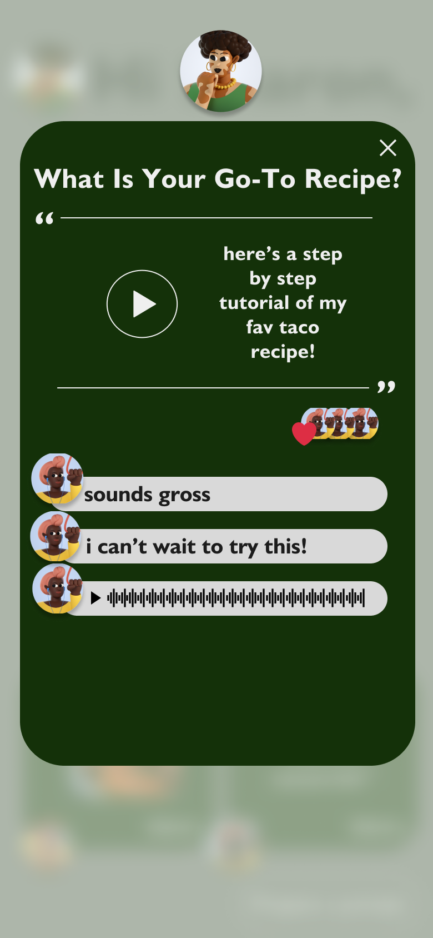
Wizard of Oz Features
Prompt generation algorithm
Submitted prompt storage & randomization
Audio recording mechanism
Daily prompts are supposed to be generated randomly and based on the family’s past submissions . Currently the prompts are magically chosen and shown on the home screen.
Submitted prompts should be stored and randomized. Currently the submitted prompts are not stored anywhere.
Currently, we don’t have an actual mechanism to record the users’ audio responses. So when the user clicks the audio button, the voice is magically recorded.

Slide 33
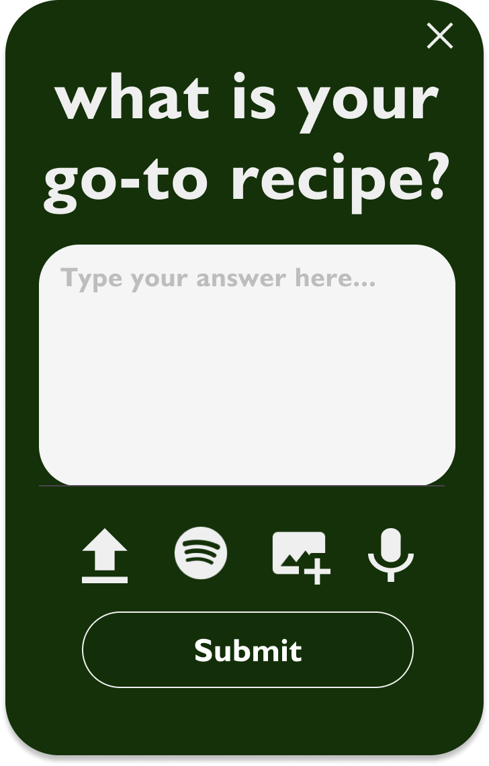
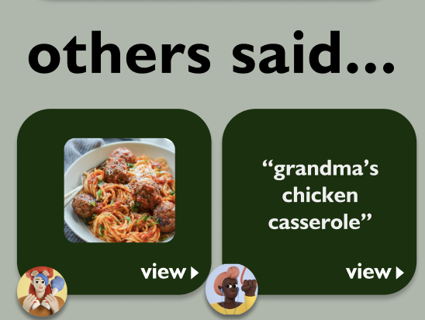
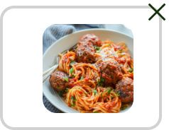
Hard coded Features
Family members
User information
User input and storage
All the user’s family members are hardcoded. The users can’t control who their family members are.
All the user information is hardcoded, including profile, pictures, and names.
On Figma, all the user input messages and storage is hardcoded.

Slide 34
Hard coded Features
Family members
User information
User input and storage
All the user’s family members are hardcoded. The users can’t control who their family members are.
All the user information is hardcoded, including profile, pictures, and names.
On Figma, all the user input messages and storage is hardcoded.

Slide 35
Appendix

Slide 36
Figma link

Slide 37
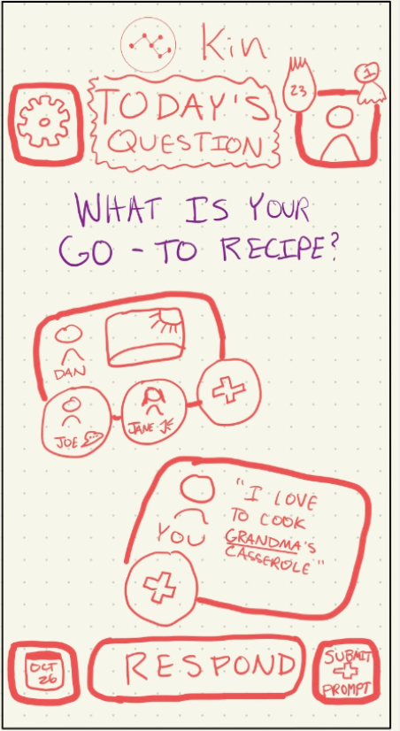
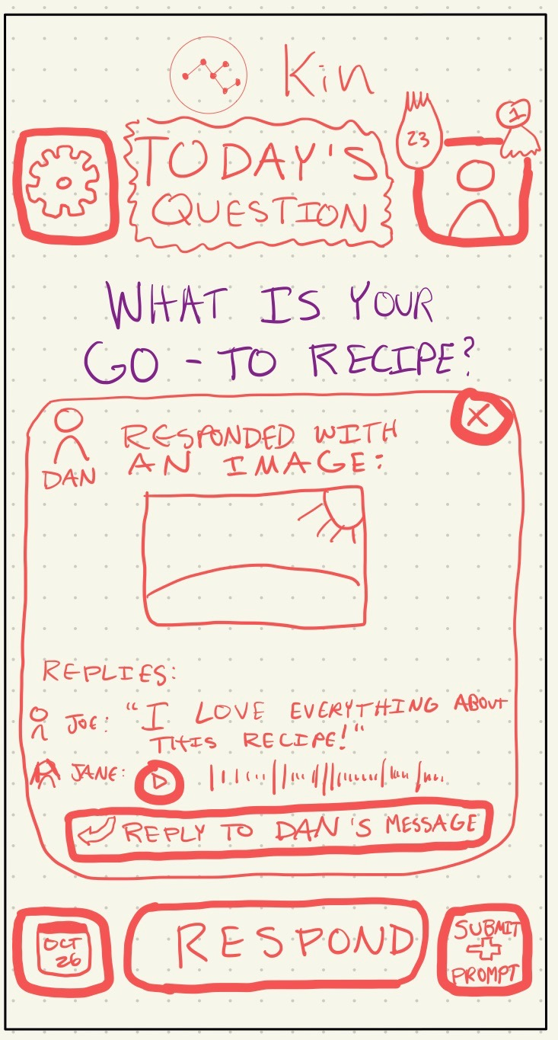
Change 1 - “Respond” -> “Answer”
Notes:
75% of people we interviewed were confused with the terminology of Respond versus Reply.
We changed “Respond” to “Answer”
We also prevented the “Respond” and “Reply” buttons from ever being on the screen at the same time

Slide 38
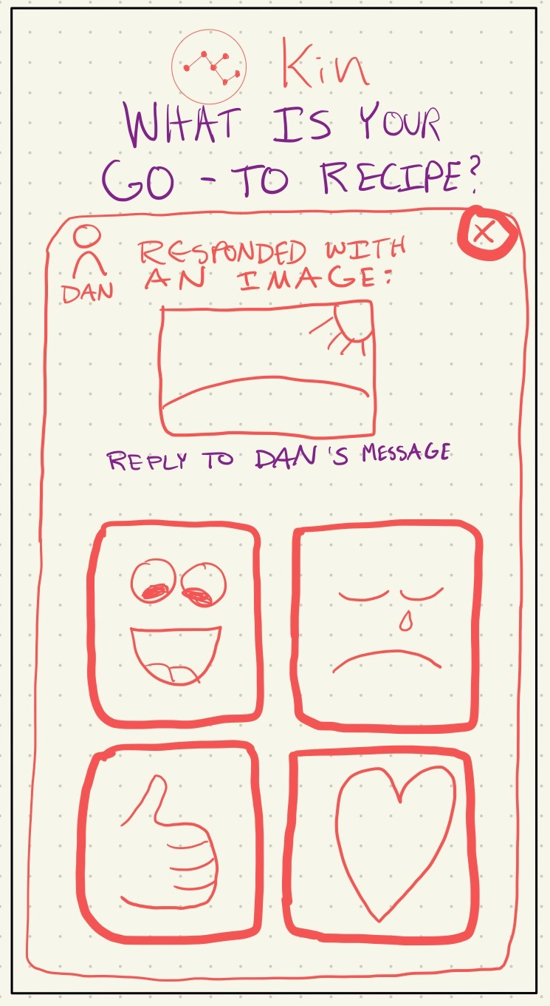
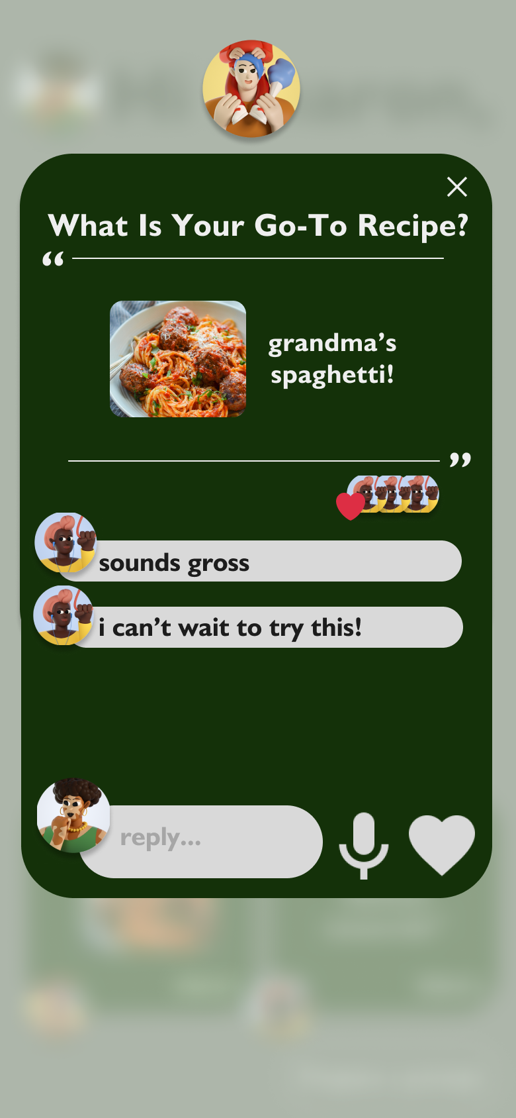
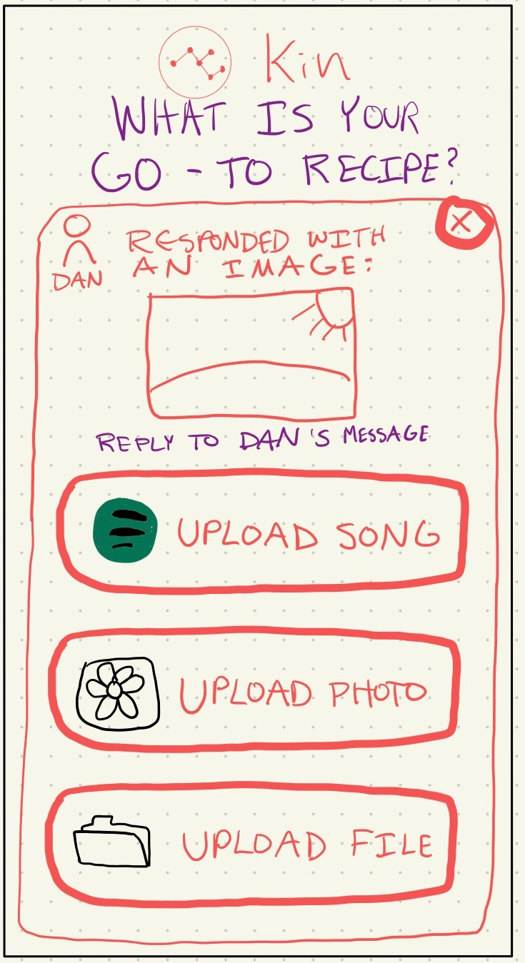
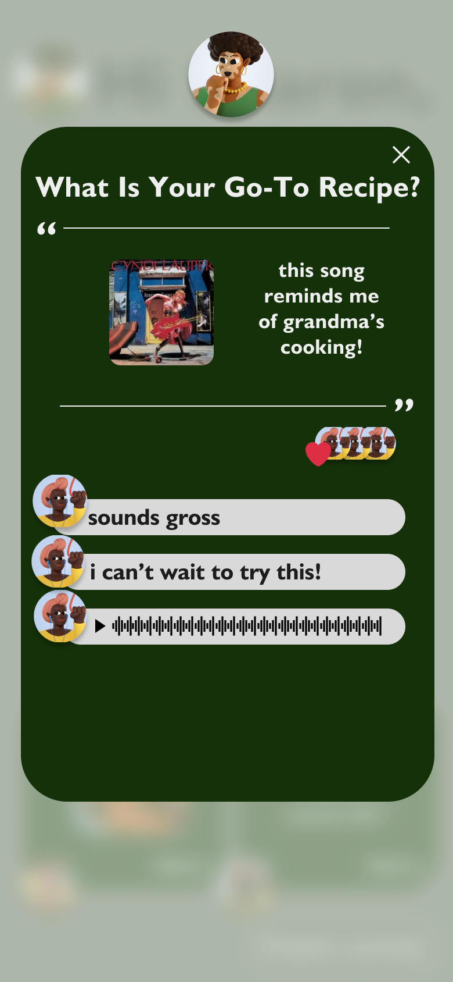
Change 2 - Standardized UI
Notes:
Made the UI more gridlike and standardized, with hopes of making it more accessible to users of all ages.
Menus with different uses all follow the same format
Regardless of whether you’ve answered the prompt or not, the home page looks virtually the same, with the exception of the “Answer” button being changed to “View"

Slide 39


Change 3 - 1 tap to get anywhere
Notes:
There is one core home page. Upon entrance of the app, the top “big card” prompts you and allows you to answer.
After that, the same “big card” is replaced with a place to view your place.
At all times, from the home page, you can access other responses, open them, and reply.

