Slide 1
A5: kin
Team 3 – Jack Clark, Shuvi Jha, Jasmine Narine, Steven Pu

Slide 2


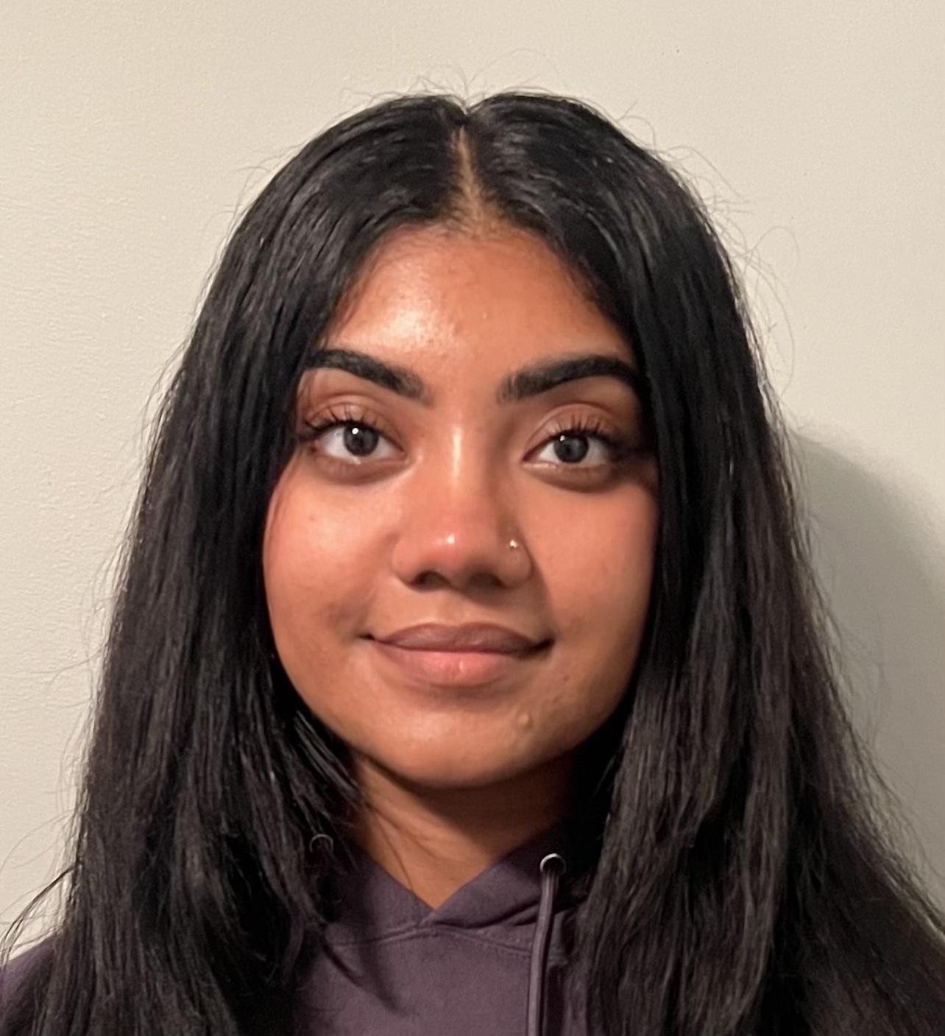
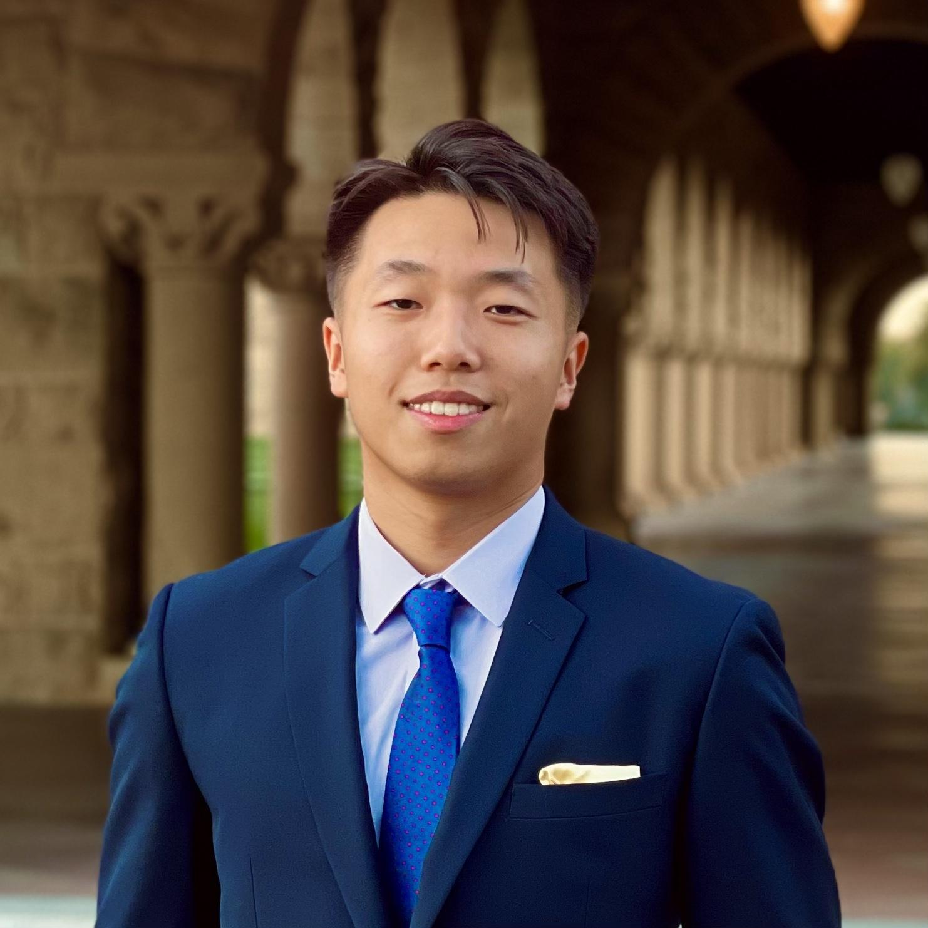
The team
Jack Clark
Shuvi Jha
Jasmine Narine
Steven Pu
MS CS (HCI)
BS MS&E
CS (HCI); Feminist, Gender, & Sexuality Studies
Senior
SYMSYS (HCI)
Senior
SYMSYS (HCI)
Senior

Slide 3
Value Proposition
kin
“Weave your family story one thread at a time”
“kin seeks to make the uncovering of family stories inviting by initiating daily, bite-sized conversations that facilitate and chronicle our familial connections”

Slide 4
Problem and Solution
It can be difficult for people to learn, share, discuss, and preserve family stories in a way that feels engaging and rewarding, especially across generations – specifically, young people and the elderly.
Problem
An tool focused on helping family members share memories through prompts and collaboration. Users can engage with prompts, read family prompts, and add their own prompts to the system to facilitate family interactions and preserve memories.
Solution

Slide 5
01
02
03
Concept Sketches
Chosen Realizations
Selected Interface
04
05
06
Low-fidelity Prototype
Three Task Flows
Testing Methods & Results

Slide 6
01
Concept Sketches

Slide 7
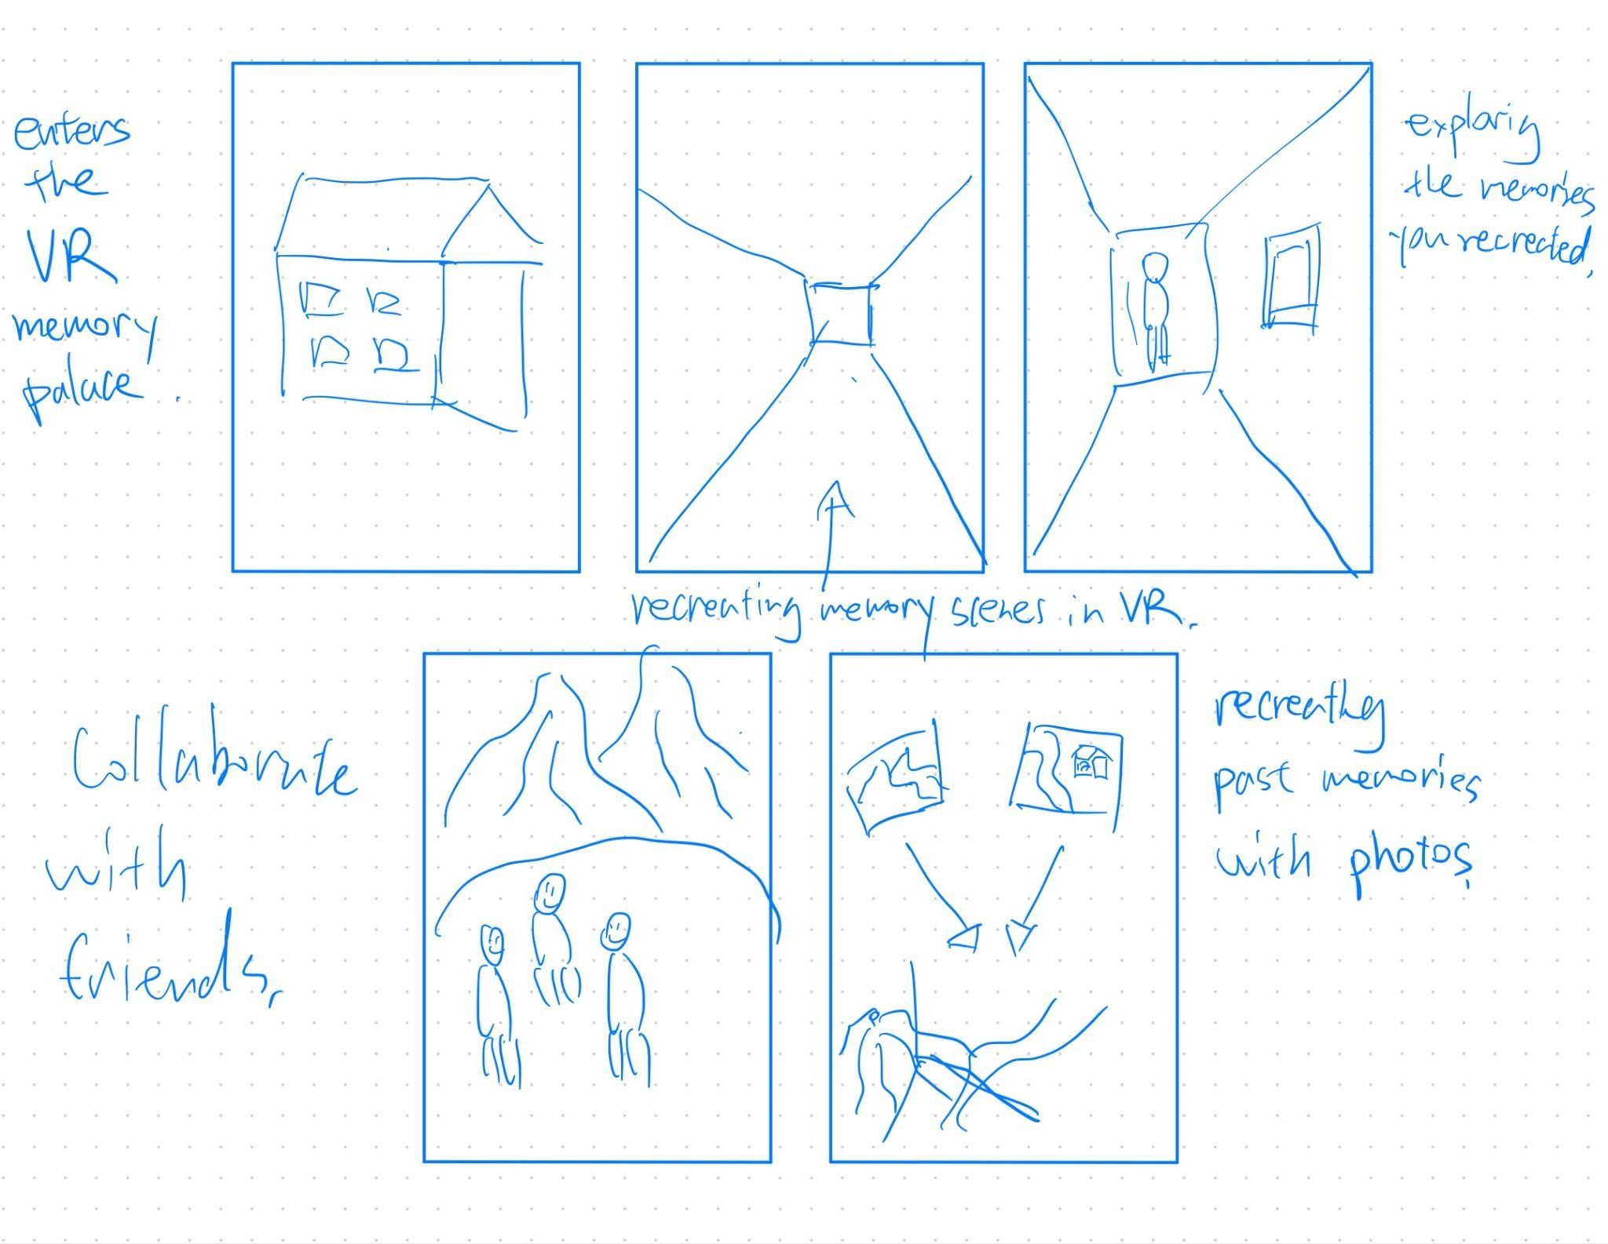
Concept 1: VR
Key feature:
Recreating and generating experiences/memories from voice descriptions and past photos from scratch.

Slide 8
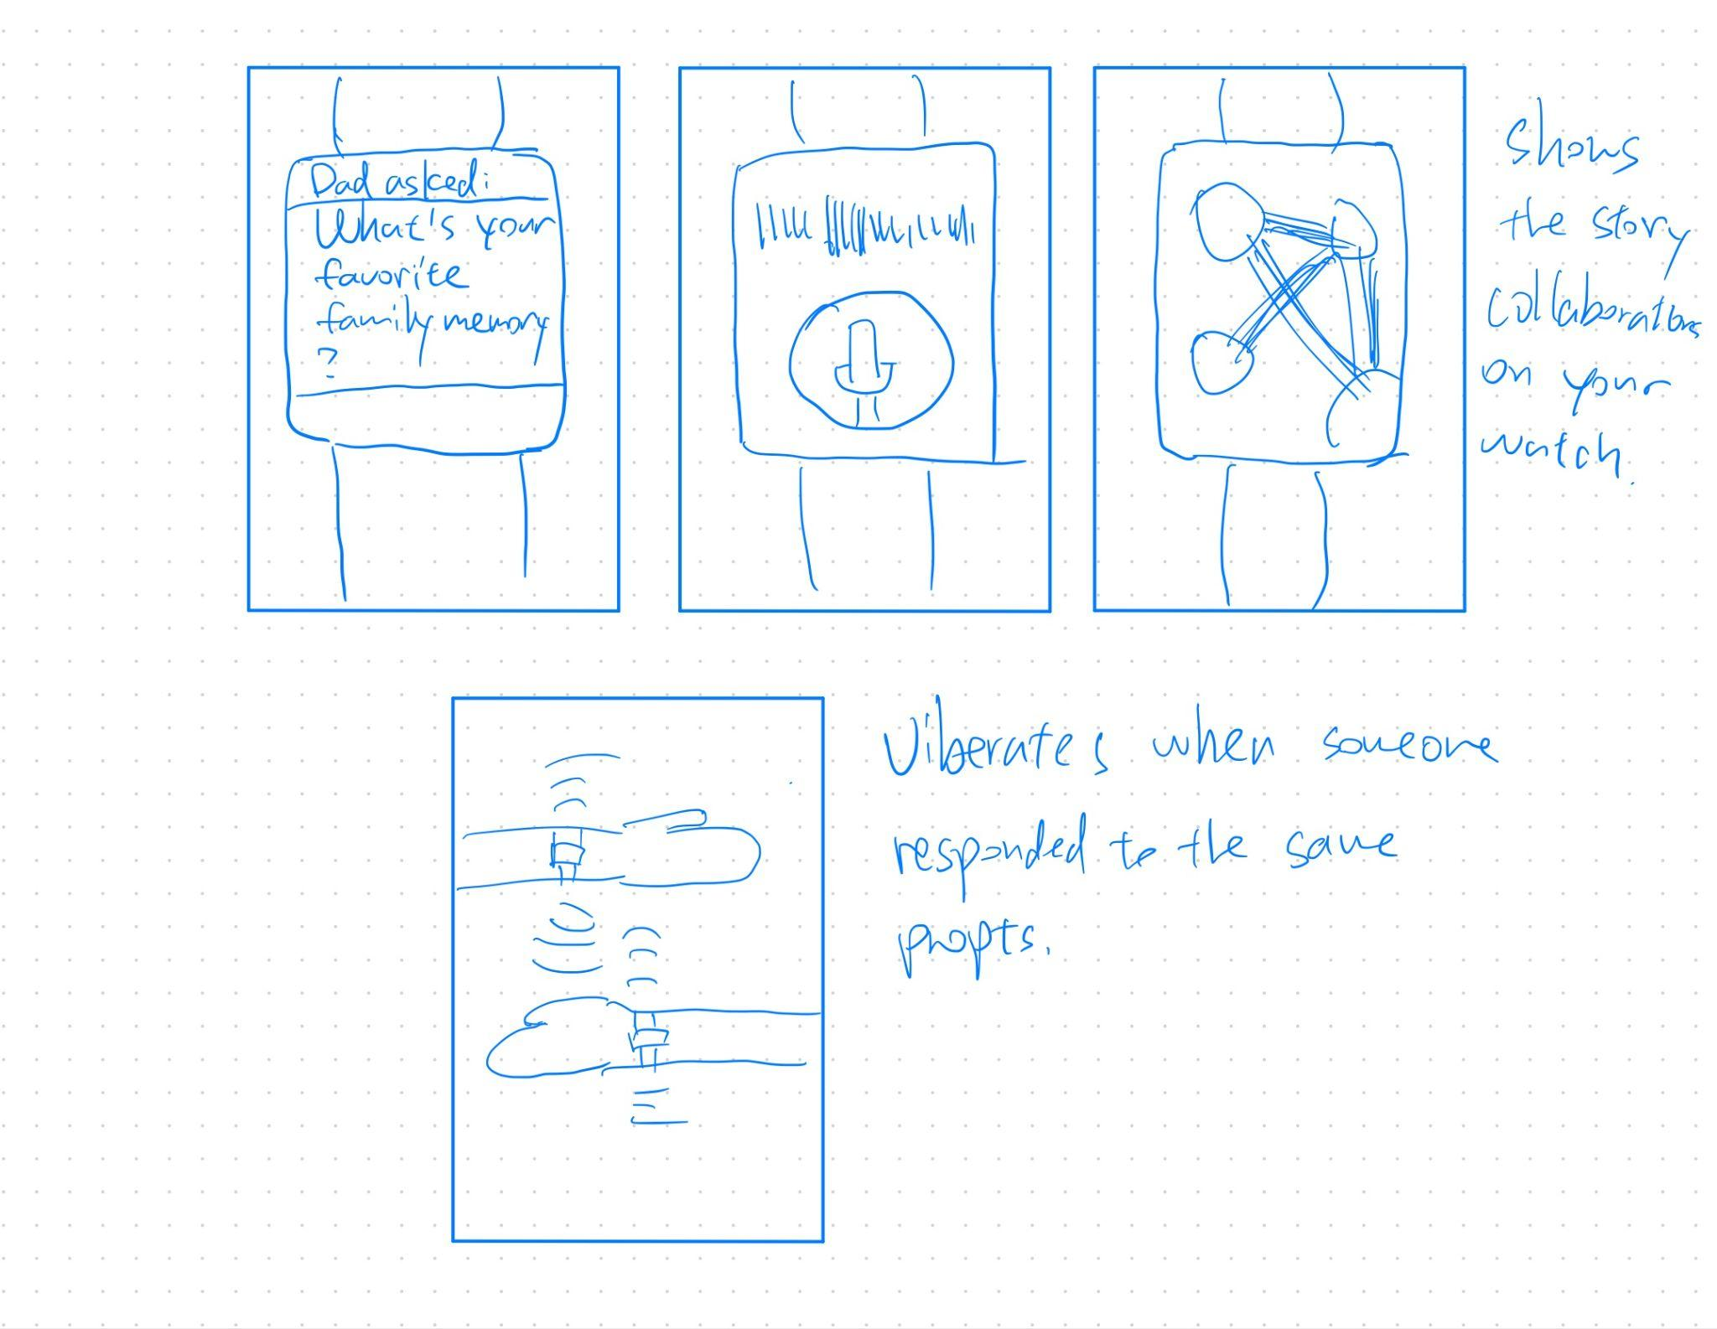
Concept 2: Wearable (Apple Watch)
Key feature:
Convenient and timely notifications when family member responds to prompts - allowing inspirations at the speed of thought.

Slide 9
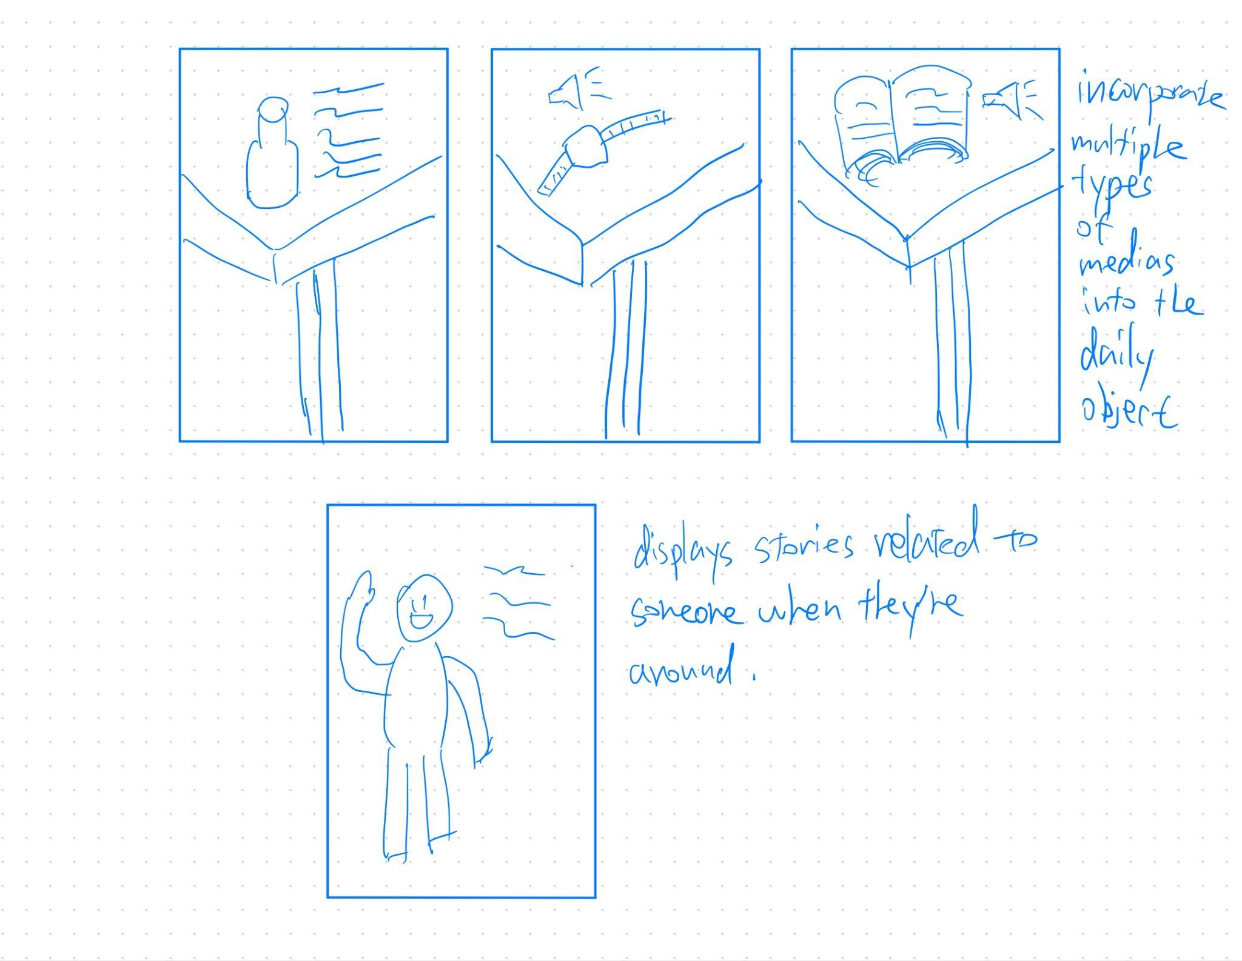
Concept 3: AR
Key feature:
Making certain real world objects memorable by incorporating live stories and meanings to them in the AR world.

Slide 10
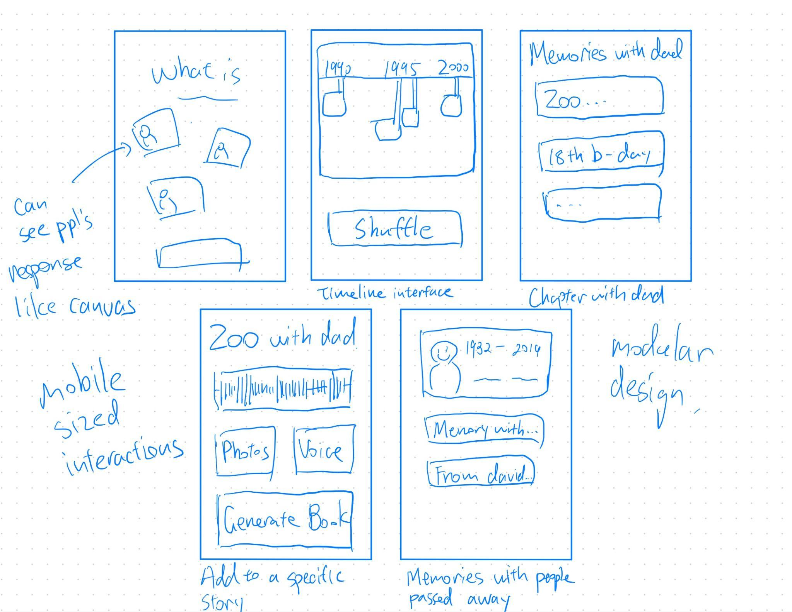
Concept 4: Mobile Application
Key feature:
Wide range of functionalities and visualization make the process of documenting family stories fun and collaborative.

Slide 11
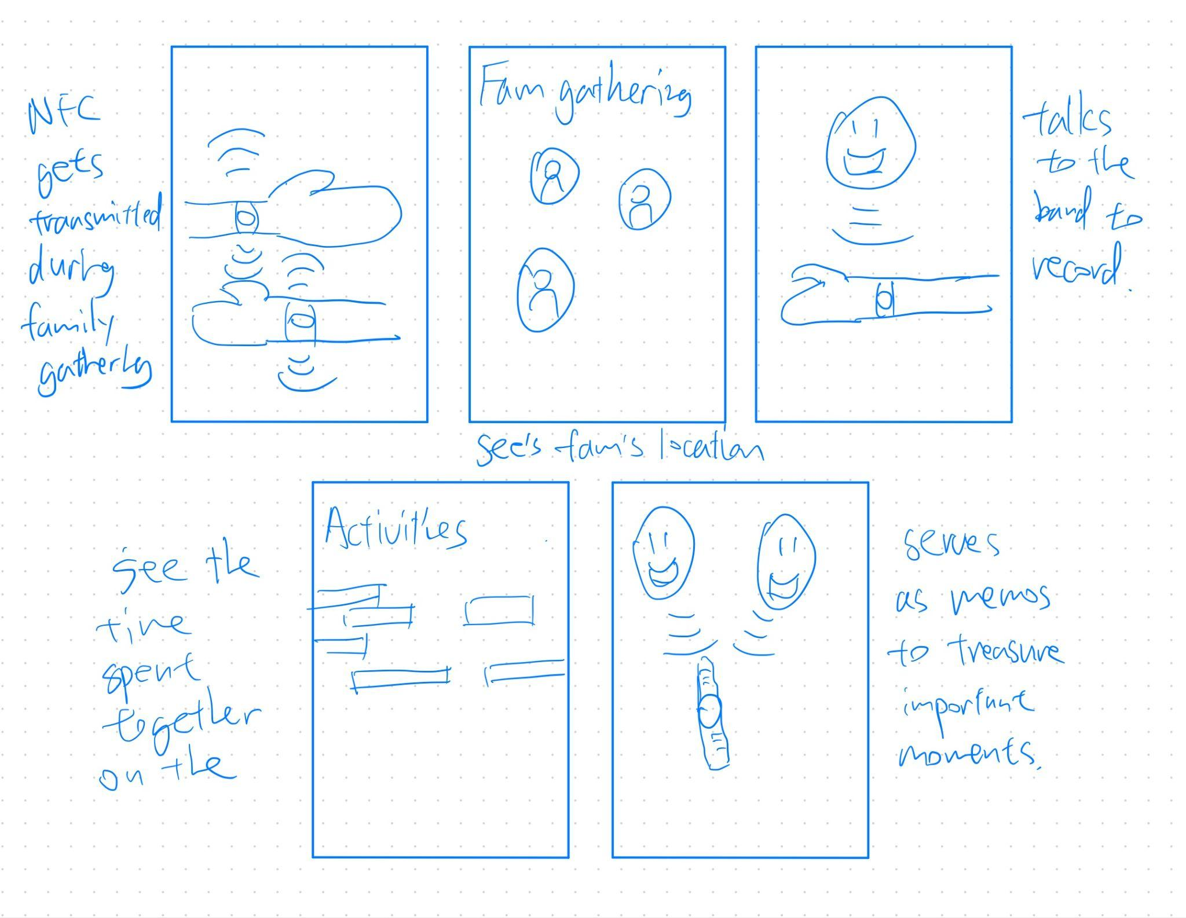
Concept 5: NFC Tags
Key feature:
Makings documenting family gathering more spontaneous and fun with NFC capabilities.

Slide 12
02
Top 2 Diverse Realizations

Slide 13
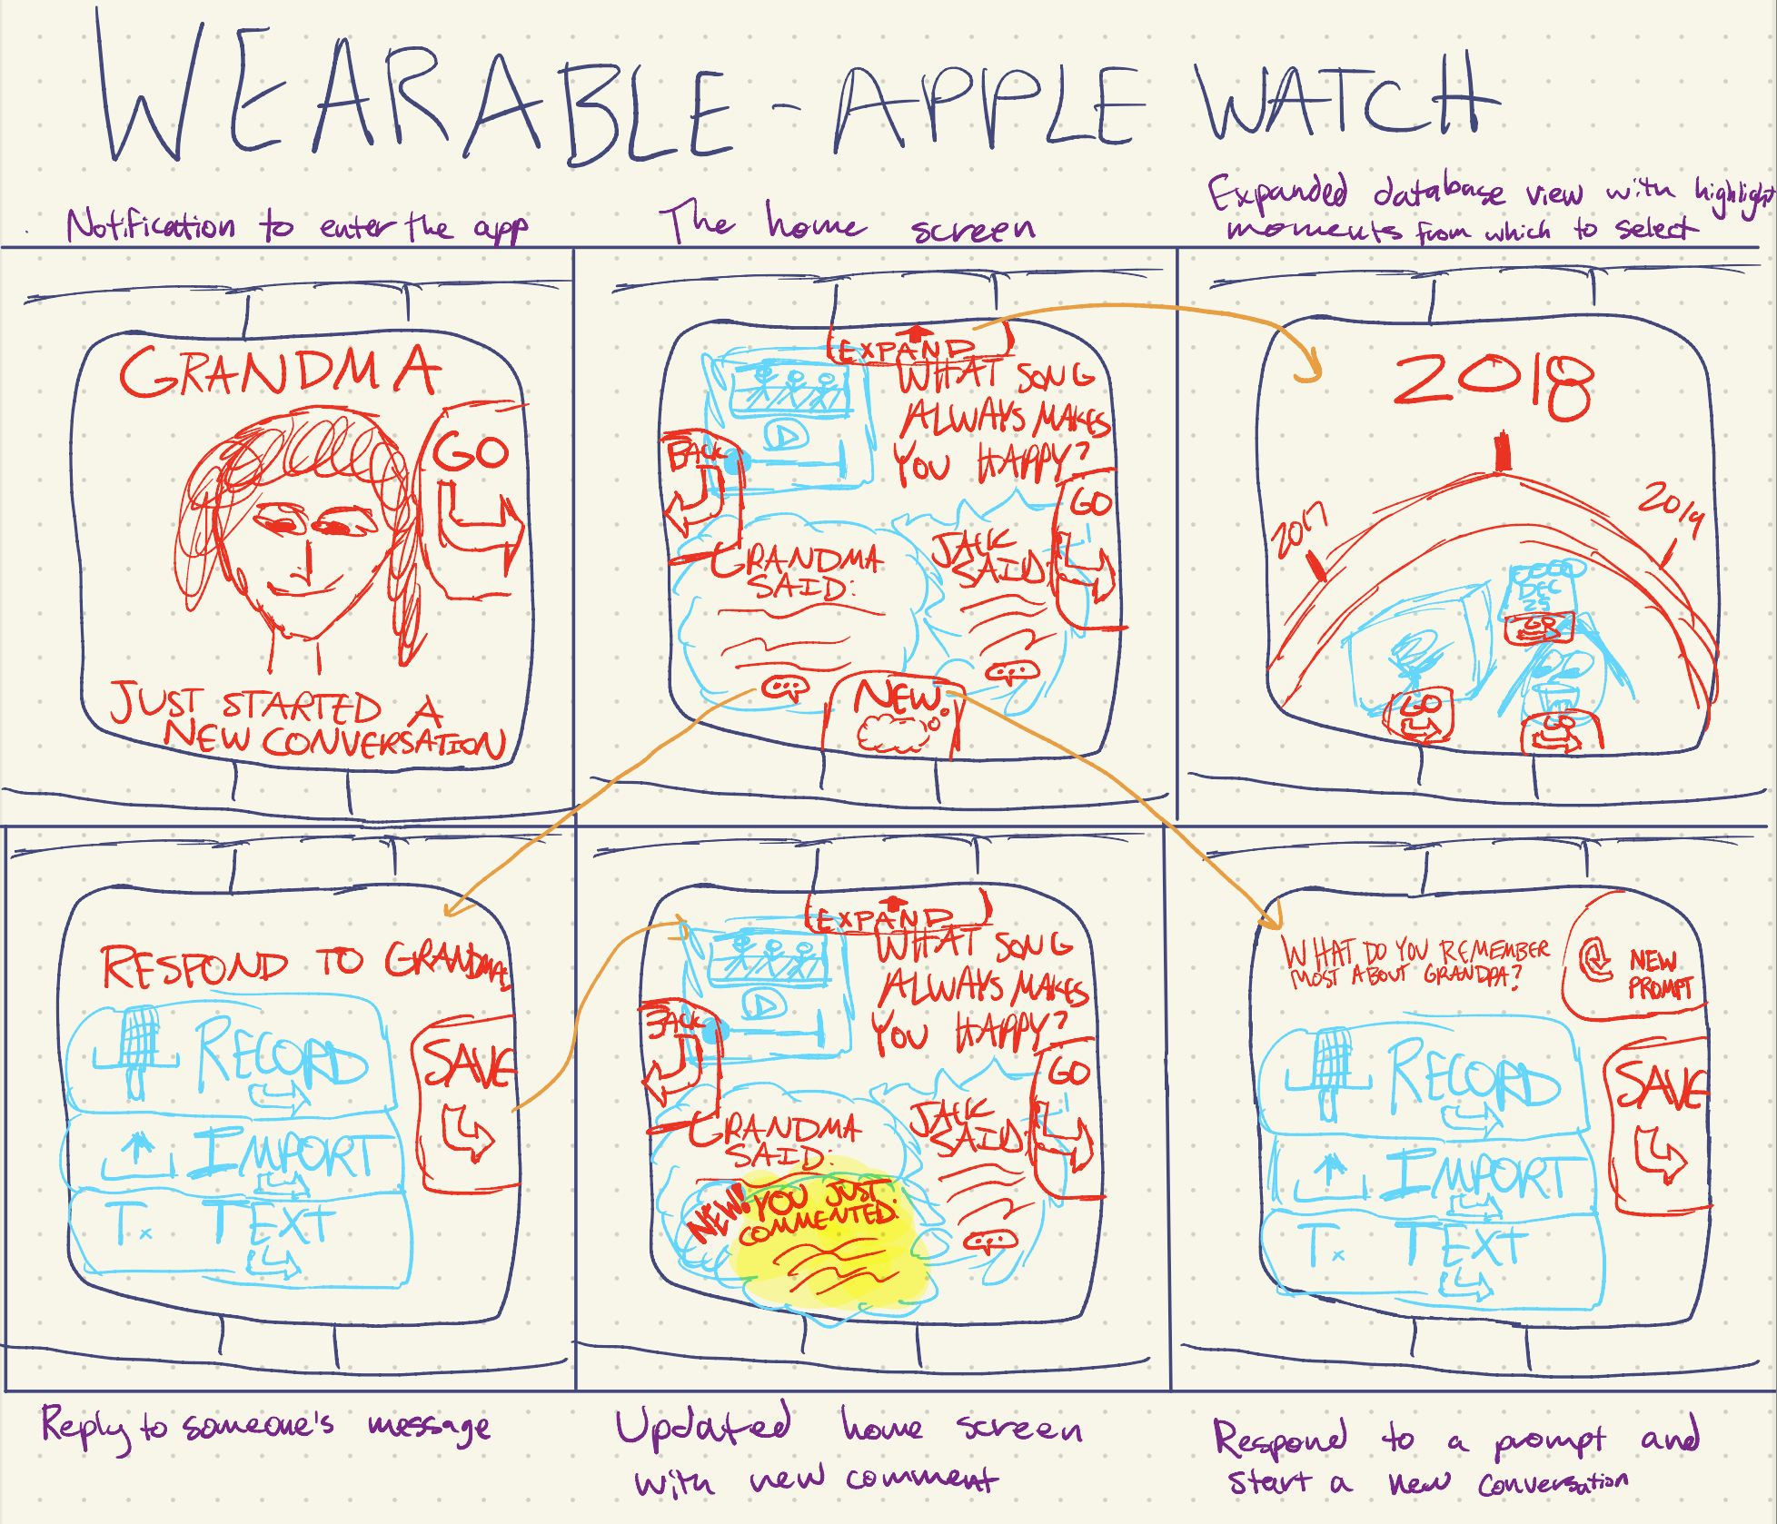
Wearable Walkthrough

Slide 14
Wearable: Pros and Cons
Pros
Cons
Simple movement-focused UI displaying one “conversation” at a time
Promotes UI familiarity as multiple screens share same frameworks
Apple Watch notifications offer improved visibility compared to iPhones due to their full-screen and bold design
Congested views may occur as conversations expand
Implicit drawback of the Apple Watch: limited storage capabilities and absence of a camera
Potential device unfamiliarity, particularly among older users
Full Pros and Cons in Appendix

Slide 15
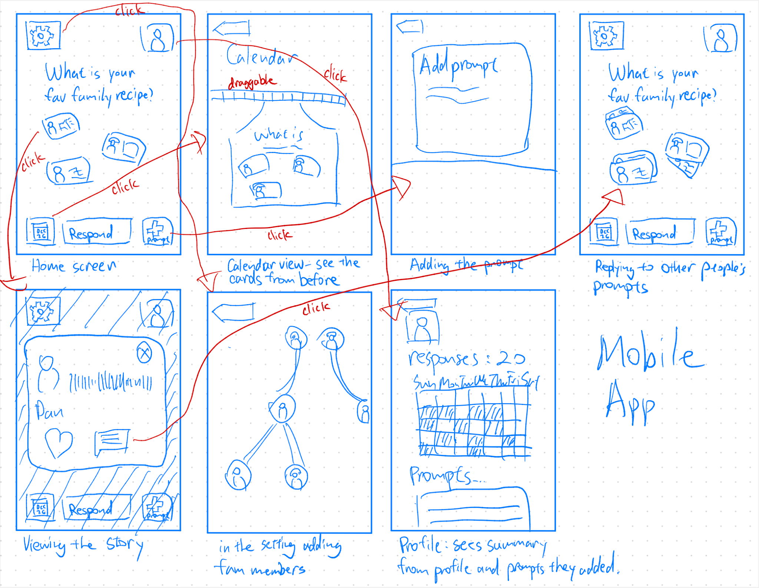
Mobile App Walkthrough

Slide 16
Mobile App: Pros and Cons
Pros
Cons
More reach into all kinds of audience since mobile platforms are still extremely popular
Easier to realize since there are many mobile development tools to help us realize our vision
Scalable functionalities: We can makes changes and add various functionalities to mobile apps
Potential complex interfaces can make it confusing for older people to use
Could potentially contribute to more screen time, which is not helpful for people who are trying to be off their phones in recent days
High friction to start: Users might have trouble using the platform if they have to put in a lot of information in the beginning
Full Pros and Cons in Appendix

Slide 17
03
Selected Interface:
Mobile App

Slide 18
As a reminder, here are our values…
Inclusive
Engaging
Intuitive
Community
Pleasant and enjoyable to use for all age groups, feels fun to engage with prompts
Making sure that prompts and active engagement with content help family members feel closer
Making sure all groups and communities, including elderly folks with disabilities, feel that they can use the app
Making sure that generating content in all its various multimedia formats and engaging with existing content is easy to understand

Slide 19
In line with our values, our rationale:
Larger screen size of smartphones provides more real estate for displaying family prompts, responses, and other content; also makes it easier to physically read (disability and age access)
Versatile interaction methods, such as touchscreens & voice input, enable various input methods (tapping, swiping, typing, & voice commands)
Robust notification system on mobile devices is essential for Kin, where timely reminders about prompts is meant to drive user engagement
Widespread adoption of mobile devices, spanning different age groups and demographics, makes Kin more accessible to a broader use base including the elderly

Slide 20
04
Low-fidelity Prototype

Slide 21
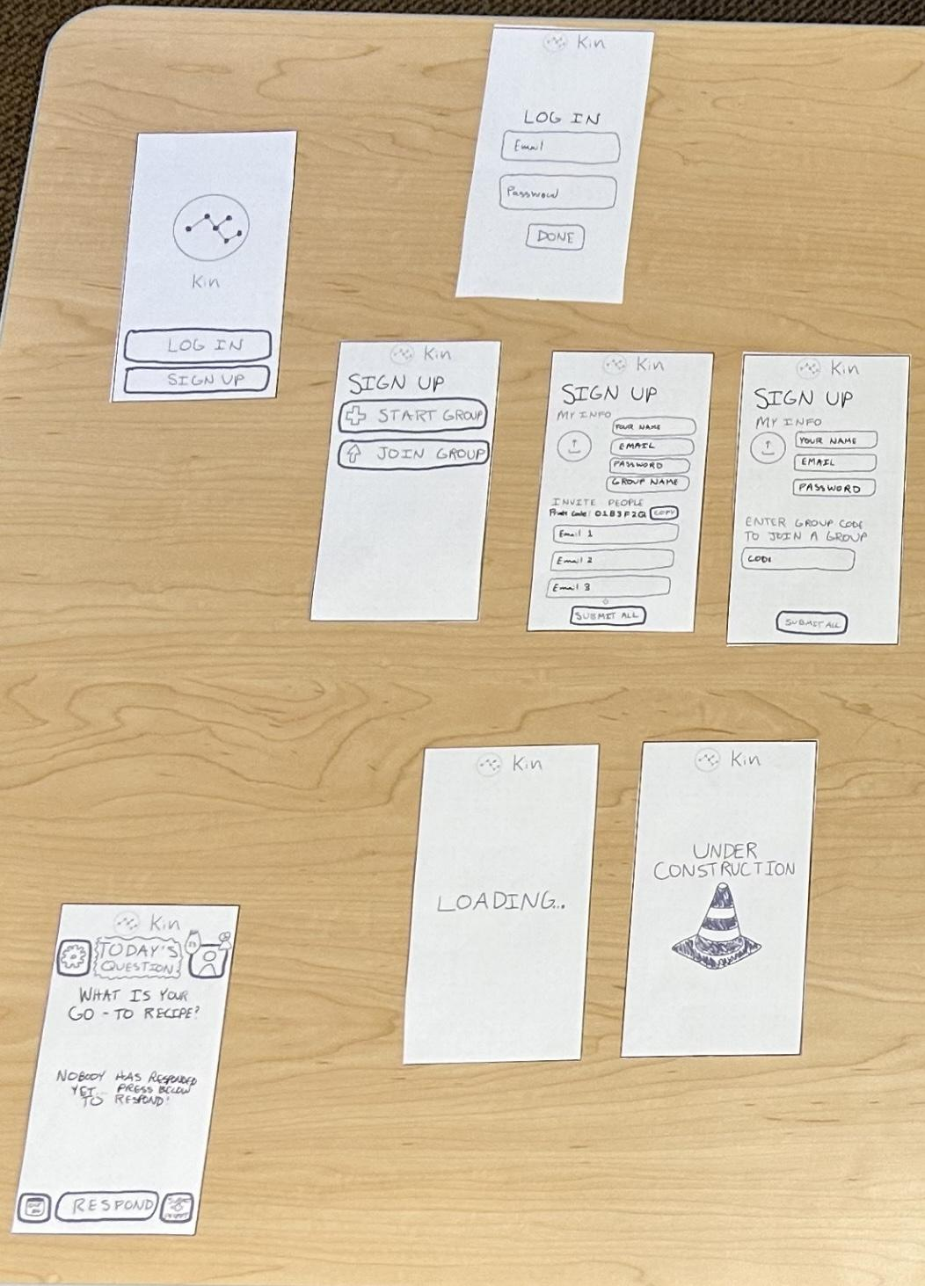
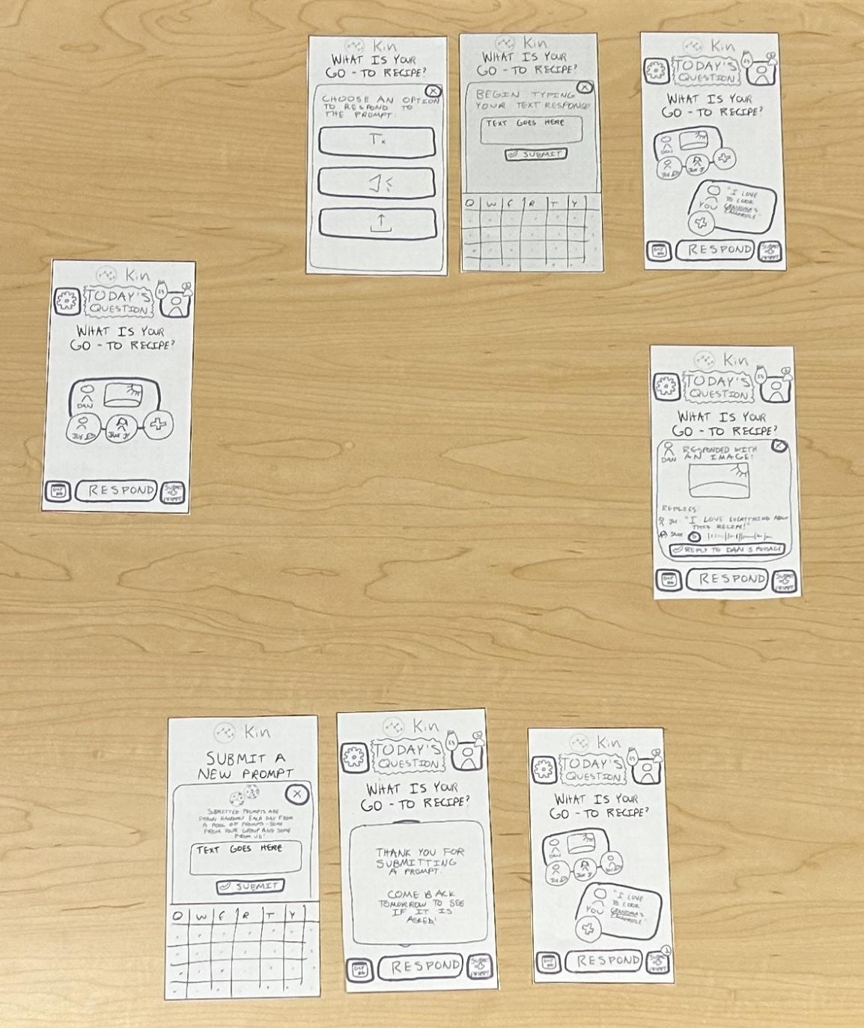

Slide 22
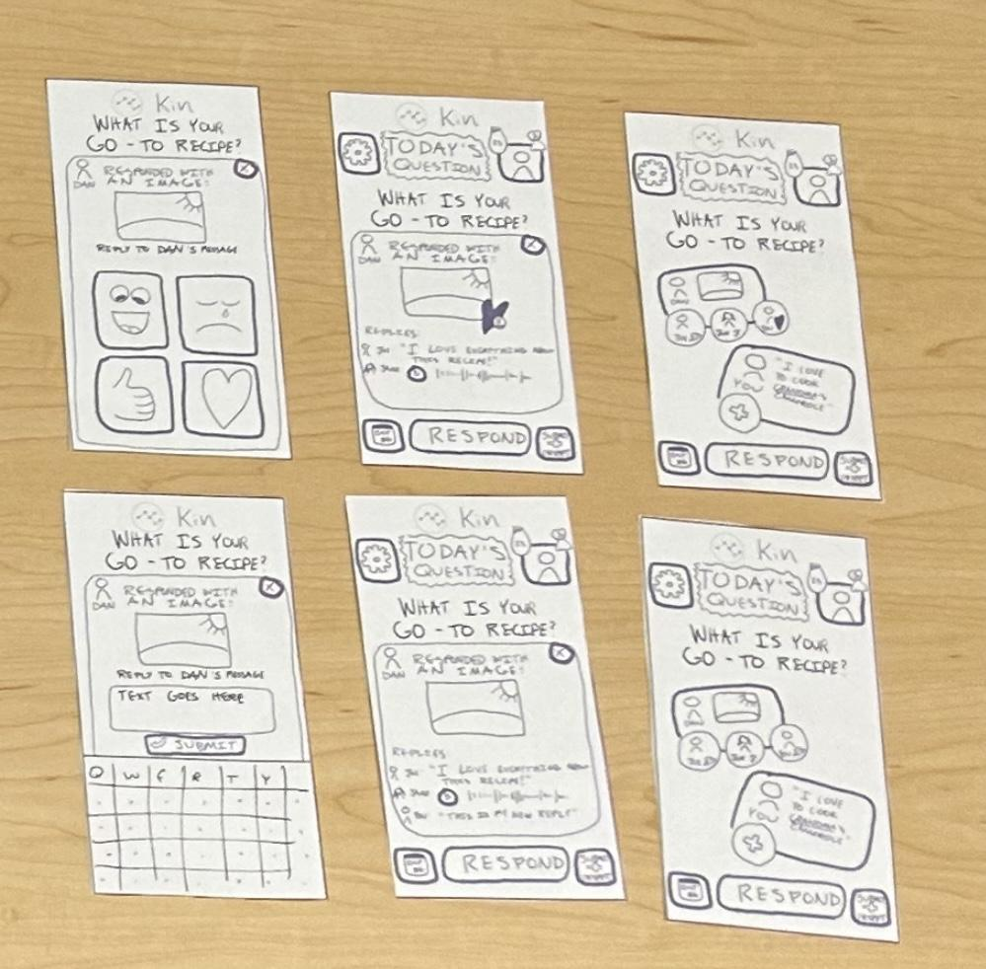

Slide 23
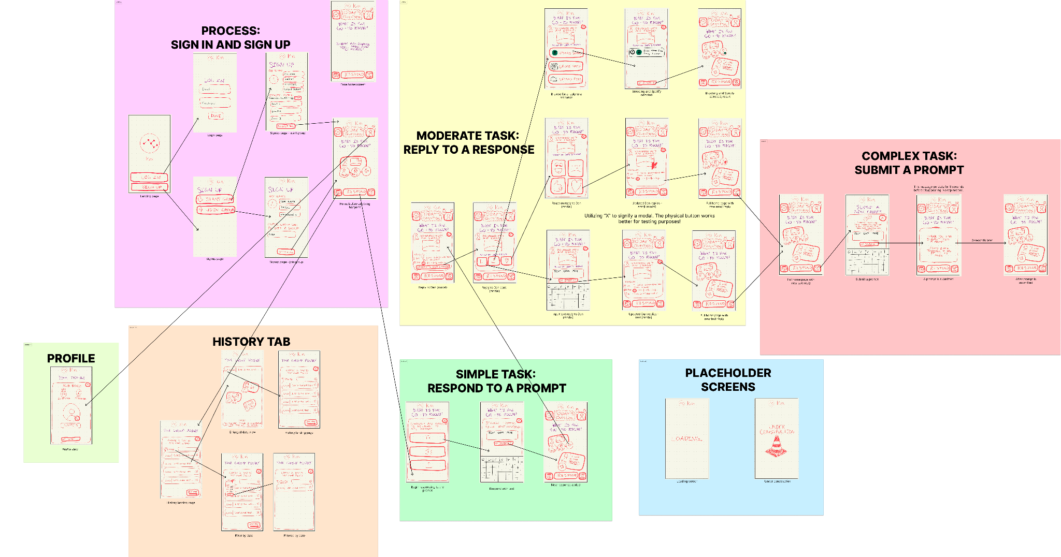

Slide 24
Screen Name | Brief description | User functionalities
Home | The nexus point for users to get anywhere on the app | Navigation to each of the other pages See own responses, responses of their family members, and brief previers of conversation between family members
Respond | Where the user goes to respond to a prompt | Choose between a text, audio, or file response Input the response via any of the 3 modalities Submit the response
Reply | Where the user goes to reply to someone’s prompt response (e.g. comment section) | See family members’ comments in full detail Choose between a text, file, or reaction reply Input the reply of any of the 3 modalities Submit the reply
Submit prompt | Where the user goes to submit their own prompt to be asked on a future day | See a description of how the prompt system works within the app Input a prompt of their own
History | Where the user can see previous days’ conversations | See responses to previous prompts See replies to previous responses Filter by date to find more specific conversations Search by keyword to find more specific conversations
Profile | Where the user can see more information and edit their profile | See badges and assess progress towards goals Edit profile photo or name
Notes:
Meant to serve as additional context for some of our decisions and our big ideas/goals with the app!

Slide 25
05
Three Task Flows

Slide 26
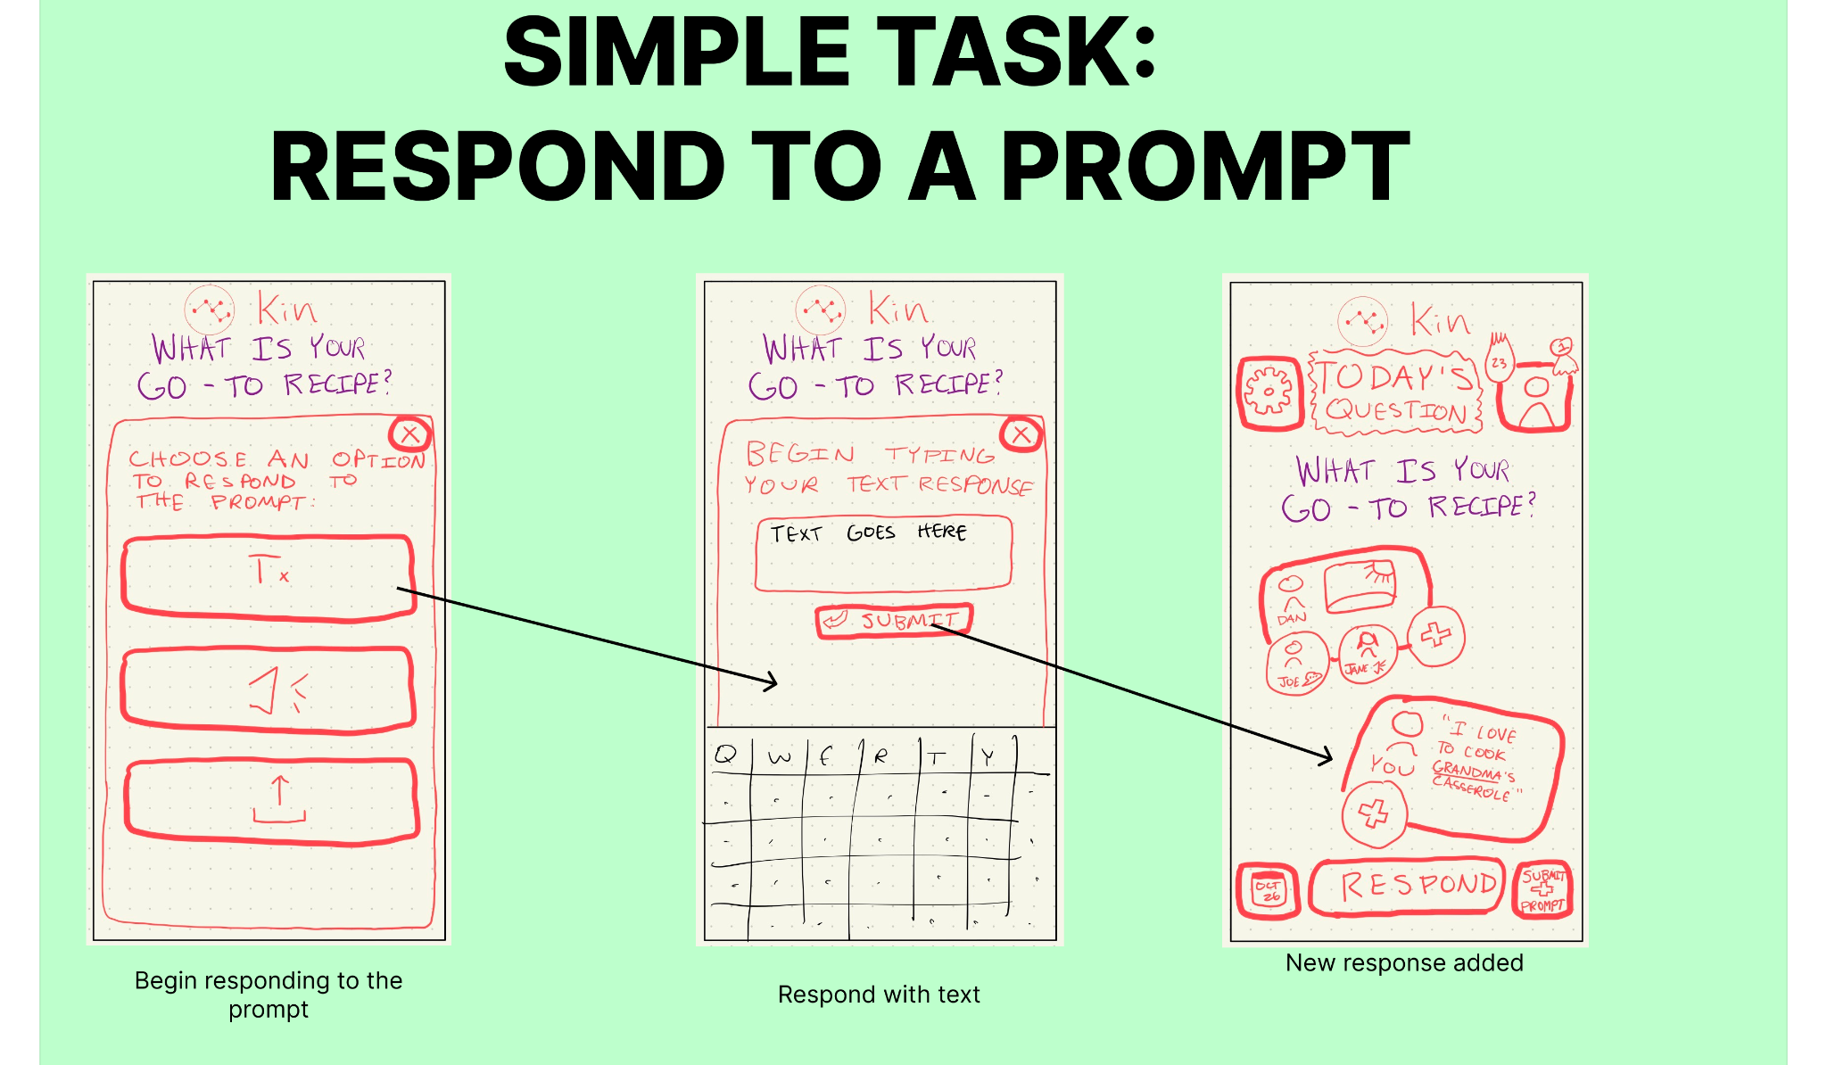
Notes:
Meant to serve as additional context for some of our decisions and our big ideas/goals with the app!

Slide 27
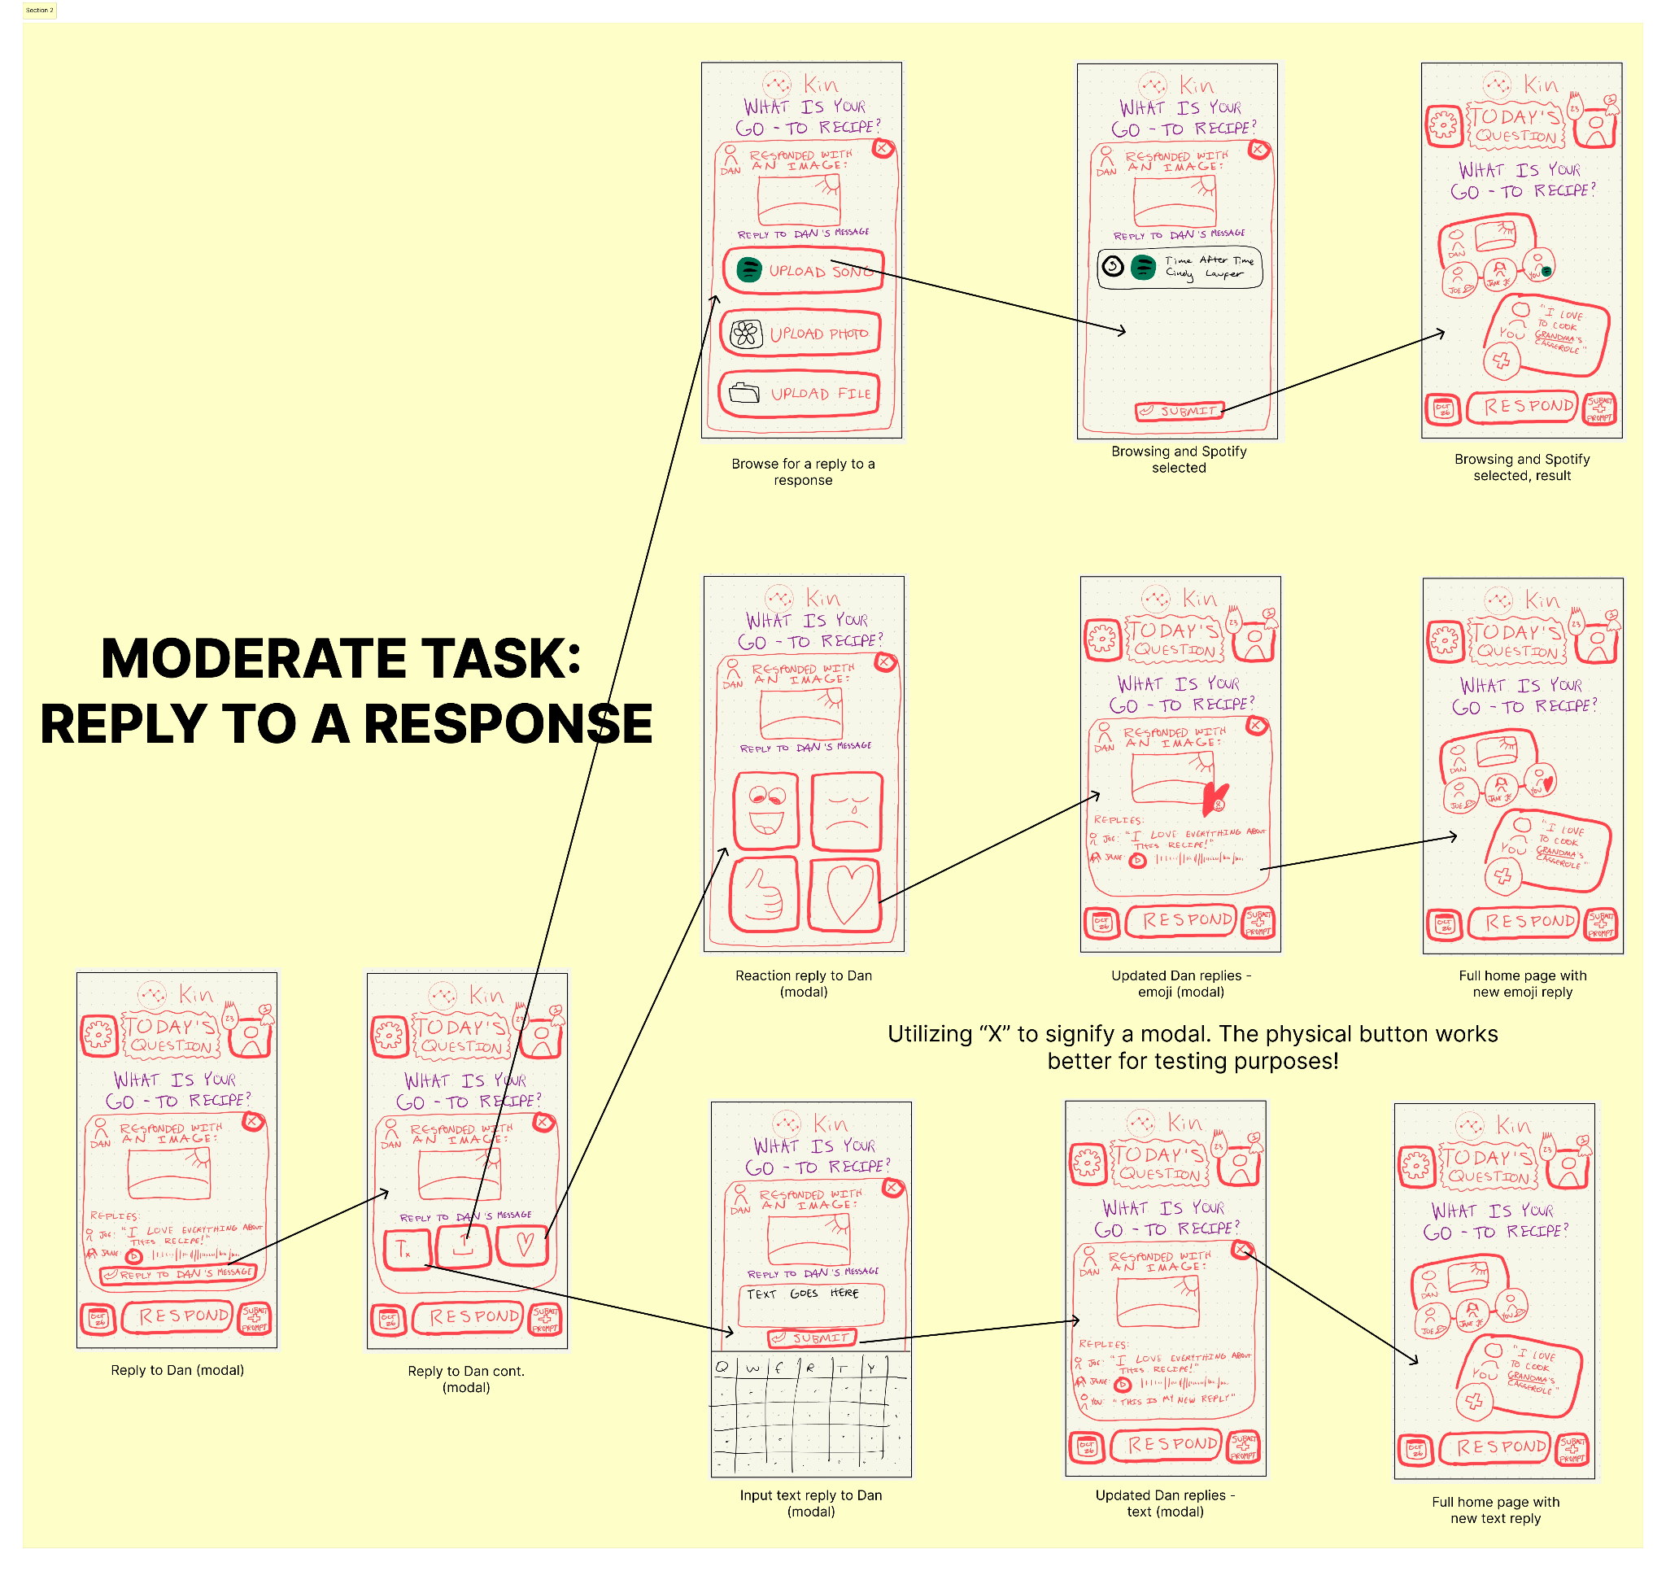
Notes:
Meant to serve as additional context for some of our decisions and our big ideas/goals with the app!

Slide 28
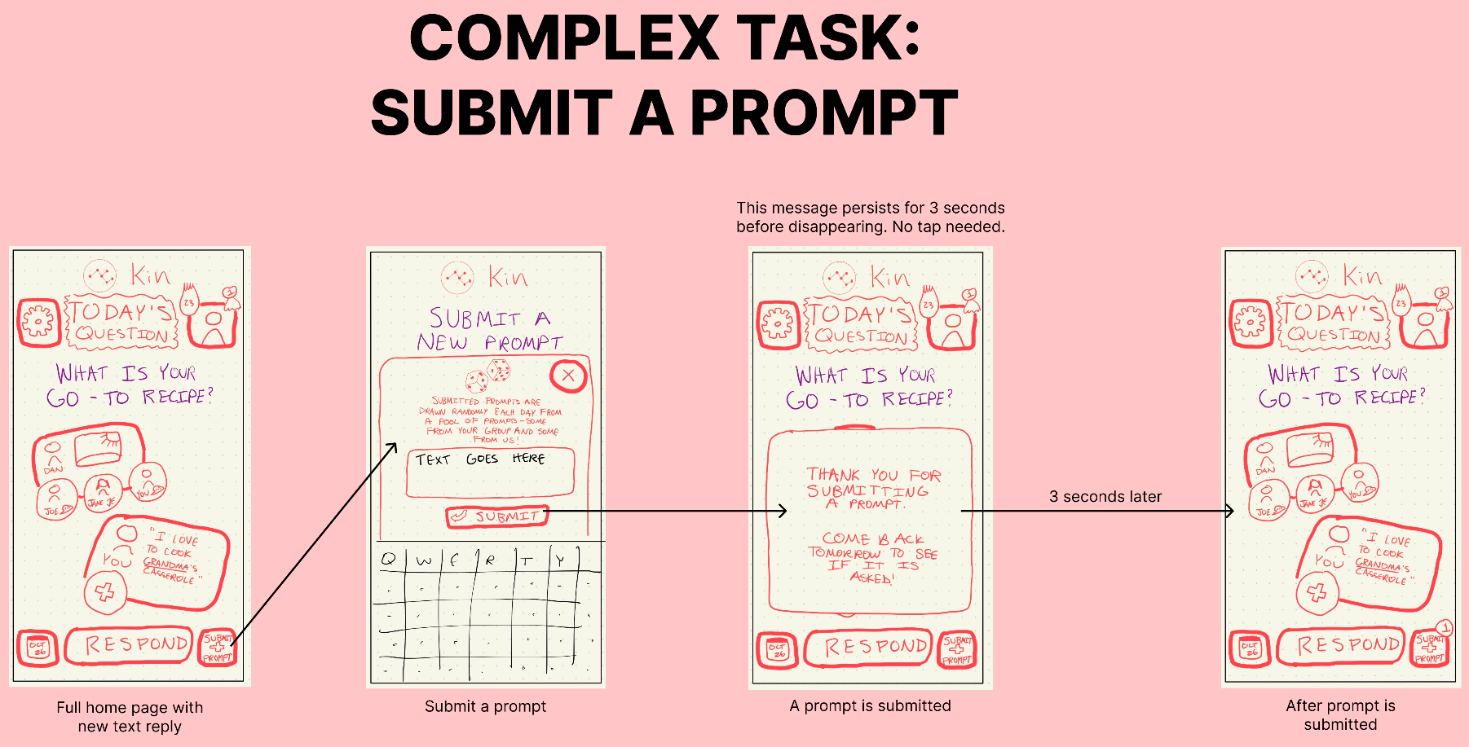
Notes:
Meant to serve as additional context for some of our decisions and our big ideas/goals with the app!

Slide 29
06
Testing Methodology

Slide 30
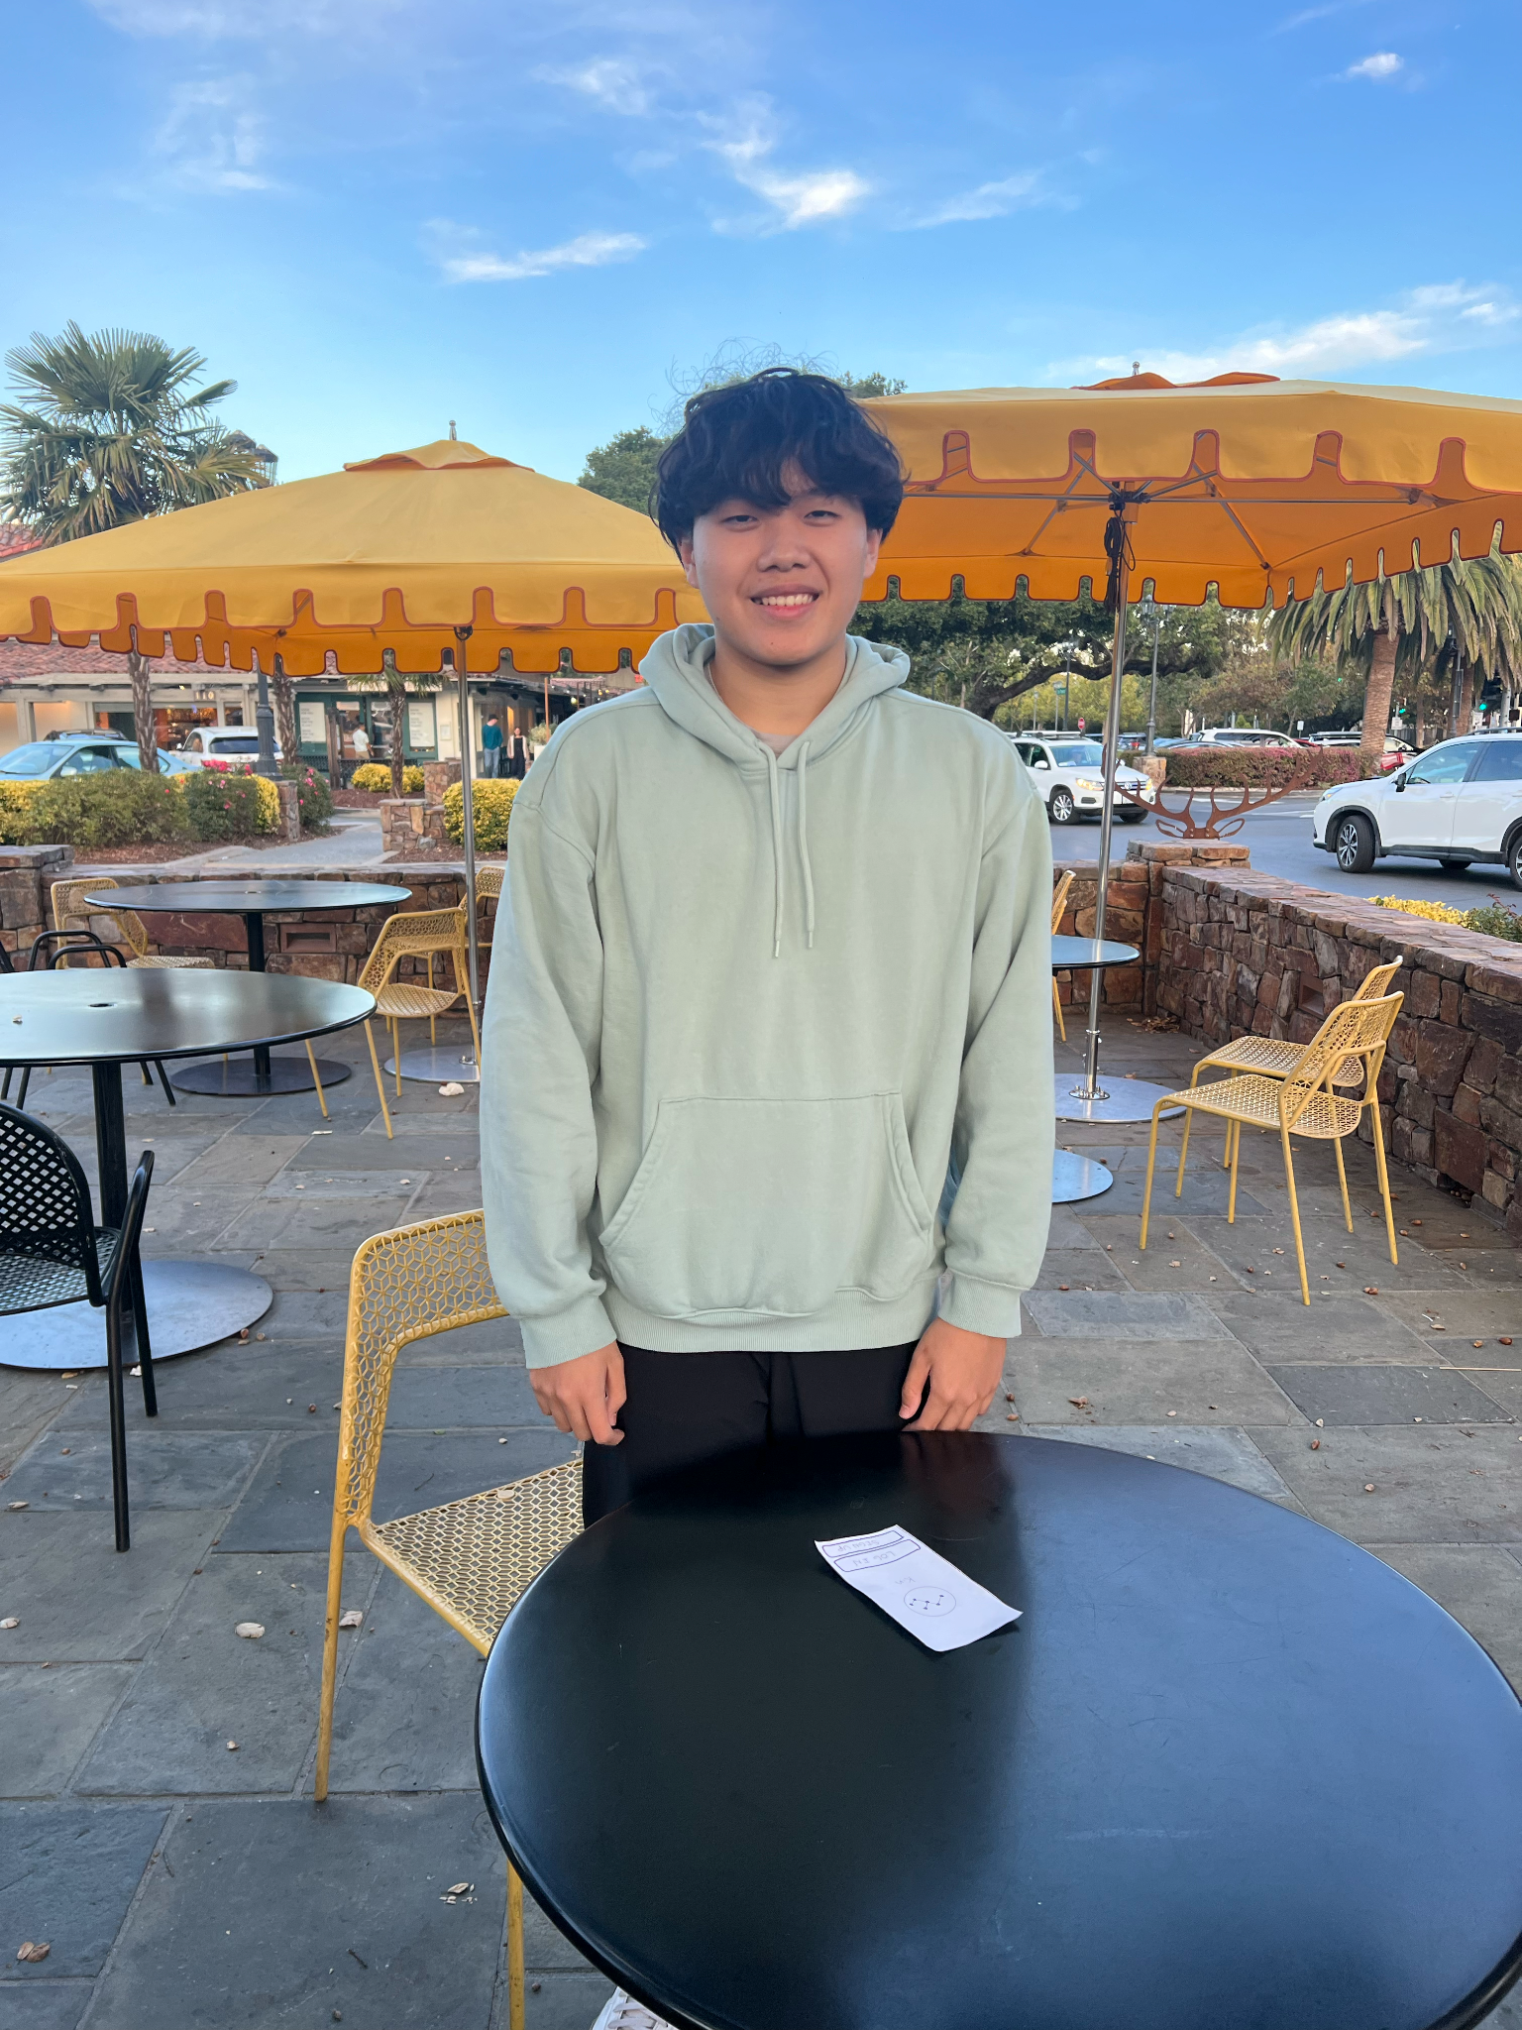
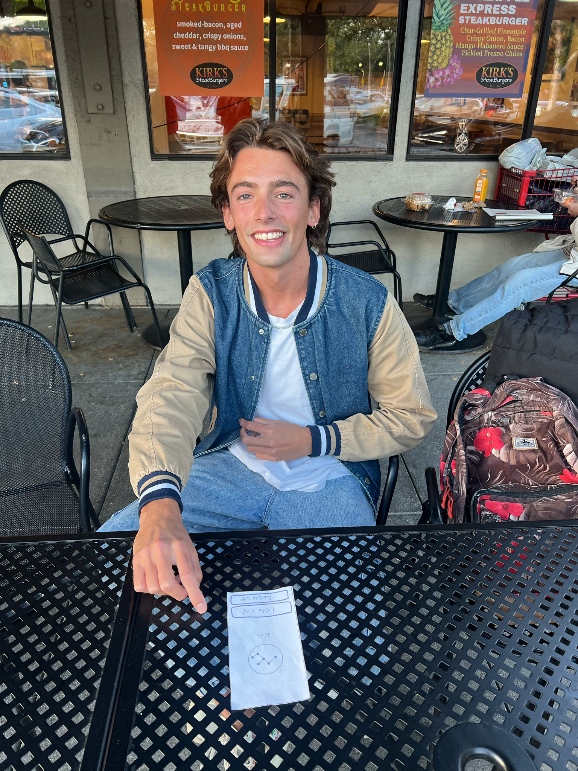
Participants
Heather Jugath
Middle aged woman, visiting from India
Martin Fossun
White Male in his 60s
Lives in Palo Alto
Zarai Tun
Student at Palo Alto HS
Clemente Antuna
Senior at Columbia

Slide 31

Environment & Apparatus
Paper prototype, manually swapped “screens” to respond to user action.
These paper prototypes were laid out on a table in front of our participants as we consulted our script and began testing.

Slide 32
Team Member Roles
Jack Clark
Shuvi Jha
Jasmine Narine
Steven Pu
Computer
Note-Taker
Note-Taker
Facilitator

Slide 33
Procedure & Process
Introduce + Provide Project Overview
Consent + Pictures
Prompted user to “onboard” onto app
Explain goal and context for current task (simple, moderate, complex)
Asked users to evaluate their experience on 1-10 scale across 5 criteria

Slide 34
Usability Goals & Key Requirements
Measurement: Task Error Rate
We will count the number of errors made per tasks (onboarding, responding to prompts, reading family responses, adding personal prompts).
Goal #1: Efficiency
Measurement: System Usability Scale (SUS) Score
After the testing session, participants can provide ratings and comments related to various usability aspects. A higher SUS score suggests that users find the app easy to use – important for our elder users.
Goal #2:
Enjoyable

Slide 35
07
Results

Slide 36
Process Data
Simple task
75% of participants found responding to the daily task intuitive
100% of participants were easily able to choose the medium of their response, without confusion
Moderate task
75% of participants found replying to other people’s posts confusing
  Unclear respond vs. reply button
Complex task
100% of participants had major trouble finding the submit prompt button

Slide 37
Usability Goals: Revisited
Efficiency:
Average of 3 “mis-clicks”
Confusion about placement, or content of a particular feature of the app
Enjoyability + Usability:
I think that I would like to use this system frequently 5.75
I found the system unnecessarily complex 4.75
I found the various functions in the system were well-integrated 8
I thought there was too much inconsistency in this system 2
I felt very confident using this system 7

Slide 38
Other Observations + Discussion
“I would use it with my friends, not really my family”
“I don’t really play around with my phone too much”
“What is the relevance of the logo?”

Slide 39
Implications
Persisting generational divide in interaction with app
  Need to prioritize intuitive interface for all age group
Confusion on where to submit the daily prompt & how the prompt system works
  Need to make sure that the prompt mechanism is clear and easy to conceive for the users
During testing, the users were confused about who their “testing family members are”
  Need to make sure that we explain it well/have good onboarding in our future testing
One of our testers said that they would be interested in using this system for friends and not families
  The system could also be used to increase ties between friends

Slide 40
Changes
Respond and reply no longer on screen together
  Reply feature becomes largest (and only) button on screen
Make an onboard screen that explains key features - submit prompt button, etc…
Include mechanisms that allows for adding and managing different members more easily

Slide 41
What Testing Couldn’t Reveal - Shortcomings
Authentic sense of how likely users are to revisit our app
How likely users are to interact with the calendar functionality on their own
How likely users are to invite their own family/friends onto the app
How enthusiastic users were about the concept of a streak/ badges -> daily use incentivized?

Slide 42
0#
Appendix

Slide 43
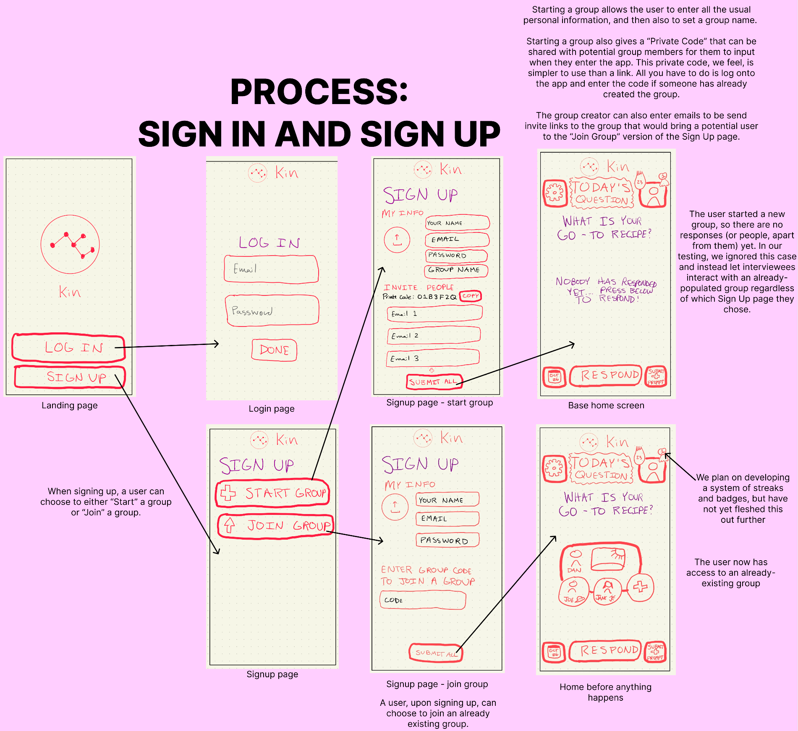
Notes:
Meant to serve as additional context for some of our decisions and our big ideas/goals with the app!

Slide 44
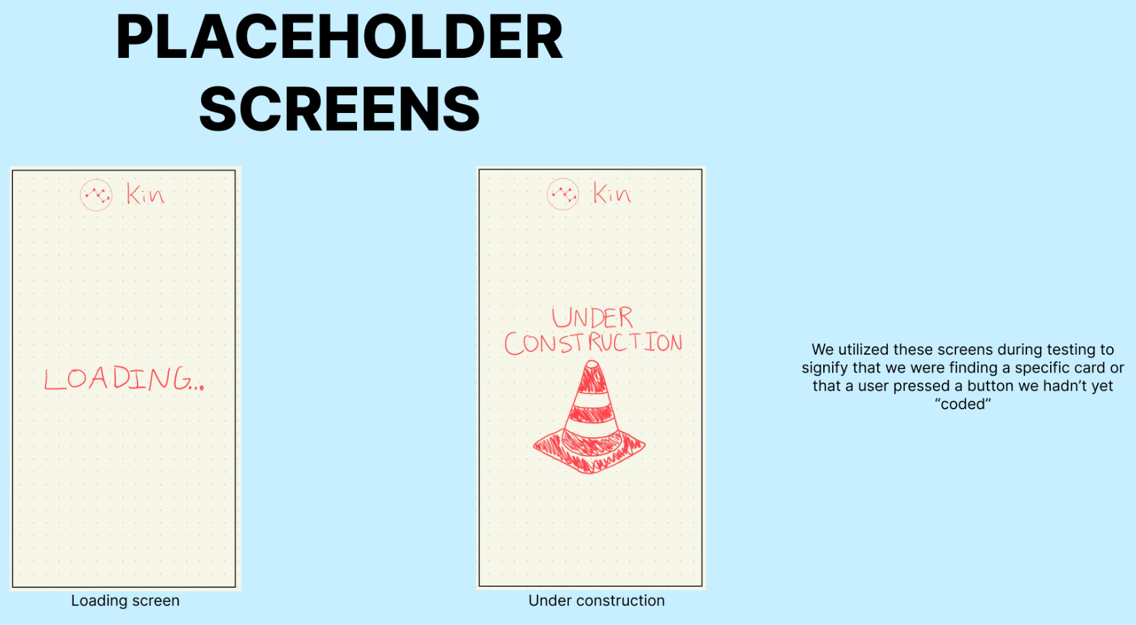
Notes:
Meant to serve as additional context for some of our decisions and our big ideas/goals with the app!

Slide 45
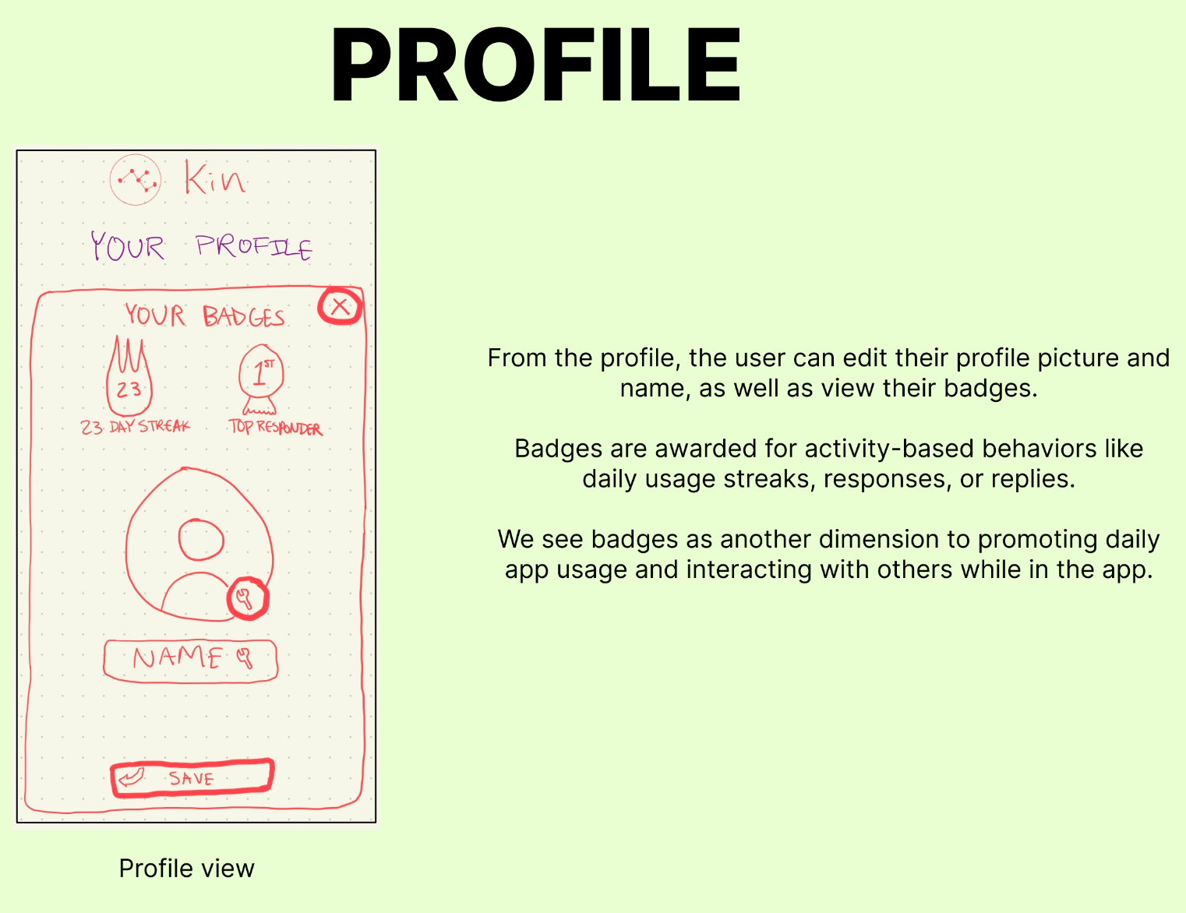
Notes:
Meant to serve as additional context for some of our decisions and our big ideas/goals with the app!

Slide 46
Wearable: additional pros & cons
Pros
Cons
Simple movement-focused UI showing one “conversation” at a time
Wholly customizable and unique conversation spaces
Fosters UI familiarity as multiple screens share same frameworks
Apple Watch notifications have better visibility than iPhones due to their full-screen and bold nature
Potential for immersive haptic feedback that feel closer than that of an iPhone
Congested views are a distinct possibility as conversations expand
Significant zooming in and out to navigate is a likely necessity, creating extra movement for the user
Implicit negatives of the Apple Watch, regarding storage capabilities and lack of camera
Device unfamiliarity is a possible issue for many users, especially older ones
Limited user accessibility and equity derived from fewer Apple Watches existing than iPhones

Slide 47
Mobile App: additional pros & cons
Pros
Cons
More reach into all kinds of audience since mobile platforms are still extremely popular
Easier to realize since there are many mobile development tools to help us realize our vision
Scalable functionalities: We can makes changes and add various functionalities to mobile apps
Interactive features: Mobile app has in-built support and features such as touchscreens, cameras and voice input
Personalization: can tailor user experience based on user preferences and usage patterns
Potential complex interfaces can make it confusing for older people to use
Could potentially contribute to more screen time, which is not helpful for people who are trying to be off their phones in recent days
High friction to start: Users might have trouble using the platform if they have to put in a lot of information in the beginning
Screen Size Limitations: could be challenging to present complex information or engage in detailed collaborative activities
Security Concerns: mobile apps need to address security and privacy concerns

Slide 48
Script
Today, you’ll be helping us to test Kin, a platform designed to facilitate the sharing of memories among family members through prompts and collaboration. We are excited to have you participate in this testing session, and your feedback will be incredibly valuable to us.
During this session, we will present you with some paper interfaces that we have prototyped, and we’ll ask you to complete a series of tasks. As you perform these tasks, we encourage you to think out loud and share your thoughts with us. Don’t hesitate to let us know if you find anything confusing or if you have suggestions for improvement.
Now, let’s immerse ourselves in the experience. Imagine you’re using the Kin app with your family. You might see some of your family members engaging with the prompts and sharing their thoughts.

Slide 49
Script, continued
First, we’d like you to onboard yourself into the app. This is a simple task to familiarize yourself with the initial steps of using Kin.
Next, we’ll ask you to respond to today’s prompt. This is a simple task that will give you a feel for what participation looks like in the app.
Following that, we’d like you to read your family’s responses for today and reply to one of your family member’s responses. This task is of moderate complexity and will help us understand how users engage with the content shared by their family members.
Finally, we’d like you to add a personal prompt to the system. This task is more complex and will test the app’s functionality for creating and sharing your own prompts.
As you go through these tasks, remember to think out loud and express your thoughts, concerns, and any ideas that come to mind. Your insights will greatly assist us in improving Kin’s platform. Thank you for your participation!

Slide 50
System Usability Scale Questionnaire
Participants are asked to score the following 10 items on a scale of 1-10 where 1 indicates Strongly Disagree and 10 indicates Strongly Agree.
I think that I would like to use this system frequently.
I found the system unnecessarily complex.
I found the various functions in this system were well-integrated.
I thought there was too much inconsistency in this system.
I felt very confident using the system.

Slide 51
SUS - Participant 1 - Misclicks: 4
I think that I would like to use this system frequently. | 5
I found the system unnecessarily complex. | 5
I found the various functions in this system were well-integrated. | 8
I thought there was too much inconsistency in this system. | 2
I felt very confident using the system. | 6

Slide 52
SUS - Participant 2 - Misclicks - 3
I think that I would like to use this system frequently. | 5
I found the system unnecessarily complex. | 6
I found the various functions in this system were well-integrated. | 8
I thought there was too much inconsistency in this system. | 2
I felt very confident using the system. | 7

Slide 53
SUS - Participant 3 - Misclicks 2
I think that I would like to use this system frequently. | 6
I found the system unnecessarily complex. | 6
I found the various functions in this system were well-integrated. | 8
I thought there was too much inconsistency in this system. | 2
I felt very confident using the system. | 8

Slide 54
SUS - Participant 4 - Misclicks: 3
I think that I would like to use this system frequently. | 7
I found the system unnecessarily complex. | 6
I found the various functions in this system were well-integrated. | 8
I thought there was too much inconsistency in this system. | 2
I felt very confident using the system. | 7

